Slide 1
Holographic thermal correlators from recursions
Jie Ren
Sun Yat-sen University
Based on 2412.xxxxx, with Zhe Yu
Gauge Gravity Duality 2024, Sanya
2024-11-30

Slide 3
Quasinormal modes of the Schwarzschild-AdS₅ black hole with momentum dissipation
Current-current correlator
JR & Wenni Zheng, 2109.07481

Slide 4
Quasinormal modes of the RN-AdS₅ black hole perturbed by a charged scalar field
JR & Zhe Yu, 2412.xxxxx

Slide 7
Classifying ODEs by singularities
Three regular singularities: Hypergeometric equation (hypergeometric function, Legendre function)
Confluent cases: Confluent hypergeometric equation
(confluent hypergeometric function, Whittaker function, Bessel function, Hermite polynomials, Laguerre polynomial, Airy function)
Four regular singularities: Heun equation (HeunG)
Confluent cases: HeunC, HeunD, HeunB, HeunT

Slide 8
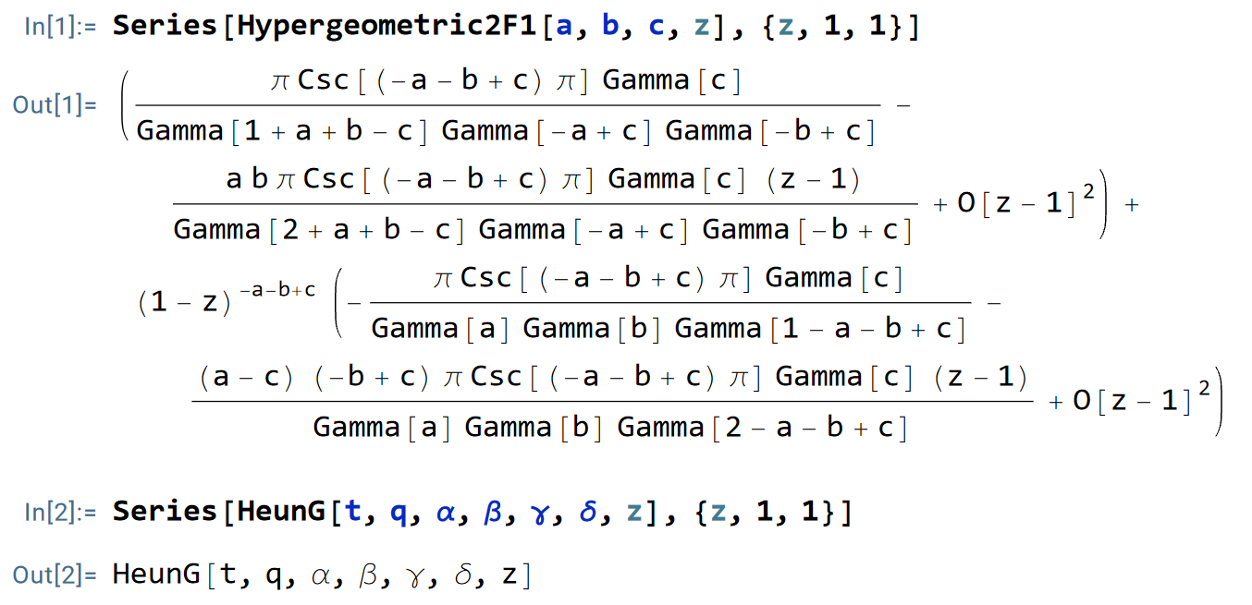
Hypergeometric function and Heun function

Slide 16
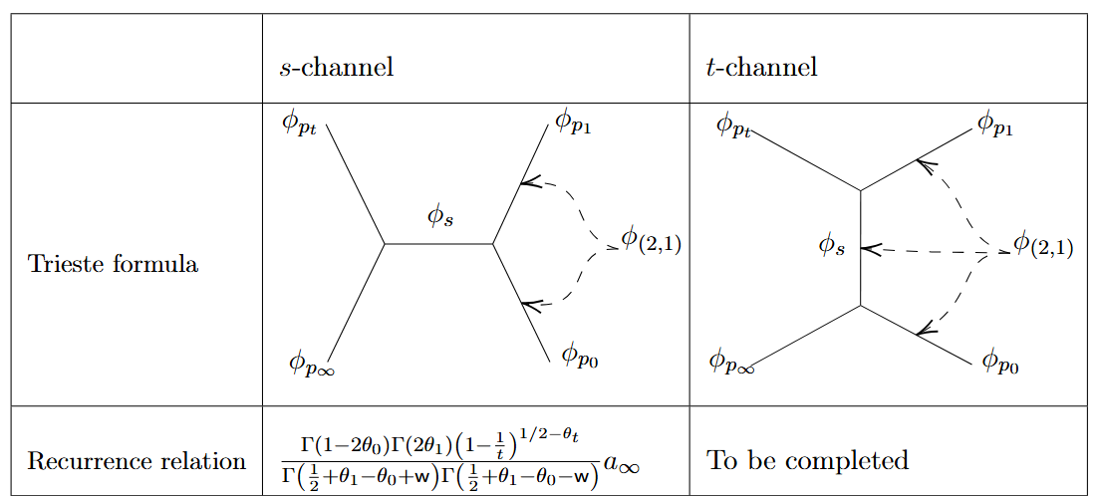

Slide 17
JR & Zhe Yu, 2412.xxxxx

Slide 18
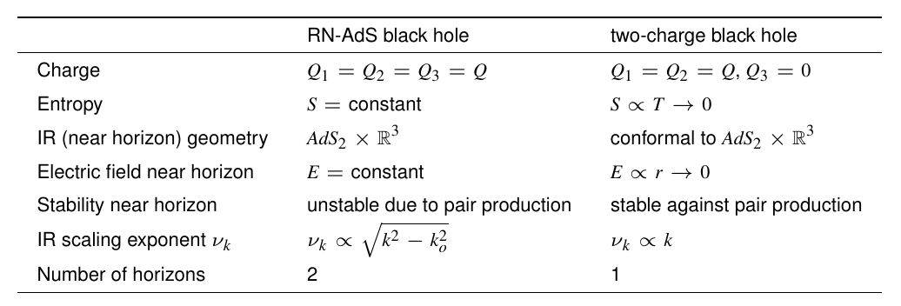

Slide 20
Quasinormal modes of the RN-AdS₅ black hole perturbed by a charged scalar field
JR & Zhe Yu, 2412.xxxxx

