Slide 1
2024 ANPhA symposium
5
Noisy Quantum Computing for Nuclear Physics Problems
Junchen Pei （School of Physics, Peking University）
2024.11.16，Huizhou

Slide 2
Contents
Background of quantum computing
Real quantum computing for a pairing Hamiltonian
Quantum computing for ab initio nuclear calculations
Summary and prospectives

Slide 3
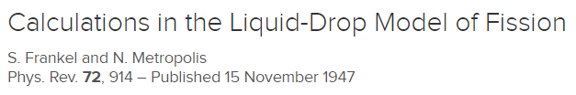
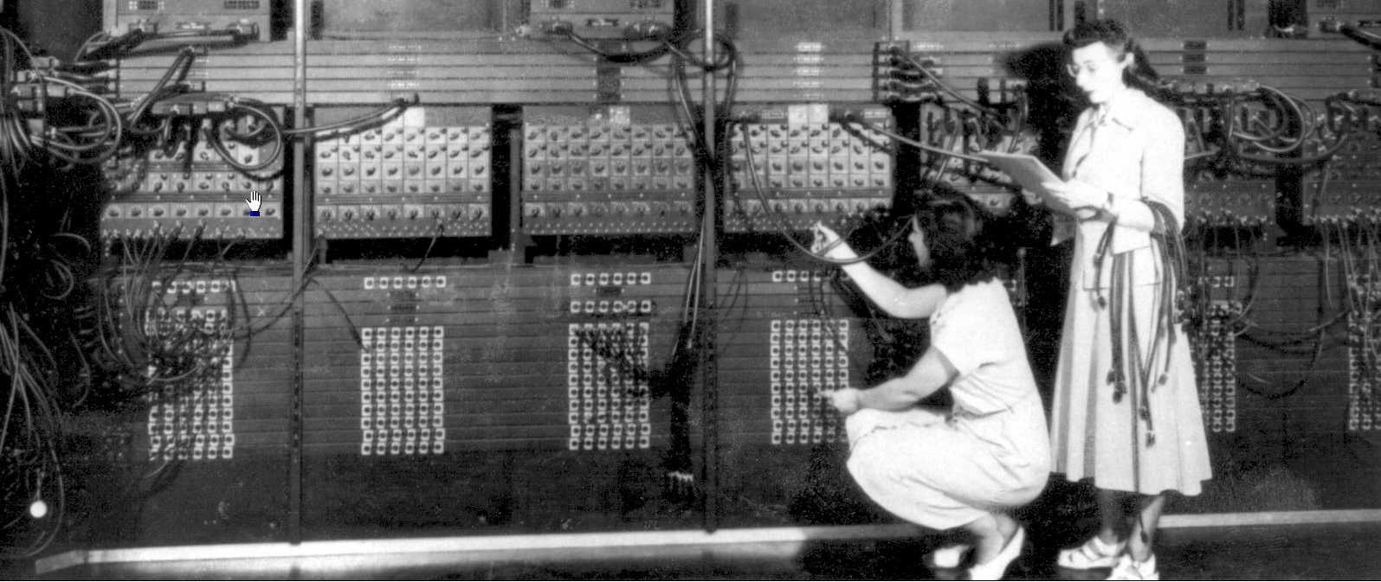
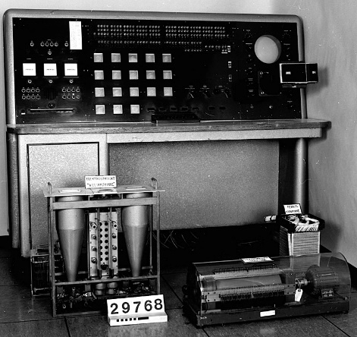
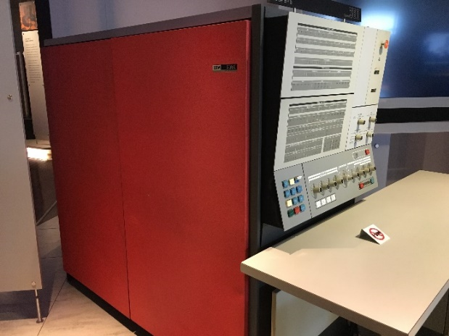
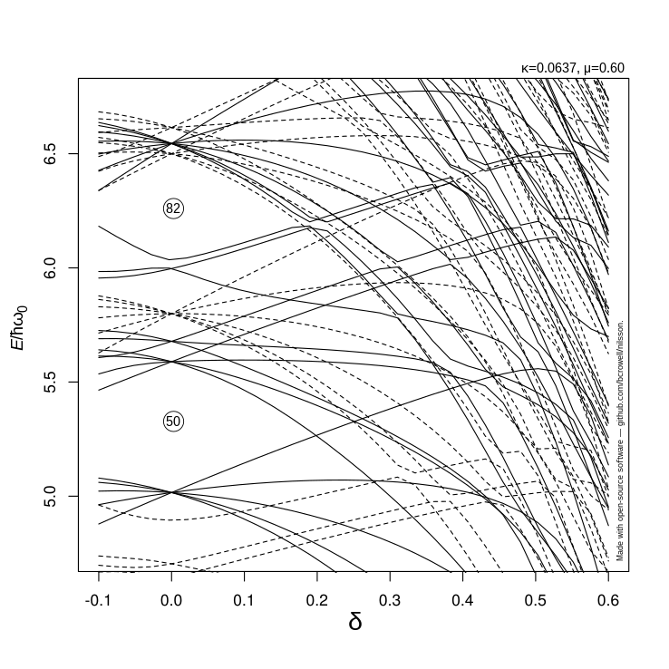
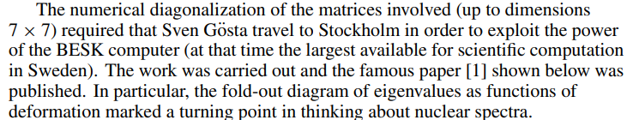
Computing and theoretical nuclear physics
Close relationship between computational capabilities and nuclear physics
Eniac
BESK
IBM-360 (1964)
Nilsson S G 1955 Mat. Fys. Medd. Dan. Vid. Selsk. 29 no 16

Slide 4
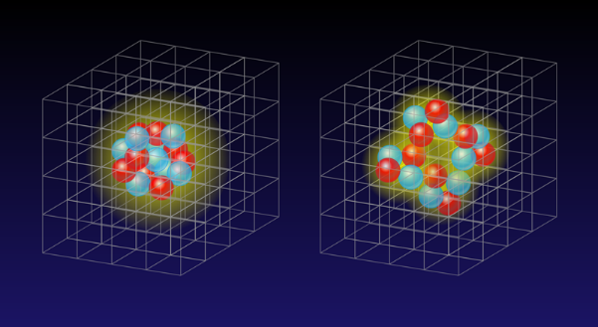
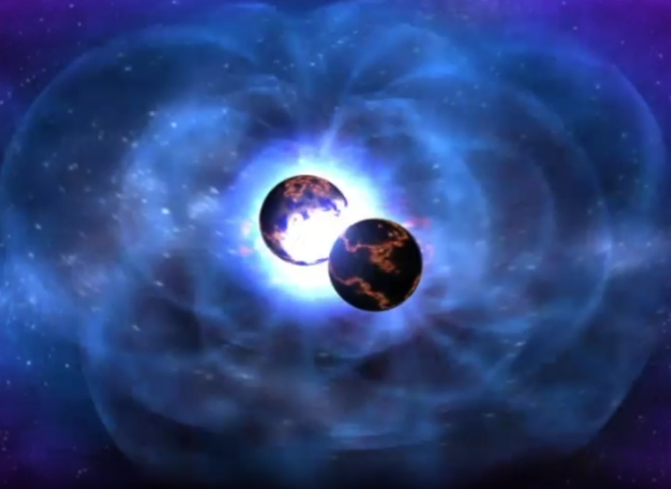
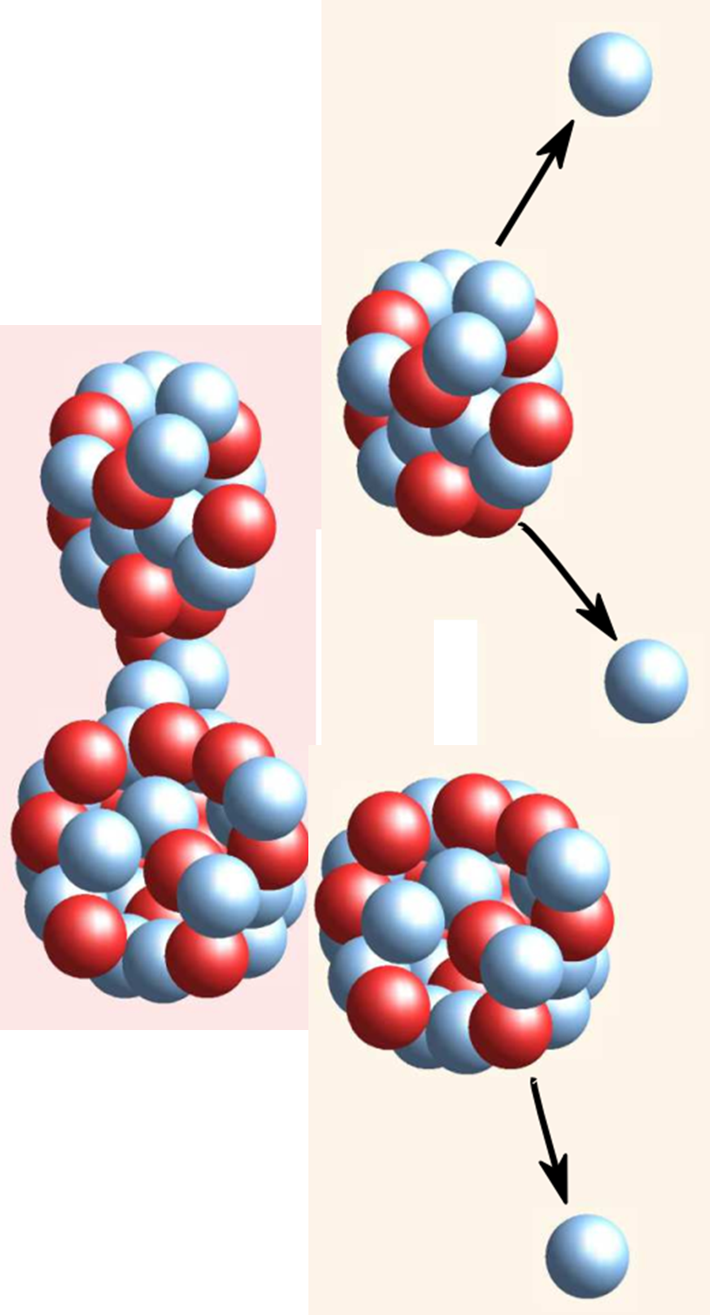
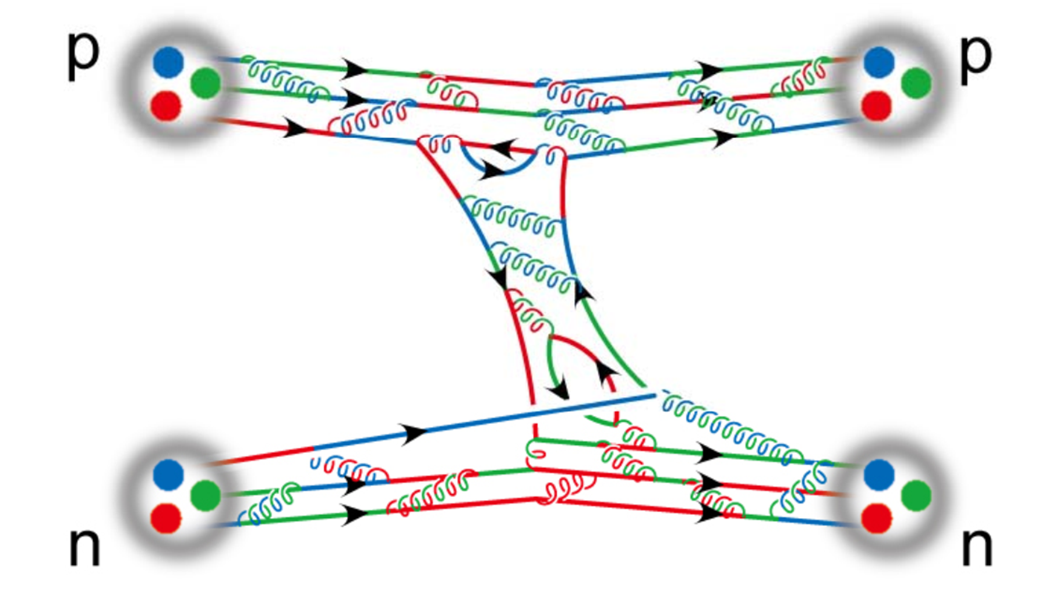
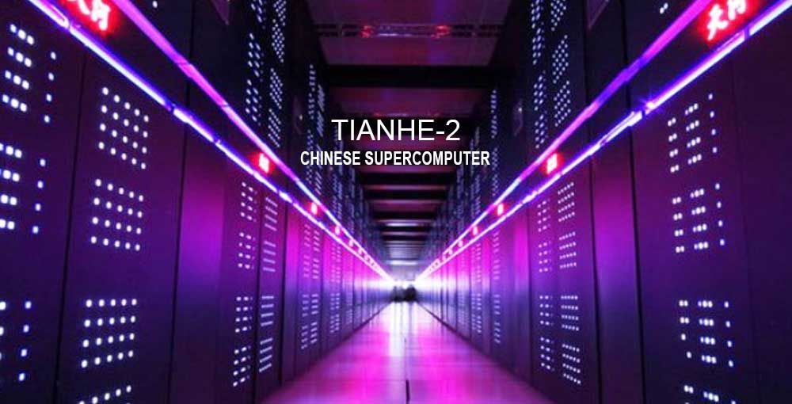
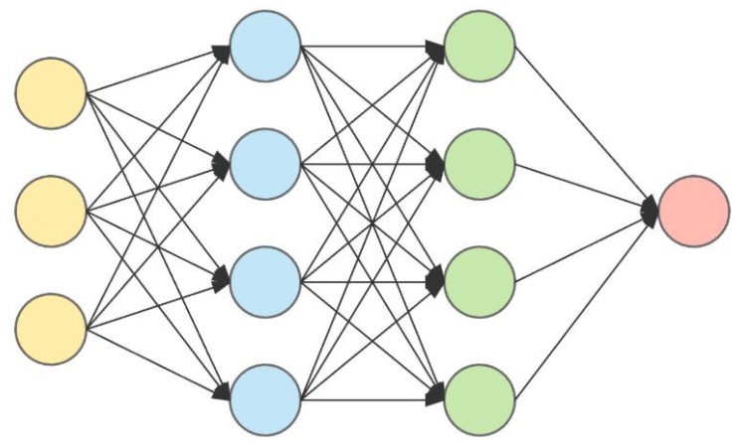
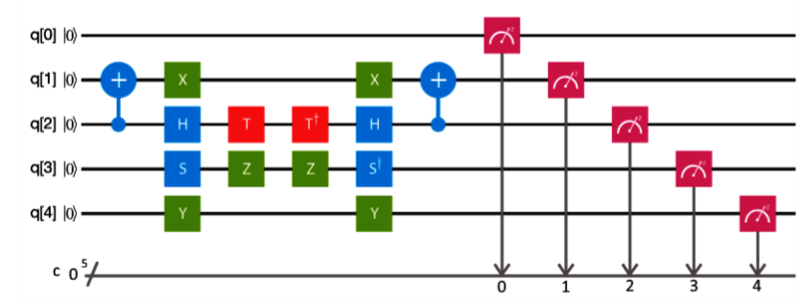
Computing and theoretical nuclear physics
Close relationship between computational capabilities and nuclear physics
Ab initio Structure
Nuclear Astrophysics
Nuclear Dynamics
Support by advanced computing
Supercomputing
Machine Learning
Quantum computing
Tianhe-1A
2012
Continuum DFT
2019
Incomplete fission yields
2023
Real quantum Computing

Slide 5
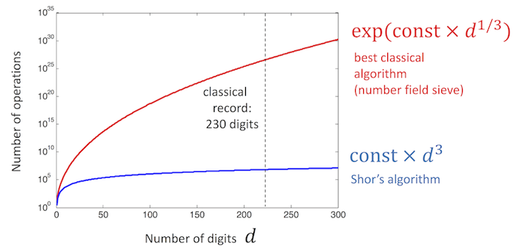
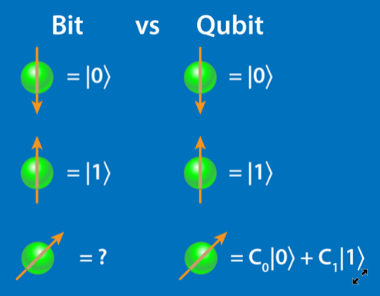


Quantum computing
Advantages of Quantum computing
Superposition
Entanglement
Shor's algorithm: an efficient polynomial time algorithm for the integer factorization problem by applying QFT (Breaking RSA cryptosystem)
N qubits could represent all 2^{N} states at the same time.
A natural choice for quantum many-body systems

Slide 6
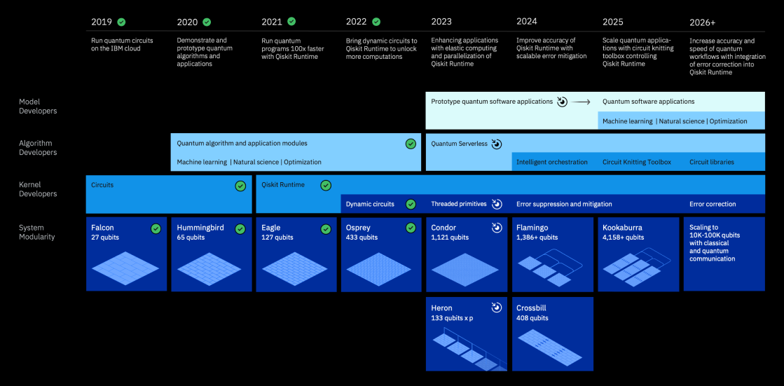
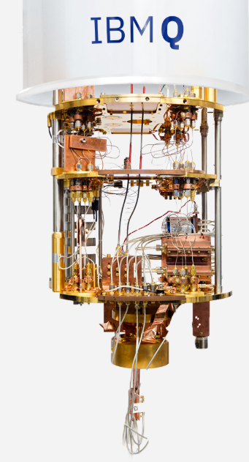
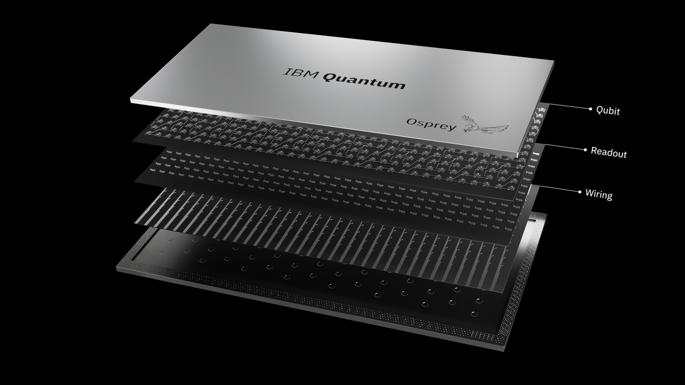
Superconductor Quantum Computing
Roadmap of quantum computing
Number of qubits; Error rate; Decoherence time

Slide 7
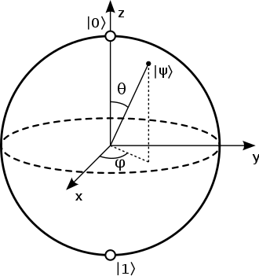

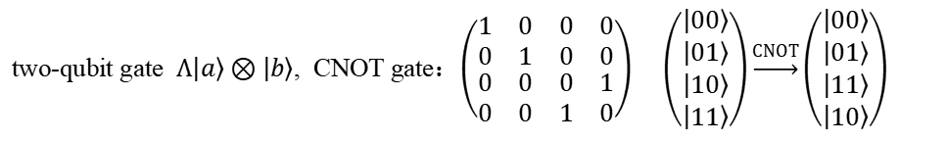
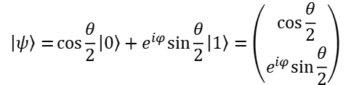
Quantum computers
Quantum qubits
Bloch sphere
$$\left|ψ\right\rangle =\cos{\frac{θ}{2}}\left|0\right\rangle +e^{iφ}\sin{\frac{θ}{2}}\left|1\right\rangle =\left({\cos{\frac{θ}{2}} \atop e^{iφ}\sin{\frac{θ}{2}}}\right)$$
Quantum gates（unitary transform）
one-qubit gate：$2×2 unitary matrix$
two-qubit gate $Λ\left|a\right\rangle ⊗\left|b\right\rangle$, CNOT gate：$\left(\begin{matrix}\begin{matrix}1 & 0 \\ 0 & 1\end{matrix} & \begin{matrix}0 & 0 \\ 0 & 0\end{matrix} \\ \begin{matrix}0 & 0 \\ 0 & 0\end{matrix} & \begin{matrix}0 & 1 \\ 1 & 0\end{matrix}\end{matrix}\right) \left(\begin{matrix}\begin{matrix}\left|00\right\rangle \\ \left|01\right\rangle \end{matrix} \\ \left|10\right\rangle \\ \left|11\right\rangle \end{matrix}\right)\underset{→}{CNOT}\left(\begin{matrix}\begin{matrix}\left|00\right\rangle \\ \left|01\right\rangle \end{matrix} \\ \left|11\right\rangle \\ \left|10\right\rangle \end{matrix}\right)$
Any unitary operator can be constructed by one and two qubit gates
$$\{R_{x}\left(θ\right),R_{y}\left(θ\right),R_{z}\left(θ\right), P\left(φ\right), CNOT\}$$
https://qiskit.org/textbook/

Slide 8

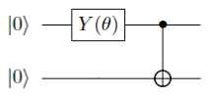
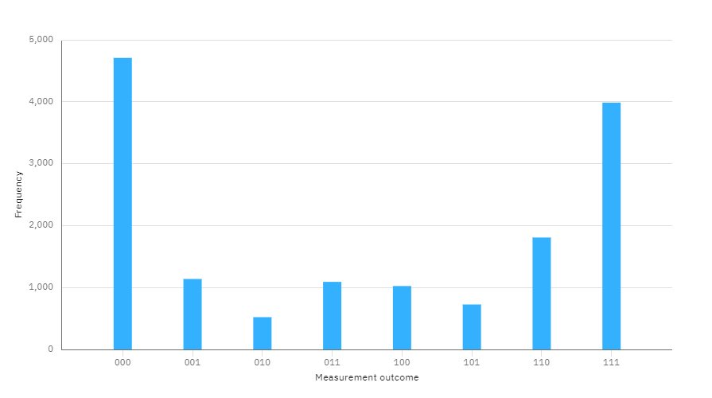
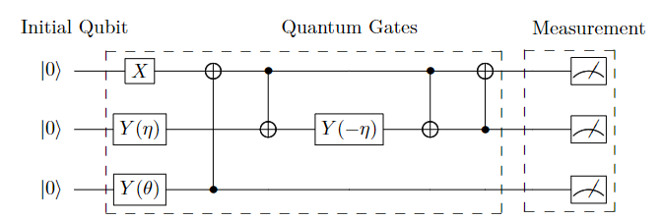


Quantum computers
Quantum entanglement
$$\left(R_{y}\left(θ\right) \left|0\right\rangle \right)⊗\left|0\right\rangle =$$
$\left(\cos{\frac{θ}{2}}\left|0\right\rangle +\sin{\frac{θ}{2}}\left|1\right\rangle \right)$ $⊗\left|0\right\rangle$
$$\cos{\frac{θ}{2}}\left|00\right\rangle +\sin{\frac{θ}{2}}\left|11\right\rangle$$
$$\left|0\right\rangle ⊗\left|0\right\rangle$$
Quantum qubits +quantum gates$⇒$ general quantum computers
$$V=\{|\left.000\right\rangle ,|\left.001\right\rangle ,|\left.010\right\rangle ,|\left.011\right\rangle ,|\left.100\right\rangle ,|\left.101\right\rangle ,|\left.110\right\rangle ,|\left.111\right\rangle \}$$

Slide 9
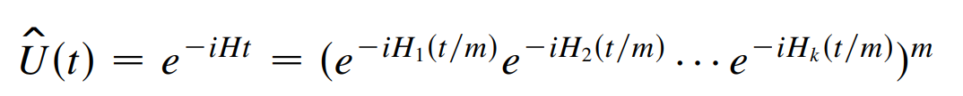
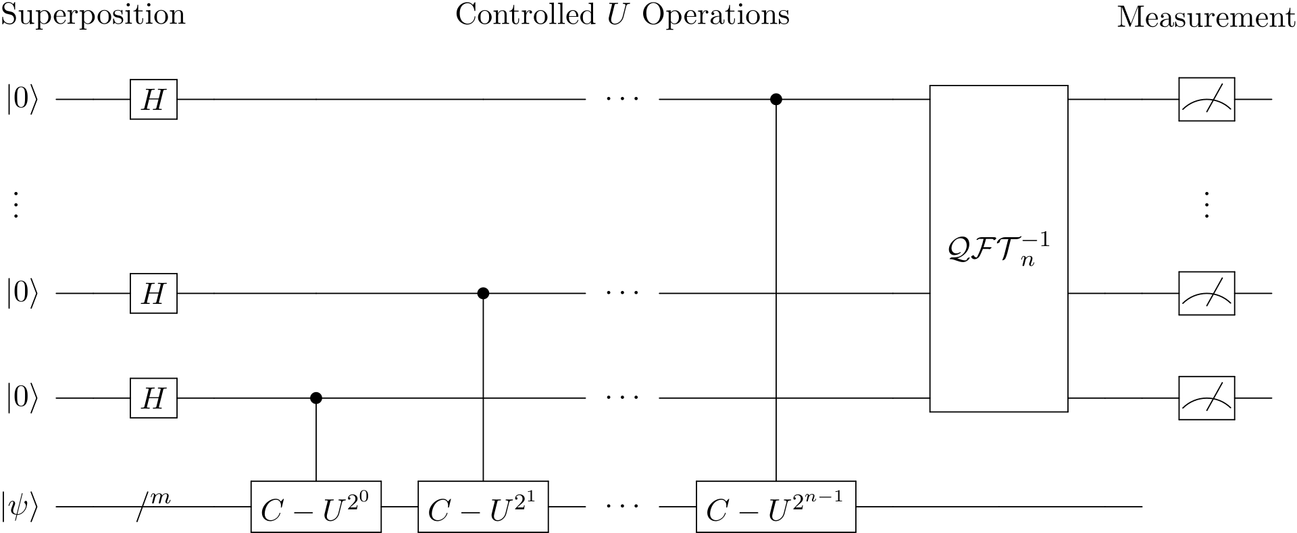
Quantum Computing without noise
Quantum many-body problem: exponential speedup
quantum fast Fourier transform to find eigenvalues and eigenvectors：Quantum Phase Estimate, QPE
Phys. Rev. Lett. 83, 5162 （1999）
$$U=e^{iHΔt}⇒U\left|Ψ\right\rangle =e^{iEΔt}\left|Ψ\right\rangle =e^{i2πφ}\left|Ψ\right\rangle ;E=\frac{2πφ}{Δt}$$

Slide 10
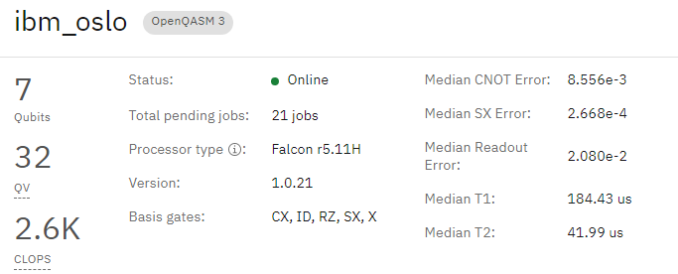
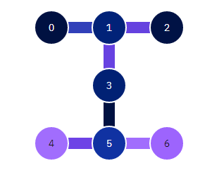
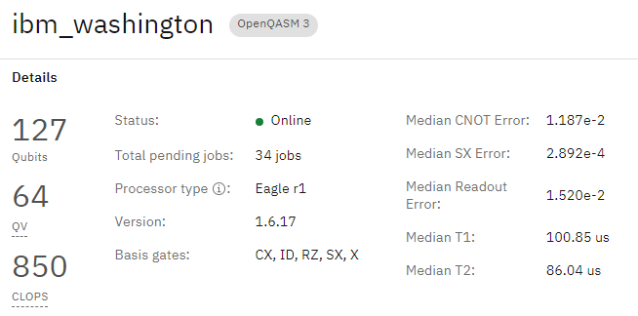
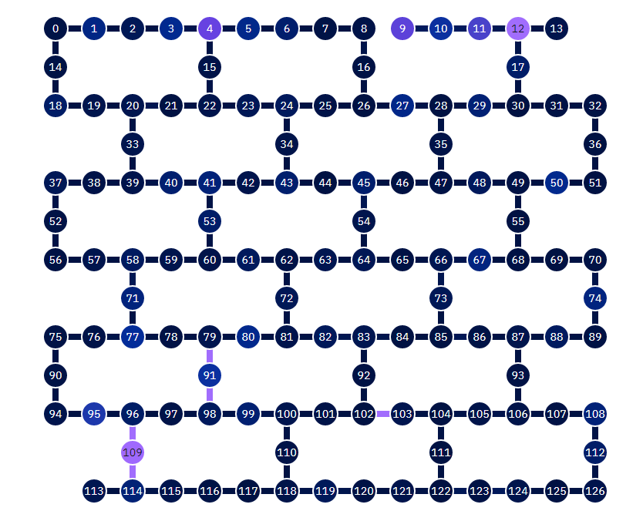
Quantum computing in real devices
Not fully connected
Source of noise： CNOT gates，readout, decoherence

Slide 11
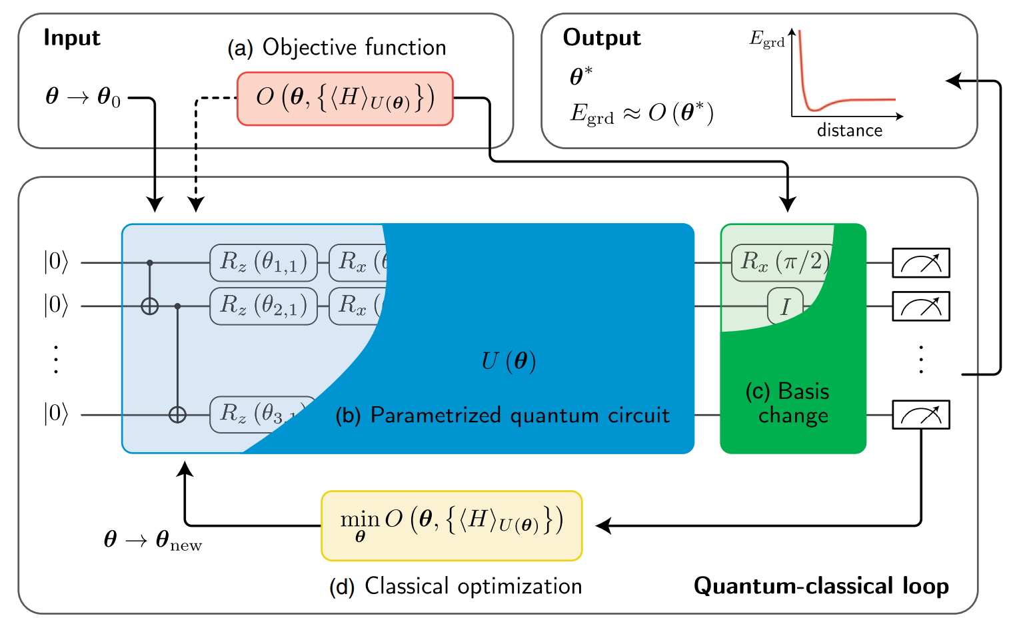
Variational Quantum Eigensolver (VQE)
Pros
  Least request of resources
  Noise resistance
  Error mitigation
Cons
  Complex for complex problems
  Need precision measurement
hybrid quantum-classical algorithm

Slide 12
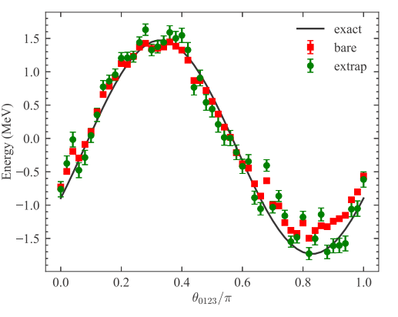
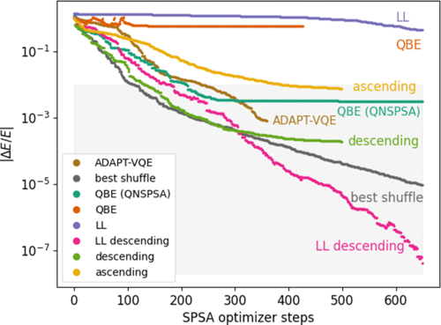
Quantum computing in nuclear physics
Current status of quantum computing in nuclear physics
2018: Cloud Quantum Computing of an Atomic Nucleus, PRL 120, 210501
VQE, unitary coupled-cluster, deuteron
2020: PRC 102, 064624 ---n(p, d)γ , time dependent evolution operator, error mitigation
2020: PRL 125, 230502---quantum-phase-estimate + symmetry projection
2021: PRA 104, 012611---Coulomb excitation of deuteron
2021: Phys. Rev. C 104, 024305---Lipkin model, VQE, 2~3 particles, error mitigation
2022: M. Hlatshwayo, Y. N. Zhang, H. Wibowo, R. LaRose, D. Lacroix, E. Litvinova, Phys. Rev. C 106, 024319 (2022).---Lipkin model, quantum EoM,
2022: Phys. Rev. C 106, 034325(2022)----⁶Li, UCC, VQE
2022: I. Stetcu, A. Baroni, J. Carlson, Phys. Rev. C 105, 064308 (2022), UCC
2023: P. Lv, S. Wei, H.-N. Xie, G. Long, SCPMA 66, 240311 (2023).
2023: C.J.Jiang, J.Pei, finite-temperature pairing Hamiltonian, PRC 2023

Slide 13
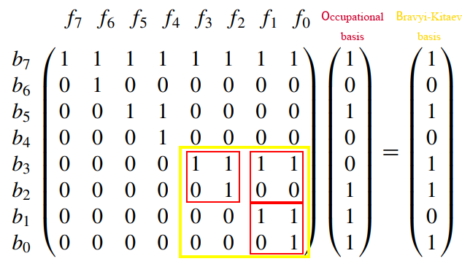
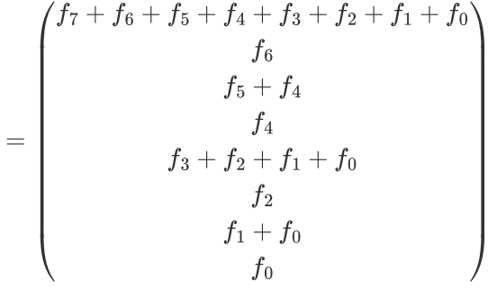

Mapping the Hamiltonian
$$\hat{H}=\sum_{i=1,N_{s}}{ε_{i}a_{i}^{†}a_{i}}+\sum_{ij,kl}{V_{ij,kl}a_{i}^{†}a_{j}^{†}a_{l}a_{k}}+\sum_{ijk,lmn}{V_{ijk,lmn}a_{i}^{†}a_{j}^{†}a_{k}^{†}a_{n}a_{m}a_{l}}$$
Jordan-Wigner transformation
$$a_{n}^{†}→\frac{1}{2}\left[\prod_{j=0}^{n−1}{−Z_{j}}\right]\left(X_{n}−iY_{n}\right)$$
$$a_{n}→\frac{1}{2}\left[\prod_{j=0}^{n−1}{−Z_{j}}\right]\left(X_{n}+iY_{n}\right)$$
Bravyi-Kitaev transform: reduce nonlocality
Nonlocal !!!

Slide 14
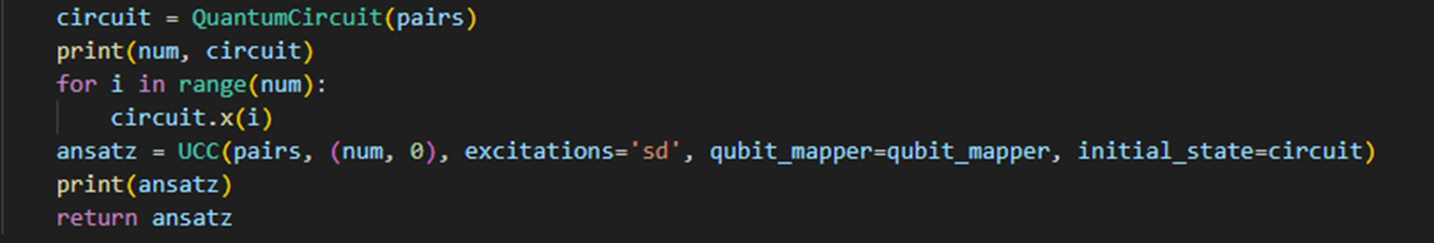
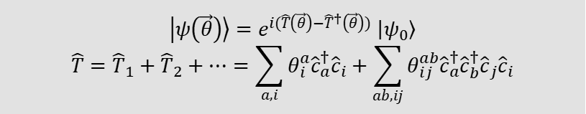
Construct quantum circuit
Unitary Couple Cluster(UCC) ansatz: J-W mapping, Hartree-Fock initial state, variational parameters θ
$\left|ψ\left(\vec{θ}\right)\right\rangle =e^{i(\hat{T}\left(\vec{θ}\right)−{\hat{T}}^{†}\left(\vec{θ}\right))}$ $\left|ψ_{0}\right\rangle$
$$\hat{T}={\hat{T}}_{1}+{\hat{T}}_{2}+⋯=\sum_{a,i}{θ_{i}^{a}{\hat{c}}_{a}^{†}{\hat{c}}_{i}}+\sum_{ab,ij}{θ_{ij}^{ab}{\hat{c}}_{a}^{†}{\hat{c}}_{b}^{†}{\hat{c}}_{j}{\hat{c}}_{i}}$$

Slide 15


Quantum measurements
Measurement of <H> by Pauli terms on Z basis
Measurement of X, Y terms
Measurements by statistical shots of up and down of spins
Finally we obtain the ground state energies
$$H^{†}XH=Z, S^{†}YS=X$$
$$X=HZH^{†}, Y=SHZHS^{†}$$
$$⟨ψ\left(\vec{θ}\right)\left|\hat{H}\right|ψ\left(\vec{θ}\right)⟩≥E_{gs}$$

Slide 16
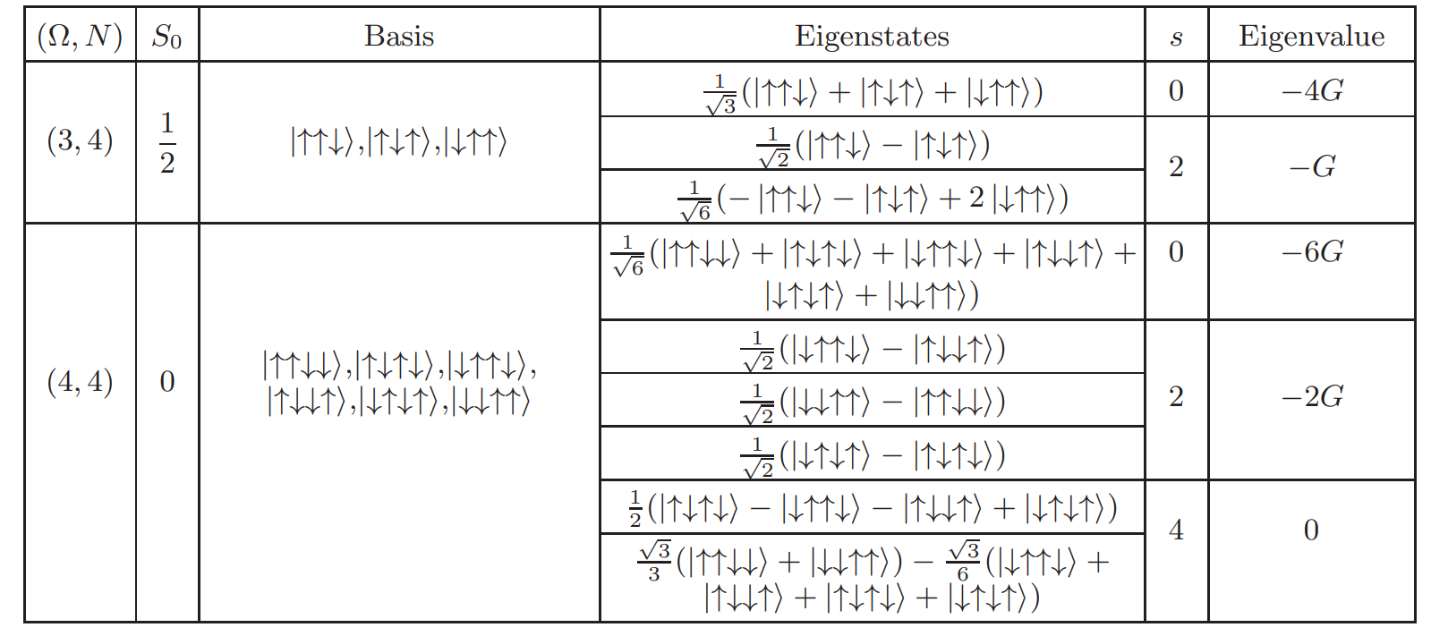
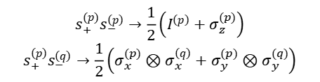

The pairing Hamiltonian
The pairing Hamiltonian: direct seniority model mapping
$$s_{+}^{\left(p\right)}s_{−}^{\left(p\right)}→\frac{1}{2}\left(I^{\left(p\right)}+σ_{z}^{(p)}\right)$$
$$s_{+}^{\left(p\right)}s_{−}^{\left(q\right)}→\frac{1}{2}\left(σ_{x}^{(p)}⊗σ_{x}^{\left(q\right)}+σ_{y}^{(p)}⊗σ_{y}^{(q)}\right)$$
$$\hat{H}=−G\sum_{m,m^{′}>0}{a_{m^{′}}^{+}a_{−m^{′}}^{+}a_{−m}a_{m}}=−G\sum_{m,m^{′}>0}{s_{+}^{\left(m^{′}\right)}s_{−}^{\left(m\right)}}$$
Exact solutions:
J=5/2
J=7/2

Slide 17
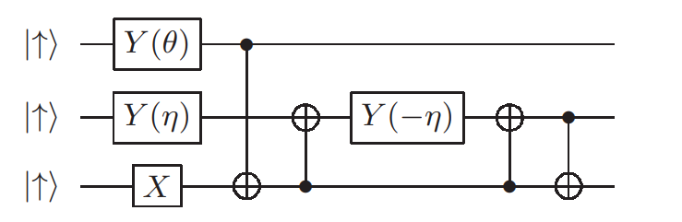
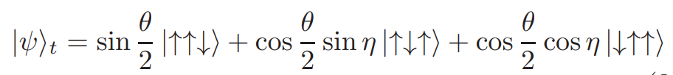
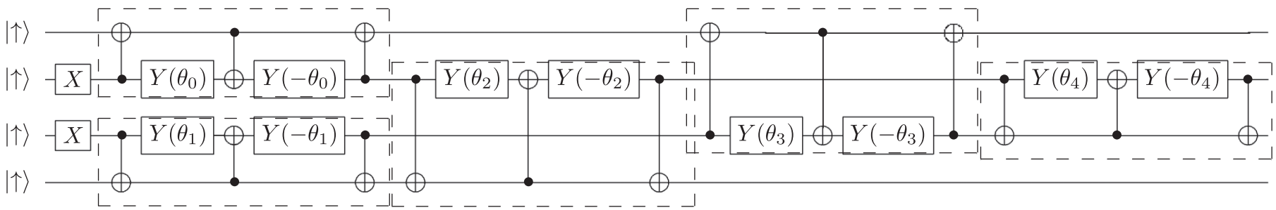

Low-Noise Variational circuit
For Ω=3
Chongji Jiang and Junchen Pei, Phys. Rev. C 107, 044308 (2023)
For Ω=4, the circuit is much more complex, has serious noise problems
$$\left|ψ\left(\vec{θ}\right)\right\rangle =\prod_{i}{U_{i}(θ_{i})}\left|ψ_{0}\right\rangle$$
$$U_{i}(θ_{i})=\left[\begin{matrix}\begin{matrix}1 & 0 \\ 0 & \sin{θ}\end{matrix} & \begin{matrix}0 & 0 \\ \cos{θ} & 0\end{matrix} \\ \begin{matrix}0 & \cos{θ} \\ 0 & 0\end{matrix} & \begin{matrix}−\sin{θ} & 0 \\ 0 & 1\end{matrix}\end{matrix}\right]$$
The 3rd component of spin don’t change
Particle-number preserving building blocks
Significantly reduce the noise

Slide 18
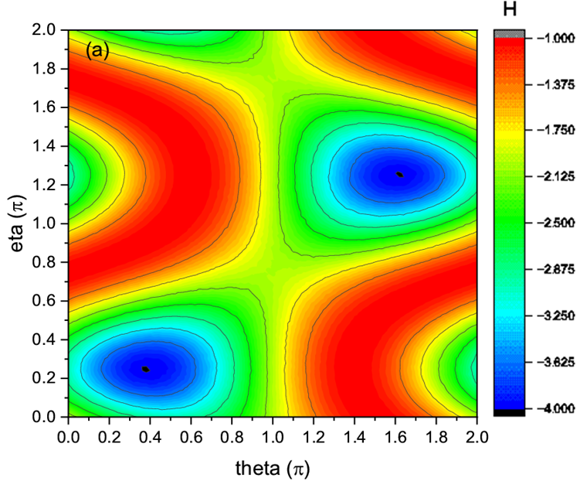

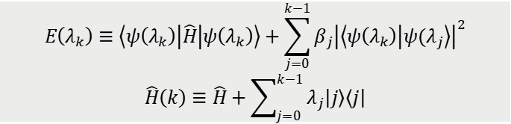
Efficient method for excited states
VQD: variational quantum deflation
Solve an effective Hamiltonian
O. Higgott, D. Wang, S. Brierley, Quantum 3, 156 (2019).
$$E\left(λ_{k}\right)≡\left\langle ψ\left(λ_{k}\right)\left|\hat{H}\right|ψ\left(λ_{k}\right)\right\rangle +\sum_{j=0}^{k−1}{β_{j}{\left|\left\langle ψ\left(λ_{k}\right) | ψ(λ_{j}\right\rangle \right|}^{2}}$$
$$\hat{H}\left(k\right)≡\hat{H}+\sum_{j=0}^{k−1}{λ_{j}\left|\left.j\right\rangle \left\langle j\right.\right|}$$
Crucial to calculate overlap:
Need at most twice the circuit depth
Advantages:
VQD works for general Hamiltonian problems and requires least resources to compute excited states compared to methos: QPE, Lanczos, equation of motion
Can obtain degenerate states
First application in nuclear physics
Chongji Jiang and Junchen Pei, Phys. Rev. C 107, 044308 (2023)

Slide 19
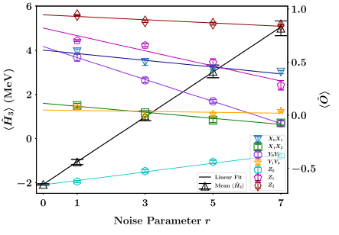
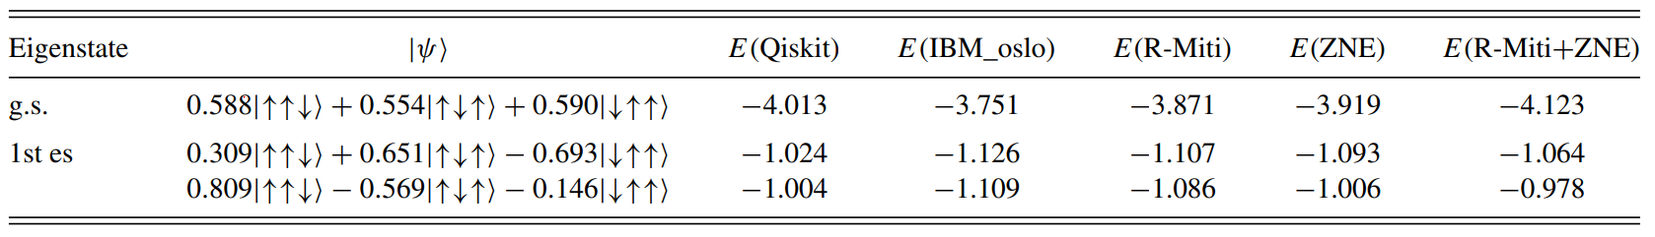

Error mitigation
r$eadout error P\left(0 | 1\right),P(1|0)$ $→$ inverse matrix
$$S_{k}=\left(\begin{matrix}P_{0,0}^{k} & P_{0,1}^{k} \\ P_{1,0}^{k} & P_{1,1}^{k}\end{matrix}\right)$$
zero-noise extrapolation
$$CNOT⋅CNOT=I$$
E.F. Dumitrescu, et al, Phys. Rev. Lett. 120, 210501 (2018)
Chongji Jiang and Junchen Pei, Phys. Rev. C 107, 044308 (2023)

Slide 20
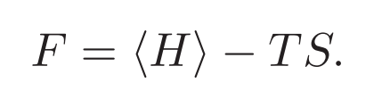



Finite temperature Pairing
Relevant to high-Tc superconducting problems, pseudo-gap, compound nuclei
Minimize the free energy
Variational circuit:
same as zero temperature
Variational mixed state, no need eigenvalues
Compared with finite-temperature BCS theory

Slide 21


Finite temperature Pairing
We expect a smooth transition of superfliudity in finite systems
Finite-temperature BCS theory break down, strong many-body correlations are important
Ω=3
Ω=4
Results are close to exact results at high temperatures
C.J.Jiang, J.C.Pei, Phys.Rev.C 107, 044308 (2023)

Slide 22

Ab initio calculations
Quantum computing of Deuteron was realized in 2018
How about heavier nuclei: 3H, 3He
What we do: chiral nuclear force, 16 qubits, p-shell, m-scheme,~3000 gates
So many Pauli terms, measurements become a BIG problem
Group measurement: different grouping with commutations
Chongji Jiang, J.Pei, in preparation

Slide 23

Noisy Measurements with different mapping
Qiskit ibm_kyoto with varying noise scale
Bravyi-Kitaev transform is better at low noises
Jordan-Wigner transformation is robust at high noise
Chongji Jiang, J.Pei, in preparation

Slide 24

Different mapping with noise
Entropy of the qubits by one-body reduced density matrix
JW has lower correlations with others,
much more gates and deep circuits
BK has higher correlations with others,
but susceptible to noise
Chongji Jiang, J.Pei, in preparation

Slide 25
Future quantum computing
Huge energy consumption for supercomputing, Google and Microscopic are buying nuclear reactors for AI, quantum computing is a game changer
Systems with large-scale superconducting qubits are available soon: ~10k, even 1M; 2024 the two-gate fidelity is at 0.999, we need precision at 10⁻⁴ ; coherence time T1,T2~1 ms
Quantum error correction using redundancy and repetition code for to achieve fault tolerant quantum computing
Ion-trap quantum computers have higher precision but fewer qubits, has some applications in nuclear shell model calculations.
Topological quantum computers is a hot topic, utilizes quasiparticles anyons and more stable for coherence
Future big problems: lattice QCD calculations with quantum computing, nuclear many-body dynamics, quantum machine learning, quantum annealing optimization

Slide 26
Summary
Noisy Quantum computing is a practical problem, totally a new research field
We implement low-noisy circuit, error mitigation, efficient method for excited states, for a finite-temperature pairing Hamiltonian
Expected smooth superfluid-normal transition in finite systems, in which strong many-body correlations are important
Ab initio calculations of 3-body systems are implemented, with several methods to improve the noisy results
Future: quantum computing of big problems such as lattice QCD and nuclear many-body dynamics are strongly motivated
Thank you for your attention!

