Slide 1
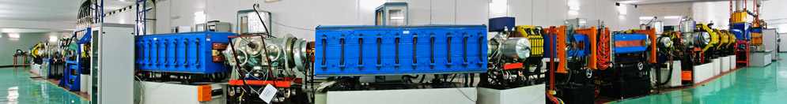
2024 ANPhA meeting and ANPhA symposium
Precision mass measurements of short-lived nuclei
at heavy ions storage ring CSRe in Lanzhou
Yu-Hu Zhang (张玉虎)
Institute of Modern Physics, Chinese Academy of Sciences,
Lanzhou 730000, P. R. China

Slide 2
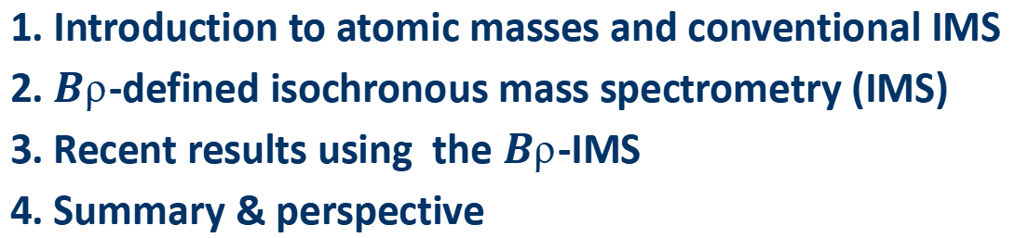
2024 ANPhA meeting and ANPhA symposium
1. Introduction to atomic masses and conventional IMS
2. $B$-defined isochronous mass spectrometry (IMS)
3. Recent results using the $B$-IMS
4. Summary & perspective

Slide 3
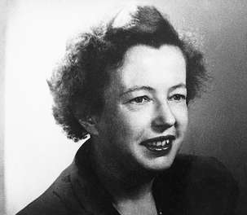
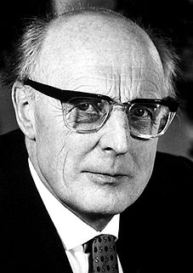
1. Introduction:
Importance of mass measurements
Atomic mass is a fundamental property of a nucleus
$$M\left(Z,N\right)=Zm_{p}+Nm_{n}−BE\left(Z,N\right)$$
M.G Mayer
J.H.D.Jensen
$$5hω$$
1h
82
Proton Number
3s
2d
$$4hω$$
1g
50
$$3hω$$
2p
1f
28
Number of nuclides：
Predicted 7000-9000
Identified ~3300
Known-mass ~2500
error<100keV ~2300
2s
20
Known-mass nuclides
$$2hω$$
1d
8
Nuclides identified
$$1hω$$
1p
Predicted but not found
2
$$0hω$$
1s
SO
SM
Neutron Number

Slide 4
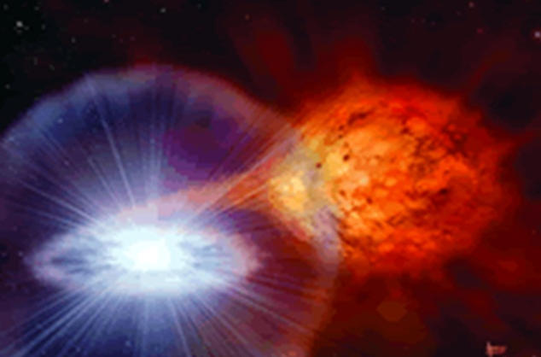
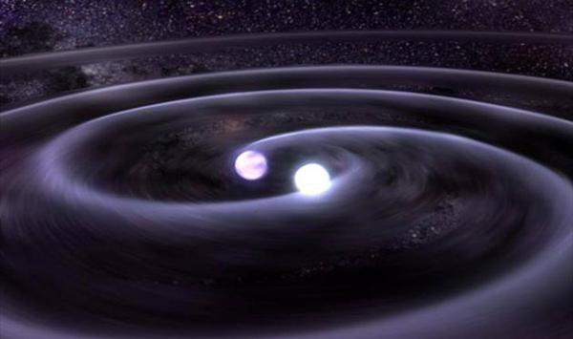
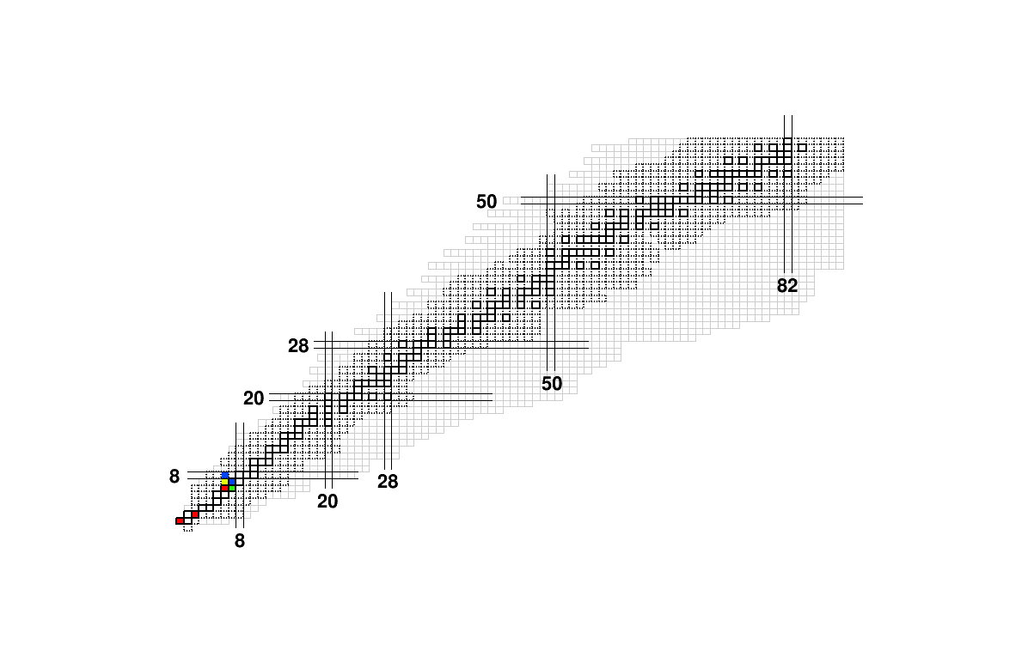
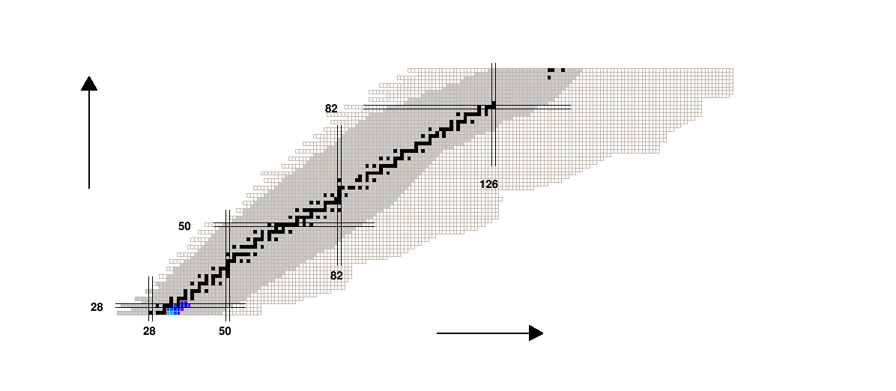
1. Introduction:
Importance of mass measurements
Applications in nuclear astrophysics
X-ray burst
Nuclear physics input:
Atomic masses, lifetimes,
reaction rates, etc
Very proton-rich or neutron-rich nuclei are involved in the stellar nucleosynthesis
Neutron star merger
Rapid proton-capture process
Rapid neutron-capture process

Slide 5
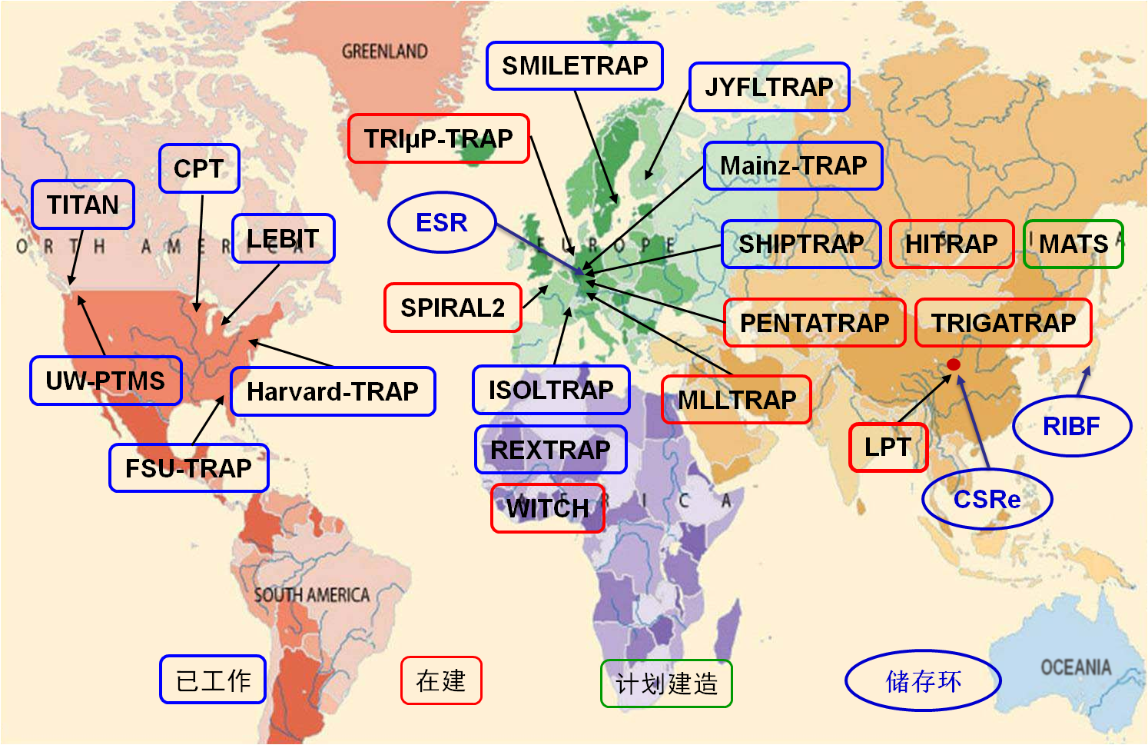
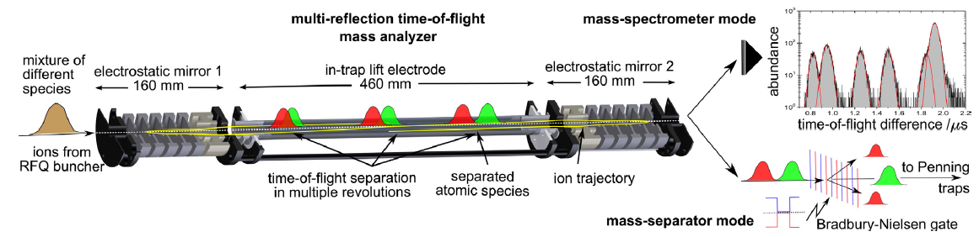
1. Introduction:
Advanced mass spectromery
SR-MS
Penning Trap
Bρ-TOF
MR-TOF

Slide 6
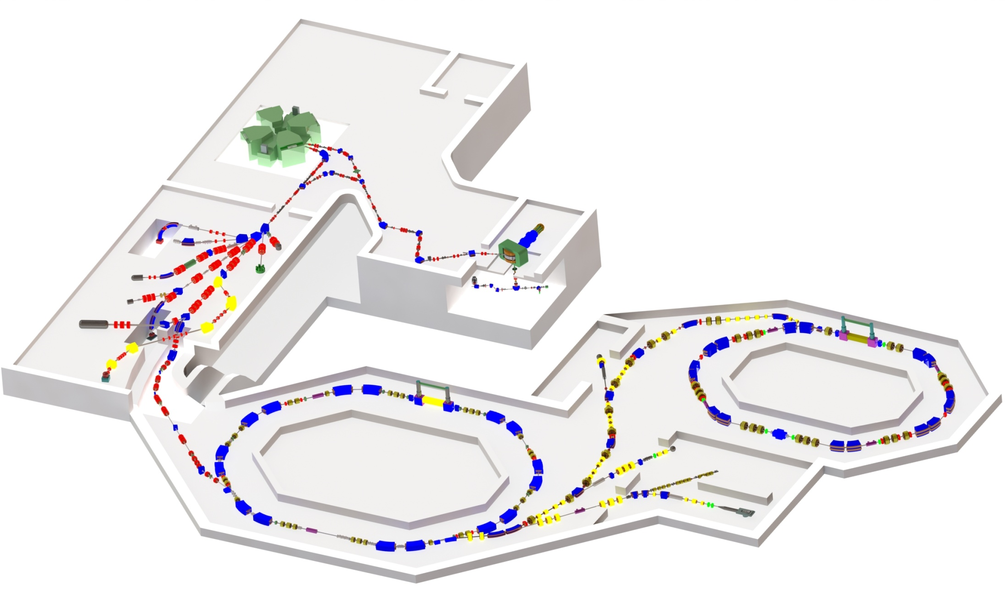
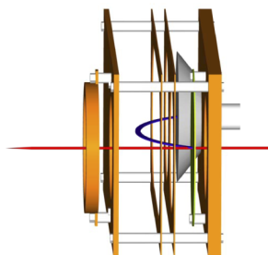


1. Introduction:
IMS in CSRe-Lanzhou
$T$: revolution time of stored ions
$$\frac{m}{q}=Bρ\sqrt{{\left(\frac{T}{C}\right)}^{2}−{\left(\frac{1}{v_{c}}\right)}^{2}}$$
$$passing time$$
$$t(N)$$
RIBLL2
CSRe
CSRm
Target
10-15 mm ¹¹Be
TOF Detector

Slide 7



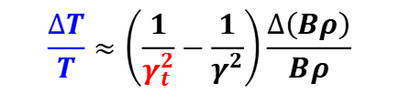
1. Introduction:
IMS in CSRe-Lanzhou
$γ_{t}$ : machine parameter
determined by beam optics
$${γ_{t}}^{−2}=\frac{∆C/C}{∆(Bρ)/(Bρ)}$$
$$\frac{∆T}{T}≈\left(\frac{1}{γ_{t}^{2}}−\frac{1}{γ^{2}}\right)\frac{∆\left(Bρ\right)}{Bρ}$$
$γ≈γ_{t}$ $←$IMS
$$passing time$$
$$t(N)$$
RIBLL2
CSRe
CSRm
Target
10-15 mm ¹¹Be
TOF Detector

Slide 8
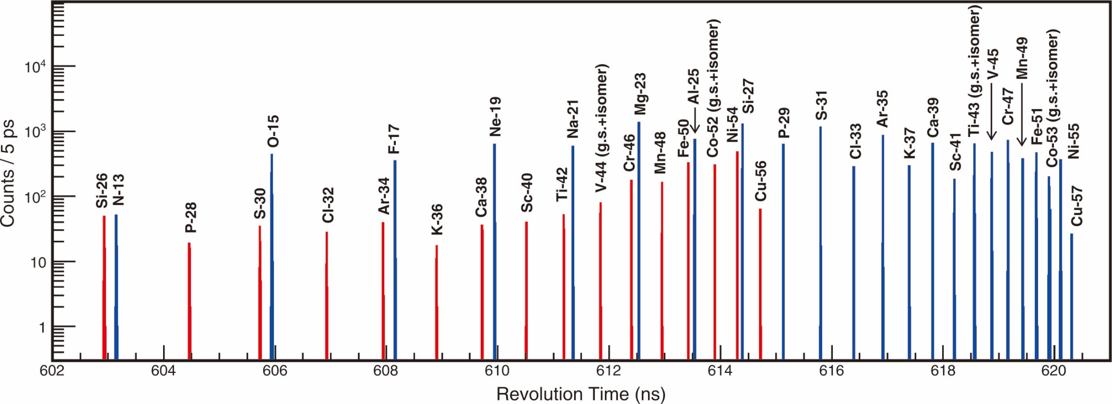
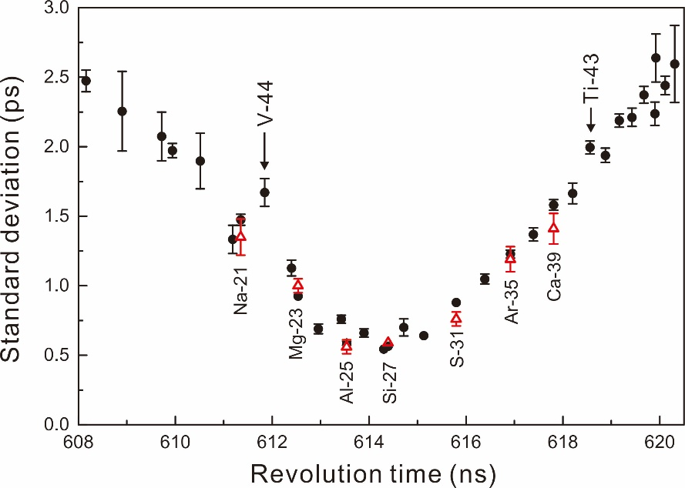
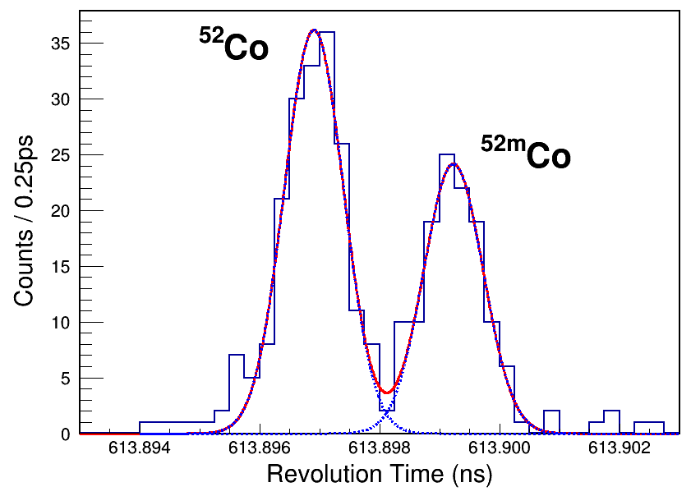
1. Introduction:
IMS in CSRe-Lanzhou
Beam: ⁵⁸Ni
⁵²Co
a slit is used to constrain the Bρ acceptance
1 ps 150 keV

Slide 9
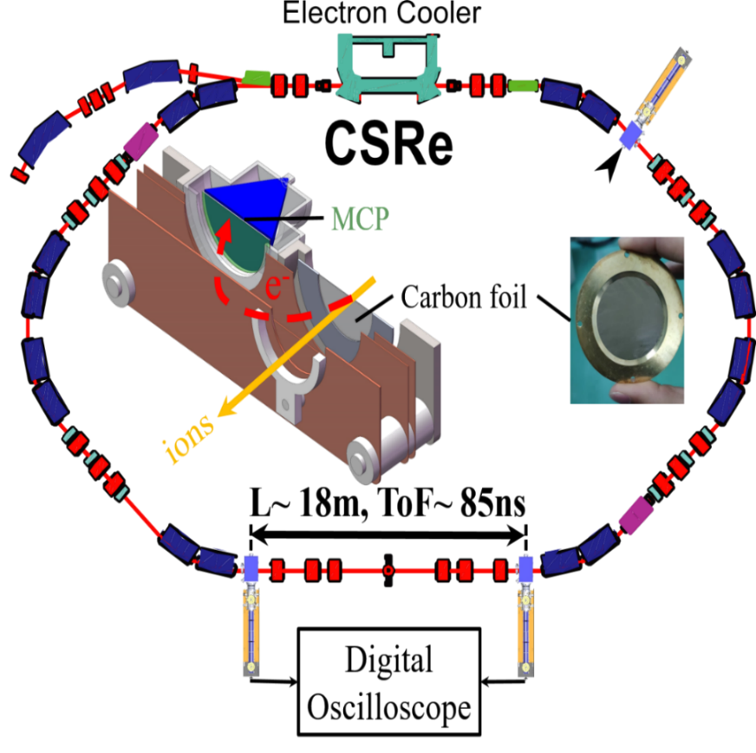
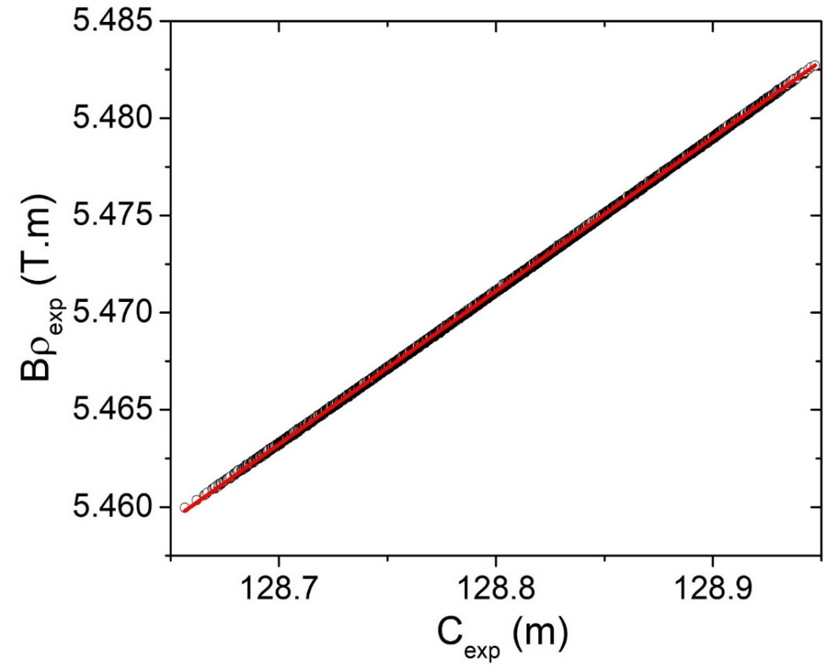
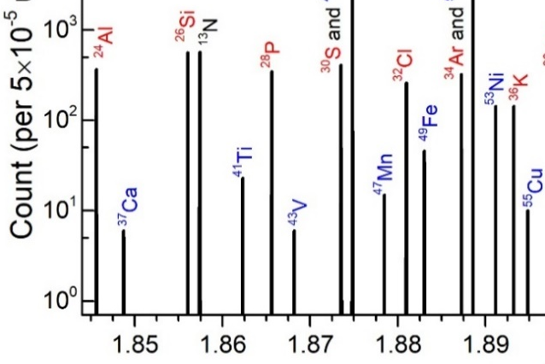




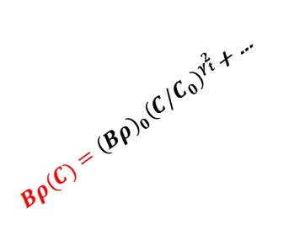



2. $B$-defined isochronous mass spectrometry IMS
From $\left\{T, v, \frac{m}{q}\right\}，→ Bρ,C$
$$Bρ=m/q∙γv$$
$C=L∙v$
establish $Bρ\sim C relation$
Magnetic rigidity $Bρ$
$Bρ(C)={\left(Bρ\right)}_{0}{\left(C/C_{0}\right)}^{γ_{t}^{2}}$+ …
TOF2
TOF1
$${\left(\frac{m}{q}\right)}_{i}=\frac{{\left(Bρ\right)}_{i}}{{\left(γv\right)}_{i}}$$
Orbital length $C$

Slide 10
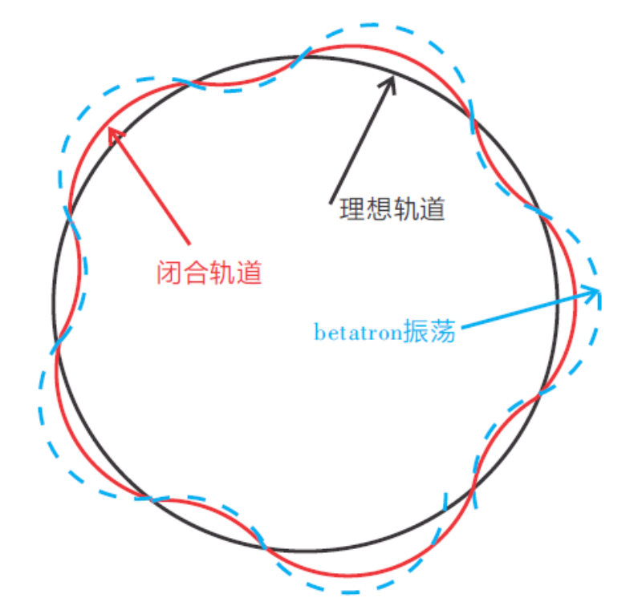
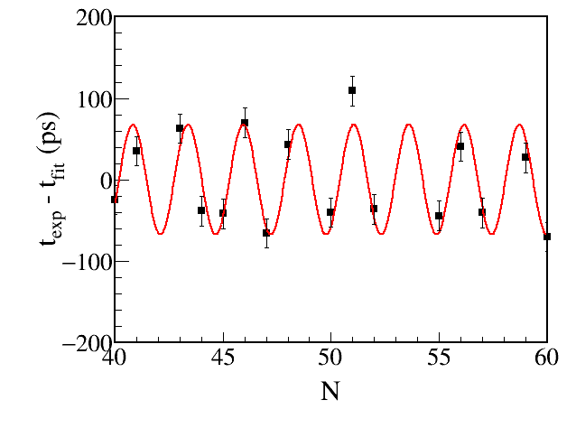
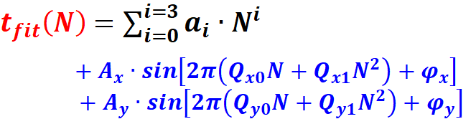


2. $B$-defined isochronous mass spectrometry IMS
Betatron oscillation
$$∆t_{exp}$$
$v_{exp}=\frac{L}{{∆t}_{exp}}$
$t_{fit}\left(N\right)$ $=\sum_{i=0}^{i=3}{a_{i}}∙N^{i}$
$+A_{x}∙sin\left[2π\left(Q_{x0}N+Q_{x1}N^{2}\right)+φ_{x}\right]$
$$+A_{y}∙sin\left[2π\left(Q_{y0}N+Q_{y1}N^{2}\right)+φ_{y}\right]$$
Revolution turn number N

Slide 11
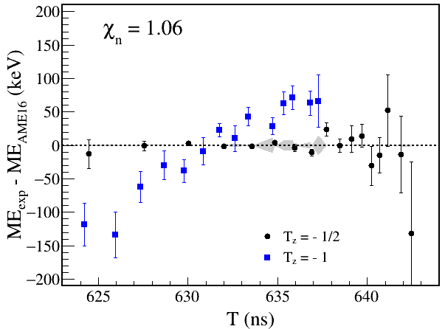
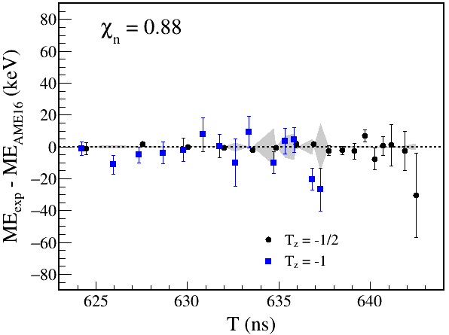

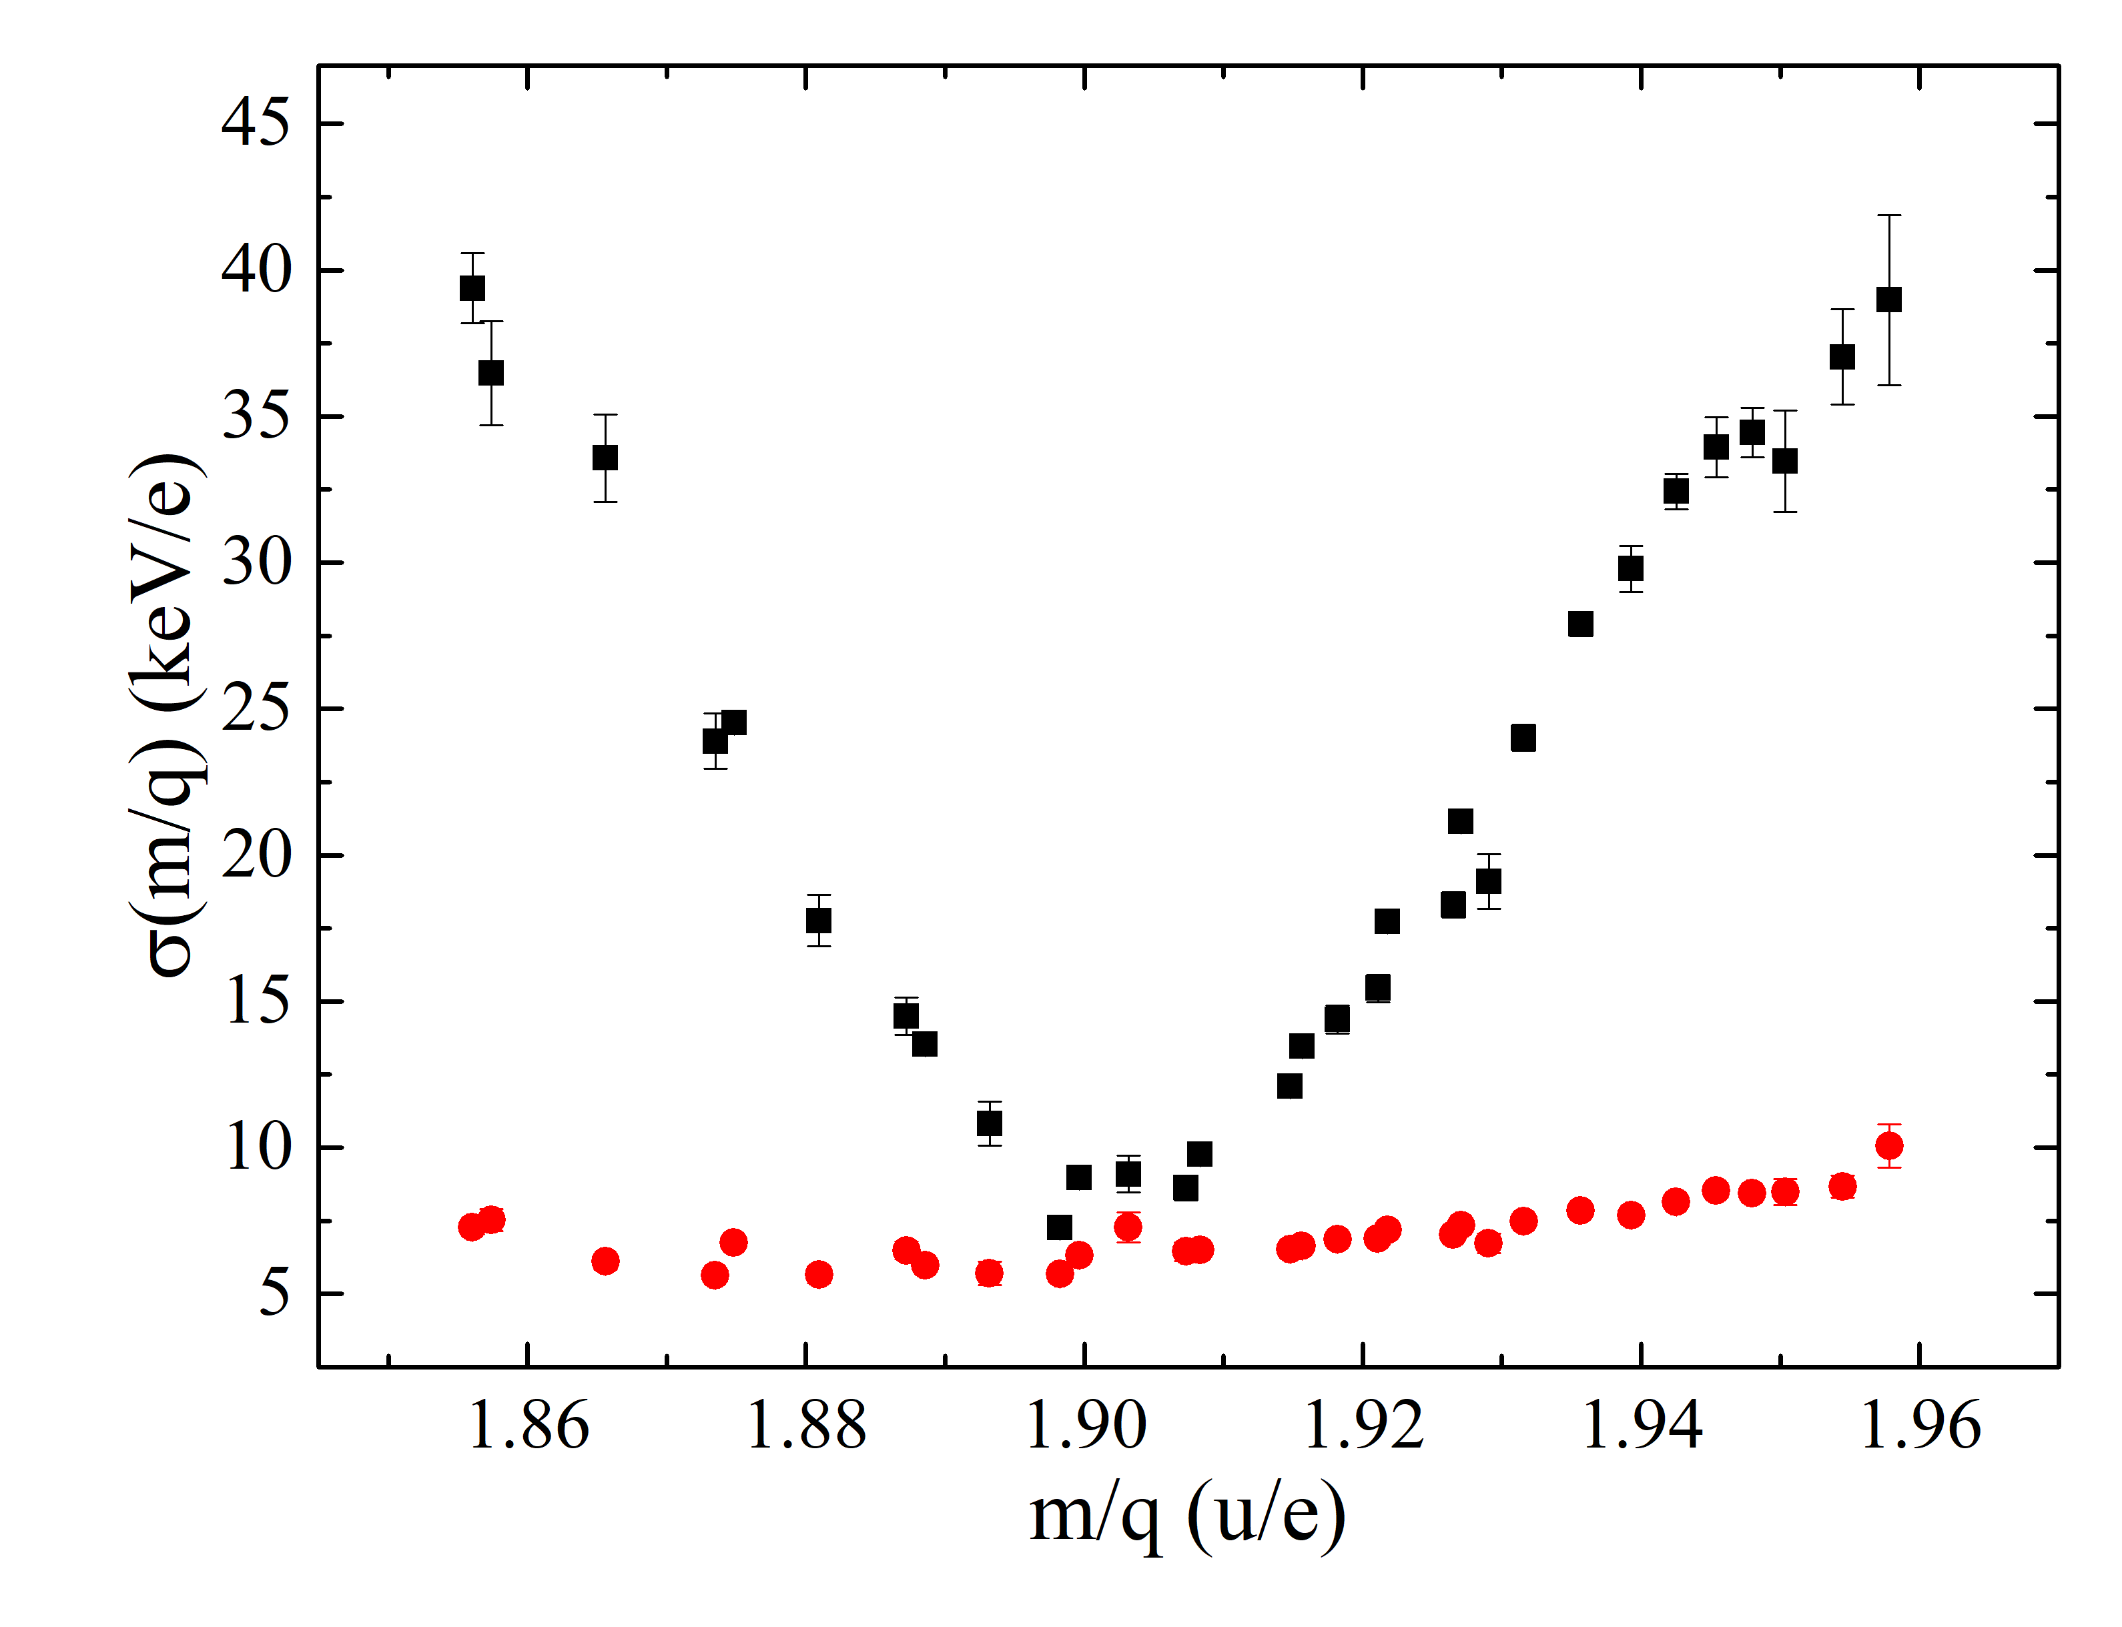


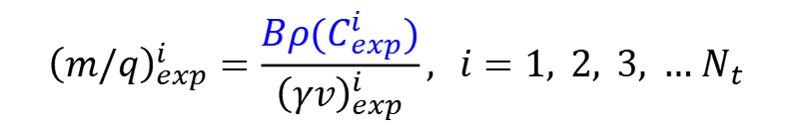
2. $B$-defined isochronous mass spectrometry IMS
Masses from T spectrum
Masses determinations
$${\left(m/q\right)}_{exp}^{i}=\frac{Bρ(C_{exp}^{i})}{{\left(γv\right)}_{exp}^{i}}, i=1, 2, 3, … N_{t}$$
$\frac{m}{q}$ spectrum
$σ_{m}≈7×q$keV

Slide 12
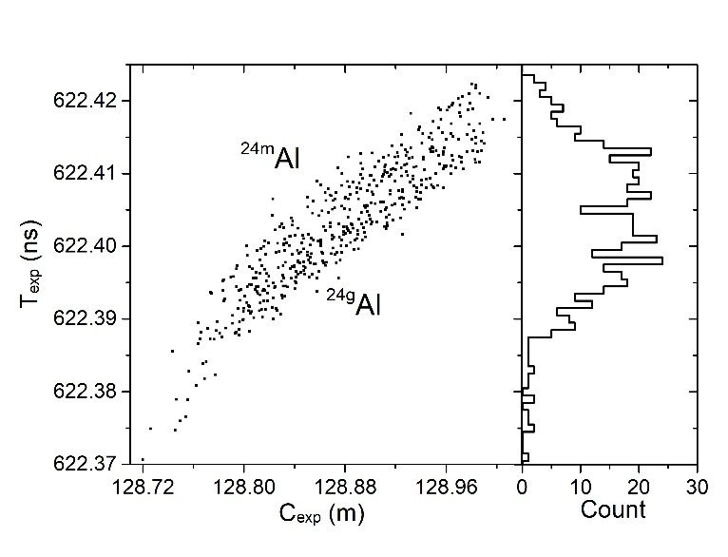
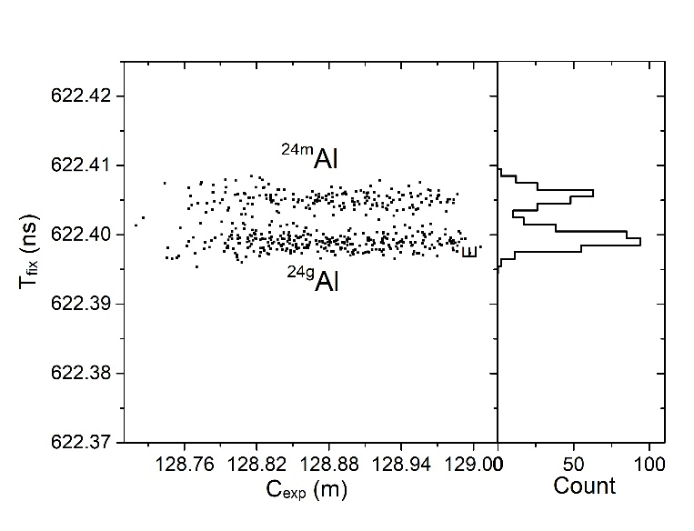


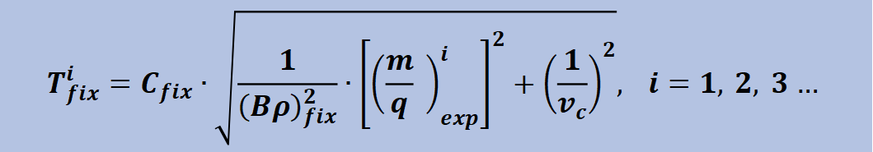
2. $B$-defined isochronous mass spectrometry IMS
$${T_{fix}^{i}=C}_{fix}∙\sqrt{\frac{1}{{\left(Bρ\right)}_{fix}^{2}}∙{\left[{\left(\frac{m}{q} \right)}_{exp}^{i}\right]}^{2}+{\left(\frac{1}{v_{c}}\right)}^{2}}, i=1, 2, 3 …$$
$$σ_{T}=9.71 ps$$
$$σ_{T}=1.26 ps$$

Slide 13
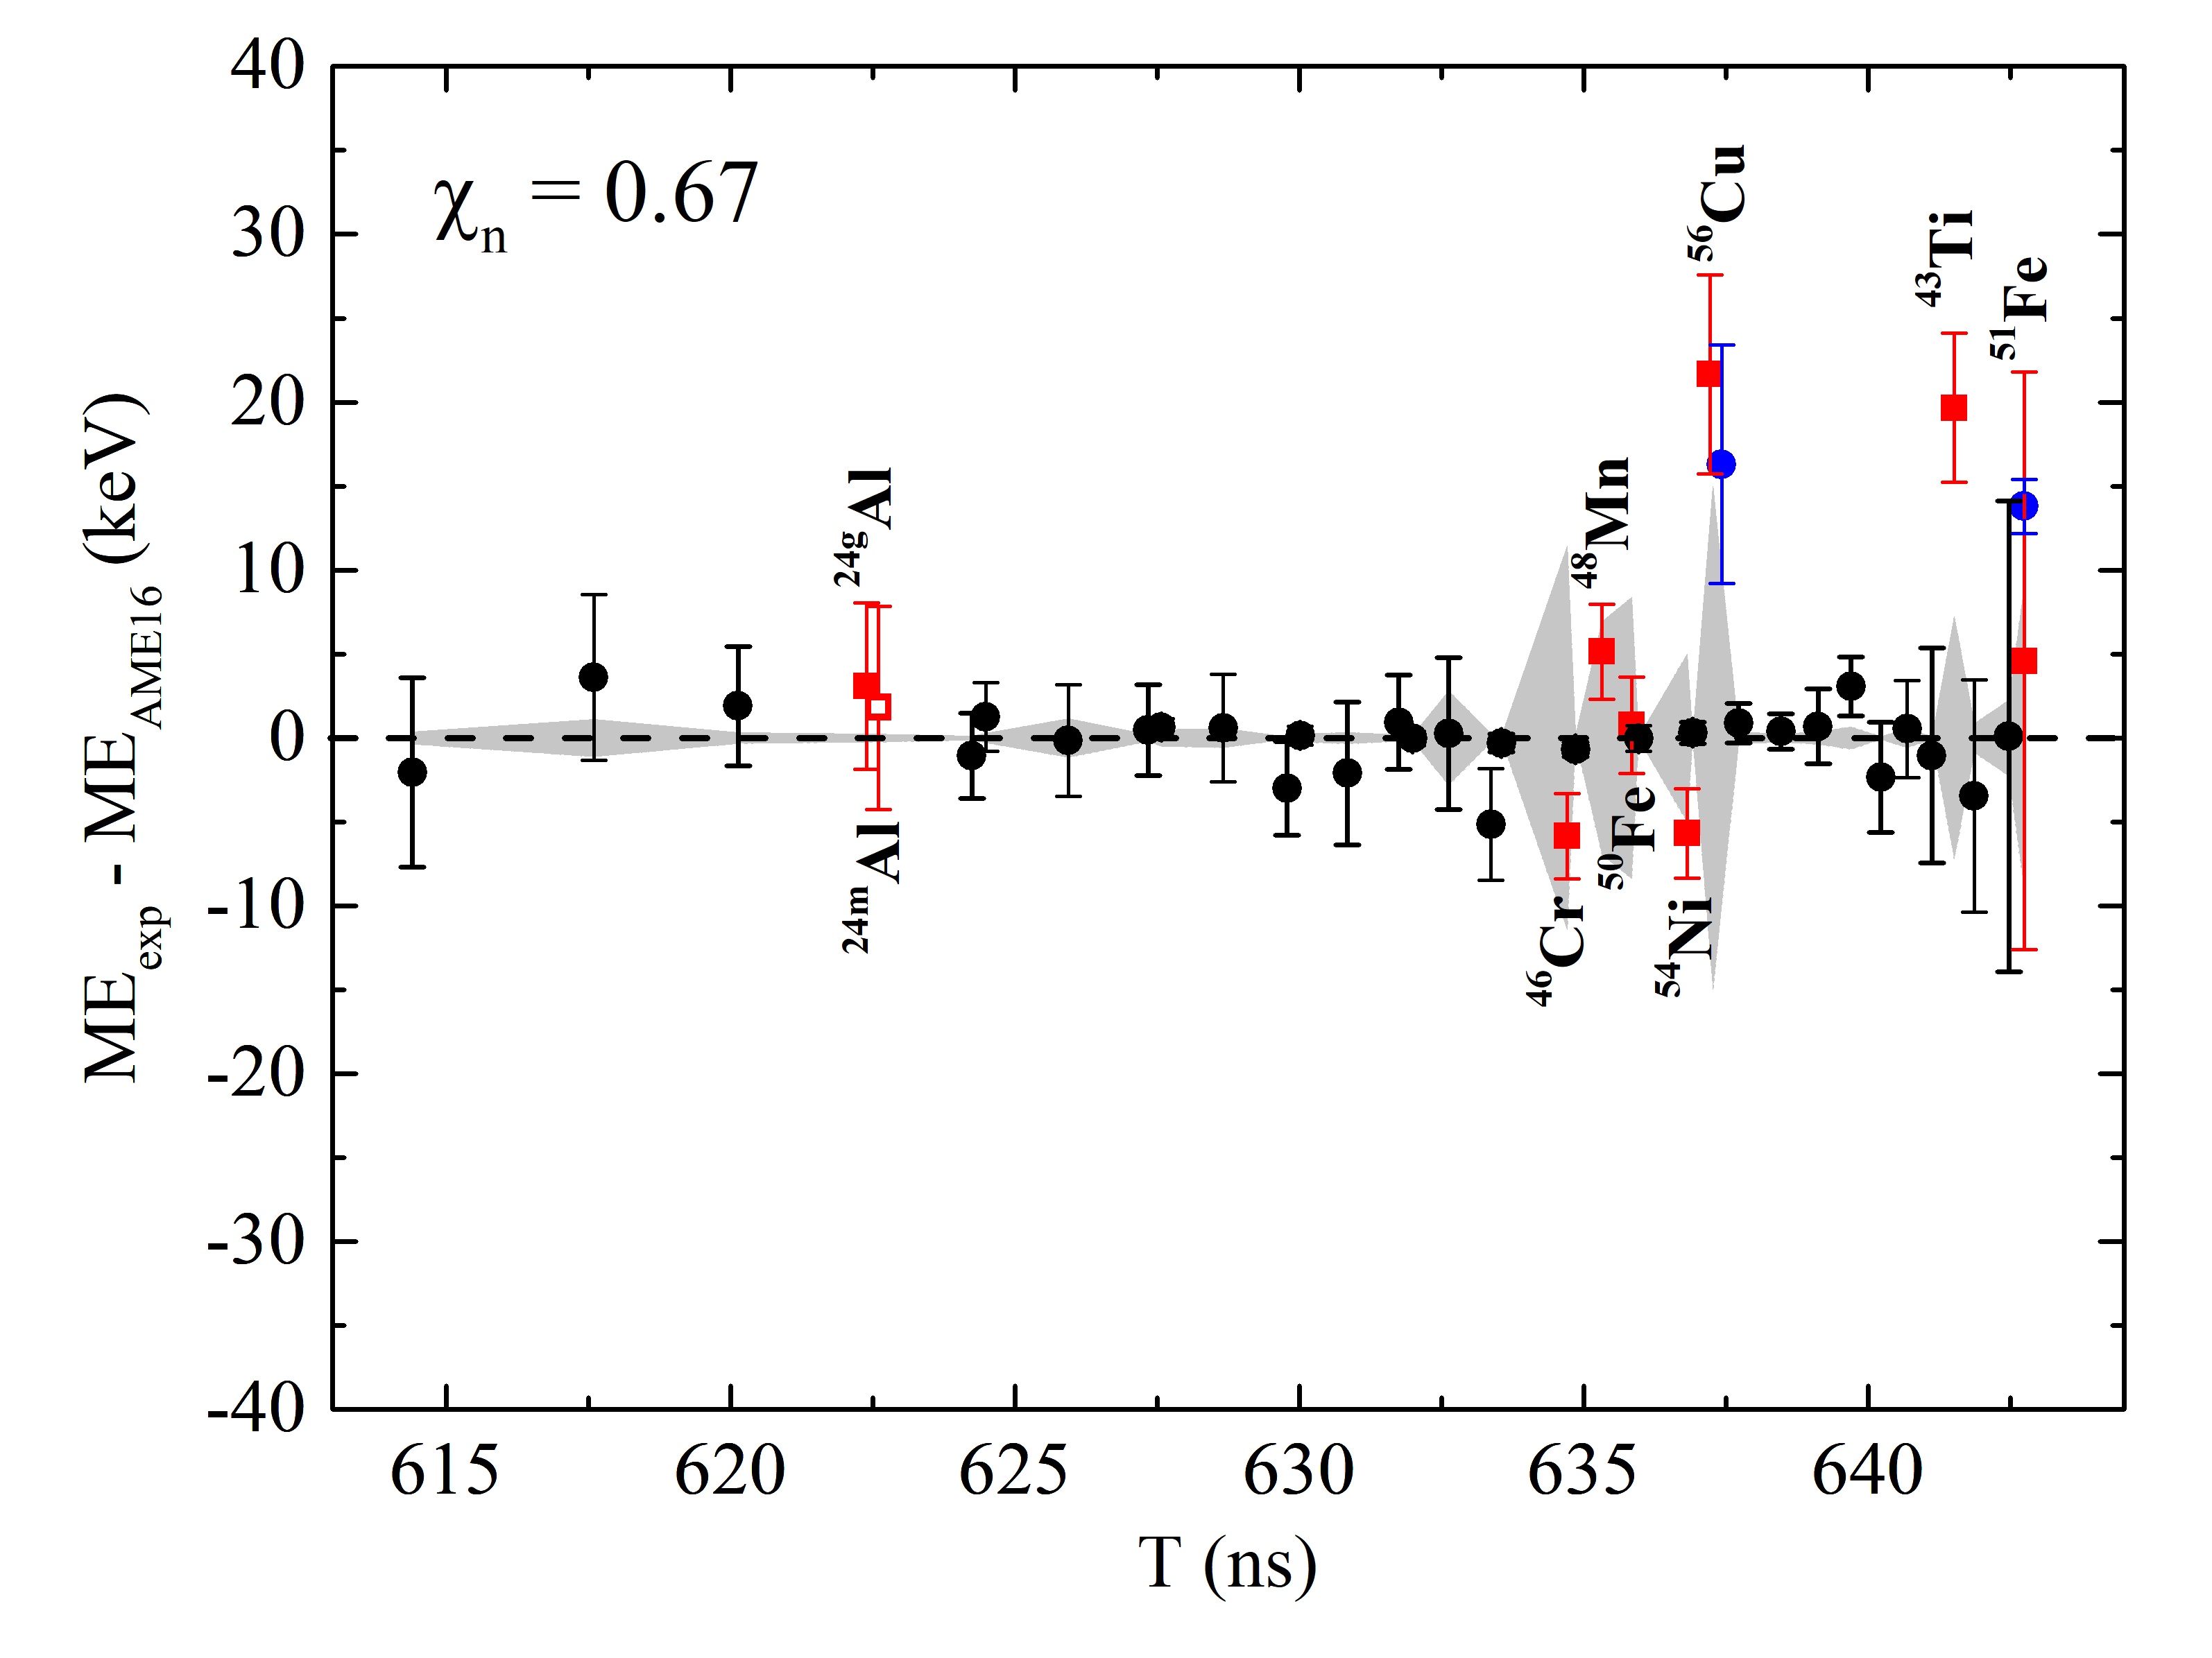
2. $B$-defined isochronous mass spectrometry IMS
⁵⁸Ni beam
Comparison with MR-TOF-MS@RIKEN
Mass accuracy using MR-TOF-MS at RIKEN
Mass accuracy using $B$-IMS at IMP
S. Kimura et al., IJMS 430, 134(2018)
5 keV error band

Slide 14
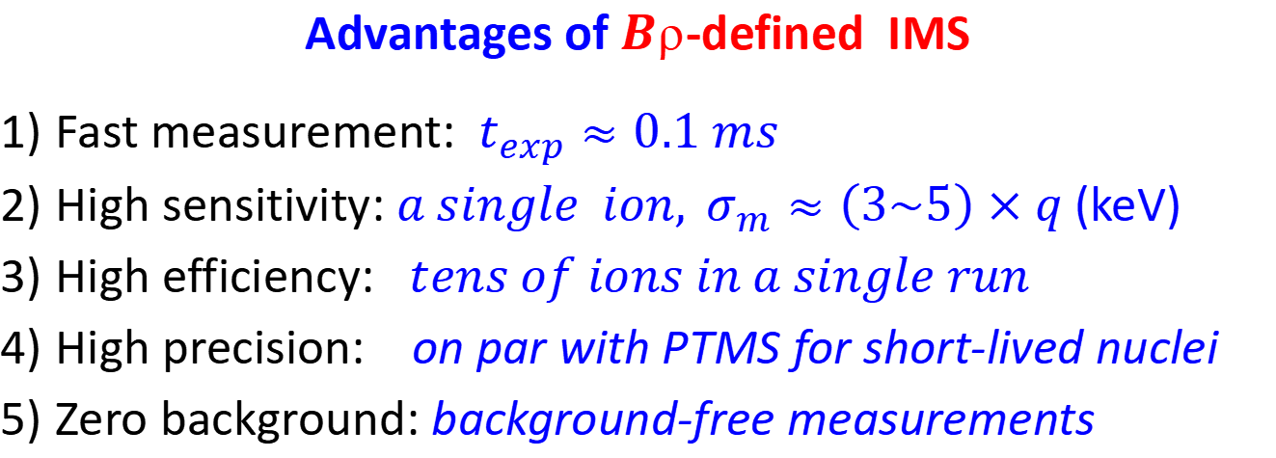
2. $B$-defined isochronous mass spectrometry IMS
Advantages of $B$-defined IMS
Fast measurement: $t_{exp}≈0.1 ms$
High sensitivity: $a single ion, σ_{m}≈\left(3\sim 5\right)×q$(keV)
High efficiency: $tens of ions in a single run$
High precision: on par with PTMS for short-lived nuclei
Zero background: background-free measurements

Slide 15
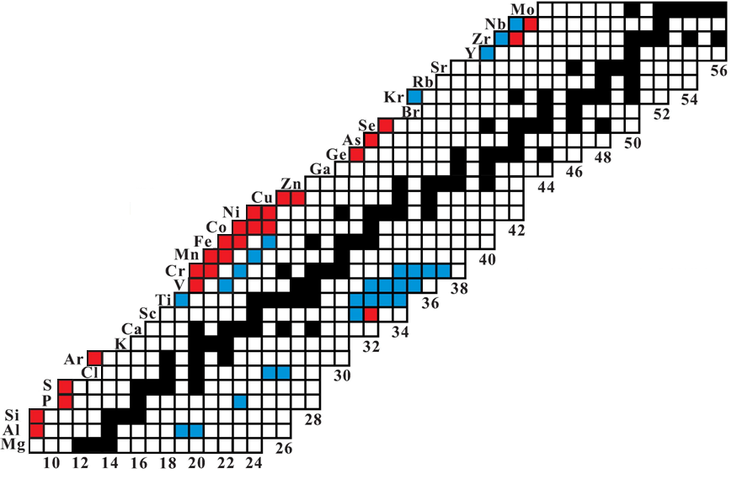
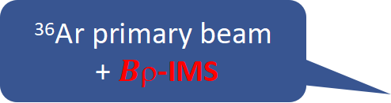


3. Recent results using $B$-IMS
Z=N
⁷⁸Kr primary beam
+$B$-IMS
⁷⁸Kr
Kr-70
Se-66
As-64
⁵⁸Ni primary beam
+$B$-IMS
Ge-62
Ga-60
Zn-58
³⁶Ar primary beam
+$B$-IMS

Slide 16
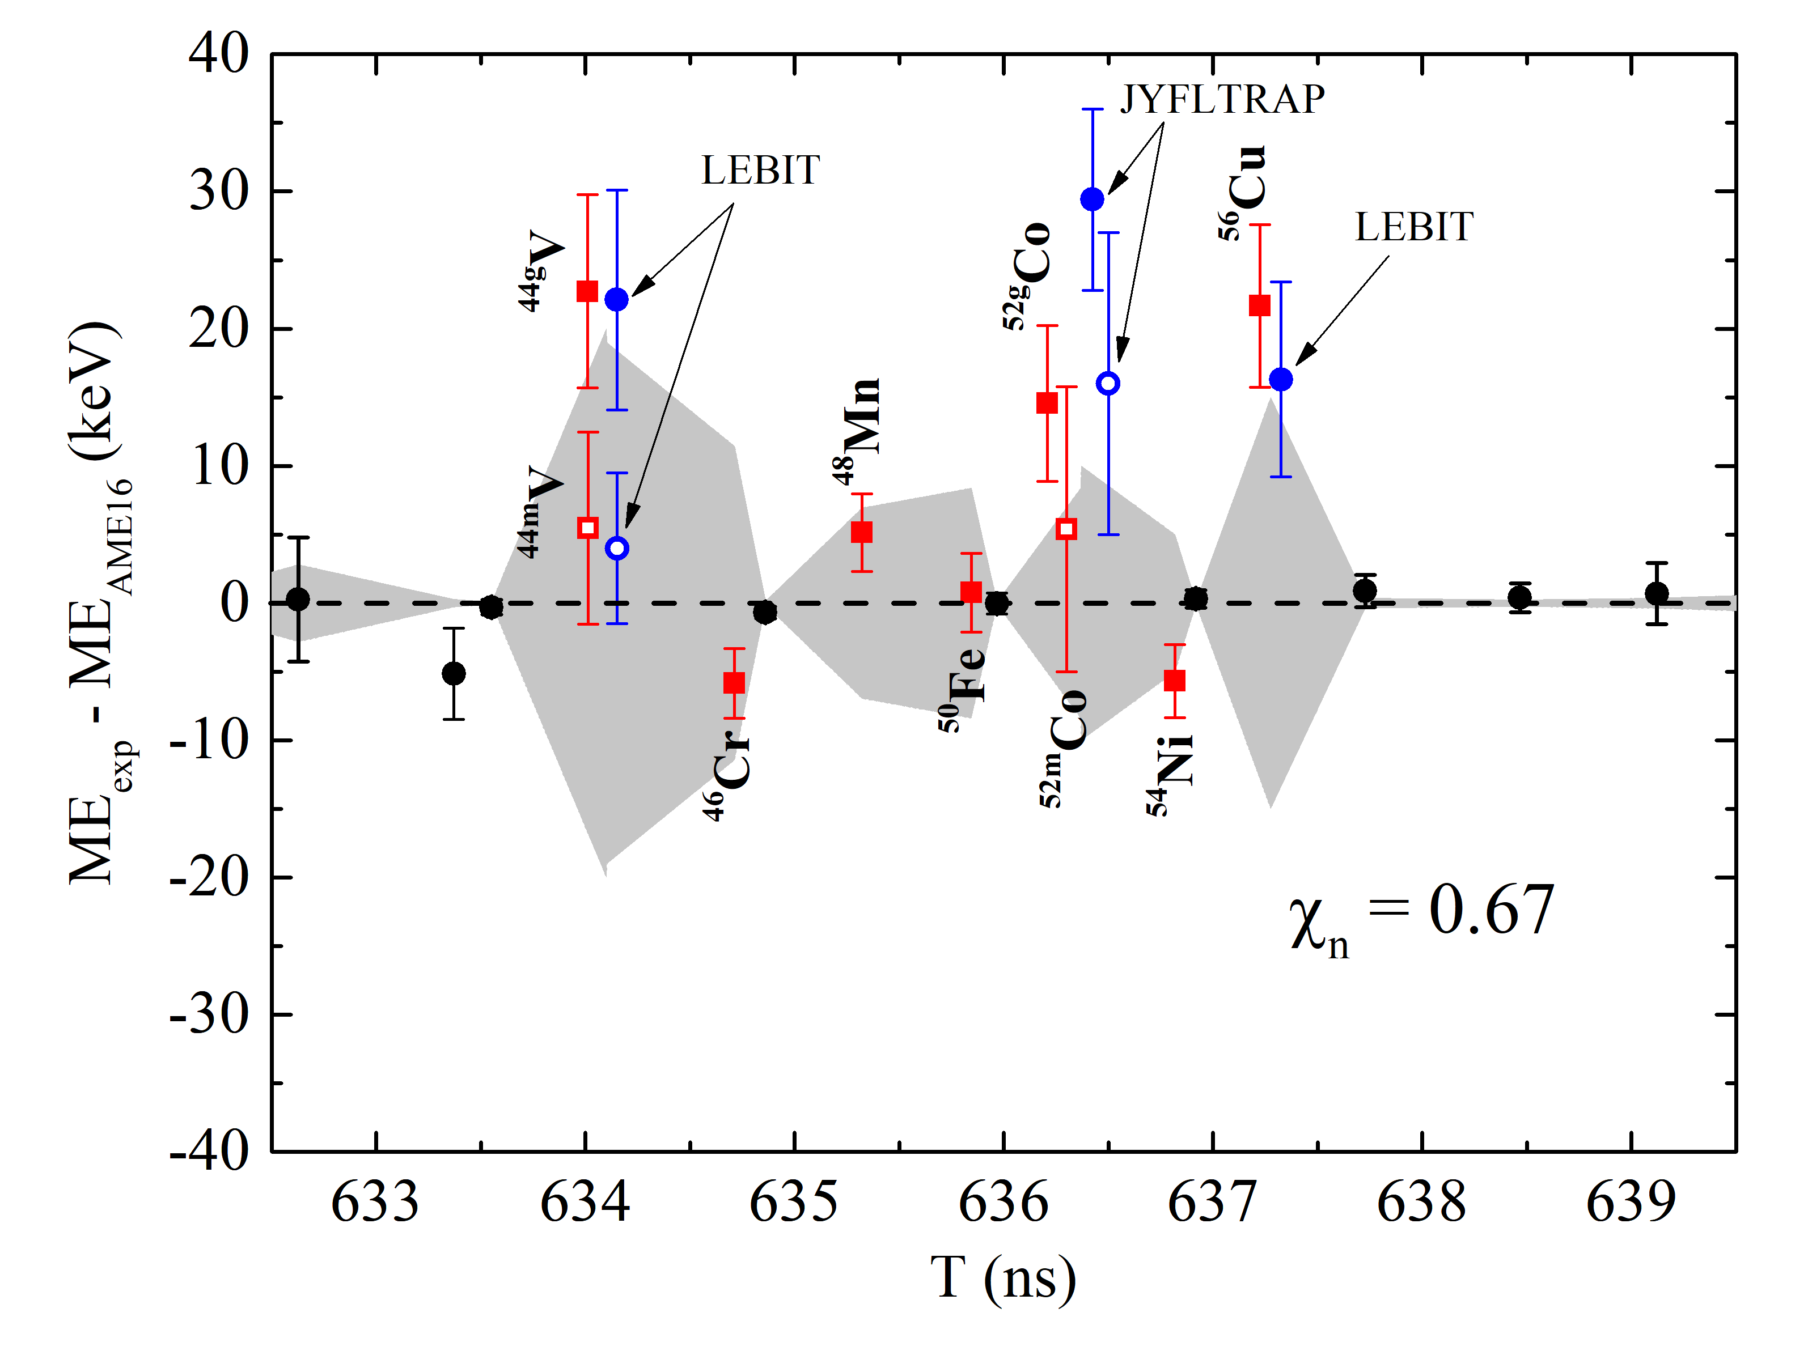
3. Recent results using $B$-IMS
⁵⁸Ni beam
Re-determined masses of$T_{z}=−1$ nuclei
M. Wang et al., PRC 106, L051301(2022)
5 keV error band
5 keV error band

Slide 17
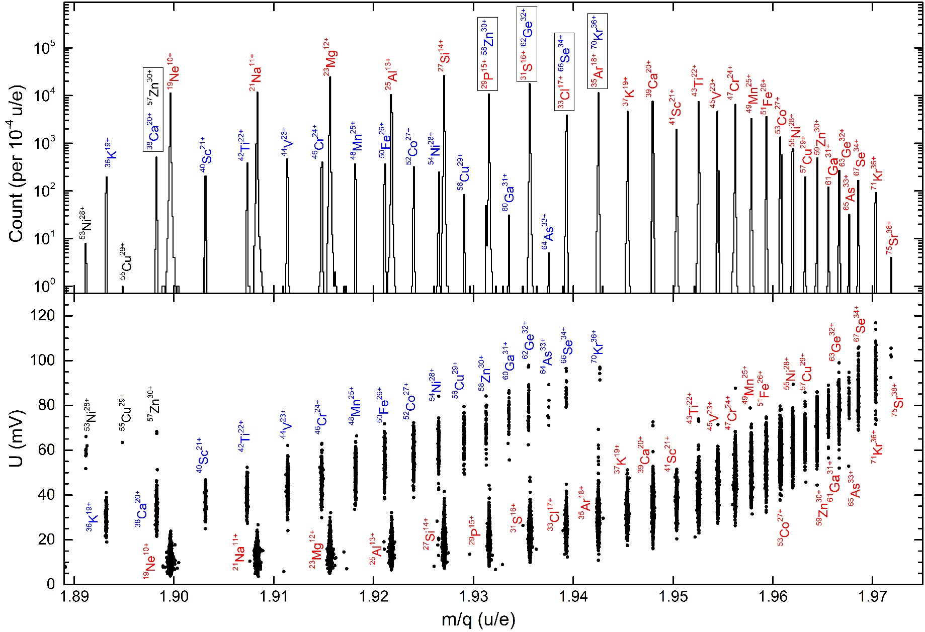
3. Recent results using $B$-IMS
⁷⁸Kr beam
⁶⁶Se
⁶⁵As

Slide 18
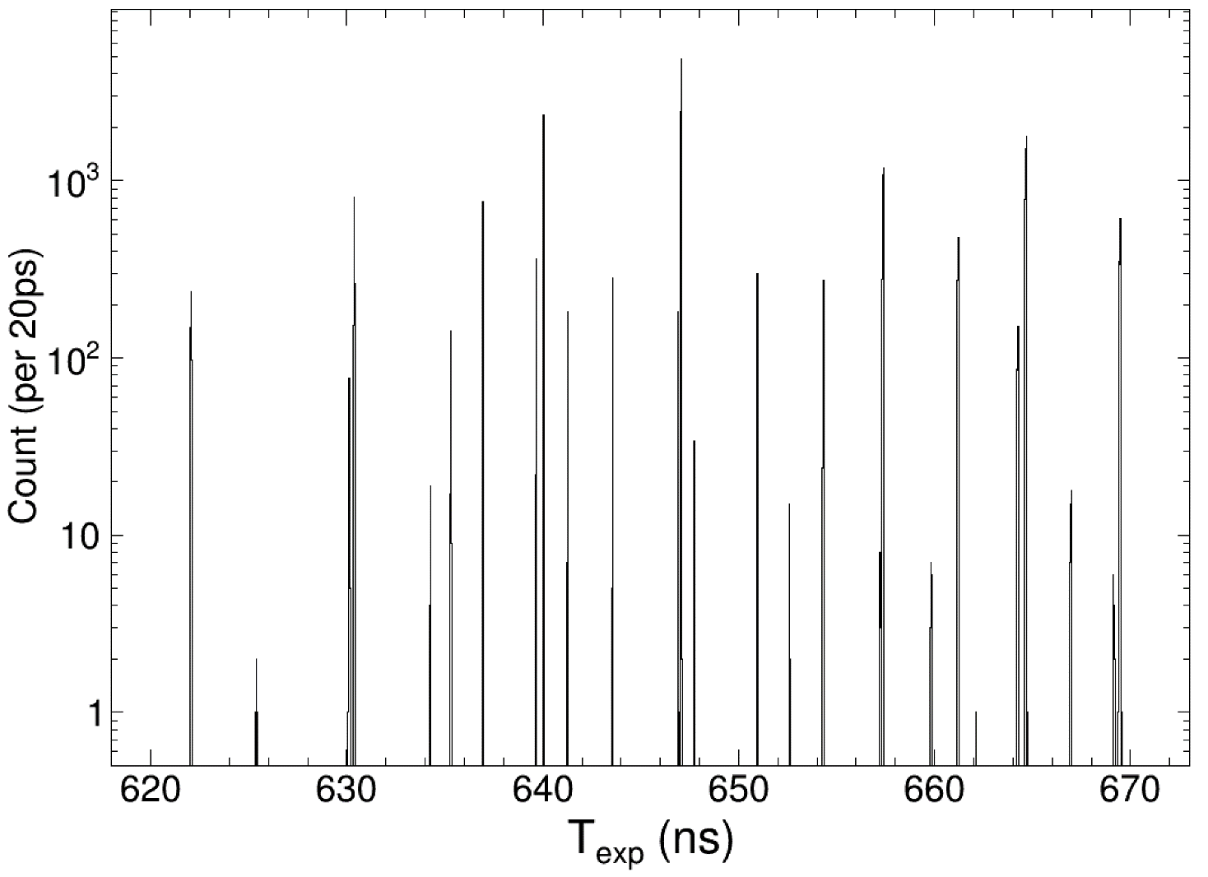
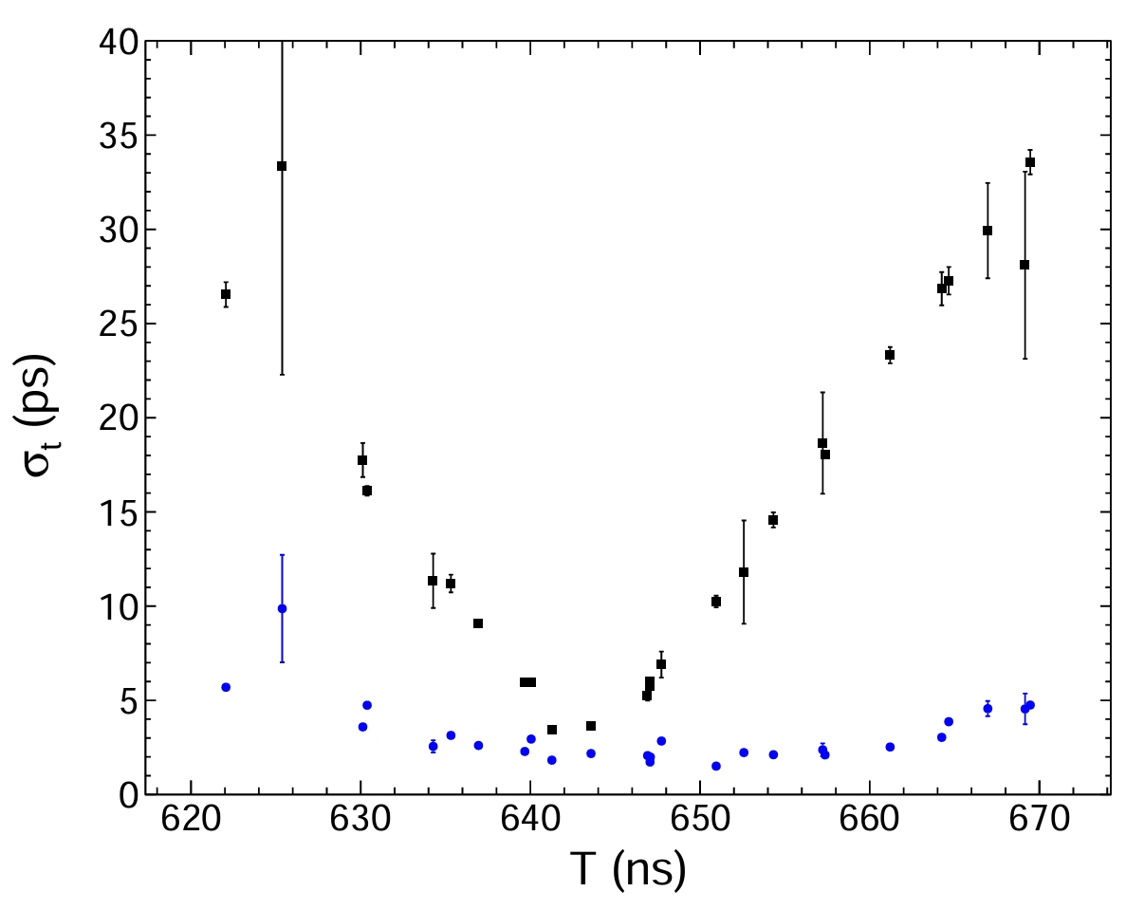

3. Recent results using $B$-IMS
³⁶Ar beam
²¹Mg+
¹⁴O
¹²N
¹¹C
¹³N
¹⁸Ne
²³Si
²⁴Al
¹⁰C
¹⁷Ne
¹³N
Isochronous setting at ²⁶P
²⁴Si
²⁶P
²⁰Na
¹¹C
²³Al
¹³O
²²Mg
²⁶Si
¹³O
³¹Ar
²⁸S
²⁵Si
²²Al
²²Mg
²⁰Na
²⁰Mg
⁷Be
²⁷P
¹⁸Ne
²⁷S
²⁴Al
²⁰Mg
³²Ar
¹⁰C
³²Ar
²⁷P
²²Al
²⁵Si
²⁹S
²⁶Si
²⁷S
²³Al
¹⁷Ne
⁷Be
$B$-IMS
²³Si
²⁴Si
¹²N
²⁸S
³¹Cl
³¹Ar

Slide 19
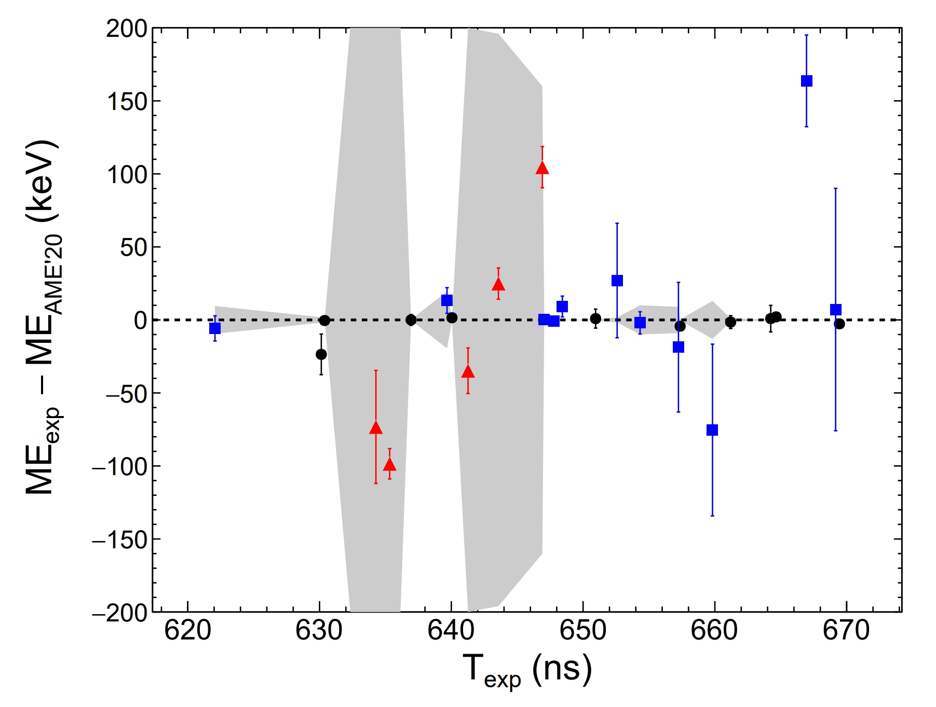
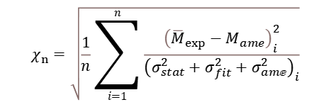

3. Recent results using $B$-IMS
³⁶Ar beam
²⁴Al (g.s+isomer)
10 keV
error band
$$χ_{n}=\sqrt{\frac{1}{n}\sum_{i=1}^{n}{\frac{{\left({\overline{M}}_{exp}−M_{ame}\right)}_{i}^{2}}{{\left({σ_{stat}^{2}+σ}_{fit}^{2}+σ_{amⅇ}^{2}\right)}_{i}}}}$$
¹²N
²⁸S
³²Ar
¹⁸Ne
¹¹C
²⁶P
²⁴Si
⁷Be
²⁶Si
$$χ_{n}=0.69±0.22$$
¹⁰C
²⁵Si
Black：reference nuclei used in
calibration
Blue: re-determined masses for
checking the reliability of
our measurement
Red: New masses
¹³O
¹⁷Ne
²³Al
²⁰Na
¹³N
²⁰Mg
²⁷P
³¹Ar
²⁷S
²¹Mg
¹⁴O
²⁹S
²²Mg
²²Al

Slide 20
3. Recent results using $B$-IMS
Beams used: ³⁶Ar×2, ⁴⁰Ar, ⁵⁸Ni×3, ⁷⁸Kr×3, ⁸⁶Kr×2, ¹¹²Sn×2
● We have established a new technique (Bρ-IMS)
with short measurement time, high precision,
back-ground free, and single-ion sensitivity.
● More than 30 short-lived nuclei are
measured for the 1st time reaching
the utmost relative precision
of 10⁻⁸ , and the shortest
T_{1/2} ∼ 0.1 ms
Nuclear structure
Nuclear astrophysics
• Isospin symmetry breaking
PRL 109, 102501 (2012)
PLB 735, 327 (2014)
PRL 117, 182503 (2016)
PRC 98, 014319 (2018)
PRC 110, L021301 (2024)
Shell evolution & N=32 number
CPC 39, 104001 (2015)
PRC 99, 064303 (2019)
PRC 107, 014304 (2023)
• Test the CVC hypothesis
PLB 767, 20 (2017)
• Bρ-defined IMS
PRC 106, L051301 (2022)
EPJA 59: 27 (2023)
• Systematics of c-coefficient of
IMME and new mass of ⁷⁰Br
PRC 108, 034301 (2023)
• pn correlation and 3N force
PRL 130, 192501 (2023)
• Proton halos
PRL accepted (2024)
• Waiting point nucleus ⁶⁴Ge in
the rp-process of X-ray bursts
PRL 106, 112501 (2011)
ApJ 818, 78 (2016)
Nat. Phys. 19, 1091 (2023)
• Ca-Sc cycle in rp-process
ApJ Lett. 766, L8 (2013)
PRC 98 (2018) 014319
• ⁴²Ti(p,γ )⁴³V reaction rate
PRC 89, 035802 (2014)
• Zr-Nb cycle & abundance of
p-nucleus ⁸⁴Sr
PLB 781, 358 (2018)
• ⁵⁷Cu(p,γ )⁵⁸Zn reaction rate
PRC 109, 045802 (2024)
… …
proton number
measured for the 1st time
Accuracy improved
Neutron number

Slide 21

Proton-halo structures in sd-shell nuclei
I. Tanihata et al., Prog. in Part. & Nucl. Phys. 68, 215 (2013)
K. Y. Zhang et al., Phys. Rev. C 107, L041303 (2023)
Discovered
by Tanihata in 1985
Halo nuclei
$$R≈r_{0}A^{1/3}$$
It is treated as confirmed by observations of
enhancement of the cross section, and
narrow momentum distribution

Slide 22
Proton-halo structures in sd-shell nuclei
Density distribution
Momentum distribution
Matter radii
B. Jonson,
Nuclear Physics A574 (1994) 151c-166c
T. Kobayashi el al., PRL 60 (1988) 2599
⁹Li from ¹¹Li+C
It is treated as confirmed by observations of
enhancement of the cross section, and
narrow momentum distribution

Slide 23

Proton-halo structures in sd-shell nuclei
New indicator of proton-halo structures from mirror energy differences (MEDs)
N=Z
$${MED}_{1}=S_{n}(n\text{−}rich )−S_{p}(p\text{−}rich)$$
$${MED}_{2}=S_{2n}(n\text{−}rich )−S_{2p}(p\text{−}rich)$$
Binding energies
odd-Z
-
+
 |  | - | +
$${MED}_{1}=$$
MEDs can be easily calculated using a mass formula assuming isospin symmetry !

Slide 24

Proton-halo structures in sd-shell nuclei
Solid lines: ab initio VS-IMSRG calculations by Q. YUAN and J.G. LI
J. Jänecke, Phys. Rev. 147, 735 (1966)
$$M\left(A,T,T_{z}\right)=M_{0}\left(A,T\right)+E_{c}\left(A,T,T_{z}\right)+T_{z}∆m_{n−H}$$
Binding energies
Coulomb energies
odd-Z
-
+
 |  | - | +
+
-
 |  | + | -
$${MED}_{1}=$$
=
$$E_{c}=\left\{0.6Z^{2}−0.46Z^{4/3}−0.15\left[1−{(−1)}^{Z}\right]\right\}\frac{e^{2}}{R_{eq}}$$

Slide 25


Proton-halo structures in sd-shell nuclei
Solid lines: ab initio VS-IMSRG calculations by Q. YUAN and J.G. LI
Weakly bound nuclei + Dominant π2s_{1/2} occupation
+ Extended spatial distribution (proton halos)
Shell model orbit
1f_{7/2}
Reduced Coulomb energy
(Thomas-Ehrman shift)
20
1d_{3/2}
16
Coulomb energies
2s_{1/2}
o-Z +
-
 |  | + | -
e-Z +
-
 | + |  | -
1d_{5/2}
14
8
1p_{1/2}
$${MED}_{1}$$
$${MED}_{2}$$

Slide 26
Proton-halo structures in sd-shell nuclei
ab initio VS-IMSRG calculations by Q. YUAN (袁琪) and J. G. LI (李健国) et al

Slide 27
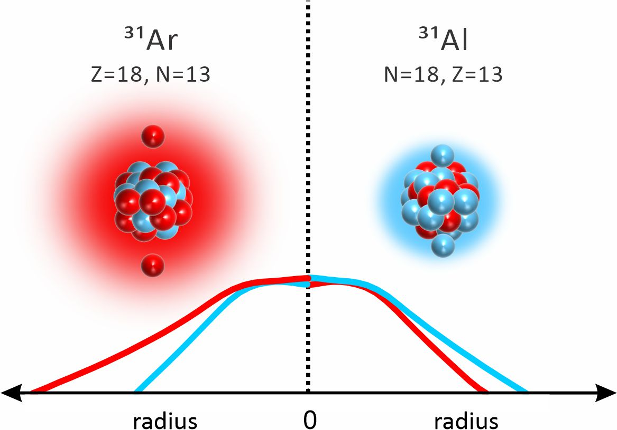
Proton-halo structures in sd-shell nuclei
Density distributions from HFB
(Dr. J.C. Pei et al. in Beijing Uni.)
N=Z
³¹Ar
³²Ar
³³Ar
³⁴Ar
³⁵Ar
³⁶Ar
³⁷Ar
³⁸Ar
³⁹Ar
⁴⁰Ar
⁴¹Ar
⁴²Ar
⁴³Ar
⁴⁴Ar
⁴⁵Ar
⁴⁶Ar
⁴⁷Ar
⁴⁸Ar
⁴⁹Ar
⁵⁰Ar
³¹Cl
³²Cl
³³Cl
³⁴Cl
³⁵Cl
³⁶Cl
³⁷Cl
³⁸Cl
³⁹Cl
⁴⁰Cl
⁴¹Cl
⁴²Cl
⁴³Cl
⁴⁴Cl
⁴⁵Cl
⁴⁶Cl
⁴⁷Cl
⁴⁸Cl
⁴⁹Cl
Potential halo candidates
²⁷S
²⁸S
²⁹S
³⁰S
³¹S
³²S
³³S
³⁴S
³⁵S
³⁶S
³⁷S
³⁸S
³⁹S
⁴⁰S
⁴¹S
⁴²S
⁴³S
⁴⁴S
⁴⁵S
⁴⁶S
⁴⁷S
⁴⁸S
²²Al
No proton halo in the g.s
Potential halo structures in the excited states

Slide 28
Proton-halo structures in sd-shell nuclei
Accepted 22 Oct. for publication in PRL

Slide 29
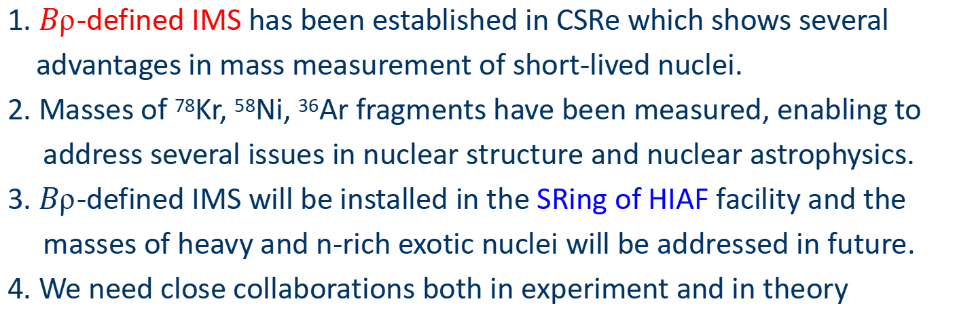
4. Summary and perspectives
1. $B$-defined IMS has been established in CSRe which shows several
advantages in mass measurement of short-lived nuclei.
2. Masses of ⁷⁸Kr, ⁵⁸Ni, ³⁶Ar fragments have been measured, enabling to
address several issues in nuclear structure and nuclear astrophysics.
3. $B$-defined IMS will be installed in the SRing of HIAF facility and the
masses of heavy and n-rich exotic nuclei will be addressed in future.
4. We need close collaborations both in experiment and in theory

Slide 30

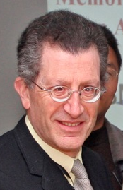
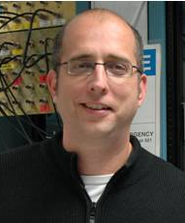




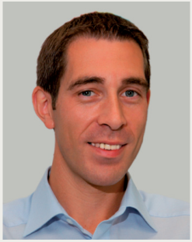





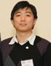


CSRe mass measurement collaboration
Yu. A. Litvinov
G. Audi
GSI
RIKEN
Domestic
MPIK
Orsay
MSU
H. Schatz
B. A. Brown
T. Uesaka
K.Blaum
B. H. Sun
Y. Sun
F. R. Xu

Slide 31
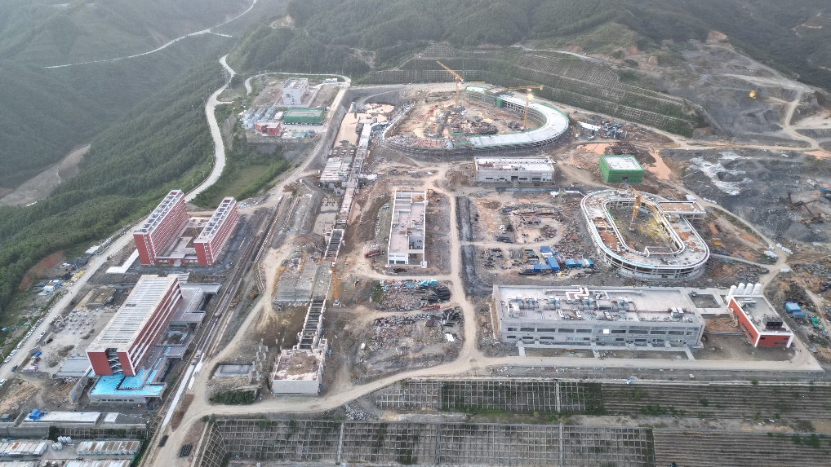
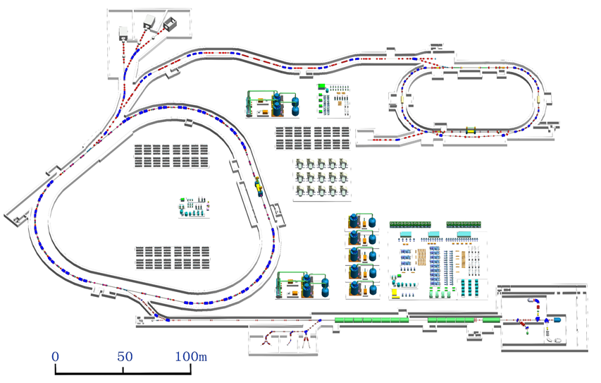

4. Summary and perspectives
High Intensity Accelerator Facility (HIAF)
2023.10.10
SRing
Guangzhou
HIAF
Hongkong
Plan to be commissioned at the end of 2026

Slide 32

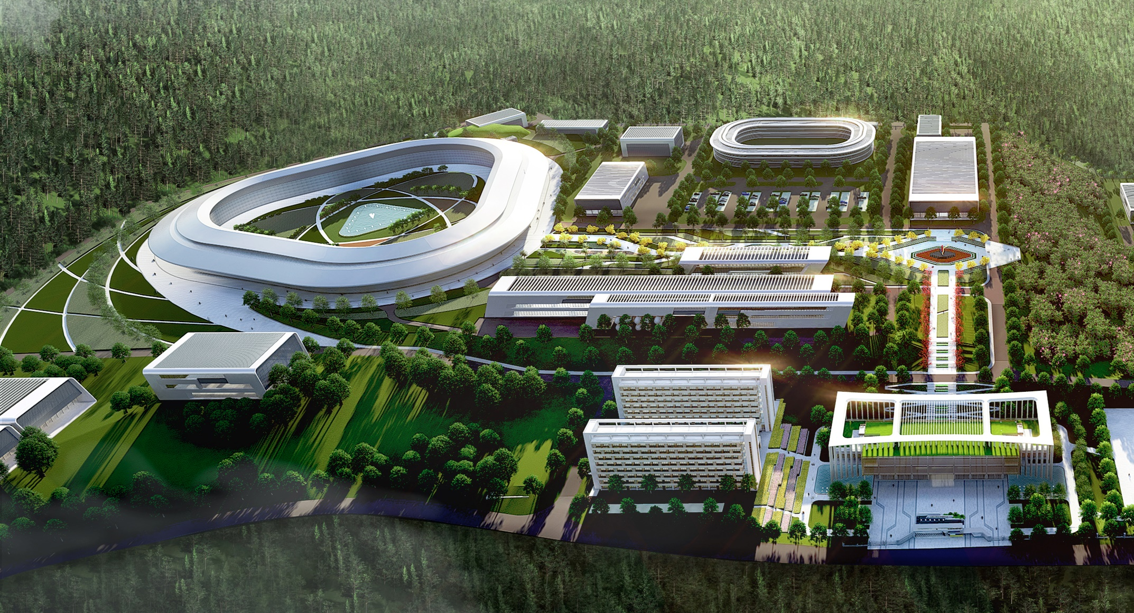
High-Intensity Heavy Ion Accelerator Facility-HIAF
HIAF is one of the major national science and technology infrastructure under construction with the support of both central and local governments
The project is proposed and constructed by IMP, CAS
The total budget is 3.0 billion CNY
The construction of project started at the end 2018, and the period is 7 years
Courtesy of Jiancheng Yang

Slide 33

2024 ANPhA meeting and ANPhA symposium
Let’s cross the bridge and collaborate !
Many thanks for your attention

Slide 34
2. $B$-defined isochronous mass spectrometry IMS
Betatron oscillation
$$∆t_{exp}$$
$v_{exp}=\frac{L}{{∆t}_{exp}}$
Revolution turn number N

Slide 35


2. $B$-defined isochronous mass spectrometry IMS
$∆t_{exp}$ determinations considering betatron oscillation of stored ions
$t_{fit}\left(N\right)$ $=\sum_{i=0}^{i=3}{a_{i}}∙N^{i}$
$+A_{x}∙sin\left[2π\left(Q_{x0}N+Q_{x1}N^{2}\right)+φ_{x}\right]$
$$+A_{y}∙sin\left[2π\left(Q_{y0}N+Q_{y1}N^{2}\right)+φ_{y}\right]$$
TOF2
$$∆t_{exp}$$
TOF1
 The polynomial function represents
ion motion with a mean orbital length
 The sine-like terms describe the
periodic time fluctuations due to
betatron oscillations.
Fit the data with $t_{fit}\left(N\right) function$
using all time stamps

Slide 36
1. Introduction
IMS in CSRe-Lanzhou
Full Bρ acceptance
Full Bρ acceptance causes systematic deviation
IMS window
calibrants
re-determined
IMS window

Slide 37
2. $B$-defined isochronous mass spectrometry IMS
$$t_{fit}\left(N\right)=\sum_{i=0}^{3}{a_{i}∙N^{i}}+A_{x} sin\left[2π\left(Q_{x0}N+Q_{x1}N^{2}\right)+φ_{x}\right]+A_{y}sin\left[2π\left(Q_{y0}N+Q_{y1}N^{2}\right)+φ_{y}\right]$$
all ⁴⁵V²³⁺
TOF1
Fit residuals
single ⁴⁵V²³⁺
TOF2

Slide 38

2. $B$-defined isochronous mass spectrometry IMS

Slide 39


2. $B$-defined isochronous mass spectrometry IMS
Mass resolving powers are significantly improved after field drift correction for all nuclides in the large m/q-range of$∆\left(m/q\right)≈0.10 ue^{−1}$
$\frac{m}{q}$ spectrum
⁵⁸Ni beam
$σ_{m}≈\left(3\sim 5\right)×q$keV
100 keV uncertainty can be achieved
for a single event of Ni (q=28) ion

Slide 40
2. $B$-defined isochronous mass spectrometry IMS

Slide 41
3. New masses from $B$-IMS and it impacts on NS & NucA
M. Wang et al., PRL 130, 192501 (2023)
Restoration of
Pseudo-SU(4) symmetry ?
Red dots: at least one of our masses is used

Slide 42

Proton-halo structures in sd-shell nuclei

Slide 43

3. Recent results using $B$-IMS
⁵⁸Ni beam
d coefficients of the cubic form of IMME
for the T = 3/2 isospin quartets.
M. Zhang et al., Eur. Phys. J. A 59: 27(2023)
$T_{Z}=−$3/2 nuclides

Slide 44





2. $B$-defined isochronous mass spectrometry IMS
Principle of $B$- IMS for mass determinations
P. M. Walker, et al.,
ILIMA Technical Proposal, GSI, 2005.
H. Geissel and Yu. A. Litvinov,
J. Phys. G: Nucl. Part. 31, S1779 (2005)
Calibration
Outputs
${\left(Bρ\right)}_{i}={\left(\frac{m}{q}\right)}_{i}∙{(γv)}_{i}$
$$C_{i}=v_{i}∙T_{i}$$
$${\left(\frac{m}{q}\right)}_{i}=\frac{{\left(Bρ\right)}_{i}}{{\left(γv\right)}_{i}}$$
Measurements
$$T_{i},v_{i}$$
$$(i=1,2,…N)$$
$$Bρ(C)$$
using nuclei with known $m/q$
New ${(m/q)}_{i}$ using ${(B)}_{fit}^{i}$

Slide 45
3. Recent results using $B$-IMS
Beams used: ³⁶Ar×2, ⁴⁰Ar, ⁵⁸Ni×3, ⁷⁸Kr×3, ⁸⁶Kr×2, ¹¹²Sn×2
One mass  several issues
Nuclear astrophysics
Nuclear structure
• Isospin symmetry breaking
PRL 109, 102501 (2012)
PLB 735, 327 (2014)
PRL 117, 182503 (2016)
PRC 98, 014319 (2018)
Shell evolution & N=32 number
CPC 39, 104001 (2015)
PRC 99, 064303 (2019)
PRC 107, 014304 (2023)
• Test the CVC hypothesis
PLB 767, 20 (2017)
• Bρ-defined IMS
PRC 106, L051301 (2022)
EPJA 59: 27 (2023)
• pn correlation and 3N force
PRL 130, 192501 (2023)
• Proton halos
PRL accepted (2024)
• rp-waiting point nucleus ⁶⁴Ge
PRL 106, 112501 (2011)
ApJ 818, 78 (2016)
Nat. Phys. 19, 1091 (2023)
• Ca-Sc cycle in rp-process
ApJ Lett. 766, L8 (2013)
PRC 98 (2018) 014319
• ⁴²Ti(p,γ )⁴³V reaction rate
PRC 89, 035802 (2014)
• Zr-Nb cycle & abundance of
p-nucleus ⁸⁴Sr
PLB 781, 358 (2018)
• ⁵⁷Cu(p,γ )⁵⁸Zn reaction rate
PRC 109, 045802 (2024)
… …
Nucleo-synthesis path
Energy
generation
Element abundance
CSRe Masses
(10⁻⁶ ~ 10⁻⁷)
Time scale
Light curves
Magicity
Shell
Drip lines
Mass Formula
Pairing Deformation
Halos
Symmetry
in nuclei

Slide 46
Waiting point ⁶⁴Ge in the rp-process of Type I X-ray bursts
All Q-values of (p,γ) reaction around ⁶⁴Ge obtained
X-ray burst GS1826-24
Multizone X-ray burst simulations
less bound: ⁶⁵As
more bound: ⁶⁶Se,
⁶⁶Se
2.01
(220)#
1.840(70)
4.689(70)
⁶⁴As
-100
(200)#
-90(80)
4.970(80)
2.220(40)
5.150(40)
⁶⁴Ge
● peak luminosity (flux) increased
● A=64 mass fraction increased by 17%
● A=65 mass fraction decreased by 14%

Slide 47
Waiting point ⁶⁴Ge in the rp-process of Type I X-ray bursts
New light curve enables us to set new constraints on the optimal d and (1 + z) parameters
● the neutron star in GS1826-24 is 6.5%
farther away (0.4 kpc=1300 ly) from us !
● reduced 1+z value indicates weaker
gravitation than believed !
● mass and radius are constrained

Slide 48
Waiting point ⁶⁴Ge in the rp-process of Type I X-ray bursts

