Slide 1
Effects of new physics in atoms and nuclei
Part 1: spectroscopy
New particles and interactions
Extra space dimensions
Space-time variation of fundamental constants and
violation of fundamental symmetries
due to interaction with Dark matter
Part 2: dark matter in underground laboratories
Part 3: composite dark matter, (anti)quark nuggets

Slide 2
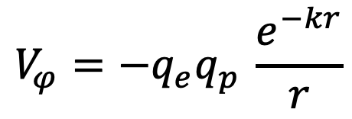
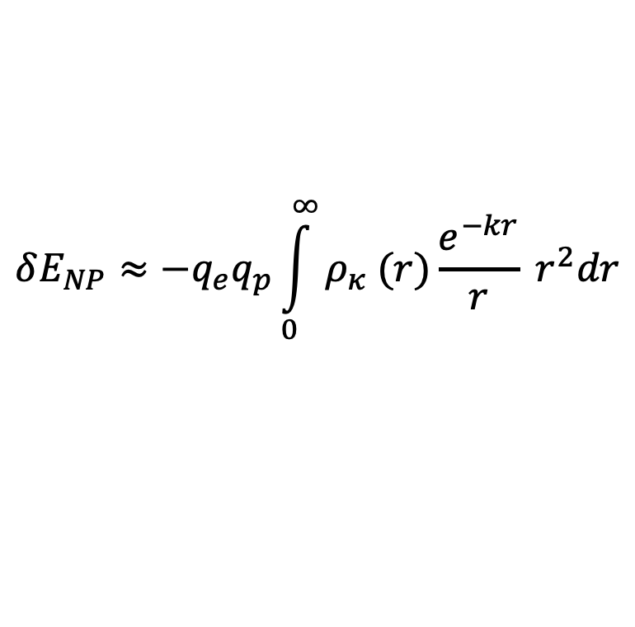

Limits on new interaction from spectra of hydrogen, muonium, positronium, deuterium
Munro-Laylim, Dzuba, Flambaum [arXiv:2207.07325] Molecular physics 2022, and references therein
Effective potential produced by new scalar particle:
$$V_{φ}=−q_{e}q_{p }\frac{e^{−kr}}{r}$$
$$k=\frac{m_{φ}c}{ℏ}$$
Particle’s coupling to electron to proton or muon
Energy shift:
$$δE_{NP}≈−q_{e}q_{p}\int_{0}^{∞}{ρ_{κ} (r)\frac{e^{−kr}}{r} r^{2}dr}$$
Electron wave function density
Notes:
People use big colliders to search for new particles, but what if we could see some effects luring in this spectroscopy tool?
The only particle we can see this way is one that couples to electrons and neutrons. (because their number change in isotope shift, and protons remain the same)
So we cannot see particles which…

Slide 3
Effects of gravity in extra dimensions in atomic spectra
V. A. Dzuba , V. V. Flambaum , and P. Munro-Laylim
PRA 106, 052804 (2022) and references therein
Arkani-Hamed - Dimopoulos-Dvali model explains weakness of gravity via extra compactified dimensions.
n extra dimensions, from Gauss law:
From H, 1s-2s
n | R_{n} (m) | M_{n}(GeV)
2 | 5.7[+01] | 6.5
3 | 2.4[-05] | 9.8
4 | 1.1[-08] | 16
5 | 1.1[-10] | 23
6 | 5.0[-12] | 30
7 | 5.6[-13] | 36
R is radius of extra dimensions, M is Plank mass in n+3 dimensions. Limits R< R_{n} , M > M_{n}
We use the data on spectra of hydrogen, muonium, positronium, and deuteron.

Slide 4
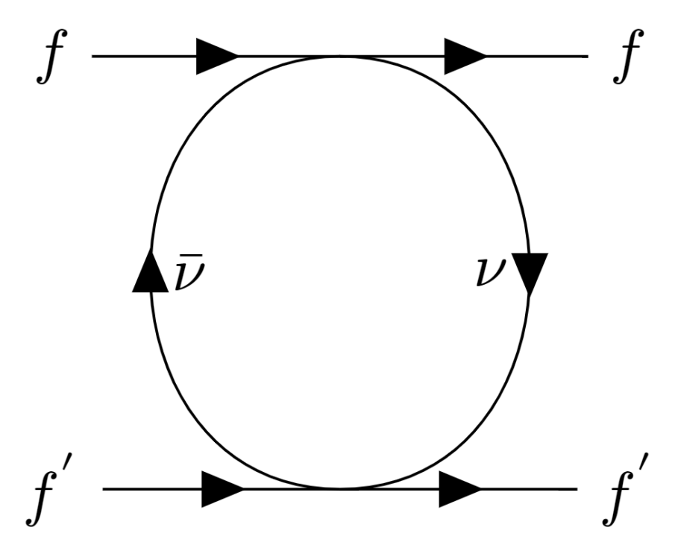
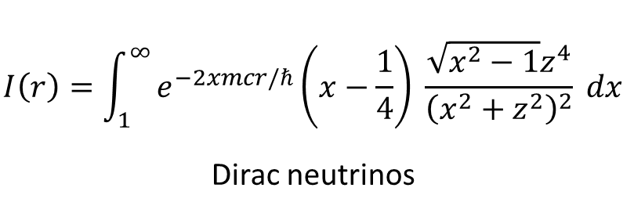
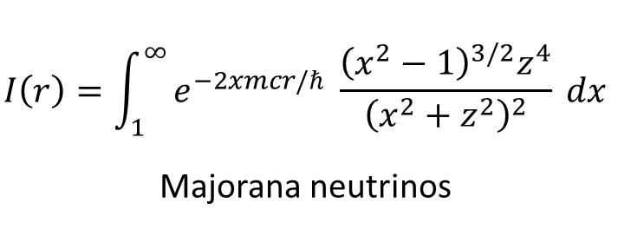
Neutrino-exchange potential
$$V\left(r\right)= \frac{2G_{F}^{2}m^{4}}{3π^{3}r}I\left(r\right)\left(a_{1}a_{2}−b_{1}b_{2}\left[{\frac{3}{2}σ}_{1}⋅σ_{2} −\frac{5}{2}(σ_{1}⋅\hat{r})(σ_{2}⋅\hat{r})\right]\right)$$
$$I\left(r\right)=\int_{1}^{∞}{e^{−2xmcr/ℏ}\left(x−\frac{1}{4}\right) \frac{\sqrt{x^{2}−1}z^{4}}{{\left(x^{2}+z^{2}\right)}^{2}} dx}$$
Dirac neutrinos
$$I\left(r\right)=\int_{1}^{∞}{e^{−2xmcr/ℏ} \frac{{\left(x^{2}−1\right)}^{3/2}z^{4}}{{\left(x^{2}+z^{2}\right)}^{2}} dx}$$
Majorana neutrinos
Effects in atomic spectroscopy
Stadnik PRL 120, 223202 (2018)
Munro-Laylim, Dzuba, Flambaum, Stadnik
PRL 129, 239901, 2022.
Munro-Laylim, Dzuba, Flambaum
[arXiv:2207.07325] Mol. Phys. 2022
Interaction has been introduced by
Gamow & Teller
Feynman
Feinberg & Sucher

Slide 5
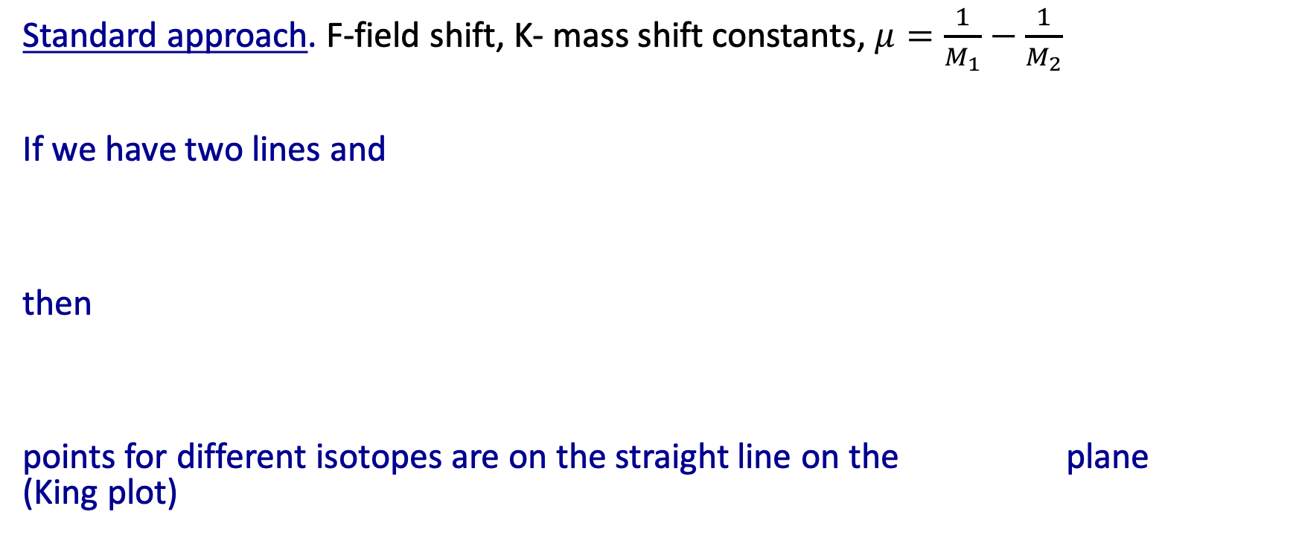
King plot for Isotope shift and 5th force
Standard approach. F-field shift, K- mass shift constants, $μ=\frac{1}{M_{1}}−\frac{1}{M_{2}}$
If we have two lines and
then
points for different isotopes are on the straight line on the plane (King plot)

Slide 6
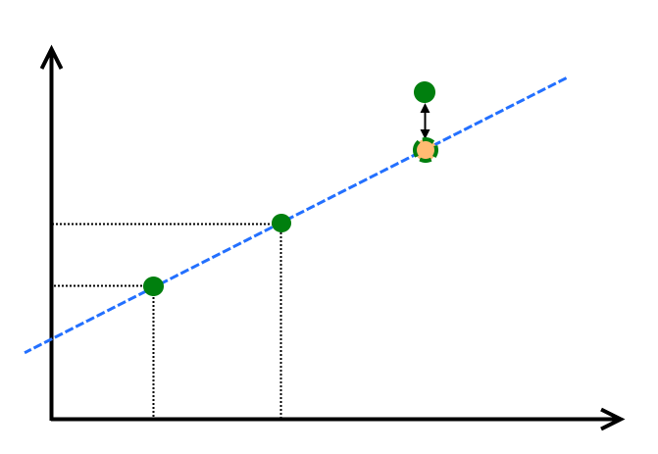
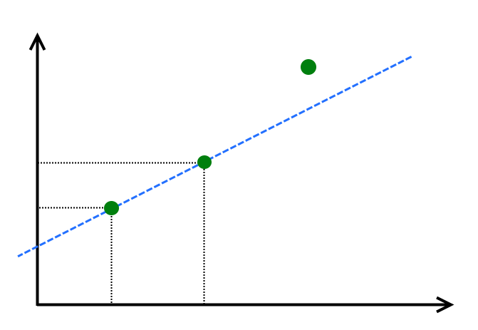
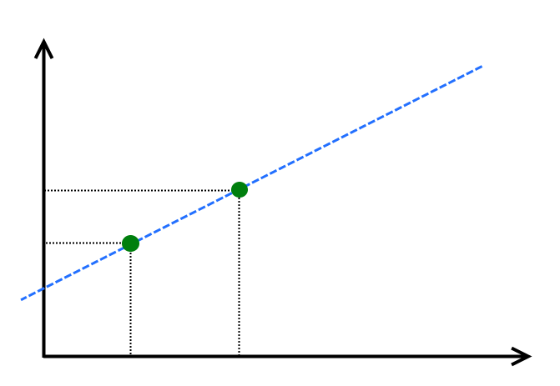
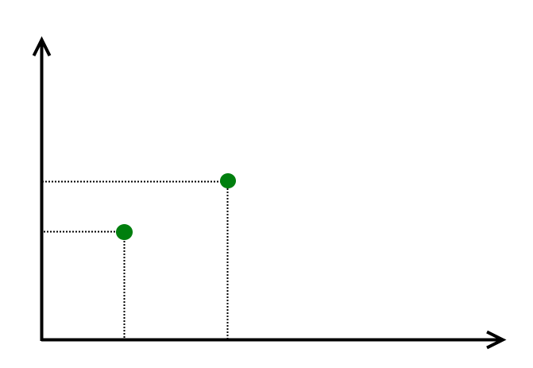




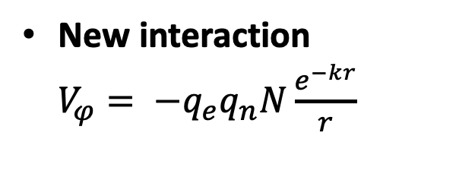






King plot non-linearity
$$n_{2}$$
New interaction $V_{φ}= −q_{e}q_{n}N\frac{e^{−kr}}{r}$
$$c=AA_{3}$$
$$\tilde{c}$$
or
$$n_{2,AA_{2}}$$
Nonlinearities from
higher-order Standard Model contributions ?
Simple systems and King plots give exclusion plots for new scalar particle, coupling strength as a function of mass
$$b=AA_{2}$$
$$n_{2,AA_{1}}$$
$$a=AA_{1}$$
$$n_{1,AA_{1}}$$
$$n_{1,AA_{2}}$$
$$n_{1}$$

Slide 7
Space-time variation of the fundamental constants, dark matter and dark energy
Fundamental constants: fine structure constant α, α_{strong} , masses.
“ Fine tuning” of fundamental constants is needed for life to exist. If fundamental constants would be even slightly different, life could not appear!
Variation of coupling constants in space provide natural explanation of the “fine tuning”: we appeared in area of the Universe where values of fundamental constants are suitable for our existence.
Source of the variation: Dark matter/Dark energy?

Slide 8
We performed atomic and nuclear calculations to link change of transition frequencies to change of constants:
Optical transitions: atomic calculations for quasar absorption spectra and for atomic clocks
ω = ω₀ + q(α²/α₀²−1), δω/ ω= K δα/α
Microwave transitions, comparison of Cs and Rb clocks.
A large number of measurements have already been performed using quasar spectra and atomic clocks.
Other proposals:
Molecular transitions
Mossbauer transitions
²²⁹Th nuclear clock are most sensitive to variation of the fundamenatal constants

Slide 9
Evidence for spatial variation of the fine structure constant α=e²/2ε₀hc=1/137.036
We calculated sensitivity to α for all transitions observed in quasar absorption spectra.
Measurements: spatial variation of α
Webb, King, Murphy, Flambaum, Carswell, Bainbridge, PRL2011,MNRAS2012
α(x)= α(0) + α ‘(0) x + …
x=r cos(φ), r=ct – distance (t - light travel time, c - speed of light)

Slide 10
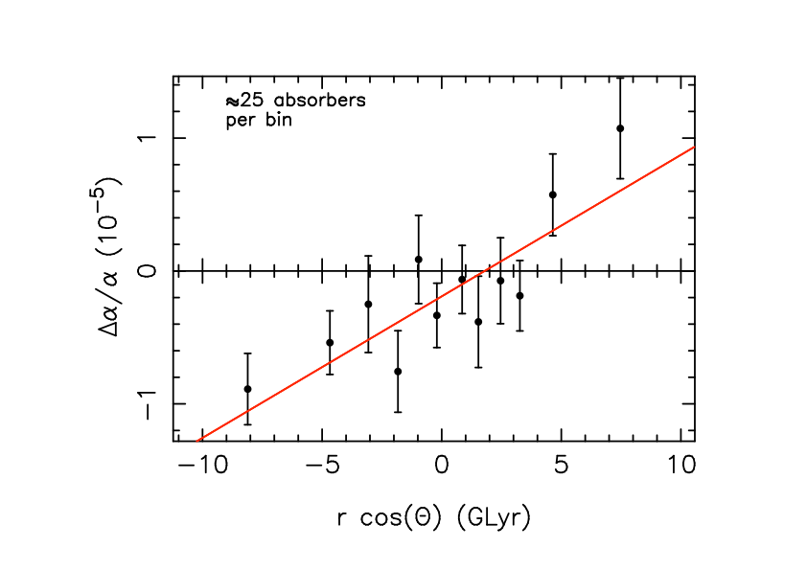
Distance dependence
∆α/α vs BrcosΘ for the model ∆α/α=BrcosΘ+m showing the gradient in α along the best-fit dipole. The best- fit direction is at right ascension 17.4 ± 0.6 hours, declination −62 ± 6 degrees, for which B = (1.1 ± 0.2) × 10⁻⁶ GLyr⁻¹ and m = (−1.9 ± 0.8) × 10−6. This dipole+monopole model is statistically preferred over a monopole-only model also at the 4.1σ level. A cosmology with parameters (H₀ , Ω_{M} , Ω_{Λ} ) = (70.5, 0.2736, 0.726).

Slide 11
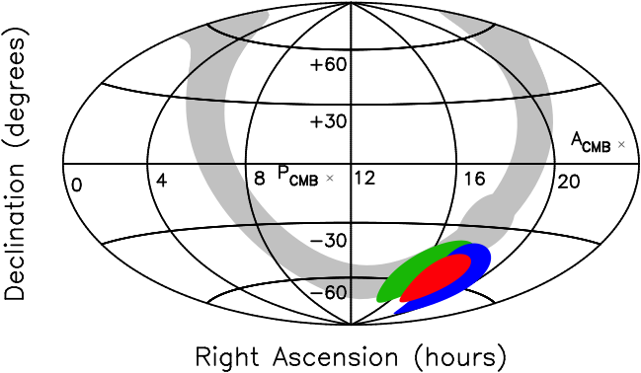
Keck & VLT dipoles independently agree, p=4%
VLT
Keck
Combined

Slide 12
Consequences of quasar result, variation of α in space, for atomic clocks
Sun moves 369 km/s relative to CMB cos(φ)=0.1
This gives average laboratory variation
Δα/α =1.5 10 ⁻¹⁸ cos(φ) ∼ 10⁻¹⁹ per year
Earth moves 30 km/s relative to Sun-
1.6 10 ⁻²⁰ cos(ωt) annual modulation
[Berengut and V.F. (2012)]

Slide 13
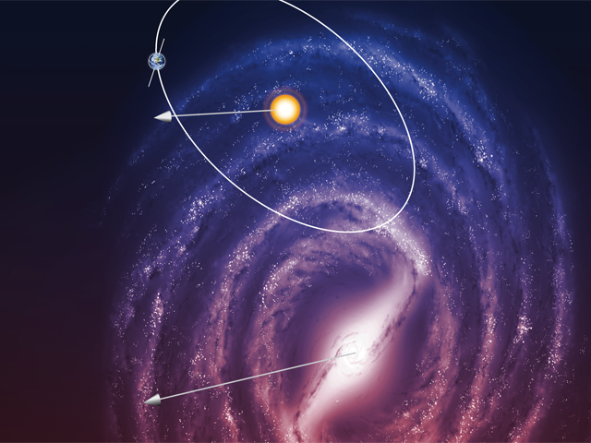
Gradient α points down

Slide 14
Limits on slow drift of α− optical atomic clocks,
m_{q}/Λ_{QCD,} m_{e} /M_{p} or m_{e}/Λ_{QCD} - Cs/Rb microwave clocks
Leefer et al,PRL 111, 060801 (2013) (Dy/Cs)
Rosenband et al,Science 319,1808 (2008) (Al⁺/Hg⁺)
Godun et al,
PRL 113, 210801 (2014)
(Yb⁺/Yb⁺)
Lange et al,
PRL 126, 011102 (2021)
(Yb⁺/Yb⁺)
best limit 1.8(2.5) x 10⁻¹⁹ yr⁻¹ Filzinger et al PRL 130, 252001, 2023

Slide 15
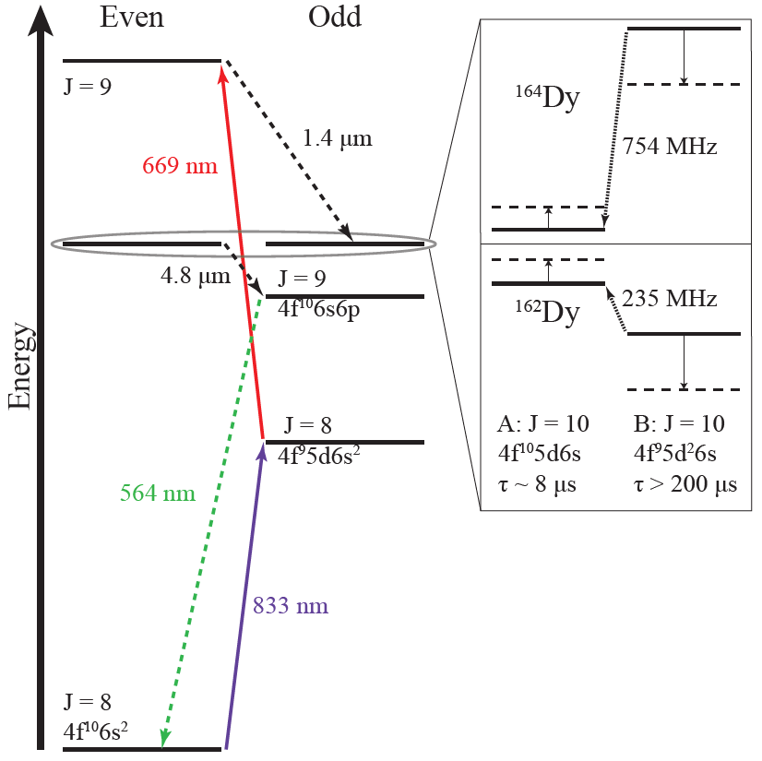
Enhanced Effects of Varying Fundamental Constants on Atomic Transitions
[Dzuba,Flambaum,Webb,PRL 82,888(1999); Flambaum PRL 97,092502(2006); PRA73,034101(2006); Berengut,Dzuba,Flambaum PRL105,120801 (2010) ]
Sensitivity coefficients may be greatly enhanced for transitions between nearly degenerate levels:
  Atoms (e.g., K_{α}(Dy) ~ 10⁶ – 10⁸
  Molecules
  Highly-charged ions
  Nuclei ²²⁹Th K=10⁴ Mossbauer transitions
Notes:
15

Slide 16
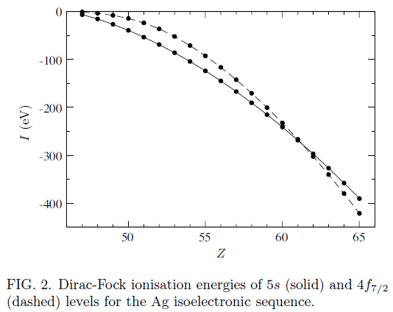
Level crossing in highly charged ions and clocks with enhanced sensitivity to α
Flambaum, Porsev PRA 2009,
Berengut, Dzuba, Flambaum PRL (2010);
Berengut, Dzuba, Flambaum, Ong PRL (2011, 2012)
In ions relativistic effects and sensitivity to α are larger (~Z²Z_{i}²), but transition frequencies are too large for laser spectroscopy. Solution – level crossing.
Near crossing points frequencies are in laser range.
We identified all electron orbital crossing areas in ions.
Experiments in Heidelberg MPK, RIKEN, …

Slide 17
Enhancement in ²²⁹ Th nuclear clock. Transition energy ω₀ =8 eV (instead of typical energy MeV)
Δω/ω₀ = 0.8 10⁴ Δα/α
Strong interaction Δω/ω₀ = 1.2 10⁴ Δm_{q}/m_{q}
V.F. PRL 2006, Berengut, Dzuba, V.F. and Porsev PRL 2009, Fadeev, Berengut and V.F. PRC 2022
Very extensive experimental activity starting from proposal of ²²⁹ Th nuclear clock by Peik and Tamm 2003,
see e.g
J. Thielking et al, Nature 556, 321, 2017 and 2018-2023 experiments,
Beeks et al arxiv:2406.18719.

Slide 18
Low-mass Spin-0 Dark Matter
Low-mass spin-0 particles form a coherently oscillating classical field φ(t) = φ₀ cos(m_{φ}c²t/ℏ), with energy density <ρ_{φ}> ≈ m_{φ}²φ₀²/2 (ρ_{DM,local} ≈ 0.4 GeV/cm³)
Coherently oscillating field, since cold (E_{φ} ≈ m_{φ}c²)
Classical field for m_{φ} ≤ 0.1 eV, since n_{φ}(λ_{dB,φ} /2π)³ >> 1
Coherent + classical DM field = “Cosmic maser”
10⁻²² eV ≤ m_{φ} ≤ 0.1 eV <=> 10⁻⁸ Hz ≤ f ≤ 10¹³ Hz
m_{φ} ~ 10⁻²² eV <=> T ~ 1 year
λ_{dB,φ} ≤ L _{dwarf galaxy} ~ 1 kpc
Classical field
Notes:
18
1 parsec = 3.26 light years; R_{dwarf galaxy} ~ 1 kpc.
Energy scales: Hubble scale ~ 10^{-33} eV; Planck scale ~ 10^{28} eV. i.e. ~ 61 orders of magnitude in range.

Slide 19
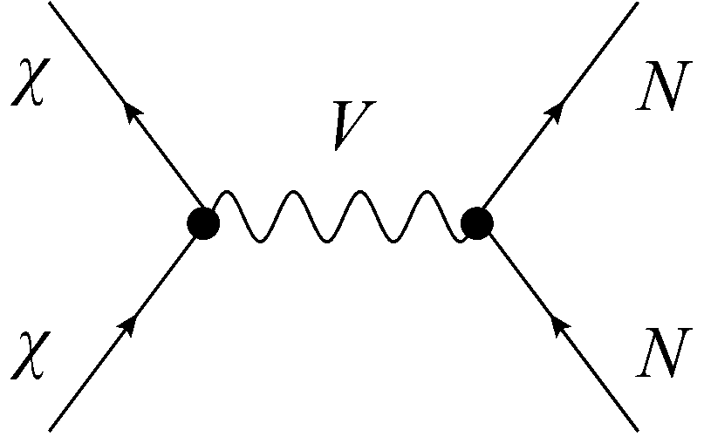
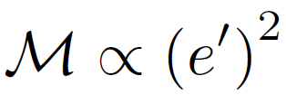
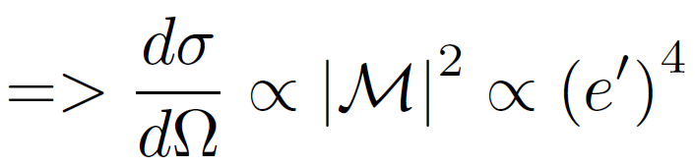
Variation of fundamental constants due to dark matter
Traditional “scattering-off-nuclei” searches for dark matter have not yet produced a strong positive result.
Problem: Observable is quartic in the interaction constant eי, which is extremely small (eי << 1)! We consider linear in eי effects. Enormous advantage!
Notes:
19

Slide 20
Low-mass Spin-0 Dark Matter
Dark Matter
Scalars
(or axion φ²):
φ → +φ
Pseudoscalars
(Axions):
φ → -φ
P
P
→ Time-varying fundamental constants
10¹⁵ improvement
→ Time-varying spin-dependent effects, EDM
10³ improvement
Notes:
20

Slide 21
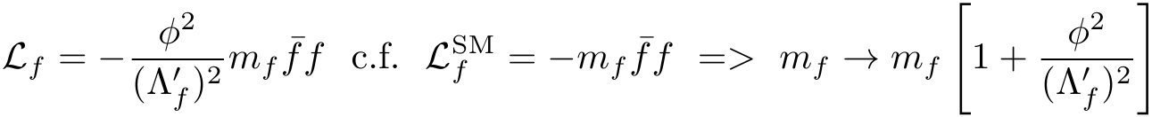
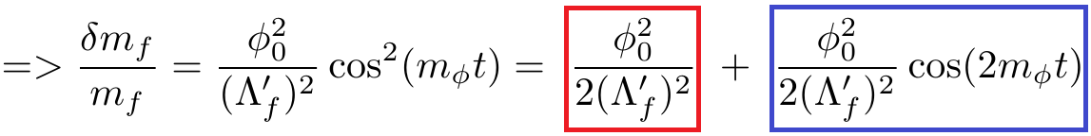
Dark Matter-Induced Cosmological Evolution of the Fundamental Constants
Consider an oscillating classical scalar or axion field, φ(t) = φ₀ cos(m_{φ}t), that interacts with SM fields (e.g. a fermion f) via quadratic couplings in φ.
‘Slow’ drifts [Astrophysics (high ρ_{DM}): BBN, CMB]
Oscillating variations [Laboratory (high precision)]
Notes:
21
Update references… Explain that electromagnetic fine-structure constant governs the strength of all electromagnetic processes in Nature and interactions.
RA: less talk --- only explain cos()^2 part…

Slide 22
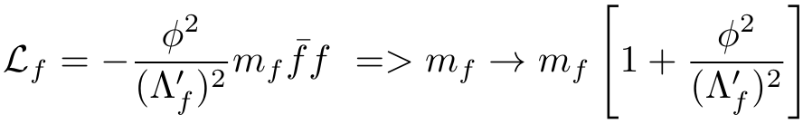
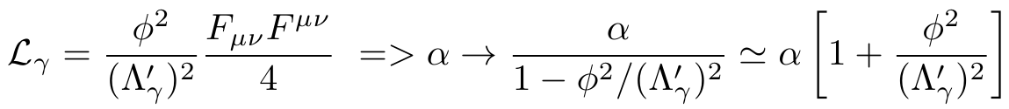
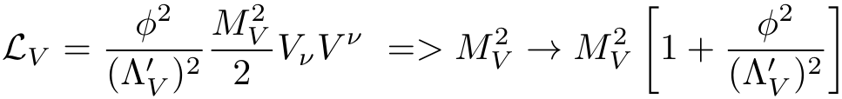
Dark Matter-Induced Cosmological Evolution of the Fundamental Constants
[Stadnik, and V.F. PRL 114, 161301 (2015); PRL 115, 201301 (2015)]
Fermions:
Photon:
W and Z Bosons:
Notes:
22

Slide 23
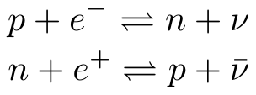
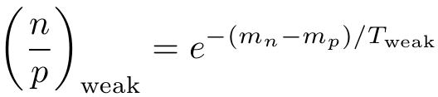
Astrophysical Constraints on ‘Slow’ Drifts in Fundamental Constants Induced by Scalar Dark Matter (BBN)
[Stadnik, Flambaum, PRL 115, 201301 (2015)]
Largest effects of scalar dark matter are in the early Universe (highest ρ_{DM} => highest φ₀²).
Earliest cosmological epoch that we can probe is Big Bang nucleosynthesis (from t_{weak} ≈ 1s until t_{BBN} ≈ 3 min).
Primordial ⁴He abundance is sensitive to relative abundance of neutrons to protons (almost all neutrons are bound in ⁴He by the end of BBN).
Weak interactions: freeze-out of weak interactions occurs at t_{weak} ≈ 1s (T_{weak} ≈ 0.75 MeV).
Notes:
23

Slide 24
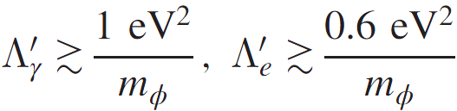
Astrophysical Constraints on ‘Slow’ Drifts in Fundamental Constants Induced by Scalar Dark Matter (CMB)
[Stadnik, Flambaum, PRL 115, 201301 (2015)]
Weaker astrophysical constraints come from CMB measurements (lower ρ_{DM}).
Variations in α and m_{e} at the time of electron-proton recombination affect the ionisation fraction and Thomson scattering cross section, σ_{Thomson} = 8πα²/3m_{e}², changing the mean-free-path length of photons at recombination and leaving distinct signatures in the CMB angular power spectrum.
Notes:
24
Need high-quality graphs!!! Better explanations!
RA: Less talk – just strongest limits

Slide 25
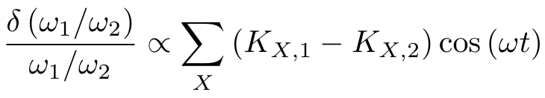
Atomic Spectroscopy Searches for Oscillating Variations in Fundamental Constants due to Dark Matter
[Arvanitaki, Huang, Van Tilburg, PRD 91, 015015 (2015)], [Stadnik, Flambaum, PRL 114, 161301 (2015)]
ω = m_{φ} (linear portal) or ω = 2m_{φ} (quadratic portal)
Precision of optical clocks approaching ~10⁻¹⁹ fractional level
Sensitivity coefficients K_{X} calculated by our group (1998 – present)
Dy/Cs: [Van Tilburg et al., PRL 115, 011802 (2015)], [Stadnik, Flambaum, PRL 115, 201301 (2015)]
Rb/Cs: [Hees et al., PRL 117, 061301 (2016)], [Stadnik, Flambaum PRA 94, 022111 (2016)]
Notes:
25
14 billion years is the current age of the Universe

Slide 26
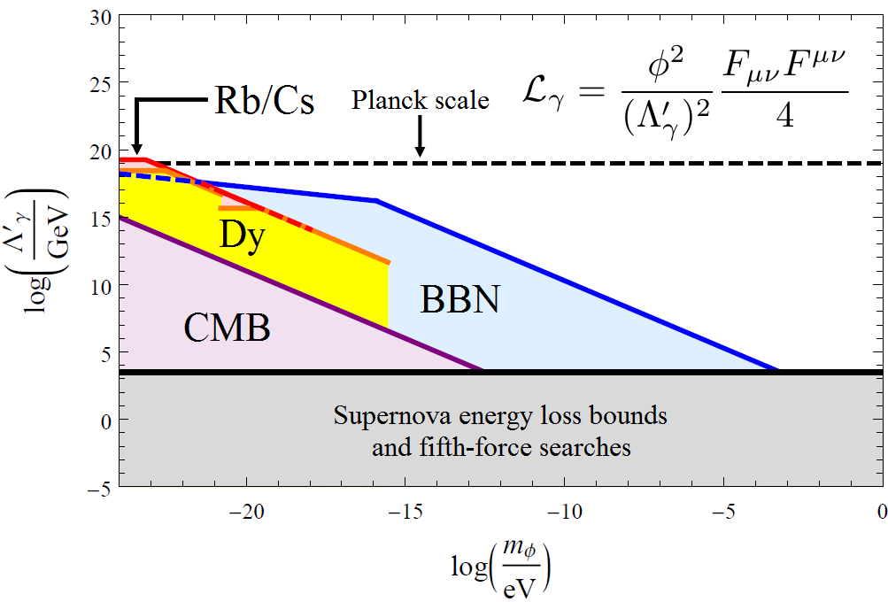
Constraints on quadratic interaction of axion or scalar dark matter with the photon
BBN, CMB, Dy and Rb/Cs constraints: [Stadnik and V.F., PRL 115, 201301 (2015) and Phys. Rev. D 2016] 15 orders of magnitude improvement!
Notes:
26
Emphasise 15 orders of magnitude improvement for the lightest masses! – Mention also constraints on other interactions (photon, electron, light quarks (u,d), massive vector bosons (W+/-,Z)

Slide 27
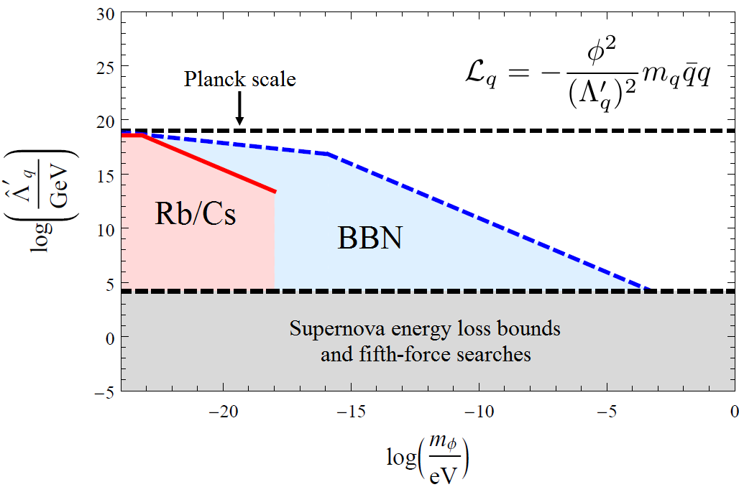
Constraints on quadratic Interactions of scalar and axion dark matter with light quarks
BBN and Rb/Cs constraints: [Stadnik and V.F., PRL 115, 201301 (2015) + Phys. Rev. D 2016]
Notes:
27
Emphasise 15 orders of magnitude improvement for the lightest masses! – Mention also constraints on other interactions (photon, electron, light quarks (u,d), massive vector bosons (W+/-,Z)

Slide 28
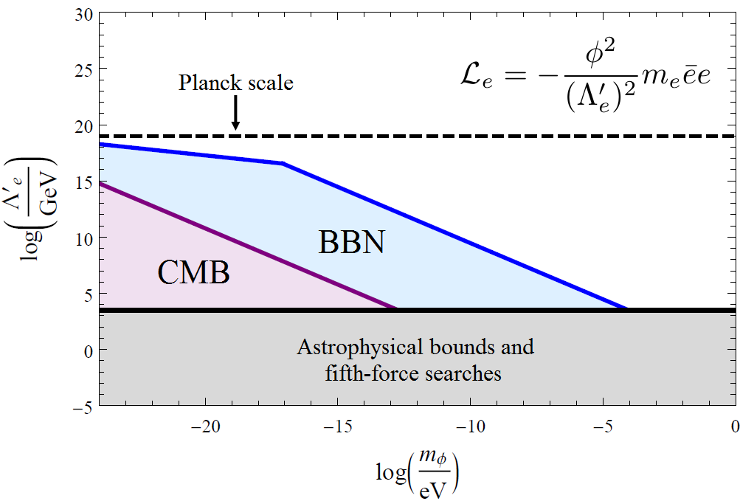
Constraints on quadratic interaction of scalar and axion dark matter with the electron
BBN and CMB constraints: [Stadnik and V.F., PRL 115, 201301 (2015)]
Notes:
28
Emphasise 15 orders of magnitude improvement for the lightest masses! – Mention also constraints on other interactions (photon, electron, light quarks (u,d), massive vector bosons (W+/-,Z)

Slide 29
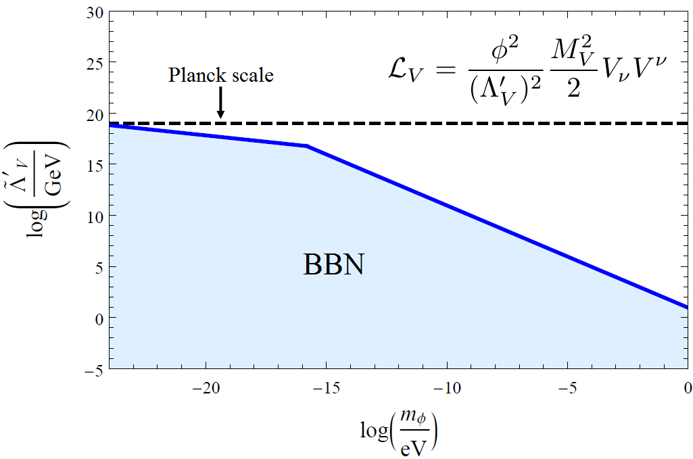
Constraints on quadratic interactions of axion and scalar dark matter with W and Z bosons
BBN constraints: [Stadnik and V.F., PRL 115, 201301 (2015)]
Notes:
29
Emphasise 15 orders of magnitude improvement for the lightest masses! – Mention also constraints on other interactions (photon, electron, light quarks (u,d), massive vector bosons (W+/-,Z)

Slide 30
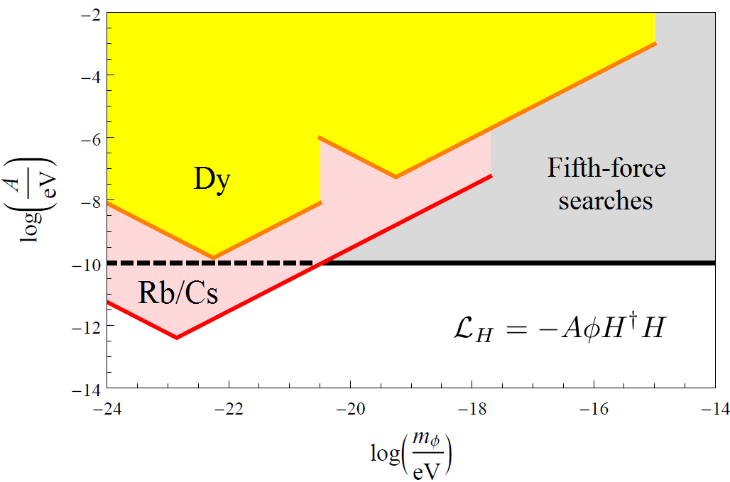
Constraints on Linear Interaction of Scalar Dark Matter with the Higgs Boson
Rb/Cs constraints: [Stadnik and V.F., PRA 94, 022111 (2016)]
2 – 3 orders of magnitude improvement!
Notes:
30

Slide 31
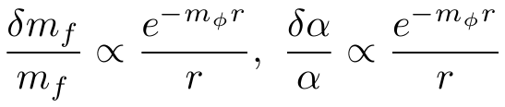
Variation of Fundamental Constants Induced by a Massive Body
[Leefer, Gerhardus, Budker, V.F. and Stadnik, PRL 117, 271601 (2016)]
Varying the distance away from a massive body hence alters the fundamental constants, in the presence of Yukawa-type interactions:
We can search for such alterations in the fundamental constants, using clock frequency comparison measurements (ω₁/ω₂ => scalar quantities), in the presence of a massive body at two different distances away from the clock pair:
  Sun (elliptical orbit, e = 0.0167)
  Moon (e ≈ 0.05, with seasonal variation and effect of finite Earth size)
  Massive objects in the laboratory (experiment with moving 300kg Pb mass)
Notes:
31

Slide 32
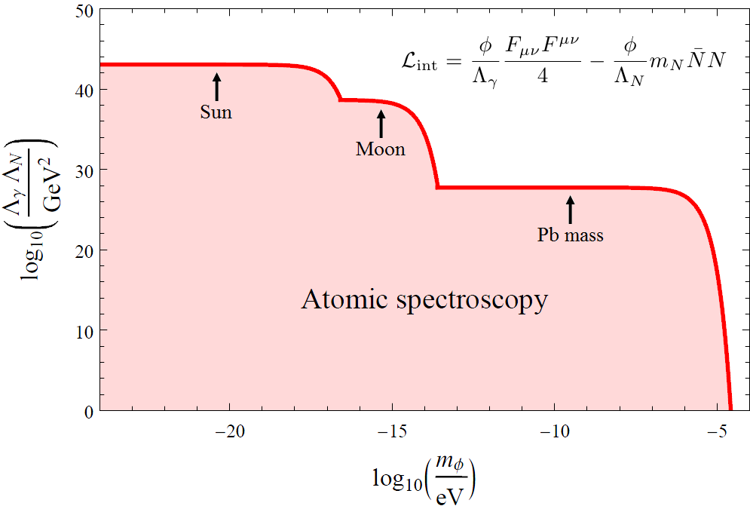
Constraints on a Combination of Linear Yukawa Interactions of a Scalar Boson
[Leefer, Gerhardus, Budker, V.F. and Stadnik, PRL 117, 271601 (2016)]
Notes:
32

Slide 33
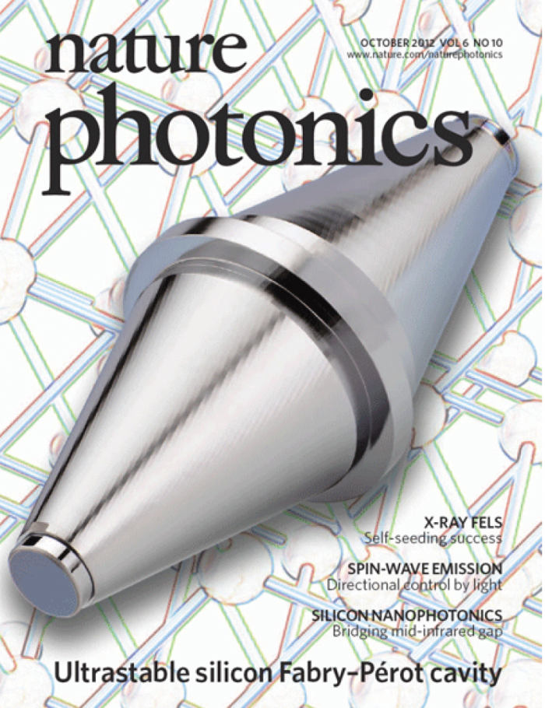
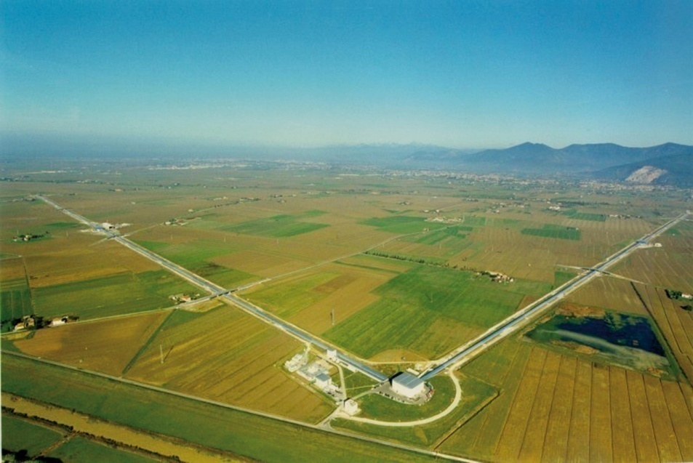
Laser Interferometry Searches for Oscillating Variations in Fundamental Constants due to Dark Matter
[Stadnik, Flambaum, PRL 114, 161301 (2015); PRA 93, 063630 (2016)]
Gravitational-wave detector (LIGO/Virgo), L ~ 4 km
Small-scale cavity, L ~ 0.2 m
Notes:
33

Slide 34
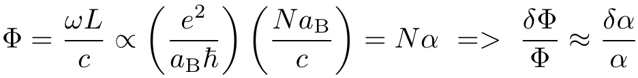
Laser Interferometry Searches for Oscillating Variations in Fundamental Constants due to Dark Matter
[Stadnik and V.F., PRL 114, 161301 (2015); PRA 93, 063630 (2016)]
Compare device length L ~ Na_{B} with wavelength λ. Phase of laser field
Multiple reflections of light beam enhance effect (N_{eff} ~ 10⁵ in small-scale interferometers with highly reflective mirrors).
Φ = 2πL/λ, δΦ = Φ δα/α = 10⁷ δα/α single passage, 10¹² δα/α for maximal number of reflections
There are several experimental papers, limits from giant gravitational wave detector GEO600 and table-top experiments, e.g. [Wcislo et al., Nature Astronomy 1, 0009 (2016)]
Notes:
34

Slide 35

Limits on axions from fluctuations of dark matter field
V.V. Flambaum and I.B. Samsonov
arXiv:2302.11167, Phys. Rev. D 2023

Slide 36
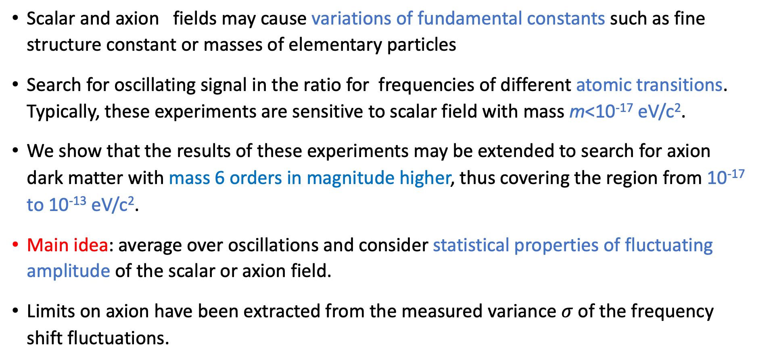
Motivation: axion & scalar field dark matter model
Scalar and axion fields may cause variations of fundamental constants such as fine structure constant or masses of elementary particles
Search for oscillating signal in the ratio for frequencies of different atomic transitions. Typically, these experiments are sensitive to scalar field with mass m<10⁻¹⁷ eV/c².
We show that the results of these experiments may be extended to search for axion dark matter with mass 6 orders in magnitude higher, thus covering the region from 10⁻¹⁷ to 10⁻¹³ eV/c².
Main idea: average over oscillations and consider statistical properties of fluctuating amplitude of the scalar or axion field.
Limits on axion have been extracted from the measured variance $σ$of the frequency shift fluctuations.

Slide 37
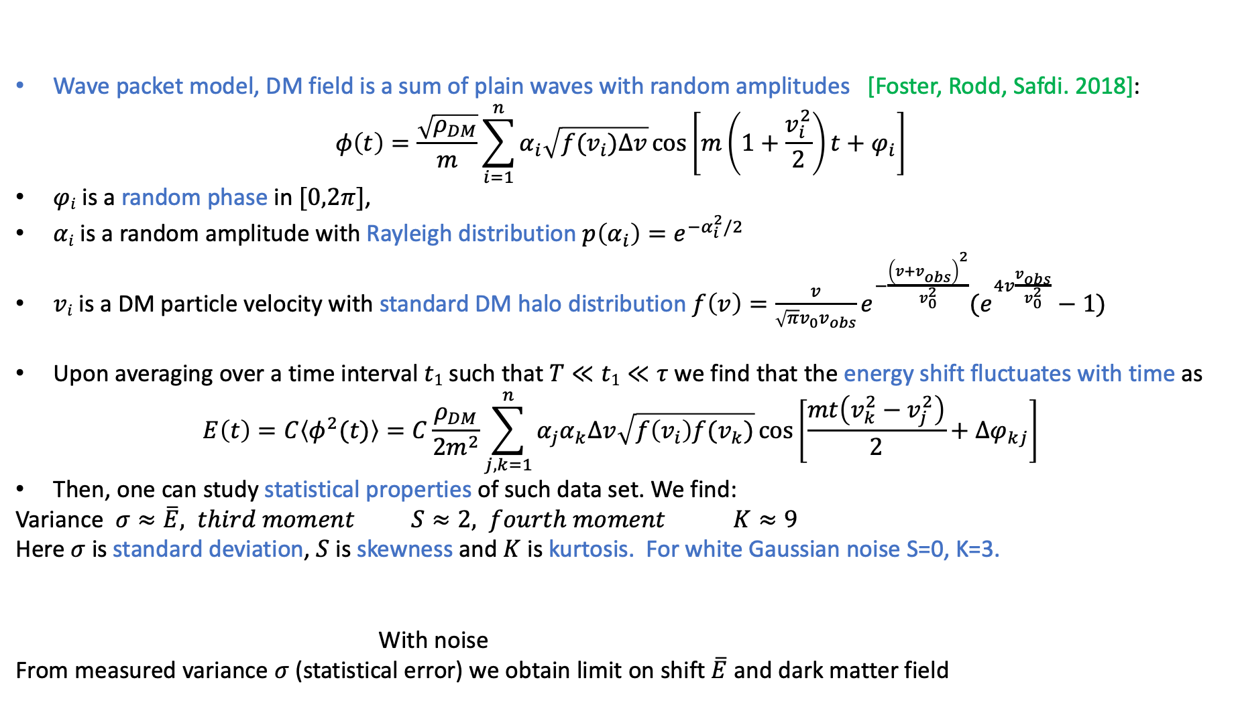

Statistical properties of the energy shifts
Wave packet model, DM field is a sum of plain waves with random amplitudes [Foster, Rodd, Safdi. 2018]:
$$φ\left(t\right)=\frac{\sqrt{ρ_{DM}}}{m}\sum_{i=1}^{n}{α_{i}\sqrt{f(v_{i})∆v}\cos\left[m\left(1+\frac{v_{i}^{2}}{2}\right)t+φ_{i}\right]}$$
$φi$is a random phase in $[0,2π]$,
$αi$ is a random amplitude with Rayleigh distribution $p\left(α_{i}\right)=e^{−α_{i}^{2}/2}$
$vi$ is a DM particle velocity with standard DM halo distribution $f\left(v\right)=\frac{v}{\sqrt{π}v_{0}v_{obs}}e^{−\frac{{\left(v+v_{obs}^{}\right)}^{2}}{v_{0}^{2}}}(e^{4v\frac{v_{obs}}{v_{0}^{2}}}−1)$
Upon averaging over a time interval $t1$ such that $T≪t1≪τ$ we find that the energy shift fluctuates with time as
$$E\left(t\right)=C\left\langle φ^{2}(t)\right\rangle =C\frac{ρ_{DM}}{2m^{2}}\sum_{j,k=1}^{n}{α_{j}α_{k}∆v\sqrt{f\left(v_{i}\right)f(v_{k})}\cos\left[\frac{mt\left(v_{k}^{2}−v_{j}^{2}\right)}{2}+∆φ_{kj}\right]}$$
Then, one can study statistical properties of such data set. We find:
Variance $σ≈\overline{E}, third moment S≈2, fourth moment K≈9$
Here $σ$ is standard deviation, $S$ is skewness and $K$ is kurtosis. For white Gaussian noise S=0, K=3.
With noise
From measured variance $σ$ (statistical error) we obtain limit on shift $\overline{E}$ and dark matter field
$$σ>\overline{E}$$

Slide 38
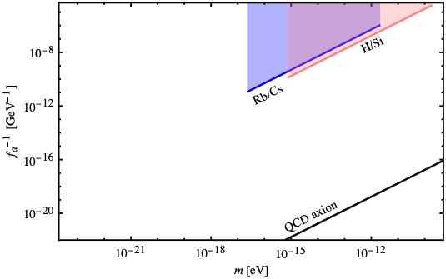
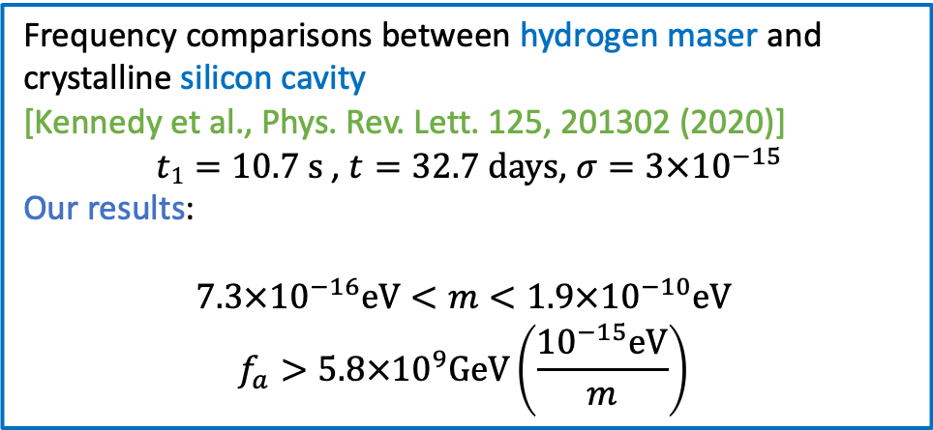
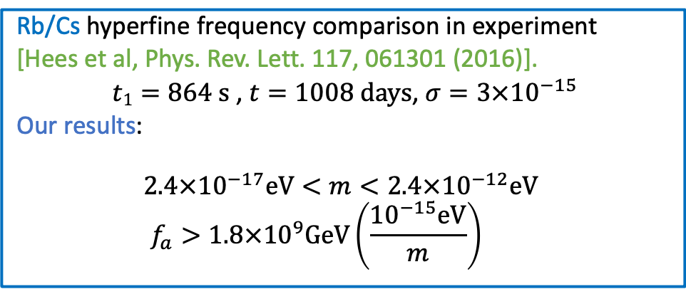
New limits from re-purposing the results of experiments searching for variations of frequencies of atomic transitions
  Rb/Cs hyperfine frequency comparison in experiment
  [Hees et al, Phys. Rev. Lett. 117, 061301 (2016)].
  $t1=864 \text{s}$ , $t=1008 \text{days}$, $σ=3×{10}^{−15}$
  Our results:
  $$2.4×{10}^{−17}\text{eV}<m<2.4×{10}^{−12}\text{eV}$$
  $$f_{a}>1.8×{10}^{9}\text{GeV}\left(\frac{{10}^{−15}\text{eV}}{m}\right)$$
  Frequency comparisons between hydrogen maser and crystalline silicon cavity
  [Kennedy et al., Phys. Rev. Lett. 125, 201302 (2020)]
  $t1=10.7 \text{s}$ , $t=32.7 \text{days}$, $σ=3×{10}^{−15}$
  Our results:
  $$7.3×{10}^{−16}\text{eV}<m<1.9×{10}^{−10}\text{eV}$$
  $$f_{a}>5.8×{10}^{9}\text{GeV}\left(\frac{{10}^{−15}\text{eV}}{m}\right)$$

Slide 39
Low-mass Spin-0 Dark Matter
Dark Matter
Scalars
(or axion φ²):
φ → +φ
Pseudoscalars
(Axions):
φ → -φ
P
P
→ Time-varying spin-dependent effects, electric dipole moments (EDM), 10³ improvement
  nEDM collaboration, CASPEr, JILA eEDM, …
→ Time-varying fundamental constants
10¹⁵ improvement
Notes:
39

Slide 40
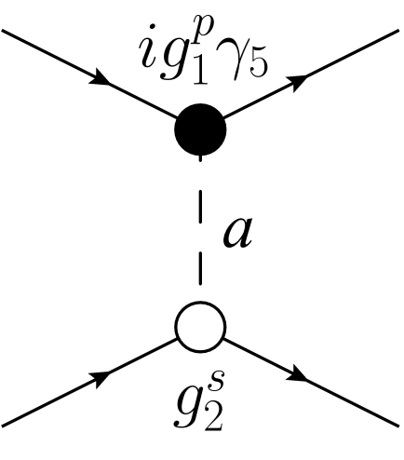
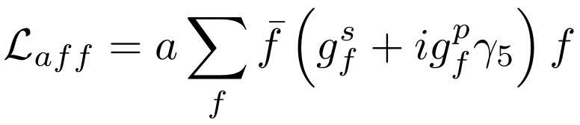
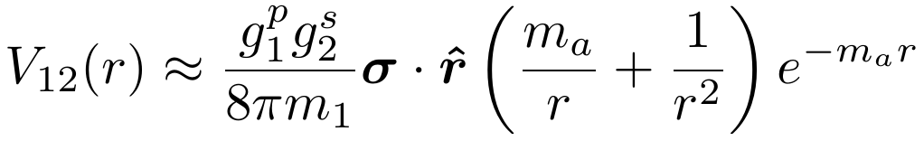
EDM produced by axion exchange
Macroscopic fifth-forces [Moody, Wilczek, PRD 30, 130 (1984)]
P,T-violating forces => Atomic and Molecular EDMs
[Stadnik, Dzuba, Flambaum PRL 2018, Dzuba,Flambaum,Samsonov,Stadnik 2018]
Atomic EDM experiments: Cs, Tl, Xe, Hg; Molecular EDM experiments: YbF, HfF⁺,ThO; YbOH Maison,Flambaum,Hutzler,Skripnikov 2021
Measurements of parity violation in atoms give limits on Z’ boson. Stadnik, Dzuba, Flambaum PRL 2017
Notes:
40

Slide 41
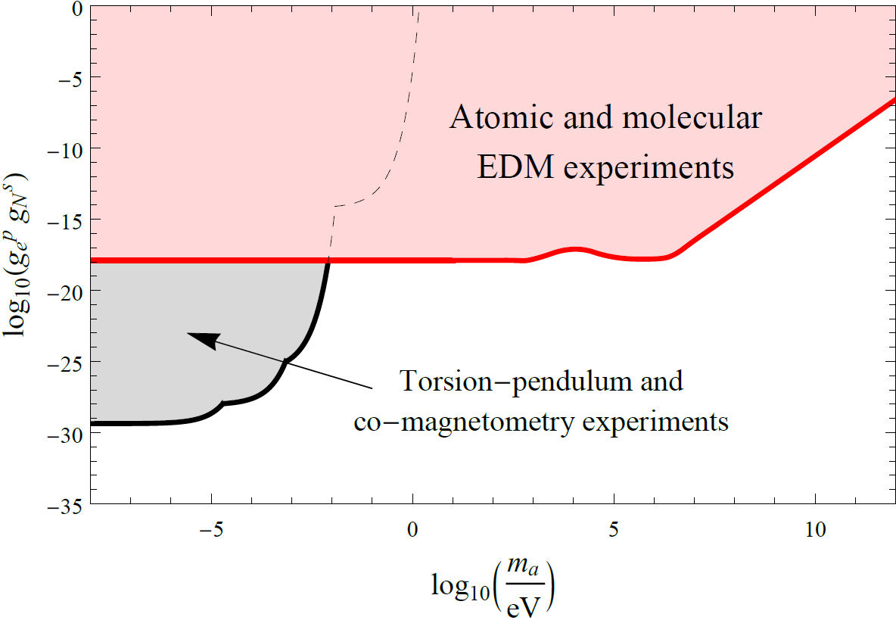
Constraints on Scalar-Pseudoscalar Nucleon-Electron Interaction
EDM constraints: [Stadnik, Dzuba , Flambaum PRL 2018]
Many orders of magnitude improvement!
Notes:
41

Slide 42
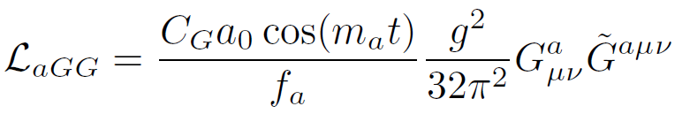

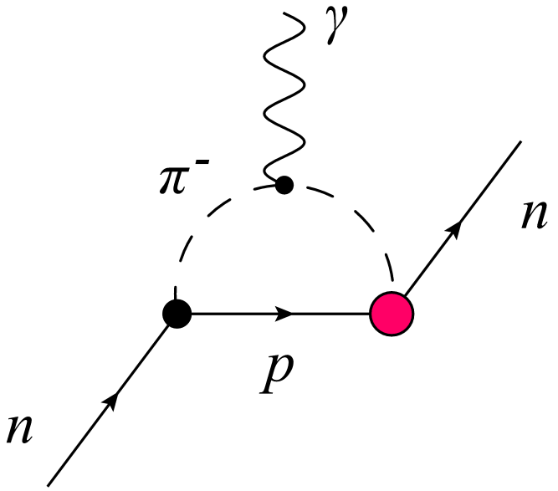


Axion-Induced Oscillating Neutron EDM
[Crewther, Di Vecchia, Veneziano, Witten, PLB 88, 123 (1979)], [Pospelov, Ritz, PRL 83, 2526 (1999)], neutron EDM due to QCD theta
[Graham, Rajendran, PRD 84, 055013 (2011)] theta(t)=a(t)/f_{a} , a(t) is axion field
Notes:
42
Chiral-log enhancement in soft pion limit.

Slide 43

Axion-Induced Oscillating Atomic and Molecular EDMs
[O. Sushkov, Flambaum, Khriplovich, JETP 60, 873 (1984)], [Stadnik , Flambaum, PRD 89, 043522 (2014)]
Induced through hadronic mechanisms:
Oscillating nuclear Schiff moments (I ≥ 1/2 => J ≥ 0)
Oscillating nuclear magnetic quadrupole moments (I ≥ 1 => J ≥ 1/2; magnetic => no Schiff screening)
Underlying mechanisms:
Intrinsic oscillating nucleon EDMs (1-loop level)
Oscillating P,T-violating intranuclear forces (tree level => larger by ~4π² ≈ 40; up to extra 1000-fold enhancement in deformed nuclei)
(1)
(2)
Notes:
43
Axion-induced P,T-odd forces due arise at tree level, while axion-induced intrinsic nucleon EDMs arise at 1-loop level -> avoid ~4*pi (or 8*pi^2 – check) loop suppression factor! (Which far outweighs the chiral log enhancement factor for instrinic nucleon EDM: ln(m_N^2/m_\pi^2) \approx 4 numerically).
Nuclear enhancement factor: for d_nucleus c.f. d_nucleons! [Read up more!]
Closely-spaced energy spacing enhancement and collective enhancement are possible in deformed nuclei → (Is this only for P,T-odd forces??!)

Slide 44
Nuclear T,P-violating moments induce atomic and molecular EDM
Victor Flambaum
Co-authors: I.Khriplovich, O.Sushkov, V.Dzuba, N.Auerbach, Spevak, J.Ginges, M.Kozlov, D. DeMille, S.Porsev, J. Berengut, Y. Stadnik, Y, L. Skripnikov, A. Petrov, A. Titov, H. Feldmeier, H.B. Tran Tan, I. Samsonov, M. Pospelov, A. Ritz, O. Vorov, P. Fadeev, A. Mansour, ...

Slide 45
Nuclear Electric Dipole Moment:
T,P-odd NN interaction gives 40 times larger contribution than nucleon EDM. Sushkov, Flambaum, Khriplovich 1984, x 10¹ - 10³ in deformed nuclei

Slide 46
Nuclear EDM is screened in atoms: d_{N} E_{N}
Schiff theorem: E_{N}=0, neutral systems
Extension for ions and molecules:
Ion acceleration a= Z_{i} eE/M
Nucleus acceleration a=Z eE_{N}/M
E_{N}=E Z_{i}/Z
In molecules screening is stronger:
a= Z_{i} eE/(M+m), E_{N}= E (Z_{i}/Z)(M/(M+m))
Z_{i} =0 → E_{N}= 0

Slide 47
Diamagnetic atoms and molecules
Source-nuclear Schiff moment
SM appears when screening of external electric field by atomic electrons is taken into account.
Nuclear T,P-odd moments:
EDM – non-observable due to total screening (Schiff theorem)
Nuclear electrostatic potential with screening (our 1984 calculation following ideas of Schiff and Sandars):
d is nuclear EDM, the term with d is the electron screening term
ϕ(R) in multipole expansion is reduced to
where is Schiff moment.
This expression is not suitable for relativistic calculations since Dirac electron wave function is infinite on the point-like nucleus.
Atomic EDM is proportional to Z² x Relativistic factor, which is infinite for the point-like nucleus

Slide 48
Flambaum, Ginges, 2002:
where
Nuclear spin
j
Electric field induced
by T,P-odd nuclear
forces which influence
proton charge density
R
E
This potential has no singularities and may be used in relativistic calculations.
Schiff moment electric field polarizes atom and produce EDM.
Relativistic corrections Z²a² originating from electron wave functions can be
incorporated into Local Dipole Moment (L)

Slide 49
Enhancement in nuclei with octupole deformation Auerbach, Flambaum, Spevak 1996
Three factors of enhancement in nuclei with octupole deformation :
Large collective moment in the body frame
Doublets with Small energy interval (E₊-E₋), 0.05 instead of 8 MeV
Large matrix element <IMK | H_{TP}|IMK>
²²⁵Ra,²²³Rn, Fr,… -100-1000 times enhancement
Results are stable – screening term is small, no cancellation
Static octupole deformation is not essential, nuclei with soft
octupole vibrations also have the enhancement.
Engel, Friar, Hayes (2000); Flambaum, Zelevinsky (2003)

Slide 50
EDMs of atoms and molecules (TlF,…).
Z | Atom | [S/(e fm3)]e cm | [10⁻²⁵ η] e cm | Experiment
2 | ³He | 0.00008 | 0.0005
54 | ¹²⁹Xe | 0.38 | 0.7 | Seattle, Ann Arbor, Heidelberg, …
70 | ¹⁷¹Yb | -1.9 | 3 | Bangalore,KyotoHeifei
80 | ¹⁹⁹Hg | -2.8 | 4 | Seattle
86 | ²²³Rn | 3.3 | 3300 | TRIUMF
88 | ²²⁵Ra | -8.2 | 2500 | Argonne,KVI
88 | ²²³Ra | -8.2 | 3400
Standard Model h =0.3 10⁻⁸ d_{n} = 5 x 10⁻²⁴ e cm h, d(¹⁹⁹Hg)/ d_{n} = 10⁻¹
Limit from Hg EDM q < 0.5 10⁻¹⁰ Seattle, V.F. and Dzuba, PRA101, 042504,2020

Slide 51
Magnetic quadrupole moment –violates T, P
Nuclear MQM Khriplovich 1976, Haxton, Henley 1983
Magnetic quadrupole moments (MQM) produce EDM in atoms and molecules
Magnetic interaction is not screened! Effect may be bigger than that of Schiff moment, generically ~10 times
Sushkov, Flambaum, Khriplovich 1984

Slide 52
Collective magnetic quadrupole moment
MQM produced by nuclear T,P-odd forces
Collective enhancement in deformed nuclei
Mechanism: T,P-odd nuclear interaction produces spin hedgehog- correlation (s r)
Spherical – magnetic monopole forbidden
Deformed- collective magnetic quadrupole
V.F. 1994

Slide 53






Atomic EDMs
Atomic limits
Leading mechanisms for EDM generation
|d(¹⁹⁹Hg)| Seattle
fundamental CP-violating phases
quark/lepton
level
|d(²⁰⁵Tl)| < 9.6 x 10⁻²⁵ e cm
(90% c.l., Berkeley, 2002)
neutron EDM
nucleon
level
|d(n)| Grenoble, PINP, PSI
Schiff moment
nuclear
level
EDMs of diamagnetic
systems (Hg,Ra)
EDMs of paramagnetic
systems (Tl)
atomic
level
+
+
+
=
-

Slide 54
Nuclear and molecular calculations of MQM effects
Nuclear and molecular estimates for
TaN, ThO, BaF, HgF, YbF, HfF+ V.F. , DeMille, Kozlov 2014
(TaO+, WN+)
Accurate molecular calculations
ThO: Skripnikov, Petrov, Titov and V.F. 2014
TaN: Skripnikov, Petrov, Mosyagin, Titov, and V.F. 2015
TaO+ T. Fleig 2017
HfF+ Petrov,Skripnikov, Titov, and V.F. 2017, 2018
YbOH Maison, Skripnikov and V.F. 2019. Experiment in progress
LuOH+ Maison, Skripnikov, V.F., Grau 2020

Slide 55



Parity and time reversal violating nuclear polarization
atomic Electric Dipole Moment due to nuclear T,P-odd polarizability.
electric + magnetic vertices instead of 2 electric vertices for usual polarisabilty
We studied this → electron EDM experiments are sensitive to hadron CP-violation, theta-term, axion dark matter, etc.
Nuclear spin may be zero as in electron EDM experiments
μ – d
d
μ
Internal nuclear excitations
V.V. Flambaum, J.S.M. Ginges, G. Mititelu, arXiv:nucl-th/0010100 (2000)
V.V. Flambaum, M. Pospelov, A. Ritz, and Y.V. Stadnik, PRD 102, 035001 (2020)
V.V. Flambaum, I.B. Samsonov, H.B. Tran Tan, JHEP 2020, 77 (2020)
V.V. Flambaum, I.B. Samsonov, H.B. Tran Tan, PRD 102, 115036 (2020)

Slide 56
Axion dark matter in JILA EDM experiment
Experimental Constraint on Axionlike Particles over Seven Orders of Magnitude in Mass.
Tanya S. Roussy, Daniel A. Palken, William B. Cairncross, Benjamin M. Brubaker, Daniel N. Gresh, Matt Grau, Kevin C. Cossel, Kia Boon Ng, Yuval Shagam, Yan Zhou, Victor V. Flambaum, Konrad W. Lehnert, Jun Ye, and Eric A. Cornell. Phys. Rev. Lett. 126, 171301 (2021)
Low-mass spin-0 particles form oscillating classical field φ(t) = φ₀ cos(m_{φ}c²t/ℏ),
with energy density <ρ_{φ}> ≈ m_{φ}²φ₀²/2 ρ_{DM,local}
Oscillating EDM = d cos(m_{φ}c²t/ℏ),

Slide 57

Constraints on Interaction of Axion Dark Matter with Gluons
nEDM constraints: [nEDM collaboration, PRX 7, 041034 (2017)]
HfF⁺ EDM constraints: [Roussy et al., PRL 126, 171301 (2021)]
Notes:
57
Point out the Planck scale for comparison --- Note that the CASPEr-Electric phase I projections “weakened” by a factor of a few thousand in going from Fig. 2 of 1306.6089 to Fig. 3 of 1711.08999 …

Slide 58
OSCILLATING NUCLEAR ELECTRIC DIPOLE, MAGNETIC QUADRUPOLE AND SCHIFF MOMENTS, INDUCED BY AXIONIC DARK MATTER, PRODUCE MOLECULEAR TRANSITIONS
M2 transition: photon suppressed, axion is not suppressed!
Smaller systematics
V.F., Tran Tan, Budker, Wickenbrock Phys. Rev. D 101, 073004 (2020)
Oscillating magnetic moment leads to oscillating magnetic field of a permanent magnet.
Bloch, Budker, Flambaum, Samsonov, A.Sushkov, Tretiak. Phys. Rev D107, 0750332023 (2023),
Results of experiment will be published soon.

Slide 59


“Axion Wind” Spin-Precession Effect. Axion field→LLIV
[V.F. , Patras Workshop, 2013], [Graham, Rajendran, PRD 88, 035023 (2013)],
[Stadnik and V.F. PRD 89, 043522 (2014)]
Motion of Earth through galactic axions gives rise to the interaction of fermion spins with a time-dependent pseudo-magnetic field B_{eff}(t), producing spin-precession effects.
Axion field→Lorentz invariance violations.
Experiments: nEDM collaboration, CASPEr→limits on axion - nucleon interaction
Notes:
59
Reinsert references!
RA: Less talk! Don’t discuss equations, but say that spins in Earth laboratory precess about the direction of Earth’s motion through Galaxy.

Slide 60
Summary 1: spectroscopy experiments
There is a hint for spatial variation of the fine structure constant in quasar absorption spectra. May explain fine tuning of fundamental constants needed for life.
New classes of dark matter effects that are linear in the underlying interaction constant (traditionally-sought effects of dark matter scale as second or fourth power), drift and oscillating variation of fundamental constants and violation of fundamental symmetries
Up to 15 orders of magnitude improvement on interactions of scalar dark matter with the photon, electron, quarks, Higgs, W⁺,W⁻,Z⁰
New clocks: nuclear ²²⁹Th, highly-charged ions. Mossbauer transitions. Enormous potential for atomic experiments to search for variation of α, new particles and dark matter with unprecedented sensitivity
Notes:
60
Update formula to have: obs \propto (1/\Lambda)^n !
A summary slide with all effects and systems (pseudoscalar ~ spin-dep.) versus (scalar ~ VFCs) would be nice --- can also use for the conclusions…
And also mention that for scalars, these are new possibilities for VFCs… (some methods are modification of existing methods, while others are new)

Slide 61




Part 2: Underground laboratories
Atomic ionization by scalar dark matter and solar scalars
H. B. Tran Tan, A. Derevianko, V. Dzuba, V.V. Flambaum. PRL 127, 081301 (2021)
Relativistic Hartree-Fock calculations corrected several orders of magnitude error. Born approximation does not work due to violation of orthogonality condition between bound and continuum electron wave functions.
New limits on electron-scalar coupling from Xenon1T data.
Data files for scalars and axions: arXiv:2105.08296.
Calculations for Na, I, Tl, Xe, Ar, Ge atoms

Slide 62


Atomic ionization by scalars
φ : scalar familon, sgoldstino, dilaton, relaxon, moduli, Higgs-portal DM, etc.
Absorption of scalar causes atomic ionization (similar to photoelectric effect)→ detectable by current DM and solar axion searches.
Xenon nT, PandaX-II, EDELWEISS-III, DAMA/LIBRA, SABRE, SuperCDMS, ArDM, DarkSide-20k, DEAP-3600.
Detector
e⁻
E_{d}
φ
e⁻
φ

Slide 63


Pitfall: wrong wave functions → wrong results
Orthogonality condition → Born approximation does not work!
Previous work Int. J. Mod. Phys. A 21:1445-1470, 2006: plane wave continuum function → errors by many orders of magnitude.
Pitfall also exists for axioelectric effect and Migdal effect→ affects low-energy cross section only.
Relativistic Hartree-Fock calculations for scalars and axions.
Migdal and boosted DM effects: V.F., L. Su, L. Wu, B. Zhu, arXiv:2012.09751

Slide 64



Results: cross sections for Na, Ar, Ge, I, Xe, Tl
With and without 1 keV cutoff.
Accuracy a few %, up to 10% near threshold.
Accurate scalar and axion data, relativistic Hartree-Fock calculations:PRL 127, 081301 (2021) arXiv:2105.08296.
Check against photoelectric experimental data

Slide 65



Scalar DM and solar scalar limits from Xenon1T data
Detection rate for scalar DM:
Detection rate for solar scalar:
New limits from Xenon1T data:

Slide 66
Relativistic effects increase ionisation by WIMP scattering on electrons by up to 3 orders of magnitude!
Ionization of atoms by slow heavy particles, including dark matter
B.M. Roberts, V.V. Flambaum, G.F. Gribakin, Phys. Rev. Lett. 116, 023201 (2016)]
Dark matter scattering on electrons: Accurate calculations of atomic excitations and implications for the DAMA signal. B. M. Roberts, V. A. Dzuba, V. V. Flambaum, M. Pospelov, and Y. V. Stadnik, Phys. Rev. D 93, 115037 (2016)
Electron-interacting dark matter: implications from DAMA/LIBRA-phase2 and prospects for liquid xenon and NaI detectors, B. M. Roberts, V. V. Flambaum, Phys. Rev. D 100, 063017 (2019).
Accurate electron-recoil ionization factors for dark matter direct detection in xenon, krypton and argon. A. R. Caddell, V. V. Flambaum, B. M. Roberts, Phys. Rev. D 108, 083030, 2023.
Relativistic Hartree-Fock calculations for Na, I, Xe, Tl, Ge, Ar, Kr atoms, scalar and vector portals. Annual modulation due to variation of velocity of WIMPs 20 - 50%
Notes:
66
Update formula to have: obs \propto (1/\Lambda)^n !
A summary slide with all effects and systems (pseudoscalar ~ spin-dep.) versus (scalar ~ VFCs) would be nice --- can also use for the conclusions…
And also mention that for scalars, these are new possibilities for VFCs… (some methods are modification of existing methods, while others are new)

Slide 67
Why are electron relativistic effects so important?
[Roberts, Flambaum, Gribakin, PRL 116, 023201 (2016)],
Non-relativistic and relativistic contributions to σ_{χe} are very different for large q
(for scalar, pseudoscalar, vector and pseudovector interaction portals):
Non-relativistic [s-wave, ψ ∝ r ⁰ (1 - Zr/a_{B}) as r → 0)], tends to constant as r → 0:
dσ_{χe} ∝ 1/q ⁸
Relativistic [s_{1/2}, p_{1/2}-wave, ψ ∝ r ^{γ-1} as r → 0, γ² = 1 - (Zα)²], increases as r → 0:
dσ_{χe} ∝ ^{(Zα)2}/q ^{6-2(Zα)2} (dσ_{χe} ∝ 1/q ^{5.7} for Xe and I)
Relativistic contribution to σ_{χe} dominates by several orders of magnitude for large q!
Notes:
67
Note: these q scalings are for both scintillation and ionisation! And the ψ asymptotic forms are the same for both discrete and continuum states (non-relativistic and relativistic)!

Slide 68



Accurate relativistic atomic calculations
[Roberts, Flambaum, Gribakin, PRL 116, 023201 (2016)],
[Roberts, Dzuba, Flambaum, Pospelov, Stadnik, PRD 93, 115037 (2016), PRD (2019), PRD (2023)]
Performed accurate (ab initio Hartree-Fock-Dirac) relativistic atomic calculations of σ_{χe} for Na, Ge, I, Xe, Ar, Kr and Tl, and event rates of various experiments: DAMA, XENON, etc.
Outgoing electron in the Hartree-Fock field (not plane wave, the problem is not reduced to momentum distribution of atomic electrons!)
3 parameter problem: m_{χ}, m_{V}, α_{χ}; vector or scalar interaction vertex
Notes:
68
DAMA (scintillation, ΔE ~ 2 – 6 keV)
XENON10 (ionisation, arbitrary energy deposition, 1+ electrons)
XENON100 (scintillation, ΔE ~ 2 – 6 keV, 3 – 14 photoelectrons)
What is low-energy cutoff in Xe100 experiment?
DAMA looks for events in 2-6 keV interval; XENON10 looks for ionisation with an arbitrary energy deposition; XENON100 looks for electron recoil with Delta(E) > 1 keV

Slide 69

Constraints from XENON Collaboration using our atomic calculations
[XENON Collaboration, PRL 118, 101101 (2017)]
Notes:
69
Strictly, this is only true for the scalar and vector portals which we examined; but probably also true for other portals!!!
Read up on constraints on alpha_xhi and m_V!!!

Slide 70



Migdal scattering
DM
DM
$$e^{−}$$
$$e^{−}$$
$$e^{−}$$
3. Before the electrons to catch up nucleus, some electrons are excited or ionized.
2. Atomic electrons can’t immediately follow the recoil nucleus. There is relative motion between them.
1. DM scatters with atoms
M. Ibe, W. Nakano, Y. Shoji, and K. Suzuk[arxiv:1707.07258]
R. Essig, J. Pradler, M. Sholapurkar, and T.-T. Yu[arxiv:1908.10881]
Z.-L. Liang, L. Zhang, F. Zheng, and P. Zhang[arxiv:1912.13484]
S. Knapen, J. Kozaczuk, and T. Lin[arxiv:2011.09496]
V. V. Flambaum, L. Su, L. Wu, and B. Zhu[arxiv:2012.09751]

Slide 71
Migdal-type effect in dark matter absorption
Difference with scattering: energy transfer in absorption is mc², 6 orders of magnitude bigger than in scattering (< mv²/2) !
Dark matter particles with smaller mass may be detected, including
m= 1-100 keV
Scalar particles produced inside Sun may be detected too.
Calculations for Na, Si, Ar, Ge, I, Xe, and Tl target atoms,
limits from XENONnT
Dark matter interacts with nucleus, but electron receives 12 orders of magnitude more energy!
V. A. Dzuba, V. V. Flambaum, and I. B. Samsonov. Phys. Rev. D 109, 115032 (2024)

Slide 72
Summary 2
Relativistic Hartree-Fock calculations correct several orders of magnitude error for the dark matter scalars and solar scalars.
Plane wave approximation does not work due to violation of orthogonality condition between bound and continuum electron wave functions → Error up to 8 orders of magnitude!
Such effect also exists for axions but the error is significant for small axion energies only.
New limits on electron-scalar coupling from Xenon1T data.
Data files for scalars and axions: arXiv:2105.08296.
Relativistic effects increase ionisation by WIMP scattering on electrons by up to 3 orders of magnitude. Plane wave approximation does not work. Annual modulation due to variation of velocity of WIMPs is 20 - 50%. Results for DAMA/LIBRA and XENON collaborations.
Migdal-type effect in absorption, huge electron energy gain compare to Migdal effect in scattering. Good for low-mass dark matter and solar scalars.

Slide 73
Quark Nugget Dark Matter hunter’s guide
Victor Flambaum and Igor Samsonov
V. V. Flambaum, I. Samsonov, G. Vong
arxiv: 2405.17775
Phys. Rev. D107, 123501 (2023)
V. V. Flambaum, I. Samsonov
Phys. Rev. D 106 (2022) 023006
Phys. Rev. D 105 (2022) 123011
Phys. Rev. D 104 (2021) 063042

Slide 74


Baryon
matter
Stable quark matter
Strangelet Model
E. Witten, Phys. Rev. D 30, 272 (1984)
E. Farhi and R. L. Jaffe, Phys. Rev. D 30, 2379 (1984)
Quark Nugget
Anti-Quark Nugget
Axion-Quark nugget model
R. Zhitnitsky,
JCAP 2003 (10), 010.
Phys. Rev. D 74, 043515 (2006)
….

Slide 75
Why two phases?
Baryon symmetry of the universe is preserved!
All antimatter is hidden in anti-quark nuggets
No particles beyond SM are required

Slide 76

Why are they ``dark?’’
Because of an extremely small cross section-to-mass ratio!
$$\frac{σ}{M}≪1\frac{{cm}^{2}}{g}$$
Typical (anti)baryon number: B>10²⁴
Typical size: R=Β^{1/3} ∗1 fm=10⁻⁵ cm
Typical mass: M=B∗m_{p}=10 g

Slide 77
How to detect (anti)quark nuggets?
Antiquark nuggets annihilate visible matter => have better chances to be detected in contrast with QNs.
Anti-QNs hit the Earth and may cause rare axion waves, seismic and atmospheric (sound waves) events [Budker, Flambaum, Liang, Zhitnitsky, Phys. Rev. D 101, 043012 (2020); Symmetry 14 (2022) 459].
Fire fountains from anti-QNs passing through Earth
Anti-QNs annihilate with gas and dust in Galaxy and Sun=> look for specific radiation in our Galaxy and from Sun

Slide 78




Light from Taurus molecular cloud
Distance to the cloud is L=140 pc
Gas density n=300 to 1000 cm⁻³
Effective QN temperature in the cloud T=0.5eV
Maximum of the thermal radiation from antiquark nuggets is in near infrared to visible light
Estimated energy flux at λ=555 nm
This corresponds to visible and absolute magnitudes
Hubble Space Telescope can, potentially resolve faint objects with m=31.5. Thus, light from anti-QNs in molecular clouds may be observed if resolved from background.

Slide 79
Summary 3
Anti-quark nuggets strongly interact with visible matter and radiate
Annihilation of gas particles in the interstellar medium on anti-QNs can create an observable flux of ω>100MeV-range photons (Fermi-LAT telescope)
Charged π mesons decay into ultrarelativistic electrons and positrons, which emit synchrotron radiation when move in the magnetic field in the galaxy. This radiation may represent a significant contribution to the galaxy RF background.
Positrons from the positron cloud annihilate with atoms in the interstellar gas and produce a flux of 511 keV photons. This flux may be observed by the SPI-INTEGRAL satellite.
It is predicted that anti-QNs can radiate in cold molecular clouds in visible light which can be detected.
Seismic waves and fire fountains from anti-QNs passing through Earth
Notes:
The main message I want to convey is that this model has many astrophysical and astronomical manifestations. If you find an anomaly in astronomical data, you have a good chance to explain it within the quark nugget dark matter model.

Slide 80






Strong interaction sector:
Variation of nuclear magnetic and electric quadrupole moments→ variation of atomic hyperfine structure →search for quark mass variation and dark matter in Rb/Cs experiment in Paris
The dependence of the magnetic dipole hyperfine constant $A$ on hadronic parameters is different for all nuclei
$θ=\frac{a}{f_{a}}$,
measurements of A and B may be used to search for scalar and axion dark matter!

Slide 81
Axion-quark nuggets, QCD balls, Compact composite objects, etc.
Quark matter nuggets are composed of large number of quarks surrounded by electron cloud
Anti-quark nuggets consist of large number of anti-quarks, surrounded by the positron cloud
Both quark and anti-quark nuggets amount to Dark Matter
Explains matter-antimatter asymmetry in nature: anti-matter is hidden in anti-quark nuggets
Has radiation which may (potentially) be detected. Annihilation of matter on antiQN: →microwave, infrared, visible, UV, X-ray, 511 keV, 100-500 MeV photons from center of Galaxy, molecular clouds and Sun;
Axion, Infrasonic, acoustic and seismic waves from Earth
Flambaum, Zhitnitsky, PRD 99, 023517 (2019), Budker, Flambaum, Liang, Zhitnitsky, PRD101,043012, 2020. Budker, Flambaum, Zhitnitsky, Symmetry 14, 459 (2022). Flambaum, Samsonov, PRD 2021, 2022, 2023, 2024
Adopted from the talk by A. Zhitnitsky
A. Zhitnitsky, JCAP10, 010 (2001)
And many subsequent papers
Notes:
In recent years, the axion-quark nugget model of DM develops intensively. This model has many attractive features, such as a resolution of matter-antimatter asymmetry.

Slide 82

Laboratory Search for Oscillating Variations in Fundamental Constants using Atomic Dysprosium
[Van Tilburg, Leefer, Bougas, Budker, PRL 115, 011802 (2015)]
Notes:
82
Circle the states!?

Slide 83

Comparison with earlier limits on the axion parameter space
[V.V. Flambaum and I.B. Samsonov, arXiv:2302.11167]

Slide 84
Other sources of non-linearity of King plot
Standard approach.
If we have two lines and
then
points for different isotopes are on the straight line on the plane (King plot).

Slide 85

Local Lorents Invariance (LLI) violation
A Tensor term in the SME
leads to dependence of atomic frequencies on
the orientation of the system.
Earth axis
z - Quantization axis
(Vertical magnetic field
at experiment site).
Metastable states with J ≥ 1 are needed.
New clock states of Yb and Au are good candidates.

Slide 86
Einstein Equivalence Principle violation
A Scalar term in SME
Leads to dependence of atomic frequencies on the date in the year
(EEP violation)

Slide 87
Largest q in multiply charged ions, narrow lines
q increases as Z² ⁽Z_{i}+1)²
To keep frequencies in optical range we use configuration crossing as a function of Z
Crossing of 5f and 7s
Th IV: q₁=-75 300
Crossing of 4f and 5s
Sm15+, Pm14+, Nd 13+
Difference q=q₂ – q₁ is 260 000
5 times larger than in Hg II/Al II
Relative enhancement up to 500
In Sm+14 there are narrow transitions and E1 transitions in the laser range
Holes in filled shells: 13 times larger q than in Hg II/Al II
Cf, Z=98: 23 times larger than in Hg II/Al II
ç

Slide 88
Conclusions – low mass dark matter
There is a hint for spatial variation of the fine structure constant in quasar absorption spectra. May explain fine tuning of fundamental constants needed for life.
New classes of dark matter effects that are linear in the underlying interaction constant (traditionally-sought effects of dark matter scale as second or fourth power), drift and oscillating variation of fundamental constants and violation of fundamental symmetries
Up to 15 orders of magnitude improvement on interactions of scalar dark matter with the photon, electron, quarks, Higgs, W⁺,W⁻,Z⁰
New clocks: nuclear ²²⁹Th, highly-charged ions. Enormous potential for atomic experiments to search for for variation of α and masses, new particles and dark matter with unprecedented sensitivity
Notes:
88
Update formula to have: obs \propto (1/\Lambda)^n !
A summary slide with all effects and systems (pseudoscalar ~ spin-dep.) versus (scalar ~ VFCs) would be nice --- can also use for the conclusions…
And also mention that for scalars, these are new possibilities for VFCs… (some methods are modification of existing methods, while others are new)

Slide 89
Search for new interaction using King plot for isotope shifts.
Isotope shift for two transitions can be linked as (F-field shift, K- mass shift constants)
straight line on the ν_{a}/μ, ν_{b}/μ plane
New interaction term breaks linearity
Berengut et al Phys. Rev. Lett. 20, 103202, 2018
M – mass of new boson.
Constrains on new interaction from Yb/Yb+ observed King plot non-linearity
Effects of standard model physics:
Sensitive to differences in nuclear shape due to relativistic effect, variation of electron wave function inside nucleus →nonlinearity
Nuclear polarization contributes to the non-linearity too

Slide 90


New Physics in King plot?
Effective potential produced by new scalar particle:
$$V_{φ}=−q_{e}q_{n}N\frac{e^{−kr}}{r}$$
$$k=\frac{m_{φ}c}{ℏ}$$
Particle’s coupling to electron to neutron
Energy shift:
$$δE_{NP}≈−q_{e}q_{n}∆N\int_{0}^{∞}{ρ_{κ} (r)\frac{e^{−kr}}{r} r^{2}dr}$$
Electron wave function density
Notes:
People use big colliders to search for new particles, but what if we could see some effects luring in this spectroscopy tool?
The only particle we can see this way is one that couples to electrons and neutrons. (because their number change in isotope shift, and protons remain the same)
So we cannot see particles which…

Slide 91

Berengut et al. (2018) PRL, 120, 091801. There are several new papers with non-zero nonlinearity in Yb+ and Yb
Notes:
Let’s contemplate this plot: it places limits on the strengths of couplings according to the hypothetical particle’s mass. Don’t pay much attention to the background,
Important are these lines. They represent the constraints from spectroscopy experiments on the linearity of king plot.
The solid red line – existing data. Linearity was constrained up to 0.1 MHz, so above would be excluded.
The dashed lines if in future linearity is measured to 1 Hz.
But what if our additional terms come from boring next order SM effects?

Slide 92

Why are electron relativistic effects so important?
[Roberts, Flambaum, Gribakin, PRL 116, 023201 (2016)],
[Roberts, Dzuba, Flambaum, Pospelov, Stadnik, PRD 93, 115037 (2016)]
Calculated atomic-structure functions for ionisation of I from 3s atomic orbital as a function of q ; ΔE = 4 keV, vector interaction portal
Notes:
92
Scalar and vector portals here!

Slide 93

Accurate relativistic atomic calculations
[Roberts, Flambaum, Gribakin, PRL 116, 023201 (2016)],
[Roberts, Dzuba, Flambaum, Pospelov, Stadnik, PRD 93, 115037 (2016)]
Calculated differential σ_{χe} as a function of total energy deposition (ΔE); m_{χ} = 10 GeV, m_{V} = 10 MeV, α_{χ} = 1, vector interaction portal. Annual modulation due to variation of velocity of WIMPs 20 - 50%
Notes:
93
DAMA -> Main contribution comes from I (there is larger effect per atom from Tl, but the relative abundance of Tl atoms is much smaller)

Slide 94


Statistical properties of the energy shifts
Wave packet model (realistic) [Foster, Rodd, Safdi. 2018]:
$$φ\left(t\right)=\frac{\sqrt{ρ_{DM}}}{m}\sum_{i=1}^{n}{α_{i}\sqrt{f(v_{i})∆v}\cos\left[m\left(1+\frac{v_{i}^{2}}{2}\right)t+φ_{i}\right]}$$
$φi$is a random phase in $[0,2π]$,
$αi$ is a random amplitude with Rayleigh distribution $p\left(α_{i}\right)=e^{−α_{i}^{2}/2}$
$vi$ is a DM particle velocity with standard DM halo distribution $f\left(v\right)=\frac{v}{\sqrt{π}v_{0}v_{obs}}e^{−\frac{{\left(v+v_{obs}^{}\right)}^{2}}{v_{0}^{2}}}(e^{4v\frac{v_{obs}}{v_{0}^{2}}}−1)$
Upon averaging over a time interval $t1$ such that $T≪t1≪τ$ we find that the energy shift fluctuates with time as
$$E\left(t\right)=C\left\langle φ^{2}(t)\right\rangle =C\frac{ρ_{DM}}{2m^{2}}\sum_{j,k=1}^{n}{α_{j}α_{k}∆v\sqrt{f\left(v_{i}\right)f(v_{k})}\cos\left[\frac{mt\left(v_{k}^{2}−v_{j}^{2}\right)}{2}+∆φ_{kj}\right]}$$
For these energy shifts, a series of experimental data may be constructed, $Ei=E(ti) = E(iΔt), i=1,…,N$. Then, one can study statistical properties of such data set. We find:
$$σ≈\overline{E}, S≈2, K≈9$$
If the noise in the detector is added, these conditions are violated. In particular
$$σ>\overline{E}$$

Slide 95



Statistical properties of the energy shifts (simplified model)
Monochromatic field model (simplified model): $φ=φ_{0}cos⁡(ωt+φ)$
φ is a random phase in [0,2π], and $φ0$ is random amplitude with Rayleigh distribution [Foster, Rodd, Safdi. 2018, Centers et al. 2021]
$$p\left(φ_{0}\right)=\frac{2φ_{0}}{φ_{DM}^{2}}\text{exp}\left(−\frac{φ_{0}^{2}}{φ_{DM}^{2}}\right)$$
As a result, the energy shift is a random variable with exponential distribution:
$$p\left(E\right)=\left\{\begin{aligned}\frac{1}{\overline{E}}\exp\left[−\frac{E}{\overline{E}}\right] \text{for} E≥0 \\ 0 \text{for} E<0\end{aligned}\right.$$
Here $σ$ is standard deviation, $S$ is skewness and $K$ is kurtosis. For white Gaussian noise S=0, K=3.
By checking the experimental data sets for these conditions one can look for the axion signal
Applicability of this approach: $T≪t_{1}≪τ≪t$
(oscillation period)<<(integration time)<<(DM coherence time)<<(duration of the experiment)
Thus, the experiment measuring energy shifts with integration time $t1$ and total time $t$ is sensitive to the axion DM with mass in the interval
$$σ=\overline{E} S≡\frac{\overline{{\left(E−\overline{E}\right)}^{3}}}{σ^{3}}=2 K≡\frac{\overline{{\left(E−\overline{E}\right)}^{4}}}{σ^{4}}=9$$
$$\text{max}\left\{\frac{π}{t_{1}},\frac{{10}^{6}π}{t}\right\}≪m≪\frac{{10}^{6}π}{t_{1}}$$

Slide 96


Effects from the axion DM
$θ$-term in QCD represents the axion-gluon interaction ($φ$ is the axion field, $fa$ is the axion decay constant):
$$L_{θ}=\frac{g θ}{32π^{2}}{\tilde{G}}^{l μν}G_{μν}^{l} θ=\frac{φ}{f_{a}}$$
The pion mass depends on the axion field quadratically [Di Vecchia, G. Veneziano 1980]:
$$m_{π}^{2}(θ)∝\sqrt{m_{u}^{2}+m_{d}^{2}+2m_{u}m_{d}\cos{θ}}$$
Oscillating axion field produces quadratic fractional shifts of nucleon masses [Kim, Perez 2022]:
$$\frac{δm_{nucleon}}{m_{nucleon}}∝\frac{δm_{π}}{m_{π}}≈−0.05θ^{2}$$
Nuclear magnetic moments and radii depend on nucleon and pion masses. As a result, there are atomic energy level shifts (e.g. in hyperfine transitions in H,Cs, Rb) proportional to the axion field squared:
$$E∝\frac{1}{2}φ_{0}^{2}[1+cos⁡(2ωt)]$$
If the experimental integration time is much larger than the oscillation period, the measured energy field is proportional to the axion field amplitude squared (C is time independent constant):
$$E≡\left\langle V\right\rangle =C\left(φ_{0}\right)2$$

Slide 97



How to identify possible signatures of axion signal in experimental data
Assume you have a data set $\left\{E_{i}\right\}$, $i=1,…,N$ of atomic or molecular energy level shifts in an atomic clocks experiment or similar. Let $t1$ be integration time in each measurement, and $t=Nt1$ be total time of the experiment. First of all, determine the coherence time $τ$ from time correlation function. The coherence time gives the number $n1=τ/t1$ of energy shift measurements per coherence time. From numerical simulations we found $τ$=0.55 ${10}^{6}π$/m.
Binning procedure to suppress noise: Divide the full data set into $Nbin$ bins with $n1$ data points in each bin. Average the energy shifts in each bin and construct a new set $\left\{{\overline{E}}_{k}\right\}$,
${\overline{E}}_{k}=\frac{1}{n_{1}}\sum_{i=1}^{n_{1}}{E_{i}}$, $k=1,…,Nbin$
Main idea: The detector noise is averaged out in each bin, but the signal from fluctuations of the axion amplitude survives in $\left\{{\overline{E}}_{k}\right\}$ if the averaging time is smaller than the coherence time.
For the set $\left\{{\overline{E}}_{k}\right\}$ calculate the standard deviation σ, skewness S and kurtosis K. A strong signature of the axion signal in the experimental data would be:
The axion mass may be estimated from $τ$=0.55 ${10}^{6}π$/m
$σ≈\overline{E},$ $S≈2$, $K≈9$ (white noise S=0, $K \sim 3$)
$m≈κ\frac{{10}^{6}π}{n_{1}t_{1}}$, numerical simulations $give κ$=0.55

Slide 98
Statistical properties of the energy shifts
Wave packet model (realistic) [Foster, Rodd, Safdi. 2018]:
$$φ\left(t\right)=\frac{\sqrt{ρ_{DM}}}{m}\sum_{i=1}^{n}{α_{i}\sqrt{f(v_{i})∆v}\cos\left[m\left(1+\frac{v_{i}^{2}}{2}\right)t+φ_{i}\right]}$$
$φi$is a random phase in $[0,2π]$,
$αi$ is a random amplitude with Rayleigh distribution $p\left(α_{i}\right)=e^{−α_{i}^{2}/2}$
$vi$ is a DM particle velocity with standard DM halo distribution $f\left(v\right)=\frac{v}{\sqrt{π}v_{0}v_{obs}}e^{−\frac{{\left(v+v_{obs}^{}\right)}^{2}}{v_{0}^{2}}}(e^{4v\frac{v_{obs}}{v_{0}^{2}}}−1)$
Upon averaging over a time interval $t1$ such that $T≪t1≪τ$ we find that the energy shift fluctuates with time as
$$E\left(t\right)=C\left\langle φ^{2}(t)\right\rangle =C\frac{ρ_{DM}}{2m^{2}}\sum_{j,k=1}^{n}{α_{j}α_{k}∆v\sqrt{f\left(v_{i}\right)f(v_{k})}\cos\left[\frac{mt\left(v_{k}^{2}−v_{j}^{2}\right)}{2}+∆φ_{kj}\right]}$$
For these energy shifts, a series of experimental data may be constructed, $Ei=E(ti) = E(iΔt), i=1,…,N$. Then, one can study statistical properties of such data set. We find:
$$σ≈\overline{E}, S≈2, K≈9$$
If the noise in the detector is added, these conditions are violated. In particular
$$σ>\overline{E}$$

Slide 99



Example: Numeric simulation
$N={10}^{5}$ data points are randomly generated with axion signal assuming axion mass $m={10}^{−12} \text{eV}/c2$. White noise is added with $σ=\overline{E}$.
Integration time is set $t1=20.7 \text{s}$.
Coherence time is found $τ=1150$ s corresponding to $n1=55$
Binning procedure is applied and the set $\left\{{\overline{E}}_{k}\right\}$ is constructed.
Standard deviation σ, skewness S and kurtosis K are found as functions of the bin width $n1$.
Axion signal manifests itself in $σ≈\overline{E},S≈2$, and $K≈9$

Slide 100

Correlation function and coherence time
$$R\left(t_{i}\right)=\frac{1}{N−i}\sum_{j=1}^{N−i}{(E_{i+j}−\overline{E})(E_{j}−\overline{E})}$$

Slide 101


Coherence time: definition
Let $E(t)=C\left\langle φ2(t)\right\rangle$be the atomic energy level shift measured as a function of time, and $\overline{E}$ be the average energy shift.
The time correlation function may be defined as
$$R\left(t\right)={\left\langle ∆E(t^{′}+t)∆E(t′)\right\rangle }_{t′}=\frac{1}{t_{w}}\int_{0}^{t_{w}}{∆E\left(t^{′}+t\right)∆E\left(t^{′}\right)dt′}$$
where $∆E\left(t^{′}\right)=E\left(t^{′}\right)−\overline{E}$ and $tw$ is a sufficiently large averaging window time interval
The coherence time $τ$ is defined as a time interval needed for the correlation function to fall to half its original value
$$R\left(τ\right)=\frac{1}{2}R(0)$$

Slide 102

New limits on the axion parameter space
Conservative limits on axion interaction strength constant $fa$ may be obtained even without full experimental data sets
It is sufficient to know the the integration time $t1$, full experiment time $t$, and total standard deviation $σ$ for the energy level shift measurements in atomic clock experiments (or similar). It is sufficient to use the constraint
$$\overline{E}< σ$$
for theoretically estimated energy level shift $\overline{E}$due to axion DM and experimentally found standard deviation $σ$.
This constraint applies to axion DM with mass in the range
$$max⁡\left\{\frac{π}{t_{1}},\frac{{10}^{6}π}{t}\right\}≪m≪\frac{{10}^{6}π}{t_{1}}$$

Slide 103

Comparison with astrophysical bounds
Direct limits well inside naturalness region.
Always better than fifth-force & comparable to HB star cooling.
An order of magnitude less stringent than RG star cooling → similar to Xenon1T axion limit.

Slide 104
Lorentz Invariance Violation in Coulomb Interaction
Anisotropy in the speed of light, that has been constrained by Michelson-Morley-type experiments, also generates anisotropy in the Coulomb interaction mediated by photon. Q. G. Bailey and V. A. Kostelecký, Phys. Rev. D 70, 076006 (2004)
²¹Ne data: Improvement by 7 orders of magnitude in comparison with previous experiments: the speed of light is isotropic to a part in 10²⁸.
V.F. and Romalis.PRL118,14250,2017
Violation of fundamental symmetries (parity, time reversal (EDM), Lorentz invariance, Einstein equivalence principle) may be due to cosmic fields.

Slide 105
Nuclear enhancement
Auerbach, Flambaum, Spevak 1996
The strongest enhancement is due to octupole deformation (Rn,Ra,Fr,…)
Intrinsic Schiff moment:
- quadrupole deformation
- octupole deformation
No T,P-odd forces are needed for the Schiff moment and EDM in intrinsic
reference frame
However, in laboratory frame S=d=0 due to rotation

Slide 106
In the absence of T,P-odd forces: doublet (+) and (-)
and
I
n
n
I
T,P-odd mixing (b) with opposite parity state (-) of doublet:
and
EDM and Schiff moment

Slide 107
Octupole deformation and enhanced Schiff moments in long-lifetime nuclei
V.F. and Feldmeier 2019; V.F. and Dzuba 2019
²²⁵Ra lifetime15 days –experiment in Argonne laboratory
²²⁷Ac 22 years, atomic EDM 6 times larger than in Ra
²³⁷Np 2 million years , EDM 4 times larger than in Ra
¹⁵³Eu stable, EDM comparable to Ra ?
Other candidates: ^{233,235}U (0.7 billion years), ^{161,163}Dy,¹⁵⁵Gd (stable), ²²⁹Th (8 thousand years),
²²⁹Pa (unstable but possibly huge SM due to very close nuclear level– 100 eV ?,
Close levels enhancement of EDM in ²²⁹Pa noted in Haxton, Henly 1983

Slide 108
Effects of Schiff moment in molecules and solids
Enhancement due to strong internal electric field in polar molecules Sandars 1967
TlF experiments: Hinds et al, DeMille, T. Zelevinsky et al
Enhancement factors in Ra, Ac, Th, Np, Eu, … molecules
Biggest Schiff moment
Highest nuclear charge Largest T,P-odd nuclear spin-molecuar axis interaction κ(I n)
²²⁵RaO= 200 TlF V.F. 2008; Kudashov,Petrov,Skripnikov,Mosyagin, Titov, V.F. 2013,
²²⁷AcF, ²²⁷AcN, ²²⁷AcO⁺, ²²⁹ThO, ¹⁵³EuO⁺ and ¹⁵³EuN
V.F., Feldmeier 2019; V.F. ,Dzuba 2019
²²⁷AcN=²²⁷AcO⁺ =400 TlF Skripnikov, Mosyagin, Titov, V. F. 2020
Recent suggestions of experiments with solids to search for oscillating Schiff moment produced by axion dark matter: CASPEr Budker et al 2014, Piezoaxionic effect Arvanitaki et al 2021 Polarization haloscope Berlin, Zhou 2022

Slide 109
How to get large sensitivity to α?
Relativistic corrections to energy:
Ways to get large sensitivity to variation of α ( ΔE_{a} – ΔE_{b}):
Large binding energy |E|
Large Z
Large Δj (i.e. s_{1/2}- f_{7/2}, p_{1/2}-f_{7/2} transitions).
Δω/ω₀ = K Δα/α small transition frequency ω₀
1,2,3,4 in highly charged ions and nuclear clock, 4 in Dy atom

Slide 110
Level crossing in highly charged ions and clocks with enhanced sensitivity to α
Flambaum, Porsev PRA 2009,
Berengut, Dzuba, Flambaum PRL (2010);
Berengut, Dzuba, Flambaum, Ong PRL (2011, 2012)
In ions relativistic effects and sensitivity to α are larger (E^{3/2}), but transition frequencies are too large for laser spectroscopy. Solution – level crossing.
Example: in neutral Th atom 5f level is higher than 7p and 7s. In one-electron Th ion E_{5f}=E_{5p}=E_{5s}
Start to remove electrons from Th: 7f crosses 7p, 7s, 6d, 6p, 6s. Near crossing points frequencies are in laser range.
We identified all electron orbital crossing areas in ions.
Experiments in Heidelberg MPK, RIKEN, …

Slide 111
Why enhancement is so large?
Total Coulomb energy E_{C}=10⁹ eV in ²²⁹ Th
Using the measured Δ<r²> and Q₂ , we found difference of the Coulomb energies between the excited and ground states
ΔE_{C}=70 keV ( = 10⁻⁴ E_{C})
Δω/ω₀ = (ΔE_{C}/ω₀)Δα/α =( 7. 10⁴ eV / 8 eV) Δα/α =
0.8 10⁴ Δα/α
Strong interaction Δω/ω₀ = 1.2 10⁴ Δm_{q}/m_{q}
Similar enhancement of Lorentz invariance and Einstein equivalence principle violation V.F. Phys. Rev. Lett. 117, 072501 (2016)

Slide 112
Enhanced sensitivity to variation of fundamental constants in nuclear clocks
Peik, Tamm 2003: UV transition between first excited and ground state in ²²⁹Th nucleus. Energy 8 eV, width 10⁻³ Hz, small systematics. Perfect clock!
V.F. PRL 2006: Nuclear/QCD estimate- Enhancement of variation 10⁴
Calculations He,Re; V.F. and Wiringa; V.F., Auerbach,Dmitriev; Hayes,Friar,Moller; Litvinova,Felmeier,Dobaczewski, V.F.;
Semiempirical method Berengut, Dzuba, V.F., Porsev PRL 2009: Fadeev, Berengut, V.F. 2020, 2022
Sensitivity to Δα/α is expressed via difference of <r²> and difference of electric quadrupole moments Q₂ between ground excited nuclear states.
Measurements J. Thielking et al, Nature 556, 321, 2017; 2018-2023 experiments, Beeks et al arxiv :2406.18719.
Δω/ω₀ = − 0.8 10⁴ Δα/α − 1.2 10⁴ Δm_{q}/m_{q}
We also calculated sensitivity of Mossbauer transitions to Δα/α , Δm_{q}/m_{q ,}
X_{q}=m_{q}/Λ_{QCD} -strong interaction

Slide 113

Variation of masses and interaction constants due to dark matter
Y. Stadnik, V. Flambaum, et al.
Physical Review Letters 120, 0132024 (2018)
Physical Review Letters 119, 223201 (2017)
Physical Review Letters 118, 142501 (2017)
Physical Review Letters 116, 023201 (2016) Physical Review Letters 117, 271601(2016)
Physical Review Letters 115, 201301 (2015) Physical Review Letters 114, 161301 (2015) Physical Review Letters 113, 151301 (2014) Physical Review Letters 113, 081601 (2014) Physical Review D 89, 043522 (2014) Physical Review D 90, 096005 (2014)
Nature Physics 12, 465 (2016)

Slide 114

WIMP-Electron Ionising Scattering
Search for annual modulation in σ_{χe} (velocity dependent)
Previous analyses treated atomic electrons non-relativistically. Plane wave for outgoing electron, Z_{effective} for bound electrons.
Non-relativistic treatment of atomic electrons inadequate for m_{χ} > 1 GeV. Coulomb interaction is important for outgoing electron.
Notes:
114

