Slide 1
Perspective on the pseudoscalar glueball
Ya-Qi Cui （崔亚琦）
Nanjing University
East Asian Workshop on Exotic Hadrons
December 9, 2024

Slide 2
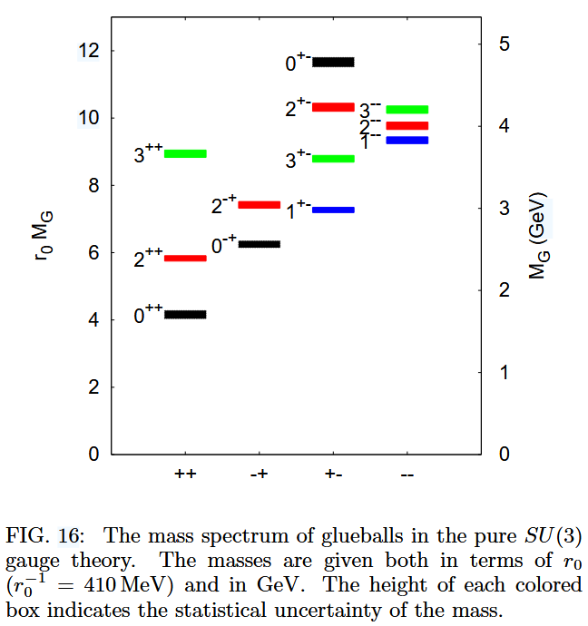
Glueball
A “Millennium Problem” prize has been established for proving that quantum $SU_{c}\left(3\right)$ gauge field theory is mathematically well-defined.
Supposing it is, one corollary must be the dynamical generation of a mass gap, ∆, in pure gauge QCD and the attendant appearance of glueball bound-states.
Numerical simulations of lattice-regularised QCD (lQCD) predict ∆ $≥$1.5 GeV and a rich spectrum of glueball bound-states.
The search and study of glueballs is closely related to the nonperturbative properties of QCD.
Y. Chen et al., Phys. Rev. D73, 014516 (2006), [hep-lat/0510074].

Slide 3
Current development of glueball
Theory:
Dyson-Schwinger Equations and Bethe-Salpeter Equations
Joseph Meyers and Eric S. Swanson (2013)
Helios Sanchis-Alepuz et al (2015)
E. V. Souza, M. N. Ferreira, A. C. Aguilar, J. Papavassiliou, C. D. Roberts and S.-S. Xu (2020)
L. Kaptari et al (2020)
M. Q. Huber, C. S. Fischer and H. Sanchis-Alepuz (2021)
“The spectrum is sensitive to the form of the analytic continuation of the gluon propagator into the Minkowski region and to the vertex models employed in the kernel.”
Bethe-Salpeter equations in quenched QCD
LQCD (quenched)
- Scalar glueballs: 1.5-1.7 GeV
- Pseudoscalar glueballs: $\sim$2.4, $\sim$2.6 GeV
- Tensor glueballs: 2.2-2.4 GeV
C. J. Morningstar, M. J. Peardon (1999)
Y. Chen et al (2006)
L.-C. Gui et al(2019)
A. Athenodorou, M. Teper (2020)……

Slide 4
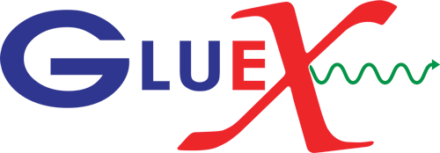
Current development of glueball
Experiment:
- Glueballs are difficult to identify due to their mixing with mesonic states sharing identical quantum numbers.
- $0^{++}$ glueball candidates : f(1500), f(1710) mixed with f(1370)
- 2024.5: BESIII Collaboration: $J/ψ→γK_{S}^{0}K_{S}^{0}η′$
X(2370) as $0^{−+}$, M=2.395 GeV
Waiting for more direct evidence of the glueball from experiments!

Slide 5
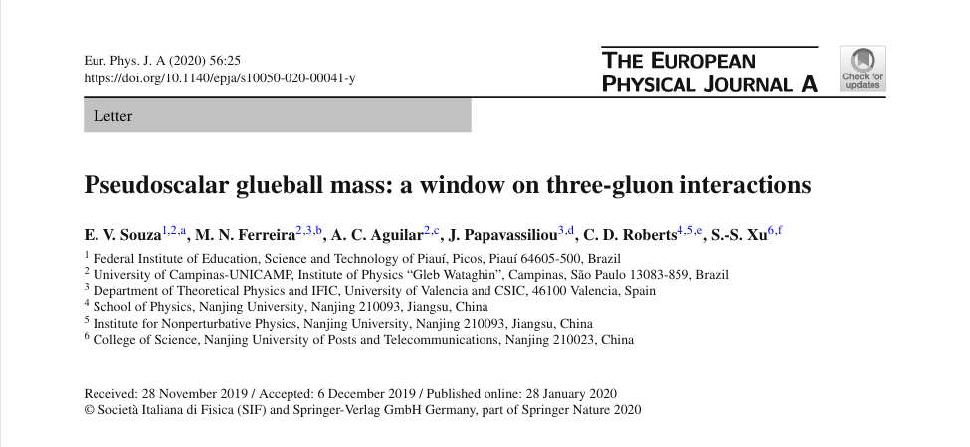

Slide 6
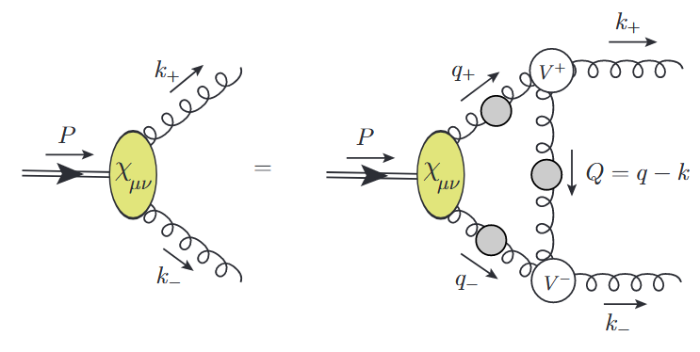
Bethe-Salpeter Equation for $0^{−+}$ glueball
In pure-gauge QCD, the $J^{PC}=0^{−+}$ glueball is the simplest case because the Bethe-Salpeter equation has only one dynamical kernel, viz. that describing gluon-gluon scattering, the leading contribution to which is illustrated below.
Bethe-Salpeter equation for $0^{−+}$ glueball :
Kernel:
Gluon propagator in Landau gauge:

Slide 7
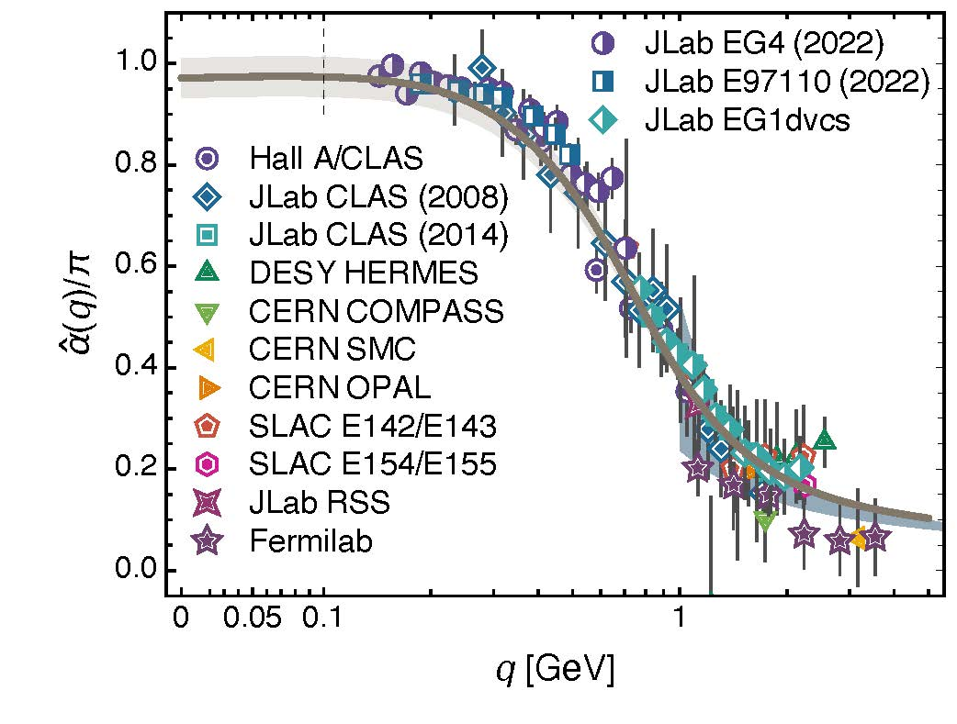
Completing the Bound-State Kernel
Gluon propagator:
- In the perturbative domain, gluon acts as massless degrees-of-freedom.
- On the other hand, gluon saturates at infrared momenta.
Such behaviour is expressed in each one of the many available numerical solutions of the gauge-sector gap equations. However, those solutions are typically restricted to $l^{2}>0$, whereas the valence gluon propagators in the BSE are required on a sizeable subdomain of the entire complex $l^{2}$-plane.
A simple algebraic Ansatz for the valence-gluon propagator:
S.-S. Xu et al., Eur. Phys. J. A 55, 113 (Lett.) (2019).
Exchange interaction:
$$g^{2}\left(Q^{2}\right)D\left(Q^{2}\right)=\frac{4π\hat{α}(Q^{2})}{q^{2}+m_{G}^{2}}$$
Daniele Binosi et al., arXiv:1612.04835 [nucl-th], Phys. Rev. D 96 (2017) 054026/1-7

Slide 8
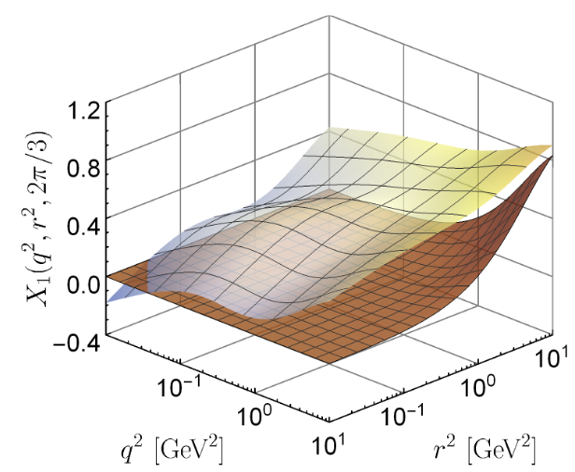
Completing the Bound-State Kernel
Three-gluon vertex:
- The tree-level tensor and its dressing is dominant.
- The prominent and striking nonperturbative effect is a marked suppression of the vertex at infrared momenta.
$$V_{αμρ}\left(k,q,Q\right)=R\left(k^{2},q^{2},Q^{2}\right){ V}_{αμρ}^{0L}$$
$${ V}_{αμρ}^{0L}\left(q,r,p\right)={\left(q−r\right)}_{ρ}δ_{αμ}+{\left(r−p\right)}_{α}δ_{μρ}+{\left(p−q\right)}_{μ}δ_{αρ}$$
$$R\left(k^{2},q^{2},Q^{2}\right)=f\left(k^{2}\right)f\left(q^{2}\right)f\left(Q^{2}\right)$$
S.-S. Xu et al., Eur. Phys. J. A 55, 113 (Lett.) (2019).
where the parameter $ω_{3g}$ prescribes the domain over which suppression of the vertex is active.
$$ω_{3g}=1.9 GeV$$

Slide 9
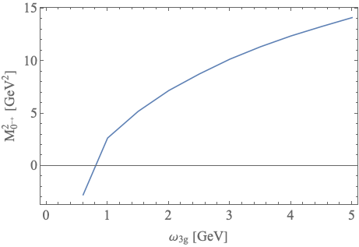
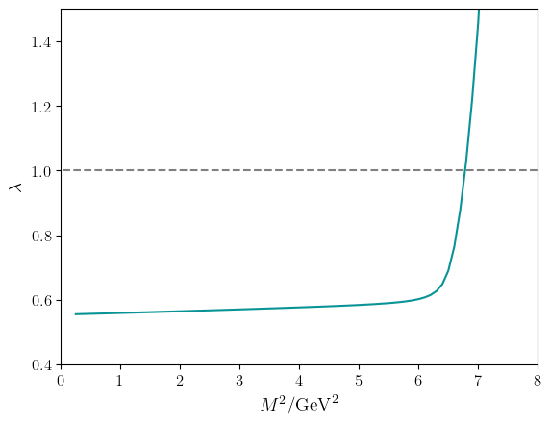
Results
the computed mass-squared of the $0^{−+}$glueball as a function of $ω_{3g}$
Some observations:
- The mass obtained decreases as $ω_{3g}$ decreases.
- Sensible solutions are only obtained with $ω_{3g}>ω_{3g}^{c}$ = 0.87 GeV.
- Using $ω_{3g}$ = 1.9 GeV, the result matches the lattice result 2.610 GeV.
$$ω_{3g}^{c}$$
The $0^{−+}$glueball mass is very sensitive to the suppression in three-gluon vertex.
Eigenvalue curve

Slide 10
Lattice fit
Bethe-Salpeter equation:
The transversely projected vertex:
planar degeneracy
$${\tilde{Γ}}_{2}≪{\tilde{Γ}}_{1},{\tilde{Γ}}_{3}≅0,{\tilde{Γ}}_{4}≅0$$
The planar degeneracy:
An extensive lattice simulation of three-gluon vertex in the Landau gauge shows a planar degeneracy. It means the corresponding form factors depend almost exclusively on a single kinematic variable $s^{2}=(q^{2}+r^{2}+p^{2})/2$. Thus, all configurations lying on a given plane in the coordinate system $(q^{2},r^{2},p^{2})$ share almost the same form factors.

Slide 11
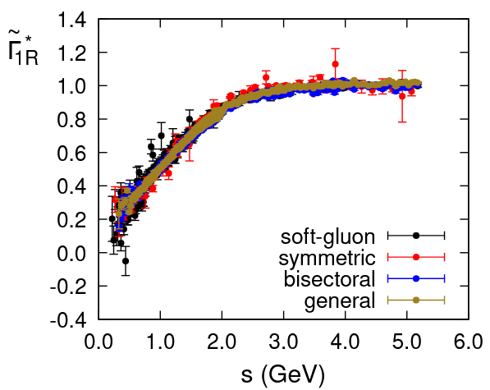
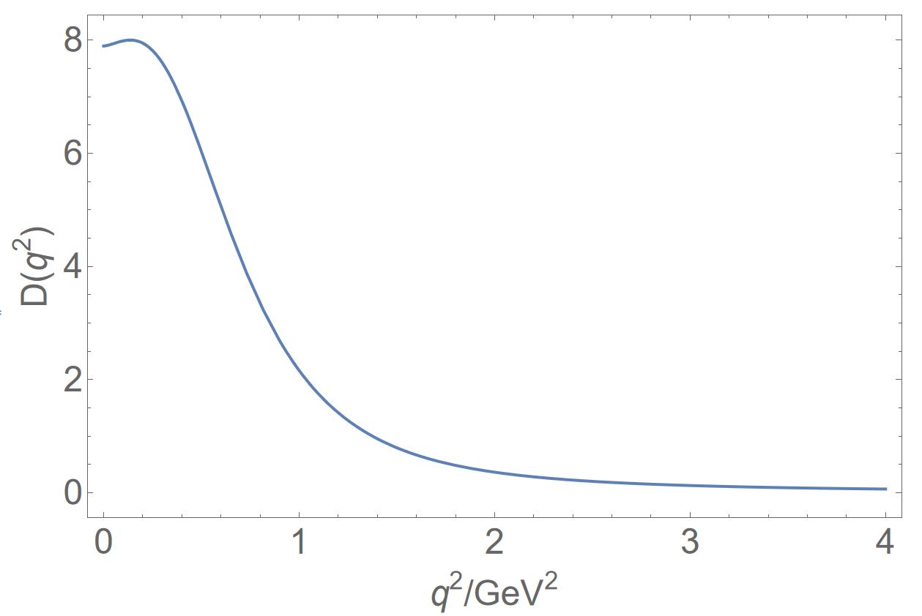
Lattice fit
The lattice fit of three-gluon vertex:
The lattice fit of gluon propagator in Landau gauge:
F. Pinto-Gomez, F. De Soto, and J. Rodrıguez-Quintero, Phys. Rev. D 110, 014005 (2024).
Renormalization point $ζ=4.3$ GeV
$g^{2}\left(ζ\right)=4πα\left(ζ\right), α\left(4.3\right)=0.31$
However, their behaviour in complex space is unstable and strange. So the extrapolation to time-like region of eigenvalue is necessary.

Slide 12
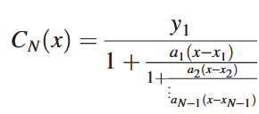
Extrapolation Methods
Padé Approximation
Schlessinger Point Method (SPM)
For a set of N data points $\{\left(x_{i},y_{i}\right)\}$, the SPM constructs the rational formula
based on interpolation via continued fractions :
L. Schlessinger, Phys. Rev. 167, 1411 (1968).
Coefficients obtained recursively:

Slide 13
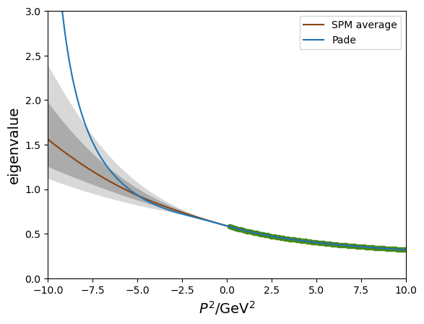
Preliminary (parameter-free) Prediction
Eigenvalue curve with the new propagators and vertex
SPM: $N=80, M≅\frac{N}{2}, P^{2}=[0.125,10]$
$\sim 15000$ extrapolation curves
theory | $$M_{0^{−+}}(GeV)$$
J. Meyers (2013) | $$2.750$$
M. Q. Huber (2021) | $$2.580(180)$$
This work (SPM) | $${2.387}_{−0.173}^{+0.221}$$
This work (Padé) | $$2.345$$
lattice | $$M_{0^{−+}}(GeV)$$
C.J. Morningstar (1999) | $$2.640(40)$$
Y. Chen (2006) | $$2.610(50)$$
L.-C. Gui (2019) | $$2.395(14)$$
A. Athenodorou (2020) | $$2.600(40)$$
BESIII: X(2370) | $${2.395}_{−0.105}^{+0.37}$$

Slide 14
Summary
Glueballs play an important role in understanding the strong interaction. At present, there is little clear evidence in experiments.
In pure-glue QCD, gluon-gluon scattering in the $J^{PC}=0^{−+}$ channel is described by a very simple equation with only one dynamical kernel. So it is an ideal starting point for investigating the structure and mass of glueballs.
By solving for the mass of pseudoscalar glueballs in quenched QCD, we find that the infrared suppression of the three-gluon vertex is crucial for the mass.
Since BSE requires the value in the complex plane, one must resort to either the analytic continuation of Schwinger functions or extrapolations, both of which present significant challenges.
Thank you!

