Slide 1
Presented by
Attaphon Kaewsnod (SUT)
Center of Excellence in High Energy Physics and Astrophysics,
School of Physics, Institute of Science, Suranaree University of Technology, Nakhon Ratchasima, Thailand
Working with: Dr. Kai Xu, Dr. Thanat Sankhakrit, Dr. Zheng Zhao, and Prof. Dr. Yupeng Yan
East Asian Workshop on Exotic Hadrons 2024
8–11 Dec 2024
Hilton Nanjing Niushoushan, Nanjing, China

Slide 2
Contents
Introduction
Baryon wave functions
Helicity amplitudes
Results
Summary

Slide 3
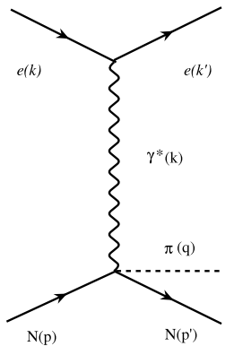
Introduction: Resonance’s substructure through helicity amplitudes
Helicity amplitudes describe the transition of a photon (or other particles) with definite helicity to a nucleon or its excited states, such as the Δ(1232).
Electroproduction of pions off nucleons in the one photon approximation
Experimental results on the γ*N → N* helicity amplitudes are extracted from the data on γ*N → Nπ diagram.

Slide 4
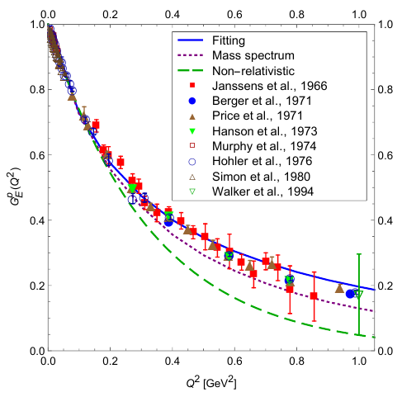
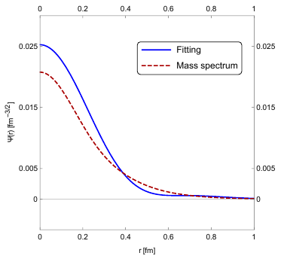
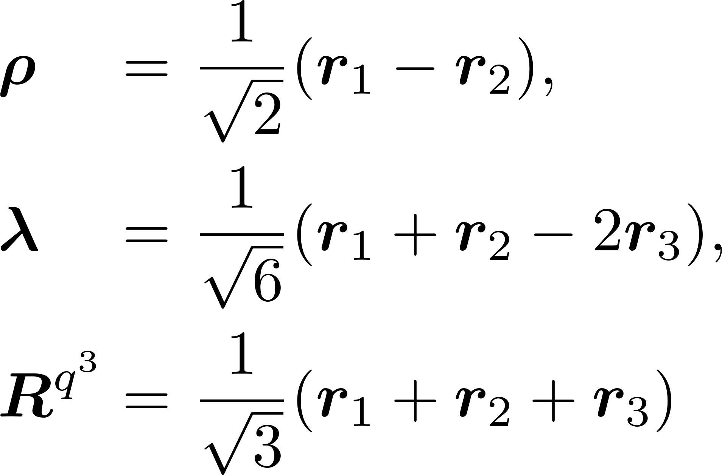
proton
Wave function of proton
The algebraic structure of a proton in a q³ picture is
q
q
q
q
q
q

Slide 5
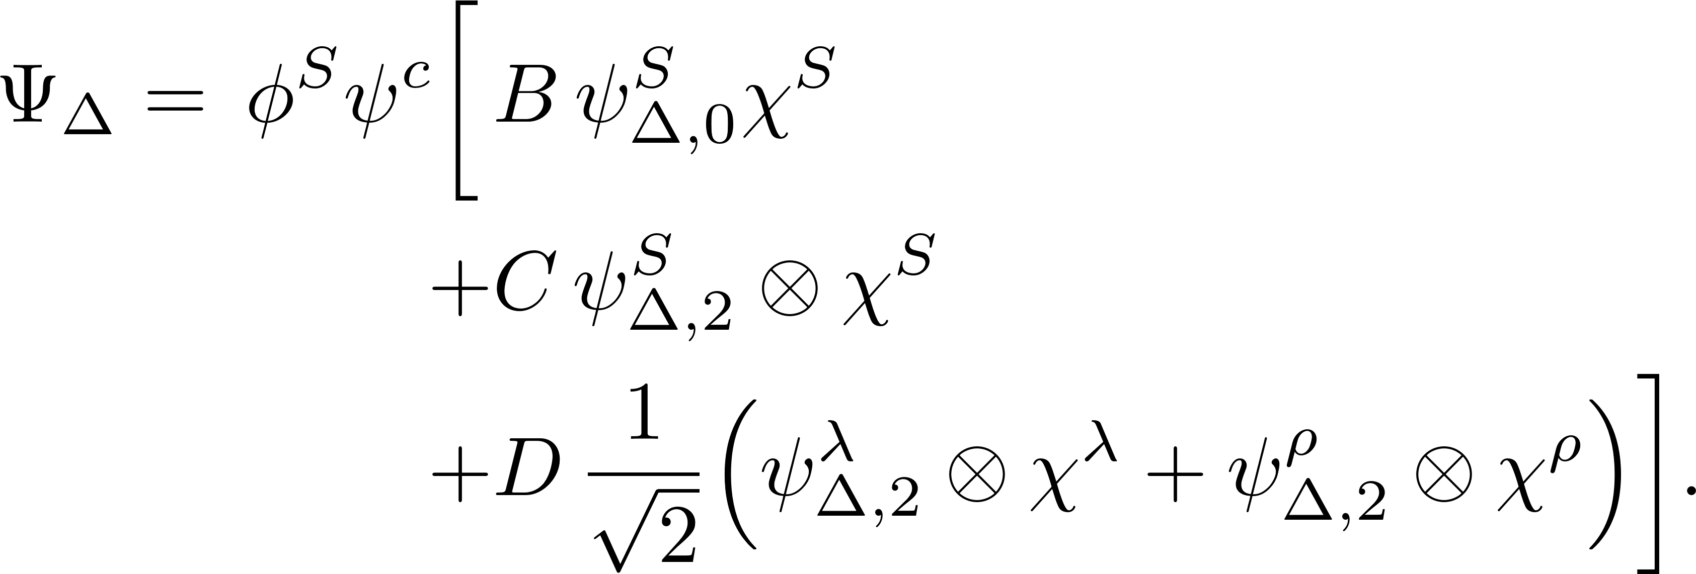
Wave function of
proton
The algebraic structure of a in a q³ picture is
q
q
q
q
q
q
Fit to the data of helicity amplitudes

Slide 6
Transition: quark core contribution
proton
q
q
q’
q’
q
q’
Helicity amplitudes of

Slide 7
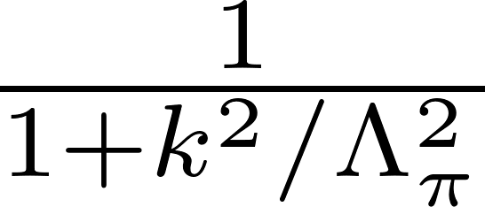
Transition: meson cloud contribution
proton
q
q
q’
q’
q
q’
Interaction Lagrangians:
Form factor:
Pauli–Villars regularization:

Slide 8
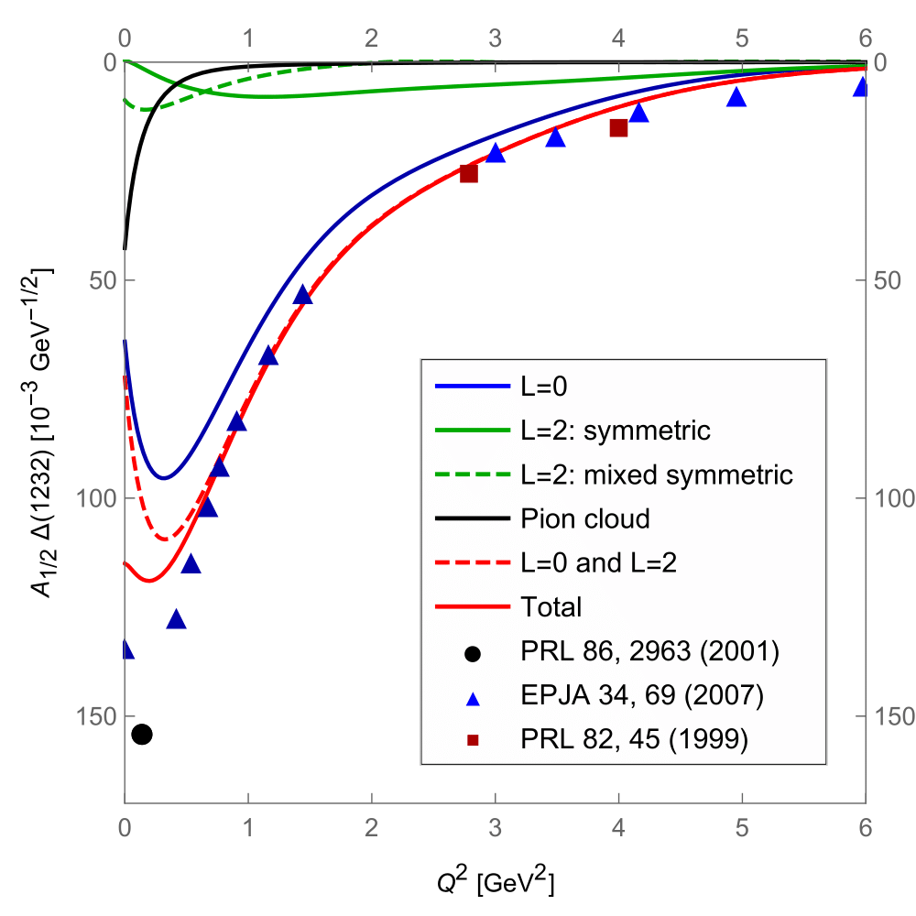
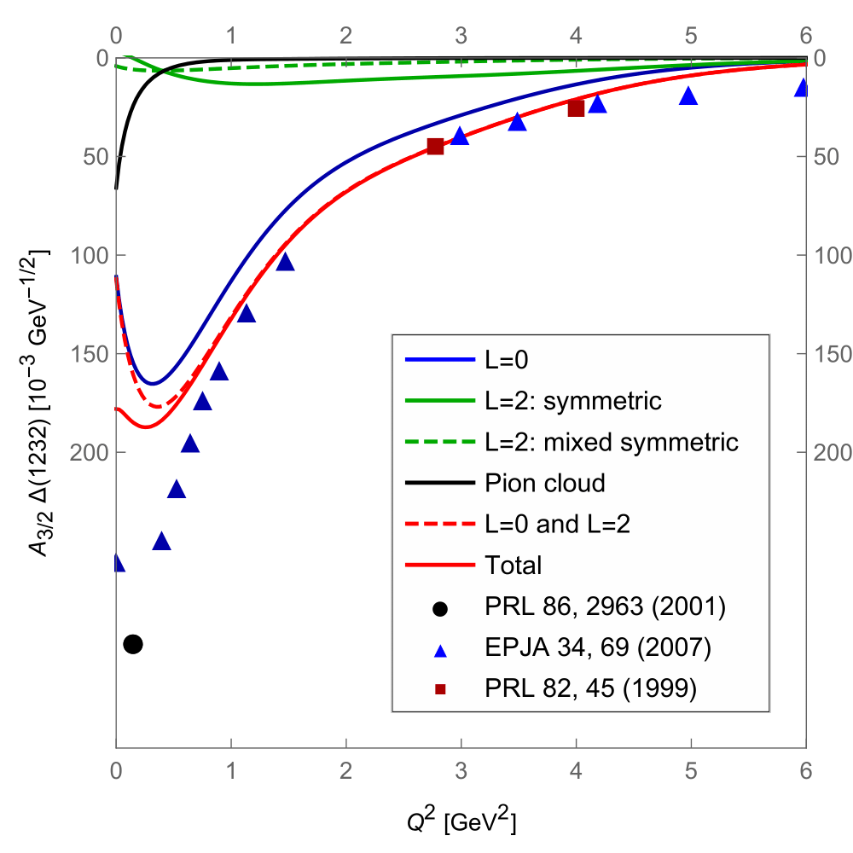
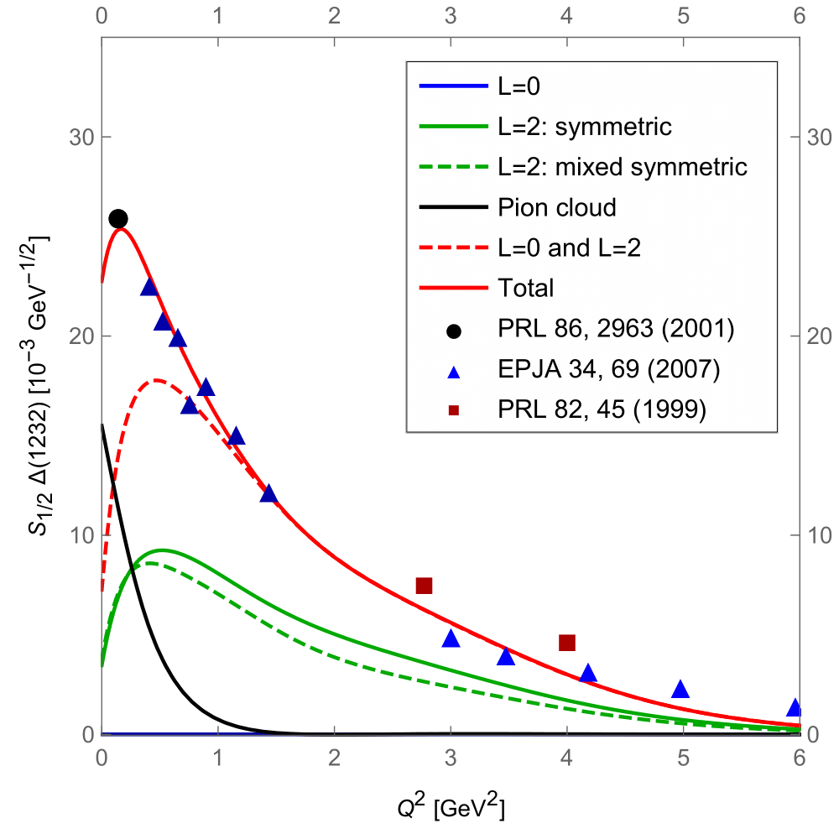
Results

Slide 9
Summary
Thank you

Slide 10
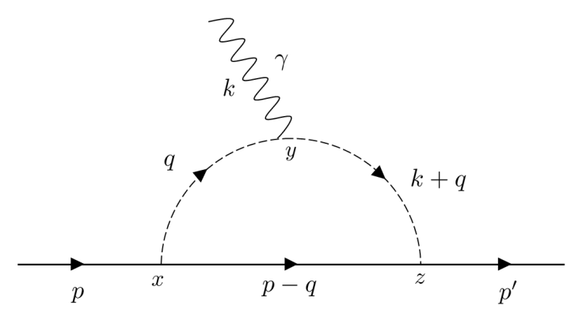
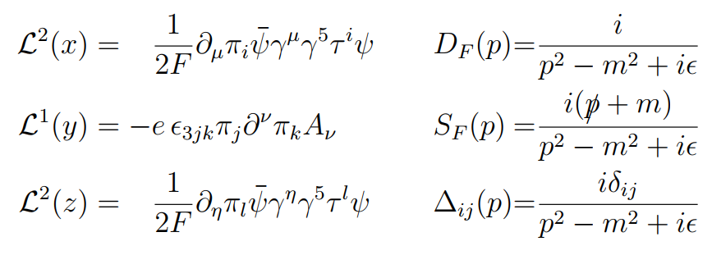

Slide 11
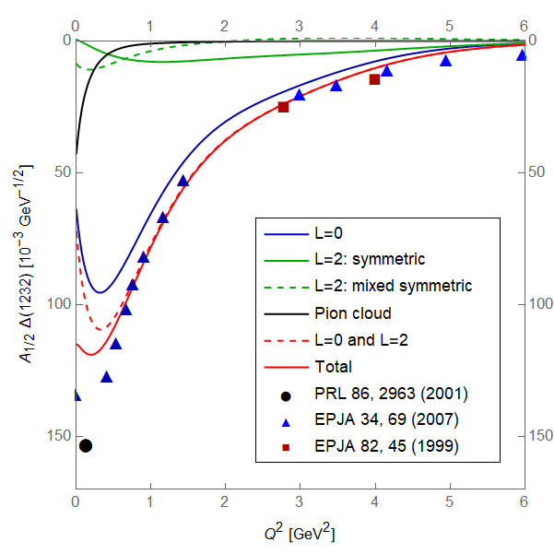
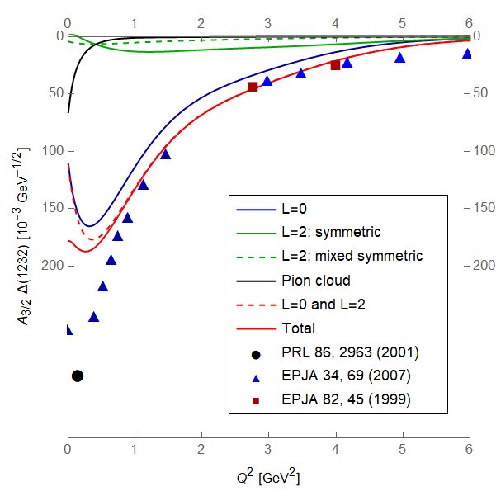
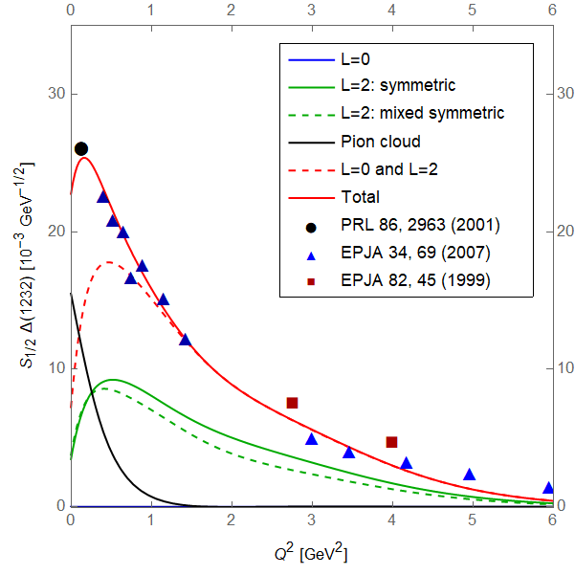
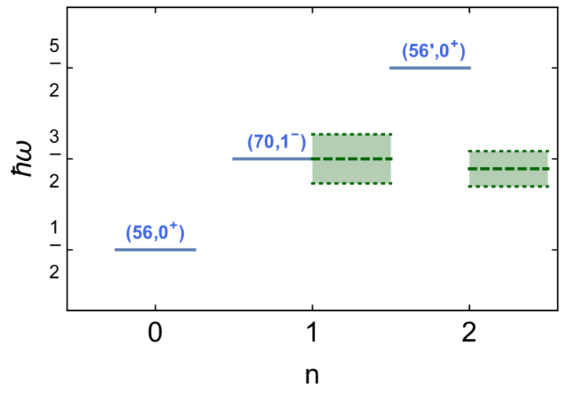
Contents
Introduction
Baryon wave functions
Helicity amplitudes
Results
Summary
q
q
q
q
q
q

Slide 12
Introduction
Baryon Resonances: Physicists have studied mass spectra for decades.
Problem: Theory and experiment don’t always match.
Solution: Understanding resonance substructure is key.
Method: Use photoproduction to investigate resonance substructure.
Notes:
-Physicist has studied the mass spectra of baryon resonances for many decades -But still has the problems of consistency between theoretical prediction and experimental data -To solve this problem we need to understand the substracture of the resonances -A new methodology to investigate the substructure of the resonances is the process of proton and nucleon producing particles, so called photoproduction.

Slide 13
