Slide 1

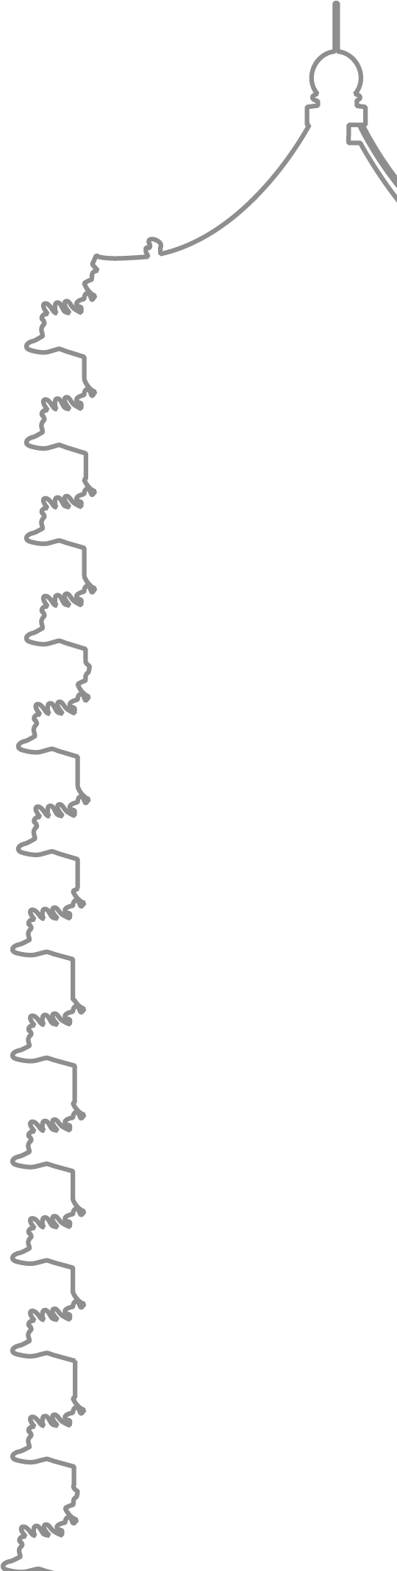
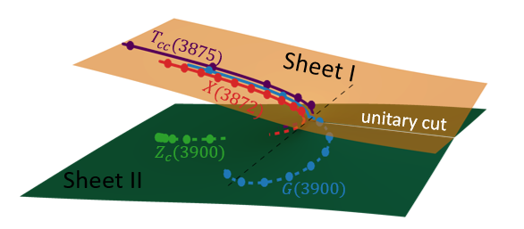
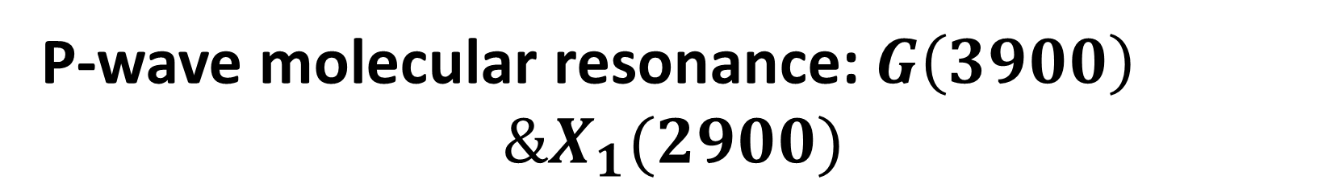
East Asian Workshop on Exotic Hadrons 2024
P-wave molecular resonance: $G\left(3900\right)$
$$\&X_{1}(2900)$$
Based on
Z.-Y. Lin, J.-Z. Wang, J.-B. Cheng, L. Meng, and S.-L. Zhu, arXiv:2403.01727 (PRL, in press)
& J.-Z. Wang, Z.-Y. Lin, B. Wang, L. Meng, and S.-L. Zhu,
Phys. Rev. D 110, 114003 (2024)
Speaker: Zi-Yang Lin (林子阳)
2024/12/9
Notes:
强子分子态，多关注S波，事实上P波不一定比S波高

Slide 2
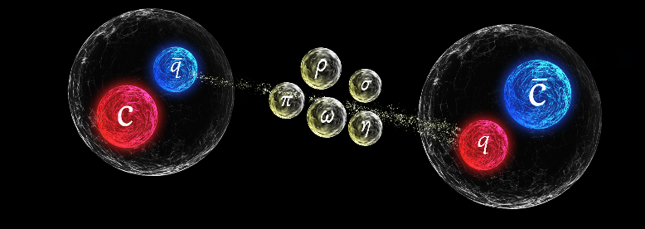
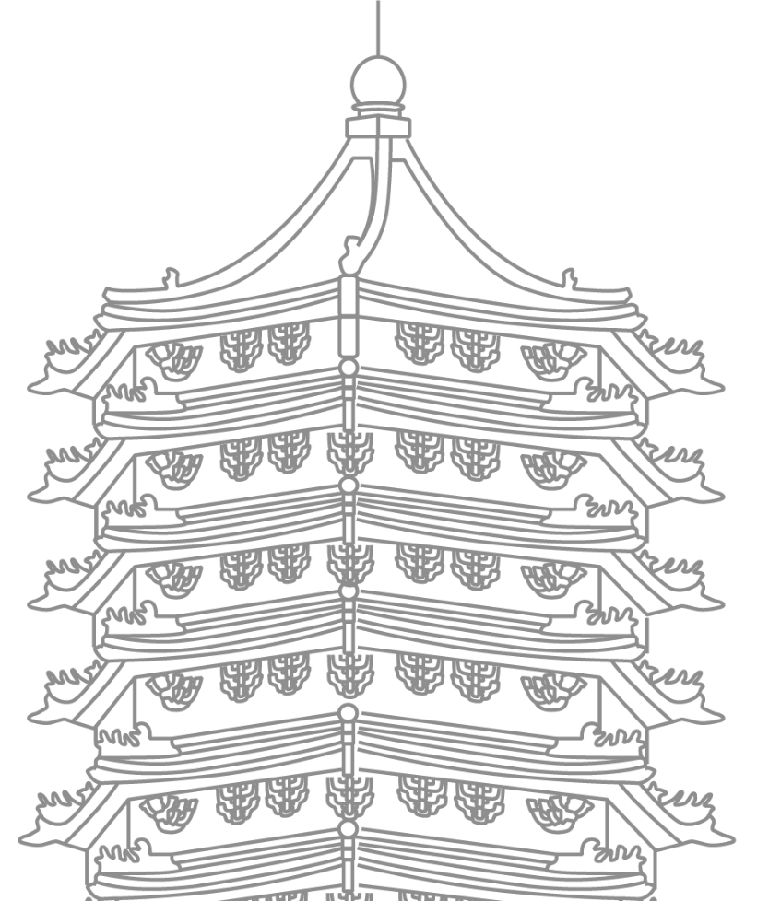
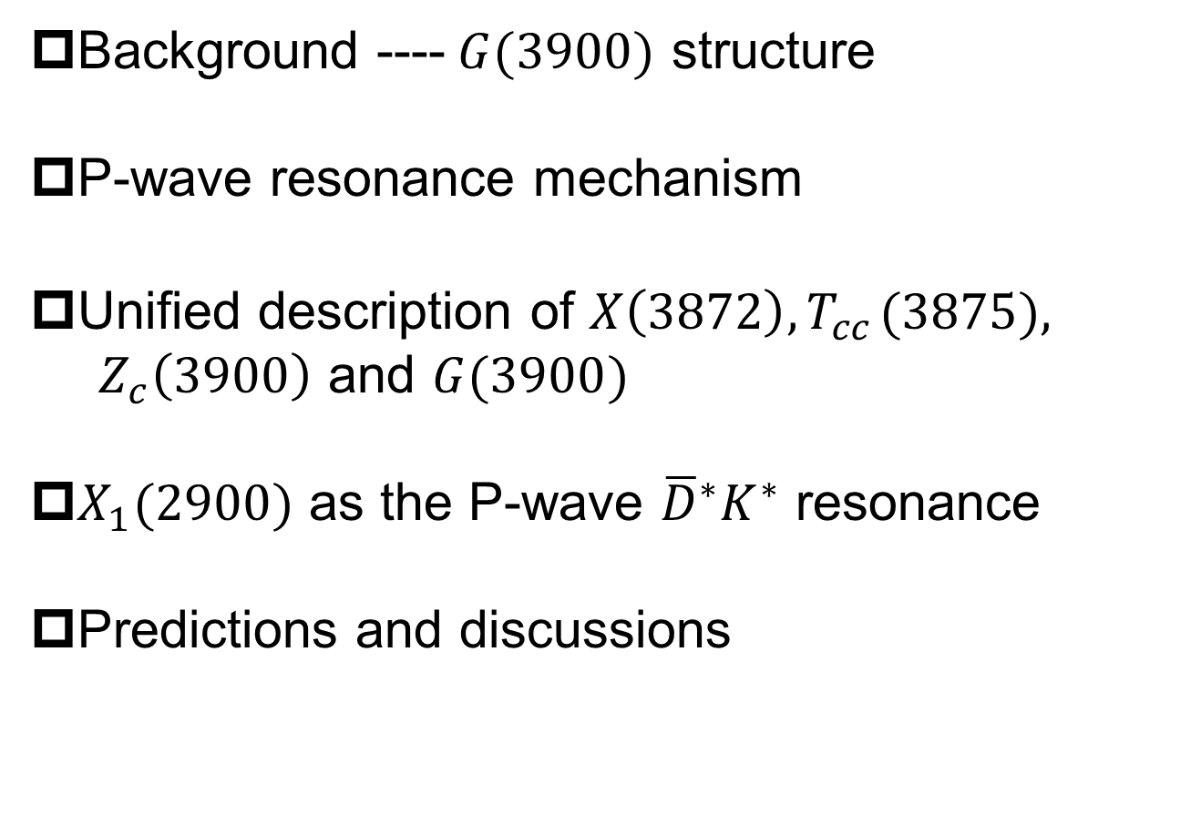
OUTLINE
Background ----$G(3900)$ structure
P-wave resonance mechanism
Unified description of $X\left(3872\right), T_{cc}^{}(3875),$
$Z_{c}\left(3900\right)$ and $G(3900)$
$X_{1}(2900)$ as the P-wave ${\overline{D}}^{∗}K^{∗}$ resonance
Predictions and discussions

Slide 3
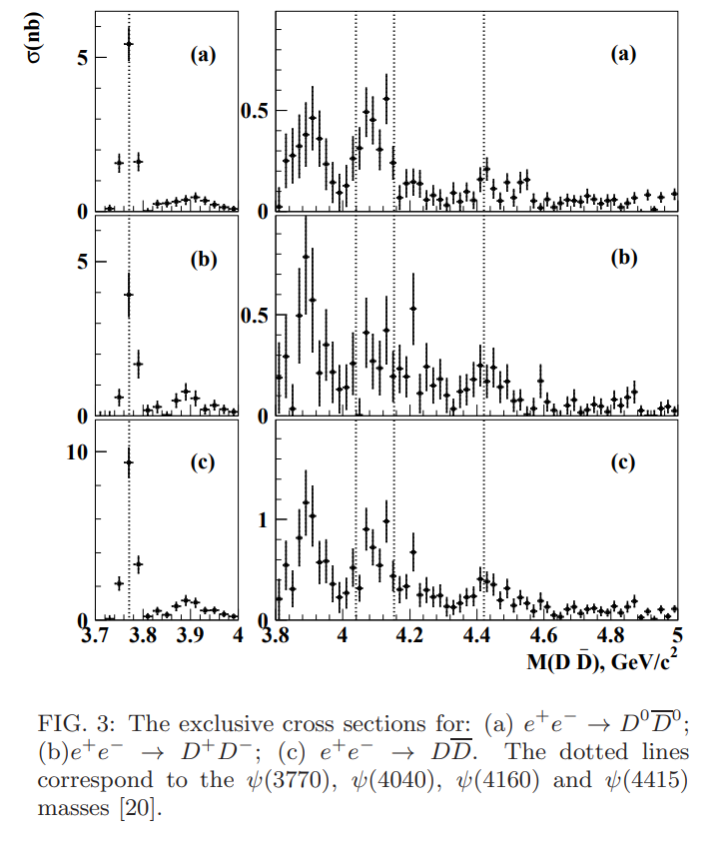
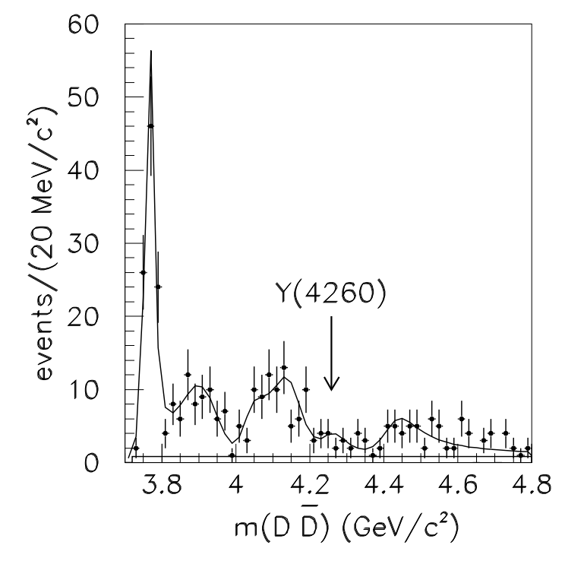


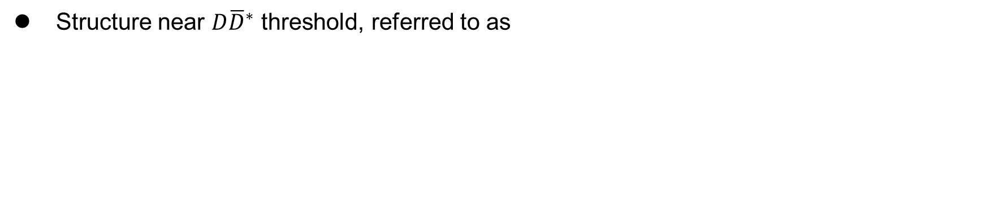

I
Motivation--Cross Sections for $e^{+}e^{−}→D\overline{D}$
fitted with Gaussian function
$G(3900)$structure
Structure near $D{\overline{D}}^{∗}$ threshold, referred to as
$$ψ(3770)$$
G(3900)
$$ψ(4040)$$
(BaBar Collaboration),
Phys. Rev. D 76, 111105 (2007),
(Belle Collaboration),
Phys. Rev. D 77, 011103 (2008)
Notes:
Gaussian function

Slide 4
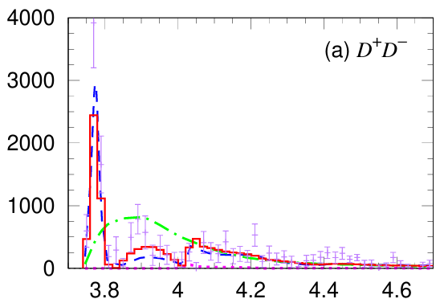
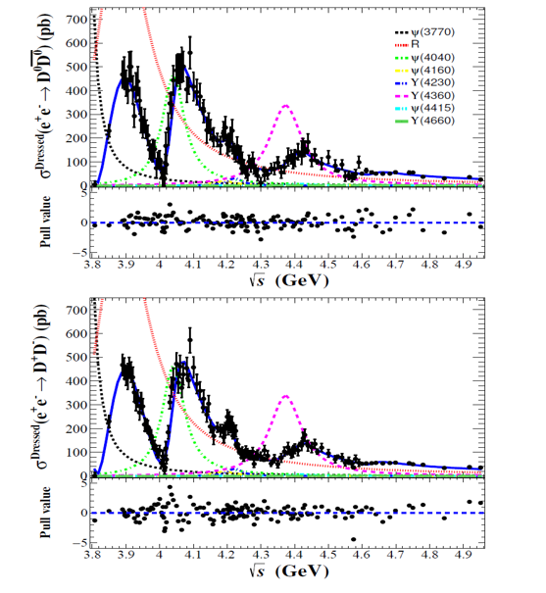
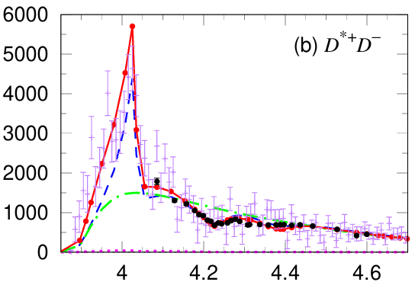
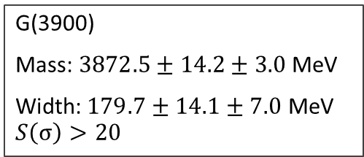
I
Motivation--Cross Sections for $e^{+}e^{−}→D\overline{D}$
Fit with relativistic BW
Global fit, no pole for G(3900)
G(3900)
Mass: $3872.5±14.2±3.0$ MeV
Width:$179.7±14.1±7.0$ MeV
$$S\left(σ\right)>20$$
S.X. Nakamura, X.-H. Li, H.-P. Peng, Z.-T. Sun, and X.-R. Zhou, arxiv: 2312.17658
(BESIII Collaboration),
Phys. Rev. Lett. 133, 081901 (2024)

Slide 5
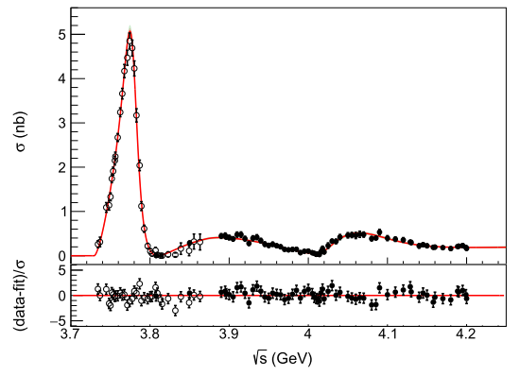
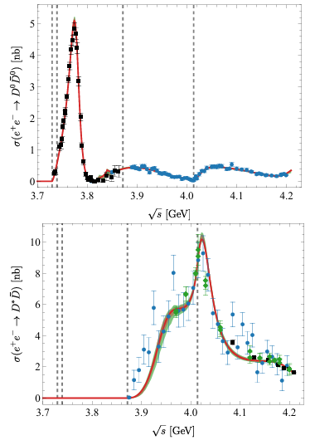


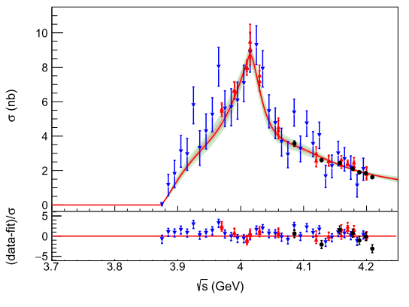
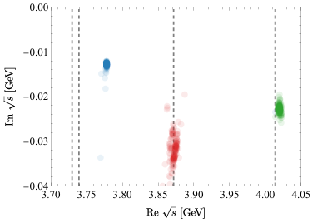
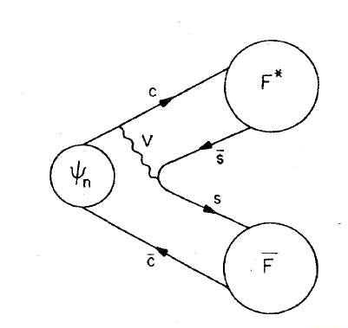
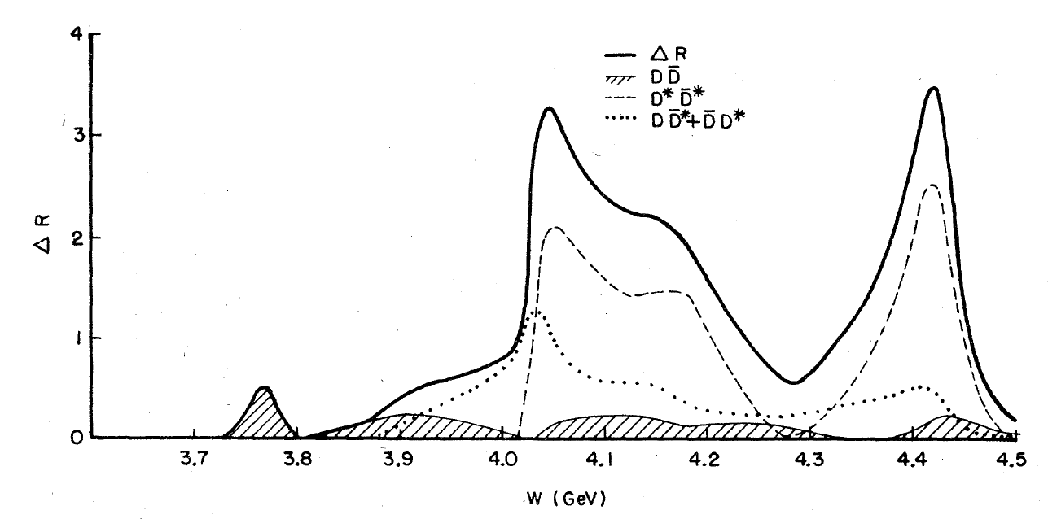

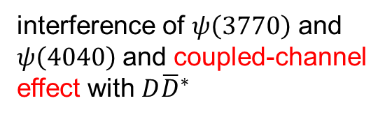

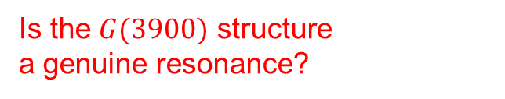


I
Background—G(3900)/Y(3872)?
Is the $G(3900)$ structure
a genuine resonance?
$$e^{+}e^{−}→D\overline{D}$$
Our K-matrix formalism fit with carefully done analytical continuation
$$e^{+}e^{−}→D\overline{D}$$
Poltergeist?
interference of $ψ\left(3770\right)$ and $ψ\left(4040\right)$ and coupled-channel effect with $D{\overline{D}}^{∗}$
$$D{\overline{D}}^{∗}$$
$$D{\overline{D}}^{∗}$$
N. Hüsken et al,
Phys. Rev. D 109, 114010 (2024)
poles
Cornell model
E. Eichten, K. Gottfried, T. Kinoshita, K. Lane, and T.-M. Yan, Phys. Rev. D 17, 3090 (1978)
Notes:
Our earliest version on the arxiv refer to G(3900) as Y(3872)
We use

Slide 6
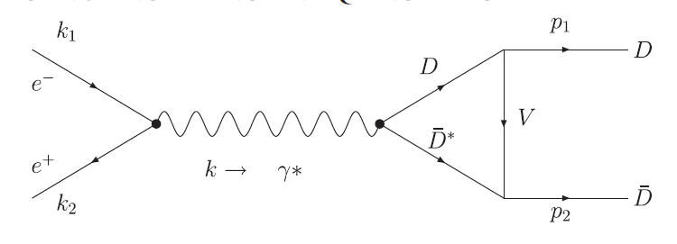
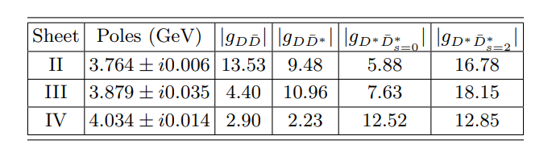

I
Background—G(3900)/Y(3872)?
Previous investigations on $G(3900)$
kinematic effect at the
threshold
coupled-channel effects driven by the contact interactions
Y.J. Zhang and Q. Zhao, Phys. Rev. D 81, 034011 (2010)
M.L. Du, U. G. Meissner and Q. Wang Phys. Rev. D 94 (2016) 9, 096006

Slide 7
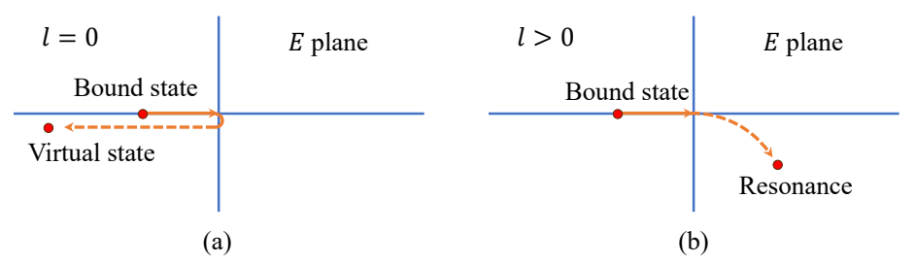
II
Formalism – P-wave resonance
Jost function becomes quadratic at the lowest order
⭐ P-wave resonance mechanism
As the attraction being weaker, p-wave bound state naturally turns resonances.
Shape-type resonance rather than Feshbach resonance (bound states coupled with open channels)
J. R. Taylor, Scattering Theory: The Quantum Theory of Nonrelativistic Collision

Slide 8
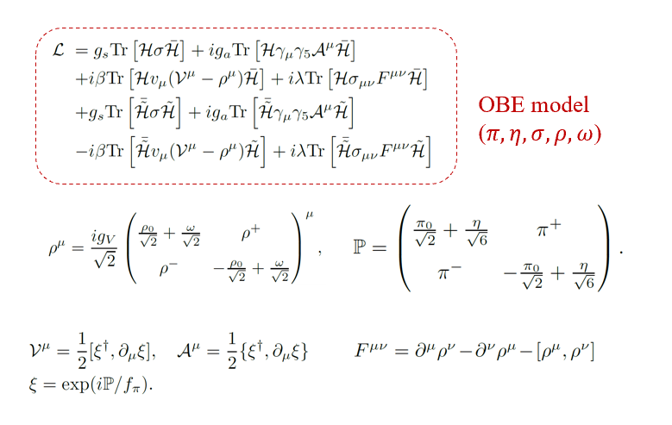
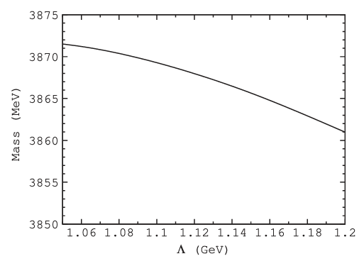
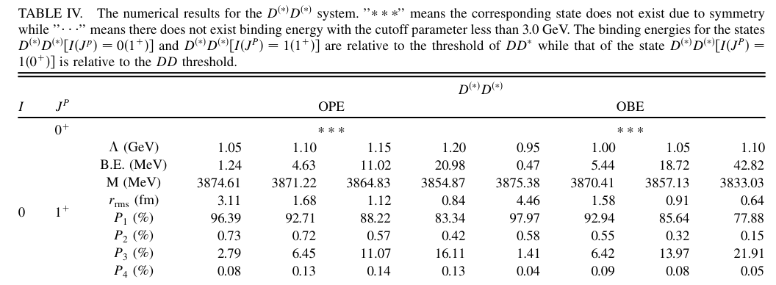


II
Formalism – OBE model
The hadron-hadron interactions are fullfilled with pseudoscalar and vector meson exchange
succeed in decribing the $X(3872)$
& predicting the $T_{cc}^{+}$
$$X(3872)$$
N. Li and S.-L. Zhu Phys. Rev. D 86, 074022 (2012)
N. Li, Z.-F. Sun, X. Liu, and S.-L. Zhu Phys. Rev. D 88,114008 (2013)
Notes:
EFT can not relate the S-wave and P-wave potentials, so we use the meson-exchange model

Slide 9
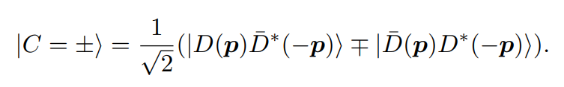
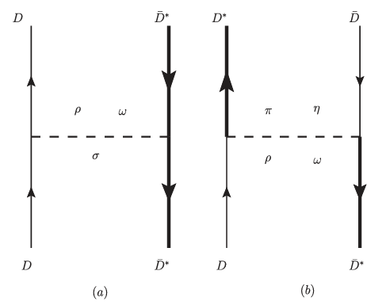
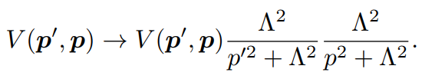
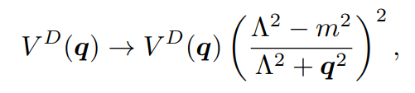
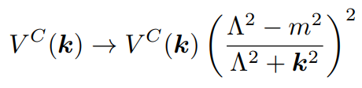

III
Formalism – OBE model
Nonlocality of one-pion exchange: $\vec{q}={\vec{p}}_{1}−{\vec{p}}_{3}$ $\vec{k}={\vec{p}}_{1}−{\vec{p}}_{4}={\vec{p}}_{1}+{\vec{p}}_{3}$
extra minus signs in cross diagrams (u-channel) related to C-parity in odd partial waves
if mistake $\vec{k}$ to $\vec{q}$
nonlocal regulator:
local regulator (to test the regulator-independency)
Poles derived by complex scaling method / Lippmann-Schwinger equation
direct diagram
cross diagram
Notes:
In two-body cases, this problem can be fixed by introduce extra signs in the wave function according to the parity. But for three bodies or more…

Slide 10
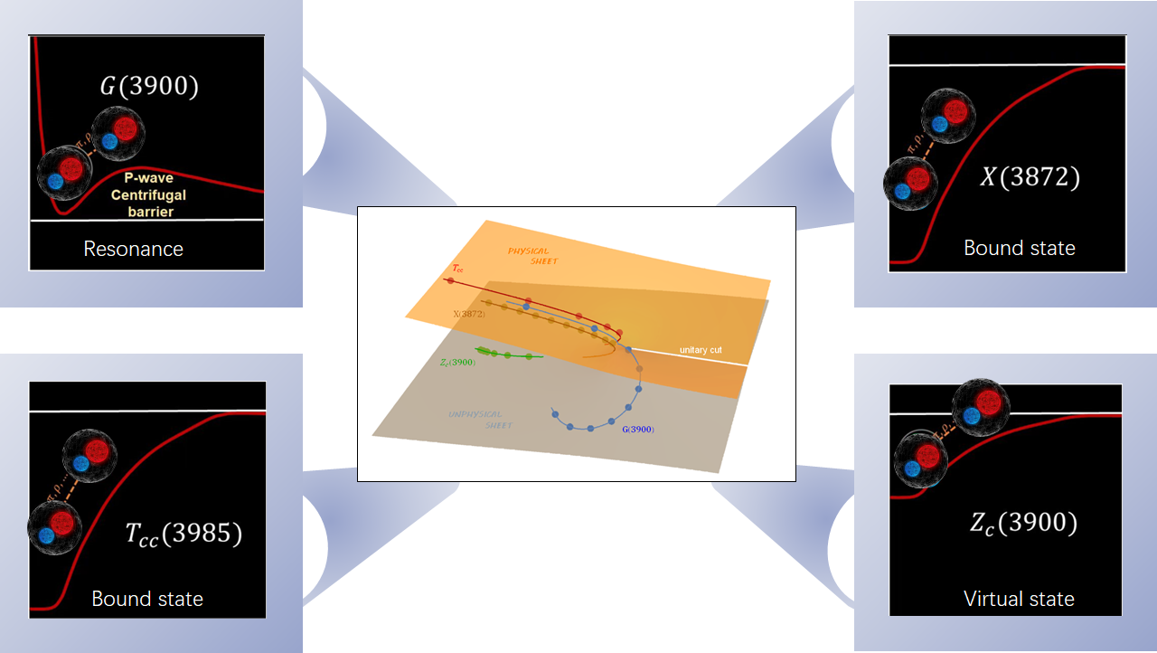
potentials in coordinate space
(local cutoff, just for display)

Slide 11
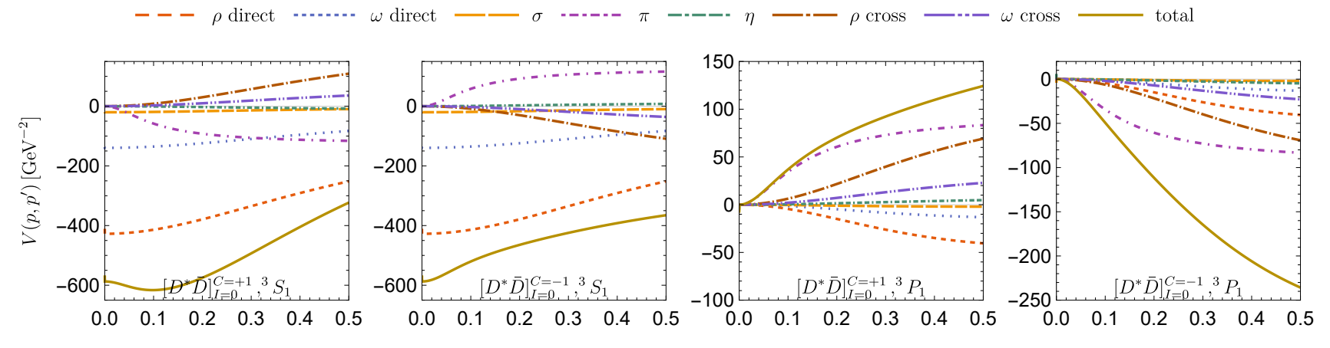







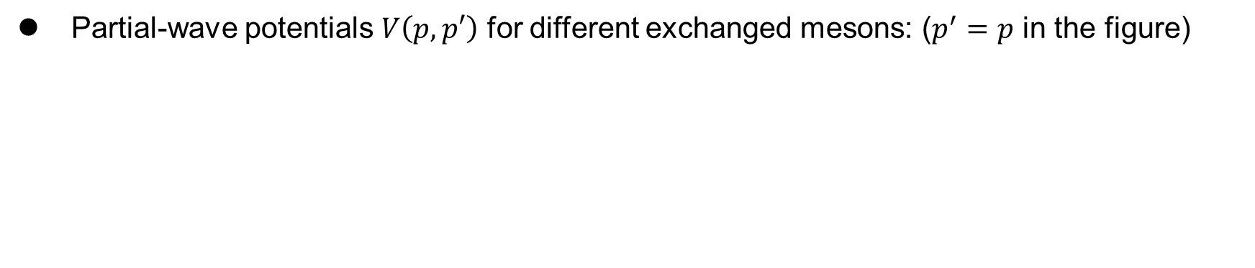

III
Results – Unified description of $D{\overline{D}}^{∗}$ molecules
Partial-wave potentials $V\left(p,p′\right)$ for different exchanged mesons: ($p^{′}=p$ in the figure)
$$p[GeV]$$
$$p[GeV]$$
$$p[GeV]$$
$$p[GeV]$$
$1^{++}$, $X\left(3872\right)$
$$1^{+−}$$
$$1^{−+}$$
$1^{−−}$, $G\left(3900\right)$
S-wave
P-wave
Notes:
Pion becomes dominant
All attractive

Slide 12
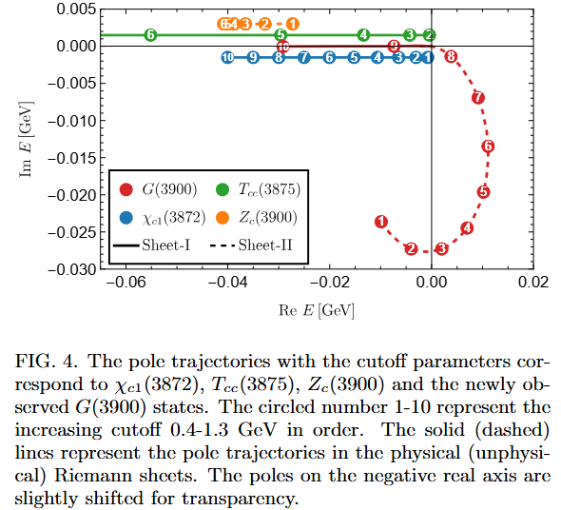
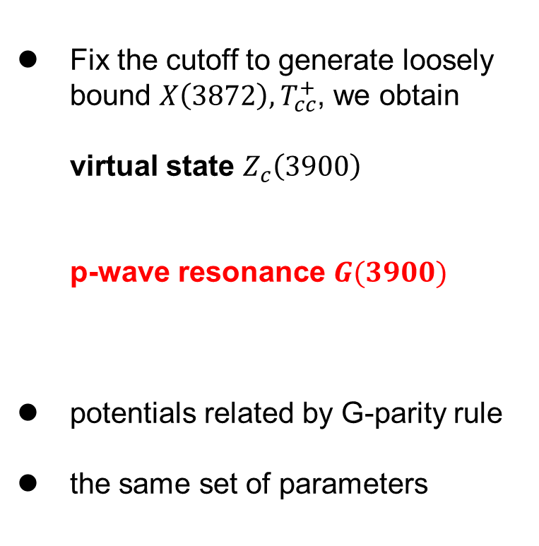
III
Results – Unified description of $D{\overline{D}}^{∗}/DD^{∗}$ molecules
Fix the cutoff to generate loosely bound $X\left(3872\right), T_{cc}^{+}$, we obtain
virtual state $Z_{c}\left(3900\right)$
p-wave resonance $G(3900)$
potentials related by G-parity rule
the same set of parameters
left-hand cut problem – need special integral contour
Notes:
One-to-one correspondence

Slide 13
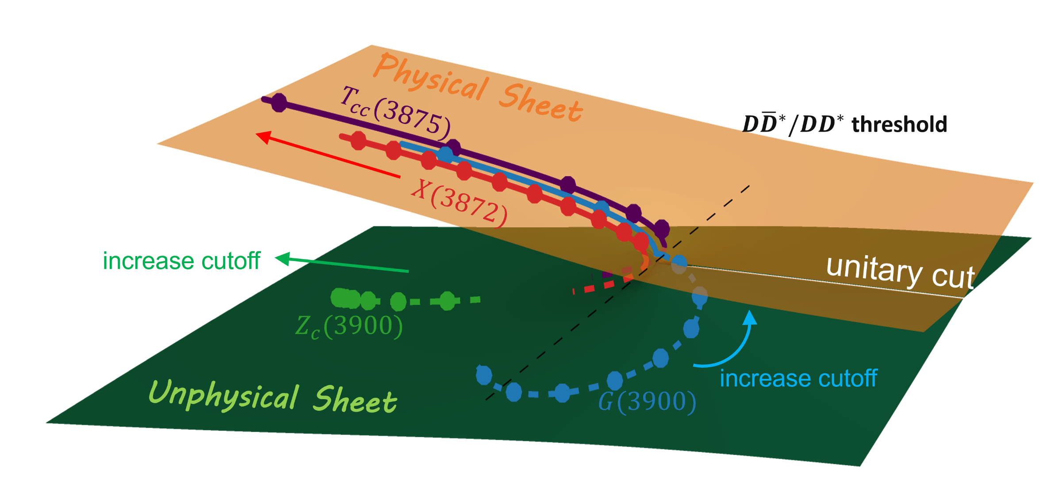
III
Results – Unified description of $D{\overline{D}}^{∗}/DD^{∗}$ molecules

Slide 14
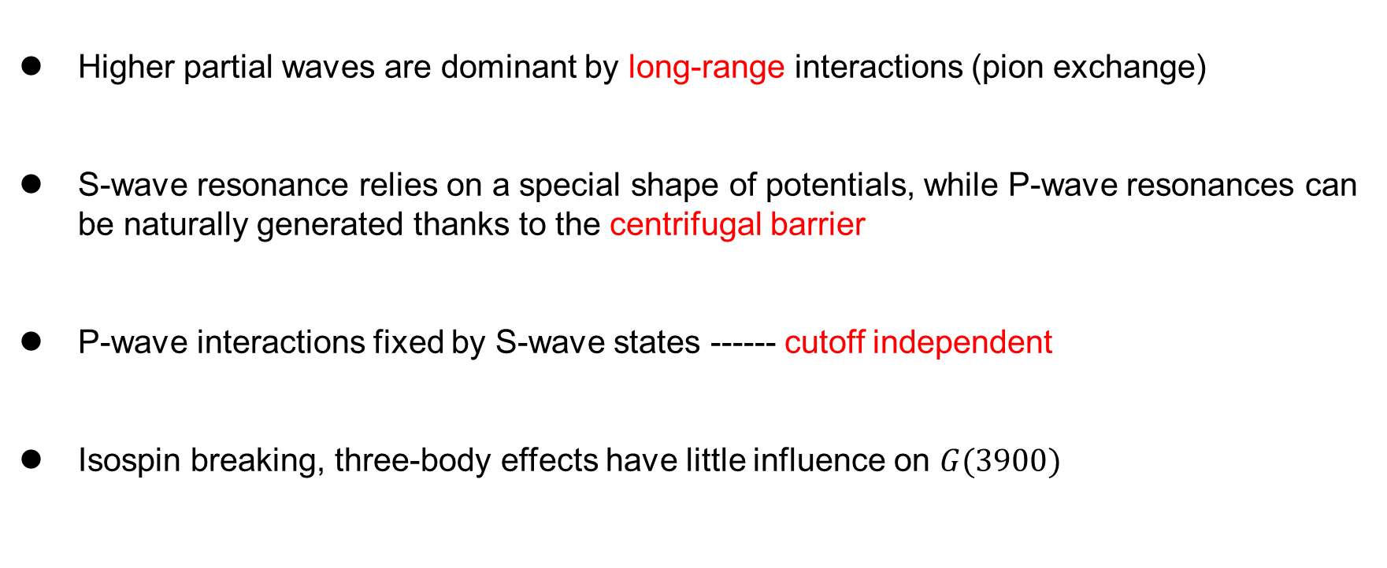
III
Discussion – Robustness of our conclusion
Higher partial waves are dominant by long-range interactions (pion exchange)
S-wave resonance relies on a special shape of potentials, while P-wave resonances can be naturally generated thanks to the centrifugal barrier
P-wave interactions fixed by S-wave states ------ cutoff independent
Isospin breaking, three-body effects have little influence on $G(3900)$

Slide 15
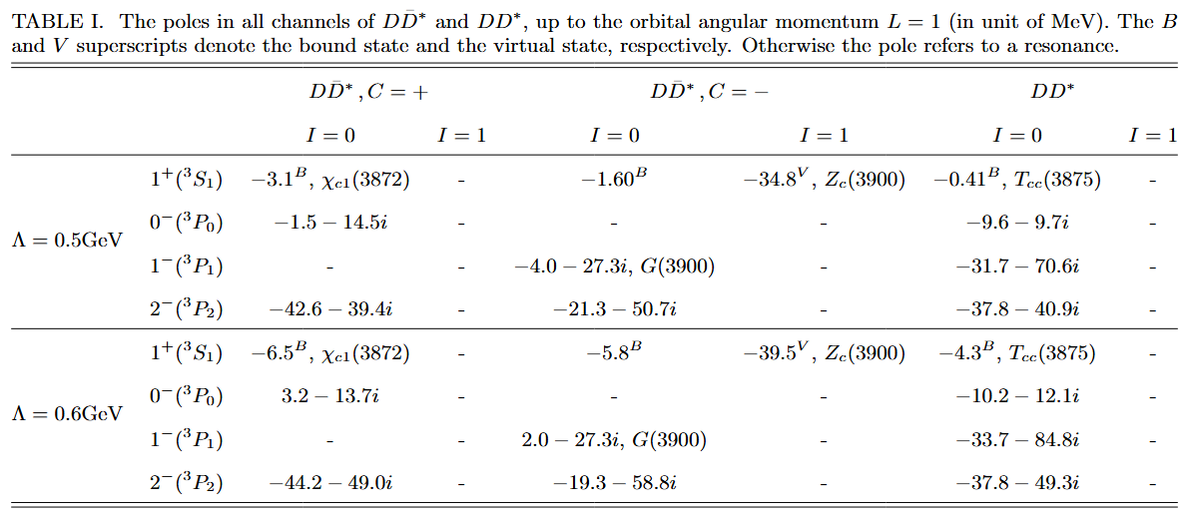

III
Predictions – P-wave resonances
Nonlocal Regulator:
P-wave resonances more likely to be observed
$1^{+−}$ partner of $X(3872)$, bound or virtual state

Slide 16

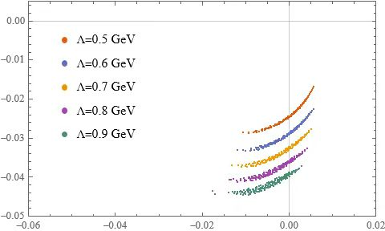
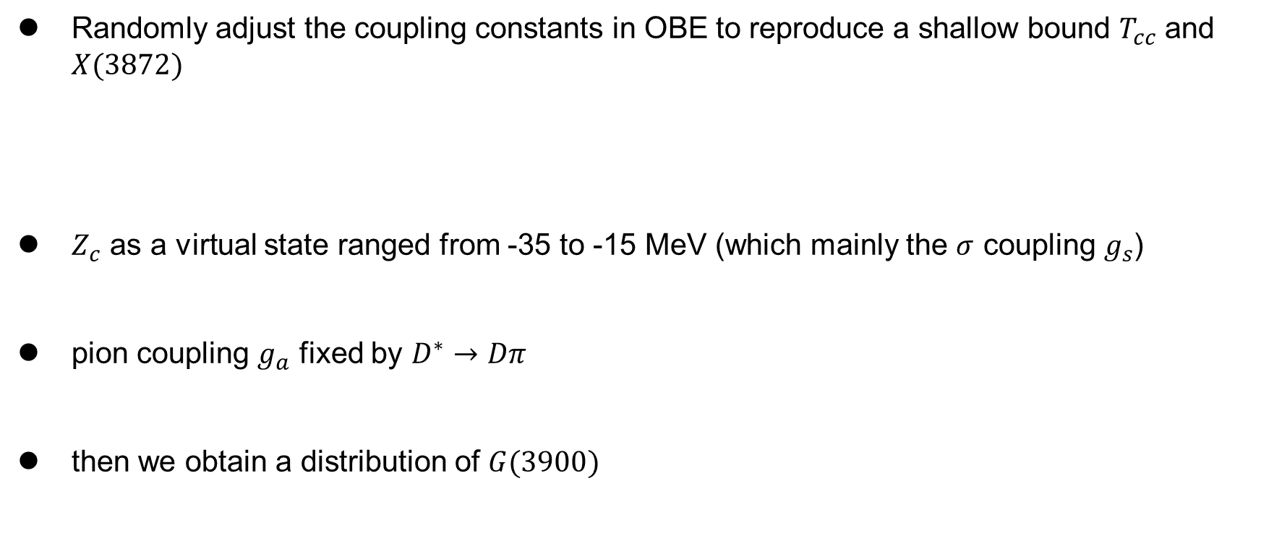
III
Systematic uncertainty – coupling constants
Randomly adjust the coupling constants in OBE to reproduce a shallow bound $T_{cc}$ and $X(3872)$
$Z_{c}$ as a virtual state ranged from -35 to -15 MeV (which mainly the $σ$ coupling $g_{s}$)
pion coupling $g_{a}$ fixed by $D^{∗}→Dπ$
then we obtain a distribution of $G(3900)$
robust near-threshold resonance

Slide 17
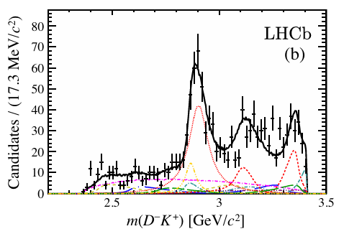
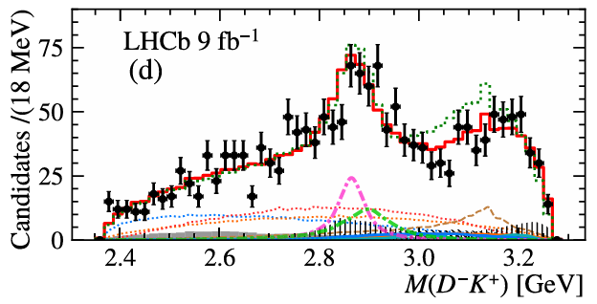









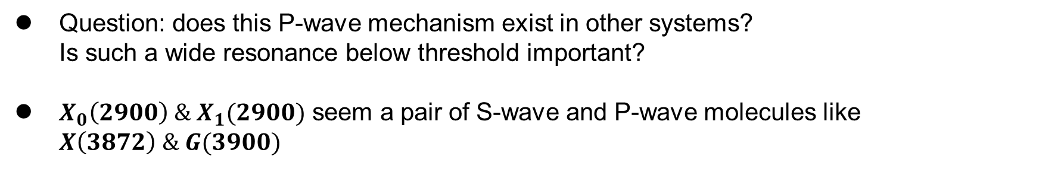





IV
Extension – $X_{1}(2900)$ as the P-wave ${\overline{D}}^{∗}K^{∗}$ resonance
Question: does this P-wave mechanism exist in other systems?
Is such a wide resonance below threshold important?
$X_{0}\left(2900\right) \& X_{1}(2900)$ seem a pair of S-wave and P-wave molecules like $X\left(3872\right) \& G(3900)$
$$T_{\overline{c}\overline{s}0}^{∗}{\left(2900\right)}^{0}$$
$$T_{\overline{c}\overline{s}1}^{∗}{\left(2900\right)}^{0}$$
$$T_{\overline{c}\overline{s}0}^{∗}{\left(2900\right)}^{0}$$
$$T_{\overline{c}\overline{s}1}^{∗}{\left(2900\right)}^{0}$$
$$m_{0}$$
$$2866±7$$
$$2904±5$$
$$2887±10$$
$$2914±19$$
$$Γ_{0}$$
57$±13$
110$±12$
92$±23$
128$±32$
(LHCb Collaboration), Phys. Rev. D 102, 112003 (2020)
(LHCb Collaboration), Phys. Rev. Lett. 133, 131902 (2024)

Slide 18
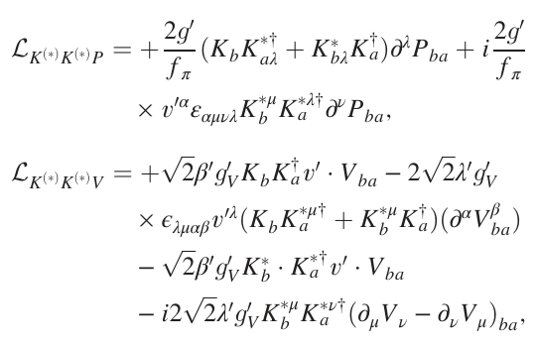


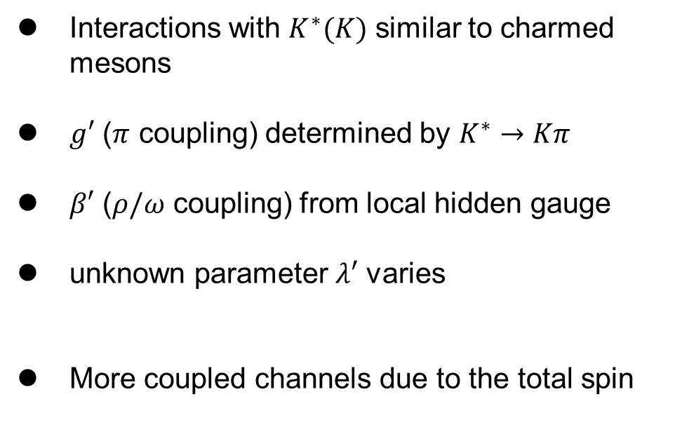
IV
Extension – $X_{1}(2900)$ as the P-wave ${\overline{D}}^{∗}K^{∗}$ resonance
Interactions with $K^{∗}(K)$ similar to charmed mesons
$g′$ ($π$ coupling) determined by $K^{∗}→Kπ$
$β′$ ($ρ/ω$ coupling) from local hidden gauge
unknown parameter $λ′$ varies
More coupled channels due to the total spin
$$0^{+}:1S_{0}$$
$$1^{−}: 1P_{1},3P_{1},5P_{1}$$
Notes:
Heavy quark flavor symmetry

Slide 19






IV
Results – $X_{1}(2900)$ as the P-wave ${\overline{D}}^{∗}K^{∗}$ resonance
$X_{0}\left(2900\right), X_{1}(2900)$ and an additional $1^{−}$ state
Dependency on the unknown parameter $λ′$
$$T_{cs0}\left(2900\right) ∼{}^{1}S_{0}$$
$T_{cs1}\left(2900\right) ∼{}^{1}P_{1}$ $+{}^{5}P_{1}$
$$T_{cs1}^{′}\left(2900\right) ∼{}^{3}P_{1}$$

Slide 20

V
Summary and perspective
Model-based calculation: unified description of $X\left(3872\right), T_{cc}^{}, Z_{c}\left(3900\right)$and $G(3900)$, with additional states predicted
Robustness from the pion exchange and P-wave mechanism
The energy of P-wave molecule is not necessarily much higher than its S-wave partner
More possible p-wave molecular states like $X_{1}(2900)$
Open question: what is the role of wide and near/below-threshold resonance?
For example, even in nucleon-nucleon system?
Thank you for your attention!

Slide 21



Backup – Unified description of $D{\overline{D}}^{∗}/DD^{∗}$ potentials
weak $I=1$ interactions, due to the cancel between $ρ$ and $ω$ exchange
Total potentials in different channels:
Strong attraction: $1^{+}(DD^{∗})、1^{++}、1^{+−}(D{\overline{D}}^{∗})$
Weak attraction: $0^{−}(DD^{∗})、0^{−+}、1^{−−}(D{\overline{D}}^{∗})$ weaker: $2^{−}(DD^{∗})、2^{−−}、2^{−+}(D{\overline{D}}^{∗})$

Slide 22

Backup – Unified description of $D{\overline{D}}^{∗}/DD^{∗}$ potentials

Slide 23


Backup —— Schrödinger equation on the 2nd Riemann sheet
threshold 1
threshold 2
Im(E)
2-channel example
$k_{1}=\sqrt{2μ_{1}(E−E_{th1})}$ $k_{2}=\sqrt{2μ_{2}(E−E_{th2})}$
Sheet I: $Im\left(k_{1}\right)>0 Im\left(k_{2}\right)>0$
bound state
Sheet II: $Im\left(k_{1}\right)<0 Im\left(k_{2}\right)<0$
quasibound state (Feshbach-type resonance)
Sheet III: $Im\left(k_{1}\right)<0 Im\left(k_{2}\right)<0$
resonance
Sheet IV: $Im\left(k_{1}\right)<0 Im\left(k_{2}\right)<0$
“threshold cusp”
0
Sheet II
Sheet III
Sheet I
Sheet IV
Re(E)
Integral path
Notes:
原则上应该可以同时描述衰变

Slide 24



Backup —— Schrödinger equation on the 2nd Riemann sheet
1st Riemann sheet: integrate along the real axis
2nd Riemann sheet: the residue of the pole must be include
Or change the integral path
E.g. complex scaling method:
Avoid the branch cut in the potential
Notes:
原则上应该可以同时描述衰变

Slide 25






Backup – OBE potential and partial-wave expansion
Partial wave decomposition of

Slide 26

Local Regulator:
Backup – Cutoff-independency

Slide 27




Backup – G(3900)/Y(3872)
pole search for the K matrix method
1st sheet for $D^{∗}{\overline{D}}^{∗}$, 2nd sheet for $D{\overline{D}}^{∗}$ and $D\overline{D}$
G(3900) related pole:
$3864−65i$ MeV

Slide 28








Backup – Line shape/residue
Line shape of $G(3872)$ in p-wave $D{\overline{D}}^{∗}→D{\overline{D}}^{∗}$
Residues of S-matrix
$Λ=0.5$ GeV, $E=−4.0−27.3i$ MeV
$Λ=1.0$ GeV, $E=9.1−6.9i$ MeV
$Λ=1.1$ GeV, $E=3.8−1.4i$ MeV

Slide 29




Backup – G-parity rule

Slide 30






III
Results – Unified description of $D{\overline{D}}^{∗}/DD^{∗}$ molecules
Physical Sheet
$$T_{cc}(3875)$$
$D{\overline{D}}^{∗}/DD^{∗}$ threshold
$$X(3872)$$
increase cutoff
unitary cut
$$Z_{c}(3900)$$
Unphysical Sheet
increase cutoff
$$G(3900)$$

Slide 31




Backup —— three-body effect in OPE
Different choice of $q_{0}$ in the denominator
Direct diagram ($P_{c}$)
$q_{0}=p_{0}−{p′}_{0}$
Cross diagram ($T_{cc}^{+}$)
$q_{0}=E−p_{0}−{p′}_{0}$

