Slide 1


第二届强子物理新发展研讨会暨强子物理在线论坛100期特别活动
Study of multi-quark states with strangeness
肖 楮 文（ Chu-Wen Xiao ）
广西师范大学（ Guangxi Normal University ）
Phys. Rev. D 103 (2021) 054016; Phys. Lett. B 839 (2023) 137760
Phys. Rev. D 109, 034038 (2024); arXiv: 2406.08313
2024.7. 合肥

Slide 2
Outline
Introduction
Formalism
Pentaquark states
(1). P_{cs} states
(2). Double-heavy states
4. Tetraquark states
5. Summary

Slide 3
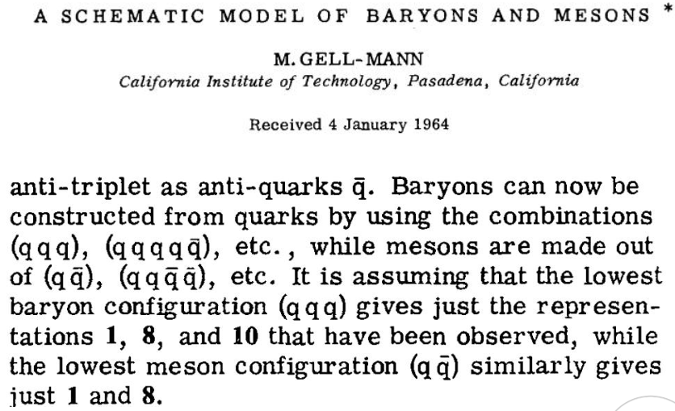
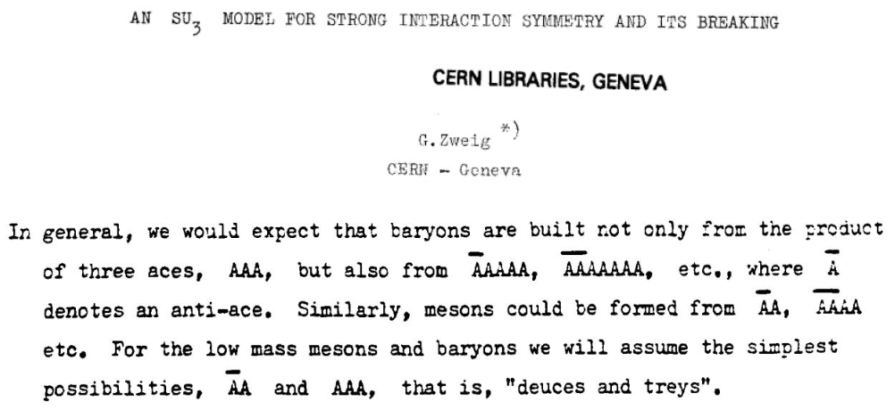
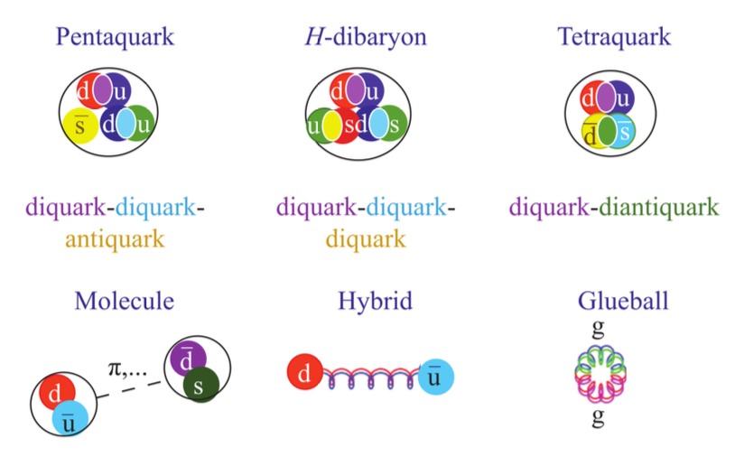
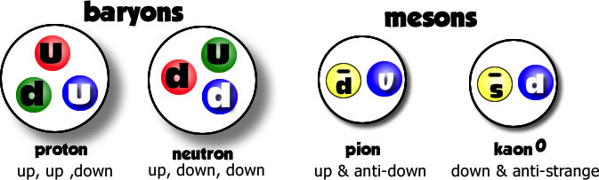
§1. Introduction
Quark model
Exotic States

Slide 4
§2. Formalism
Coupled Channel Unitary Approach：solving Bethe-Salpeter equations, which take on-shell approximation for the loops.
where V matrix (potentials) can be evaluated from the interaction Lagrangians.
D. L. Yao, L. Y. Dai, H. Q. Zheng and Z. Y. Zhou, Rept. Prog. Phys. 84, 076201 (2021)
J. A. Oller and E. Oset, Nucl. Phys. A 620 (1997) 438
E. Oset and A. Ramos, Nucl. Phys. A 635 (1998) 99
J. A. Oller and U. G. Meißner, Phys. Lett. B 500 (2001) 263

Slide 5
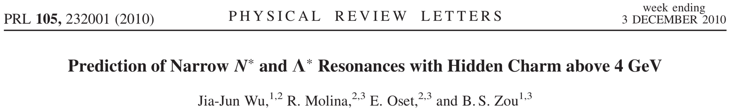
§3. Pentaquark states
(1). Pcs states
J. J. Wu, R. Molina, E. Oset and B. S. Zou, Phys. Rev. Lett. 105 (2010) 232001.
J. J. Wu, R. Molina, E. Oset and B. S. Zou, Phys. Rev. C 84 (2011) 015202.
H. X. Chen, L. S. Geng, W. H. Liang, E. Oset, E. Wang and J. J. Xie, Phys. Rev. C 93 (2016) 065203.
R. Chen, J. He and X. Liu, Chin. Phys. C 41 (2017) 103105.
E. Santopinto and A. Giachino, Phys. Rev. D 96 (2017) 014014.
C. W. Shen, J. J. Wu and B. S. Zou, Phys. Rev. D 100 (2019) 056006.
CWX, J. Nieves and E. Oset, Phys. Lett. B 799 (2019) 135051.
B. Wang, L. Meng and S. L. Zhu, Phys. Rev. D 101 (2020) 034018.
Bing-Song Zou, Sci. Bull 66, 1258 (2021)

Slide 6
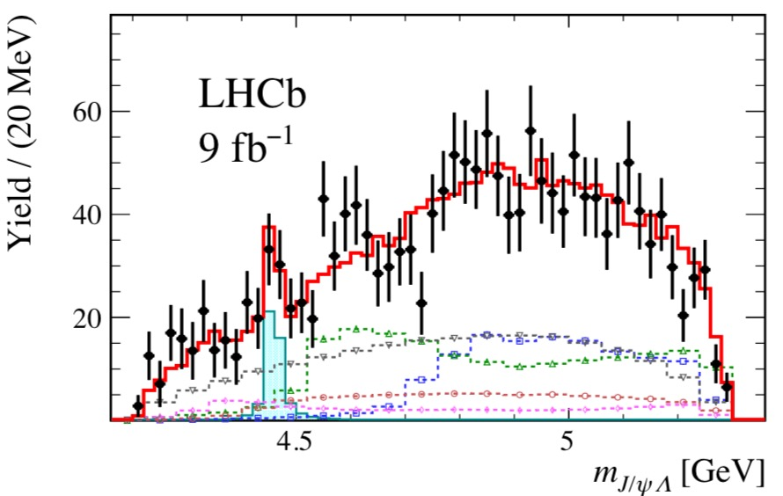

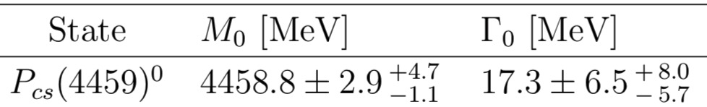
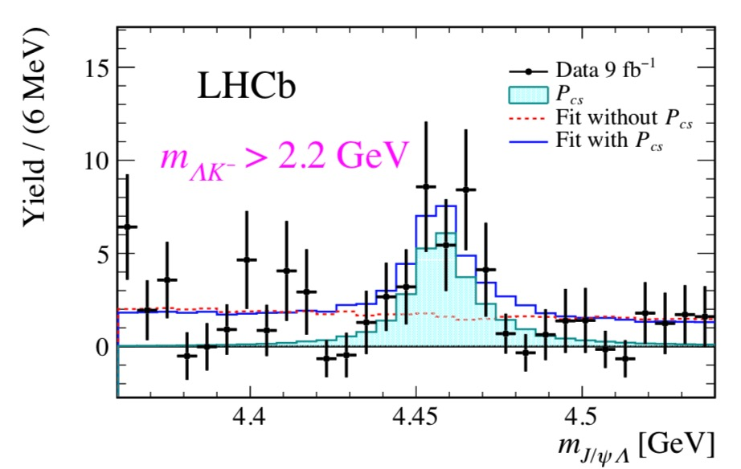
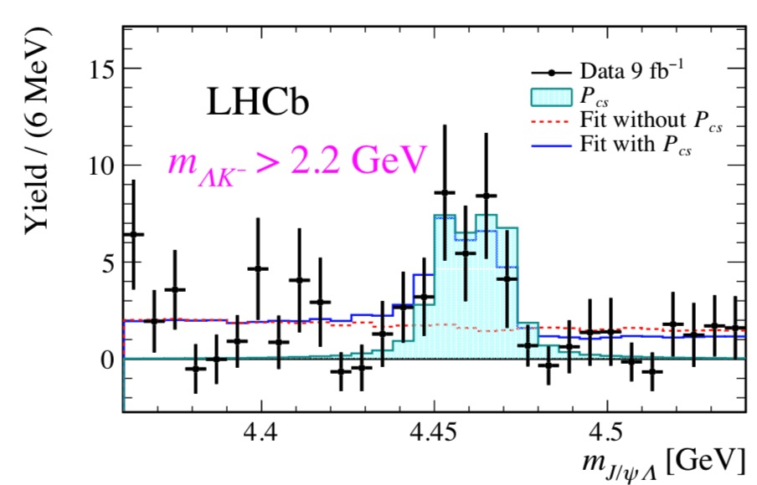

Findings for the Pcs state
H.-X. Chen, L.-S. Geng, W.-H. Liang, E. Oset, E. Wang, J.-J. Xie, Phys. Rev. C 93 (2016) 065203
R. Aaij et al. (LHCb Collaboration), Sci. Bull. 66 (2021) 1278-1287
$$J^{P} ?$$
B. Wang, L. Meng and S. L. Zhu, Phys. Rev. D 101 (2020) 034018.

Slide 7
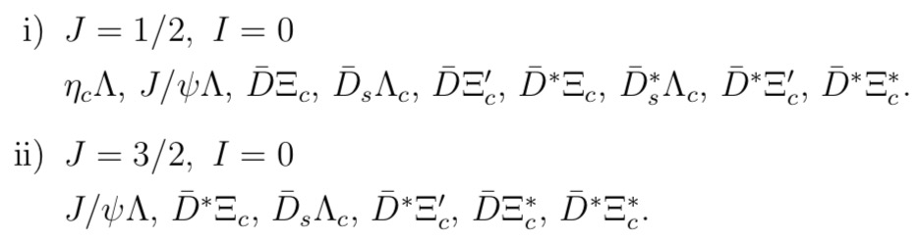

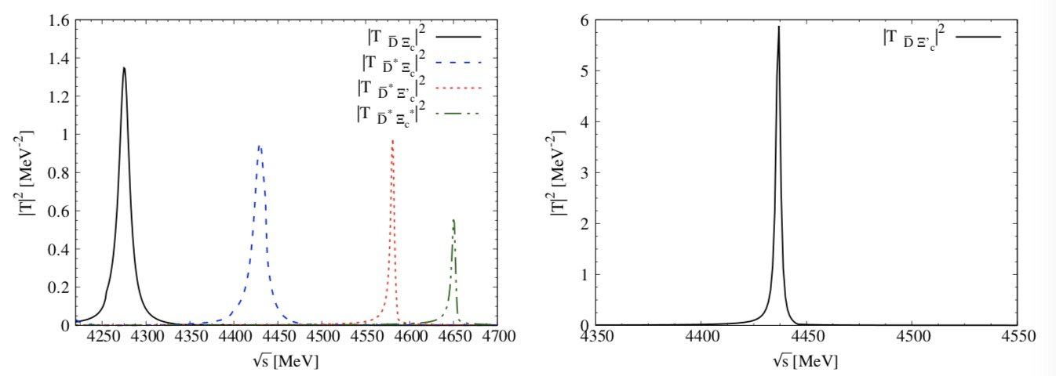
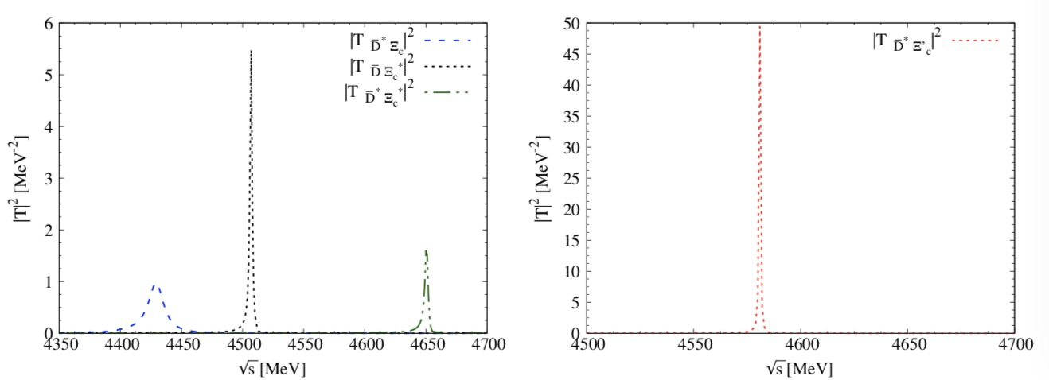
Recalling our prediction for Pcs
HQSS
CWX, J. Nieves and E. Oset, Phys. Rev. D 100 (2019) 014021
CWX, J. Nieves and E. Oset, Phys. Lett. B 799 (2019) 135051.

Slide 8


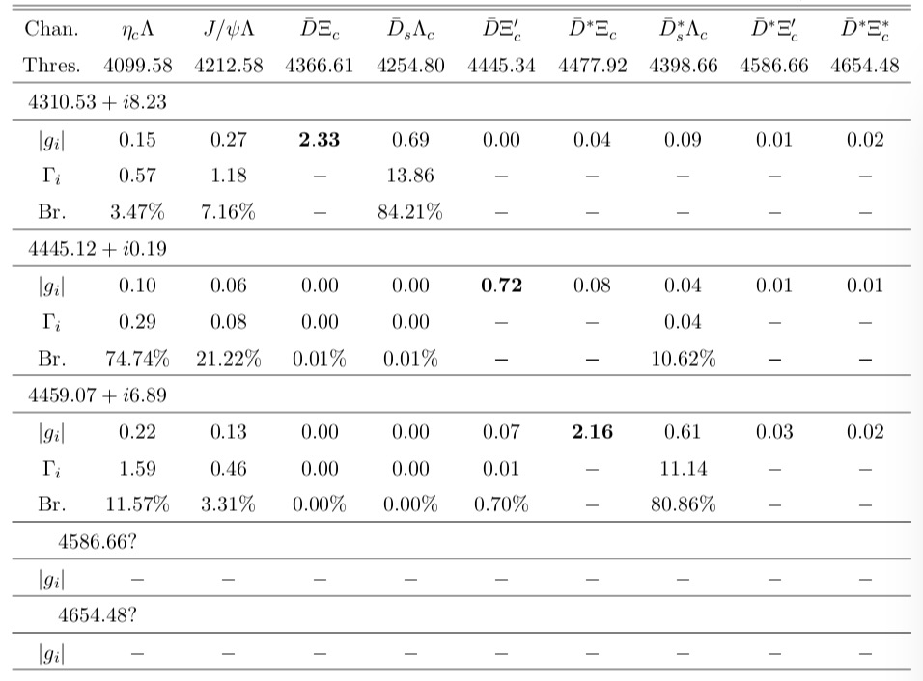




F. L. Wang and X. Liu, Phys. Lett. B 835, 137583 (2022).
X.-W. Wang, Z.-G. Wang, Chin. Phys. C 47 (2023) 013109
L. Meng, B. Wang, S.-L. Zhu, Phys. Rev. D 107 (2023) 014005
J.-T. Zhu, S.-Y. Kong, J. He, Phys. Rev. D 107 (2023) 3, 034029
H.-X. Chen, W. Chen, X. Liu, X.-H. Liu, Eur. Phys. J. C 81 (2021) 409
K. Azizi, Y. Sarac, H. Sundu, Phys. Rev. D 103 (2021) 094033
F.-Z. Peng, M.-J. Yan, M. Sánchez Sánchez, M.P. Valderrama, Eur. Phys. J. C 81 (2021) 666
R. Chen, Phys. Rev. D 103 (2021) 054007
M.-Z. Liu, Y.-W. Pan, L.-S. Geng, Phys. Rev. D 103 (2021) 034003
W.-Y. Liu, W. Hao, G.-Y. Wang, Y.-Y. Wang, E. Wang, D.-M. Li, Phys. Rev. D 103 (2021) 034019

Slide 9


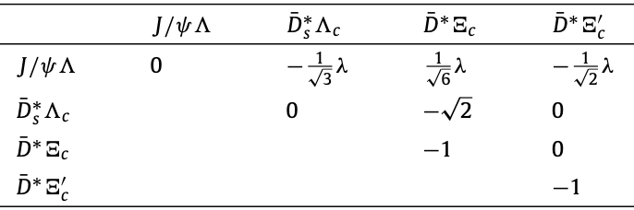

CWX, J. J. Wu and B. S. Zou, Phys. Rev. D 103 (2021) 054016.

Slide 10
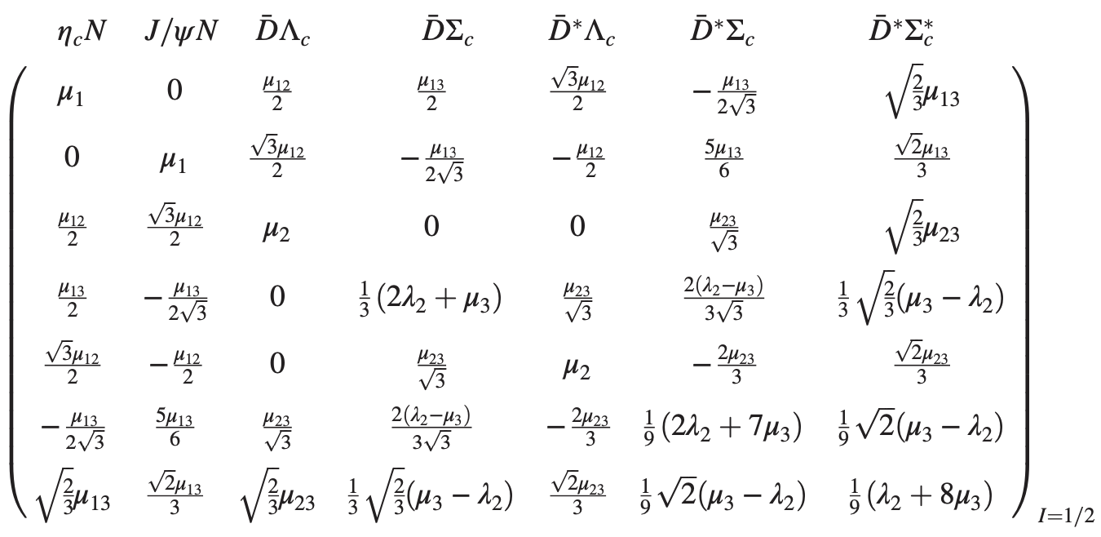
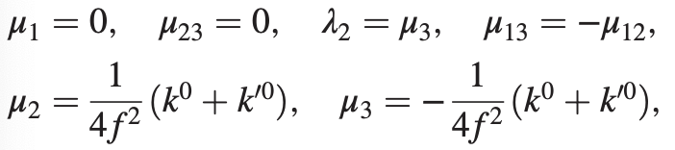
Noting the results for Pc
CWX, J. Nieves and E. Oset, Phys. Rev. D 100 (2019) 014021

Slide 11

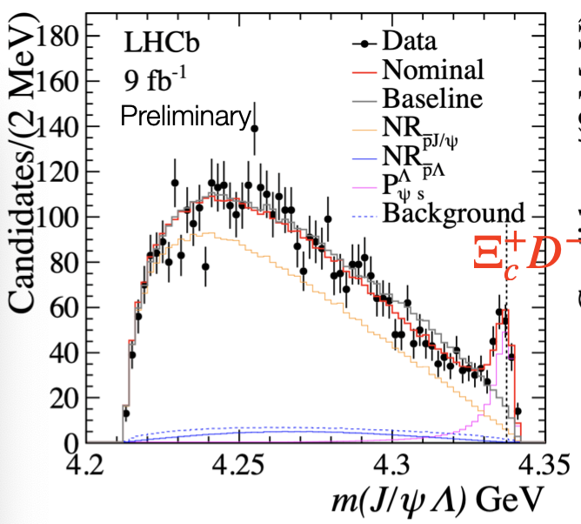
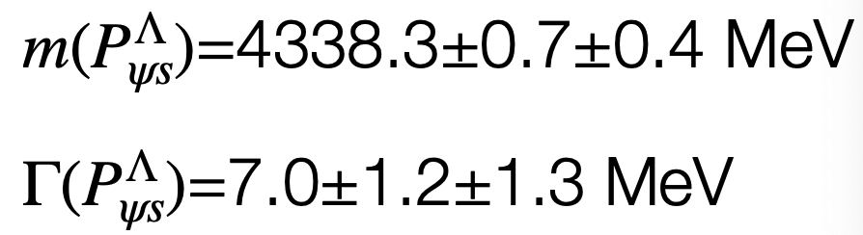

LHCb, Phys. Rev. Lett. 131, 031901 (2023)

Slide 12
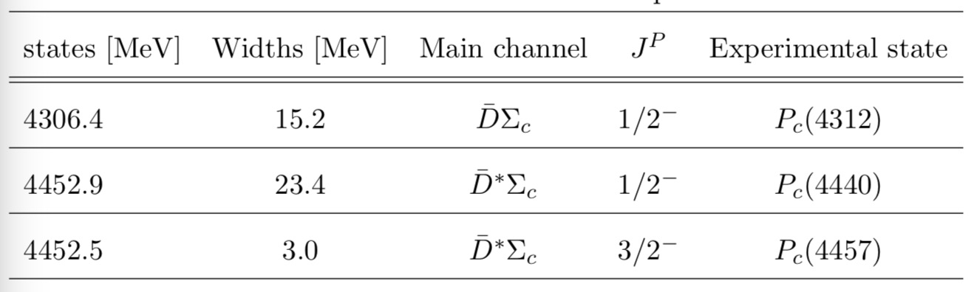
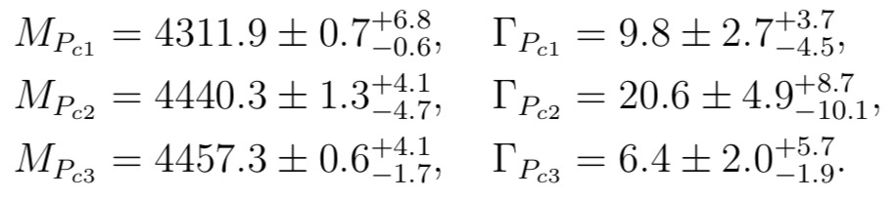
Recalling the results in Pc states
CWX, J. Nieves and E. Oset, Phys. Rev. D 100 (2019) 014021
M. Z. Liu, Y. W. Pan, F. Z. Peng, M. S. Sanchez, L. S. Geng, A. Hosaka, and M. P. Valderrama, Phys. Rev. Lett. 122 (2019) 242001
R. Chen, Z. F. Sun, X. Liu, and S. L. Zhu, Phys. Rev. D 100, 011502 (2019)
H. X. Chen, W. Chen, and S. L. Zhu, Phys. Rev. D 100, 051501 (2019)
J. He, Eur. Phys. J. C 79, 393 (2019)
C. J. Xiao, Y. Huang, Y. B. Dong, L. S. Geng, and D. Y. Chen, Phys. Rev. D 100, 014022 (2019)
Z. H. Guo and J. A. Oller, Phys. Lett. B 793, 144 (2019)

Slide 13
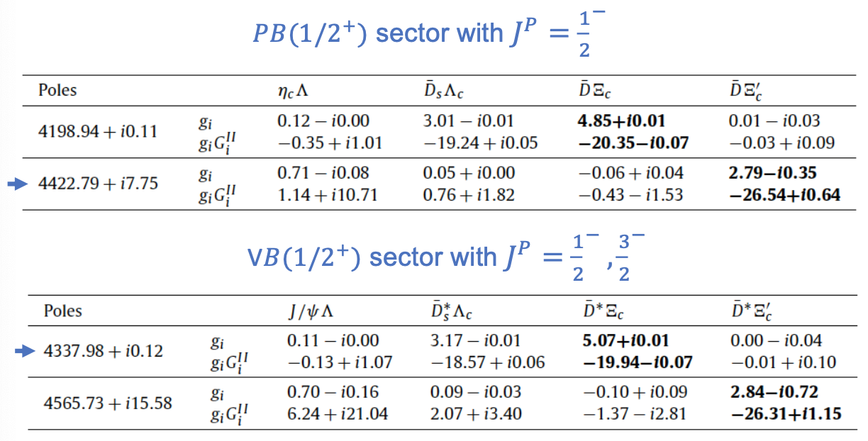
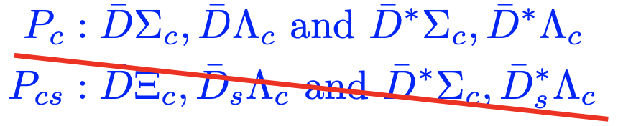
Recent investigation
A. Feijoo, W. F. Wang, CWX, J. J. Wu, E. Oset, J. Nieves, B. S. Zou, Phys. Lett. B 839 (2023) 137760

Slide 14
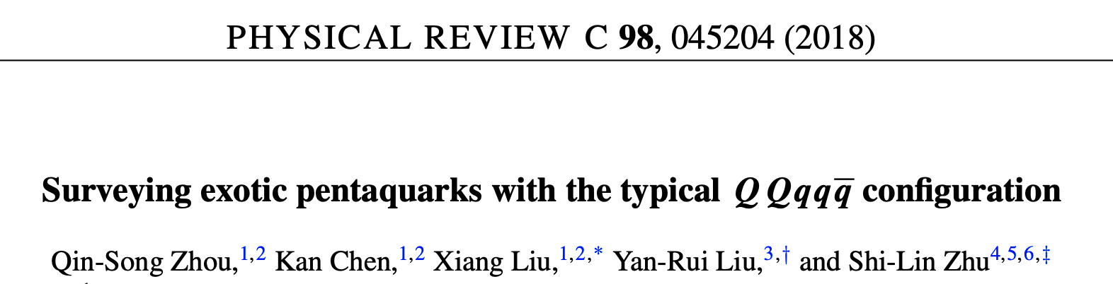
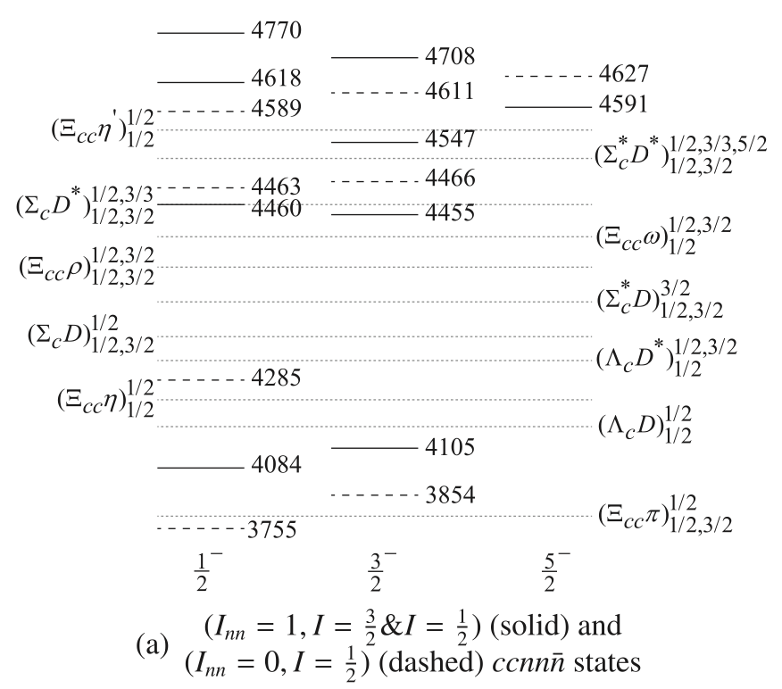
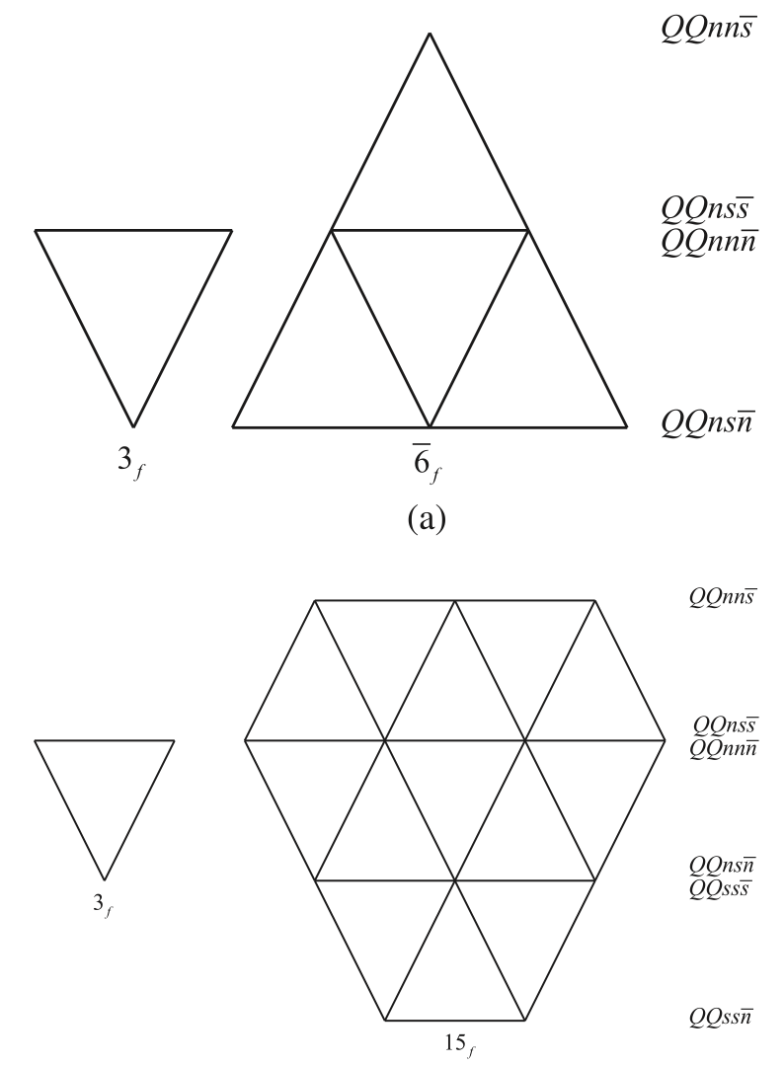
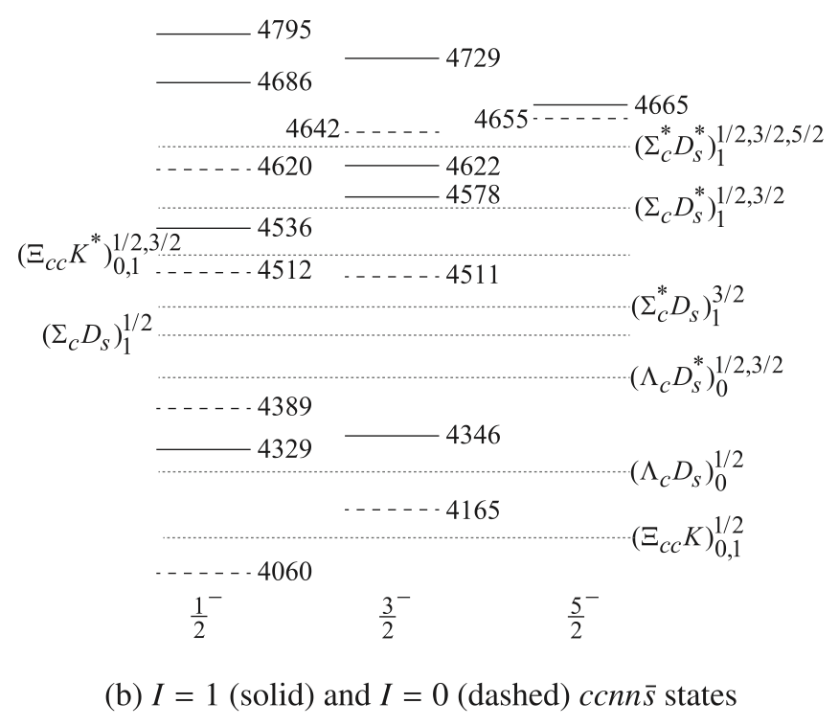
(2). Double-heavy states

Slide 15
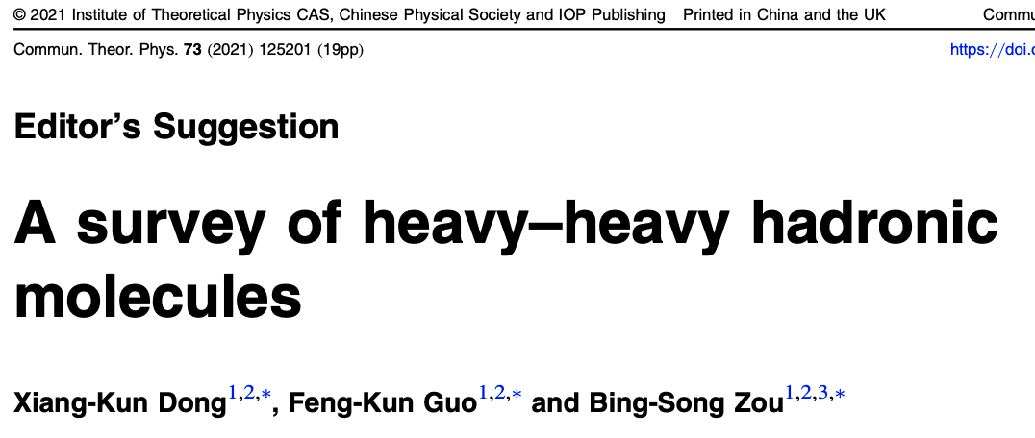
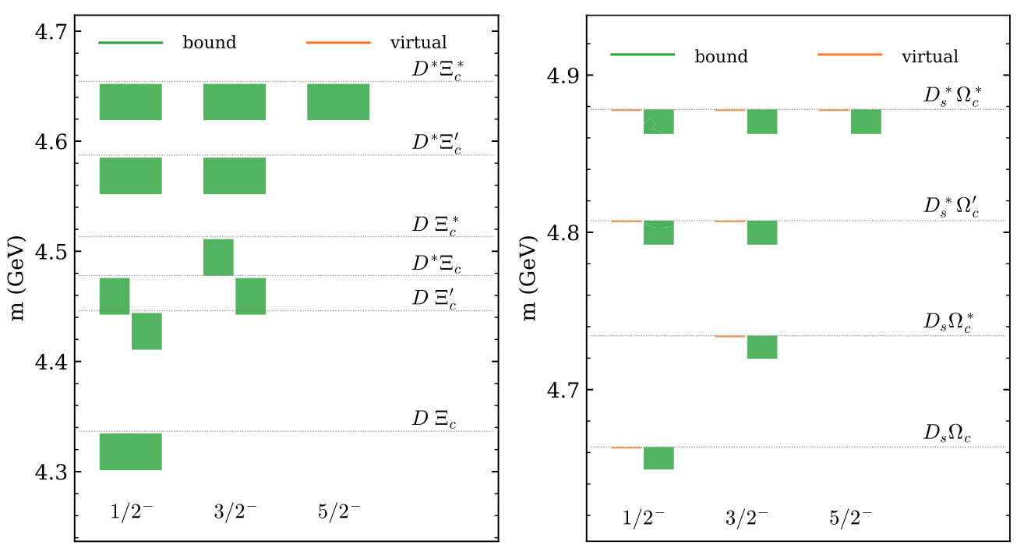

Slide 16
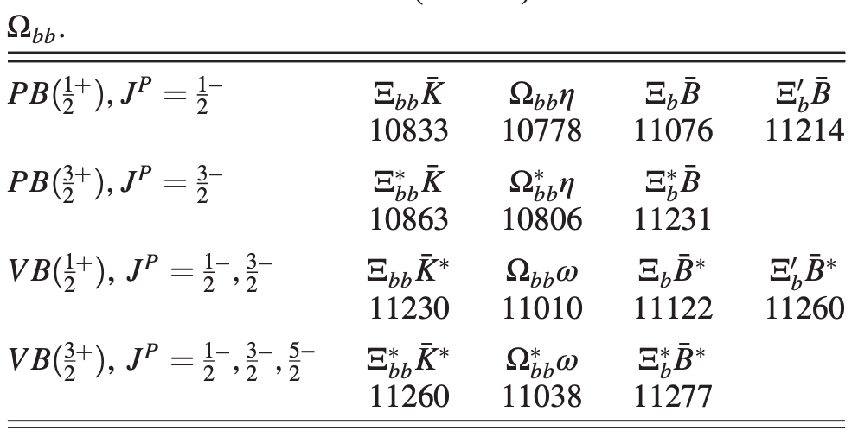
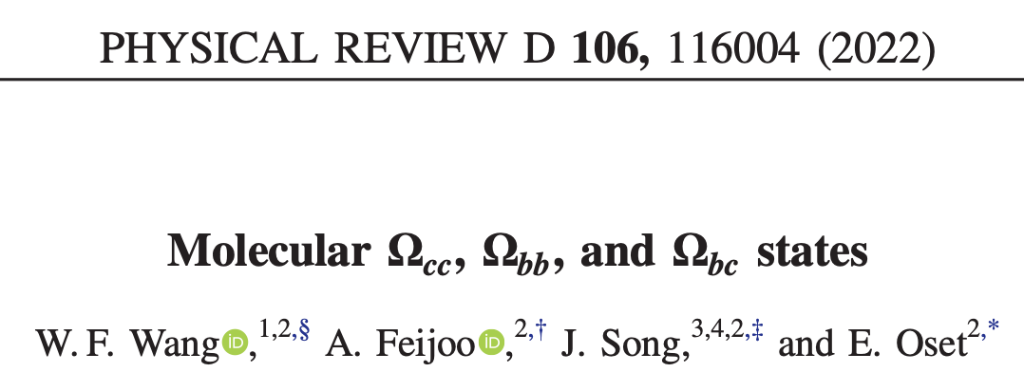
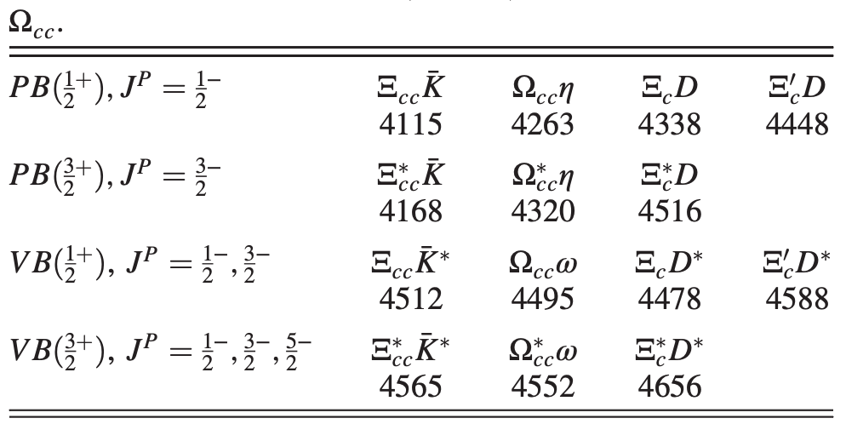
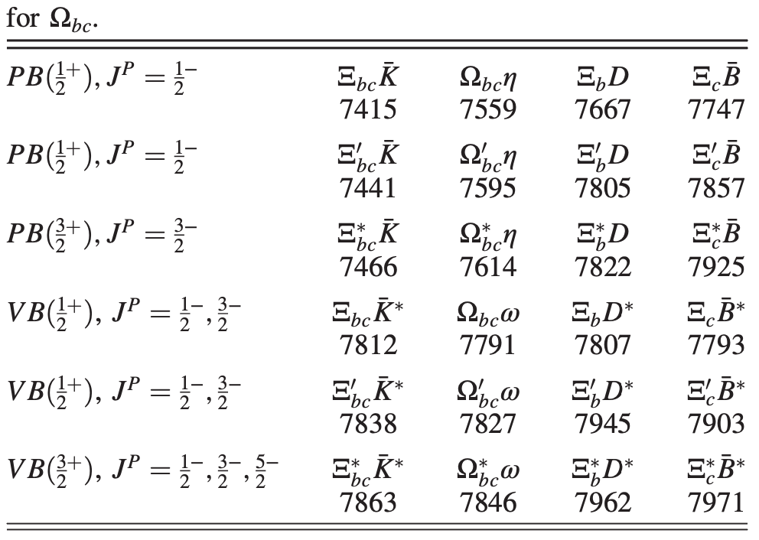

Slide 17
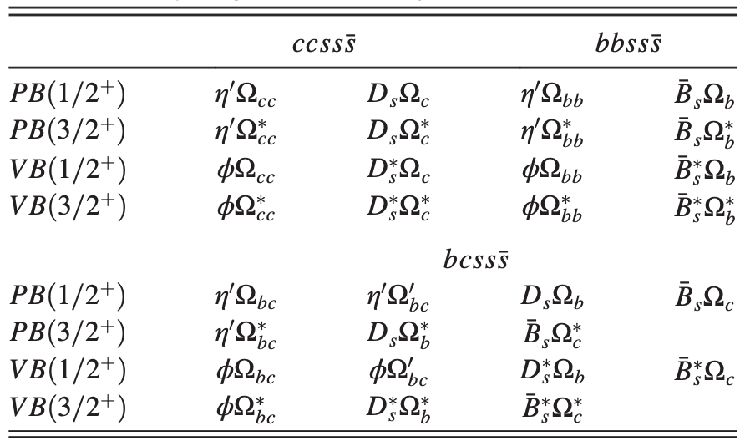
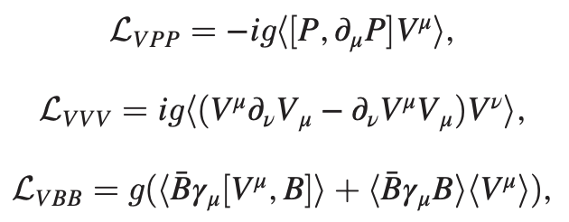
We focus on the systems with strangeness(es)
Z. Y. Wang, CWX, Z. F. Sun and X. Liu, Phys. Rev. D 109, 034038 (2024)

Slide 18
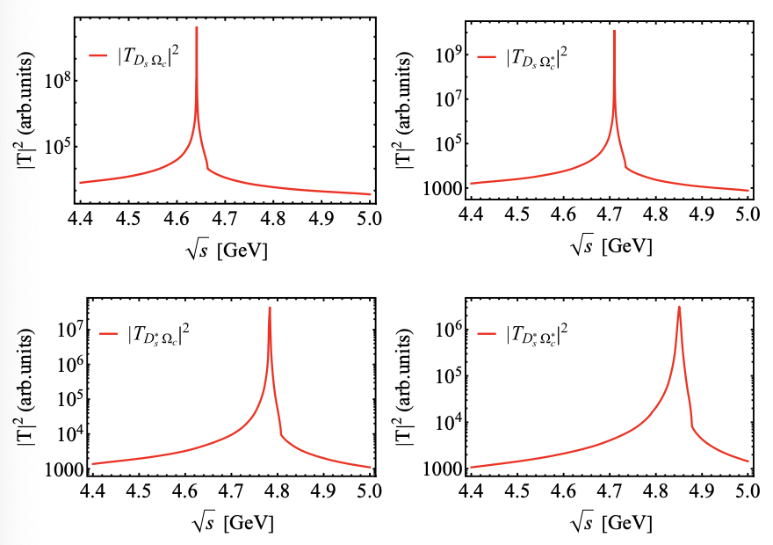

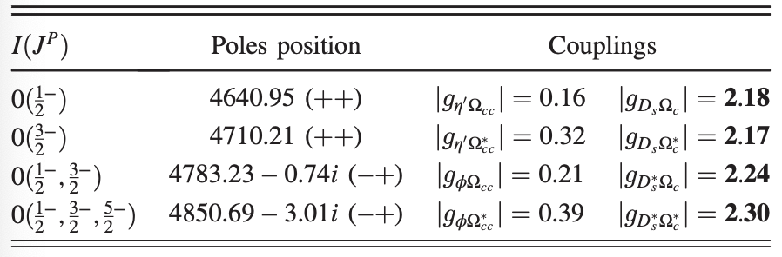

Slide 19
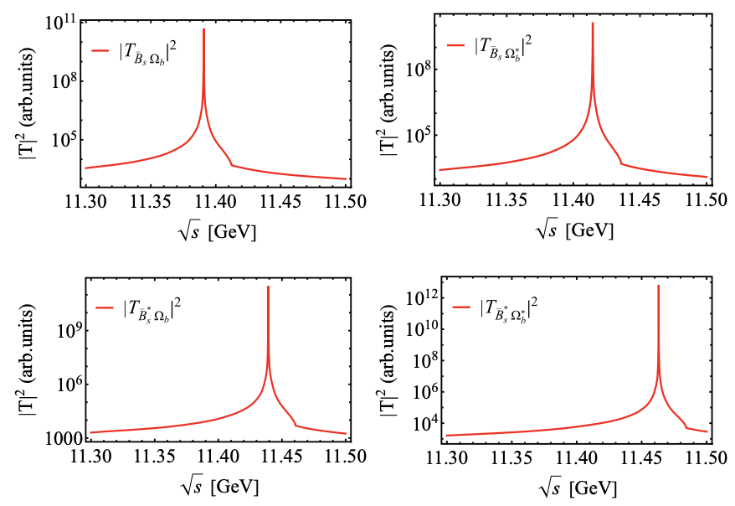

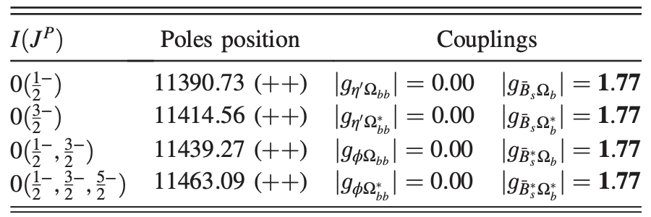

Slide 20
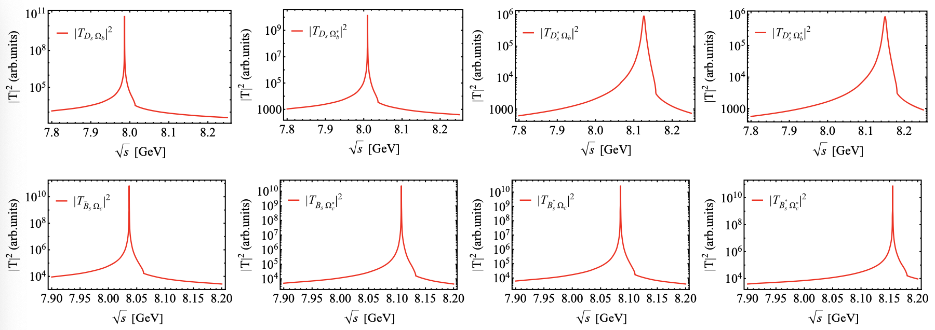

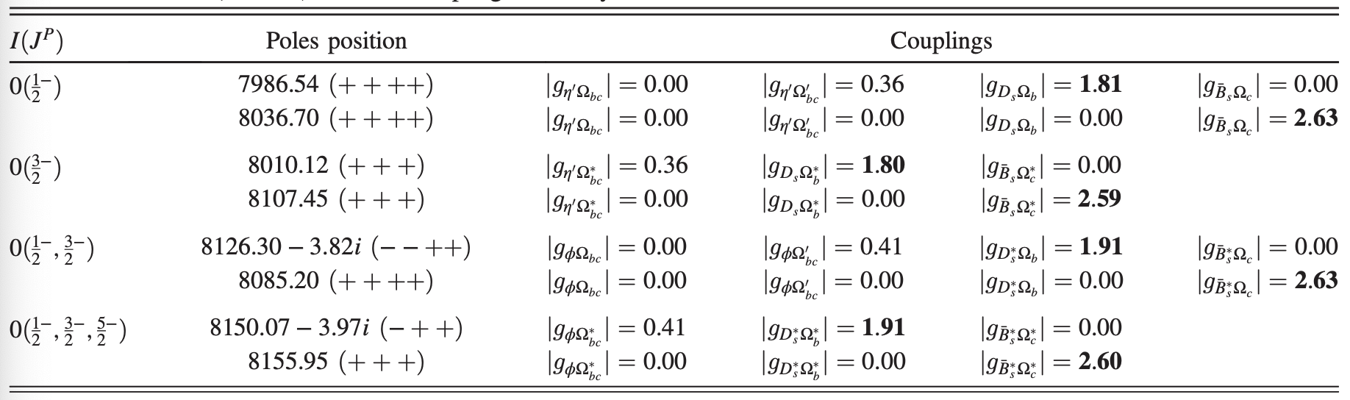

Slide 21
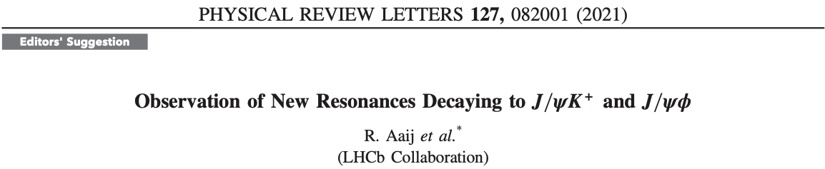
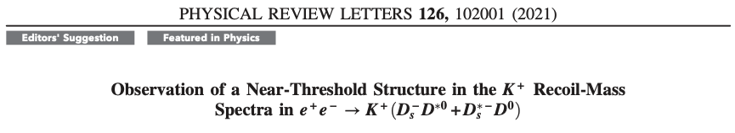
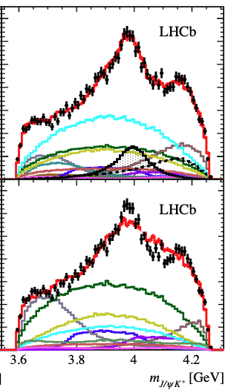
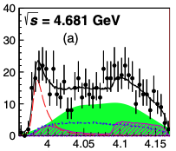
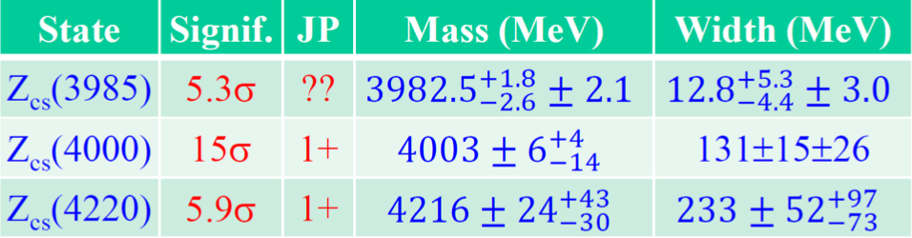
§4. Tetraquark states
BESIII Collaboration

Slide 22
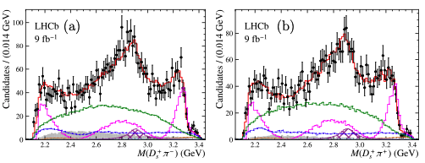
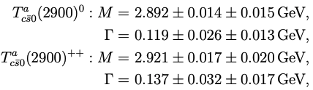
R. Aaij et al. [LHCb], Phys. Rev. Lett. 131 (2023) 4, 041902

Slide 23
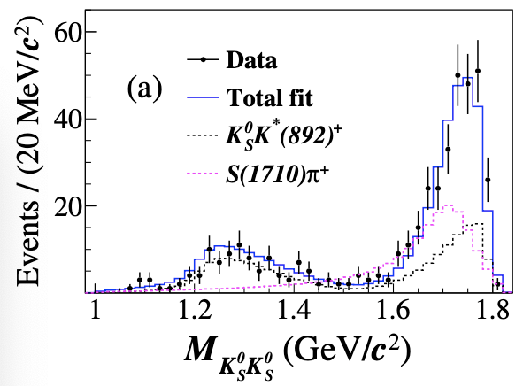
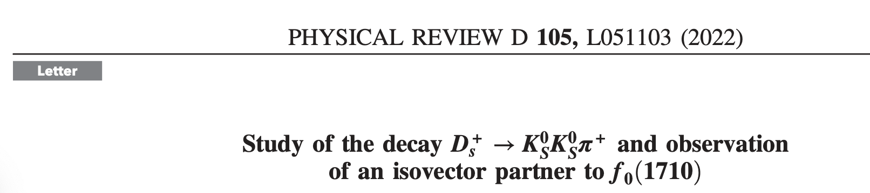
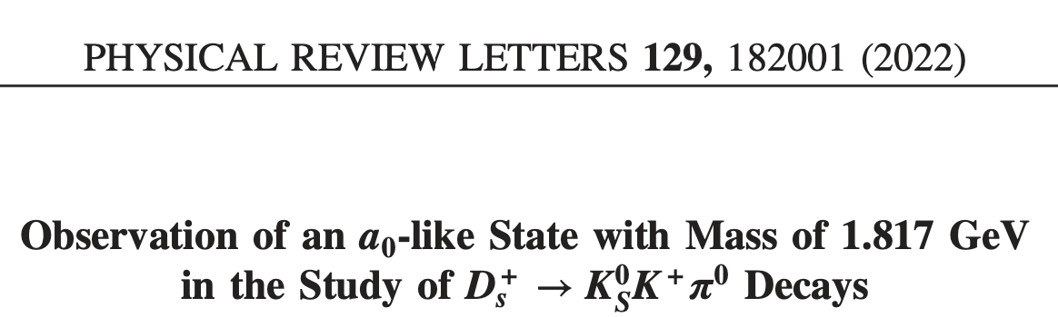

Recent Findings from BESIII

Slide 24




Progr. Phys. 41 (2021) 65
C = 0 sector

Slide 25




Molecular nature
F.-K. Guo, C. Hanhart, U.-G. Meißner, Q. Wang, Q. Zhao and B.-S. Zou, Rev. Mod. Phys. 90, 015004 (2018)
H.-X. Chen, W. Chen, X. Liu and S.-L. Zhu, Phys. Rept. 639, 1 (2016)
N. Brambilla, S. Eidelman, C. Hanhart, A. Nefediev, C. P. Shen, C. E. Thomas, A. Vairo and C. Z. Yuan, Phys. Rept. 873, 1 (2020)
f₀ (1710) and a₀(1710) states
L. S. Geng and E. Oset, Phys. Rev. D 79, 074009 (2009): Coupled channel approach
$K^{∗}{\overline{K}}^{∗}$ molecular state
$K\overline{K}$ molecular state
S = 0 sector
S ≠ 0 sector ？

Slide 26






We try to investigate……

Slide 27











Slide 28






Slide 29




Slide 30


Singularity condition:

Slide 31




Spin projection

Slide 32


Slide 33


CWX, J. J. Wu, arXiv: 2406.08313

Slide 34





Theoretical study on Zcs states

Slide 35





Slide 36

§5. Summary
Are there also existing two Pcs states
From the view of molecular state, what components are for
We dynamically generate the resonances:
We find some attractive interactions, which would be more molecular (tetraquark) states with strangeness as our predictions?
$$?$$
Hope future experiments and theories bring more clarifications on these issues…….

Slide 37
Thanks for your attention!
感谢大家的聆听！

