Slide 1
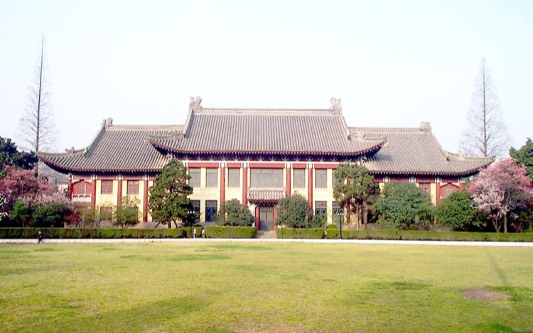


全重四夸克态的系统研究
Hongxia Huang (黄虹霞)
Collaborate with Yuheng Wu（吴雨衡），Xin Jin(金鑫) and Jialun Ping（平加伦）
Nanjing Normal University
第二届强子物理新发展研讨会 暨 强子物理在线论坛100期特别活动
中国科学技术大学 2024年6月30日~7月4日

Slide 2
I.
Introduction
II.
Quark models
III.
Fully heavy tetraquarks
IV.
Fully heavy pentaquarks and dibaryons
Outline
V.
Summary
正德厚生笃学敏行
NANJING NORMAL UNIVERSITY

Slide 3
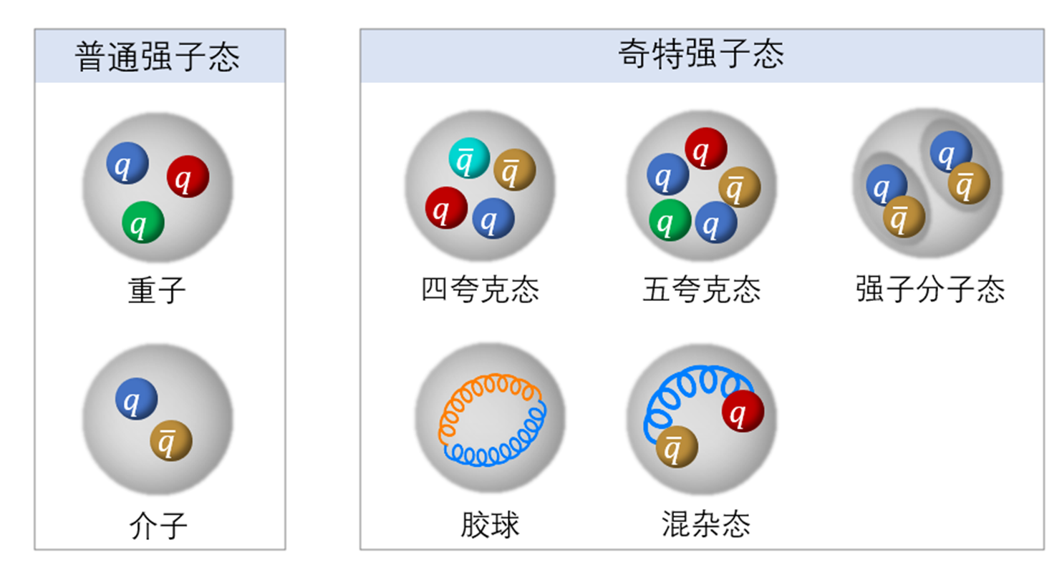
I. Introduction
Hadrons: conventional & exotic
正德厚生笃学敏行
NANJING NORMAL UNIVERSITY

Slide 4
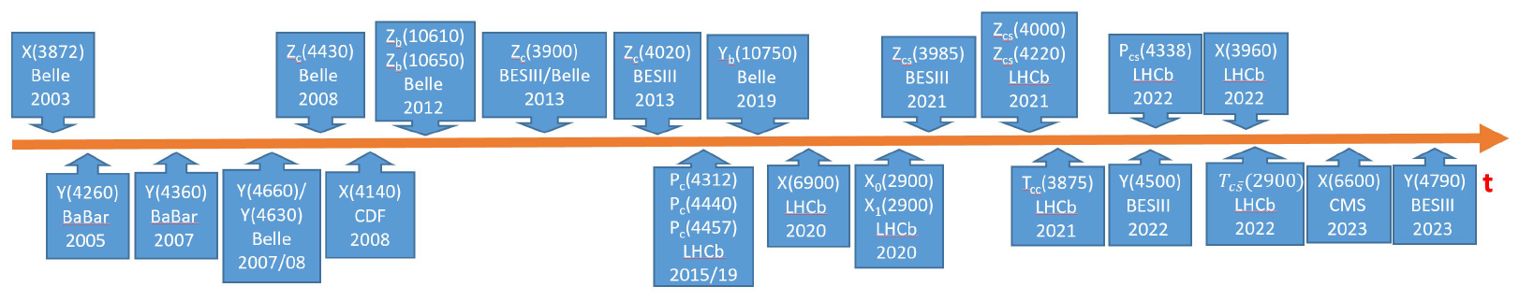
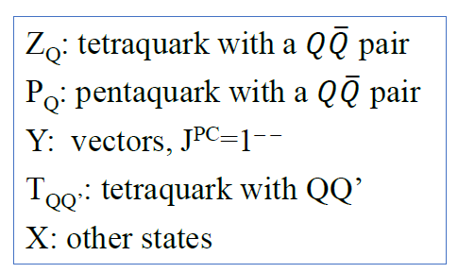
Lots of states with heavy quarks (c, b) and exotic properties were observed since the discovery of the X(3872) in 2003!
They are candidates of hadronic molecules, hybrids, and multiquark states.
These states provide us with an ideal platform to
deepen our understanding of the non-perturbative QCD.
From C.Z.Yuan’s slide
正德厚生笃学敏行
NANJING NORMAL UNIVERSITY

Slide 5
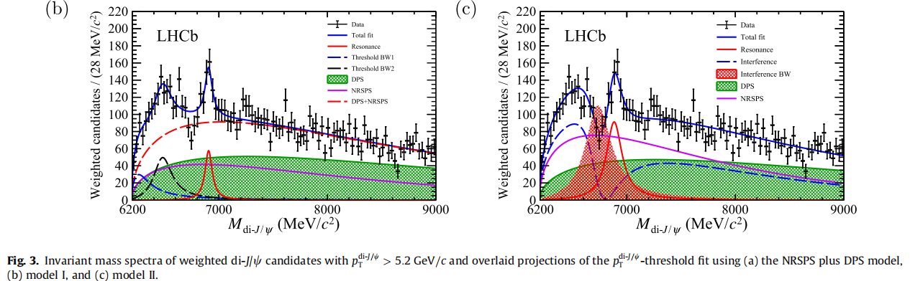

Experimental results
LHCb
σ
Sci. Bull. 65, no.23,1983-1993(2020).
正德厚生笃学敏行
NANJING NORMAL UNIVERSITY

Slide 6
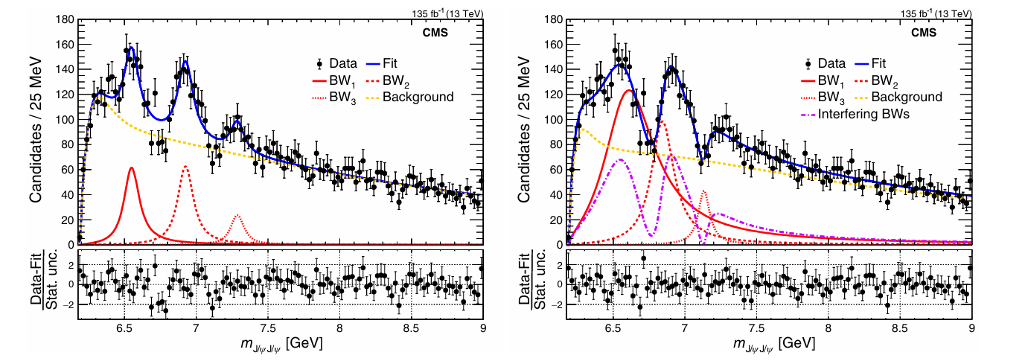
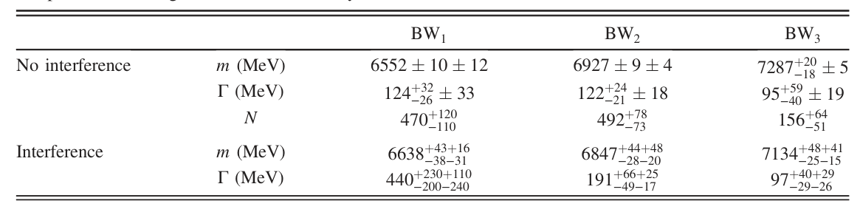
CMS
X(6600)
X(6900)
X(7100)
Phys. Rev. Lett. 132, no.11, 111901 (2024)
正德厚生笃学敏行
NANJING NORMAL UNIVERSITY

Slide 7
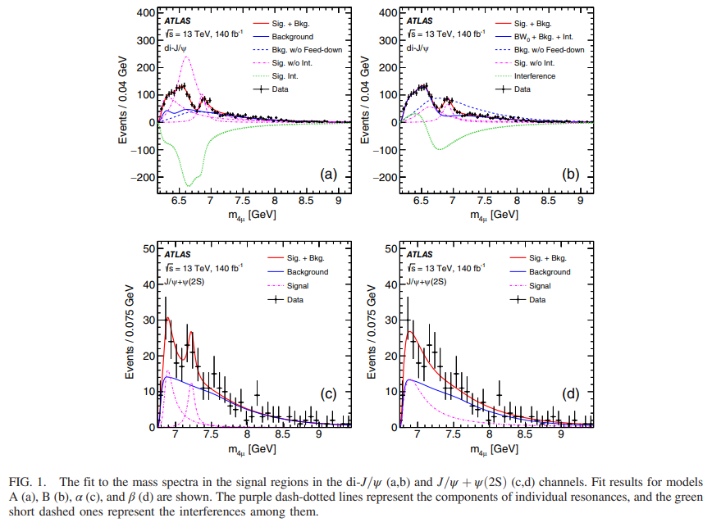
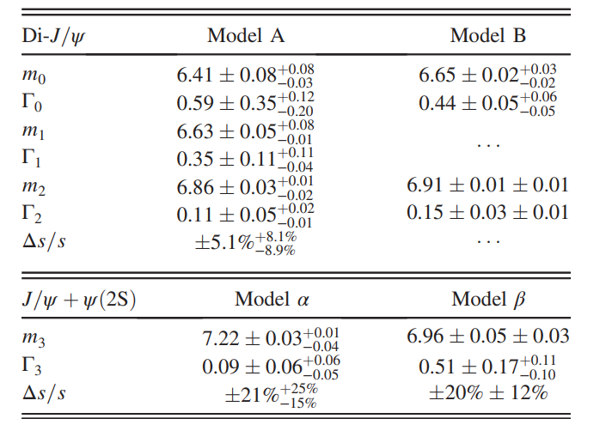
ATLAS
Phys. Rev. Lett. 131, no.15, 151902 (2023).
正德厚生笃学敏行
NANJING NORMAL UNIVERSITY

Slide 8
Triggered questions
How to explain these resonance states?
What is the structure of these states?
What is the quantum number?
Are there any other fully heavy tetraquark states?
正德厚生笃学敏行
NANJING NORMAL UNIVERSITY

Slide 9
Theoretical studies
Before LHCb’s results
1) Possible to exist
Y. Iwasaki, Prog. Theor. Phys. 54, 492 (1975)
K.T. Chao, Z. Phys. C 7, 317 (1981)
L. Heller, J.A. Tjon, Phys. Rev. D 32, 755 (1985)
R.J. Lloyd, J.P. Vary, Phys. Rev. D 70, 014009 (2004)
A.V. Berezhnoy, A.V. Luchinsky, A.A. Novoselov, Phys. Rev. D 86, 034004 (2012)
V.R. Debastiani, F.S. Navarra, Chin. Phys. C 43(1), 013105 (2019)
Y. Bai, S. Lu, J. Osborne, Phys. Lett. B 798, 134930 (2019)
A. Esposito, A.D. Polosa, Eur. Phys. J. C 78(9), 782 (2018)
W. Chen, H.X. Chen, X. Liu, T.G. Steele, S.L. Zhu, Phys. Lett. B 773, 247 (2017)
……
正德厚生笃学敏行
NANJING NORMAL UNIVERSITY

Slide 10
2) Disapprove the existence of the fully heavy tetraquark states
J. Wu, Y.R. Liu, K. Chen, X. Liu, S.L. Zhu, Phys. Rev. D 97(9), 094015 (2018)
M. Karliner, S. Nussinov, J.L. Rosner, Phys. Rev. D 95(3), 034011 (2017)
C. Hughes, E. Eichten, C.T.H. Davies, Phys. Rev. D 97(5), 054505 (2018)
J.M. Richard, A. Valcarce, J. Vijande, Phys. Rev. D 95(5), 054019 (2017)
M.S. Liu, Q. F. L, X. H., Q. ZhaoZhong, Phys. Rev. D 100, (1), 016006 (2019)
G.J.Wang, L. Meng, S.L. Zhu, Phys. Rev. D 100(9), 096013 (2019)
X. Chen, Eur. Phys. J. A 55(7), 106 (2019)
……
正德厚生笃学敏行
NANJING NORMAL UNIVERSITY

Slide 11
After 2020
Q. F. Lü, D. Y. Chen, Y. B. Dong, Eur. Phys. J. C 80, 871 (2020)
P. Lundhammar and T. Ohlsson, Phys. Rev. D 102, 054018 (2020)
J. F. Giron and R. F. Lebed, Phys. Rev. D 102, 074003 (2020)
C. Becchia, J. Ferrettib, A. Giachinoa, L. Maianic, E. Santopintoa, Phys. Lett. B 811, 135952 (2020)
M. S. Liu, F. X. Liu, X. H. Zhong, Q. Zhao, arXiv: 2006.11952
G. Yang, J. L. Ping, L. He and Q. Wang, arXiv: 2006.13756
J. W. Zhu, X. D. Guo, R. Y. Zhang, W. G. Ma and X. Q. Li, arXiv: 2011.07799
Z. G. Wang, Chin. Phys. C 44 (2020) 11, 113106
H. X. Chen, W. Chen, X. Liu and S. L. Zhu, Sci. Bull. 65 (2020) 1994-2000
J. Z. Wang, D. Y. Chen, X. Liu and T. Matsuki, Phys. Rev. D 103 (2021) 7, 071503
M. Karlinera and J. L. Rosnerb , Phys. Rev. D 102 (2020) 11, 114039
X. K. Dong, V. Baru, F. K. Guo, C. Hanhart, and A. Nefediev, Phys. Rev. Lett. 127 (2021) 11, 119901 (erratum), Phys. Rev. Lett. 126 (2021) 13, 132001
J. Zhao, S. Shi and P. Zhuang , Phys. Rev. D 102 (2020) 11, 114001
X. Z. Weng, X. L. Chen, W. Z. Deng and S. L. Zhu, Phys. Rev. D 103 (2021) 3, 034001
正德厚生笃学敏行
NANJING NORMAL UNIVERSITY

Slide 12
J. Z. Wang and X. Liu, Phys.Rev.D 106 (2022) 5, 054015
Z. Kuang, (BLFQ Collaboration), Phys.Rev.D 105 (2022) 9, 094028
Q. N. Wang, Z. Y. Yang and W. Chen, Phys.Rev.D 104 (2021) 11, 114037
A. V. Nefediev, Eur.Phys.J.C 81 (2021) 8, 692
X. K. Dong, V. Baru, F. K. Guo, C. Hanhart, A. Nefediev and B. S. Zou, Sci.Bull. 66 (2021) 24, 2462-2470
A. J. Majarshin, Y. A. Luo, F. Pan and J. Segovia, Phys.Rev.D 105 (2022) 5, 054024
G. J. Wang, L. Meng, M. Oka and S. L. Zhu, Phys.Rev.D 104 (2021) 3, 036016
X. Y. Chen, Universe 7 (2021) 5, 155
H. Mutuk, Eur.Phys.J.C 81 (2021) 4, 367
G. Yang, J. Ping and J. Segovia, Phys.Rev.D 104 (2021) 1, 014006
Y. Huang, F. Feng, Y. Jia, W. L. Sang, D. S. Yang and J. Y. Zhang, Chin.Phys.C 45 (2021) 9, 093101
H. W. Ke, X. Han, X. H. Liu and Y. L. Shi, Eur.Phys.J.C 81 (2021) 5, 427
B. D. Wan and C. F. Qiao, Phys.Lett.B 817 (2021) 136339
R. L. Zhu, Nucl.Phys.B 966 (2021) 115393
J. R. Zhang, Phys.Rev.D 103 (2021) 1, 014018
R. N. Faustov, V. O. Galkin and E. M. Savchenko, Phys.Rev.D 102 (2020) 11, 114030
C. Gong, M. C. Du, Q. Zhao, X. H. Zhong and B. Zhou, Phys. Lett. B 824 (2022), 136794
G. L. Yu, Z. Y. Li, Z. G. Wang, J. Lu and M. Yan, Eur. Phys. J. C 83 (2023), 416
P. G. Ortega, D. R. Entem and F. Fern´andez, Phys. Rev. D 108 (2023), 094023
S. S. Agaev, K. Azizi, B. Barsbay and H. Sundu, Phys. Lett. B 844 (2023), 138089; Nucl. Phys. A 1041 (2024), 122768
……
正德厚生笃学敏行
NANJING NORMAL UNIVERSITY

Slide 13
Tetraquark states
meson-meson (c anti-c)—(c anti-c)
diquark-antidiquark (cc)—(anti-c anti-c)
Hybrid (c c anti-c anti-c g)
Triangle-singularities
CUSP
……
正德厚生笃学敏行
NANJING NORMAL UNIVERSITY

Slide 14
II. Quark Models
(1) Quark delocalization color screening model (QDCSM)
QDCSM was developed by Nanjing-Los Alamos collaboration in1990s aimed to multi-quark study. (PRL 69, 2901, 1992)
Two new ingredients (based on quark cluster model configuration)
quark delocalization (orbital excitation)
color screening (color structure)
Apply to the study of baryon-baryon interaction and dibaryons
deuteron, d*, NN, NΛ, NΩ, …
Apply to the study of baryon-meson interaction and pentaquarks
NK, Npi, Pc, Nφ …
正德厚生笃学敏行
NANJING NORMAL UNIVERSITY

Slide 15
正德厚生笃学敏行
NANJING NORMAL UNIVERSITY

Slide 16

(2) Chrial Quark Model (ChQM)
Provide the intermediate-range attraction by meson-exchange.
Rep. Prog. Phys. 68, 965 (2005)
SU(2) ChQM: only meson-exchange;
SU(3) ChQM: full scalar octet meson-exchange.
PRC 75, 034002 (2007)
正德厚生笃学敏行
NANJING NORMAL UNIVERSITY

Slide 17
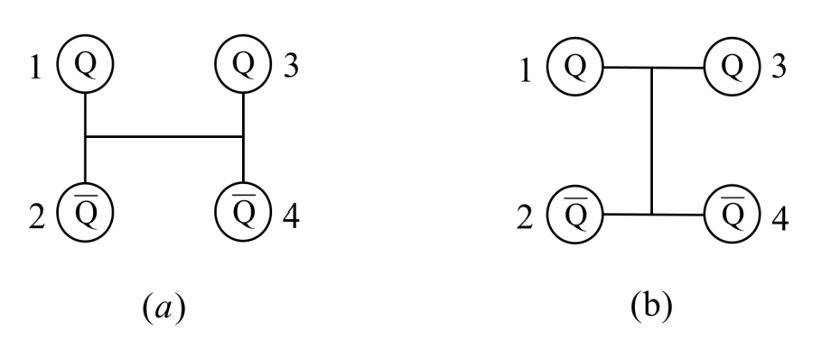
(3) Wave functions
The wave function of the four-quark system
The meson-meson structure
The diquark-antidiquark structure
正德厚生笃学敏行
NANJING NORMAL UNIVERSITY

Slide 18
Flavor wave functions
Spin wave functions
正德厚生笃学敏行
NANJING NORMAL UNIVERSITY

Slide 19
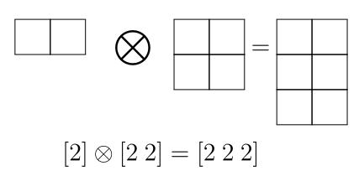
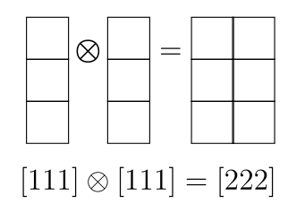
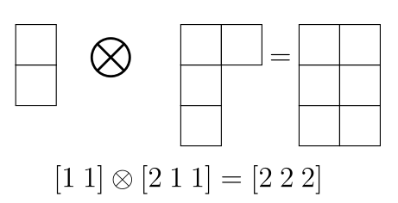
Color wave functions
Meson-meson structure
Diquark-antidiquark structure
正德厚生笃学敏行
NANJING NORMAL UNIVERSITY

Slide 20
III. Fully heavy tetraquarks
Eur. Phys. J. C. 80, 1083 (2020)
1. Fully charm tetraquarks
Bound state calculation
Meson-meson structure
The energies are above the corresponding theoretical threshold in both two models with different sets of parameters.
The channel-coupling effect is very small and cannot help much.
There is no any bound states with the meson-meson structure in both two models.
正德厚生笃学敏行
NANJING NORMAL UNIVERSITY

Slide 21
Diquark-antidiquark structure
The energies of this configuration are higher than that of meson-meson configuration.
The effect of the channel-coupling is also very small in both two models.
Is there any resonance state because of the color structure?
正德厚生笃学敏行
NANJING NORMAL UNIVERSITY

Slide 22
Effective potentials
In ChQM, the minimum potential of each channel (except the first channel of IJ=00) appears at the separation of 0.3 fm, which indicates that two subclusters are not willing to huddle together or fall apart. So each state is possible to be a resonance state.
In QDCSM, the results are similar. The minimum potential of each channel appears at the separation of 0.5 fm. So it is also possible for each channel to be a resonance state in QDCSM.
正德厚生笃学敏行
NANJING NORMAL UNIVERSITY

Slide 23
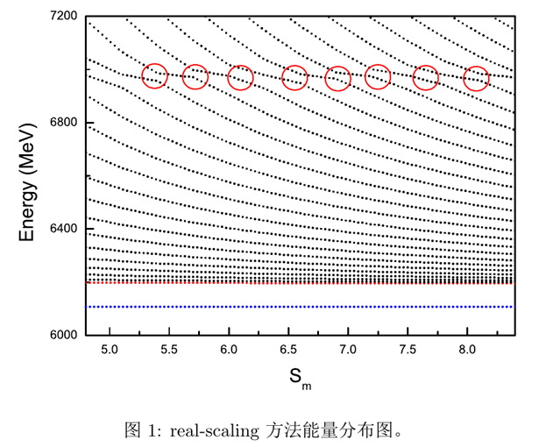
A stabilization method (real scaling method)
J. Simon, J. Chem, Phys. 75, 2465 (1981).
正德厚生笃学敏行
NANJING NORMAL UNIVERSITY

Slide 24
E. Hiyama, A. Hosaka, M. Oka, and J-M. Richard, Phys. Rev. C 98, 045208 (2018)
One resonance at 4690 MeV
正德厚生笃学敏行
NANJING NORMAL UNIVERSITY

Slide 25
The repeated occurrence of such avoid-crossing structures suggests the possibility of resonance states occurring.
正德厚生笃学敏行
NANJING NORMAL UNIVERSITY

Slide 26
正德厚生笃学敏行
NANJING NORMAL UNIVERSITY

Slide 27
Energy Decay width Decay channels
IJ^P=00^+: 6205–6270 MeV 13.2–22.3 MeV ηcηc, J/ψJ/ψ
6825–6975 MeV 54.5–61.3 MeV
7140–7170 MeV 27.6–40.7 MeV
7210–7260 MeV 64.7–87.1 MeV
IJ^P=01^+: 6740 ~ 7150 MeV 257.3–285.5 MeV ηcJ/ψ
7250 ~ 7280 MeV 55.3–87.8 MeV
IJ^P=02^+: 6725 ~ 7050 MeV 202.1–296.2 MeV J/ψJ/ψ
X(6900) J^P=0^+
X(7100) J^P=0^+
X(7200) J^P =0^+
X(6600) J^P =2^+ ?
X(6200)
Structure: compact resonance states
正德厚生笃学敏行
NANJING NORMAL UNIVERSITY

Slide 28
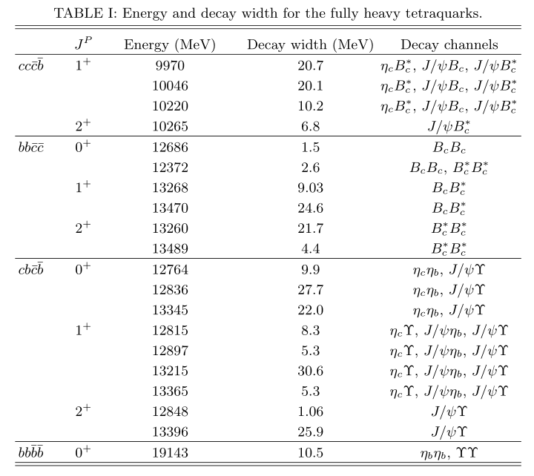
2. Other fully heavy tetraquarks
Energy and decay width
正德厚生笃学敏行
NANJING NORMAL UNIVERSITY

Slide 29
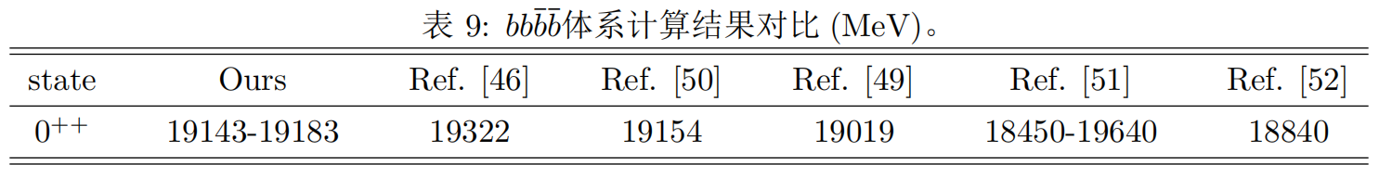
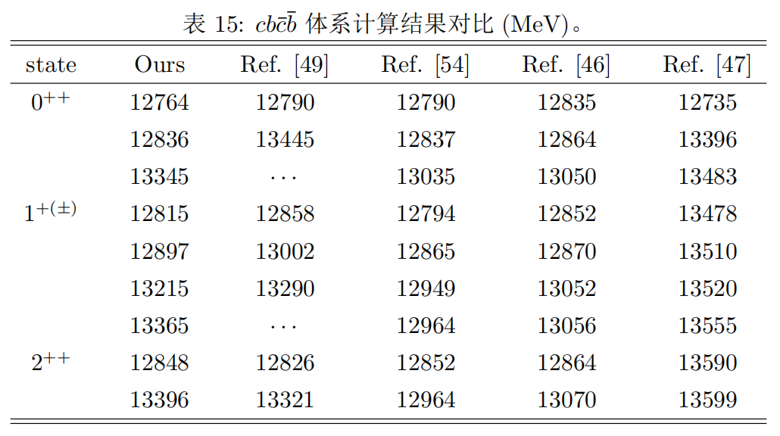
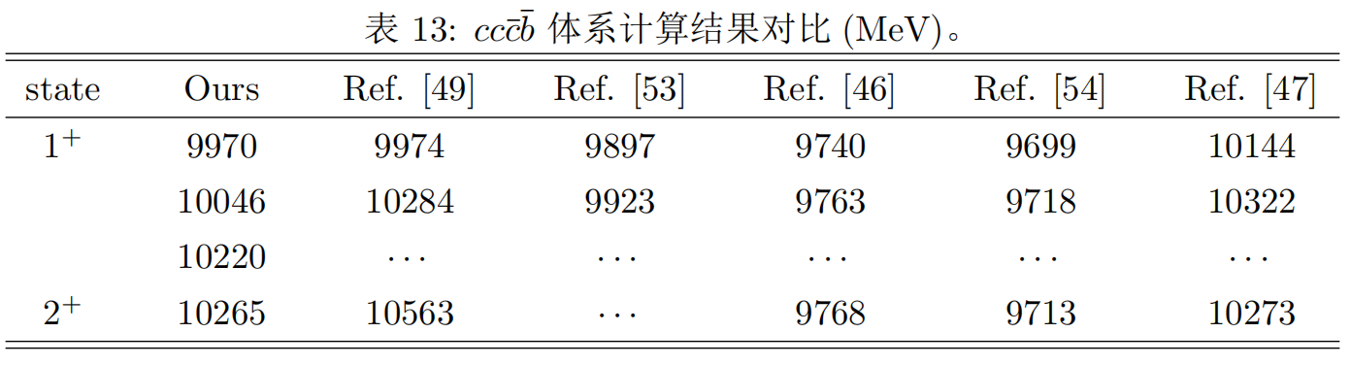
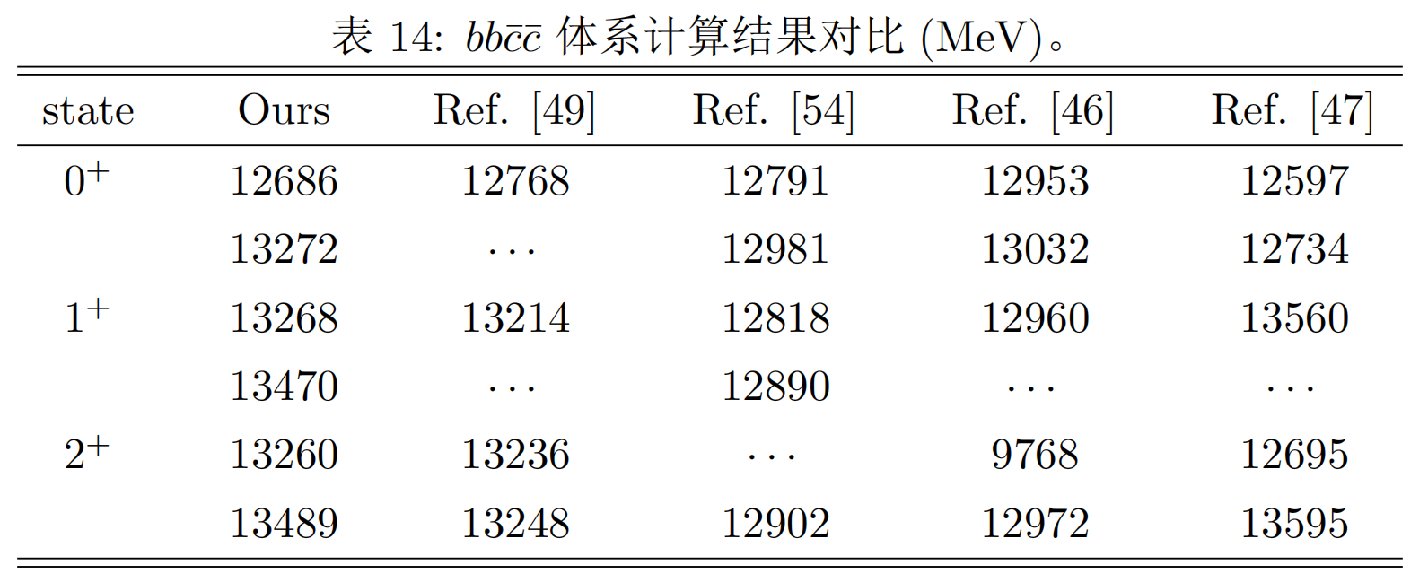
Comparison with other work
[46] PRD 100, no.1, 016006 (2019). A potential model
[49] PRD 104, no.1, 014006 (2021). Lattice-QCD insipired quark model
[50] PRD 102, no.11, 114001 (2020). Four-body Schrödinger equation
[51] PLB 773, 247 (2017). QCD sum rules
[52] EPJC 77, 432 (2017). QCD sum rules
正德厚生笃学敏行
NANJING NORMAL UNIVERSITY

Slide 30
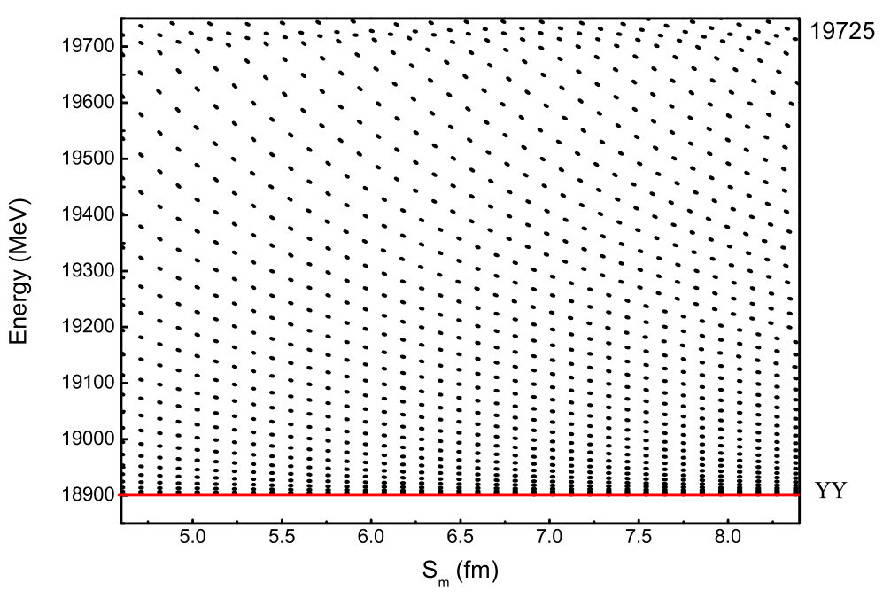
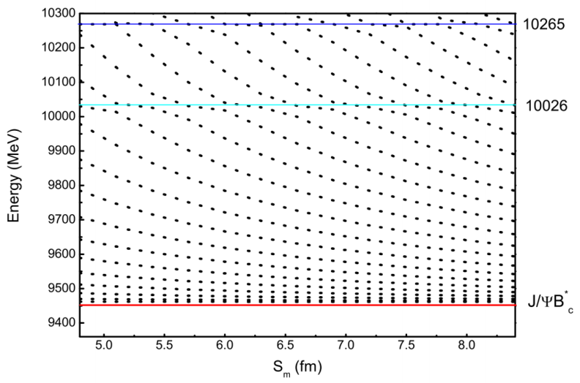
J^{P} = 2⁺
J^{P} = 2⁺
The proportion of the 19725 MeV molecular state is about 70%, and due to the lack of its resonance mechanism, we consider it as a false resonance state.
The molecular state of the resonance signal at an energy of 10026 MeV accounts for 85%, which may be a false resonance state.
正德厚生笃学敏行
NANJING NORMAL UNIVERSITY

Slide 31
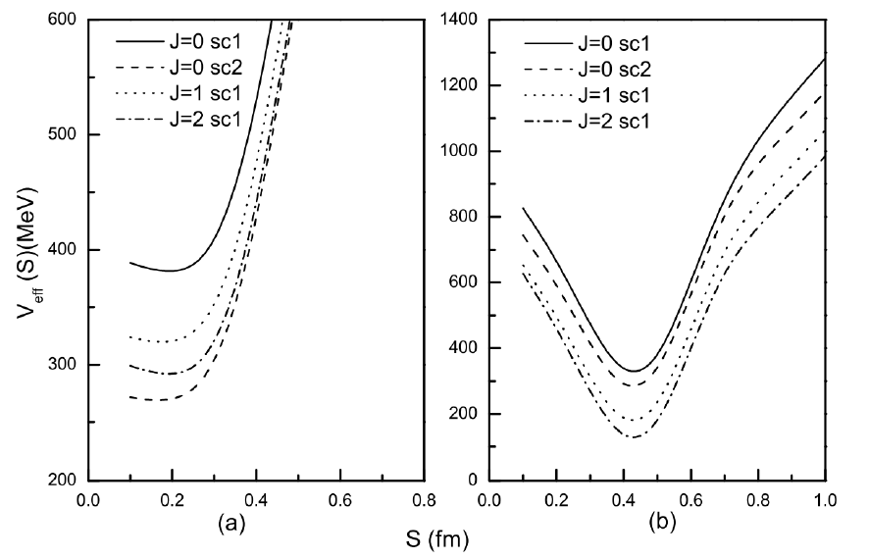
Comparison of interactions between fully bottom and fully charm systems
The effective potential of the fully bottom system is shallow, while the effective potential of the fully charm system is much deeper.
The fully charm system with diquark-antidiquark structure is more likely to exist stably, thereby forming a stable resonant state.
The fully bottom system with diquark-antidiquark structure , due to its shallow potential well, is not easily stable or has an extremely short existence time, and is more likely to directly decay into two mesons.
Therefore, there should be a more stable resonant state in the fully charm system than in the fully bottom system.
正德厚生笃学敏行
NANJING NORMAL UNIVERSITY

Slide 32

IV. Fully heavy pentaquarks and dibaryons
1. Heavy-Antiquark-Diquark Symmetry (HADS)
Phys.Lett. B248 (1990) 177-180
Phys.Rev. D73 (2006) 054003
Heavy diquark behaves as a heavy anti-quark from color freedom
Phys. Rev. D 98, 114030 (2018).
???
From M. Liu’s slide
正德厚生笃学敏行
NANJING NORMAL UNIVERSITY

Slide 33
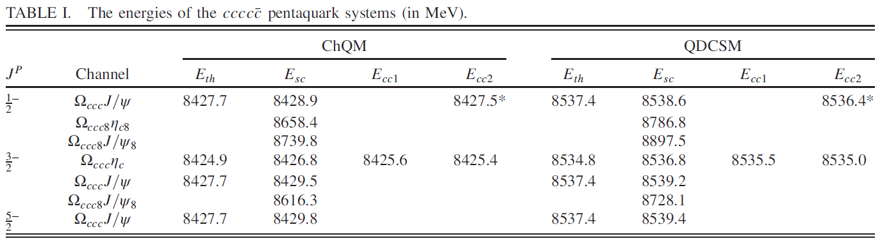
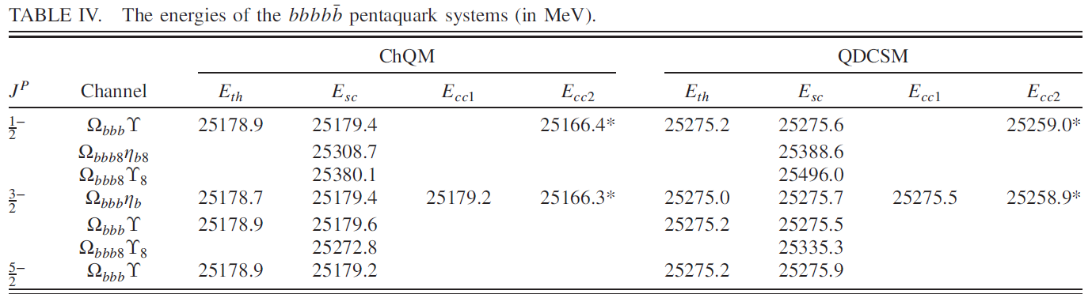
2. Fully heavy pentaquarks
Bound state calculation
Phys. Rev. D 105, 014027 (2022)
正德厚生笃学敏行
NANJING NORMAL UNIVERSITY

Slide 34
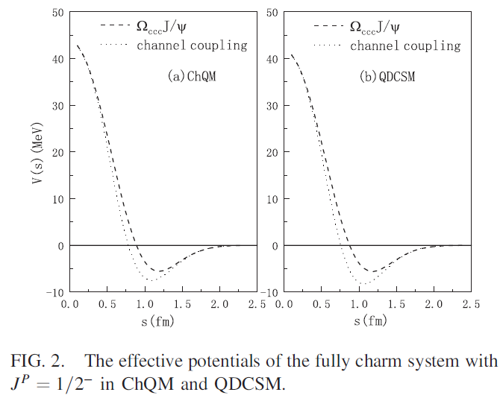
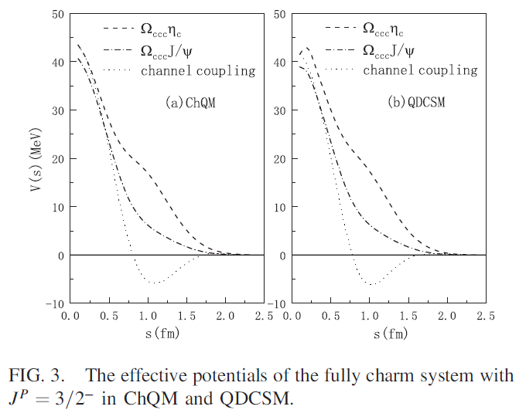
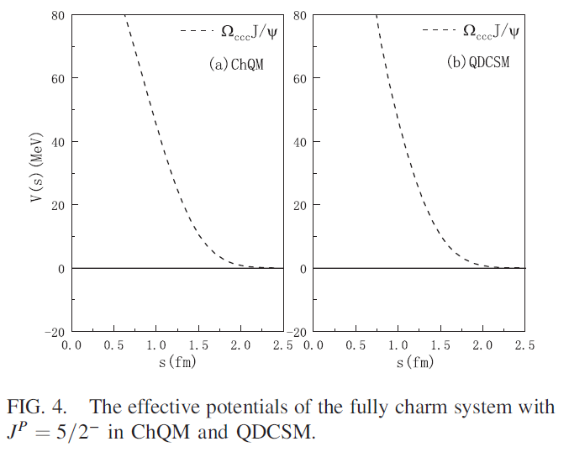
Study of interaction between heavy baryon and meson
正德厚生笃学敏行
NANJING NORMAL UNIVERSITY

Slide 35
3. Fully heavy dibaryons
Bound state calculation
Eur. Phys. J. C. 82, 805 (2022)
The dibaryon composed of six c or b quarks with J = 0 is able to be bound.
The channel coupling between the color-singlet and hidden-color channels causes the binding energy to increase.
It is difficult for the dibaryon with the color-singlet type ΩcccΩbbb to form any bound state.
It is possible for the ΩccbΩbbc state to be bound.
The channel coupling of all channels of both ΩccbΩbbc and ΩcccΩbbb structures leads to the bound conclusion of this fully heavy system composed of three c quarks and three b.
正德厚生笃学敏行
NANJING NORMAL UNIVERSITY

Slide 36
Study of interaction between two heavy baryons
The interactions between two Ωcccs or Ωbbbs are attractive.
There is no attractive interaction between Ωccc and Ωbbb.
The principal reason is that there is no symmetry requirement between the clusters Ωccc and Ωbbb because the quark c and quark b is nonidentical quarks. While for the Ωccc or full Ωbbb, the requirement of the antisymmetrization between the same baryon clusters introduce attractive interaction between two full heavy baryons, which leads to a super-heavy bound dibaryon.
正德厚生笃学敏行
NANJING NORMAL UNIVERSITY

Slide 37
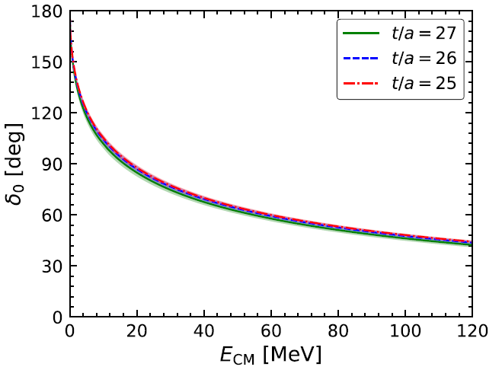
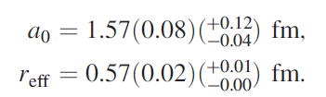
Low-energy scattering phase shifts
Lattice QCD,
Phys. Rev. Lett. 127 (2021) 072003
正德厚生笃学敏行
NANJING NORMAL UNIVERSITY

Slide 38
V. Summary
1. Fully charm tetraquarks: there may exist some resonance states, with masses range between 6.2 GeV to 7.4 GeV, and the quantum numbers J^{P}=0^{+}, 1^{+}, and 2^{+}.
X(6900), J^{P} = 0⁺; X(7100) J^{P} = 0⁺ ；X(7200), J^{P} = 0⁺; X(6600) J^{P} = 2⁺ ? X(6200)
Structure: compact resonance states
The study of scattering process is needed.
2. Other fully heavy tetraquarks:
J^{P} = 1⁺ : E(9970), E(10046), E(10020) ; J^{P} = 2⁺ : E(10265)
J^{P} = 0⁺ : E(12686), E(12372); J^{P} = 1⁺ : E(13268), E(13470); J^{P} = 2⁺ : E(13260), E(13489)
J^{P} = 0⁺ : E(12764), E(12836), E(13345); J^{P} = 1⁺ : E(12815), E(12897), E(13215), E(13365); J^{P} = 2⁺ : E(12848)，E(13396)
J^{P} = 0⁺ : E(19143)
3. Fully heavy pentaquarks:
7891.9–7892.7 MeV, 23810.1–23813.8 MeV, 23748.2–23752.3 MeV
4. Fully heavy dibaryons:
cccccc: 9735 MeV; cccbbb: 19696 MeV; bbbbbb: 29780 MeV
正德厚生笃学敏行
NANJING NORMAL UNIVERSITY

Slide 39
5. Some inspirations
For a multiquark system, it is easy to obtain stable states for the structure with colorful sub-clusters. However, the observable of these states depends on its coupling to the open channels. The coupling can shift the energy of the resonance, give the width to the resonance and even destroy the resonance.
The study of the scattering process and the real-scaling method are two effective ways to look for the genuine resonances. Furthermore, it is important to search for resonance mechanisms.
The joint efforts of both theorists and experimentalists are greatly needed!
正德厚生笃学敏行
NANJING NORMAL UNIVERSITY

Slide 40
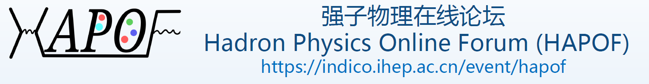
THANKS

