Slide 1
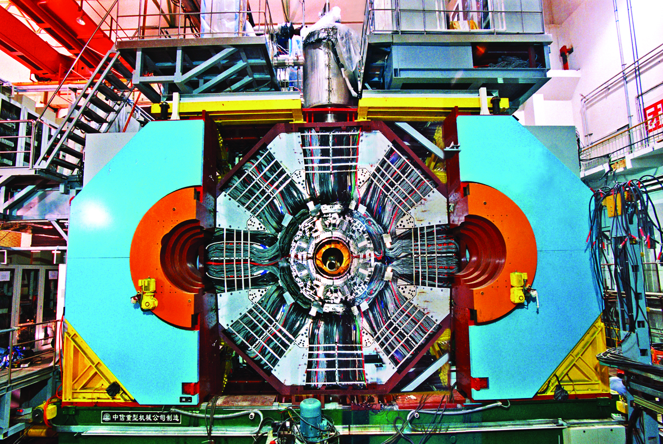
Charm Physics at BESIII
Hai-Bo Li
on behalf of BESIII Collaboration
Institute of High Energy Physics, Beijing
第二届强子物理新发展研讨会暨强子物理在线论坛100期特别活动
合肥，2024年7月1日

Slide 2
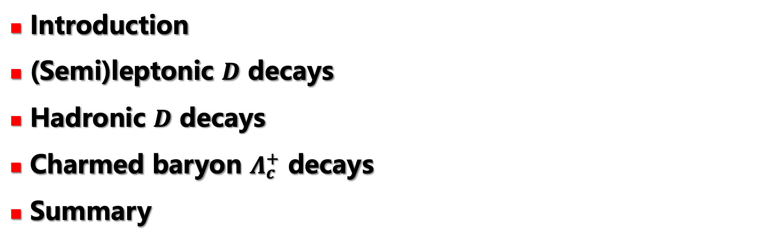
Outline
Introduction
(Semi)leptonic $D$ decays
Hadronic $D$ decays
Charmed baryon $Λ_{c}^{+}$ decays
Summary

Slide 3
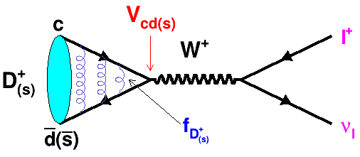
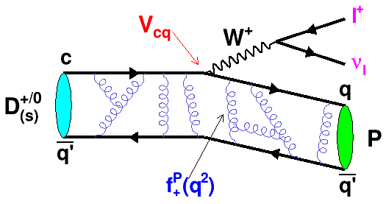
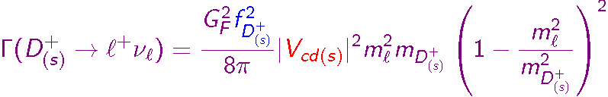

(Semi)leptonic $D$ decays
Bridges between quarks and leptons:
Decay constant, form factors
CKM matrix elements: |V_{cs}|、|V_{cd}|
Lepton Universalities
→ Calibrate LQCD
→ Tests of Standard Model

Slide 4


















Status of CKM matrix elements
PDG2014
$$ΔV_{ud}/V_{ud}=0.02\%$$
$ΔV_{us}/V_{us}=0$.4$\%$
$$ΔV_{ub}/V_{ub}=12\%$$
1
l
l
l
n
ν
K
ν
B
ν
p
π
π
Indirect constraint: Hadronic and semi-leptonic D decays
BESIII +
B factories +
LQCD
Direct measurement: (semi)leptonic D decays from BESIII
$$ΔV_{cd}/V_{cd}=3.6\%$$
$$ΔV_{cs}/V_{cs}=1.6\%$$
$$ΔV_{cb}/V_{cb}=\text{3}\text{.}2\%$$
l
l
l
D
ν
D
ν
B
ν
π
Κ
D
$$ΔV_{td}/V_{td}=\text{7.1}\%$$
$$ΔV_{ts}/V_{ts}=\text{6.8}\%$$
$$ΔV_{tb}/V_{tb}=\text{3}\text{.}1\%$$
1
B_{d}
B_{d}
B_{s}
B_{s}
V_{ud} and V_{us} are the best determined. V_{cd} & V_{cs} and rest of the beauty sector (V_{cb} V_{ub}, V_{td}, V_{ts}) are poorly determined. Theoretical errors on hadronic matrix element dominate.

Slide 5
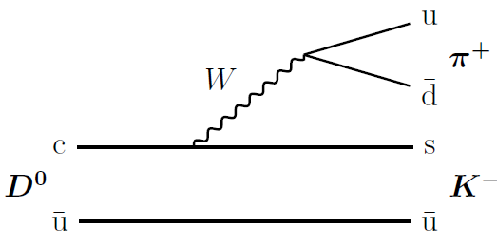
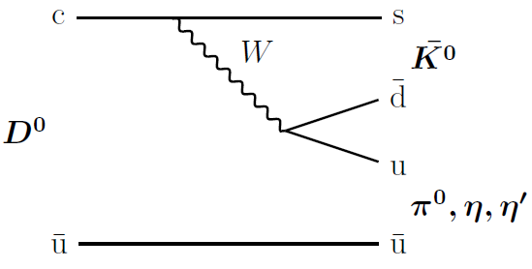
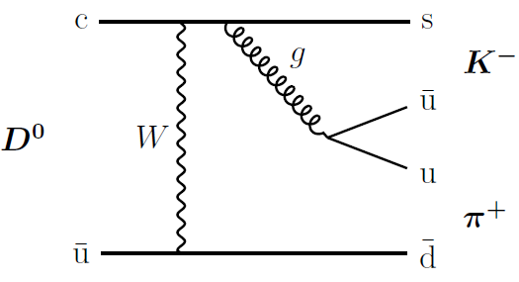
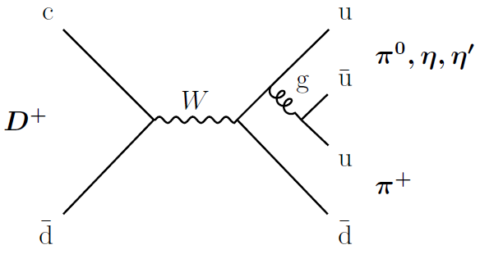

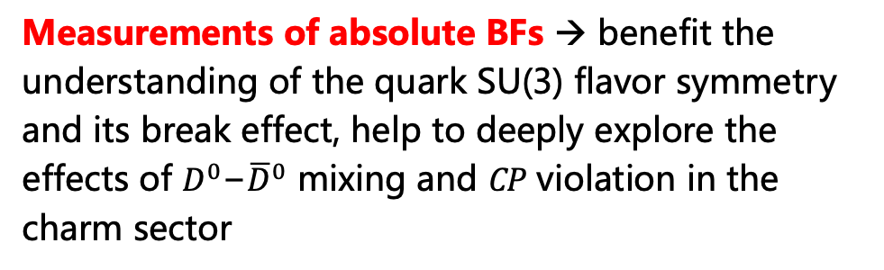
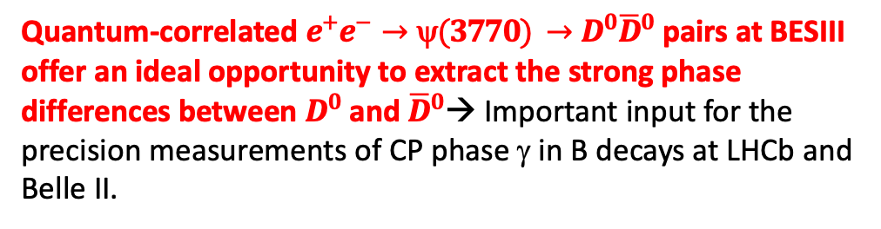

Hadronic $D$ decays
Typical Feynman diagrams of two-body hadronic $D$ decays ($D→VP,PP$ for example)
Measurements of absolute BFs → benefit the understanding of the quark SU(3) flavor symmetry and its break effect, help to deeply explore the effects of $D^{0}\text{−}{\overline{D}}^{0}$ mixing and $CP$ violation in the charm sector
Tree
Amplitude analysis of multi-body hadronic charm decays → probe light hadron spectroscopy, more information of $D→VP$, $PS$, $VV$, $TS,$ $TP,$ $AP$…
Color suppressed
Quantum-correlated $e^{+}e^{−}→\text{y}(3770) →D^{0}{\overline{D}}^{0}$ pairs at BESIII offer an ideal opportunity to extract the strong phase differences between $D^{0}$ and ${\overline{D}}^{0}\text{→}$ Important input for the precision measurements of CP phase γ in B decays at LHCb and Belle II.
W-exchange
Annihilation

Slide 6
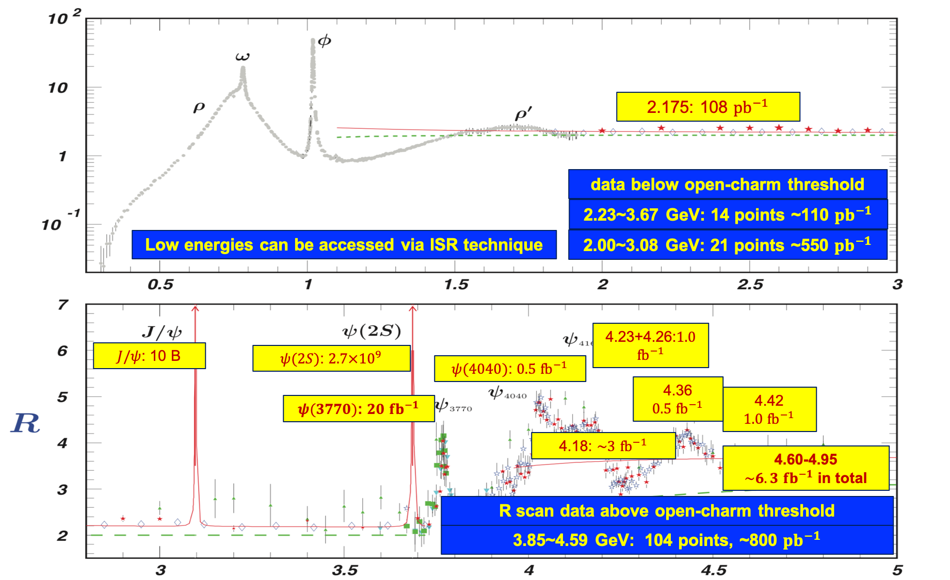
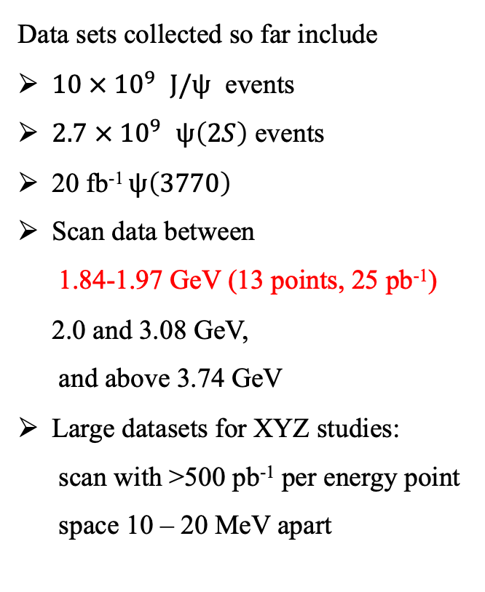
BESIII Data Samples: rich Physics
Data sets collected so far include
$10 × {10}^{9}$ $J/ψ$ events
$2.7 × {10}^{9}$ $ψ\left(2S\right)$ events
20 fb⁻¹ $ψ\left(3770\right)$
Scan data between
1.84-1.97 GeV (13 points, 25 pb⁻¹)
2.0 and 3.08 GeV,
and above 3.74 GeV
Large datasets for XYZ studies:
scan with >500 pb⁻¹ per energy point
space 10 – 20 MeV apart
Totally about 50 fb⁻¹ integrated luminosity from 2.0-4.95 GeV
Entangled hadron pair-productions
near thresholds: form-factors,
relative phase, polarization and CP violation.
Hadron structure & dynamics in the non-perturbative QCD regime
About 20 fb⁻¹ on the $ψ\left(3770\right)$ had been collected

Slide 7
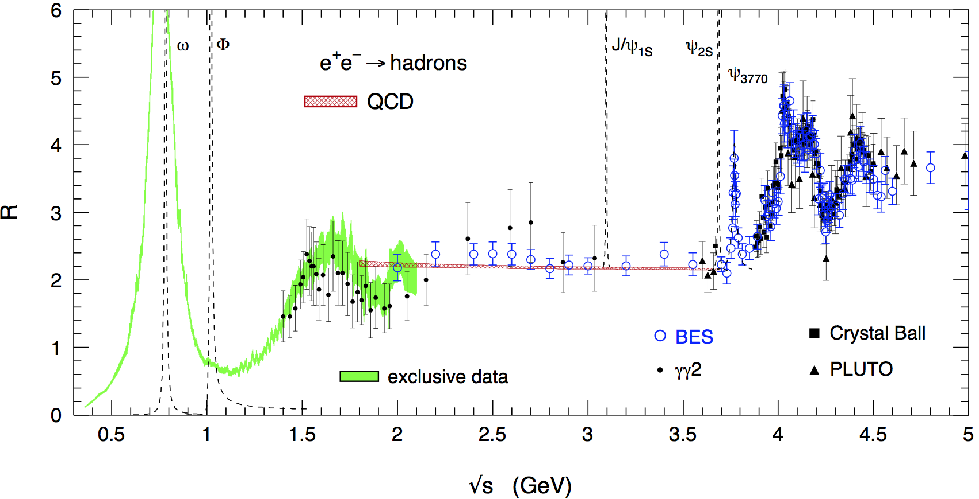
Rich physics program
Hadron form factors
R values and QCD
Light hadron spectroscopy
Gluonic and exotic states
Physics with τ lepton
XYZ particles
Charm mesons
Charm baryons

Slide 8

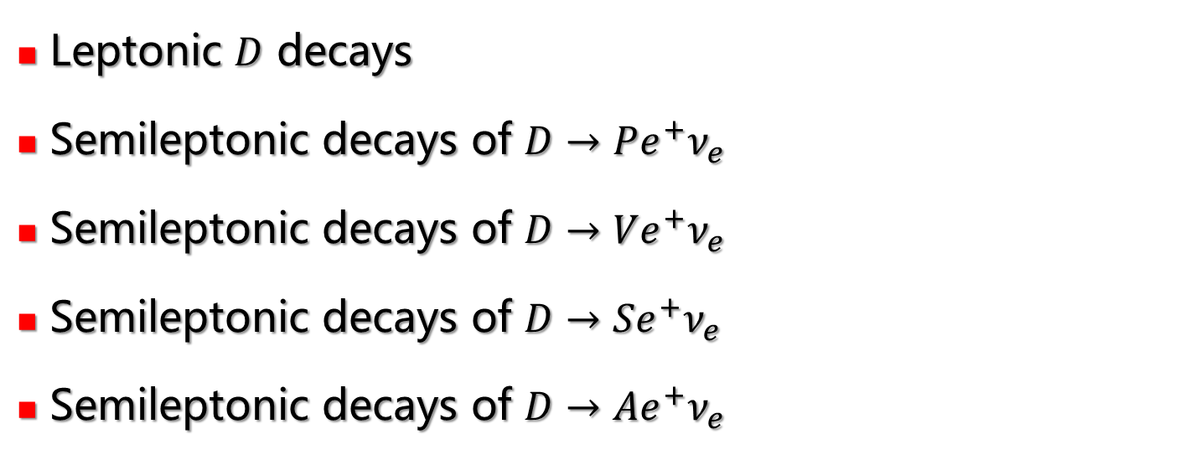
(Semi)leptonic $D$ decays
Leptonic $D$ decays
Semileptonic decays of $D→Pe^{+}ν_{e}$
Semileptonic decays of $D→Ve^{+}ν_{e}$
Semileptonic decays of $D→Se^{+}ν_{e}$
Semileptonic decays of $D→Ae^{+}ν_{e}$

Slide 9
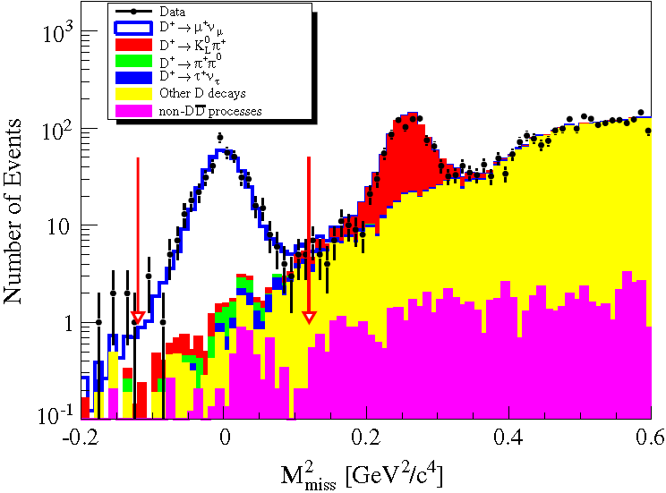
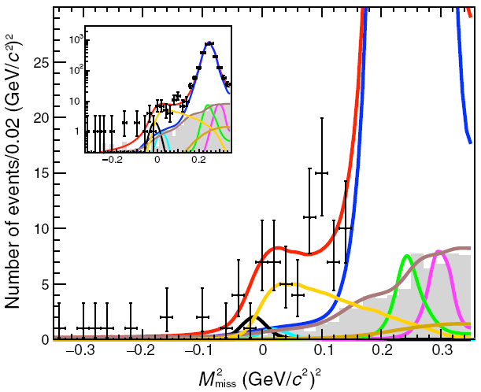



Studies of $D^{+}→l^{+}ν_{l}$
PRD89(2014)051104
PRL123(2019)211802
409±21
First observation
137±27
The most precise to date
$$B[D^{+}→μ^{+}v]=(3.71±0.19±0.06)×10^{−4}$$
$$B[D^{+}→τ^{+}v]=(1.20±0.24±0.12)×10^{−3}$$
$$f_{D^{+}}|V_{cd}|= 46.7±1.2±0.4 \text{MeV}$$
$$f_{D^{+}}|V_{cd}|=50.4±5.0±\text{2.5} \text{MeV}$$
Precision~2.7%
Precision~11%

Slide 10
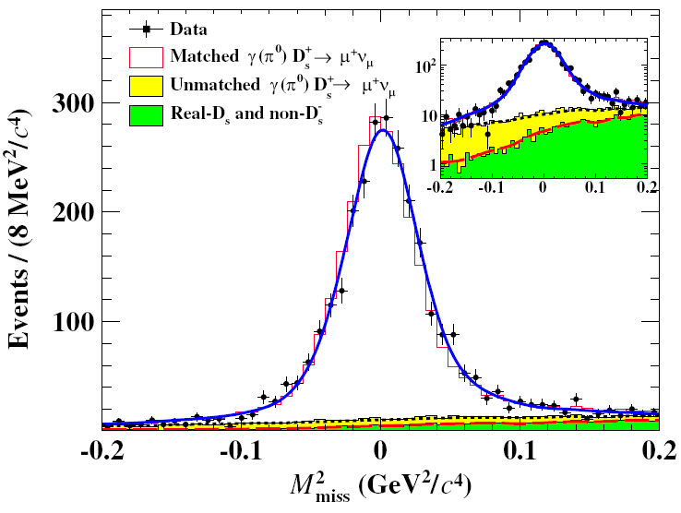
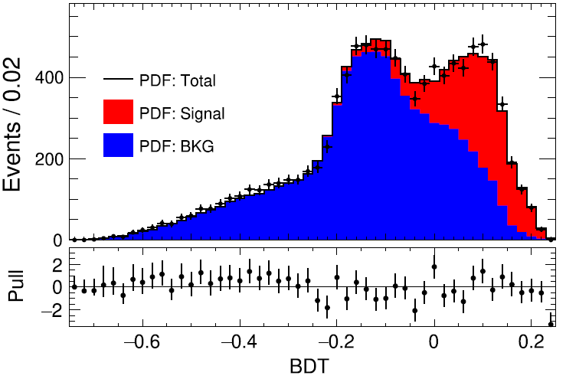
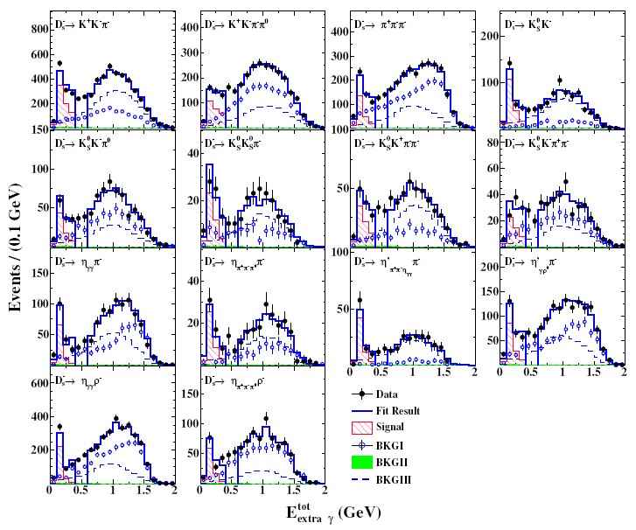








Measurements of $D_{s}^{+}→l^{+}ν_{l}$
PRD108(2023)112001
PRD108(2023)092014
JHEP09(2023)124
$D_{s}^{+}→μ^{+}v$
$$D_{s}^{+}→τ^{+}({\text{p}}^{+}v)v$$
BDT
$$D_{s}^{+}→τ^{+}(^{+}vv)v$$
7.33 fb⁻¹
2515±52
7.33 fb⁻¹
2411±75
7.33 fb⁻¹
2281±73
with μ counter information
$$B[D_{s}^{+}→μ^{+}v]=(5.29±0.11±0.09)×10^{−3}$$
$$B\left[D_{s}^{+}→τ^{+}v\right]=\left(5.44±0.17±0.13\right)\%$$
$$B\left[D_{s}^{+}→τ^{+}v\right]=\left(5.37±0.17±0.15\right)\%$$
$$f_{D_{s}^{+}}|V_{cs}|=(241.8±2.5±2.\text{2)} \text{MeV}$$
$$f_{D_{s}^{+}}|V_{cs}|=(248.3±3.9±\text{3.2)} \text{MeV}$$
$$f_{D_{s}^{+}}|V_{cs}|=(246.7±3.9±\text{3.6}\text{)} \text{MeV}$$
Precision~1.4%
Precision~2.0%
Precision~2.2%
The most precise to date

Slide 11
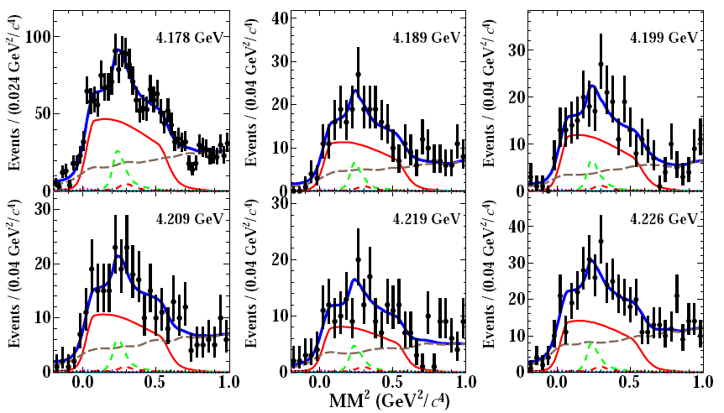
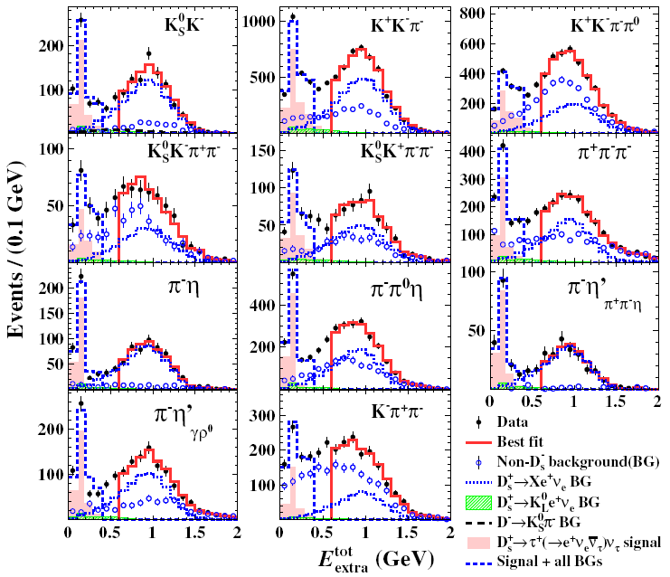






Studies of $D_{s}^{+}→τ^{+}ν_{τ}$
PRD104(2021)032001
PRL127(2021)171801
$D_{s}^{+}→τ^{+}({\text{r}}^{+}v)v$
$$D_{s}^{+}→τ^{+}(e^{+}vv)v$$
6.3 fb⁻¹
1745±84
6.3 fb⁻¹
4940±97
$$B\left[D_{s}^{+}→τ^{+}v\right]=\left(5.29±0.25±0.20\right)\%$$
$$B\left[D_{s}^{+}→τ^{+}v\right]=\left(5.27±0.10±0.12\right)\%$$
$$f_{D_{s}^{+}}|V_{cs}|=(244.8±5.8±\text{4.8}\text{)} \text{MeV}$$
$$f_{D_{s}^{+}}|V_{cs}|=(244.4±2.3±\text{2.9)} \text{MeV}$$
Precision~3.1%
Precision~1.5%

Slide 12
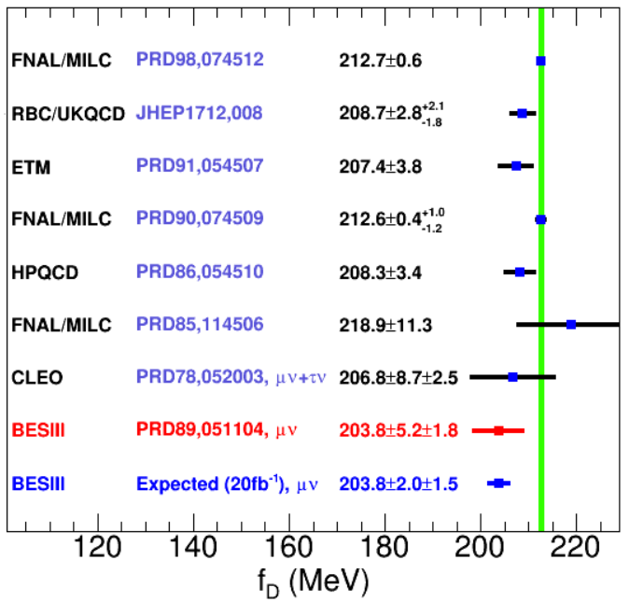
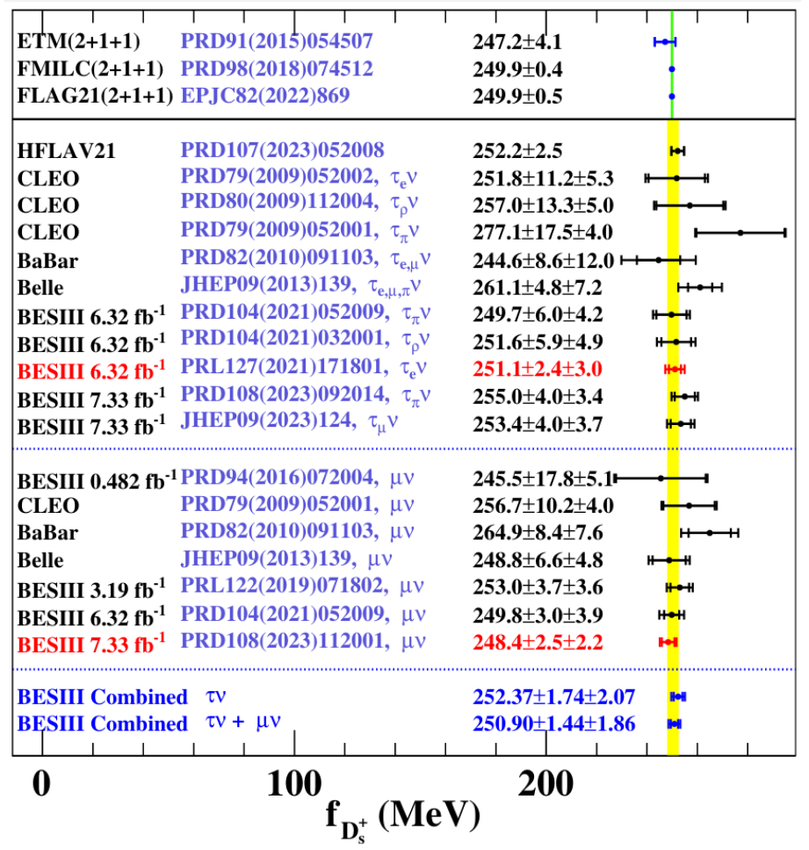
Comparisons of $f_{D^{+}}$and $f_{D_{s}^{+}}$
Precision~1.2%
Precision~0.9%

Slide 13
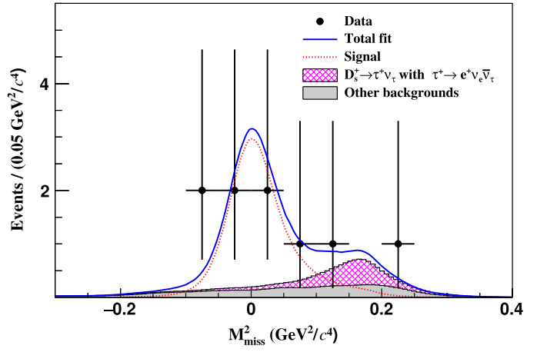
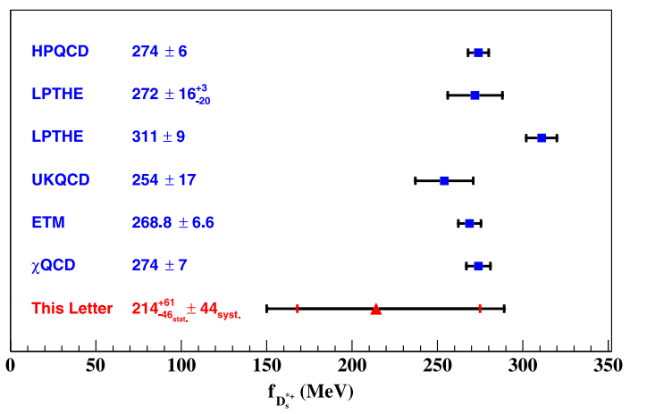


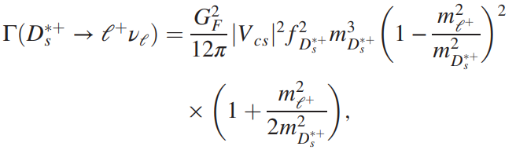



First evidence of vector $D_{s}^{∗+}→e^{+}ν_{e}$
PRL131 (2023) 141802
联合格点QCD计算的$D_{s}^{∗+}$总宽度，首次抽取$D_{s}^{∗+}$衰变常数
7.33 fb⁻¹@4.13-4.23 GeV
2.9σ
→ 为约束格点QCD计算的$D_{s}^{∗+}$衰变常数首次提供实验依据
→ 对$D_{s}^{∗+}$宽度上限的约束改进3个量级

Slide 14





Studies of $D→Pl^{+}ν_{l}$ dynamics
Dynamic study
$$f_{+}^{D→P}(0)|V_{cs(d)}|$$
Form factor parameterizations:
Single pole form
Modified pole
ISGW2
Series expansion

Slide 15
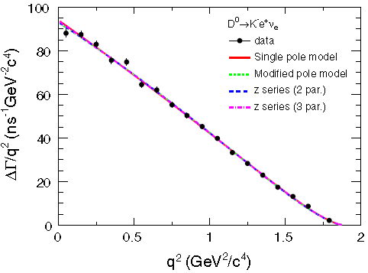
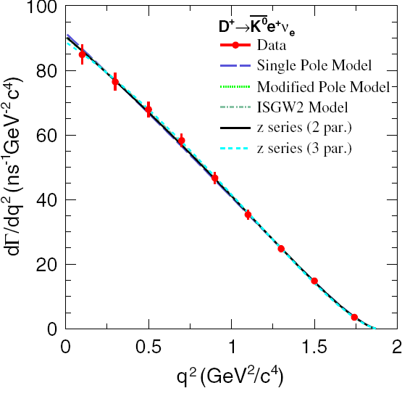
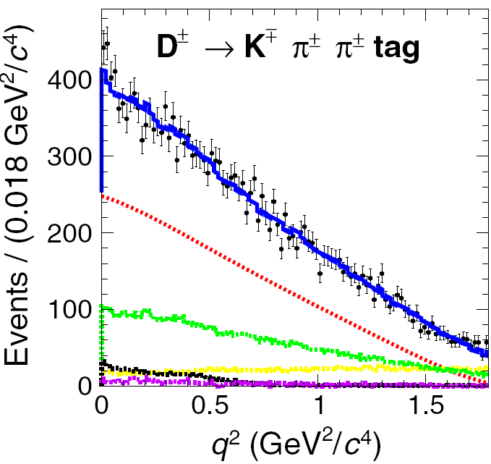

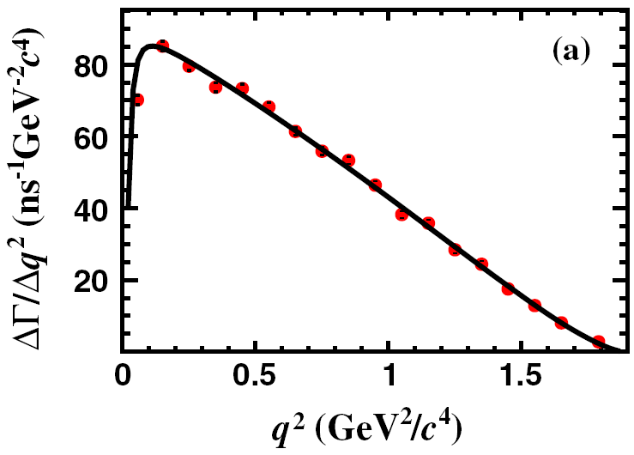
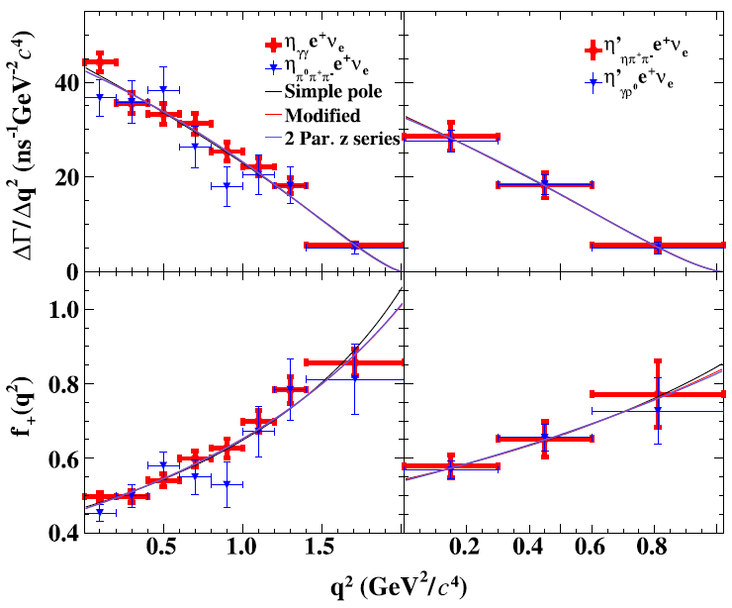
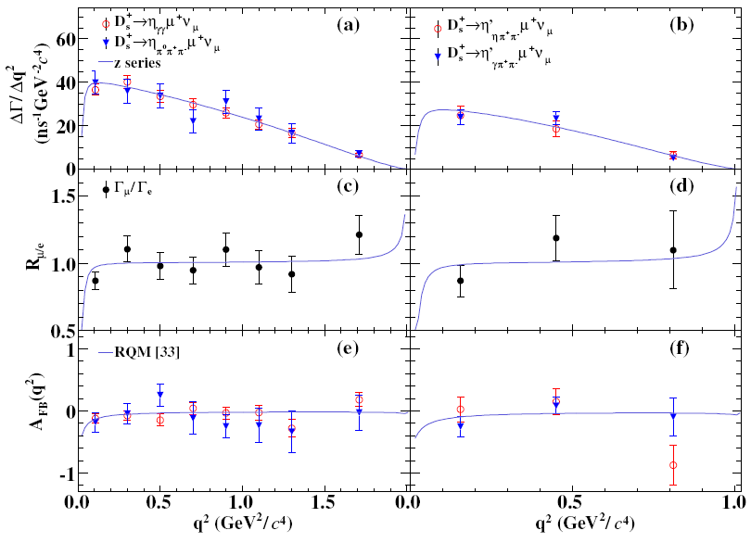














Studies of $c→sl^{+}ν_{l}$semileptonic decays
PRD92(2015)072012
PRD96(2017)012002
PRD92(2015)112008
$$D^{0}→K^{−}e^{+}ν_{e}$$
$$D^{+}→{\overline{K}}^{0}e^{+}ν_{e}$$
$$D^{+}→K_{L}^{0}e^{+}ν_{e}$$
$$f_{+}^{D→K}(0)|V_{cs}|=0.717(03)(04)$$
$$f_{+}^{D→K}(0)|V_{cs}|=0.705(04)(11)$$
$$f_{+}^{D→K}(0)|V_{cs}|=0.728(06)(11)$$
PRL123(2019)121801→
PRD108(2023)092003
PRL 132(2024), 091802
PRL122(2019)011804
$$D_{s}^{+}→{\text{h}}^{(′)}e^{+}ν_{e}$$
$$D_{s}^{+}→{\text{h}}^{(′)}μ^{+}ν_{μ}$$
$$D^{0}→K^{−}μ^{+}ν_{μ}$$
First extraction
$$f_{+}^{D_{s}→η}(0)|V_{cs}|=0.452(07)(07)$$
$$f_{+}^{D_{s}→η}(0)|V_{cs}|=0.451(10)(08)$$
$$f_{+}^{D→K}(0)|V_{cs}|=0.7148(38)(29)$$
$${f_{+}^{D_{s}→η}}^{′}(0)|V_{cs}|=0.525(24)(09)$$
$${f_{+}^{D_{s}→η}}^{′}(0)|V_{cs}|=0.506(37)(11)$$

Slide 16
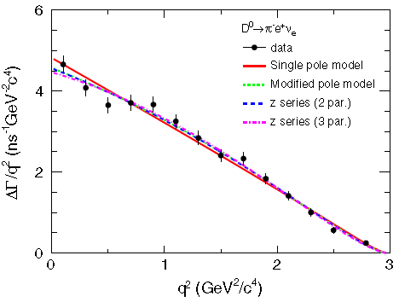
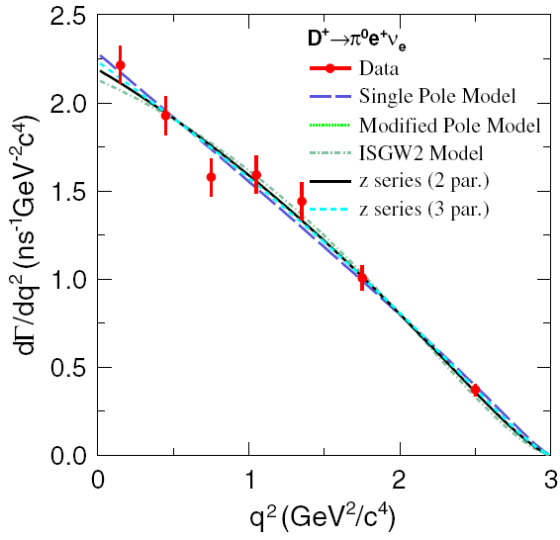
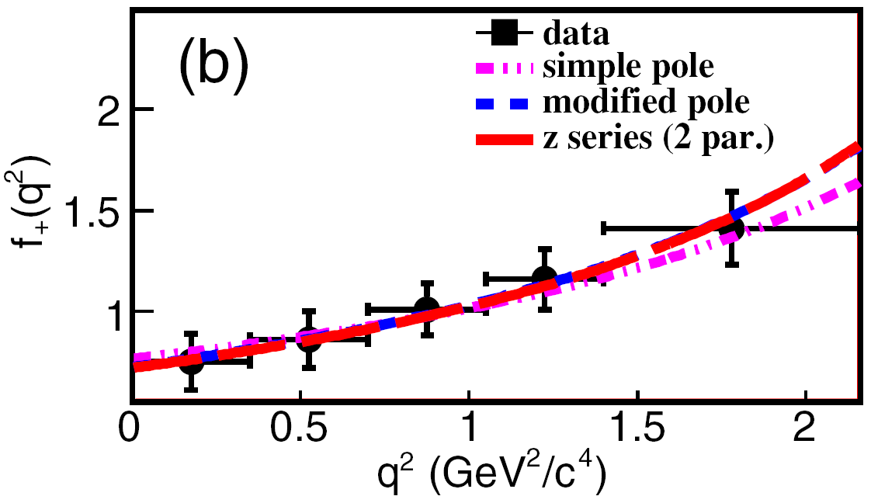
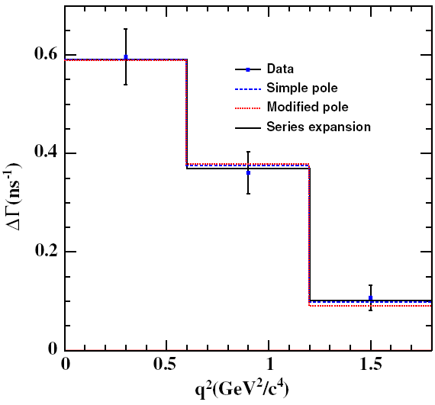
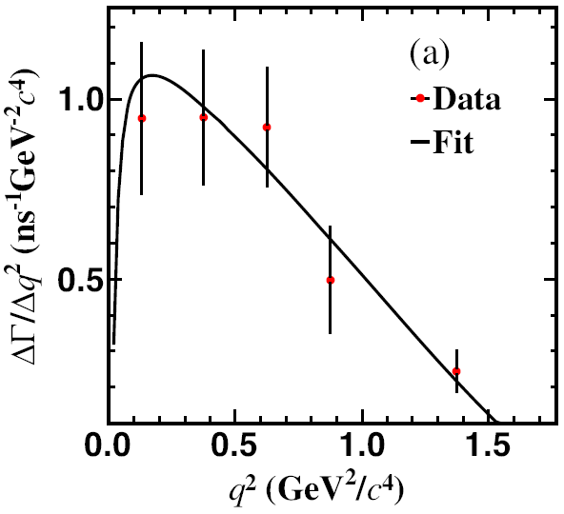










Studies of $c→dl^{+}ν_{l}$semileptonic decays
PRD92(2015)072012
PRD96(2017)012002
PRL122(2019)061801
$$D^{0}→{\text{p}}^{−}e^{+}ν_{e}$$
$$D^{+}→{\text{p}}^{0}e^{+}ν_{e}$$
$$D_{s}^{+}→{\text{K}}^{0}e^{+}ν_{e}$$
First extraction
$$f_{+}^{D→π}(0)|V_{\text{cd}}|=0.144(02)(01)$$
$$f_{+}^{D→π}(0)|V_{\text{cd}}|=0.140(03)(01)$$
$$f_{+}^{D_{s}→K}(0)|V_{cd}|=0.162(19)( 03)$$
PRD97(2018)092009
PRL124(2020)231801
$$D^{+}→\text{h}e^{+}ν_{e}$$
$$D^{+}→\text{h}μ^{+}ν_{μ}$$
First extraction
$$f_{+}^{D→\text{h}}\left(0\right)|V_{cd}|=0.079(06)(02)$$
$$f_{+}^{D→\text{h}}\left(0\right)|V_{cd}|=0.087(08)(02)$$

Slide 17
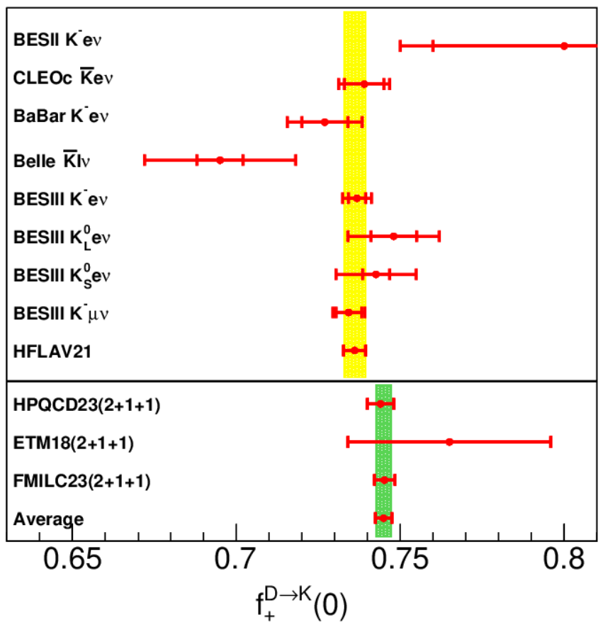
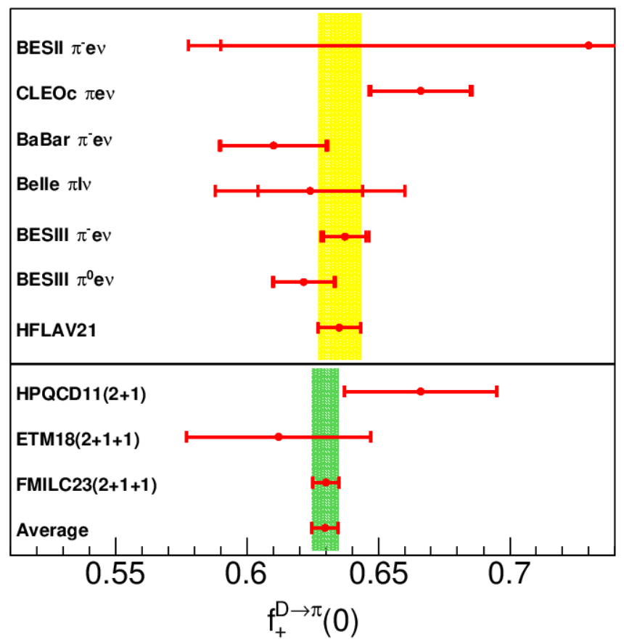


Comparisons of $f_{+}^{D→K}\left(0\right)$ and $f_{+}^{D→π}(0)$
0.7%
1.6%
2010→2023
2011→2023
2.4%→0.4%
4.4%→0.8%
Experimental precision of $f_{+}^{D→K}\left(0\right)$ is comparable to the latest LQCD precision
Experimental precision of $f_{+}^{D→π}(0)$ is still dominated by statistical uncertainties

Slide 18
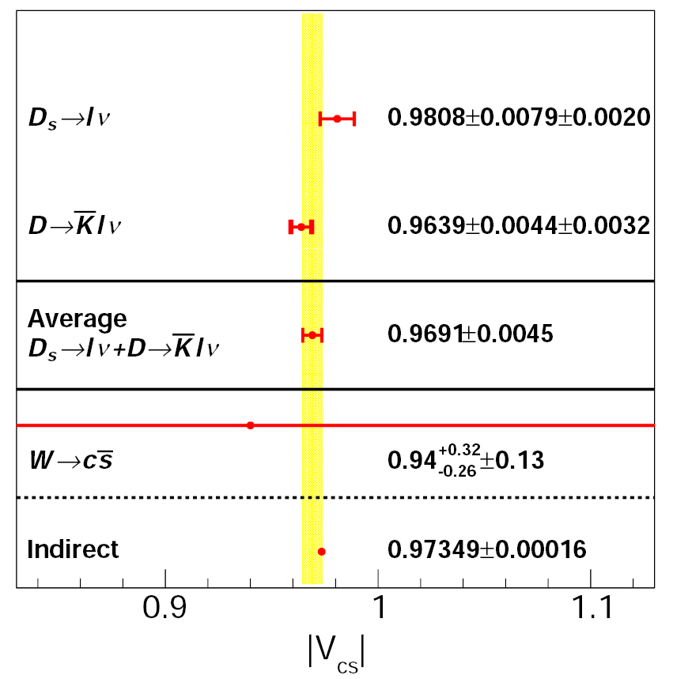
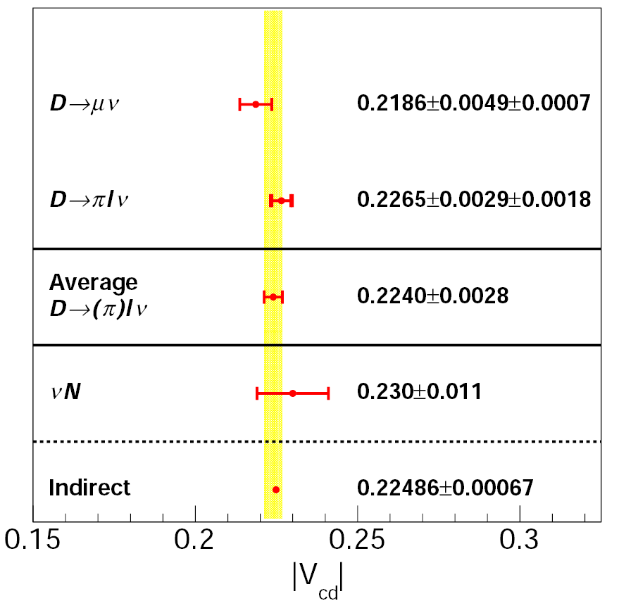


Comparisons of $|V_{cs}|$ and $|V_{cd}|$

Slide 19
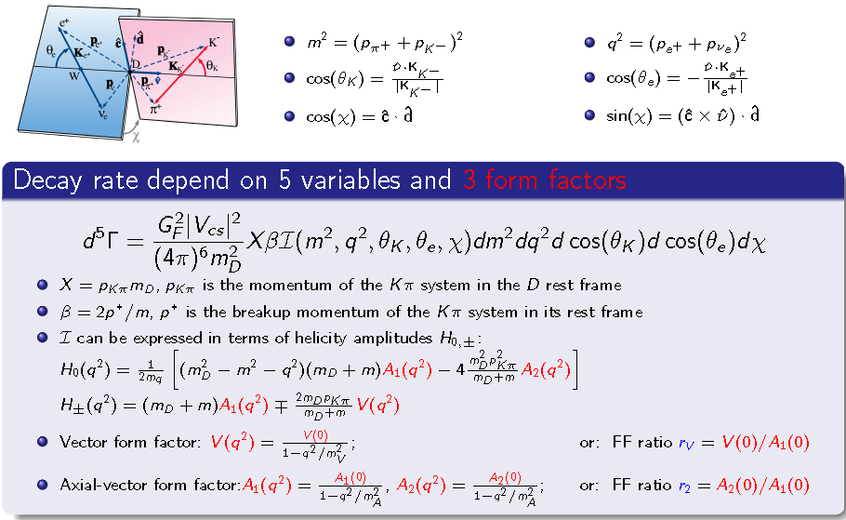
Studies of $D→Ve^{+}ν_{e}$ dynamics

Slide 20
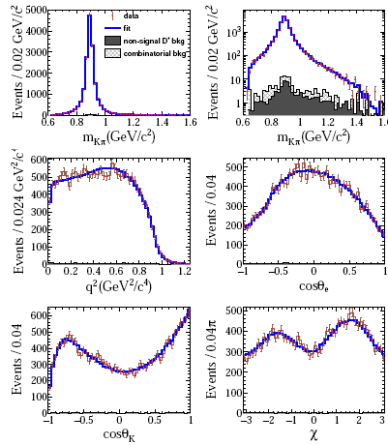
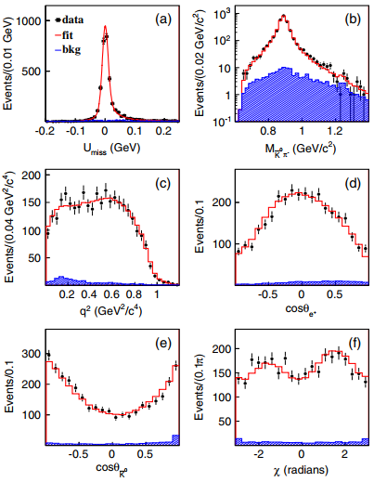
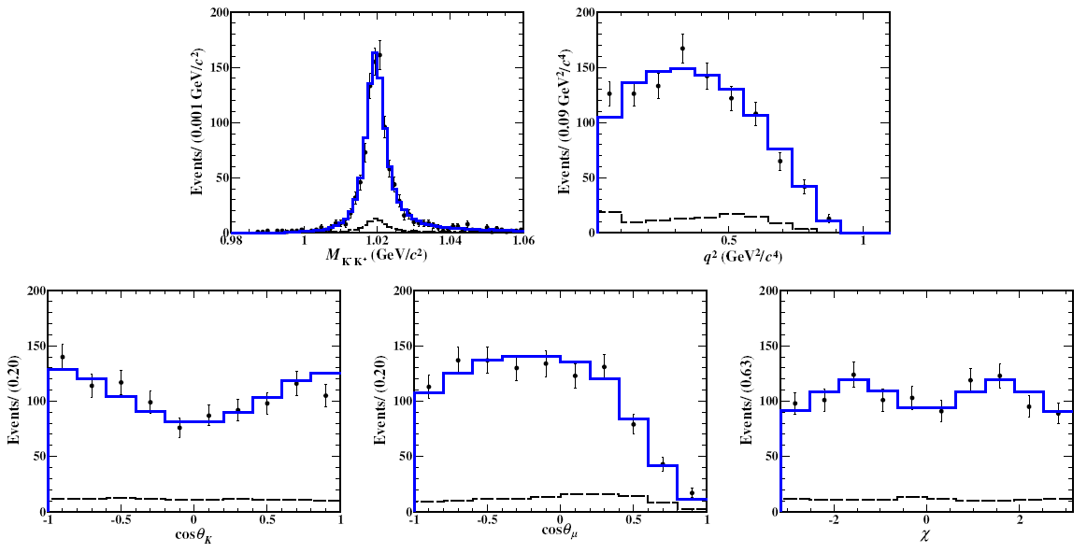
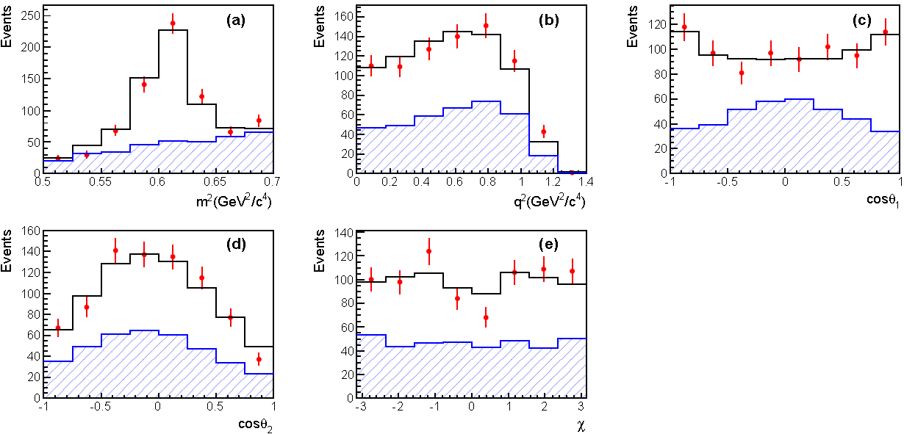
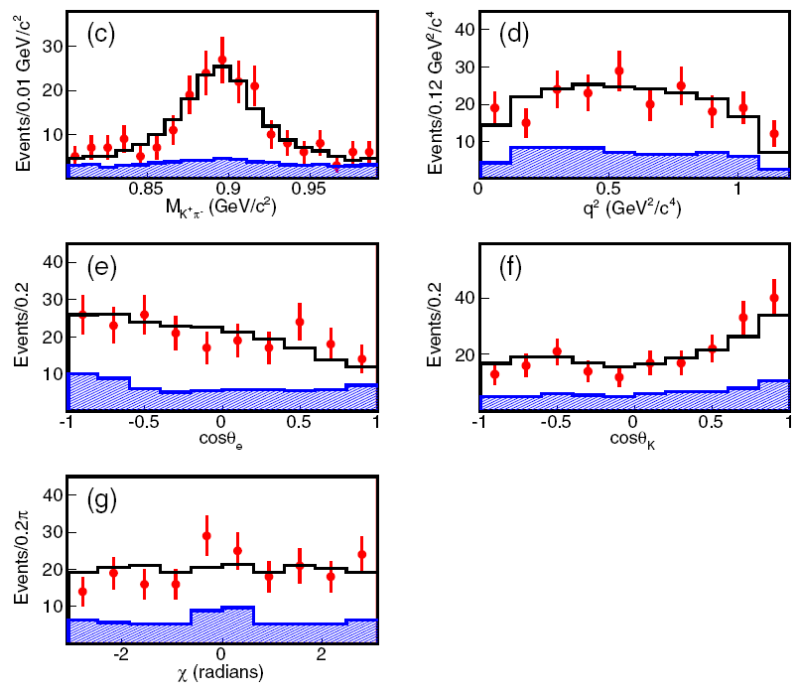







Analyses of $D→Ve^{+}ν_{e}$ dynamics
$$D^{+}→{\overline{K}}^{∗0}e^{+}ν_{e}$$
PRD94(2016)032001
$$D^{0}→K^{∗−}e^{+}ν_{e}$$
PRD99(2018)011103
$$D_{s}^{+}→{φμ}^{+}ν_{μ}$$
JHEP12(2023)072
First extraction
$$D^{+}→ωe^{+}ν_{e}$$
PRD92(2015)071101
$$D_{s}^{+}→K^{∗0}e^{+}ν_{e}$$
PRL122(2019)061801
$$r_{V}=1.58±0.17±0.02$$
$$r_{2}=0.71±0.14±0.02$$
First extraction
First extraction

Slide 21
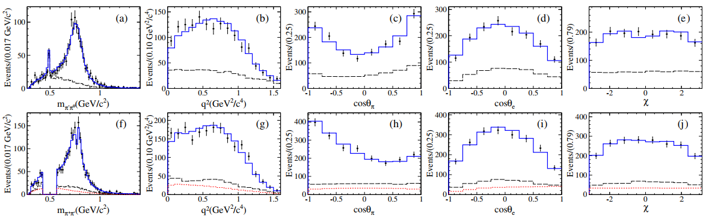
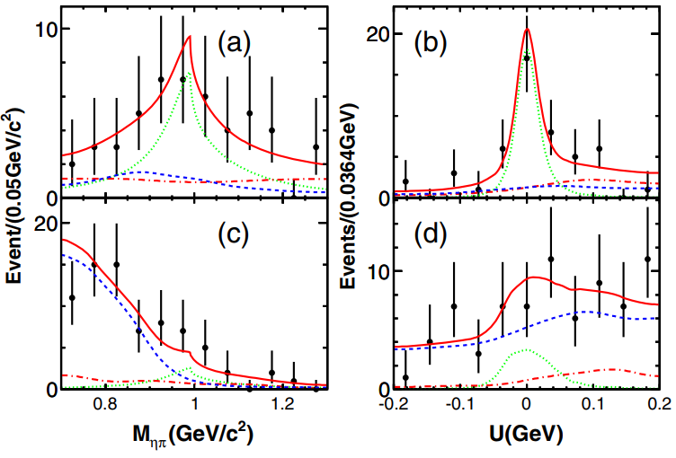







Analysis of $D^{0(+)}→\text{pp}e^{+}ν_{e}$and observation of $D→Se^{+}ν_{e}$
PRL122(2019)062001
PRL121(2018)081802
$$D^{+}→a_{0}(980)^{0}e^{+}ν_{e}$$
$$D^{0}→a_{0}(980)^{−}e^{+}ν_{e}$$
3.0σ
6.5σ
$$r_{V}=1.695±0.083±0.051$$
$$r_{2}=0.845±0.056±0.039$$
$$B_{D^{0}→a_{0}(980)^{−}e^{+}v}B_{a_{0}(980)^{−}→ηπ^{−}}=(1.33_{−0.29}^{+0.33}±0.09)×10^{−4}$$
Observation of ${D^{+}→f}_{0}(500) e^{+}ν_{e}$
$$B_{D^{+}→a_{0}(980)^{0}e^{+}v}B_{a_{0}(980)^{0}→ηπ^{0}}=(1.66_{−0.66}^{+0.81}±0.11)×10^{−4}$$
[$B_{D^{+}→f_{0}(500)e^{+}v}+B_{D^{+}→f_{0}(980)e^{+}v}]/B_{D^{+}→a_{0}(980)^{0}e^{+}v}>2.7$
Supports tetraquark assumption for light mesons of $a_{0}$ and $f_{0} ?$
W. Wang and C. D. Lu, Phys. Rev. D 82, 034016 (2010).

Slide 22









First studies of $D_{(s)}^{+}→f_{0}l^{+}ν_{l}$ decay dynamics
首次开展末态为标量介子动力学研究
$$D_{s}^{+}→f_{0}(980)^{0}e^{+}ν_{e}$$
arXiv:2303.12927
$$D^{+}→f_{0}(500)^{0}e^{+}ν_{e}$$
arXiv:2401.13225
$$f_{+}^{D_{s}→f0(980)}(0)|V_{cs}|=0.504(17)(35)$$
$$f_{+}^{D^{+}→f0(500)}(0)|V_{cd}|=0.0787(60)(33)$$
实验测量值与理论基于$f_{0}$是两夸克成分假定时的理论计算明显偏离，暗示它们可能含有四夸克态成分

Slide 23






Observation of $D→Ae^{+}ν_{e}$
$$D^{+}→{\overline{K}}_{1}^{0}(1270)e^{+}ν_{e}$$
PRL123(2019)231801
$$D^{0}→K_{1}(1270)^{−}e^{+}ν_{e}$$
PRL127(2021)131801
>10σ
>10σ
$$B_{D^{+}→{\overline{K}}_{1}^{0}(1270)e^{+}v}=(2.30±0.26±0.18±0.25)×10^{−3}$$
$$B_{D^{0}→K_{1}(1270)^{−}e^{+}v}=(1.09±0.13±0.13±0.12)×10^{−3}$$
New window to explore the property and nature of $K_{1}$and $K_{1}$ mixing angle
S. Momeni, JPG46(2019)105006
Combined analysis of $D→\overline{K}\text{1}e^{+}v$and $B→γ\overline{K}$₁ helps to constrain new physics effect in the studies of photon polarization in $b→sγ$ process
Wei Wang et al. PRL125(2020)051802

Slide 24


Hadronic $D$ decays
Strong phase difference in neutral $D$ decays
Two-body decays $D^{0}→PP, VP, VV$
Amplitude analyses of multi-body $D$ decays

Slide 25







Strong phase differences between $D^{0}$ and ${\overline{D}}^{0}$
$${D→K}_{S/L}^{0}π^{+}π^{−}$$
PRL124(2020)241802
$e^{+}e^{−}→ψ\left(3770\right)→D^{0}{\overline{D}}^{0}$at 3.773 GeV
Constraint on γ measurement ~ 0.9°
$${D→K}_{S/L}^{0}K^{+}K^{−}$$
$$D→ K^{−}π^{+}π^{+}π^{−} and K^{−}π^{+}π^{0}$$
PRD102(2020)052008
JHEP05(2021)164
Constraint on γ measurement ~ 1.3°
Constraint on γ measurement ~ 6°

Slide 26




Observation of $D^{0}→ω$φ
Transverse polarization in $D^{0}→VV$ is found to deviate significantly with theoretical prediction
PRL128(2022)011803
Phase space
Horizonal polarization
Transverse polarization
$$B[D^{0}→ω\text{φ}]=(6.48±0.96±0.40)×10^{−3}$$
Benefits to explore the mechanisms of $D^{0}−{\overline{D}}^{0}$ mixing and $CP$ violation in theory

Slide 27









Amplitude analyses of $D^{+}→K_{S}^{0}π^{+}η$
֍ $D^{+}→K_{S}^{0}π^{+}η$
Observation of W-annihilation-free decay $D^{+}→$ $K_{S}^{0}a_{0}{(980)}^{+}$
Provide sensitive constraints in the extraction of contributions from internal W-emission diagrams of D → SP
PRL 132, 131903 (2024)
$$2.93{fb}^{−1} @3.773GeV$$
More Amplitude analyses: $D^{0}→K_{S}^{0}π^{0}η$, $D^{0}→K^{−}π^{+}η$, $D^{+}$ $→$ $K_{S}^{0}K_{S}^{0}K^{+}$, $D^{0}→K_{S}^{0}$/ $K_{L}^{0}K^{+}K^{−}$, $D^{+}$ $→π^{+}ηη$, …

Slide 28













Amplitude analyses of $D^{0}→π^{+}π^{−}η$, $D^{+}{(D}_{s}^{+})→π^{+}π^{0}η$
Submitted to PRL (arXiv:2404.09219)
֍ $D^{0}→π^{+}π^{−}η$, $D^{+}→π^{+}π^{0}η$
Observation of D $→a_{0}(980)π$
$=$
$=$
$→$ Disagrees with theoretical predictions by orders of magnitudes
֍ $D_{s}^{+}→π^{+}π^{0}η$
$$7.9 {fb}^{−1} @3.773GeV$$
$$D^{0}→π^{+}π^{−}η$$
PRL 123, 112001 (2019)
$$D^{+}→π^{+}π^{0}η$$
$$3.19 {fb}^{−1} @4.178GeV$$
$$D_{s}^{+}→π^{+}π^{0}η$$
Observation of a W-annihilation process
Ds→a0(980)pi
*here,
Notes:
Some specific predictions can be made for the decays
B ! a0 if factorization is assumed and if the decay is a
tree or penguin (loop) process. The dominant such process
is shown in Fig. 1(a). The companion tree process, shown
in Fig. 1(b), is expected to be greatly suppressed, since the
virtual W cannot produce an a0 meson [3]. This is a firm
prediction of the standard model because the weak current
has a G-parity even vector part and a G-parity odd axialvector
part. The latter can produce an axial-vector or
pseudoscalar particle while the former produces a vector
particle, but neither can produce a G-parity odd scalar
meson.
S. Laplace and V. Shelkov, Eur. Phys. J. C 22, 431
(2001).

Slide 29








First amplitude analyses of $D_{s}^{+}→KK$π
$$D_{s}^{+}→K_{S}^{0}K_{S}^{0}π^{+}$$
PRD105(2022)L051103
constructive interference:$a_{0}\left(1817\right)$⁰ and $f_{0}\left(1710\right)$
The isovector partner of $f_{0}\left(1710\right)$ or $X(1812)$?
Same resonance observed in $η_{c}$ to $ππη$ by BaBar?
PRD104(2021)072002
Support a discovery of iso-vector a0(1917)
destructive interference:$a_{0}\left(980\right)$ and $f_{0}\left(980\right)$
$$D_{s}^{+}→K_{S}^{0}K^{+}π^{0}$$
PRL129(2022)182001
$M$=$1.817±0.008±0.020 {GeV}/{c^{2}}$
$Γ$=$0.097±0.022±0.015 {GeV}/{c^{2}}$
$ℬ\left(D_{s}^{+}→{{ a}_{0}\left(1817\right)}^{+}π^{0}\right)$
$=(3.44±0.52±0.32) ×{10}^{−3}$
Significance > 10$σ$
Observation of the charged ${a_{0}\left(1817\right)}^{+}$ in $K_{S}^{0}K^{+}$ mass spectrum

Slide 30

Charmed baryon $Λ_{c}^{+}$ decays

Slide 31




Absolute BFs of $Λ_{c}^{+}$ decays
PRL116(2016)052001
Based on 0.57 fb⁻¹@4.6 GeV:
  Hadronic decay
    $Λ_{c}^{+}→pK^{−}π^{+}$ + 11 CF modes PRL116(2016)052001
    $Λ_{c}^{+}$ $→$pK⁺K⁻, pπ⁺π⁻ PRL117(2017)232002
    $Λ_{c}^{+}$ $→$n$K_{s}^{0}$π⁺ PRL118(2017)112001
    $Λ_{c}^{+}$ $→$pη, pπ⁰ PRD95(2017)111102(R)
    $Λ_{c}^{+}$ $→$ $Σ^{−}$π⁺π⁺π⁰ PLB772(2017)388
    $Λ_{c}^{+}→Ξ^{0(∗)}K^{+}$ PLB783(2018)200
    $Λ_{c}^{+}→Ληπ^{+}$ PRD99(2019)032010
    $Λ_{c}^{+}→Σ^{+}η,Σ^{+}η′$ CPC43(2019)083002
    $Λ_{c}^{+}→$ BP decay asymmetries PRD100(2019)07200
    $Λ_{c}^{+}→pK_{s}η$ PLB817(2021)136327
  Semi-leptonic decay
    $Λ_{c}^{+}→Λ$e⁺$ν_{e}$ PRL115(2015)221805
    $Λ_{c}^{+}$ $→Λ$μ⁺$ν_{μ}$ PLB767(2017)42
  Inclusive decay
    $Λ_{c}^{+}$ $→Λ$X PRL121(2018)062003
    $Λ_{c}^{+}$ $→ e^{+}$X PRL121(2018)251801
    $Λ_{c}^{+}$ $→ K_{s}^{0}$X EPJC80(2020)935
  Production
  $Λ_{c}^{+}Λ_{c}^{−}$ cross section PRL120(2018)132001
PRL115(2015)221805
Very productive for data taken in 35 days!

Slide 32




Impact on the world data of $Λ_{c}^{+}$
PDG2014
For example
PDG2020
PDG2020
in PDG2020
With 0.567 fb⁻¹ data at 4.6 GeV, BESIII significantly contributed to the $Λ_{c}^{+}$ decay, with much improved precision and new decay modes

Slide 33





Observation of $Λ_{c}^{+}→$nπ⁺
首次观测到$Λ_{c}^{+}→$nπ⁺
PRL128(2022)142001
3.9 fb⁻¹数据
R=B[$Λ_{c}^{+}$→nπ⁺]/B[$Λ_{c}^{+}$→pπ⁰]>7.2@90% C.L.
结果有助于检验、完善基于夸克SU(3)对称性的理论计算

Slide 34







Study of $Λ_{c}^{+}→Λe^{+}ν_{e}$
PRL129(2022)231803
4.5 fb⁻¹数据
$$B[Λ_{c}^{+}→Λe^{+}ν_{e}]=(3.56±0.11±0.07)\%$$

Slide 35






Decay asymmetry for pure W-exchange process $Λ_{c}^{+}→Ξ^{0}K^{+}$
PRL132(2024)031801
$α_{Ξ^{0}K^{+}}=0.01±{0.16}_{stat}±{0.03}_{syst}$
$β_{Ξ^{0}K^{+}}=−0.64±{0.69}_{stat}±{0.13}_{syst}$
$γ_{Ξ^{0}K^{+}}=−0.77±{0.58}_{stat}±{0.11}_{syst}$
$α_{Ξ^{0}K^{+}}$is in good agreement with zero.
Combine decay width and decay asymmetry, the decay dynamics parameters are derived.
Especially, $cos⁡(δ_{p}−δ_{s})$ is measured to close to zero =>not considered in previous literature.
Fills the long-standing puzzle on how to model $α_{Ξ^{0}K^{+}}$ and $ℬ(Λ_{c}^{+}→Ξ^{0}K^{+}$) simultaneously.

Slide 36
BESIII white paper: Future Physics Programme
arXiv:1912.05983 : Chin.Phys. C44 (2020) no.4, 040001
Another 6 years running to collect >60 fb⁻¹ data at different energies .

Slide 37


BEPCII upgrades in 2024
BEPCII upgrade (installation: 2024. 6- 2024. 12)
Highest beam energy: : 2.8 GeV
Luminosity: 4.0 ~ 5.0 GeV : 1.2$×1033$ cm⁻²s⁻¹
5.0 ~ 5.6 GeV: (0.5-0.7)$×1033$ cm⁻²s⁻¹
Potential physics:
Cover energy up to 5.6 GeV
Deeper studies of the XYZ states
Study the ground-state charmed baryons
Provide information on charm-quark fragmentation function
Notes:
The fragmentation functions of the light quarks have been measured with a reasonable precision, while the information on the c-quark fragmentation function (CFF) is scarce. There is virtually no experimental data on CFF below the energy of the B-factories. Such information is vital. It is proposed to perform a first measurement of the inclusive D-meson production in e⁺e⁻ collisions in the energy domain between charmonium and bottomonium using a unique data sample of about 5 fb⁻¹ integrated luminosity at energies from 4.60 to 4.95 GeV.

Slide 38


Summary
BESIII is running smoothly, and very productive now;
BEPCII upgrades will be finished by the end of 2024, more data taking above 4.0 GeV, up to 5.6 GeV to study: charmonium-like states, XYZ particles, charmed baryon …
Advantages at BECPII/BESIII: scan data near thresholds, quantum-entangled meson and baryon pairs
BESIII plays leading role in hadron physics, flavor physics(charmed hadron and strange hadron).
Charm is still needed for precision test of the SM!
2021
2035
Strong phase in
neutral D decay

Slide 39
谢谢!

Slide 40






Observation of DCS decay $D^{+}→K^{+}{\text{p}}^{+}{\text{p}}^{−}{\text{p}}^{0}$
PRL125(2020)241802
Comparison of B_{DCS}/B_{CF}:
First observation
>10σ
Asymmetry of charge-conjugated BFs:
A very large BF:
$$B_{D^{+}→K^{+}{\text{p}}^{+}{\text{p}}^{−}{\text{p}}^{0}}=\text{(1.13}\text{±0.08±0.03)}×10^{−3}$$
$B_{DCS}/B_{CF}=\text{(6.28}\text{±0.52}\text{)}\text{tan}$⁴θ_{C}
Evidence for $D^{+}→K^{+}\text{w}$ (3.2σ):
θ_{C} is Cabibbo mixing angle
Naïve theoretical prediction:
$B_{DCS}/B_{CF}$~$\text{(0.5−2.0)}\text{tan}$⁴θ_{C}

Slide 41
















标准模型的精确检验：CKM矩阵幺正三角形 -- $γ$角的测量
$$V_{ud}V_{ub}^{∗}+V_{cd}V_{cb}^{∗}+V_{td}V_{tb}^{∗}=0$$
利用B介子衰变测量三个CP破坏相角，检验三角形的闭合性，是检验电弱统一理论的重要途径
中性D介子衰变的强相位差
$$α$$
$$γ$$
$$β$$
直接测量：$γ=\left({65.4}_{−4.2}^{+3.8}\right)°$
2021年BESIII 2.9 ${fb}^{−1}$结果为输入
直接测量误差远大于全局拟合，急需改善
全局拟合：$γ=\left({65.8}_{−1.3}^{+0.9}\right)°$
BESIII $ψ(3770)$ 产生的量子关联的$D^{0}{\overline{D}}^{0}$样本是测量强相角差的最佳途径
$$α$$
当前BESIII对$$测量约束为$0.9−1.3$
$$γ$$
$$β$$
强相角对γ测量约束<$0.5°$
2030年BESIII $20{fb}^{−1}$结果为输入

Slide 42

BESIII detector
NIMA614(2010)345
Excellent resolution, particle identification, and large coverage for neutral and charged particles

Slide 43



Europe (18)
Germany(6): Bochum University,
GSI Darmstadt, Helmholtz Institute Mainz, Johannes Gutenberg University of Mainz, Universitaet Giessen, University of Münster
Italy(3): Ferrara University, INFN, University of Turin,
Netherlands(1 ):KVI/University of Groningen
Russia(2): Budker Institute of Nuclear Physics, Dubna JINR
Sweden(1):Uppsala University
Turkey (1):Turkish Accelerator Center Particle Factory Group
UK(3): University of Manchester, University of Oxford, University of Bristol
Poland(1): National Centre for Nuclear Research
BESIII Collaboration
USA(3)
Carnegie Mellon University
Indiana University
University of Hawaii
Mongolia(1)
Institute of Physics and Technology
Pakistan(2)
COMSATS Institute of Information Technology
University of the Punjab
Korea(1)
Chung-Ang University
Thailand(1)
Suranaree University of Technology
India(1)
Indian Institute of Technology madras
China (53)
Beihang University, Central China Normal University, Central South University, China Center of Advanced Science and Technology, China University of Geosciences, Fudan University, Guangxi Normal University, Guangxi University, Hangzhou Normal University, Hebei University, Henan University, Henan Normal University, Henan University of Science and Technology, Henan University of Technology, Huangshan College, Hunan University, Hunan Normal University, Inner Mongolia University, Institute of High Energy Physics, Institute of Modern Physics, Jilin University, Lanzhou University, Liaoning Normal University, Liaoning University, Nanjing Normal University, Nanjing University, Nankai University, North China Electric Power University,Peking University, Qufu Normal University, Renmin University of China，Shanxi University, Shanxi Normal University, Sichuan University, Shandong Normal University, Shandong University, Shanghai Jiao Tong University, Soochow University,South China Normal University, Southeast University, Sun Yat-sen University, Tsinghua University, University of Chinese Academy of Sciences, University of Jinan, University of Science and Technology of China,
University of Science and Technology Liaoning, University of South China,
Wuhan University, Xinyang Normal University, Yantai University , Yunnan University , Zhejiang University, Zhengzhou University
Chile(1)
University of Tarapaca
>600 members
From 81 institutions in 16 countries

