Slide 1
Supernova Neutrino and Atmospheric Neutrino Event Generators
Jie Cheng (程捷)
North China Electric Power University
2024/05/19
chengjie@ncepu.edu.cn

Slide 2
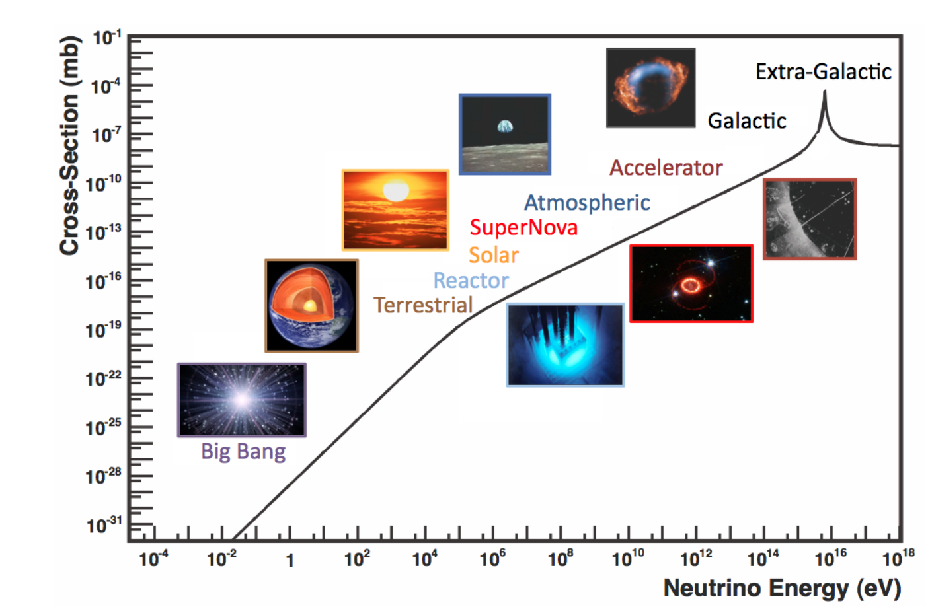
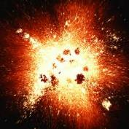
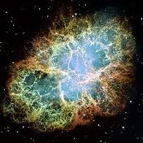
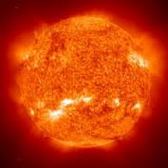
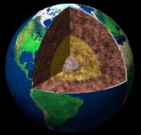
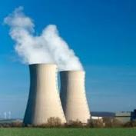
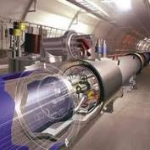
Neutrino Sources
Big Bang
Supernova
Solar
Atmospheric
Formaggio & Zeller, Rev. Mod. Phys. 84, 1307 (2012)
Earth
Human
Reactor
Accelerator
This talk focuses on supernova and atmospheric neutrinos

Slide 3
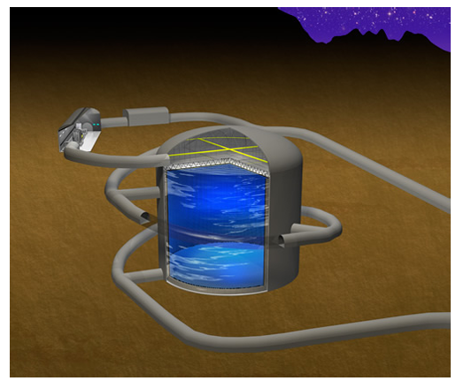
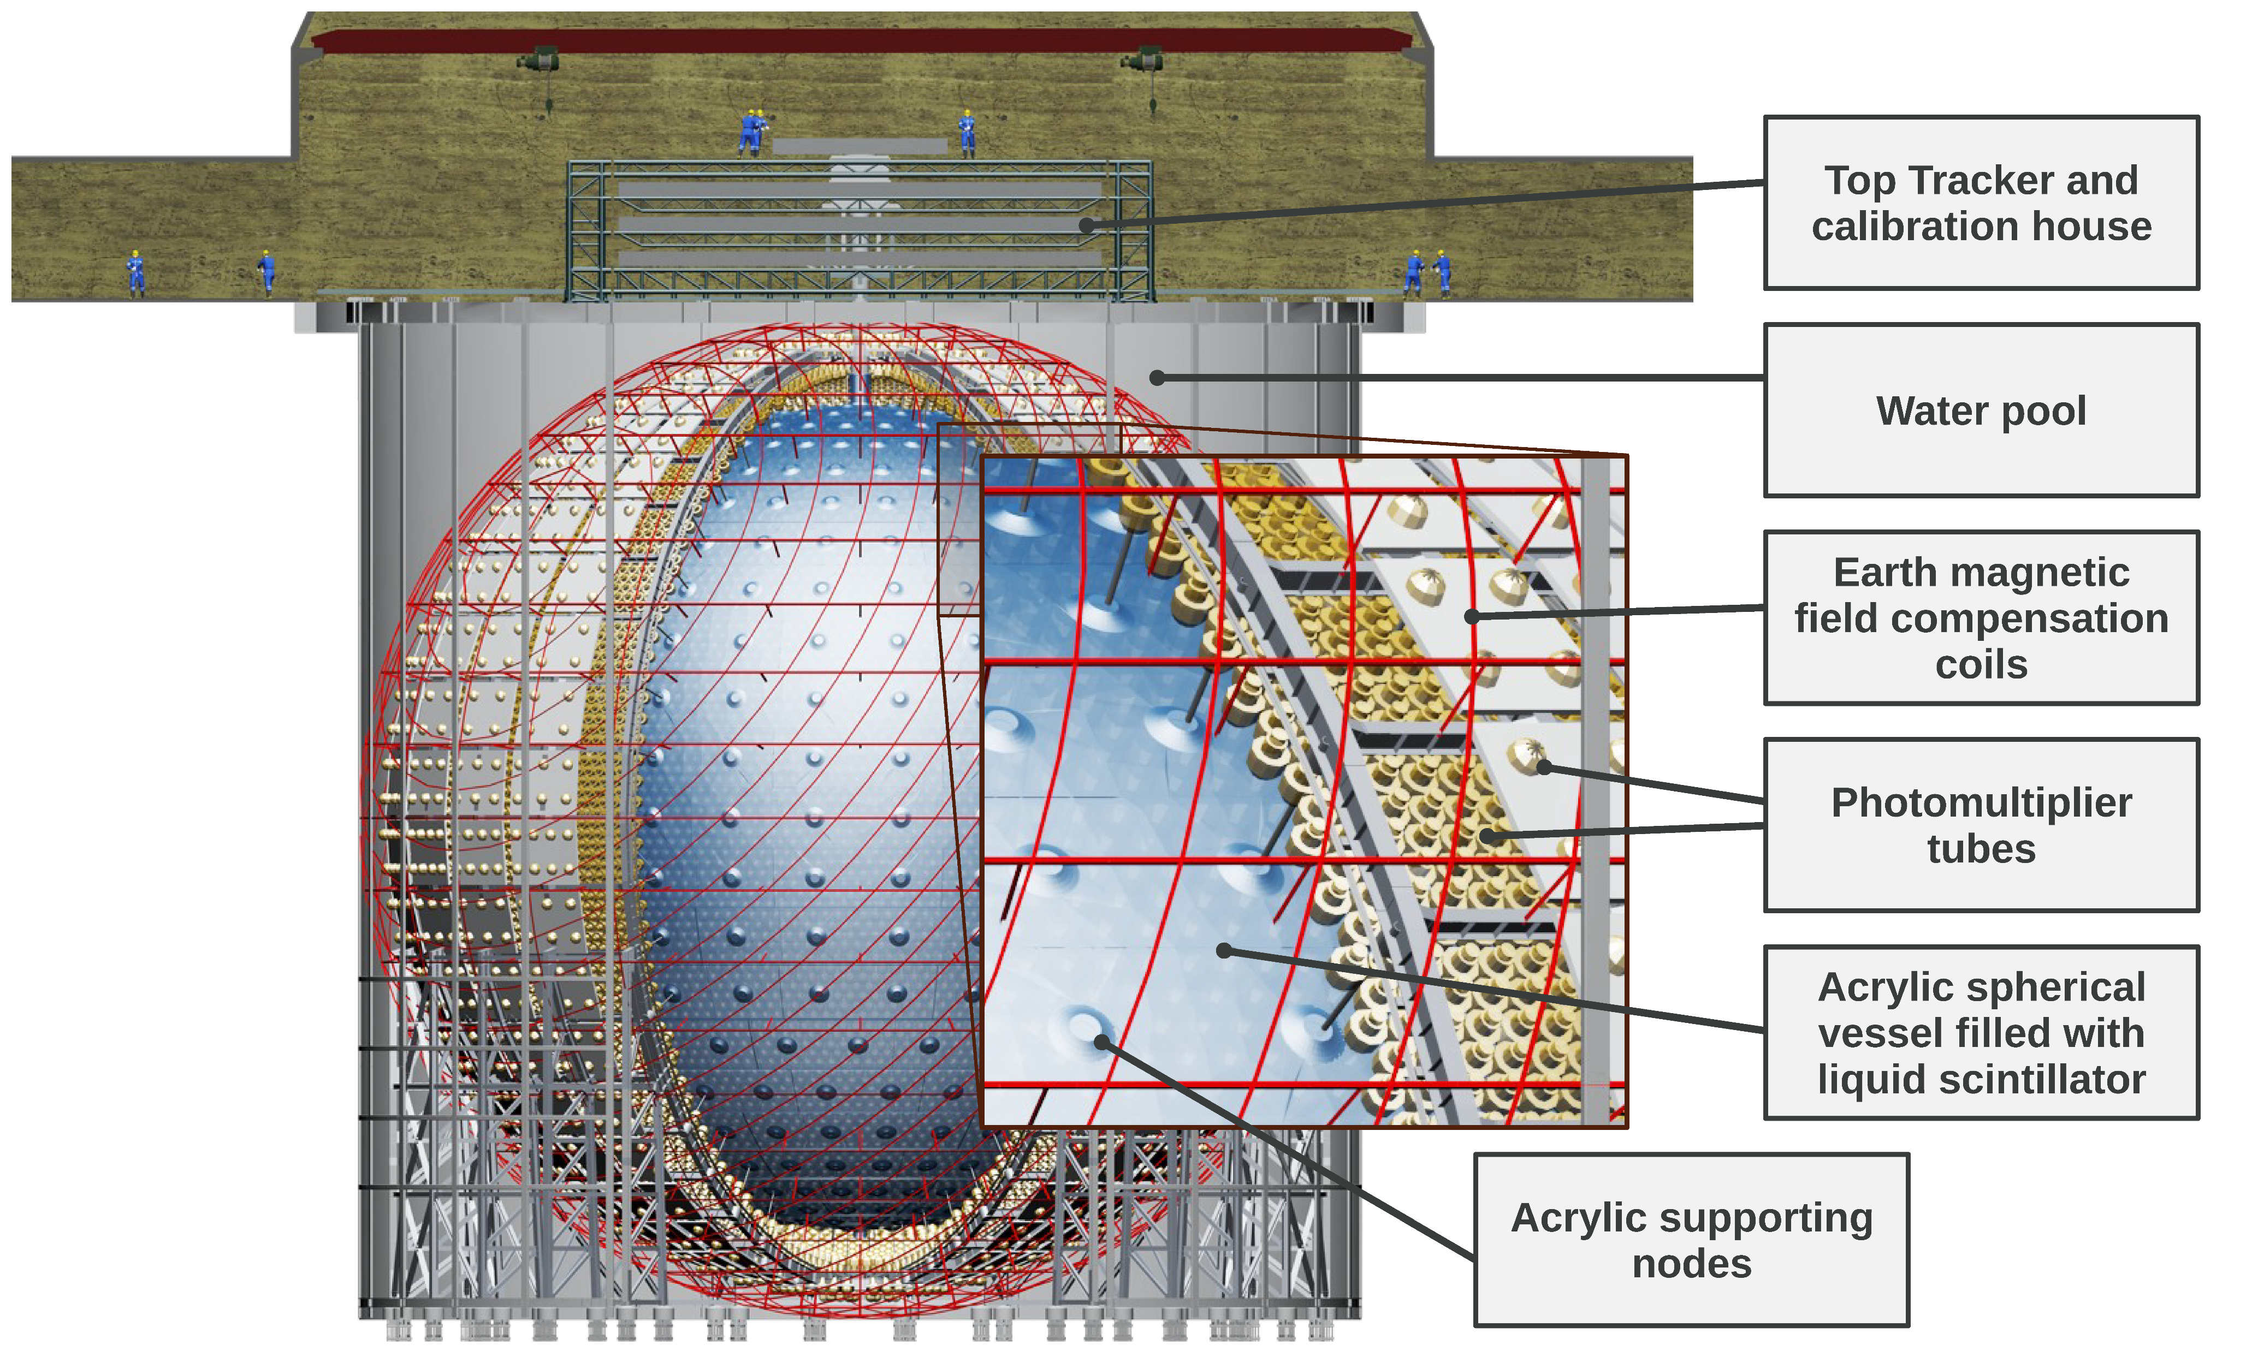
Next-generation Neutrino Detectors
Hyper-Kamiokande
Water detector
Target: ¹⁶O and H
DUNE
Liquid argon time-projection chamber detector
Main targets: Ar
JUNO
Liquid Scintillator (LS)
Main targets: ¹²C and H
Take the JUNO detector for example

Slide 4
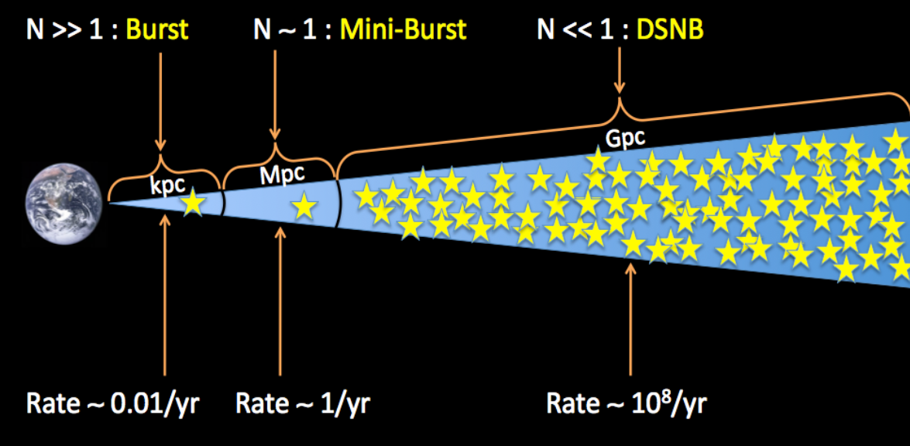
Neutrinos from Supernova
Expected number of observed supernova neutrinos
SN1987A
©J. Beacom
only neutrinos produced by SN1987A have been observed
DSNB is yet to be discovered
Supernova burst rate
Supernova neutrinos: studying the fate of stars, the evolution of the cosmos, element nucleosynthesis, and the nature of neutrinos, etc.
Two complementary methods:
Neutrinos from core-collapse supernova (CCSN) bursts within or near the Milky Way
High statistics , almost no background , rare Galactic SNe rate (2-3 / century)
Diffuse supernova neutrino background (DSNB): neutrinos from supernovae that have either exploded successfully or failed to explode in the cosmos , low event rate (e.g., ~2-4 IBD events / year @ JUNO)

Slide 5
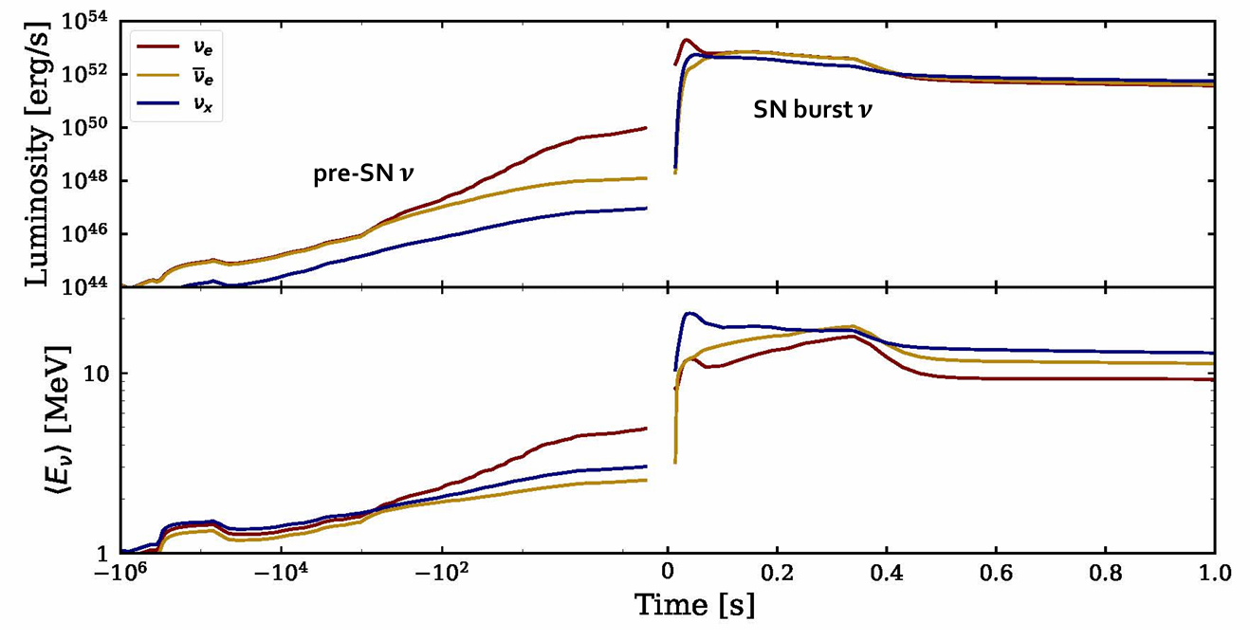
Neutrino Emissions from CCSN
Pre-supernova (pre-SN) neutrino:
Days before core-collapse
$\left\langle E_{ν}\right\rangle <2 MeV$
Supernova (SN) burst neutrino
~ $𝓞$(10 s)
$\left\langle E_{ν}\right\rangle \sim 𝓞\text{(10 }\text{MeV}\text{)}$
From Huiling Li @ neutrino 2020
Available pre-SN neutrino models:
Guo et.al, Phy. Lett. B 2019
kato et al, Astrophys. J. 848, no.1, 48 (2017)
Patton et.al, Astrophys. J. 851 (2017) 6
Available SN neutrino models:
Nakazato group, Astrophys. J. Suppl. 205 (2013) 2
Garching group, L. Hudepohl, Ph.D. thesis
⬆ Pre-SN neutrino model: kato et al,
⬆ SN burst neutrino model: Nakazato et al,

Slide 6
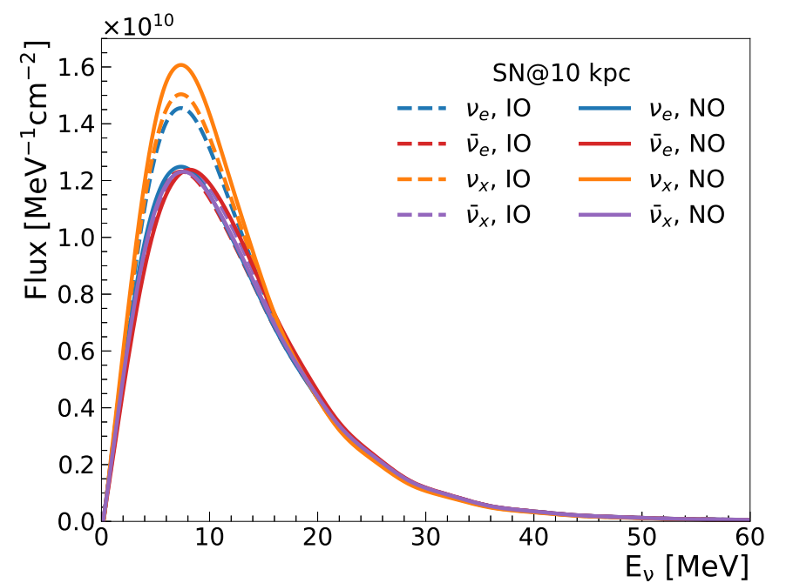
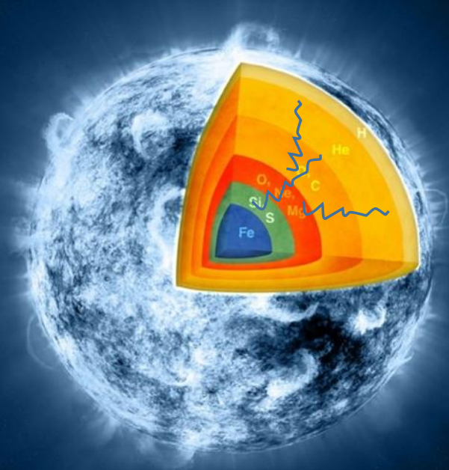
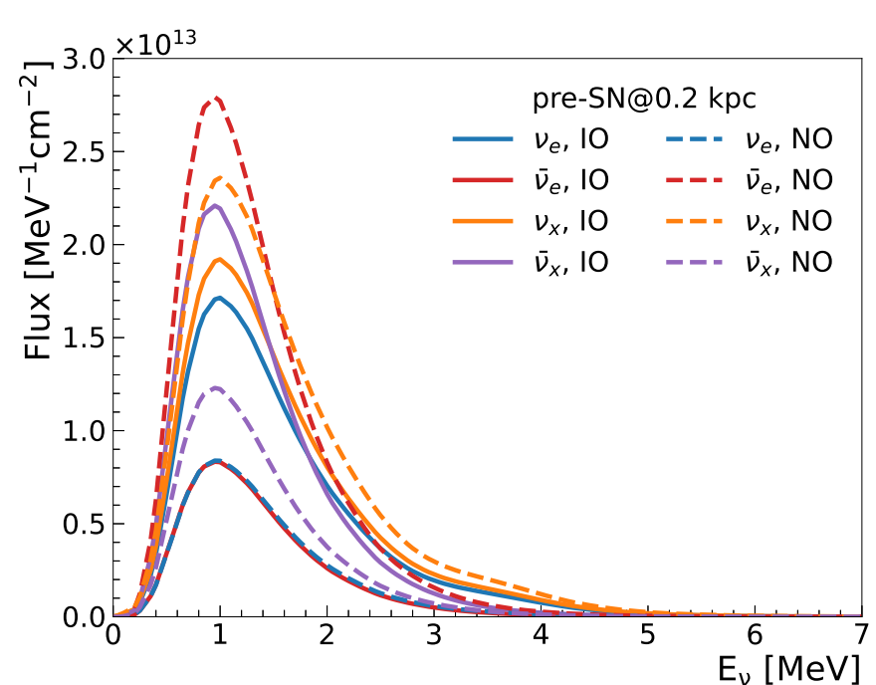
CCSN Neutrino Oscillation
JUNO, JCAP 01 (2024) 057
SN neutrinos:
Collective oscillation (?)
Unclear and temporarily neglect
MSW matter effects (√)
Adiabatic and depend on neutrino mass ordering
SN burst neutrino model: 30 $M_{⨀}$ Nakazato model
JUNO, JCAP 01 (2024) 057
Neutrino oscillation
Pre-SN neutrinos:
Collective oscillation (×)
Suppressed due to the low neutrino density
Mikheyev-Smirnov-Wolfenstein (MSW) matter effects (√)
Adiabatic and depend on neutrino mass ordering
Pre-SN neutrino model: 30 $M_{⨀}$ Patton model

Slide 7
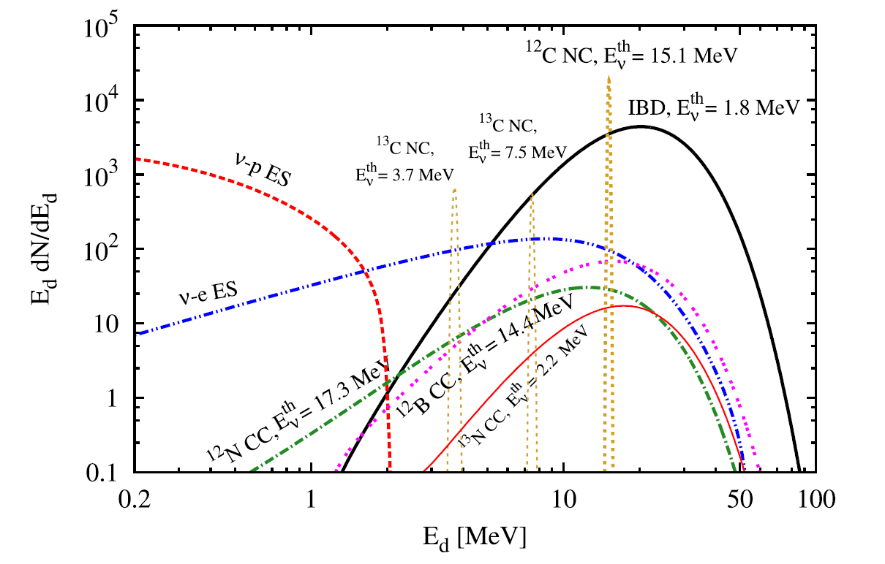
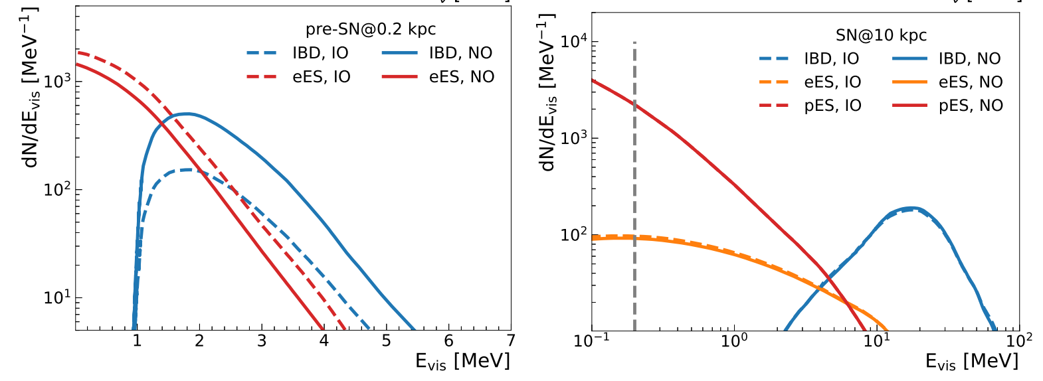
Detection of CCSN Neutrinos at JUNO
Expected CCSN neutrino energy spectra
SN distance @ 10 kpc
CCSN @ 10 kpc in JUNO [J. Phys. G43:030401 (2016) ]
Not accessible for pre-SN neutrinos
JUNO, JCAP 01 (2024) 057
JUNO can detect all flavors of neutrinos
Pre-SN neutrino model: 30 $M_{⨀}$ Patton model
⬅ SN burst neutrino model: 30 $M_{⨀}$ Nakazato model

Slide 8
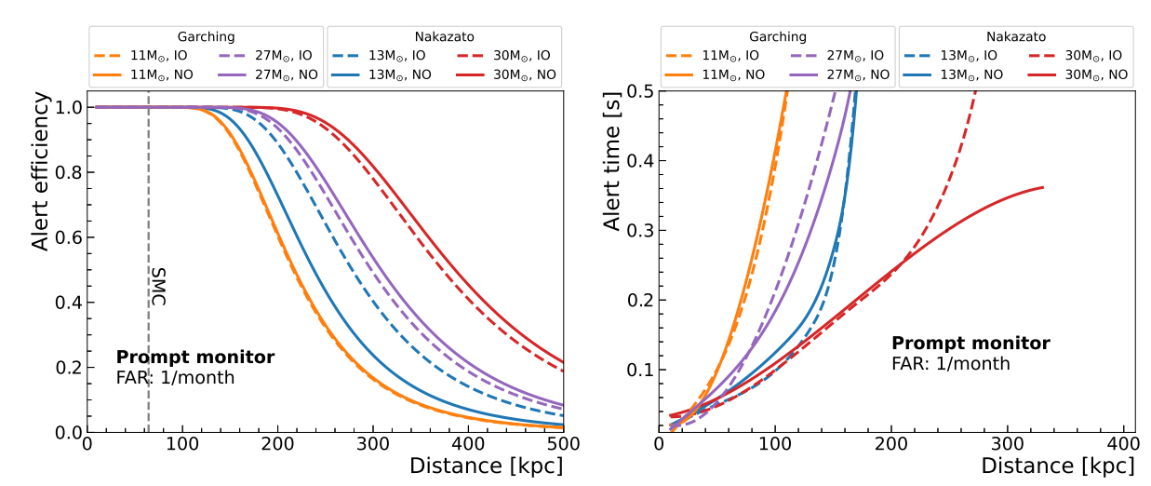
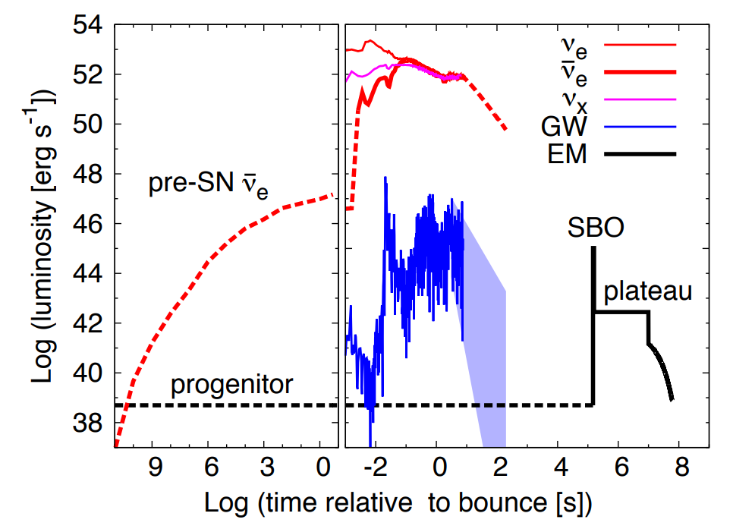
CCSN Monitoring System in JUNO
Multi-messengers of core-collapse supernova: electromagnetic signals, gravitational waves, neutrinos
Neutrino → early warning
Mon. Not. Roy. Astron. Soc. 461 (2016) 3
SN alert
SN alert
False alert rate
JUNO, JCAP 01 (2024) 057
Pre-SN monitor
Alert distance: 0.6 ~ 1.7 kpc with 50% alert efficiency
Alert time @ 0.2 kpc: > ~ 100 hr earlier
SN prompt monitor
Alert distance: 240 ~ 400 kpc with 50% alert efficiency
Alert time @ 10 kpc: 10 ~ 30 ms
A dedicated Multi-Messenger Trigger System is on the way

Slide 9
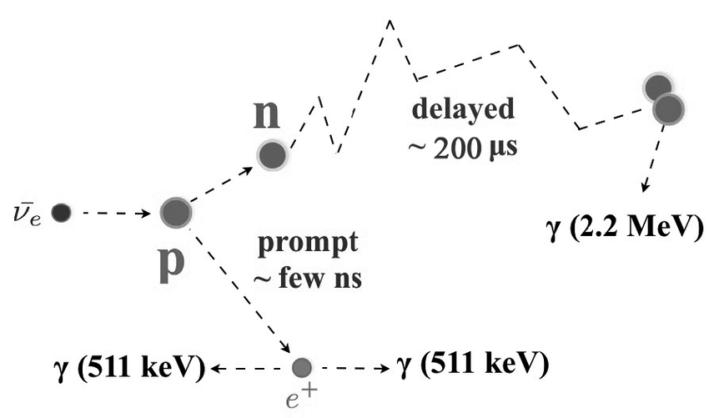
Diffuse Supernova Neutrino Background (DSNB)
DSNB flux
DSNB primary detection: inverse beta decay (IBD)
DSNB prompt visible spectra:
Average neutrino spectrum:
Failed SNe
Successful SNe
Three key (uncertain) parameters：
Supernova (SN) rate ($R_{SN}\left(0\right)$)
Average energy of SN neutrinos ($\left\langle E_{ν}\right\rangle$)
Fraction of black hole ($f_{BH}$)
Depend on cosmological evolution
Core-collapse supernova rate
Reference parameter value：
$\left\langle E_{ν}\right\rangle =15 MeV$
$f_{BH}=0.27$
$R_{SN}\left(0\right)=1.0×{10}^{−4}{yr}^{−1}{Mpc}^{−3}$
JUNO: nH capture
2-4 DSNB IBD events/year
Scan a reasonable parameter space for sensitivity studies
Measured energy
DSNB flux
Detector capabilities
Jacobian factor

Slide 10
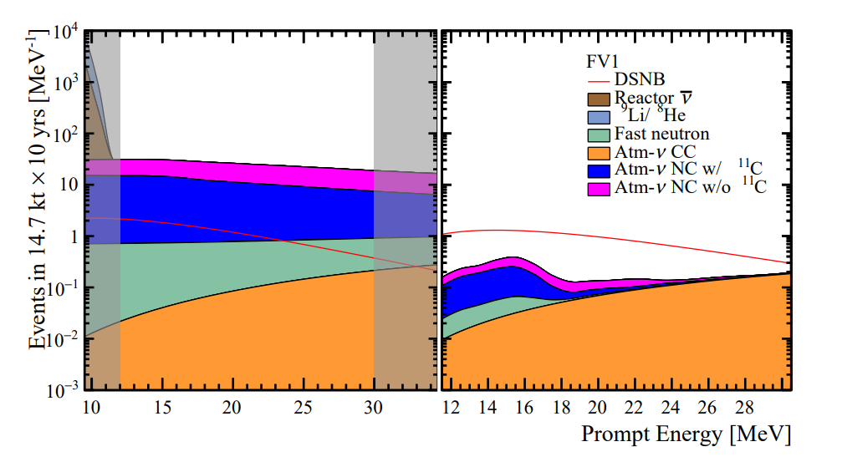
DSNB Detection at JUNO
Dominant background (above 12 MeV):
Atm-$ν$ NC interactions
Highlights on background suppression
Muon veto
Pulse shape discrimination (PSD) technique
Triple coincidence (¹¹C delayed decay)
JUNO, JCAP 10 (2022) 033
Before background suppression
After background suppression
Improvements compared to JUNO physics book J. Phys. G43:030401(2016) :
Background evaluation: 0.7 per year → 0.54 per year
PSD: signal efficiency 50%→80% (1% residual background)
Realistic DSNB signal model: non-zero fraction of failed Supernova
S/B ratio improved from 2 to 3.5

Slide 11
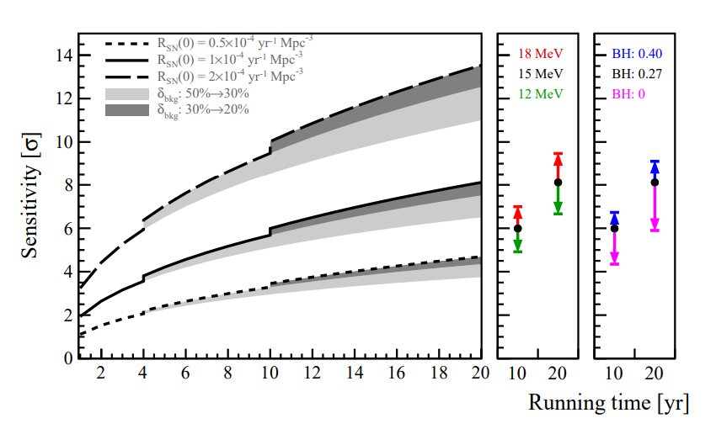
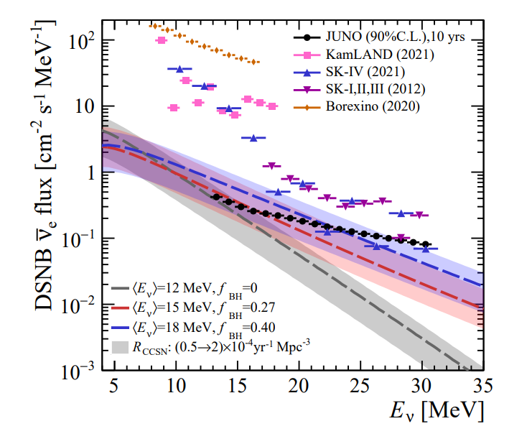
DSNB Sensitivity in JUNO
JUNO, JCAP 10 (2022) 033
Nominal model
Supernova (SN) rate ($R_{SN}\left(0\right)$)
Average energy of SN neutrinos ($\left\langle E_{ν}\right\rangle$)
Fraction of black hole ($f_{BH}$)
If no positive observation, JUNO can set the world-leading best limits of DSNB flux
With the nominal model (black solid curve (left plot)): 3$σ$ (3 yrs) and 6$σ$ (10 yrs)

Slide 12
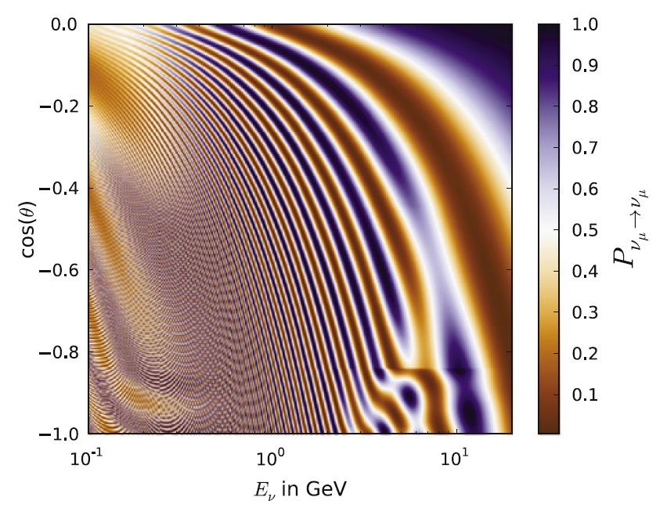
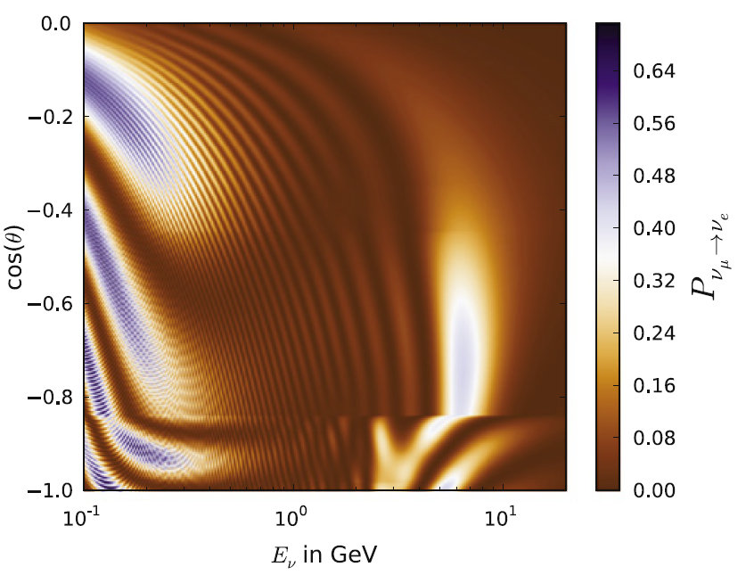
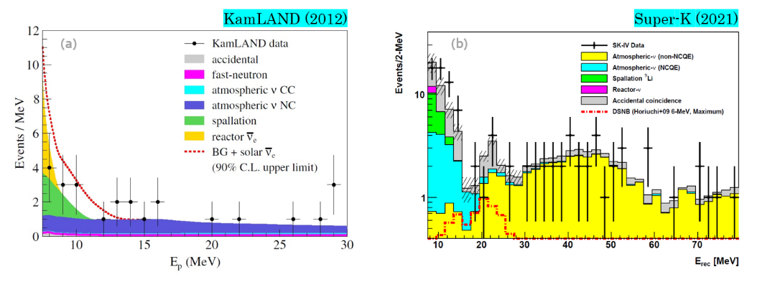
Atmospheric Neutrino
Important signal in neutrino oscillation study (discovery in 1998)
JUNO, J. Phys. G: Nucl. Part. Phys. 43 (2016) 030401
Kajita, Nobel Lecture
$δ_{cp}$= 0, NO
$δ_{cp}$= 0, NO
In the near future:
Important signal in neutrino oscillation study: Mass ordering, CP phase
Significant background in rare event researches: DSNB, proton decay, dark matter, etc.

Slide 13
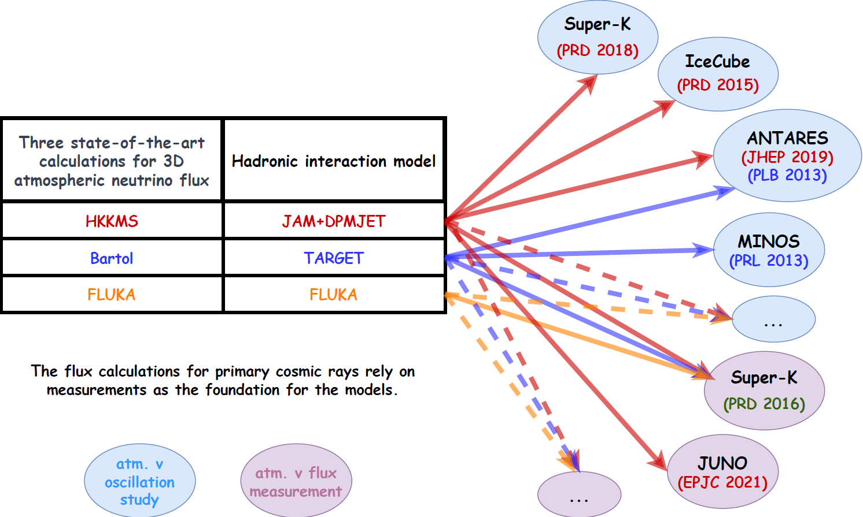
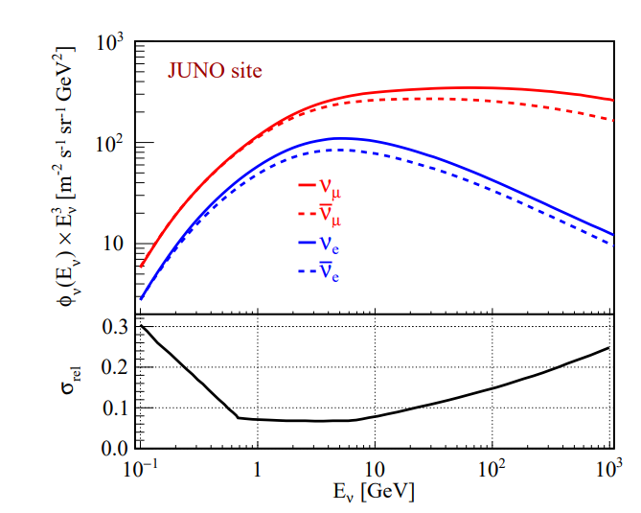
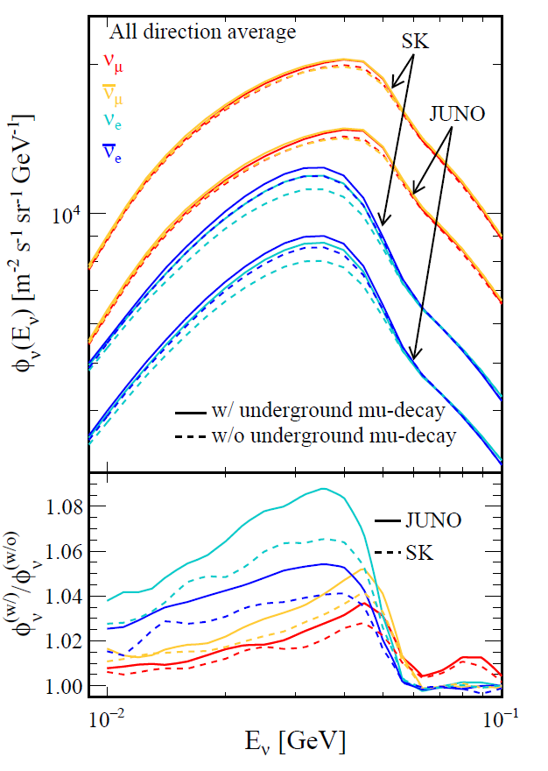
Atmospheric Neutrino: Flux
Phys.Rev.D 103 (2021) 5, 053001
JUNO site
Curtesy of the Honda Group
Jie Cheng@WANP2022
Sato Kazufumi@Neutrino2022
HKKMS atmospheric neutrino flux model for JUNO
Flux calculation developed from 10 MeV to 100GeV

Slide 14
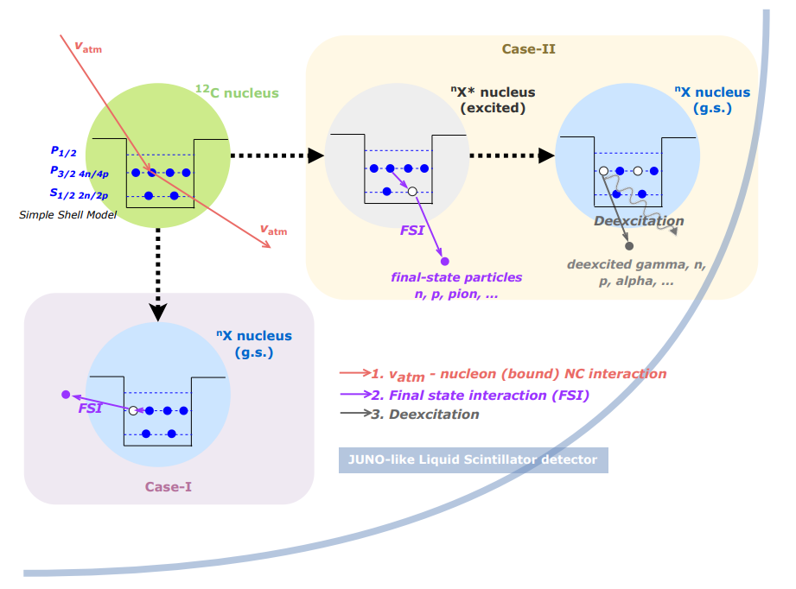
Methodology for Atm-$ν$ and ¹²C Interaction Prediction
Cheng et al, Phys. Rev. D 103. 05001 (2021)
Cheng et al, arXiv 2404.07429
GENIE, NuWro, etc.
Neutrino Interaction in LS
Residual nucleus is excited
TALYS
De-excitation of Residual nucleus
Residual nucleus is g.s.
Decay of Residual nucleus
Geant4
Detector simulation
$$N_{det}= φ ⨂{ }P ⨂{ σ} ⨂{ ε}$$
Atm-$ν$ measurement
Taking neutral-current (NC) interaction for example
Detector efficiency
Neutrino flux
Oscillation probability
Cross section
of $v_{x}+12C$

Slide 15
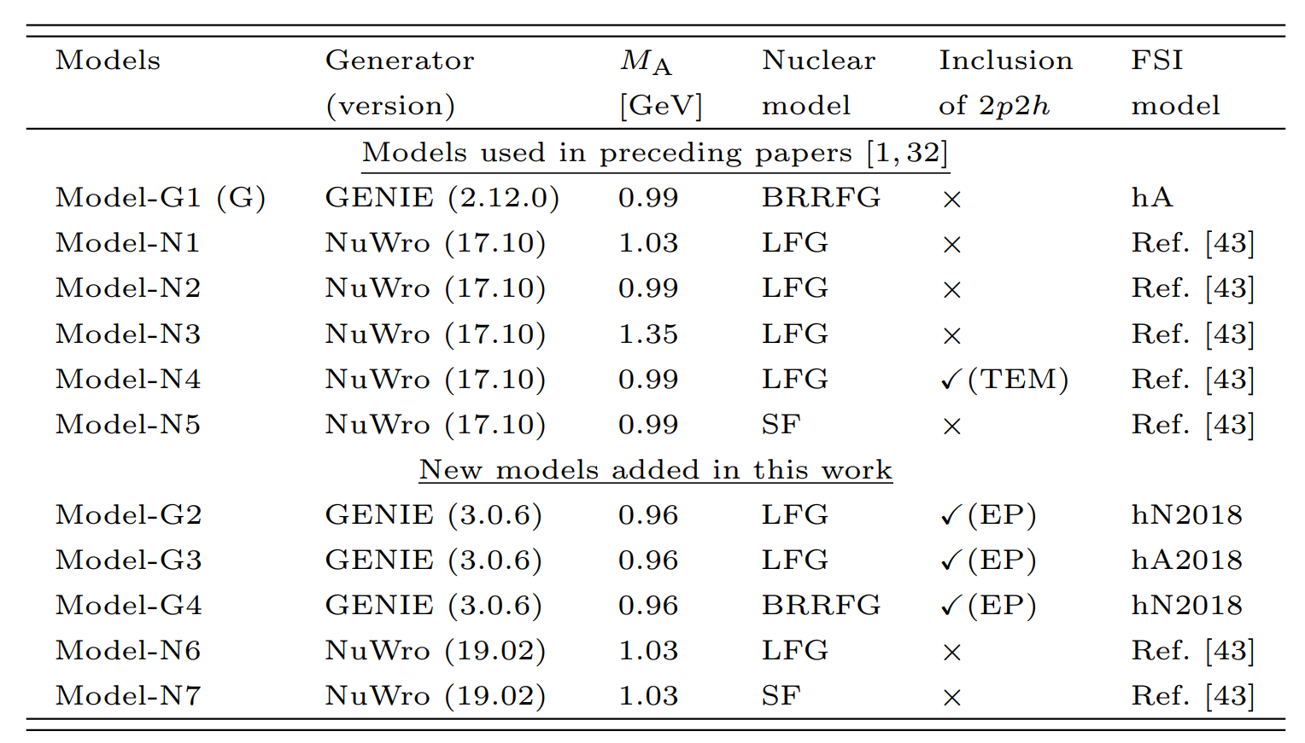
Neutrino Generator Models
Summary of the main features of models used in early and recent stages
for QE
Validated with MINERvA data
https://zenodo.org/records/6774990
Investigate the impact of different generators, nuclear model, FSI models on the prediction
All processes are included, new models primarily focus on variations related to QE and do not fully explore variations related to RES, COH, and DIS
Plan to include GiBUU and NEUT in our calculation

Slide 16
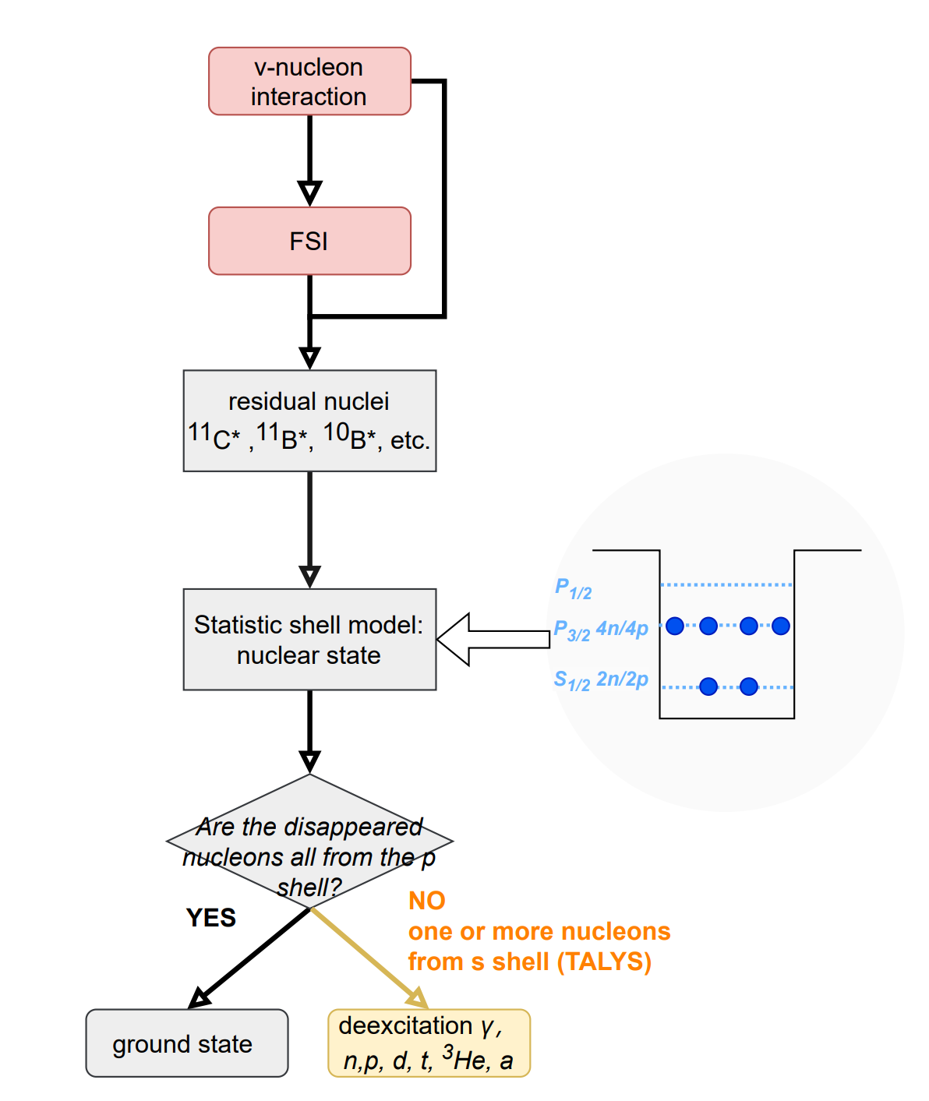
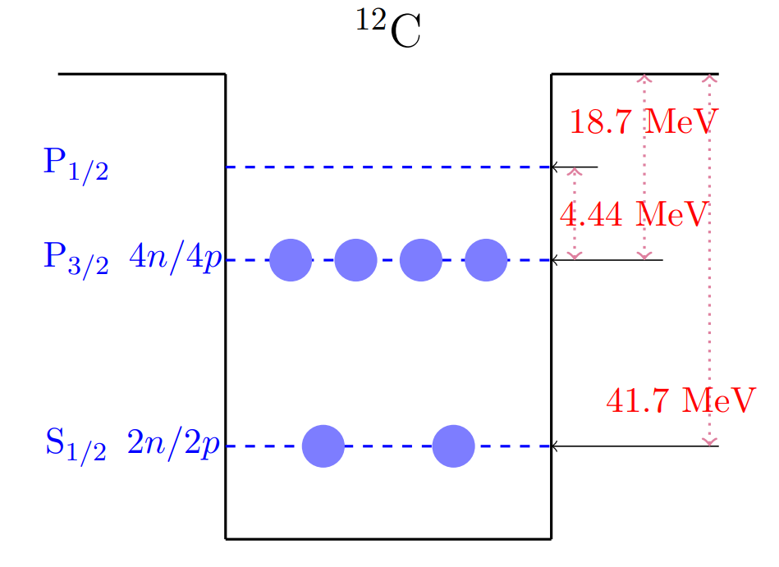
TALYS-based Deexcitation Model of Residual Nucleus
Simple shell model → Status of the residual nuclei
Phys. Rev. D 67 (2003) 076007
All residual nuclei with A>5 have been considered
Go beyond simple shell model
considering the correlation between P shell (P_{1/2} and P_{3/2})
will be implemented
2. TALYS → Simulate residual nucleus at certain high excited energy

Slide 17
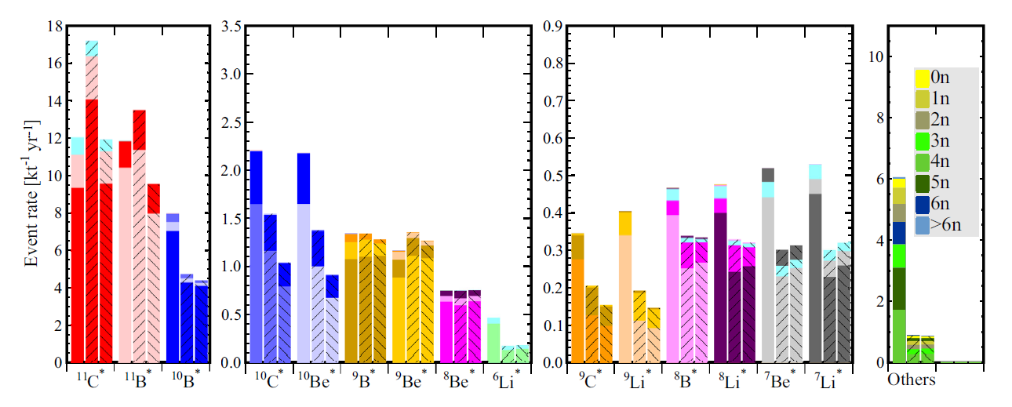
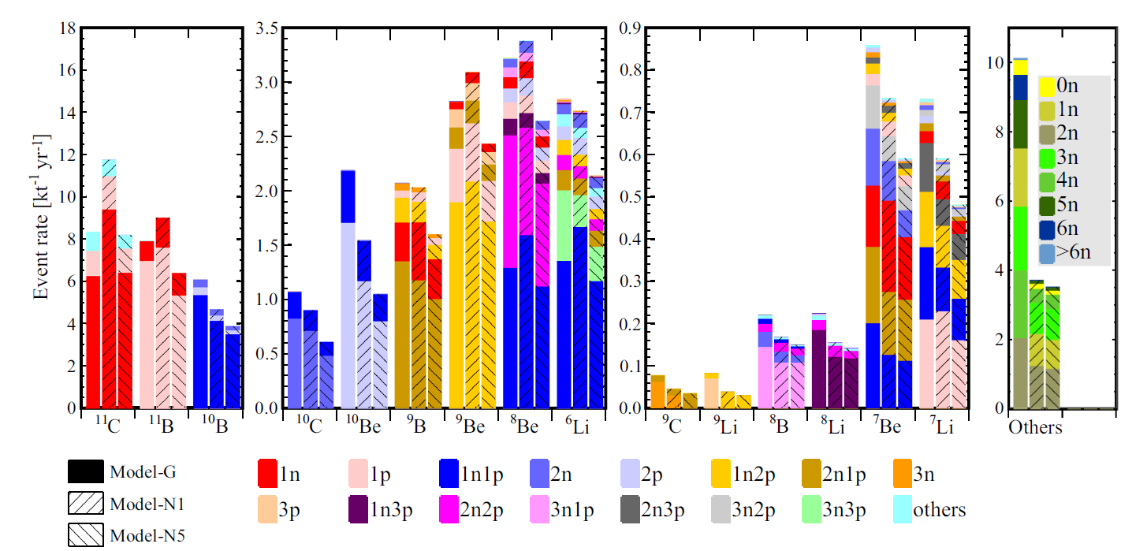
Impact of Deexcitation on Final-state Production of NC Events
Cheng et al, Phys. Rev. D 103. 05001 (2021)
Before deexcitation, ¹¹C, ¹¹B, ¹⁰B dominated
After deexcitation , ¹¹C, ¹¹B, ¹⁰B reduced, with more lighter nuclei
Exclusive final-state information, such as the neutron multiplicity, the charge pion multiplicity, the unstable nuclei, is important for tagging and reducing the background

Slide 18
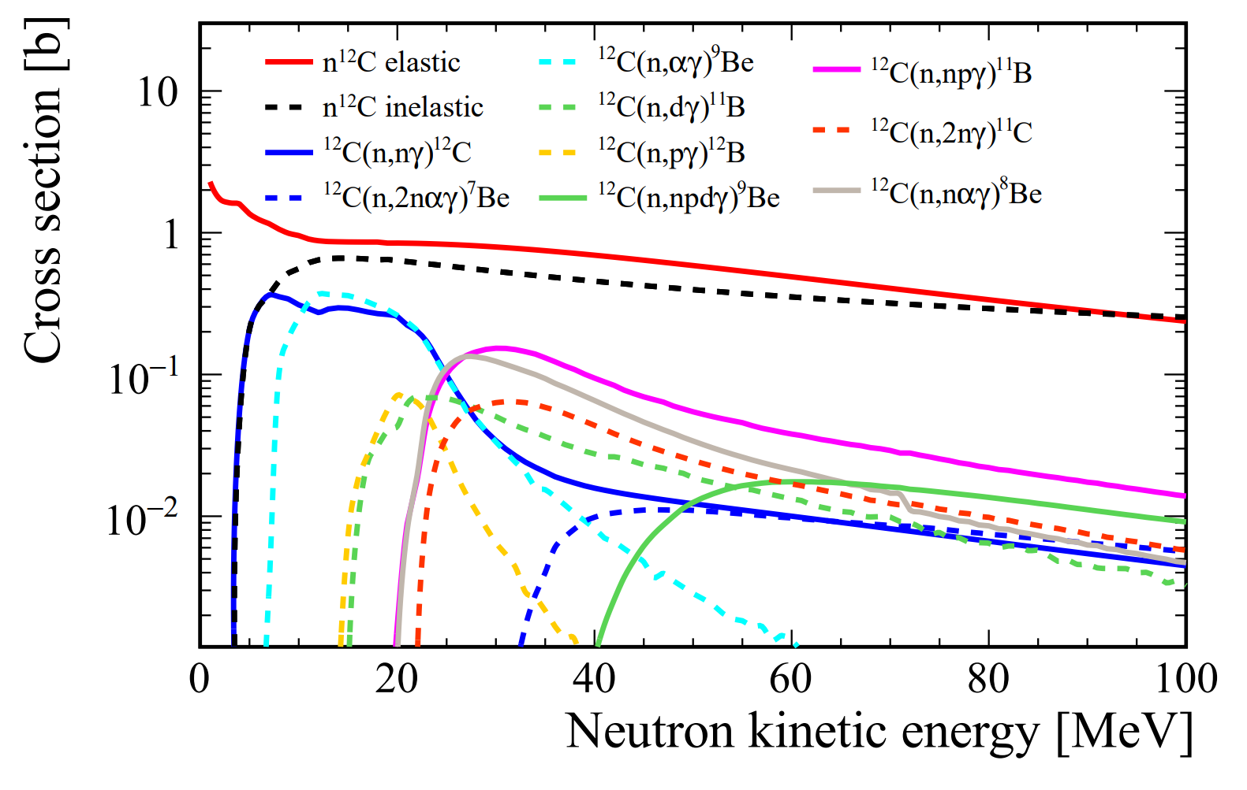
GEANT4-based Detector Simulation
GEANT4 (4.10.p02)➔ simulate the propagation of final-state particles in LS
Hadronic models: QGSP_BERT_HP
JUNO detector as our reference
Considering decay processes of unstable isotopes after deexciation stage in detector simulation
Secondary interactions (SI): final-state particles produced by a primary interaction, subsequently interact within the LS
Neutron tagging takes place after the SI
Tagged neutrons $≠$ final-state neutrons
arXiv 2311.16550
Extracted from the results of TALYS

Slide 19
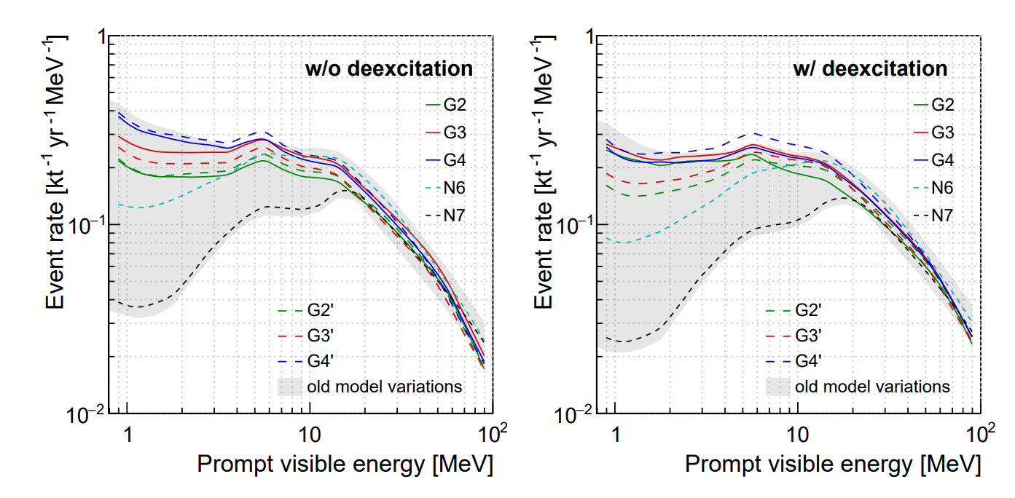
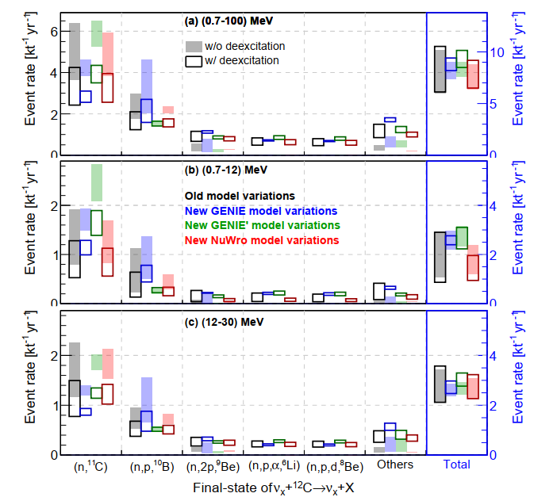
IBD-like NC Background
Cheng et al, arXiv 2404.07429
Reactor neutrino energy range
DSNB energy range
Focus on the prompt visible energy below 100 MeV
Large model variation in energy < 20 MeV, the model prediction lack sufficient experimental constraints.
With deexcitation,
energy spectra shift to higher energies and enlarge the model variations
dominant channels with ¹¹C and ¹⁰B reduce, and channels with lighter nuclei increase
The NC background rate with deexcitation as the nominal result
First detailed calculation of atm-v NC background in reactor neutrino energy range

Slide 20
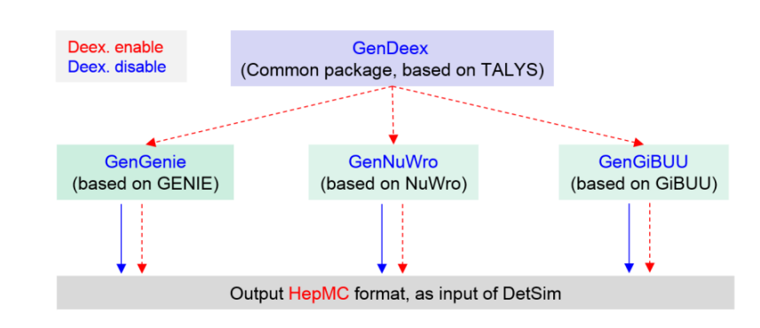
GeV Neutrino Event Generator-DetSim Interface at JUNO
GenNEUT (on-going)
(based on NEUT)
GANYMEDE (GeV neutrino interaction) group is established to deeply understand the GeV neutrino interaction
Work on the latest versions of GENIE, NuWro, GiBUU, NEUT, and integrating them into the JUNO offline software framework.

Slide 21
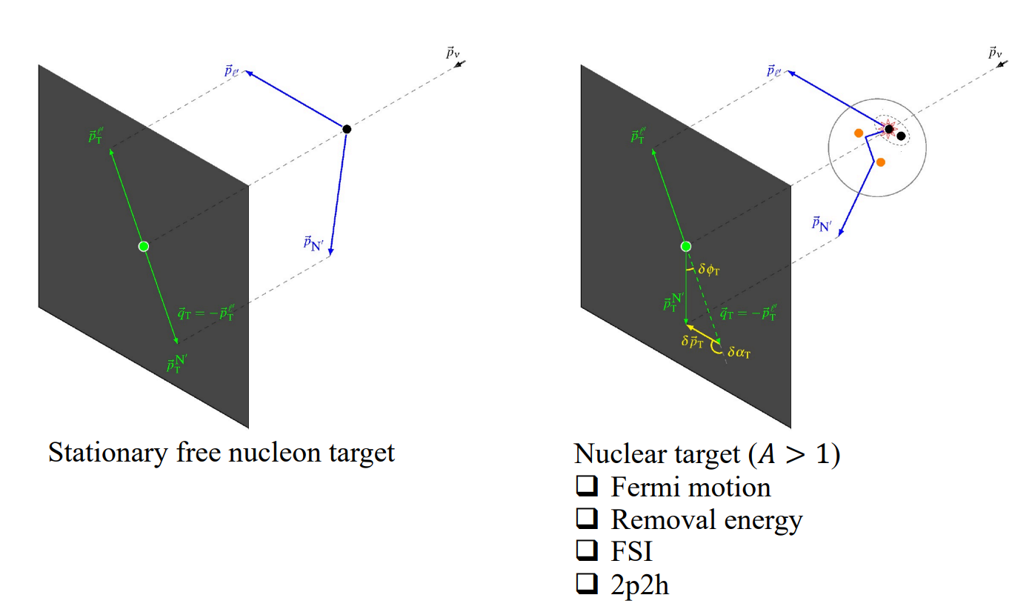
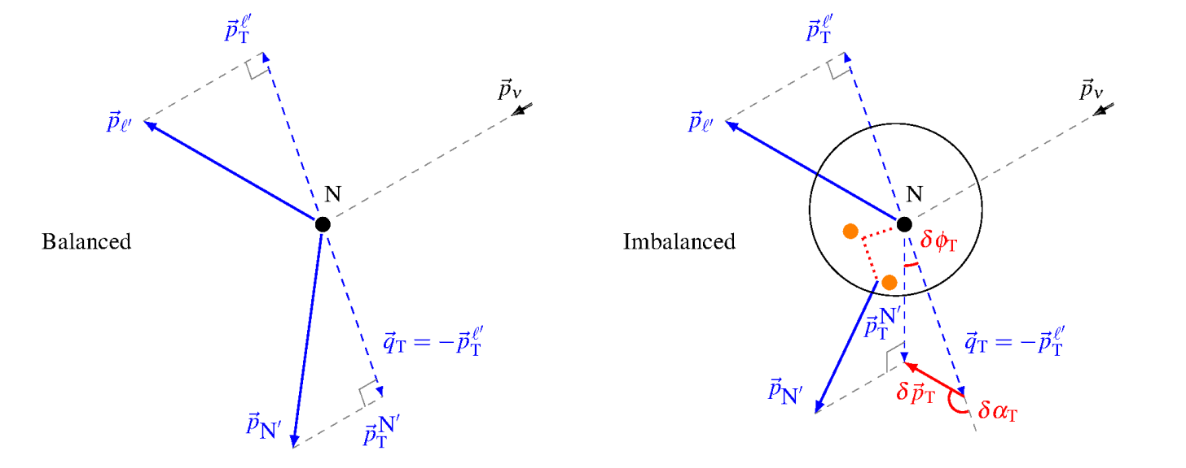
Constraining Neutrino Interactions → Transverse Kinematic Imbalance (TKI)
TKI: precisely identify intranuclear dynamics, or the absence thereof, in neutrino-nucleus interactions – an analogue of the missing energy technique used in collider experiments.
Furmanski-Sobczyk emulated nucleon momentum p_{n}： the Fermi motion of the struck nucleon
Transverse boosting angle $δα_{T}$： the direction of$δp_{T}$

Slide 22
Generator Performance in TKI
Cheng, Qu, Wen, Lu @ neutrino 2022
Predictions of TKI by GENIE, GiBUU, NuWro compared to the MINERvA $π^{0}$ measurement
Provide reference models

Slide 23
Summary and Prospects
Supernova neutrino and atmospheric neutrino generators are important (necessary) tools to forecast what’s happened if these neutrinos attend the detectors
Deeply understand neutrino flux, propagation (oscillation), cross section, as well as the detector response
Introduce more reliable (or data-driven) models into the neutrino experiment
➔For atmospheric (GeV) neutrino, develop
Flux calculation at low energies
Neutrino interactions (including de-excitation)
Not only rely on the model predictions, but also seek measurements to tune the model and constrain the associated uncertainty
JUNO
…
Thank you!

Slide 24
backup

