Slide 1

Neutrino Theory in the Precision Era
Shun Zhou
(IHEP & UCAS, Beijing)
Neutrino Scattering: Theory, Experiment & Phenomenology (νSTEP)
@ HIAS, Hangzhou, 2024-5-18

Slide 2
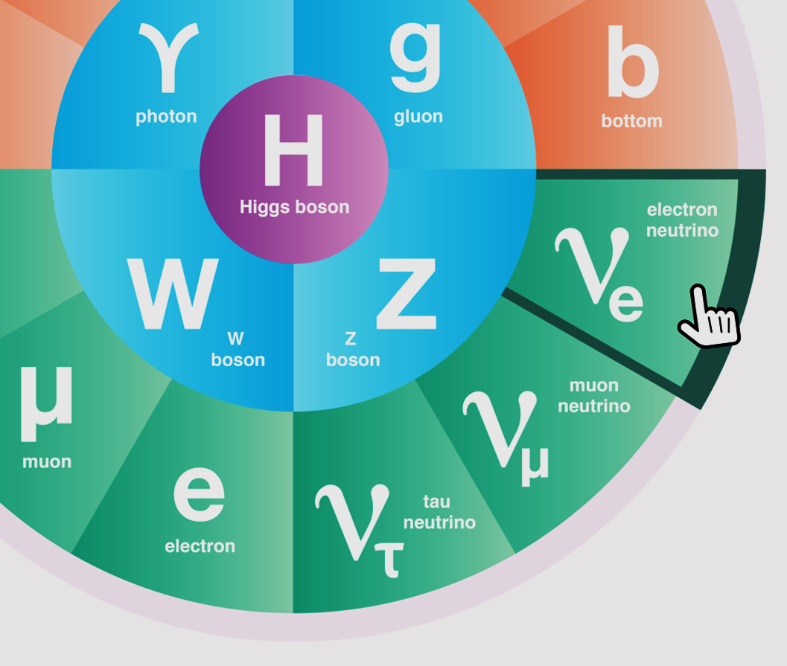
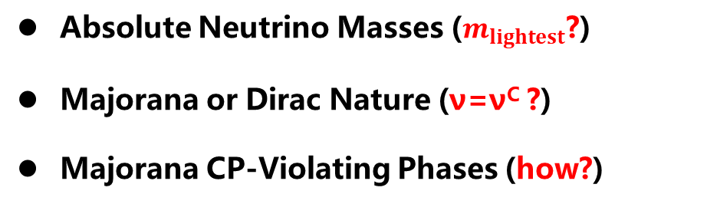
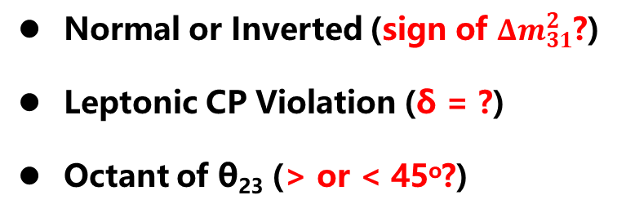
Open Questions in Neutrino Physics
Normal or Inverted (sign of ${Δm}_{31}^{2}$?)
Leptonic CP Violation (δ = ?)
Octant of θ₂₃ (> or < 45º?)
Absolute Neutrino Masses ($m_{lightest}$?)
Majorana or Dirac Nature (ν=ν^{C} ?)
Majorana CP-Violating Phases (how?)
Extra Neutrino Species
Exotic Neutrino Interactions
Various LNV & LFV Processes
Leptonic Unitarity Violation
Origin of Neutrino Masses
Flavor Structure (Symmetry)
Quark-Lepton Connection
Baryon Number Asymmetry

Slide 3
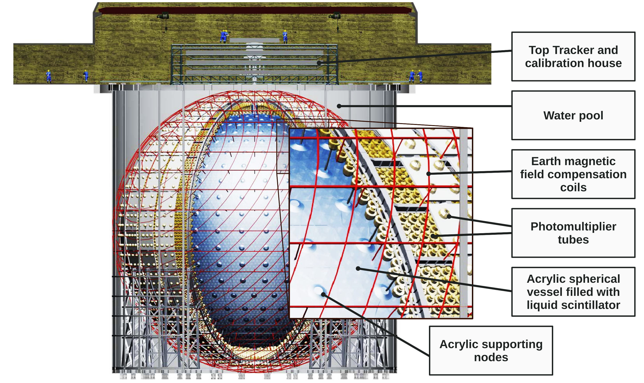
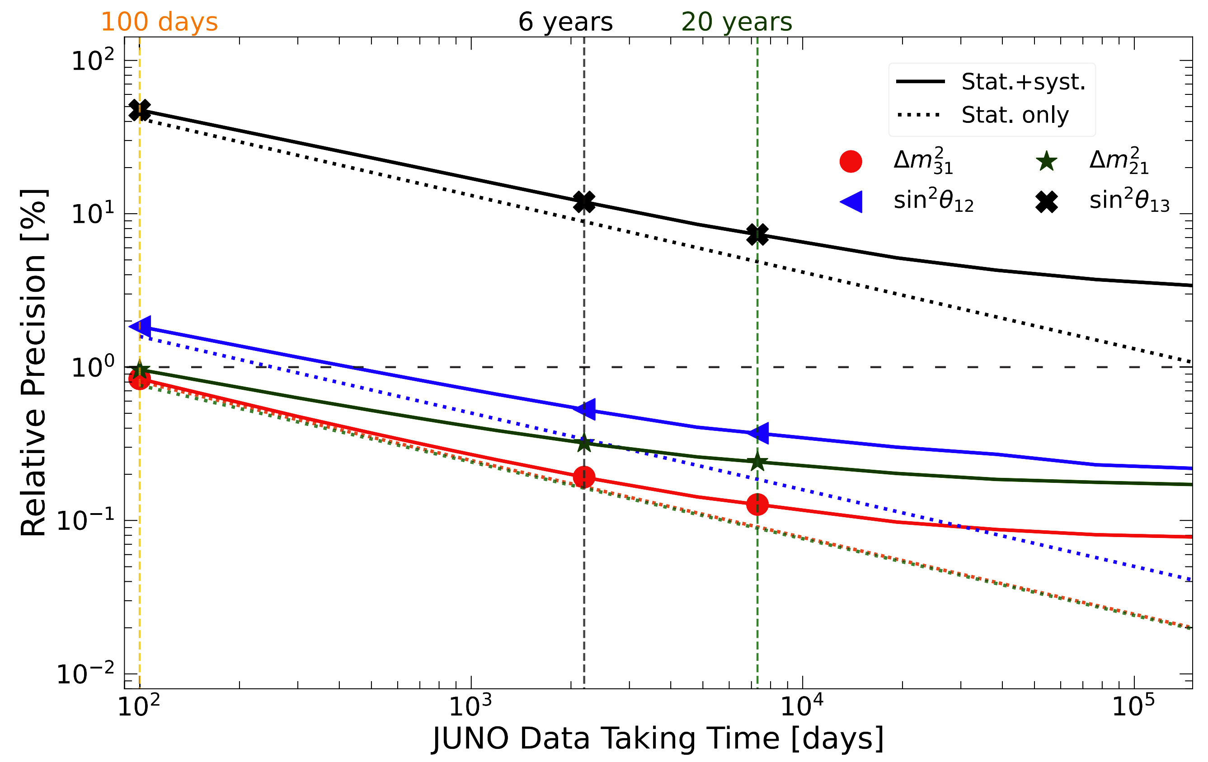
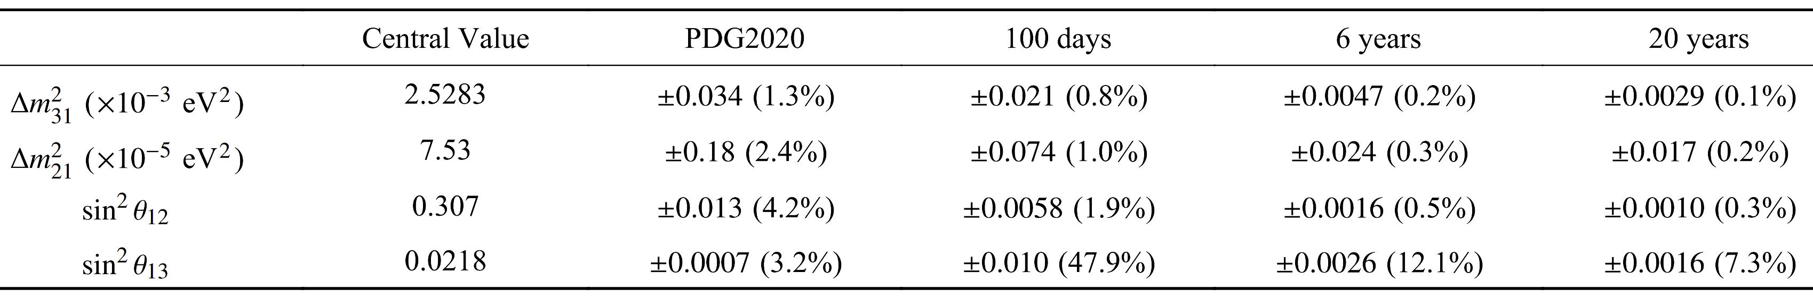
Motivation
JUNO: to be completed in 2024, data-taking in 2025
20 kiloton liquid-scintillator (LS)
Chin. Phys. C 46, 123001 (2022)
Sub-percent precision at JUNO
After 6-year running, 3~4σ for neutrino mass ordering at JUNO (+Solar/Geo/SN ν)
Meanwhile precision of three oscillation parameters improved to sub-percent level
Neutrino scattering with matter (e.g., proton, electron, carbon) in large LS detector

Slide 4
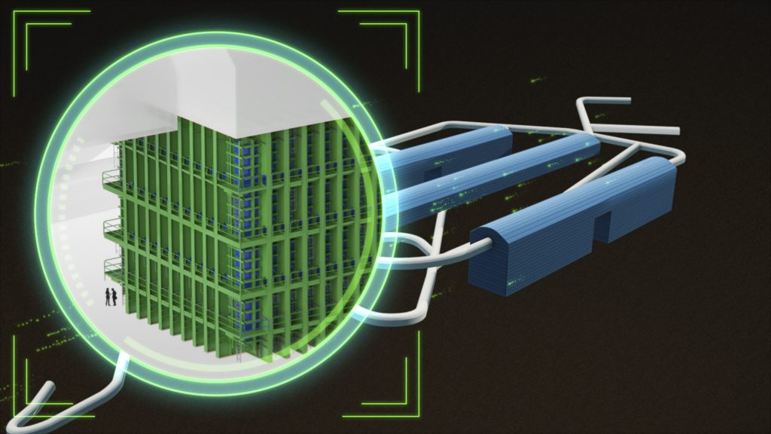
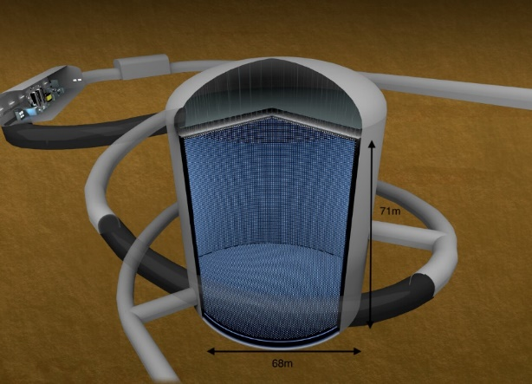

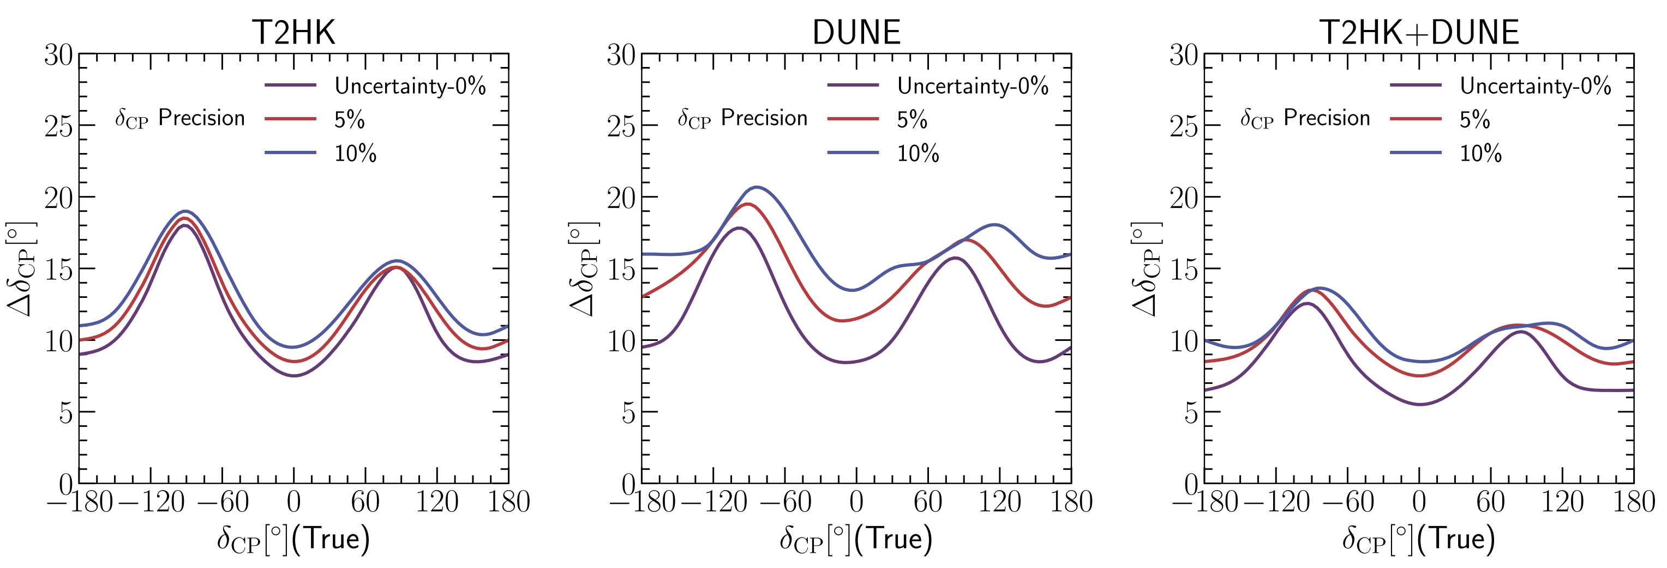
Motivation
DUNE: late 2020s, 34 kt liquid-Argon
Hyper-K: 2027, 260 kt water-Cherenkov
Ghosh, Yasuda, NPB, 23

Slide 5
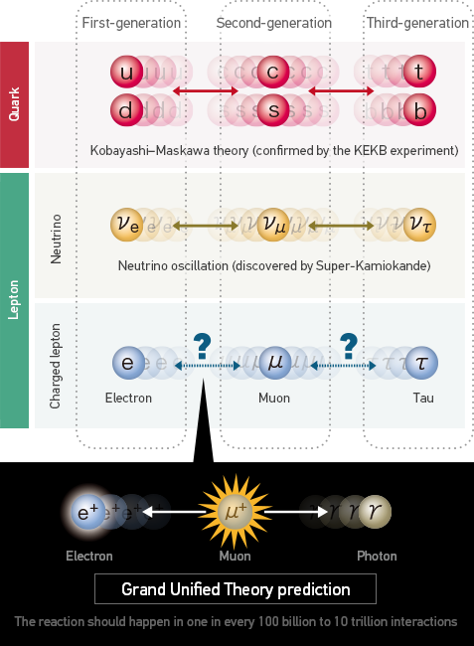
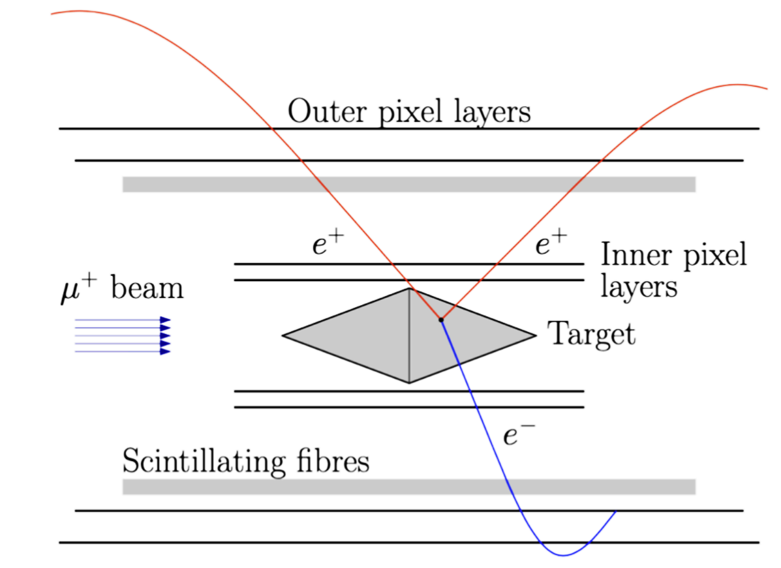
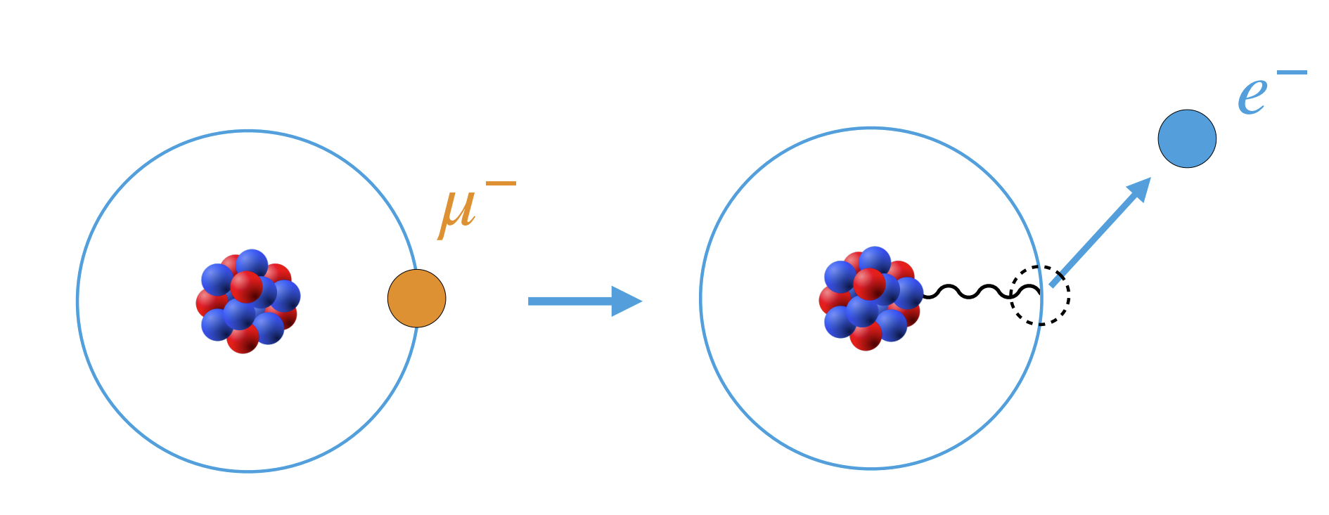




Motivation
Charged-lepton Flavor Violation
Bernstein & Cooper, Phys. Rep. 532 (2013) 27
Villanueva @ FPCP 22
$$B\left(μ→eγ\right)<{10}^{−14}$$
$$B\left(μ→3e\right)<{10}^{−16}$$
$$B\left(μN→eN\right)<{10}^{−17}$$
$$<{10}^{−19}$$
LFV decays of Z & H @ CEPC & FCCee

Slide 6
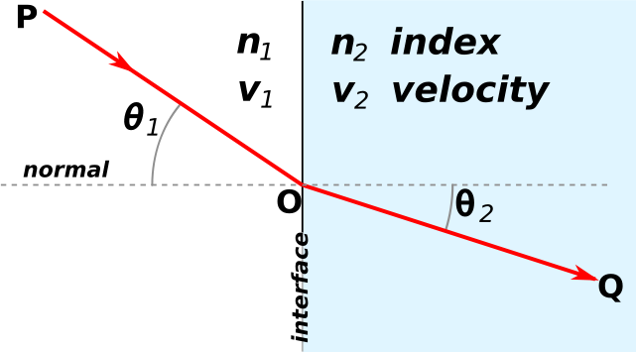
Part A: Wolfenstein Potential @ One Loop
W
Refraction of light in media
Refraction of neutrinos in media, where both CC and NC interactions contribute to refractive indices (not far from 1)
CC-potential
NC-potential

Slide 7



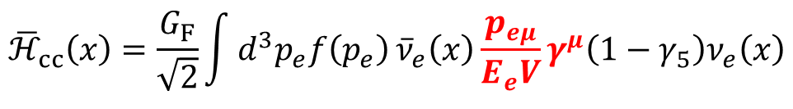





Solar Neutrino Problem
Contribute to the energy of left-handed neutrinos
$${\overline{ℋ}}_{cc}\left(x\right)=\frac{G_{F}}{\sqrt{2}}\int{d^{3}p_{e}f\left(p_{e}\right)}{\overline{ν}}_{e}\left(x\right)\frac{p_{eμ}}{E_{e}V}γ^{μ}\left(1−γ_{5}\right)ν_{e}\left(x\right)$$
$$={\sqrt{2}G}_{F}N_{e}ν_{eL}^{†}\left(x\right)ν_{eL}\left(x\right)$$
$$V_{CC}={\sqrt{2}G}_{F}N_{e}$$
Why is the matter potential important for neutrino oscillations?
For example, consider solar ⁸B neutrinos of E = 10 MeV with the net electron number density $N_{e}=100 N_{A}/{cm}^{3}$ for $ρ=150 g/{cm}^{3}$ in the solar center
$V_{CC}={\sqrt{2}G}_{F}N_{e}≈7.5×{10}^{−12}$ $eV$
$$ν_{e}$$
Giunti & Kim, 2007
$$A={2\sqrt{2}G}_{F}N_{e}E≈1.5×{10}^{−4} {eV}^{2}$$
$$ν_{2}$$
comparable
$${Δm}_{21}^{2}=7.5×{10}^{−5} {eV}^{2}$$
$${\tilde{m}}_{2}^{2}$$
Mikheyev-Smirnov-Wolfenstein (MSW)
$$ν_{1}$$
M
S
W
$${\tilde{m}}_{1}^{2}$$

Slide 8
Matter Potential @ One Loop
ordinary matter
extremely small
But changes dramatically flavor content of SN neutrinos in the envelope 𝝆=𝟏𝟎⁶ 𝐠/𝐜𝐦^{𝟑}
Why not a complete one-loop calculation?

Slide 9
Matter Potential @ One Loop
Strategy for one-loop calculations of the matter potential
NC couplings in the Standard Model (SM)
Extract one-loop corrections to couplings from the renormalized amplitudes
Dimensional regularization and on-shell renormalization scheme
Physical parameters: the EM fine-structure constant and particle masses
Aoki et al., 82; Bohm, Spiesberger, Hollik, 86; Hollik, 90; Denner, 93

Slide 10
Matter Potential @ One Loop
Tree & one-loop diagrams for the CC potential
Jihong Huang, SZ, PRD, 23
Finite corrections to CC couplings
Tree & one-loop diagrams for the NC potential
Finite corrections to NC couplings

Slide 11
Matter Potential @ One Loop
One example for the f-f-Z vertex
Jihong Huang, SZ, PRD, 23

Slide 12
Matter Potential @ One Loop
Corrections to the NC couplings
Jihong Huang, SZ, PRD, 23
Estimate of one-loop correction
Corrections to the CC couplings
In conclusion, the one-loop correction to the CC potential is 5.8%, while that for the NC potential is 8.2%. Go further and calculate more observables!

Slide 13
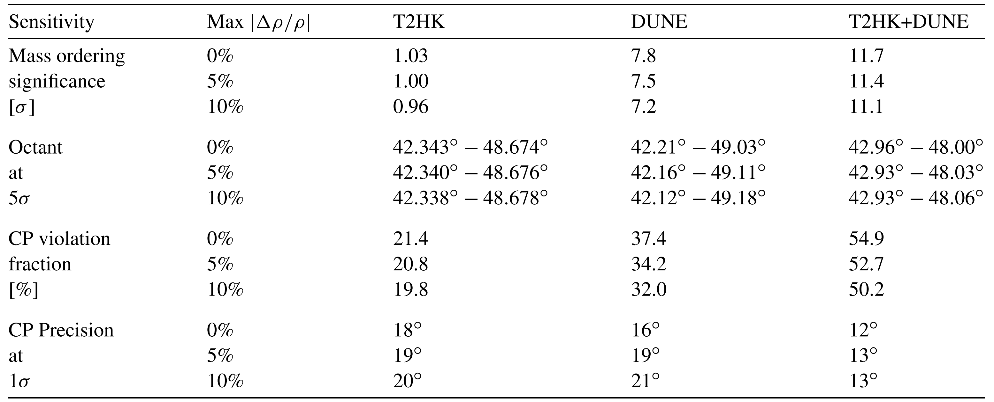
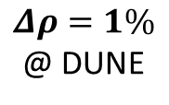
Matter Potential @ One Loop
Impact on the precision measurement of the CP-violating phase
Ghosh, Yasuda, NPB, 23
Uncertainty on the matter density
One-loop corrections
$Δρ=1\%$ @ DUNE

Slide 14
Part B: Seesaw EFT @ One Loop
Extend the SM with new particles but keep its gauge symmetries intact
Ohlsson, SZ, Nat. Commun., 2014

Slide 15
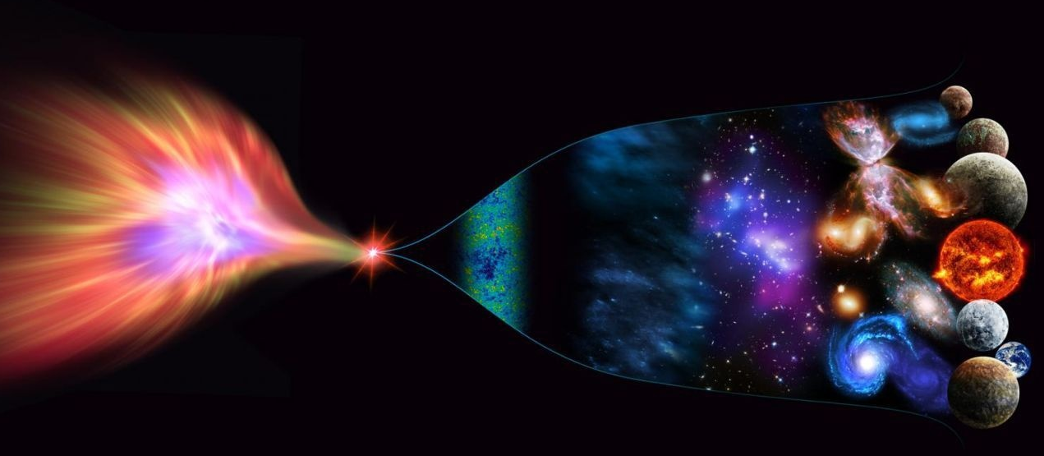
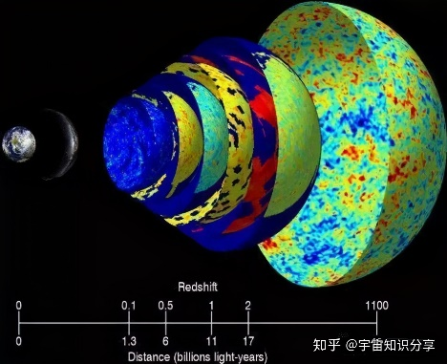
Where is the Seesaw Scale?
New Physics
Cosmic Frontier：Matter-antimatter asymmetry/CMB/LSS
10¹⁹ GeV
Planck scale
10¹⁶ GeV
GUT scale
High-intensity Frontier：
Construct low-energy effective field theories (EFTs)，do precision calculations, compare with experimental data
10³ TeV
Seesaw scale？
10² TeV
High-energy Frontier: Direct searches at colliders
10³ GeV
TeV
EW
10² GeV
ν oscillations → ν masses → NP
Cai, Han, Li, Ruiz, Front. in Phys. 6 (2018) 40

Slide 16
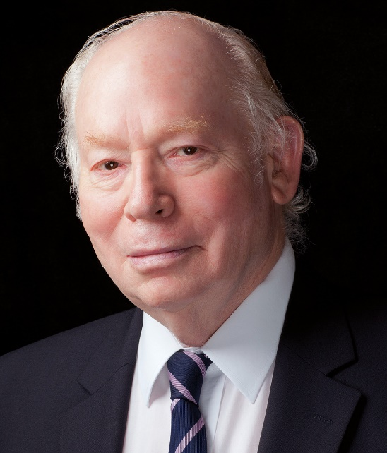
SM as Effective Field Theory
Weinberg, 79
Unique
dim-5 Weinberg operator
for Majorana neutrino masses
SM Effective Field Theory (SMEFT)

Slide 17
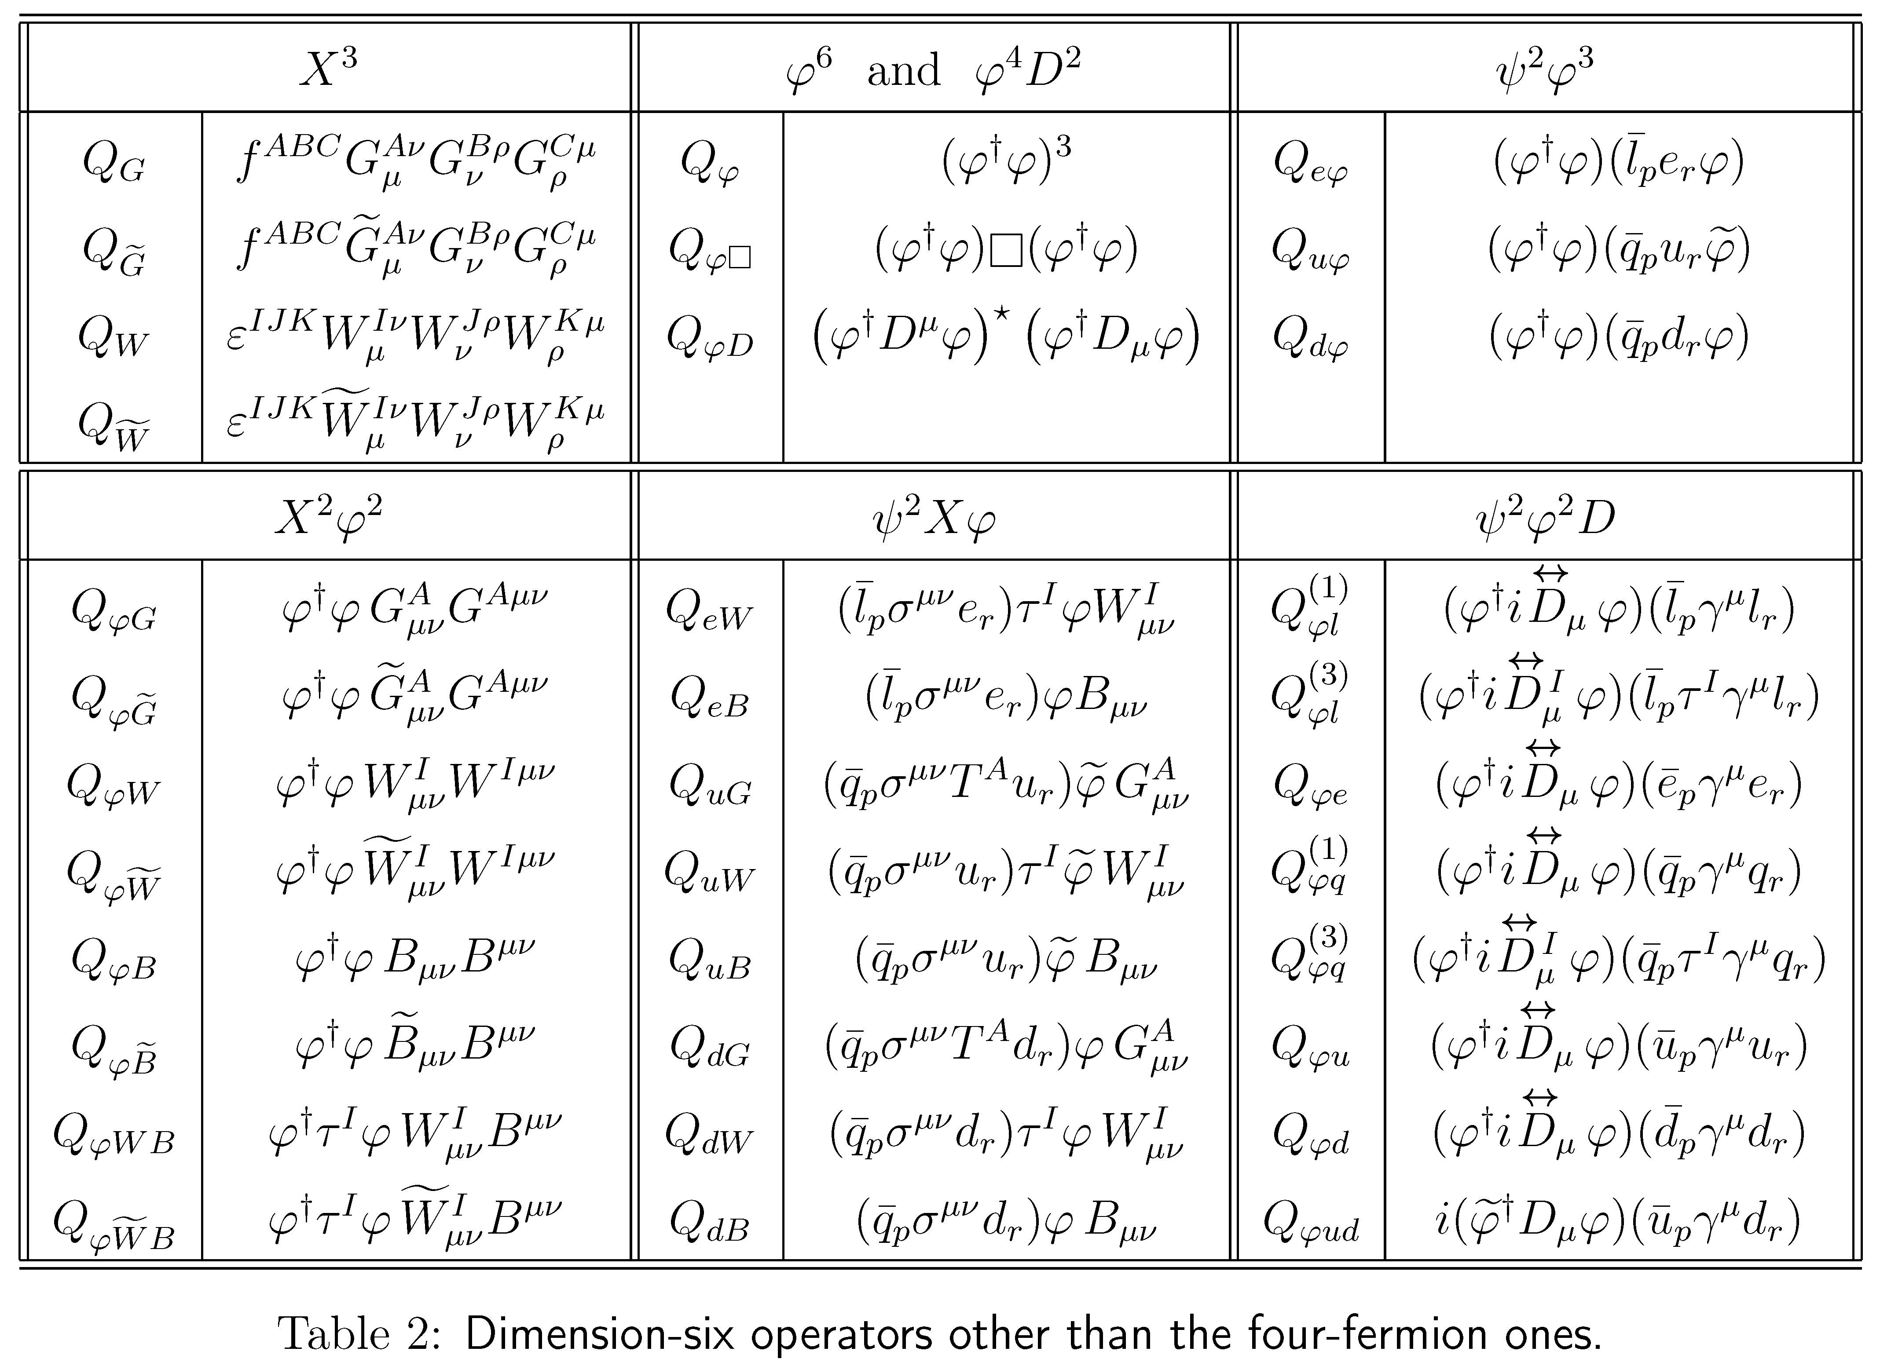
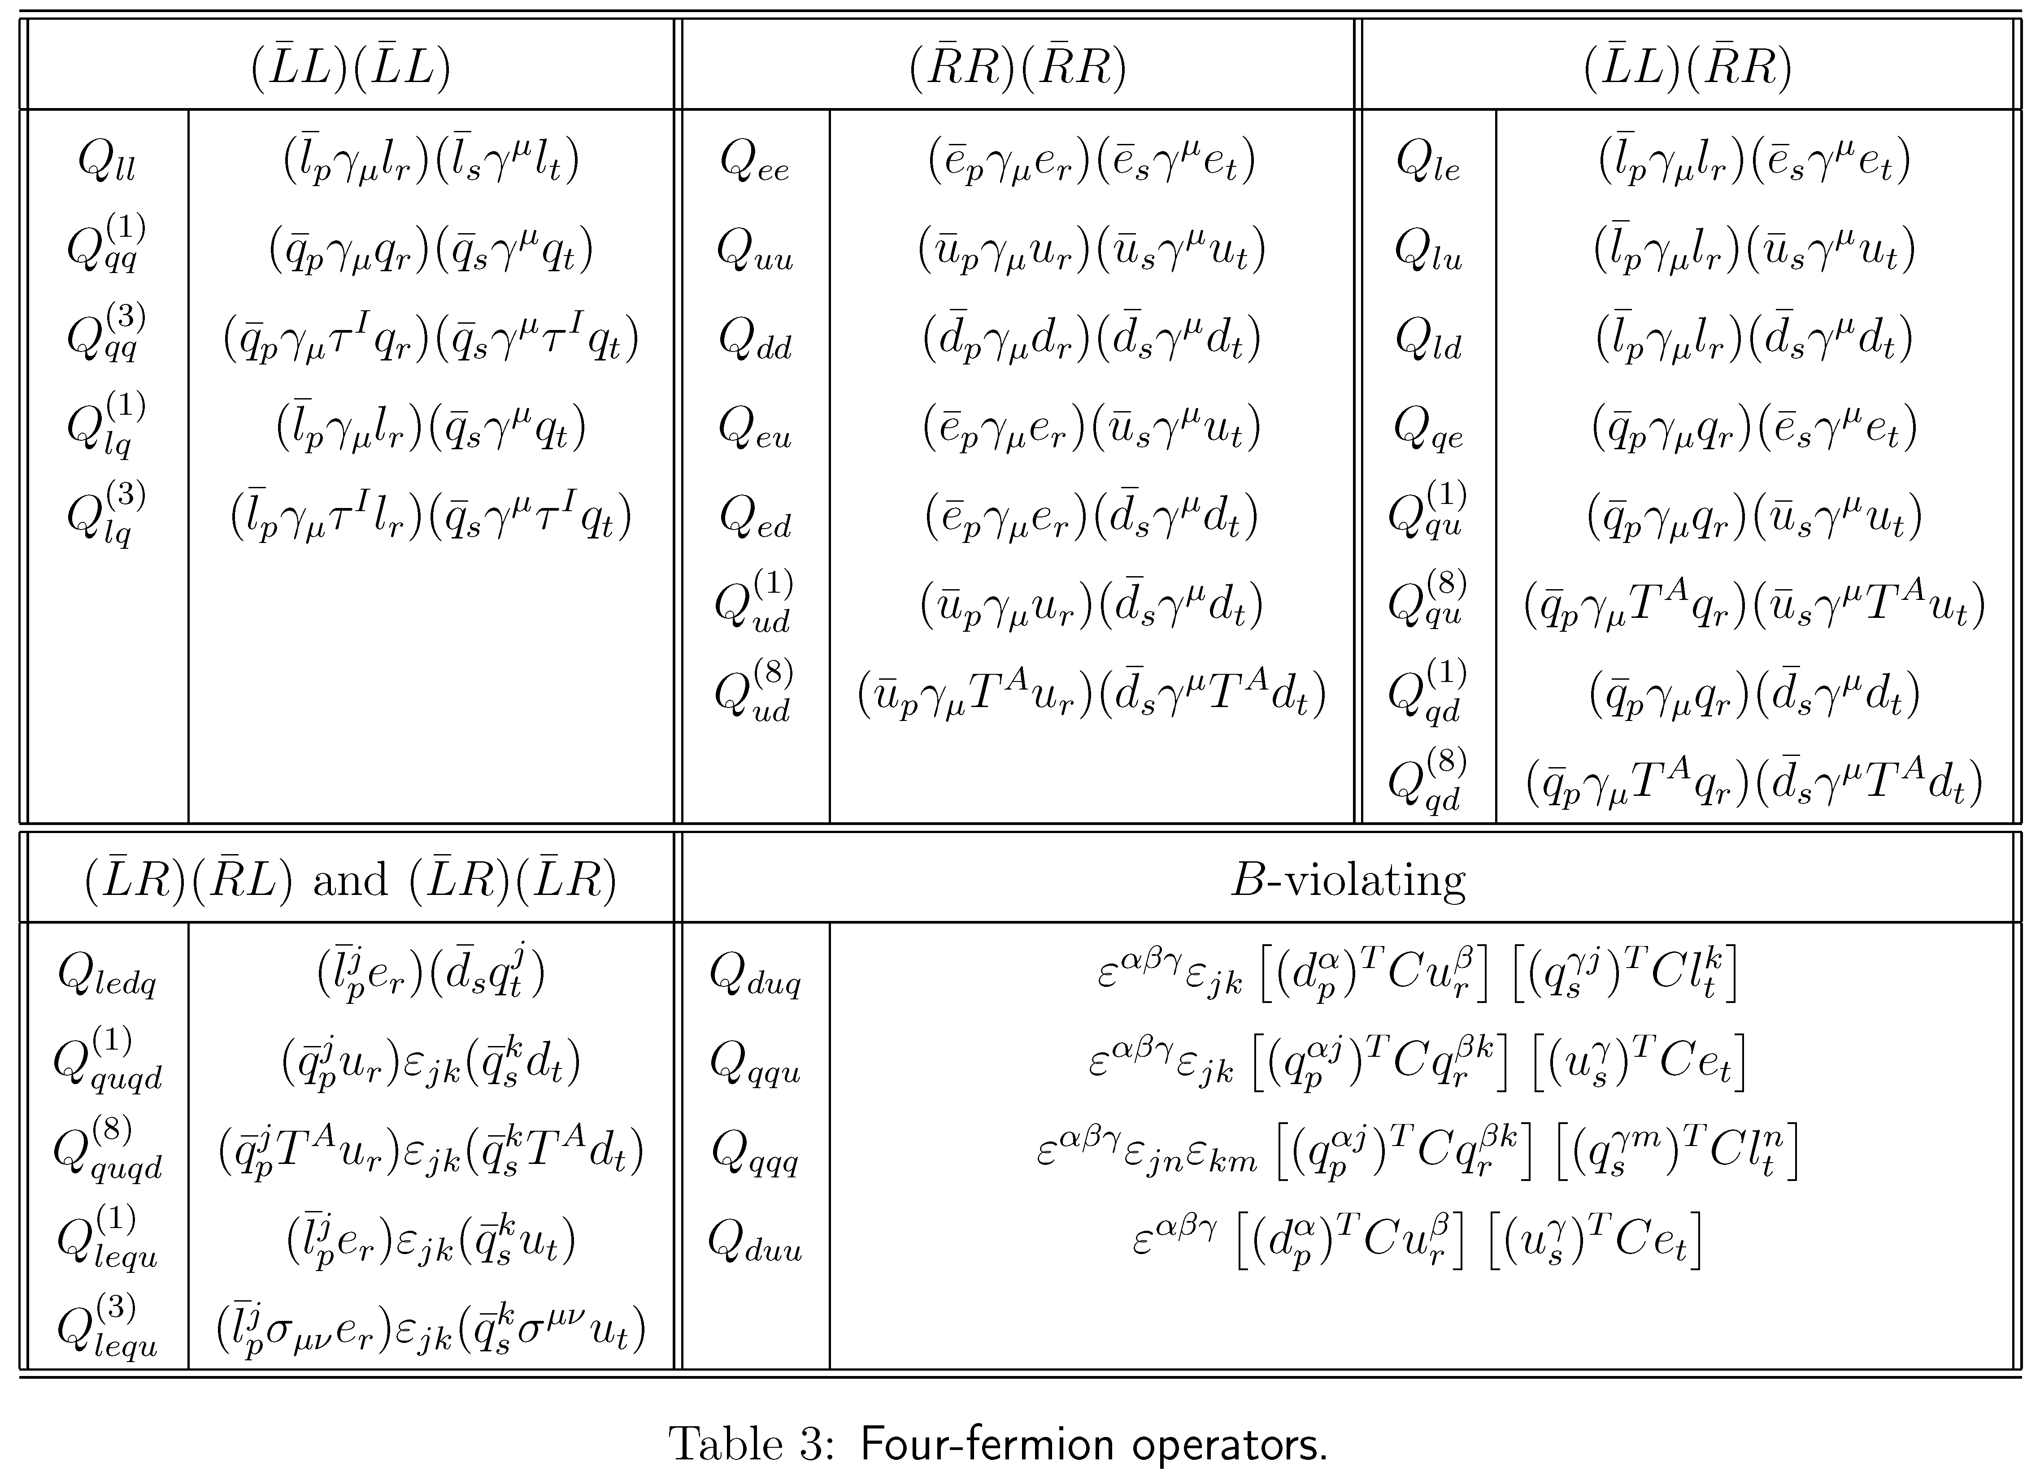
SM Effective Field Theory
Buchmüller & Wyler, 86
Dim-6 operators in the Warsaw basis
Brivio & Trott, Phys. Rept. 793 (2019) 1
Grzadkowski, Iskrzynski, Misiak, Rosiek, 1008.4884
Too many free parameters?

Slide 18
Low-energy Tests of Type-I Seesaw Model
The type-I seesaw model as a UV-complete theory
Tree-level matching: simply applying the EOM
Expansion up to M⁻² (dim-6 operators)
Seesaw Effective Field Theory (SEFT) @ tree level
Neutrino masses &
flavor mixing
Unitarity violation of
flavor mixing matrix

Slide 19

Low-energy Tests of Type-I Seesaw Model
After the spontaneous gauge symmetry breaking
Normalization:
Diagonalization:
$$U=V^{†}U_{0}$$
The SEFT Lagrangian in the mass basis:
Non-unitary flavor mixing
Minimal unitarity violation (MUV) “equivalent” to SEFT @ tree level
Non-unitarity
Antusch et al., hep-ph/0607020; Antusch & Fischer, 1407.6607

Slide 20
Low-energy Tests of Type-I Seesaw Model
LFV decays of charged leptons in the MUV scheme
The decay width
Xing & Zhang, 2009.09717
However, the calculation in the full theory for M_{i} >> M_{W} gives
Question: What goes wrong with tree-level SEFT? EFT must give the same result as UV theory for low-energy observables

Slide 21
Seesaw Effective Field Theory @ one-loop
Answer: Radiative decays at one-loop require one-loop matching!
Another two relevant dim-6 operators @ one loop
Zhang & SZ, 2102.04954
leading to the direct EM-dipole vertex
exactly reproducing the result in the full theory (with M_{i} >> M_{W})

Slide 22
Seesaw Effective Field Theory @ one-loop
Matching between UV theory and EFT
Cohen, Lu & Zhang, 2011.02484
Functional method for one-loop matching
Covariant Derivative Expansion (CDE)
Expansion by Regions (hard and soft loop momentum)
Gaillard, 86; Chen, 86; Cheyette, 88
Beneke & Smirnov, 98; Smirnov, 02

Slide 23
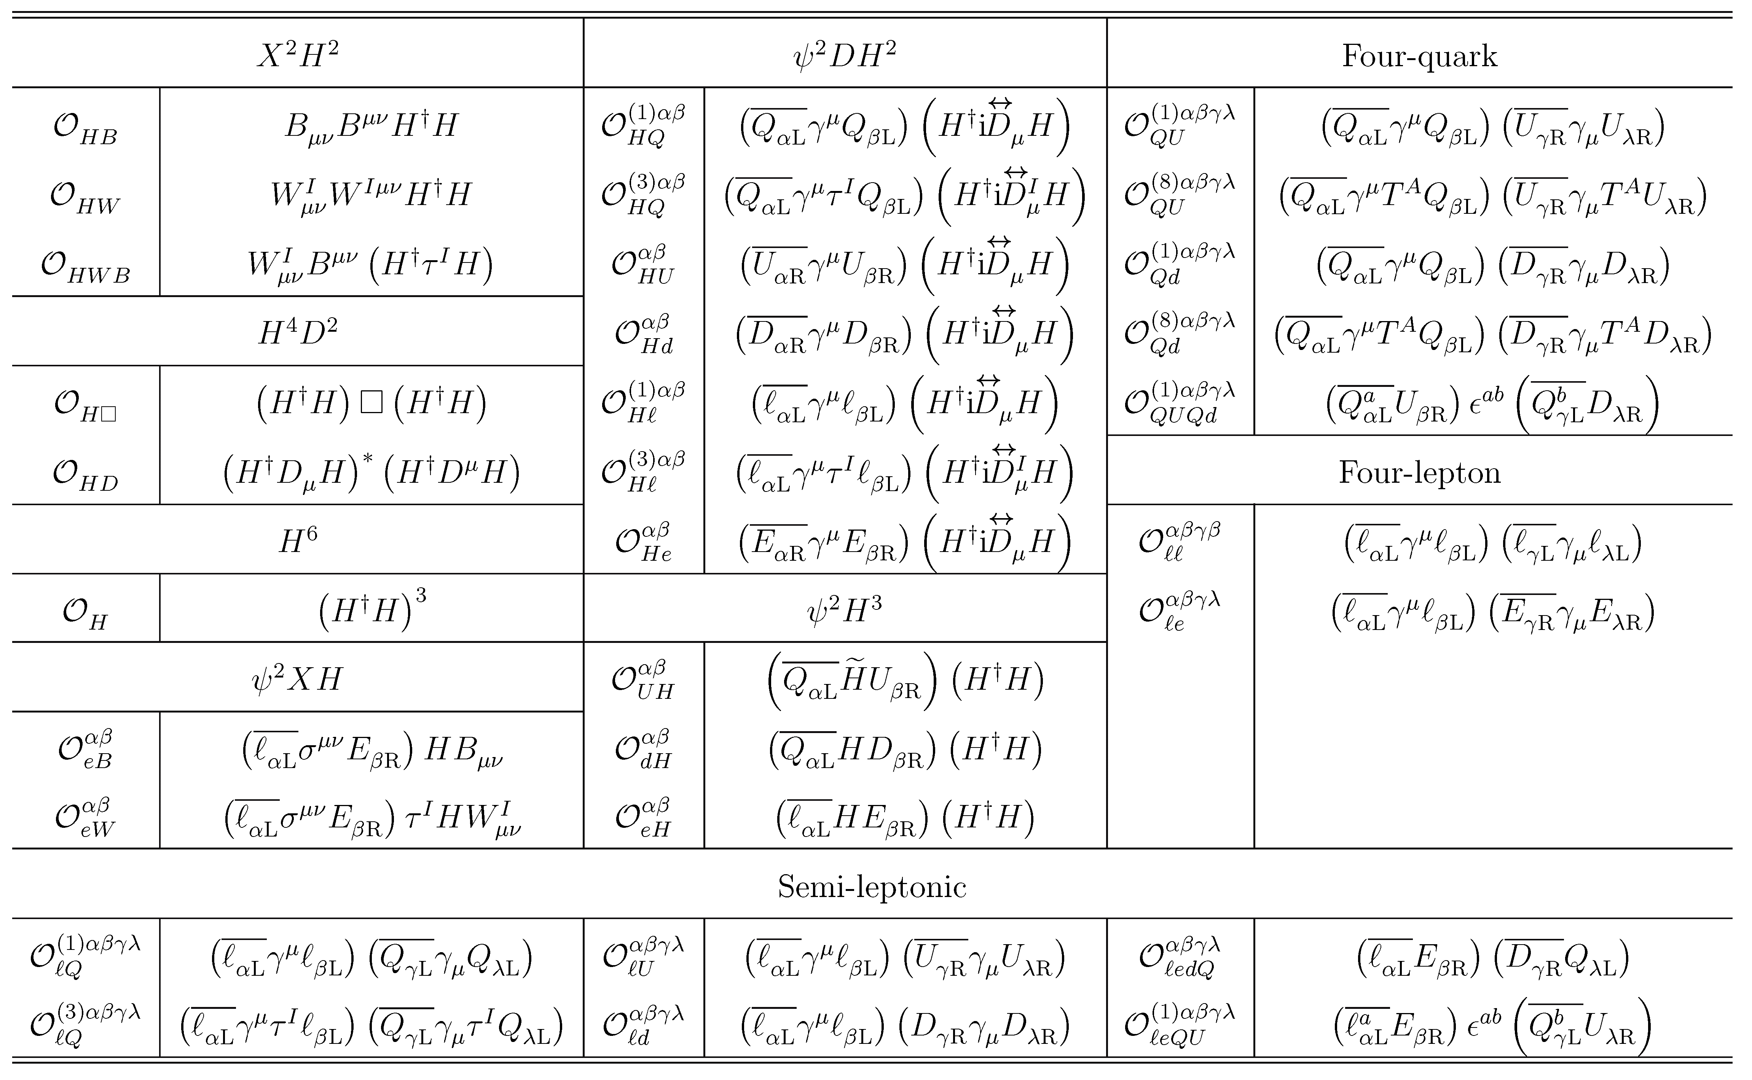
Seesaw Effective Field Theory @ one-loop
Zhang & S.Z., 2107.12133
Out of 59 operators in the Warsaw basis, 31 dim-6 operators in type-I SEFT

Slide 24
Seesaw Effective Field Theory @ one-loop
Physical Parameters in SEFT： (12 + 9 from C₆=21)
3 charged-lepton masses + 3 ν masses+ 15 non-unitary mixing = 21
Physical Parameters in Seesaw:
3 charged-lepton masses + 3 heavy Majorana ν masses + 15 Yukawa Y_{ν} = 21
Though 31 dim-6 operators at 1-loop level, all Wilson coefficients correlated
Strategy for precision tests of seesaw models @ 1-loop
Matching scale
Low-energy scale
Renormalization-group (RG) Running
One-loop
31 dim-6 operators
Wang, Zhang & S.Z., 2302.08140
19 dim-6 operators RGE-induced
A self-consistent framework for precision calculations up to dim-6/at 1-loop
RG Running
Tree-level
operators
+ corrections
12 dim-6 operators

Slide 25
Seesaw Effective Field Theory @ one-loop
Wang, Zhang & S.Z, 2302.08140
Tree-level matching:
Matching conditions:
Mass terms & weak interactions
Vanishing @ matching scale
Different RGEs leading to FCNC terms
LFV Z-decays

Slide 26
Seesaw Effective Field Theory @ one-loop
The seesaw scale
@ 10⁴ GeV
RG effects on the dim-6 Wilson coefficients
up to 15%
SEFT = SM + O⁵
+O⁶
RG effects on the mixing angles & CP phases
Effects from dim-6 operators

Slide 27
Summary & Outlook
Neutrino oscillations indicate neutrinos are massive, calling for new physics (NP) beyond the Standard Model (SM)
Canonical seesaw models account for tiny neutrino masses and cosmological matter-antimatter asymmetry in a natural way
In the precision era, theoretical calculations at one-loop level in neutrino physics is timely and necessary
One-loop calculations in the SM are definitely required, since NP effects may be at the same level
Reexamine one-loop effects in the neutrino sector within the SM framework: precision tests of the SM/searches for NP effects
Systematic studies of low-energy EFTs of neutrino mass models and their phenomenological implications
Thanks a lot for your attention!

