Slide 1
A New Concept for Polarized ³He⁺ Ion Source
26 February 2024
Ralf Engels (IKP-2@FZJ/GSI)
Notes:
25 minutes + 5 minutes discussion

Slide 2
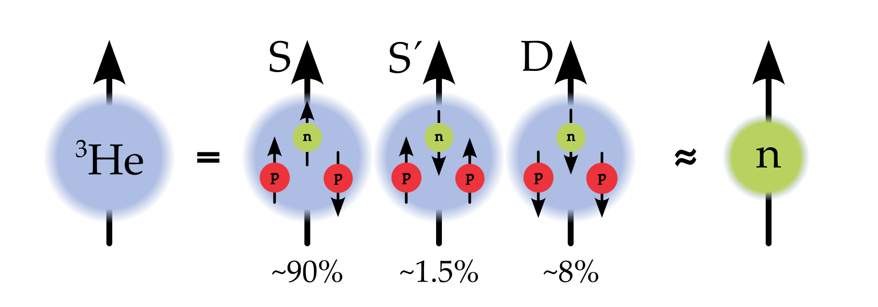
Polarized ³He ion sources
Nuclear Physics
³He spin dominated by neutron spin
Ideal substitute for polarized neutron beam
Polarized Fusion
d + ³He$→$⁴He + p + 18.4 MeV
Increased cross section and control over ejectile directions (talk at 5 pm)
Other polarized ³He ion source
either limited to small polarization (<10% Rice, 1969)
or limited to small currents ($∼$0.1 nA Birmingham, 1974 | $∼$100 nA Laval, 1983)
or complicated development ($∼$20 years RHIC/EIC, 2024?)

Slide 3
optical pumping of ³He
Spin-exchange OP
Rb
$${5P}_{1/2}$$
$$≈1.5 eV$$
$$γ$$
$${5S}_{1/2}$$
26.02.2024

Slide 4
optical pumping of ³He
SEOP
Metastability exchange OP
Rb
$${}_{ }^{3}{He}$$
$${5P}_{1/2}$$
$$2^{3}P^{ }$$
$$≈1.5 eV$$
$$≈1.14 eV$$
$$γ$$
$$γ$$
$${5S}_{1/2}$$
$${2^{3}S}_{ }$$
26.02.2024

Slide 5
optical pumping of ³He
Method:
Polarized Laser Photons
↓
Polarized Electrons
↓
Polarized Nucleons
Efficiency
1 kW of Laser Power
~ 10²² Photons/s
~ 10¹⁸ pol. ³He/s
SEOP
MEOP
Rb
$${}_{ }^{3}{He}$$
$${5P}_{1/2}$$
$$2^{3}P^{ }$$
$$≈1.5 eV$$
$$≈1.14 eV$$
$$γ$$
$$γ$$
$${5S}_{1/2}$$
$${2^{3}S}_{ }$$
P_{3He} ~ 0.8
26.02.2024

Slide 6
Polarized ³He Source
Big Problem:
Polarization is lost during the ionization process !!!
one electron removed → residual electron and nucleon will couple
→ nuclear spin is partialy flipped → polarization mostly lost
Idea in Brookhaven:
remove both electron at the same time in a strong magnetic field
→ EBIS
26.02.2024

Slide 7
New method:
Radio-Wave Pumping
+
Quantum Interference
Example: metastable hydrogen atoms (2S)
26.02.2024

Slide 8
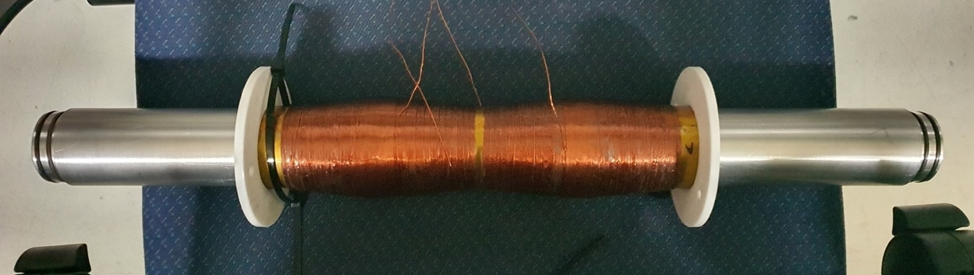
New method: Radio-Wave pumping
B
B
S. Aswani, Bachelor thesis, (2022)

Slide 9
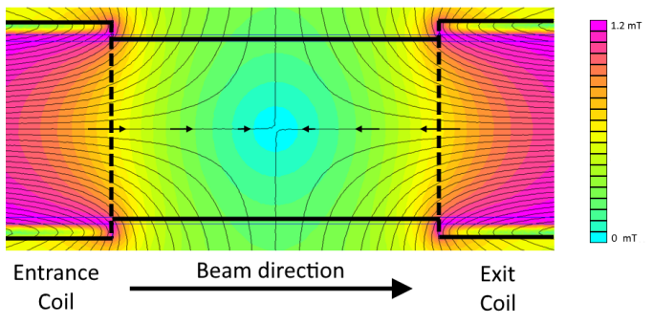
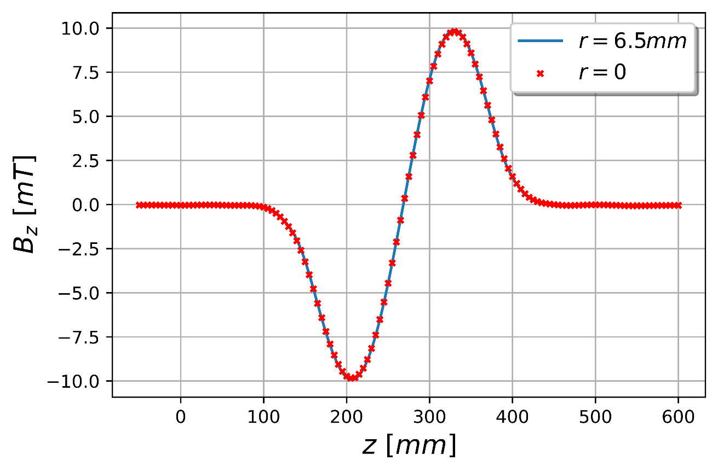
Radio-Wave Pumping: Photon model
Static magnetic field
$$\overset{⃑}{B}∙\overset{⃑}{∇}=0$$
$$⇒$$
$$B_{r}=−\frac{r}{2}\frac{∂B_{z}}{∂z}$$
$$B_{z}=B_{0}\sin\left(kz\right)$$
$$B_{r}=−\frac{r}{2}B_{0}k\cos\left(kz\right)$$
P. Buske, Bachelor thesis, (2016)

Slide 10
Photon model
Static magnetic field
$$\overset{⃑}{B}∙\overset{⃑}{∇}=0$$
$$⇒$$
$$B_{r}=−\frac{r}{2}\frac{∂B_{z}}{∂z}$$
$$B_{z}=B_{0}\sin\left(kz\right)$$
$$B_{r}=−\frac{r}{2}B_{0}k\cos\left(kz\right)$$
P. Buske, Bachelor thesis, (2016)
Beam enters the Sona transition unit

Slide 11
Photon model
Static magnetic field
$$\overset{⃑}{B}∙\overset{⃑}{∇}=0$$
$$⇒$$
$$B_{r}=−\frac{r}{2}\frac{∂B_{z}}{∂z}$$
$$B_{z}=B_{0}\sin\left(kz\right)$$
$$B_{r}=−\frac{r}{2}B_{0}k\cos\left(kz\right)$$
P. Buske, Bachelor thesis, (2016)
Beam enters the Sona transition unit
Lorentz transformation into the rest frame of the beam
$$F^{μ′ν′}={Λ^{μ′}}_{μ}{Λ^{ν′}}_{ν}F^{μν}$$
$$⇒$$
$${B′}_{z}=B_{0}\sin\left(k^{′}t′\right)$$
$${B′}_{r}=−\frac{r}{2}B_{0}k\cos\left(k^{′}t′\right)$$

Slide 12
Photon model
Static magnetic field
$$\overset{⃑}{B}∙\overset{⃑}{∇}=0$$
$$⇒$$
$$B_{r}=−\frac{r}{2}\frac{∂B_{z}}{∂z}$$
$$B_{z}=B_{0}\sin\left(kz\right)$$
$$B_{r}=−\frac{r}{2}B_{0}k\cos\left(kz\right)$$
P. Buske, Bachelor thesis, (2016)
Beam enters the Sona transition unit
Lorentz transformation into the rest frame of the beam
$$F^{μ′ν′}={Λ^{μ′}}_{μ}{Λ^{ν′}}_{ν}F^{μν}$$
$$⇒$$
$${B′}_{z}=B_{0}\sin\left(k^{′}t′\right)$$
$${B′}_{r}=−\frac{r}{2}B_{0}k\cos\left(k^{′}t′\right)$$
Electromagnetic fields ➔ Photon pulse ➔ lead to magnetic dipole transitions

Slide 13
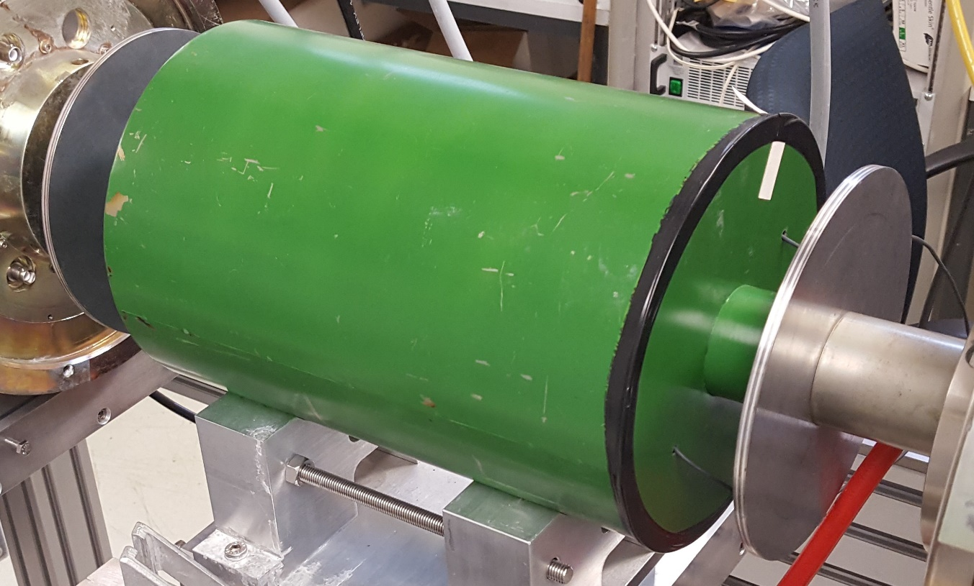
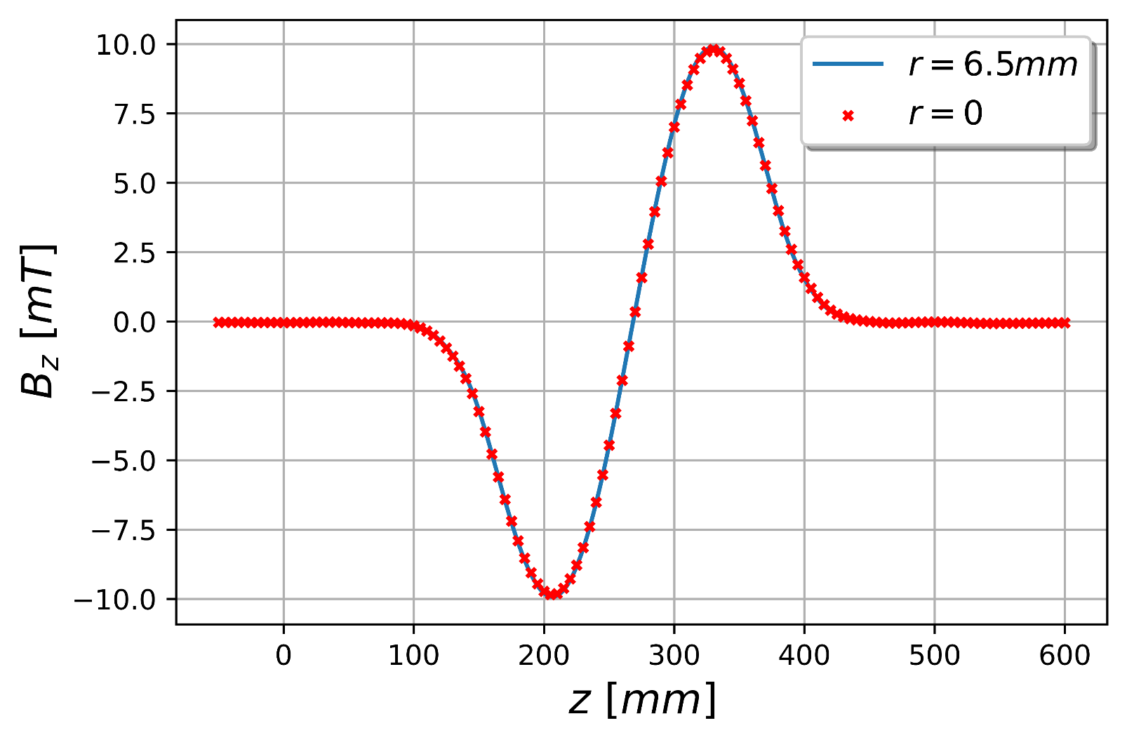
Photon model
$$λ$$
λ = 0.25 m / v = 4 · 10⁵ m/s
→ E_{Ph} = 6 · 10⁻⁹ eV ≈ 1.6 MHz
$$Δt=\frac{λ}{v} → f=\frac{1}{Δt} = \frac{v}{λ} → E=h·f=h·v/λ$$

Slide 14
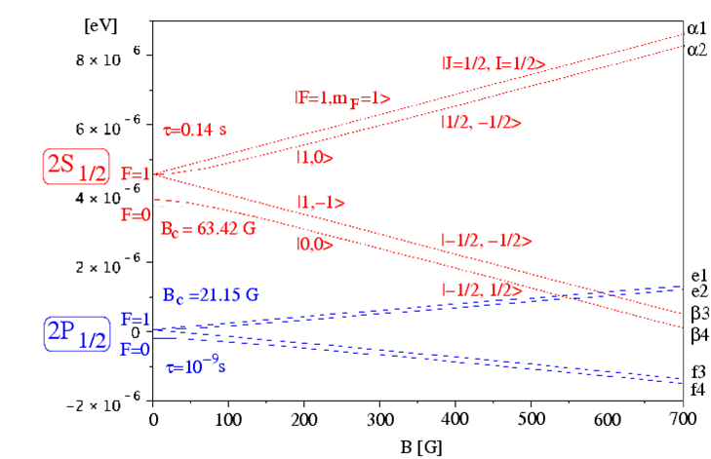
Photon model
Zeeman region
F = J + I
|m_{J}=1/2, m_{I} =1/2>
Breit-Rabi diagram:
Hyperfine Splitting
of metastable
Hydrogen atoms
with the Lamb shift
Paschen-Back region
B
(2n-1)

Slide 15
Photon model
Components of a Lamb-shift polarimeter (see talk by N. Faatz)
H₂ → p, H₂⁺ → p → H_{2S} → α1 → ? → α1, α2, α1+α2
α2
α1+α2
all 4 HFS

Slide 16
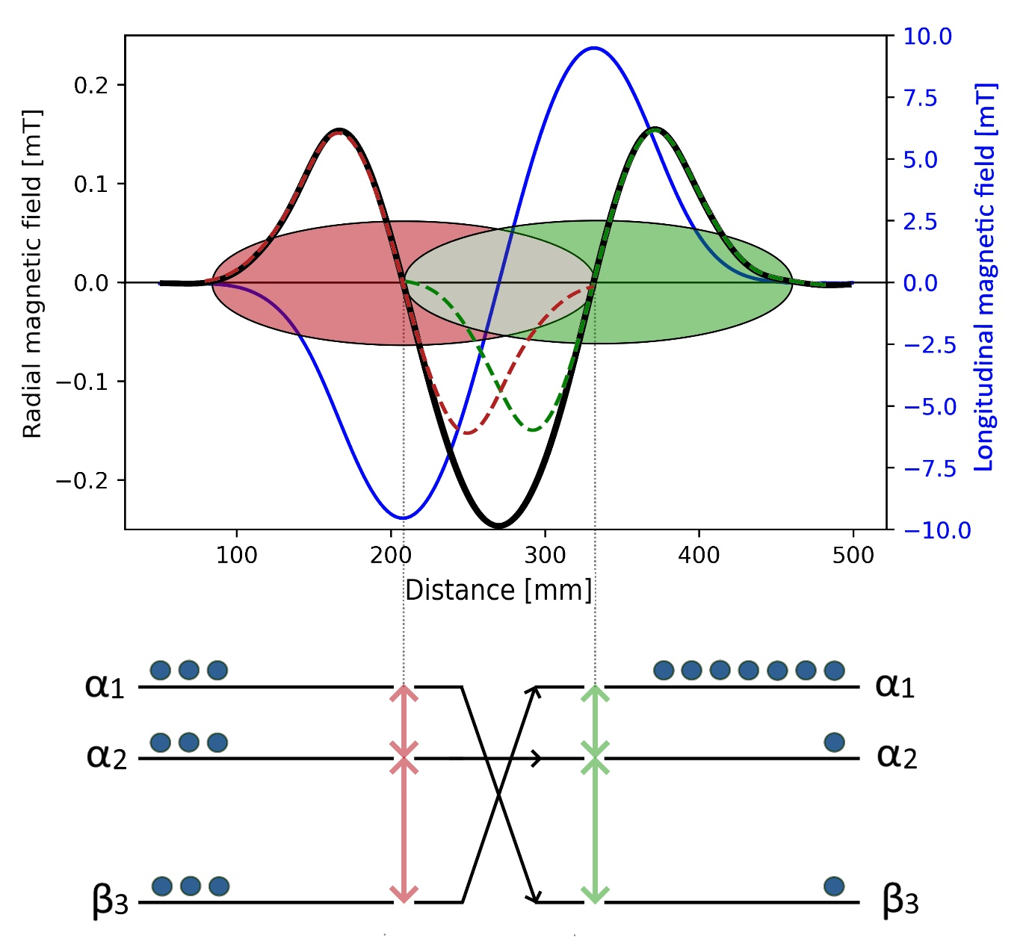
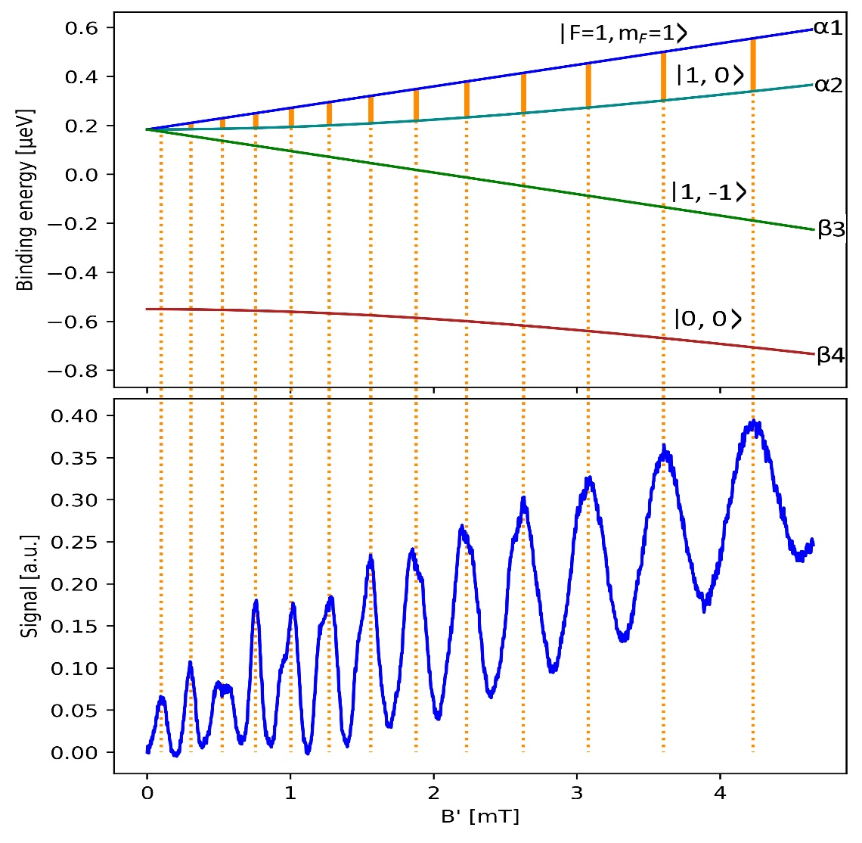
Photon model
m_{S}= +1
Breit-Rabi Diagram of H_{2S}
m_{S}= -1

Slide 17
Theoretical approach
Hamiltonian
$$H=H_{Hyp}+V_{B}\left(t\right)$$
$$H_{Hyp}=A\frac{\overset{⃑}{I}∙\overset{⃑}{J}}{ℏ^{2}}$$
$$V_{B}\left(t\right)=\left(g_{j}μ_{B}\frac{\overset{⃑}{J}}{ℏ}−g_{I}μ_{K}\frac{\overset{⃑}{I}}{ℏ}\right)∙\overset{⃑}{B}\left(t\right)$$

Slide 18
Theoretical approach
Hamiltonian
$$H=H_{Hyp}+V_{B}\left(t\right)$$
$$H_{Hyp}=A\frac{\overset{⃑}{I}∙\overset{⃑}{J}}{ℏ^{2}}$$
$$V_{B}\left(t\right)=\left(g_{j}μ_{B}\frac{\overset{⃑}{J}}{ℏ}−g_{I}μ_{K}\frac{\overset{⃑}{I}}{ℏ}\right)∙\overset{⃑}{B}\left(t\right)$$
Time-dependent perturbation
$$\left.|ψ\right\rangle =\sum_{F=|J−I|}^{J+I}{\sum_{m_{F}=−F}^{F}{c_{m_{F},F}(t){∙e}^{−{iE_{m_{F},F}∙t}/ℏ}}}\left.|m_{F},F\right\rangle$$
$$H_{Hyp}\left.|m_{F},F\right\rangle =E_{m_{F},F}\left.|m_{F,}F\right\rangle$$
$${\dot{c}}_{{\tilde{F},m}_{\tilde{F}}}=−\frac{i}{ℏ}\sum_{F=\left|J−I\right|}^{J+I}{\sum_{m_{F}=−F}^{F}{c_{F,m_{F}}}}e^{−i{\left(E_{F,m_{F}}−E_{\tilde{F},m_{\tilde{F}}}\right)t}/ℏ}\left\langle {\tilde{F},m}_{\tilde{F}} | V\left(t\right) | {F,m}_{F}\right\rangle$$

Slide 19
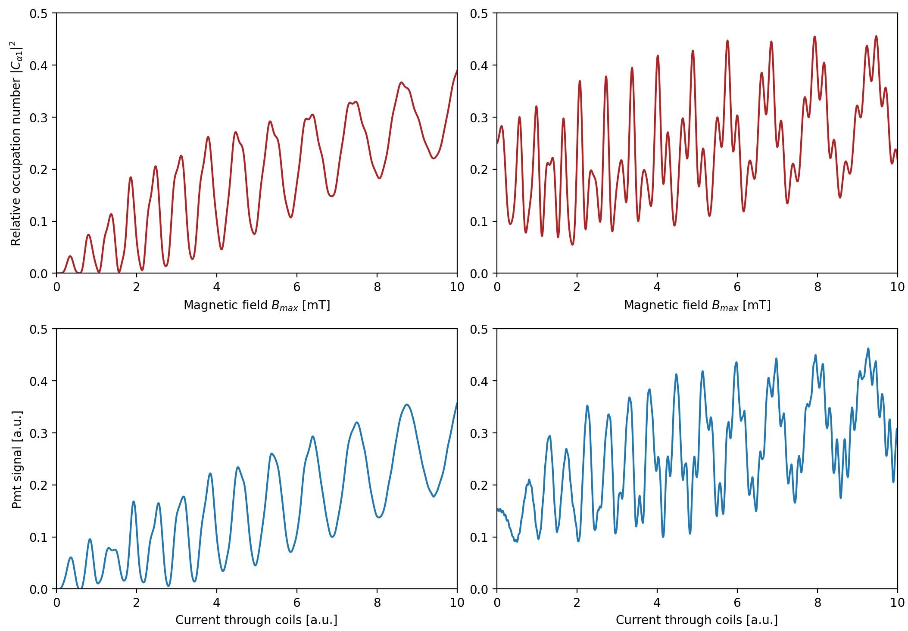
Photon model
only α1 unpol beam
Simulation
Measurement

Slide 20
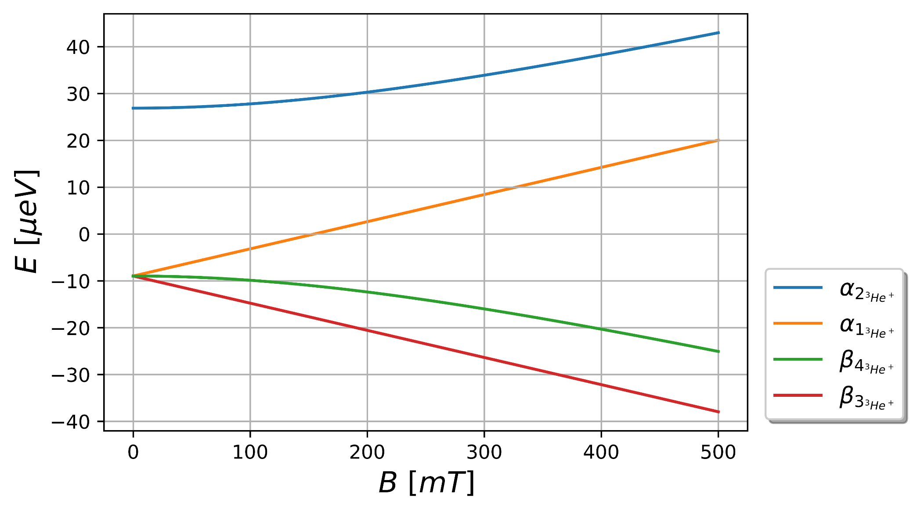
${}_{ }^{3}{{He}^{+}}$ Breit-Rabi diagram
A. Schneider, B. Sikora, S. Dickopf et al., Nature 606, 878 (2022).
DOI: 10.1038/s41586-022-04761-7
+$\left.|↑,↓\right\rangle$
$$H=A\frac{\overset{⃑}{J}⋅\overset{⃑}{I}}{ℏ^{2}}+\left(g_{j}μ_{B}\frac{\overset{⃑}{J}}{ℏ}−g_{I}μ_{k}\frac{\overset{⃑}{I}}{ℏ}\right)⋅\overset{⃑}{B}$$
$$\left.|↑,↑\right\rangle$$
$$\overset{⃑}{B}=B_{0}{\hat{e}}_{z}$$
$$\left.−|↓,↑\right\rangle$$
$$\left.|↓,↓\right\rangle$$

Slide 21
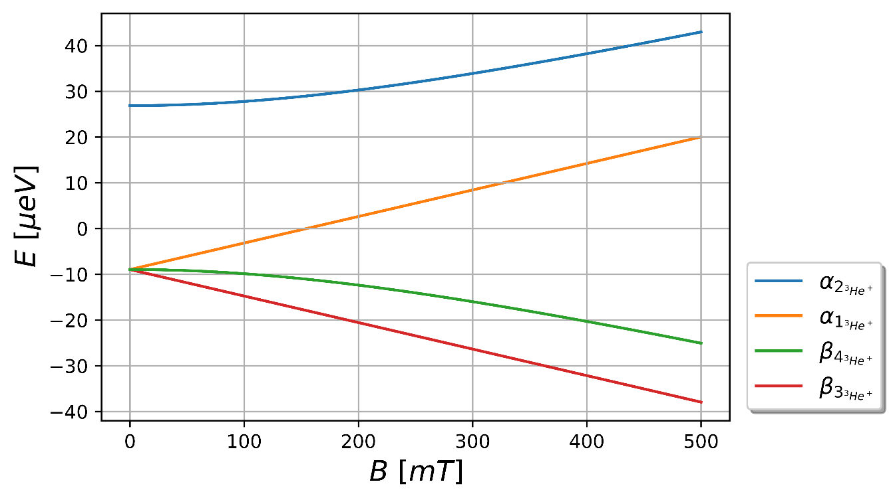
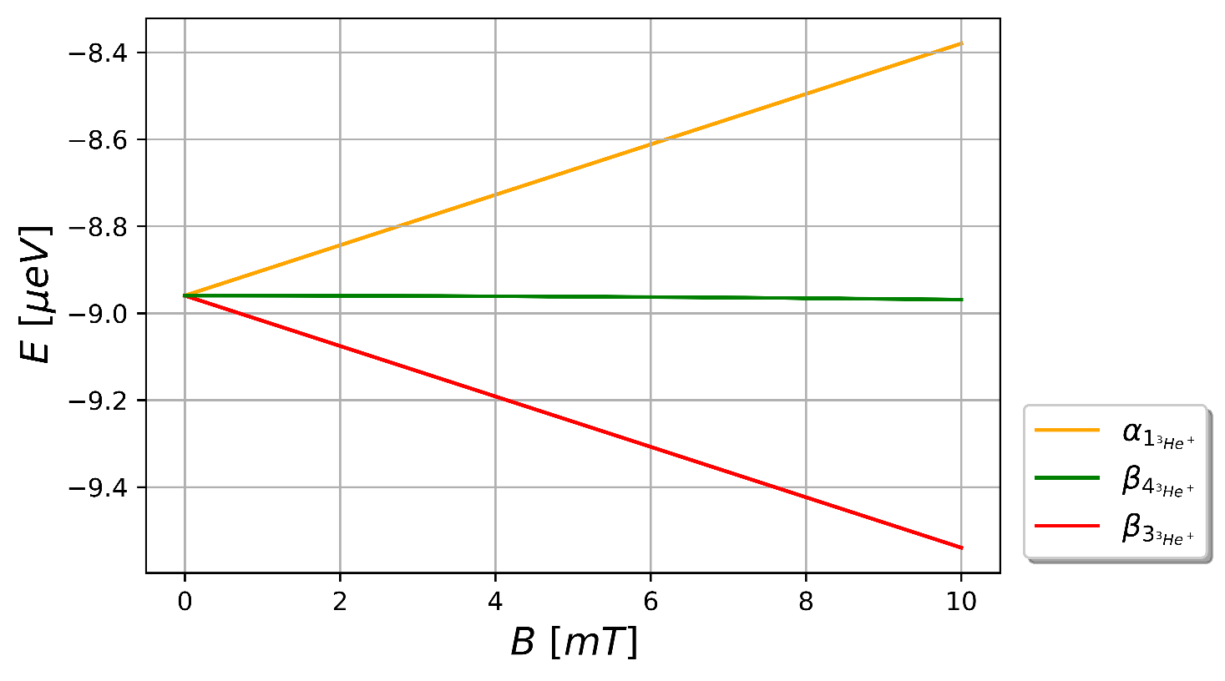
${}_{ }^{3}{{He}^{+}}$ Breit-Rabi diagram
$$≈310 neV$$

Slide 22
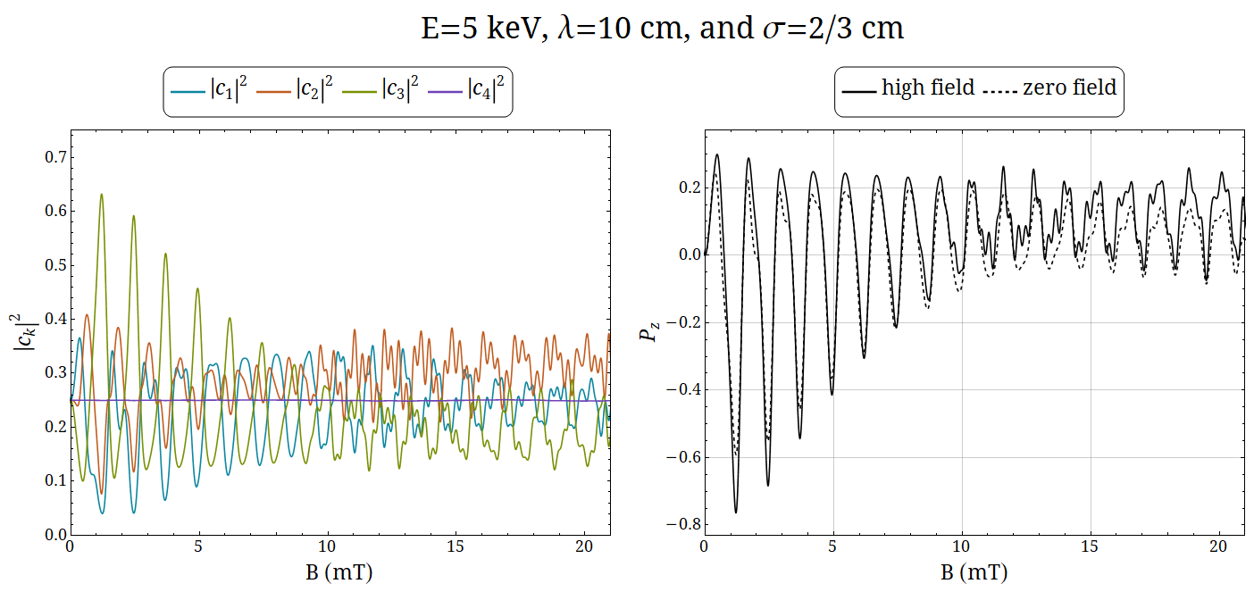
Simulation for ${}_{ }^{3}{{He}^{+}}$

Slide 23
Experimental set-up
→
➔${}_{ }^{3}{{He}^{+}}$

Slide 24
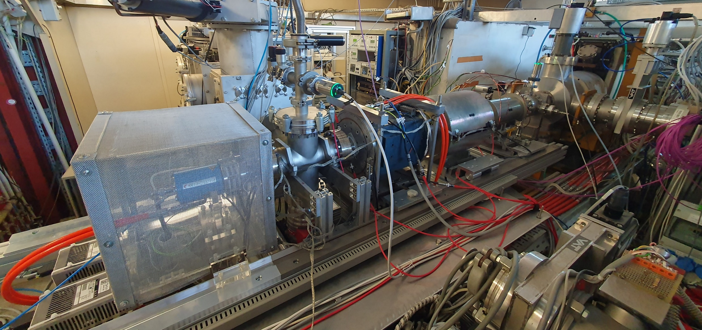

Slide 25
Measurement
Problem:
How to measure the nuclear (electron) polarization of ³He⁺ ?
Option:
Nuclear reaction polarimeter
Analyzing powers of p(³He, p)³He and d(³He, p)⁴He are known at MeV energies

Slide 26
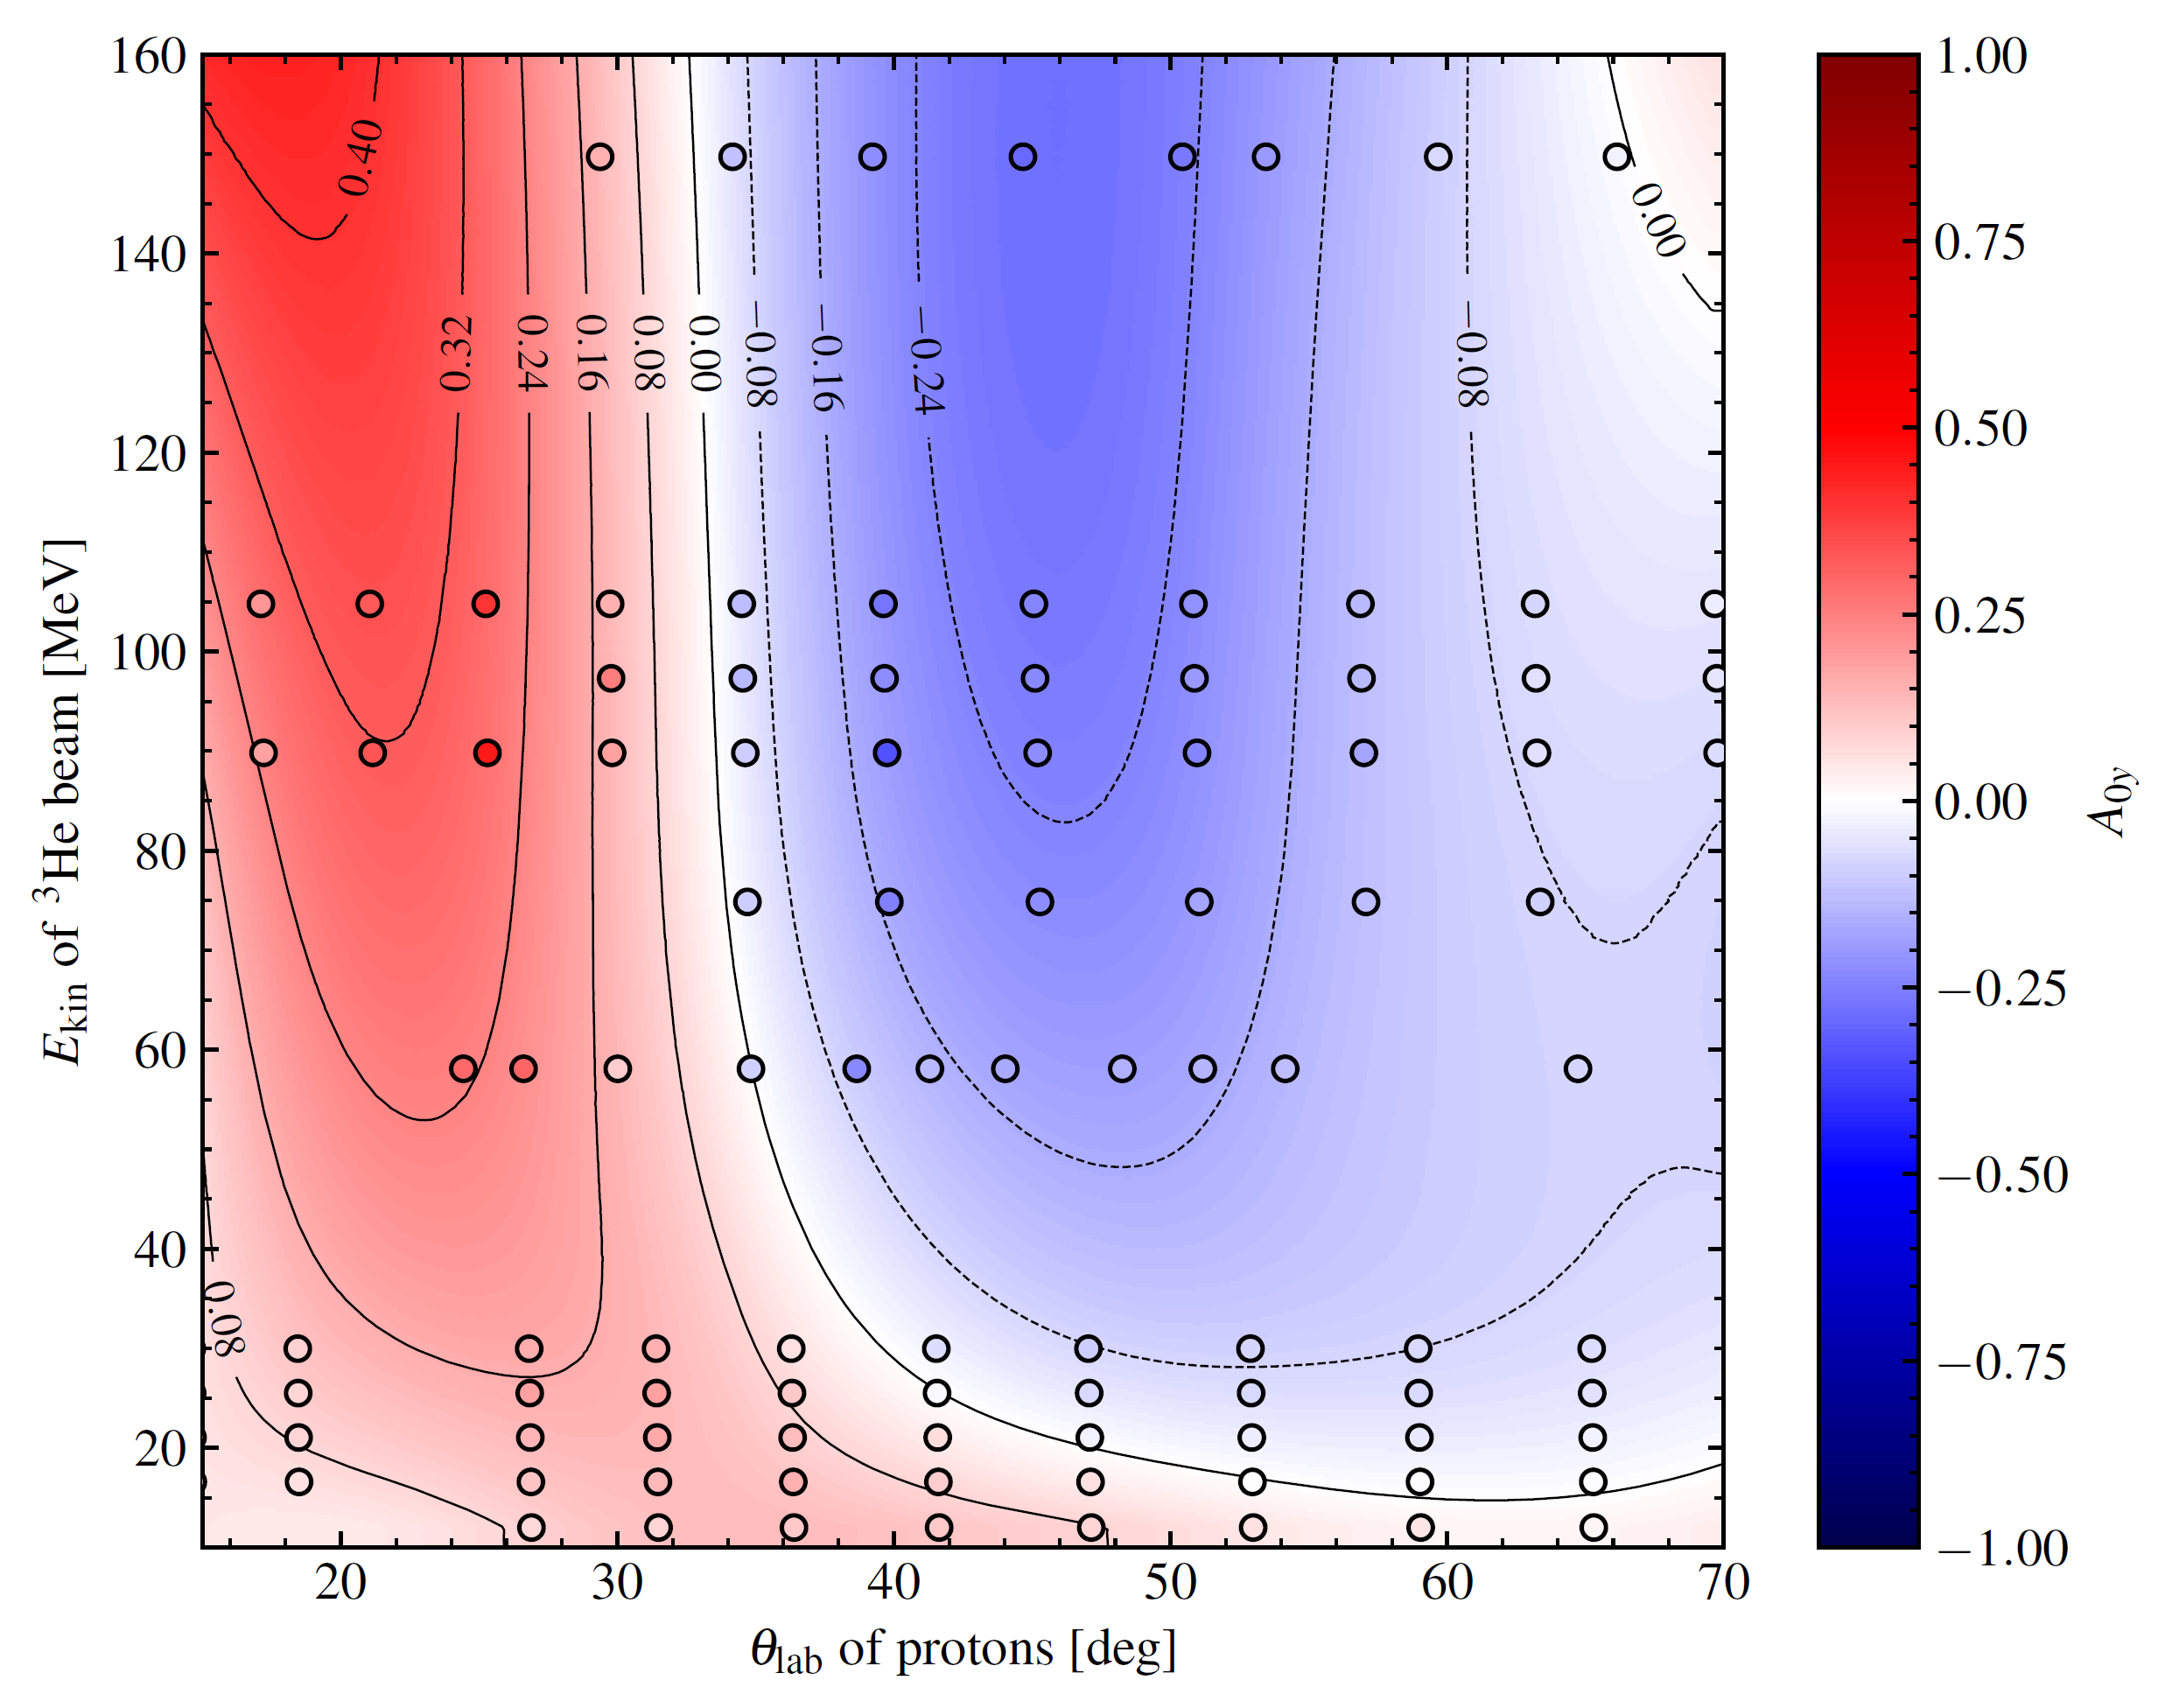
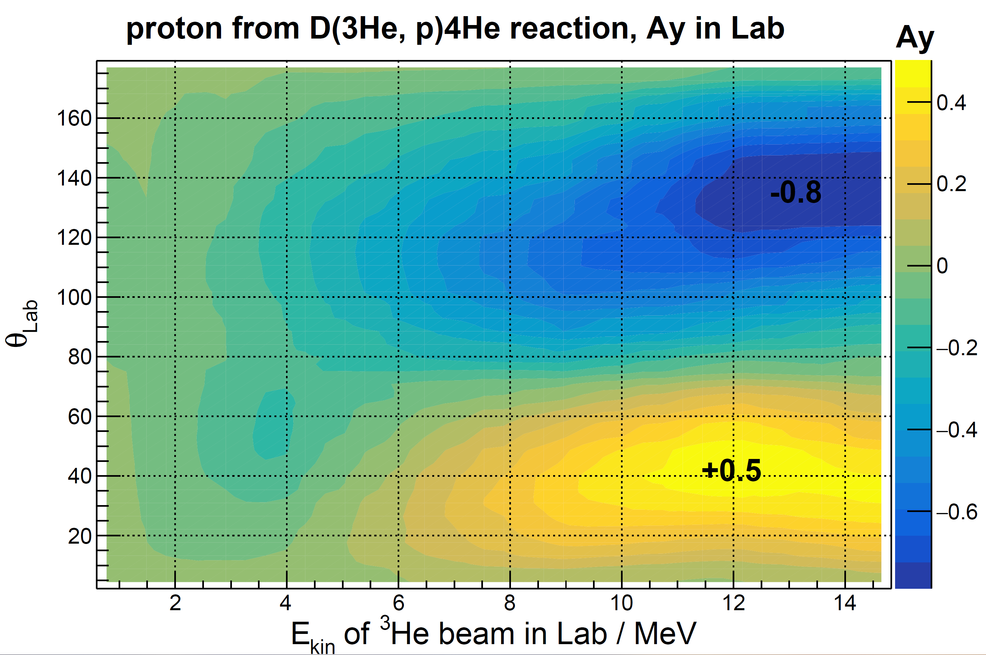
Analyzing Powers
d(³He,p)⁴He
p(³He,p)³He
C. Zheng

Slide 27
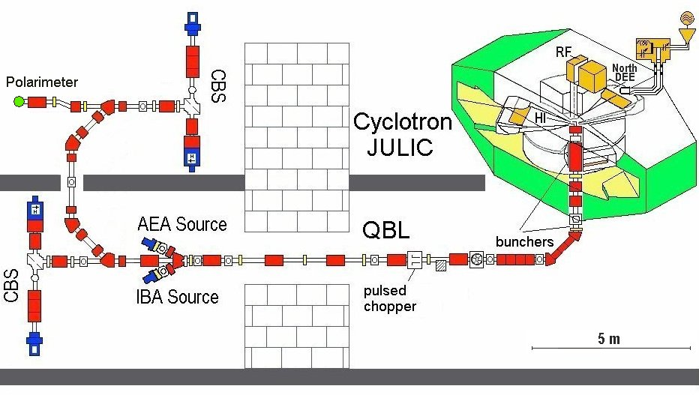
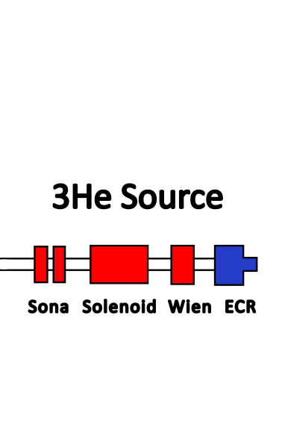
LOW ENERGY BEAMLINE
Purely magnetic bending + focusing
6 Dipoles
15 Quadrupoles
10 Solenoids
10 Steerer
5 Viewer
FB5
R.Gebel, PSTP2007

Slide 28
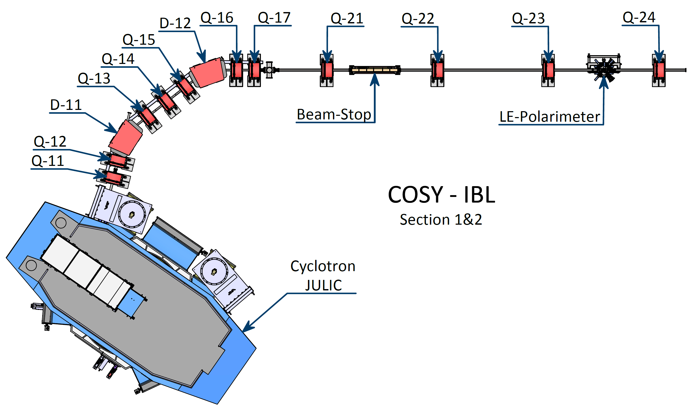
HIGH ENERGY BEAMLINE
2 Dipoles
10 Quadrupoles
3 Steerer
1 LEPol
Beam transport very similar to 45 MeV protons
5m

Slide 29
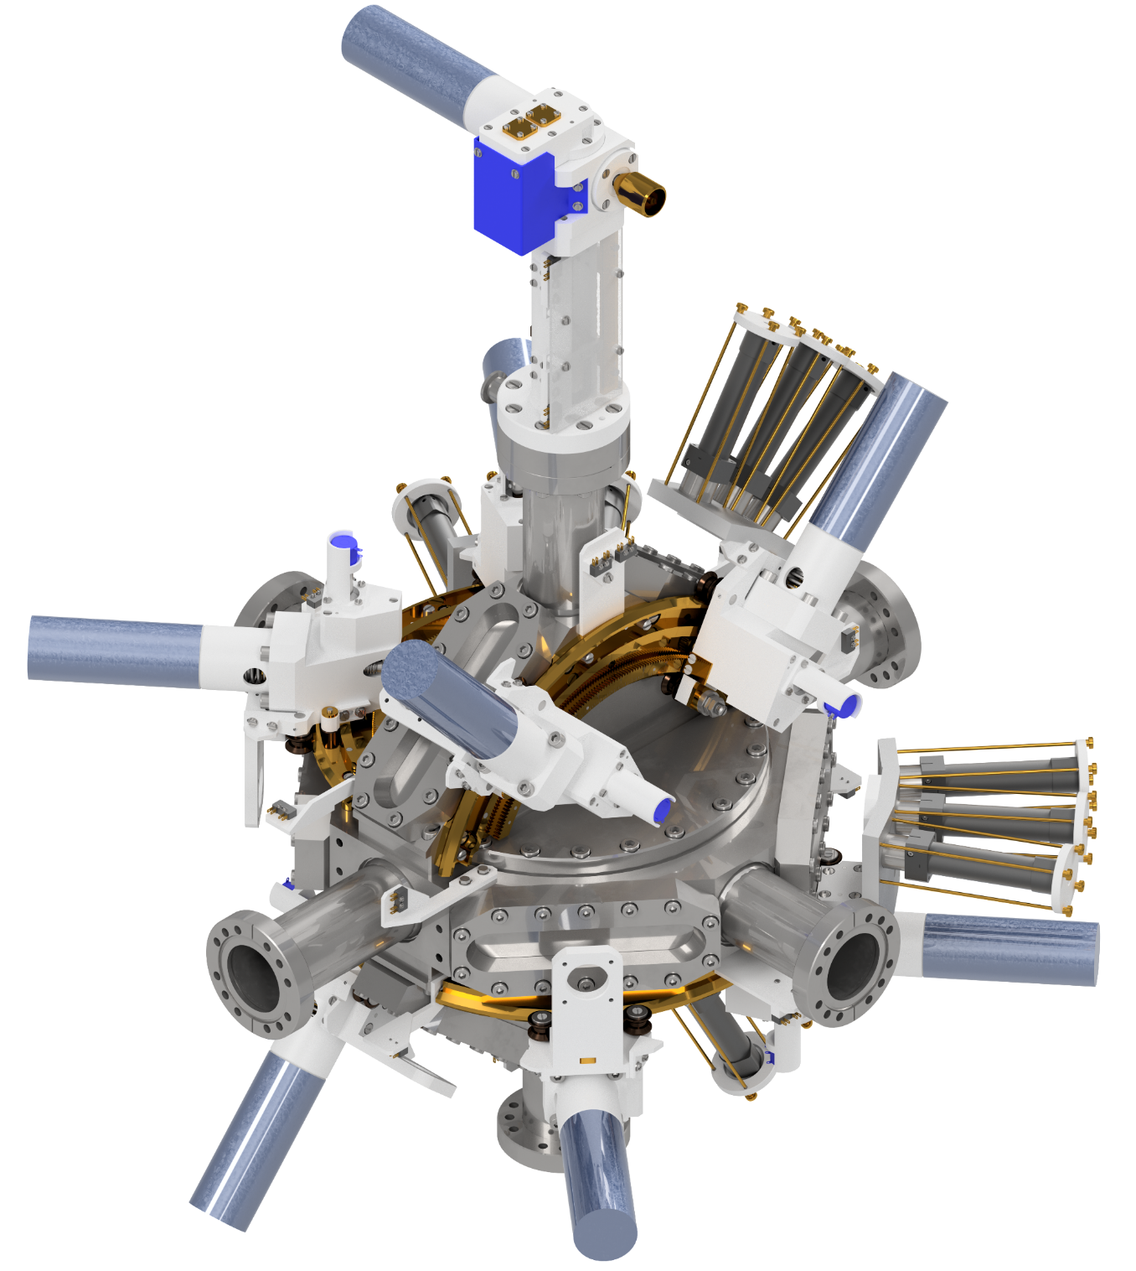
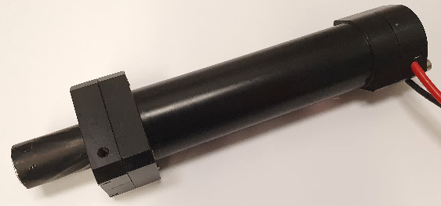
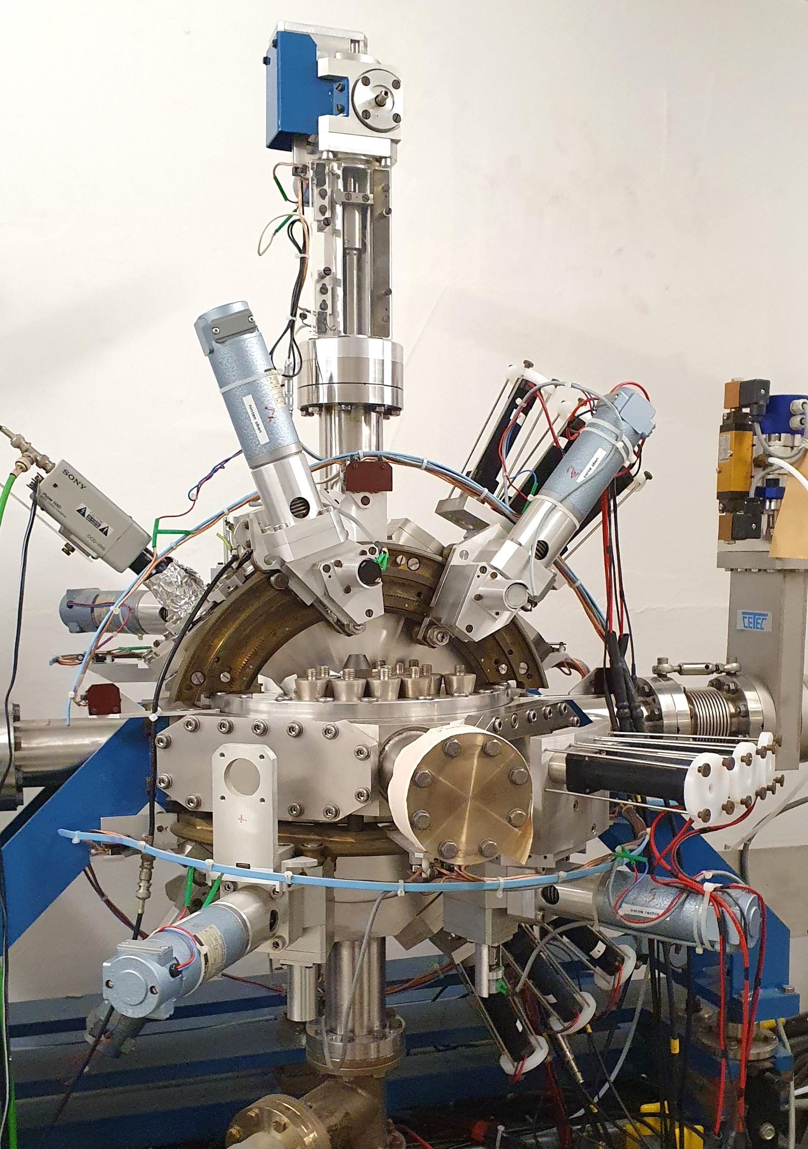
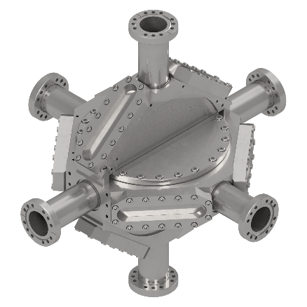
LE-POLARIMETER
12 Detectors
Plastic scintillator with photomultiplier
Target-Ladder
Remote controlled exchange of different targets
Vacuum-Chamber
8 pipe connections
8 windows (75$\text{μm}$ steel)
³He⁺ beam
8 Motorized Carts
Automated angle selection

Slide 30
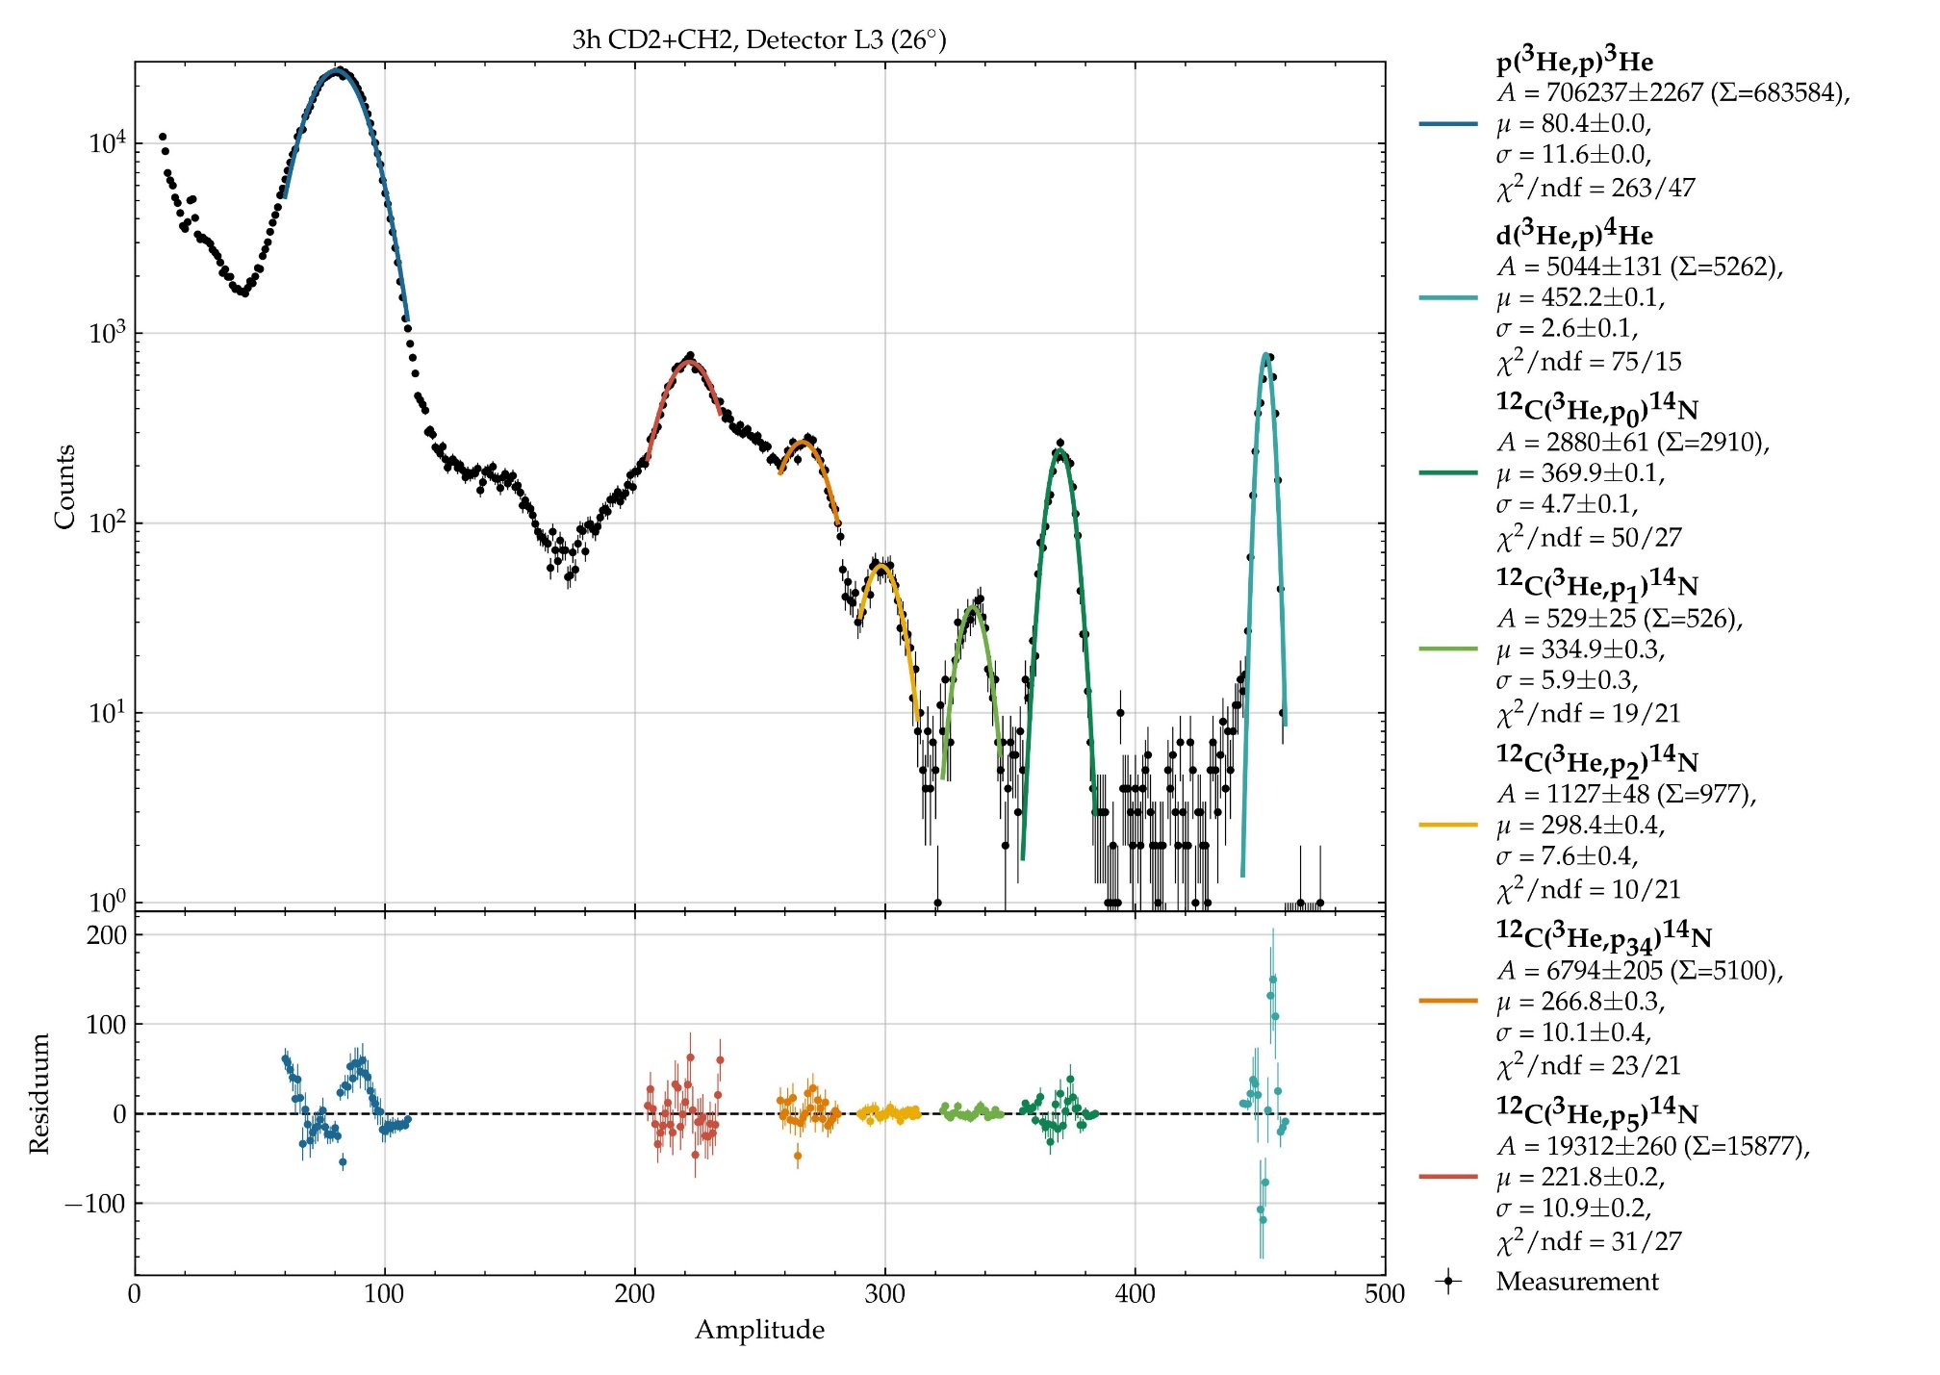
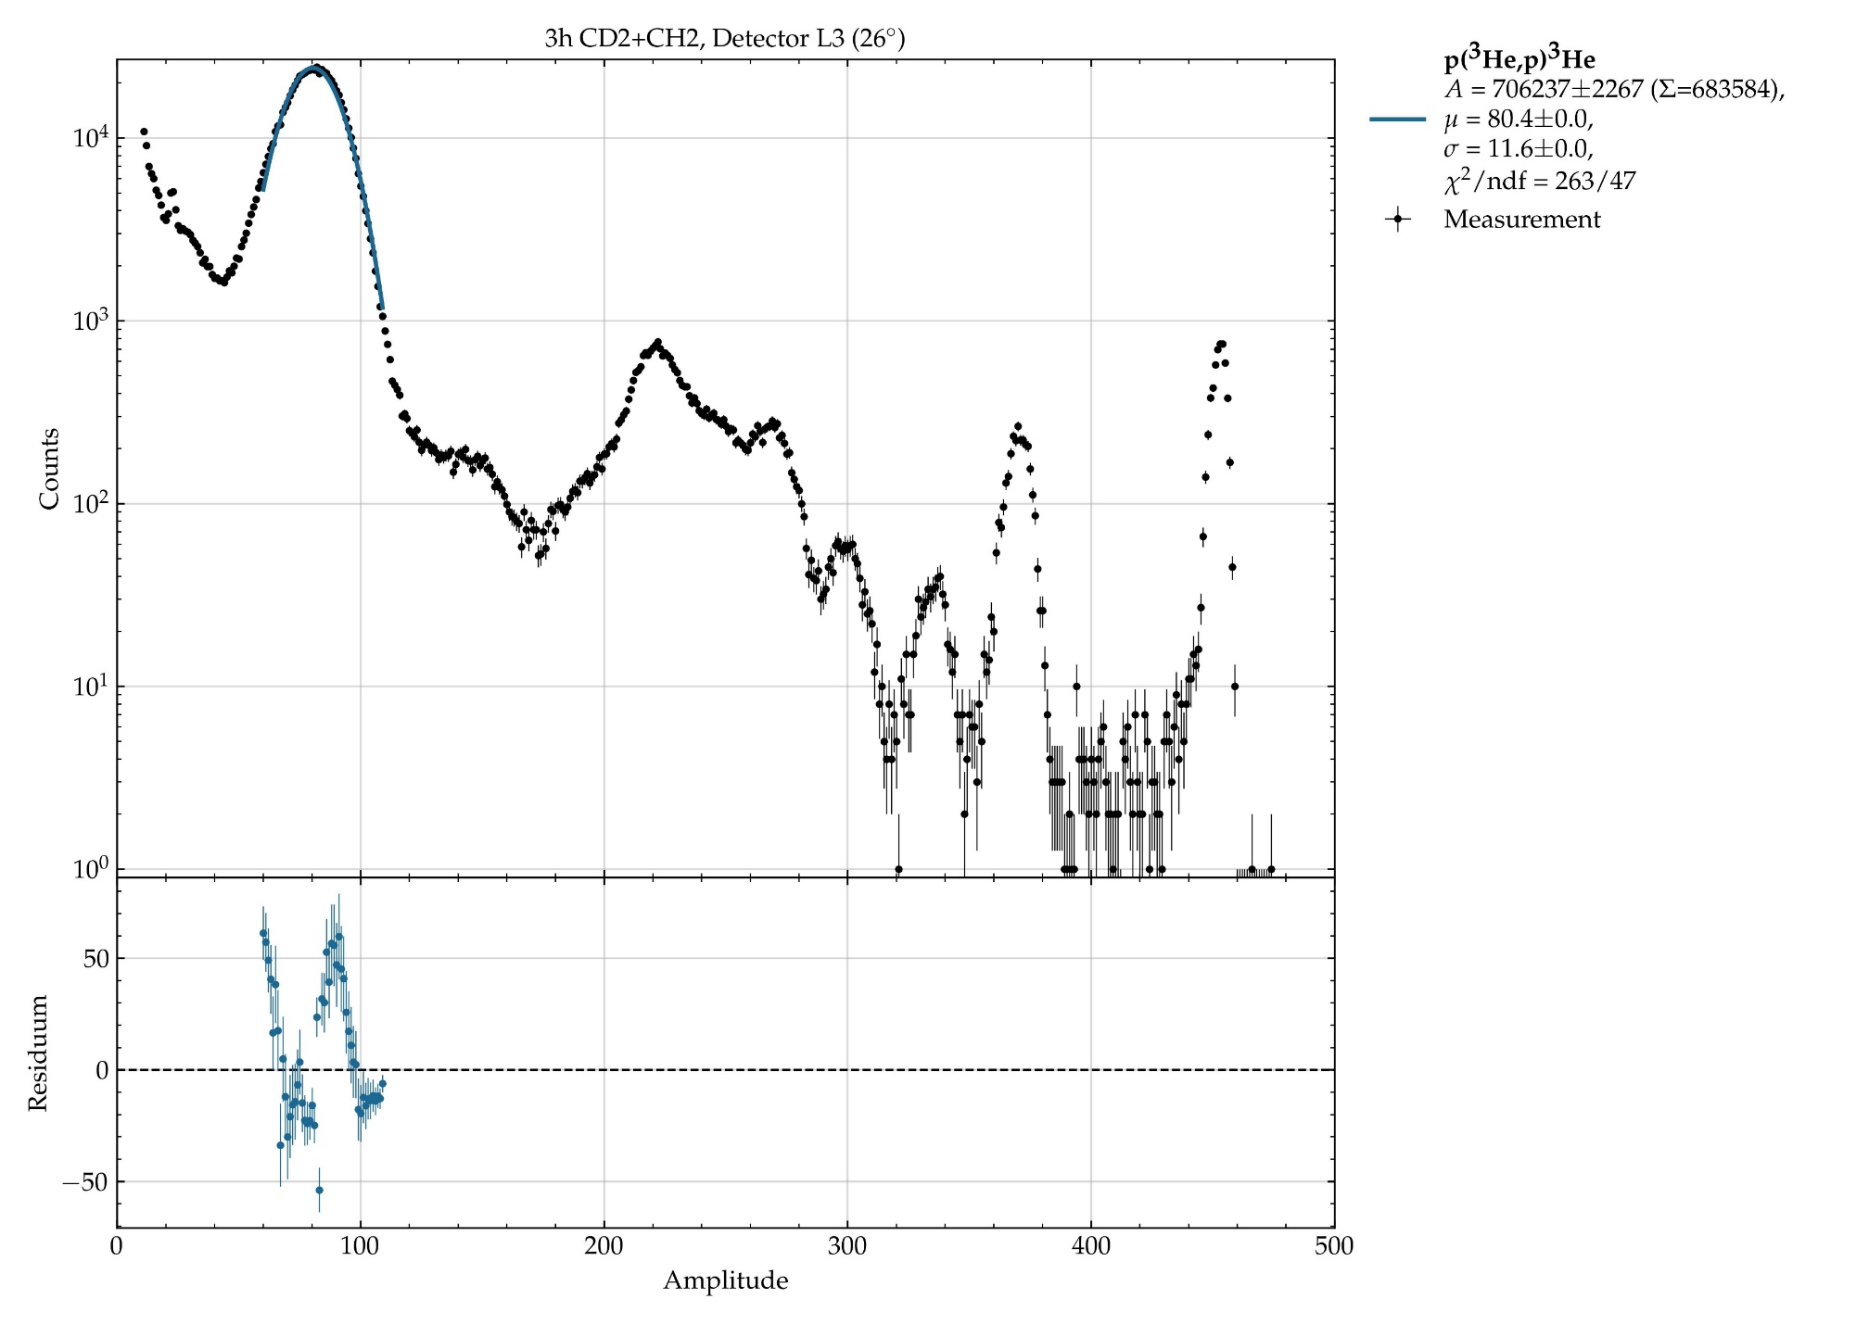
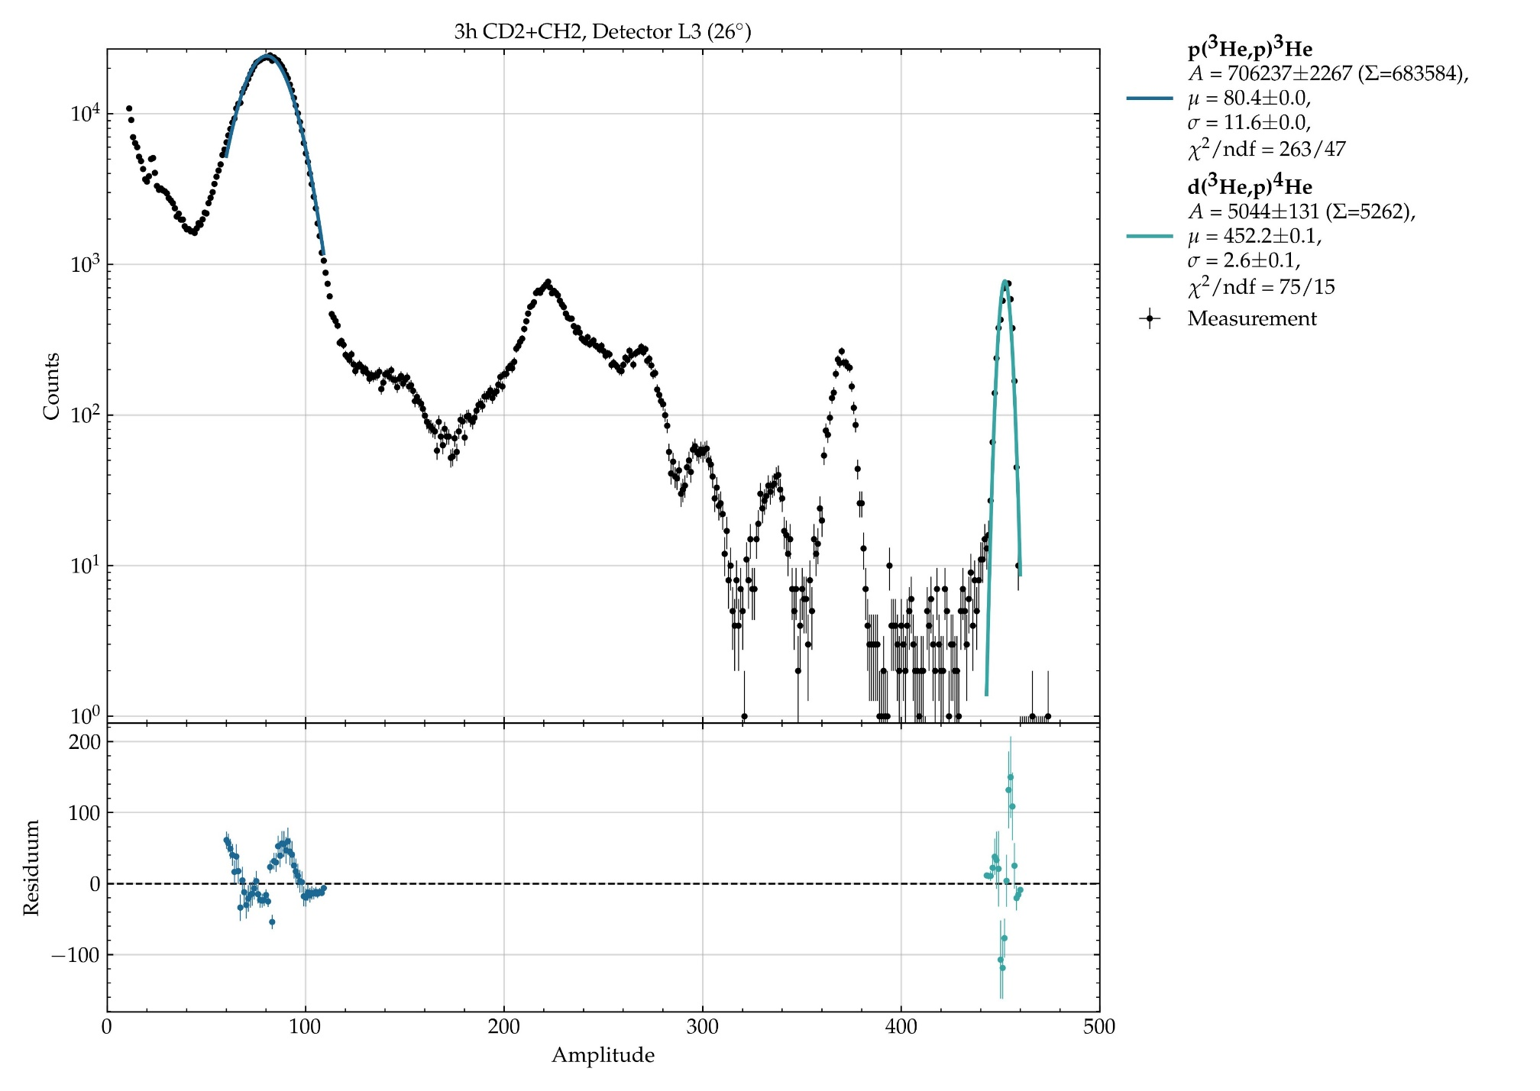
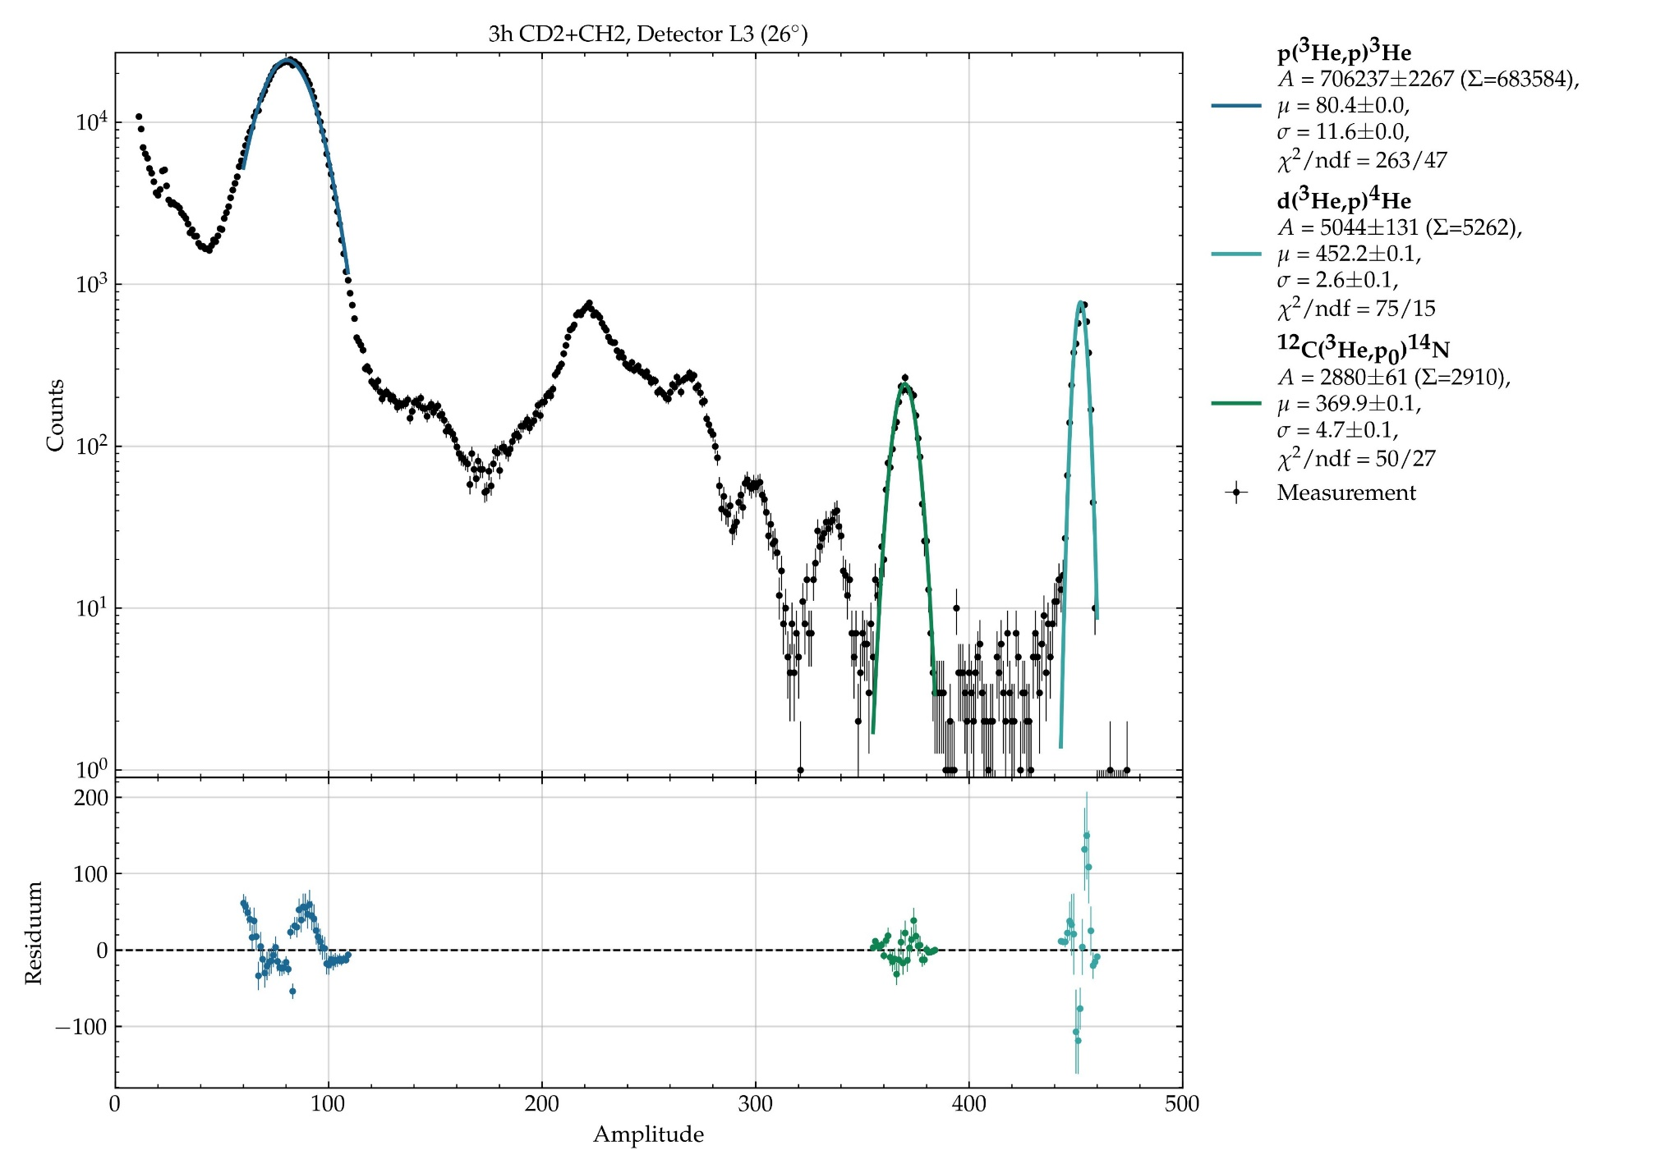
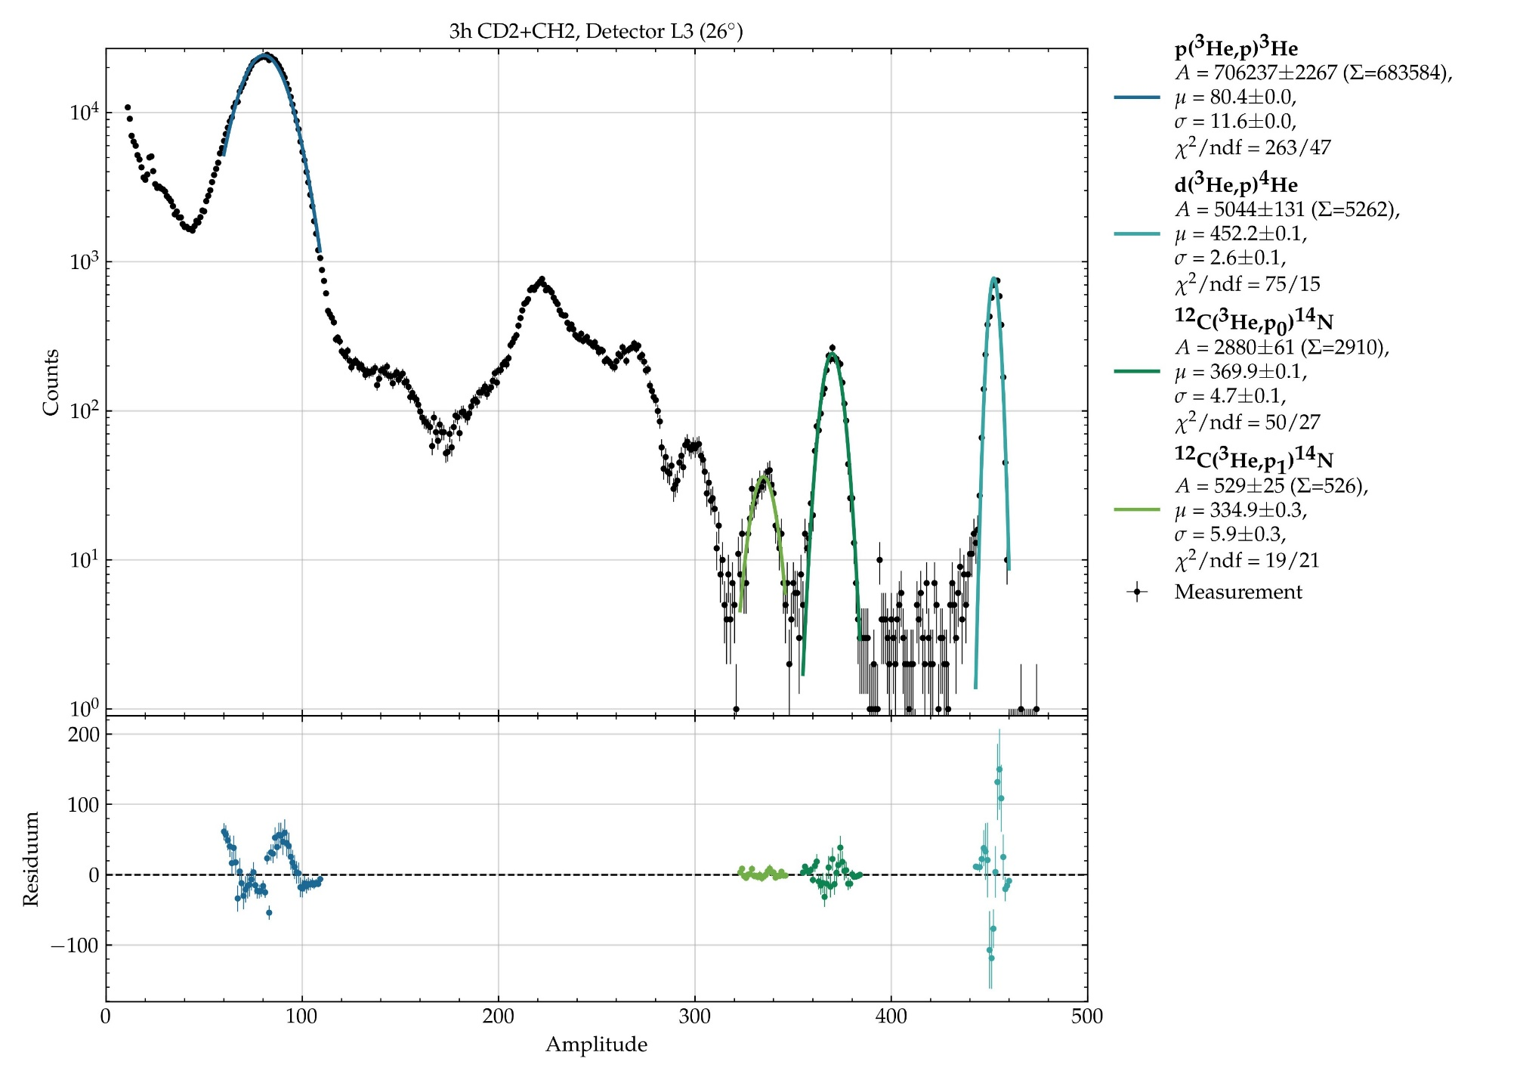
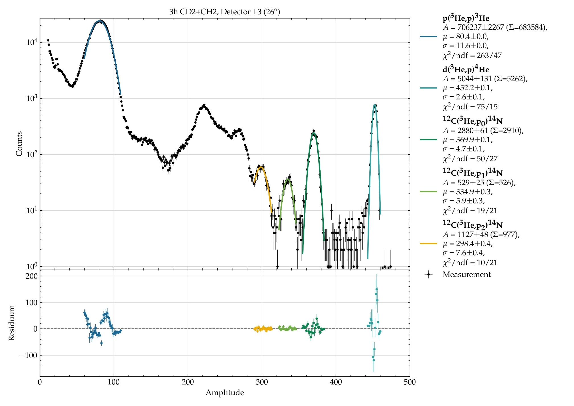
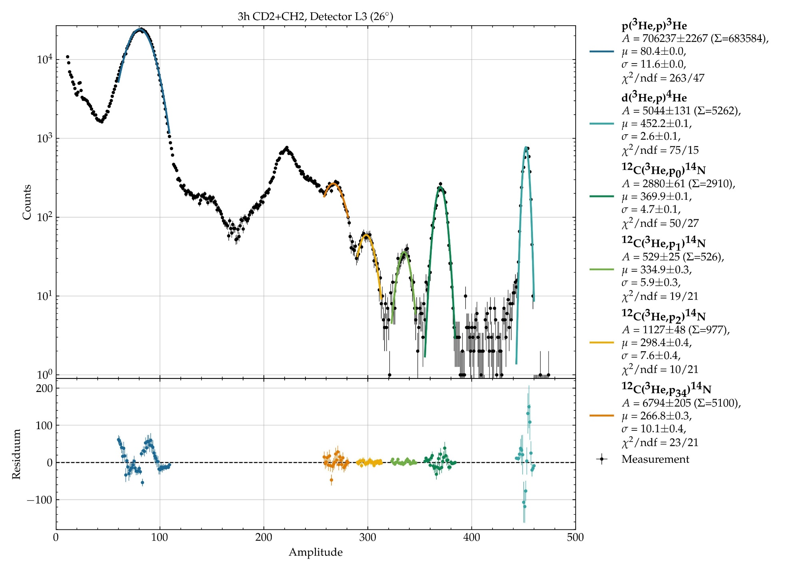
Identification of reactions at 14 MeV
x20

Slide 31
Discussion
Last beam time at the IKP !!!
Long list of problems
1.) Last supervisor left the IKP during the beam time
2.) The polarity of the cyclotron must be changed for the first time in 25 years !!!
→ The expected energy of 70 MeV could not be reached,
just 14 MeV are reached (p(³He,p)³He)
→ No stripping behind cyclotron possible (Plan B)
Data Analysis is still ongoing !!!

Slide 32
Discussion
This method works for: (Patent No. DE102022213860.0)
1.) H and D atoms → Polarized fuel for fusion reactors (see talk at 5 p.m.)
2.) H₂⁺ and D₂⁺ ions → Polarized molecular ion sources for stripping injection
3.) H₂ and D₂ molecules → New type of polarized target (coupling: J_{rot} ↔ I)
4.) Polarized tracers in medicine
5.) New type of low-field NMR ? (see talk by Dimitry Budker tomorrow)
6.) Precission spectroscopy
7.) New type or MRI in medicine ?

