Slide 1
热化动力学—
经典晶格热化的普适规律
（Thermalization Dynamics）
赵鸿（Hong Zhao）
厦门大学物理系
Notes:
1

Slide 2
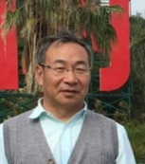
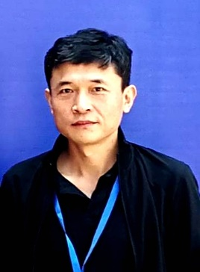
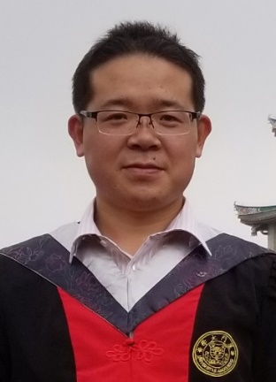
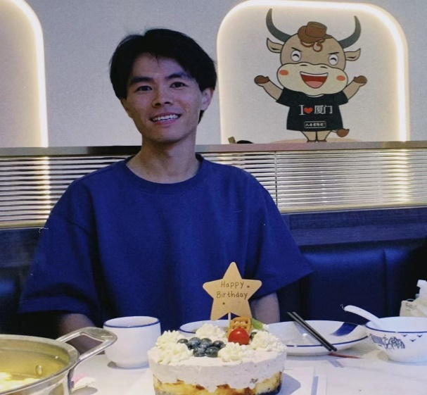
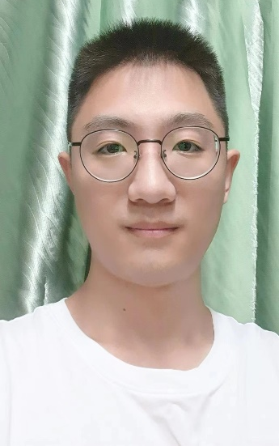
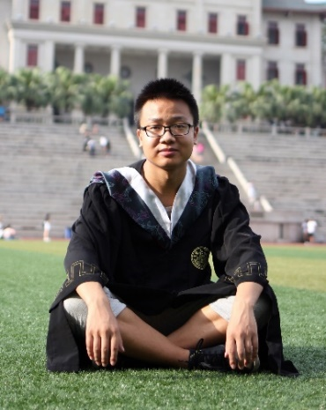
ACKNOWLEDGMENTS
Hong Zhao (赵鸿)
Yong Zhang(张勇)
Weicheng Fu(符维成)
Zhen Wang(王振)
Wei Lin (林炜）
Jialin Zhang (张嘉林）

Slide 3
提纲
1、热化与能均分
2、我们组的主要贡献
3、展望：从动力学到统计物理分布

Slide 4
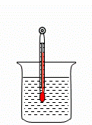

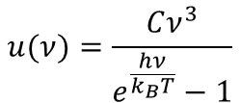

1 热化与能均分
热化问题：
热力学
层面
能达到相同的温度—假设！
温度计
统计物理
层面
动力学系统演化到平衡态分布—假设！
微正则分布
（等概率原理）
正则分布
黑体辐射分布（量子）
$$ρ_{s}=\frac{1}{Ω}$$
$$Z=\sum{e^{−\frac{E_{s}}{k_{B}T}}}$$
$$u(ν)=\frac{Cν^{3}}{e^{\frac{hν}{k_{B}T}}−1}$$
热化猜测：从任意微观态出发能演化到对应的统计物理分布上

Slide 5



1 热化与能均分
能均分问题：
$$H=H_{0}+λH′$$
$$λ≠0$$
$$E_{k}=\frac{1}{2}(P_{k}^{2}+{ω_{k}^{2}Q}_{k}^{2})$$
能均分猜测：无穷小的扰动能够使系统实现能量按自由度均分

Slide 6
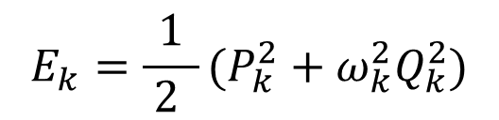
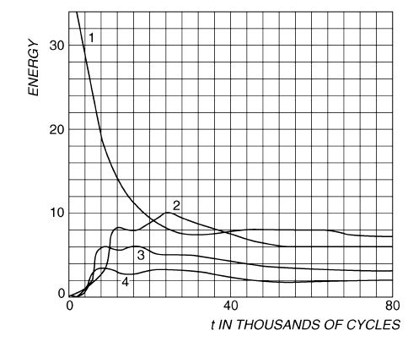
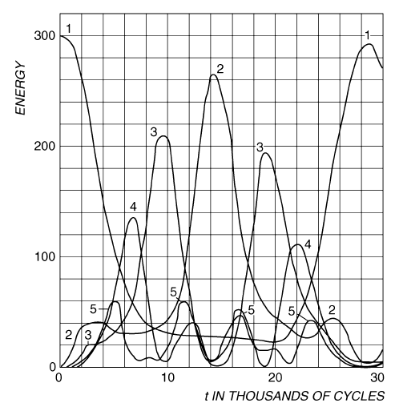

能均分定理的直接检验和证明
$$H=H_{0}+λH′$$
首次检验
Fermi-Pasta-Ulam-Tsingou （FPUT） 回归(1954)：
Anticipation:
Result in Fermi’s time:
没有看到期望
的均分！
（16、32、64个晶格粒子）
E. Fermi, J. Pasta, and S. Ulam, Los Alamos Scientific Laboratory, Report No. LA-1940, 1955

Slide 7

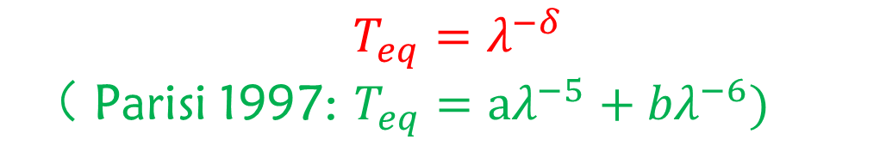
能量均分研究之前的进展（一维晶格）
小系统：1980s-1990s，强扰动能够实现均分；弱扰动是否均分
存在争论。2015 Onorato 等（PNAS）证明FPUT（$T_{eq}$均分时间，$λ$扰动强度）：
大系统（热力学极限）：2019前认为强扰动能够实现均分；弱
扰动是否均分没有明确结论。一般猜测
$$T_{eq}=λ^{−6}$$
$$T_{eq}=λ^{−δ}$$
（ Parisi 1997: $T_{eq}={aλ}^{−5}+{bλ}^{−6})$

Slide 8

能量均分研究之前的进展（二维、三维晶格）
For 2D lattices,
G. Benettin, Chaos 15, 015108 (2005). G. Benettin and G. Gradenigo, Chaos 18, 013112 (2008), for hexagonal lattice with LJ potential,
$$T_{eq}\sim ε^{−1}$$
Y. Wang, Z. Zhu, Y. Zhang, and L. Huang, Appl. Phys. Lett. 112, 111910 (2018); Phys. Rev. E 97, 012143 (2018). For a graphene sheet out-of-plane flexural modes.
For 3D lattices,
A. Carati, L. Galgani, F. Gangemi, and R. Gangemi, Physica A 532, 121911 (2019).
studied an ionic crystal, inferred that ergodicity may not occur

Slide 9
提纲
1、热化与能均分
2、我们组的主要贡献
3、展望：从动力学到统计物理分布

Slide 10
目标:
I. Whether arbitrarily small nonlinear perturbations are sufficient to distribute energy equally among each of the normal modes for sufficiently large lattices?
II. The time scale on which the system evolves to the equilibrium state
III. Does small lattices can really reach equilibrium?

Slide 11
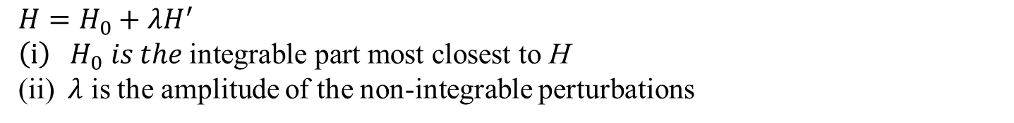
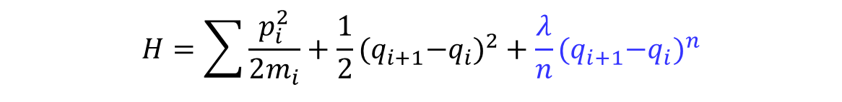
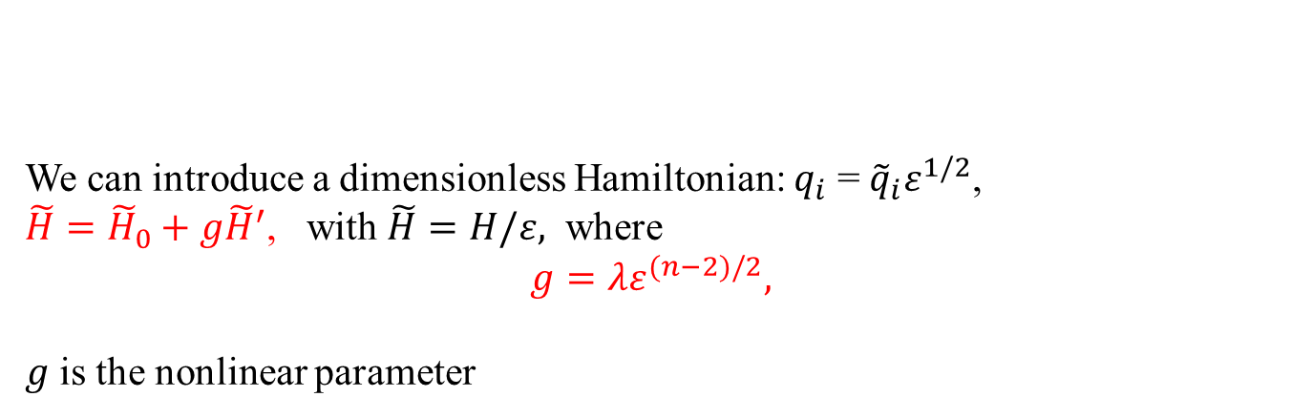

Lattice models in general:
On-site potential
$H=\sum{\frac{p_{i}^{2}}{2m_{i}}}+V\left(q_{i+1}−q_{i}\right)$+U($q_{i}$)
Interatomic potential
$H=H_{0}+{λH}^{′}$
$$\left(i\right){ H}_{0} is the \text{i}\text{ntegrable} \text{part} \text{most} \text{closest} \text{to} \text{H}$$
(ii) $λ$ is the amplitude of the non-integrable perturbations
We can introduce a dimensionless Hamiltonian: $q_{i}$ =${\tilde{q}}_{i}ε^{1/2}$,
$\tilde{H}={\tilde{H}}_{0}+g{\tilde{H}}^{′}$, with $\tilde{H}=H/ε,$ where
$$g=λε^{(n−2)/2},$$
$g$ is the nonlinear parameter
$$H=\sum{\frac{p_{i}^{2}}{2m_{i}}}+\frac{1}{2}{{(q}_{i+1}−q_{i})}^{2}+\frac{λ}{n}{{(q}_{i+1}−q_{i})}^{n}$$
$H=\sum{\frac{p_{i}^{2}}{2m_{i}}}+\frac{1}{2}{{(q}_{i+1}−q_{i})}^{2}+\frac{λ_{1}}{n}{{(q}_{i+1}−q_{i})}^{n}$+ $\frac{λ_{2}}{n+1}{{(q}_{i+1}−q_{i})}^{n+1}+…$

Slide 12
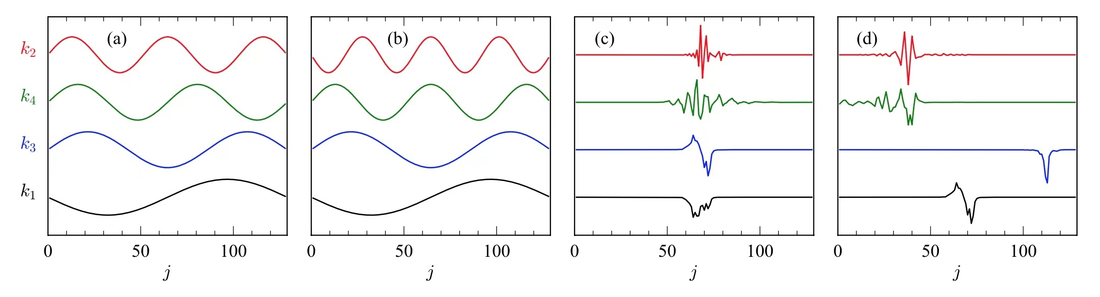
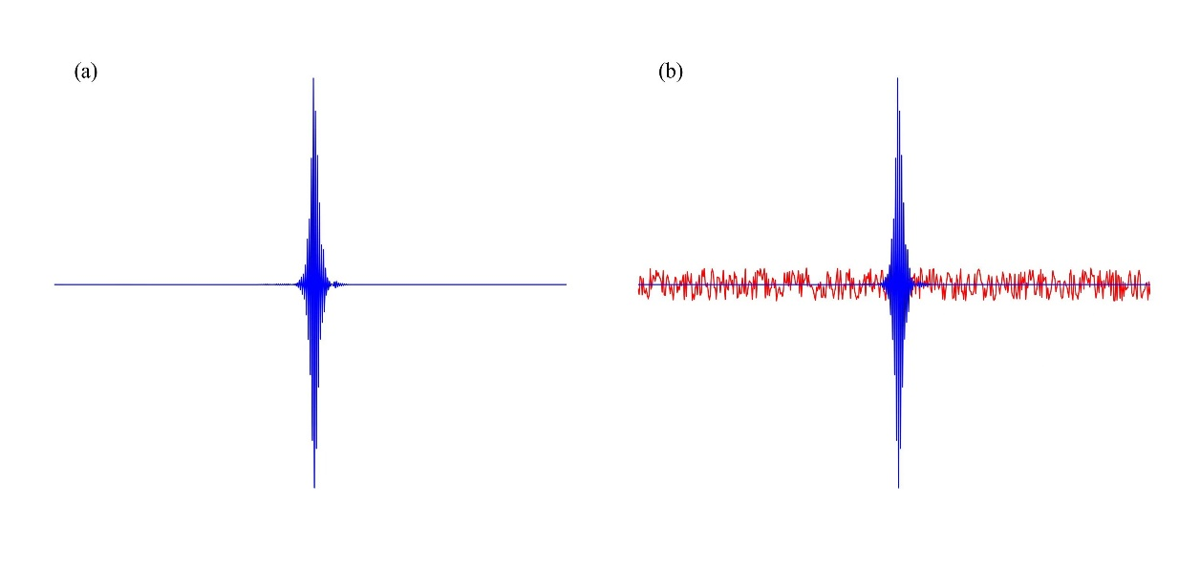
扩展模、局域模、安德森局域模的热稳定性问题
安德森局域模在热涨落扰动下是否稳定一直没有答案
？

Slide 13
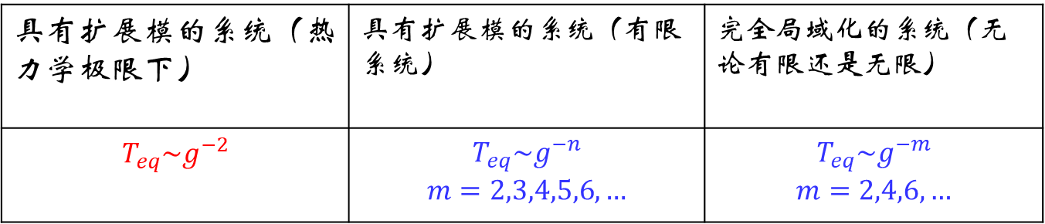

我们的主要结论 (in the weak perturbation regime)
$H=\sum{\frac{p_{i}^{2}}{2m_{i}}}+V\left(q_{i+1}−q_{i}\right)$+U($q_{i}$)
规律
具有扩展模的系统（热力学极限下） | 具有扩展模的系统（有限系统） | 完全局域化的系统（无论有限还是无限）
$$T_{eq}\sim g^{−2}$$ | $$T_{eq}\sim g^{−n}$$ $$m=2,3,4,5,6,…$$ | $$T_{eq}\sim g^{−m}$$ $$m=2,4,6,…$$
机制：多波共振+契利科夫共振（简并系统）
（ PRE 2019；PRE 2019；NJP 2019；PRE 2021，中国科学 2021， JSMTE 2022； PRL 2020 ）+若干正在投稿或整理中的文章

Slide 14
我们的理论：准共振联网理论

Slide 15

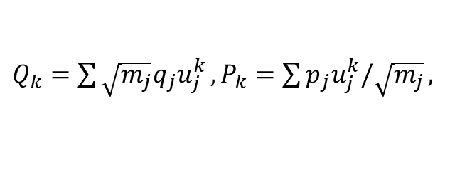
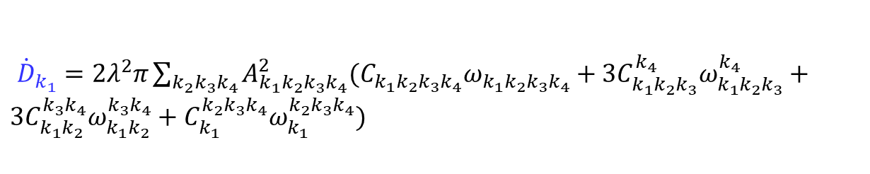
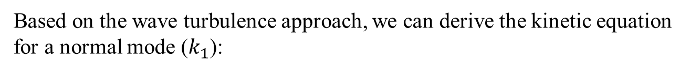
We apply the lattice $φ^{4}$model as an example (pure extended, full localized, partial localized)
$H=\sum{\frac{p_{i}^{2}}{2m_{i}}}+\frac{1}{2}{(q_{i+1}−q_{i})}^{2}+\frac{1}{2}b{q_{i}}^{2}+\frac{λ}{4}{q_{i}}^{4}=H_{0}+\frac{λ}{4}{q_{i}}^{4}$
$$g=λε^{(n−2)/2}$$
With $λ=0$ this model appears as an integrable model
$Q_{k}=\sum{\sqrt{m_{j}}q_{j}u_{j}^{k}},P_{k}=\sum{p_{j}u_{j}^{k}/\sqrt{m_{j}}},$
Then
$H=\sum{\frac{1}{2}(P_{k}^{2}}+ω_{k}^{2}{Q_{k}}^{2})+\frac{λ}{4}\sum_{k_{1}k_{2}k_{3}k_{4}}{Q_{k_{1}}Q_{k_{2}}Q_{k_{3}}Q_{k_{4}}\sum_{j}{\frac{u_{j}^{k_{1}}u_{j}^{k_{2}}u_{j}^{k_{3}}u_{j}^{k_{4}}}{m_{j}^{2}}}}$
Where $u_{j}^{k}$ is the amplitude of the kth normal mode, and $ω_{k}$ is its frequency.
Based on the wave turbulence approach, we can derive the kinetic equation for a normal mode ($k_{1}$):
${\dot{D}}_{k_{1}}=2λ^{2}π\sum_{k_{2}k_{3}k_{4}}{A_{k_{1}k_{2}k_{3}k_{4}}^{2}(C_{k_{1}k_{2}k_{3}k_{4}}ω_{k_{1}k_{2}k_{3}k_{4}}}+3C_{k_{1}k_{2}k_{3}}^{k_{4}}ω_{k_{1}k_{2}k_{3}}^{k_{4}}+3C_{k_{1}k_{2}}^{{k_{3}k}_{4}}ω_{k_{1}k_{2}}^{{k_{3}k}_{4}}+C_{k_{1}}^{{{k_{2}k}_{3}k}_{4}}ω_{k_{1}}^{{k_{2}k_{3}k}_{4}})$
Where $D_{k_{1}}=\left\langle a_{k_{1}}a_{k_{1}}^{∗}\right\rangle$, and $a_{k_{1}}=\frac{1}{\sqrt{2ω_{k_{1}}}}(ω_{k_{1}}Q_{k_{1}}+iP_{k_{1}})$

Slide 16
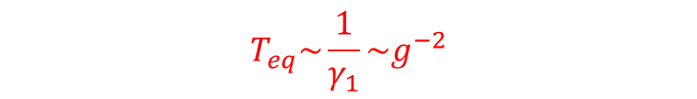
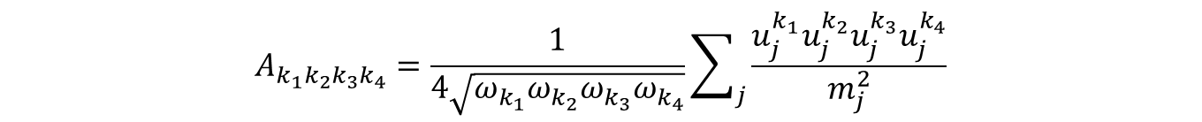

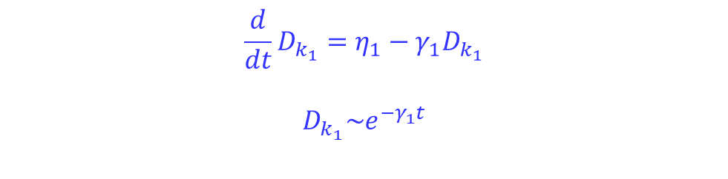
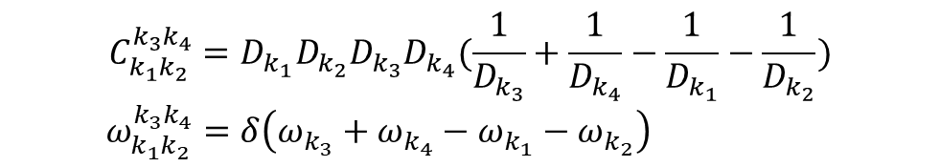
$$A_{k_{1}k_{2}k_{3}k_{4}}=\frac{1}{4\sqrt{ω_{k_{1}}ω_{k_{2}}ω_{k_{3}}ω_{k_{4}}}}\sum_{j}{\frac{u_{j}^{k_{1}}u_{j}^{k_{2}}u_{j}^{k_{3}}u_{j}^{k_{4}}}{m_{j}^{2}}}$$
$$C_{k_{1}k_{2}}^{{k_{3}k}_{4}}=D_{k_{1}}D_{k_{2}}D_{k_{3}}D_{k_{4}}(\frac{1}{D_{k_{3}}}+\frac{1}{D_{k_{4}}}−\frac{1}{D_{k_{1}}}−\frac{1}{D_{k_{2}}})$$
$$ω_{k_{1}k_{2}}^{{k_{3}k}_{4}}=δ\left(ω_{k_{3}}+ω_{k_{4}}−ω_{k_{1}}−ω_{k_{2}}\right)$$
$C_{k_{1}k_{2}k_{3}k_{4}}{,ω}_{k_{1}k_{2}k_{3}k_{4}}$, $C_{k_{1}k_{2}k_{3}}^{k_{4}},ω_{k_{1}k_{2}k_{3}}^{k_{4}},C_{k_{1}}^{{{k_{2}k}_{3}k}_{4}},ω_{k_{1}}^{{k_{2}k_{3}k}_{4}}$
Similarly,
The kinetic equation
$${\frac{d}{dt}D}_{k_{1}}=η_{1}−γ_{1}D_{k_{1}}$$
$$D_{k_{1}}\sim e^{−γ_{1}t}$$
If $γ_{1}≠0!$
$$T_{eq}\sim \frac{1}{γ_{1}}{\sim g}^{−2}$$

Slide 17

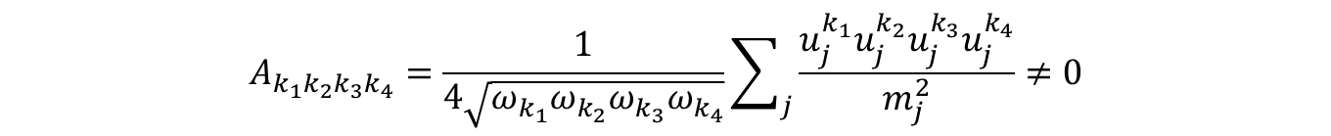



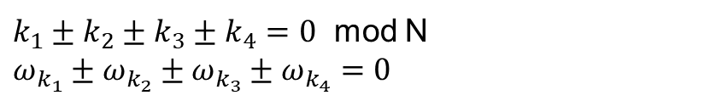
How to guarantee
$$γ_{1}≠0 ?$$
$$A_{k_{1}k_{2}k_{3}k_{4}}=\frac{1}{4\sqrt{ω_{k_{1}}ω_{k_{2}}ω_{k_{3}}ω_{k_{4}}}}\sum_{j}{\frac{u_{j}^{k_{1}}u_{j}^{k_{2}}u_{j}^{k_{3}}u_{j}^{k_{4}}}{m_{j}^{2}}}≠0$$
$ω_{k_{1}k_{2}}^{{k_{3}k}_{4}}=δ\left(ω_{k_{3}}+ω_{k_{4}}−ω_{k_{1}}−ω_{k_{2}}\right)$ $≠0$
$ω_{k_{1}k_{2}k_{3}}^{k_{4}}=δ\left(ω_{k_{4}}−ω_{k_{1}}−ω_{k_{2}}−ω_{k_{3}}\right)$ $≠0$
$ω_{k_{1}k_{2}{k_{3}k}_{4}}^{}=δ\left({ω_{k_{1}}+ω_{k_{2}}+ω}_{k_{3}}+ω_{k_{4}}\right)$ $≠0$
$ω_{k_{1}}^{k_{2}{k_{3}k}_{4}}=δ\left({−ω}_{k_{1}}+ω_{k_{4}}+ω_{k_{1}}+ω_{k_{2}}\right)$ $≠0$
For lattice with translation invariance (ordered system),if
$k_{1}±k_{2}±k_{3}±k_{4}=0$ mod N
$ω_{k_{1}}±ω_{k_{2}}±ω_{k_{3}}±ω_{k_{4}}=0$
Satisfied, which are the exact resonance conditions

Slide 18
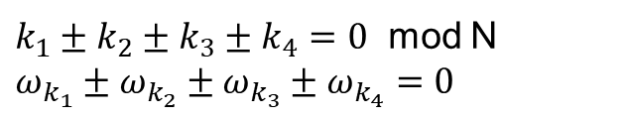




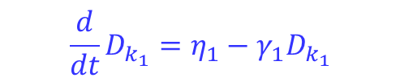
波湍流分析的主要优点
To further prove the 4-wave resonant set exist, i.e. the exact resonance condition satisfied ($γ_{1}≠0$)
$$k_{2}^{(1)}$$
$$k_{4}^{(1)}$$
$$k_{1}^{(1)}$$
$k_{1}±k_{2}±k_{3}±k_{4}=0$ mod N
$ω_{k_{1}}±ω_{k_{2}}±ω_{k_{3}}±ω_{k_{4}}=0$
$${\frac{d}{dt}D}_{k_{1}}=η_{1}−γ_{1}D_{k_{1}}$$
$$k_{3}^{(1)}$$
(b) To further prove all of the modes are interconnected by resonant 4 waves
Nazarenko S,2011 Wave Turbulence; Onorato et.al., PNAS 2015; Lvov and Onorato, PRL 2018; Pistone et. al. EPL 2018

Slide 19
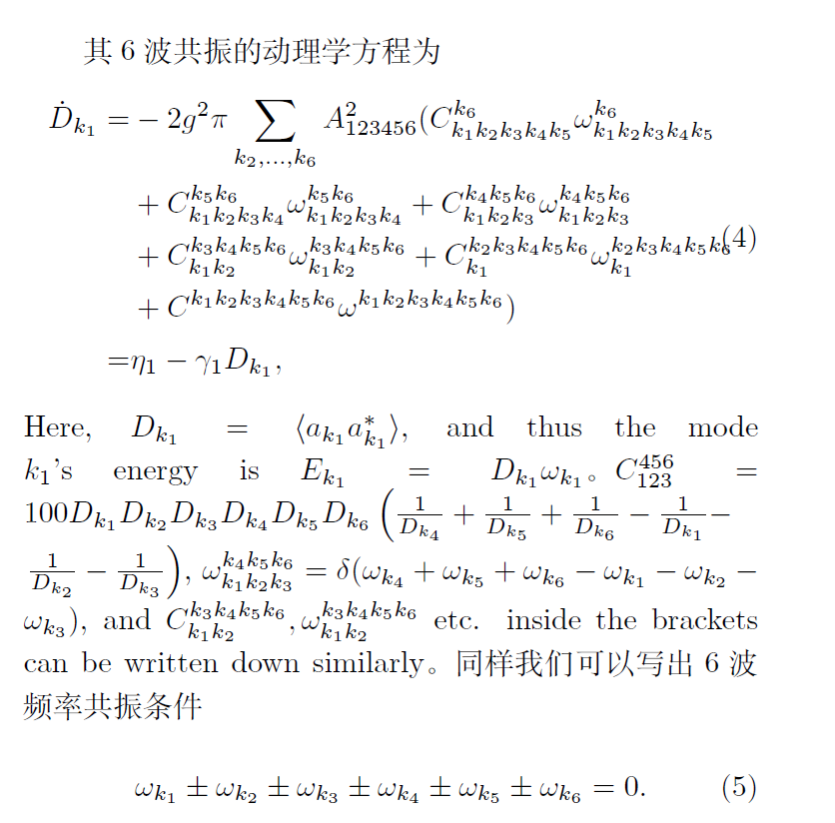
六波精确共振的例子：

Slide 20
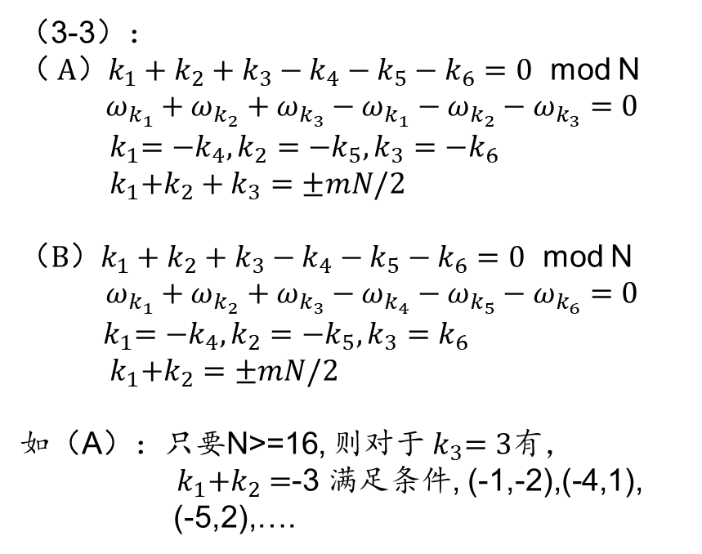
六波精确共振的例子：
（3-3$）：$
（$A）k_{1}+k_{2}+k_{3}−k_{4}−k_{5}−k_{6}=0$ mod N
$$ω_{k_{1}}+ω_{k_{2}}+ω_{k_{3}}−ω_{k_{1}}−ω_{k_{2}}−ω_{k_{3}}=0$$
${ k}_{1}=−k_{4},k_{2}=−k_{5},k_{3}=−k_{6}$
${ k}_{1}+k_{2}+k_{3}=±mN/2$
（$B）k_{1}+k_{2}+k_{3}−k_{4}−k_{5}−k_{6}=0$ mod N
$$ω_{k_{1}}+ω_{k_{2}}+ω_{k_{3}}−ω_{k_{4}}−ω_{k_{5}}−ω_{k_{6}}=0$$
${ k}_{1}=−k_{4},k_{2}=−k_{5},k_{3}=k_{6}$
${ k}_{1}+k_{2}=±mN/2$
如（A）：只要N>=16, 则对于${ k}_{3}=3$有，${ k}_{1}+k_{2}=$-3 满足条件, (-1,-2),(-4,1),
(-5,2),….

Slide 21
但是3波、4波、不存在联网的精确共振解；无序系统精确共振理论不适用

Slide 22
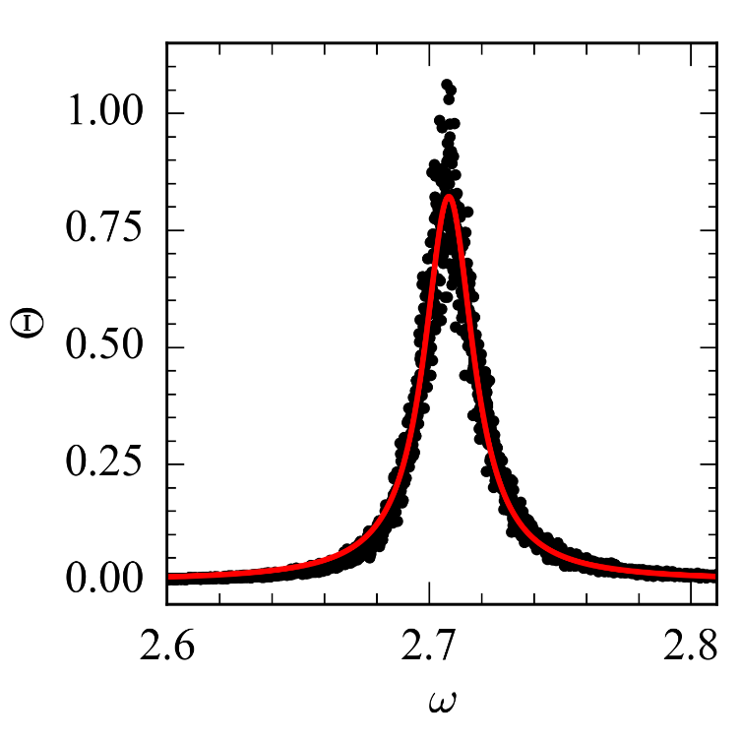
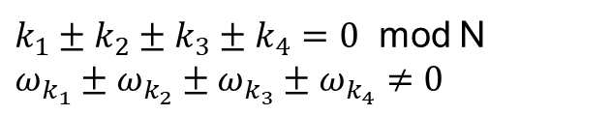
我们的准共振分析方法
(a) For disordered systems, the exact resonance conditions fails
$k_{1}±k_{2}±k_{3}±k_{4}=0$ mod N
$ω_{k_{1}}±ω_{k_{2}}±ω_{k_{3}}±ω_{k_{4}}≠0$
Therefore the exact resonance conditions are not applicable
Nonlinear interactions can induce
the broaden of frequencies.
Therefore, the frequency resonance
condition may be temporally satisfied,
$ω_{k_{1}}\left(t\right)±ω_{k_{2}}\left(t\right)±ω_{k_{3}}\left(t\right)±ω_{k_{4}}\left(t\right)=0$

Slide 23
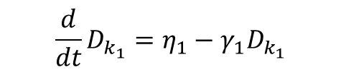

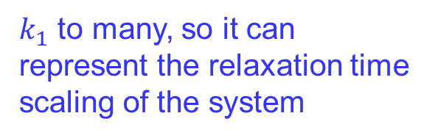
我们的准共振分析方法
(b) To guarantee the time scaling predicted by the kinetic equation can characterize the energy relaxation time scaling of the system,
connect in this way is not sufficient
should connected in this way
$${\frac{d}{dt}D}_{k_{1}}=η_{1}−γ_{1}D_{k_{1}}$$
$k_{1}$ to many, so it can represent the relaxation time scaling of the system
$k_{1}$

Slide 24

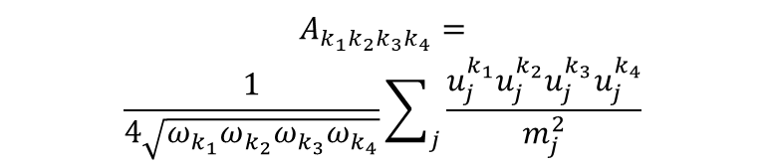

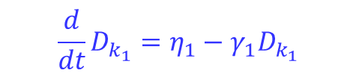
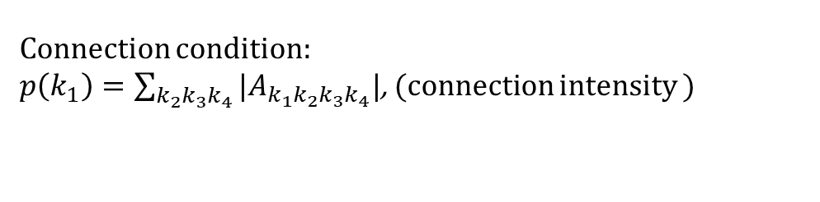
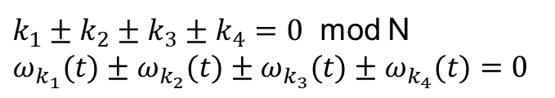
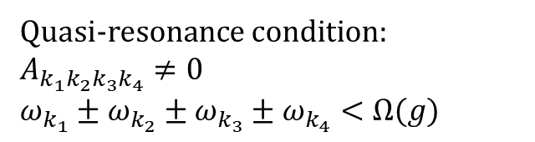

我们的准共振分析方法
$$A_{k_{1}k_{2}k_{3}k_{4}}=$$
$$\frac{1}{4\sqrt{ω_{k_{1}}ω_{k_{2}}ω_{k_{3}}ω_{k_{4}}}}\sum_{j}{\frac{u_{j}^{k_{1}}u_{j}^{k_{2}}u_{j}^{k_{3}}u_{j}^{k_{4}}}{m_{j}^{2}}}$$
Our quasi-resonance approach
Quasi-resonance condition:
$A_{k_{1}k_{2}k_{3}k_{4}}≠0$
$ω_{k_{1}}±ω_{k_{2}}±ω_{k_{3}}±ω_{k_{4}}<Ω(g)$
$k_{1}±k_{2}±k_{3}±k_{4}=0$ mod N
$ω_{k_{1}}(t)±ω_{k_{2}}(t)±ω_{k_{3}}(t)±ω_{k_{4}}(t)=0$
Here$Ω$ is determined by the nonlinear interaction amplitude
Connection condition:
$p\left(k_{1}\right)=\sum_{k_{2}k_{3}k_{4}}{|A_{k_{1}k_{2}k_{3}k_{4}}|}$, (connection intensity )
$${\frac{d}{dt}D}_{k_{1}}=η_{1}−γ_{1}D_{k_{1}}$$
big $p\left(k_{1}\right)$
small $p\left(k_{1}\right)$
zero$p\left(k_{1}\right)$

Slide 25
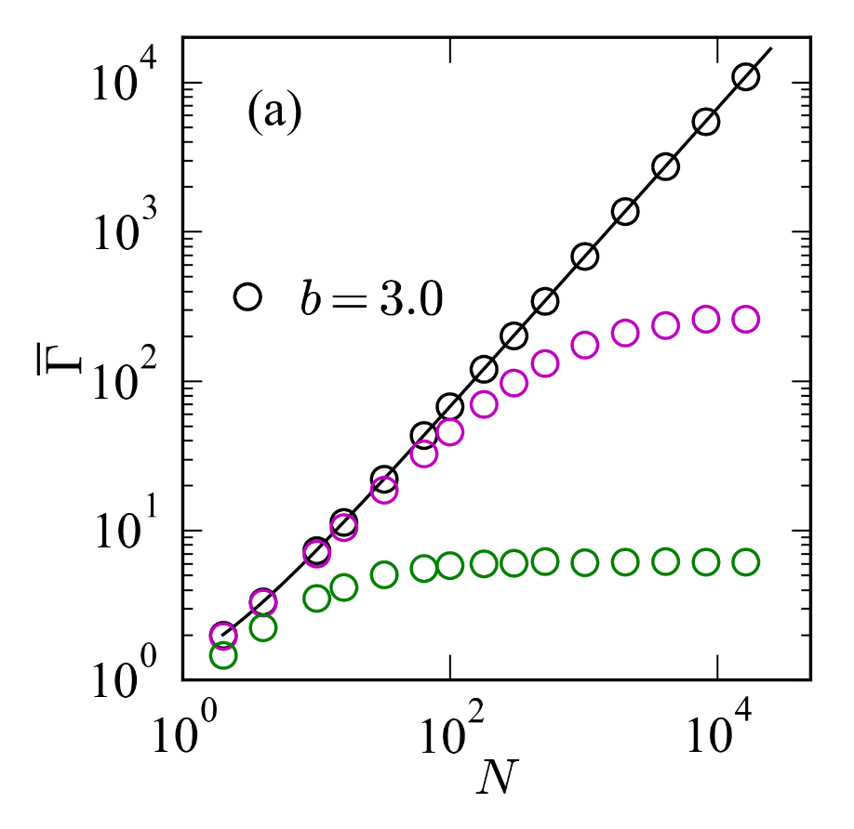
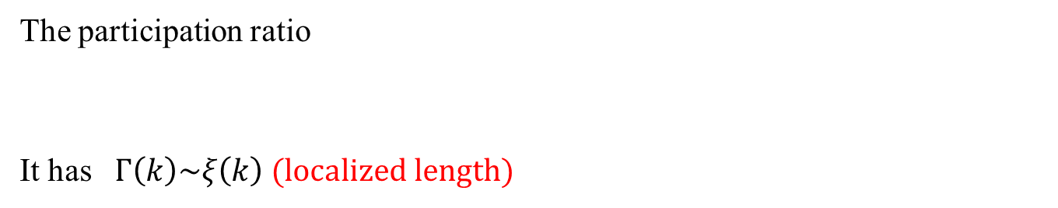
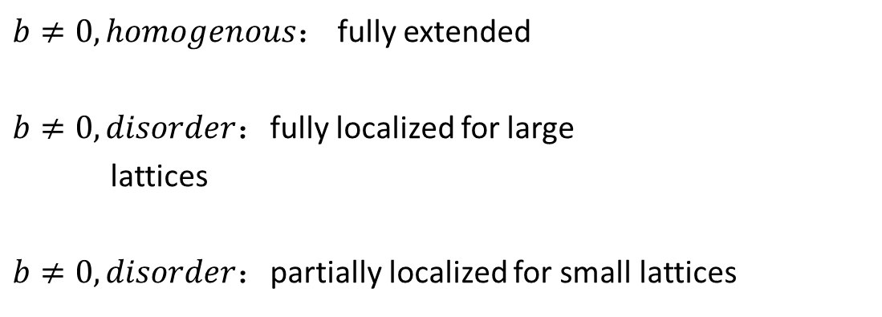
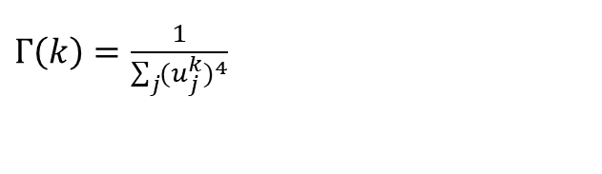
准共振预测
The participation ratio
It has $Γ\left(k\right)\sim ξ\left(k\right) (localized length)$
$Γ\left(k\right)=\frac{1}{\sum_{j}{{(u_{j}^{k})}^{4}}}$
$b≠0, homogenous：$ fully extended
$b≠0, disorder：$fully localized for large
lattices
$b≠0, disorder：$partially localized for small lattices

Slide 26
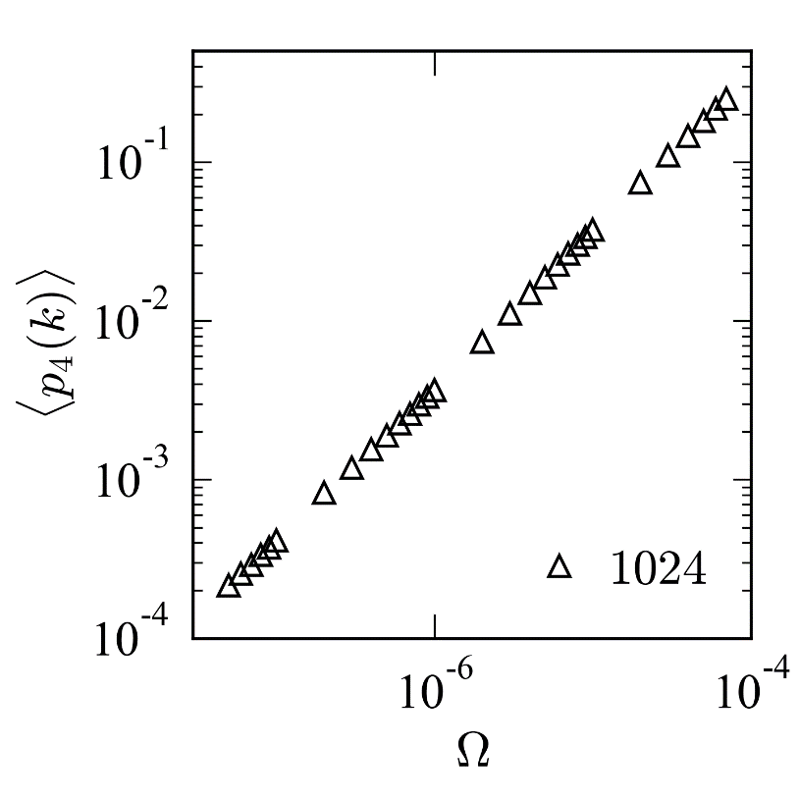
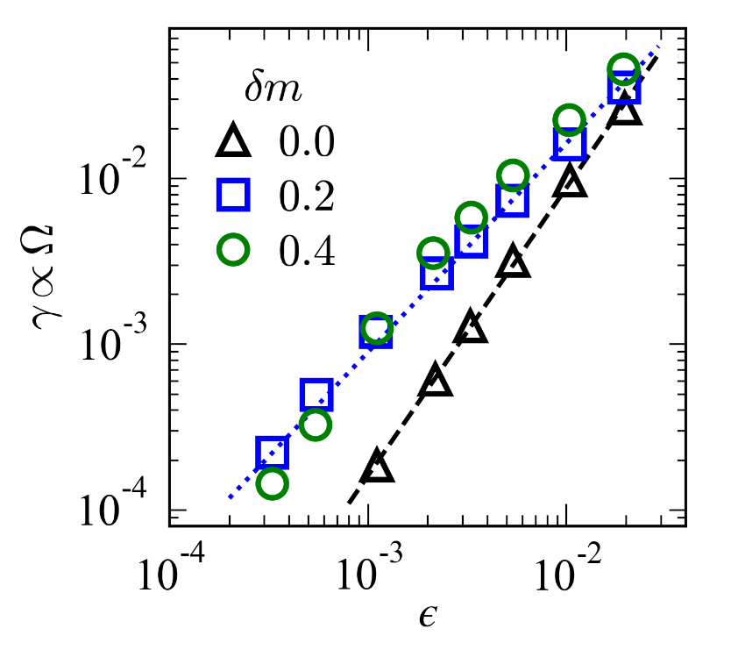
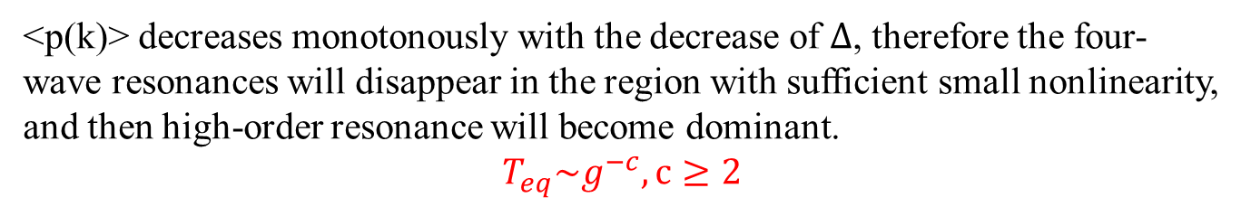
准共振预测
Prediction for ordered lattice with a finite size
<p(k)> decreases monotonously with the decrease of $Δ$, therefore the four-wave resonances will disappear in the region with sufficient small nonlinearity, and then high-order resonance will become dominant.
$$T_{eq}\sim g^{−c}, c≥2$$
Notes:
Here we present the average connection intensity, pk, plotted against omega for a homogeneous lattice, with a lattice size of N=1024. It's evident that pk declines progressively with the reduction of omiga. Through this plot, we see that the width of frequency broadening is directly proportional to the nonlinear parameter. It's worth noting that this broadening determines the value of omega.
From these results, it can be inferred that when the nonlinear parameter is adequately small, the 4-wave resonances will cease. Thus, for a finite-sized homogeneous lattice, the thermalization time scaling will transition from g-2 to an index greater than 2. This suggests that higher order resonances will take precedence in energy diffusion

Slide 27
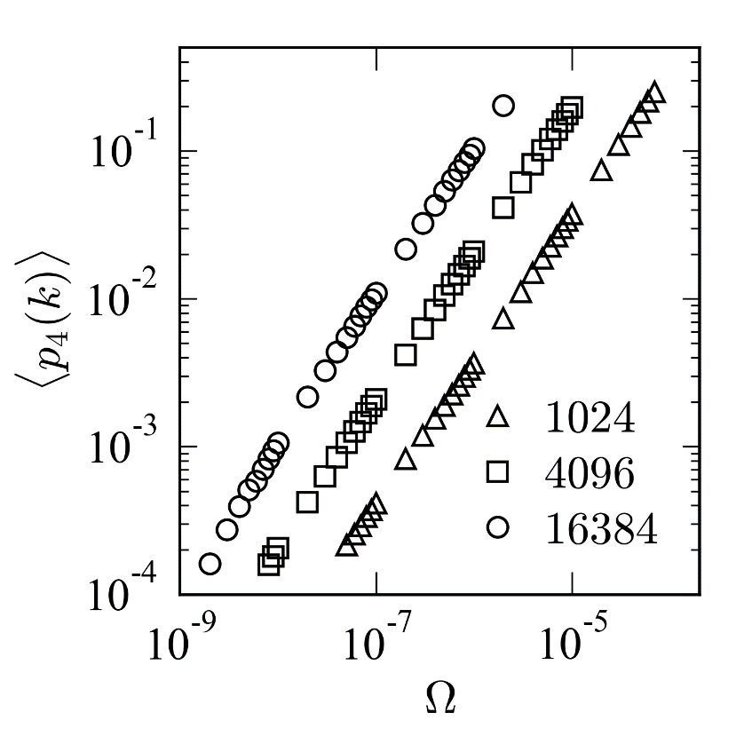
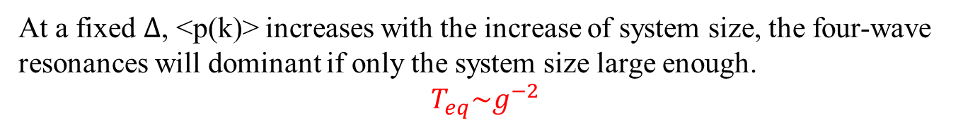
准共振预测
Prediction for homogenous lattice in the thermodynamic limit
At a fixed $Δ$, <p(k)> increases with the increase of system size, the four-wave resonances will dominant if only the system size large enough.
$$T_{eq}\sim g^{−2}$$

Slide 28

准共振预测
Prediction for partially extended and partially localized lattices
So, it is same as in the case for pure extended modes

Slide 29



准共振预测
$$A_{k_{1}k_{2}k_{3}k_{4}}=$$
$$\frac{1}{4\sqrt{ω_{k_{1}}ω_{k_{2}}ω_{k_{3}}ω_{k_{4}}}}\sum_{j}{\frac{u_{j}^{k_{1}}u_{j}^{k_{2}}u_{j}^{k_{3}}u_{j}^{k_{4}}}{m_{j}^{2}}}$$
Prediction for fully localized lattices
<p(k)> is size-independent, but decreases monotonously with the decrease of $Δ$, therefore we can predict
$$T_{eq}\sim g^{−n}, n=2,4,6,…,$$

Slide 30

准共振预测
No modes have vanished pk:
Large numbers of mode have zero pk:
N = 16384

Slide 31





Models with on-site potential
$H=\sum{\frac{p_{i}^{2}}{2m_{i}}}+\frac{1}{2}{(q_{i+1}−q_{i})}^{2}+\frac{1}{2}b{q_{i}}^{2}+\frac{λ}{4}{q_{i}}^{4}$
N = 4096,2048
slop=-2
slop=-2
$T_{eq}\sim g^{−2}\sim λ^{−2}$ $ε^{−2}$
$$T_{eq}\sim g^{−n}\sim λ^{−n} ε^{−(n−2)}, n=2,4,6,…,$$
The predictions are fully verified

Slide 32


For 1D ordered and disordered lattices (weak perturbation; large enough lattices)
generalized FPUT-$β$ models: $H=\sum{\frac{p_{i}^{2}}{2m_{i}}}+\frac{1}{2}{{(q}_{i+1}−q_{i})}^{2}+\frac{λ}{n}{{|q}_{i+1}−q_{i}|}^{n}$
generalized FPUT-$α$ models: $H=\sum{\frac{p_{i}^{2}}{2m_{i}}}+\frac{1}{2}{{(q}_{i+1}−q_{i})}^{2}+\frac{λ}{n}{{(q}_{i+1}−q_{i})}^{n}$ n: odd
Nonintegrable Toda lattices: $H=\sum_{i=1}^{N}{\begin{aligned}\frac{p_{i}^{2}}{2m_{i}}+V\left(q_{i+1}−q_{i}\right) ; \\ \end{aligned}}$
$H=\sum_{i=1}^{N}{\begin{aligned}\frac{p_{i}^{2}}{2m}+V\left(q_{i+1}−q_{i}\right)+\frac{λ}{n}{{(q}_{i+1}−q_{i})}^{n}; \\ \end{aligned}}$ $with V\left(x\right)=\frac{e^{2x}−2x−1}{4},$
This class of 1D lattices with sufficient large size can be generally thermalized following an universal relaxion time scaling, In both ordered and disordered systems
$$T_{eq}\sim g^{−2}$$
Phys. Rev. E 100, 010101(R) (2019; New J. Phys. 21, 043009 (2019); Phys. Rev. E 100, 052102 (2019); Phys. Rev. Lett.., 124.186401(2020); Phys. Rev. E 104 L032104(2021); SCPMA 2021， JSMTE 2022

Slide 33








Emphasize: to observe the universal scaling, one should properly chose $H_{0}$
$$H=\sum_{i=1}^{N}{\left(\frac{p_{i}^{2}}{2m}+\frac{1}{2}{(q_{i+1}−q_{i})}^{2}+\frac{λ}{n}{(q_{i+1}−q_{i})}^{n}\right)}$$
$$H=\sum_{i=1}^{N}{\begin{aligned}\frac{p_{i}^{2}}{2m_{i}}+V\left(q_{i+1}−q_{i}\right)+\frac{λ}{n}{{(q}_{i+1}−q_{i})}^{n} \\ \end{aligned}},$$
with harmonic lattice to be $H_{0}$
Since:$V\left(x\right)=\frac{e^{2x}−2x−1}{4}=\frac{x^{2}}{2}+\frac{{αx}^{3}}{3}+\sum_{n=4}^{∞}{\frac{{λ(α)x}^{n}}{n}}$
thus$H^{′}=−\sum_{n=4}^{∞}{\frac{{λ(α)x}^{n}}{n}}$ for the FPUT-$α$ model
$$T_{eq}$$
$$T_{eq}$$
$$ε$$
$$n=3, T_{eq}\sim ε^{−2.3}$$
$$n=5, T_{eq}\sim ε^{−3.4}$$
$$n=7, T_{eq}\sim ε^{−4.1}$$
g

Slide 34







For 2D&3D ordered and disordered lattices (weak perturbation & large enough lattice)
$$H=\frac{1}{2}\sum_{l}{\frac{p_{l}^{2}}{m\left(l\right)}}+\frac{1}{2}\sum_{l,l′}{V(q\left(l\right)−q\left(l^{′}\right))}$$
$$q\left(l\right)$$
$$u_{x}\left(l\right)$$
Expanding around the lattice sites,
Equalibrium position
$$H=\frac{1}{2}\sum_{l,α}{m\left(l\right){\dot{u}}_{α}^{2}\left(l\right)}+\frac{1}{2}\sum_{l,l′}{\sum_{αβ}{Φ_{αβ}\left(l,l^{′}\right)u_{α}\left(l\right)u_{β}\left(l^{′}\right)}}$$
$$+\sum_{n=3}{\frac{1}{n!}}\sum_{l,l′}{\sum_{α_{1}⋯α_{n}}{Ψ_{1⋯n}\left(l,l^{′}\right)}\prod_{j=1}^{n}{[u_{β_{j}}\left(l\right)−u_{β_{j}}\left(l^{′}\right)]}}$$
$$Φ_{αβ}\left(l,l^{′}\right)=\frac{∂^{2}V}{{∂u}_{α}\left(l\right){∂u}_{β}\left(l^{′}\right)}$$
Kinetic equation
$$\left\langle {\dot{I}}_{k_{1}}^{s_{1}}(t)\right\rangle =η_{k_{1}}^{s_{1}}−γ_{k_{1}}^{s_{1}}\left\langle I_{k_{1}}^{s_{1}}(t)\right\rangle$$
$$α,β∈\{x,y,x\}$$

Slide 35




$g=λε^{(n−2)/2}$
(a) LJ model:$H=\sum{\frac{p_{i}^{2}}{2m_{i}}}+V\left(q_{i+1}−q_{i}\right) with V\left(r\right)=r^{−12}−2r^{−6}$
n=3,4,5,…,$g^{−2}=λ^{−2}ε^{−1}$
(b) 4th polynomial potential
$$H=\frac{1}{2}\sum_{l,α}{m\left(l\right){\dot{u}}_{α}^{2}\left(l\right)}+\frac{1}{2}\sum_{l,l′}{\sum_{αβ}{Φ_{αβ}\left(l,l^{′}\right)u_{α}\left(l\right)u_{β}\left(l^{′}\right)}}$$
$$+\frac{λ}{4}\sum_{l,l′α}{{(u_{α}\left(l\right)−u_{α}\left(l^{′}\right))}^{4}}$$
n=4,$g^{−2}=λ^{−2}ε^{−2}$

Slide 36
高维晶格又按照高简并和低简并分为两个类

Slide 37



For 2D&3D ordered and disordered lattices (weak perturbation & large enough lattice)
(a) Lattices with low degeneracy
The dispersion relation of the hexagonal lattice:
2D hexagonal
3D face-centered cubic
$$T_{eq}\sim g^{−2}$$
$$ε$$
Z. Wang, W. Fu, Y. Zhang, and H. Zhao, arXiv:2005.03478

Slide 38



For 2D&3D ordered and disordered lattices (weak perturbation)
(b) Lattices with high degeneracy
The dispersion relation of the square lattice:
2D square
3D simple cubic
$$T_{eq}\sim g^{−2}$$

Slide 39

低简并晶格：扩散过程由多波准共振主导
高简并晶格：扩散过程由多波准共振和契利科夫共振两种机制决定，但热化尺度律一般由多波过程主导
高简并系统热化快于低简并

Slide 40

总结：经典晶格热化有两个普适类
$H=\sum{\frac{p_{i}^{2}}{2m_{i}}}+V\left(q_{i+1}−q_{i}\right)$+U($q_{i}$)
规律
具有扩展模的系统（热力学极限下） | 具有扩展模的系统（有限系统） | 完全局域化的系统（无论有限还是无限）
$$T_{eq}\sim g^{−2}$$ | $$T_{eq}\sim g^{−n}$$ $$m=2,3,4,5,6,…$$ | $$T_{eq}\sim g^{−m}$$ $$m=2,4,6,…$$
机制：多波共振+契利科夫共振（简并系统）
（ PRE 2019；PRE 2019；NJP 2019；PRE 2021，中国科学 2021， JSMTE 2022； PRL 2020 ）+若干正在投稿或整理中的文章

Slide 41



晶格中能量扩散的图像—热化动力学
研究波共振网络的结构、联通性、以及各阶波共振网产生级联的条件、揭示多声子过程的图像和机理，建立多声子效应的识别理论。
三波
共振网
四波
共振网
五波
共振网
$$T_{eq}=ε^{−1}$$
$$T_{eq}=ε^{−2}$$
$$T_{eq}=ε^{−3}$$
目标：建立多波共振级联能量扩散和弛豫理论，修正基于玻尔
兹曼方程的单模弛豫理论
拟解决的关键问题：准共振的定量刻画以及各阶共振效应
的分离问题

Slide 42
提纲
1、热化与能均分
2、我们组的主要贡献
3、展望：从动力学到统计物理分布

Slide 43




微正则分布
（等概率原理）
吉布斯分布
黑体辐射分布
玻色分布
$$ρ_{s}=\frac{1}{Ω}$$
$$Z=\sum{e^{−\frac{E_{s}}{k_{B}T}}}$$
$$u(ν)=\frac{Cν^{3}}{e^{\frac{hν}{k_{B}T}}−1}$$
$$g(ε)=\frac{1}{e^{\frac{ε−μ}{k_{B}T}}−1}$$
均分
不均分
牛顿方程、麦克斯韦方程、
薛定谔方程

Slide 44
我们初步尝试建立热化动力学，从微观动力学演化出能均分或不均分的稳态分布，也就是热化态。

Slide 45

解决凝聚态物理的一些问题
热熔曲线频率不人为截断
能量不均分
能量均分
目标：不引入爱因斯坦或德拜频率截断，从动力学得到自然的分布

Slide 46





中国科学：物理学 力学 天文学
SCIENCE CHINA Physics, Mechanics & Astronomy
主编: 谢心澄 院士
英文版：Science China Physics, Mechanics & Astronomy
Editor’s Focus栏目：高标准录用，快审快发
JCR Q1区，中科院文献情报中心期刊分区表物理大类1区Top期刊
接受后实时在线预出版，优秀成果限时免费阅读
国内外公众媒体多渠道新闻宣传和精准推送
中文版： 中国科学: 物理学 力学 天文学
中文核心期刊，并被ESCI ，Scopus国际数据库收录
连续入选“中国百种杰出学术期刊”
特色专题出版, 已组织专题(辑)70余期
扫描二维码
关注期刊最新动态

Slide 47


由中国科学院理论物理研究所和中国物理学会主办的学术期刊：
Communications in Theoretical Physics
创刊主编为“两弹一星”功勋奖章获得者彭桓武院士
何祚庥院士为第二任主编
现任主编为孙昌璞院士
创刊于1982年，被SCI以及其他多个检索系统收录。
最新影响因子3.1，在全球85份物理综合类期刊中排第33名。
坚持刊发理论为主的各领域文章，旨在服务和推动中国及国际理论物理的发展
不收版面费，依靠主办单位提供的办刊经费和期刊争取到的竞争性基金。
高效反馈，期刊审稿周期短，第一次审稿意见三周左右反馈；投稿到接收平均两个月的时间。

Slide 48

敬请指正！

Slide 49

Notes:
I explain how to measure the time of equipartition. Here it is the definition of equipartition. For a normal mode, one can calculate the average energy in a sufficient long time period. If It equals to the average energy E/N, then the energy equipartition is approached.
Due to the transient time towards a complete equipartition is usually vary long. The convenient way is to introduce such an indicator function, and employ 0.5 as the indicator of equipartition.
In this way one can obtain the equipartition time as a function of the nonlinear parameter or as a function of energy density of the system.

Slide 50






The problem: Can we Inferring Quantum Mechanical Behavior based on classical models?
$L=bm$
$$b$$
Discrete nonlinear Schrödinger equation
$$i\frac{∂}{∂t}ψ_{l}=−∇^{2}ψ_{l}+β{|ψ_{l}|}^{2}ψ_{l}$$
$$b=1$$
$i{\dot{ψ}}_{l}=\frac{1}{b^{2}}\left[2ψ_{l}−ψ_{l+1}−ψ_{l−1}\right]+β{\left|ψ_{l}\right|}^{2}ψ_{l}$.
$b→0,i\dot{ψ}=−∇^{2}ψ$.
The idea is to decrease b to approach the Schrödinger equation in the presents of beta.

Slide 51
Conclusion: it is possible to inferring quantum mechanical behavior based on classical models
Thanks for your attention!

