Slide 1
Pion Boer-Mulders function
Dan-Dan Cheng
Supervisor: Zhu-Fang Cui
Collaboration with: Craig Roberts, Ming-Hui Ding

Slide 2
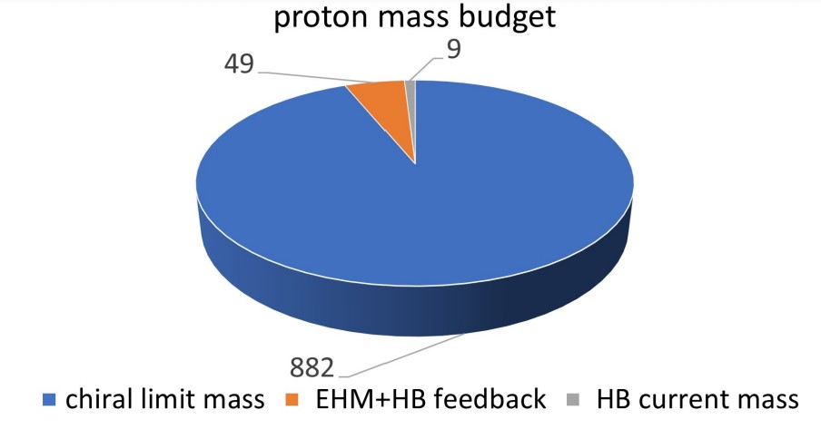
Mass in Nature
Proton mass budget
Craig D. Roberts, David G. Richards, Tanja Horn, Lei Chang
Prog. Part. Nucl. Phys. 120 (2021) 103883
Only 9 MeV/939 MeV is directly from Higgs
Evidently, there is another phenomenon in Nature that is extremely effective in producing mass:
Emergent Hadron Mass (EHM)
Alone, it produces 94% of the proton’s mass
Remaining 5% is generated by constructive interference between EHM and Higgs-boson
What is the origin of EHM?
Does it have a reductionist explanation?
If so, what are they and do they lie within the Standard Model?

Slide 3
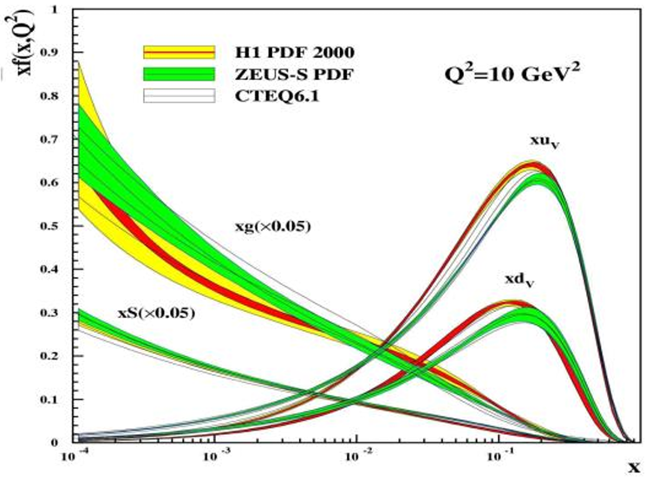
The nucleon structure
Over the past 50 years, the traditional DFs contain information solely about the one-dimensional longitudinal motion of quarks and gluons within the nucleon.
The most direct method is to directly derive the wave function of each quark and gluon inside the nucleon from QCD through first principles
Form Factors
$$5D$$
$$d^{2}k_{T}$$
$$GPDs/IPDs$$
$$d^{2}r_{T}$$
$$1D$$
$$ψ\left(\vec{x},\vec{k},t\right)$$
$$W_{p}^{u}\left(\vec{x},k_{T},r_{T}\right)$$
Winger distributions
$$d^{2}r_{T}$$
$$3D$$
Parton Distribution Functions
$$TMD$$
$$d^{2}k_{T}$$
QCD is impossible (or very difficult) to solve directly. Some theoretical simplification and define some distribution functions need to do
The nucleon structure can only be studied in three-dimensional momentum space or three-dimensional coordinate space (Pauli exclusion principle)

Slide 4
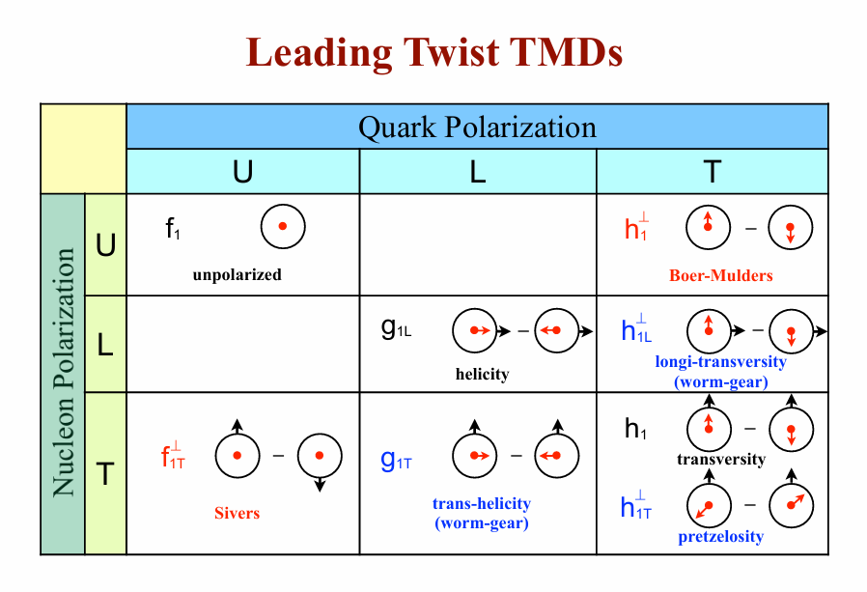
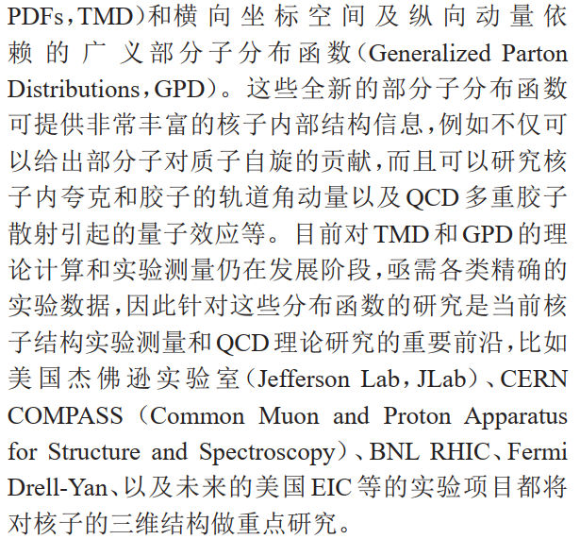
Transverse momentum dependent distribution functions

Slide 5
Dyson-Schwinger Equation
Continuum Schwinger function
methods (CSMs)
nonperturbative
symmetry-preserving
Owing to the infinite coupling feature, it is necessary to truncate the DSEs at a certain level for practical calculations
Craig D. Roberts and Anthony G. Williams.
Prog. Part. Nucl. Phys. 33 (1994) 477-575
Craig D. Roberts and Sebastian M. Schmidt.
Prog. Part. Nucl. Phys. 45 (2000) S1-S103
Pieter Maris and Craig D. Roberts.
Int. J. Mod. Phys. E 12 (2003) 297-365

Slide 6
Contact Interaction
In Euclidean space, the dressed quark propagator is determined from the gap equation：
Rainbow-Ladder truncation：
Contact interaction (CI)：
where $m_{G}≈0.5GeV$ is a gluon mass-scale and the $α_{IR}≈π$ is the zero-momentum value of a running-coupling constant in QCD.
algebraic simplicity
paucity of parameter
applicable to a wide varity of systems and process
$${S(p)}^{−1}=iγ∙p+M$$

Slide 7
Bethe-Salpeter Equation
The homogeneous Bethe-Salpeter equation(BSE)：
Bethe–Salpeter amplitude
Bethe–Salpeter wave-function and S is the dressed quark propagator
Scattering kernel (contact interaction)
Rainbow-ladder truncation (gluon and quark interaction vertex)

Slide 8
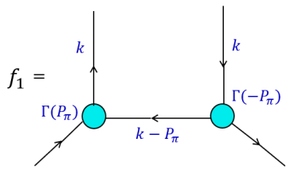
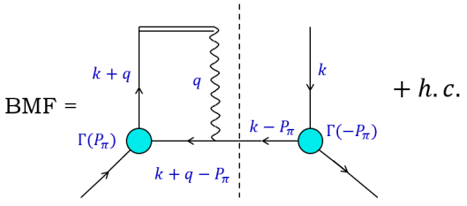
Pion TMDs in the leading twist
The most direct expressions of EHM in the SM are located in the massless NG modes
Pion is NG boson and simplest bound-state (only two valence body)
Pion can be parametrized into a set of transverse momentum dependent distribution functions in leading-twist as follows
The unpolarized distribution function and Boer-Mulders function are constrained by
$$f_{1}^{ }\left(x,k_{⊥}^{2}\right)≥\frac{k_{⊥}^{ }}{M_{π}}h_{1}^{⊥}\left(x,k_{⊥}^{2}\right)$$

Slide 9
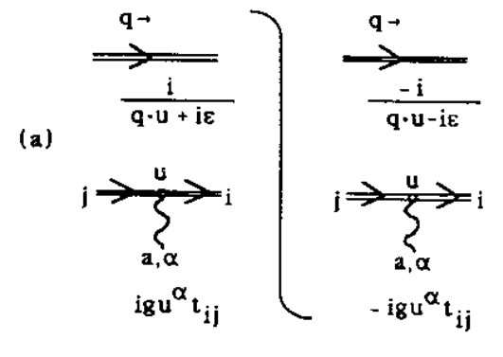
Boer-Mulders function
final/ Initial state interaction
T-odd functions with Wilson line
Taking the eikonal approximation and one gluon exchange approximation
$$𝒫\exp\left[ig\int_{0}^{∞}{dλ n∙A\left(λn^{μ}\right)}\right]=1+𝒫\sum_{n=1}^{∞}{\prod_{i=1}^{n}{\int{\frac{d^{4}q_{i}}{{\left(2π\right)}^{4}}gn∙\tilde{A}(q_{i}^{μ})\frac{1}{n∙\sum_{j=1}^{i}{q_{j}}+iε}}}}$$

Slide 10
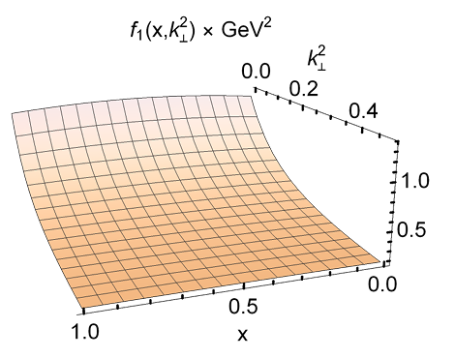
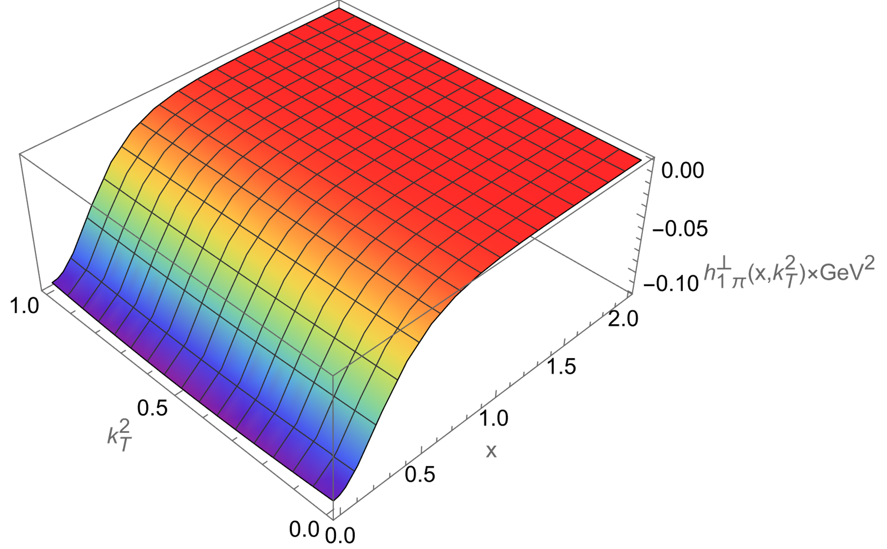
Pion TMDs in the leading twist
Jin-Li Zhang, Zhu-Fang Cui, Jia-Lun Ping, et, al. Eur. Phys. J. C 81 (2021) 1, 6
Algebraic result
$$f_{1}\left(x,k_{⊥}^{2}\right)=\frac{N_{c}}{{2π}^{3}}\left[E_{π}\left(E_{π}−2F_{π}\right){\overline{C}}_{2}\left(ω_{1}\right)+3{\left(E_{π}−2F_{π}\right)}^{2}x\left(1−x\right)M_{π}^{2}{\overline{C}}_{3}\left(ω_{1}\right)\right]$$
$$h_{1}^{⊥}\left(x,k_{⊥}^{2}\right)=−\frac{N_{c}α_{IR}M_{π}\left(E_{π}−2F_{π}\right){\overline{C}}_{2}\left(ω_{1}\right)}{4m_{G}^{2}π^{3}M}\left\{\left[M^{2}\left(E_{π}−F_{π}\right)−F_{π}x\left(1−x\right)M_{π}^{2}\right]{\overline{C}}_{1}\left(ω_{2}\right)+F_{π}{\overline{C}}_{0}\left(ω_{2}\right)\right\}$$

Slide 11
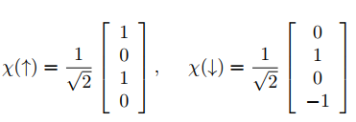
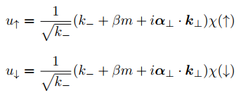
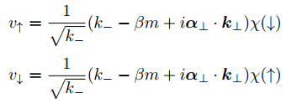
Pion Light Front Wave Function
Construction of light front wave function
Hung Hsiang Liu and Davison E. Soper. Phys. Rev. D 48 (1993) 1841-1851
G. Peter Lepage and Stanley J. Brodsky. Phys. Lett. B 87 (1979) 359-365
Dirac spinors
Pion Light front wave function
$$B_{π}=M^{2}−x(1−x)M_{π}^{2}$$
$$Ψ_{π}\left(x,k_{⊥};λ_{1},λ_{2}\right)=\frac{\sqrt{6}}{k_{T}^{2}+B_{π}}\left(\begin{matrix}−\left(E_{π}−2F_{π}\right)\left(k_{1}−ik_{2}\right) & \frac{E_{π}M^{2}+F_{π}\left[\left(k_{T}^{2}−M^{2}\right)+x\left(x−1\right)M_{π}^{2}\right]}{M} \\ −\frac{E_{π}M^{2}+F_{π}\left[\left(k_{T}^{2}−M^{2}\right)+x\left(x−1\right)M_{π}^{2}\right]}{M} & −\left(E_{π}−2F_{π}\right)\left(k_{1}+ik_{2}\right)\end{matrix}\right)$$

Slide 12
Pion TMDs in Contact Interaction
$$B_{π}=M^{2}−x(1−x)M_{π}^{2}$$
$$ω_{1}=k_{⊥}^{2}+B_{π},ω_{2}=B_{π}$$
Light front wave function
$$N_{c}=3$$
$$f_{1}\left(x,k_{⊥}^{2}\right)=\frac{3}{{2π}^{3}}\left[E_{π}\left(E_{π}−2F_{π}\right){\overline{C}}_{2}\left(ω_{1}\right)+3{\left(E_{π}−2F_{π}\right)}^{2}x\left(1−x\right)M_{π}^{2}{\overline{C}}_{3}\left(ω_{1}\right)+\frac{F_{π}^{2}}{M^{2}}\right]$$
$$h_{1}^{⊥}\left(x,k_{⊥}^{2}\right)=\frac{3α_{IR}M_{π}\left(E_{π}−2F_{π}\right){\overline{C}}_{2}\left(ω_{1}\right)}{4π^{3}M}\int_{0}^{1}{dα_{1}\left\{2\left(1−α_{1}\right){\overline{C}}_{2}\left(ω_{3}\right)\left[−E_{π}M^{2}−x\left(x−1\right)M_{π}^{2}F_{π}+\left(M^{2}+α_{1}k_{T}^{2}\right)F_{π}\right]−F_{π}{\overline{C}}_{1}\left(ω_{3}\right)\right\}}$$
Feynman diagram
Jin-Li Zhang, Zhu-Fang Cui, Jia-Lun Ping, et, al. Eur. Phys. J. C 81 (2021) 1, 6
$$f_{1}\left(x,k_{⊥}^{2}\right)=\frac{N_{c}}{{2π}^{3}}\left[E_{π}\left(E_{π}−2F_{π}\right){\overline{C}}_{2}\left(ω_{1}\right)+3{\left(E_{π}−2F_{π}\right)}^{2}x\left(1−x\right)M_{π}^{2}{\overline{C}}_{3}\left(ω_{1}\right)\right]$$
$$h_{1}^{⊥}\left(x,k_{⊥}^{2}\right)=\frac{N_{c}α_{IR}M_{π}\left(E_{π}−2F_{π}\right){\overline{C}}_{2}\left(ω_{1}\right)}{4π^{3}M}\int_{0}^{1}{dα_{1}\left\{2\left(1−α_{1}\right){\overline{C}}_{2}\left(ω_{3}\right)\left[−E_{π}M^{2}−x\left(x−1\right)M_{π}^{2}F_{π}+\left(M^{2}+α_{1}k_{T}^{2}\right)F_{π}\right]−F_{π}{\overline{C}}_{1}\left(ω_{3}\right)\right\}}$$

Slide 13
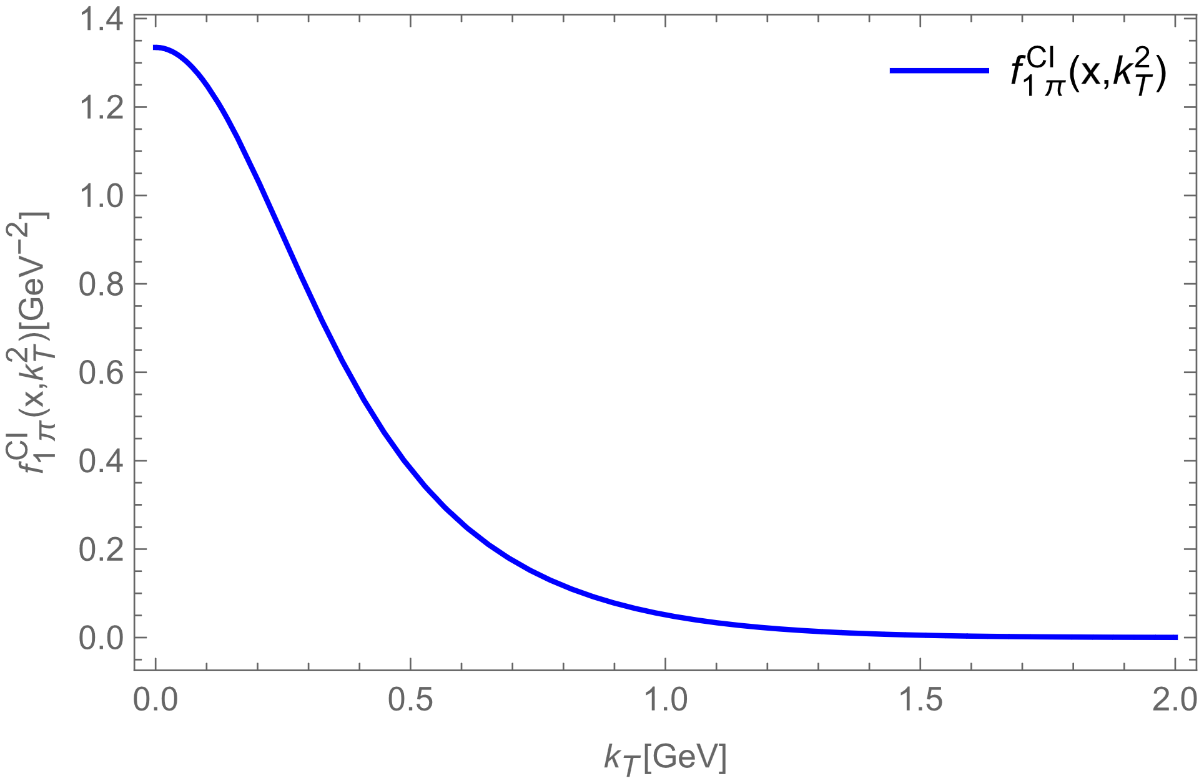
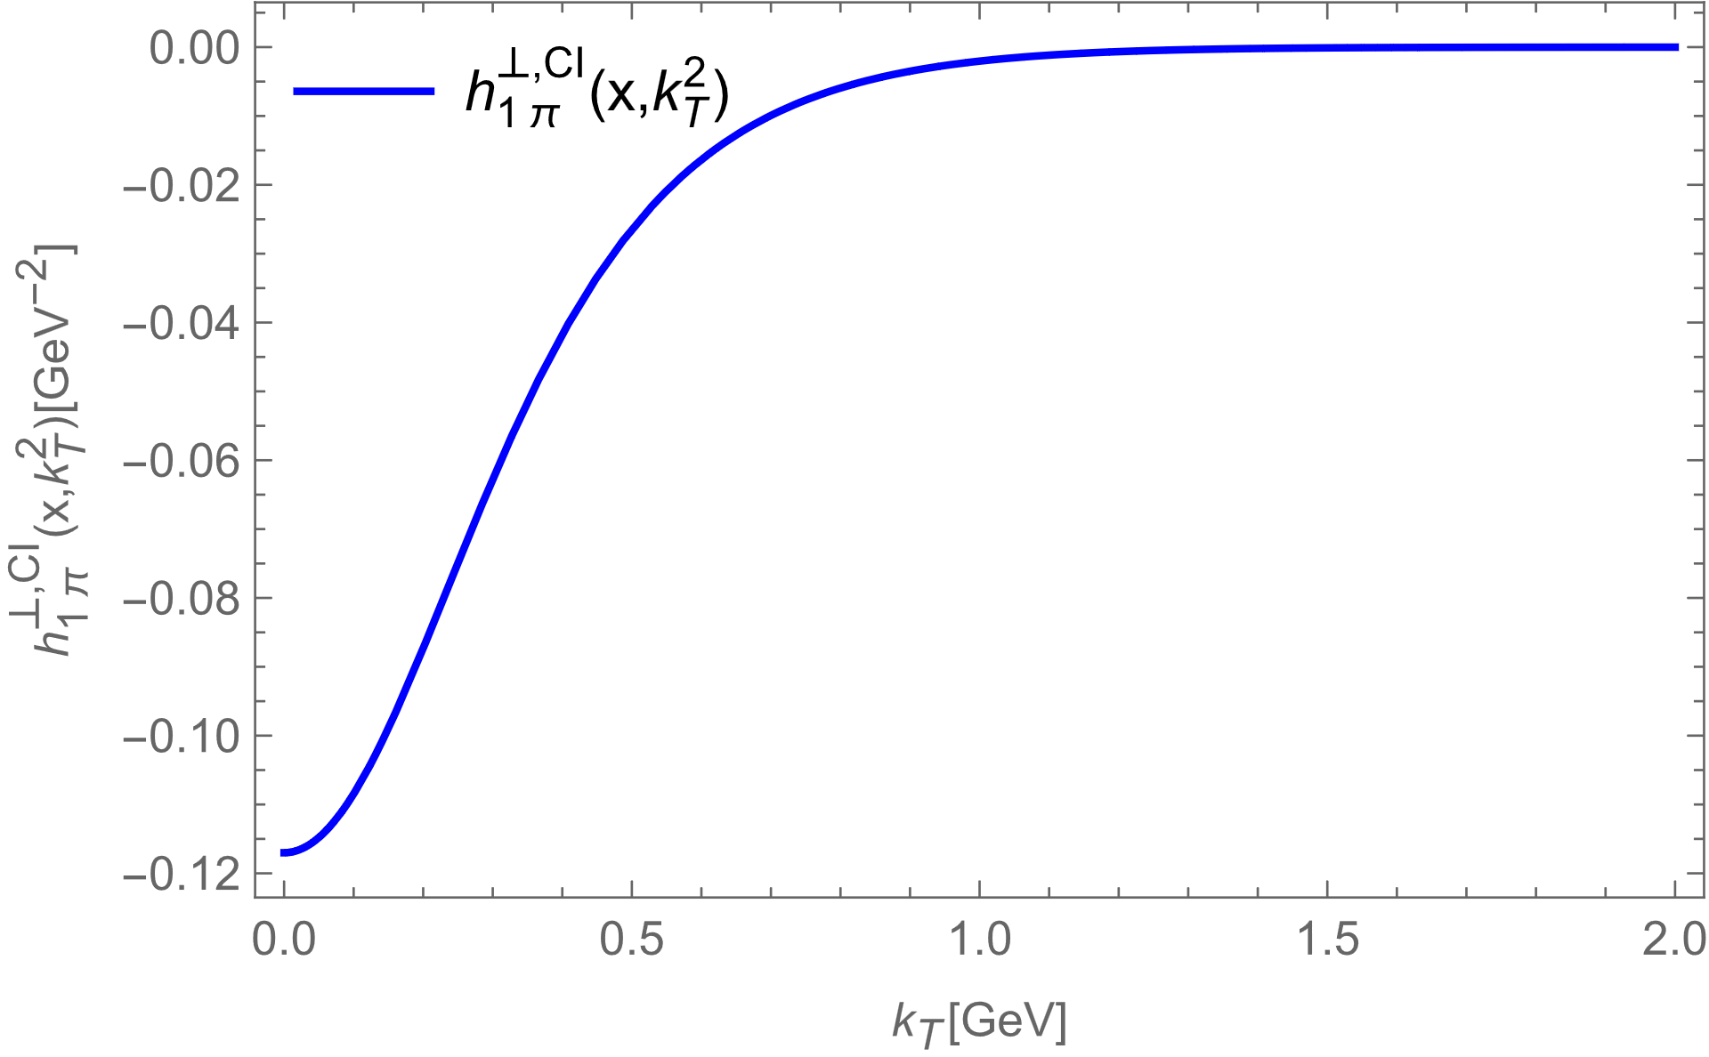
TMDs in Contact Interaction
$h_{1π}^{⊥}\left(x,k_{⊥}^{2}\right)$ $\text{for}$ $\text{the} \text{valence} \text{antiquark} \text{can} \text{be} \text{obtained} \text{through} \text{a} \text{similar} \text{calculation} \text{by} \text{replacing} \text{the} \text{antiquark} \text{spectator} \text{with} \text{the} \text{quark} \text{spectator}\text{. }\text{And} h_{1π}^{⊥q}\left(x,k_{⊥}^{2}\right)=h_{1π}^{⊥\overline{q}}\left(x,k_{⊥}^{2}\right)$.
$h_{1π}^{⊥}\left(x,k_{⊥}^{2}\right)<0$. It is consistent with
Matthias Burkardt, Brian Hannafious. Phys. Lett. B 658 (2008) 130-137
Zhun Lu, Bo-Qiang Ma. Phys. Rev. D 70 (2004) 094044
Santiago Noguera, Sergio Scopetta, JHEP 11, 102, 2015
Wei Kou, Chao Shi, Xu-Rong Chen, et, al. Phys. Rev. D 108 (2023) 3, 036021

Slide 14
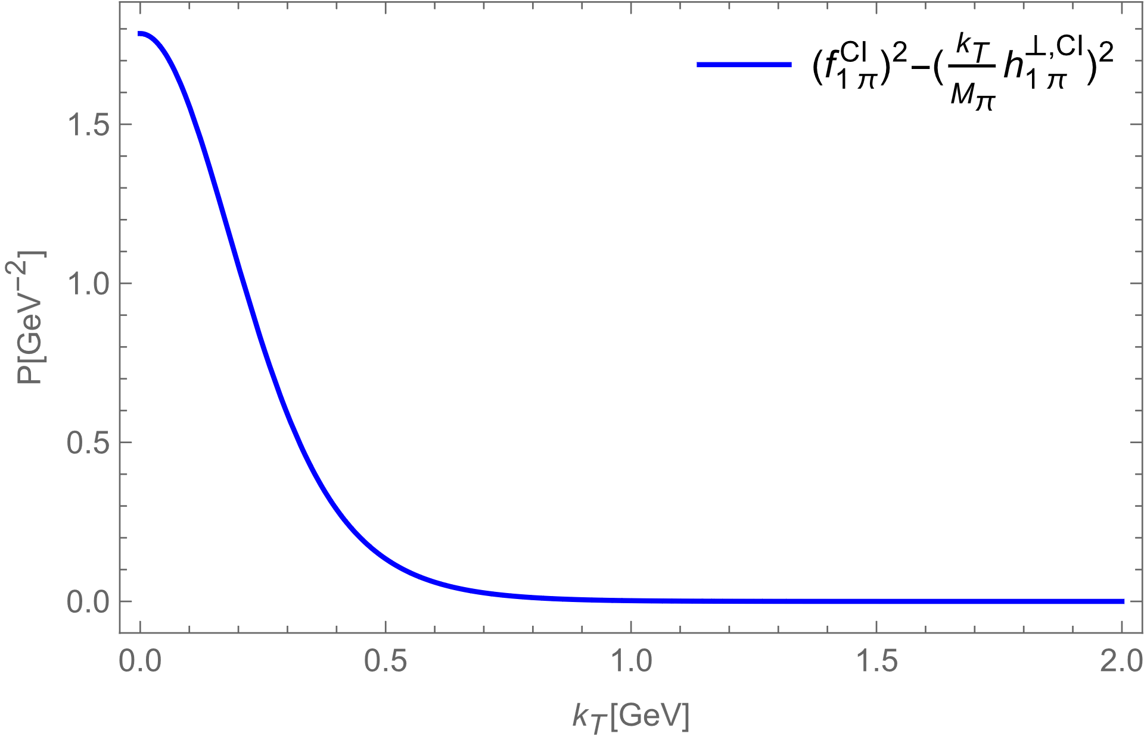
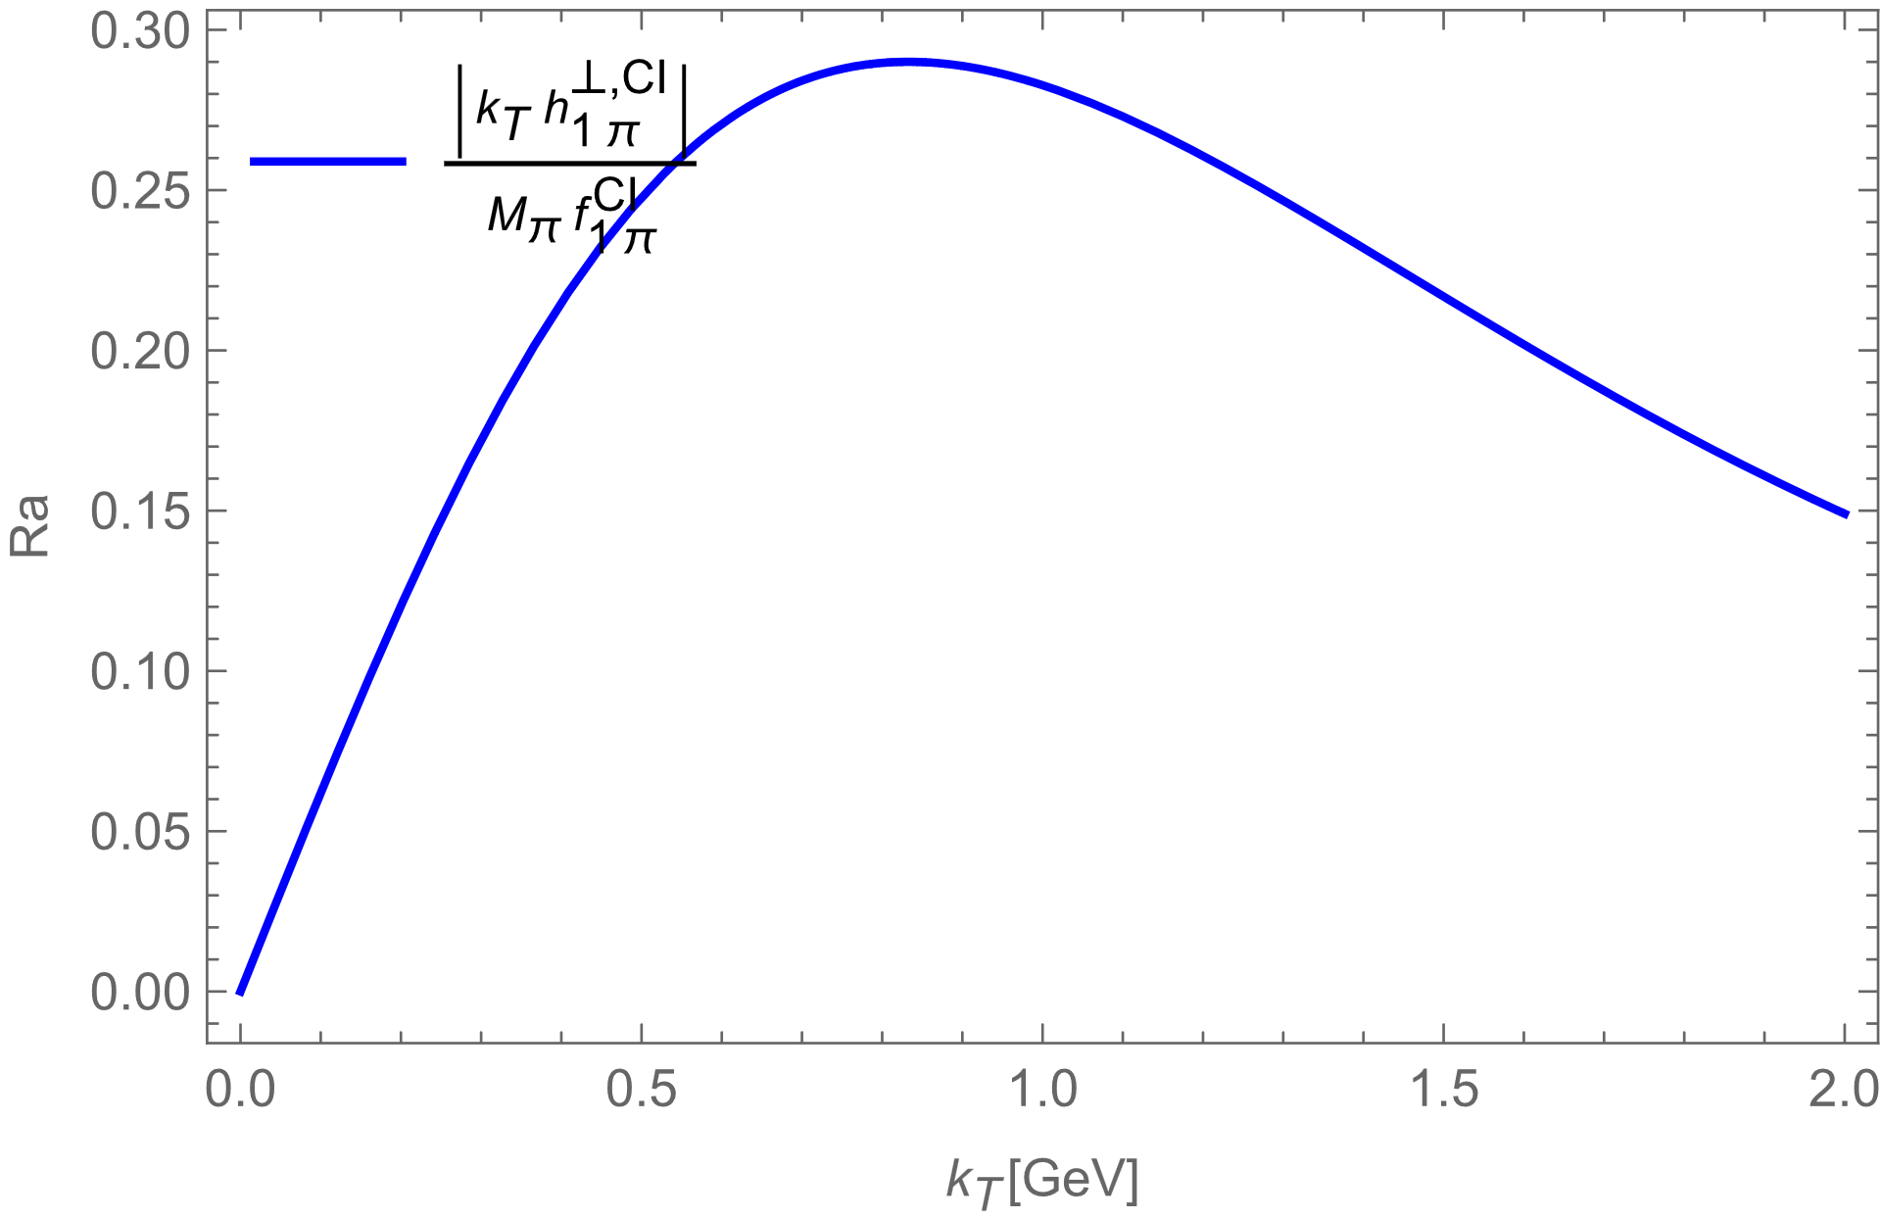
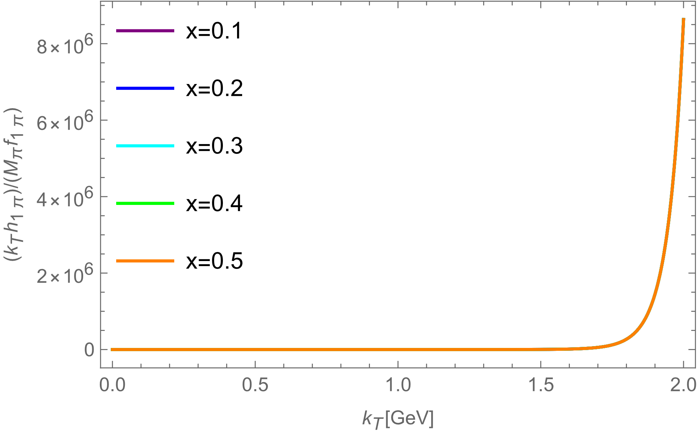
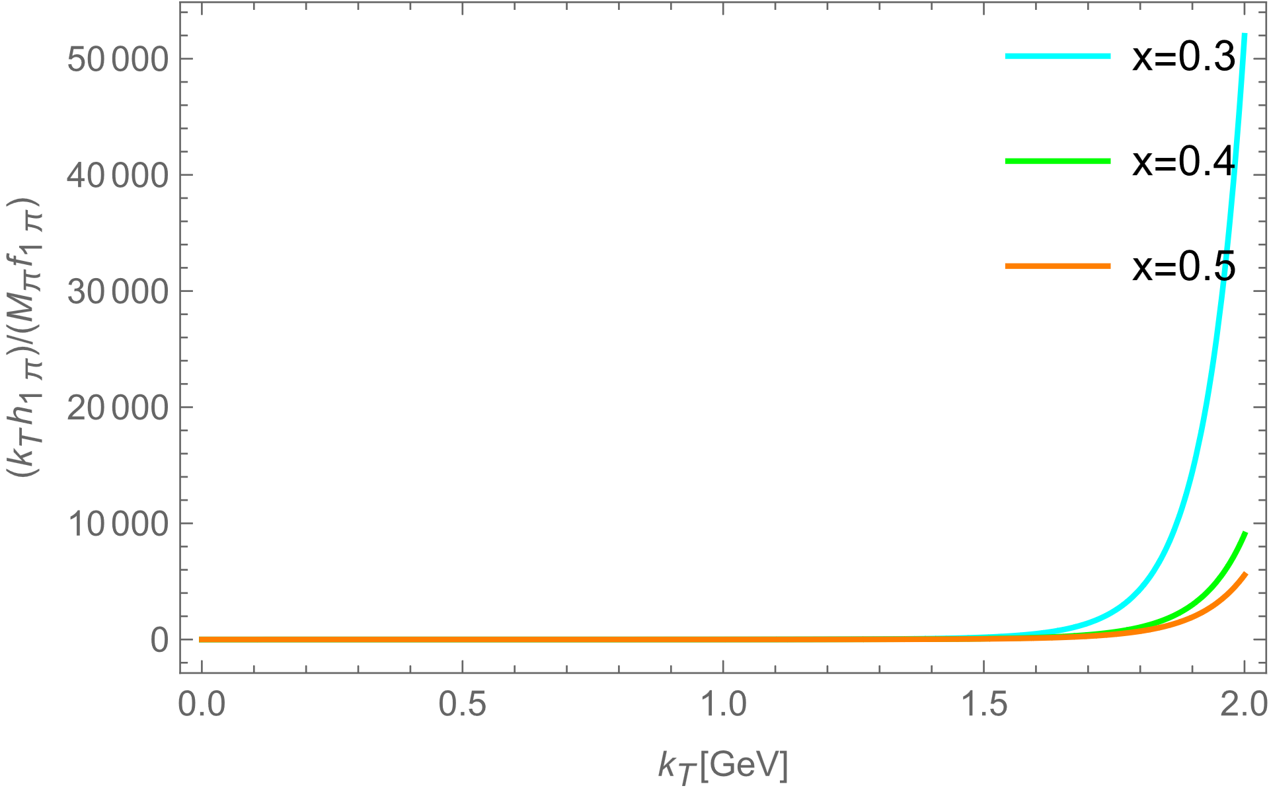
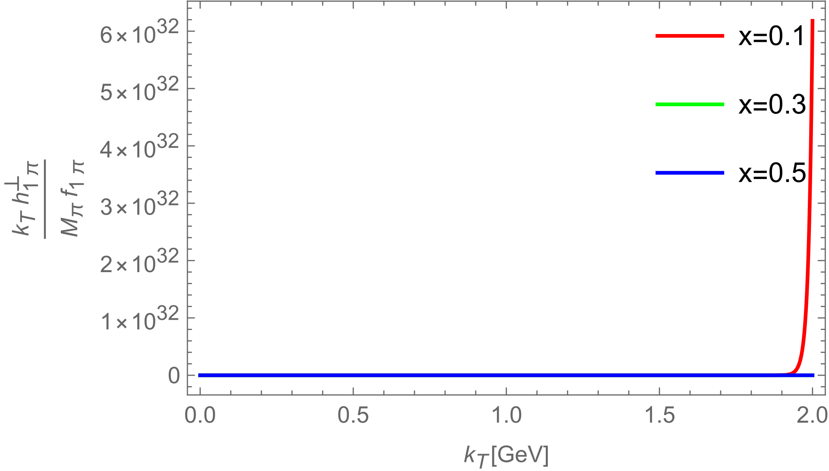
Positivity Bound
$The$ unpolarized distribution function and Boer-Mulders function are constrained by positivity bound
Gaussian type
BHL description
Holographic wave function

Slide 15
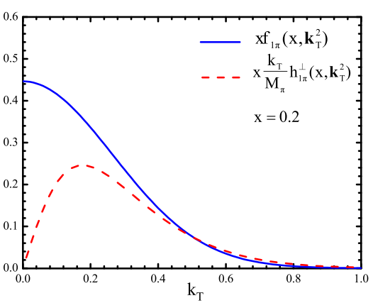
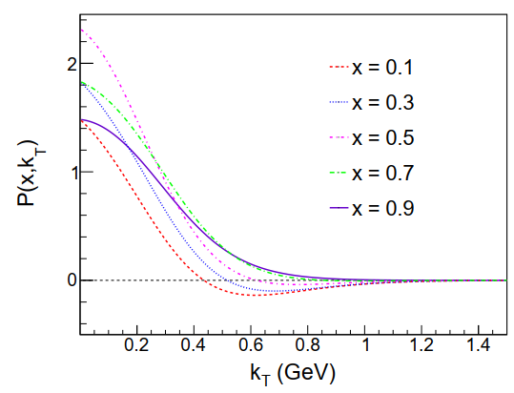
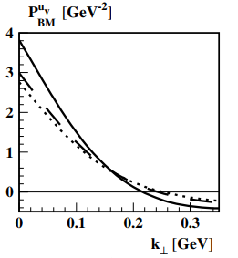
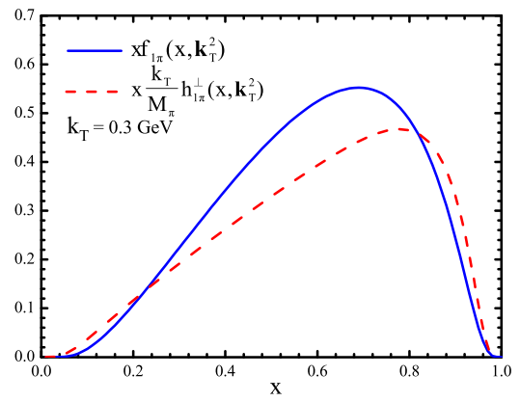
Violation of Positivity Bound
Zheng-Xian Wang, Xiao-Yong Wang, Zhun Lu, Phys. Rev. D 95 (2017) 9, 094004
The violations were reported in many model studies
B. Pasquini and P. Schweitzer, Phys. Rev. D 90 (2014) 1, 014050
Wei Kou, Chao Shi, Xu-Rong Chen, et, al. Phys. Rev. D 108 (2023) 3, 036021
Aram Kotzinian. Transversity, 0806, 3804, 2008

Slide 16
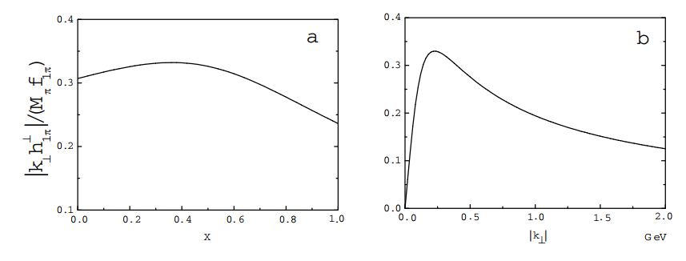
Violation of Positivity Bound
$h_{1π}^{⊥}\left(x,k_{⊥}^{2}\right)$ is calculated to “first order of the expansion of the Wilson line,” whereas $f_{1π}\left(x,k_{⊥}^{2}\right)$is evaluated to “zeroth order” in that expansion. To preserve positivity the Wilson link expansion should be truncated consistently at the same order for both $h_{1π}^{⊥}\left(x,k_{⊥}^{2}\right)$ and $f_{1π}\left(x,k_{⊥}^{2}\right)$.
B. Pasquini and P. Schweitzer, Phys. Rev. D 90 (2014) 1, 014050
Zhun Lu, Bo-Qiang Ma. Phys. Rev. D 70 (2004) 094044
The higher order gluonic (non-perturbative gluon re-scattering kernel) contributions to $h_{1π}^{⊥}\left(x,k_{⊥}^{2}\right)$ from the gauge link.
Wei Kou, Chao Shi, Xu-Rong Chen, et, al. Phys. Rev. D 108 (2023) 3, 036021

Slide 17
Holographic light front wave function
$$\tilde{ψ}\left(x,k_{⊥}\right)=𝒩\frac{1}{\sqrt{x\overline{x}}β^{3/2}}\exp\left(−\frac{k_{T}^{2}+m^{2}}{2𝓀^{2}x\overline{x}}\right)$$
The ratio of $f_{1}$and $h_{1}^{⊥}$ is mainly determined by the form of the momentum-space component of LFWF.
$$\tilde{ψ}\left(x,k_{⊥}\right)=𝒩\frac{1}{\sqrt{x\overline{x}}β^{3/2}}\exp\left(−\frac{k_{T}^{2}+m^{2}}{2𝓀^{2}x\overline{x}}\right)$$
$$\tilde{ψ}\left(x,k_{⊥}\right)=𝒩\frac{1}{\sqrt{x\overline{x}}β^{3/2}}\exp\left(−\frac{k_{T}^{2}+m^{2}}{2𝓀^{2}x\overline{x}}\right)$$
$$\tilde{ψ}\left(x,k_{⊥}\right)=𝒩\frac{1}{\sqrt{x\overline{x}}β^{3/2}}\exp{[−\frac{{(k_{⊥}−q_{⊥})}^{2}+m^{2}}{2𝓀^{2}x\overline{x}}]}$$
$$f_{1}\left(x,k_{⊥}\right)\sim \exp\left(−\frac{k_{T}^{2}+m^{2}}{𝓀^{2}x\overline{x}}\right)$$
$$h_{1}^{⊥}\left(x,k_{⊥}\right)\sim \exp\left(−\frac{k_{T}^{2}+m^{2}}{𝓀^{2}x\overline{x}}\right)\int{\frac{d^{2}q_{⊥}}{16π^{3}}}\frac{k_{⊥}∙q_{⊥}}{k_{T}^{2}}iG\left(x,q_{⊥}\right)\exp\left[−\frac{q_{T}^{2}−2k_{⊥}∙q_{⊥}}{2𝓀^{2}x\overline{x}}\right]$$
The $k_{T}^{2}$ dependence of this integration is exponential.

Slide 18
Contact Interaction
$$\tilde{ψ}\left(x,k_{⊥}\right)=\frac{\sqrt{6}}{k_{T}^{2}+B_{π}}$$
The ratio of $f_{1}$and $h_{1}^{⊥}$ is mainly determined by the form of the momentum-space component of LFWF.
$$\tilde{ψ}\left(x,k_{⊥}\right)=\frac{\sqrt{6}}{k_{⊥}^{2}+M^{2}−x(1−x)m_{π}^{2}}$$
$$\tilde{ψ}\left(x,k_{⊥}\right)=\frac{\sqrt{6}}{k_{⊥}^{2}+M^{2}−x(1−x)m_{π}^{2}}$$
$$\tilde{ψ}\left(x,k_{⊥}^{′2}\right)=\frac{\sqrt{6}}{{(k_{⊥}−q_{⊥})}^{2}+M^{2}−x(1−x)m_{π}^{2}}$$
$$f_{1}\left(x,k_{⊥}\right)\sim \frac{\sqrt{6}}{{[k_{⊥}^{2}+M^{2}−x(1−x)m_{π}^{2}]}^{2}}$$
$$h_{1}^{⊥}\left(x,k_{⊥}\right)\sim \frac{\sqrt{6}}{k_{⊥}^{2}+M^{2}−x(1−x)m_{π}^{2}}\int{\frac{dq_{⊥}}{4π^{2}}}iG\left(x,q_{⊥}\right)\frac{1}{\left[{\left(k_{T}−q_{T}\right)}^{2}+M^{2}−x(1−x)m_{π}^{2}\right]}$$
The$k_{T}^{2}$ dependence of gluon momentum integration decreases slightly with $k_{T}$.

Slide 19
Violation of Positivity Bound
The $k_{T}^{2}$ dependence of the ratio between $f_{1}$and $h_{1}^{⊥}$ is mainly determined by the form of the momentum-space component of LFWF.
Under the case of exponential form, the $k_{T}^{2}$ dependence of ratio is exponential and divergent in the large $k_{T}^{2}$ region.
So exponential form can not accurately capture the large $k_{T}$ behavior of the Boer-Mulders function. The violations of positivity bound for Pasquini, Ahmady, and ZhengXian are all originated from their exponential momentum-space component of LFWF.

Slide 20
Summary
The unpolarized TMD and Boer-Mulders function of Pion were predicted by using a symmetry-preserving contact interaction based on Dyson-Schwinger equations
To account for the non-zero Boer-Mulders function, arising from the final state interaction between the quark and antiquark, one gluon exchange approximation was employed.
The calculations were completed by using both Feynman diagram and pion light front wave functions.
The comparison of different model calculations was performed accompanied by a discussion on the model-independent positivity relation constraining unpolarized TMD and Boer-Mulders function.
Thankyou

