Slide 1
Axion like particle production in $η→ππa$ decay
arXiv: 2403.16064 [hep-ph]
Speaker: 王金葆
Advisor: 郭志辉, 周海清
第七届强子谱和强子结构研讨会 四川 成都

Slide 2
OUTLINE
Introduction and motivation
Axion SU(3) chiral perturbation theory
Axion like particle (ALP) production in $η$ decay
Summary

Slide 3
Introduction and motivation
Introduction
PQ mechanism is an elegant solution of the strong CP problem [Peccei and Quinn 1977]
$U{\left(1\right)}_{PQ}$ spontaneously symmetry breaking (SSB) $→$ Axion [Weinberg, 1978][Wilczek, 1978]
$$ℒ_{a}=\frac{1}{2}{\left(∂_{μ}a\right)}^{2}+\frac{a}{f_{a}}\frac{g_{s}^{2}}{32π^{2}}G_{μν}^{c}{\tilde{G}}_{c}^{μν}+ℒ\left(∂_{μ}a, ψ\right) .$$
Axion couples to gauge bosons, quarks, leptons fields, has abundant phenomenology.
Standard QCD axion mass relation
$$m_{a}=\sqrt{\frac{m_{u}m_{d}}{{\left(m_{u}+m_{d}\right)}^{2}}}\frac{F_{π}}{f_{a}} m_{π}≃5.7 \left(\frac{{10}^{6} GeV}{f_{a}}\right) eV .$$
Visible axion model: $f_{a}≲{10}^{4} GeV$ (ruled out by astrophysical experiments)
Invisible axion model: ${10}^{9} GeV≲f_{a}≲{10}^{12} GeV$, [Kim and Carosi, Rev. Mod. Phys., 2010]
[Luzio, et.al, Phys.Rept., 2020]
[Dicus, et.al, Phys. Rev. D, 1978][Dicus, et.al, Phys. Rev. D, 1980]
KSVZ axion model [Kim, Jihn E, 1979, Shifman, et al., Valentin I, 1980]
DFSZ axion model [Dine, et al., 1981, Zhitnitsky, 1980]

Slide 4
Introduction and motivation
Motivation
Heavy axions/Axion like particles (ALPs)
ALPs phenomenology
Holdom and Peskin, “Raising the Axion Mass”, NPB 208 (1982) 397-412.
Agrawal and Howe, “Factoring the Strong CP problem”, JHEP 12 (2018) 029.
Giorgi, et.al., “GeV ALP from TeV Vector-like Leptons”, arXiv:2402.14059 [hep-ph].
Jaeckel and Spannowsky, “Probing MeV to 90 GeV axion-like particles with LEP and LHC”, PLB (2016) 482-487.
Bauer and Neubert and Thamm, “Collider Probes of Axion-Like Particles”, JHEP 12 (2017) 044.
Aloni and Soreq and Williams, “Coupling QCD-Scale Axionlike Particles to Gluons”, PRL 123 (2019) 3, 031803.
Di Luzio and Piazza, $a→πππ$ decay at next-to-leading order in chiral perturbation theory”, JHEP 12 (2022) 041.
We focus on ALP production in $η→ππ$a decay
Rare $η^{(′)}$ decays provide ideal probes to detect sub-GeV new light particles.
ALPs in $η^{(′)}$ decay
[Precision frontier experiments in JLab, BESIII, STCF]
Landini and Meggiolaro, “Study of the interactions of the axion with mesons and photons using a chiral effective Lagrangian model”, EPJC 80 (2020) 4, 302.
Gan, et.al., “Precision tests of fundamental physics with $η$ and $η′$ mesons”, Phys. Rept. 945 (2022) 1-105.
Alves and Sergi, “Final state rescattering effects in axio-hadronic $η$and $η′$decays”, arXiv:2402.02993 [hep-ph].

Slide 5
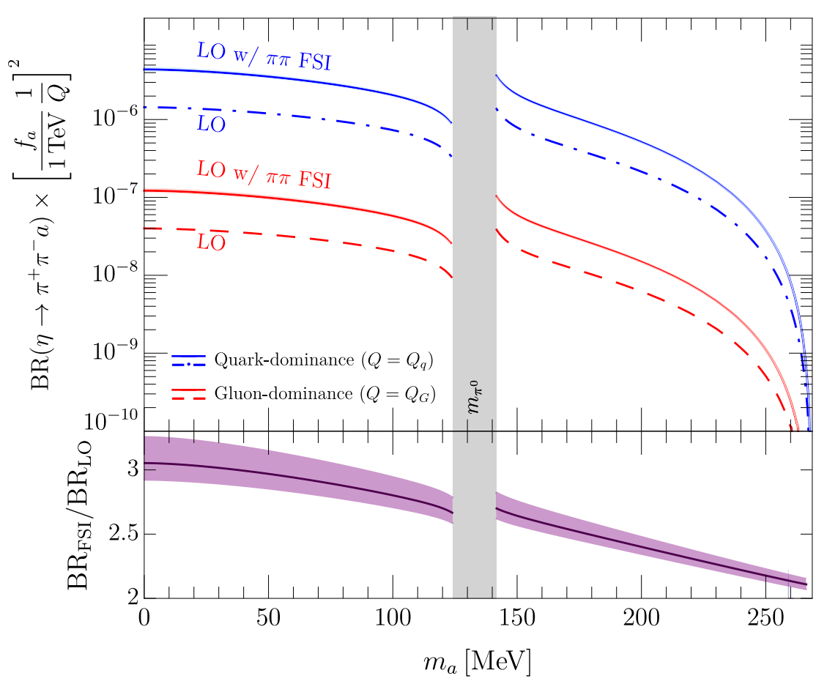
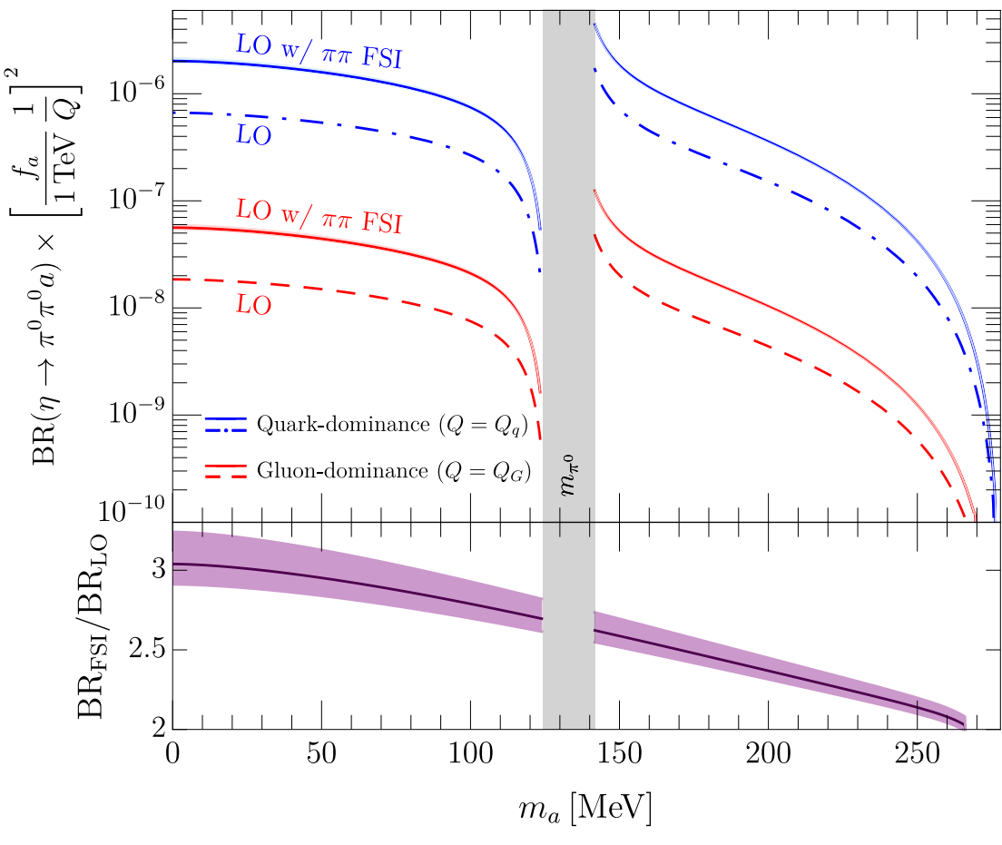
Introduction and motivation
Motivation
Alves and Sergi, arXiv:2402.02993 [hep-ph].
In this talk, we discuss $η→ππa$ decay in SU(3) ChPT up to NLO.
NLO perturbative decay amplitude include $s$- and $t\left(u\right)$-channel interactions perturbatively.
The unitarized decay amplitude will also constructed to account for the $s$-channel $ππ$ final state interaction (FSI) effect.

Slide 6
Axion SU(3) chiral perturbation theory
Effective Lagrangians
We stick on the minimal axion coulping
$m_{a,0}$ the bare PQ breaking axion mass.
Axial transformation
work in isospin limit

Slide 7
Axion SU(3) chiral perturbation theory
Effective Lagrangians
Study $η→ππa$ decay in SU(3) chiral perturbation theory (ChPT)
[Gasser and Leutwyler, NPB, 1985]
Effective d.o.f: eight pNGBs corresponding to SSB $SU{\left(3\right)}_{L}×SU{\left(3\right)}_{R}→SU{\left(3\right)}_{V}$
Effective Lagrangians can be constructed order by order
Chiral expansion by soft momentum and light quarks masses
$$p^{2}, m_{q}∼O\left(p^{2}\right)$$
axion couplings can be introduced as external fields.
LO Lagrangian
LECs: $F, B_{0}, L_{1\sim 8}$.
${\overline{Q}}_{a}$ denotes octet component of $Q_{a}$.
We ignore the singlet component of $\overline{q}γ^{μ}γ_{5}Q_{a}q$.
NLO Lagrangian

Slide 8
Axion SU(3) chiral perturbation theory
Mixing between ALP and $η_{8}$ fields
There is mixing between ALP and $η_{8}$ fields
LO mixing
LO contribution of pNGBs masses from light quarks masses
Fields redefinitions up to $O(1/f_{a}^{3})$

Slide 9
Axion SU(3) chiral perturbation theory
Mixing between ALP and $η_{8}$ fields
NLO mixing and fields redefinitions for ALP and 𝜂 fields
$Σ_{ij}^{\left(4\right)}\left(p^{2}\right)$ is the $O\left(p^{4}\right)$ two-point 1PI amplitude
$Σ_{ij}^{{\left(4\right)}^{′}}$ denotes $dΣ_{ij}^{\left(4\right)}\left(p^{2}\right)/dp^{2}$, which is momentum independent up to NLO.
$Σ_{aa}^{\left(4\right)}=O\left(p^{4}/f_{a}^{2}\right) ,$ $Σ_{aη}^{\left(4\right)}=O\left(p^{4}/f_{a}\right) ,$ $Σ_{ηη}^{\left(4\right)}=O\left(p^{4}\right) .$
Fields redefinitions at NLO
Perturbative calculation of the amplitude is performed by using fields variables $a_{phy}$ and $η_{phy}$.

Slide 10
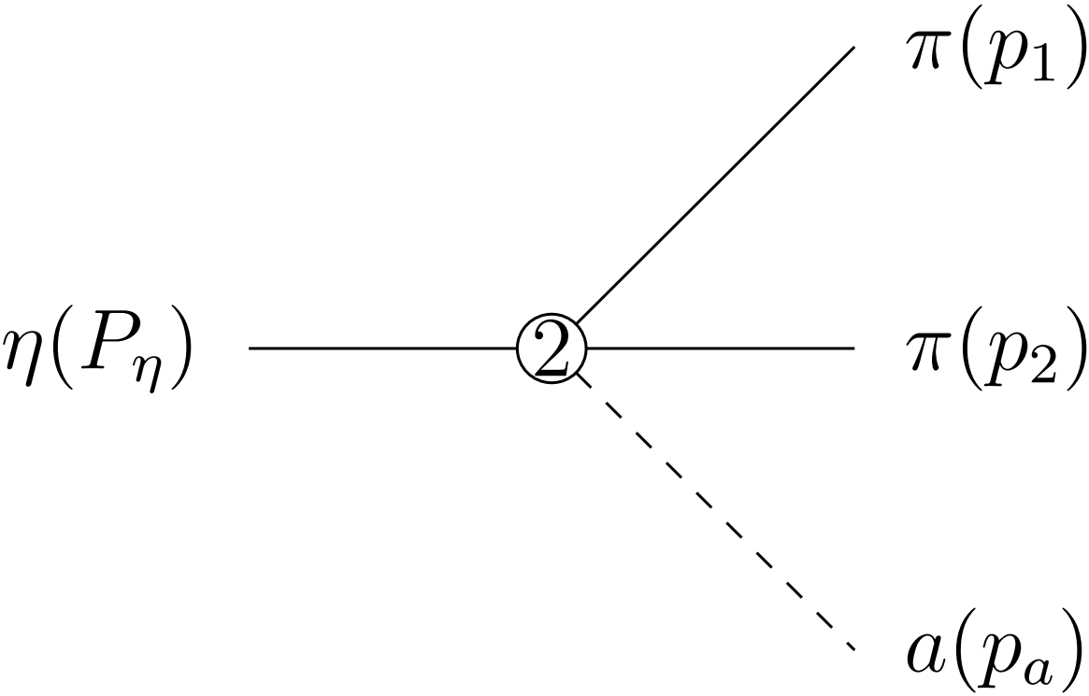
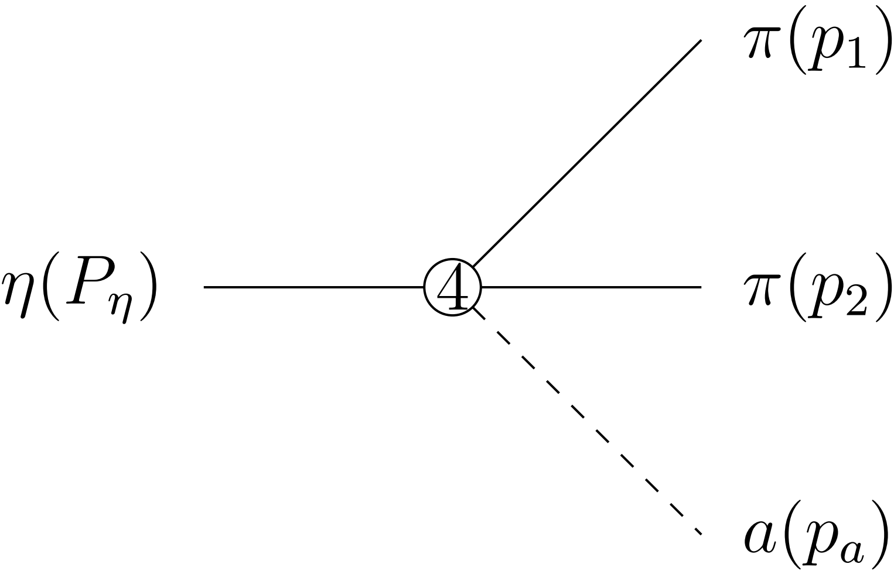
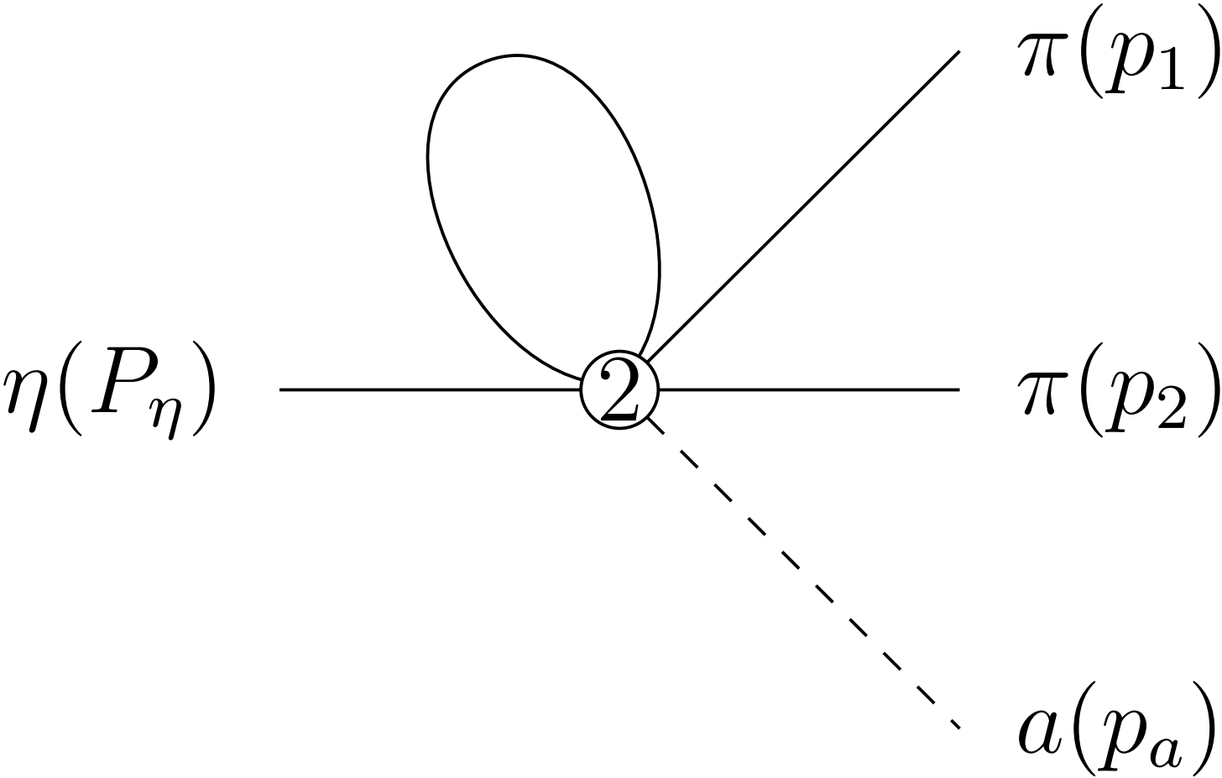
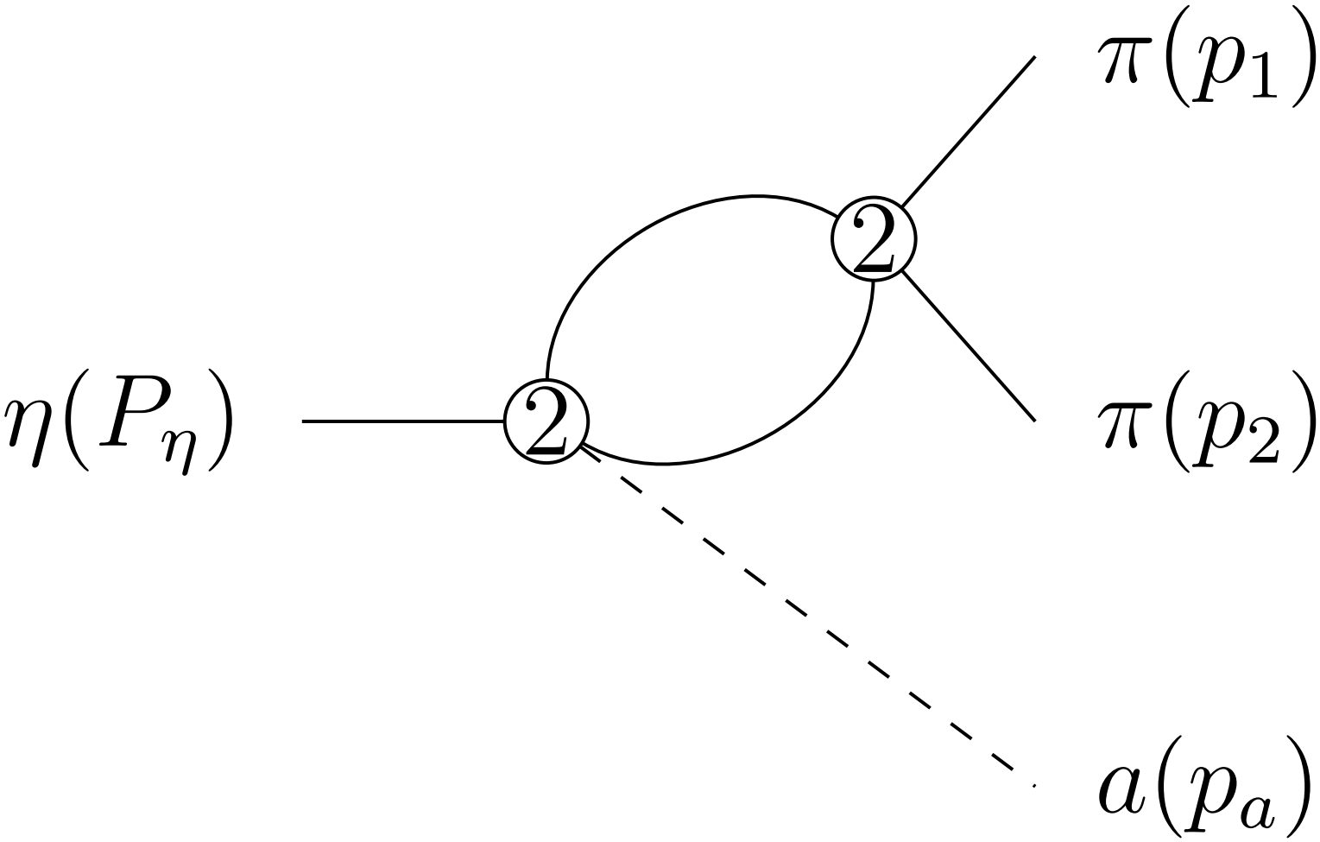
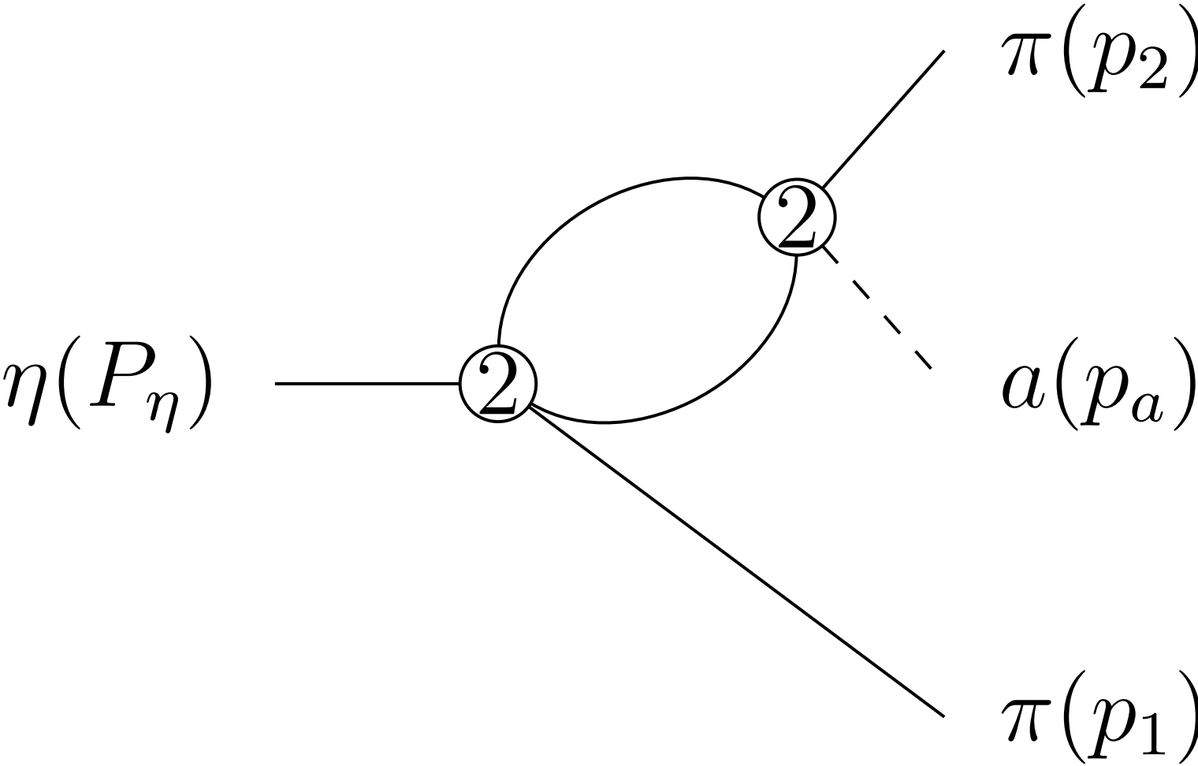
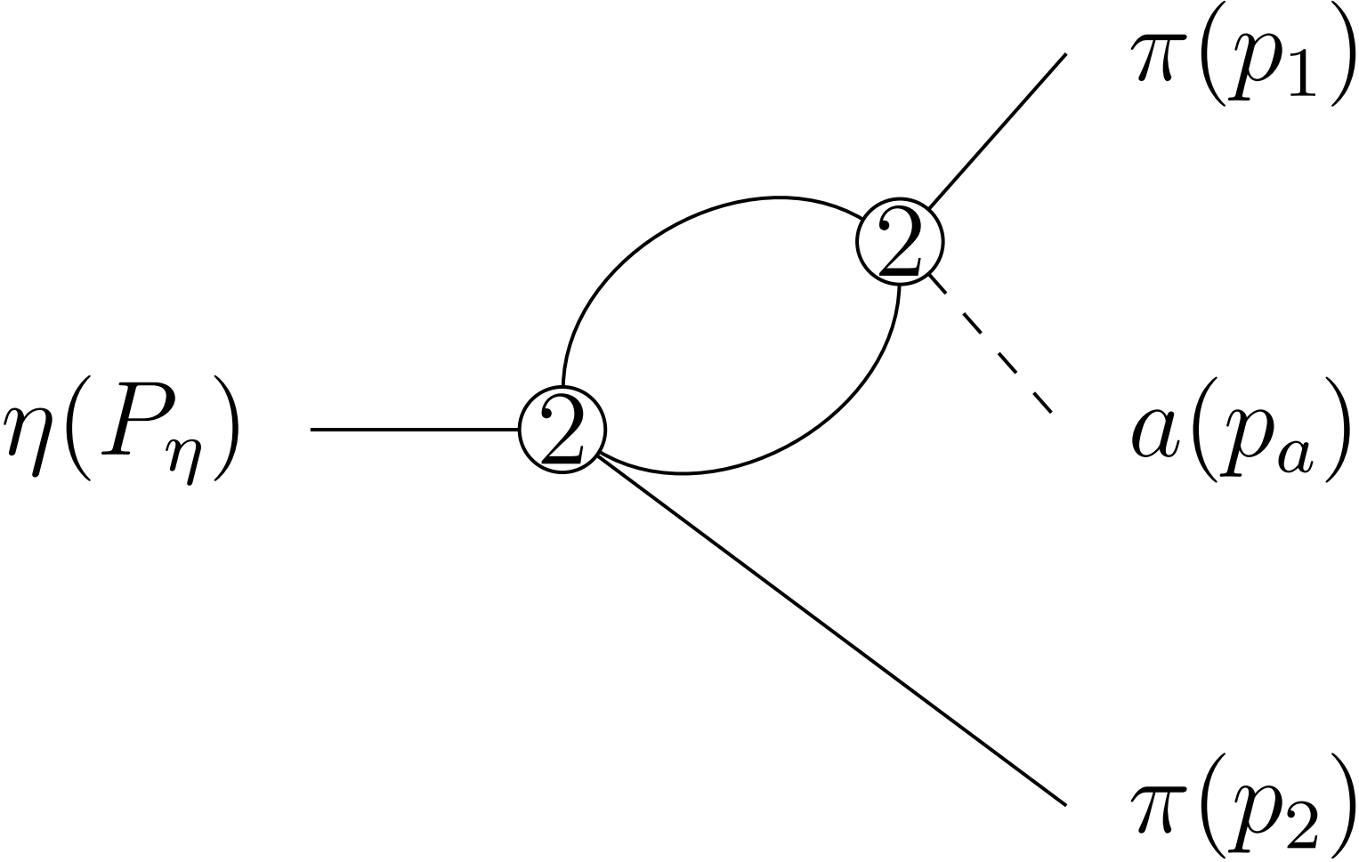
Axion like particle (ALP) production in 𝜂 decay
$$s={\left(p_{1}+p_{2}\right)}^{2}=m_{ππ}^{2}, t={\left(p_{a}+p_{2}\right)}^{2}=m_{aπ}^{2}, u={\left(p_{a}+p_{1}\right)}^{2}$$
Feynman diagrams up to NLO
Parameters
[J. Bijnens and G. Ecker, Ann. Rev. Nucl. Part. Sci. 64, 149 (2014)]

Slide 11
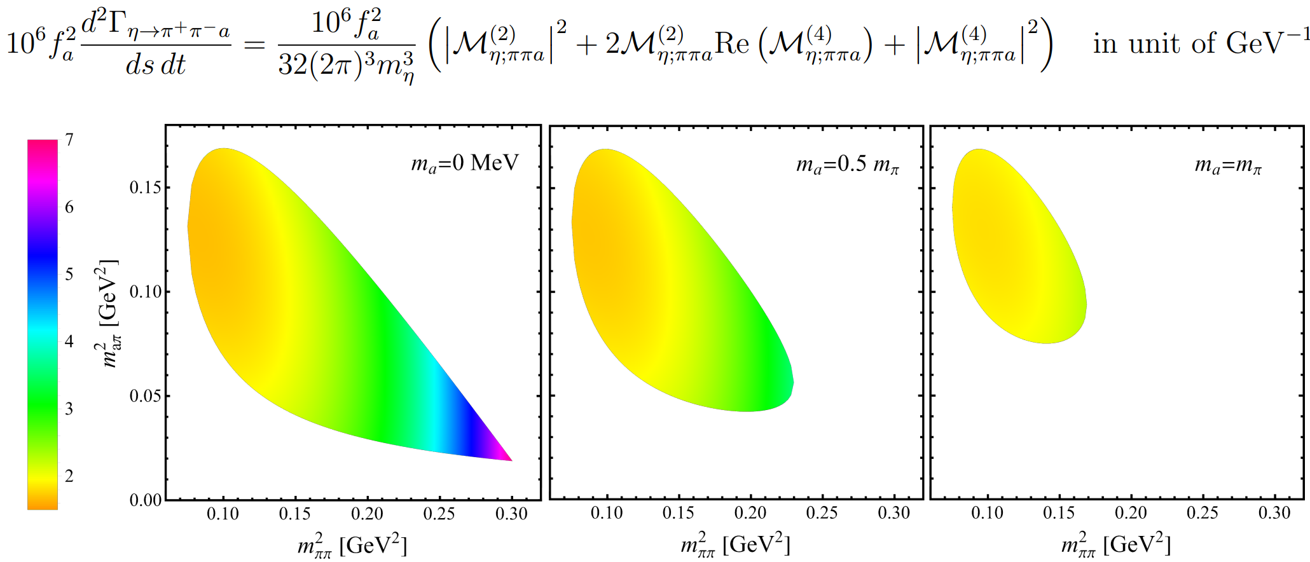
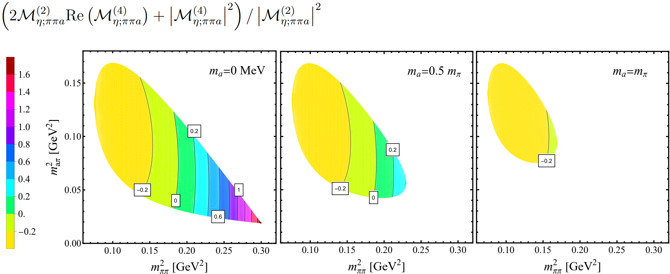
Axion like particle (ALP) production in 𝜂 decay
In isospin limit, the decay amplitudes for $π^{+}π^{−}$ channel and $π^{0}π^{0}$ channel turn out to be the same up to NLO.
We focus on $s$-channel $ππ$ two-body FSI in unitarization.

Slide 12
Axion like particle (ALP) production in 𝜂 decay
Isospin amplitude
Partial waves (PWs) in $ππ$ c.o.m frame
Unitary relation consider $s$-channel $ππ$ contribution

Slide 13
Axion like particle (ALP) production in 𝜂 decay
Unitarized PW amplitude
The unitarized amplitude satisfies the relation
if we define the unitarized $ππ$ PW
Unitarized PW amplitude based on LO amplitude

Slide 14
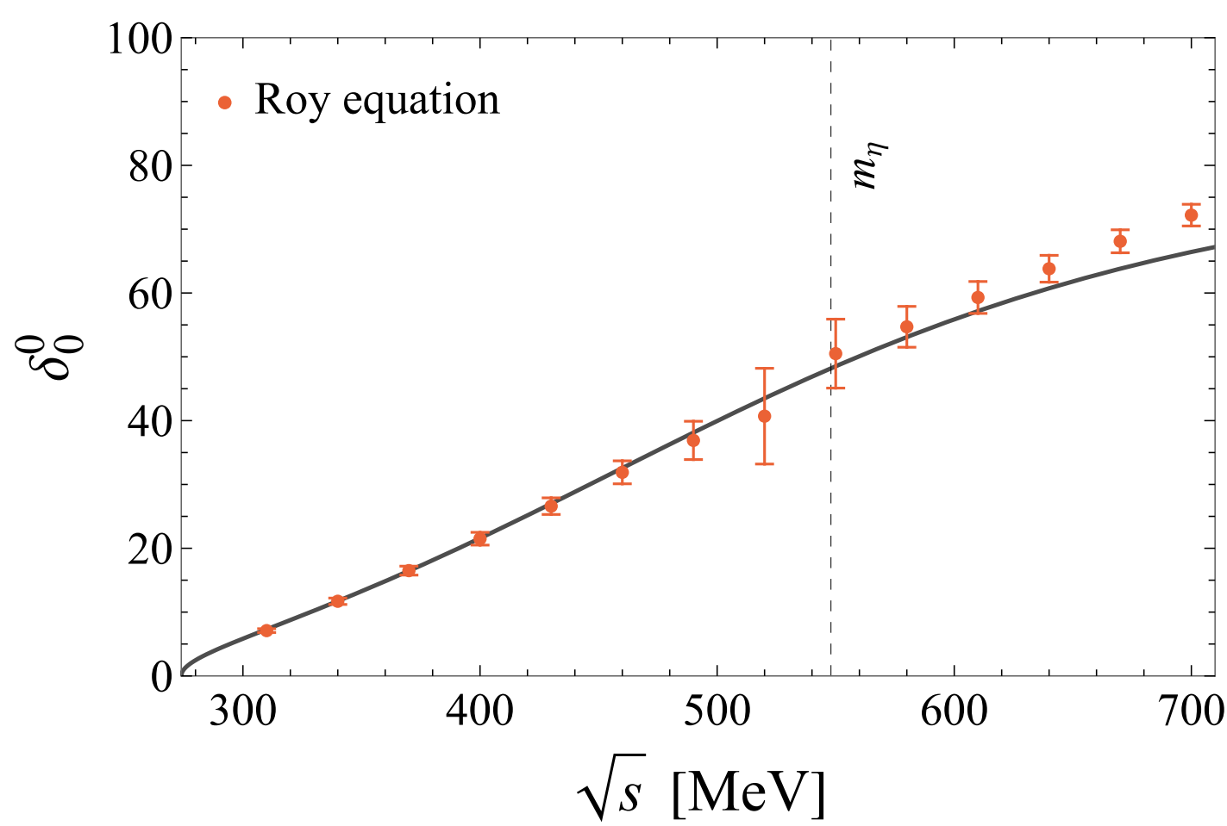
Axion like particle (ALP) production in 𝜂 decay
[R. Garcia-Martin, et.al., PRD 2011]

Slide 15
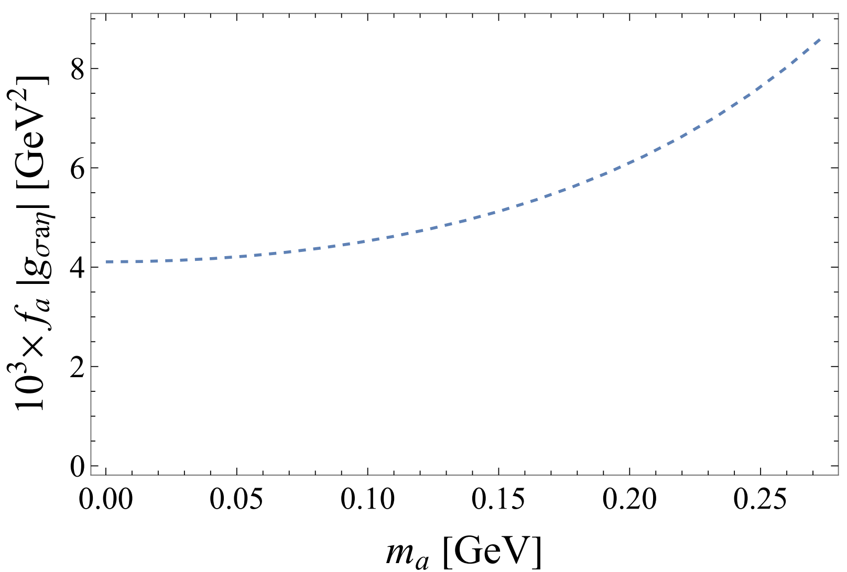
Axion like particle (ALP) production in 𝜂 decay
Pole position of $f_{0}\left(500\right)/σ$ on the second Riemann sheet
$$\sqrt{s_{σ}}=457±i251 MeV$$
$σ$-$aη$ coupling varying with $m_{a}$

Slide 16
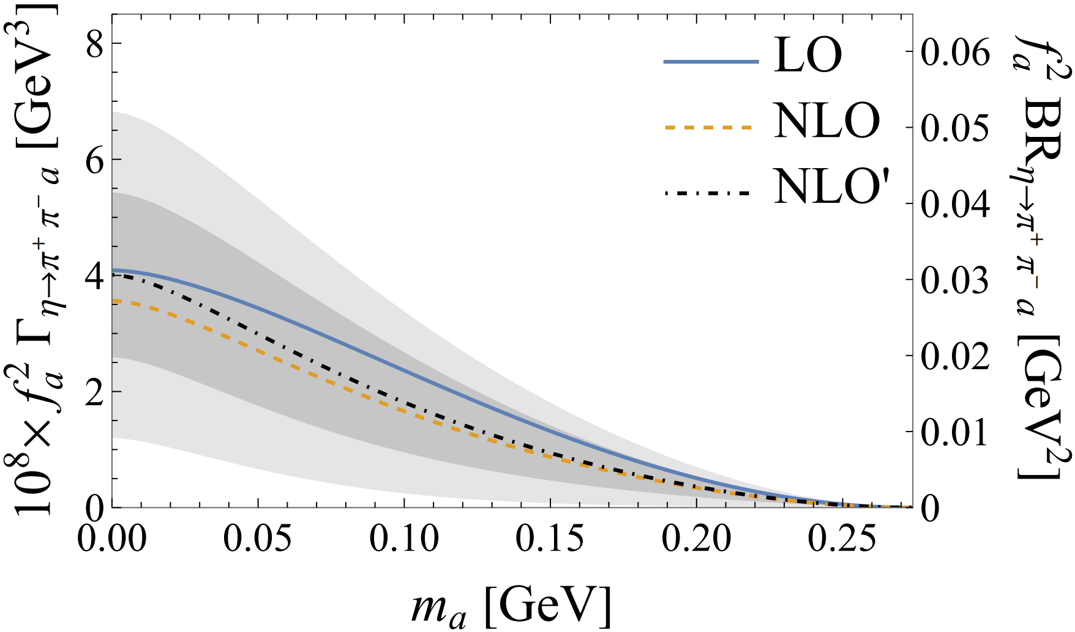
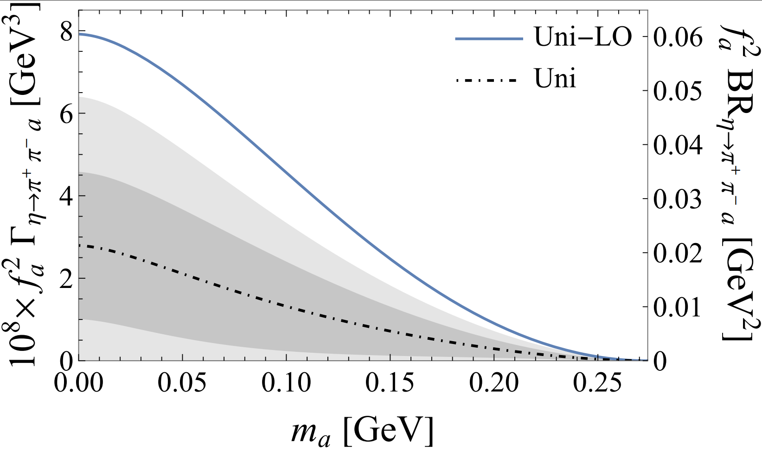
Axion like particle (ALP) production in 𝜂 decay
Center value

Slide 17
Summary
SUMMARY
We study $η→ππa$ decay up to NLO in SU(3) ChPT.
The unitarized decay amplitudes were further constructed to consider the $s$-channel $ππ$ final state interaction effect, which can cause 30% correction in the estimation of partial decay width.
We predict the branch ratio for $η→ππa$ decay by varying $m_{a}$ from $0$ to $m_{η}−2m_{π}$,
but the result has a large uncertainty due to the error of LECs. To further pin down the error bars of LECs will be helpful to give more precise predictions to $η→ππa$ decay process.
Thank you for listening

Slide 18
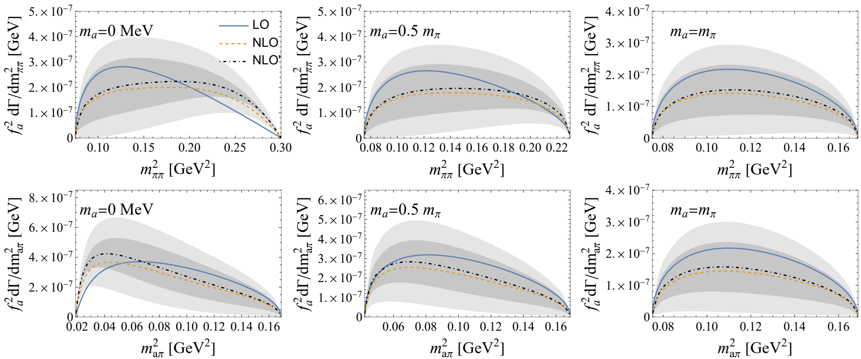
Back up

Slide 19
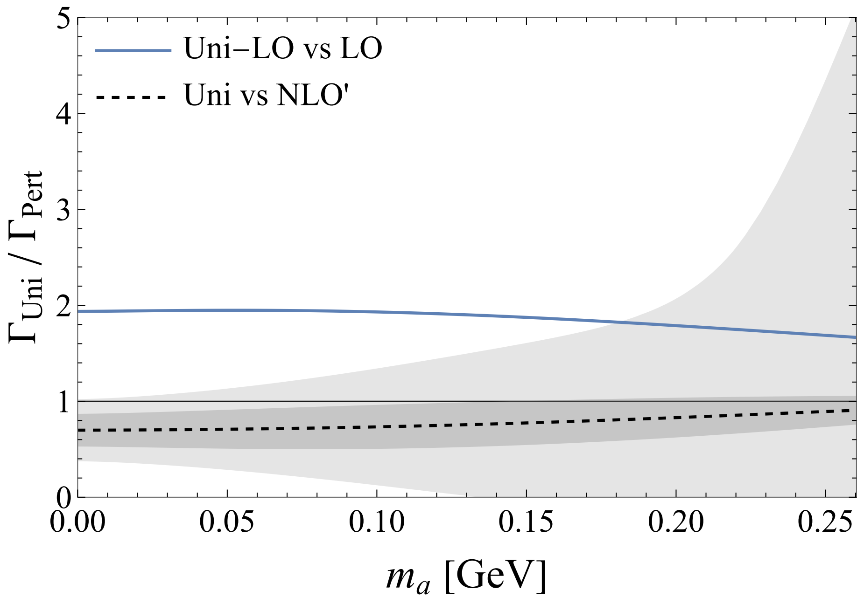
Back up

