Slide 1
Highlight of Recent ATLAS Results
Yusheng Wu (吴雨生)
University of Science and Technology of China
5th Workshop on Frontiers of Particle Physics @ SYSU, Shenzhen
April 12-16, 2024

Slide 2
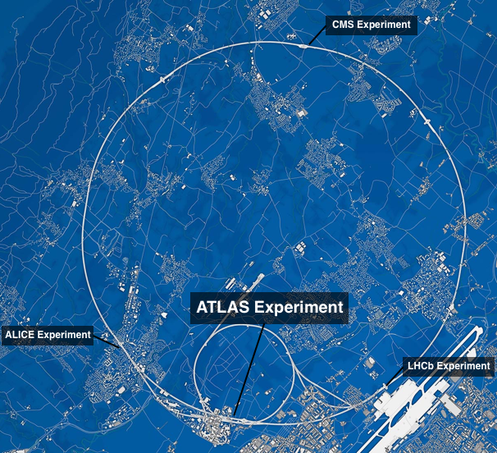
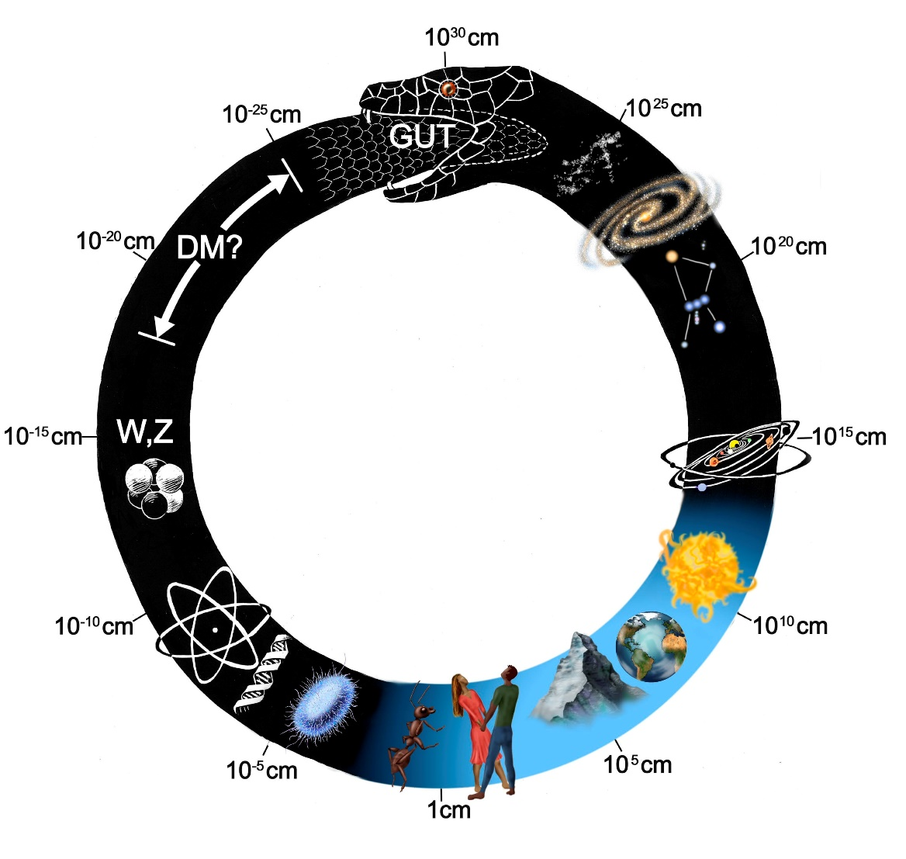
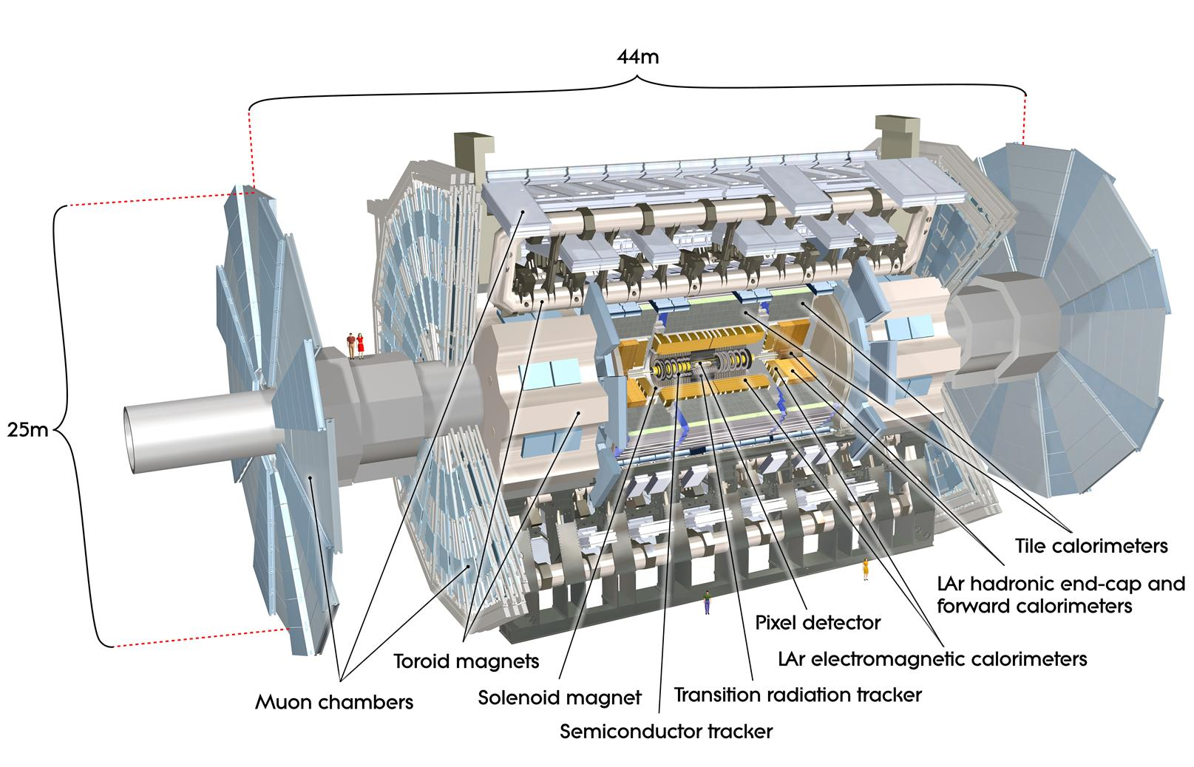
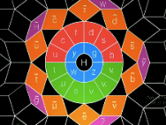
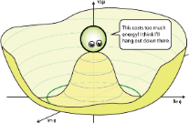
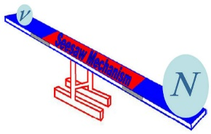
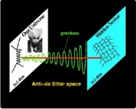
ATLAS Experiment @ Energy Frontier

Slide 3
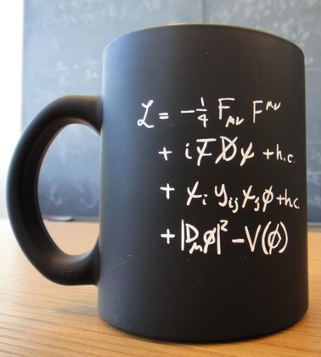
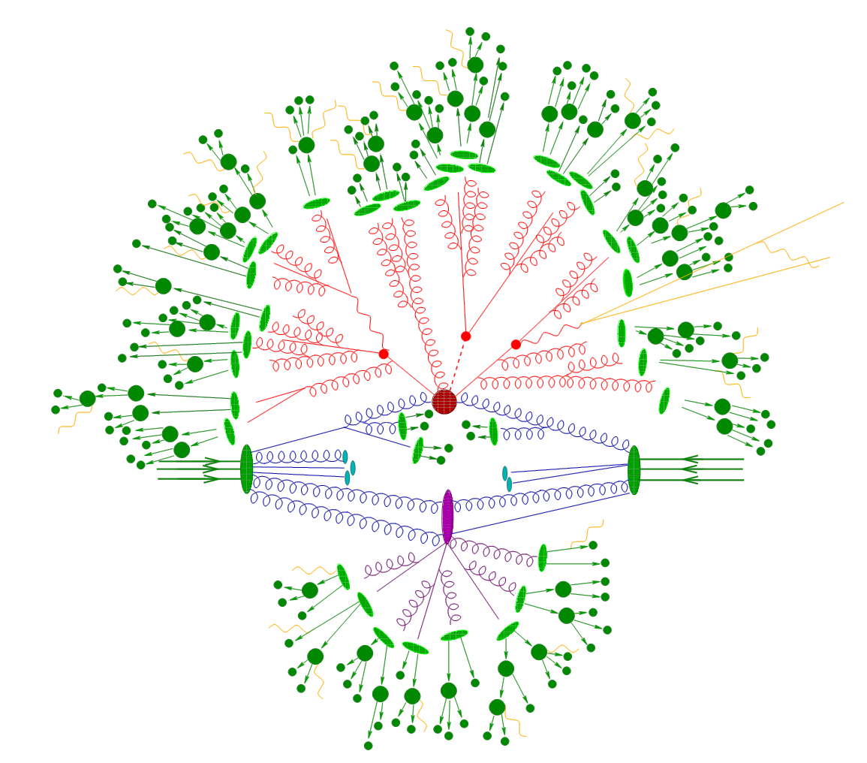
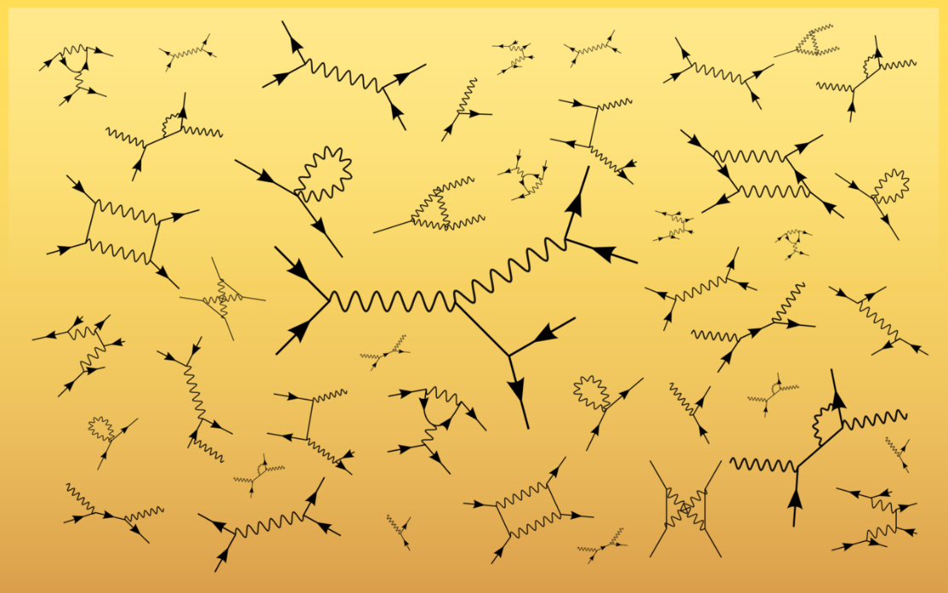
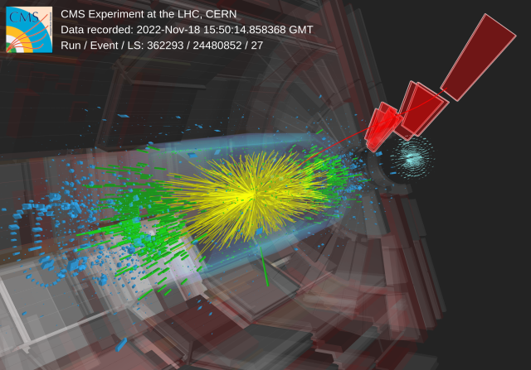
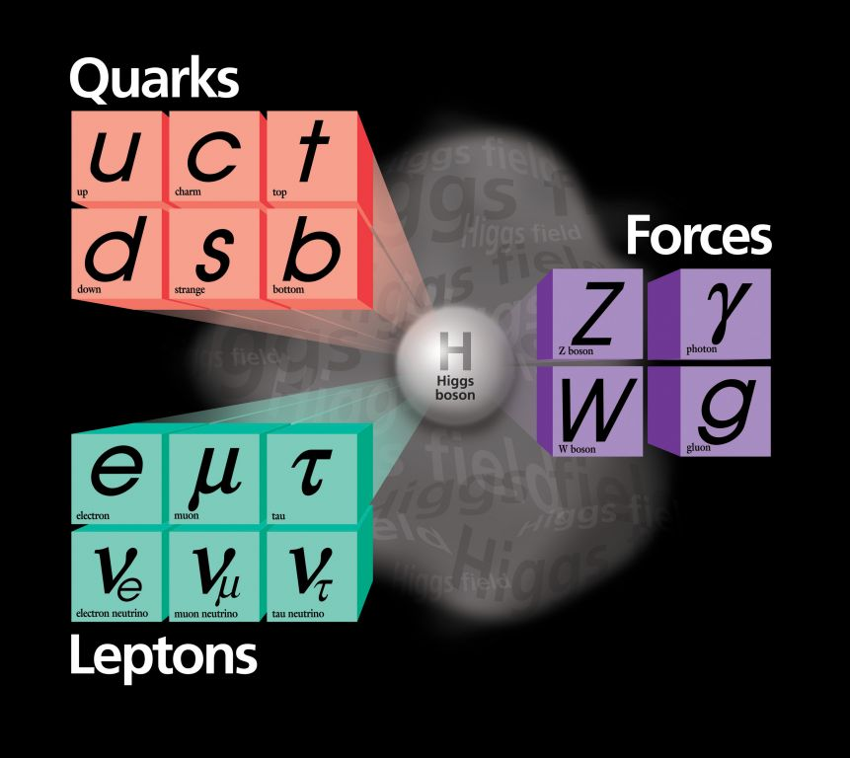
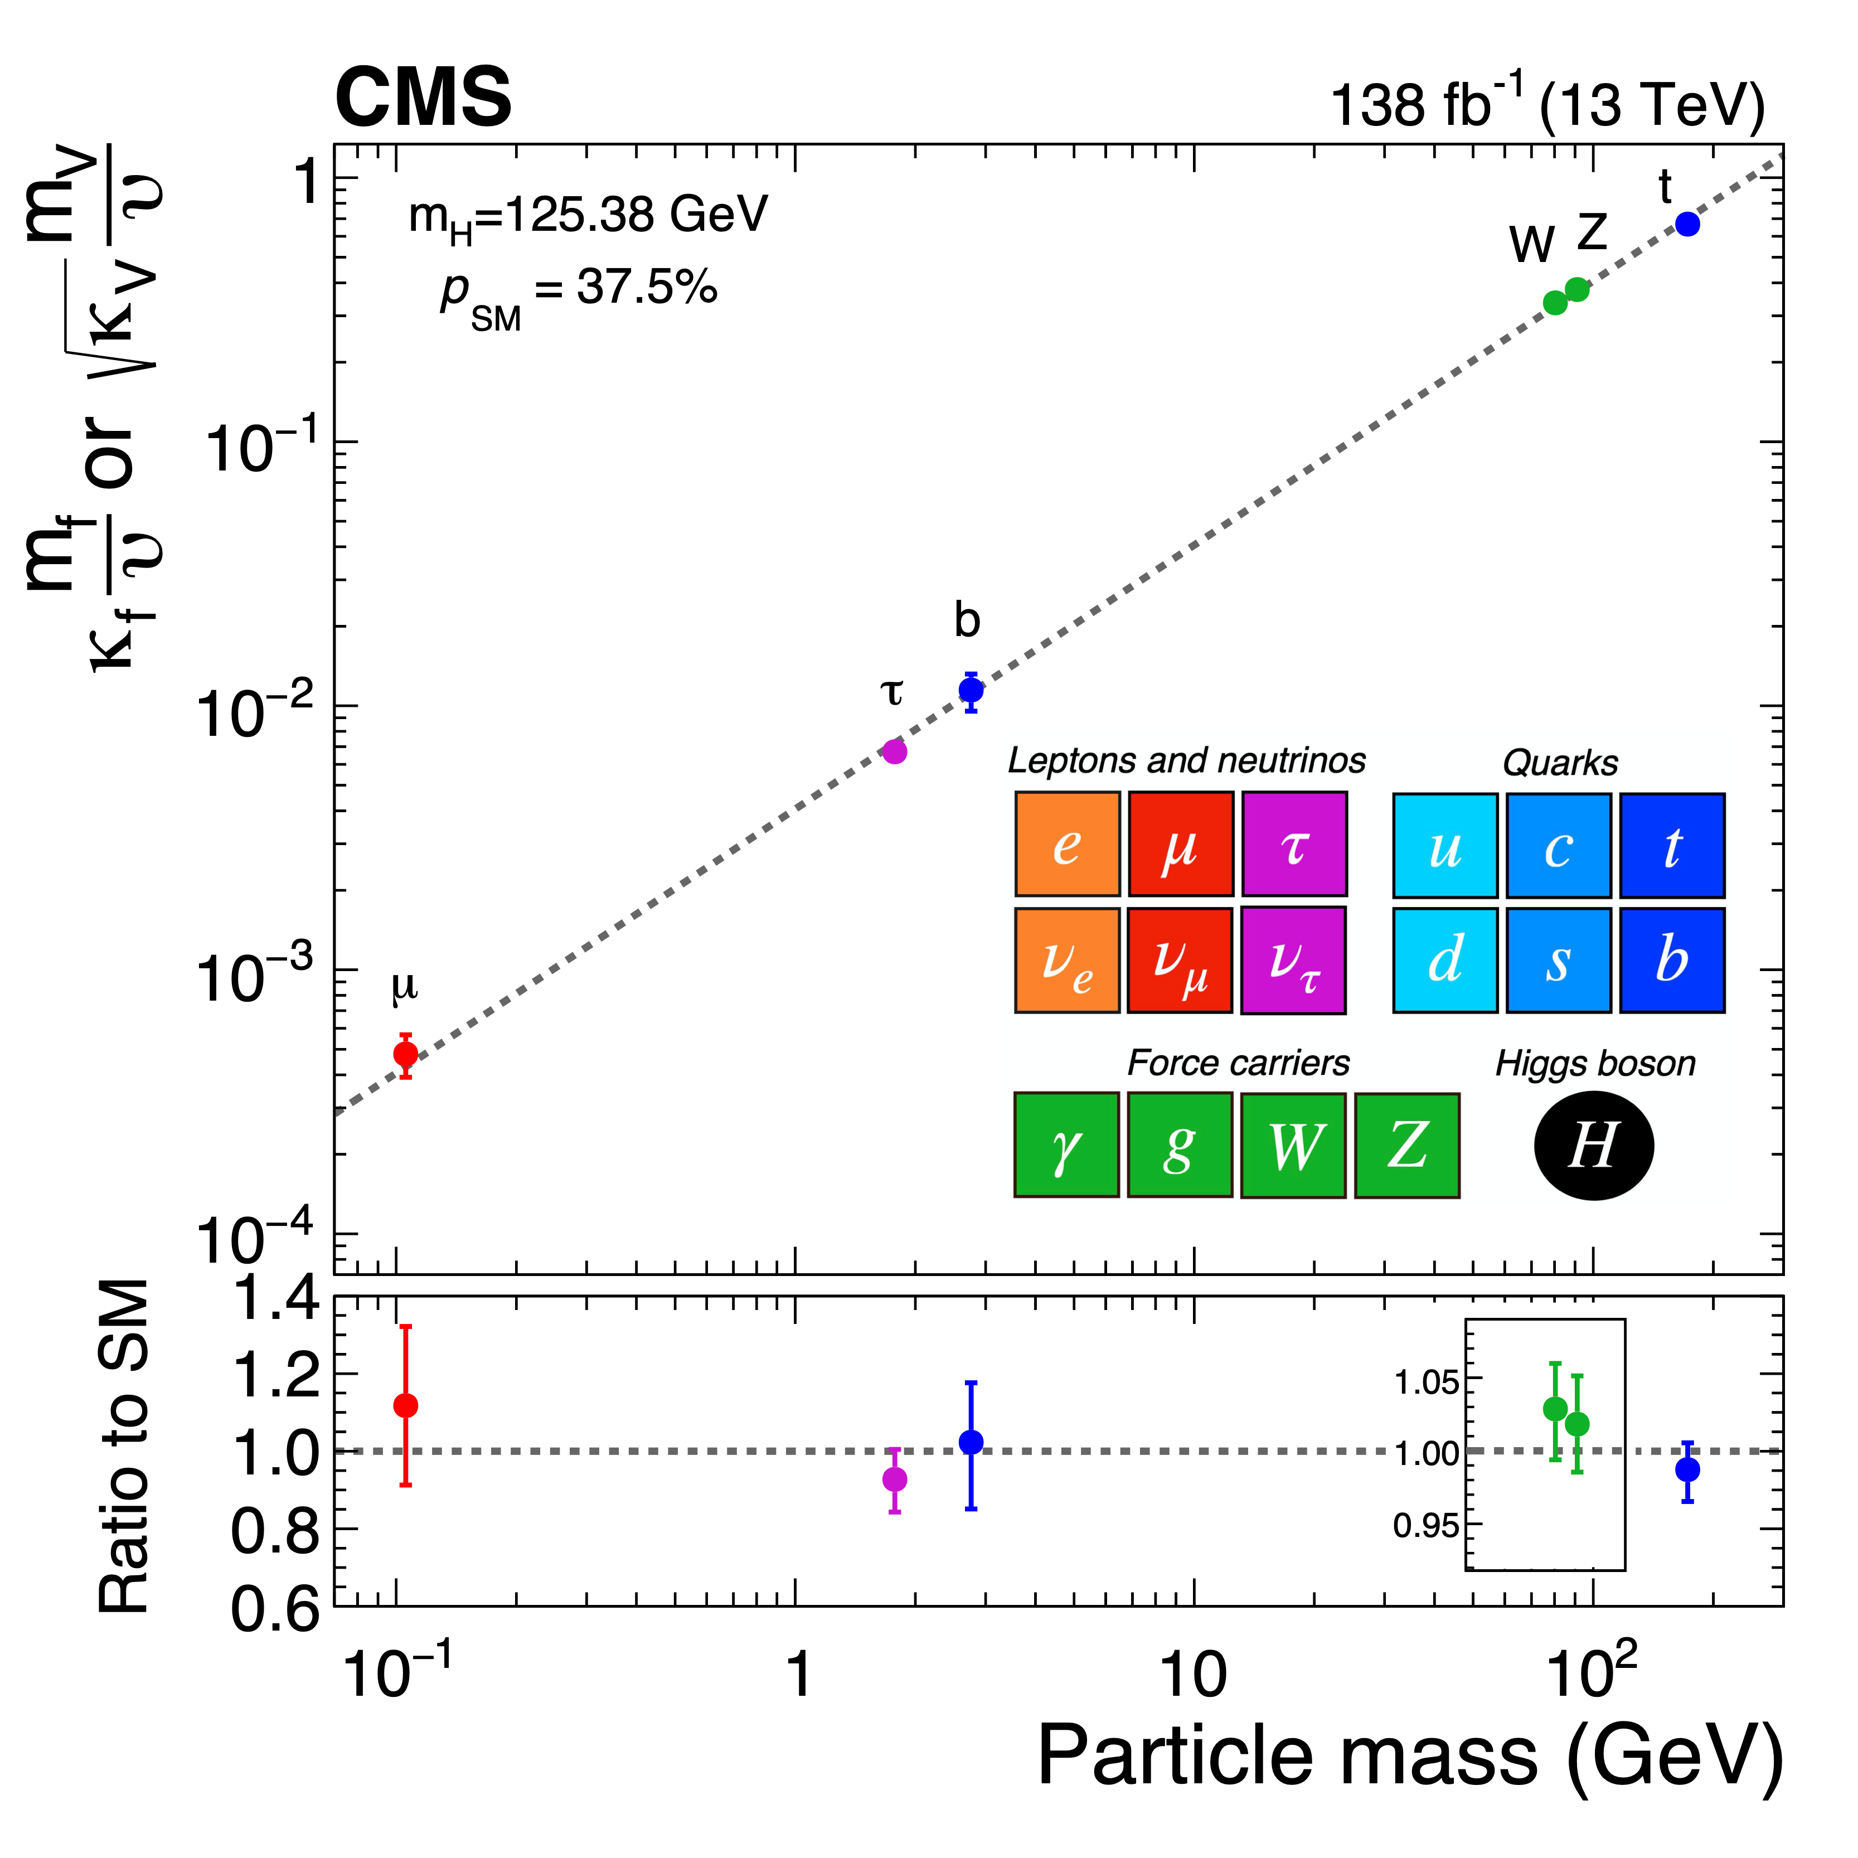
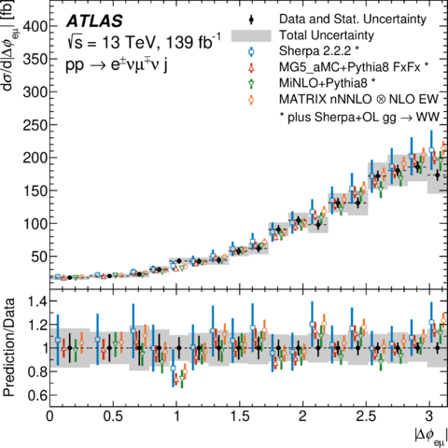
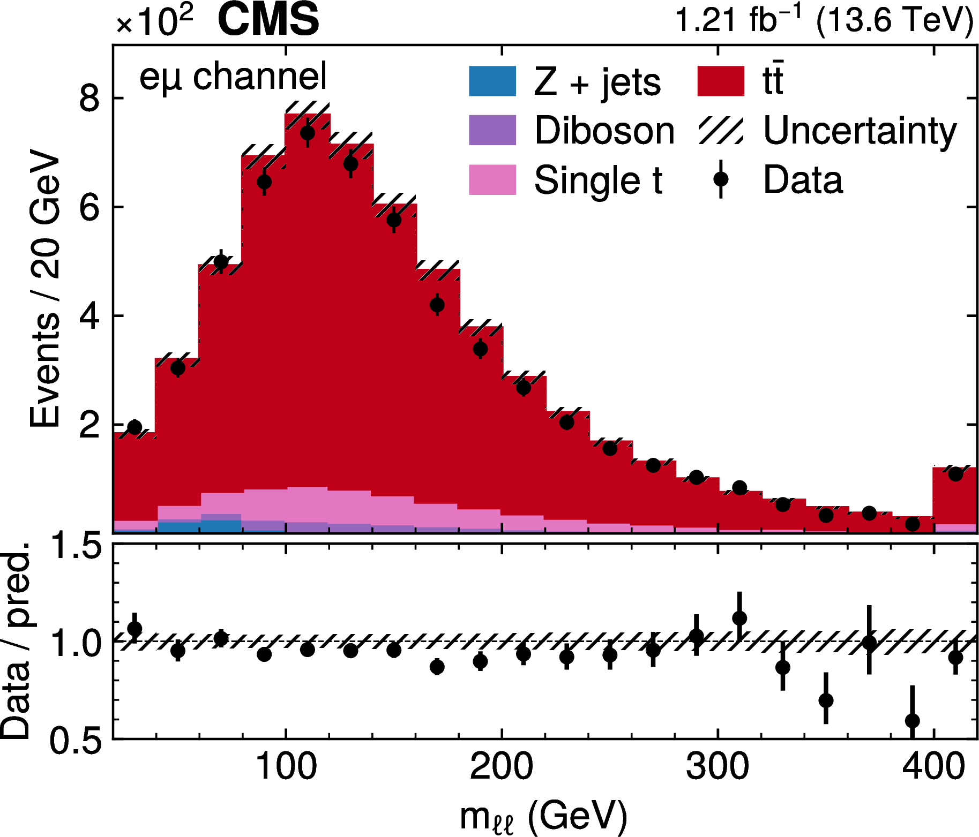
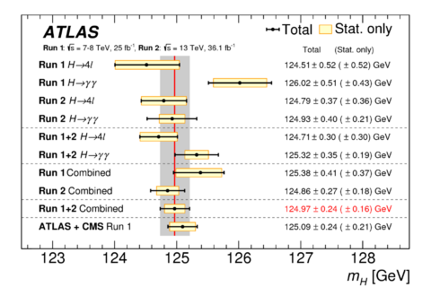
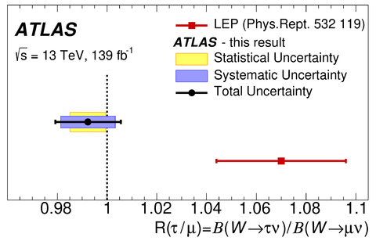
Road to Physics Results
Predictions
New Physics
Measurements/Searches
Quantum field structures, symmetries and intrinsic properties, model parameters
Couplings, interactions
Cross-sections
Detector observables

Slide 4
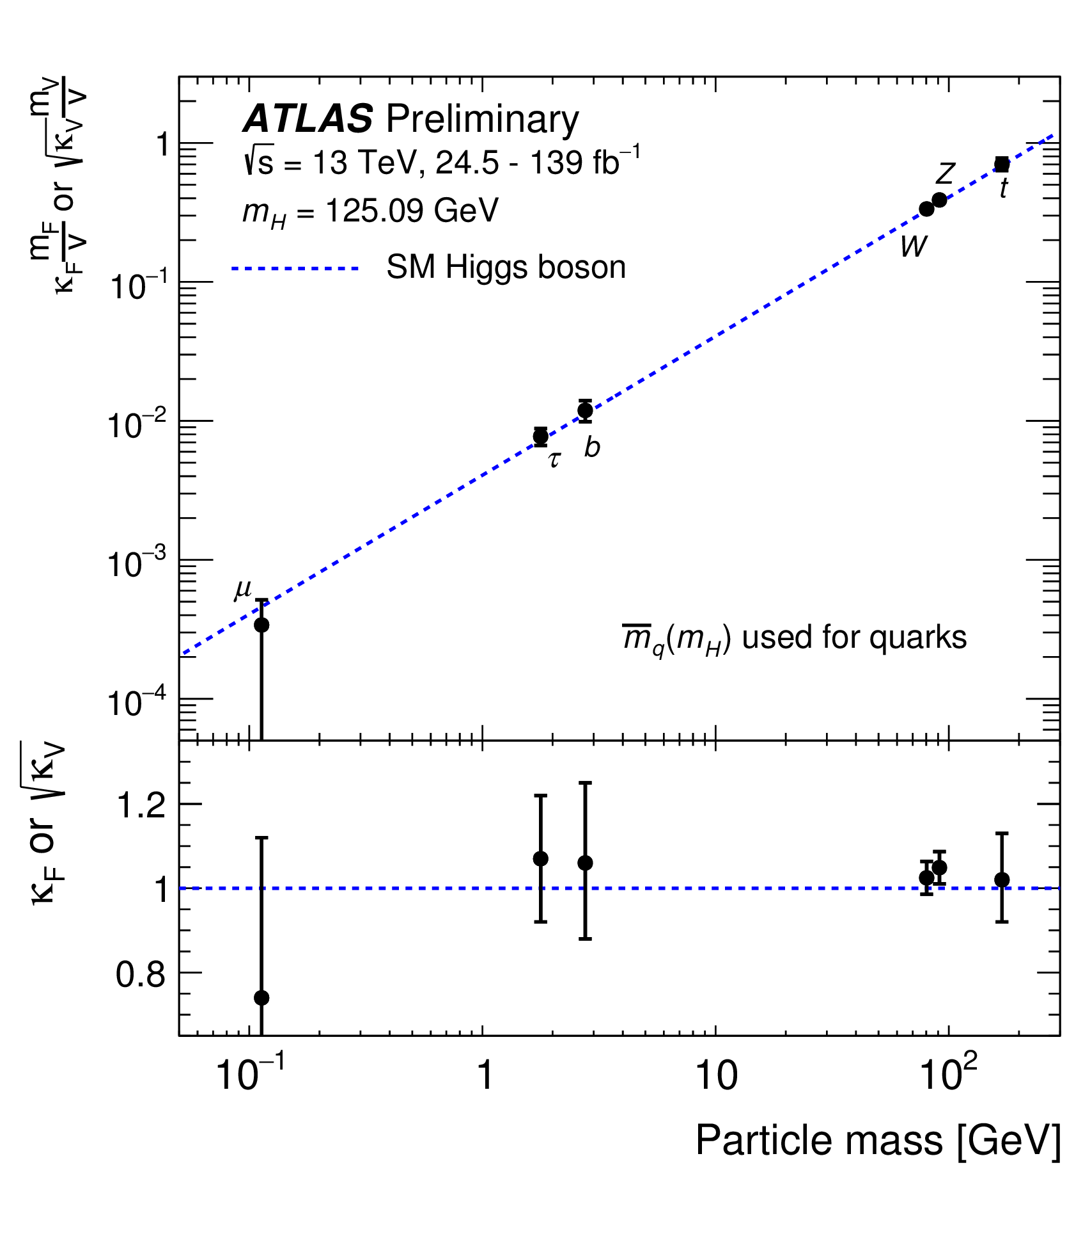
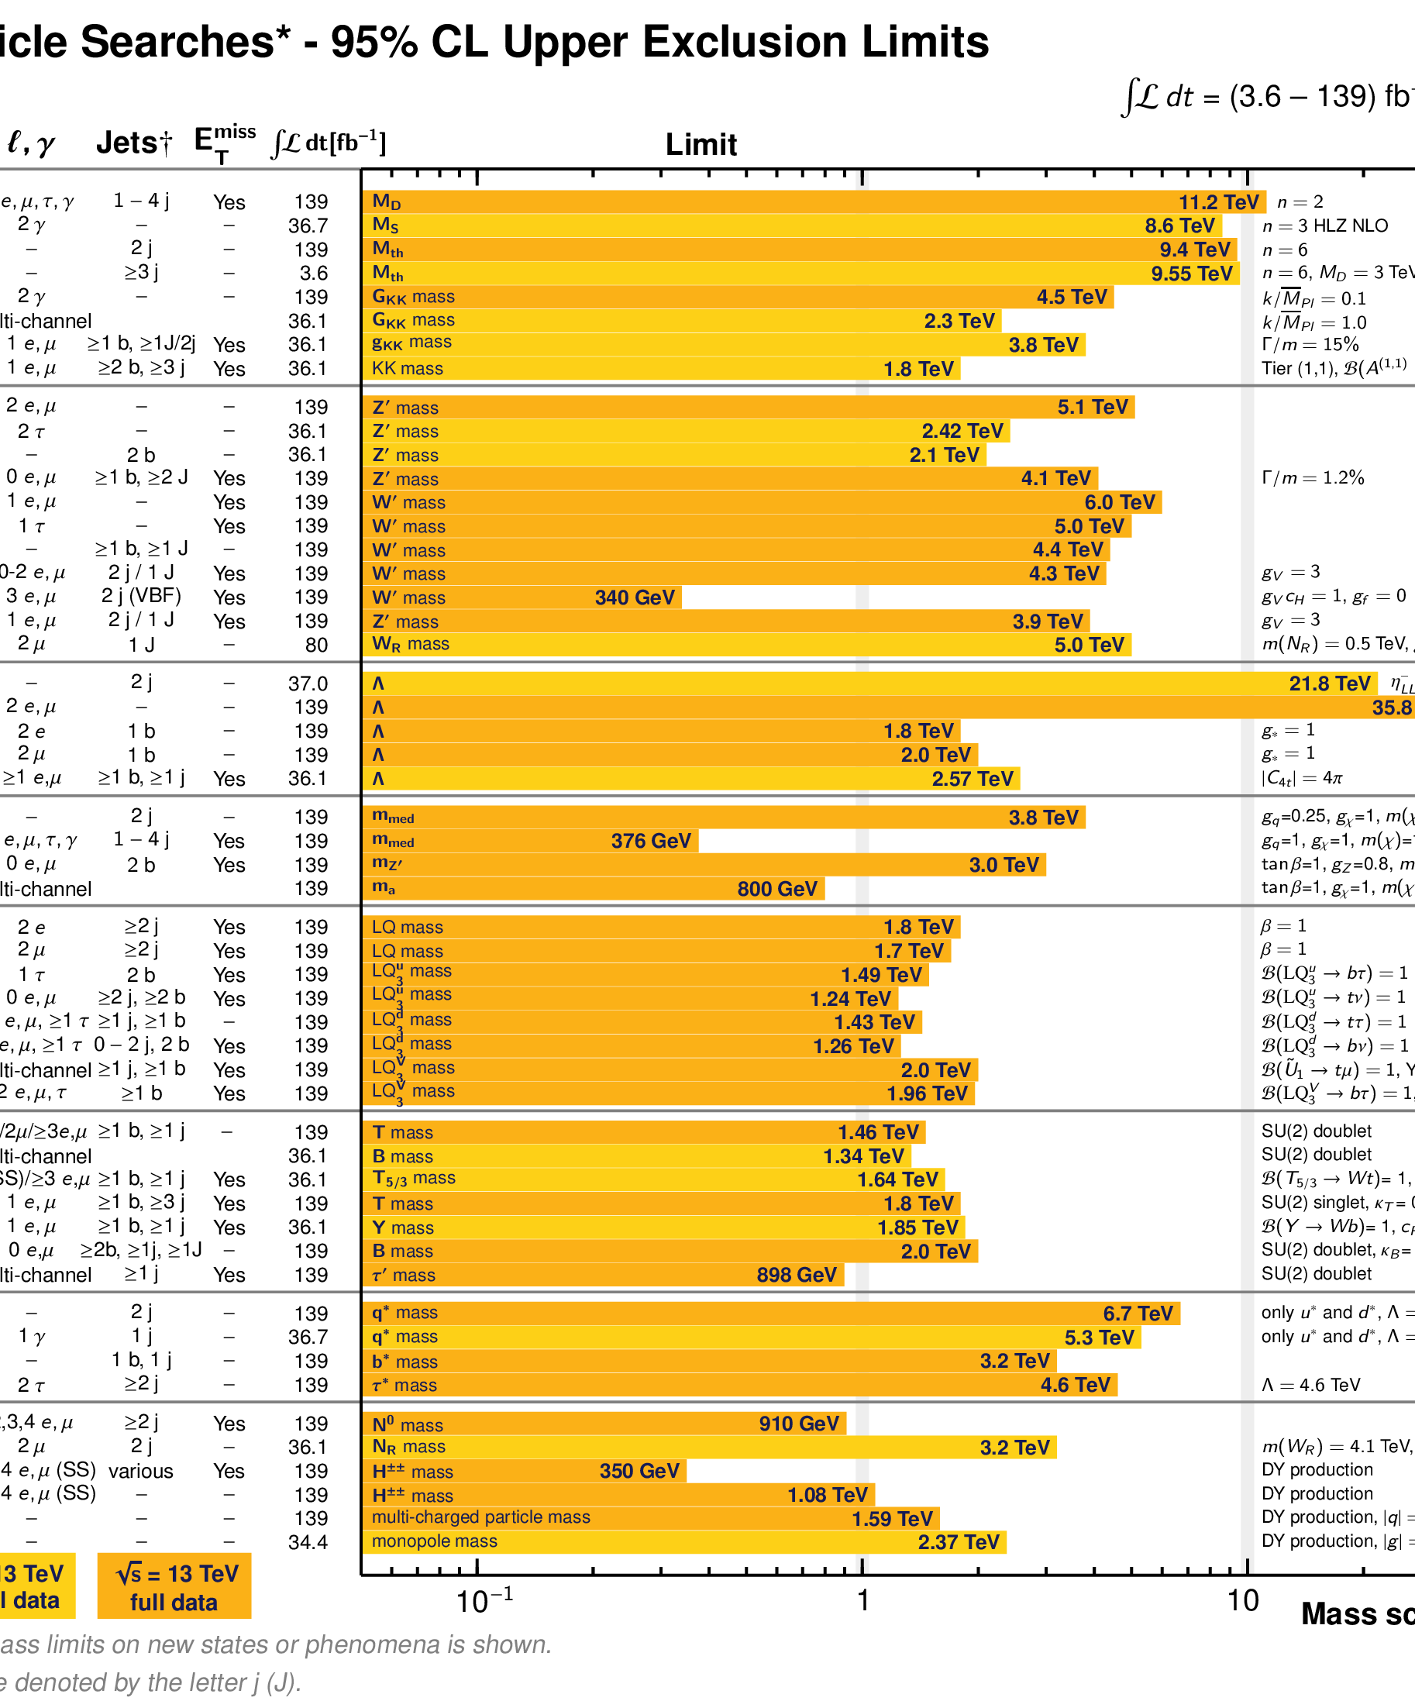
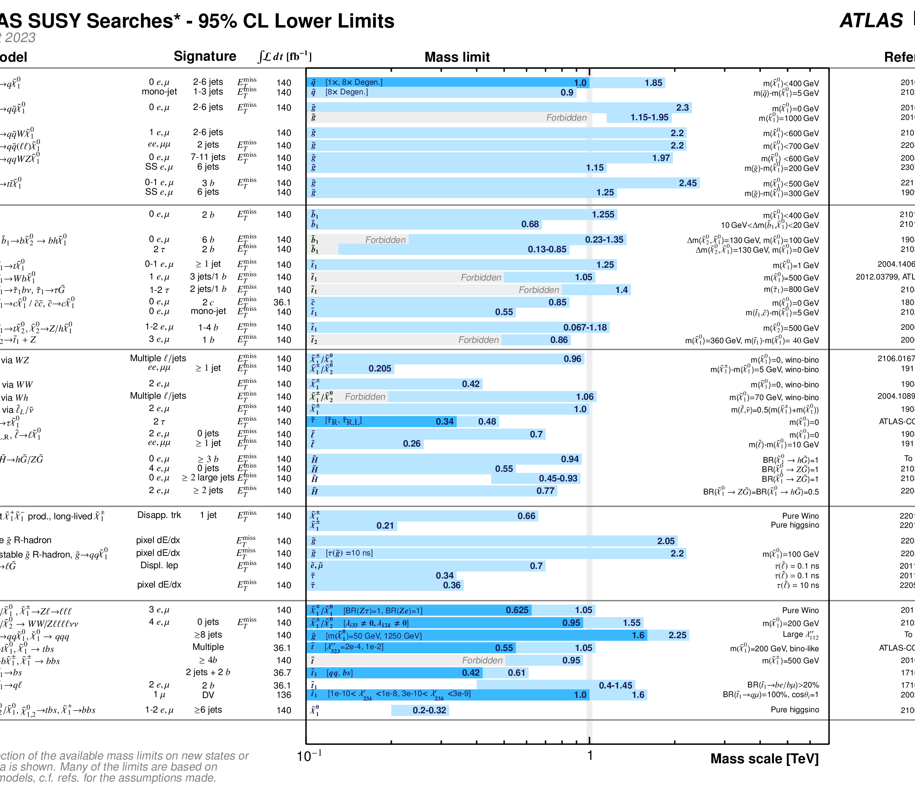
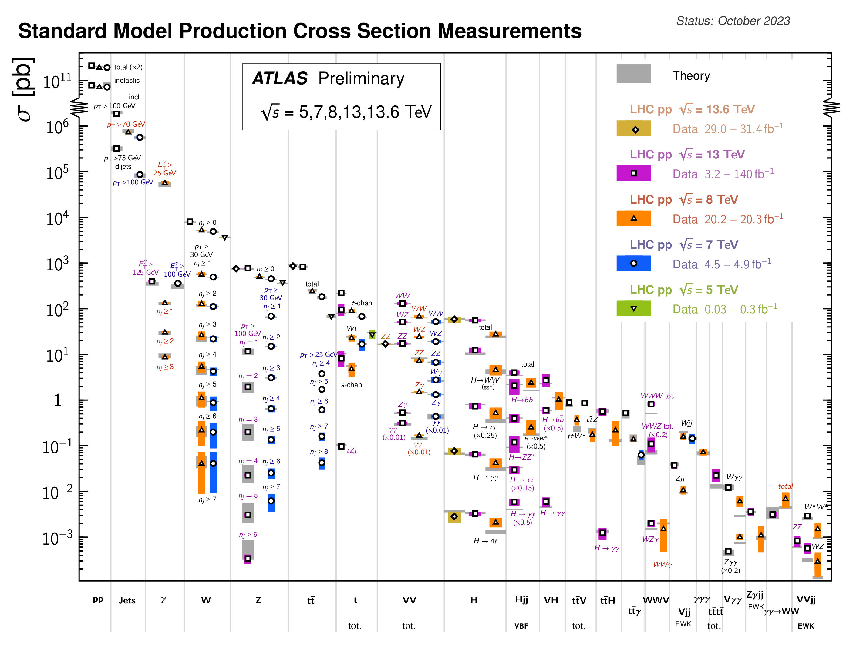
https://twiki.cern.ch/twiki/bin/view/AtlasPublic

Slide 5
Physics Results in a few (random) Facts
Overall | No surprises so far, but 1000+ results to expand the territories of human exploration at high-energy frontier
SM parameter measurements | Matching or better than historical precision
Higgs property measurements | 0⁺; 100 MeV; 10 MeV; <10%; 1→10⁻⁴; 3→2; HH x 1
SM process measurements | V: 1%, 3D+; V+jets 1→3→2; VV: 3→4, non-abelian, <5%, LL; Top: 2→1→4; multi-jets: DPI, shape, more…; γγ collider; EFT
Heavy resonance search | TeV → 5 TeV; inclusive → helicity; symmetry violation
Modelled search (SUSY, DM, …) | TeV; strong→weak; Higgs portal
Unconventional search | dark photon, axion, monopoles, low β, anomalous dE/dx, long-lived

Slide 6
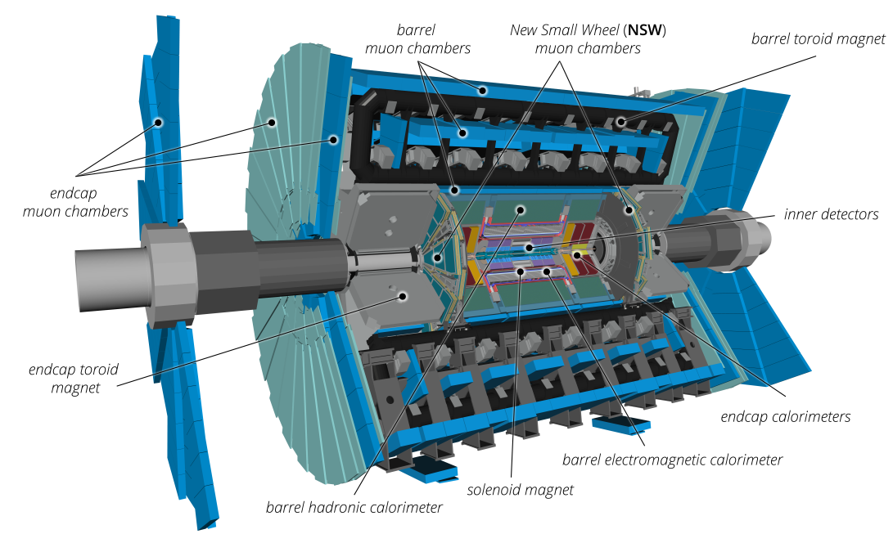
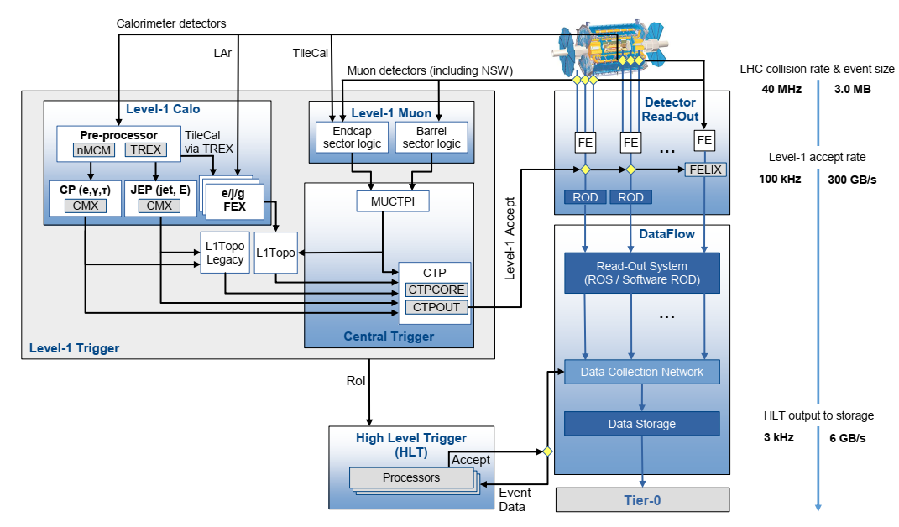
Results behind Results
Latest Run-3 detector and DAQ scheme
more on arXiv:2305.16623
Online data reduction of 99.9999%
ns → μs responding and triggering speed
All-around capability of measuring physics objects precisely

Slide 7
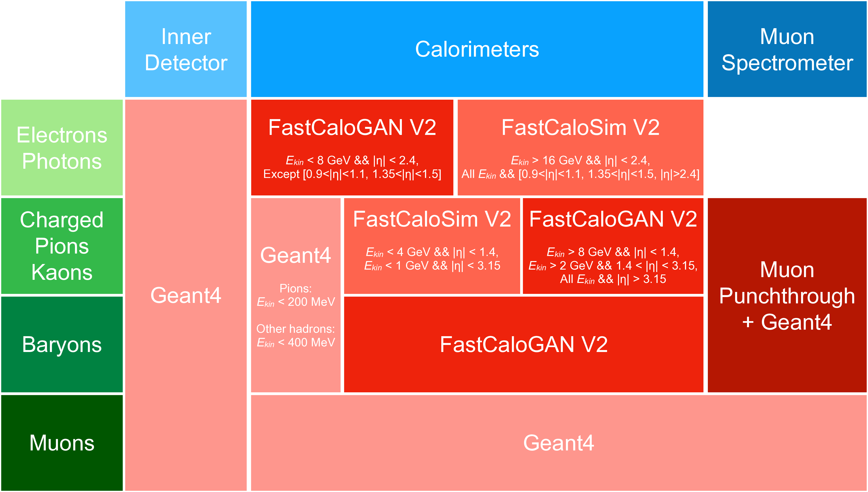
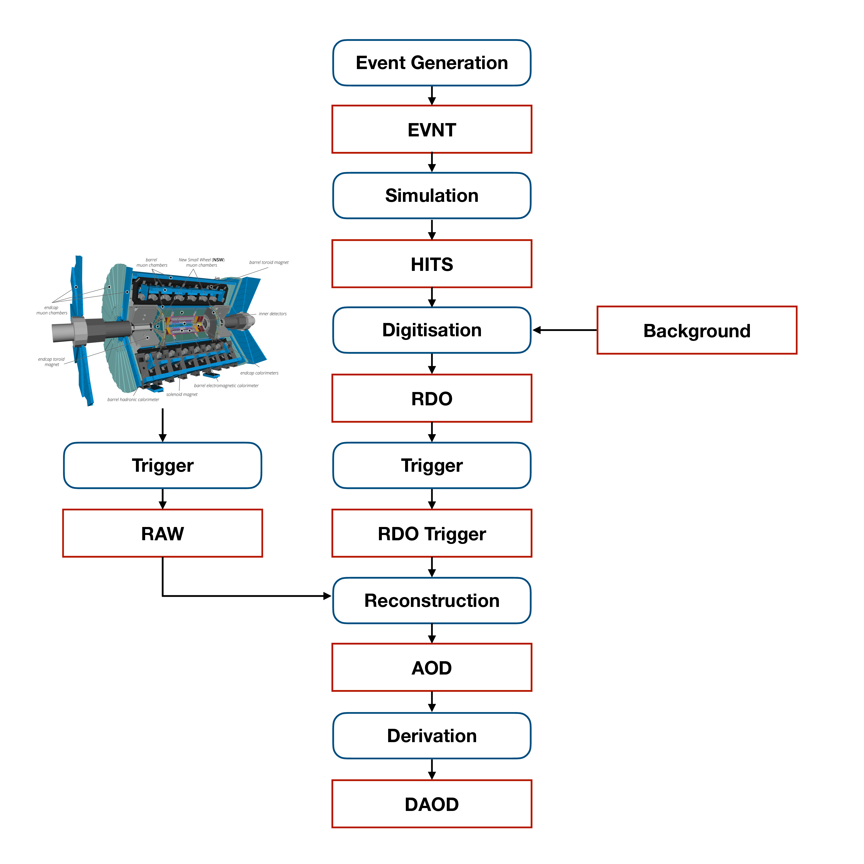
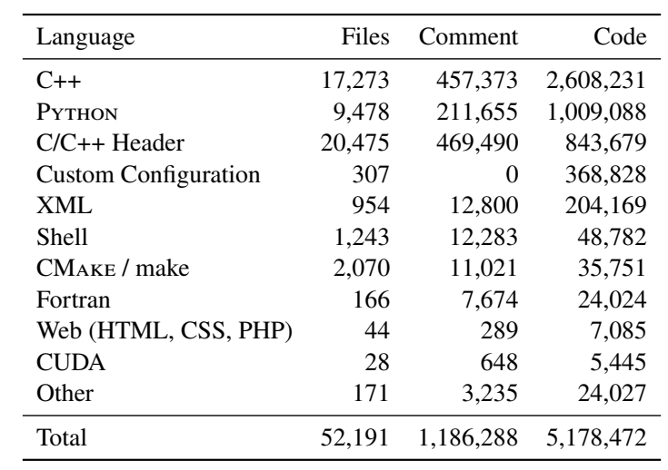
Results behind Results
arXiv:2404.06335
Full-scale comprehensive software system: ~ 5M lines

Slide 8
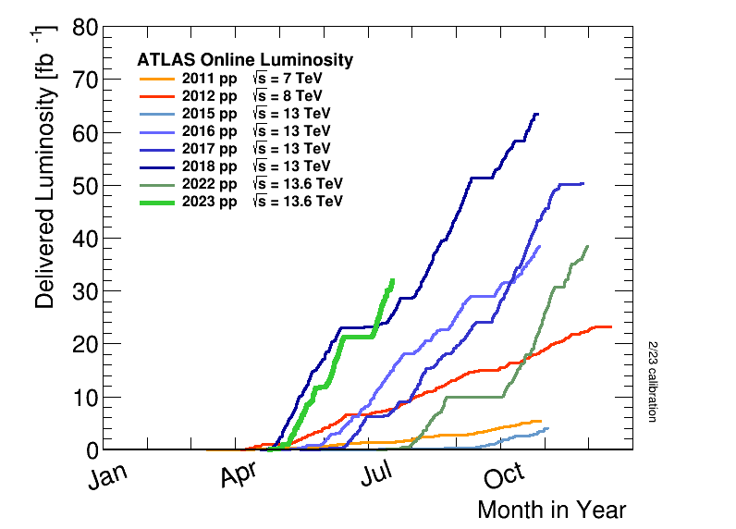
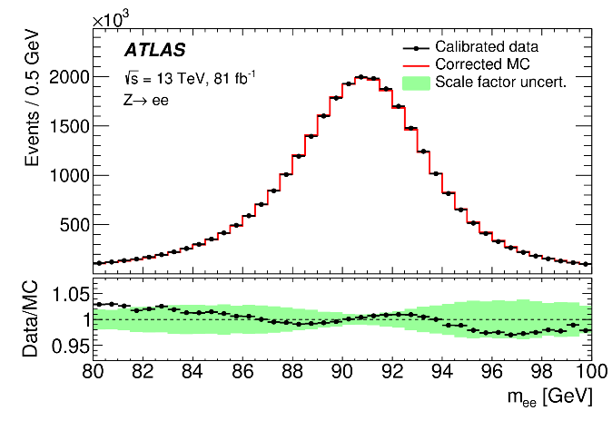
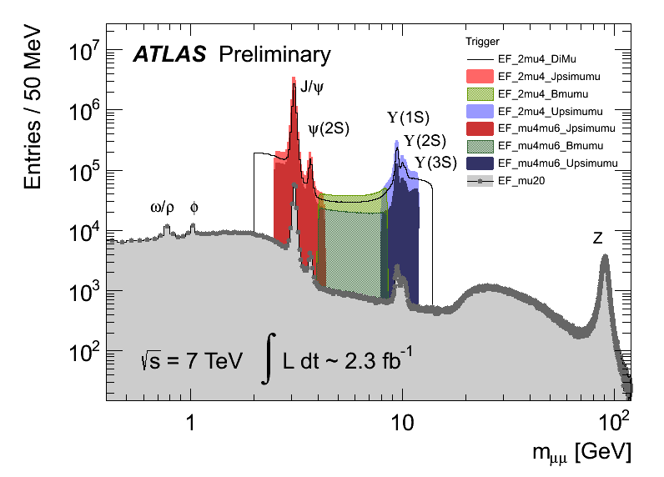
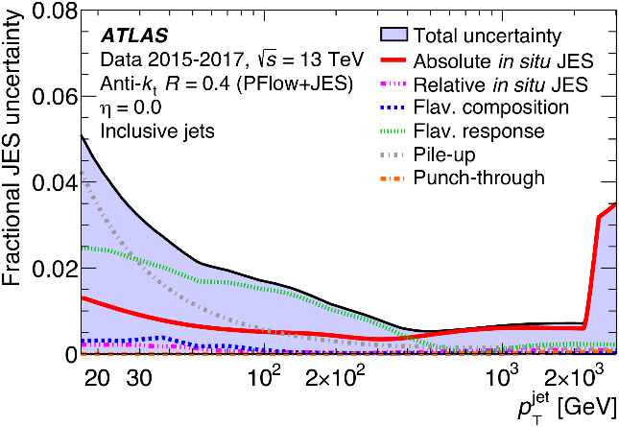
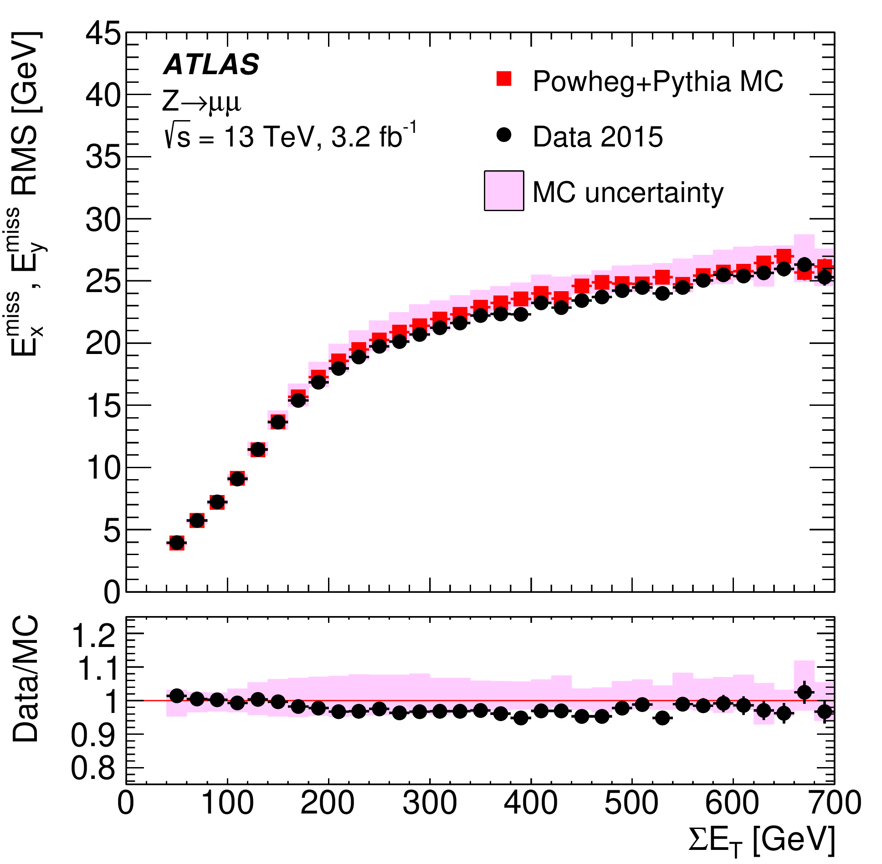
Results behind Results
Physics successes owing to precise understanding of e, μ, jets, E_{T}^{miss}, and tagging of heavy-flavor jets
Per-mil to percentage precision achieved in many
dimuon mass
Z(ee)
scale
JINST 14 (2019) P12006
Tremendous efforts from LHC, detector teams to make the data collection smooth
Jet energy scale
Missing E_{T} resolution
EPJC 81 (2021) 689
EPJC 78 (2018) 903

Slide 9
Pick up a few recent examples in the talk:
Final states on
Higgs, V, V+jets,
Top, VV, VVjj
Not meant for full coverage, pick with personal biases

Slide 10
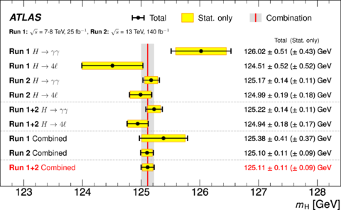
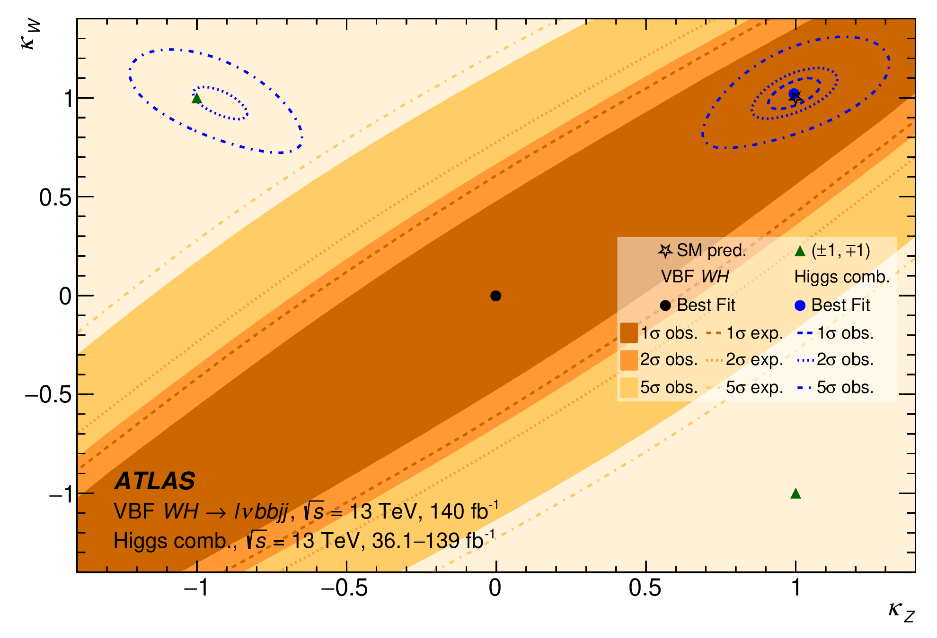
Higgs Mass, Coupling
arXiv:2402.00426, submitted to PRL
PRL 131 (2023) 251802
Unprecedented precision from direct measurement: ~100 MeV
Interference effect in WH process used to prove same sign of W-H and Z-H couplings

Slide 11
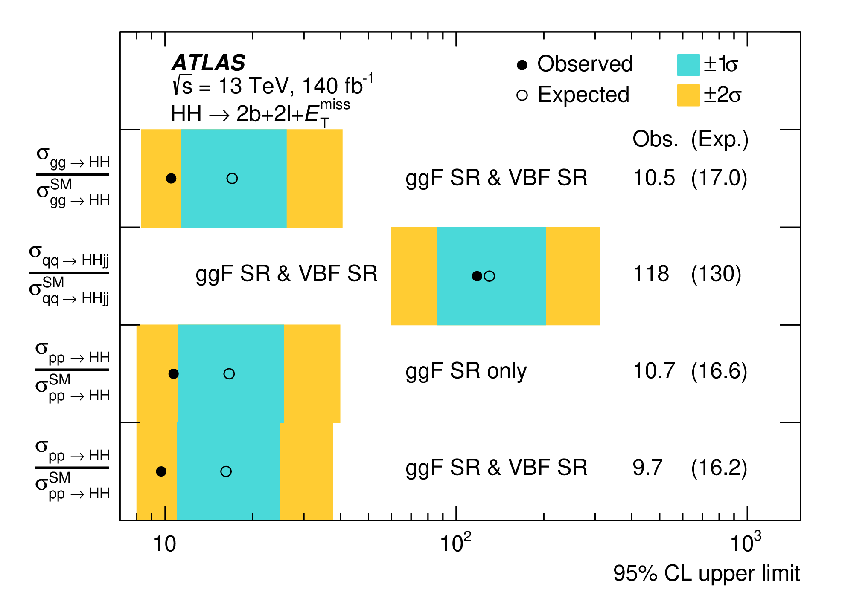
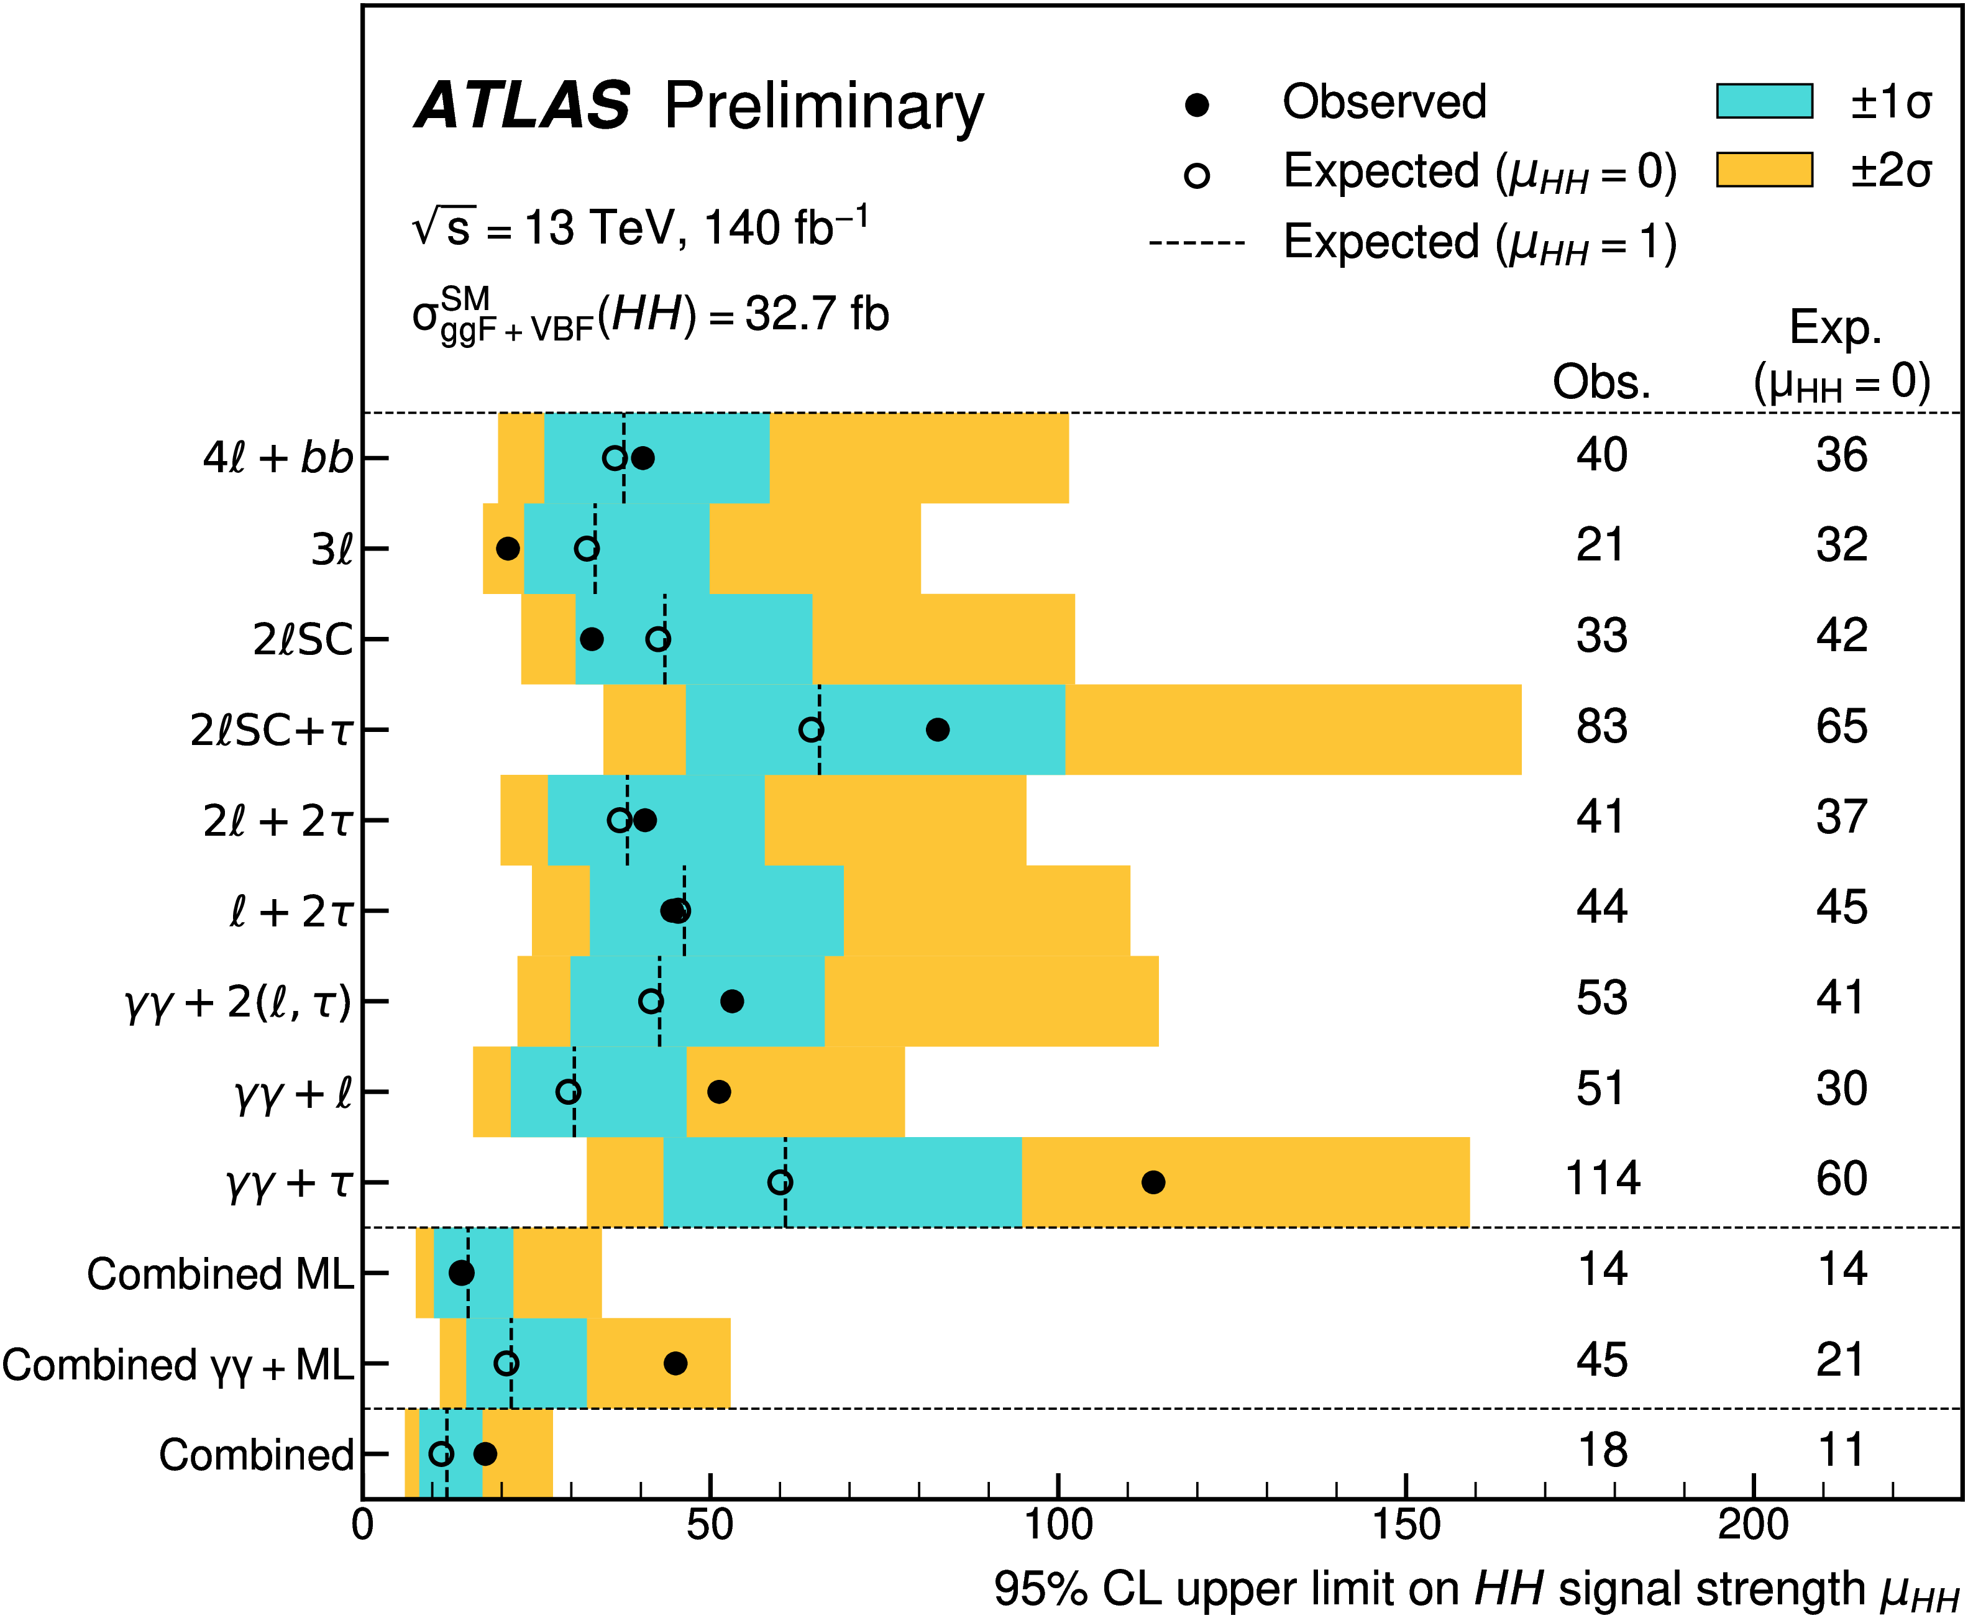
HH
JHEP 02 (2024) 037
ATLAS-CONF-2024-005
Explore all possible final states sensitive to HH production beyond the leading channels: mapping for the future

Slide 12
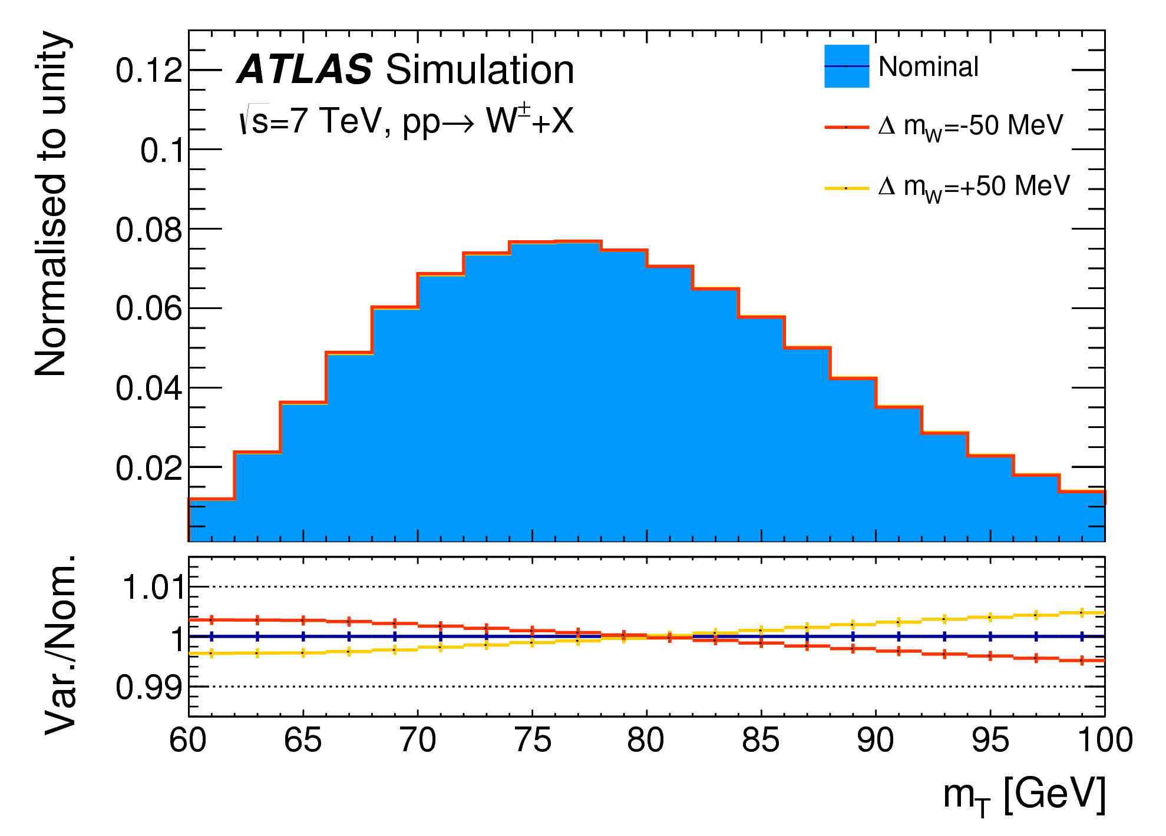
W Mass is Demanding
Sensitive variables p_{T}^{lepton} and m_{T}W
O(10) MeV m_{W} precision requires per-mil precision in predicting and measuring p_{T}^{l} and m_{T}
Correcting MC simulation to start-of-art predictions
Calibrating physics objects to best possible precisions
EPJC 78 (2018) 110

Slide 13
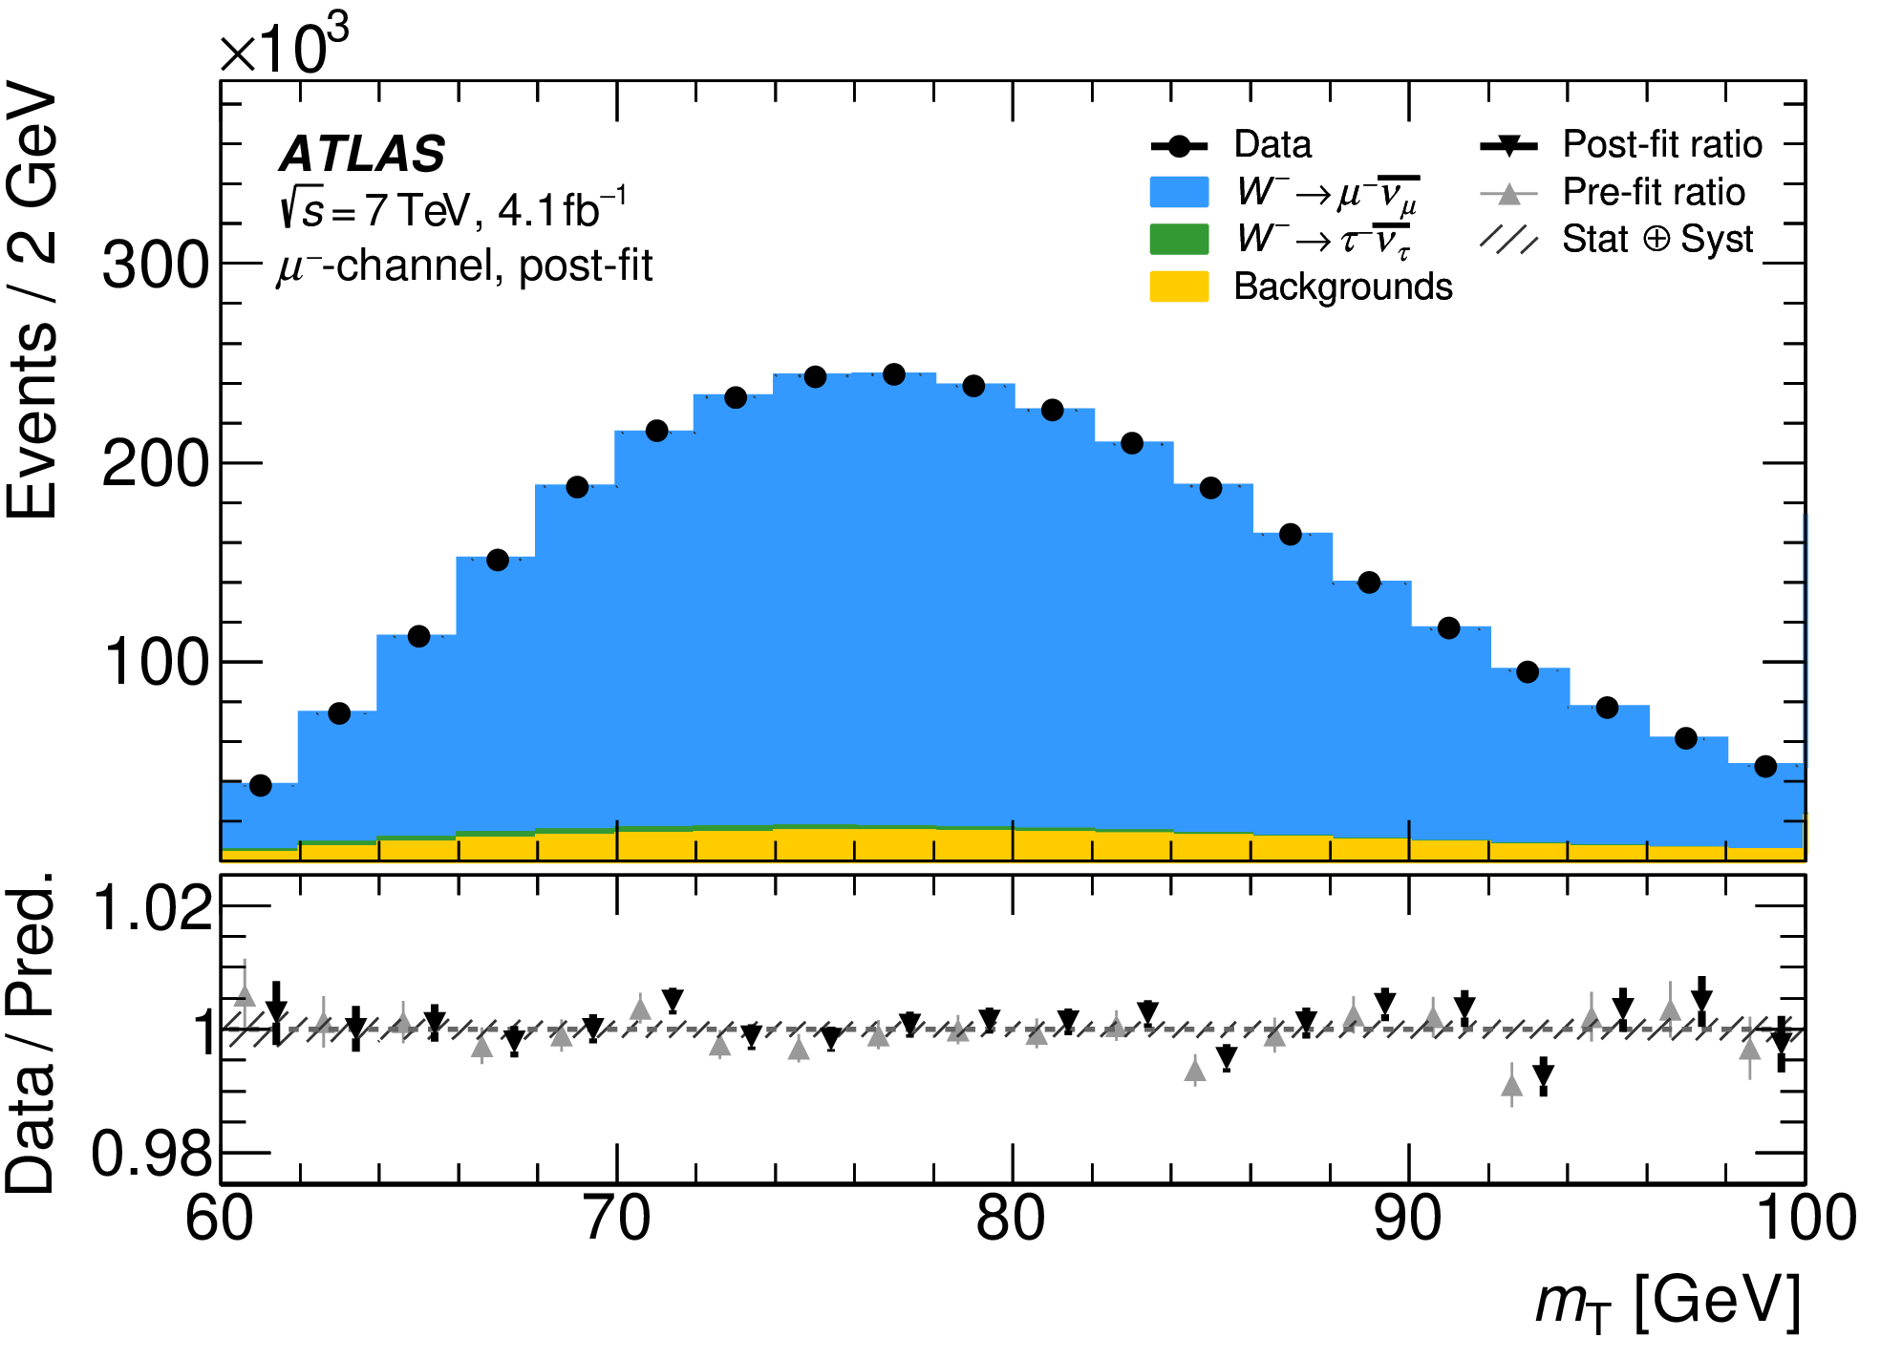
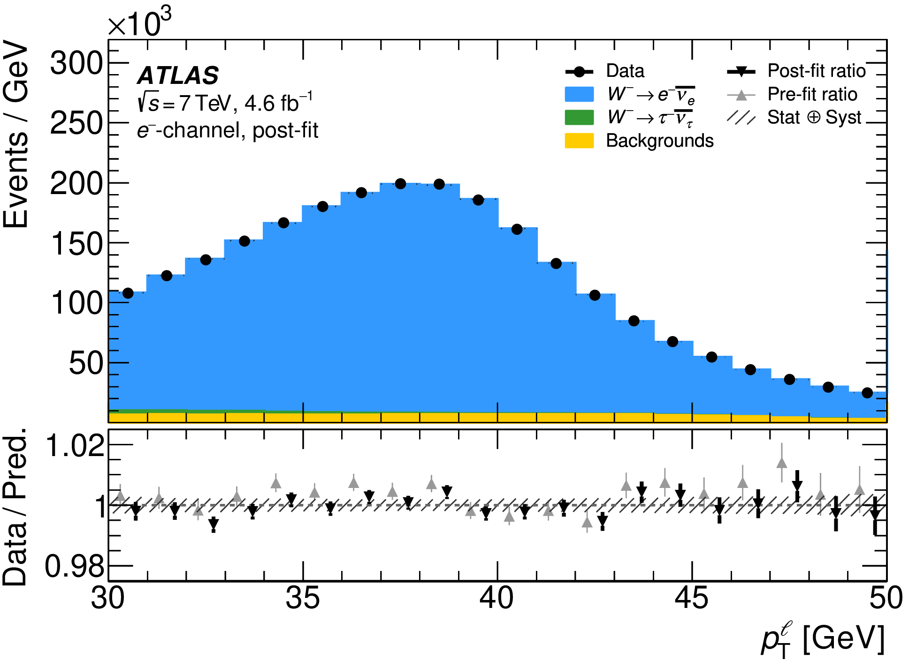
Related Distributions for W Mass
arXiv:2403.15085, submitted to EPJC
>> Precise modelling leads to desired precision in data vs MC comparison
>> Statistical fits to observables to derive m_{W}

Slide 14
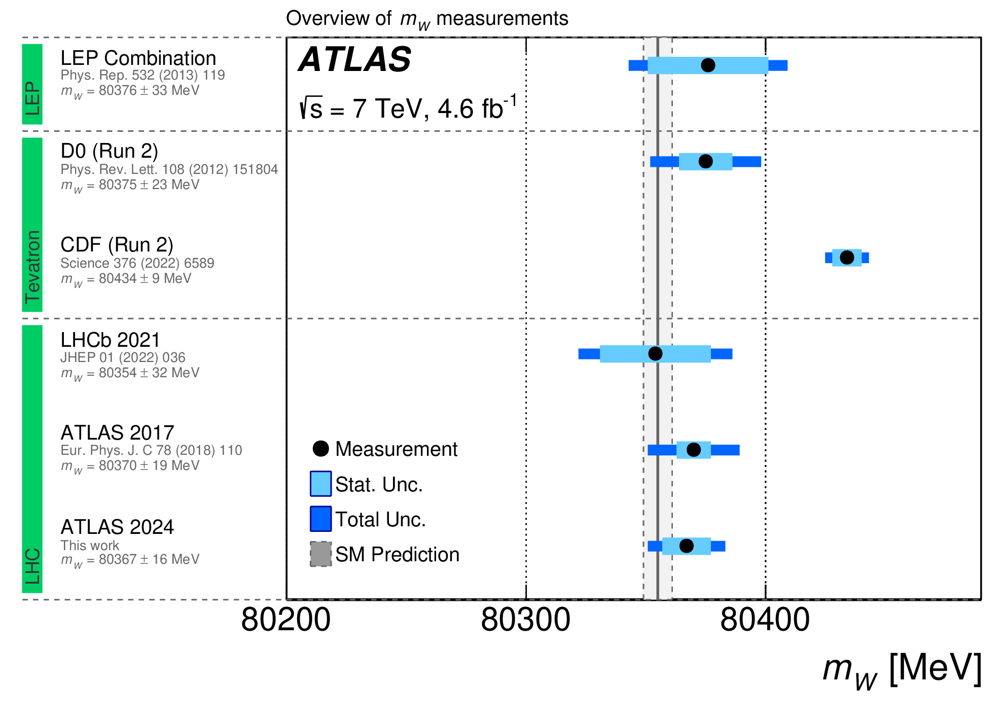
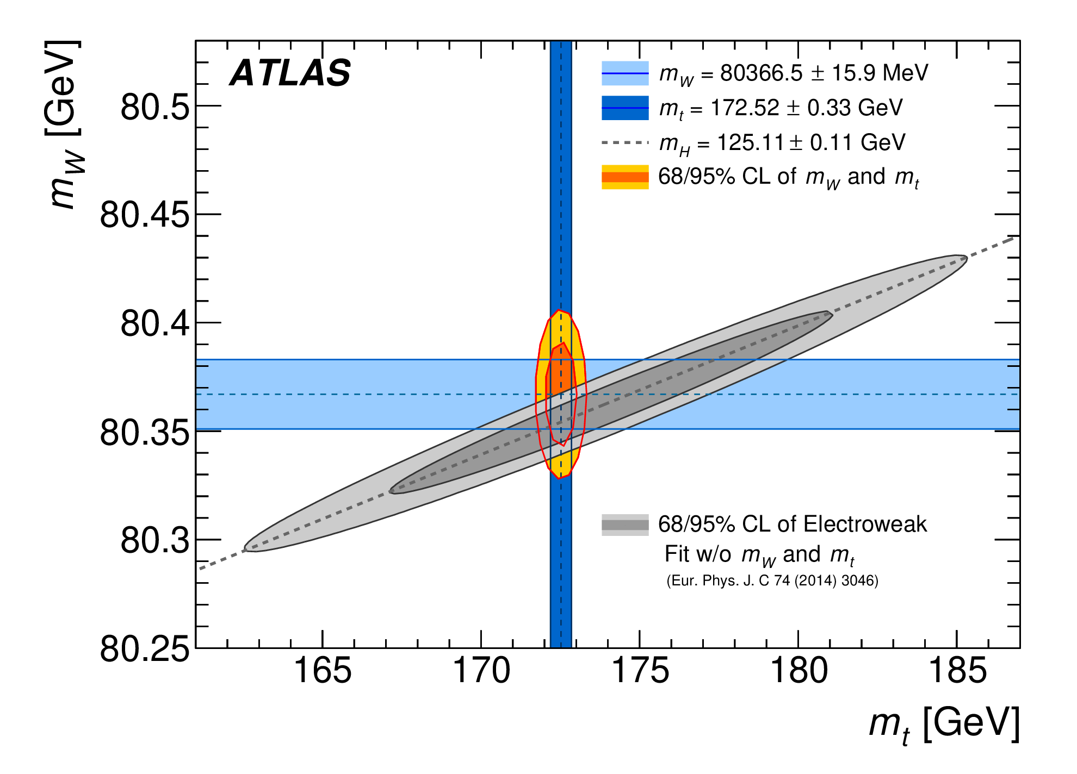
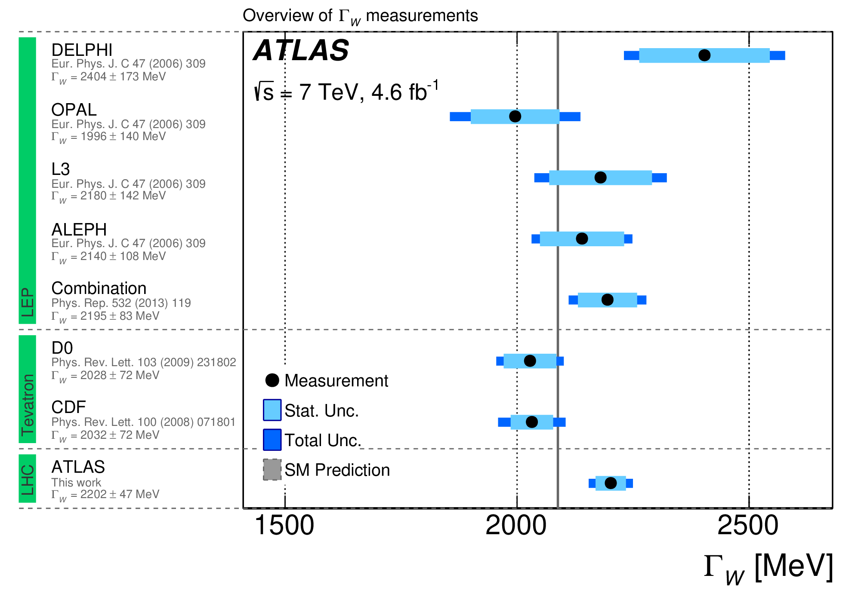
Update of 7 TeV Reanalysis for W Mass
arXiv:2403.15085, submitted to EPJC
Good consistency with electroweak fit results, best width measurement
FUTURE:
more precise, independent measurements from ATLAS, CMS, LHCb will be desired (in view of discrepancies w.r.t. CDF results) ➔ more precise calibrations (with more data), better pT modelling, better PDF modelling (more relevant PDF measurements at the LHC)

Slide 15
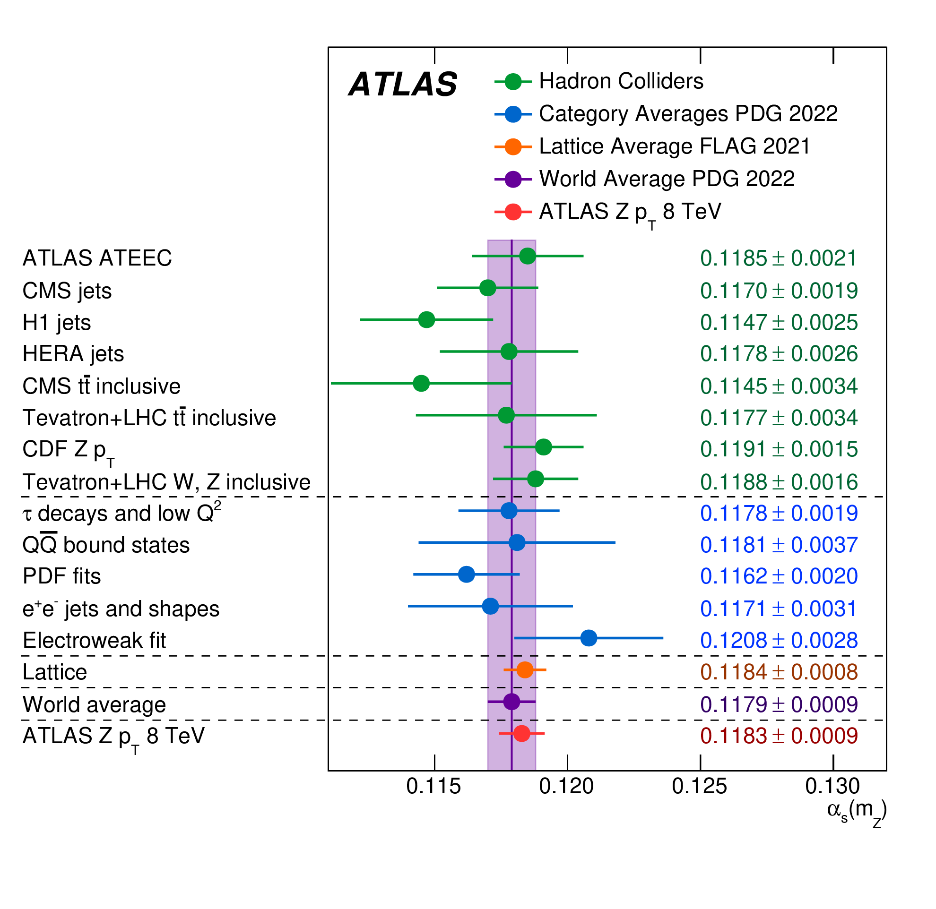
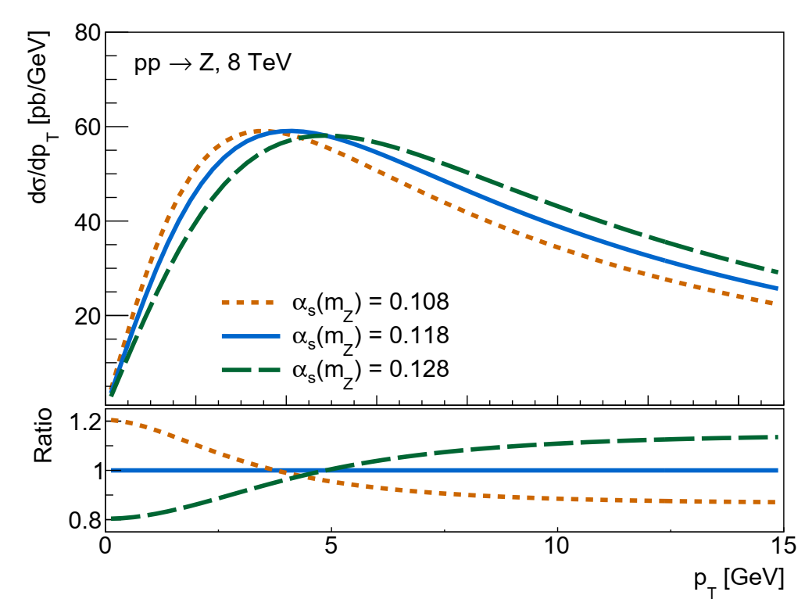
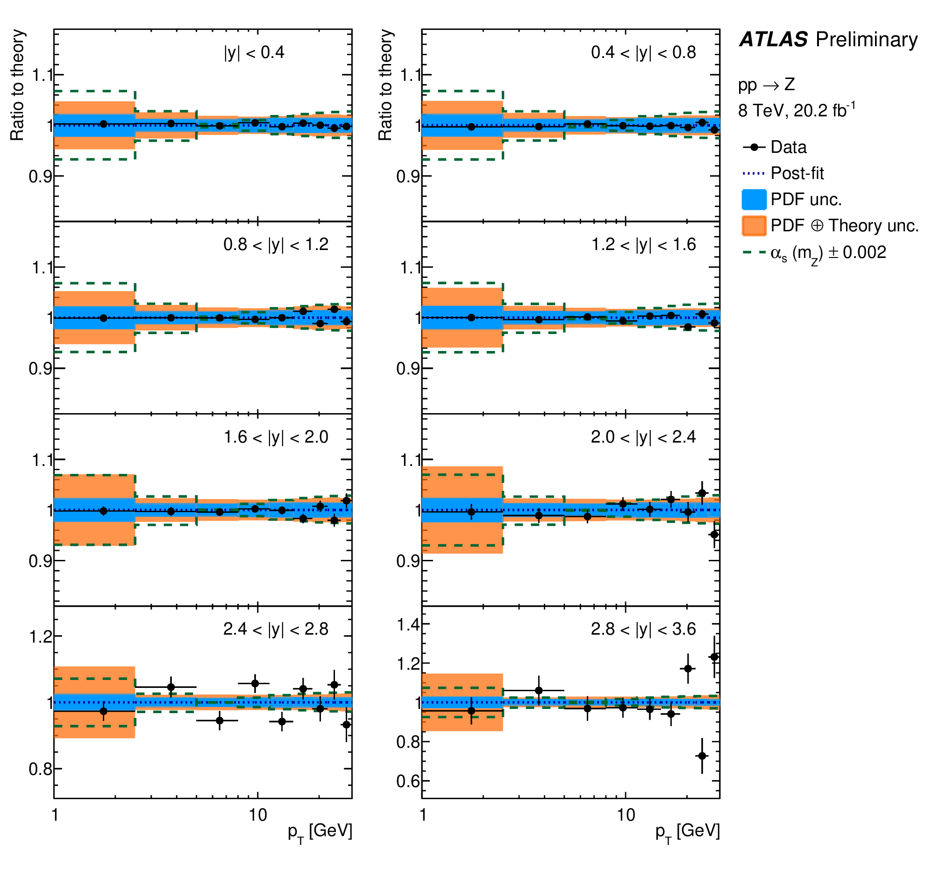
ISR matters: Z pT → $α_{S}$
arXiv:2309.12986, submitted to Nature Physics
Demonstration of ZpT and $α_{S}$ relationship
Very precise Z pT measurement matching to very precise modelling can yield great precision in $α_{S}$
State of art prediction:
DYTurbo: N⁴LL resummation
+ aN³LO perturbative
with N³LO MSHT20 PDF
A single best precision measurement so far
0.8% precision in $α_{S}$

Slide 16
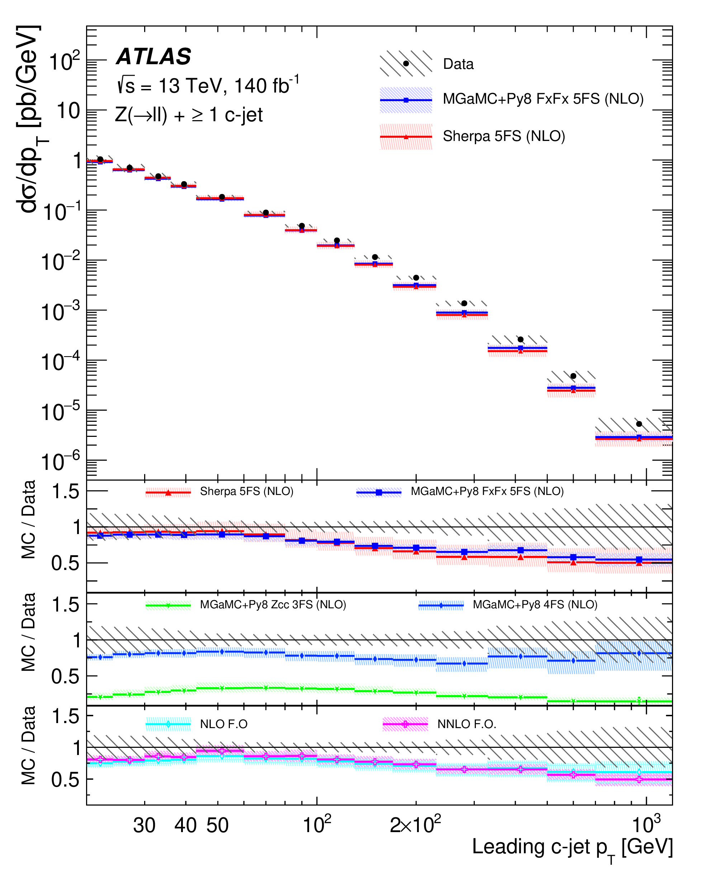
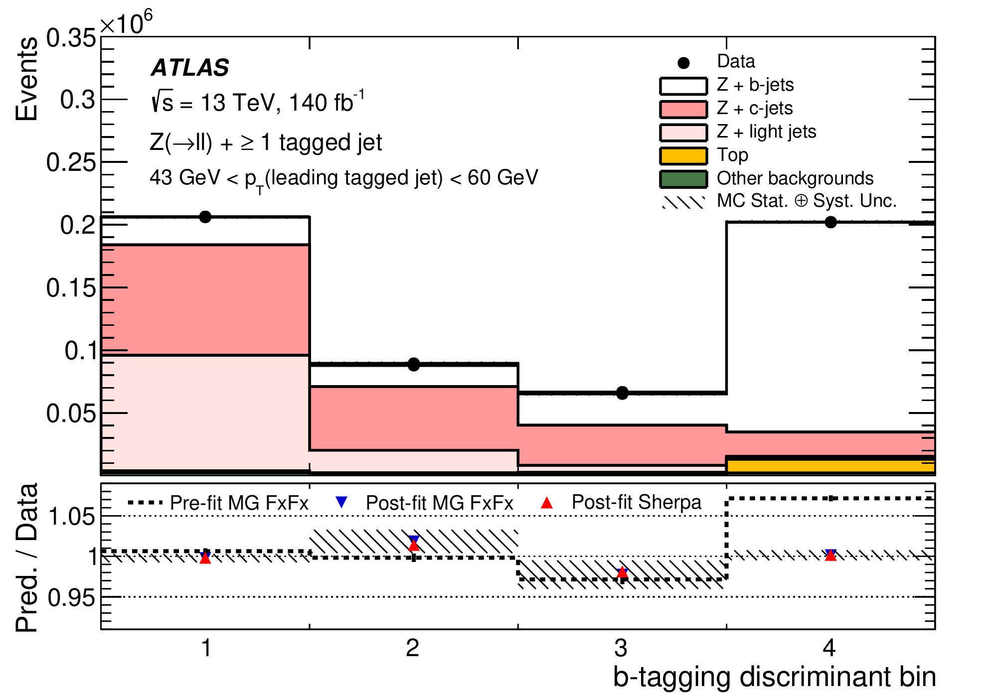
1→3→2 for Z+jets
arXiv:2403.15093, submitted to EPJC
Jet tagging technics improving over years, possible to precisely measure Z+b and Z+c
Diverse probes: QCD dynamics, HF PDF, intrinsic charms, HF related new physics, VV decays, VH Yukawa couplings …
New results on Z+b/c, we start to make charm-jet process more accessible

Slide 17
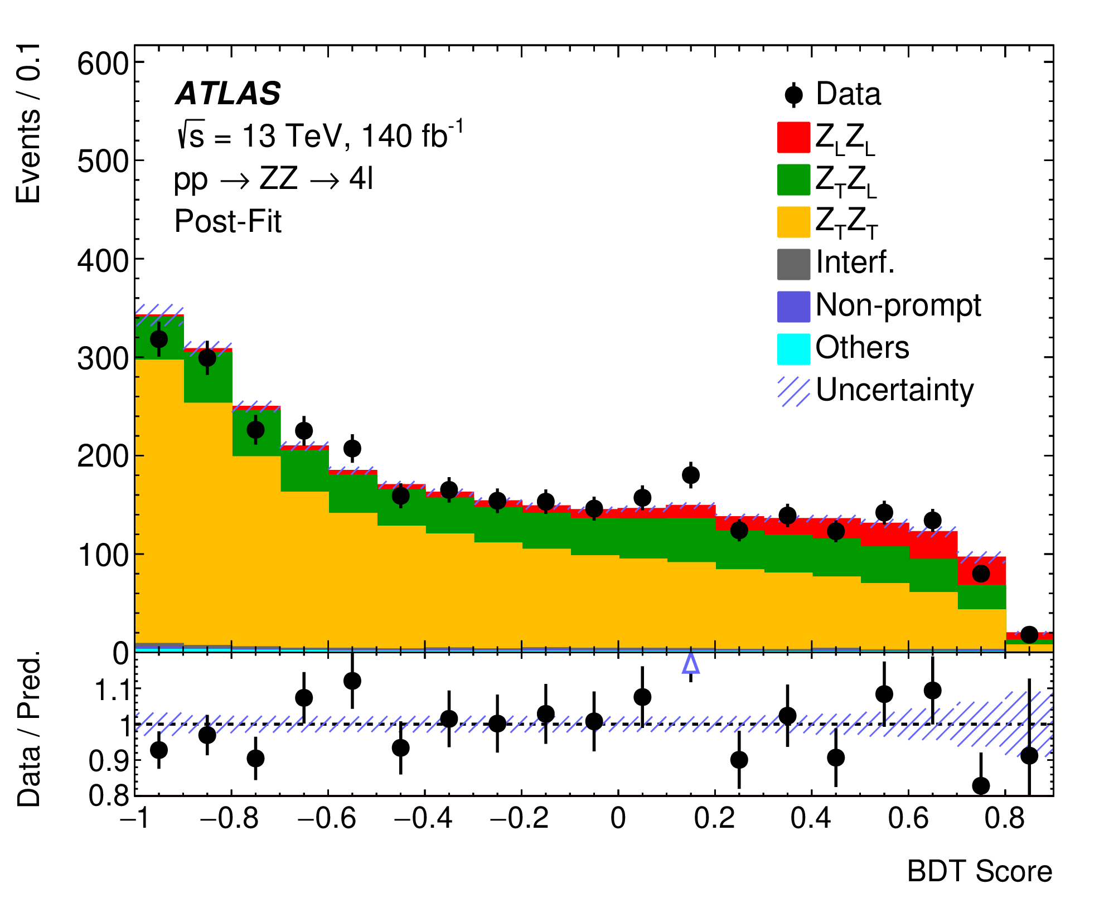
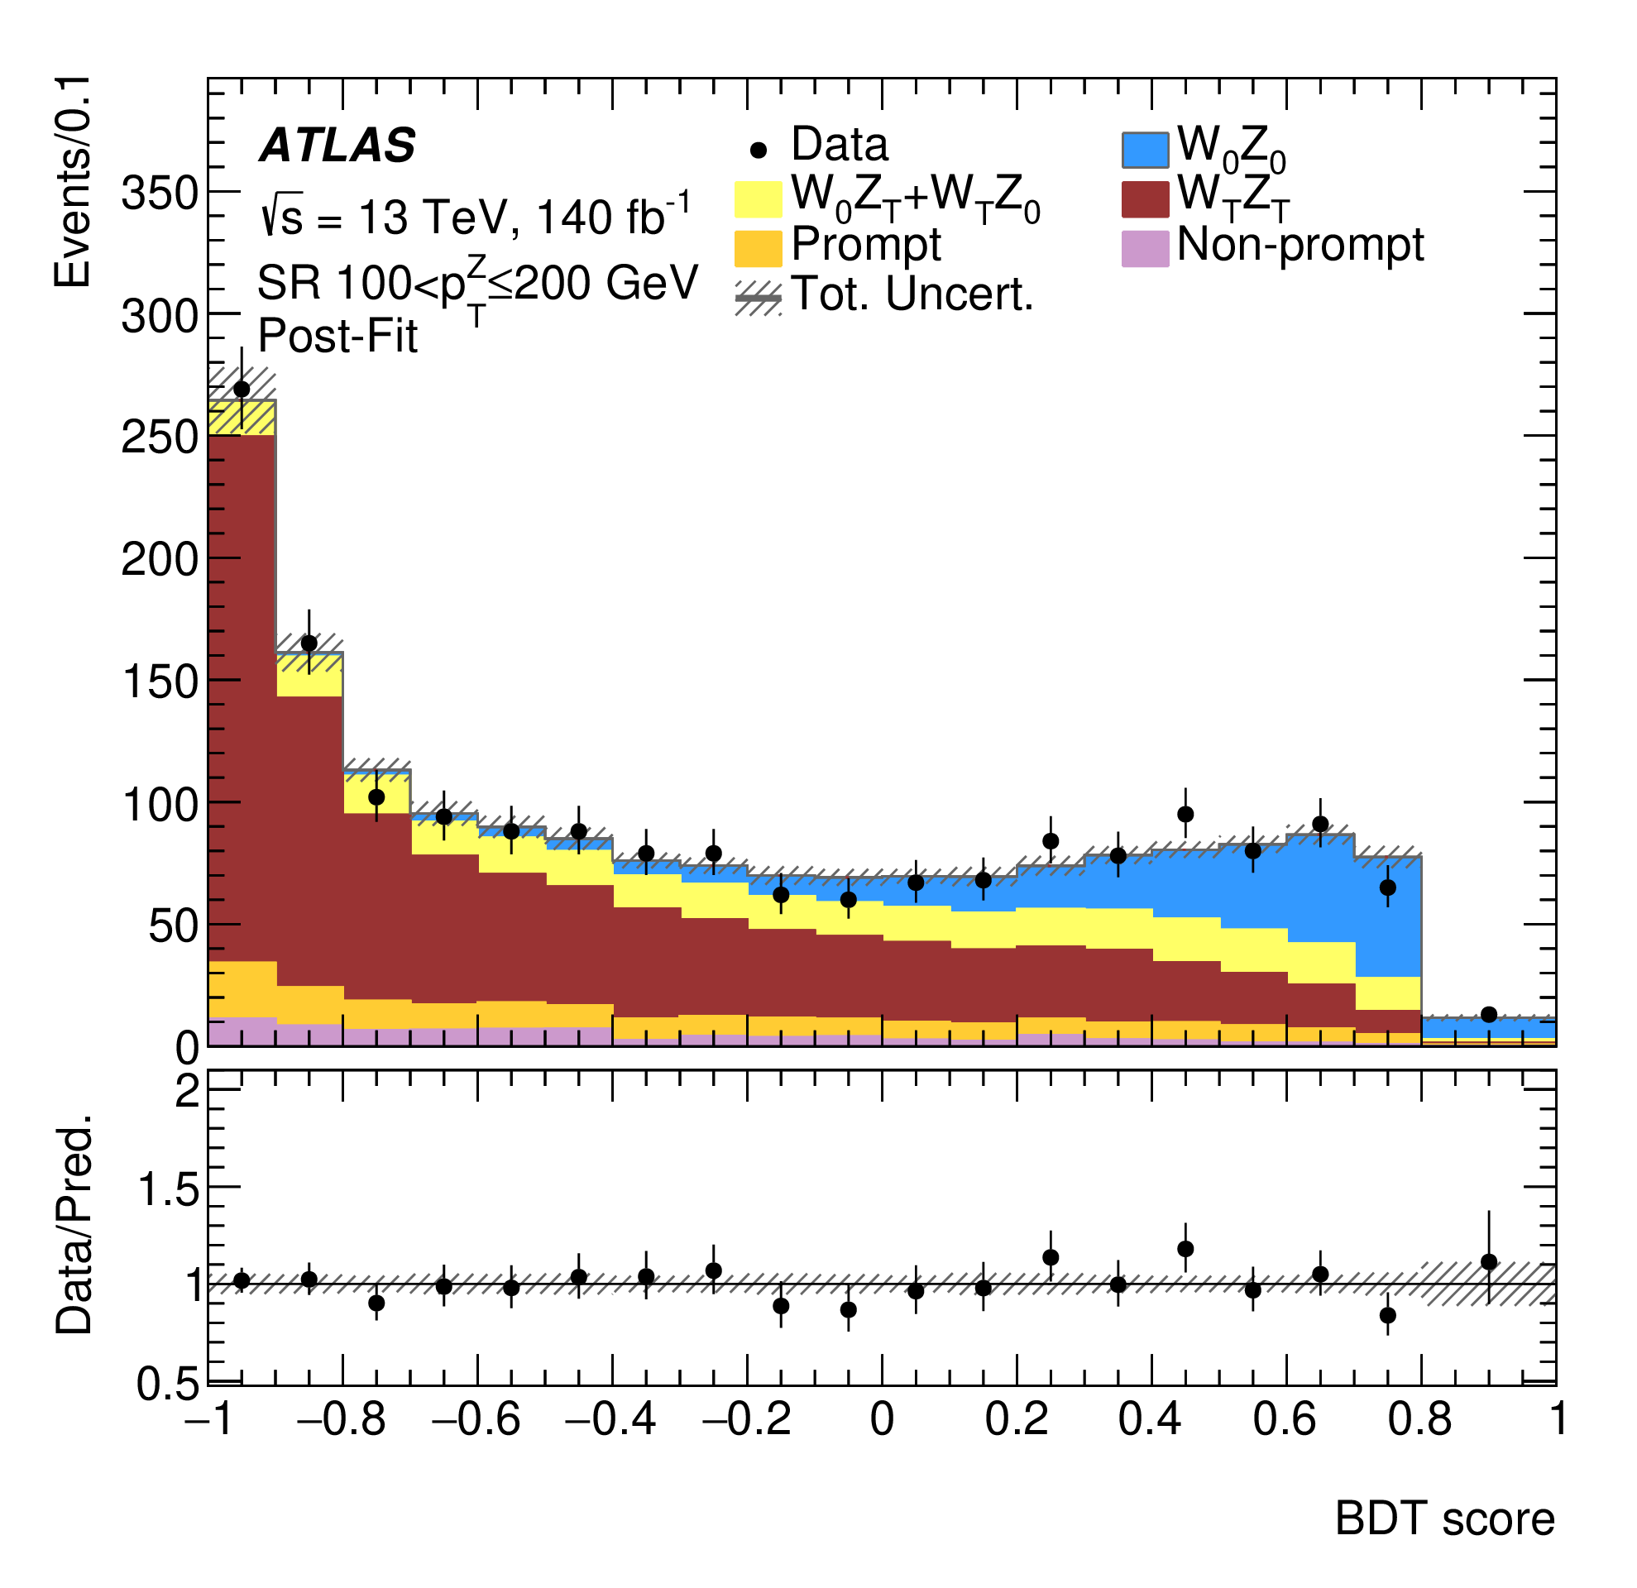
Polarized VV
Look more precisely into SM structures:
helicity-dependent interactions, and goldstone theorem predictions, next-level sensitivity to new physics
arXiv:2402.16365, submitted to PRL
JHEP 12 (2023) 107
A comprehensive study + ML → first evidence on Z_{L}Z_{L} production
A first study of high pT W_{L}Z_{L} production, also RAZ effects

Slide 18
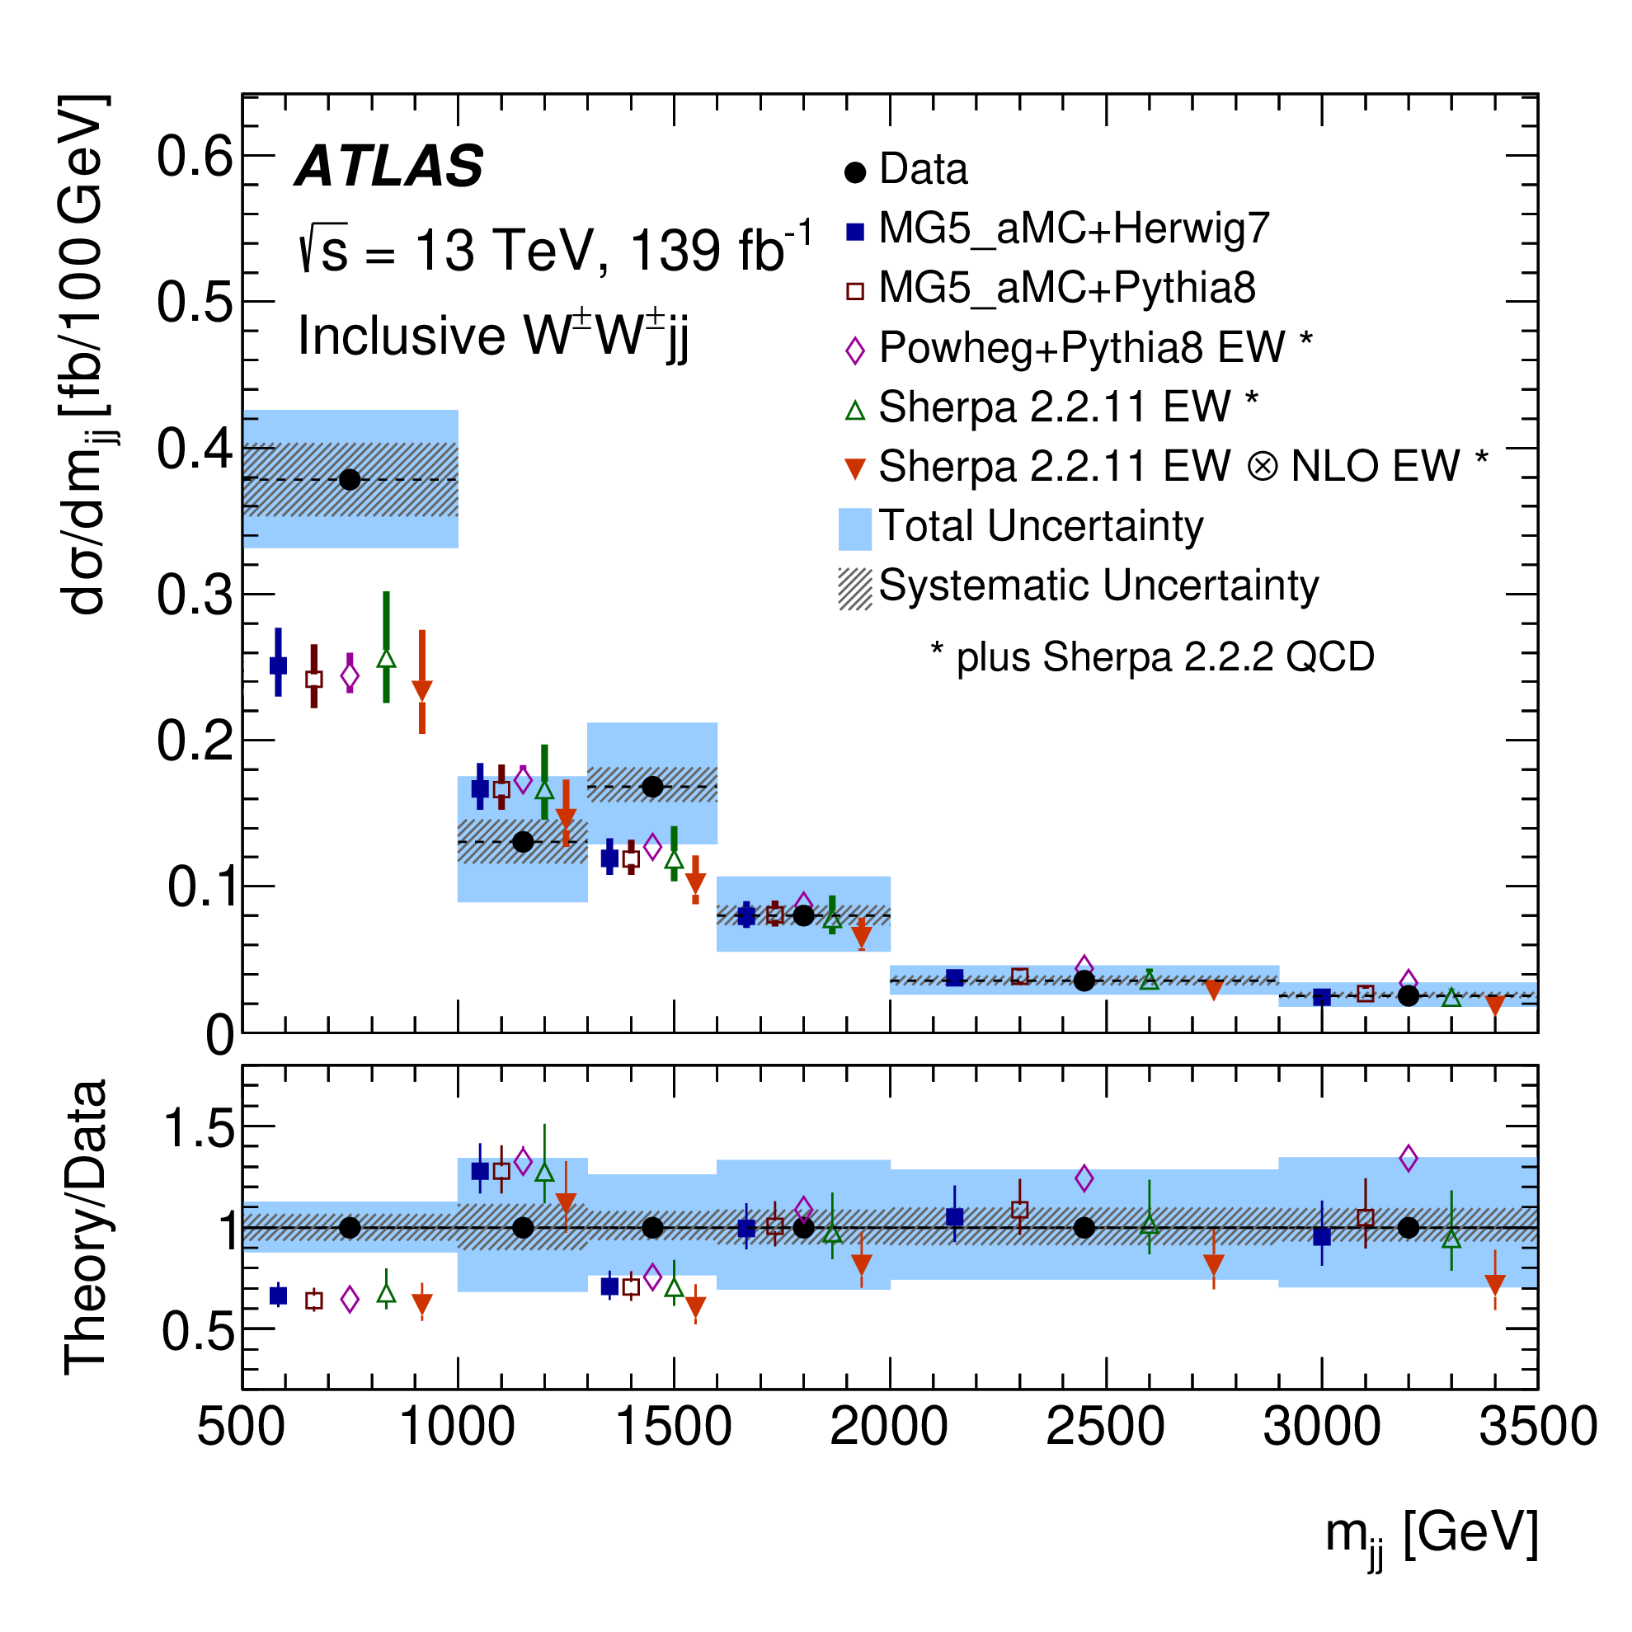
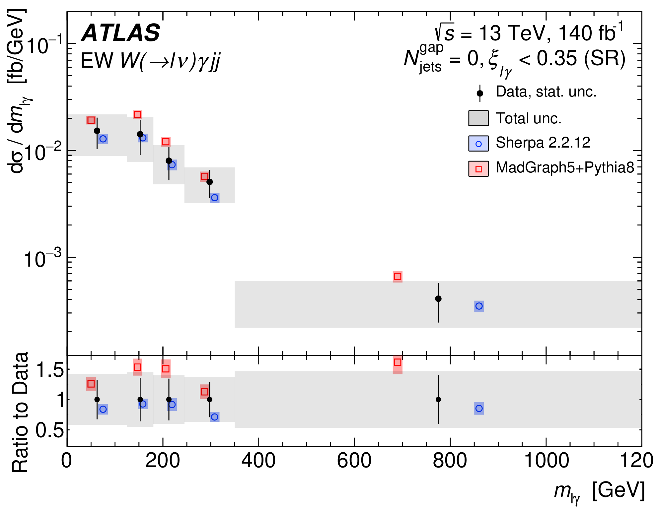
More into rare VBS
Delicate cancellation effects to restore TeV unitarity → sensitive to ESWB, new physics
Beyond the observation phase, we started to pursue further insights with differential
JHEP 04 (2024) 026
arXiv:2403.02809, submitted to EPJC

Slide 19
Entanglement in ttbar
arXiv:2311.07288, submitted to Nature
Full use of final state information to allocate best scenario for maximized entanglement between top quarks
How entanglement could be used
to probe new physics to be thought

Slide 20
Small-mass Resonances
arXiv:2402.15212, submitted to PRL
PRL 131 (2023) 251801
Search for low mass Z’in L_{μ}-L_{τ} model with three muons, best sensitivity at low mass
Look precisely into Z→4l+X decays to search for dark photons

Slide 21
Into Anomalous Detector Signatures
ATLAS-CONF-2023-044
arXiv:2403.15332, submitted to PRL
Search for massive, charged, long-lived particle using dE/dx and TOF information
Displaced vertices to search for long-lived small mass resonances (light scalar, ALPs)
cτ in x-axis

Slide 22
New Adventure Started
arXiv:2311.09715, submitted to PLB
First result with 13.6 TeV pp collision data!
More to expect …

Slide 23
This is a short story to give some (biased) ideas about recent results from ATLAS
We made quite some progress to expand the exploration into next level
Which has been guaranteed by both precision in experimental apparatus and theoretical advances (not covered here)
We desire for even more outstanding insights, stay connected and tuned for Run2+Run3 data analyses and HL-LHC, and beyond!
Collaborations with theorists warmly welcomed (crucial to expand the territories with common interests)!

Slide 24
Thanks!

