Slide 1
Electroweak Corrections for $H→Zγ$ decay
陈龙斌
arXiv:2404.****
广州大学
2024/4/14
In collaborations with Zi-Qiang Chen, Cong-Feng Qiao and Ruilin Zhu

Slide 2
Motivation

Slide 3
The agreement with the SM predictions for production modes and decay channels
CMS Collaboration Nature 607(2022)60

Slide 4
ATLAS Collaboration Nature 607(2022)52

Slide 5
Higgs boson Rare decay

Slide 6
ATLAS and CMS results
Branching Ratios:
$$(3.4±1.1)×{10}^{−3}$$
Signal strength $μ=2.2±0.7$
Observed significance 3.4 $σ$
ATLAS and CMS Phys. Rev. Lett. 132 (2024) 021803

Slide 7
$H→Zγ$ is sensitive to some BSM models

Slide 8
The branching ratios and the relative uncertainty for a SM Higgs boson with $m_{h}$= 125GeV.
The main uncertainty is from missing high order electroweak corrections
PDG 2023

Slide 9
Motivation for EW corrections
Matthew D. Schwartz, Quantum Field Theory and the Standard Model

Slide 10
Calculation

Slide 11
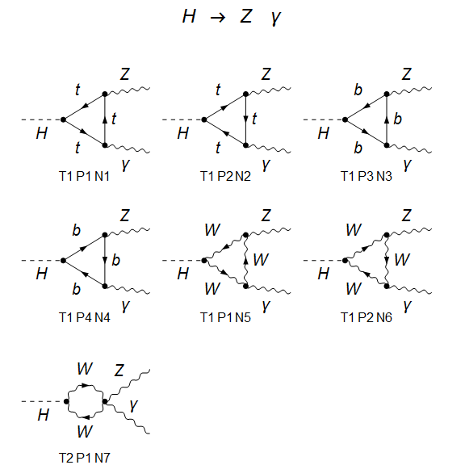
Leading Order:

Slide 12
NLO QCD Corrections
QCD Corrections:
Numerical : M. Spira, A. Djouadi and P. M. Zerwas, Phys. Lett. B 276 (1992) 350.
Analytic calculation: [arXiv:1505.00561], [arXiv:1505.00567]
NLO QCD corrections are only about 0.22% of the LO predictions

Slide 13
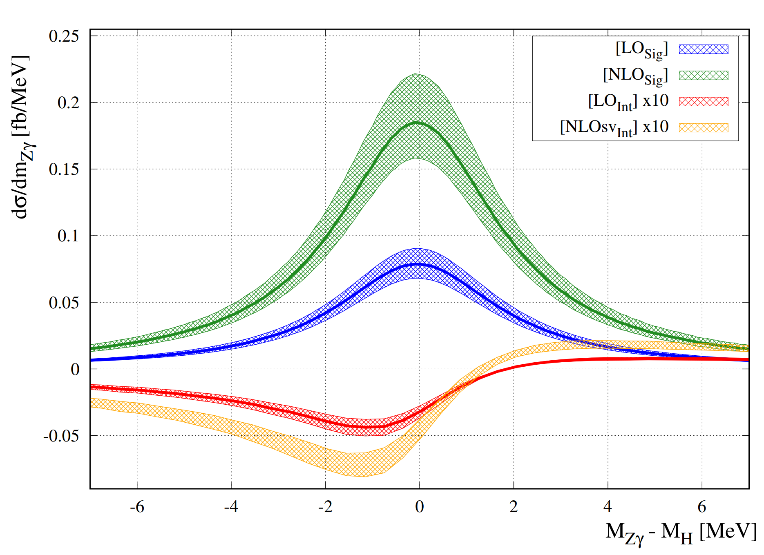
Signal background interference effects arXiv:2312.12384
The effects are small and negative!

Slide 14
Progress in Electroweak Corrections Calculation
0809.3667（H to rr,H to gg, NLO EW）
2311.16963(Di-higgs production NLO EW corrections) see Huan-Yu Bi’s Talk
2209.14953(Z+H production at CEPC )
Our work:

Slide 15
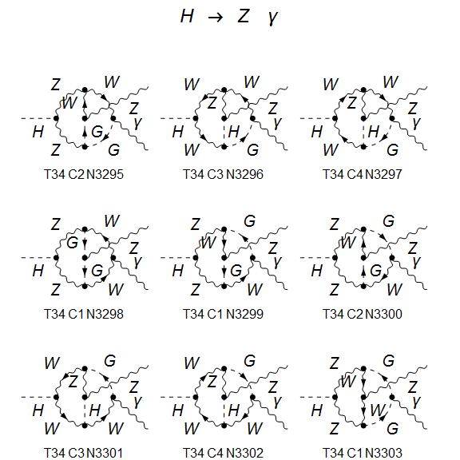
Two-loop Feynman Diagrams for H Z$γ$ (about 5000)
Two-loop diagrams produced by FeynArts

Slide 16
Calculation
Diagrams and Amplitudes: Feynarts & FeynCalc.
Integrals Reduction: FIRE, Kira and Blade.
Master Integrals Calculation: AMFLOW.
The Amplitudes contain only 1/$ε$ divergences.

Slide 17
Renormalization scheme

Slide 18
Renormalization
Two EW diagrams are free of infra and collinear divergences.
UV divergence completely removed after renormalization.

Slide 19
Results

Slide 20
Electroweak corrections results:
Uncertainty of NLO EW is below 2%

Slide 22
Branching Ratio

Slide 23
Conclusion
NLO electroweak corrections decrease leading order predictions.
The discrepancy between Experiments and SM theory had been amplified.
New Physics beyond SM? Statistical Fluctuation?
NLO electroweak corrections prefer New Physics.

Slide 24
Thanks!

