Slide 1
Axions in electromagnetodynamics and their detection
Based on JHEP03(2023)088 and Chin.Phys.C 47 (2023)12, 123104
Speaker: 张瑞珈(Rui-jia Zhang)
In collaboration with 李佟(Advisor Tong ,Li) and 代昌杰(Chang-jie Dai)
The Fifth Workshop on Frontiers of Particle Physics, Shenzhen
12-16 April 2024

Slide 2
Outline
Magnetic monopole, axion and their interaction
QEMD and QEMD-axion modified Maxwell equations
Solutions and numerical results
Two different axion searching strategies in framework of QEMD
Haloscope experiment (sub-μeV axion)
Cavity haloscope experiment (~μeV axion)
5. Summary

Slide 3
1. Magnetic monopole, axion and their interaction
$$M_{S}$$
$$M_{L}$$
The existence of monopole
magnetic
monopole
$$\oint{\overset{⃑}{B}·d\overset{⃑}{S}=0}$$
?
e
Ze
e
In 1931, Dirac first proposed the notion of ‘monopole’ in quantum theory.
not necessary, but not absent on theory level
Charge quantization condition:
Generalized by Schwinger and Zwanziger (DSZ quantization condition)
Monopoles at different energy scale:
QCD (Wu, Yang 1975), grand unification theory ('t Hooft, Polyakov 1974), electroweak (Cho, Maison 1997)
Axion
A natural solution to strong CP problem and candidate of cold dark matter.
axion
${U(1)}_{PQ}$ symmetry and dynamical field $a(x,t)$ are introduced to give the anomaly term~
which can remove the CP-violating phase $θ$.
It can be mainly divided into μeV & sub-μeV axion by mass.
PQWW, KSVZ and DFSZ

Slide 4
Axion-monopole interaction
?
axion
A non-zero vacuum angle θ in the CP violating term introduces an electric charge proportional to θ for magnetic monopoles:
magnetic
monopole
monopole → dyon
(Witten, 1979)
In axion theories, Witten effect implies the electromagnetic interactions between axions and magnetic monopoles due to the axion-photon coupling $g_{aγγ}$ .
arXiv: 2312.01355
The connection between axion and monopole was first derived under the semi-classical quantization of electromagnetism, which gives the classical axion-monopole scattering cross section:
(Fischler et al, 1983)
The proper approach to quantize the axion-dyon dynamics needs to utilize the quantum electromagnetodynamics (QEMD) (Schiwinger 1966, Zwanziger 1968)
Recently, a generic axion-photon Lagrangian has been constructed in the framework of low-energy effective field theory. (arXiv: 2205.02605 Sokolov, Ringwald). There exists more anomalous axion-photon couplings $g_{aAA}$, $g_{aBB}$ and $g_{aAB}$ in contrary to the ordinary axion EFT $g_{aγγ}$.
modified EoM
modified axion-Maxwell equations

Slide 5
2. QEMD and QEMD-axion modified Maxwell equations
Electromagnetic symmetry in QEMD
We take such substitution for gauge group:
$U\left(1\right)$ → ${U(1)}_{E}×{U(1)}_{M}$
to describe the coupling of electric charge, magnetic charge and photon.
$A_{μ}$ $B_{μ}$
They have opposite parity
The electromagnetic field strength tensors are introduced in this way:
——Zwanziger QEMD local-Lagrangian
,where $n=(0,\overset{⃑}{n} )$ is an arbitrary fixed spatial vector.
According to the work in arXiv:2205.02605, the anomalous axion-photon coupling can be briefly written by
Witten effect induced
CP violating
CP conserving

Slide 6
QEMD-axion modified Maxwell equations
The conventional axion-Maxwell equations are modified through the above anomalous axion-photon interactions, and given the interactions as well as free Lagrangian, one can derive QEMD axion-Maxwell equations by classical equations of motion:
1. The DSZ quantization condition indicates:
$g_{0}≫e$
$$g_{aAA}≪\left|g_{aAB}\right|≪g_{aBB}$$
2. Assuming
$$E≃|D|≃M$$
$$g_{aAA}/g_{aBB}≃{({e/g}_{0})}^{2}≃{10}^{−4}$$
New Klein-Gordon equation
$${|g}_{aAB}|/g_{aBB}≃{e/g}_{0}≃{10}^{−2}$$
3. The suppression from axion DM velocity
One can calculate the coupling coefficients, they are related to their corresponding anomaly coefficients E, M, D, respectively.
$$\left| \vec{∇}a\right|\sim {10}^{−3}∂a/∂t$$

Slide 7
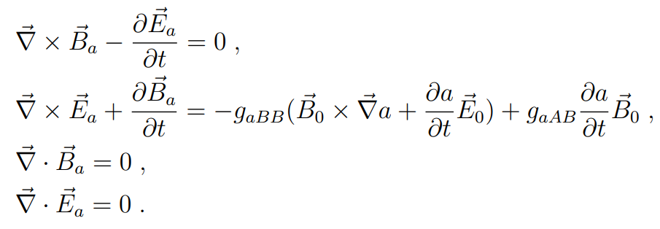
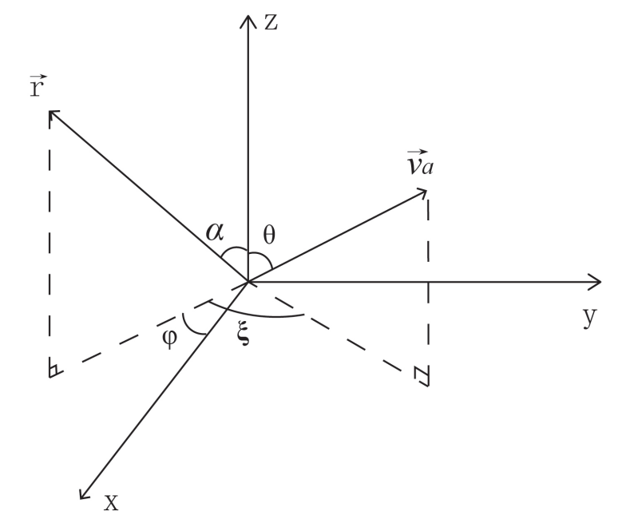
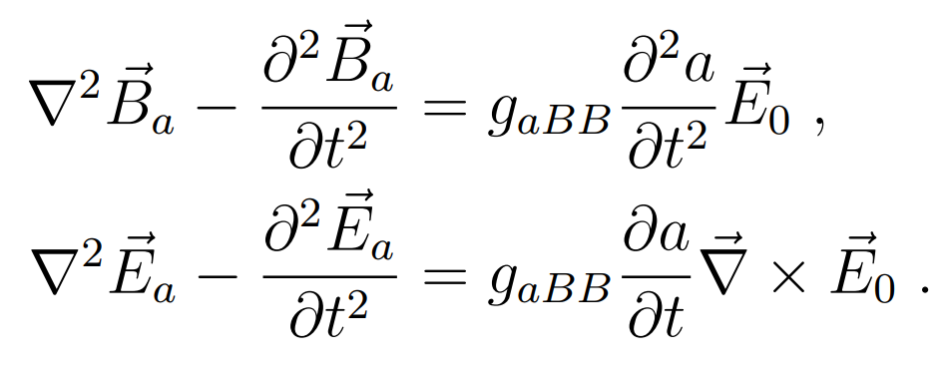
Further simplified QEMD-axion modified Maxwell equations
Some conventions:
with $ω_{a}=m_{a}$ and ${\vec{k}}_{a}=m_{a}{\vec{v}}_{a}$
Besides, we parameterize the direction of axion in spherical coordinates with these angles:
Case I: For ordinary haloscope experiments, they adopt a non-zero magnetic field $B_{0}≠0$ but vanishing electric field $E_{0}=0$.
Case II: Electric field $E_{0}≠0$ but vanishing magnetic field $B_{0}=0$.

Slide 8
3. Solutions and numerical results
(arXiv: 1809.10709 Ouellet, Bogorad)
Solutions in the static external magnetic/electric field.
Case I: $B_{0}≠0$, $E_{0}=0$.
Case II: $E_{0}≠0$, $B_{0}=0$.
Assuming a static magnetic field $B_{0}$ along the $\hat{z}$ direction generated by a long solenoid with radius R.
Similarly, a static electric field $E_{0}$ along $\hat{z}$ direction can be obtained by a pair of parallel plates with radius R.
The field solutions of case II are analogous to the results of $E_{a,φ}$ and $B_{a,z}$ in case I, only differing by the substitution of $g_{aAB}B_{0}$→ $−g_{aBB}E_{0}$.
Considering the limit of large Compton wavelengths $λ_{a}=\frac{2π}{ω_{a}}≫R$ and thus $ρ^{′}=ω_{a}R≪1$

Slide 9
Case I: $B_{0}≠0$, $E_{0}=0$.
Case II: $E_{0}≠0$, $B_{0}=0$.
$g_{aAB}B_{0}$→ $−g_{aBB}E_{0}$
$B_{0}$ → to measure $g_{aAB}$
* The solutions of other components $E_{a,z}$, $B_{a,φ}$, $B_{a,ρ}\sim g_{aBB}$ are all suppressed by axion DM velocity $v\sim {10}^{−3}$, thus they are not considered.
$E_{0}$ → to measure $g_{aBB}$
The dominant solutions $E_{a,φ}$ and $B_{a,z}$ are no velocity suppression and equivalent to the solutions of arXiv: 1809.10709 only by replacing $E_{a,φ}→B_{a,φ}$, $B_{a,z}→{−E}_{a,z}$in our results.

Slide 10
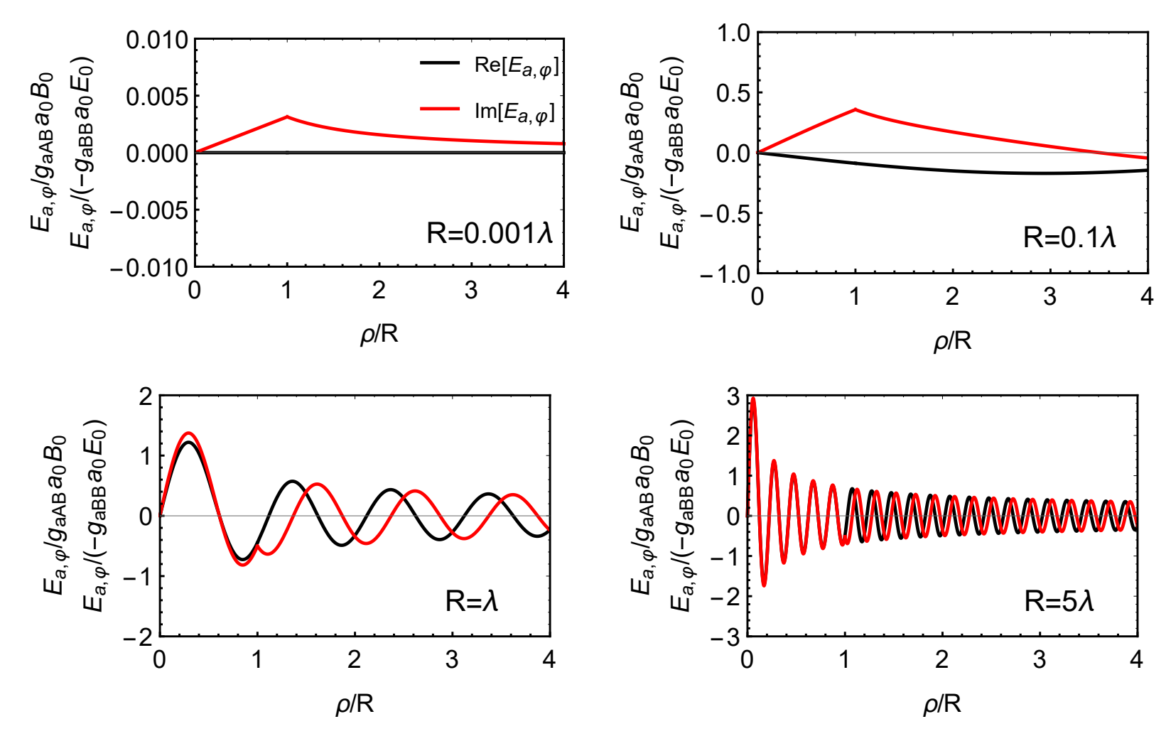
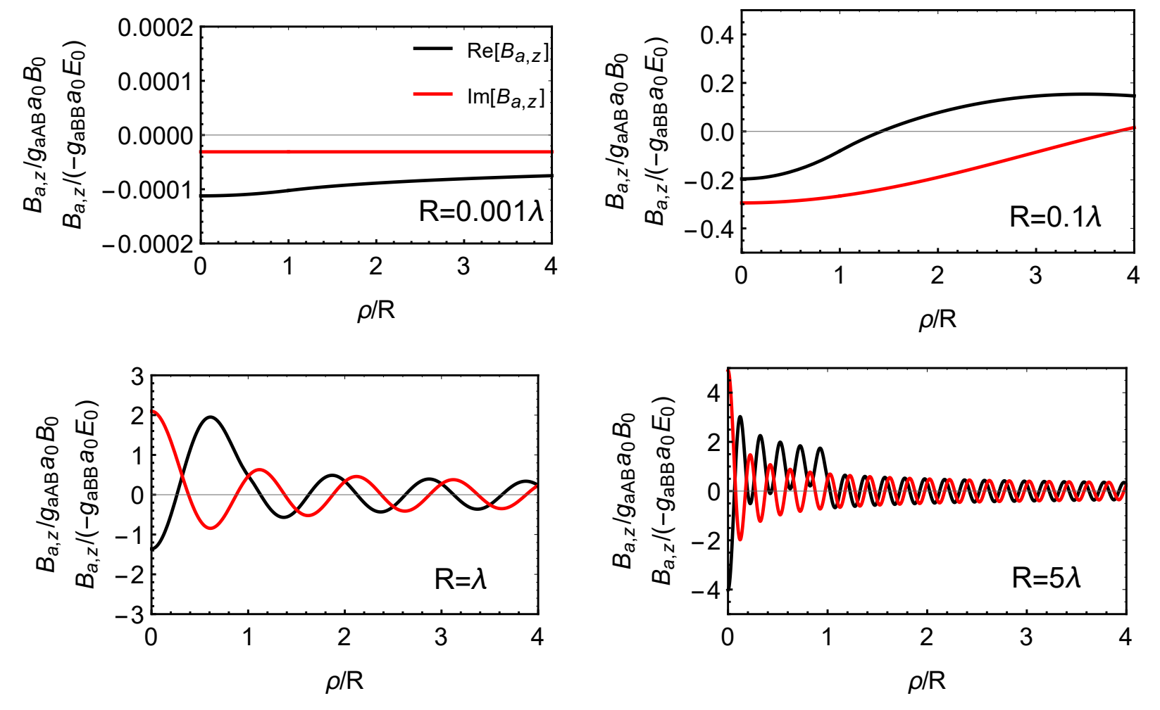
Numerical results of axion-induced electromagnetic fields

Slide 11
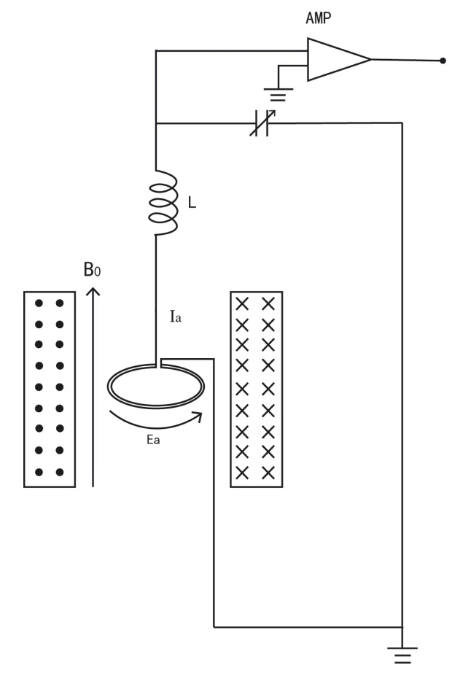
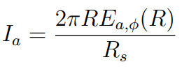
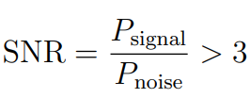
4. Two different axion searching strategies in framework of QEMD
Beside directly amplifying the signal current, one can also adopt SQUID magnetometer.
Haloscope experiment (sub-μeV axion) JHEP03(2023)088
The induction current in wire loop is:
The total noise can be divided into two parts: thermal noise $T_{c}$ from circuit and the input white noise $T_{Amp}$ from amplifiers.
( $g_{aAB}B_{0}$→ $g_{aBB}E_{0}$)
(arXiv: 2206.13543 Duan, Gao et al)
To measure $g_{aBB}$, the solenoid can be replaced by horizontally placed parallel plates.
Sensitivity criterion
Experimental setup

Slide 12
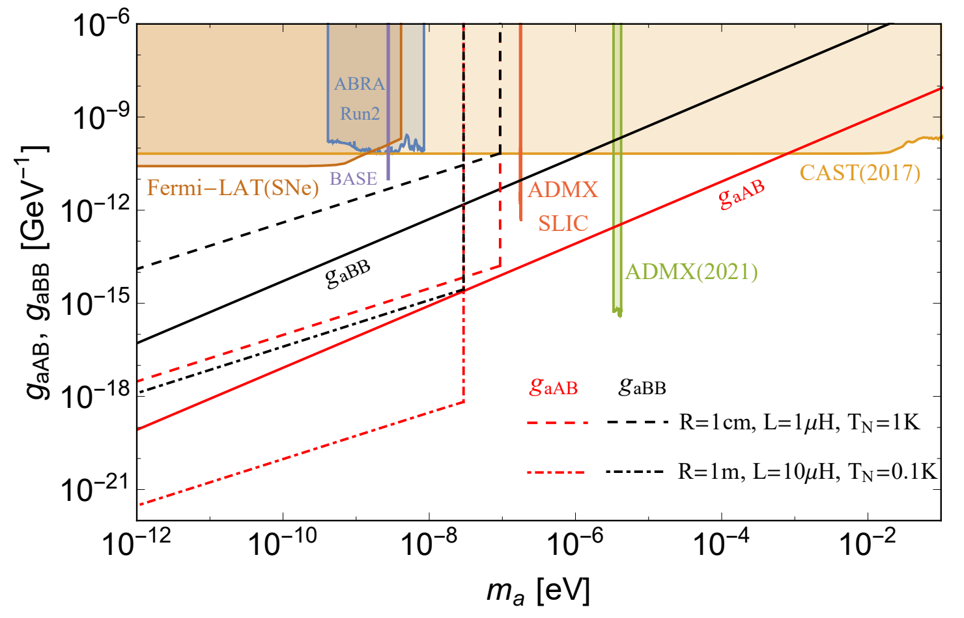
New strategies to sub-μeV axion detection
Expected sensitivity bounds
The conventional axion detection:
$B_{0}→B_{a}$ to search $g_{aγ}$
New strategies to sub-μeV axion detection:
$B_{0}→E_{a,φ}$ to search $g_{aAB}$
$E_{0}→E_{a,φ}$ to search $g_{aBB}$

Slide 13
4. Two different axion searching strategies in framework of QEMD
b) Cavity haloscope experiment (~μeV axion) Chin.Phys.C 47 (2023) 12, 123104
Suppose an external magnetic field ${\vec{B}}_{0}$ along the z direction
In QEMD, the axion induced fields $\vec{B}$and $\vec{E}$ can occur simultaneously due to the presence of three couplings.
Traditional axion-QED

Slide 14
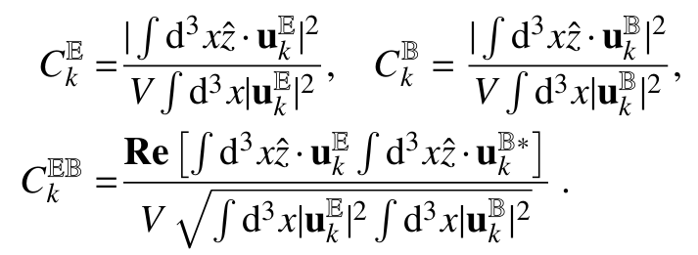
|0>→|1> photon transition matrix element and the transition probability inside the cavity under an external magnetic field. Up to the first order, we have
Q. Yang, Y. Gao, and Z. Peng 2201.08291
an enhancement of the conversion rate through the resonant cavity in axion haloscope experiments.
Finally, the transition rate in the cavity can be obtained as
TE/TM mode

Slide 15
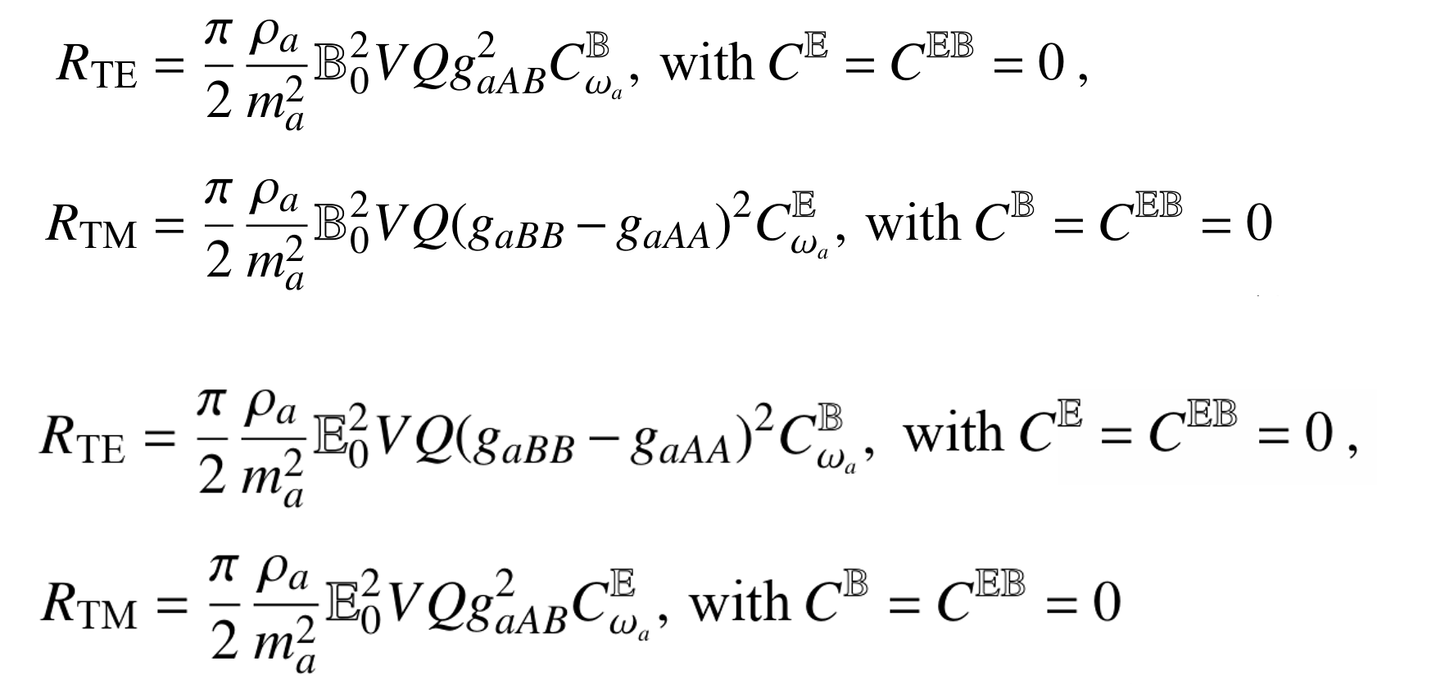
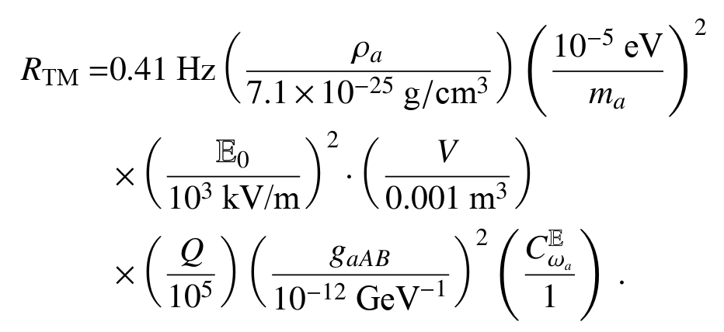
Transition rate in different external fields
External magnetic field
$$𝔹_{0}$$
External electric field
$$𝔼_{0}$$

Slide 16
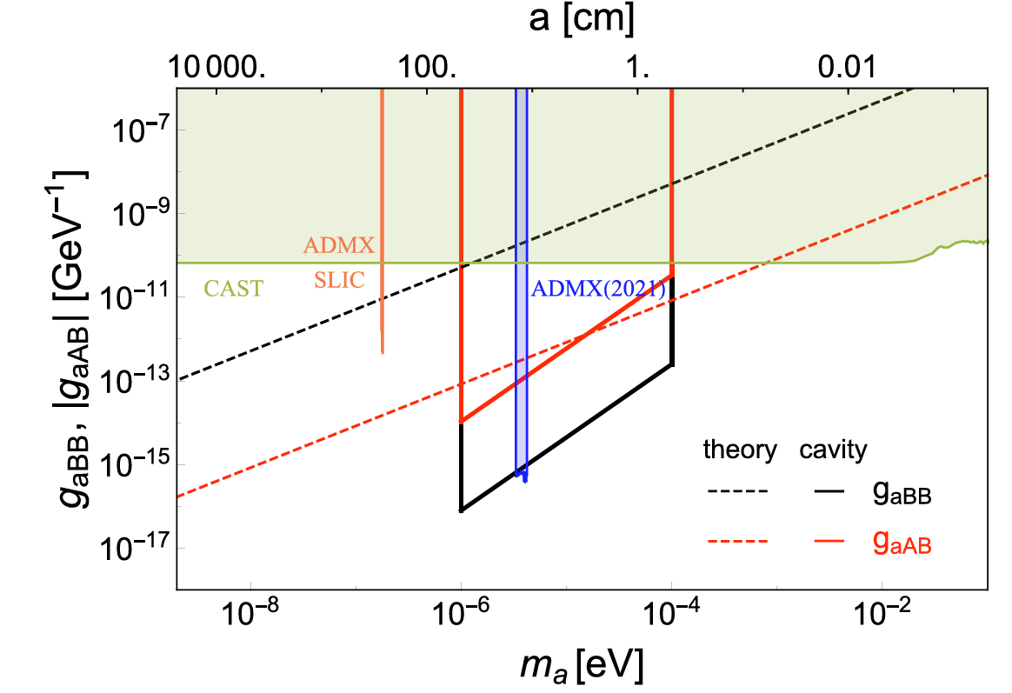
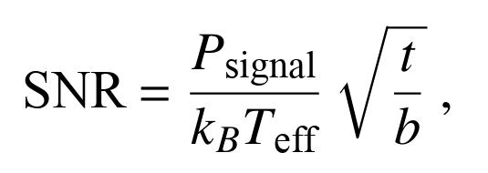
Strategies to ~μeV axion detection
Expected sensitivity bounds
External magnetic field
$$𝔹_{0}$$
$$g_{aBB}$$
replacement
$$𝔼_{0}$$
$$g_{aAB}$$
External electric field
The corresponding sensitivity bounds are given by the experimental configuration of the cavity and the form factor $C_{010}^{E}$in the TM mode for QEMD axion couplings.

Slide 17
5. Summary
Quantum electromagnetodynamics (QEMD) gives anomalous axion-photon coefficients and interactions in a low-energy EFT.
Such interaction provides new axion Maxwell equations which involve effective magnetic current. The solutions imply the induced oscillating magnetic fields are always suppressed compared with electric field.
New strategies are proposed to measure the axion-induced electric fields for sub-μeV axion in haloscope experiments.
In cavity haloscope, we find that an external magnetic field can be set to measure the ${(g}_{aBB}−g_{aAA})≈$ $g_{aBB}$ coupling or an external electric field to measure the $g_{aAB}$ coupling.
Thank you!

