Slide 1
LHAASO观测和相关新物理研究
毕效军
中国科学院高能物理研究所
第五届粒子物理前沿研讨会
中山大学（深圳），2024.4.12-15

Slide 2
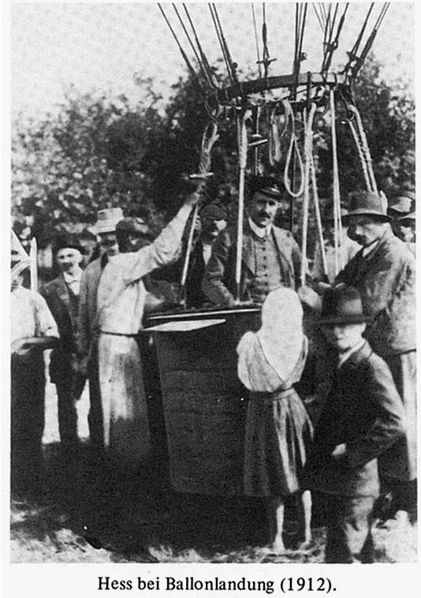
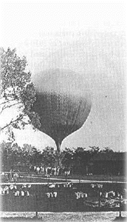
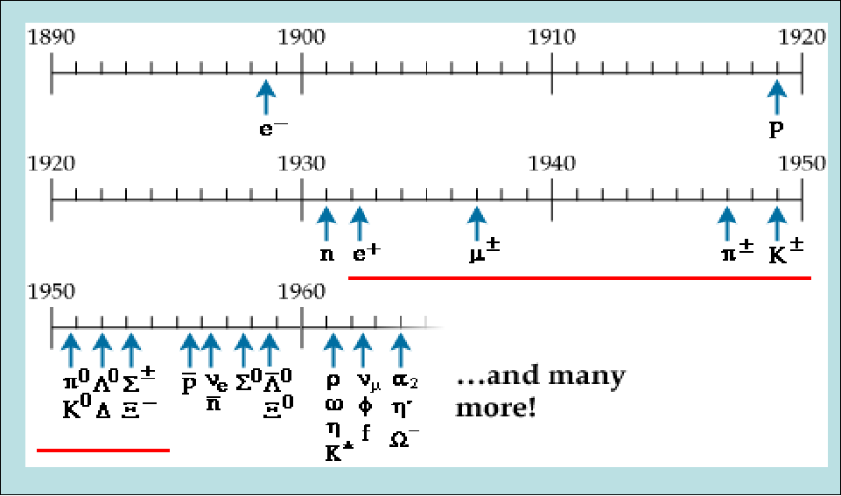
Historical review
Cosmic rays were discovered by V. Hess in 1912 by a balloon experiment
From 1930s to 1950s, cosmic rays observation derives the particle physics development.
Positron, muon, pion were
all revolutionary progresses on
human being understanding
of the world.

Slide 3
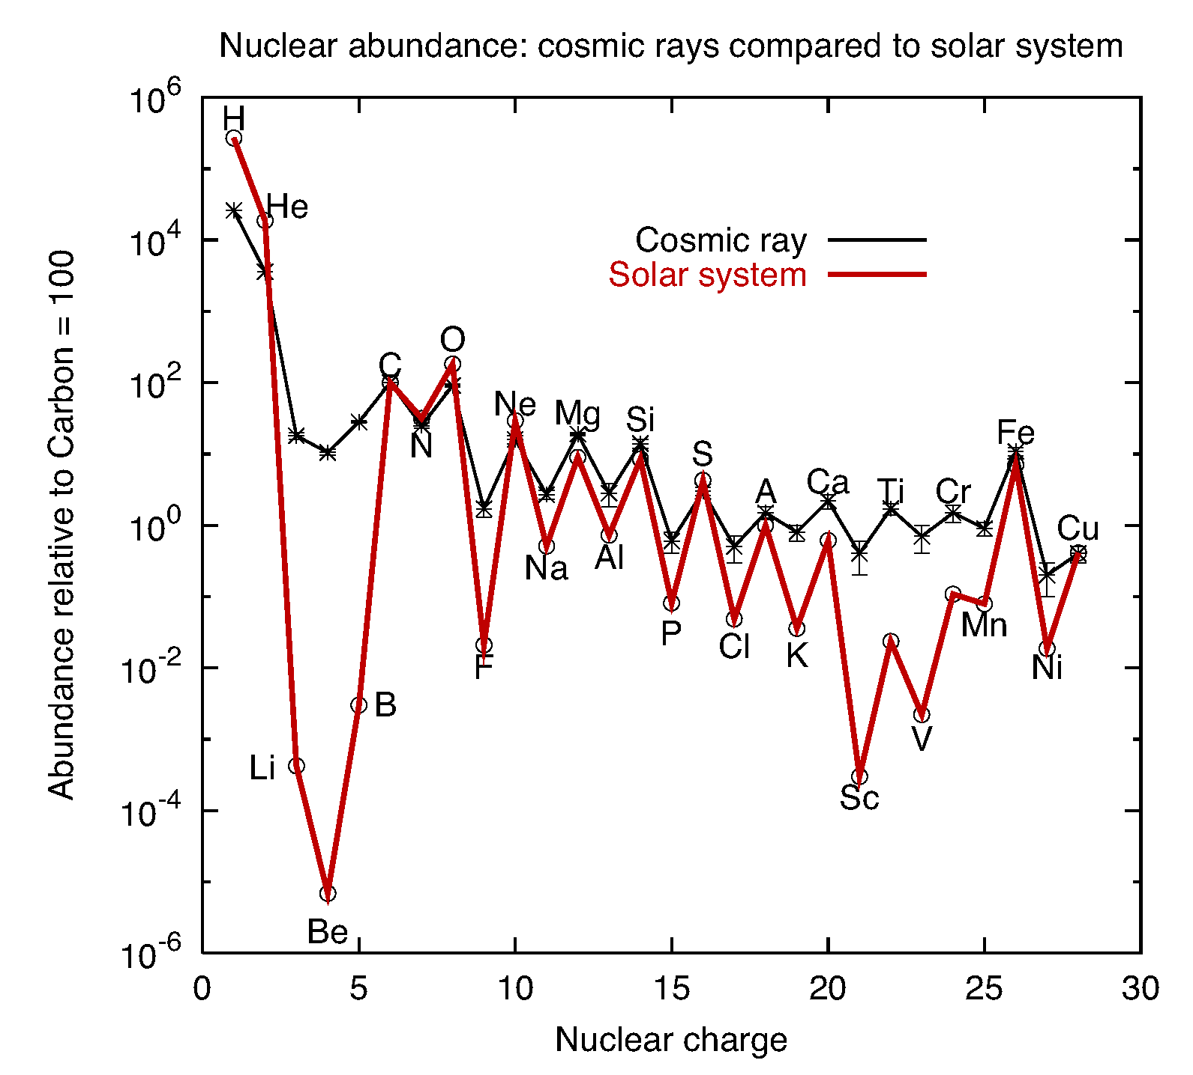
宇宙线科学
寻找暗物质
把宇宙线加速到极高能的机制
发现洛伦兹破坏等
发现新物理
寻找宇宙线加速源
极端条件下物理（极高能、高密、强引力等）
天文学
宇宙线中包含地球上发现的几乎所有元素
3

Slide 4
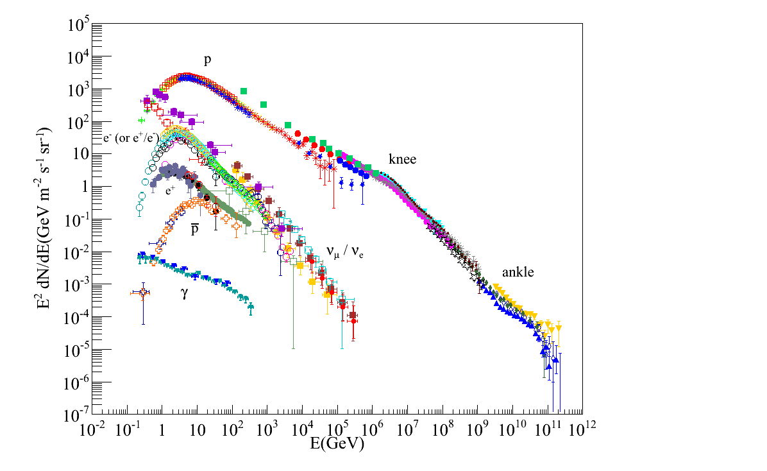
宇宙线实验
流强
宇宙线实验分空间实验和地面实验
  空间实验探测能量低（流量高）
  能够区分不同粒子种类
  磁谱仪可以区分正反粒子
  地面实验探测能量高（面积大）
  难以区分不同种类的粒子（大气簇射）
LHAASO面积大、粒子鉴别能力强
空间实验
$$E^{2}\frac{dN}{dE}$$
高海拔地面实验
膝
(PeV~光年)
10²⁰eV
踝
(EeV~千光年)
LHC
能量

Slide 5
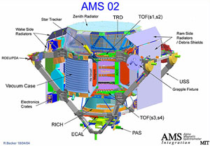
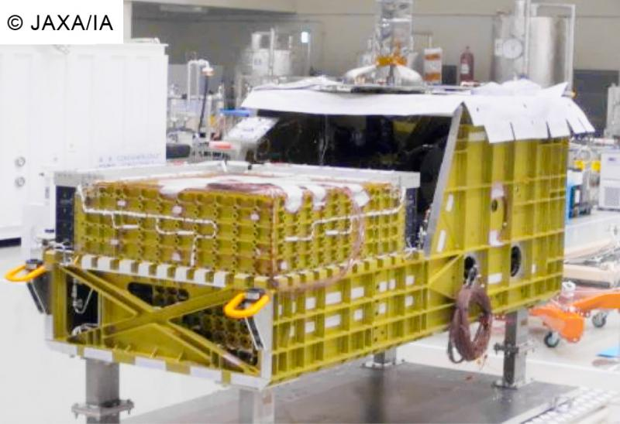
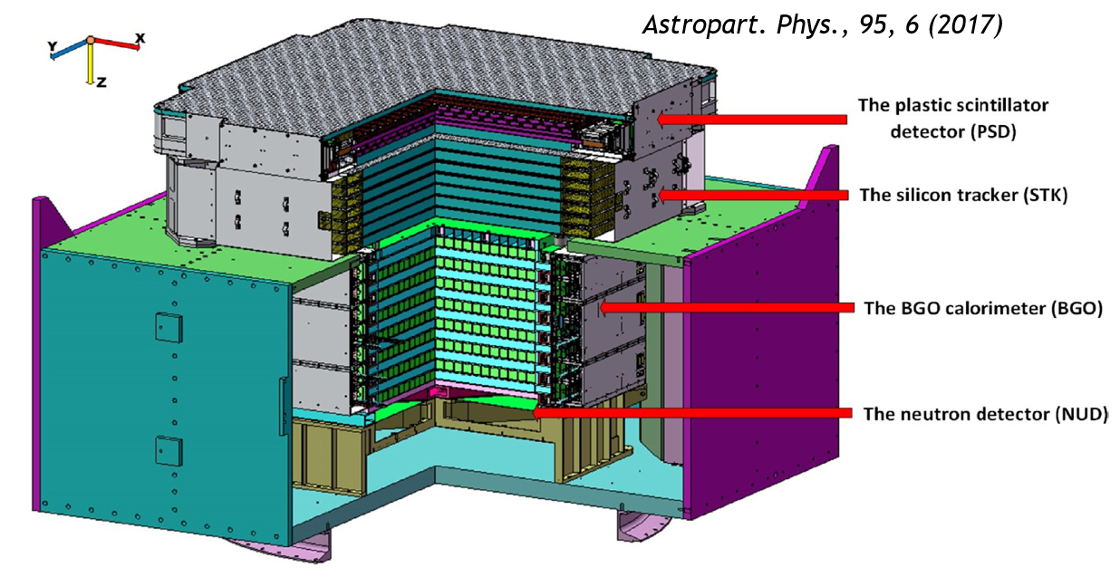
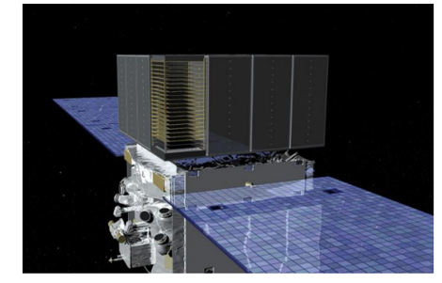
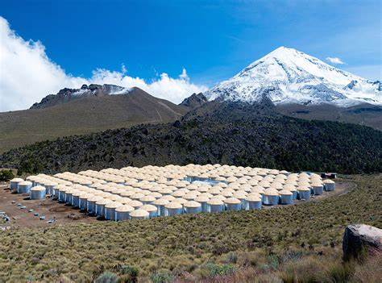
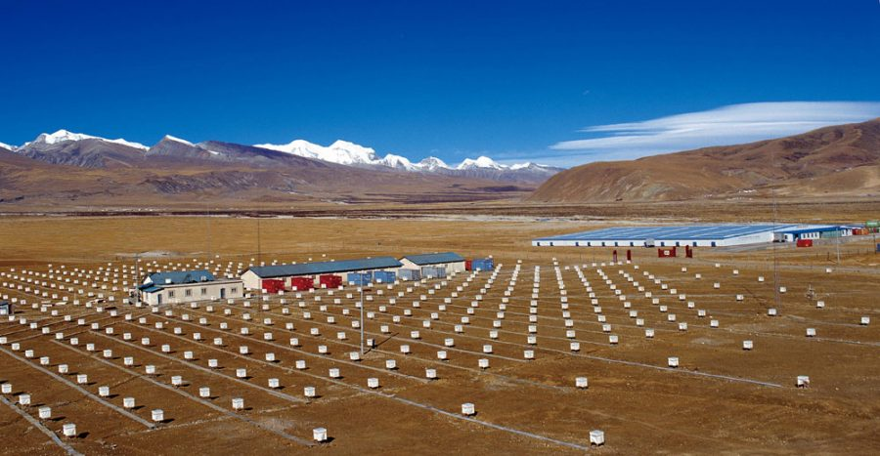
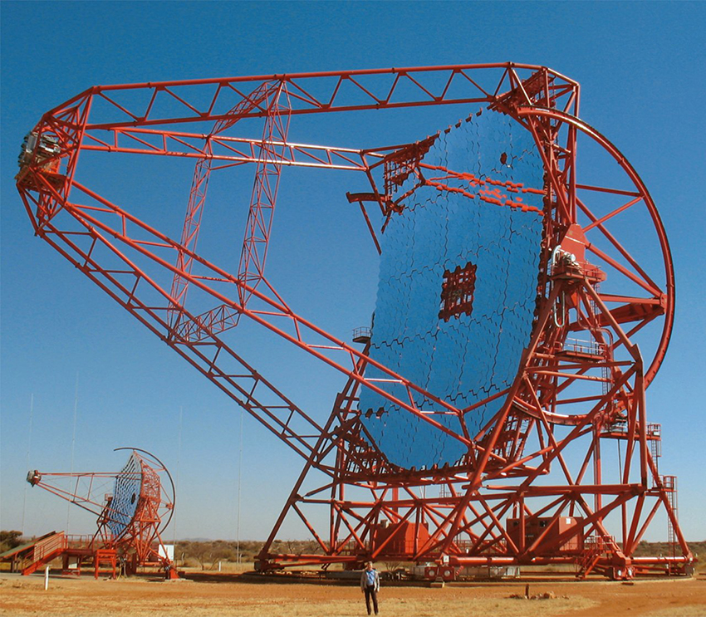
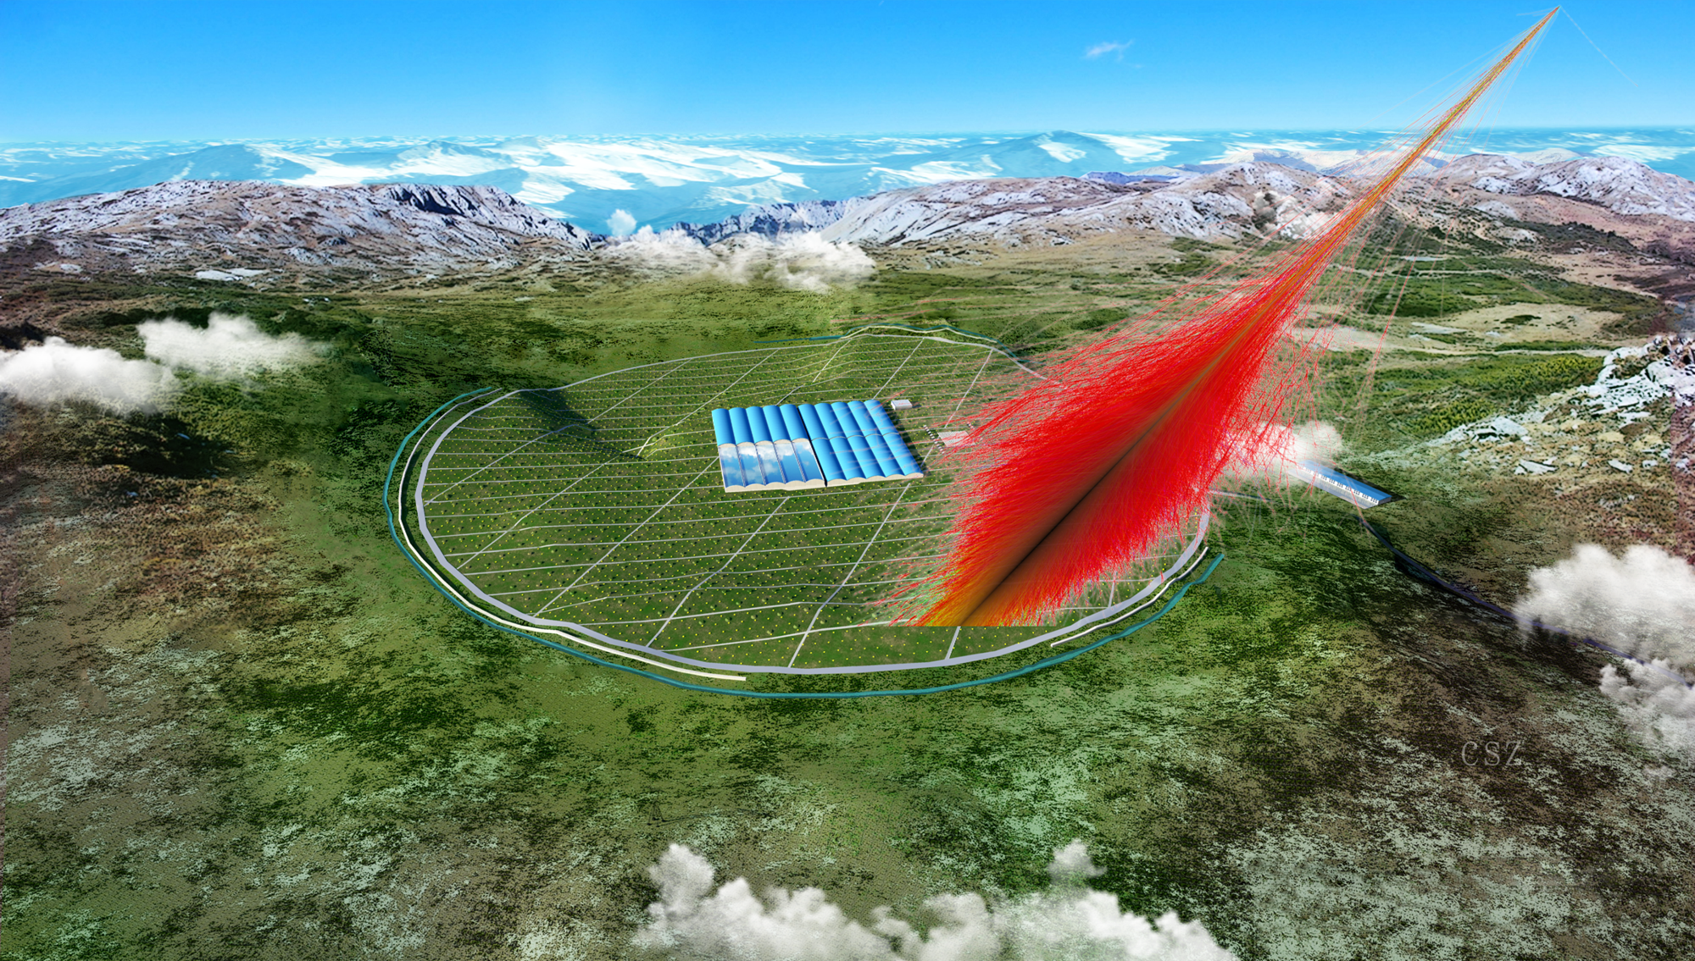
Recent/ongoing experiments
Fermi AMS-02 CALET DAMPE
HAWC 羊八井 HESS/MAGIC/VERITAS LHAASO
5

Slide 6
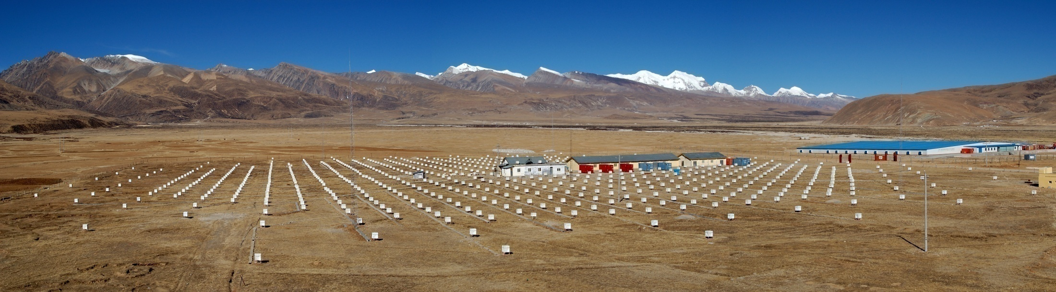
正是广延大气簇射提供给我们另一种探测宇宙线的手段——测量
宇宙线和大气相互作用产生的次级粒子，即所谓间接探测。
西藏羊八井宇宙线观测站就是利用广延大气簇射对宇宙线进行探测。
中日ASγ探测阵列
中意ARGO实验大厅

Slide 7
LHAASO: Large High Altitude Air Shower Observatory
高海拔宇宙线观测站
2008年4月开始R&D
2015年12月正式立项
2017年5月开工建设
2018年3月首批33个ED运行
2019年1月开始71ED+10MD运行
2019年建成1/4阵列
2021年完成全阵列建设
四川省稻城县海子山,海拔4410米

Slide 8
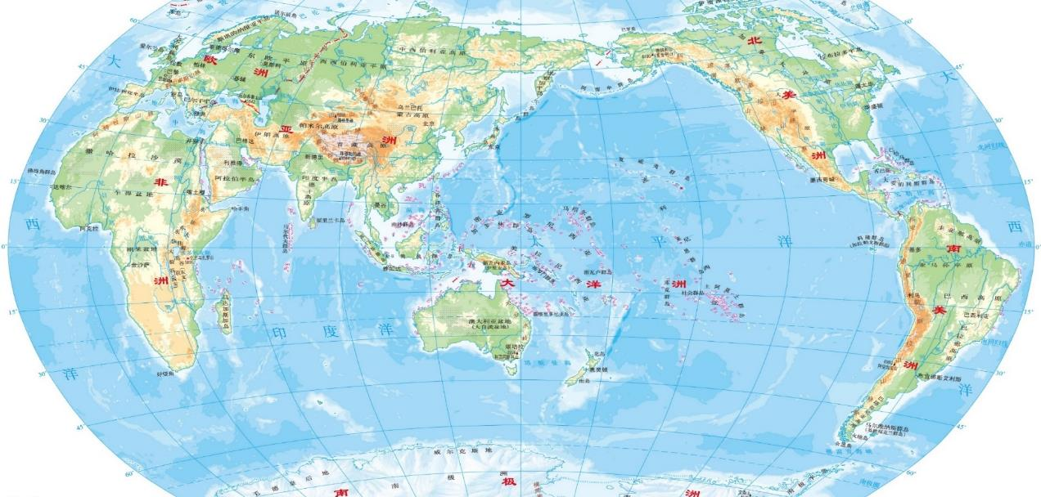
Where is LHAASO?
Haizi Mountain 4410 m a.s.l. , Sichuan province, China
Location：29º21’27.6” N, 100º08’19.6” E.
LHAASO

Slide 9
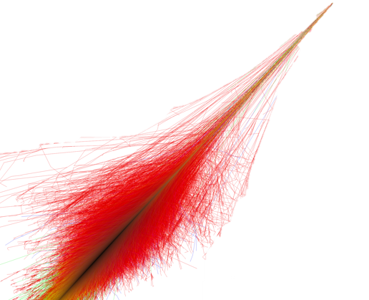
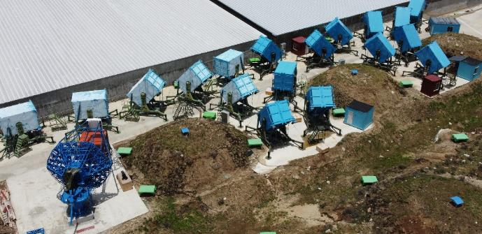
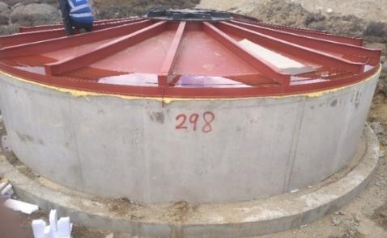
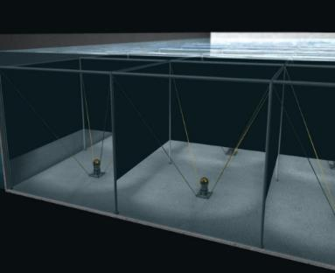
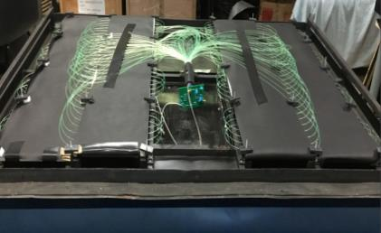
LHAASO detectors
KM2A
Cosmic-ray/γ
7m
WFCTA
18x4.7m²
MD: 1188x36m²
1.2m
5m
WCDA
ED: 5216x1m²
1.3 km²
3120x25m²

Slide 10
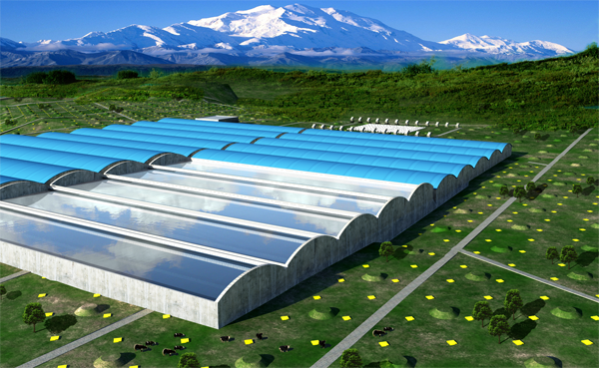
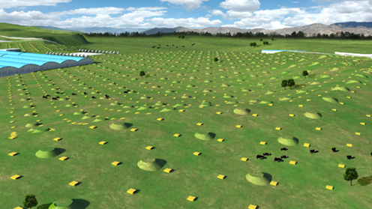
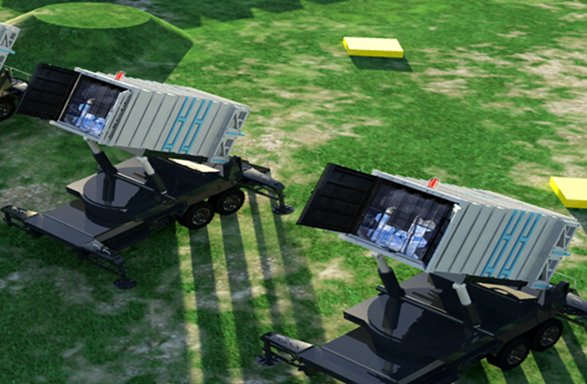
3 sub-arrays cover 3 regions
WCDA (100 GeV-30 TeV)
  VHE gamma-ray astronomy
KM2A (10 TeV-10 PeV)
  UHE gamma-ray astronomy
WFCTA (10TeV to 1 EeV)
  Combined with WCDA, and KM2A
  Individual Cosmic ray nuclei spectra

Slide 11
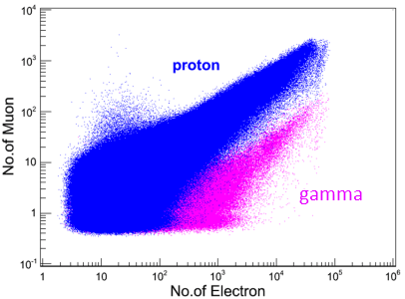
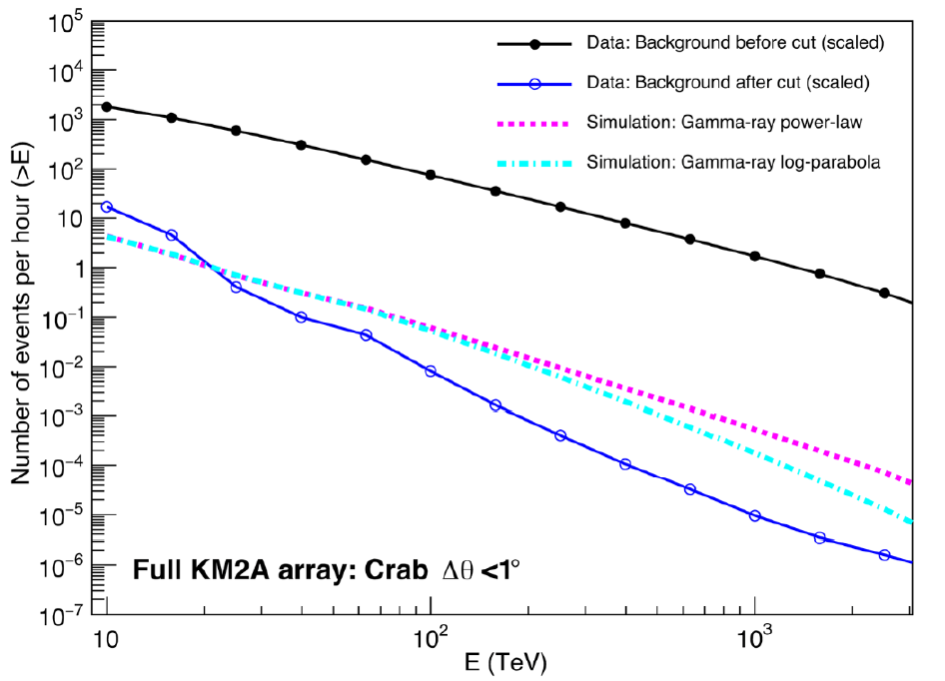
Gamma-ray/cosmic ray discrimination
Before cut: CR rate
10⁻⁵
Gamma-ray rate
After cut: CR rate

Slide 12
LHAASO主要科学目标
水切伦科夫探测器阵列（WCDA）
78,000平方米
TeV伽马巡天 → WCDA (100 GeV-30 TeV)
  活动星系核、伽玛暴、双星…
>20 TeV 伽马巡天→KM2A (10TeV-1PeV)
  超新星遗迹、脉冲星风云、 …
宇宙线能谱→WFCTA (10TeV to EeV)
  联合WCDA和KM2A测量宇宙线成分能谱
其它方向:
  新物理（暗物质、洛伦兹破缺）、太阳物理、粒子物理 …
平方公里阵列（KM2A）
5195 块闪烁体探测器
1171地下μ子探测器
广角大气切伦科夫/大气荧光望远镜（WFCTA）12台

Slide 13
Nature文章
源表的文章
Crab文章
Diffuse gamma
GRB的工作
LIV
DM
Halo的工作

Slide 14
1 First view of the UHE universe

Slide 15
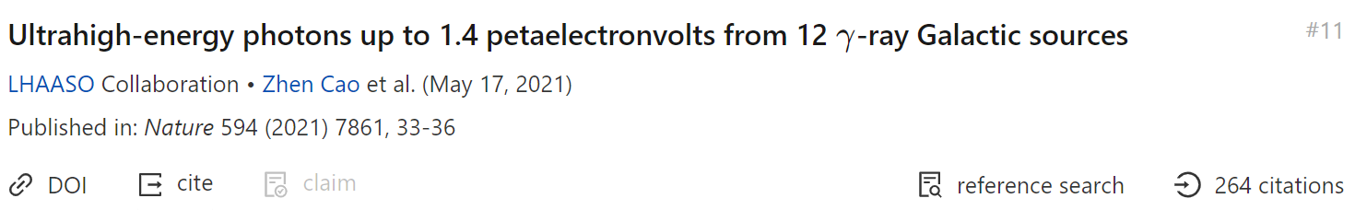
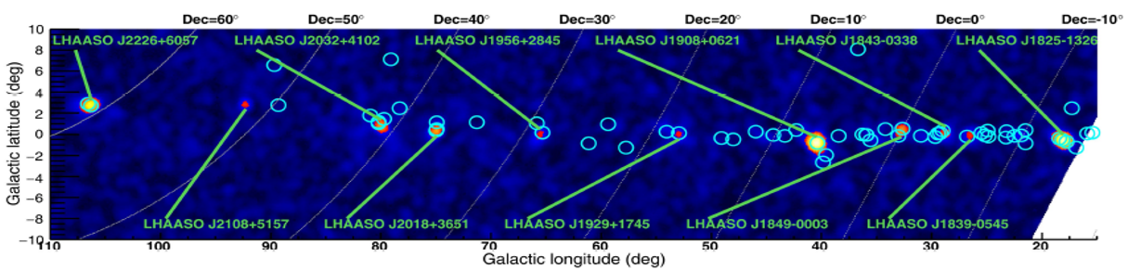
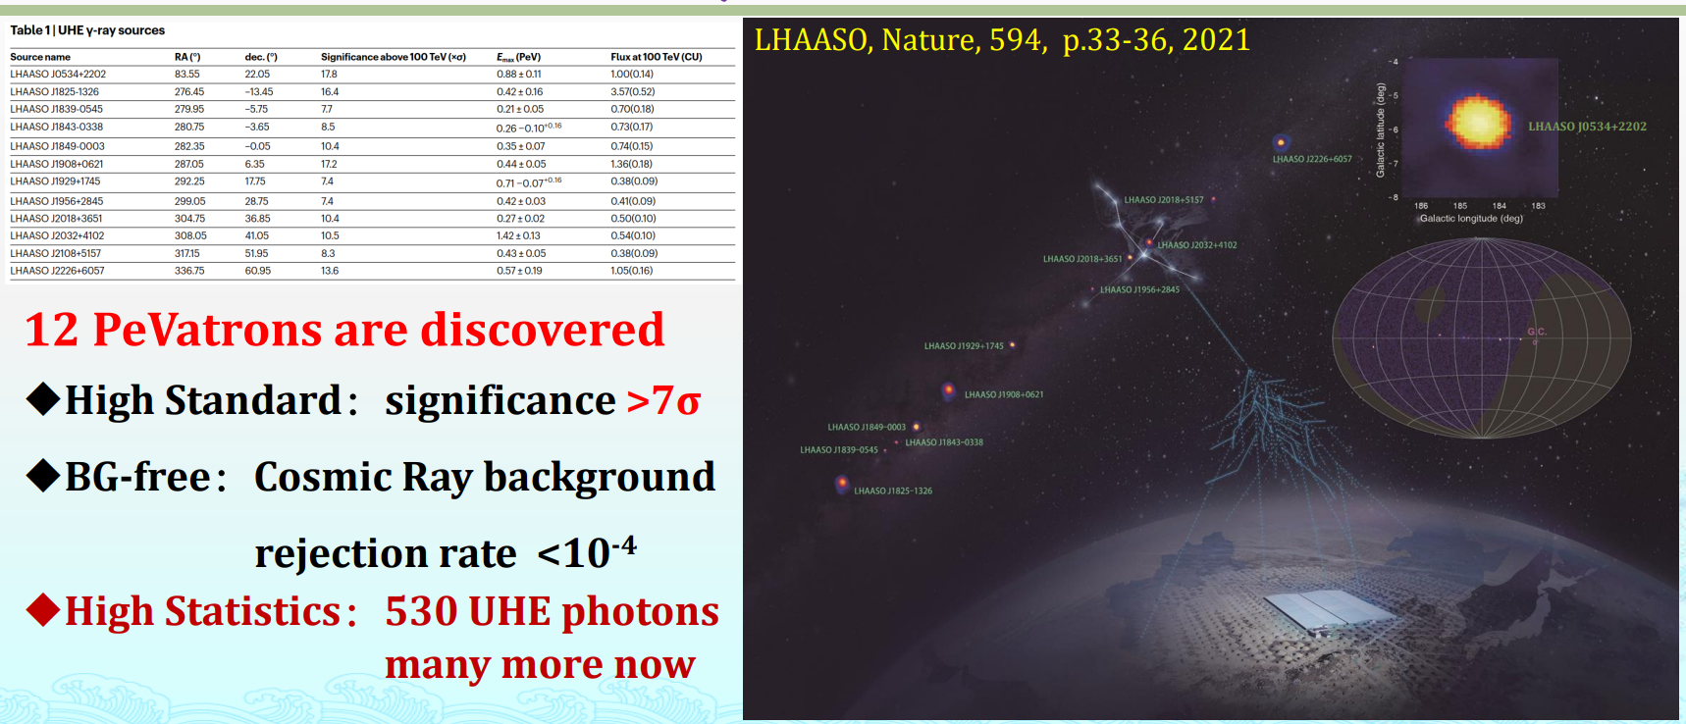
LHAASO最新成果
打开伽马射线探测新的能量窗口
首次测量到拍电子伏的伽马射线

Slide 16
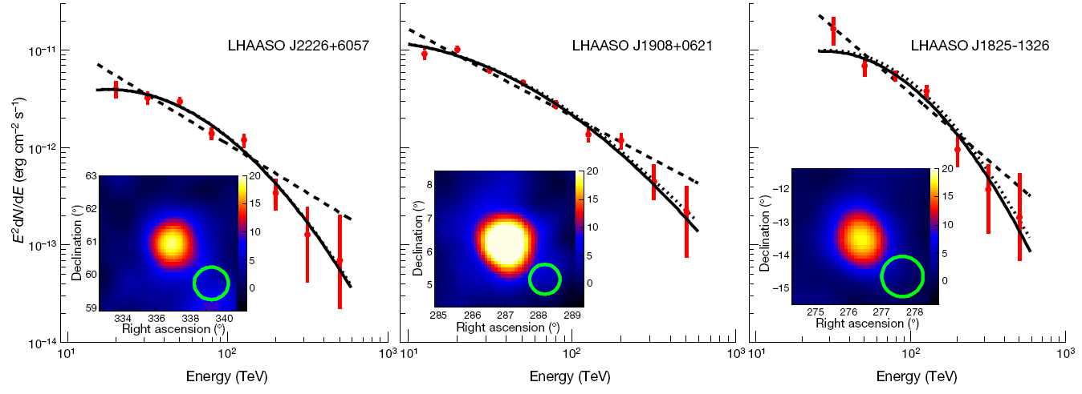
Reveal PeV particle accelerators
No clear cut-off for the three brightest UHE source
LHAASO coll. 2021 (Nature 594:33-36)

Slide 17
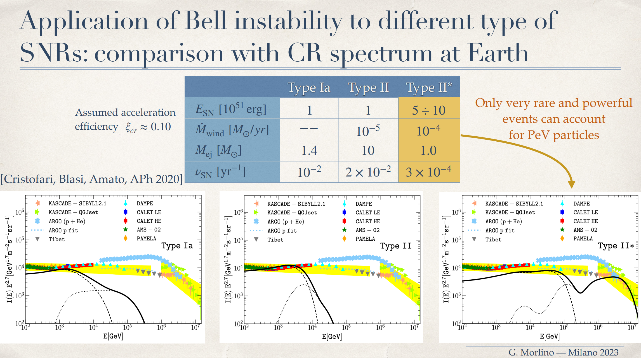

Slide 18
2 LHAASO Catalog of new VHE/UHE sources

Slide 19
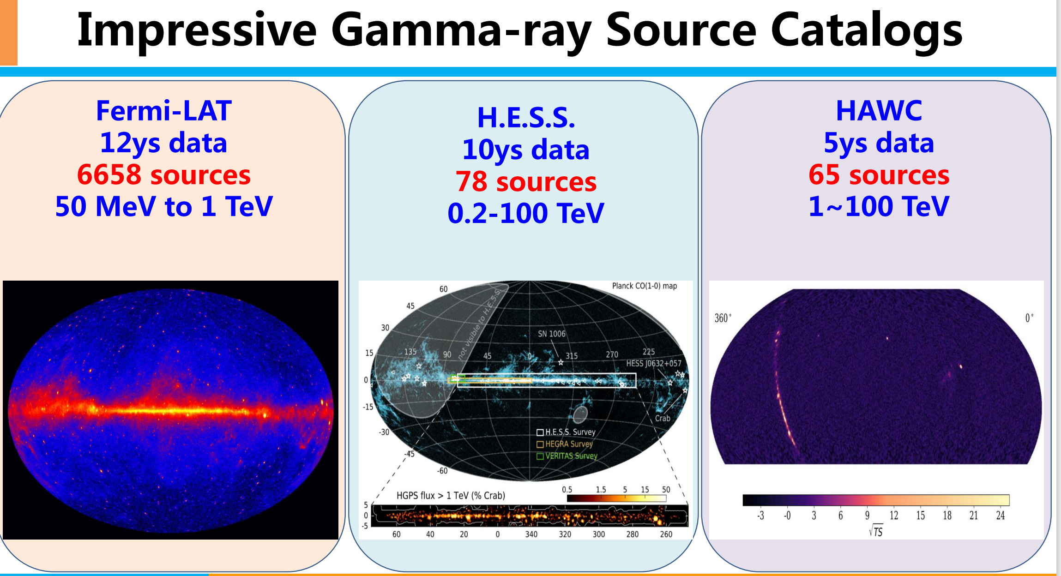

Slide 20
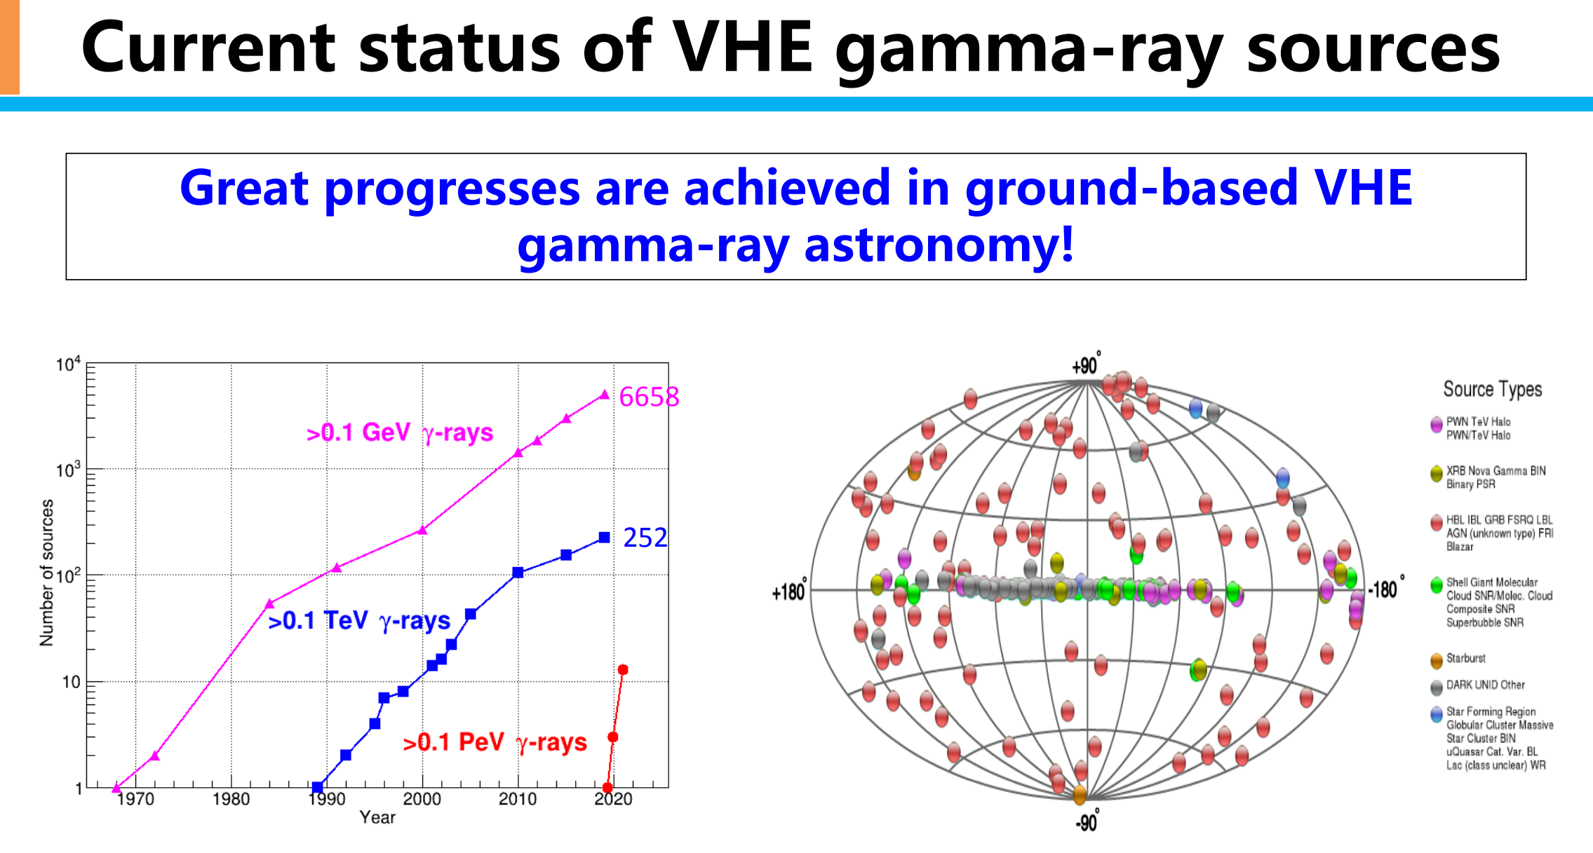

Slide 21
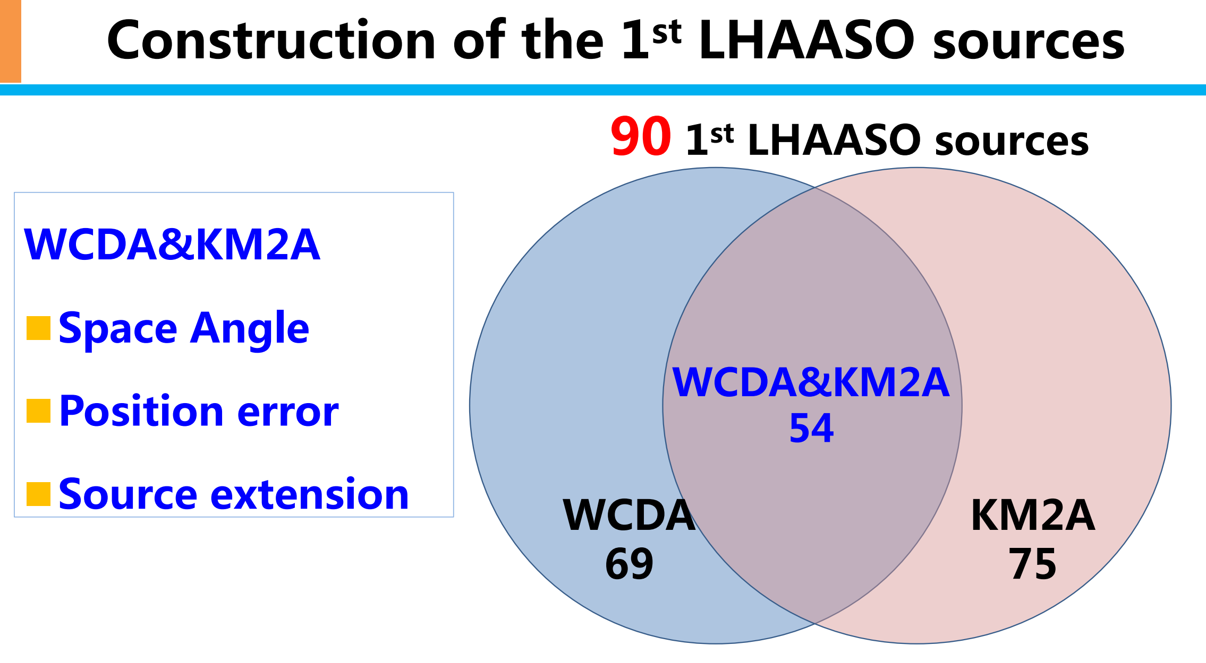

Slide 22
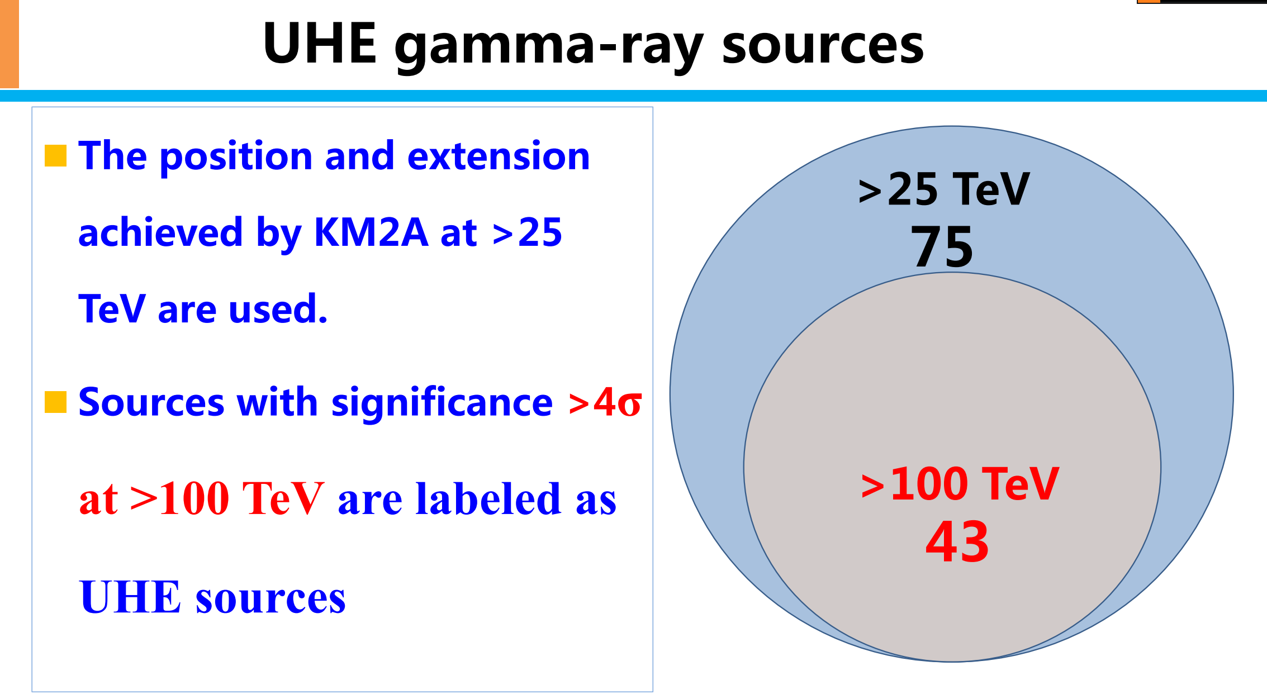

Slide 23
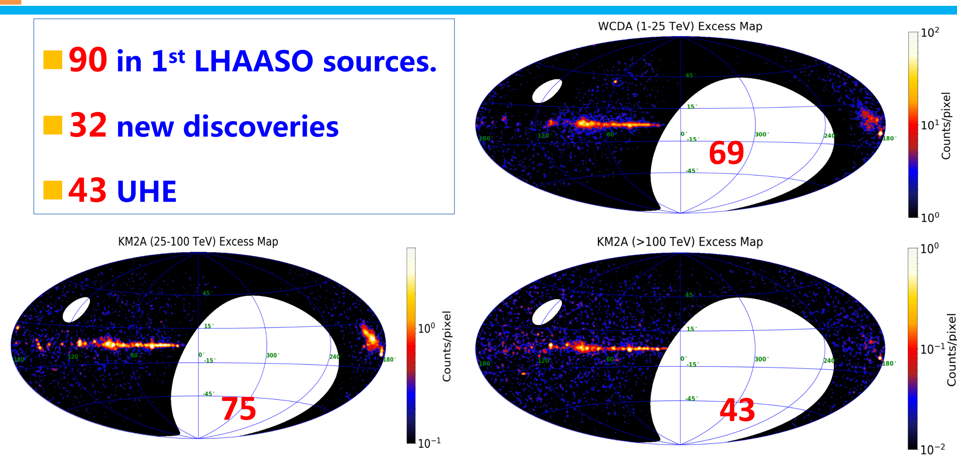

Slide 24
3 Innovative measurement of the standard candle Crab Nebula

Slide 25


Reveal an extreme e-accelerator
0.3-1.1 PeV measured for the first time.
Maximum photon energy 1.12±0.09 PeV→ primary electron energy 2.3 PeV
LHAASO coll. 2021 (Science 373:425-430)

Slide 26
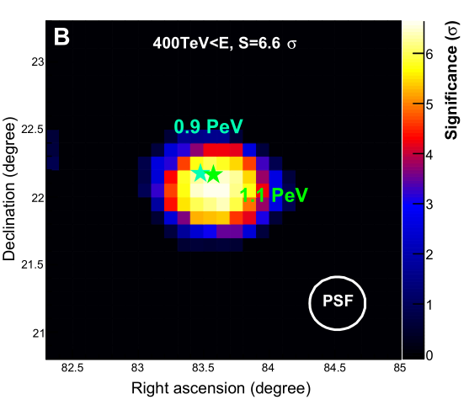

New knowledge of the acceleration rate
η<1 according to classical electrodynamics and ideal MHD
Acceleration rate η≈0.16 balancing the synchrotron losses rate for maximum energy.
1000×SNR shock acceleration rate
LHAASO coll. 2021 (Science 373:425-430)

Slide 27
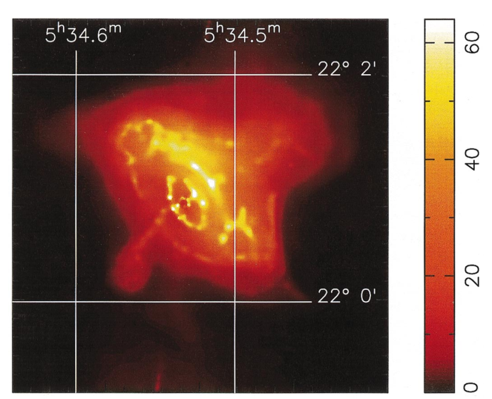

New knowledge of the accelerator size
Accelerator size l >electron gyro radius R_{g}=0.025 pc (according to the 1.1 PeV photon)
Knot ~0.03pc
0.14pc
Chandra
LHAASO coll. 2021 (Science 373:425-430)
Martin et al. 2000

Slide 28
4 Diffuse gamma rays of the Milky Way

Slide 29
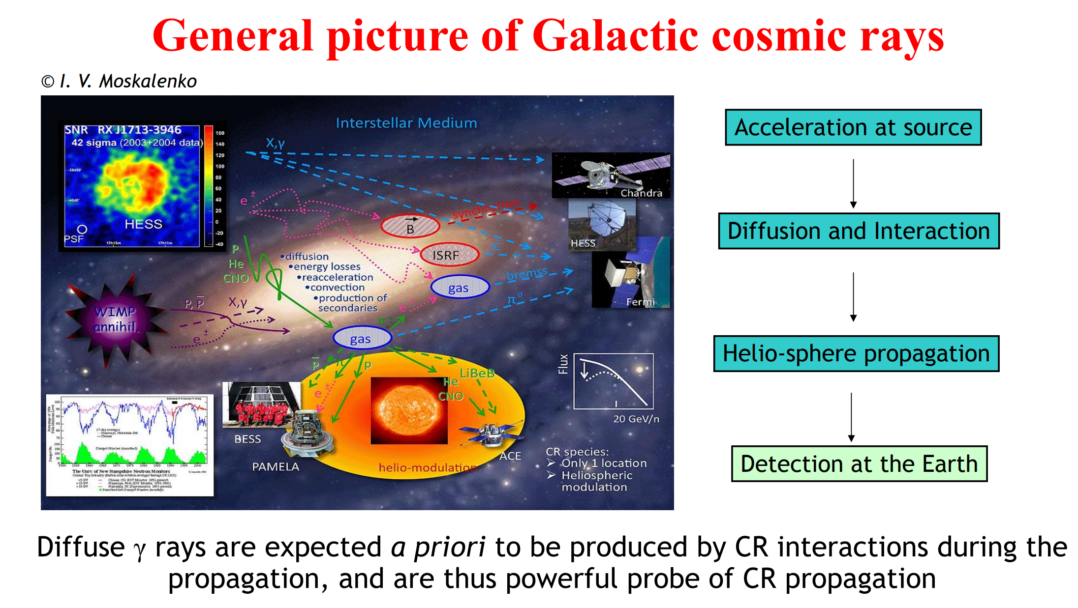
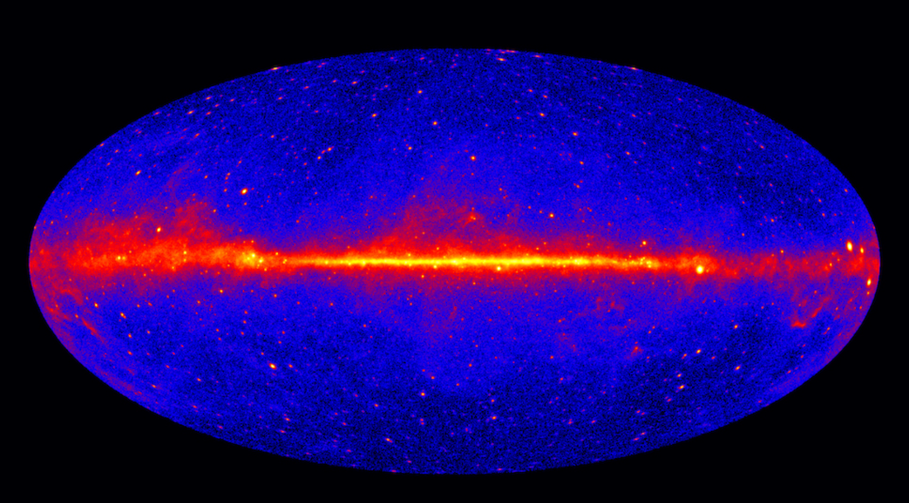

Slide 30
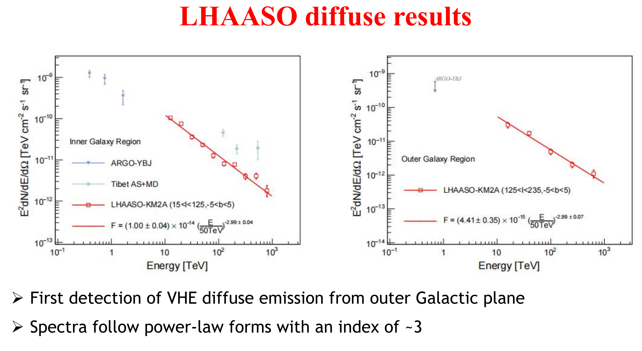

Slide 31
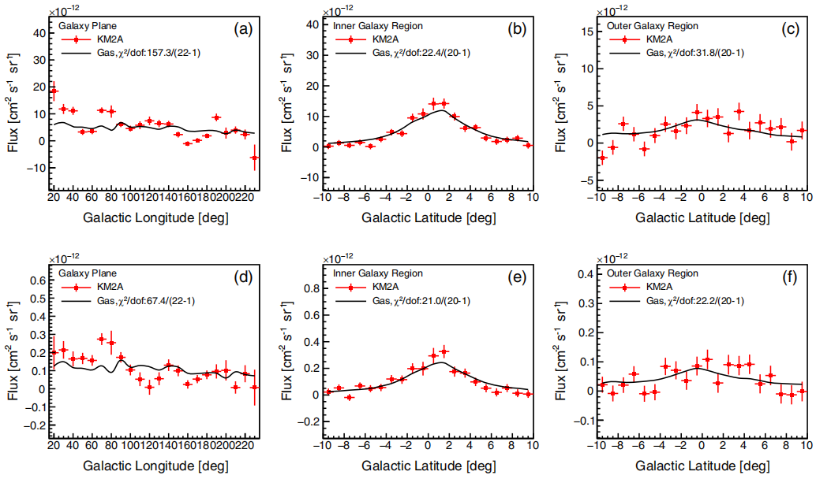
Longitude and latitude profiles
10-63 TeV
63-1000 TeV
Roughly consistent with gas distributions for b, but show significant deviation for l
31

Slide 32
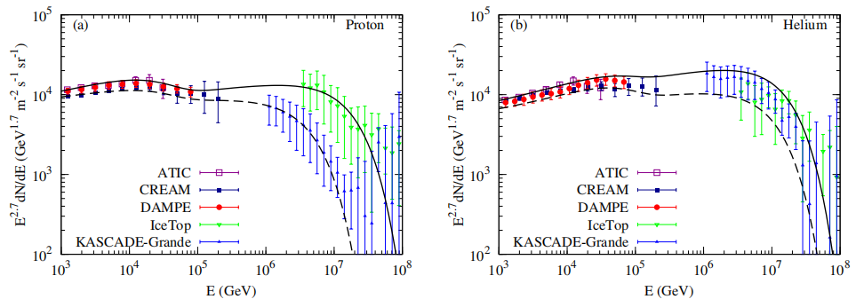
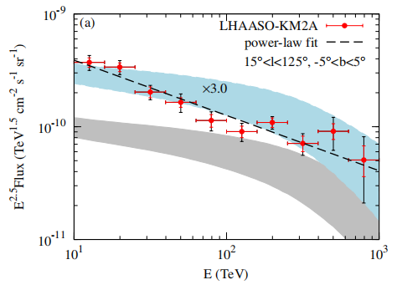
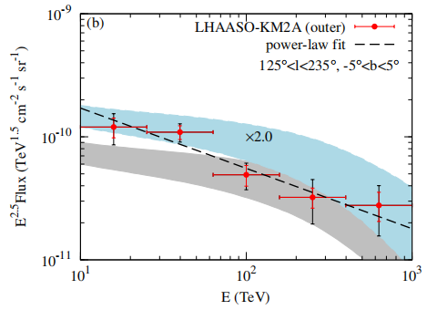
Confront LHAASO data with a toy model
Toy model prediction: local CR × gas column (PLANCK dust opacity)
Measured fluxes are higher by a factor of 2~3 than predictions: unresolved sources or propagation effect?
Spectra are slightly different from the prediction: fitting p-values of 10⁻⁴~10⁻² in the inner region
32

Slide 33
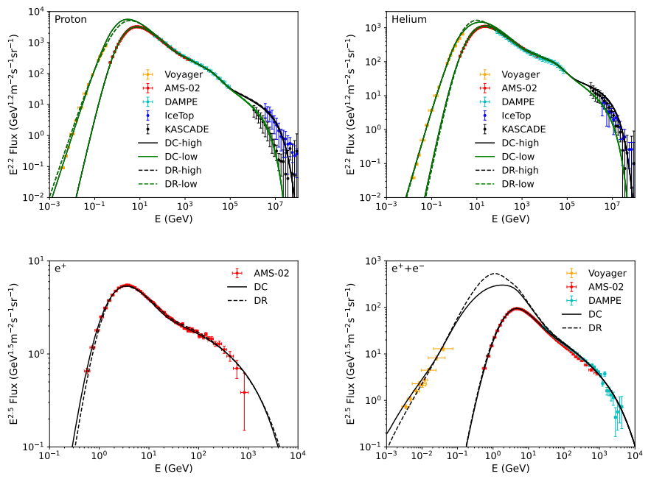
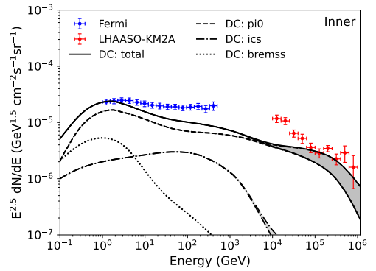
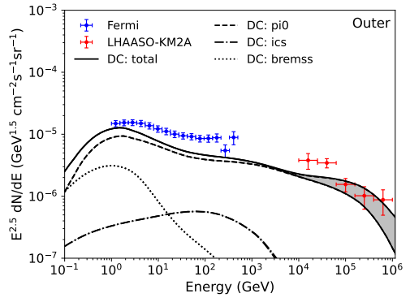
Confront LHAASO data with a GALPROP model
R. Zhang et al. (arXiv:2305.06948)
33

Slide 34
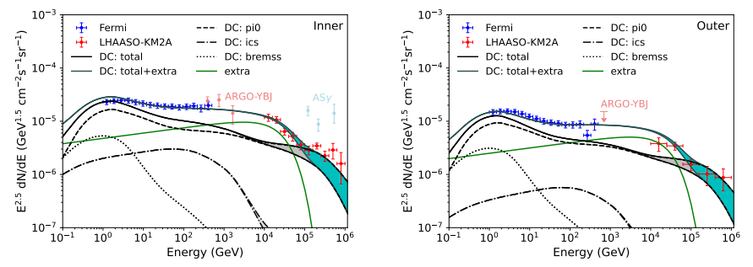

Unresolved source population?
R. Zhang et al. (arXiv:2305.06948)
34

Slide 35
5 Brightest GRB

Slide 36
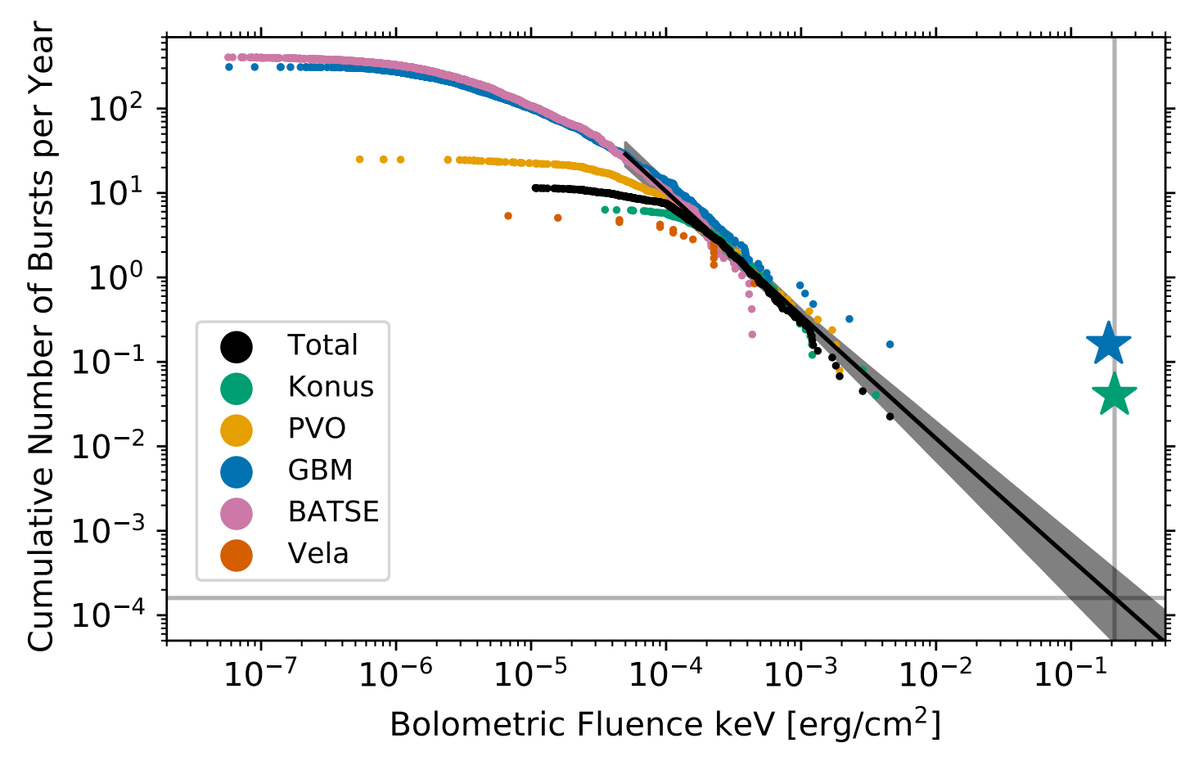
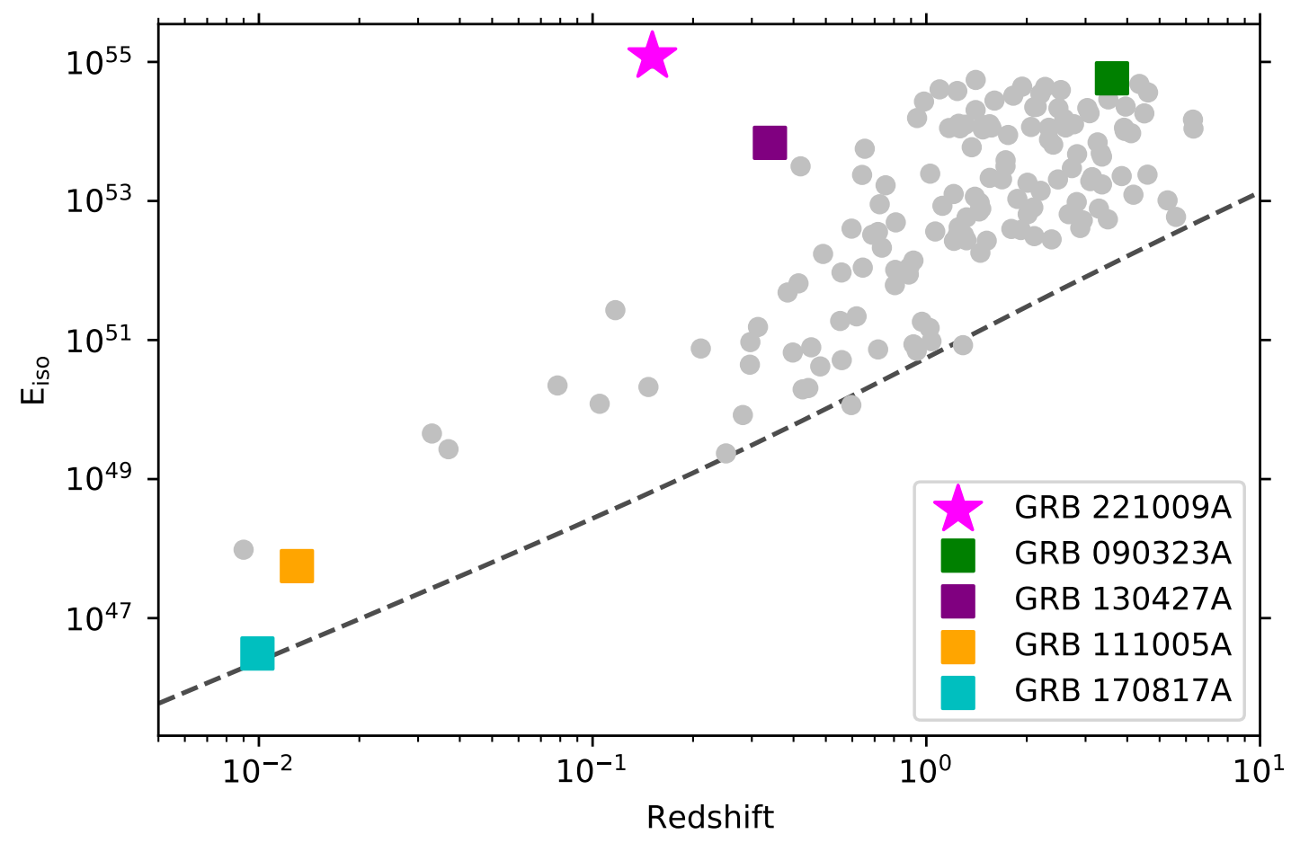
GRB 221009A: A very rate event
Fluence: >5 × 10 ⁻² erg/cm²
R<10^-3 yr
Buns et al. 2023
R_GRB≤ 6.1 × 10⁻⁴ Gpc⁻³ yr⁻¹
z=0.151 volume ~ 1 Gpc^3

Slide 37


LHAASO对GRB221009A的探测
LHAASO detection of GRB 221009A: first GRB seen by a extensive air shower detector
High statistics: >60,000 photons above 0.2TeV (LHAASO-WCDA)
TeV count rate light curve: Smooth temporal profile –external shock origin
高海拔宇宙线观测站（LHAASO）
四川稻城 海拔4400m
GRB 221009A
First time detection of the TeV afterglow onset !

Slide 38


SED measured by LHAASO-WCDA
.EBL model: A. Saldana-Lopez et al. (2021)
Intrinsic spectrum
Observed spectrum

Slide 39



A narrow GRB jet
LHAASO coll. 2023 (Science 380, 1390)
Jet breaks have been seen in optical/X-ray bands
First time seeing a jet break at TeV band
Helps to understand the total energy of the GRB

Slide 40
First time observing the onset of an TeV afterglow
This enables
  Setting the most strict limit on the prompt emission in the TeV band
  Finding an unusually fast rise phase
  Estimating the initial bulk Lorentz factor Γ₀ of the jet
Finding a jet break in the TeV light curve in its decay phase
  The narrowest jet of 0.8° (the earliest jet break), revealing the “core” of a structured jet
  A reasonable E_{γ,jet} ~ 10⁵¹ erg with the beam correction
  The unprecedently large fluence may be due to seeing the brightest core of a nearby GRB jet

Slide 41
6 cosmic ray spectrum and <lnA>

Slide 42


Cao, Z. PRL2024
arXiv: 2403.11832
宇宙线起源：AMS02-DAMPE-HAWC-LHAASO-TUNKA-Auger energies are calibrated and rescaled to AMS02. very impressively that most rescale less than 5%.
膝
SBG?
AGN?
LE踝
2nd膝
踝
Geminga?
PaVatrons，YMSC? MQ？PWN？
GZK
低能，SNR?
Cutoff of GA Fe
Old models
Cutoff of nearby Fe spec
rise by second

Slide 43


LHAASO probe of new physics beyond the standard model
The SM is an extremely successful model that describes nearly all micro phenomena with a shocking accuracy. However it has many problems ……
It doesn’t account for the dark matter/dark energy.
It can not explain why the world consists only normal matter but no antimatter.
It has the strong CP problem.
  An elegant solution predicts axion, which is a DM candidate.
It has the hierarchical problem.
  SUSY/extraD generally predicts WIMP as dark matter.
It does not include gravity.
  Quantum gravity theories which may indicate Lorentz invariance violation.
……

Slide 44
Advantages of new physics search at LHAASO
LHAASO 的观测提供了独特的数据用于新物理信号的寻找，比如可以提供远远高于对撞机的能量（PeV gamma，~EeV P），可以探测宇宙学距离的源以搜寻新物理信号的累积效应。
Heavy dark matter singals (> PeV)
Lorentz invariant violation (LIV) （高能量）
LIV from the light curve （距离累积）
Axion scenario （距离累积）

Slide 45
7 Constraints on Lorentz Invariance violation

Slide 46
Lorentz invariance violation （LIV）
For the case of Lorentz invariance a free particle satisfies the dispersion relation: E² = m² c⁴ +p² c²
For some quantum gravity theories, Lorentz invariance may be violated at Planck scale, which leads to modification of the dispersion relation at low energies.
The dispersion relation at low energies, E² = m² c⁴ +p² c² *(1 + a1(pc/ M_{pl} c²)+ a2(pc/ M_{pl} c²) ² + …)
a1, a2 … are model parameters of LIV
LIV effect is suppressed at low energy by M_{pl} c²
Many exotic phenomena may take place in the LIV scenario which are forbidden in LI

Slide 47

Energy dependent speed of light at LIV
From the LIV DR, E² = p² c² *(1 + a1(pc/ M_{pl} c²)+ a2(pc/ M_{pl} c²) ² + …)
Group velocity v(E) =
v(E) is not a constant and can be superluminal or subluminal depending on the sign of a_{n}, for n=1,2 the first and second order of LIV
As (E/E_{LIV,n}) is highly suppressed for E<<E_{LIV,n} ，it is generally very hard to observe the effect
It is the great advantages for astrophysical probe: the highest energy possibly achieved in the universe; or long distance propagation from the source may accumulated the tiny effect to be observable.
Constraints on LIV by time decay of photons from GRBs have been set

Slide 48




Decay of a free photon
A free photon in vacuum is stable in LI
For LIV，
When the effective mass > a pair of e+e-, the photon decay into e+e- very fast and leads to a sharp cutoff at the SED
If no such decay the LIV energy scale is constrained as
For n=1,2，we have
The constraints are very sensitive to the highest energy of gamma

Slide 49


Photon splitting
LIV also leads to a photon splitting to 3 photons
LIV decay or splitting leads to s sharp cutoff the
high energy end of the spectrum
We analyze the LHAASO data of gamma ray SED
to look for the LIV cutoff

Slide 50

Z. Cao, et al., Nature 594, 33 (2021)

Slide 51

The result
Phys.Rev.Lett. 128 (2022) 5, 051102

Slide 52



KM2A, 高能伽马有限的宇宙视界

Slide 53



LHAASO-KM2A观测
LHAASO coll. 2023 (Science adv. 9, 2778)
First observation of the EBL absorption of g-flux
highest energy photon is about ~13TeV, depending on the spectrum
Even 13 TeV is out of expectation. Flux is about 1 order of magnitude higher than expectation.

Slide 54


LIV by GRB 221009A
The intrinsic gamma spectrum shows a bump at the highest energy. It stimulates a lot of interests. LIV is a possible solution which leads to more transparent EBL.
As the significance is not high. Constraint on LIV is set finally E_{LIV} > 1.5 M_{Pl}.

Slide 55



Constraint on LIV by time lag of different energy photons from GRB 221009A
Cross correlation function (CCF). Light curves of different energy bands are given by the WCDA data. CCF method is adopted to derive the time lags of the different light curves.
Maximal likelihood method. The probability density function (PDF) of a photon at time t and N_{hit} is given. λ(t) is the intrinsic light curve with possible time lag Δt_{LIV}(E).

Slide 56

The stringent LIV constraint by time of flight
Cao, Z. et al., PRL 2024
For the 2nd LIV the LHAASO constraint is the best one with 6-8 times improvement to Fermi-LAT result.

Slide 57

我们联合KM2A的高能事例和WCDA的精确测量事例通过到达时间限制LIV

Slide 58


Slide 59


Slide 60

通过模拟得到限制的置信区间

Slide 61

得到LIV的限制

Slide 62


Maximal likelihood 方法

Slide 63



Slide 64
8 Dark matter searches

Slide 65

LHAASO data

Slide 66




Carefully selected regions for DM decay
The signal region is chosen
  Away from Galactic plane and Fermi bubble
  Close to the GC as possible
4 control regions by shifting ROI₀ along the RA direction by 90°, 135°, 240°, 285° respectively
  Same declination and same detector performance
  For accurate estimate the bkg and
  eliminate systematics

Slide 67

a

Slide 68

Constraints on Heavy Decaying Dark Matter from 570 Days of LHAASO Observations
Phys.Rev.Lett. 129 (2022) 26, 261103

Slide 69


Dark matter annihilation signals from the dwarf galaxies

Slide 70


矮星系模型参数

Slide 71



对不同矮星系观测的TS分布
计算三维似然函数，及不同矮星系的TS值

Slide 72


Most stringent constraint on heavy DM annihilation by LHAASO
Submitted to Phys.Rev.Lett.
With 756 dates WCDA and 794 dates KM2A data and by combining the 16 dwarfs the most stringent constraint on DM annihilation is derived.

Slide 73

Axion and axion-like particles
Axion 为了解决标准模型的强CP问题引入
可以作为冷暗物质存在
Axion和光子耦合，有独特的探测信号
伽马射线在银河系磁场中能够和axion相互转化

Slide 74


Slide 75

Best fit of axion is not significant

Slide 76

A stringent constraint is set on axion coupling
LHAASO coll. 2023 (Science adv. 9, 2778)
Axion significance < 2sigma, we give constraints on axion coupling

Slide 77


Slide 78


Slide 79



NGC1052-DF2
Identified by Dragonfly Telephoto Array in deep, wide-field imaging observations of the NGC1052 group
UDG (Ultra Diffuse Galaxy)
low surface brightness ($μ>24 mag{arcsec}^{−2}$);
dispersed spatial distribution of stars ($R_{eff}>1.5 kpc$)
Imaging: Dragonfly, SDSS, HST, Gemini…
Spectroscopy of objects in DF2: W. M. Keck Observatory
DF2 in the Dragonfly field
Deep imaging from Gemini

Slide 80




Anomaly of DF2
Extremely dark matter deficit
dynamical mass estimate based on velocity dispersion of GCs, $M_{h}\sim {10}^{8}M_{ʘ}$;
star mass $\sim 2×{10}^{8} M_{ʘ}$
Dispersed spatial distribution of stars
$R_{eff}={22.6}^{′′} or 2.2 kpc assuming a distance of 20 Mpc$
10 confirmed GCs (Globular Clusters) with high luminosity
comparable in size and luminosity to 𝜔-Cen, the biggest and brightest GC in MW; The $M_{h}−N_{GC}$ relation predicts a halo mass of $5×{10}^{10} M_{ʘ}$

Slide 81

轨道参数
Zhang et al., 2403.11403

Slide 82


Mass loss by tidal effect
Mass loss

Slide 83



Evolution of star distribution

Slide 84
总结
由于LHAASO大面积阵列、高鉴别能力的优势，取得了一些重要的观测进展。
首次观测到大量超高能伽马源、精确测量高能弥散伽马辐射、伽玛暴的高能精确测量等，极大促进伽马天文的研究。
新物理研究方面：在洛伦兹对称性破坏、轴子暗物质、超重暗物质搜寻方面取得了初步成果，以及在某些方面设置了最强限制。

