Slide 1
DGLAP方程和BFKL方程的高扭度修正
阮建红
近代物理研究所 惠州 2023.11.17

Slide 2
主要内容
一、QCD动力学演化方程简介
二、对DGLAP演化方程的高扭度修正
三、对BFKL演化方程的高扭度修正
四、小结

Slide 3
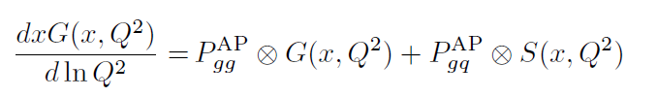

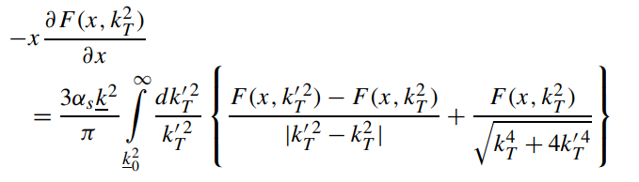
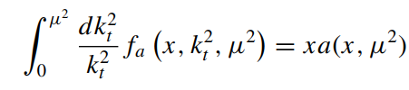



一、QCD动力学演化方程简介
$$\begin{matrix}xq(x,Q^{2}), & xG(x,Q^{2})\end{matrix}$$
DGLAP equation
Evolution to large Q^2
$$\begin{matrix}F\left(x,k_{T}^{2},μ^{2}\right) & \end{matrix}$$
$$（unintegrated parton distribution）$$
BFKL equation
Evolution to small x

Slide 4

fusion
splitting
基本演化过程
高扭度修正
Modified DGLAP = DGLAP
+ shadowing ( - )
保证动量守恒
+ antishadowing ( + )
Modified BFKL = BFKL
+ shadowing ( - )
+ antishadowing ( + )

Slide 5
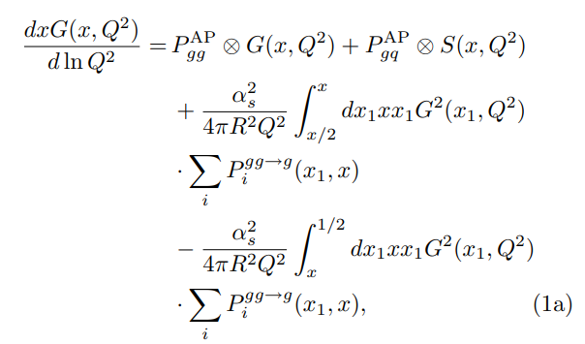

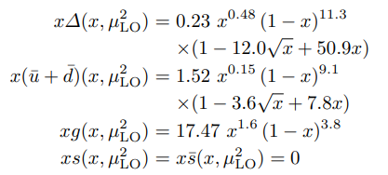
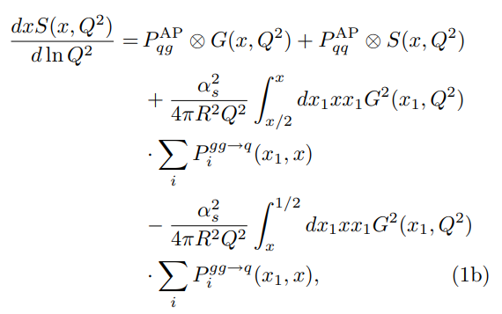

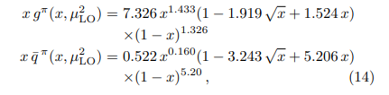
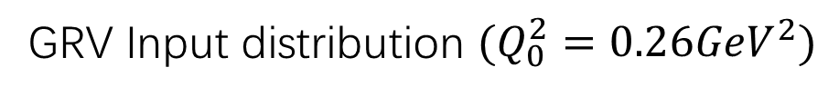
二、对DGLAP演化方程的高扭度修正
GRV Input distribution $(Q_{0}^{2}=0.26GeV^{2})$
proton
pion
Valence-like input distributions

Slide 6


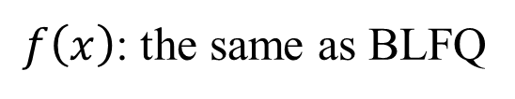



(A) The input pion parton distributions
BLFQ：
（Phys. Rev. D 101 (2020) 034024, Phys. Rev. Lett. 122 (2019) 172001 ）
valence quark input distribution
$Q_{0}^{2}=0.12GeV^{2}$
$$f\left(x\right)=$$
Our model :
valence quark input distribution
$Q_{0}^{2}=0.09GeV^{2}$
$f\left(x\right)$: the same as BLFQ
（参数的选取是根据结构函数的数据来定的）
CHIN. PHYS. LETT. 38 (2021) 042501

Slide 7
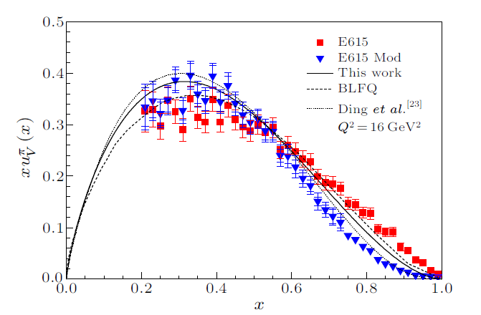





(B) Parton distributions comparison
BLFQ:
$$Q_{0}^{2}=0.12GeV^{2}$$
DGLAP evolution equation
Our model :
$$Q_{0}^{2}=0.09GeV^{2}$$
ZRS evolution equation
Ding et al:
$$Q_{0}^{2}=0.09GeV^{2}$$
$$f\left(x\right)$$
valence quark distributions
（Phys. Rev. D 101 (2020) 054014 )
Chin. Phys. C 44 (2020) 031002）

Slide 8
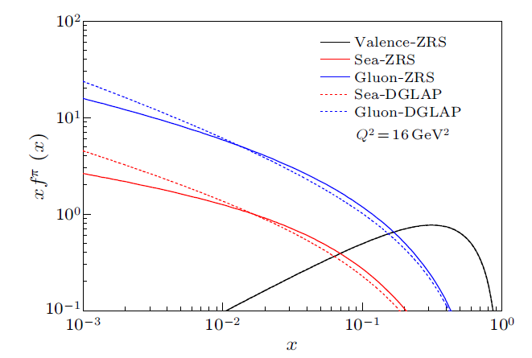


$$Q_{0}^{2}：$$
input distribution：
$$0.09GeV^{2}$$
BLFQ
Evolution equation:
DGLAP equation
ZRS equation
valence quark, sea quark and gluon distributions
This fig directly show the effect of shadowing and anti-shadowing . If the equation contains only the shadowing part, without the anti-shadowing part, the solid lines will always be lower than the dashed lines, and momentum conservation will not be maintained.

Slide 9
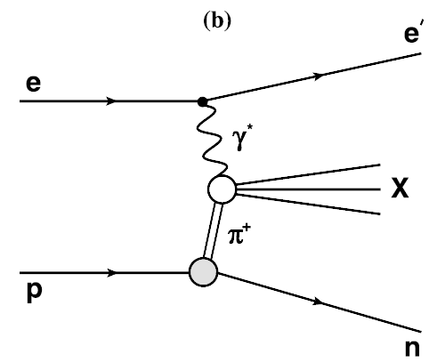








(C) Structure functions
H1:
one pion exchange model
$$x_{L}=0.73$$
$${0.68<x}_{L}<0.77$$
$$p_{T}<0.2 GeV$$
ZEUS:
effective one-pion-exchange model
additive quark model
$$x_{L}=0.73$$
${0.64<x}_{L}<0.$82
the pion flux associated with the splitting of a proton into a 𝜋+𝑛 system
$$p_{T}<0.656x_{L}$$
𝑑𝜎(𝑒𝜋+ → 𝑒′𝑋): the cross section of the e-pion interaction

Slide 10
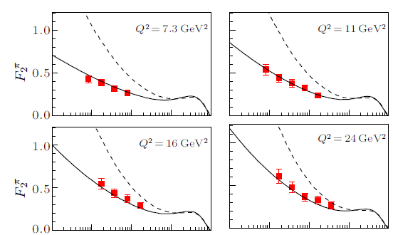
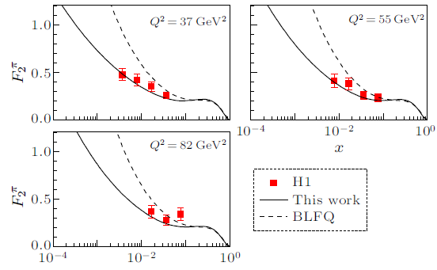

Comparing with H1 data
The dashed lines obtained via the evolution of the DGLAP equation are clearly higher than those for the experimental data.
The solid lines are obtained via the evolution of the ZRS equation The higher-twist correction played an important role in the small x region.
In the leading-order approximation

Slide 11
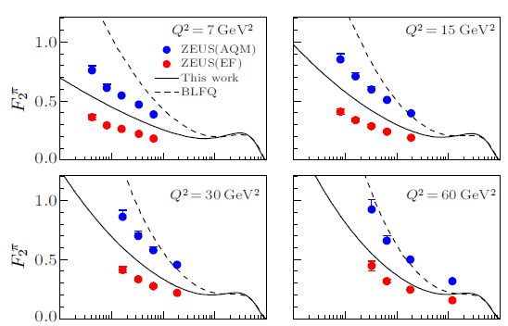
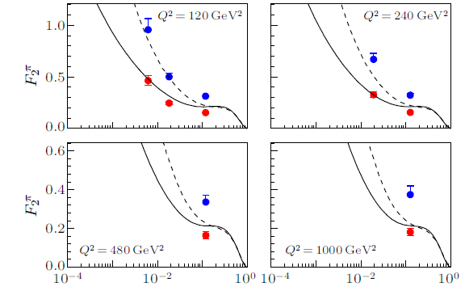
Comparing with ZEUS data
There are two groups of data of ZEUS，our lines are in-between the two sets of data。
The results of BLFQ are much closer to the data of the additive quark model, their line slope is obviously larger than that of the data, particularly in the small x region.
It seems that higher-twist corrections cannot be neglected, even in comparison with the additive quark model.

Slide 12
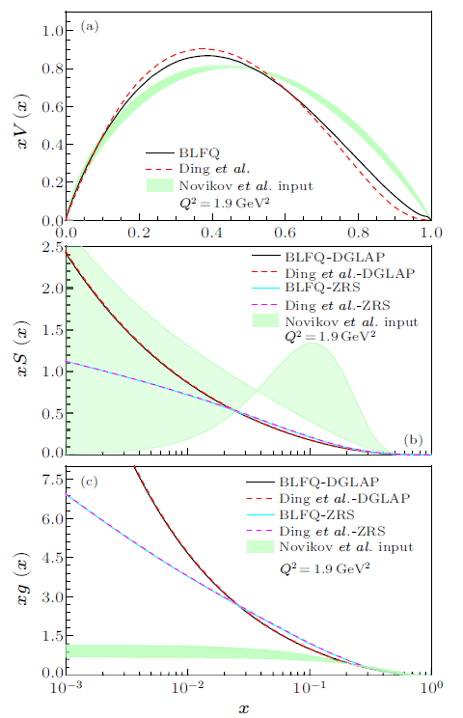

Comparision of BLFQ、Ding et al., and Novikov at al.
$$Q^{2}=1.9{GeV}^{2}$$
Valence quark:
BLFQ is similar to Ding
Novikov: obviously higher in large x region
Sea quark:
BLFQ 、Ding almost the same
Novikov: a very large uncertainty region
obviously higher in large x region
gluon:
BLFQ 、Ding almost the same
Novikov much smaller in small x region
Novikov at al: Phys. Rev. D 102(2020) 014040

Slide 13
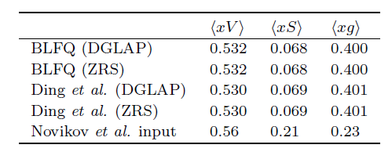
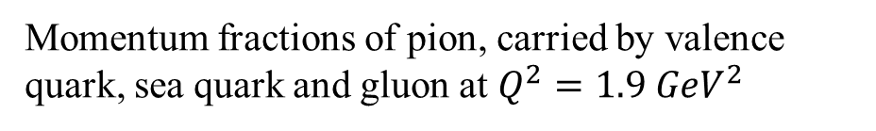
(D) momentum comparison
The momentum fraction of BLFQ and Ding are almost the same
Momentum fractions of pion, carried by valence quark, sea quark and gluon at $Q^{2}=1.9 {GeV}^{2}$
The sea quark momentum of Novikov is much larger than the other two models, and the gluon momentum is much smaller.
The evolution of ZRS equation does not influence the momentum fraction, since it is momentum conservation, it will only change the shape of sea quark and gluon distributions

Slide 14
(E) Conclusion 1:
ZRS equation is an evolution equation considering twist-4 corrections, which satisfies the conservation of momentum. Using the input distribution function of BLFQ and the evolution of ZRS equation, the experimental data of valence quarks distribution and structure functions can be well explained.
The experimental data of structure function show that the higher-twist effect should not be neglected in small x region.
Through comparison, it is found that BLFQ model is very close to Ding's model, but they are quite different from Novikov model.

Slide 15

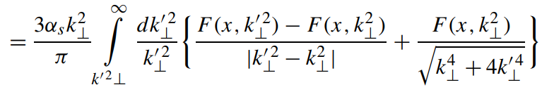
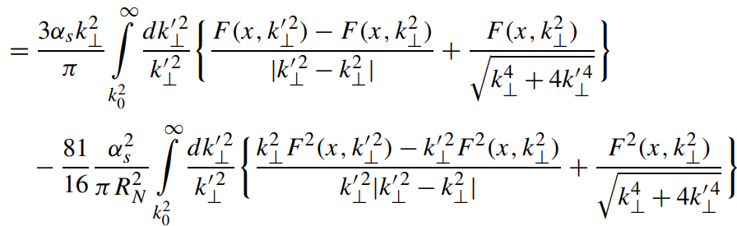
三、对BFKL演化方程的高扭度修正
BFKL equation
Our equation

Slide 16
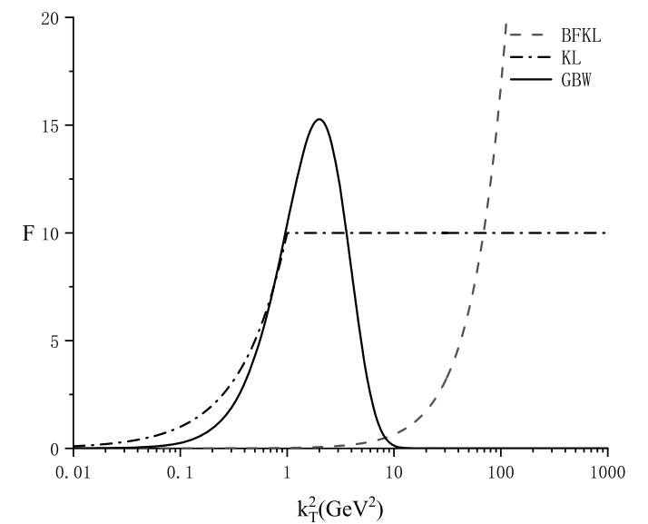

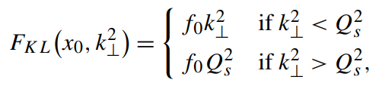
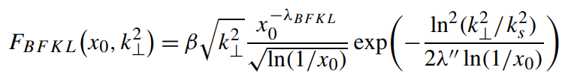
(A) 输入分布函数
① Golec-Biernat and Wusthoff (GBW) model
② Kharzeev-Levin (KL) model
③ a normal BFKL-input
The GBW-, KL- and BFKL-inputs

Slide 17
演化过程with GBW input
胶子凝聚现象

Slide 18
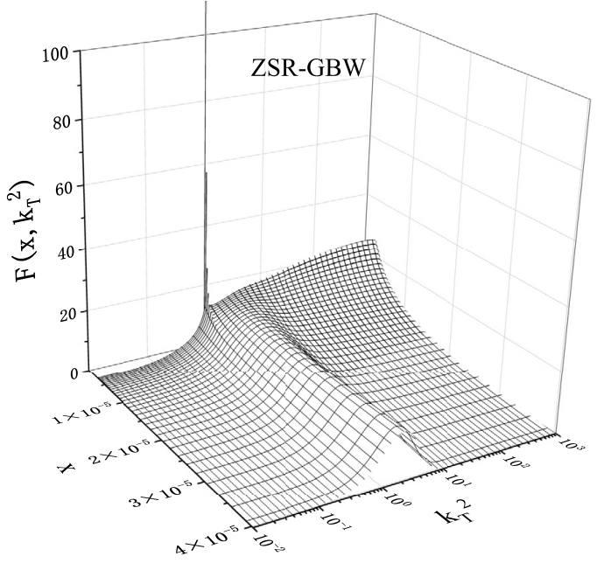
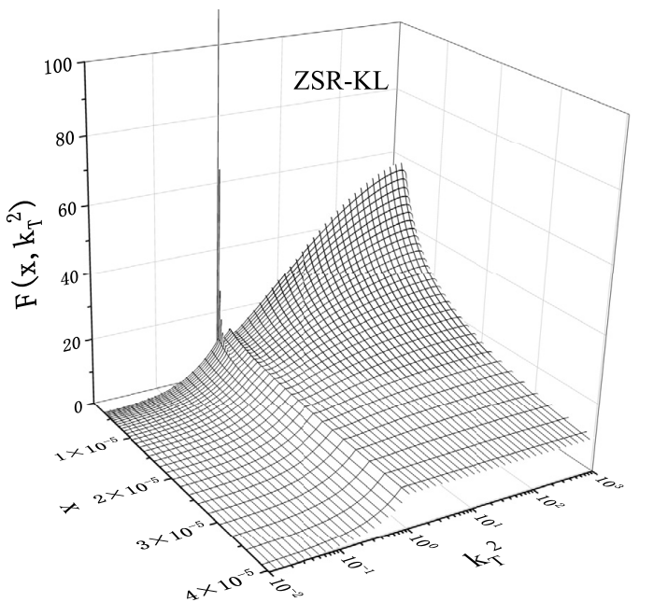
(B) 胶子凝聚现象
W.Zhu et al., Nucl.Phys.B 916 (2017) 647
W.Zhu et al., Nucl.Phys.B 984 (2022) 115961

Slide 19
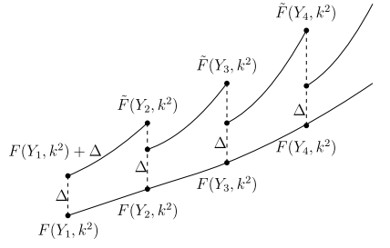

（C）非线性方程的混沌效应
chaos：the Lyapunov exponent > 0
混沌的一个判断依据是系统具有正的李雅普诺夫指数，表明系统对初始条件的微小变化具有很强的敏感性

Slide 20

高能宇宙线能谱中的胶子凝聚效应
1、gamma光谱
2、电子谱
3、电子谱与质子谱的关联
极高能宇宙线目前达到的能量范围超过${10}^{20}GeV$，宇宙线与大气原子核碰撞的质心能量远超过LHC的能量，因此，我们试图在极高能宇宙线能谱中寻找胶子凝聚效应。由于胶子凝聚效应，可能会出现特殊形状的宇宙线能谱曲线。

Slide 21
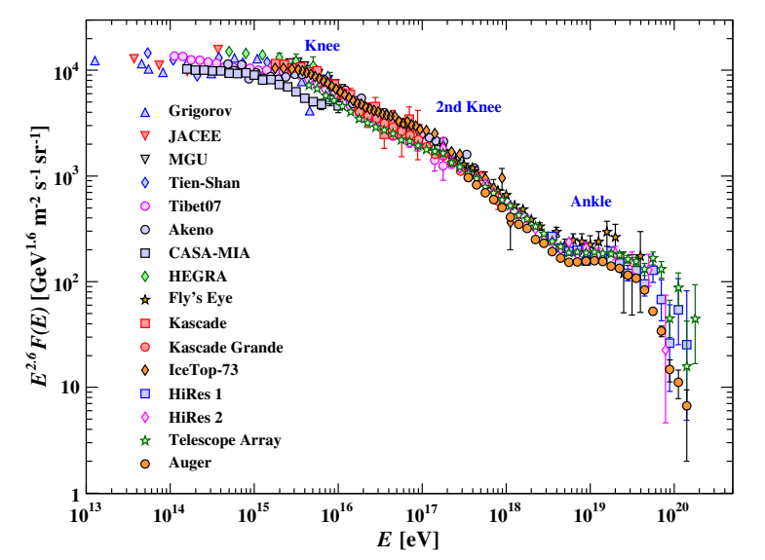
Energy spectrum of high-energy cosmic rays measured by several experiments

Slide 22
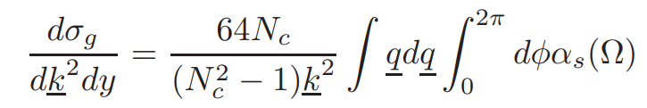
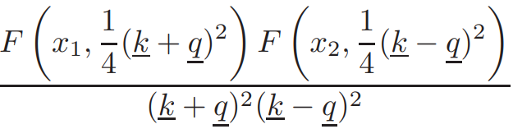
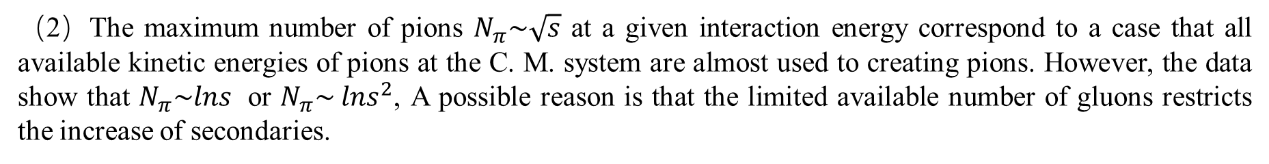
胶子凝聚下次级粒子产生的模型：
（1）The cross-section of inclusive gluon mini-jet production in high energy p − p collisions,
the number of secondary particles is proportional it if we neglect the mechanism of fragmentation of gluons into secondary particles.
（2）The maximum number of pions $N_{π}\sim \sqrt{s}$ at a given interaction energy correspond to a case that all available kinetic energies of pions at the C. M. system are almost used to creating pions. However, the data show that $N_{π}\sim lns$ or $N_{π}\sim {lns}^{2}$, A possible reason is that the limited available number of gluons restricts the increase of secondaries.
（3）We assume that a large number of gluons at the central region due to the GC-effects create the maximum number $N_{π}$ of pions.

Slide 23




（4）Focus on the central rapidity region, where the multi-hadrons (mainly pions) are produced due to the excited gluons. This process contains two steps
$p+p→$ $gluons(or gluons and quark−antiquark pairs)→π^{±,0}+others$
（5）Image that almost all available energy of the collision at the center-of-mass system is used to create pions.

Slide 24


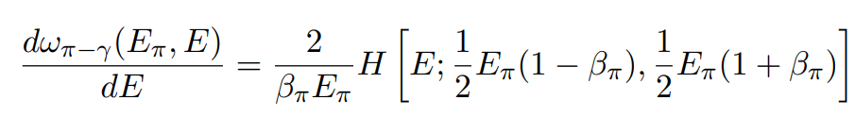
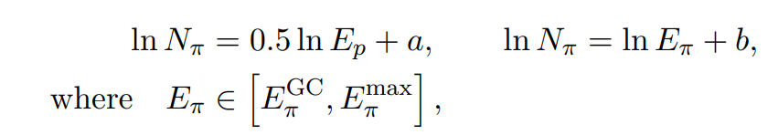


1、Gamma光谱
$$p+p→π^{±,0}+others$$
$$π^{0}→2γ$$

Slide 25
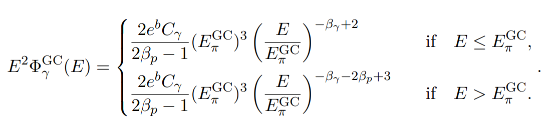
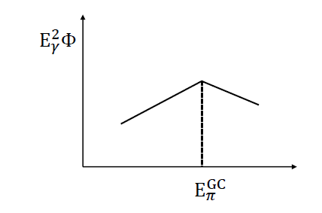

Slide 26
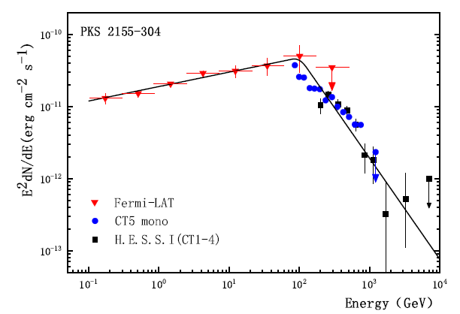
APJ868(2018)2
APJ889(2020)127
JCAP08(2021)065
JCAP01(2021)038
IJMPE27(2018)1850073

Slide 27

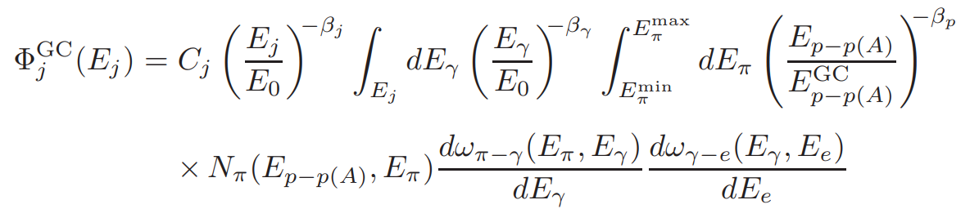










2、正负电子谱
$$p+p→π^{±,0}+others$$
$$π^{0}→2γ$$
$$γ+γ→e^{−}+e^{+}$$
$$π^{±}→μ^{±}+ν_{μ}({\overline{ν}}_{μ})$$
$$μ^{±}→e^{±}+ν_{e}\left({\overline{ν}}_{e}\right)+{\overline{ν}}_{μ}(ν_{μ})$$

Slide 28
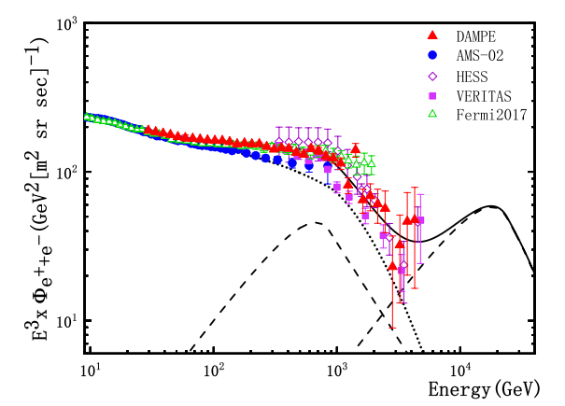

$$γ+γ→e^{−}+e^{+}$$
Predicted cosmic electron spectrum multiplied by $E^{3}$ as a function of energy

Slide 29
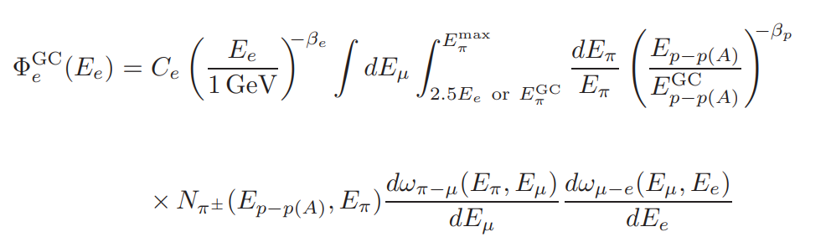

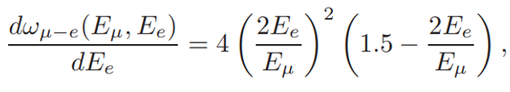
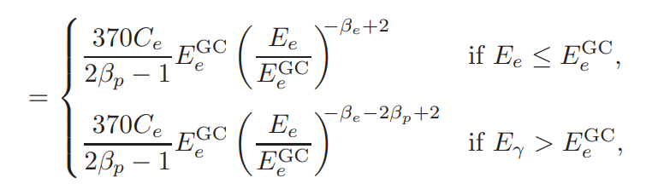


$$π^{±}→μ^{±}+ν_{μ}({\overline{ν}}_{μ})$$
$$μ^{±}→e^{±}+ν_{e}\left({\overline{ν}}_{e}\right)+{\overline{ν}}_{μ}(ν_{μ})$$

Slide 30
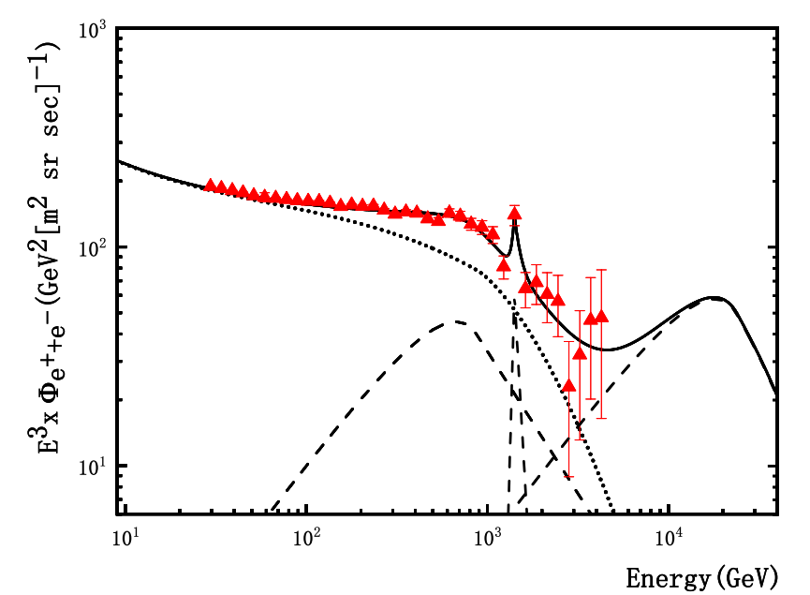


$$π^{±}→μ^{±}+ν_{μ}({\overline{ν}}_{μ})$$
$$μ^{±}→e^{±}+ν_{e}\left({\overline{ν}}_{e}\right)+{\overline{ν}}_{μ}(ν_{μ})$$
Predicted cosmic electron spectrum multiplied by $E^{3}$ as a function of energy

Slide 31



3、电子谱与质子谱的关联
$$p+p\left(A\right)→π^{±}+π^{0}+p+\overline{p}+others$$
假定所有次级粒子在质心系中动能为零

Slide 32
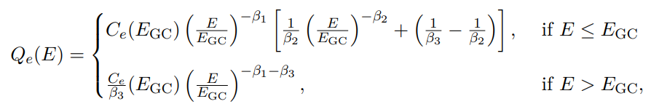
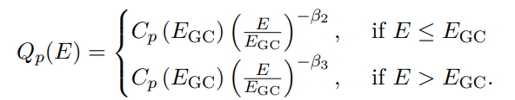


电子谱：
质子谱：
电子谱与质子谱之间的关联：
JCAP10(2023)059

Slide 33
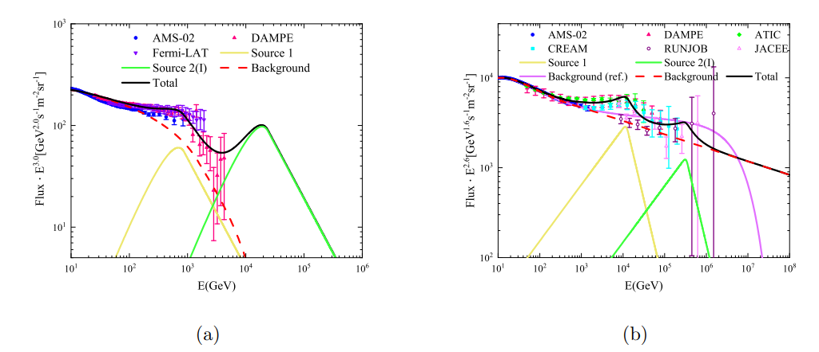




预言DAMPE电子谱的第二个峰的大小和能区（最小）
$$E_{π}^{GCI}=880GeV$$
$$E_{π}^{GCII}=24.0TeV$$
$$E_{X}^{GCI}=11.9TeV$$
$$E_{X}^{GCII}=324.0TeV$$

Slide 34
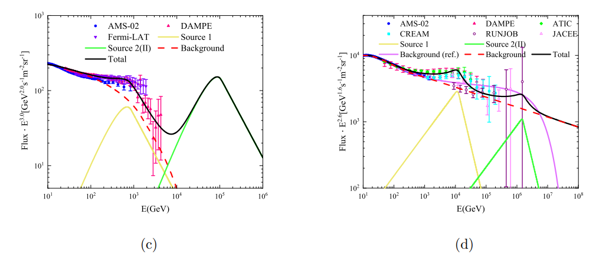




预言DAMPE电子谱的第二个峰的大小和能区（最大）
$$E_{π}^{GCI}=0.88TeV$$
$$E_{π}^{GCII}=110TeV$$
$$E_{X}^{GCI}=11.9TeV$$
$$E_{X}^{GCII}=1500TeV$$

Slide 35
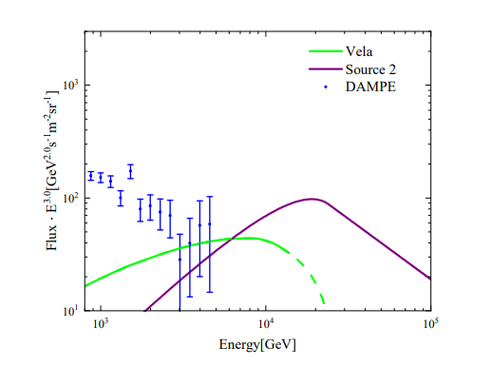
与DAMPE预言的比较

Slide 36
Conclusion 2
（1）Gluon condensation(GC) in proton is an interesting result, it will change our traditional of understanding proton behavior at high energy.
（2）Large number of gluons will accumulate near a certain energy when the GC effects occurring, this phenomenon provides a possible source of the broken power-law in the energy spectra of cosmic rays.
（3）Using the GC model we predict a possible connection of the energy spectra between electron and proton. According to the proton measurements, we assume that the spectra of electron exist a second excess。

Slide 37
谢 谢

