Slide 1



Discovery of the anomalous shape of the structure around 1.84 GeV
房双世（高能物理研究所）
强子物理在线论坛，2023年11月8日
Notes:
1（P2-4). 2（P5).

Slide 2
OUTLINE
p‾p bound state ?
X(p‾p ) and X(1835) at BESII
Confirmations and new decay modes at BESIII
Anomalous line-shapes of the structure at 1.84 GeV
Summary

Slide 3
Fermi & Yang (1949; 7 years before ‾p discovery):
if N anti-N potential is attractive, they could bind to form π-like states.

Slide 4
Fermi & Yang (1949; 7 years before ‾p discovery):
if N anti-N potential is attractive, they could bind to form π-like states.
A good idea for the birth of Quark Model
Gell-Mann(1961): The Eightfold Way: A Theory of strong interaction symmetry
Gell-Mann(1962): Symmetries of baryons and mesons, PRD125,1067(1962)
Gell-Mann, Neemann(1964): The Eightfold way: a review with a collection of reprints

Slide 5
Hadron Spectroscopy
Quark Model
QCD allows for hadrons beyond Quark Model
baryon meson
dibaryon Penta-quark tetra-quark
hybrid glueball molecule

Slide 6
the underlying idea remains: baryonium ?
loosely bound 3-q 3‾q color singlets

Slide 7
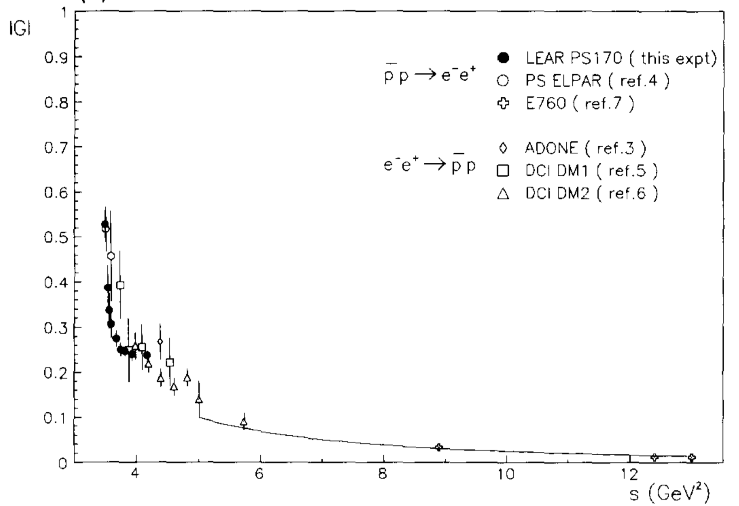
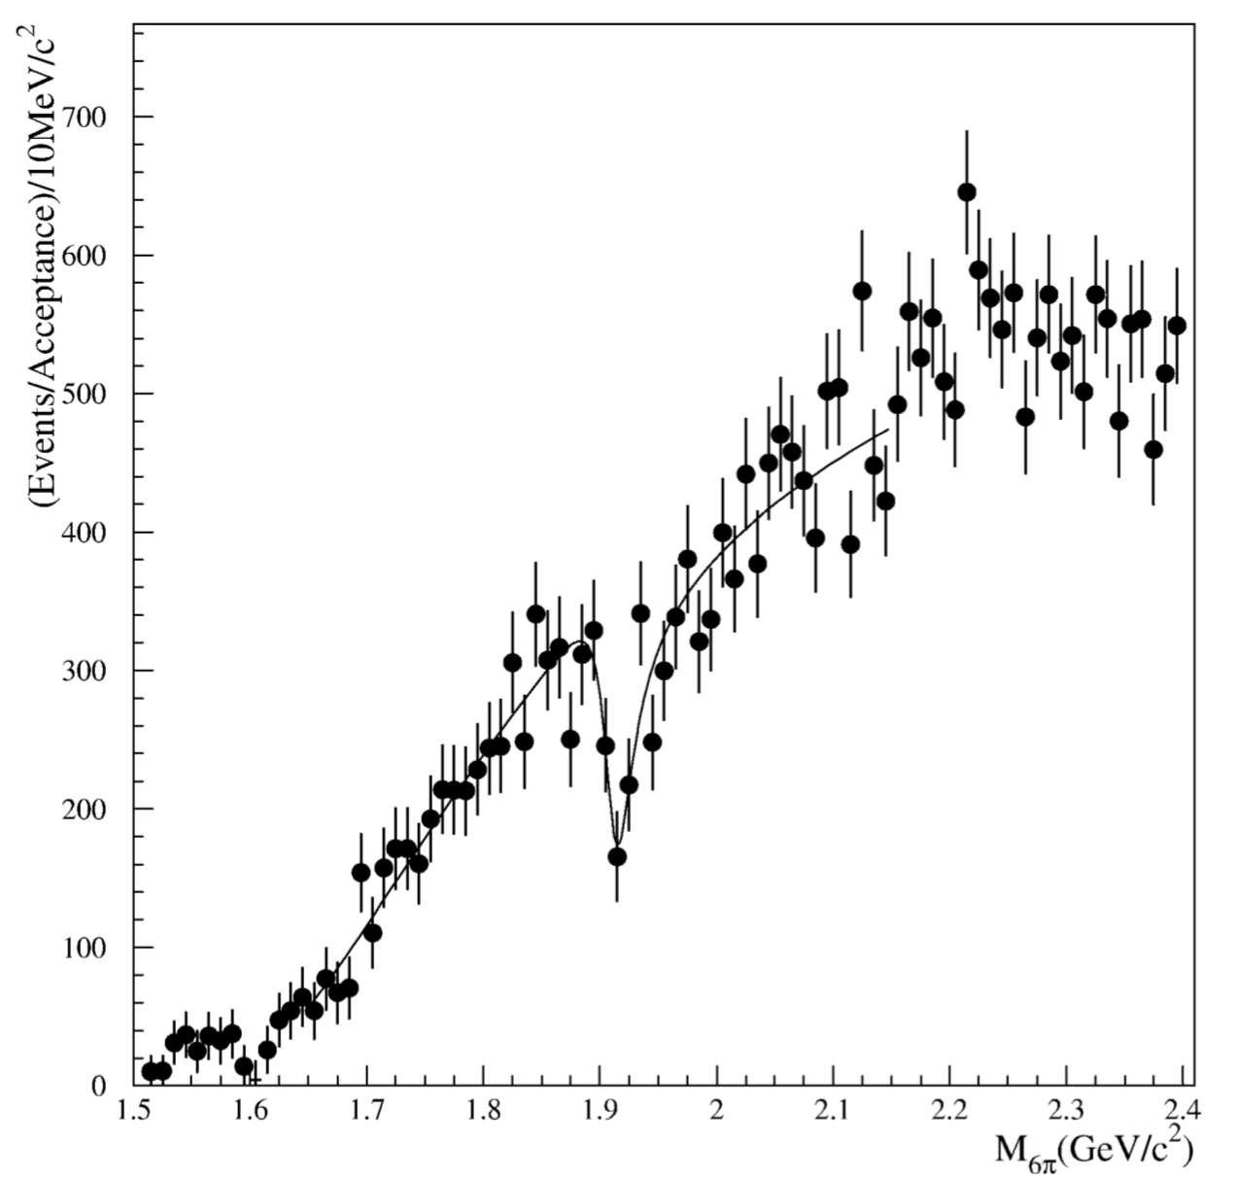
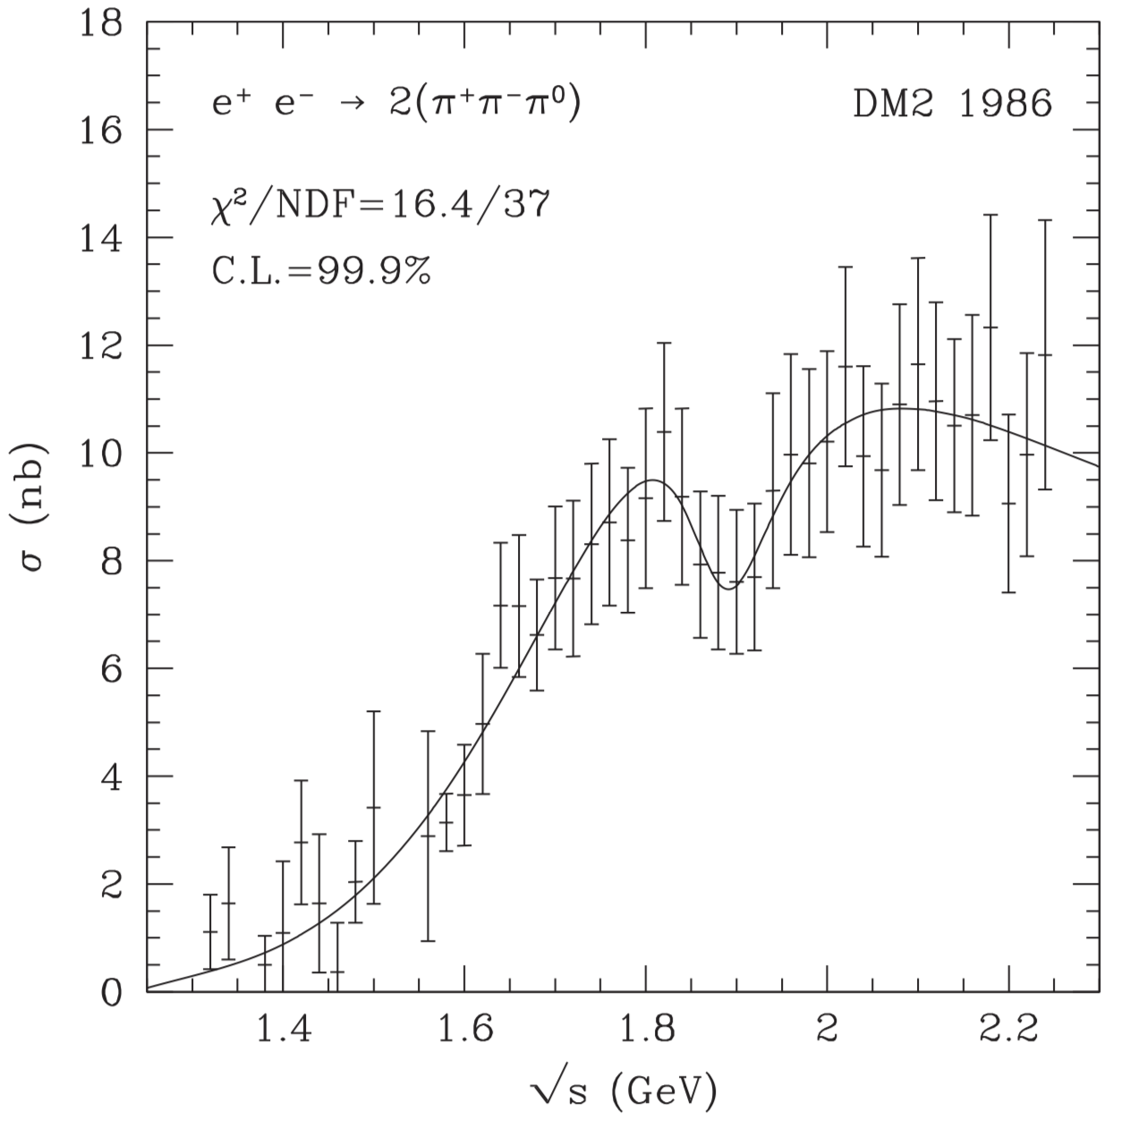
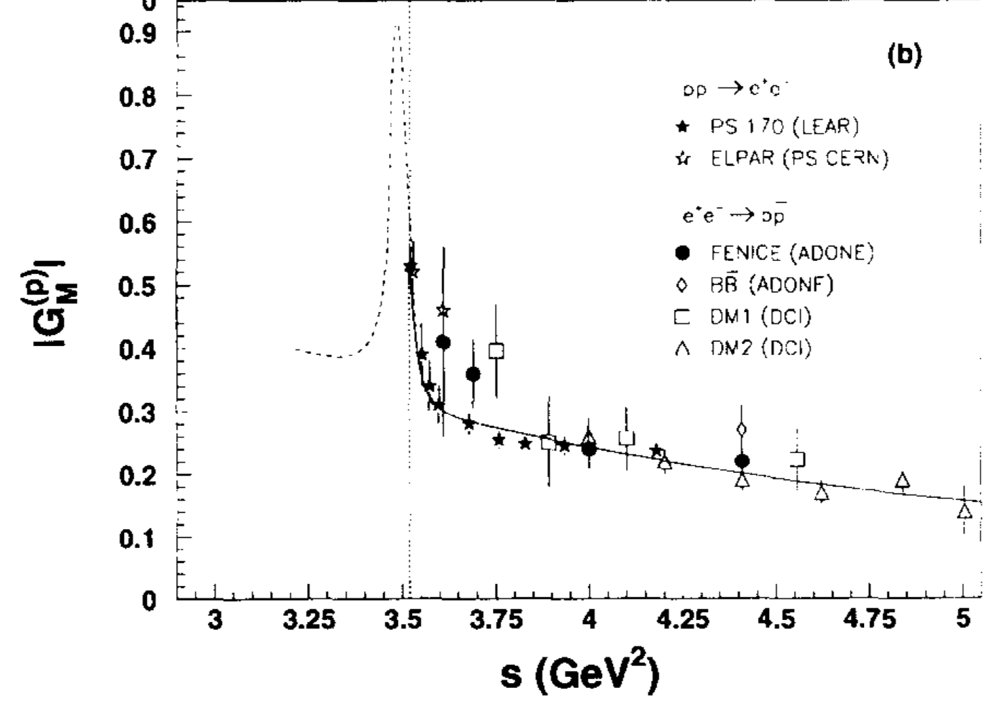
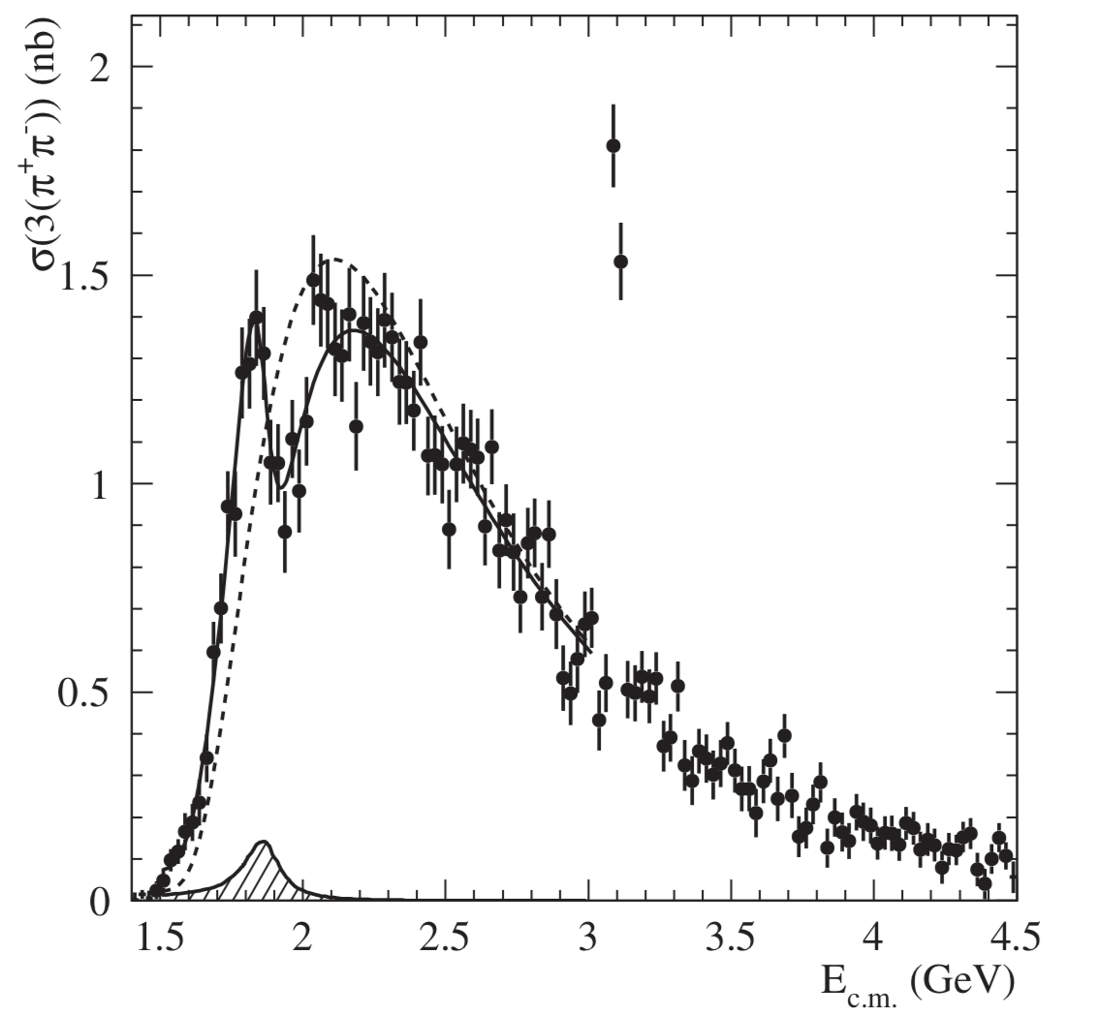
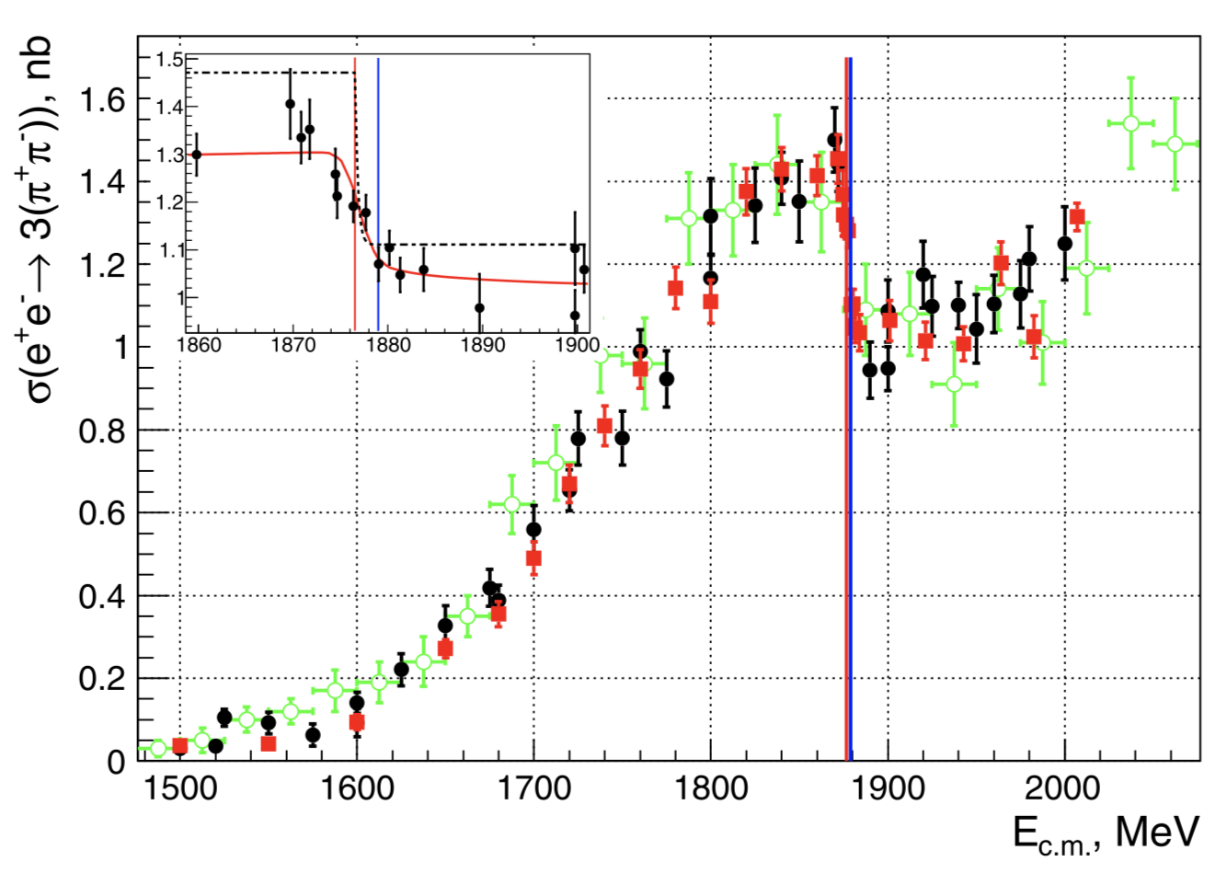
LEAR Nucl. Phys. B411, 3 (1994)
E687， PLB 514, 240 (2001)
a narrow J^{PC}=1⁻⁻ system near p‾p mass threshold ?
DM2
Babar, PRD 73, 052003 (2006)
CMD-3, PLB794 (2019) 64
FINICE, Nucl. Phys. B517, 3 (1998)

Slide 8
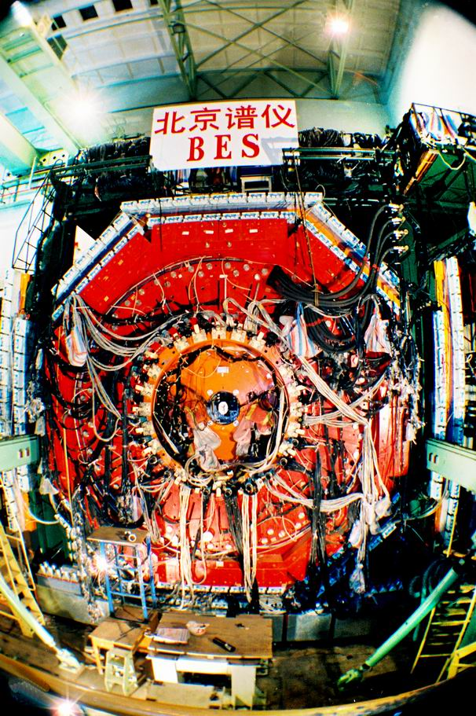
BESII: the largest J/ψ data sample
(1999-2001)
J/ψ
J/ψ decays are well suited for light hadron spectroscopy

Slide 9
Near pp threshold enhancement in J/ψ→γ p‾p
J/ψ→‾p pπ⁰
enhancement
data
η_{c}
three-body phase space
MC

Slide 10
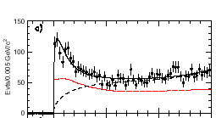
Fit results
PRL91，022001(2003)
Fitted peak
J/ψ→γpp
+3 +5
−10 −25
Mass: M=1859 MeV/c²
Width: Γ < 30 MeV/c² (90% CL)
C-parity = +
S (P?)-wave for M ~ 2m _{p}
J^{PC}= 0⁻⁺ (0⁺⁺?) state
0
0.1
0.2
0.3
M(pp)-2m_{p} (GeV)
BG curve
Eff. curve

Slide 11
Theoretical speculations on its nature!
Conventional meson? FSI, baryonium state?
Baryonium interpretation would be supported by observation of the resonance in decay modes which are expected for a 𝑝𝑝̅ bound state.
Observation of its new decay modes strongly needed!
  π⁺π⁻π⁺π⁻η ,π⁺π⁻η′ ?
  C.S. Gao, S.L. Zhu, Commun.Theor.Phys. 42 (2004) 844; G.J. Ding, M.L. Yan, Phys.Rev.C 72 (2005) 015208

Slide 12
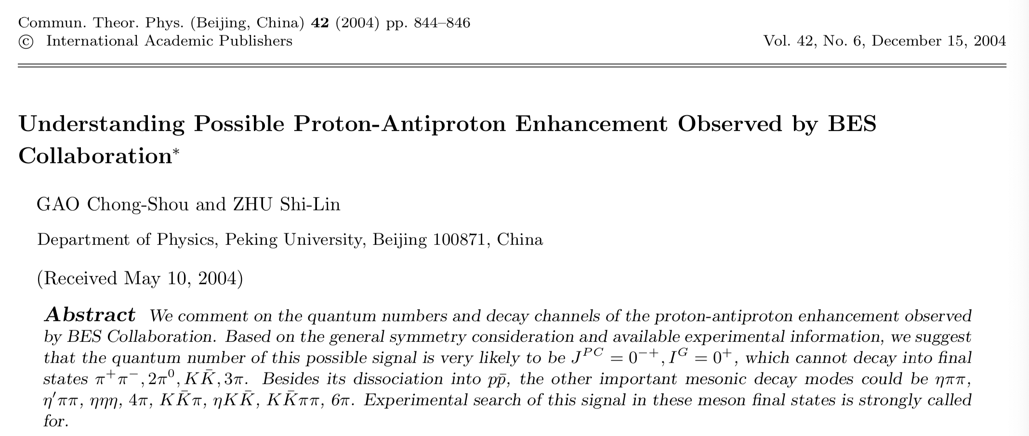
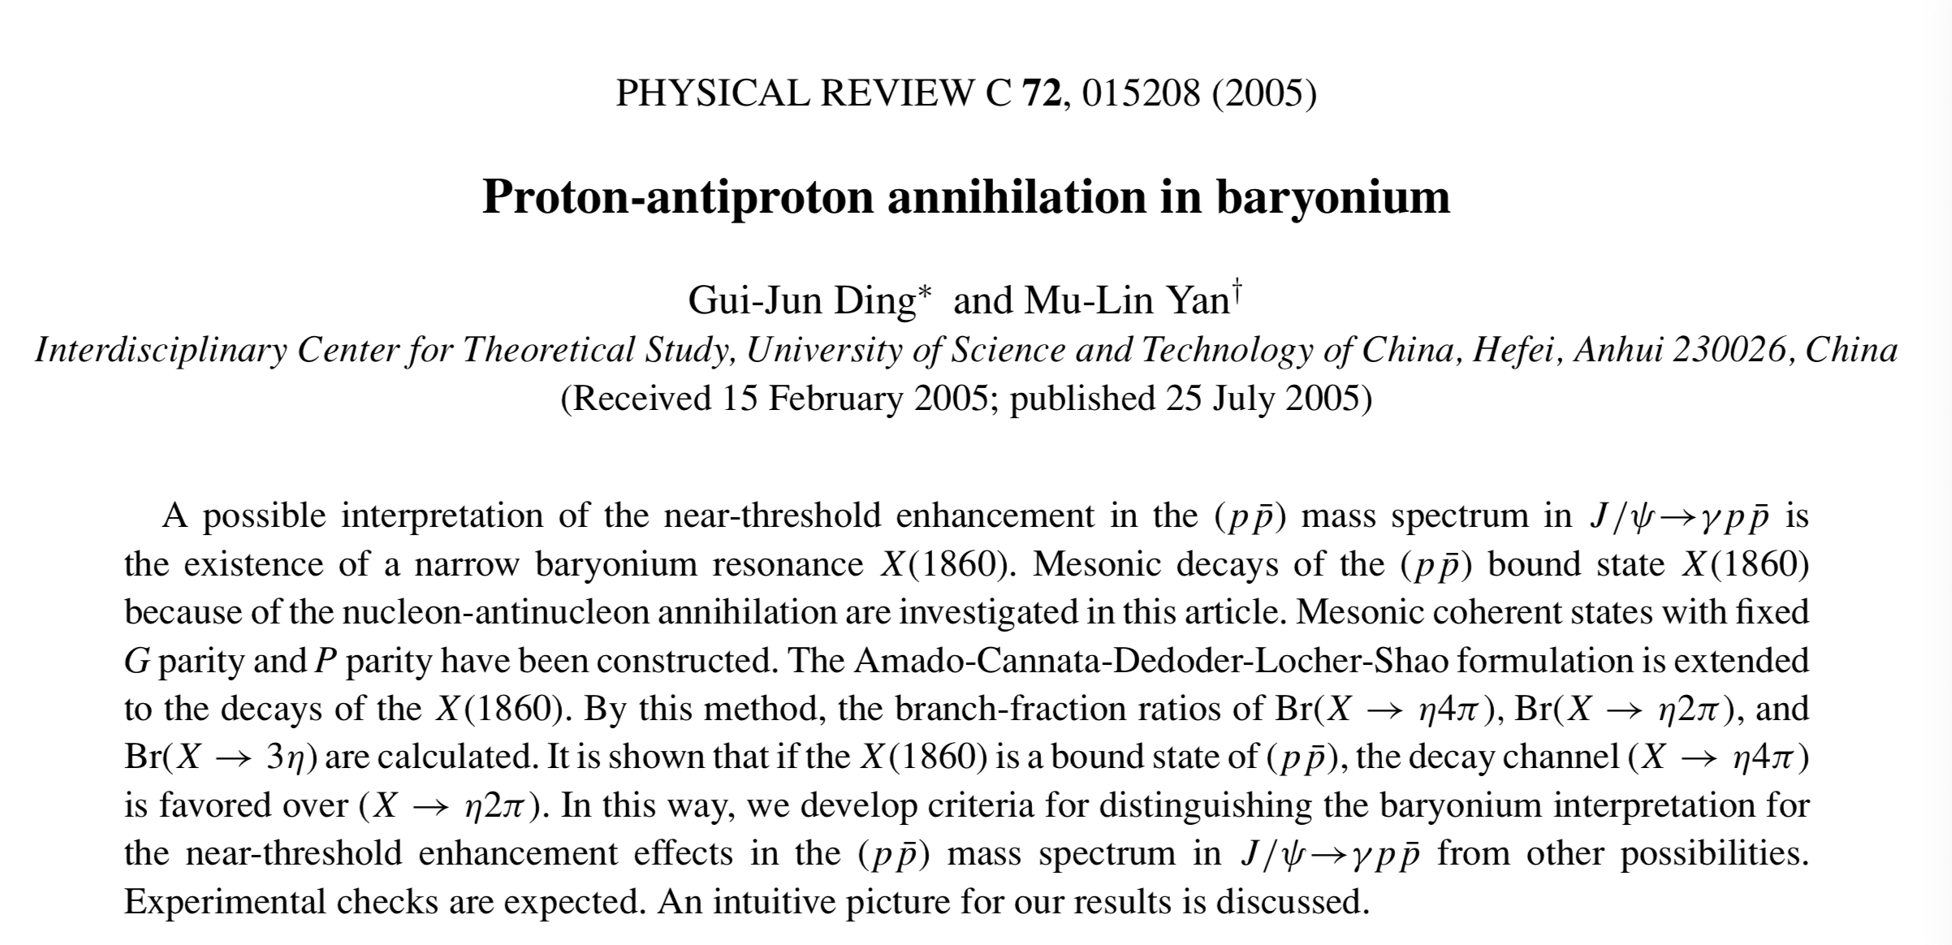
Theoretical speculations on its nature!
Conventional meson? FSI, baryonium state?
Baryonium interpretation would be supported by observation of the resonance in decay modes which are expected for a 𝑝𝑝̅ bound state.
Observation of its new decay modes strongly needed!
  π⁺π⁻π⁺π⁻η ,π⁺π⁻η′ ?
  C.S. Gao, S.L. Zhu, Commun.Theor.Phys. 42 (2004) 844; G.J. Ding, M.L. Yan, Phys.Rev.C 72 (2005) 015208

Slide 13
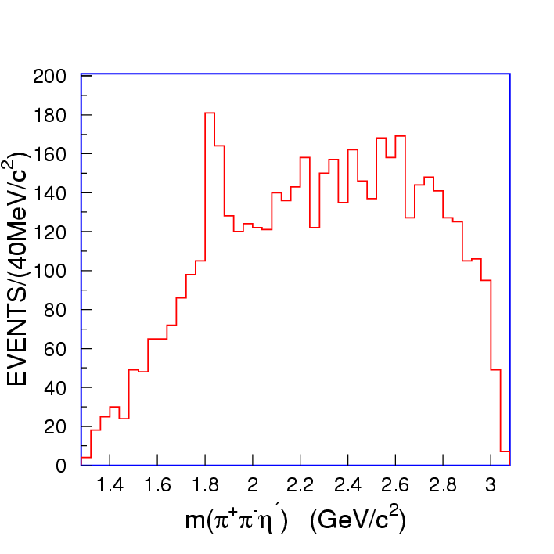
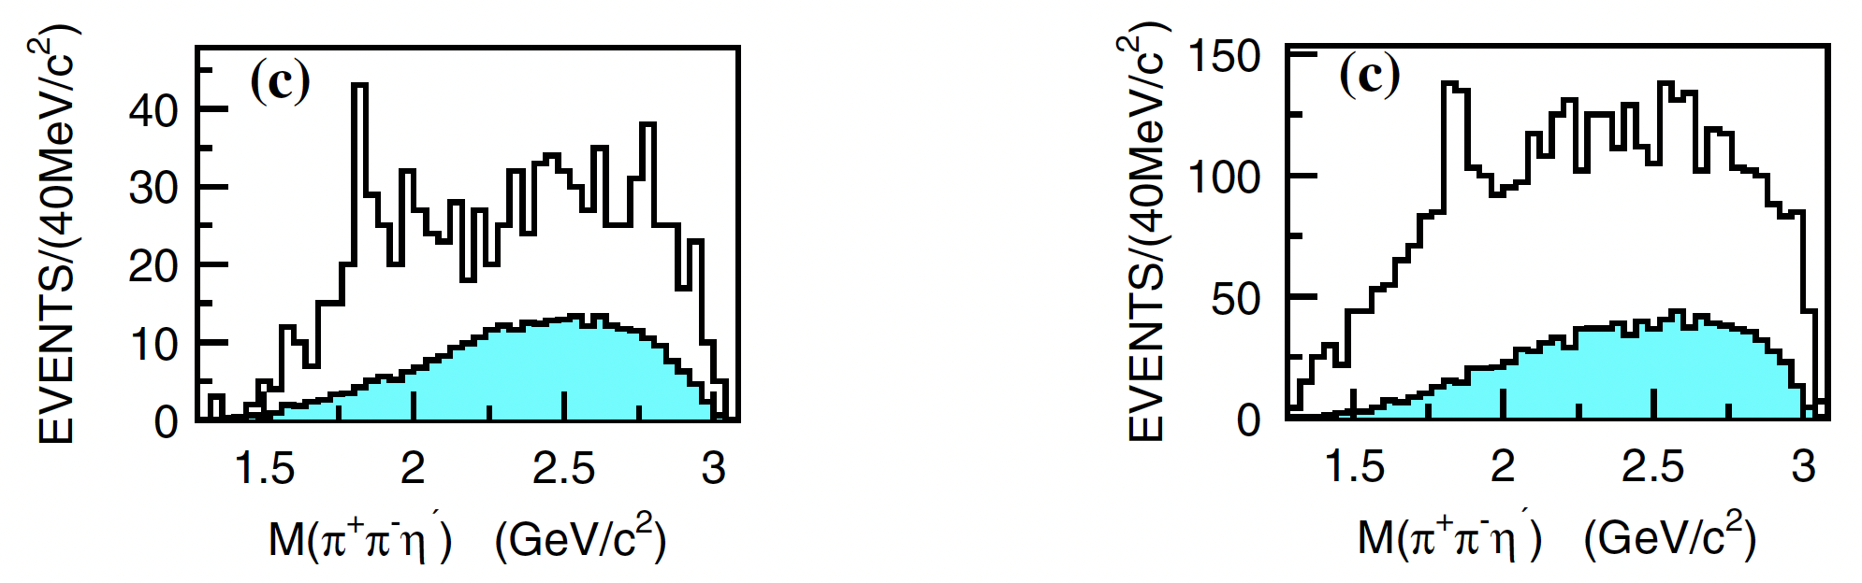
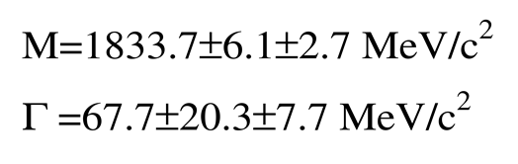
Observation of X(1835)in J/ψ→γ π⁺π⁻η′
η′→ π⁺π⁻η
X(1835)
η′ →γ π⁺π⁻

Slide 14
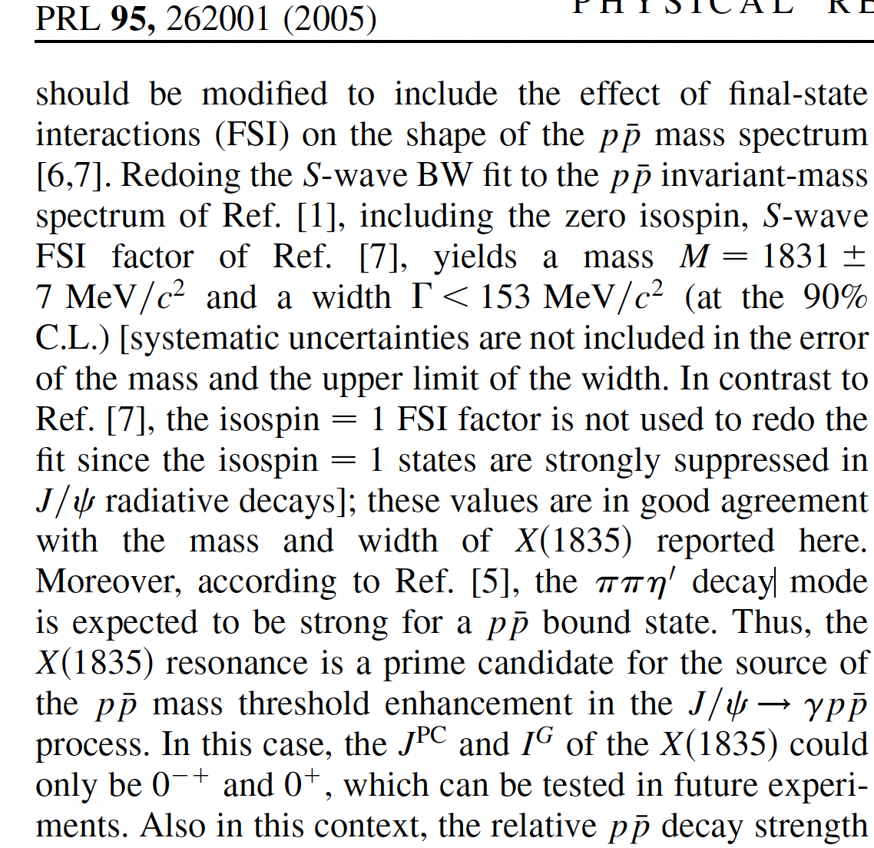
Redo the fit to 𝑝𝑝̅ by including FSI, the mass is consistent with that of X(1835)
𝐵(𝑋 → 𝑝𝑝̅ )/𝐵( 𝑋 → 𝜋𝜋𝜂’) ≈ 1/3
Unusually strong coupling to 𝑝𝑝̅ as expected for 𝑝𝑝̅ quasi-bound state!

Slide 15
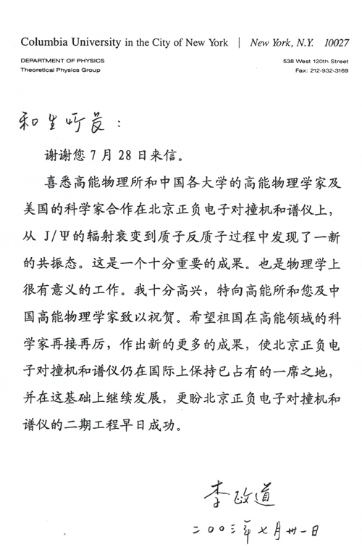



Slide 16

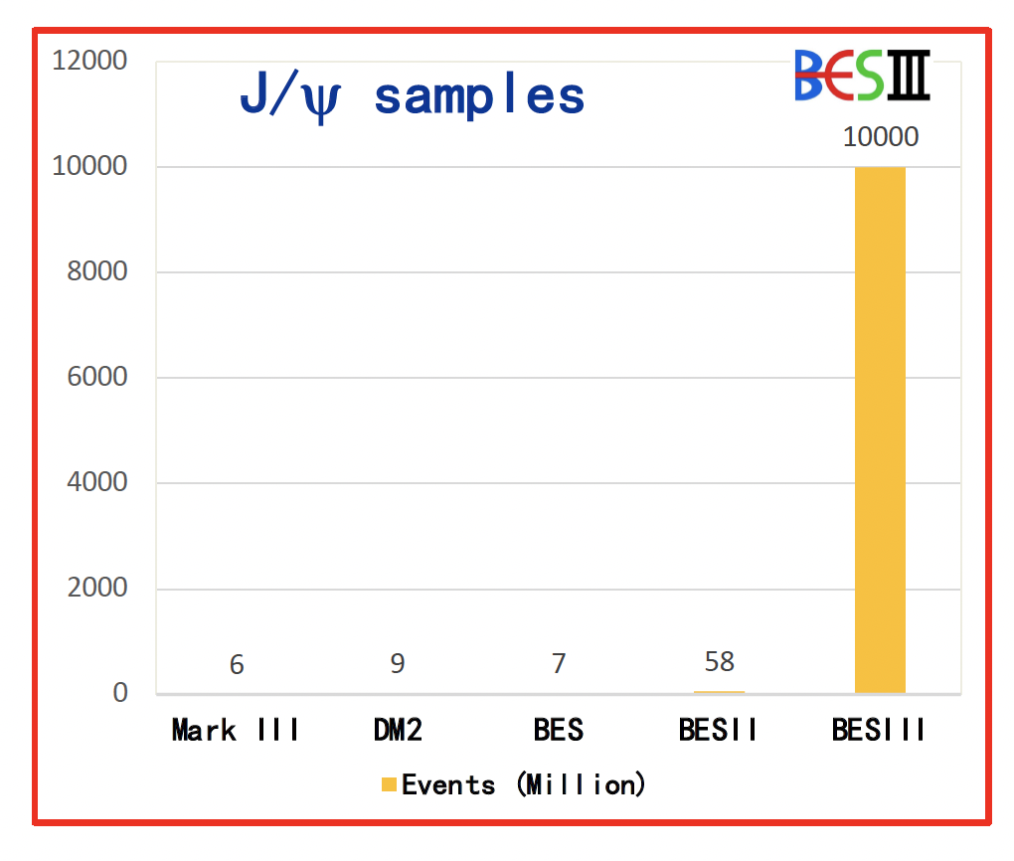
10 billion J/ψ events at BESIII
Chin. Phys. C 46, 074001 (2022)
2009, 225 million
2012, 1.08 billion
2018-19, 8.7 billion
Notes:
Because of High cross sections of e^+ e^−→J/ψ, ψ^′ and Low background at e+e- machine
Secondly, Charmonium decays provide Well defined initial and final states.
There are Kinematic constraints and quantum number constriants , which can make the analyses much easier.
Charmonium decays are gluon rich process, which is benefit to the study of glueballs and hybrids.

Slide 17
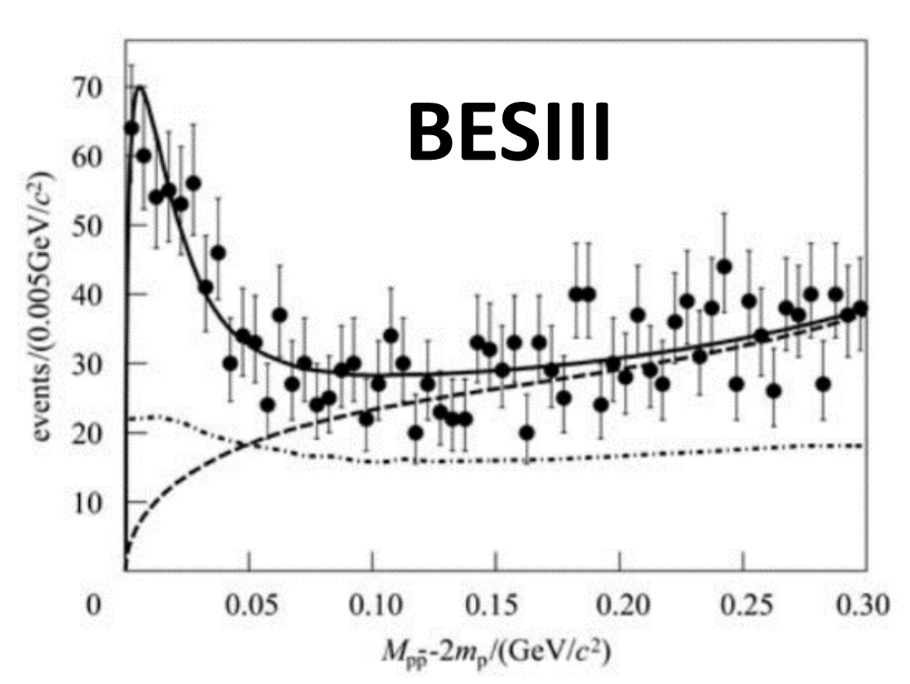
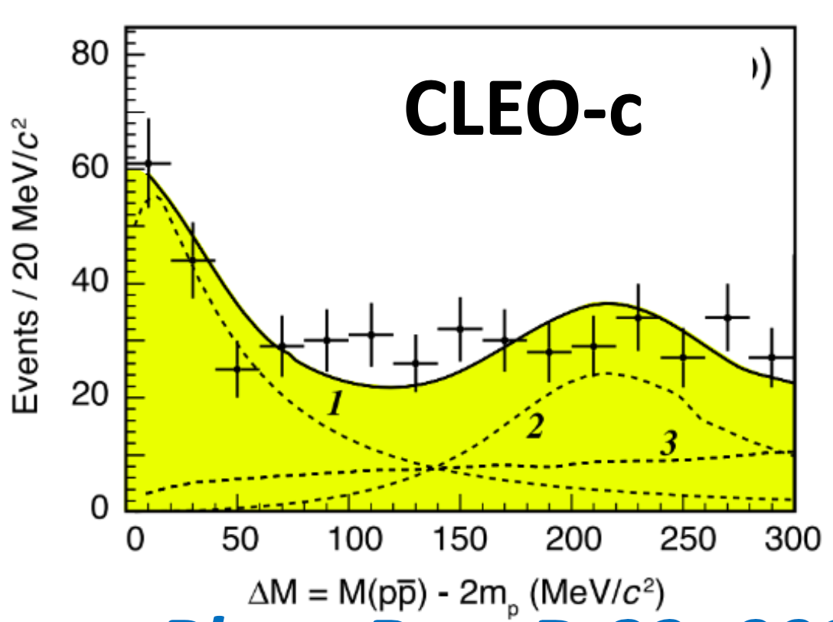


$\text{Confirmed} p\overline{p}$ threshold enhancement in $ψ$(2S)
$ψ(3686)→π^{+}π^{−}$ $J/ψ$, $J/ψ→γp\overline{p}$
Chin. Phys. C 34, 421 (2010)
Phys. Rev. D 82, 092002 (2010)

Slide 18
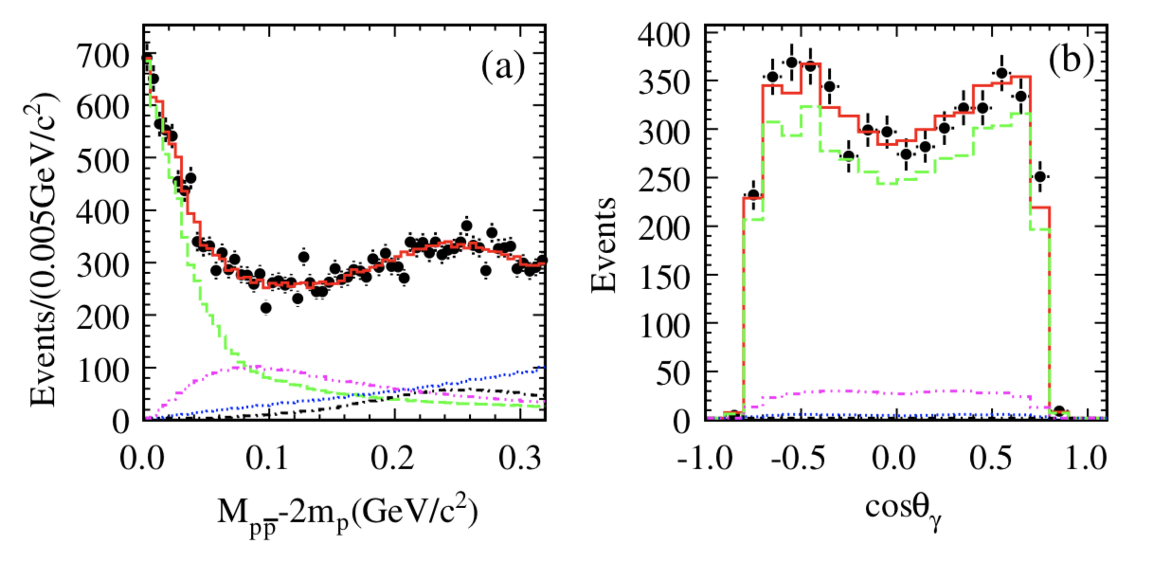

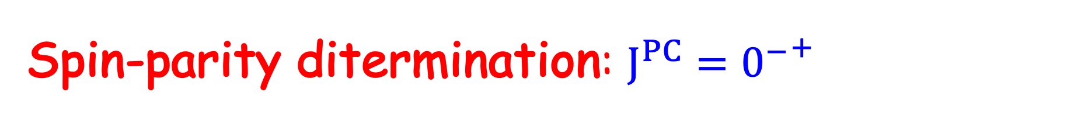
$\text{Spin}\text{-}\text{parity} \text{ditermination}$: $J^{PC}={0^{−}}^{+}$
  The fit with a BW and S-wave FSI (I=0) factor can well describe $p\overline{p}$ mass threshold structure
+19 +18
-5 -17
M=1832 MeV/c²
Γ < 76 MeV/c² (90% CL)
PRL 108 112003(2012)

Slide 19
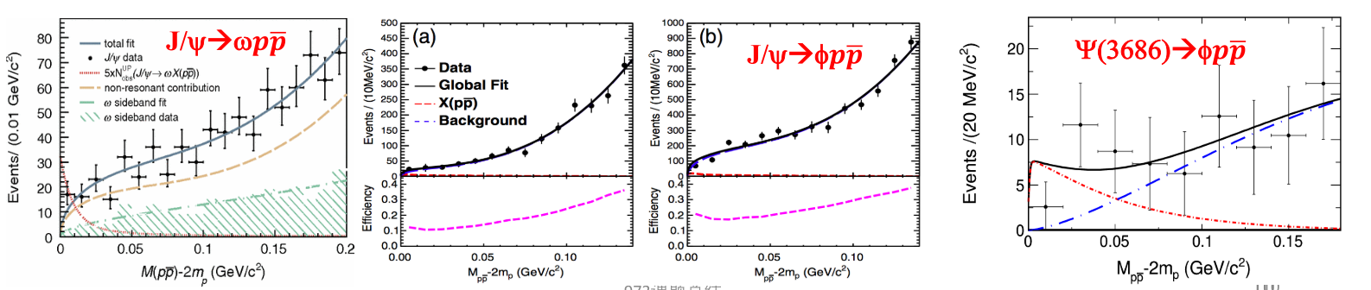

No $p\overline{p}$ threshold enhancement in hadronic decays
Implies that this structure not from pure FSI
PRD87,112014(2013)
PRD93,052010(2016)
PR D99 112010(2019)

Slide 20
Confirmation of X(1835) in J/ψ→γ π⁺π⁻η′
two news !
PRL 106, 072002(2011)
f1(1510)
Resonance | M( MeV/c²) | Γ( MeV/c²) | Stat.Sig.
X(1835) | 1836.5±3.0^{+5.6}_{-2.1} | 190.1±9.0⁺³⁸₋₃₆ | >20σ
X(2120) | 2122.4±6.7^{+4.7}_{-2.7} | 83±16⁺³¹₋₁₁ | 7.2σ
X(2370) | 2376.3±8.7^{+3.2}_{-4.3} | 83±17⁺⁴⁴₋₆ | 6.4σ
X(1835) consistent with 0⁻

Slide 21

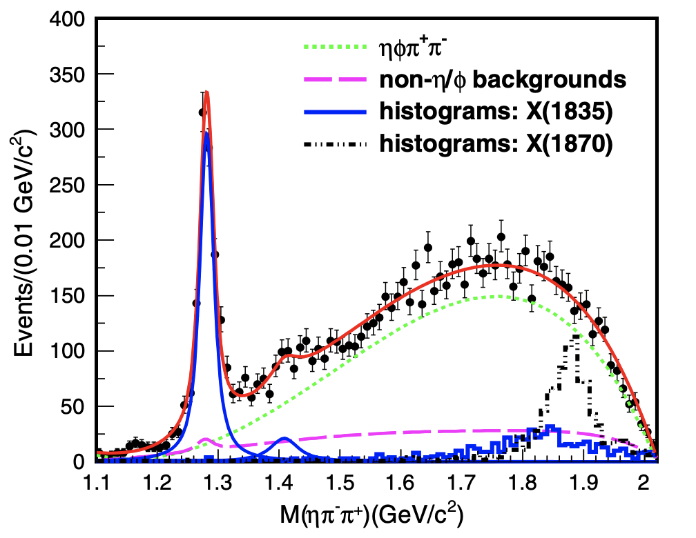
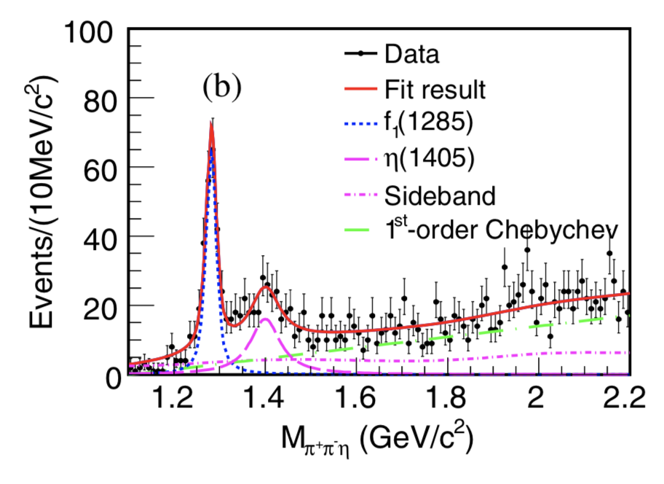
No evident structure in J/ψ hadronic decays
J/ψ→ω ππ η’
J/ψ→φηππ
PRD97,052017(2015)
PRD 99, 071101(R)(2019)
PRD100,092003(2019)

Slide 22
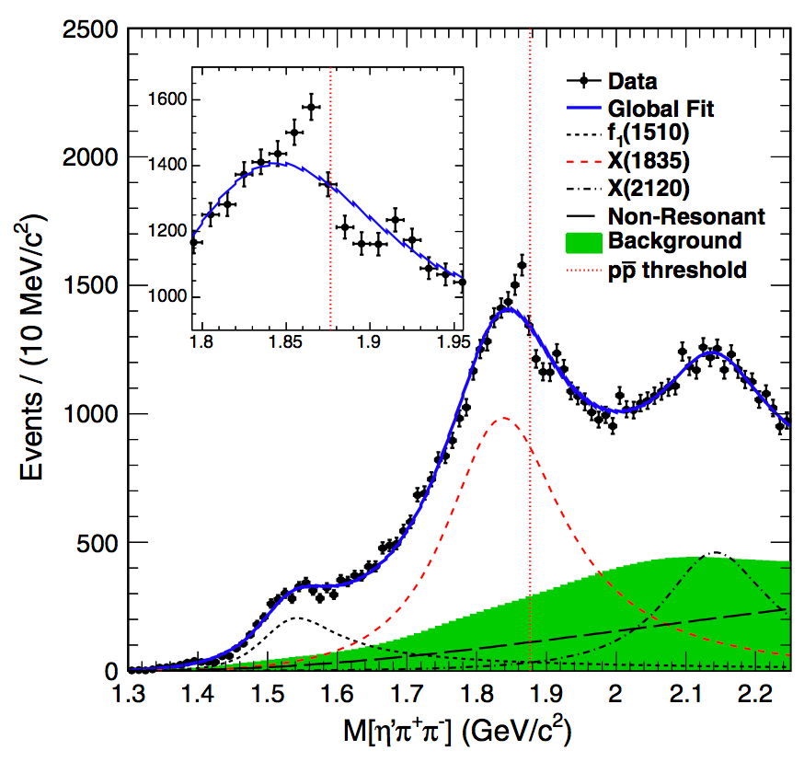

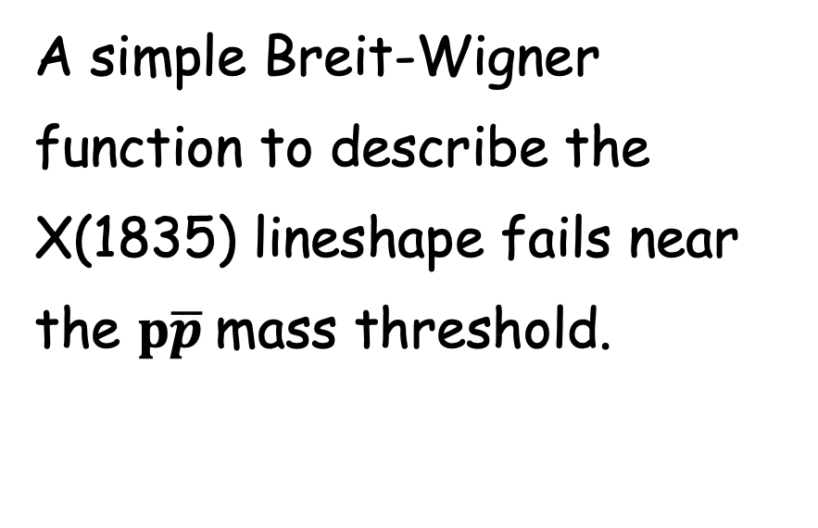
Anomalous line-shape of ${η^{′}π}^{+}π^{−}$in $J/ψ→γ{η^{′}π}^{+}π^{−}$
PRL117, 042002 (2016) 【1.3 billion $J/ψ$events】
A simple Breit-Wigner function to describe the X(1835) lineshape fails near the $p\overline{p}$mass threshold.

Slide 23
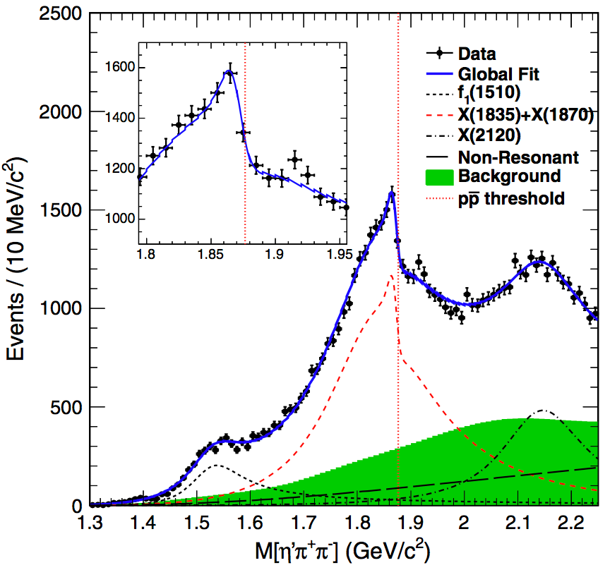

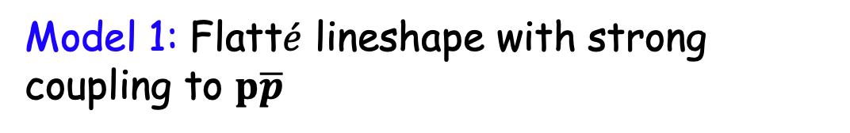
Anomalous line shape of ${η^{′}π}^{+}π^{−}$in $J/ψ→γ{η^{′}π}^{+}π^{−}$
PRL117, 042002 (2016) 【1.3 billion $J/ψ$events】
Model 1: Flatt$\acute{e}$ lineshape with strong coupling to $p\overline{p}$
M=1638.2±121.9 ^{+127.8}_{-254.3} MeV/c²
g²₀ = 93.7±35.4 ^{+47.6}_{-43.9} GeV/c²
g²_{p‾p} /g²₀ = 2.31±0.37 ^{+0.83}_{-0.60}

Slide 24
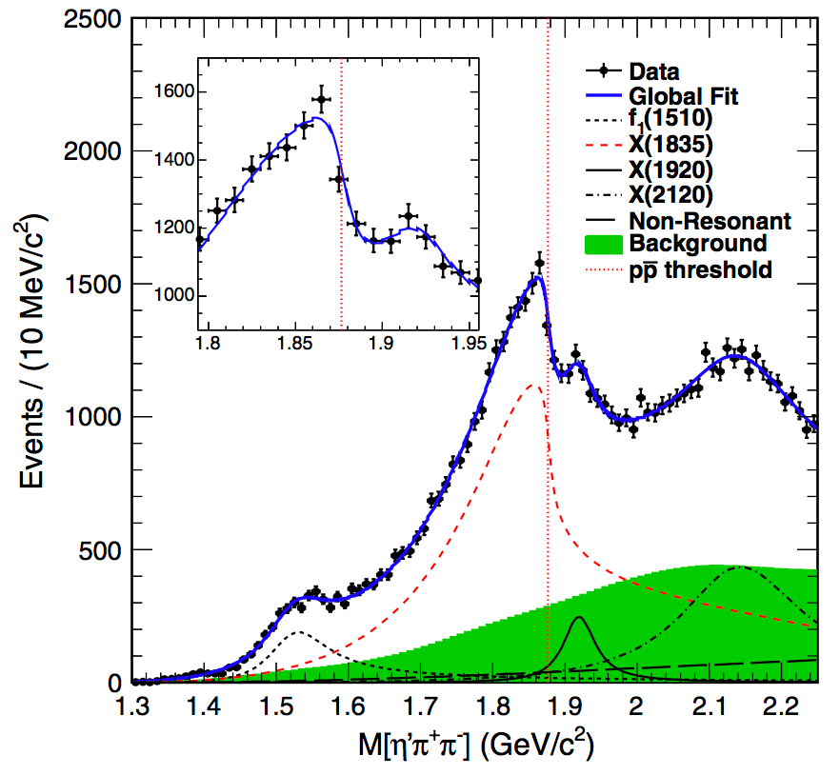
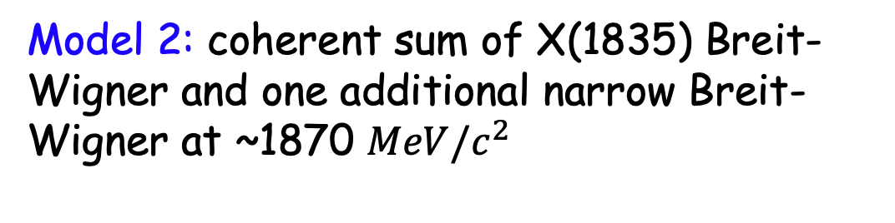
Anomalous line shape of ${η^{′}π}^{+}π^{−}$in $J/ψ→γ{η^{′}π}^{+}π^{−}$
PRL117, 042002 (2016) 【1.3 billion $J/ψ$events】
Model 2: coherent sum of X(1835) Breit-Wigner and one additional narrow Breit-Wigner at ~1870 $MeV/c^{2}$
Resonance | M( MeV/c²) | Γ( MeV/c²)
X(1870) | 1870.2±2.2^{+2.3} _{-0.7} | 13.0±6.1^{+2.1} _{-3.8}
X(1835) | 1825.3±2.4 ^{+17.3} _{-2.4} | 245.2±13.1^{+4.6} _{-9.6}
Fit suggests narrow state below 𝑝𝑝̅ threshold !

Slide 25


Anomalous line shape of ${η^{′}π}^{+}π^{−}$in $J/ψ→γ{η^{′}π}^{+}π^{−}$
PRL117, 042002 (2016) 【1.3 billion $J/ψ$events】
Model 2: coherent sum of X(1835) Breit-Wigner and one additional narrow Breit-Wigner at ~1870 $MeV/c^{2}$
Resonance | M( MeV/c²) | Γ( MeV/c²)
X(1870) | 1870.2±2.2^{+2.3} _{-0.7} | 13.0±6.1^{+2.1} _{-3.8}
X(1835) | 1825.3±2.4 ^{+17.3} _{-2.4} | 245.2±13.1^{+4.6} _{-9.6}
FK Guo, XH Liu, S. Sakai, Prog. Part. Nucl. Phys. 112,10375(2020)
Fit suggests narrow state below 𝑝𝑝̅ threshold !

Slide 26
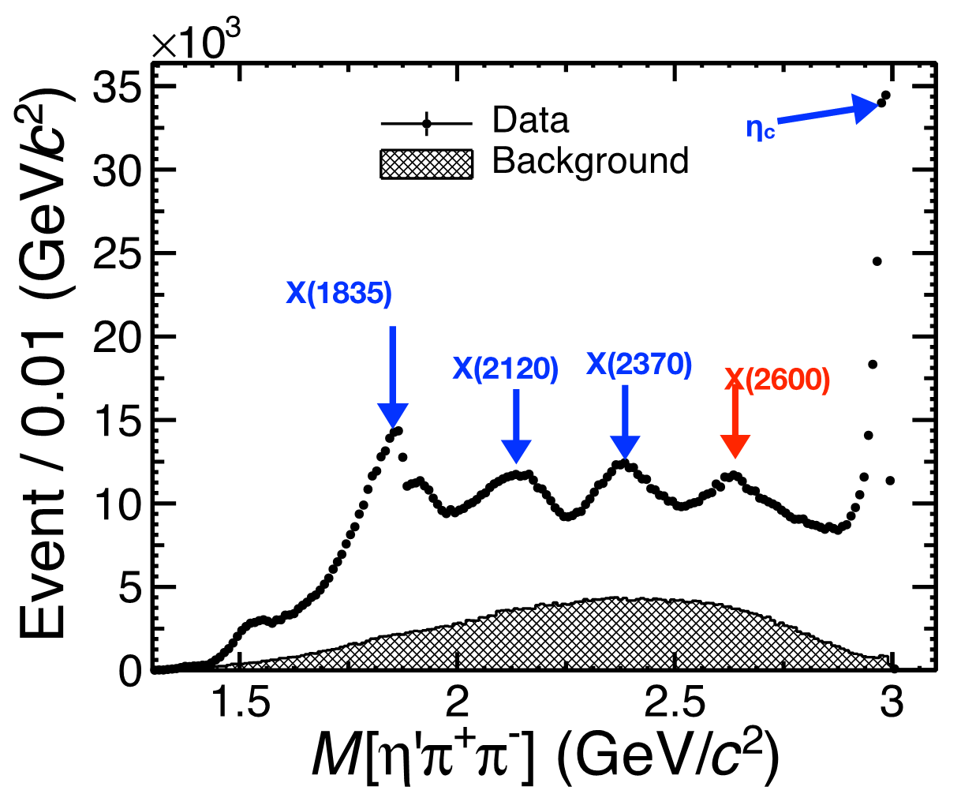
Anomalous line-shape of ${η^{′}π}^{+}π^{−}$ with 10 billion $J/ψ$ events
J/ψ→γππη′
PRL129 (2022) 042001
Notes:
最近的一篇关于新强子态的综述中，对于X（2370）是胶球候选者作了特别讨论！

Slide 27
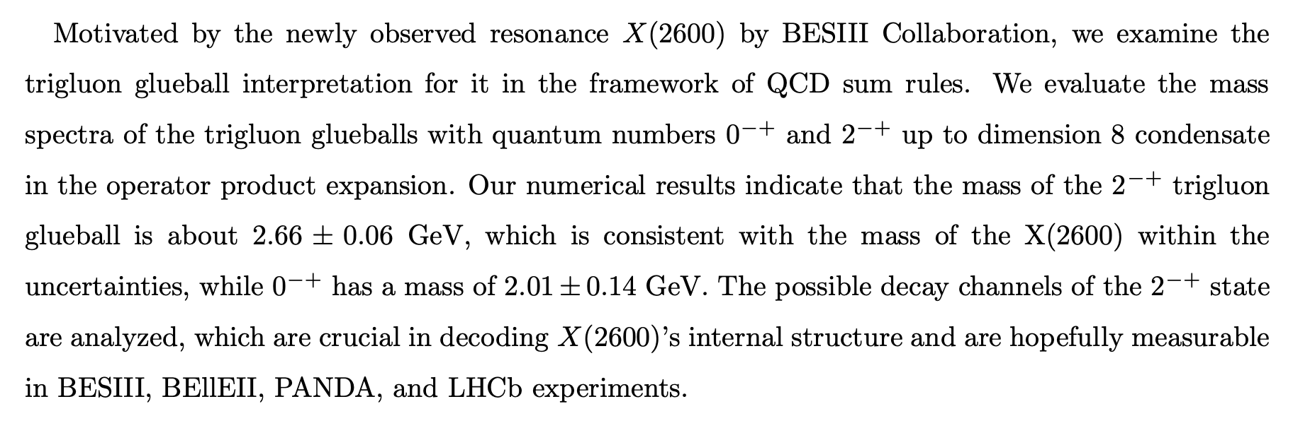
Anomalous line-shape of ${η^{′}π}^{+}π^{−}$ with 10 billion $J/ψ$ events
QCD sum rules arXiv:2206.13133
X(2600) new glueball candidates ?
Notes:
最近的一篇关于新强子态的综述中，对于X（2370）是胶球候选者作了特别讨论！

Slide 28
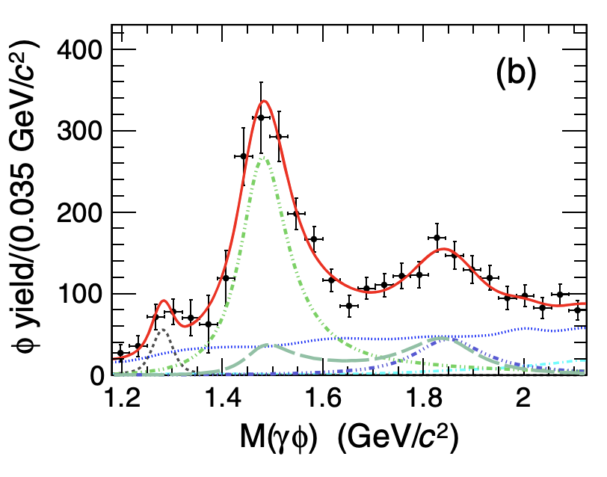
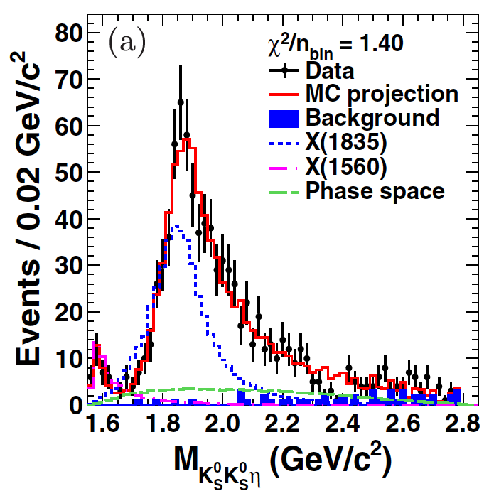
New decay modes of X(1835)
J/ψ→$γ γ$φ
J/ψ→$γ$ K_{s}K_{s}$η$
J/ψ→$γ \text{3(}\text{π}\text{+}\text{π}\text{−}\text{)}$
PRD 88, 091502 (2013)
PRD97, 051101(2018)
PRL 115, 091803(2018)
X(1840) → 3(π⁺π⁻) , new decay mode?
  X(1840) → $γ$φ, sizable $s\overline{s}$ component
  X(1835)→𝐾_{𝑆}𝐾_{𝑆}𝜂 with J^{PC}=0⁻⁺
Further investiigations needed to understand the structures around 1.84 GeV

Slide 29
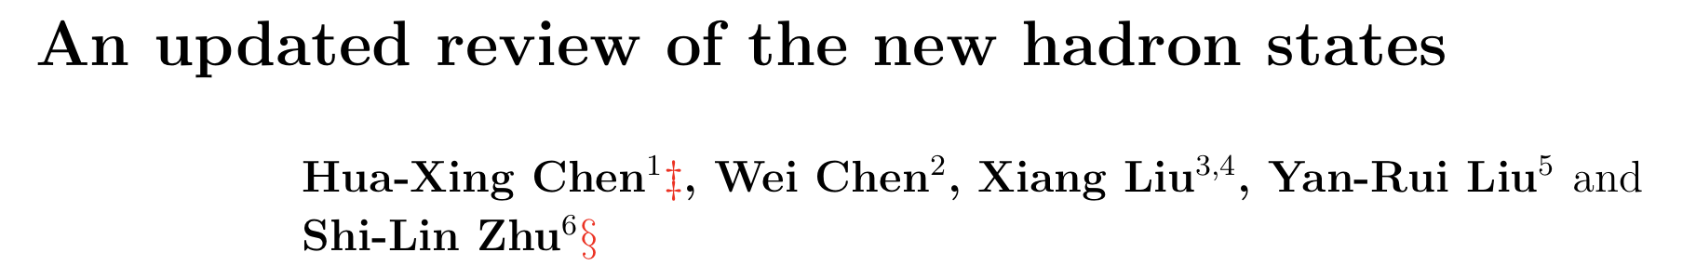
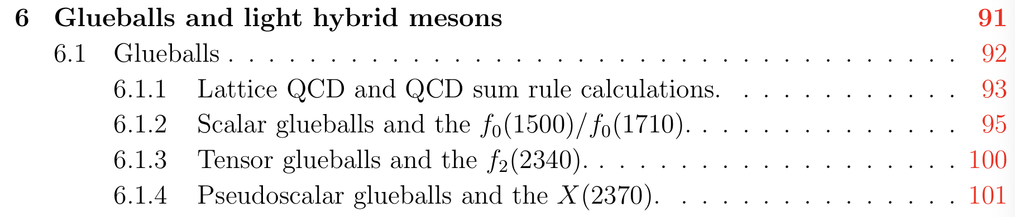
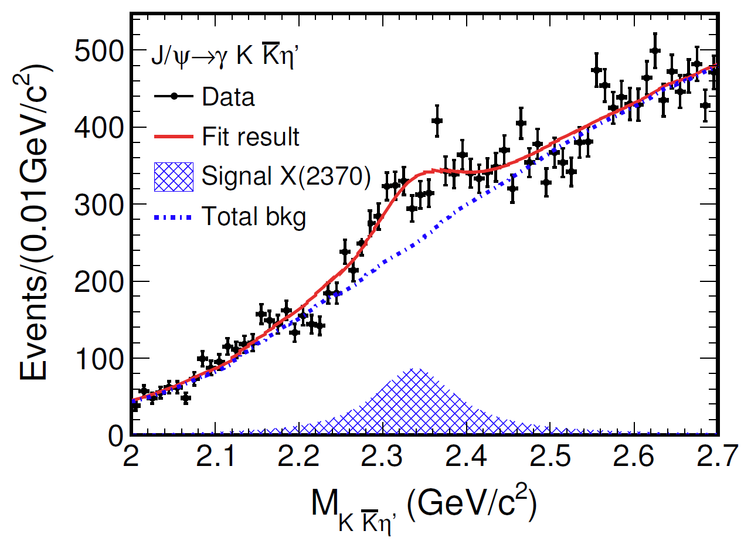

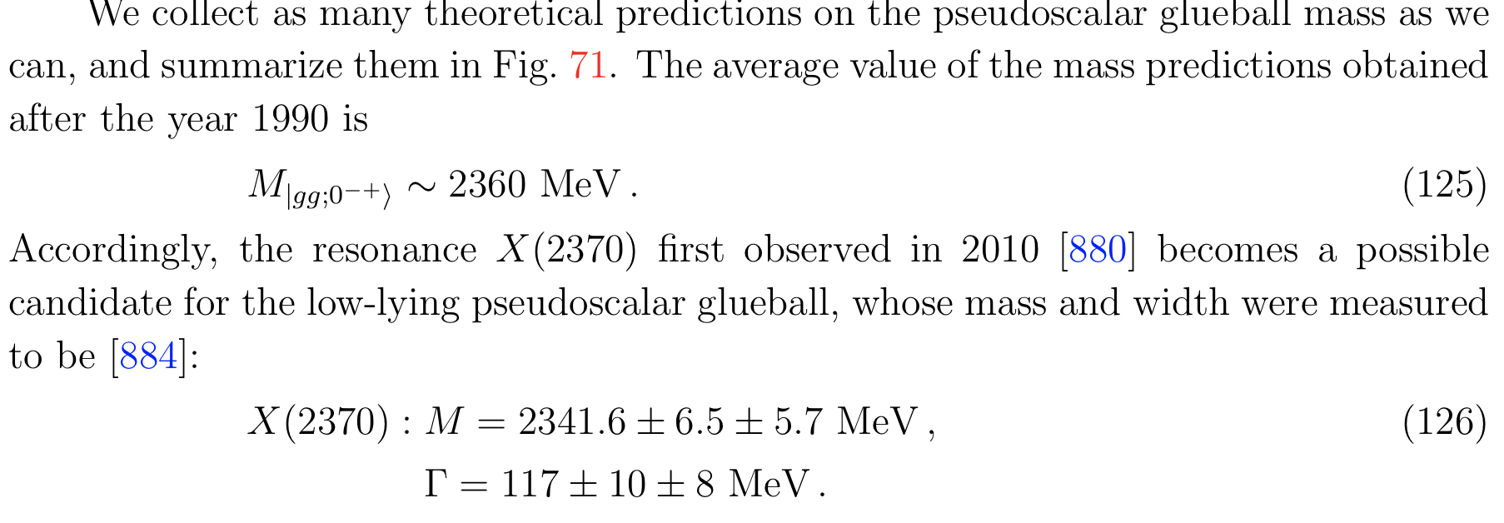
X(2370）: glueball candidate?
J/ψ→γKKη′
X(2370)
Eur. Phys. J. C 80, 746 (2020)
Notes:
最近的一篇关于新强子态的综述中，对于X（2370）是胶球候选者作了特别讨论！

Slide 30
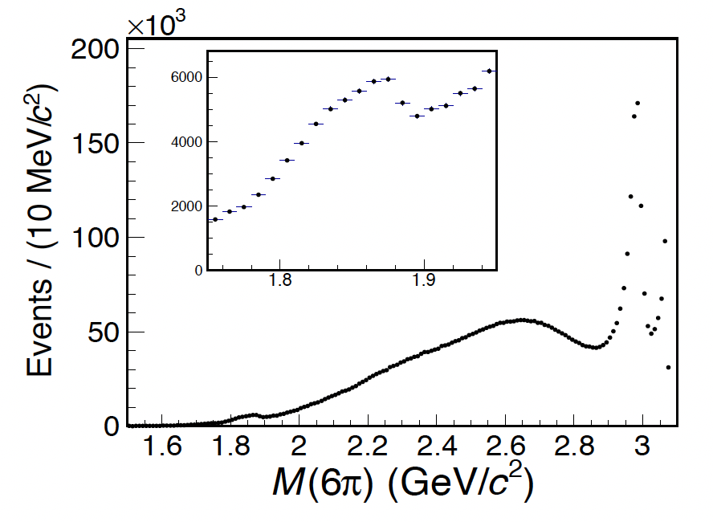
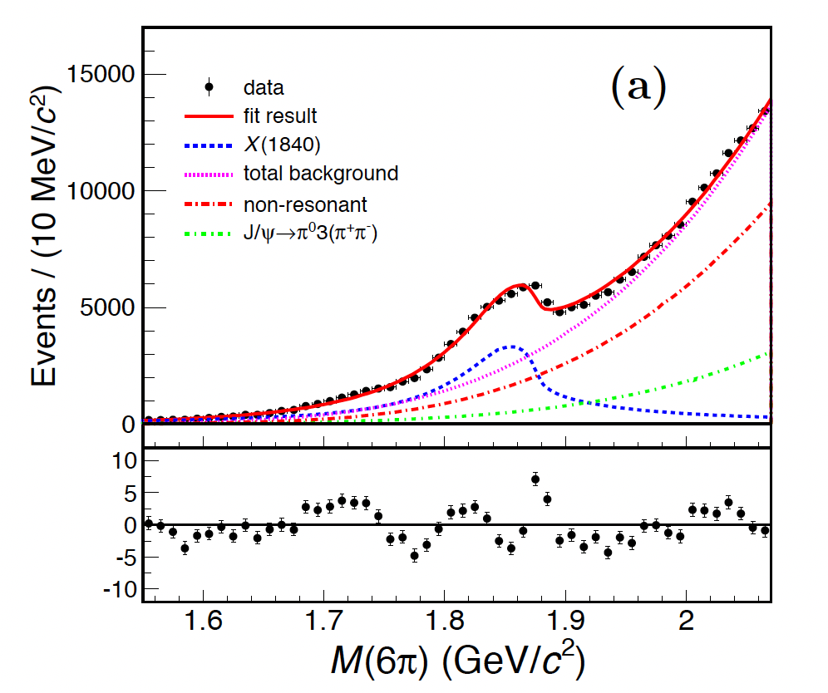

Anomalous line-shape of ${3(π}^{+}π^{−}) in$J/ψ→γ ${3(π}^{+}π^{−})$
Flatte function
$$ηc$$
X(1840)
arXiv:2310.17937

Slide 31
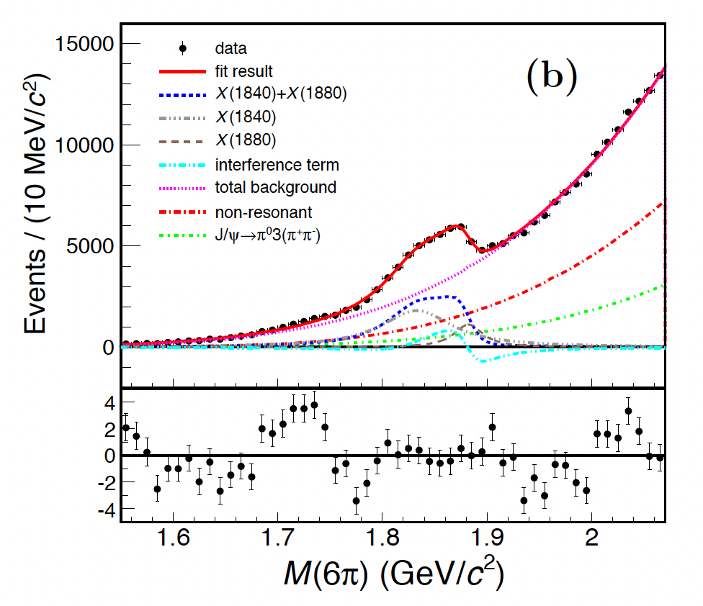
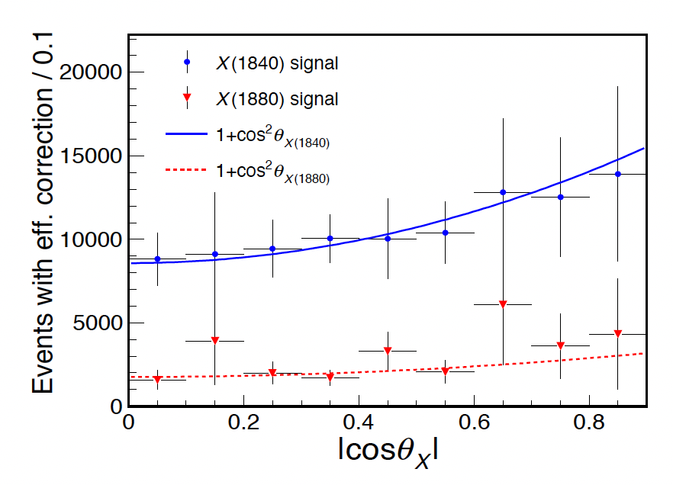
Two BWs
Consistent with pseudoscalars
Resonance | M( MeV/c²) | Γ( MeV/c²)
X(1880) | 1882.1±1.7±0.7 | 30.7±5.5±2.4
X(1830) | 1832.5±3.1±2.5 | 80.7±5.2±7.7
narrow state below 𝑝𝑝̅ threshold !

Slide 32
Summary
BESIII offers high precision measurements around 1.84 GeV
𝑝𝑝̅ mass threshold enhancement confirmed
Observed new decay modes in radiative decays, while not in hadronic decays
Anomalous line-shapes of π⁺π⁻η′ and 3(π⁺π⁻) suggest a narrow state strongly coupling to 𝑝𝑝̅
More works needed to understood their connections

Slide 33
非常感谢大家聆听！
非常感谢强子物理在线论坛！

