Slide 1




Institute of High Energy Physics
Triangle singularity in the hidden charm pentaquark decays and a feed-down mechanism at LHCb
Qiang Zhao
Institute of High Energy Physics, CAS
zhaoq@ihep.ac.cn
Workshop on near-threshold J/psi photoproduction
Feb. 19-22, 2024, Huizhou

Slide 2
Outline
A brief review of the Pc’s at LHCb
Novel phenomena arising from the Pc three-body and four-body decays
Comments on the J/psi photoproduction near threshold

Slide 3
1. A brief review of the Pc’s at LHCb
The mass positions and the preferred quantum numbers indicate the hadronic molecule nature of these observed enhancements.
Theoretical predictions: [1] J. J. Wu, T. S. H. Lee, and B. S. Zou, PRC 403, 044002 (2012)
[2] Z. C. Yang, Z. F. Sun, J. He, X. Liu, and S. L. Zhu, CPC36, 6 (2012)
Run-I: LHCb, PRL115, 072001 (2015)
Run-II: LHCb, PRL122, 222001 (2019)

Slide 4
Observation of $P_{c}(4380)$ and $P_{c}(4450)$ in $Λ_{b}^{0}→J/ψpπ$
LHCb, Phys.Rev.Lett. 117 (2016) 8, 082003, Phys.Rev.Lett. 117 (2016) 10, 109902 (addendum), Phys.Rev.Lett. 118 (2017) 119901 (addendum)

Slide 5
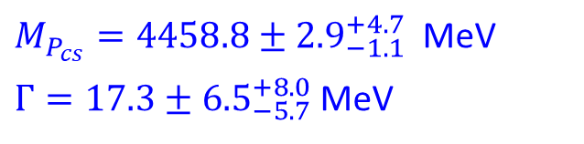

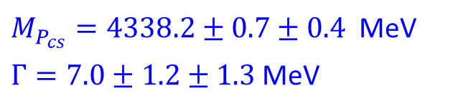
Observation of $P_{ψ_{s}}^{Λ}(4459)$ in $Ξ^{−}→J/ψΛK^{−}$ and $P_{ψ_{s}}^{Λ}(4338)$ in $B^{−}→J/ψΛ\overline{p}$
$M_{P_{cs}}=4458.8±{2.9}_{−1.1}^{+4.7}$MeV
$Γ=17.3±{6.5}_{−5.7}^{+8.0}$ MeV
$M_{P_{cs}}=4338.2±0.7±0.4$MeV
$Γ=7.0±1.2±1.3$ MeV
$Ξ_{c}^{+}D^{−}$ thresh.
LHCb, Sci.Bull. 66 (2021) 1278-1287
LHCb, Phys.Rev.Lett. 131 (2023) 3, 031901

Slide 6
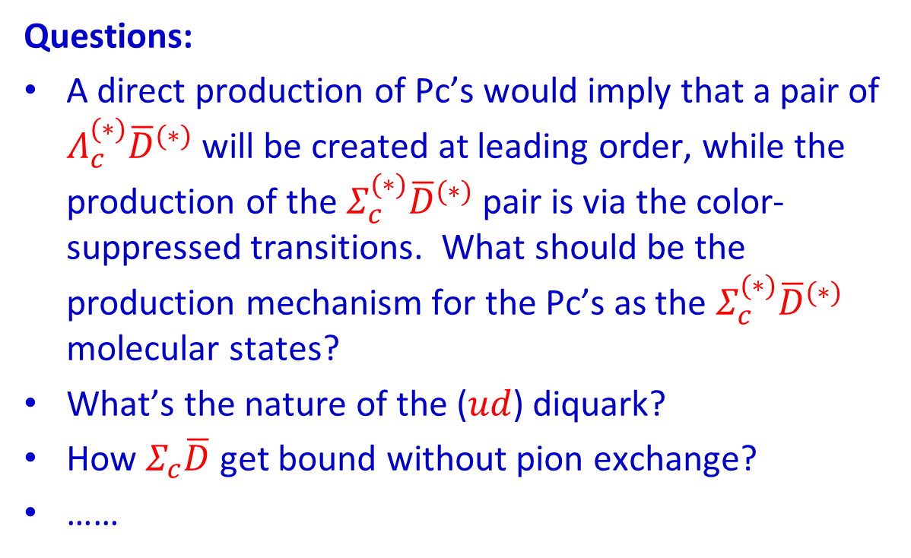
Crucial issues with the observed Pc pentaquarks
Questions:
A direct production of Pc’s would imply that a pair of $Λ_{c}^{(∗)}{\overline{D}}^{(∗)}$ will be created at leading order, while the production of the $Σ_{c}^{(∗)}{\overline{D}}^{(∗)}$ pair is via the color-suppressed transitions. What should be the production mechanism for the Pc’s as the $Σ_{c}^{(∗)}{\overline{D}}^{(∗)}$ molecular states?
What’s the nature of the ($ud$) diquark?
How $Σ_{c}\overline{D}$ get bound without pion exchange?
……
A novel feature that a loosely bound system is driven by the short-ranged interaction in the framework of hidden gauge symmetry dynamics.
[See Wu, Molina, Oset and Zou, PRL (2010). ]

Slide 7
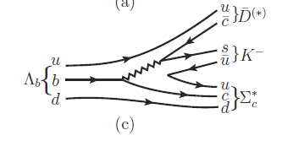

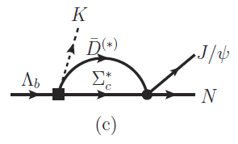
The color suppressed diagram may not be so suppressed!
Rescattering to generate a pole?
Favored by the molecular picture.
Coupled channel picture?
[see Y. Yamaguchi and E. Santopinto, PRD96, 014018 (2017); N. Yalikun et al., PRD104, 094039 (2021)]
X.-H. Liu, Q. Wang, and Q. Zhao, PLB(2016); arXiv:1507.05359 [hep-ph]

Slide 8
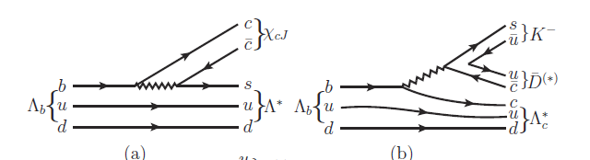
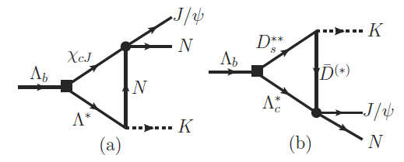
Rescatterings via triangle diagrams
X.-H. Liu, Q. Wang, and Q. Zhao, PLB(2016); arXiv:1507.05359 [hep-ph]
F.K. Guo, U.-G. Meissner, W. Wang and Z. Yang, PRD92, 071502 (2015); arXiv:1507.04950[hep-ph]

Slide 9
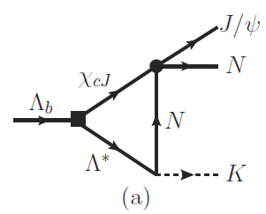

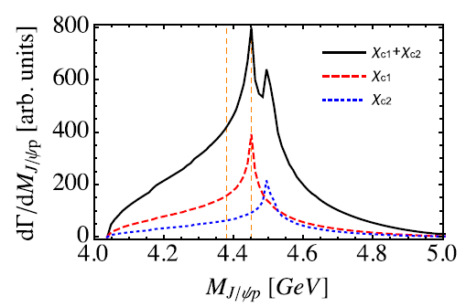
Thresholds for χ_{cJ} p
X.-H. Liu, Q. Wang, and Q. Zhao, PLB(2016); arXiv:1507.05359 [hep-ph]

Slide 10
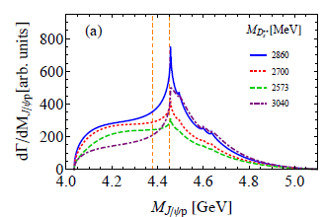
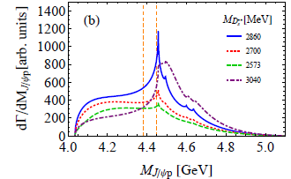
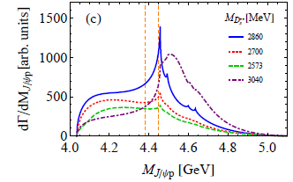
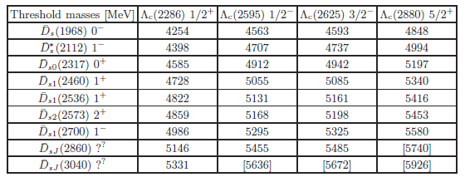
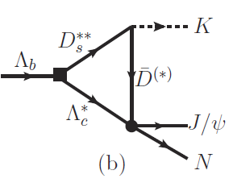
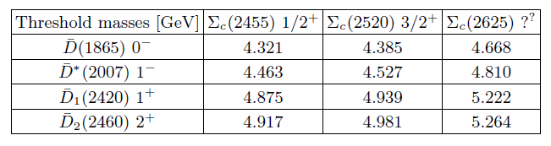
Threshold structures arising from the TS mechanism involving both W emission and color-suppressed trans.
The TS is not sufficient for explaining the Run-II data. Pole structures are needed for those observed Pc signals.
Do we have further evidences for understanding the nature of Pc’s?

Slide 11











2. Novel phenomena arising from the Pc three-body and four-body decays
Two-body decay:
Hidden charm decays are generally suppressed.
Three-body decay:
Hidden charm decays are further suppressed by the phase space. However, the presence of triangle singularity (TS) or box singularity (BS) may produce unique structures.
$Σ_{c}^{\left(∗\right)}$
$p$
$Σ_{c}^{\left(∗\right)}$
$π$
Pc
Pc
$D$
$Λ_{c}$
${\overline{D}}^{(∗)}$
$J/ψ$
${\overline{D}}^{(∗)}$
$J/ψ$
$p$

Slide 12
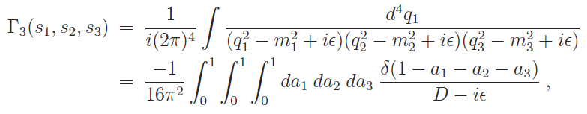
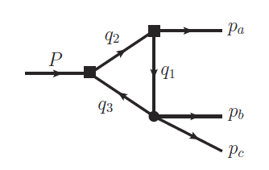



Exotics of Type-III:
Peak structures caused by kinematic effects, in particular, by triangle singularity.
The TS occurs when all the three internal particles can approach their on-shell condition simultaneously:
for all j=1,2,3.
L. D. Landau, Nucl. Phys. 13, 181 (1959);
J.J. Wu, X.-H. Liu, Q. Zhao, B.-S. Zou, Phys. Rev. Lett. 108, 081003 (2012)
Q. Wang, C. Hanhart, Q. Zhao, Phys. Rev. Lett. 111, 132003 (2013); Phys. Lett. B 725, 106 (2013)
X.-H. Liu, M. Oka and Q. Zhao, PLB753, 297(2016)
M.-C. Du and Q. Zhao, Phys.Rev.D 100 (2019) 3, 036005
F.-K. Guo, C. Hanhart, U.-G. Meissner, Q. Wang, Q. Zhao, B.-S. Zou, Rev. Mod. Phys. 90, 015004 (2018)
F.-K. Guo, X.-H. Liu, and S. Sakai, Prog.Part.Nucl.Phys. 112 (2020) 103757

Slide 13
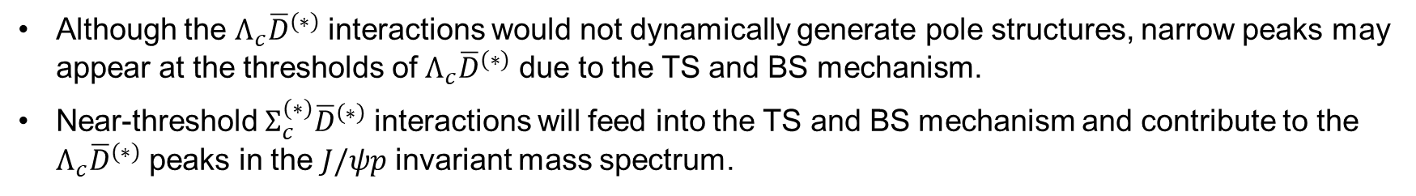
Triangle and box singularity in Pc three and four-body decays
Although the $Λ_{c}{\overline{D}}^{(∗)}$ interactions would not dynamically generate pole structures, narrow peaks may appear at the thresholds of $Λ_{c}{\overline{D}}^{(∗)}$ due to the TS and BS mechanism.
Near-threshold $Σ_{c}^{(∗)}{\overline{D}}^{\left(∗\right)}$ interactions will feed into the TS and BS mechanism and contribute to the $Λ_{c}{\overline{D}}^{(∗)}$ peaks in the $J/ψp$ invariant mass spectrum.

Slide 14








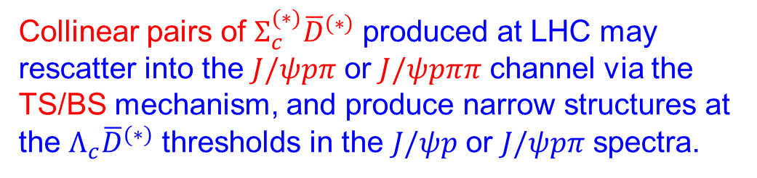
A feed-down mechanism for producing the enhancements at the $Λ_{c}{\overline{D}}^{(∗)}$ thresholds
$p$
$p$
Collinear pairs of $Σ_{c}^{(∗)}{\overline{D}}^{\left(∗\right)}$ produced at LHC may rescatter into the $J/ψpπ$ or $J/ψpππ$ channel via the TS/BS mechanism, and produce narrow structures at the $Λ_{c}{\overline{D}}^{(∗)}$ thresholds in the $J/ψp$ or $J/ψpπ$ spectra.
$Σ_{c}^{\left(∗\right)}$
$π$
${\overline{D}}^{(∗)}$
$Λ_{c}$
$J/ψ$
$p$
M.-X. Duan, L. Qiu, X.-Z. Ling, and Q. Zhao, PRD in press; arXiv:2303.13329 [hep-ph]

Slide 15
Effective Lagrangians for the interaction vertices:
The coupling strength is determined by the t-channel scattering with the heavy meson exchange and the Lagrangians are:
M.-X. Duan, L. Qiu, X.-Z. Ling, and Q. Zhao, PRD in press; arXiv:2303.13329 [hep-ph]

Slide 16
The triangle loop amplitudes have the following forms:
where a monopole form factor is adopted to regularize the UV divergence:

Slide 17
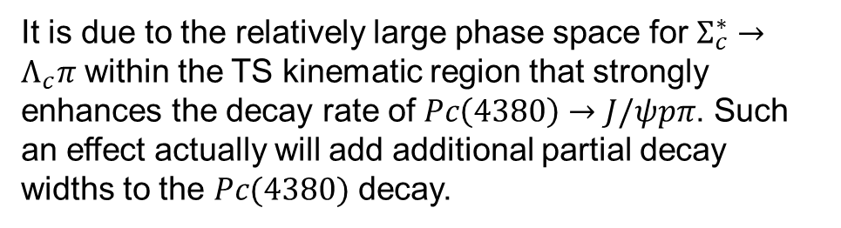


The invariant mass spectra of $J/ψp$ for the exclusive decays of Pc states into $J/ψpπ$ and/or $J/ψpππ$ channels.
$$Λ_{c}\overline{D}$$
$$Λ_{c}\overline{D}$$
It is due to the relatively large phase space for $Σ_{c}^{∗}→Λ_{c}π$ within the TS kinematic region that strongly enhances the decay rate of $Pc\left(4380\right)→J/ψpπ$. Such
an effect actually will add additional partial decay widths to the $Pc(4380)$ decay.

Slide 18
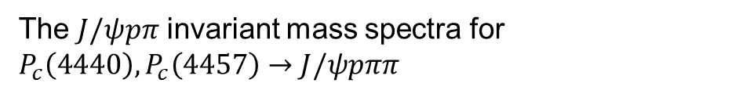
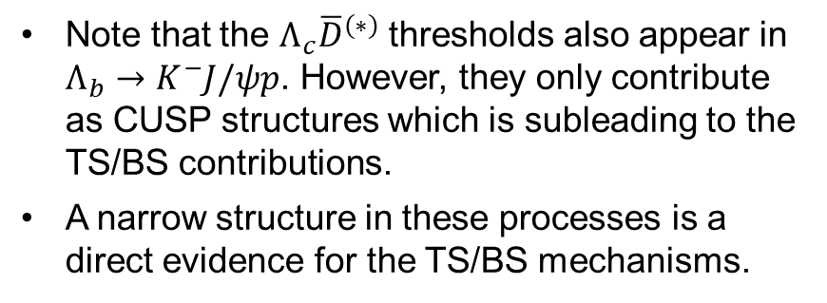
The $J/ψpπ$ invariant mass spectra for $P_{c}\left(4440\right), P_{c}\left(4457\right)→J/ψpππ$
Note that the $Λ_{c}{\overline{D}}^{(∗)}$ thresholds also appear in $Λ_{b}→K^{−}J/ψp$. However, they only contribute as CUSP structures which is subleading to the TS/BS contributions.
A narrow structure in these processes is a direct evidence for the TS/BS mechanisms.

Slide 19
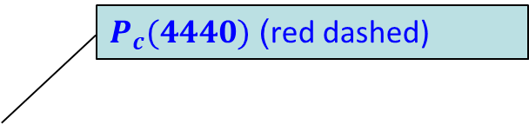
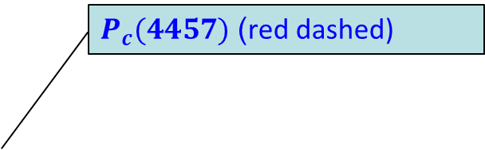
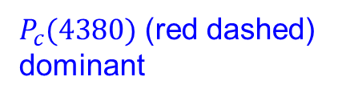
The accumulated $J/ψp$ (left) and $J/ψpπ$ (right) invariant mass spectra from all different Pc states
$P_{c}(4380)$ (red dashed)
dominant
$P_{c}(4457)$ (red dashed)
$P_{c}(4440)$ (red dashed)

Slide 20
3. Comments on the J/psi photoproduction near threshold

Slide 21
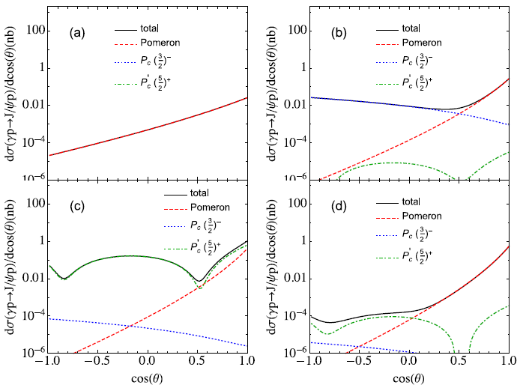
Photoproduction will provide crucial evidence for understanding the Pc’s nature
γ
eh₁
J/ψ
P_{c}
dσ/dΩ
p
p
t-channel:
Pomeron exchange
γ
g₁
J/ψ
J/ψ
P_{c}
p
p
s-channel, direct Pc’s
J/ψ
e⁺
u-channel
e⁻
Q. Wang, X.-H. Liu, and Q. Z., PRD92, 034022 (2015); arXiv:1508.00339 [hep-ph]
V. Kubarovsky and M.B. Voloshin, PRD92, 031502 (2015)
M. Karliner and J. Rosner, PLB752, 329 (2016)
M.L. Du et al., Eur.Phys.J.C 80 (2020) 11, 1053
0
90
180
Scattering angle

Slide 22
Photoproduction mechanism:
S. Adhikari et al. [GlueX], Phys. Rev. C 108, no.2, 025201 (2023)

Slide 23
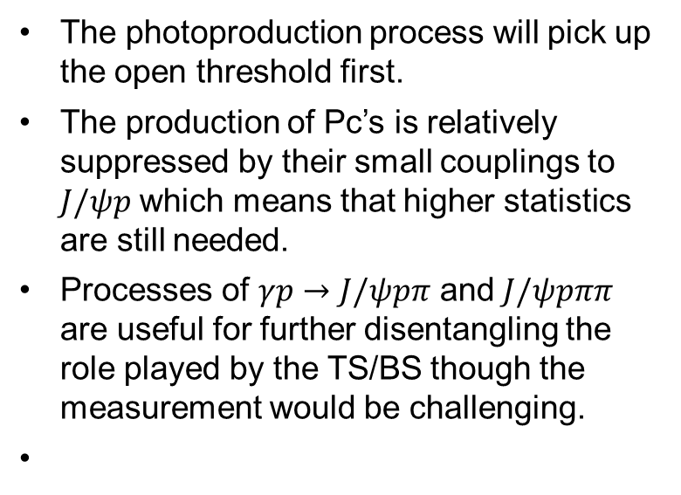
Exclusive and inclusive contributions from different open threshold channels
The photoproduction process will pick up the open threshold first.
The production of Pc’s is relatively suppressed by their small couplings to $J/ψp$ which means that higher statistics are still needed.
Processes of $γp→J/ψpπ$ and $J/ψpππ$ are useful for further disentangling the role played by the TS/BS though the measurement would be challenging.
Thanks for your attention!

Slide 24
Kinematic features of the production mechanism
Forward angle peaking is predominant due to the diffractive process, i.e. Pomeron exchanges.
S-channel resonance excitations contribute to the cross sections at middle and backward angles.
U-channel contributes to backward angles.
dσ/dΩ
t-channel:
Pomeron exchange
s-channel
u-channel
Interferences from different transition mechanisms
0
90
180
Scattering angle
Q. Wang, X.-H. Liu, and Q. Z., PRD92, 034022 (2015); arXiv:1508.00339 [hep-ph]

Slide 25
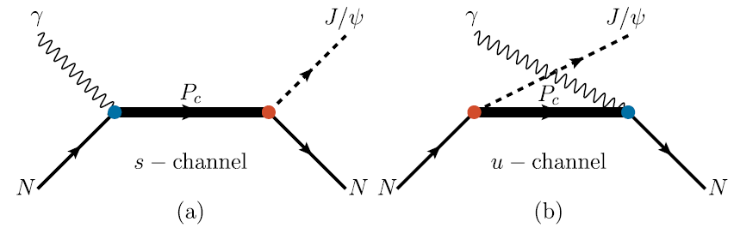
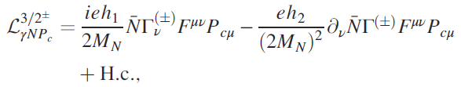
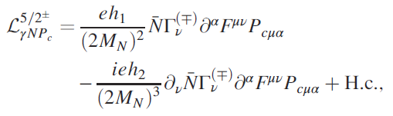

s and u-channel pentaquark production
Coupling vertices for γNP_{c}:
S. H. Kim, S. i. Nam, Y. Oh and H. C. Kim, PRD 84, 114023 (2011)
Q. Wang, X.-H. Liu, and Q. Zhao, PRD92 (2015) 034022; arXiv:1508.00339 [hep-ph]

Slide 26
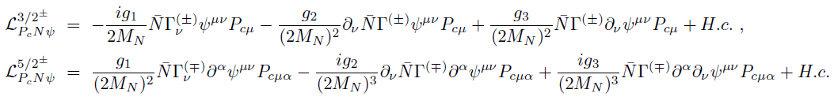
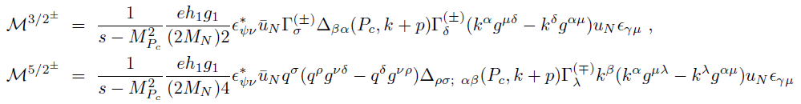
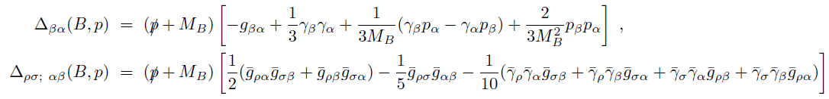
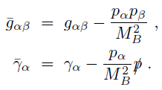
Coupling vertices for J/ψNP_{c}:
Leading transition matrix elements:
Rarita-Schwinger spin projections:
with

Slide 27



Vector meson dominance
γ
γ
eh₁
J/ψ
J/ψ
g₁
J/ψ
P_{c}
P_{c}
p
p
p
p
J/ψ
e⁺
e⁻
By assuming that the J/ψ p saturate the decay widths of the Pc states, we have
A form factor is included:

Slide 28
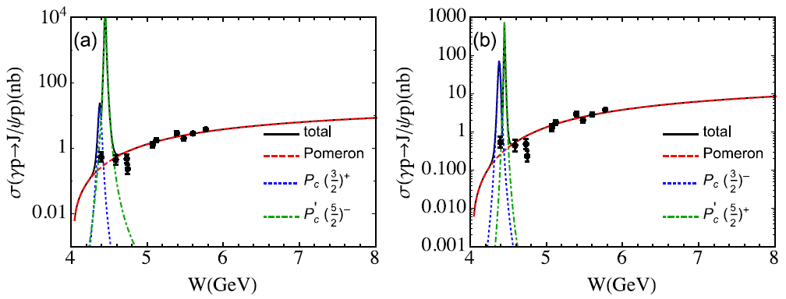
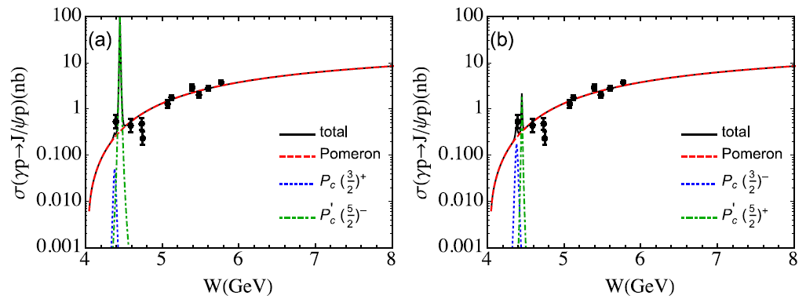
Total cross sections predicted:
Full width prediction
Prediction with 5% of b.r. to J/ψ p:

Slide 29
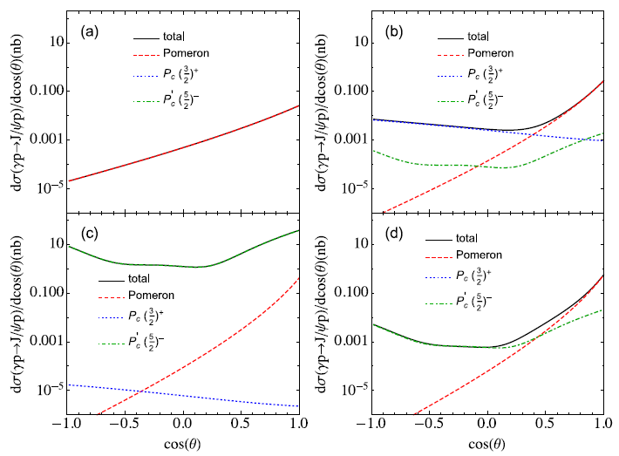
Predicted differential cross sections at different energies:
W= 4.15 GeV
W= 4.38 GeV
W= 4.45 GeV
W= 4.50 GeV

Slide 30
Predicted differential cross sections at different energies:
W= 4.15 GeV
W= 4.38 GeV
W= 4.45 GeV
W= 4.50 GeV

Slide 31
Some early studies:
J. J. Wu, R. Molina, E. Oset and B. S. Zou, Phys. Rev. Lett. 105, 232001 (2010) [arXiv:1007.0573 [nucl-th]].
J. J. Wu, R. Molina, E. Oset and B. S. Zou, Phys. Rev. C 84, 015202 (2011) [arXiv:1011.2399 [nucl-th]].
J. J. Wu, T.-S. H. Lee and B. S. Zou, Phys. Rev. C 85, 044002 (2012) [arXiv:1202.1036 [nucl-th]].
Z. C. Yang, Z. F. Sun, J. He, X. Liu and S. L. Zhu, Chin. Phys. C 36, 6 (2012) [arXiv:1105.2901 [hep-ph]].

Slide 32
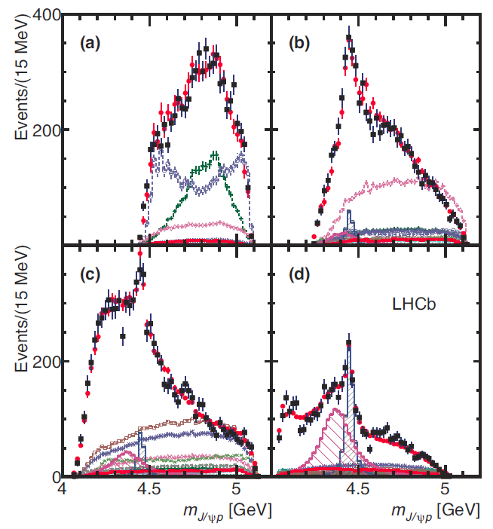
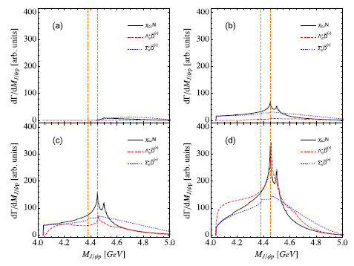
Invariant mass distribution of J/ψ p with different K⁻p momentum cuts

Slide 33
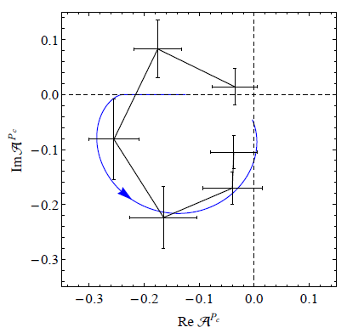
The ATS can mimic a resonance behavior in certain cases
F.K. Guo, U.-G. Meissner, W. Wang and Z. Yang, PRD92, 071502 (2015); arXiv:1507.04950[hep-ph]

