Slide 1
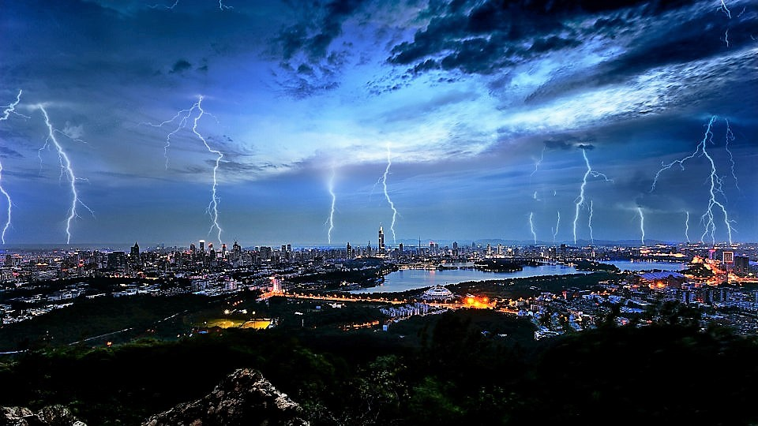
Craig Roberts … http://inp.nju.edu.cn/
Grant no. 12135007
Emergence of Mass and Spin
from Gauge Sector Dynamics

Slide 2
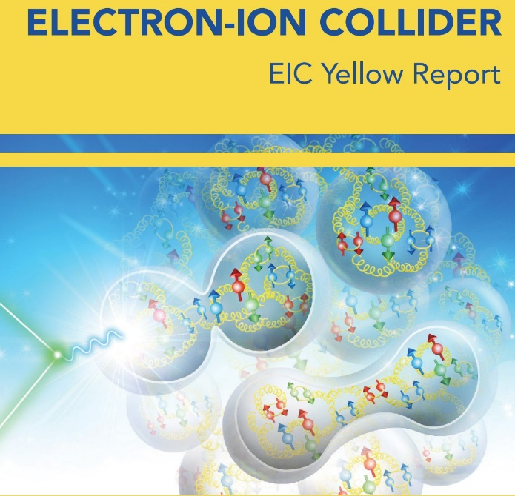
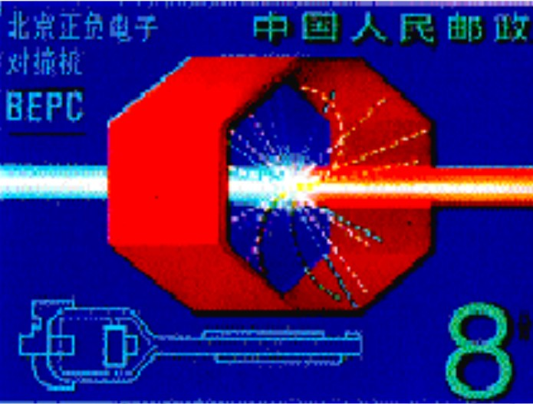
Focus of experiments New Generation Facilities

Slide 3
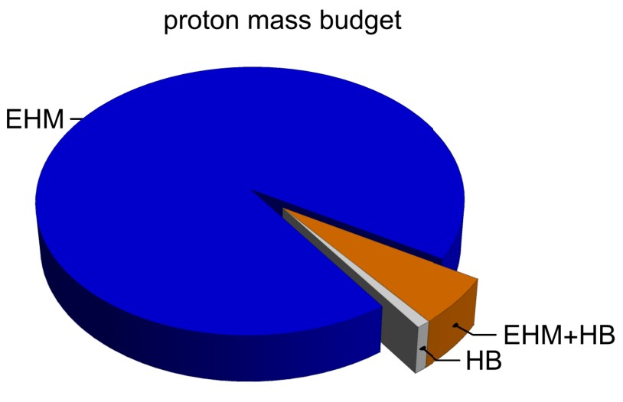
Emergence of Hadron Mass
Standard Model of Particle Physics has one obvious mass-generating mechanism
= Higgs Boson … impacts are critical to evolution of Universe as we know it
However, Higgs boson alone is responsible for just ∼ 1% of the visible mass in the Universe
Proton mass budget … only 9 MeV/939 MeV is directly from Higgs
Decomposition is
gauge invariant
Poincaré invariant
scale invariant
Evidently, Nature has another very effective mechanism for producing mass:
Emergent Hadron Mass (EHM)
Alone, it produces 94% of the proton’s mass
Remaining 5% is generated by constructive interference between EHM and Higgs-boson

Slide 4
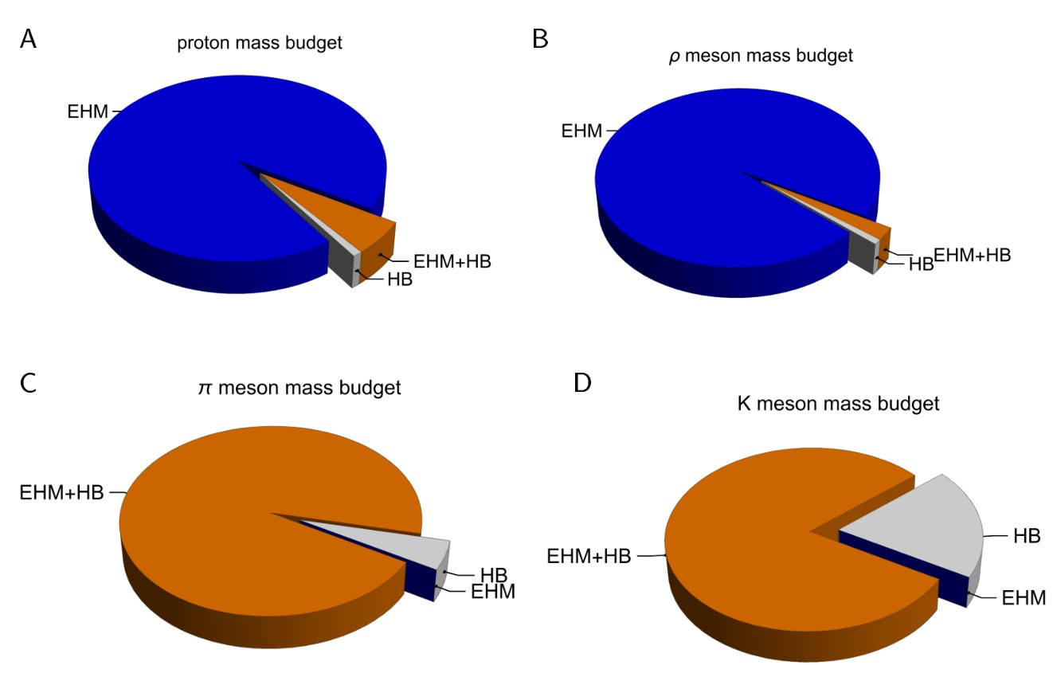
Emergence of Hadron Mass - Basic Questions
Decompositions are
gauge invariant
Poincaré invariant
scale invariant
What is the origin of EHM?
Does it lie within QCD?
What are the connections with …
Gluon and quark confinement?
Dynamical chiral symmetry breaking (DCSB)?
Nambu-Goldstone modes = π & K?
What is the role of Higgs in modulating observable properties of hadrons?
Without Higgs mechanism of mass generation, π and K would be indistinguishable
What is and wherefrom mass?
Proton and $ρ$-meson mass budgets are practically identical
$π$- and $K$-meson mass budgets
are essentially/completely different from those of proton and $ρ$

Slide 5
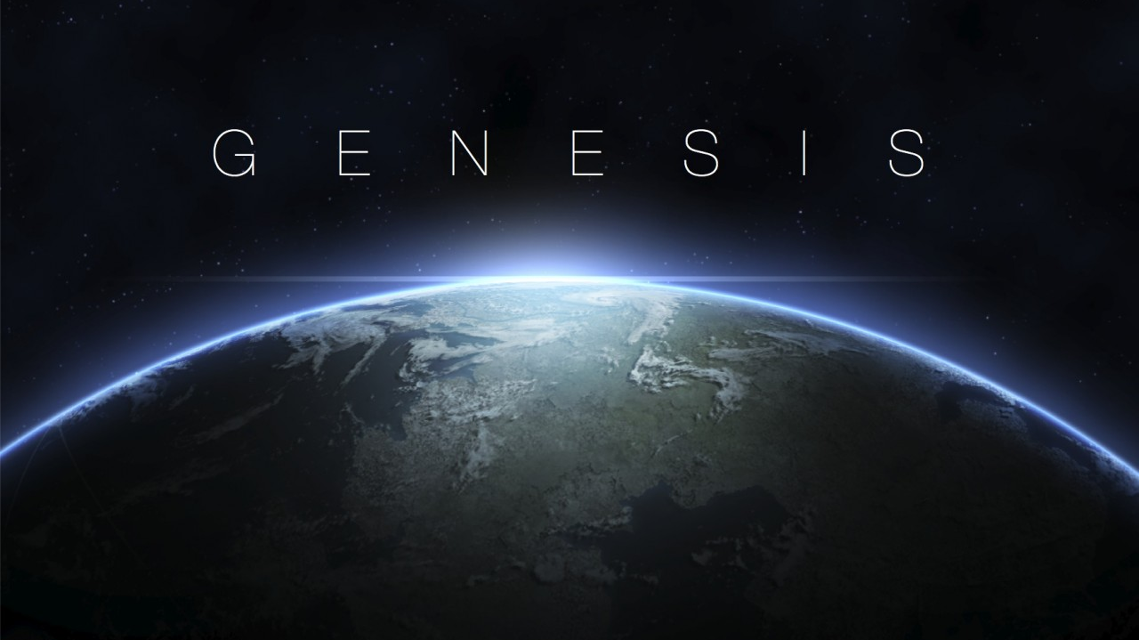

Slide 6
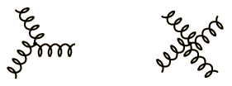
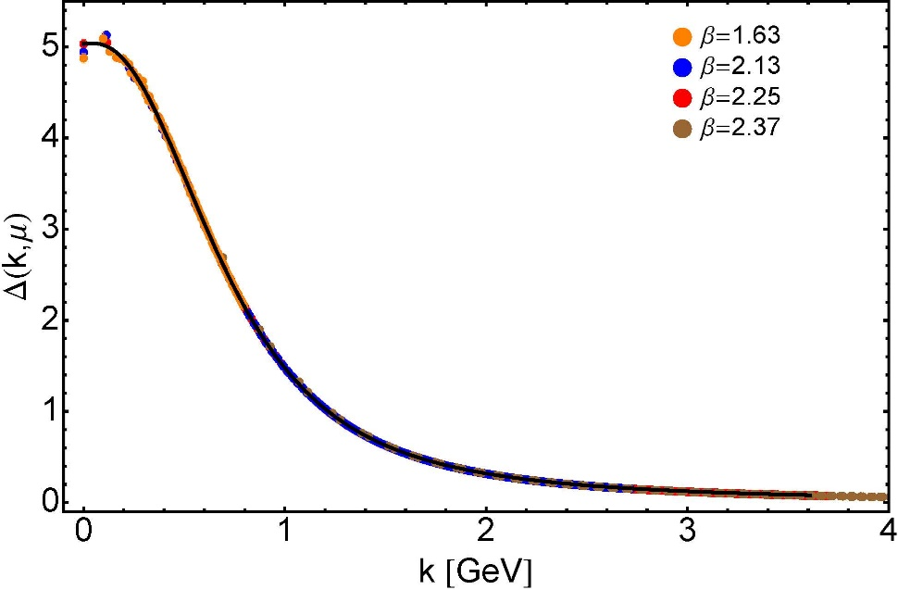
Modern Understanding Grew Slowly from Ancient Origins
More than 40 years ago
Dynamical mass generation in continuum quantum chromodynamics,
J.M. Cornwall, Phys. Rev. D 26 (1981) 1453 … $>1100$ citations
Owing to strong self-interactions, gluon partons $⇒$ gluon quasiparticles,
described by a mass function that is large at infrared momenta
3-gluon vertex
4-gluon vertex
$$\frac{1}{m_{g}^{2}}$$
Truly mass from nothing
An interacting theory, written in terms of massless gluon fields, produces dressed gluon fields that are characterised by a mass function that is large at infrared momenta
Gluon propagator … continuum and lattice QCD agree
QCD fact
Continuum theory and lattice simulations agree
Empirical verification?

Slide 7
Modern Understanding Grew Slowly from Ancient Origins
D. Binosi, Emergent Hadron Mass in Strong Dynamics, Few Body Syst. 63 (2022) 42.
M. N. Ferreira, J. Papavassiliou, Gauge Sector Dynamics in QCD, Particles 6 (1) (2023) 312–363.
EHM means
Gluons are massive – Schwinger Mechanism
More than 40 years ago
Dynamical mass generation in continuum quantum chromodynamics,
J.M. Cornwall, Phys. Rev. D 26 (1981) 1453 … $∼1050$ citations
Owing to strong self-interactions, gluon partons $⇒$ gluon quasiparticles,
described by a mass function that is large at infrared momenta
3-gluon vertex
4-gluon vertex
$$\frac{1}{m_{g}^{2}}$$
Truly mass from nothing
An interacting theory, written in terms of massless gluon fields, produces dressed gluon fields that are characterised by a mass function that is large at infrared momenta
Gluon propagator … continuum and lattice QCD agree
QCD fact
Continuum theory and lattice simulations agree
Empirical verification?

Slide 8
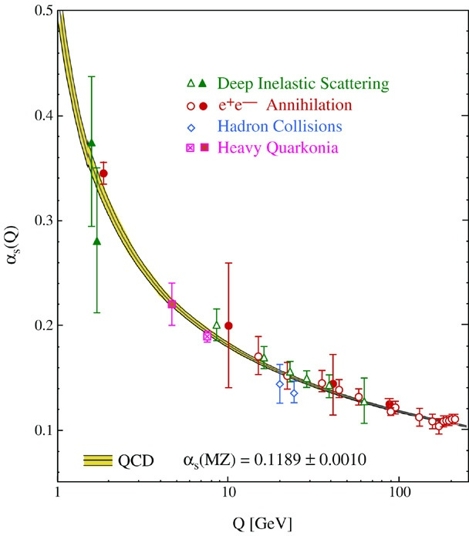
QCD’s Running Coupling
This is where we live
Asymptotic Freedom
Interaction becomes weaker
as energy grows
(as charges get closer together)
⇐
What’s happening
out here?!

Slide 9
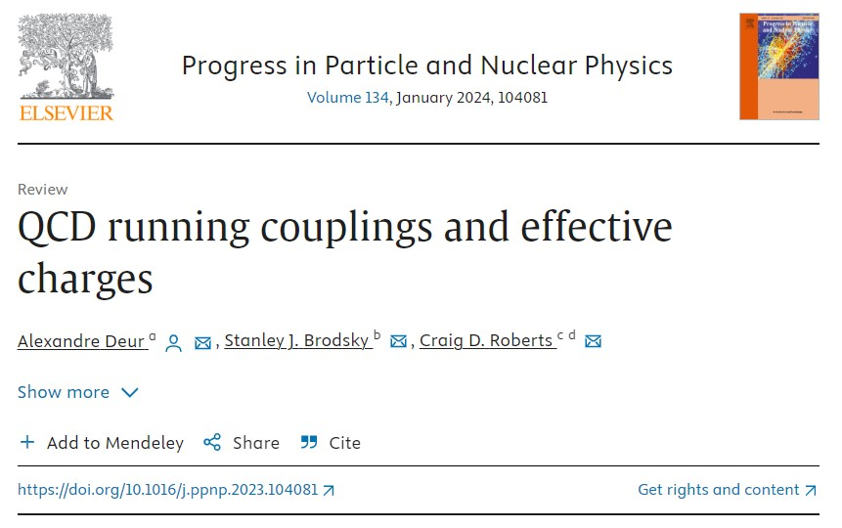
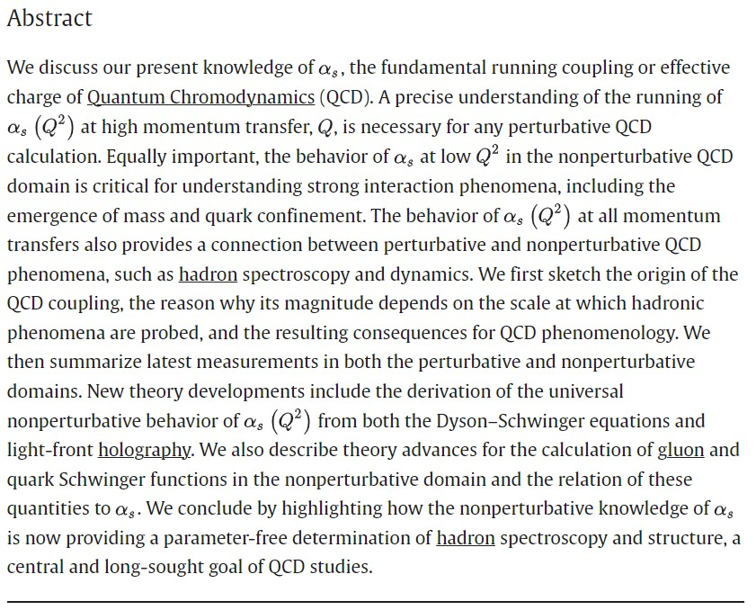

Slide 10
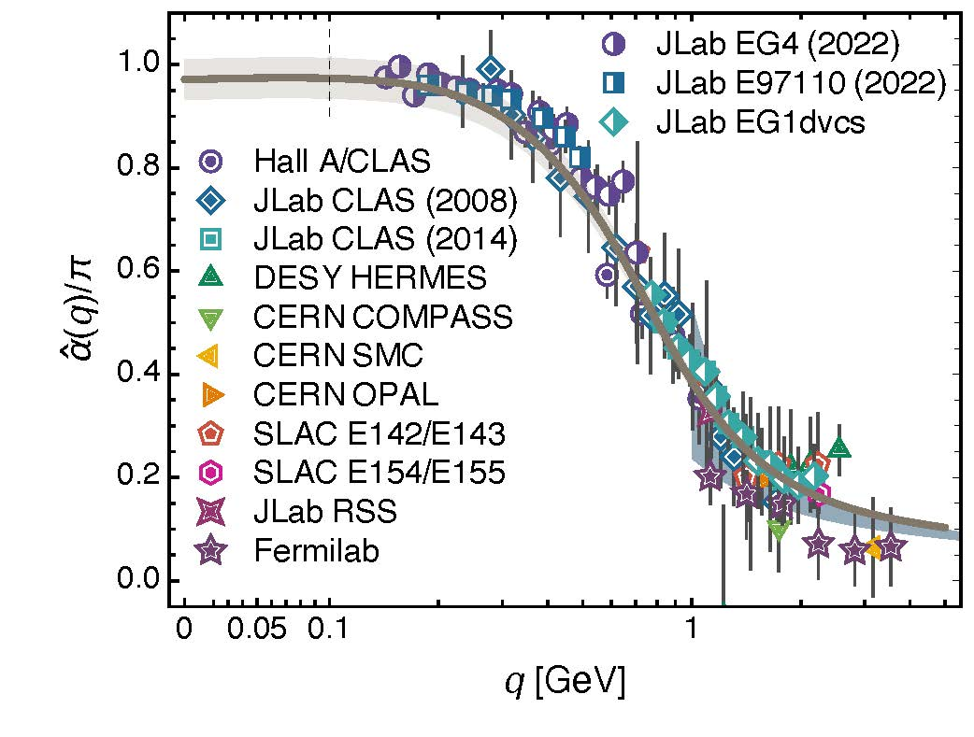
Process independent effective charge = running coupling
W orkshop on Dyson-Schwinger Equations in Modern Mathematics
and Physics (DSEMP2014) Trento, Italy, September 22-26, 2014
Effective charge from lattice QCD, Zhu-Fang Cui, Jin-Li Zhang et al.,
NJU-INP 014/19, arXiv:1912.08232 [hep-ph], Chin. Phys. C 44 (2020) 083102/1-10
$∼$2500 total downloads
Modern theory enables unique QCD analogue of
“Gell-Mann – Low”
running charge to be
rigorously defined and calculated
Analysis of QCD’s gauge sector
yields a parameter-free prediction
N.B. Qualitative change in α̂_{PI}(k) at k ≈ ½ m_{p}
No Landau Pole
“Infrared Slavery” picture – linear potential – is not viable explanation of real-world confinement
Below $k∼{{\hat{m}}_{0}}_{ },$interactions become scale independent, just as they were in the Lagrangian; so, QCD becomes practically conformal again
Process independent strong running coupling
Daniele Binosi et al., arXiv:1612.04835 [nucl-th], Phys. Rev. D 96 (2017) 054026/1-7
Experimental determination of the QCD effective charge α_{g1}(Q).
A. Deur; V. Burkert; J.-P. Chen; W. Korsch, Particles 5 (2022) 171
QCD Running Couplings and Effective Charges, Alexandre Deur, Stanley J. Brodsky and Craig Roberts, e-Print: 2303.00723 [hep-ph], Prog. Part. Nucl. Phys. 134 (2024) 104081

Slide 11
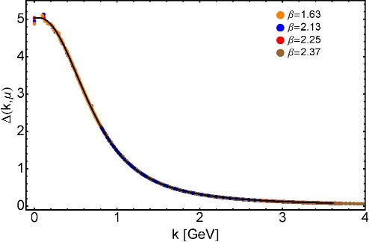
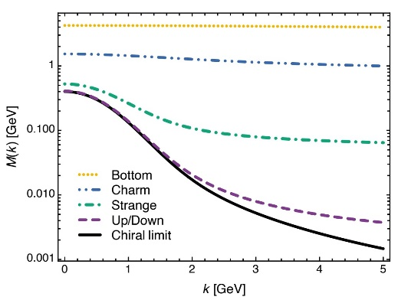
EHM Basics
Absent Higgs boson couplings, QCD Lagrangian is scale invariant
Yet …
Massless gluons become massive
A momentum-dependent charge is produced
Massless quarks become massive
EHM is expressed in
EVERY strong interaction observable
Challenge to Theory =
Elucidate all observable consequences of these phenomena
and highlight the paths to measuring them
Challenge to Experiment =
Test the theory predictions so that
the boundaries of the Standard Model can finally be drawn
Three pillars of EHM
$3×M\left(0\right)$ sets the scale of the proton mass.
Meson-loops provide $20$% quantum corrections

Slide 12
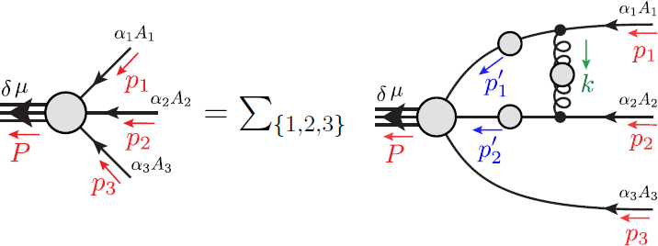
Faddeev Equation for Baryons
Nucleon mass from a covariant three-quark Faddeev equation
G. Eichmann et al., Phys. Rev. Lett. 104 (2010) 201601
Poincaré-covariant analysis of heavy-quark baryons
Si-Xue Qin (秦思学) et al., Phys.Rev. D 97 (2018) 114017/1-13
Weak form factors of octet baryons
Zhao-Qian Yao (姚照千), et al. – nearing completion

Slide 13
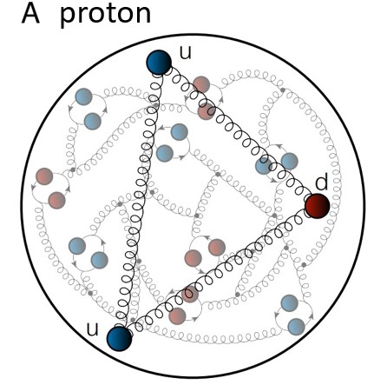
Structure of Baryons
Poincaré covariant Faddeev equation sums all possible exchanges and interactions that can take place between three dressed-quarks
Direct solution of Faddeev equation using rainbow-ladder truncation is now possible, but remains challenging problem – algorithms and numerical analysis

Slide 14
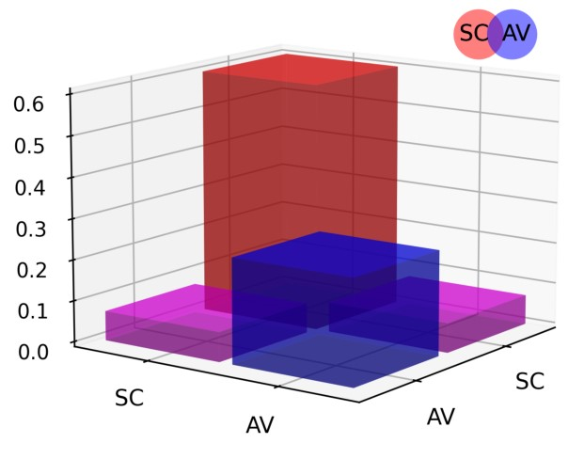
Structure of Baryons
Solution delivers
Poincaré-covariant
proton wave function
Poincaré covariant Faddeev equation sums all possible exchanges and interactions that can take place between three dressed-quarks
Direct solution of Faddeev equation using rainbow-ladder truncation is now possible, but remains challenging problem – algorithms and numerical analysis
For many/most applications, diquark approximation to quark+quark scattering kernel is used
Prediction: owing to EHM, strong diquark (quark + quark) correlations exist
within baryons - proton & neutron … both scalar and axial-vector diquarks are present
CSM prediction = presence of axialvector (AV) diquark correlation in the proton
AV Responsible for $≈40\%$ of proton charge

Slide 15
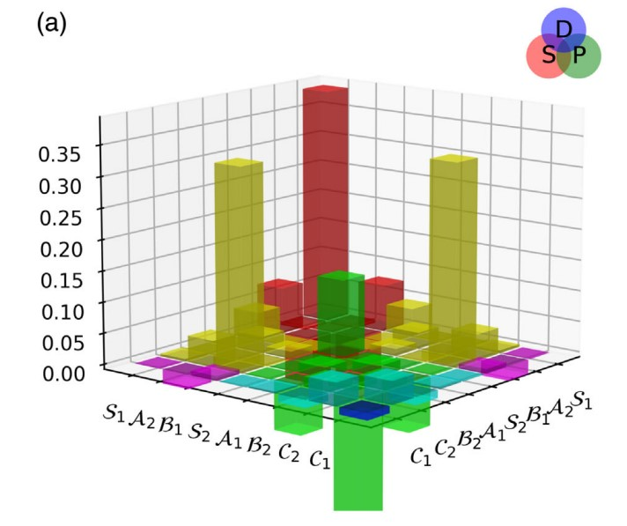
Structure of Baryons
Solution delivers
Poincaré-covariant
proton wave function
Poincaré covariant Faddeev equation sums all possible exchanges and interactions that can take place between three dressed-quarks
Direct solution of Faddeev equation using rainbow-ladder truncation is now possible, but numerical challenges remain
For many/most applications, diquark approximation to quark+quark scattering kernel is used
Prediction: owing to EHM:
proton wave function is not just S-wave, but contains strong P-wave contributions
baryon wave functions
necessarily contain
orbital angular momentum
CSM prediction = canonical normalization dominated by $S⊗S$, but receives large $S⊗P$ and $P⊗P$
contributions
Non-$S⊗S$make-up 6$0\%$ of proton charge

Slide 16
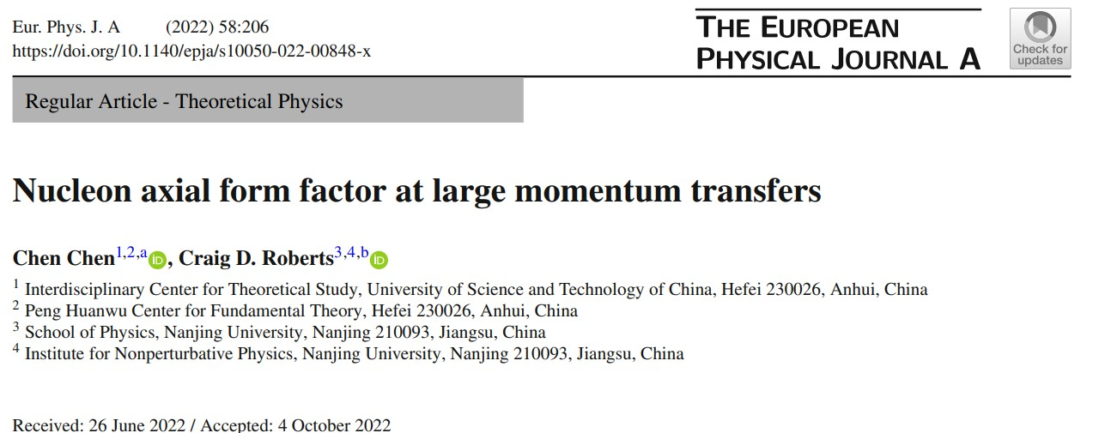
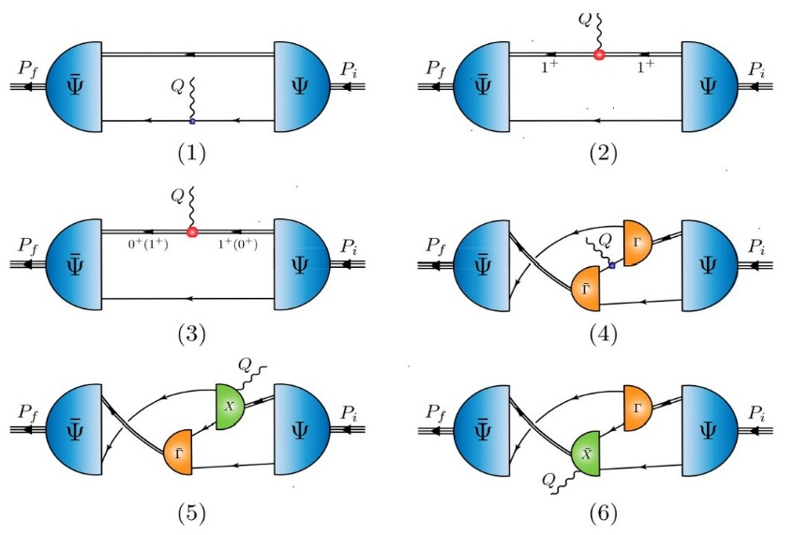
Exploited CSMs to identify and calculate all diagrams contributing to a symmetry preserving treatment of nucleon axial and pseudoscalar currents

Slide 17
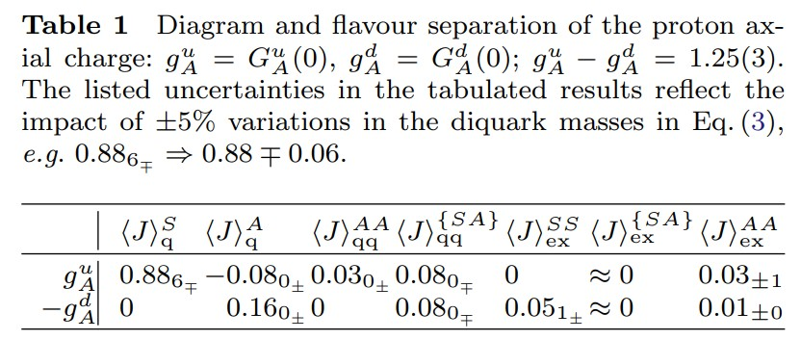
Proton Spin Structure
Flavour separation of proton axial charge
d-quark receives large contribution from probe+quark in presence of axialvector diquark
$\frac{g_{A}^{d}}{g_{A}^{u}}=^{0^{+}\&1^{+}}−0.32\left(2\right)$
$\frac{g_{A}^{d}}{g_{A}^{u}}=^{0^{+} only}−0.054(13)$
Probability that scalar diquark only picture of proton is consistent with data = 1/7,100,000
Experiment$^{D\&F EFT}$: $\frac{g_{A}^{d}}{g_{A}^{u}}=^{0^{+}\&1^{+}}−0.27\left(4\right)$ $⇐$ strong pointer to importance of AV correlation
Hadron scale: $g_{A}^{u}+g_{A}^{d }(+g_{A}^{s}=0)=0.65\left(2\right)⇒$ quarks carry 65% of the proton spin
Poincaré-covariant proton wave function: remaining 35% lodged with quark+diquark orbital angular momentum
Extended to entire octet of ground-state baryons: dressed-quarks carry 50(7)% of proton spin at hadron scale
Contact interaction analysis of octet baryon axialvector and pseudoscalar form factors, Peng Cheng (程鹏), Fernando E. Serna, Zhao-Qian Yao (姚照千) et al., NJU-INP 063/22, e-Print: 2207.13811 [hep-ph], Phys. Rev. D 106,(2022) 054031

Slide 18
Baryon Structure
Poincaré covariance $⇒$ irrespective of quark model assignments $n^{2s+1}ℓ_{J}$,
every hadron contains orbital angular momentum, e.g.,
$π$ contains two S-wave components and two P-wave components
No system is simply radial excitation of another
No separation of $J$ into $L+S$ is Poincaré invariant
Consequently, e.g., negative parity states are not simply orbital angular momentum excitations of positive parity ground states
In quantum field theory,
there is no direct connection between parity and orbital angular momentum
Parity is a Poincaré invariant quantum number
$L$ is not Poincaré invariant = value depends on the observer’s frame of reference
QCD structure of hadrons – mesons and baryons – is far richer than can be produced by quark models, relativized or not
Baryons are the most fundamental three-body systems in Nature
If we don’t understand how QCD, a Poincaré-invariant quantum field theory, builds each of the baryons in the complete spectrum, then we don't understand Nature.

Slide 19
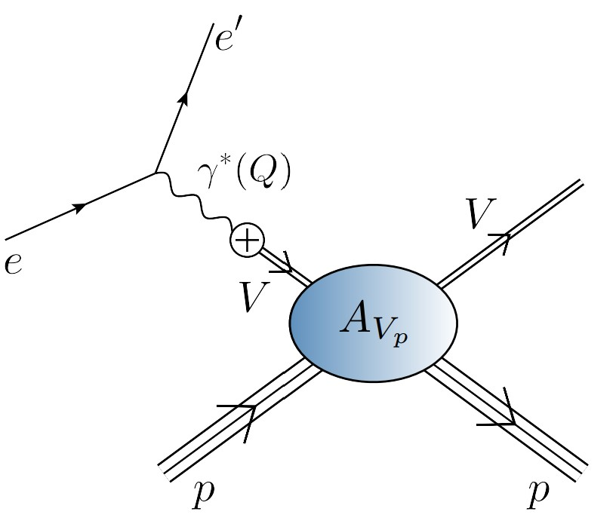
EHM Measurements How does the mass of the nucleon arise?
Related to QCD scale anomaly
Measurement = femtoscopic low-momentum correlation measurements
QCD multipole expansion … J/ψ and/or $Υ$ chromopolarisability relates forward scattering amplitude to a key matrix element in the origin of the nucleon mass problem
viz. the average chromoelectric gluon distribution in the nucleon:
Once considered viable …
electromagnetic vector-meson production reaction ($V=J/ψ, Υ$)
$e+p→e^{′}+V+p$
to access purely hadronic process
$$V+p→V+p$$

Slide 20
EHM Measurements How does the mass of the nucleon arise?
Once considered viable …
Electromagnetic process ($V=J/ψ, Υ$) … $e+p→e^{′}+V+p$
to access purely hadronic process … $V+p→V+p$
But …
Deciphering the mechanism of near-threshold J/ψ photoproduction, M.-L. Du, V. Baru, F.-K. Guo et al., Eur. Phys. J. C 80, 1053 (2020)
Vector-meson production and vector meson dominance, Yin-Zhen Xu, Si-Yang Chen, Zhao-Qian Yao et al., Eur. Phys. J. C 81 (2021) 895/1-11
Near threshold heavy quarkonium photoproduction at large momentum transfer, P. Sun, X.-B. Tong, F. Yuan, Phys. Rev. D 105 (2022) 5, 054032
There is no objective, model-independent means by which to connect $e+p→e^{′}+V+p$ with $V+p→V+p$
Hence, vector meson photoproduction
does not provide a path to the QCD trace anomaly
This route is blocked … Is there a viable alternative?

Slide 21
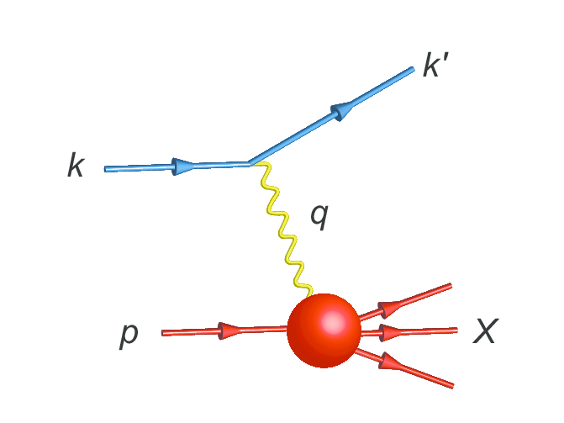
Parton Distribution Functions

Slide 22
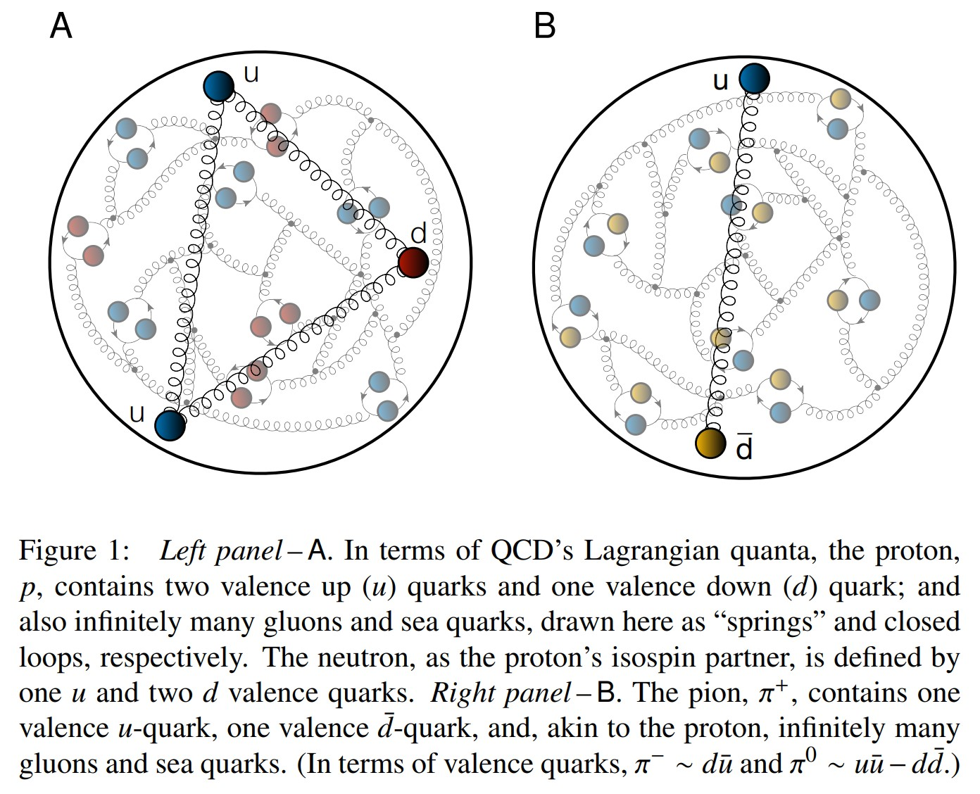
Proton and pion distribution functions in counterpoint
massive
almost massless
Today, despite enormous expense of time and effort, much must still be learnt before proton and pion structure may be considered understood in terms of DFs
Most simply, what are the differences, if any, between the distributions of partons within the proton and the pion?
The question of similarity/difference between proton and pion DFs has particular resonance today as science seeks to explain EHM
How are obvious macroscopic differences between protons and pions expressed in the structural features of these two bound-states?
proton
pion

Slide 23
Proton and pion distribution functions in counterpoint
Proton and pion distribution functions in counterpoint, Ya Lu (陆亚) et al.,
NJU-INP 056/22, e-Print: 2203.00753 [hep-ph], Phys. Lett. B 830 (2022) 137130
Valence-quark domain: there is a scale $ζ_{H}<m_{p}$ at which
$ζ>m_{p}$: val. $∝{\left(1−x\right)}^{β_{p,π}}$ , $β_{p}=3+γ_{p}$, $β_{π}=2+γ_{π}$
Gluon DFs: $β_{p,π}^{glue}≥$ $β_{p,π}^{val}+1$
Sea DFs: $β_{p,π}^{sea}≥$ $β_{p,π}^{val}+2$
These are simple consequences of DGLAP equations.
Argument can be reversed:
if large-x glue or sea DF exponent is smaller than that of valence DF at any given scale, then it is smaller at all lower scales.
DF with lowest exponent
defines the valence degree-of-freedom.
Proton is supposed to be a stable bound-state of three valence-quarks
Yet, modern global analyses of proton DIS and related data encompass fits with role of glue and valence-quarks reversed!
Proton has valence glue but no valence quarks!
Further, no simultaneous global fits to proton and pion data have ever been performed
Largely because pion data are scarce
Existing approaches are unlikely to yield definitive answers because fitting practitioners typically overlook QCD constraints

Slide 24
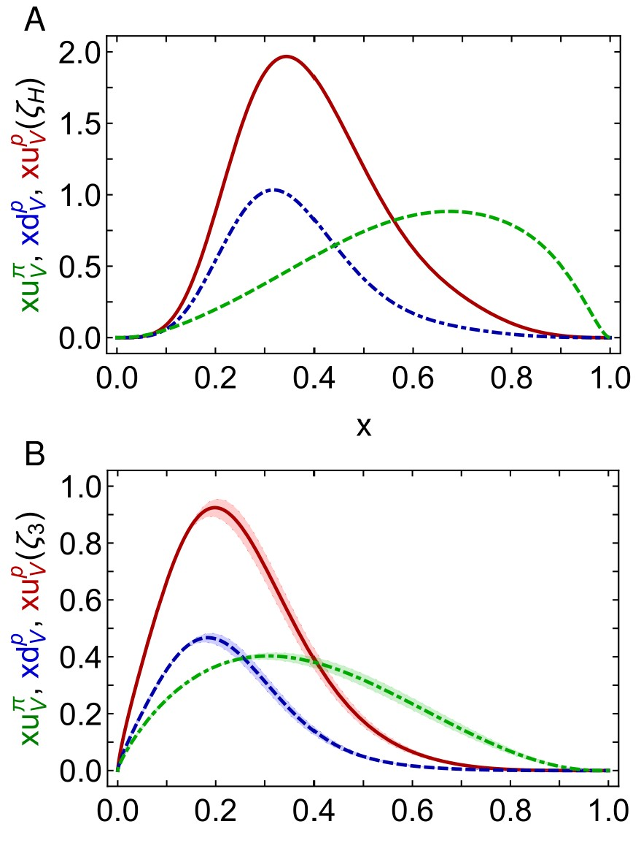
Proton and pion distribution functions in counterpoint
Proton and pion distribution functions in counterpoint, Ya Lu (陆亚) et al.,
NJU-INP 056/22, e-Print: 2203.00753 [hep-ph], Phys. Lett. B 830 (2022) 137130
Symmetry-preserving analyses using continuum Schwinger function methods (CSMs) deliver hadron scale DFs that agree with QCD constraints
Valence-quark degrees-of-freedom carry all hadron’s momentum at $ζ_{H}$:
Diquark correlations in proton, induced by EHM
${⇒u}_{V}(x)≠2d_{V}\left(x\right)$
Proton and pion valence-quark DFs have markedly different behaviour
$u^{π}(x;ζ_{H})$ is Nature’s most dilated DF
“Obvious” because ${\left(1−x\right)}^{2}$ vs. ${\left(1−x\right)}^{3}$ behaviour & preservation of this unit difference under evolution
Also “hidden” = strong EHM-induced broadening
dilation
u in proton
d in proton
u in pion
dilation

Slide 25
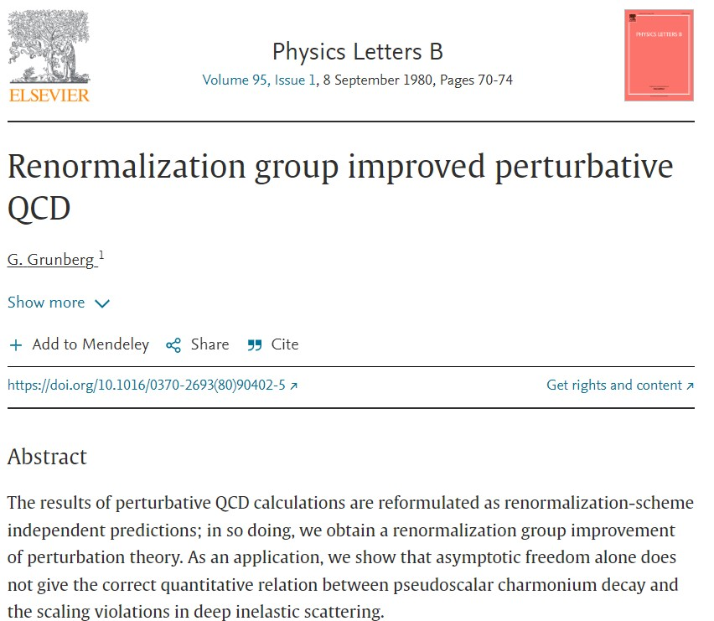
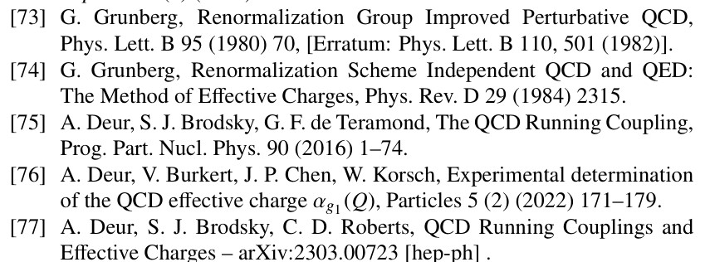
All-orders evolution
All-Orders Evolution of Parton Distributions: Principle, Practice, and Predictions
Pei-Lin Yin (尹佩林) et al., e-Print: 2306.03274 [hep-ph]
Chin. Phys. Lett. Express 40 (2023) 091201/1-8.
P1 – In the context of Refs. [73, 74], there exists at least one effective charge, $α_{1ℓ}(k^{2})$, which, when used to integrate the leading-order perturbative DGLAP equations, defines an evolution scheme for parton DFs that is all-orders exact.
CSM Process-Independent charge serves this purpose
Hadron scale, $ζ_{H}$
Scale at which all properties of a given hadron are carried by valence degrees-of-freedom

Slide 26
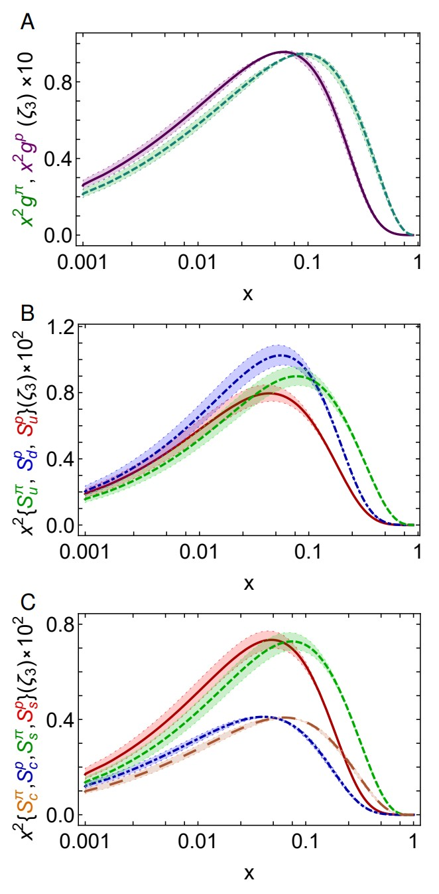
Proton and pion distribution functions in counterpoint – glue and sea
CSM prediction for glue-in-pion DF confirmed by recent lQCD simulation
[Regarding the distribution of glue in the pion, Lei Chang (常雷) and Craig D Roberts, e-Print: 2106.08451 [hep-ph], Chin. Phys. Lett. 38 (8) (2021) 081101/1-6]
Glue-in-π DF possess significantly more support on the valence domain $\left(x≥0.2\right)$ than the glue-in-p DF
Sea-in-π DF possess significantly more support on the valence domain than sea-in-p DFs.
s and c sea DFs are commensurate in size with those of the light-quark sea DFs
For s-and c-quarks, too, the pion DFs possess significantly greater support on the valence domain than the kindred proton DFs.
These outcomes are measurable expressions of EHM

Slide 27
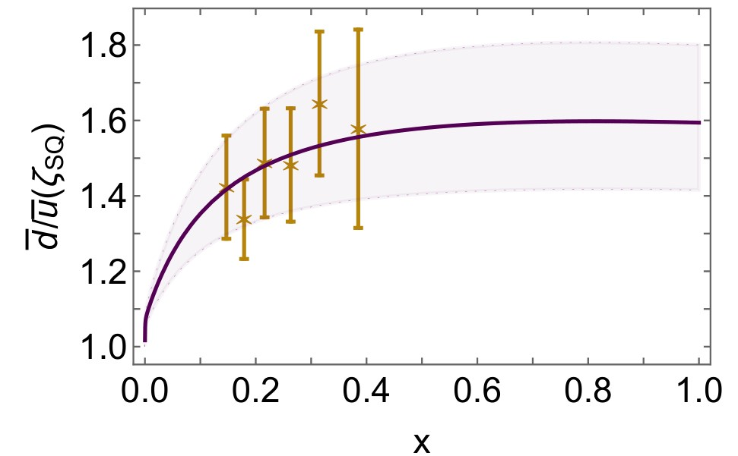
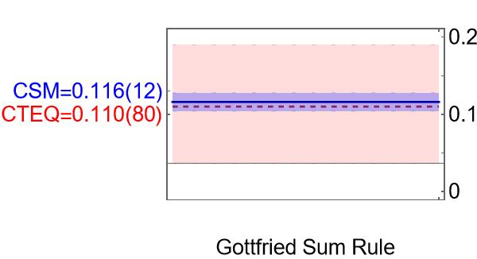
Asymmetry of antimatter in the proton
Proton = u + u + d
$⇒$ Pauli blocking: gluon splitting produces
$d+\overline{d}$ in preference to $u+\overline{u}$
Comparison with SeaQuest data
[J. Dove, et al., The asymmetry of antimatter in the proton, Nature 590 (7847) (2021) 561–565.]
Gottfried sum rule
Most recent result from global fits [CT18]: 0.110(80)
$ζ=2 GeV…{\left\langle x\right\rangle }_{\overline{u}}↓25\% \& {\left\langle x\right\rangle }_{\overline{d}}↑25\%$
Proton and pion distribution functions in counterpoint, Ya Lu (陆亚), Lei Chang (常雷), Khépani Raya, Craig D. Roberts and José Rodríguez-Quintero, NJU-INP 056/22, e-Print: 2203.00753 [hep-ph], Phys. Lett. B 830 (2022) 137130/1-7
Parton distributions of light quarks and antiquarks in the proton, Lei Chang (常雷), Fei Gao (高飞) and Craig D. Roberts, NJU-INP 055/22, e-Print: 2201.07870 [hep-ph], Phys. Lett. B 829 (2022) 137078/1-7

Slide 28
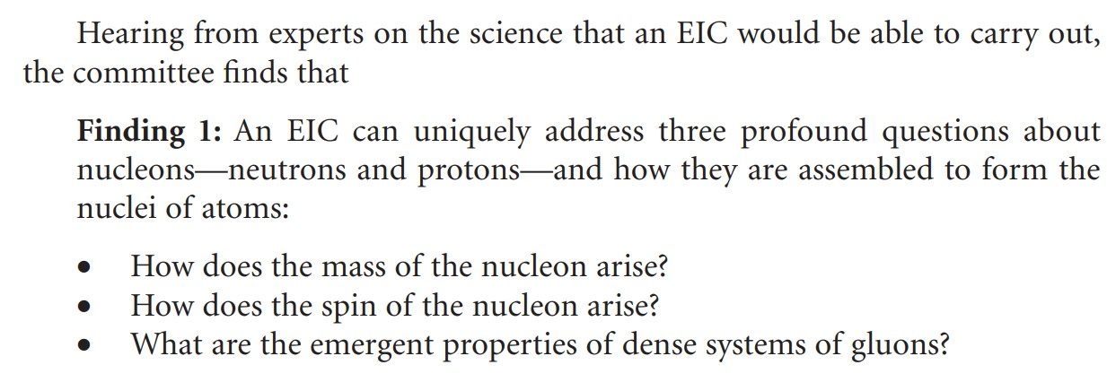
Proton Spin Crisis
Long story … 35+ years … $-billions …
Future … Electron Ion Collider … Total project cost is expected to range from $1.7-2.8 billion
… First beam $∼2034$
USA NAS Report
EHM is the keystone for future experiments in hadroparticle physics

Slide 29
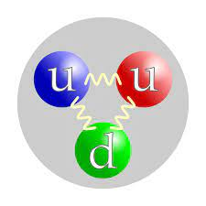
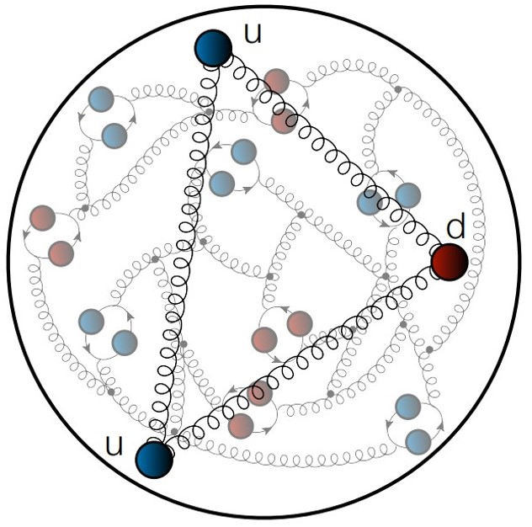
Origin of Proton Spin
Basic answer
This is NOT the proton
In relativistic quantum non-Abelian gauge field theory (QCD), this is the proton
2 valence $u$ quarks + 1 valence $d$ quark + sea of infinitely many quarks and antiquarks and gluons
$∃$orbital angular momentum in every frame
Infinitely many spin $\left(J\right)=1$ gluons can potentially carry a lot of the proton spin

Slide 30
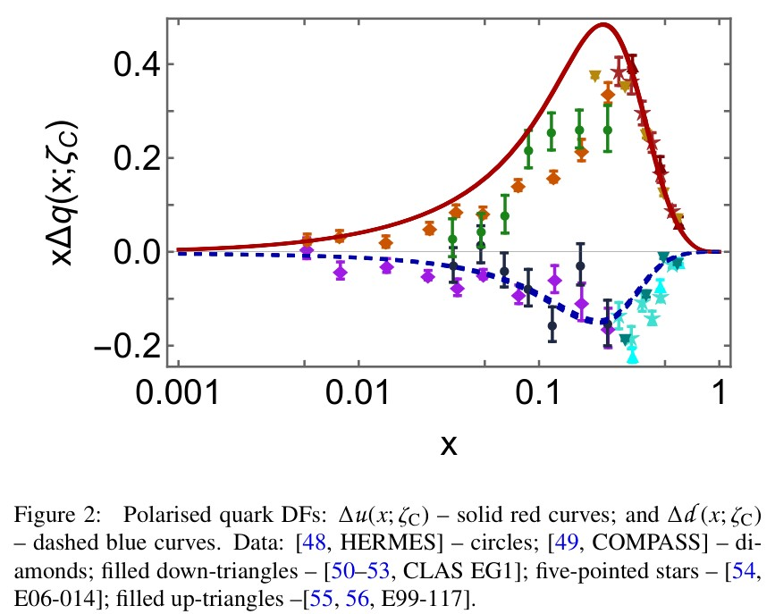
Polarised quark distribution functions at $ζ=\sqrt{3}$GeV
Continuum predictions for helicity-dependent quark DFs deliver quantitative agreement with all available world data
COMPASS $Δu(x)$ lead to underestimate of $g_{A}$ by 25%
Explains why COMPASS data lie below prediction
Polarised parton distribution functions and proton spin, Peng Cheng (程鹏), Yang Yu (俞杨), Hui-Yu Xing (邢惠瑜) et al., e-print: 2304.12469 [hep-ph], Phys. Lett. B 844 (2023) 138074/1-7

Slide 31
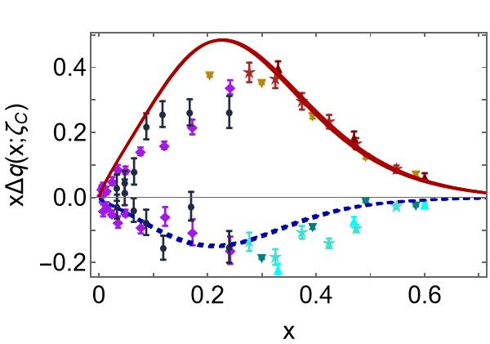
Polarised quark distribution functions at $ζ=\sqrt{3}$GeV
Continuum predictions for helicity-dependent quark DFs deliver quantitative agreement with all available world data
COMPASS $Δu(x)$ lead to underestimate of $g_{A}$ by 25%
Explains why COMPASS data lie below prediction
Predictions for sea are consistent with available data
Polarised parton distribution functions and proton spin, Peng Cheng (程鹏), Yang Yu (俞杨), Hui-Yu Xing (邢惠瑜) et al., e-print: 2304.12469 [hep-ph], Phys. Lett. B 844 (2023) 138074/1-7

Slide 32
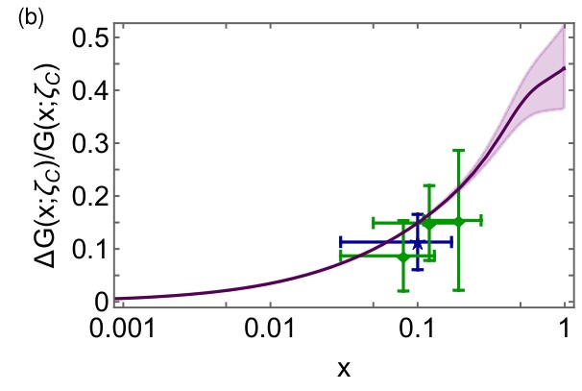
Polarised glue distribution functions at $ζ=\sqrt{3}$GeV
Parameter-free CSM prediction
compared with COMPASS data
C. Adolph, et al., Leading-order determination of the gluon polarization from semi-inclusive deep inelastic scattering data, Eur. Phys. J. C 77 (4) (2017) 209
e.g. average value over data window
$0.167{\left(3\right)}_{CSM}$ cf. $0.113±0.038±{0.036}_{COMPASS}$
Comparison with phenomenological global fits
$$\int_{0.05}^{1}{dx ΔG(x;ζ=10GeV)}=0.199{\left(3\right)}_{CSM}$$
cf. DSSV14: $0.19(6)$
$ΔG/G$ is positive definite
Phenomenological fits should implement this constraint

Slide 33
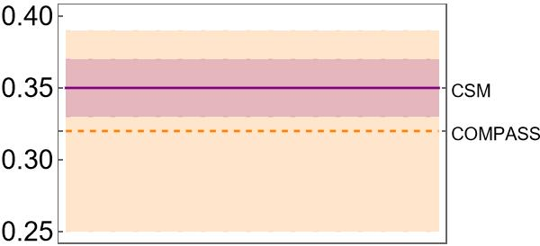
Proton Spin
Polarised parton distribution functions and proton spin, Peng Cheng (程鹏), Yang Yu (俞杨), Hui-Yu Xing (邢惠瑜) et al., e-print: 2304.12469 [hep-ph], Phys. Lett. B 844 (2023) 138074/1-7
Recall page 19, which records
$a_{0}≈65\%$of proton spin
carried by valence quark
quasiparticle degrees of freedom at the hadron scale.
Under P1 evolution, this value is independent of scale.
However, measurements of the proton spin are sensitive to
non-Abelian anomaly corrected combination $\left(n_{f}=4\right)$
CSM prediction: $a_{0}^{E}\left(ζ=\sqrt{3}GeV\right)=0.35(2)$
COMPASS: $a_{0}^{COMPASS}\left(ζ=\sqrt{3}GeV\right)=0.32(7)$
Parameter-free explanation
of proton spin measurement

Slide 34
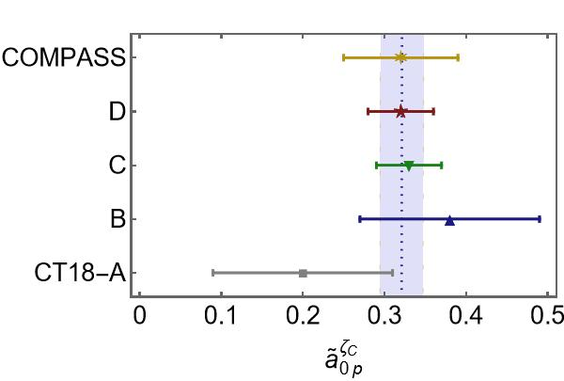
Theory Predictions
Viable parameter-free explanation
of proton spin measurement
Novel approach to understanding character of proton internal structure has enabled derivation of algebraic formula for the gluon contribution to the proton spin
Reveals that gluon contribution is positive
and grows as resolving scale of the probe increases,
removing measurable spin from the quarks
Prediction for valence-quark part of proton spin: $a_{0}^{E}\left(ζ=\sqrt{3}GeV\right)=0.32(3)$
COMPASS (CERN) measurement (2016): $a_{0}^{COMPASS}\left(ζ=\sqrt{3}GeV\right)=0.32(7)$
Symmetry, symmetry breaking, and pion parton distributions, Minghui Ding, Khépani Raya et al., arXiv:1905.05208 [nucl-th], Phys. Rev. D 101 (2020) 054014/1-14
Parton distributions of light quarks and antiquarks in the proton, Lei Chang (常雷), Fei Gao (高飞) and Craig D. Roberts, e-Print: 2201.07870 [hep-ph], Phys. Lett. B 829 (2022) 137078/1-7
All-Orders Evolution of Parton Distributions: Principle, Practice, and Predictions, Pei-Lin Yin (尹佩林), Yin-Zhen Xu (徐胤禛), Zhu-Fang Cui (崔著钫) et al., e-Print: 2306.03274 [hep-ph], Chin. Phys. Lett. Express 40 (2023) 091201/1-8. Express Letter.
“Empirical $a_{0}$”

Slide 35
Proton Spin Budget
Contact interaction study of proton parton distributions, Yang Yu (俞杨), Peng Cheng (程鹏), Hui-Yu Xing (邢惠瑜),
Fei Gao (高飞) and Craig D. Roberts,
NJU-INP 083/24, e-Print: 2402.06095 [hep-ph]
Consider a light-front separation of the proton spin into contributions from quark and gluon spin and angular momenta:
$\frac{1}{2}=\frac{1}{2}a_{0}+L_{q}\left(ζ\right)+ΔG\left(ζ\right)+L_{g}(ζ)$
At hadron scale:
$a_{0}=0.55$, $L_{q}\left(ζ_{H}\right)=0.23$
$ΔG\left(ζ_{H}\right)=0$, $L_{g}\left(ζ_{H}\right)=0$
all proton spin is lodged with valence quark helicity and orbital angular momentum
Evolved to COMPASS scale
$a_{0}=0.54$, $L_{q}\left(ζ\right)=0.03$, $ΔG\left(ζ\right)=1.07$, $L_{g}\left(ζ\right)=−0.87$
Including calculation uncertainties
Valence quark helicity: $(50±12)$%,
glue: $≈40$%,
sign and magnitude of valence quark light-front orbital angular momentum is uncertain

Slide 36
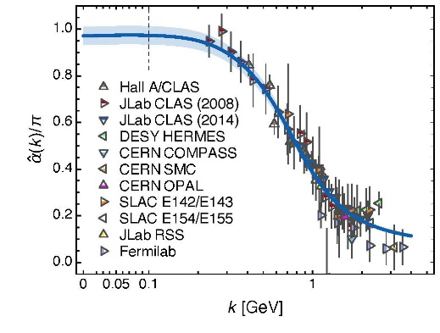
Epilogue
Vector meson photoproduction does not provide a path to the QCD trace anomaly
Trace anomaly is manifest in the Three Pillars of EHM
Emergent features of QCD are expressed in every strong interaction observable
They explain the emergence of proton mass and spin
High energy and high luminosity facilities are the key to validating these concepts
Could prove QCD to be 1st well-defined 4D quantum field theory ever contemplated
This may open doors that lead far beyond the Standard Model

Slide 37
Epilogue
Vector meson photoproduction does not provide a path to the QCD trace anomaly
Trace anomaly is manifest in the Three Pillars of EHM
Emergent features of QCD are expressed in every strong interaction observable
Explain the emergence of proton mass and spin
High energy and high luminosity facilities are the key to validating these concepts
Could prove QCD to be 1st well-defined 4D quantum field theory ever contemplated
This may open doors that lead far beyond the Standard Model
$${\text{L}}_{Nature}= ?$$
There are theories of many things,
But is there a theory of everything?

Slide 38
Thankyou
$${\text{L}}_{Nature}= ?$$
There are theories of many things,
But is there a theory of everything?

Slide 40
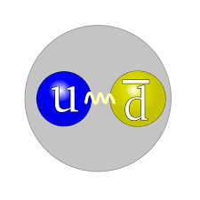
Structure of Baryons
The most important lessons to be learnt in modern hadron physics are …
This is NOT a baryon
This is NOT a meson
Three “constituent” quarks “confined” within some three-dimensional volume by an instantaneous potential

Slide 41
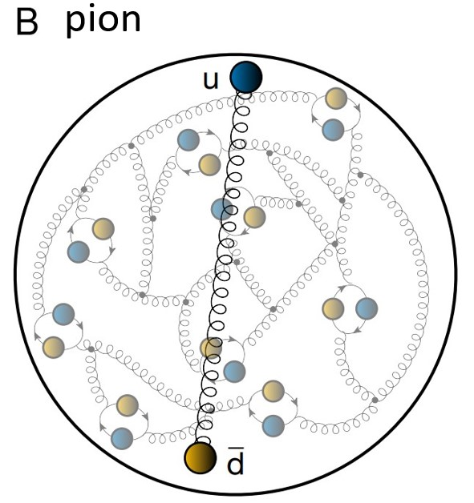
Structure of Baryons
The most important lessons to be learnt in modern hadron physics are …
This IS a baryon
This IS a meson
A few “valence” quark partons and/or antiquark partons, and infinitely many sea and glue partons confined by spacetime-dependent nonperturbative, nonlinear dynamics

