Slide 1


Lattice QCD inversion
Peng Sun
中国科学院近代物理研究所

Slide 2
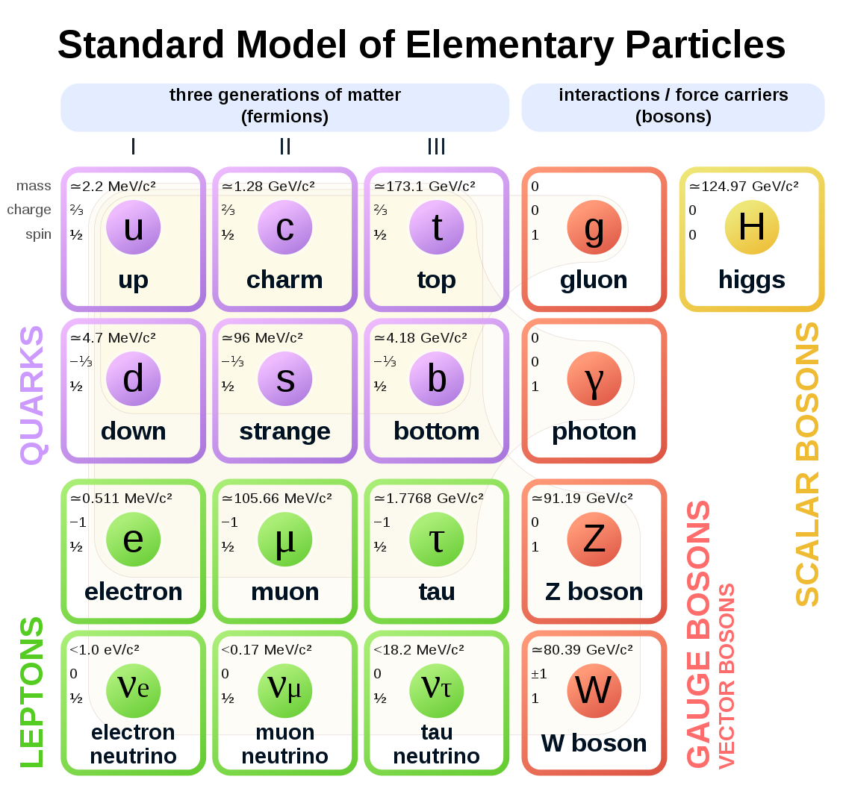
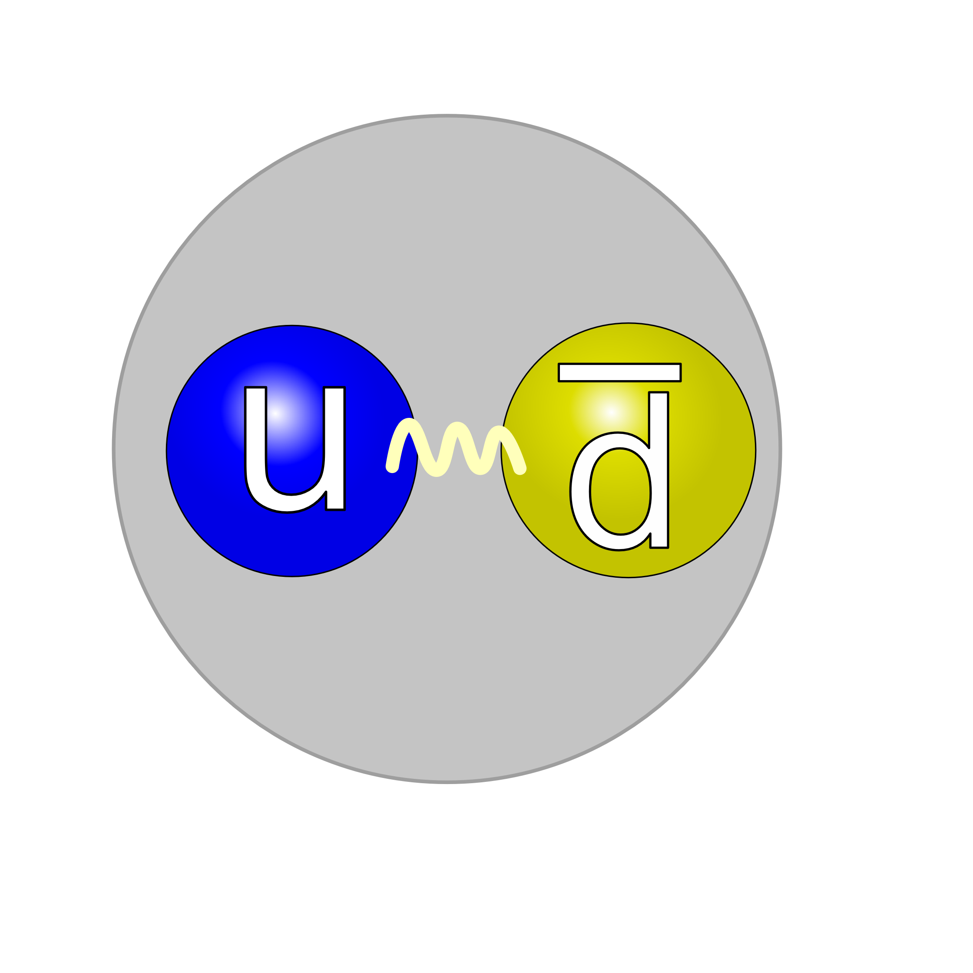
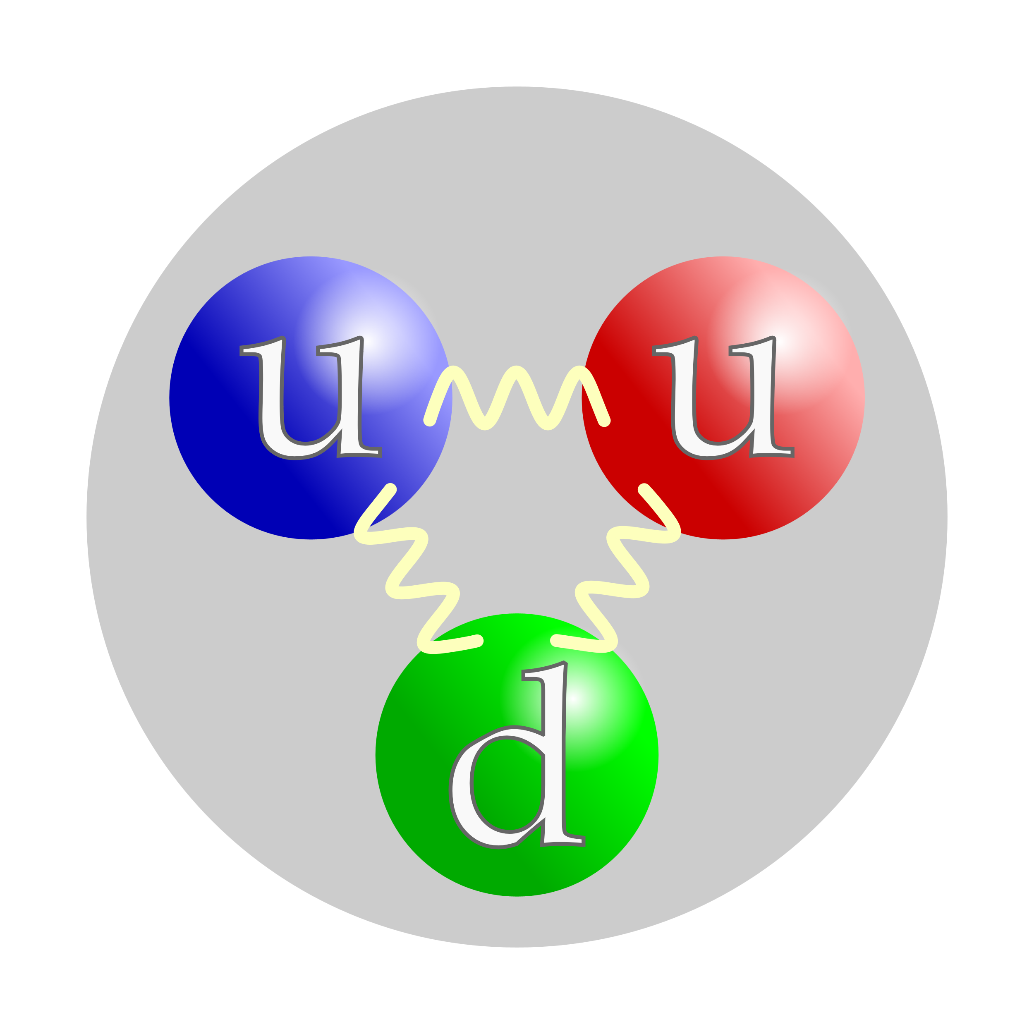
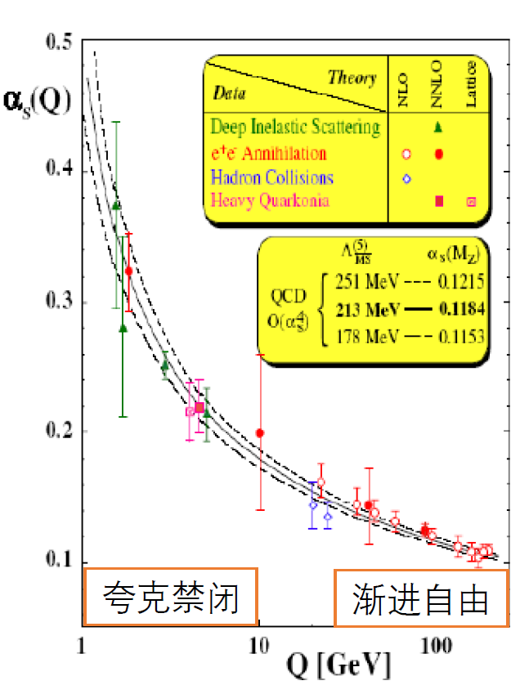
标准模型
介子
重子
Quarks are imprisoned in hadrons

Slide 3
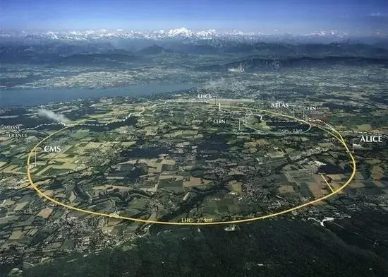
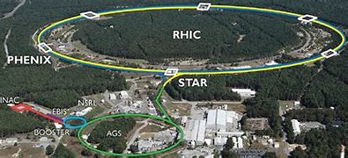
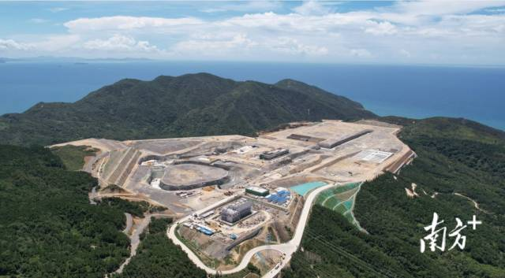
高能物理与高能核物理
High Intensity Heavy-Ion
Accelerator Facility (HIAF)
The Large Hadron Collider（LHC）
Relativistic Heavy Ion Collider（RHIC）

Slide 4
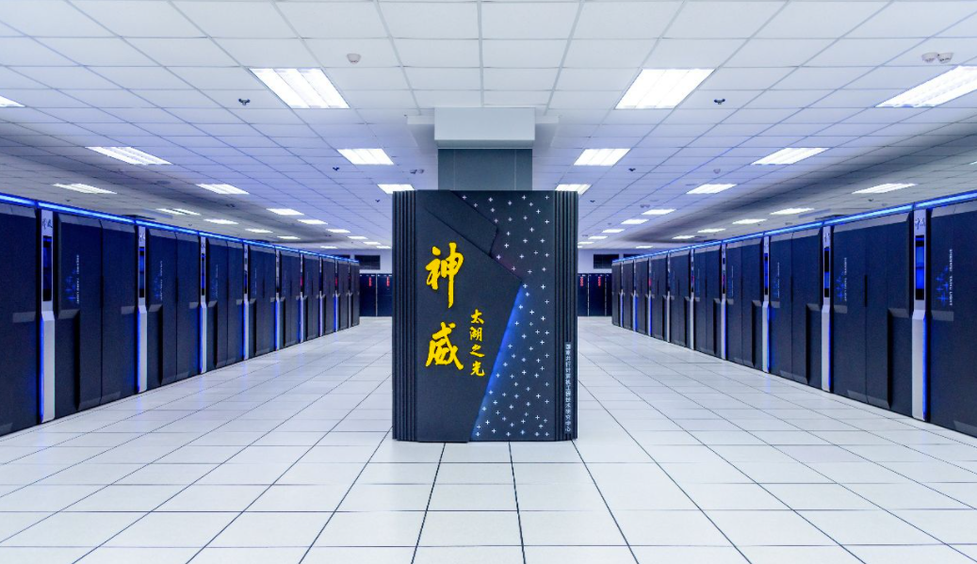
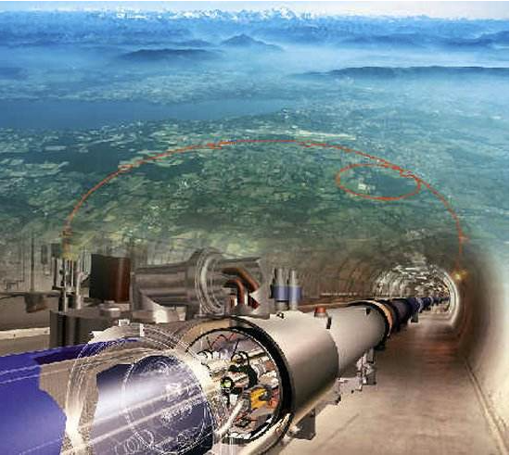
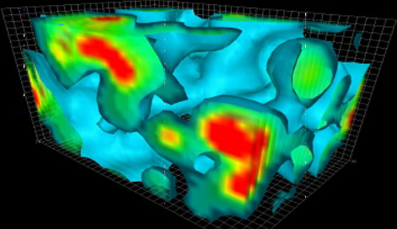
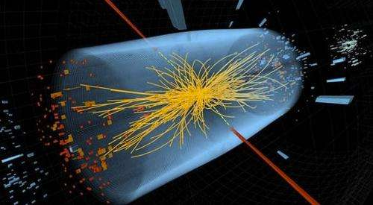

格点 QCD （类比粒子物理实验）
超级计算机
粒子加速器
QCD真空 （组态）
对撞事例

Slide 5
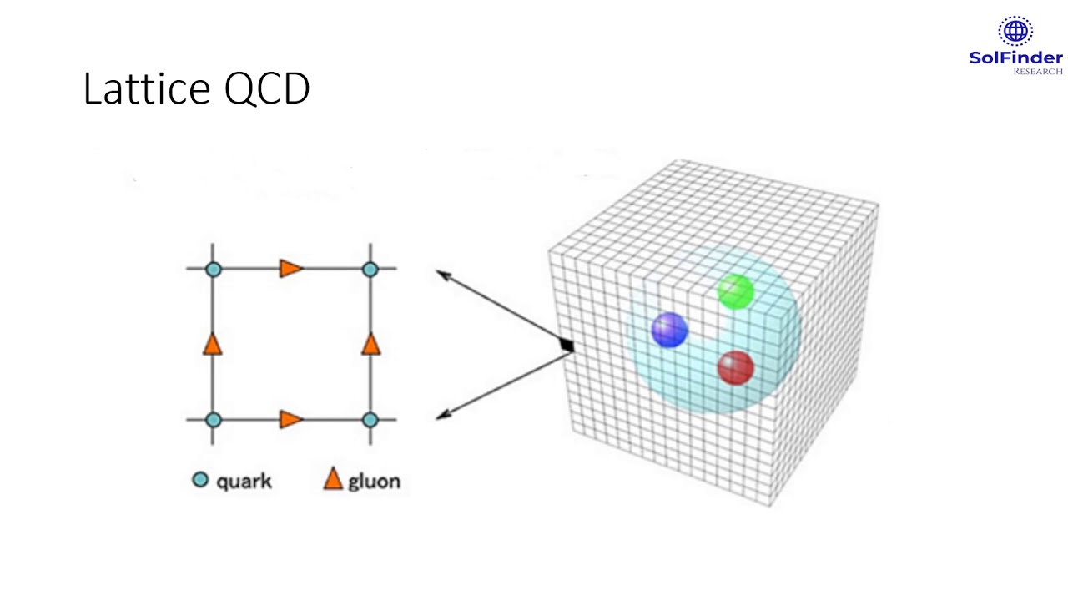

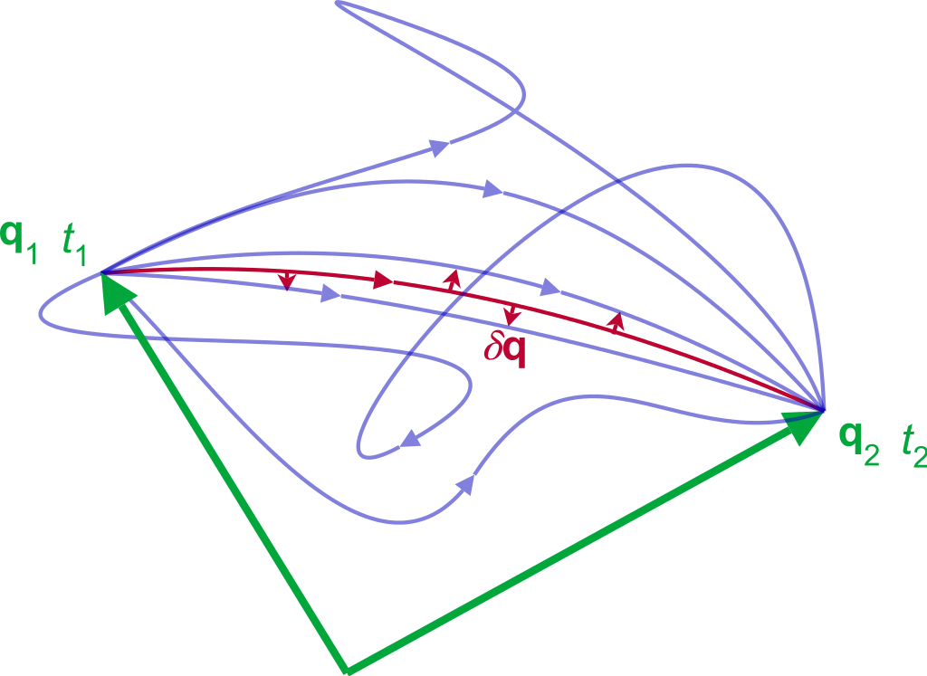
Lattice QCD
Lattice is made by configurations in super computers
A configuration contain one possible gauge link value at every time-space point
Each configuration is one possible path in the path integration

Slide 6
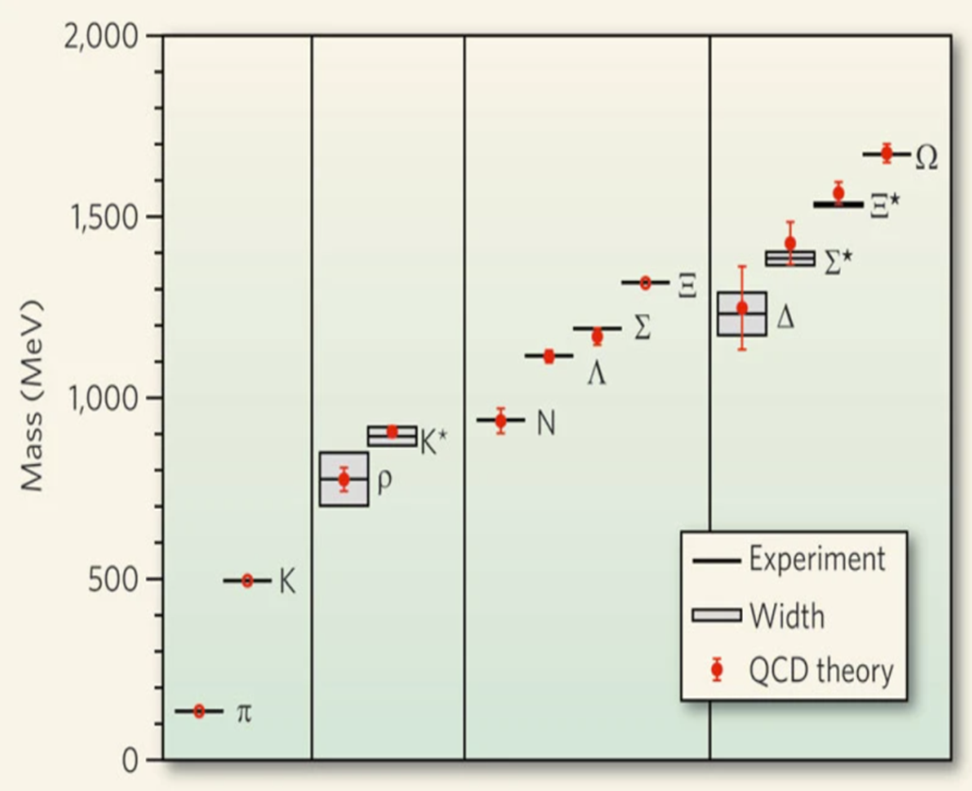
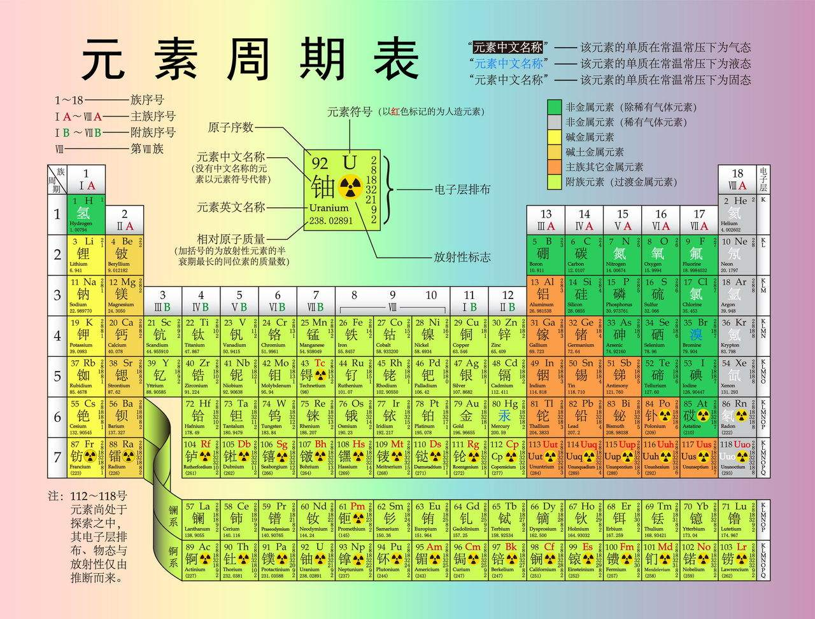
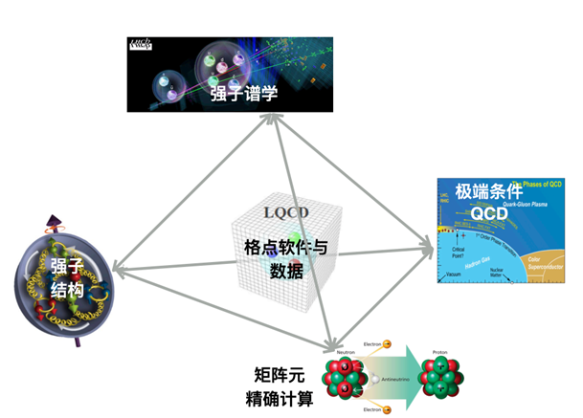
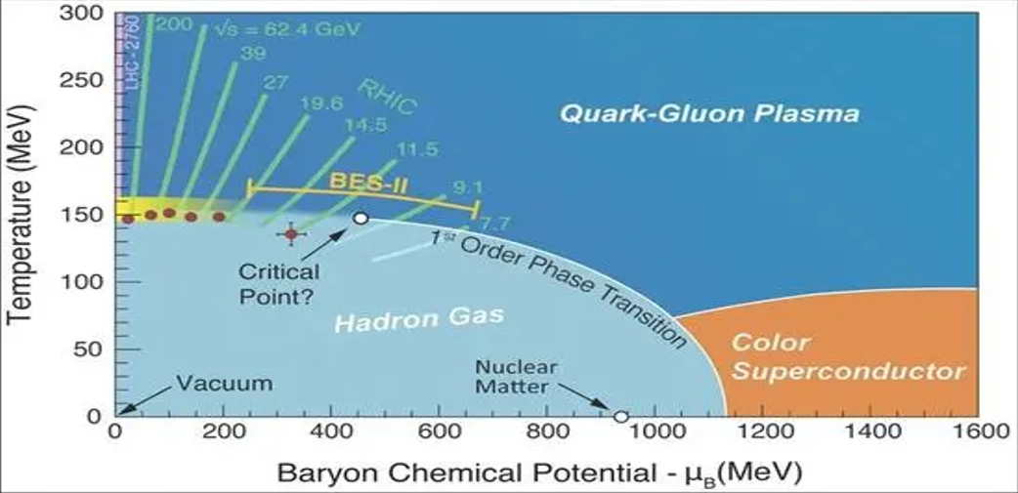

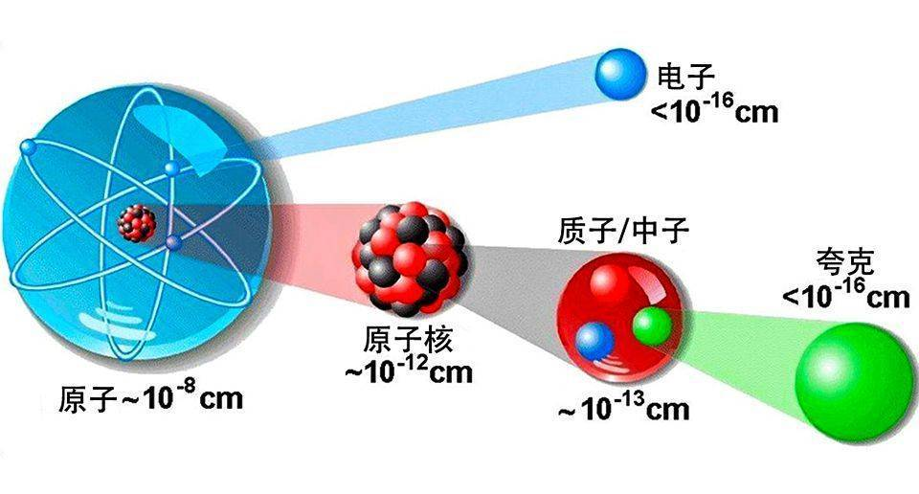
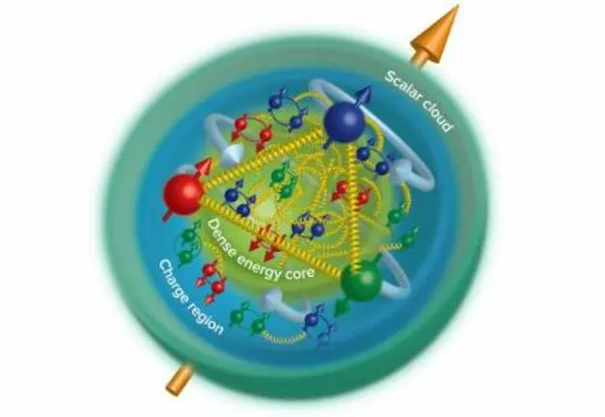
中国格点QCD现有的主要研究方向

Slide 7
Lattice QCD 3 steps
1 product configurations
2 do inversion or Calculate Green function S(x,y)
3 Do contraction

Slide 8
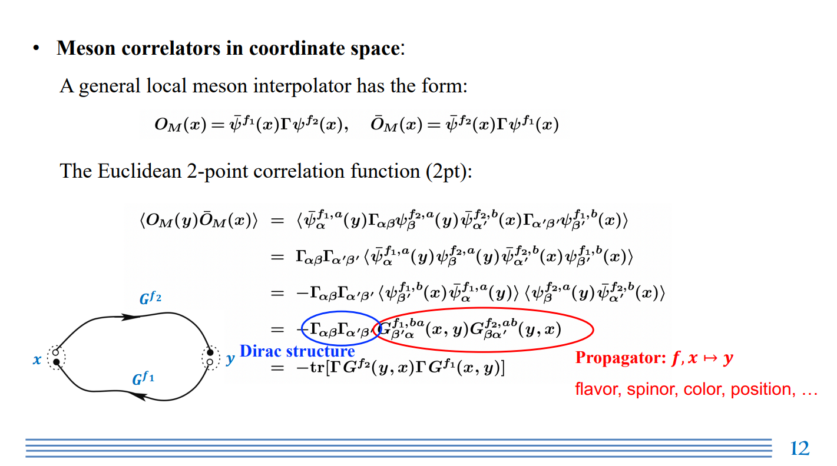

Slide 9
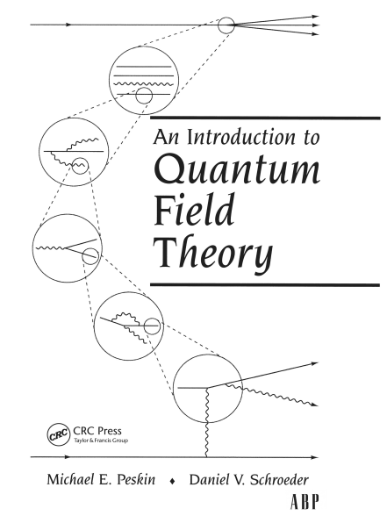

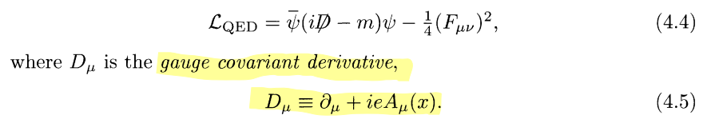



自由场的传播子：
有相互作用的传播子：

Slide 10
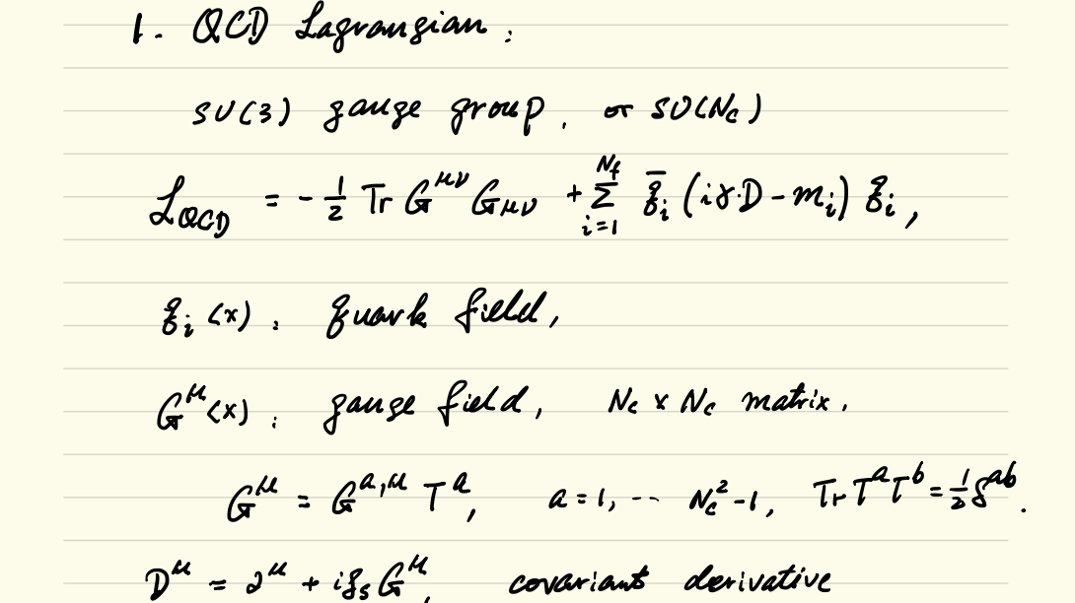

Slide 11
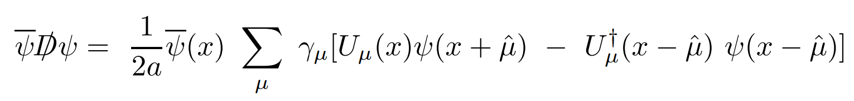
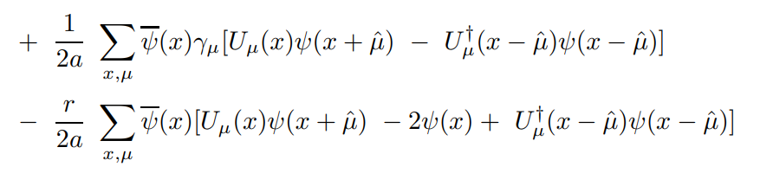
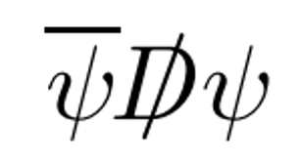




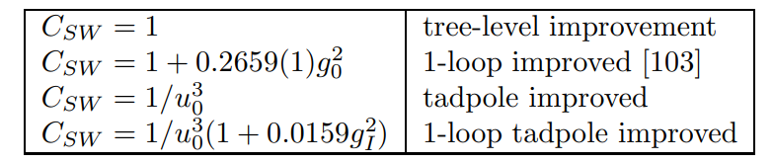
Clover Action
Naive fermion
Wilson fermion
Clover fermion

Slide 12
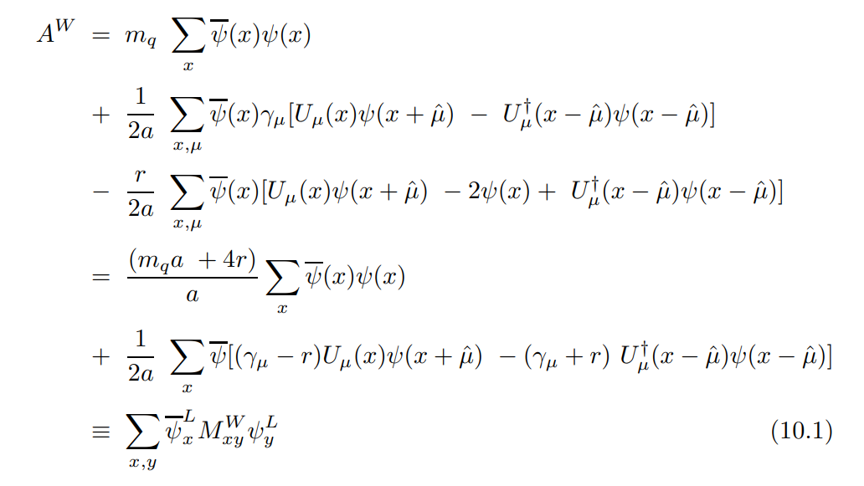
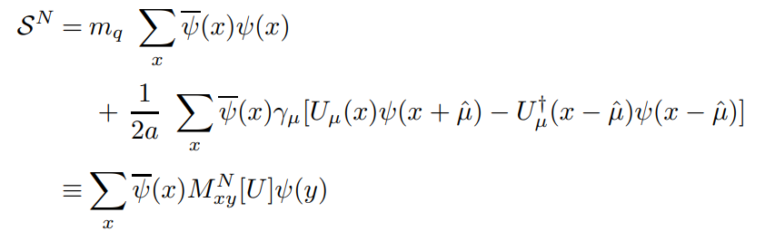
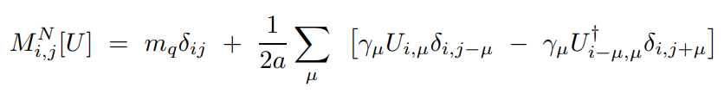





Wilson Action and Clover Action
Niave Action
Clover term
with

Slide 13
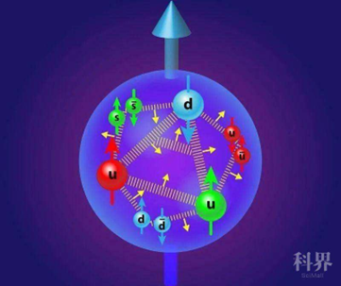
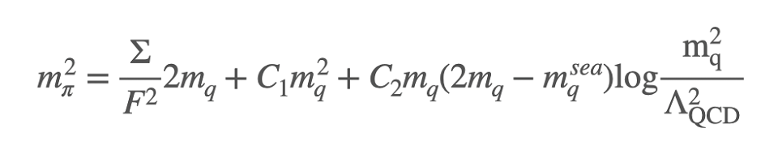
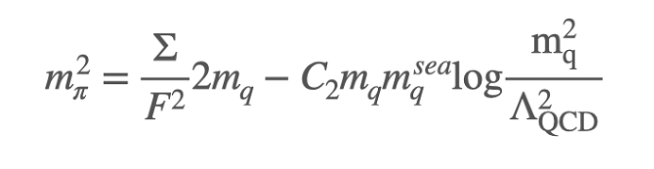

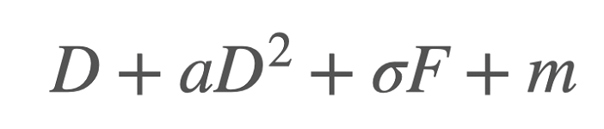
quark mass and pion mass in clover Action
Sea quark :
Valance quark :
For Clover action，
become

Slide 14
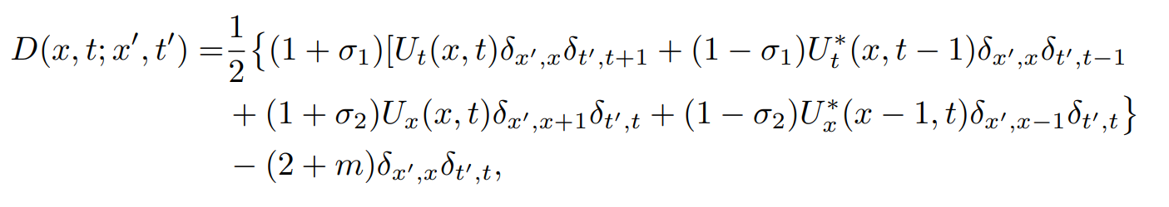
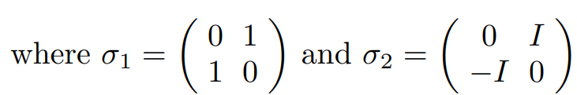
Wilson Dslash in 2D

Slide 15

2D QED Dslash
(0,0,0,0)
(1,0,0,0)
(2,0,0,0)
(0,1,0,0)
(1,1,0,0)
(2,1,0,0)
(0,2,0,0)
(1,2,0,0)
(2,2,0,0)
x
3 X 3 lattice as an example
(0,0,1,0)
(1,0,1,0)
(2,0,1,0)
(0,1,1,0)
x
t
(0,0,2,0)
(1,0,2,0)
(2,0,2,0)
x
( x, t, x’, t’)
(0,0,0,1)
(0,0,1,1)
(1,0,1,1)
(0,0,2,1)
$$σ ( Puali matrix)$$
D is (9 X 2) x (9 X 2 ) Matrix
x’
x’
x’
t’

Slide 16
inversion
Do inversion for M ( Dslash )
The Mass terms are diagonal elements
It is easy to do inversion for the larger valance mass

Slide 17
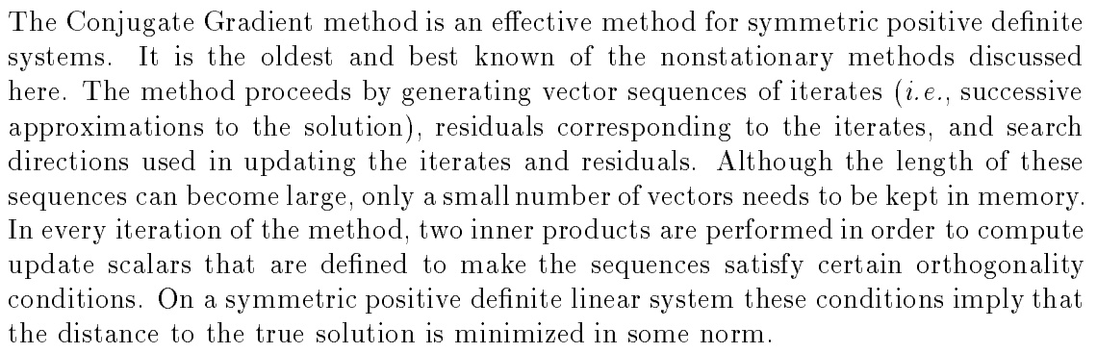
Conjugate Gradient Method

Slide 18
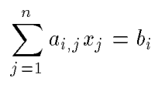

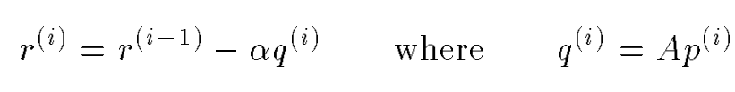



The problem we need to solve

Slide 19
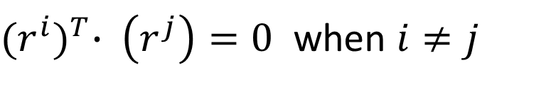
With these conditions, you will found the all r are orthogonal
${(r^{i})}^{T}∙ \left(r^{j}\right)=0$ when $i≠j$
Since the degree of freedom is limited, the number of $r^{i}$ is also limited. When $r^{i}=0$ , the solution is found.
However, we do not need the precise solution, when ${(r^{i})}^{T}∙ \left(r^{i}\right)$ is small enough, $x^{i}$can be an approximate solution.

Slide 20
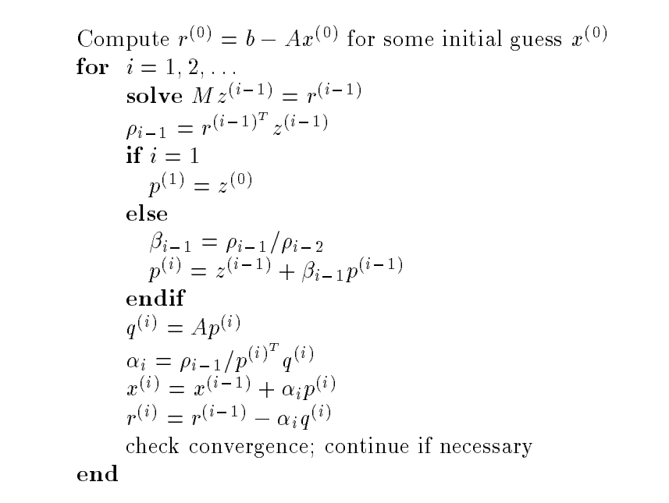
CG
here M=1

Slide 21
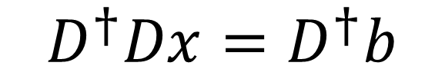
D is not a symmetric positive definite matrix, so we can not use CG algorithm. But we can solve
$$D^{†}Dx=D^{†}b$$

Slide 22
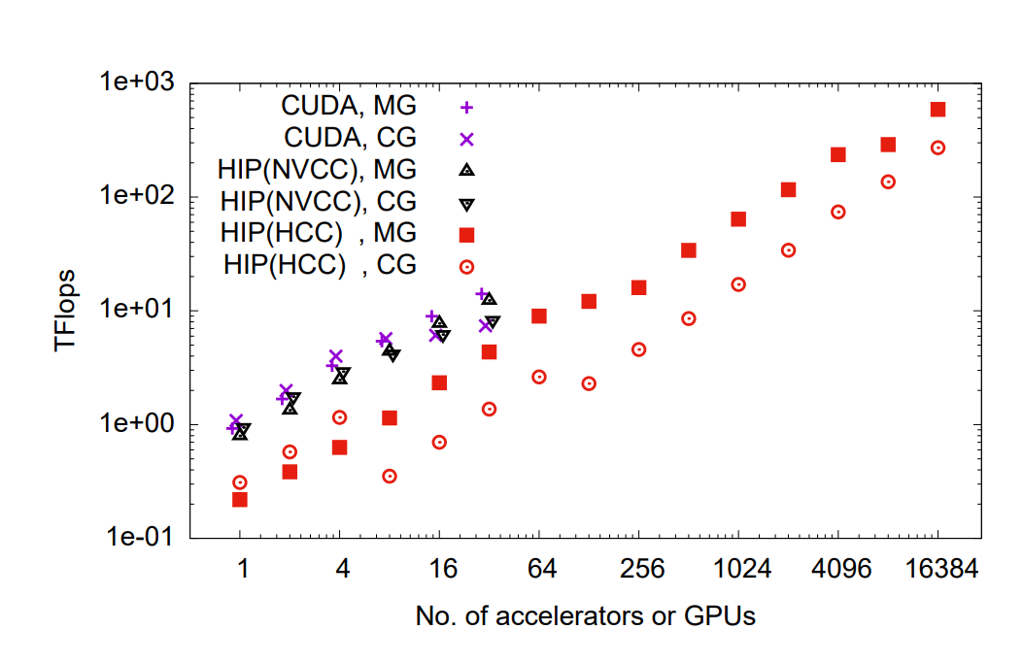
Multigrid Algorithm

Slide 23

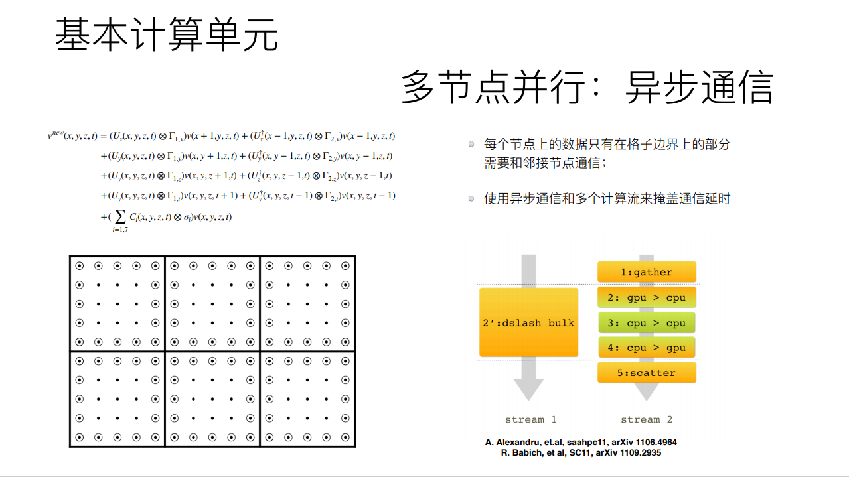
开发计划

Slide 24
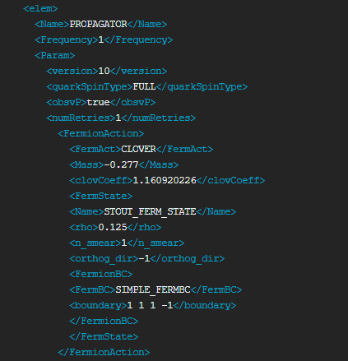
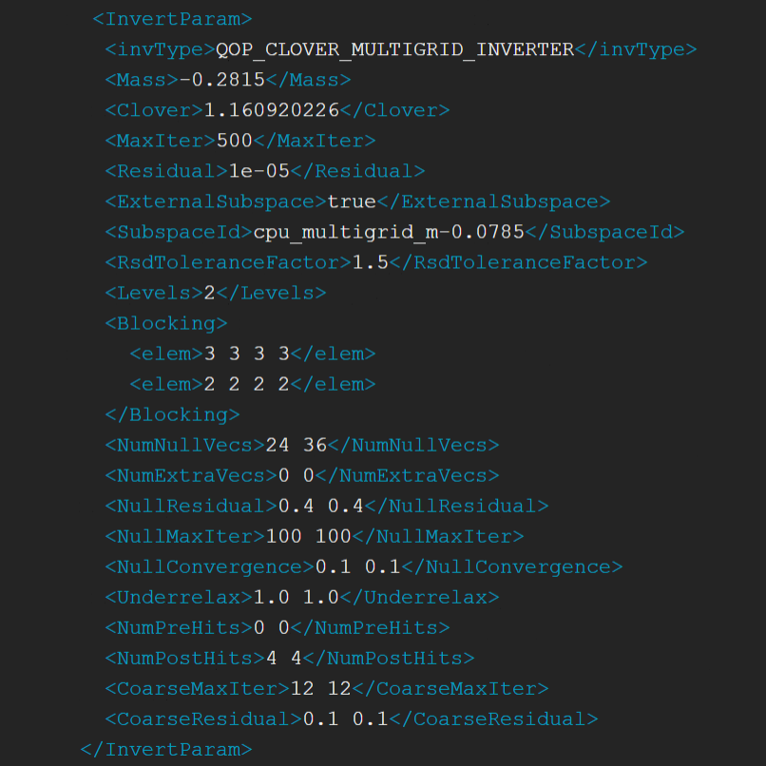
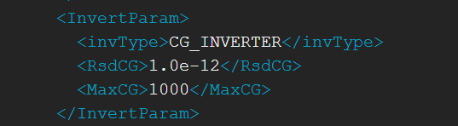
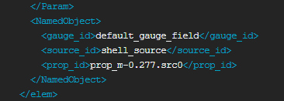
or

Slide 25
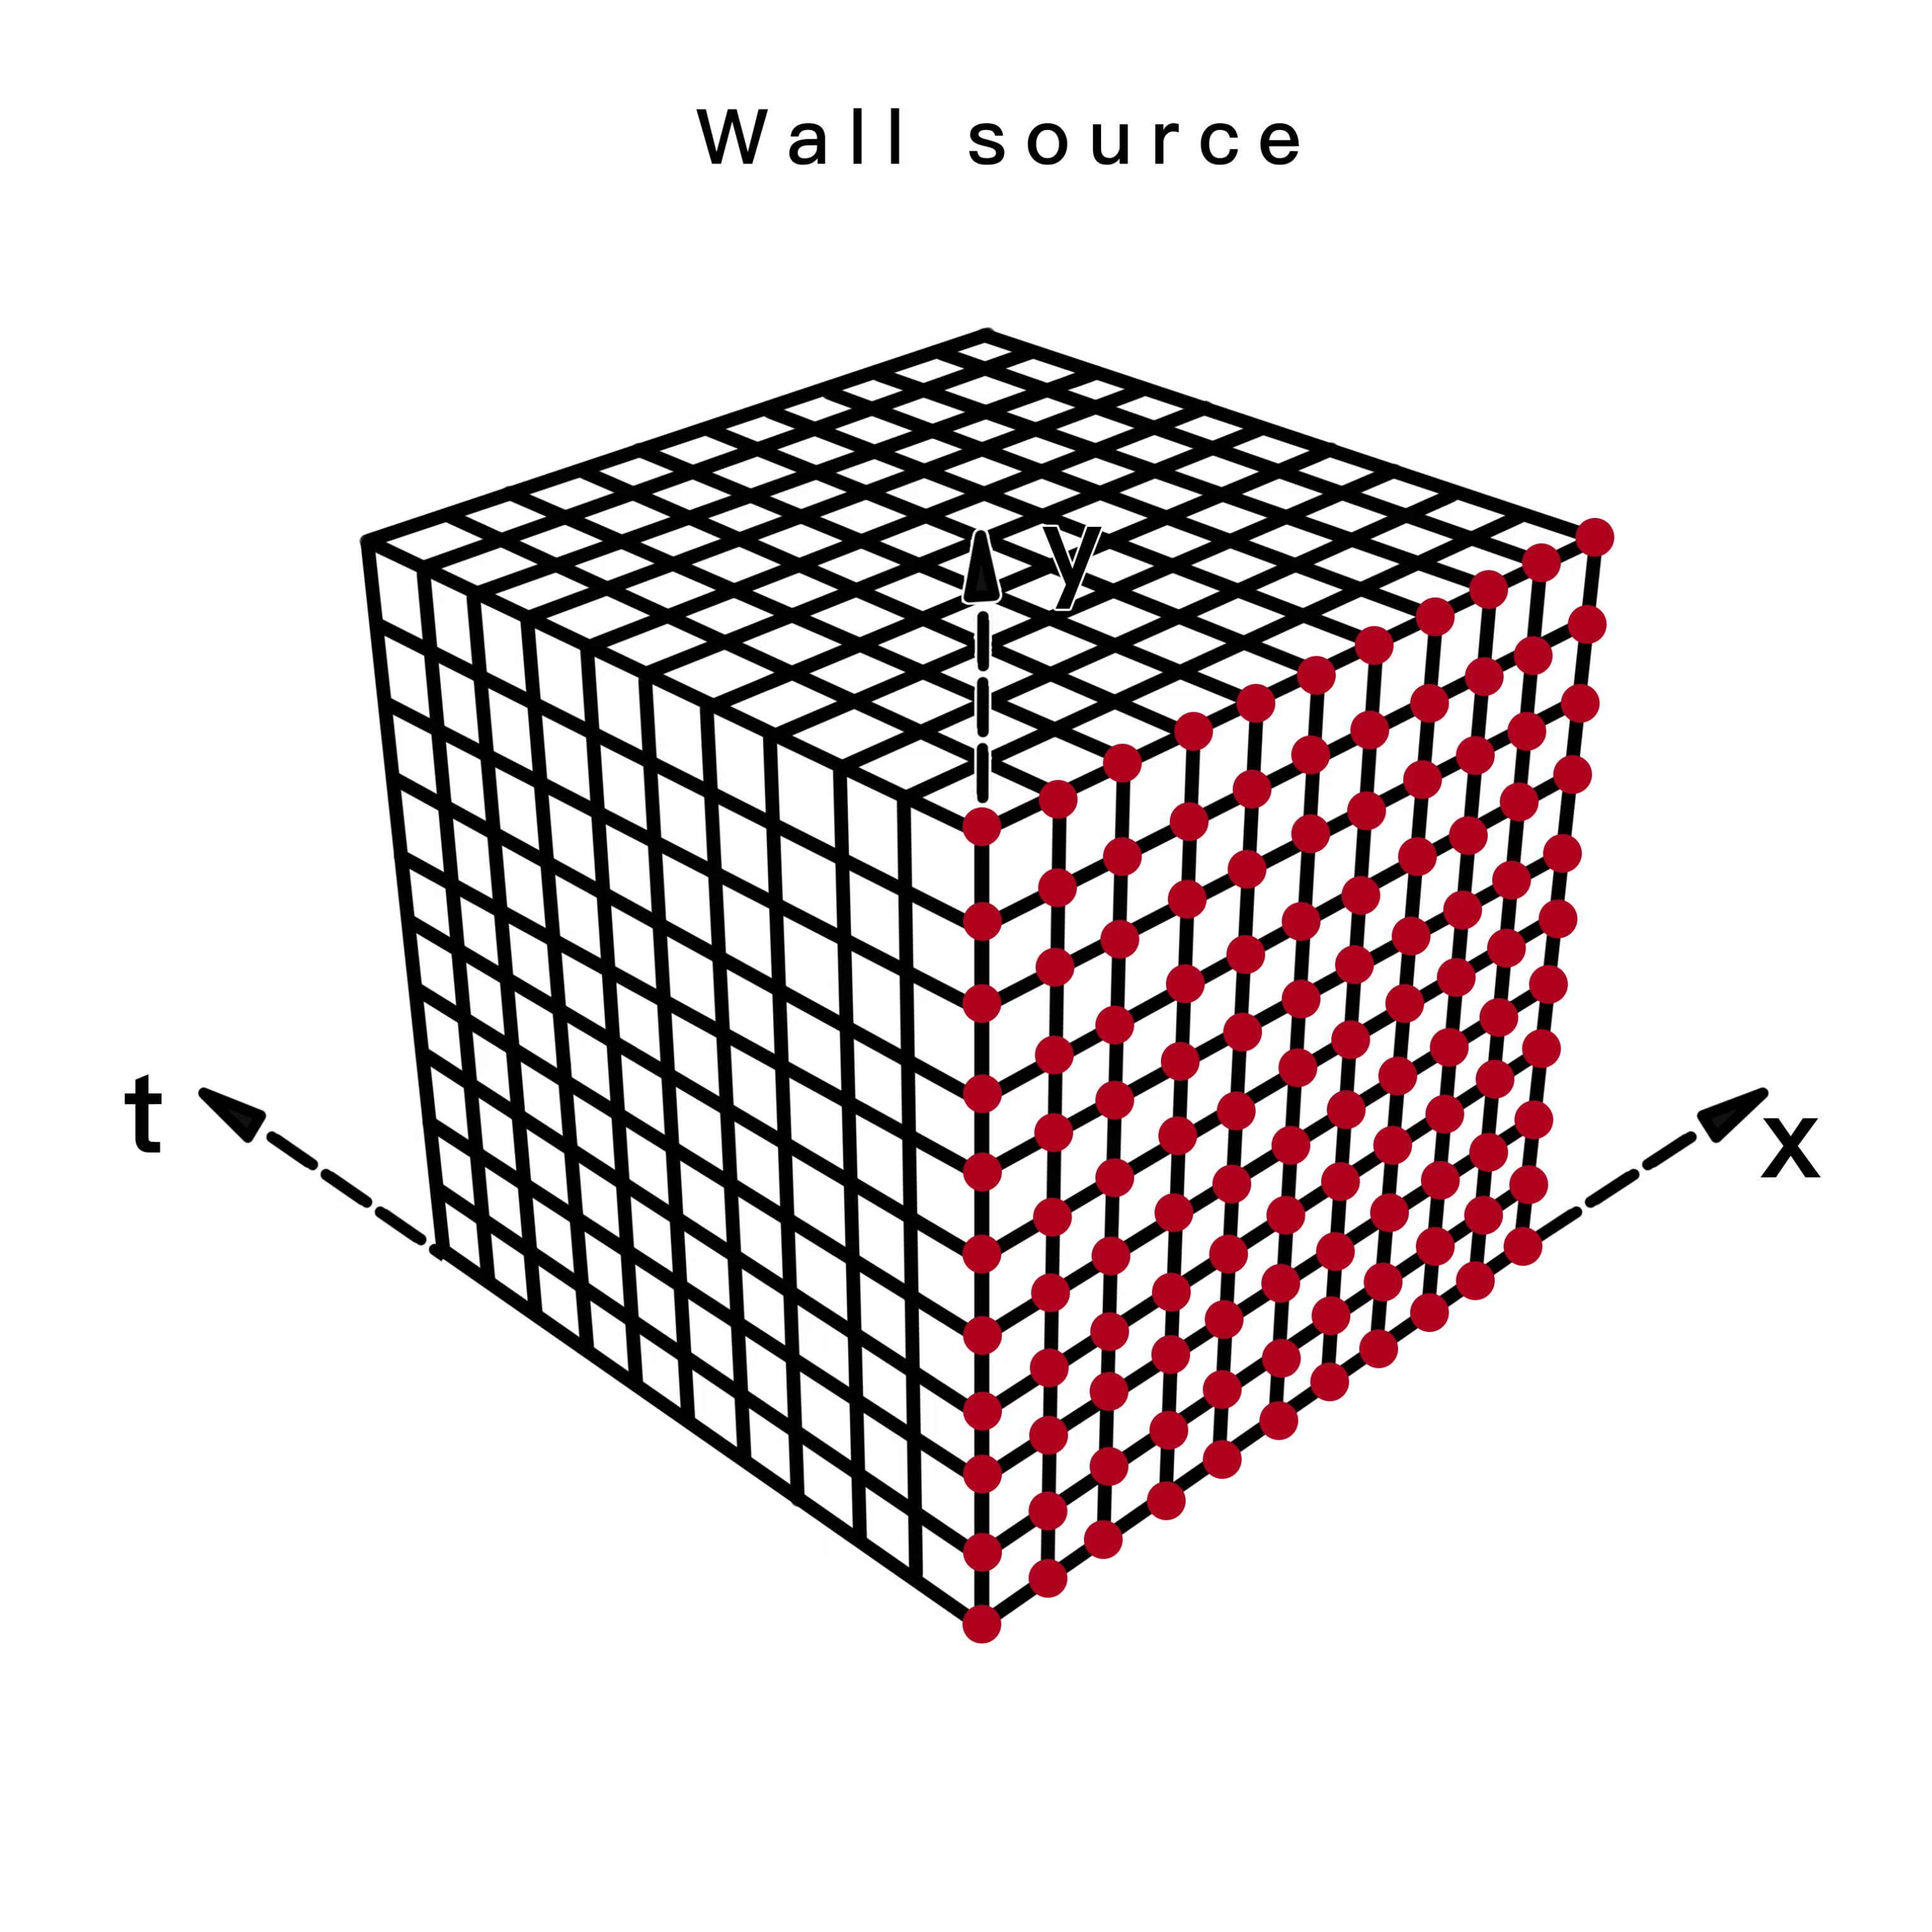
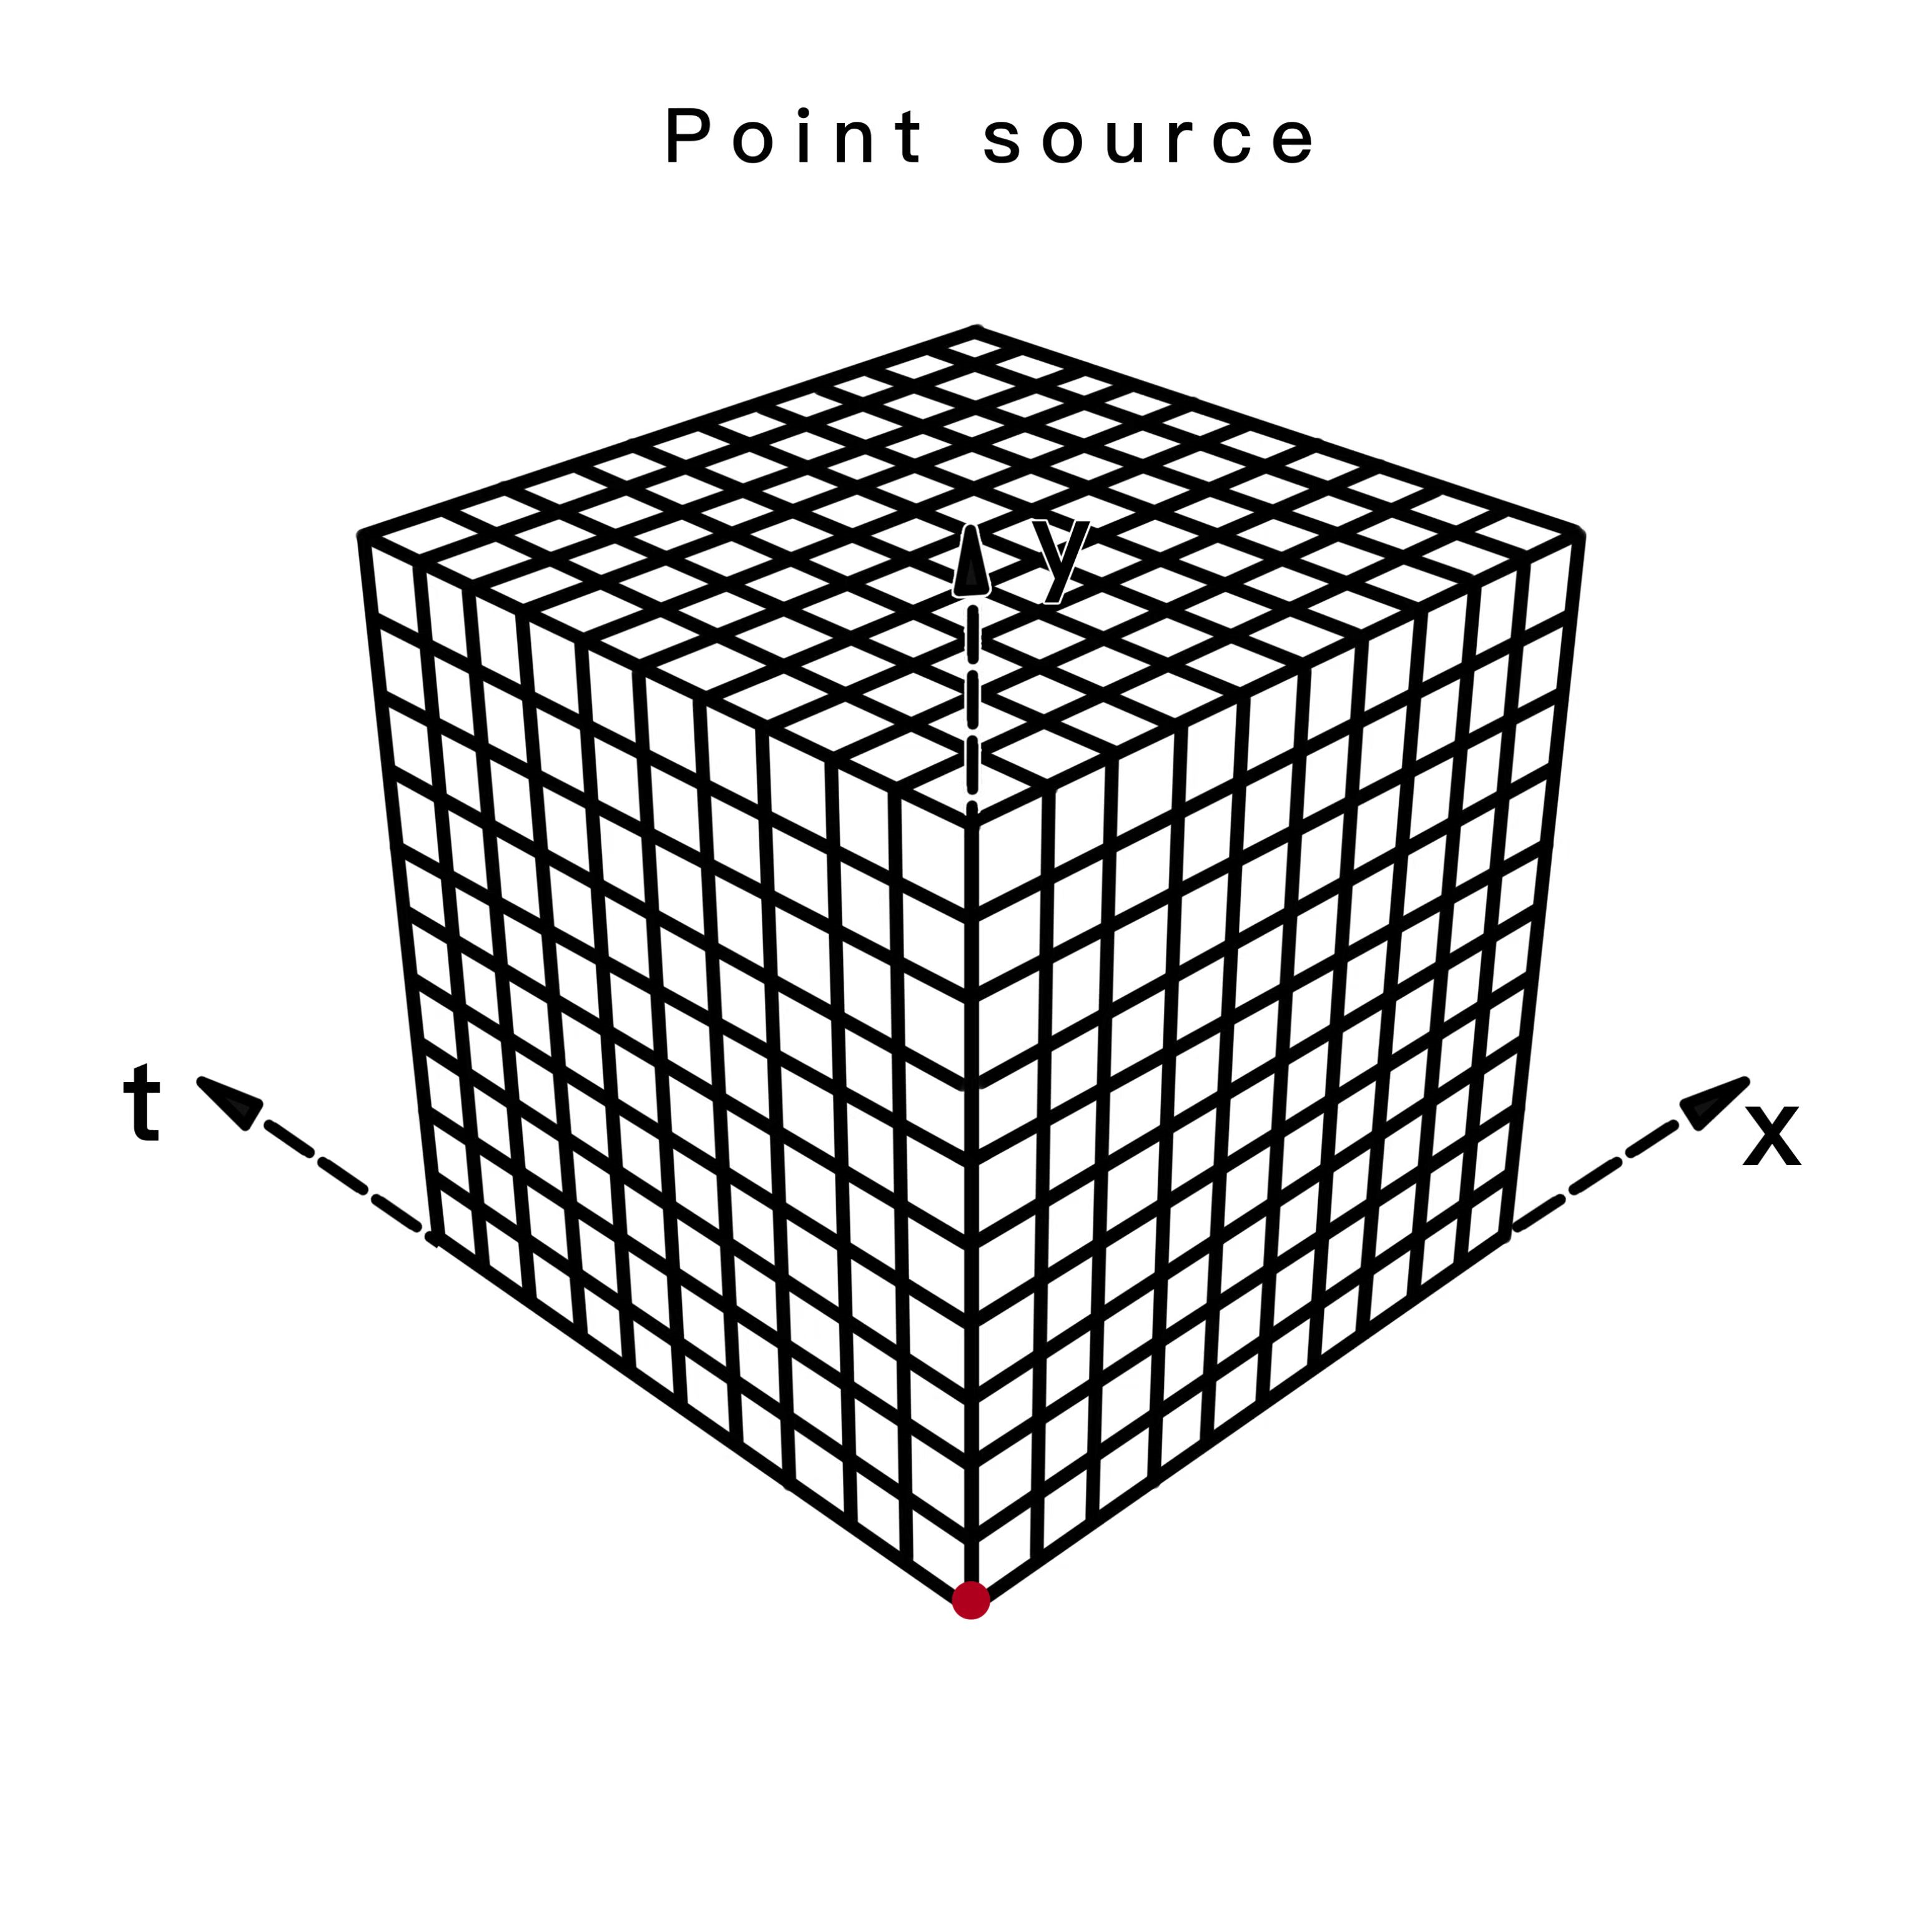
Source

Slide 26


Slide 27



Slide 28


Slide 29


Slide 30
Homework
CG
MG
Light -0.2815
Heavy strange -0.2310
Heavy charm 0.4763
light mg, light cg, strange cg, charm cg

Slide 31


Slide 32
In lattice
In QCD or QED theory, we have spin-1 gauge field and spin-1/2 fermion field
We still do not know how to build up a fermion field on lattice, now. and in the configurations there is only gauge field.
However, we could calculate the related Green’s function for fermion

Slide 33


The related Green’s function for fermion
The relationship between Green function and Dslash.
The S(x , y) is what we need to solve.

Slide 34


Slide 35



Clover ensembles
Symanzik + Clover Action @ Zero T
name | Volume | Lattice spacing | $$β$$ | $π$mass | $η_{s}$ mass | L x M | L | conf
C11P29S | 24³x72 | 0.105fm | 6.20 | 290MeV | 640MeV | 3.8 | 2.6fm | 900
C11P29M | 32³x64 | 0.105fm | 6.20 | 290MeV | 640MeV | 5.0 | 3.5fm | 700
C11P22M | 32³x64 | 0.105fm | 6.20 | 220MeV | 640MeV | 3.9 | 3.5fm | 450
C11P22L | 48³x96 | 0.105fm | 6.20 | 220MeV | 640MeV | 5.6 | 5.4fm | 400
C11P14L | 48³x96 | 0.105fm | 6.20 | 135MeV | 700MeV | 3.4 | 5.4fm | 100
C08P30S | 32³x96 | 0.080fm | 6.41 | 300MeV | 650MeV | 3.9 | 2.6fm | 500
C08P30M | 48³x96 | 0.080fm | 6.41 | 300MeV | 650MeV | 5.0 | 3.8fm | 400
C08P21S | 32³x64 | 0.080fm | 6.41 | 210MeV | 650MeV | 4.1 | 2.6fm | 460
C08P21M | 48³x96 | 0.080fm | 6.41 | 210MeV | 650MeV | 4.1 | 3.8fm | 450
C06P30S | 48³x144 | 0.054fm | 6.72 | 300MeV | 650MeV | 4.0 | 2.6fm | 500
Chin.Phys.C 46 (2022)
arXiv: 2207.00183
arXiv: 2207.14132
LM Liu, M Gong, P Sun and YB Yang

Slide 36


Slide 37


Slide 38


Actions
(image-time theory)

