Slide 1

New analyses of event shapes and the determination of $αs$
in e⁺e⁻ annihilation
贵州民族大学
王声权
第四届粒子物理前沿研讨会
山西 太原
2023.08.08
Based on arXiv:2112.06212; 1908.00060; 1902.01984, in collaboration with Stanley J. Brodsky, Xing-Gang Wu, Jian-Ming Shen, and Leonardo Di Giustino

Slide 2
Outline
Introduction for the QCD Running Coupling
Event shapes at e⁺e⁻ collider
The determination of 𝛼_{𝒔} at LEP
Summary

Slide 3
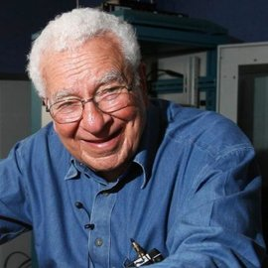

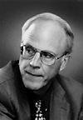
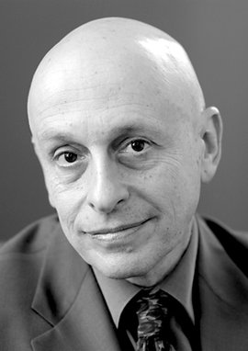
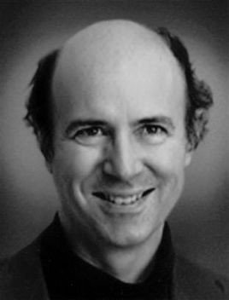
Introduction
Quark model
1964(1969)
默里·盖尔曼(Murray Gell-Mann)
戴维·格罗斯(David J. Gross)
戴维·普利策(H. David Politzer)
弗兰克·维尔泽克(Frank Wilczek)
QCD
1973(2004)

Slide 4
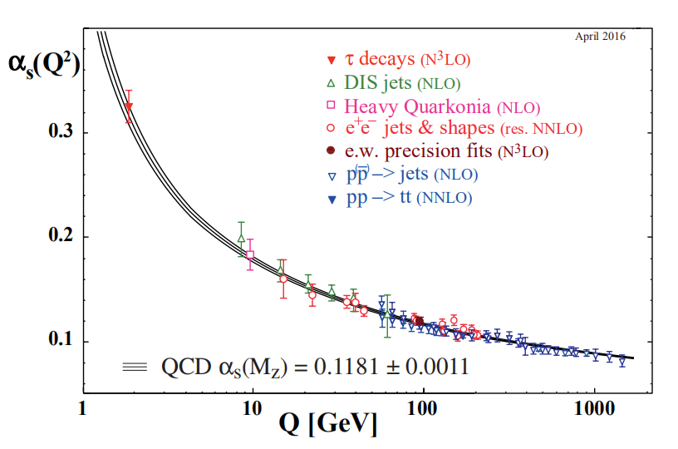
Introduction
夸克禁闭和渐进自由

Slide 5
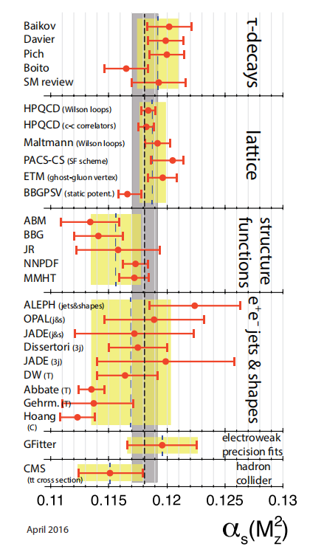
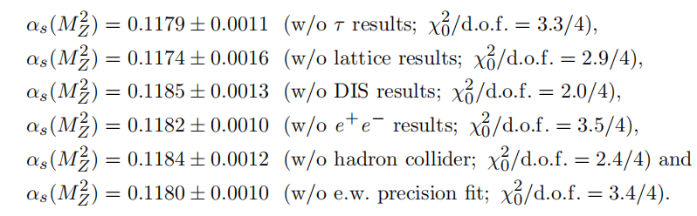

Introduction
Beside the quark masses, the only free parameter in the QCD Lagrangian is the strong coupling constant.
0.8%
[Particle Data Group],
Prog. Theor. Exp. Phys. 2022, 083C01 (2022)

Slide 6
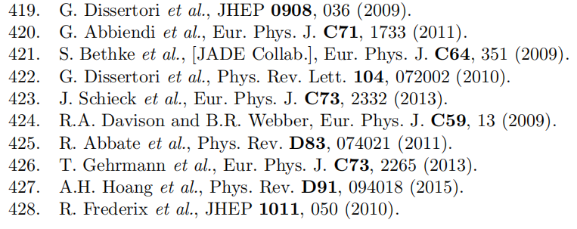
Event shapes at e⁺e⁻ collider
The a_{s}(M_{Z}) are plagued by significant scale uncertainty
Some extracted a_{s}(M_{Z}) are deviated from the world average
non-self-consistent

Slide 7
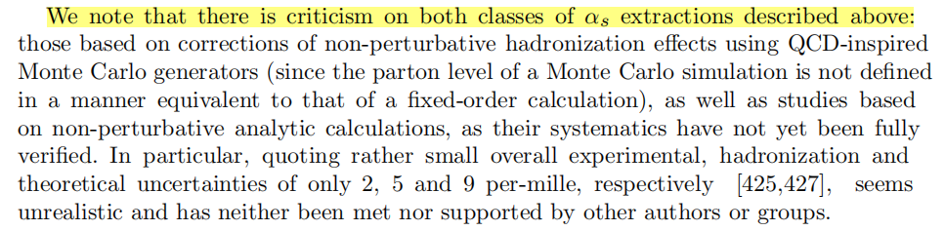
Event shapes at e⁺e⁻ collider
The method for extracting a_{s}(M_{Z}) in e⁺e⁻ collider:
the renormalization scale is fixed to Q =
predictions matched Monte Carlo models to correct for hadronization effects
based on analytic calculations of non-perturbative and hadronization effects, using methods like power corrections, factorization of soft-collinear effective field theory, dispersive models and low scale QCD effective couplings
?
[Particle Data Group],
Phys. Rev. D98, 030001 (2018)

Slide 8
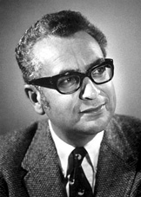

Principle of Maximum Conformality(PMC)
BLM/FAC/PMS
In the case of QED, the renormalization scale can be set unambiguously by using the Gell-Mann-Low method, which automatically sums all vacuum polarization contributions to the photon propagators to all orders.
BLM=> nf-term
BLM method reduces in the
Abelian limit to the
Gell-Mann-Low method

Slide 9
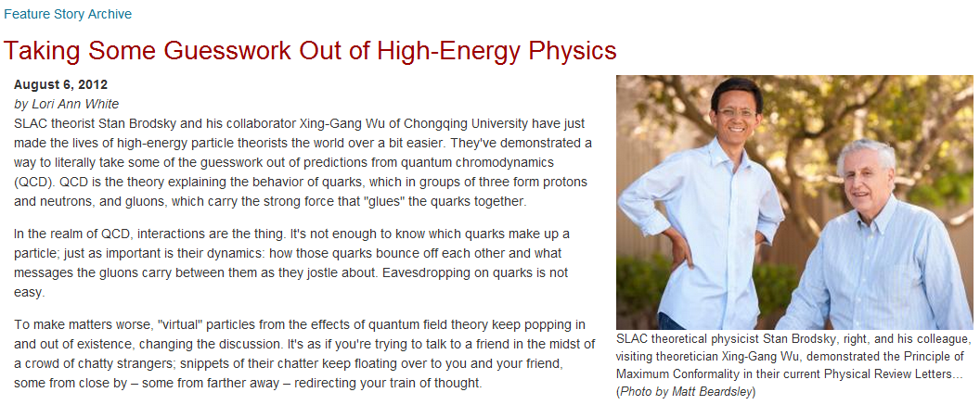
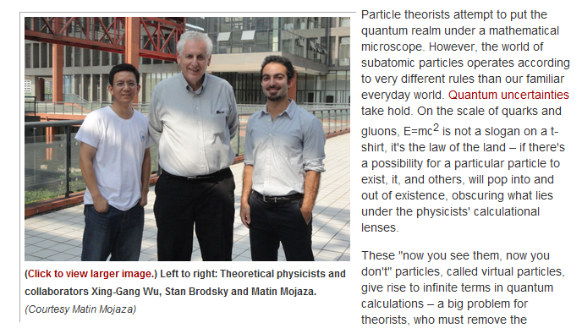
Principle of Maximum Conformality(PMC)
Stan and Wu, Phys.Rev.Lett.109,042002(2012)
Matin, Stan and Wu, Phys.Rev.Lett.110,192001(2013)
Stan and Wu, Phys.Rev.D85,034038(2012)
Wu, Stan and Matin, Prog.Part.Nucl.Phys. 72,44(2013)
Wu, Ma, Wang, Fu, Ma, Stan and Matin, Rep.Prog.Phys. 78, 126201 (2015)
Wu, Shen, Du, Huang, Wang, Stan, Prog.Part.Nucl.Phys. 108 (2019) 103706

Slide 10
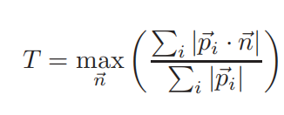
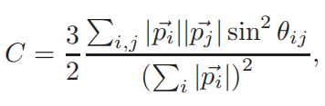
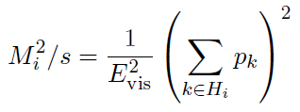

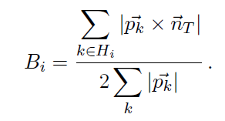

Event shapes at e⁺e⁻ collider
The classic event shapes: the thrust (T), the heavy jet mass (M_H^2/s), the wide and total jet broadenings B_W and B_T, the C-parameter (C)
Phys. Lett. 12, 57 (1964).
Phys. Rev. Lett. 39, 1587 (1977).
Phys. Lett. B 74, 65 (1978).
Phys. Rev. D20, 2759 (1979).
Currently, the main obstacle for achieving a precise determination of a_{s}(M_{Z}) is not the lack of precise experimental data, especially at Z⁰ peak, but the ambiguity of theoretical predictions.
Rep. Prog. Phys. 69, 1771 (2006).

Slide 11
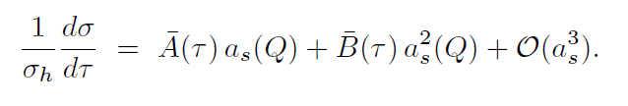
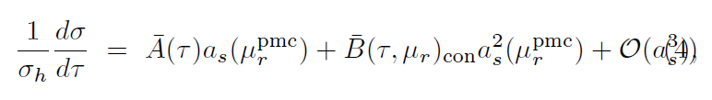


The determination of 𝛼_{𝒔} at LEP
The differential distribution for a event shape:
Q = using conventional method

Slide 12
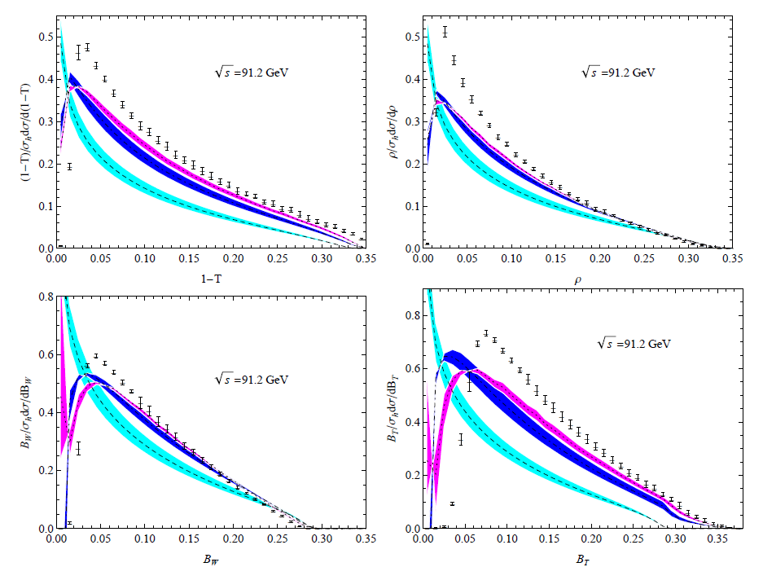
The determination of 𝛼_{𝒔} at LEP
Conventional results
at 91.2 GeV
Central values are Q = 91.2 GeV , the errors are [Q/2, 2Q].
Phys. Rev. Lett. 99, 132002
JHEP 0712, 094
Phys.Rev. Lett. 101, 162001
JHEP 0906, 041

Slide 13
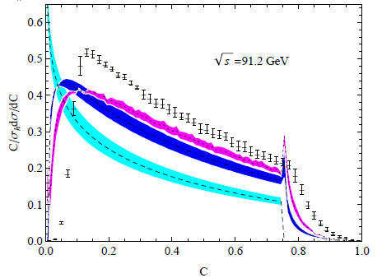
The determination of 𝛼_{𝒔} at LEP
Event shapes using the conventional method:
The NLO and NNLO are large and the pQCD series shows a slow convergence.
Estimating the unknown higher order QCD by varying the scale [1/2Q, 2Q] is unreliable.
The predictions are plagued by scale uncertainty, and even up to NNLO, the predictions do not match the data.
The extracted coupling constants are deviated from the world average, and are also plagued by scale uncertainty.

Slide 14
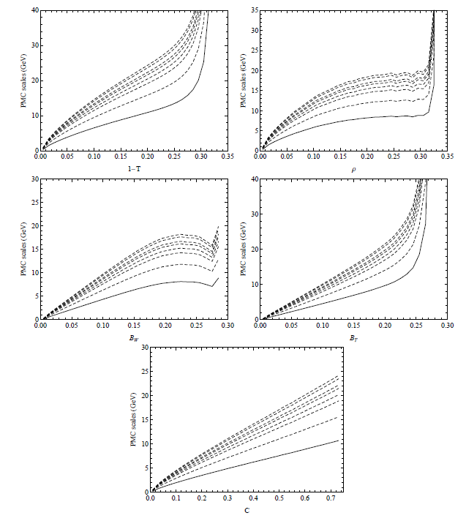
The determination of 𝛼_{𝒔} at LEP
PMC scales:
Remarkably, the PMC scales change dynamically with event shapes;
The quarks and gluons have soft virtuality near the two-jet region. The PMC scales are very soft in this region, while in the regions away from the two-jet region, the PMC scales are increased, as expected;
The PMC scales are small in the wide kinematic regions compared to the conventional method \sqrt{s};
The PMC scales increase with the center-of-mass energy;
yields the correct physical behavior, and similar behavior are obtained in the SCET theory and other literatures (ZPA 339, 189; EPJC 74, 2896).

Slide 15
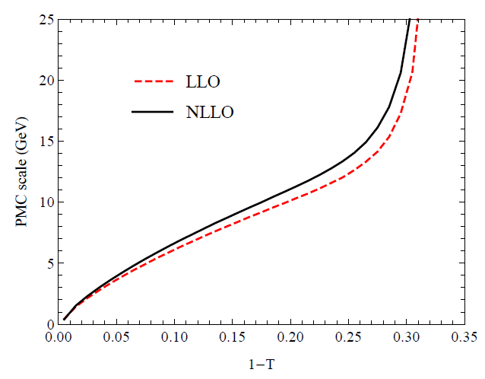
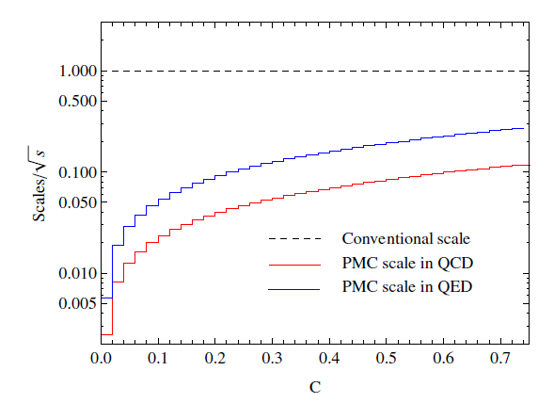
The determination of 𝛼_{𝒔} at LEP
T
C

Slide 16

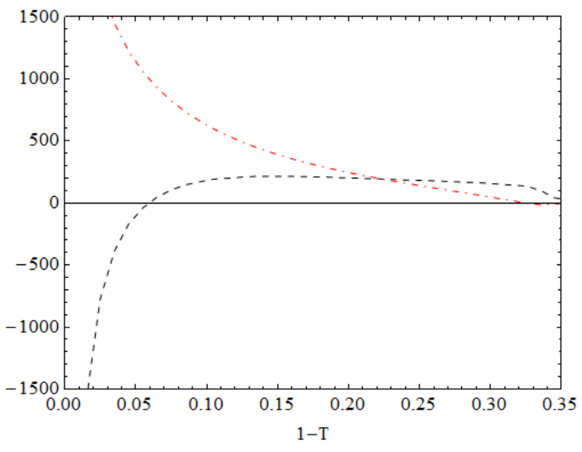
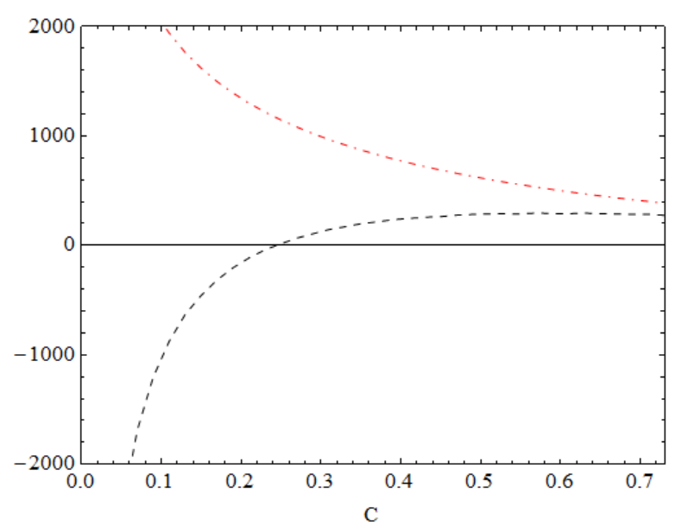
The determination of 𝛼_{𝒔} at LEP
Perturbative coefficients:
In addition to the PMC scales, the behavior of the PMC conformal coefficients is very different from that of the conventional scale-setting method.

Slide 17
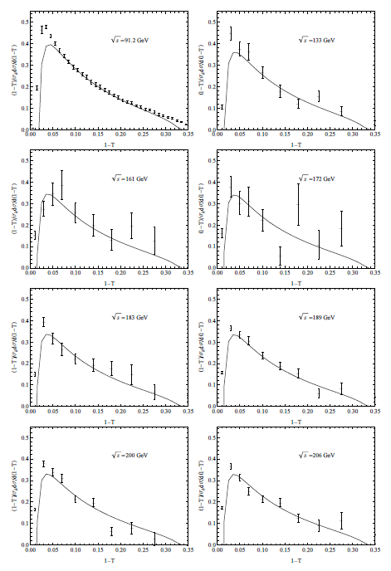
The determination of 𝛼_{𝒔} at LEP
The resulting PMC predictions are increased in wide kinematic regions compared to the conventional predictions.
Since the PMC scales are independent of the choice of renormalization scale and the conformal coefficients are also renormalization scale independent, the PMC predictions eliminate the renormalization scale uncertainty.

Slide 18
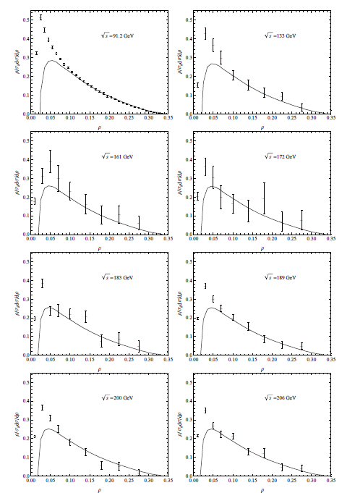
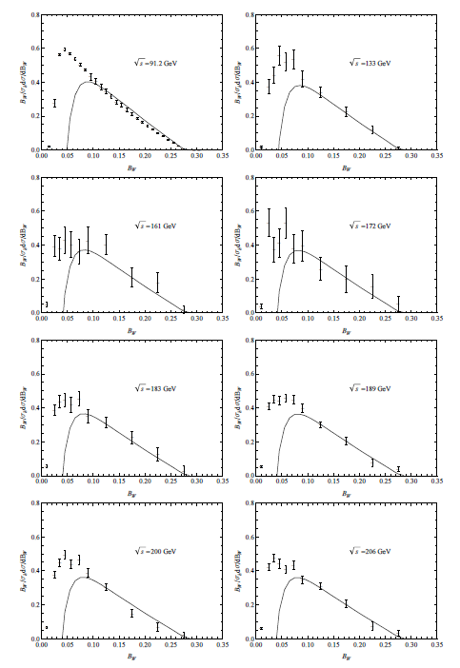
The determination of 𝛼_{𝒔} at LEP

Slide 19
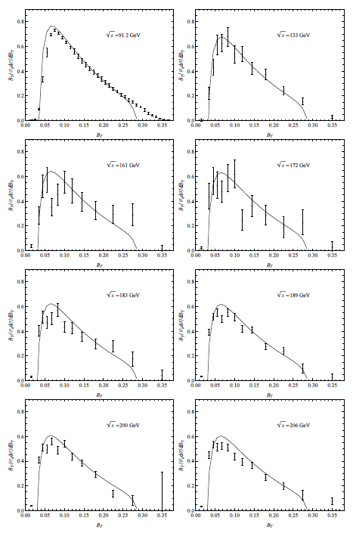
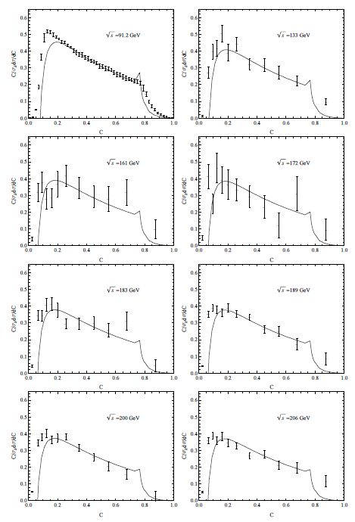
The determination of 𝛼_{𝒔} at LEP

Slide 20
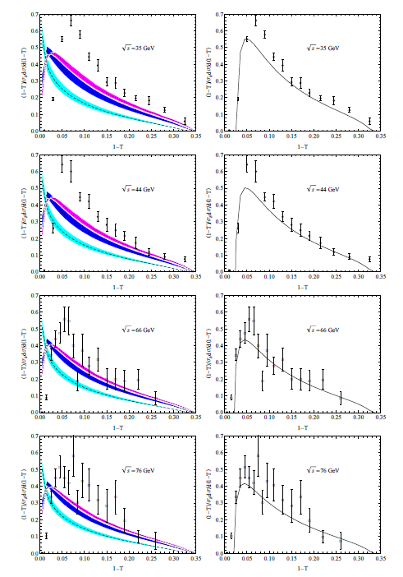
The determination of 𝛼_{𝒔} at LEP
Event shape distributions
below Z0 peak

Slide 21
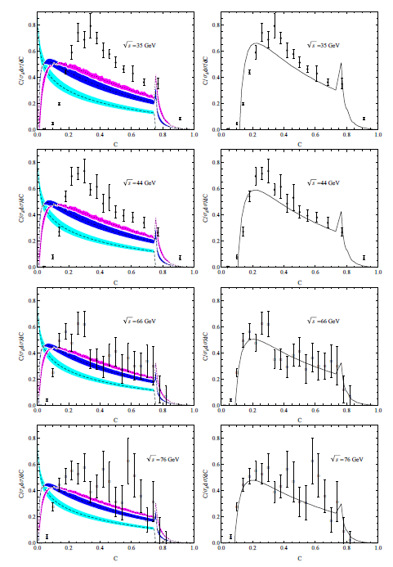
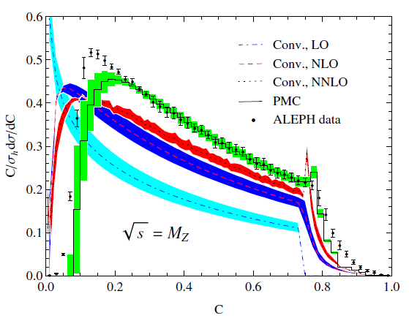
The determination of 𝛼_{𝒔} at LEP
The PMC predictions are greatly increased in wide kinematic regions, which leads PMC results to be closer to the experimental data.
There are some deviations near the two-jet and multijet regions, since there are large logarithms that spoil the perturbative regime of the QCD. The resummation of large logarithms is thus required for the PMC results especially near the two-jet regions.

Slide 22
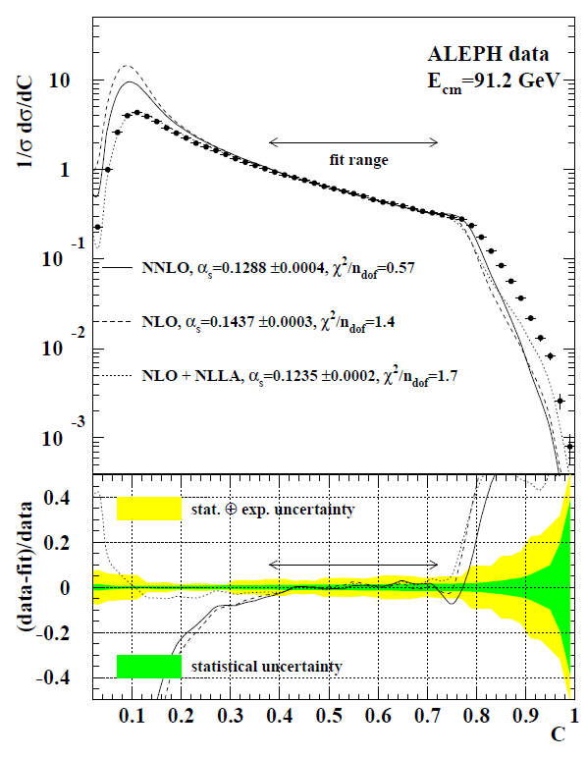
The determination of 𝛼_{𝒔} at LEP
Q = = M_{Z}
Conv.
One value α_{s} at scale M_{Z} is extracted (α_{s} (M_{Z})).
the fit range of T (C) distribution is narrow.
the fit range is arbitrary.
different fit range leads to different α_{s} .
JHEP 0802 (2008) 040

Slide 23
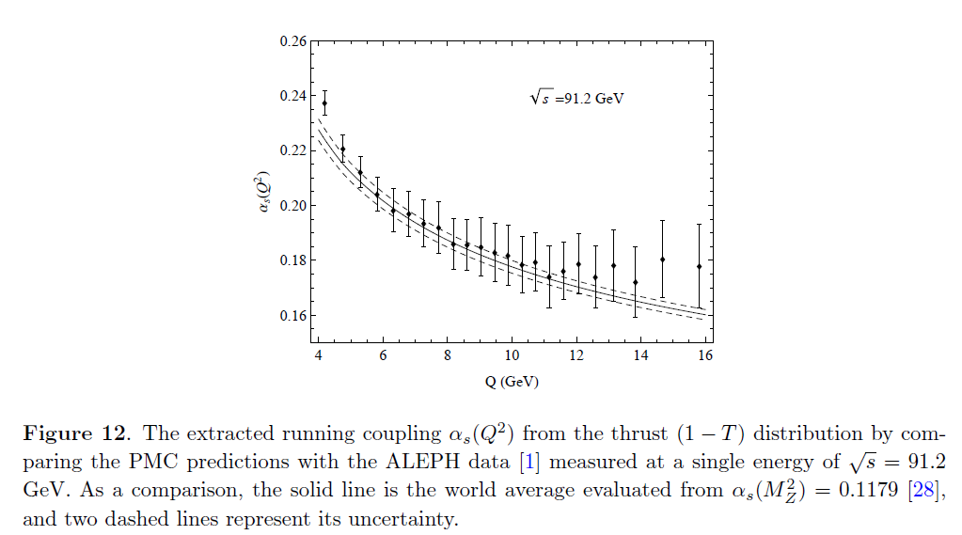
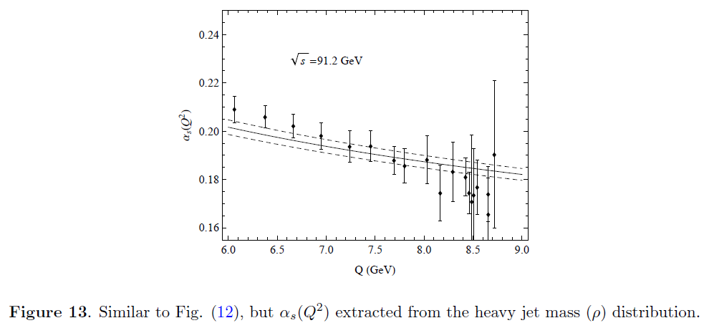
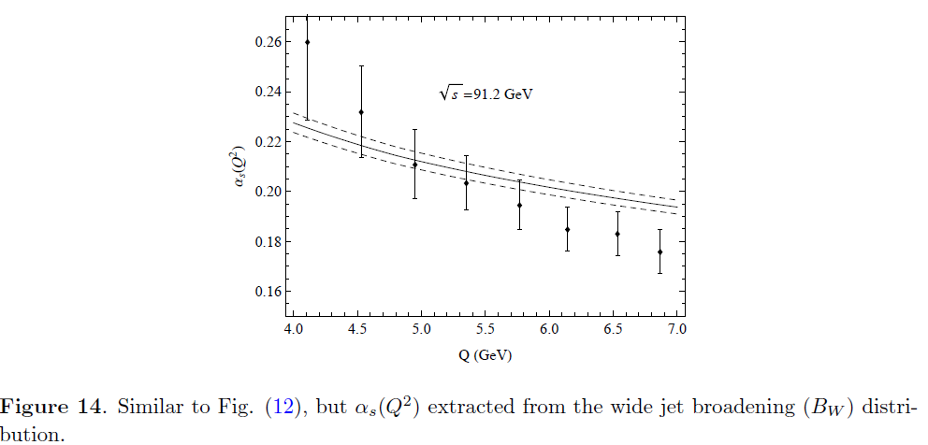
The determination of 𝛼_{𝒔} at LEP
Q = = M_{Z}
4 < Q < 16 GeV
6 < Q < 9 GeV
4 < Q < 7 GeV

Slide 24
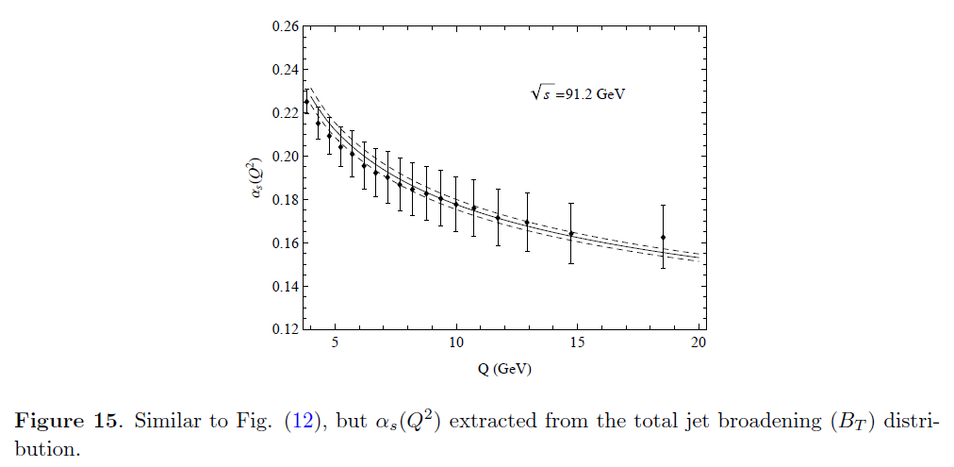
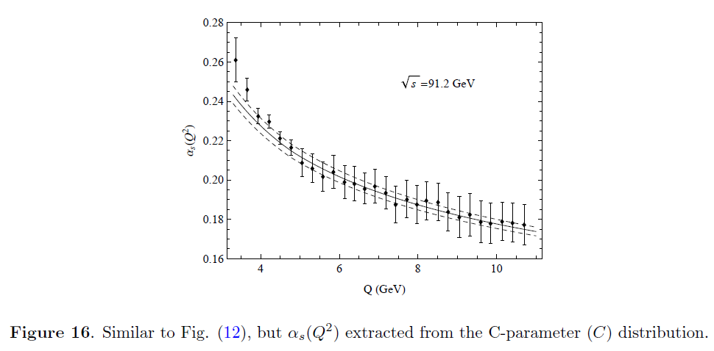
The determination of 𝛼_{𝒔} at LEP
The extracted α_{s} are in agreement with the world average in wide range of Q.
The extracted α_{s} are not plagued by scale uncertainty.
Since PMC scale varies with event shapes, we can extract the strong coupling at a wide scale range using the experimental data at single center-of mass-energy.
4 < Q < 19 GeV
In QED, the running of the QED coupling at a wide scale range can be determined from events at a single energy
e.g., (OPAL Collaboration), EPJC 45, 1 (2006)
3 < Q < 11 GeV

Slide 25
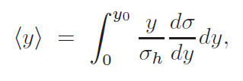


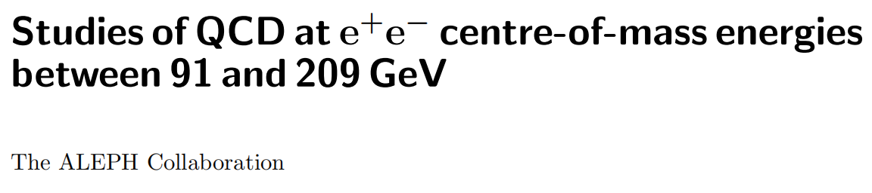
The determination of 𝛼_{𝒔} at LEP
the mean value of event shapes,
it involves an integration over the full phase space.
it provides an important complement to the differential distributions and to determinate α_{s}
is also suggested by
PMC scales of differential distribution are also very small.
the average of the PMC scale for differential distribution is close to the scale of mean value. self-consistent.
Eur. Phys. J. C 35, 457–486 (2004)

Slide 26
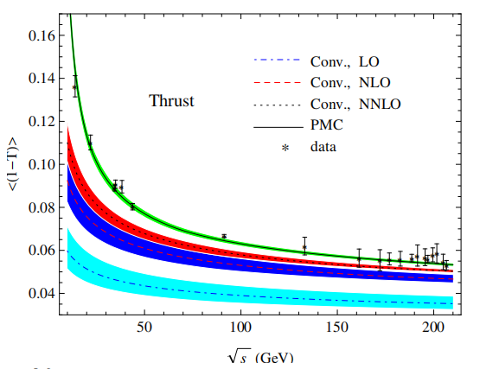
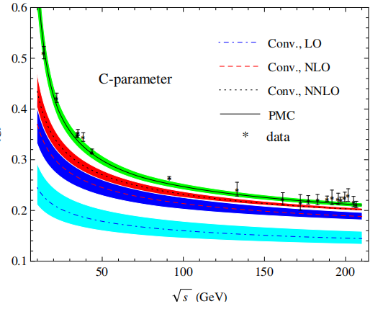
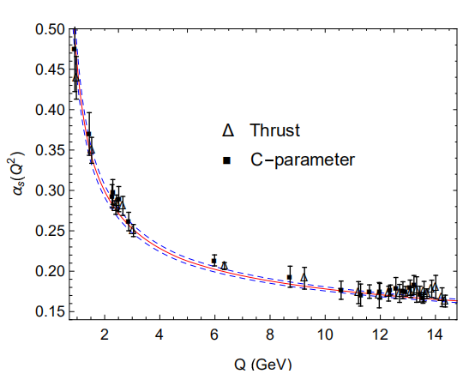
The determination of 𝛼_{𝒔} at LEP

Slide 27
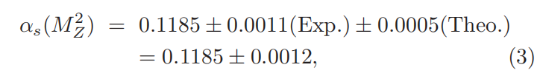
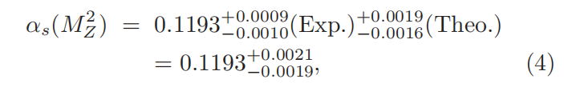
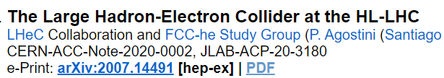
The determination of 𝛼_{𝒔} at LEP
T
C
Cited by LHeC and FCC group and PDG
[Particle Data Group], Prog. Theor. Exp. Phys. 2020 (2020), 083C01.
PDG
mean value for other event shapes, EEC,

Slide 28
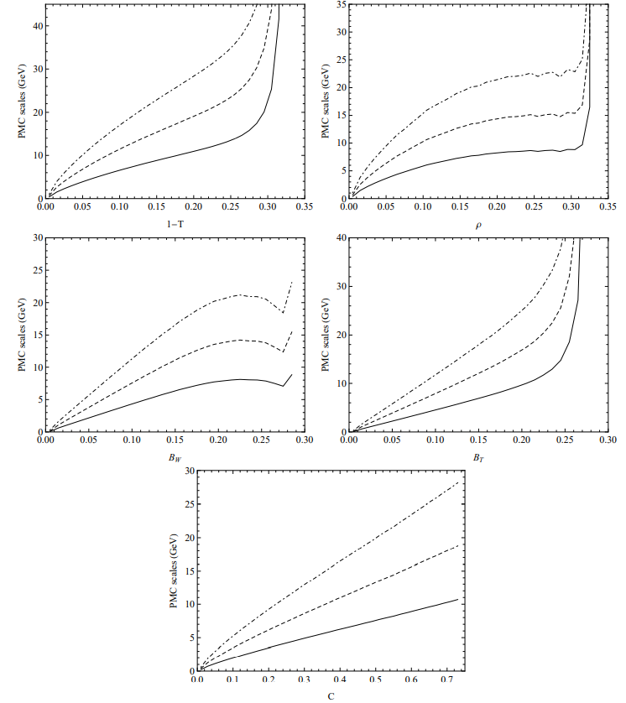
Event shapes at CEPC
We calculate the classical event shapes at the CEPC at 91.2, 160 and 240 GeV.
240
PMC scales for event shape
observables at CEPC
91.2
Similar to the case of the PMC scale at LEP

Slide 29
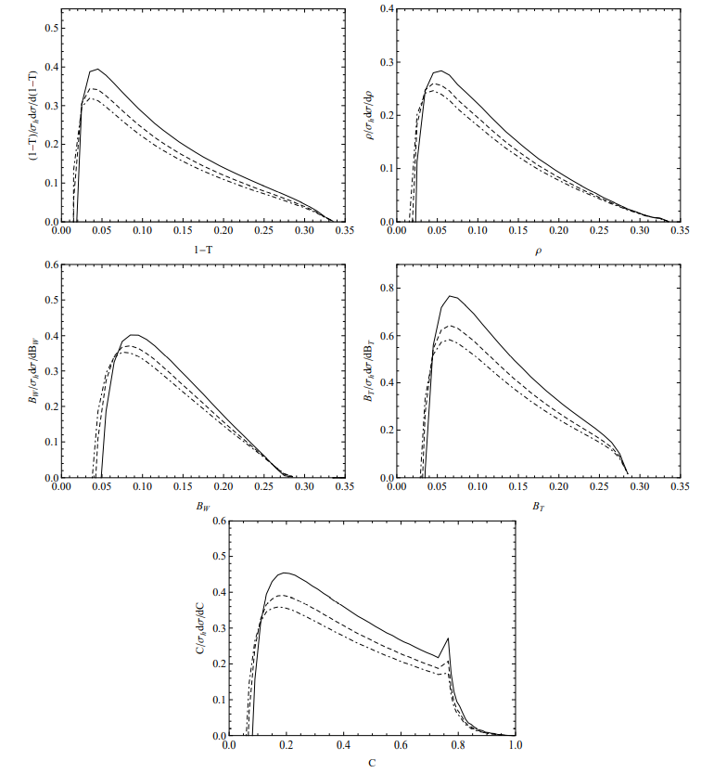
Event shapes at CEPC
91.2
240
Our precise and scale-independent predictions for event shape observables, and a novel way to verify the running of αs(Q^2) call for the precise measurements at CEPC.

Slide 30
Summary
To eliminate the renormalization scheme-and-scale ambiguities
There is no renormalon divergence in the pQCD series
The more convergent perturbative series is in general achieved
A novel method for the precise determination
of the QCD running coupling is obtained

Slide 31
thanks

