Slide 1
Experimental Progress of APEX
Zhihui Peng
Hunan Normal University
Dongning Zheng
Institute of Physics
On behalf of
Axion and dark Photon EXperiment (APEX) collaboration
AXION 2023, July 24th- 28th, 2023
Xian, Shaanxi, China
1

Slide 2
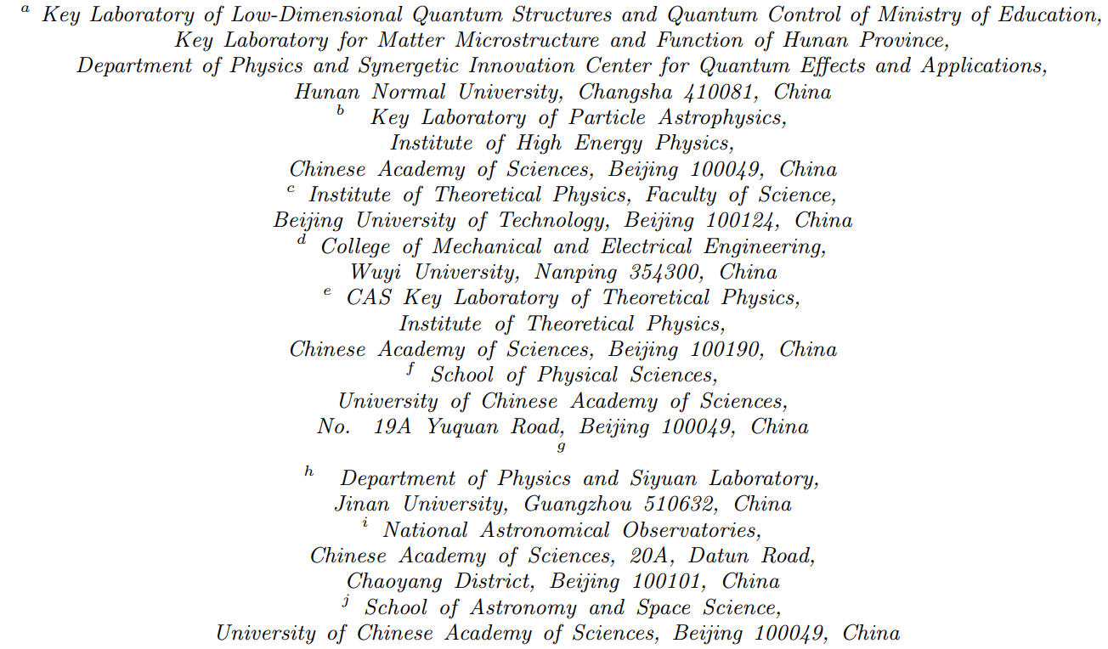
APEX Collabration
Dong He a, Yu Gao b, Nick Houston c, Chuang Li d, Tianjun Li e,f, Shi-hang Liu a, Zhihui Peng a, Liang Sun g, Jia Wang g, Qiaoli Yang h, Chi Zhang g, Xin Zhang i,j, Dongning Zheng g, and Jian-yong Zhou a
2

Slide 3
Outline
Background
Quantum Sensing Technology based on
Superconducting Circuits Developed in APEX
Initial Results about Dark Photon Measurements
from a 7.138 GHz Cavity Haloscope Experiment
Summary
3

Slide 4
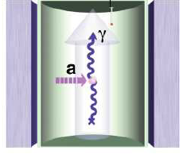
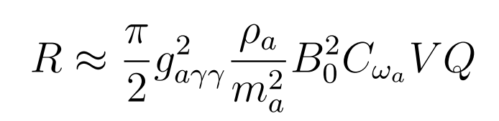

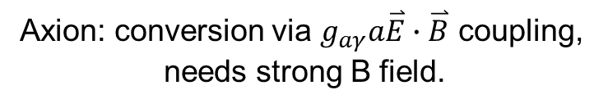
Background
Axion and Dark Photon are perfect dark matter candidates.
Axion/DP can convert to a microwave photon signal inside a resonant cavity
Axion: conversion via $g_{aγ}a\overset{⃑}{E}∙\overset{⃑}{B}$ coupling,
needs strong B field.
Dark photon: conversion via kinetic mixing,
no need for strong B field.
Resonant conversion
in a high Q cavity
Axion signal rate:
DP signal rate:
$R≈κ^{2}ρ_{DP}VQ$
4

Slide 5
Background
Microwave signals converted from Axion and Dark Photon are very weak (single photon level)
Techniques developed in Superconducting QIT during the past two decades can play important roles in this field
  Superconducting qubits (artificial atom)
  Josephson parametric amplifier
  High Q cavity
  Superconducting magnet

Slide 6
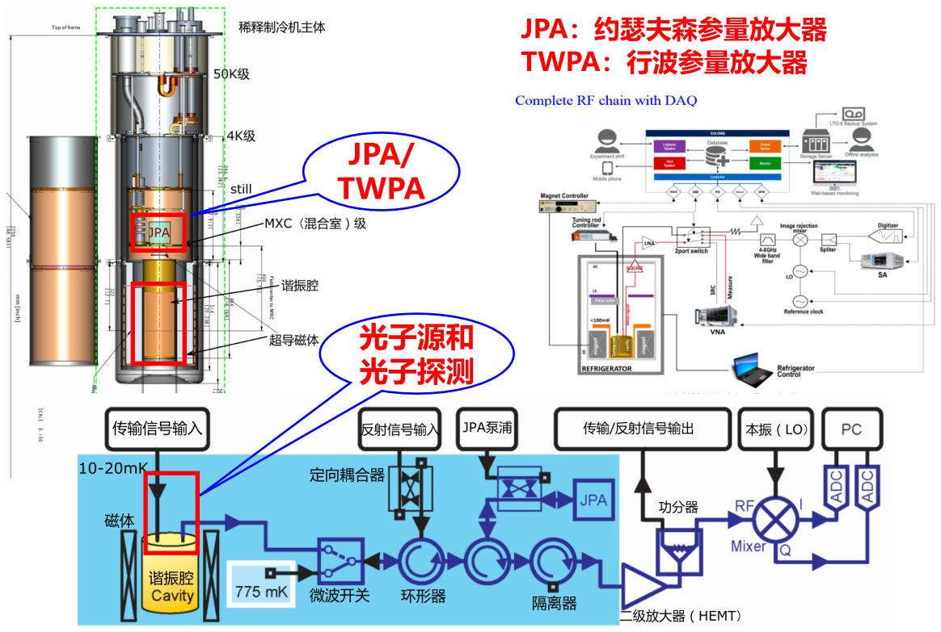

Axion and Dark Photon Detection
$\sim {10}^{\text{−}24}$W/Hz
噪声光子数：~4
Notes:
轴子暗物质和暗光子探测需要应用大量超导量子信息实验发展出来的量子精密测量技术，如微波单光子源（对探测系统验证），微波单光子探测（探测单个微波光子具有高的信噪比），JPA/TWPA等

Slide 7
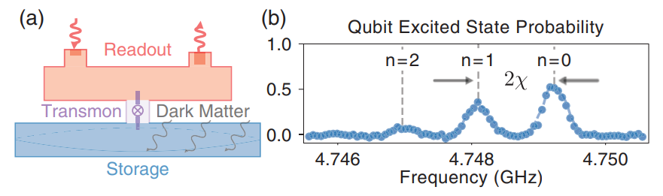
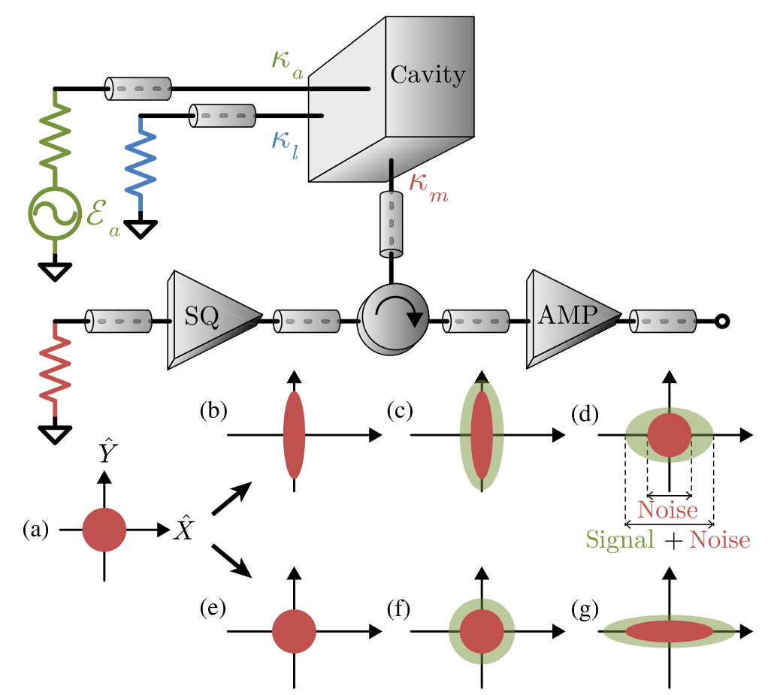
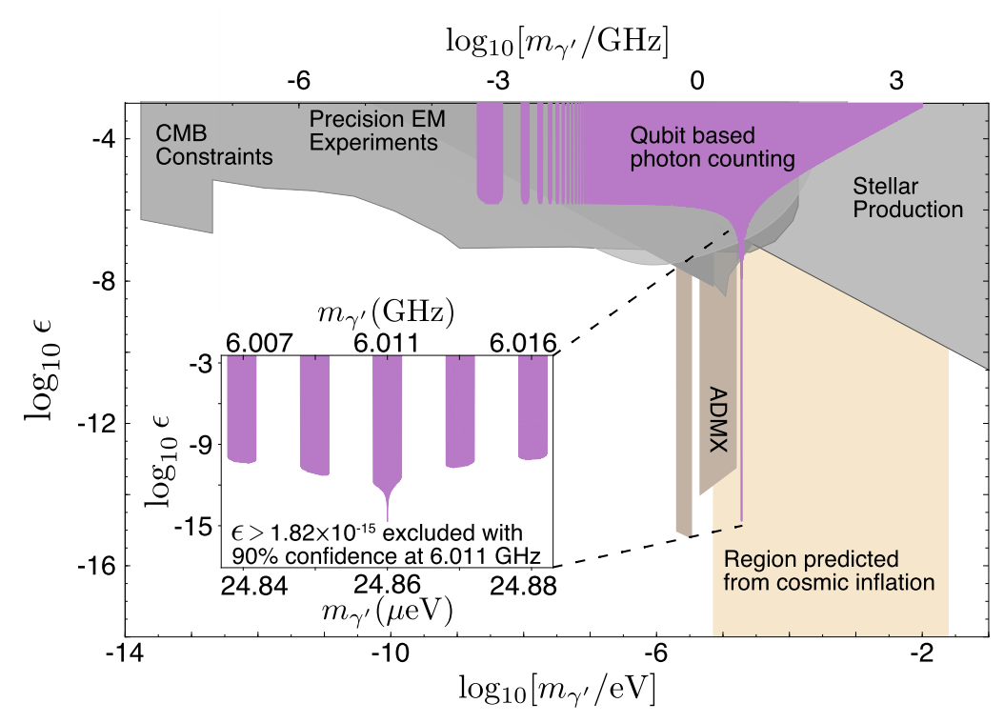
Application of Superconducting QIT in Axion Detection
Chicago, PRL 126, 141302 (2021)
JILA, PRX 9, 021023 (2019)
Reduce the noise with 15.7dB below quantum-limit
enhance the spectral scan rate by a factor of ~2 with squeeze degree 4.5dB
Notes:
Left :Reduce the noise with 15.7dB below quantum-limit
Right: enhance the spectral scan rate by a factor of ~2 with squeeze degree 4.5dB

Slide 8
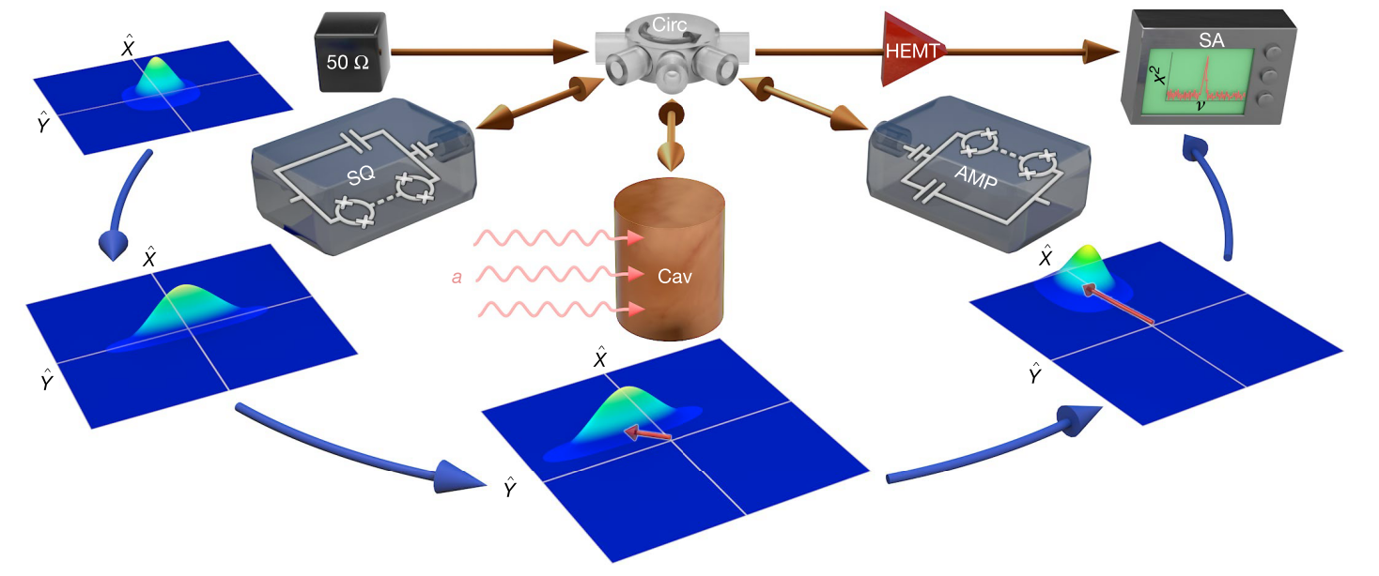
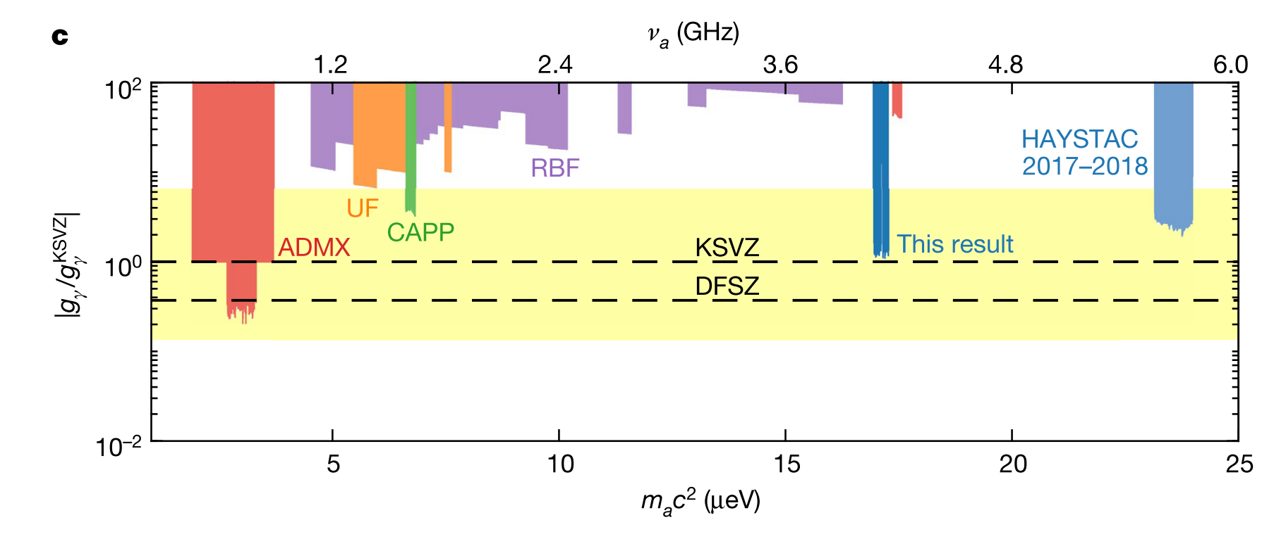
Application of Superconducting QIT in Axion Detection
Backes et al., Nature 590, 238 (2021)
enhance the spectral scan rate by a factor of ~2 with 4dB squeeze degree
Notes:
enhance the spectral scan rate by a factor of ~2 with 4dB squeeze degree

Slide 9
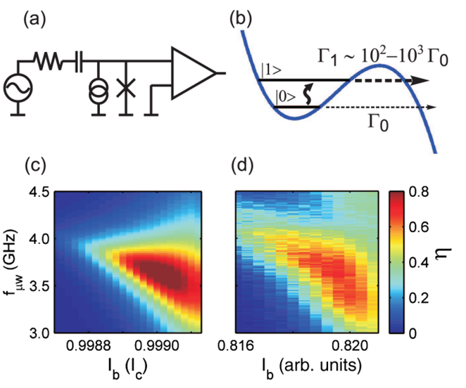
Single Microwave photon detector
based on Biased Josephson Junction
detection efficiency ~10%
Chen et al., PRL 107, 217401(2011)
Notes:
美国Wisconsin大学基于结隧穿的微波单光子探测方案，探测效率小于10%，需要入射光子频率、入射时间等先验知识，长恢复时间。2018年应用于超导量子比特单发非破坏性测量，保真度可达92%。

Slide 10
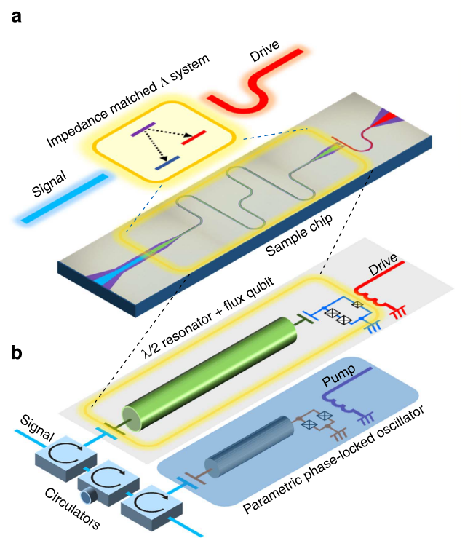
Single-photon detector
based on impedance-matched Λ system
detection efficiency ~66%, dark count rate~1.4%,
reset time~400ns, herald information
Inomata et al., Nat. Commun. 7, 12303, (2016)
Notes:
日本RIKEN蔡老师组工程化原子和腔的相互作用，形成阻抗匹配的lambda系统，探测效率约66%，暗计数约1.4%，需要入射光子频率，入射时间等先验知识。

Slide 11
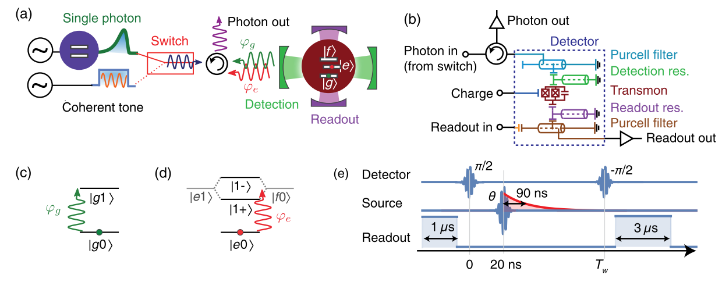
Detection of Propagation single Microwave Photon
Check the detector with single-photon state
External (internal) detection fidelity ~50%(71%)
limited by the loss between source and detector (75%)
ETHZ Group
Besse et al., PRX 8, 021003 (2018)
Notes:
2018年日本东京大学和瑞士ETHZ几乎同时利用原子和腔的色散相互作用，探测效率约80%，需要入射光子频率、入射时间等先验知识。
微波频段尚无光学频段高探测效率、宽频率响应、无需先验知识的单光子探测器！

Slide 12
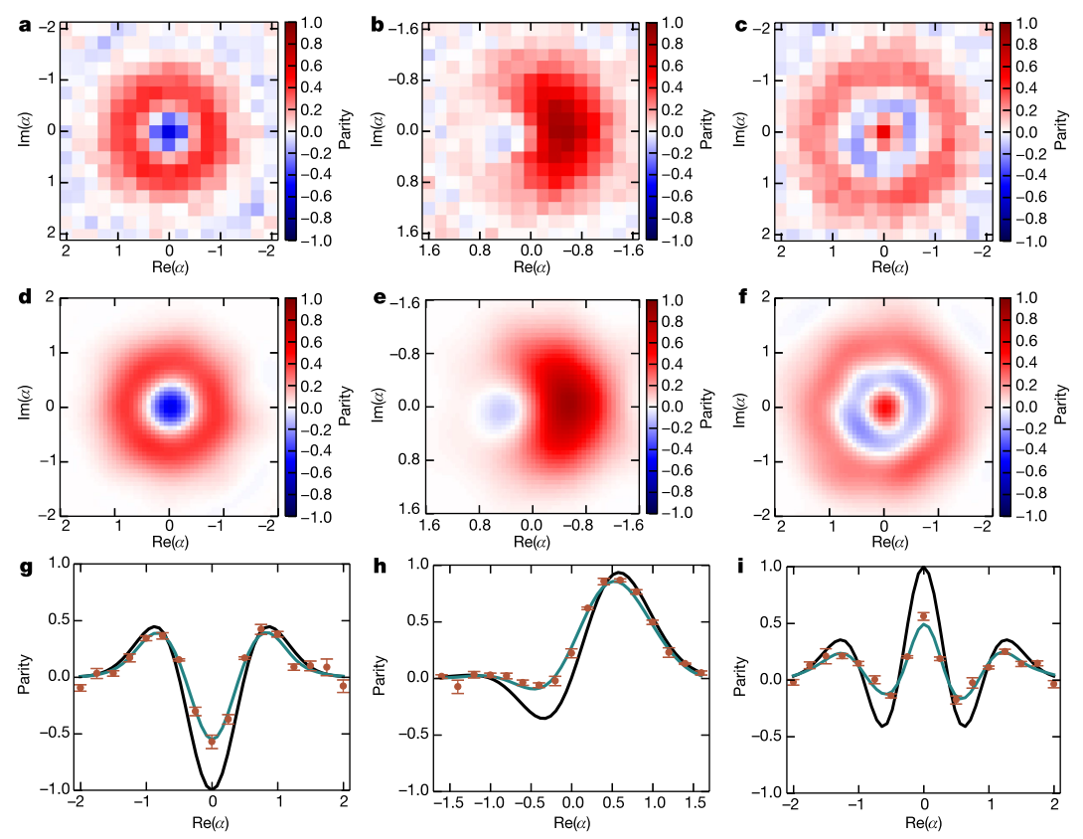
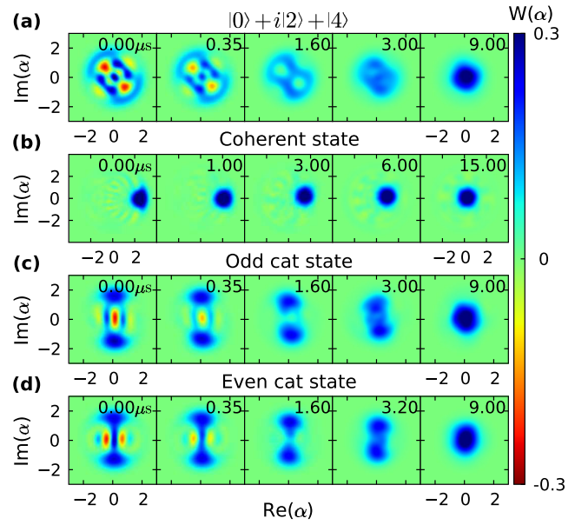
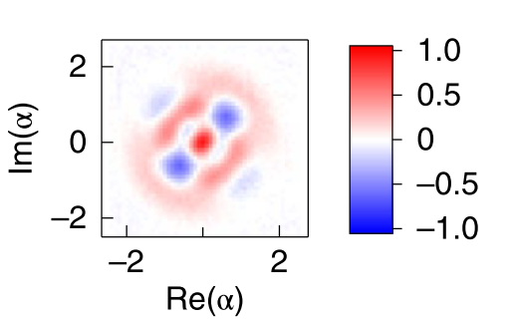
Detection of photon state based on a qubit
Photon state
Read-out
Qubit
Yale, Chicago…
‘Cat’State in a cavity
Non-classical state in a cavity
Wang et al., PRL 103，200404 (2009)
Ma et al., Nat. Phys. 16, 827 (2020)
Notes:
目前探测微波光子态，重构其Wigner函数的方法主要有两个。一个是基于原子和腔的相互作用，用超导量子比特作为“尺子”来测量腔中的光子量子态，用另外一个腔来读取
量子比特的状态，通过测量量子比特的奇偶性来重构腔中的光子量子态。如2009年美国Martinis课题组实现Fock态和猫态，控制原子和腔的相互作用，测量腔内微波非经典态,
中国清华大学也是采用类似的办法测量腔中微波光子的非经典态。

Slide 13
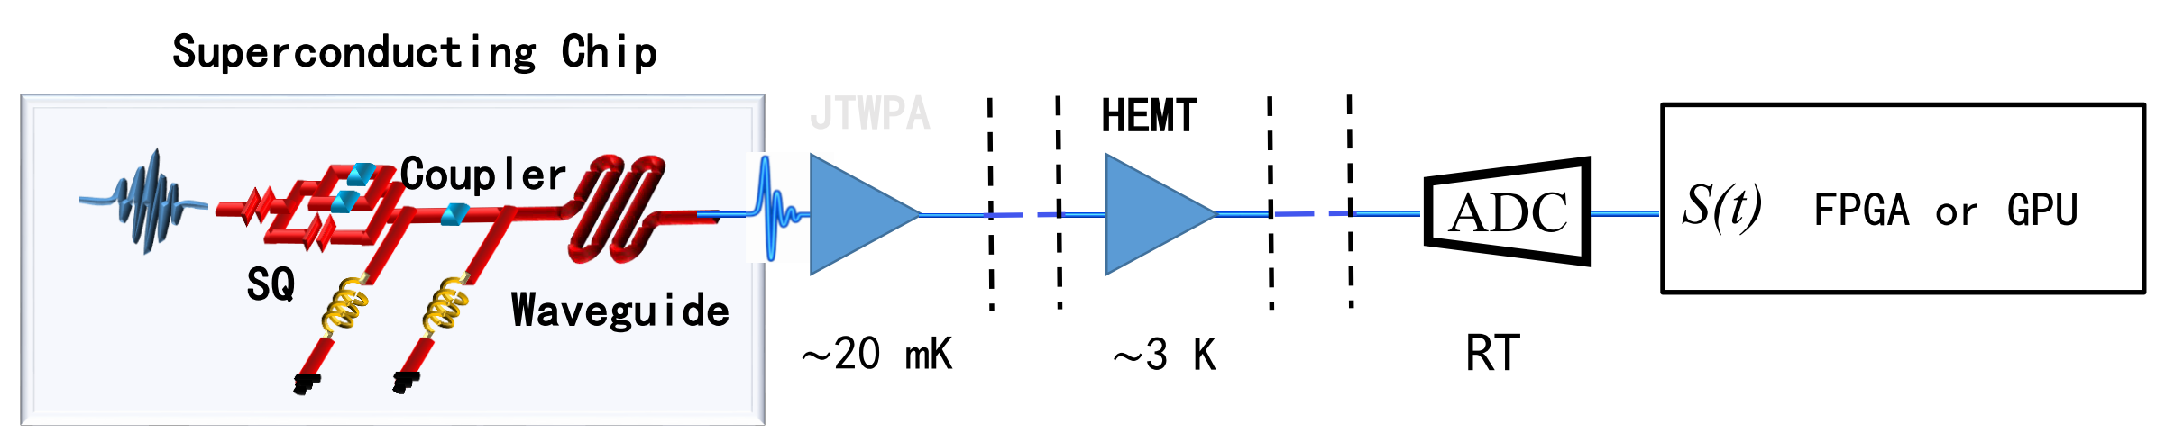
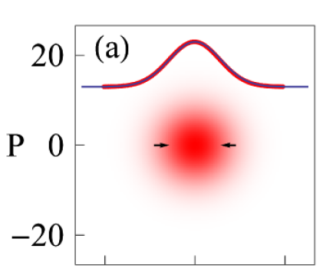
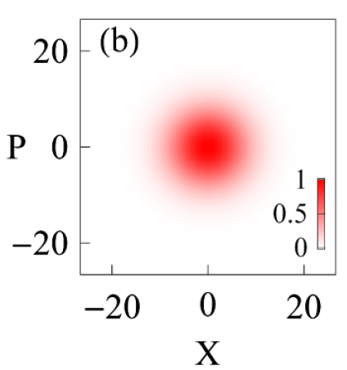
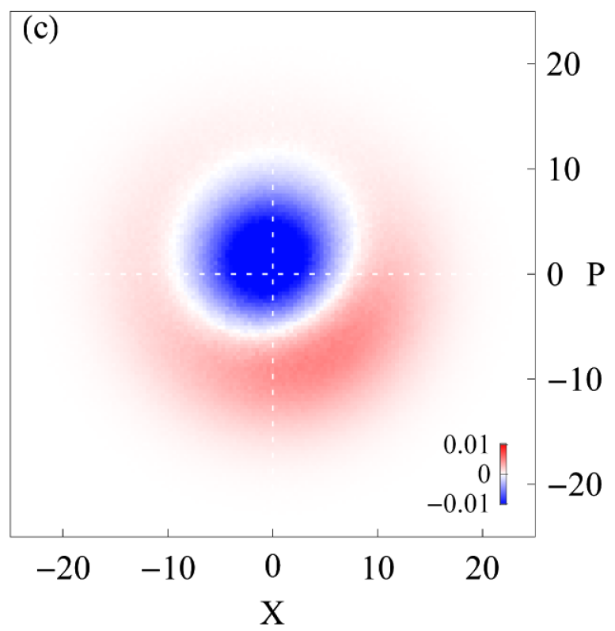
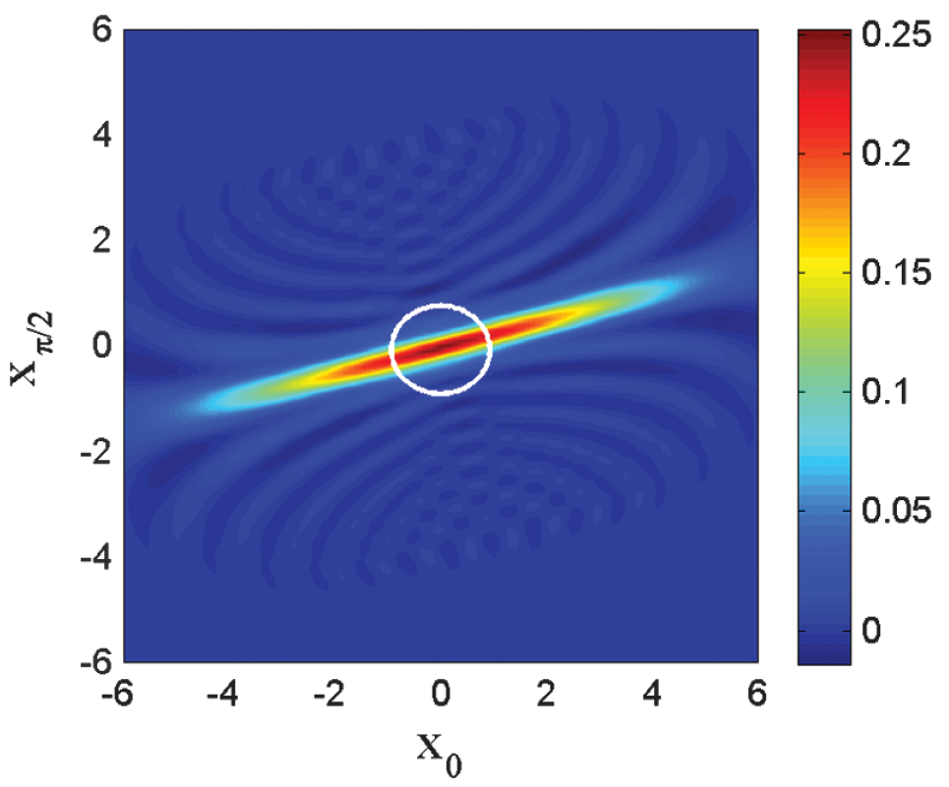
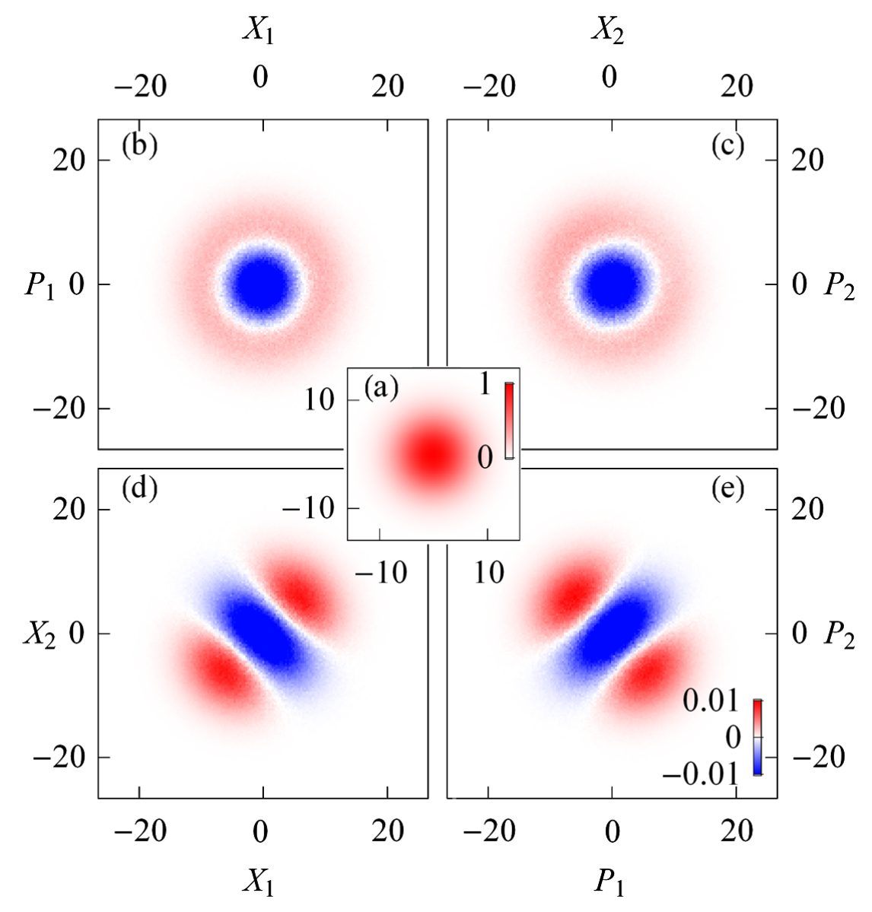
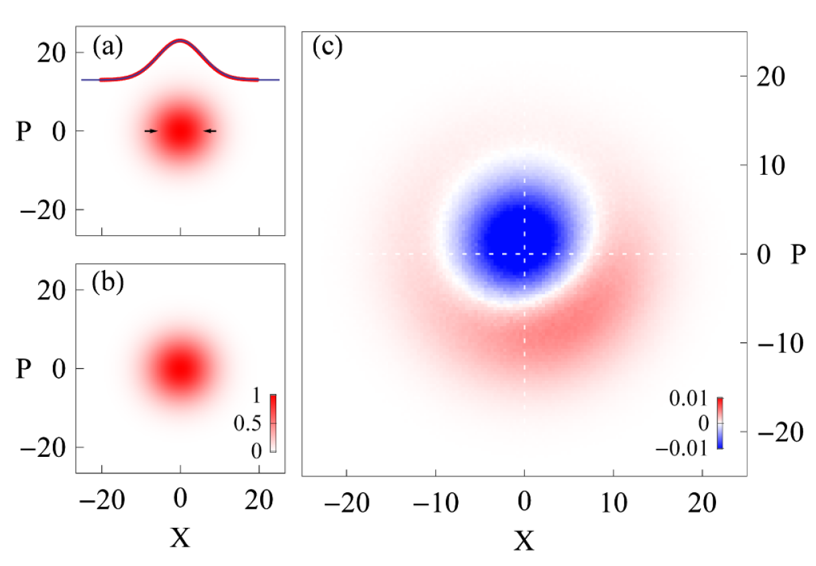
Detection of Propagation Microwave Photons
SNR~10⁻²
ETHZ, Chalmers, NIST…
-
=
Squeezing State
Single-photon Fock State
Two-mode Squeezing State
Eichler et al., PRL 106, 220503 (2011)
PRL 107, 113601(2011)
Mallet et al., PRL 106, 220502 (2011)
Notes:
另外一个常用的探测微波光子量子态的办法，是利用线性放大器对飞行的微波光子进行放大，然后利用室温的数采卡对信号进行采集和数据处理，得到微波场信号的I和Q，
以重构微波光子量子态。美国Jila的Lehnert课题组JPA实现单模压缩态，利用另一个JPA重构飞行微波场Wigner函数，压缩度~-4dB；瑞士Wallraff组两个PRL，用HEMT
重构飞行非经典微波场。对于轴子和暗光子探测，更多情况需要对飞行的微波光子态进行重构。

Slide 14
Outline
Background
Quantum Sensing Technology based on
Superconducting Circuits Developed in APEX
Initial Results about Dark Photon Measurements
from a 7.138 GHz Cavity Haloscope Experiment
Summary
14

Slide 15
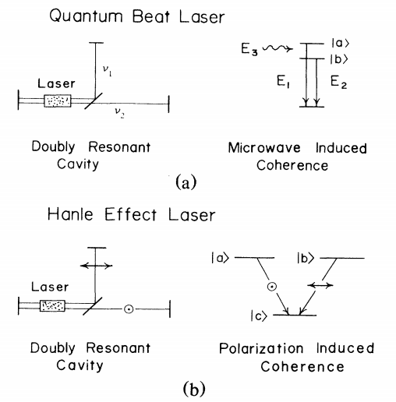
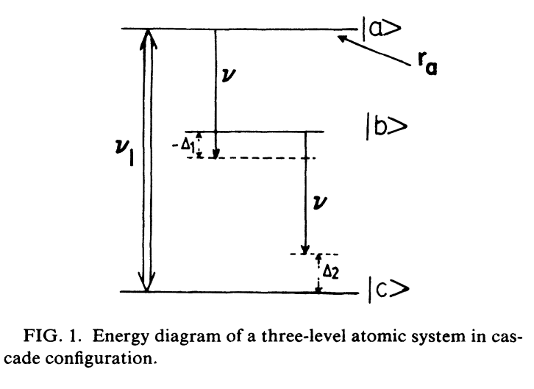
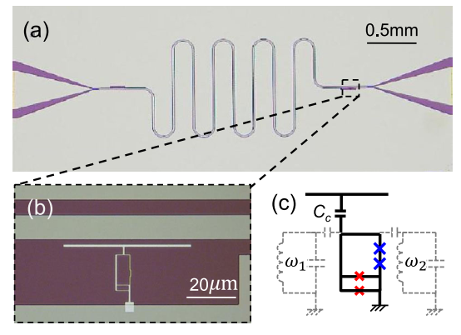
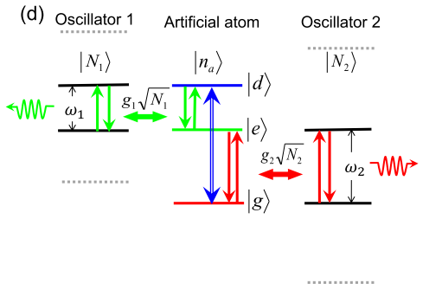
Generation of Squeezing State with CEL
Two-mode CEL：
Degenerate CEL：
Correlated Emission Lasing
Scully, M. O. Phys. Rev. Lett. 55, 2802 (1985).
Zubairy, M. S. et al. Phys. Rev. A 41, 5179 (1990).
Artificial Atom CEL
Peng et al., Phys. Rev. Lett. 115, 223603 (2015).
Notes:
理论上已经严格证明利用经典非线性元件，在腔内最高只能产生压缩度为-3dB的压缩态。Scully等人在80年代理论提出利用关联辐射激光中原子的相干性，把传统激光中原子的自发
辐射转换为关联相干动力学，可以在腔内产生任意压缩度的强压缩态。2015年APEX成员利用三能级超导人工原子实验实现双模非兼并的关联辐射激光。

Slide 16
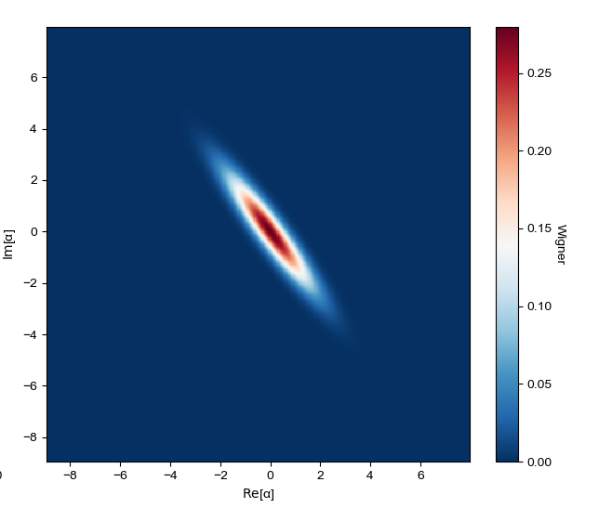
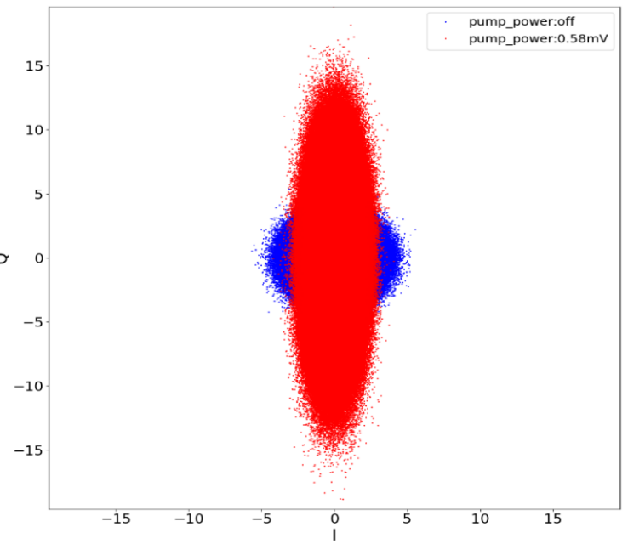



Generation of Squeezing State with CEL
$$Q$$
$$I$$
$$Average Times：5.12×{10}^{6}$$
Squeezed degree：3.05 dB
Ruan et al., (In preparation)
Notes:
最近APEX成员利用兼并的关联辐射激光在超导传输线振子内产生微波压缩态，并利用线性放大器重构飞行微波光子的Wigner函数，证明腔内压缩度在3dB左右。由于实验上
只利用了在3K左右的HEMT，测量需要大量的统计平均，而且重构的压缩态Wigner函数受到测量线路噪声温度的严重影响（标定的噪声温度约7.5K）。目前我们已经得到接近
标准量子极限的TWPA，计划用在压缩态的Wigner函数重构上，我们相信不远的将来能基于TWPA重构此压缩态的Wigner函数，证明用CEL可以在腔内产生压缩度超过3dB的压缩态。

Slide 17
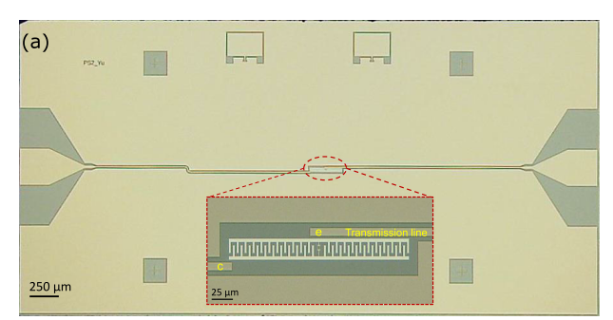
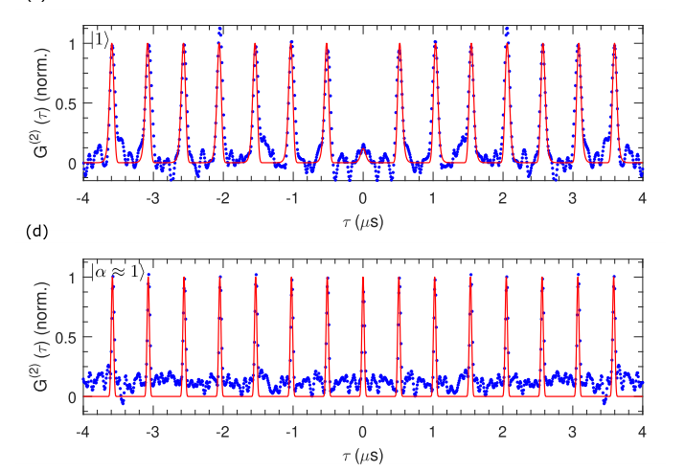
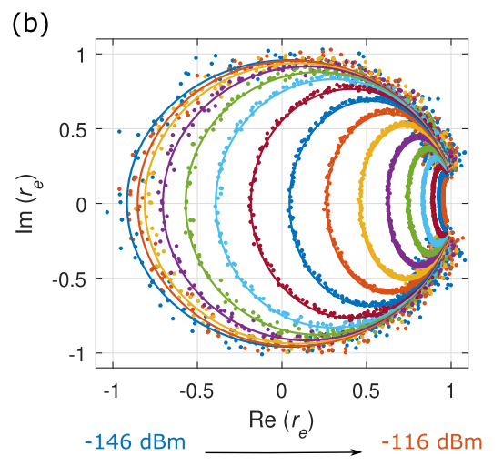

High Efficiency Single Microwave Photon Source
$$Avearge Times：5×{10}^{9}$$
Zhou et al., Phys.Rev.Appl. 13, 034007(2020)

Slide 18
Outline
Background
Quantum Sensing Technology based on
Superconducting Circuits Developed in APEX
Initial Results about Dark Photon Measurements
from a 7.138 GHz Cavity Haloscope Experiment
Summary
18

Slide 19
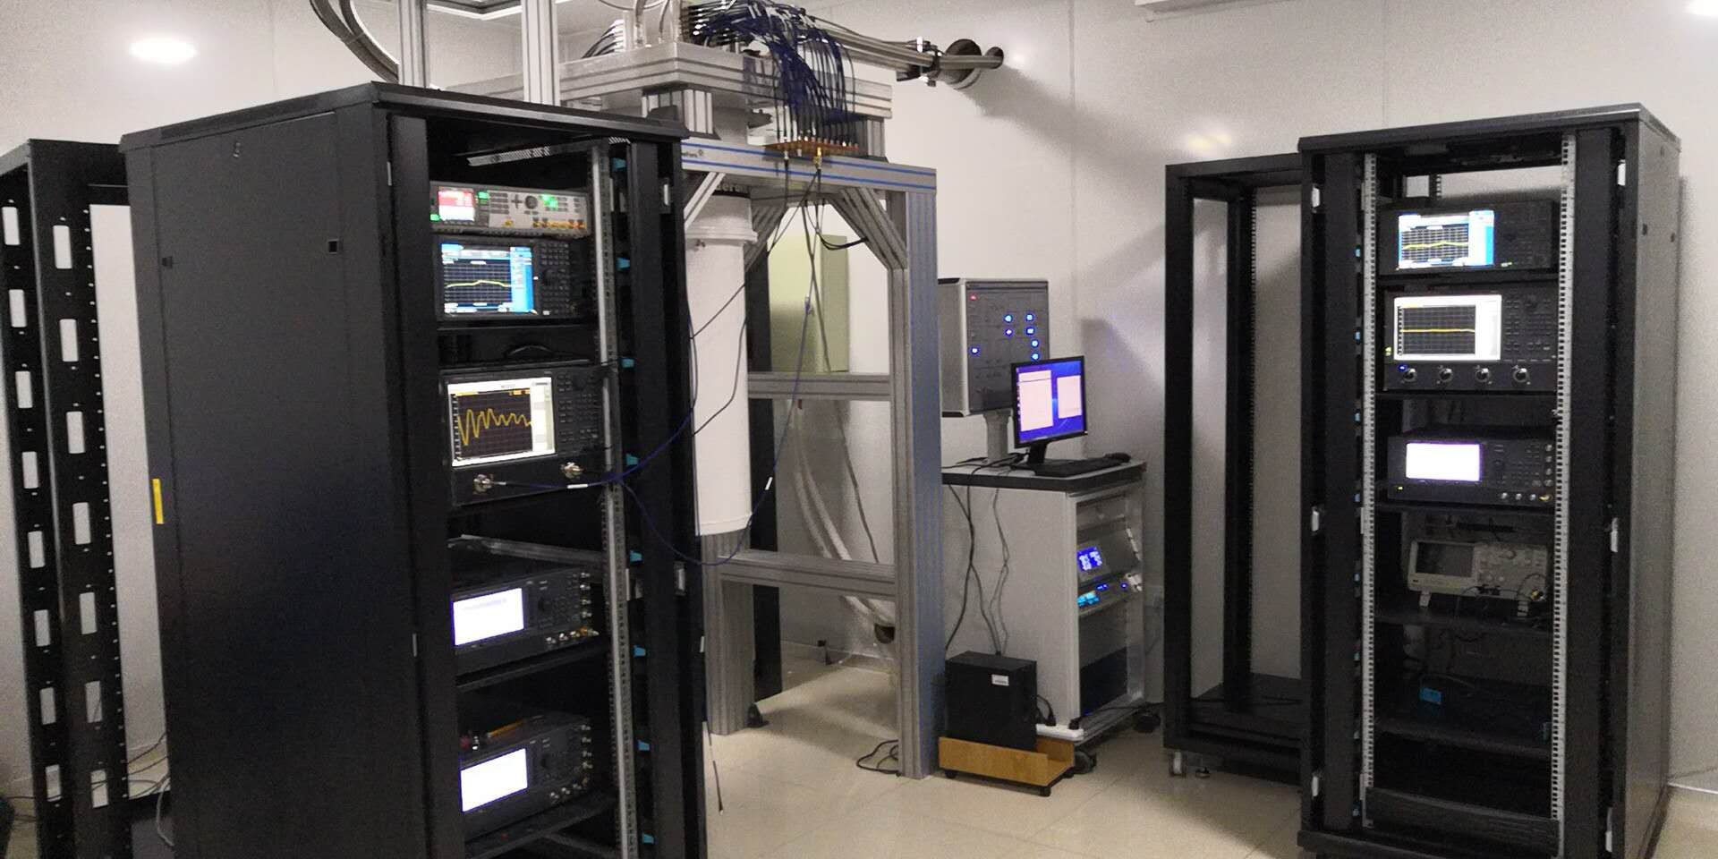
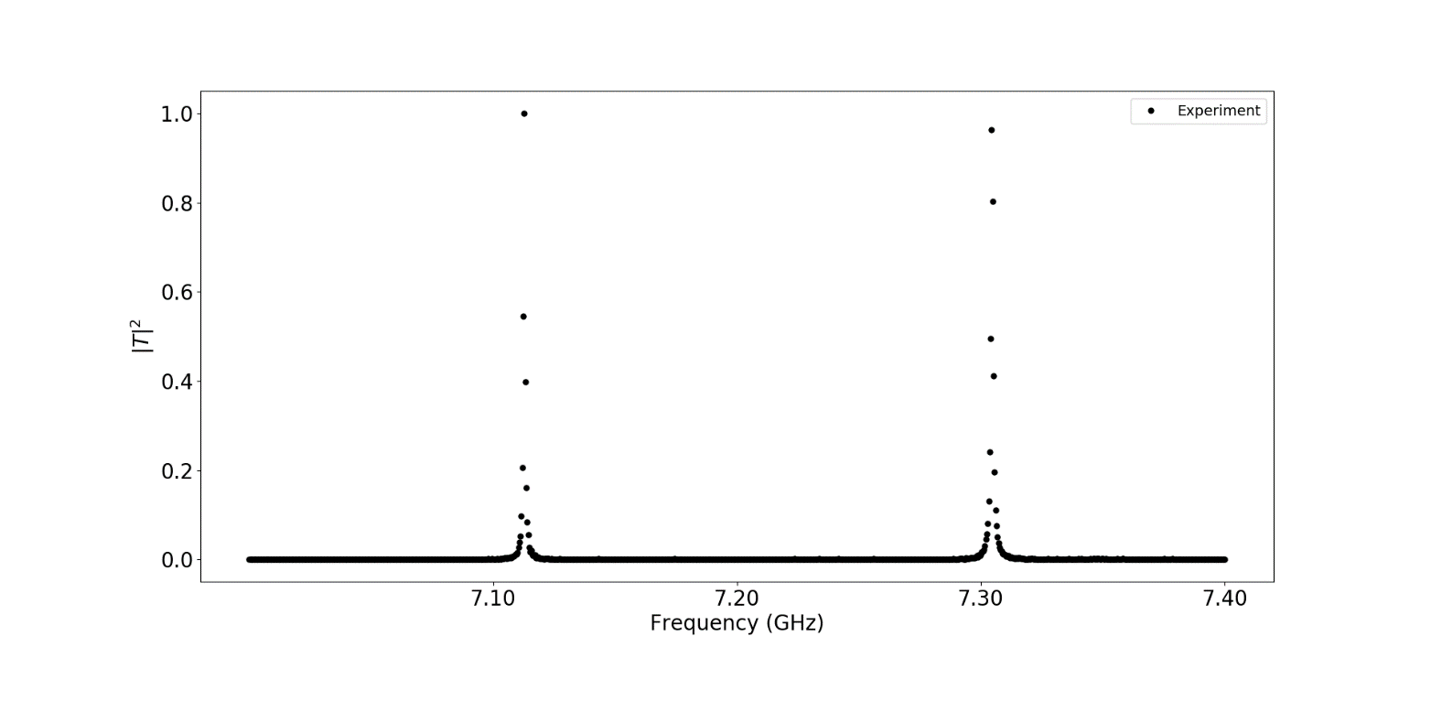
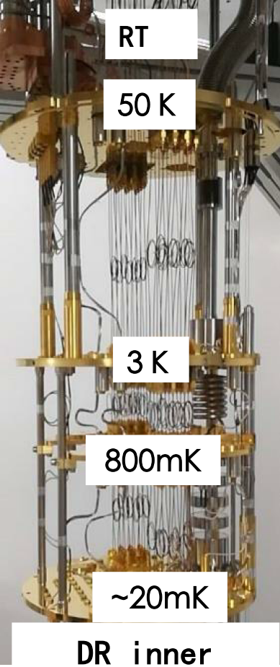
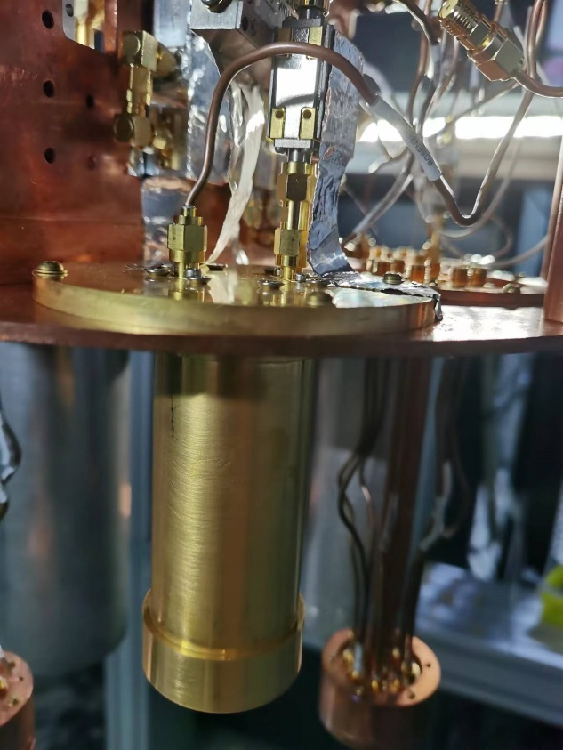
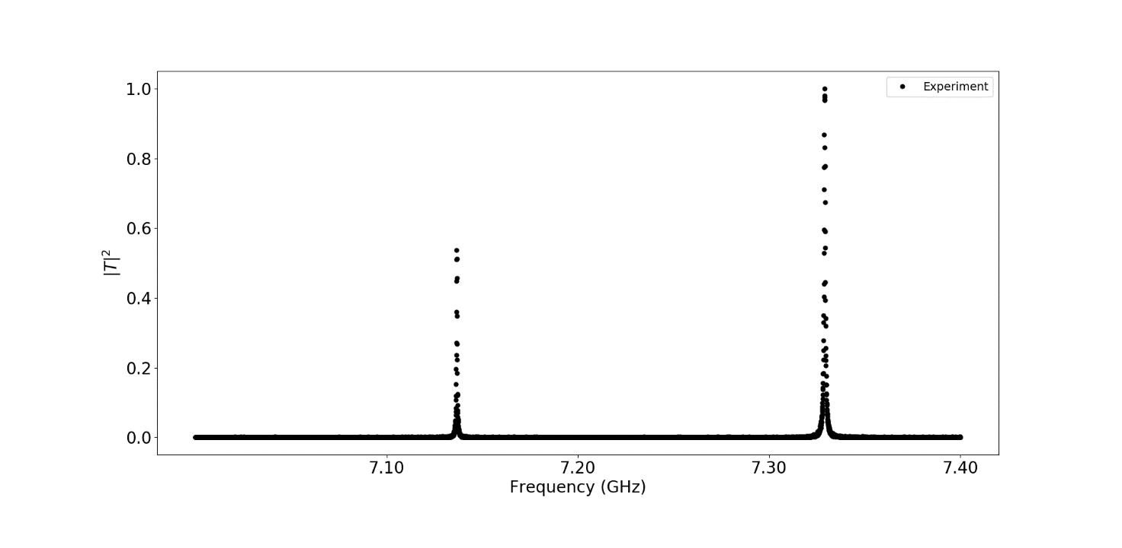
Measurement Setup
T=RT
T=30 mk

Slide 20
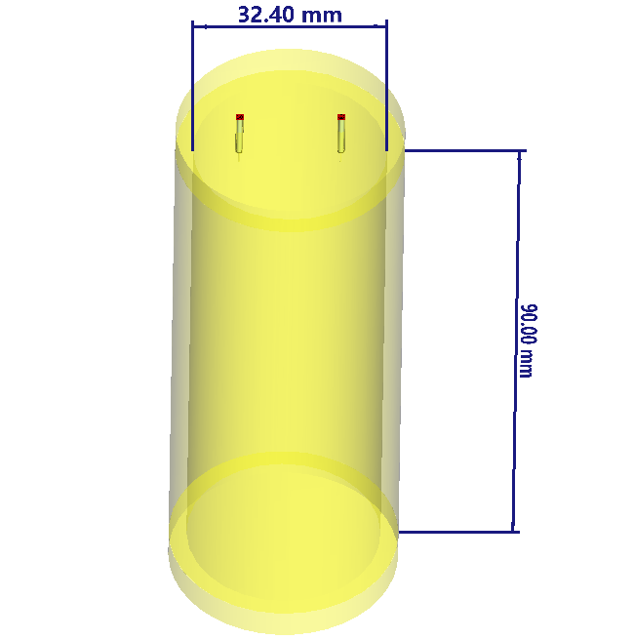
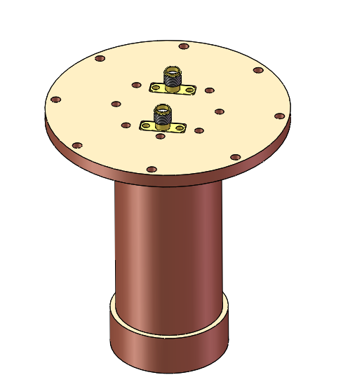
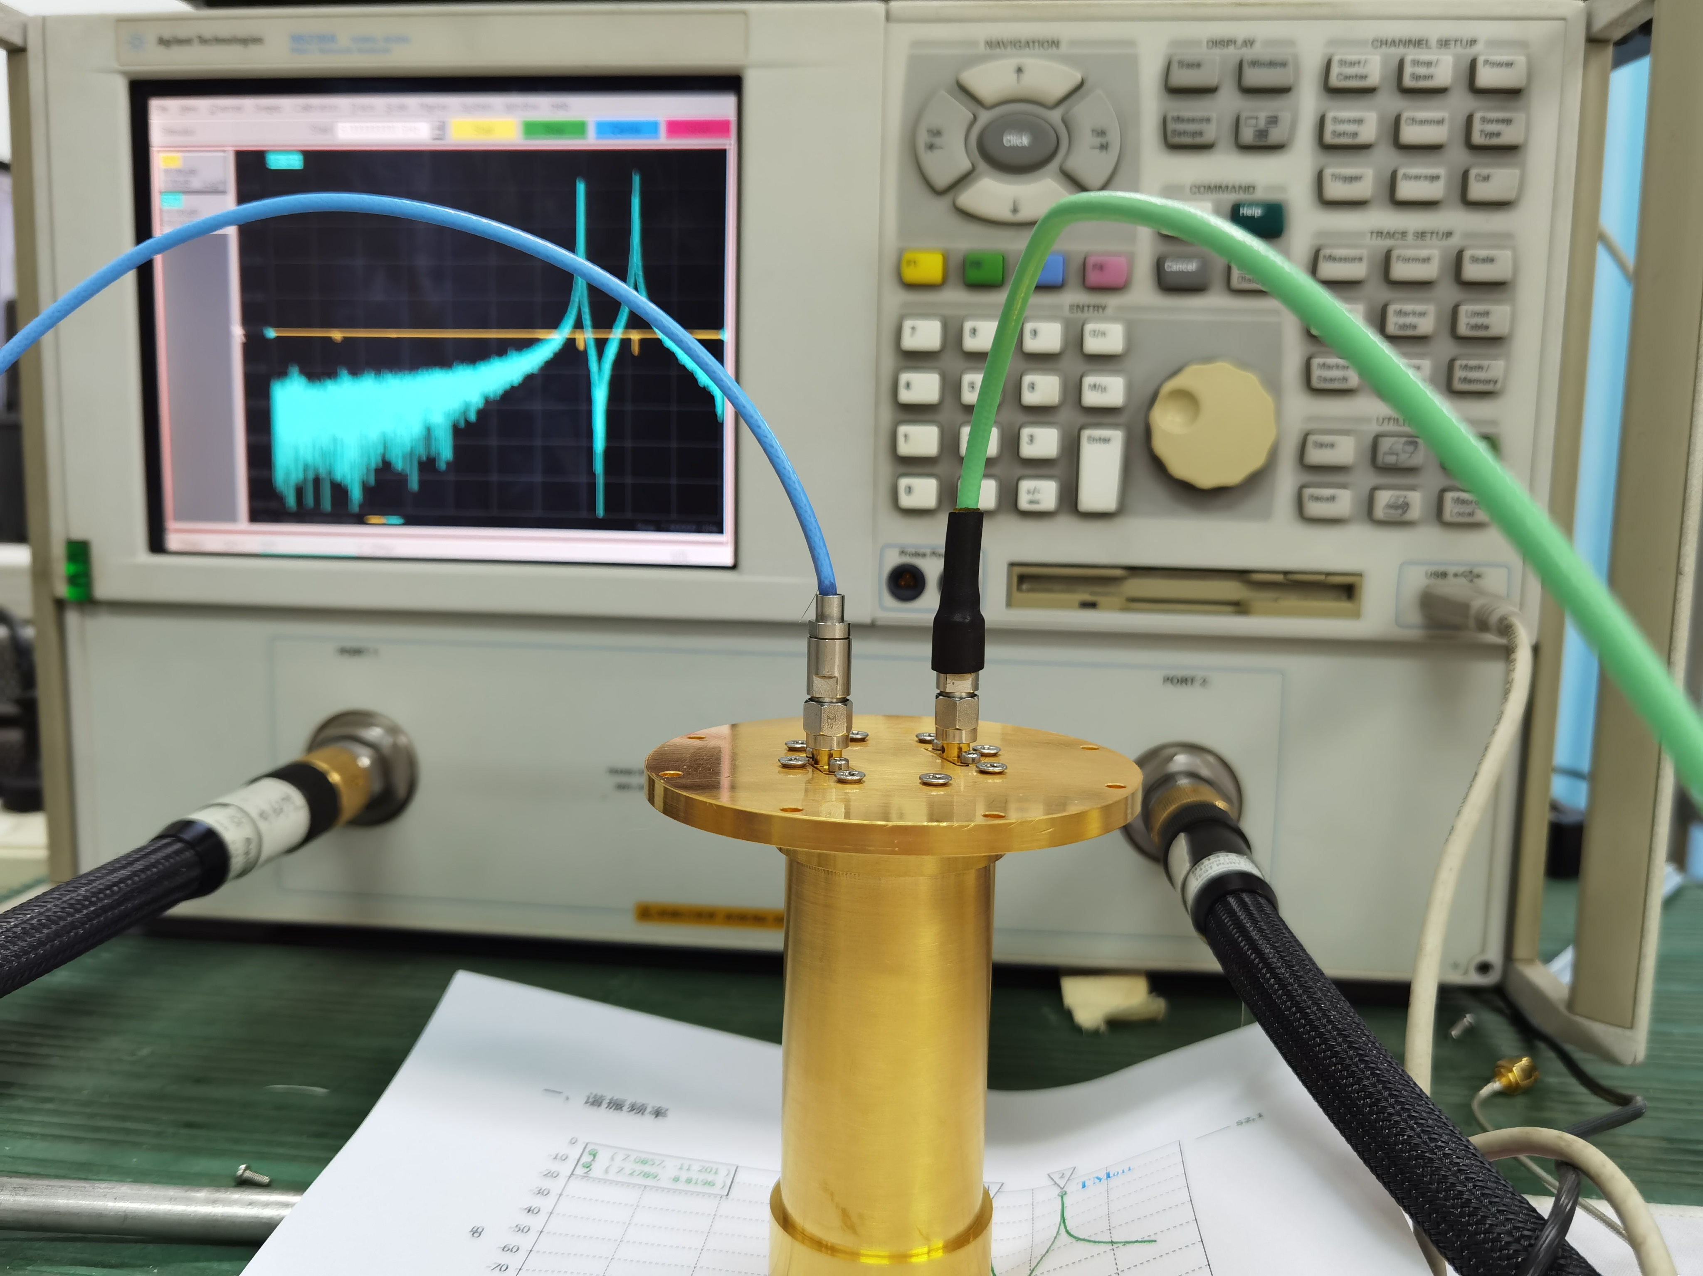
谐振腔仿真模型
谐振腔机械设计模型
谐振腔实物图

Slide 21
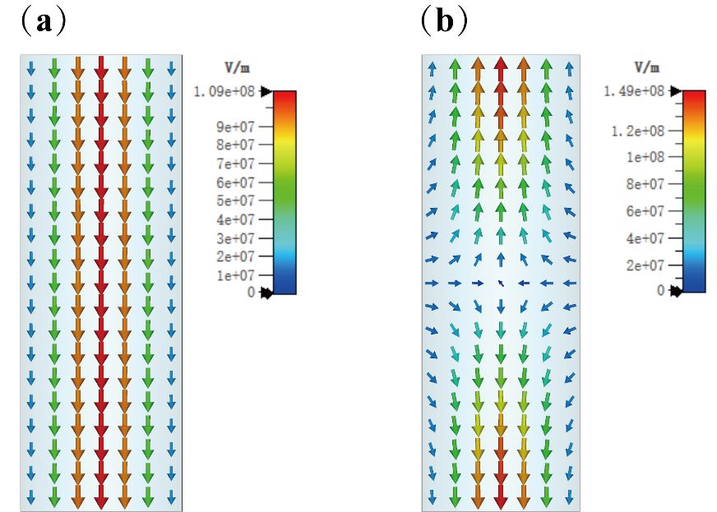
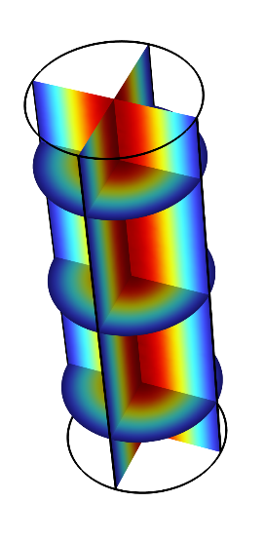
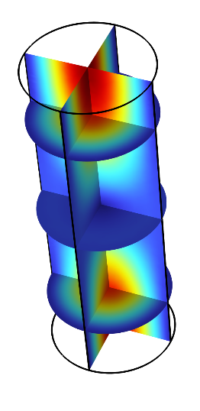
CST仿真得到的（a）TM₀₁₀模式和（b）TM₀₁₁模式的rz平面内的电场分布情况
TM₀₁₀模式和TM₀₁₁模式的电场强度分布情况

Slide 22
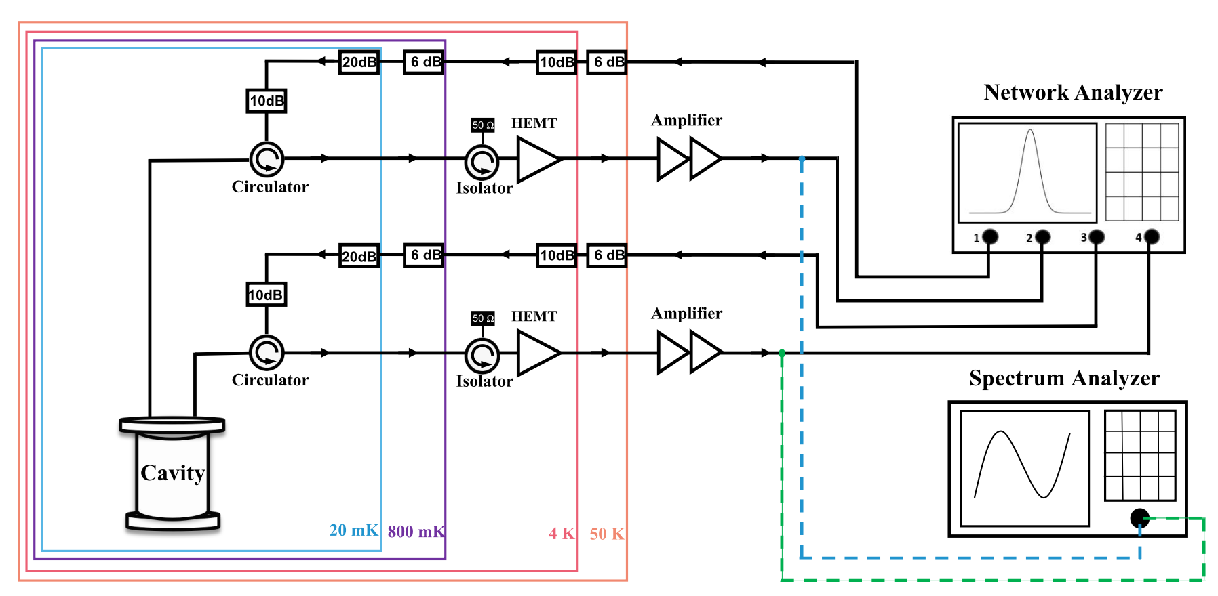
Measurement Setup

Slide 23
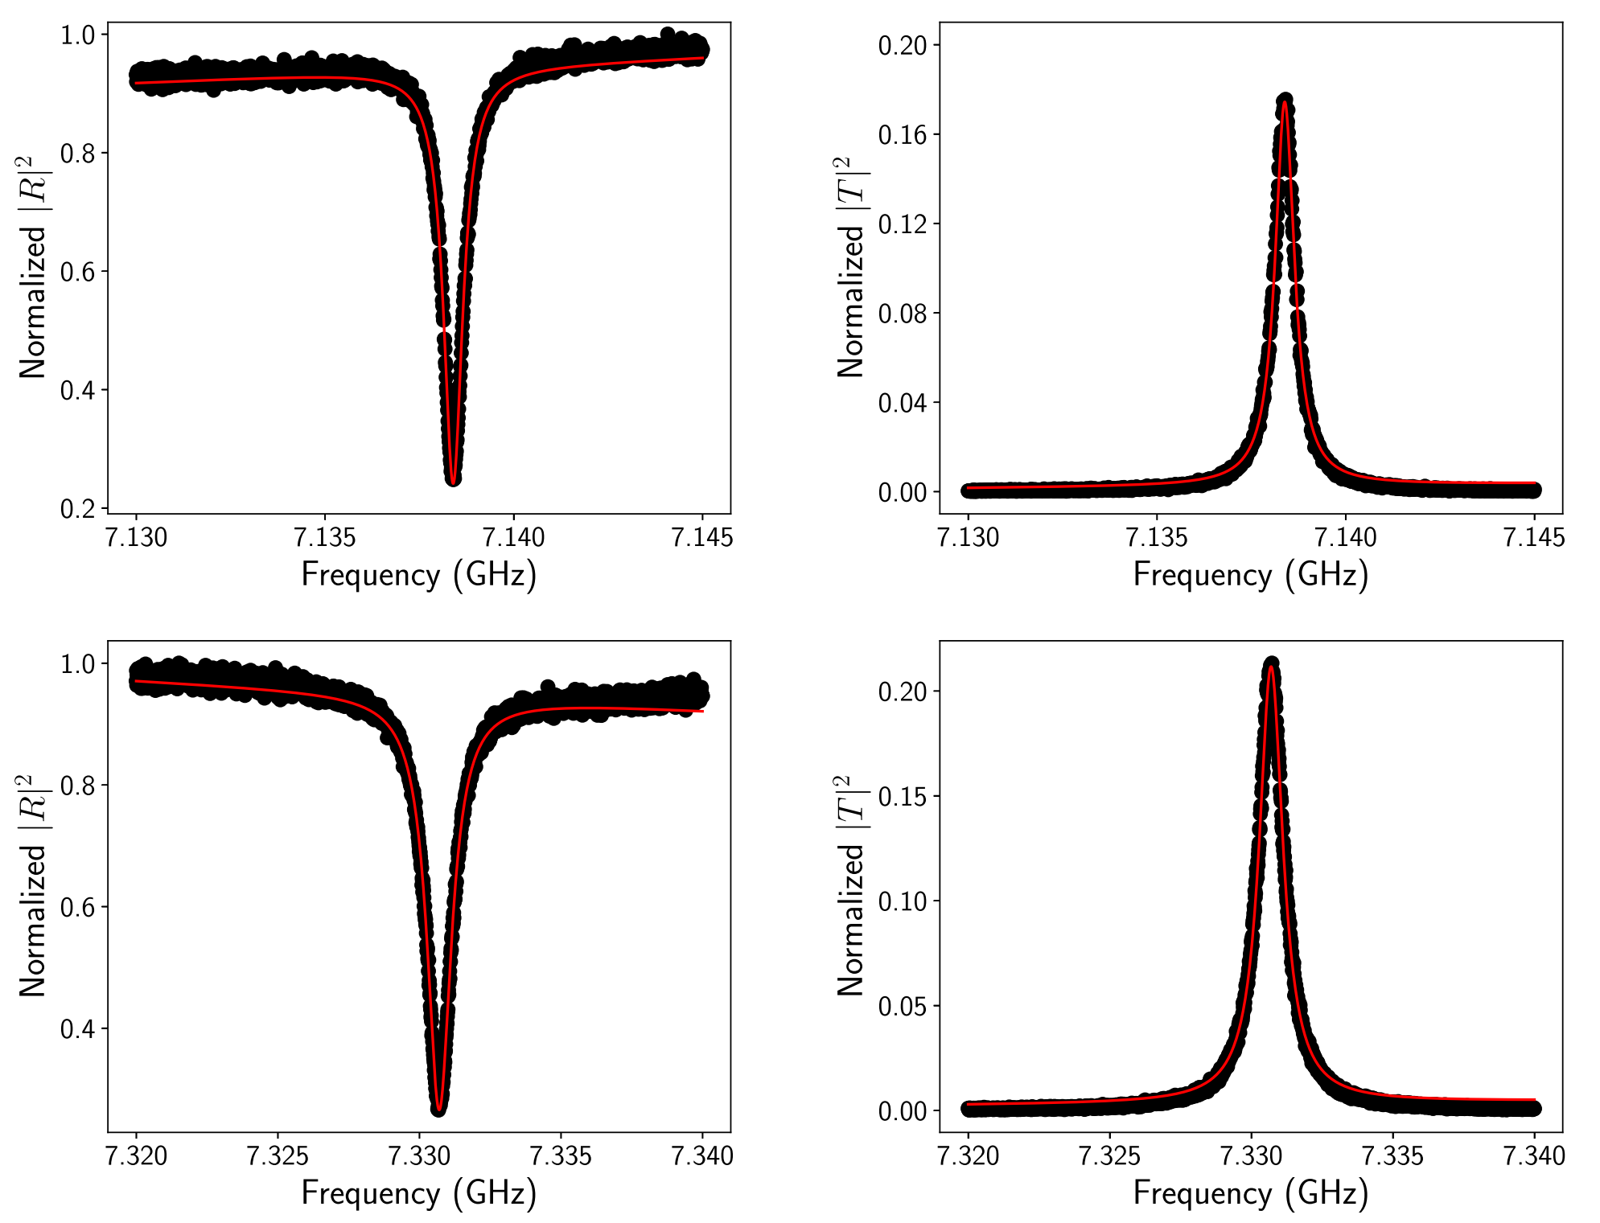
Measurement Results
Q=11500
Qc =39506
Qi = 18503
Q=7200
Qc =9122
Qi = 15077
Notes:
将稀释制冷机冷却到最低温20mK左右，我们利用网络分析仪在探测信号平均光子数小于1的情况下，对三维腔的两个模式（TM010和TM011）的频谱特性做了测量。左边两个图是相应的反射曲线，
右边两个图是两个模式的透射曲线。低频模式频率在7.138GHz, Q值约11500；高频模式频率在7.331GHz, Q值约7200.

Slide 24
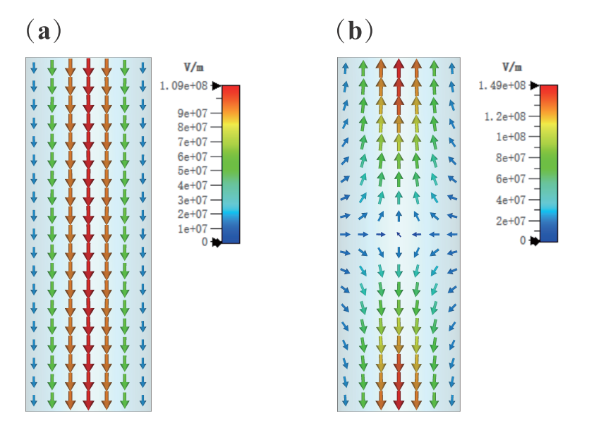
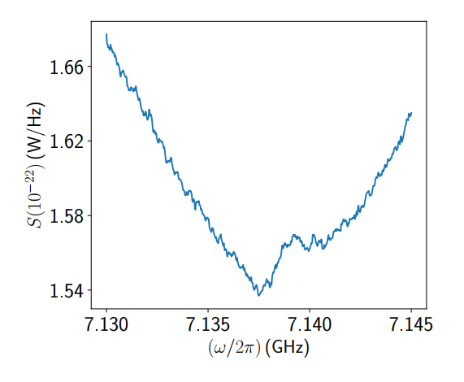
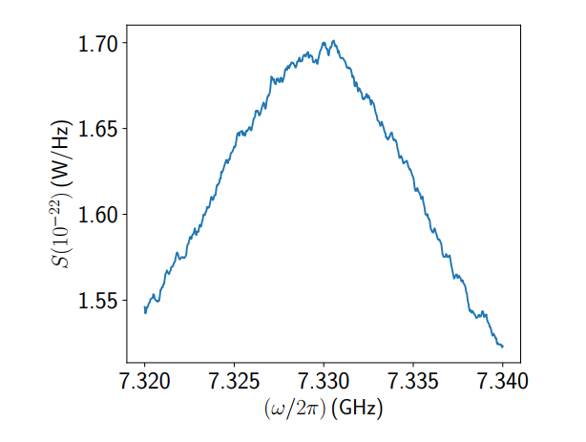
Measurement Results
Notes:
上面两个图是三维腔两个模式TM010和TM011的电场分布。下面两个图是相应两个图为实验上，用谱分析仪测量并经线路功率校准后的系统在腔模频率附近的噪声本底。

Slide 25
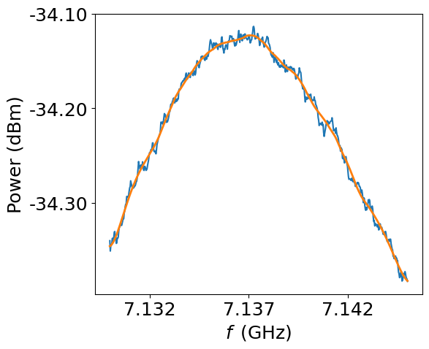
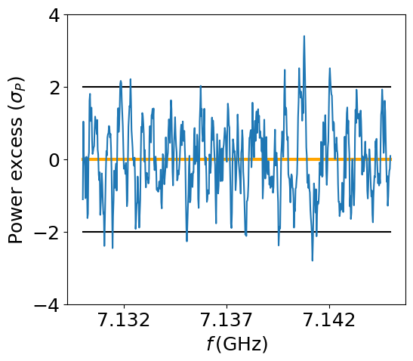


Data analysis
(Following 2204.09475,
ADMX collaboration)
Remove RF
Gain variation
PDF of signal power
in each bin is a
(truncated)
Gaussian
Integrate to find CDF,
solve for 90% CL limit
Notes:
The data analysis procedure for haloscopes is at this point relatively standardized, so we follow the approach laid out by the ADMX collaboration in arxiv: 2204.09475. Fortunately since we’re not tuning the cavity the overall procedure is actually simpler here, since we don’t need to combine multiple spectra measured at different frequencies
From the raw power spectra measured by a VNA (Vector Network Analyzer), we apply a Savitzky-Golay filter to obtain the gain variation from the RF electronics (shown by the orange line). Dividing out this gain variation and subtracting one then provides a dimensionless power spectrum of fluctuations about zero, in units of the standard deviation. (Figures shown here are a sample spectrum from the low frequency mode)
Comparing the resulting data points with the lines corresponding to 2 and 4 sigma we can see that the data are well described by the null hypothesis (i.e. no dark photon signal present). We have around 600 data points here, so we do expect around 1 point to be 3 sigma away from zero. The bin widths here are 25 kHz, which is a wider than the (7 kHz) anticipated linewidth of the dark photon, so a signal would appear as a power excess in a single bin.
(If someone asks why we use 25 kHz here, we can say that this is just test data, and we’ll probably use a smaller bin width in future.)
The bottom right figure here shows the same data points with a Gaussian fit. There is a slight preference for excess power, but overall the data are well fit by a the standard Gaussian we would expect from background noise only.
Here the probability distribution of signal power in each bin (with a certain power excess in that bin) can be found via Bayes theorem and integrated to find the 90% CL limits on the signal power. This being the case we can place constraints on the excess signal power, which are in turn converted into constraints on the dark photon kinetic mixing parameter.
(In case any one asks about the effect of the SG filter: Care is required, as it leads to an additional signal attenuation factor eta. We estimate this by injecting signals with a known SNR into the analysis chain, and calculating the resulting SNR they appear with in the final result. Eta is defined as the ratio of these 2 SNRs.)
The figures shown here are just from preliminary data, so that by analyzing them we can then estimate the ultimate sensitivity of this experiment to dark photon dark matter.
(If anyone asks, you can explain we use the radiometer equation to calculate what the increase in SNR would be with e.g. greater integration time, and from that we can calculate the improvement in experimental sensitivity from this preliminary data.)

Slide 26
Projected experimental sensitivity
(90% CL)
Frequency (GHz)
Kinetic mixing
Dark photon mass (eV)
Notes:
Here we can see our projected sensitivity in the center, at a frequency of 7.13 GHz (LF, blue) and 7.33 GHz (HF, purple). The peak sensitivities in the kinetic mixing parameter are 7e-14 (LF) and 1e-8 (HF). The difference in sensitivity between LF and HF is due to the difference in effective volume between the LF and HF modes. V_LF is O(1e-5 m^3), while V_HF is O(1e-15 m^3).
Recall that there is no cavity tuning here, so this is relatively simple search to perform. These sensitivity estimates correspond to a day or two of actual data taking time.
We can see that the low-frequency sensitivity is competitive with many other haloscope experiments, and in particular exceeds the result just to the right from the ADMX-sidecar experiment. This being the case we hope to soon place world-leading constraints on the dark photon parameter space.

Slide 27
Summary
Developing Quantum Sensing Technology for Axion and Dark Photon Detection
Initial Results about Dark Photon Measurements from a 7.138 GHz Cavity Haloscope Experiment
We expect Strong Dark Photon Constraint from a 7.138 GHz Cavity Experiment with higher SNR
27

Slide 28

Thank you for your attention!

Slide 29

三种基本超导量子比特
X. Gu et al., Phys. Rep. 718, 1 (2017)

Slide 30

各种扩展方案
X. Gu et al., Phys. Rep. 718, 1 (2017)

Slide 31
Josephson effect and Josephson junction
Superconductor 1
Barrier
Superconductor 2
Josephson Effect (1962)
Phase f₁
Phase f₂
Charge Number N
Nf > 1
Another Deg. of Freedom
1st Josephson equations:
Supercurrent ∝ f₁- f₂
Electron quantum state
(Macroscopic Quantum State)
Phase difference
2nd Josephson equation: accurate to 1/10²⁰ !

Slide 32



Josephson Junction
Superconductor 1
Superconductor 1
Superconductor 1
Normal Metal
Insulating
Barrier
Superconductor 2
Superconductor 2
Superconductor 2
Micro bridge
Super/Normal/Super junction
Tunnel junction
In
Micro bridge
Nb/Cu/Nb
SNS Junction
Pb/PbOx/Pb
Tunnel junction

Slide 33


超导纳米线单光子探测器（SSPD）
光电倍增管（PMT）
主要工作在紫外、可见和近红外区，具有响应快速、成本低、阴极面积大等优点。
供应商：日本滨松
神冈中微子探测实验、高海拔宇宙线观测站（LHAASO）和江门中微子实验中大量使用

Slide 34


半导体雪崩光电二极管（APD）
体积小、集成度高，主流的SPD技术，在激光测距、分布式传感、弱光成像、高速光电分析仪器、无线光通信以及量子信息等领域得到了广泛的应用。
供应商：中电科44所

Slide 35







Quantum Oscillator and Anharmonic Oscillator
$$ℏω≫k_{B}T$$
10GHz
20mK
$$3—30\text{GHz}$$
$$2×{10}^{\text{−}24}—2×10^{\text{−}23}\text{W}\text{/}\text{Hz}$$

Slide 36




宽可调、高效、按需微波单光子源
Transmission lines
qubit
Peng et al., Nature Commun. 7, 12588 (2016).

Slide 37

单光子形状

Slide 38



关联函数测量
Det1
Either photon at a time
Det2
Single pulsed photon
Multi-photons coherent state
$$平均次数：1.5×{10}^{10}$$
耗时：~10天

Slide 39
High Efficiency Single Microwave Photon Source
$$Avearge Times：5×{10}^{9}$$
Zhou et al., Phys.Rev.Appl. 13, 034007(2020)

