Slide 1
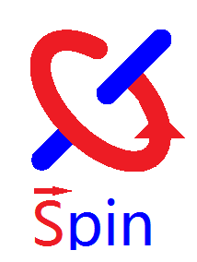
Searching for Axions and Axion-Like Particles via Spin-Dependent Interactions
H.Yan
Institute of Nuclear Physics and Chemistry, CAEP
Notes:
First and foremost, I would like to express my gratitude to the organizing committee, particularly Tianjun and Lina, for providing me this valuable opportunity to present our latest research progress. This marks my first-ever attendance at a domestic conference that is solely dedicated to the study of axions. According to a Chinese proverb, I can say that I have finally found the right organization.

Slide 2
Outline
Background
Magnetometer array study
Constraints at Astrophysical distances
Neutron spin rotation experiment
3He spin relaxation time

Slide 3
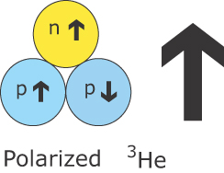
The 3He Neutron Spin Filter Project
The Polarized 3He neutron spin filter：
Unpolarized Incoming Neutrons
Polarized ³He
Polarized Outgoing Neutrons
Strong spin dependent neutron absorption cross sections.

Slide 4

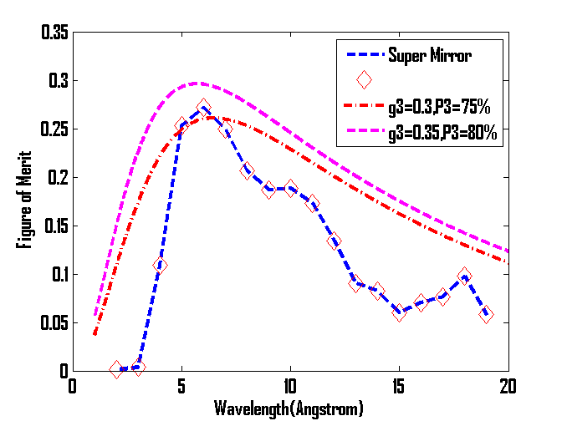
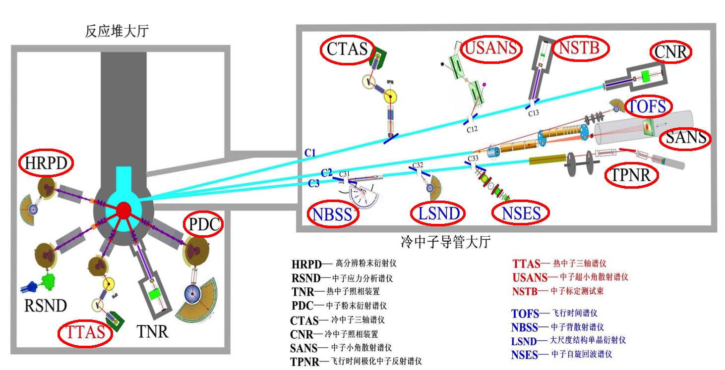
The 3He Neutron Spin Filter
The Necessity of Polarized 3He in Spallation and Reactor Neutron Sources
Wide neutron spectrum
Large acceptance angle
Uniform analyzing and polarizing power

Slide 5
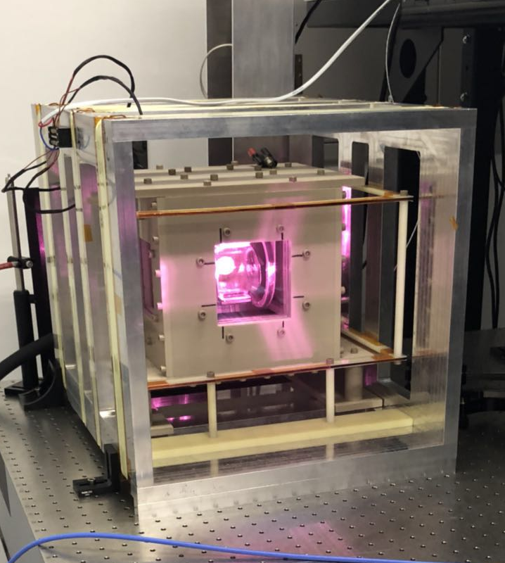
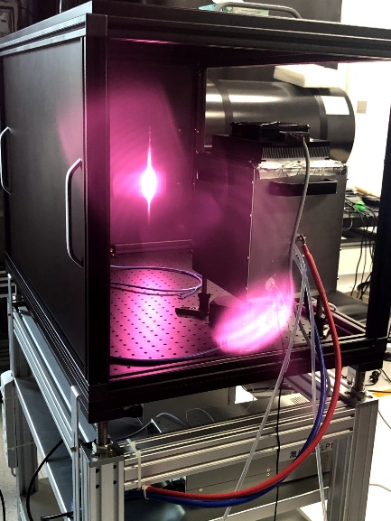
3He Polarizing apparatus：
Our expertise: producing polarized spins

Slide 6
Polarized ³He：
High polarization
Long relaxation time
Long coherence time
~room temperature
Low magnetic field~10G

Slide 7
Polarized ³He：
High polarization
Long relaxation time
Long coherence time
~room temperature
Low magnetic field~10G
Can be used for spin dependent precision measurement!

Slide 8

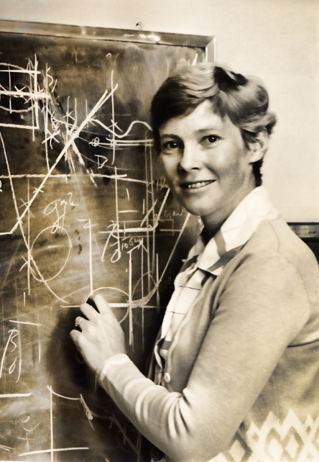
PQ Mechanism：Proposed by Peccei and Quinn In 1977
A new global symmetry is introduced and spontaneously broken：
R.Peccei与H.Quinn

Slide 9
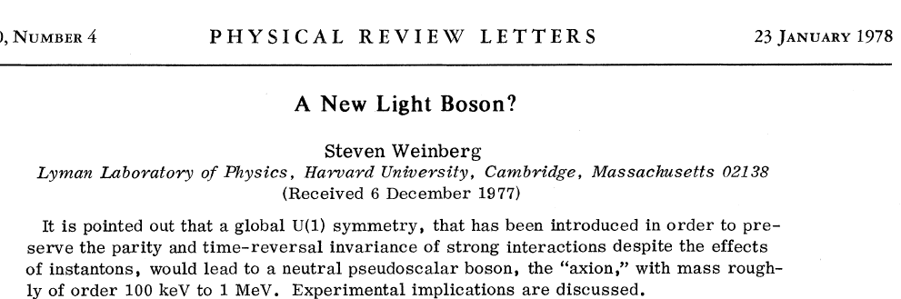
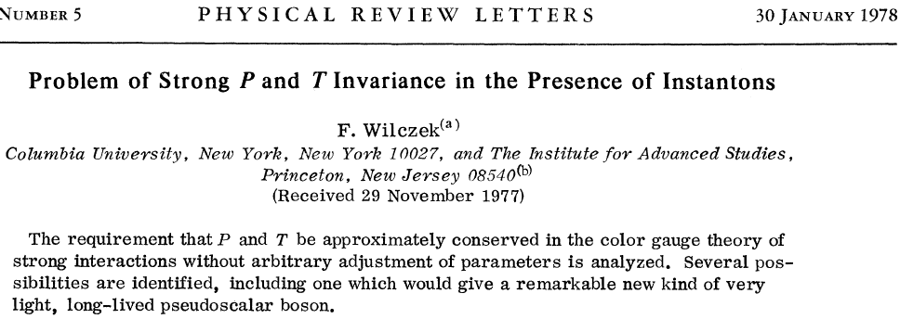


W&W: noticing axion generation simutaneously
S.Weinberg与F.Wilczek

Slide 10

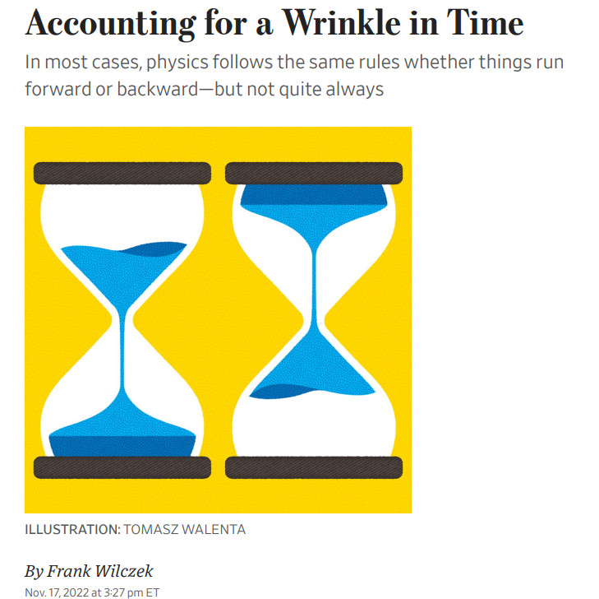
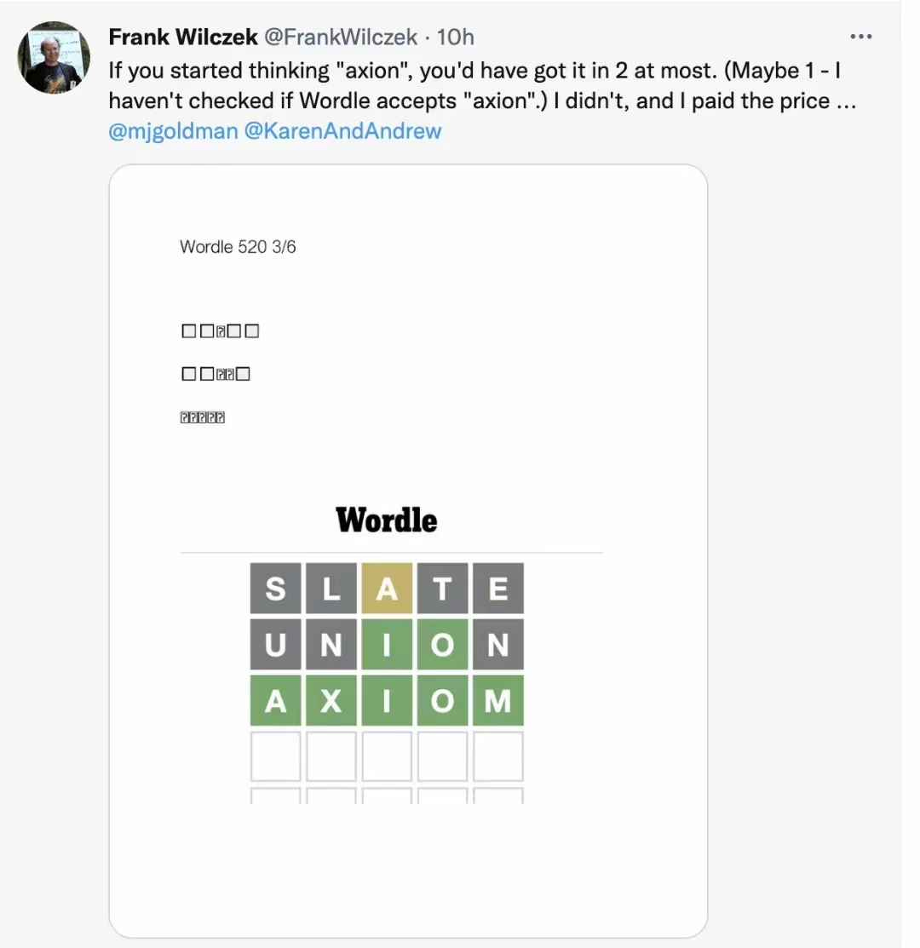
F. Wilczek：More than Just the Namer of Axion
Axions are predicted to be hard to detect, but research physicists around the world are designing and building instruments that could be up to the job. If so, the ultimate explanation for exceptions to T would be different from Feynman’s joke and more in line with one of Einstein’s:
“Subtle is the Lord, but malicious He is not!”
Notes:
Frank is not only the creator of the term 'axion,' but he also has a profound fascination for the concept. Whenever I saw him, he was in discussions about axions. When I checked his twitter, I saw him playing word game trying to incorporate word axion. While reading the Wall Street Journal, I encountered an essay he had written on the topic of axions. When I attended the conference celebrating the 95th birthday of TD Lee, he delivered a presentation on the subject of axions.

Slide 11
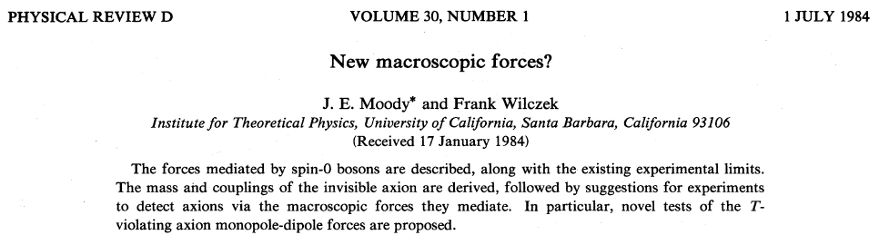




Axions: mediating macroscopic interactions
1.The most elegant and promising solution to the strong CP problem in QCD;
2.Very hard to detect, couple to the ordinary matter very weakly—candidate for cold dark matter;
3.Axion and ALPs can mediate macroscopic interactions thus can be probed through the bosonic field they generate;
4. Spin dependent interactions can be propagated—polarized spins are needed.
Notes:
Wilczek was the first to propose that Axion-like particles could mediate macroscopic interactions. Axions remain the most elegant and promising solution to the strong CP problem in Quantum Chromodynamics (QCD). Despite their extreme difficulty to detect due to their weak coupling to ordinary matter, they are considered a candidate for cold dark matter.
Both Axions and Axion-Like Particles (ALPs) can mediate macroscopic interactions and can, therefore, be probed through the bosonic field they generate. Furthermore, spin-dependent interactions can be propagated. This requires polarized spins, aligning with our specific area of expertise.

Slide 12

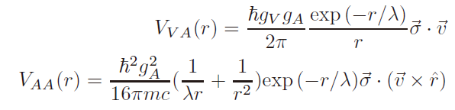
Axion Like Particles: generalization
Spin 1 boson coupled Lagrangian：
1.Dobrescu et al: the propagator of the new interaction could be spin-1 particle；
2.Fayet noticed that spontaneous breaking of supersymmetry theory could generate spin 1 particle with light mass and weak coupling.
B. Dobrescu and I. Mocioiu, J. High Energy Phys. 11, 005(2006).
P.Fayet， Phys. Lett., 95B(2), 285, (1980).

Slide 13
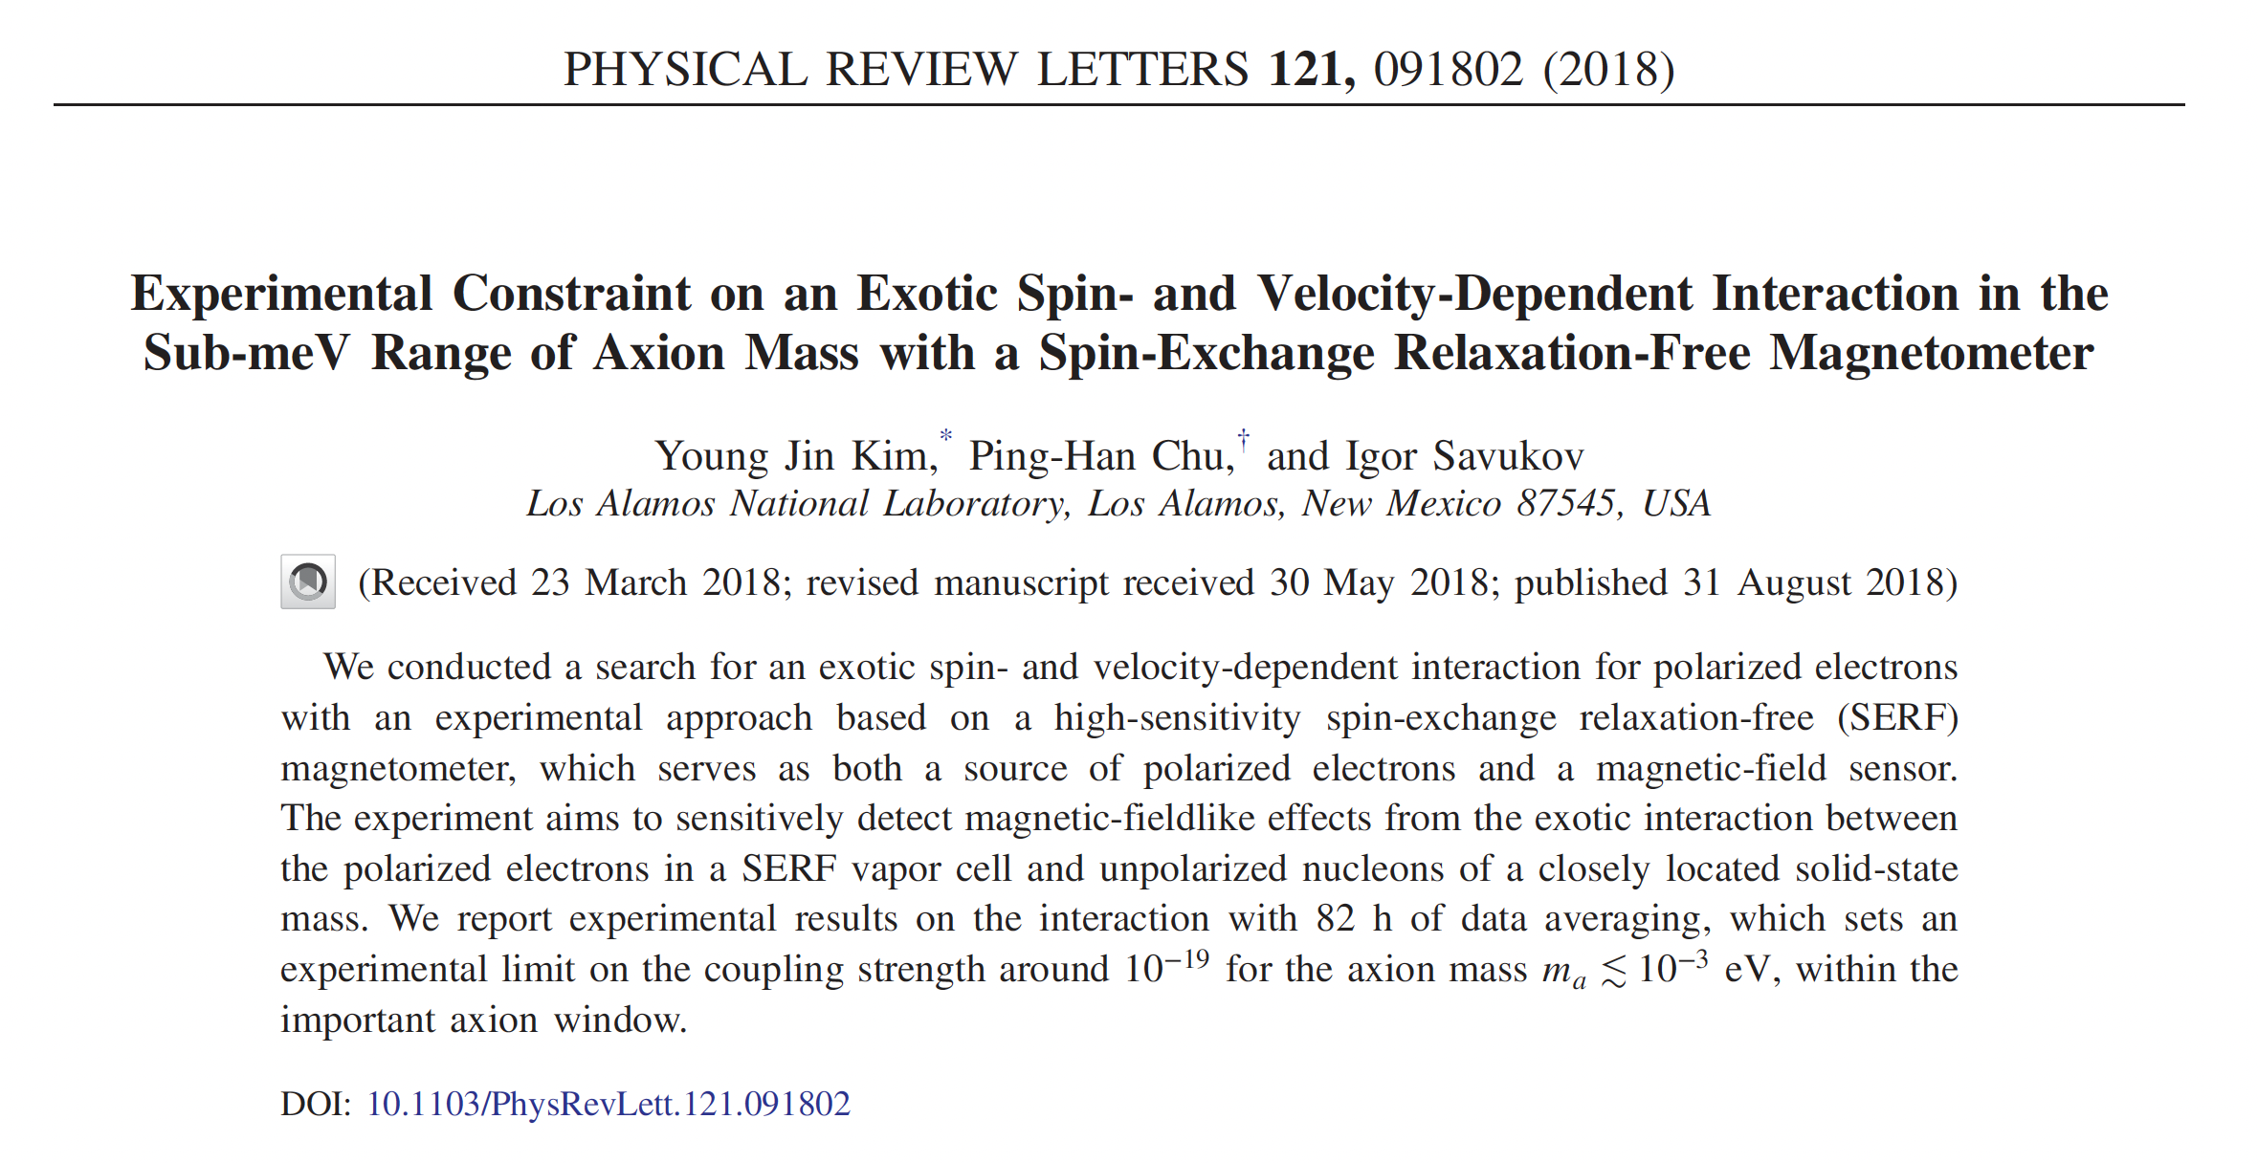
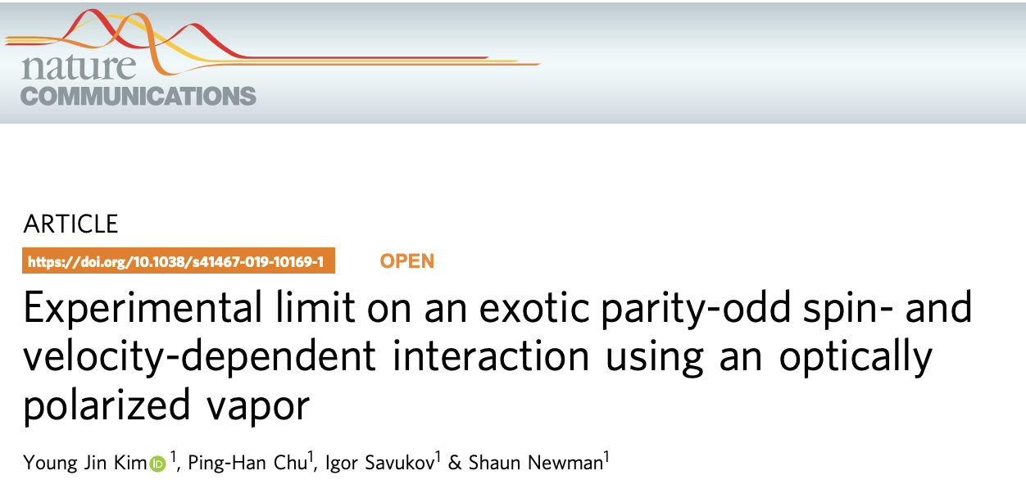
Definition of axion & ALPs：
Axions: mass and coupling inversely proportional to F:
ALPs: mass and coupling are independent----PDG2020
Vector particles are called axions in some literatures.
Our definition of ALP :
All such exotic particles that are characterized by their light mass and weak coupling.
Notes:
Let's further explore the concept and definition of Axion-Like Particles (ALPs). Initially, 'axions' referred specifically to the QCD axion, which emerges at the electro-weak symmetry breaking scale. However, this was soon ruled out by experimental results. Theorists subsequently proposed that the symmetry breaking scale could be much higher. In this context, an 'axion' is defined as a scalar particle with a mass and coupling that are inversely proportional to the symmetry breaking scale, F.
Some theorists then suggested that the new particle's mass and coupling could be independent, and this was officially defined as ALPs in PDG2020. Yet, some experimentalists refer to the aforementioned vector particle as ALPs or even axions, as seen in these two references. As an experimentalist, we decided not to care what your theoretists are thinking. we call All such exotic particles that are characterized by their light mass and weak coupling axion or ALPs.

Slide 14
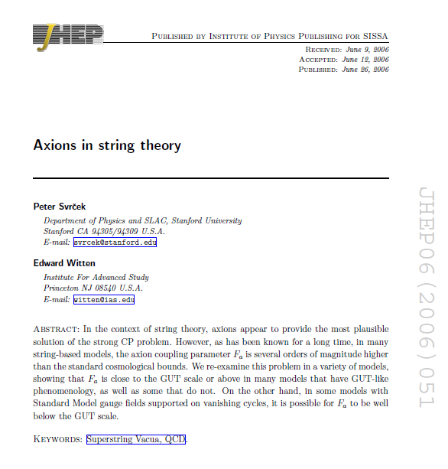
Axions & ALPs:
The intersection of the most important problems in modern physics and astronomy
Strong CP Problem
Dark Energy
Supersymmetry
Axion
Dark Matter
超对称
String Theory

Slide 15
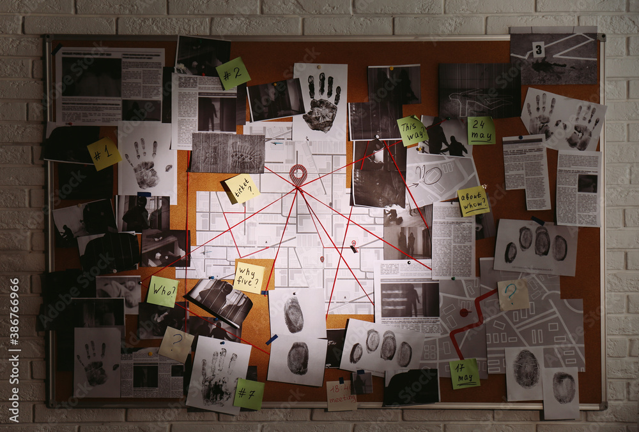
A detective board:

Slide 16
To detect, you have to interact:
Ordinary
Dark
Ordinary
Notes:
Any attempt to observe a subject requires a level of interaction with it. Without this interaction, observation becomes an impossibility. We have a comprehensive understanding of ordinary matter, but our knowledge about the dark sector remains limited. Consequently, our strategy revolves around conducting highly precise measurements within the ordinary sector to deduce the existence of the dark sector through the interactions they mediate between the ordinary sectors.

Slide 17
Three scalars to be measured：
1.σ·r pseudo-Scalar, breaks P and T
2.σ·v pseudo-Scalar, breaks P and C
3.σ·(v×r) scalar

Slide 18
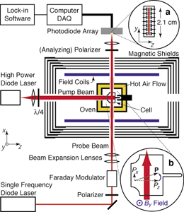
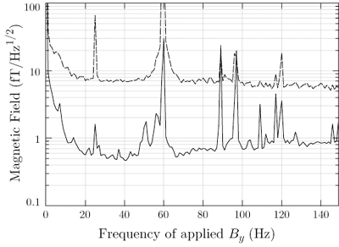
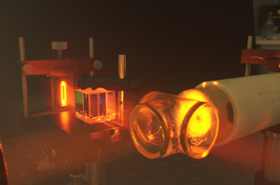
SERF Magnetometers：
based on polarized alkaline metal and have ultra high sensitivity
I. K. Kominis, T. W. Kornack, J. C. Allred & M. V. Romalis, "A subfemtotesla multichannel atomic magnetometer." Nature 422, 596 (2003).

Slide 19
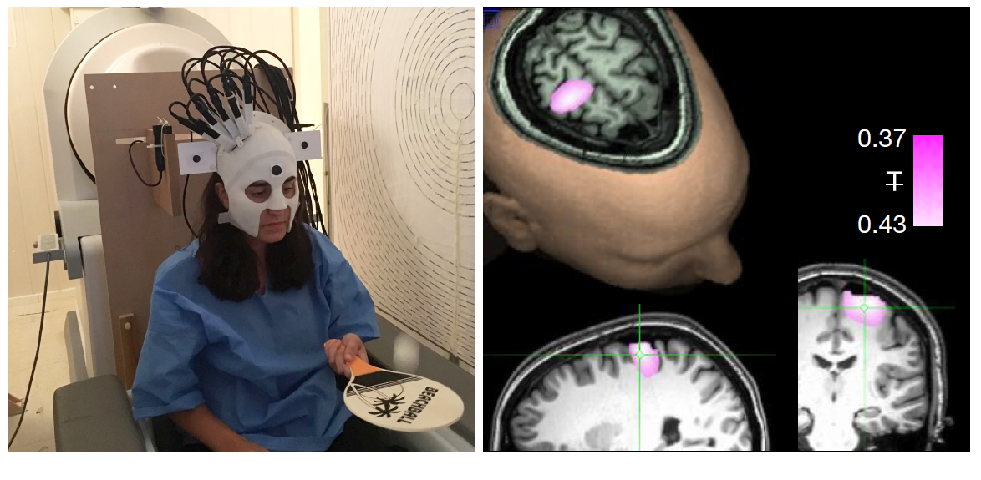
SERF magnetometers：measuring bio-magnetic field
Nature volume 555, pages657–661 (2018)

Slide 20
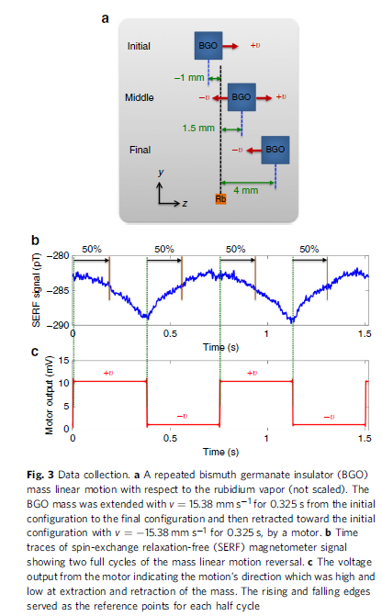
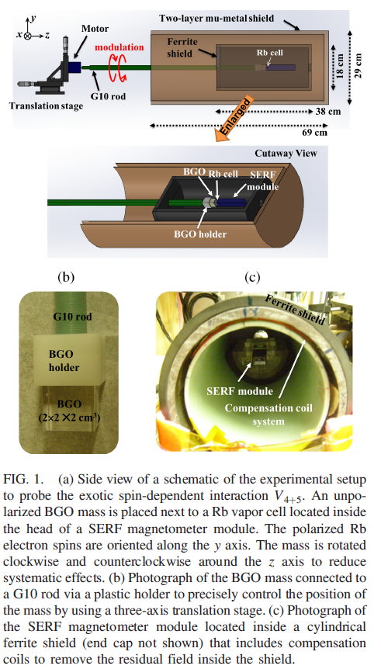
Existing experiments：modulation frequency
J. Lee, A.Almasi, and M. Romalis, PRL,120, 161801 (2018)
Y.J.Kim, P.H.Chu, I.Savukov & S. Newman, NC, 10:2245,(2019)
Y.J.Kim, P.H.Chu, I.Savukov , PRL, 121,091802,(2018)

Slide 21
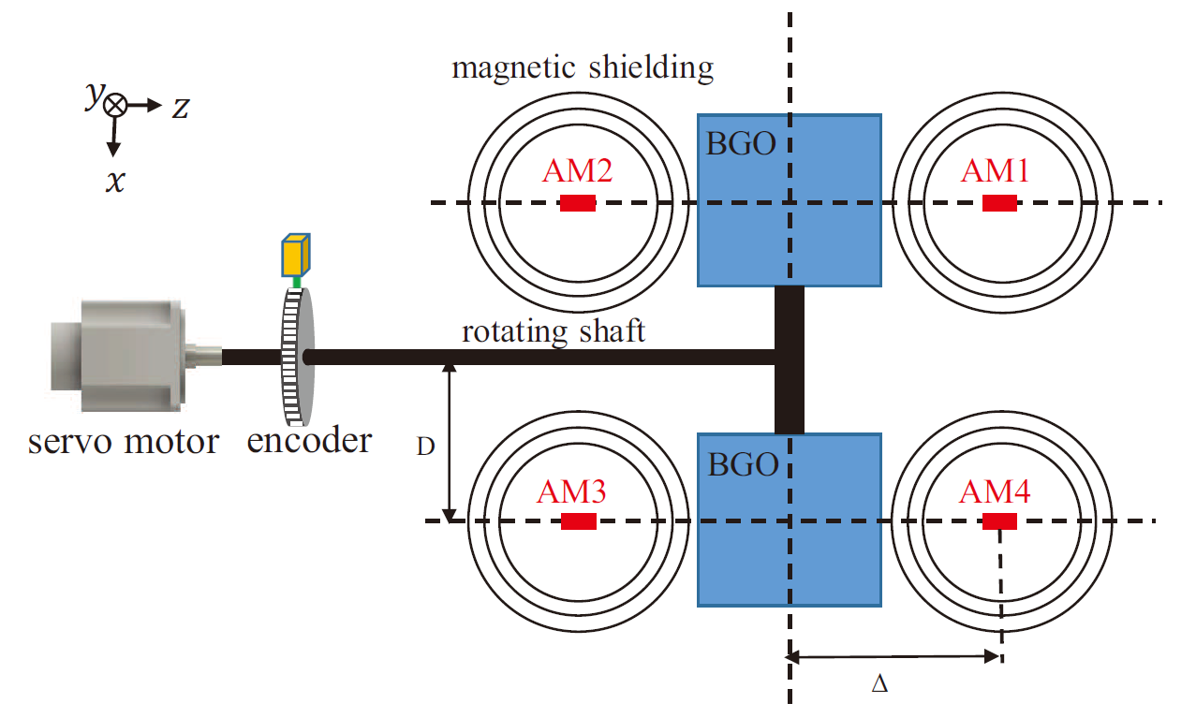
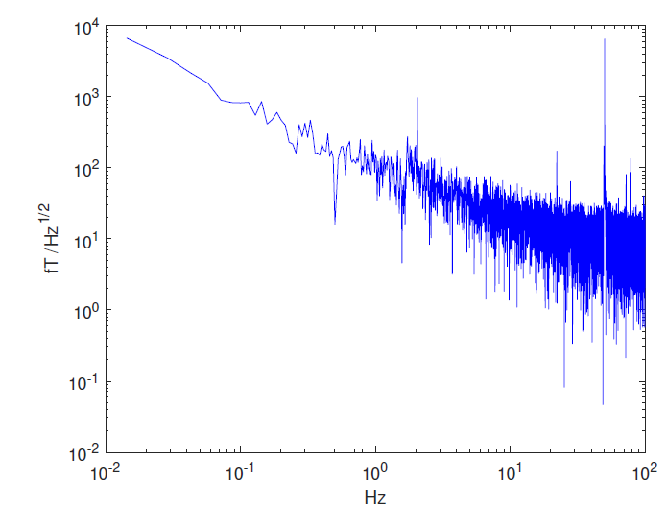
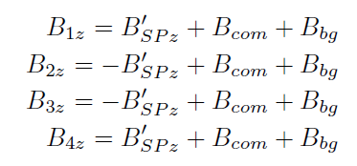
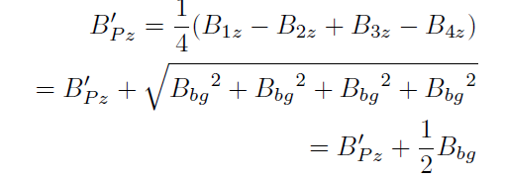
The proposed experiment scheme:
The typical noise power density of a Rb magnetometer
High speed rotating mass sources + magnetometer array
1.Modulation frequency~20Hz，40 times noise reduction；
2.Magnetometer array，increases statistics and cancels common-mode noise
K. Y. Wu, S. Y. Chen, J. Gong, M. Peng, and H. Yan， Phys. Rev. D 105, 055020（2022）

Slide 22
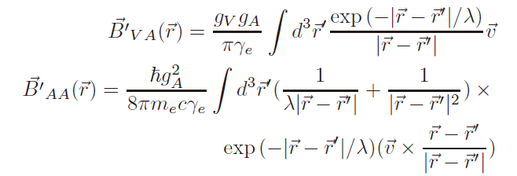





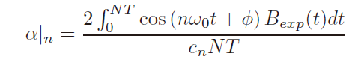

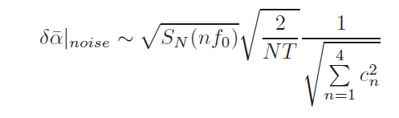

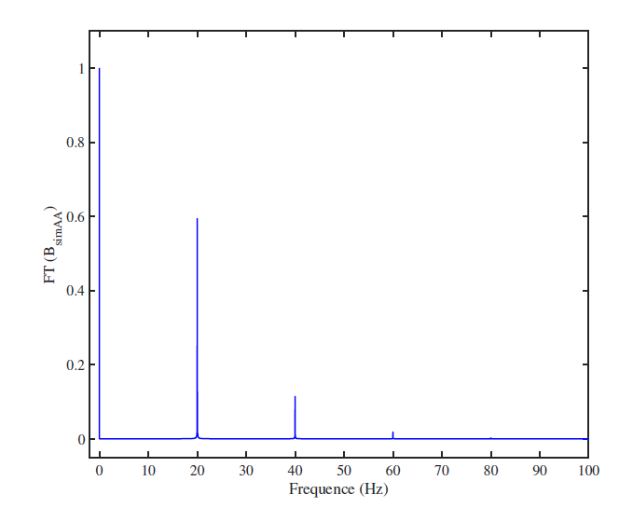
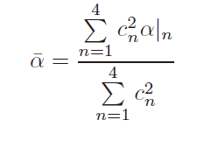
Data processing method：
30 days~10aT(10⁻¹⁷T) precision
Phys. Rev. D 105, 055020（2022）

Slide 23
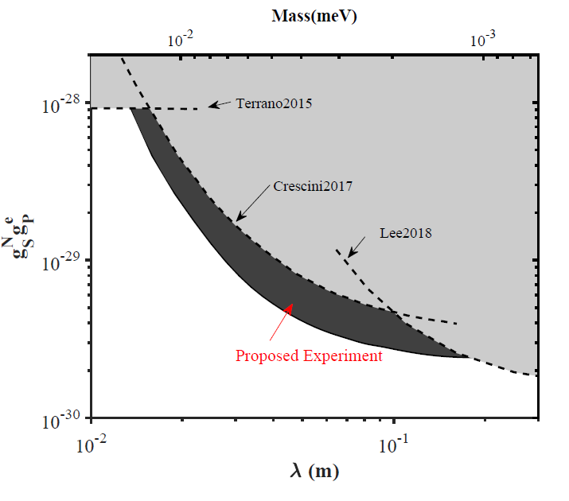
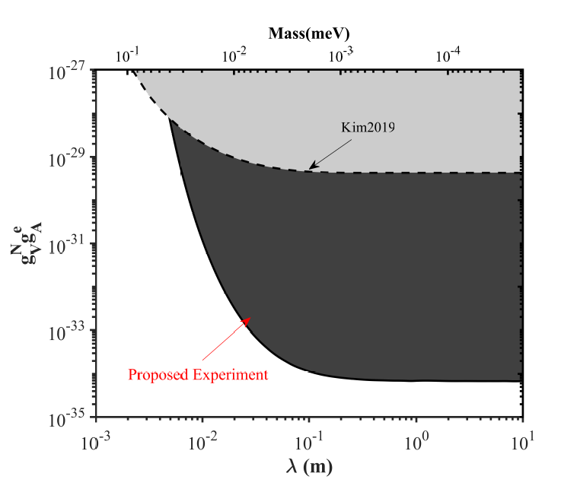
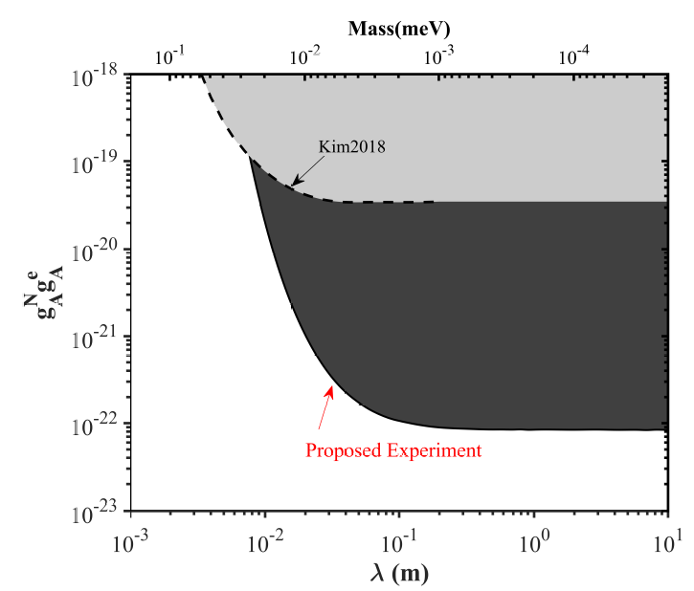
The proposed sensitivity：
Through Monte Carlo simulation, it has been verified that (with 30 days of integration time)：
1.𝑉_{𝑆𝑃} :improves the existing result by~1.5 times；
2.𝑉_{𝑉𝐴}: improves the existing result by ~5 orders in magnitude；
3.𝑉_{𝐴𝐴}: improves the existing result by ~3 orders in magnitude；
K. Y. Wu, S. Y. Chen, J. Gong, M. Peng, and H. Yan， Phys. Rev. D 105, 055020（2022）

Slide 24
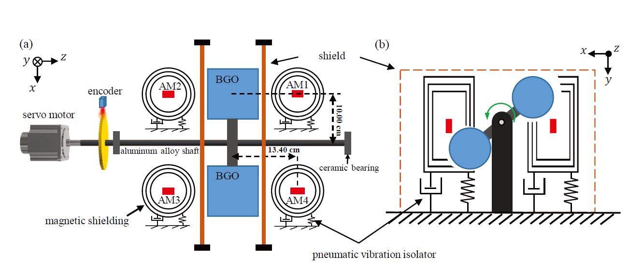
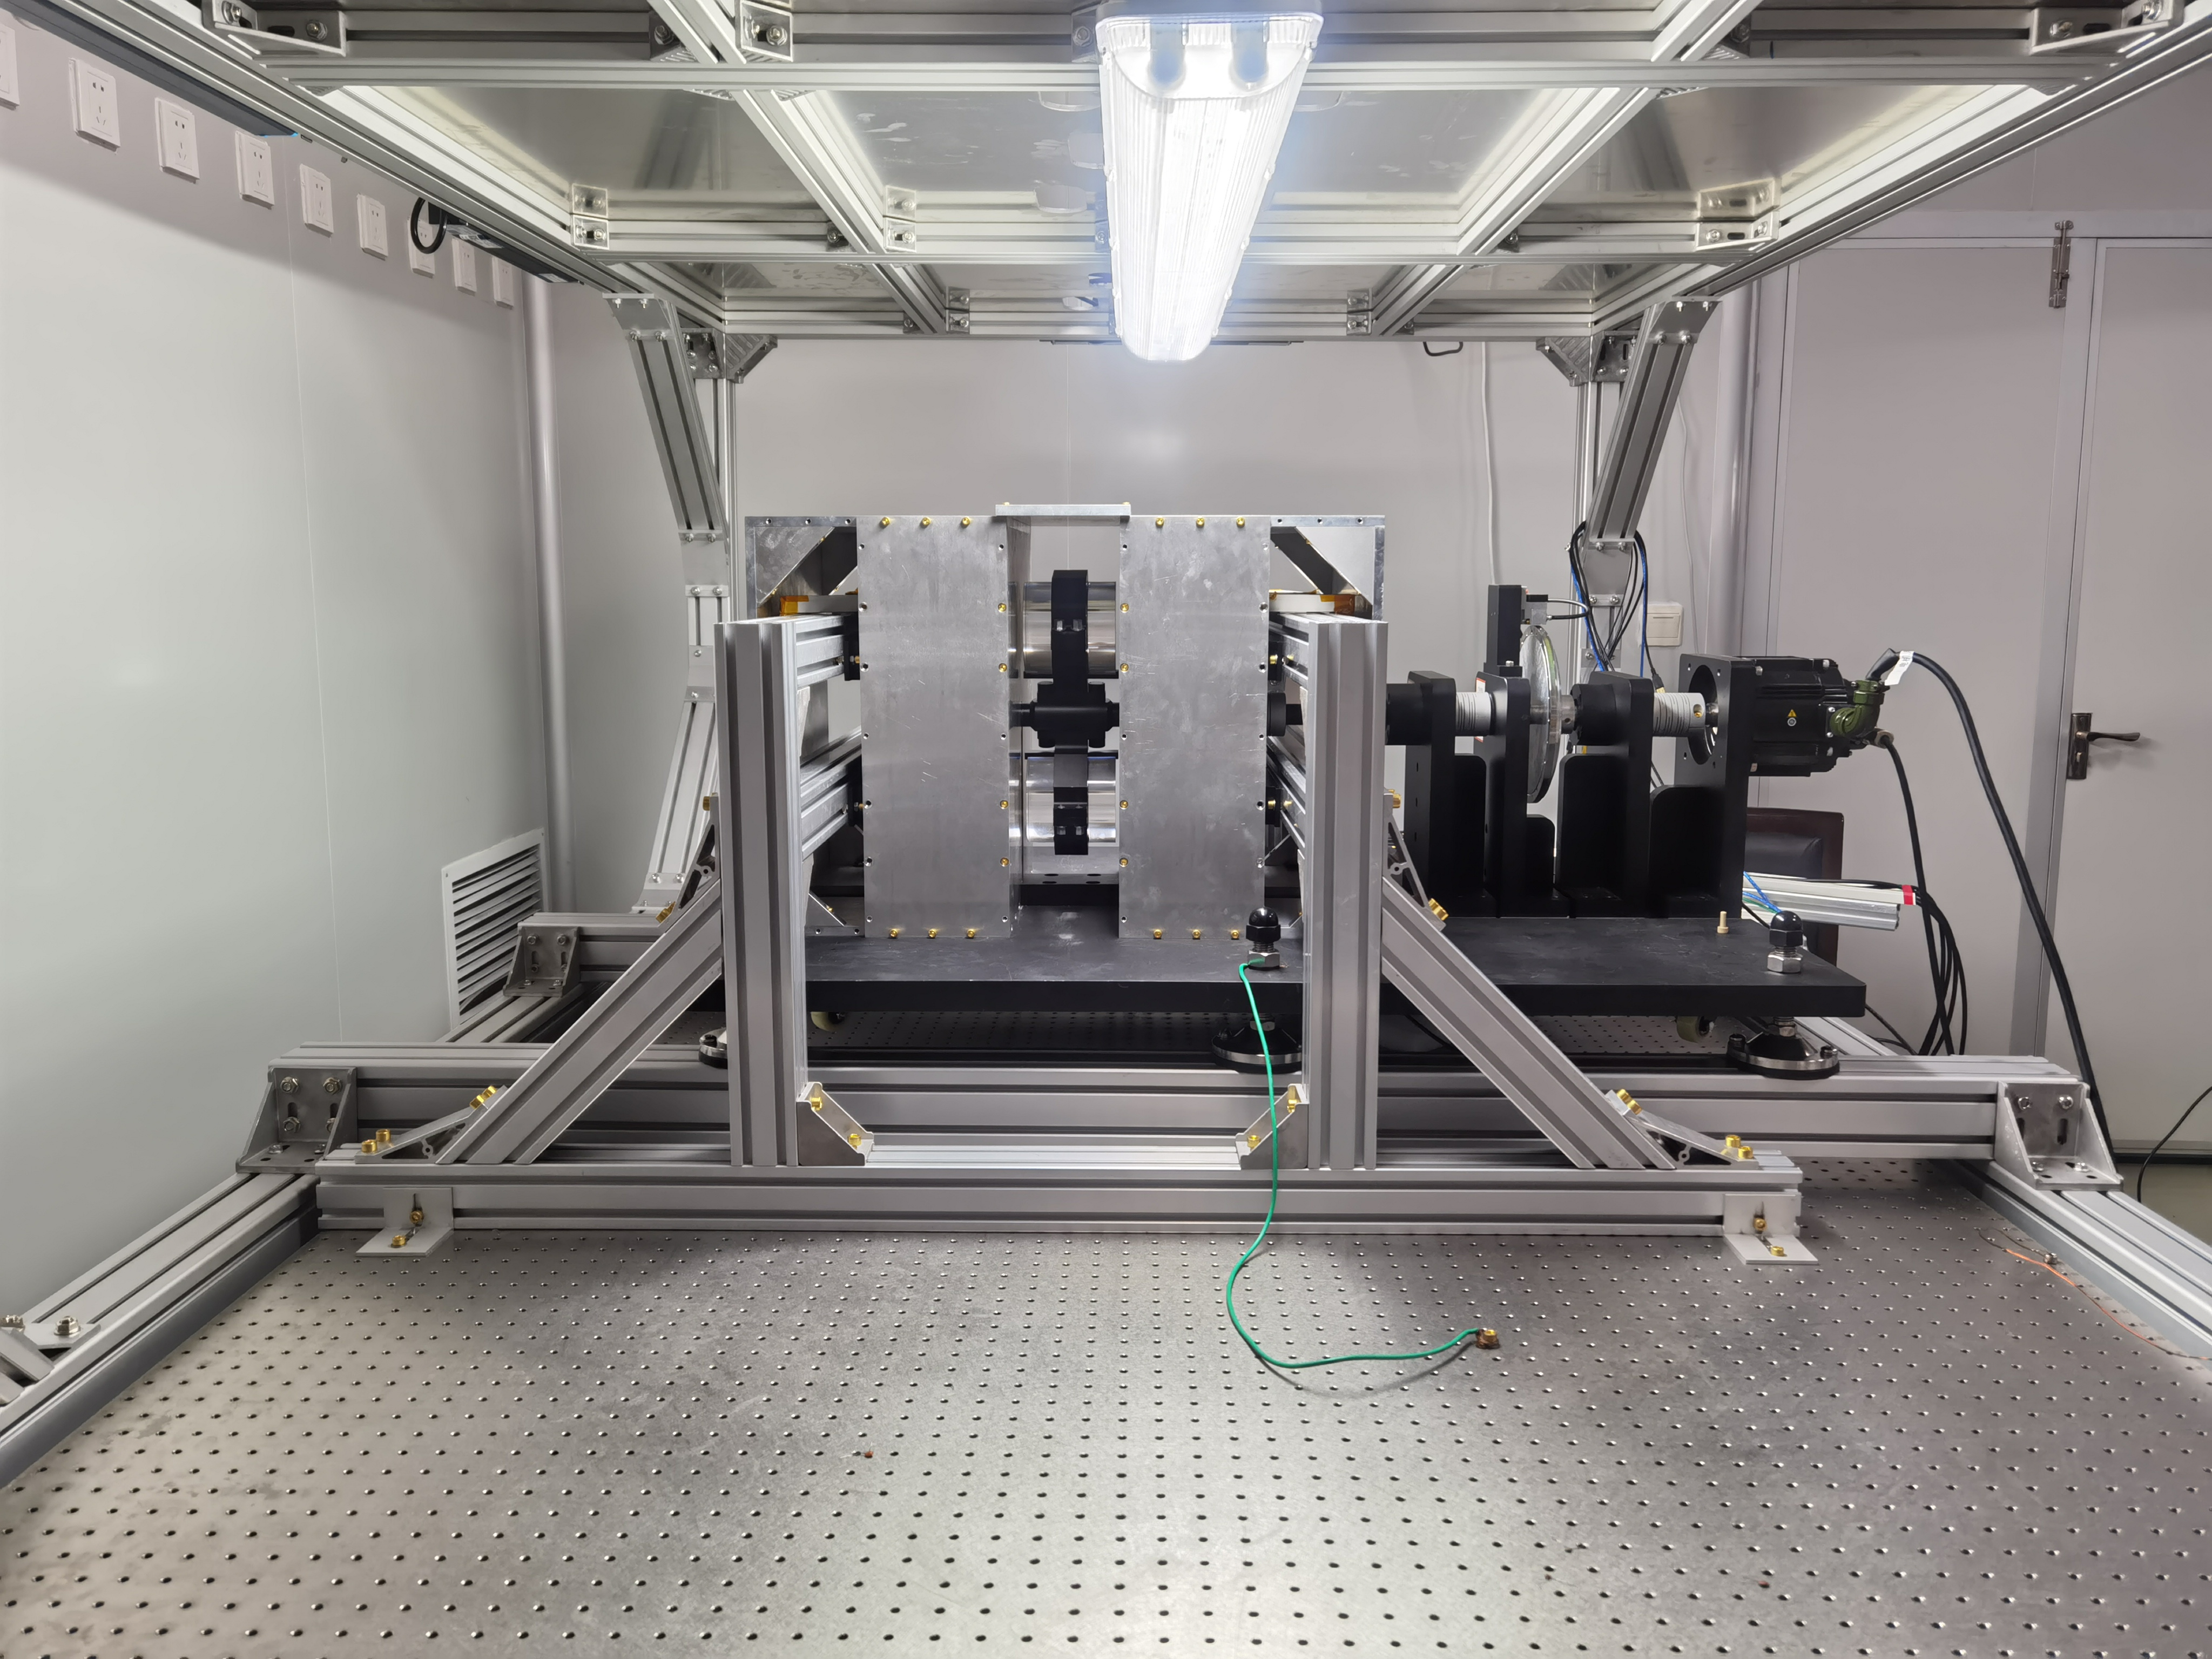
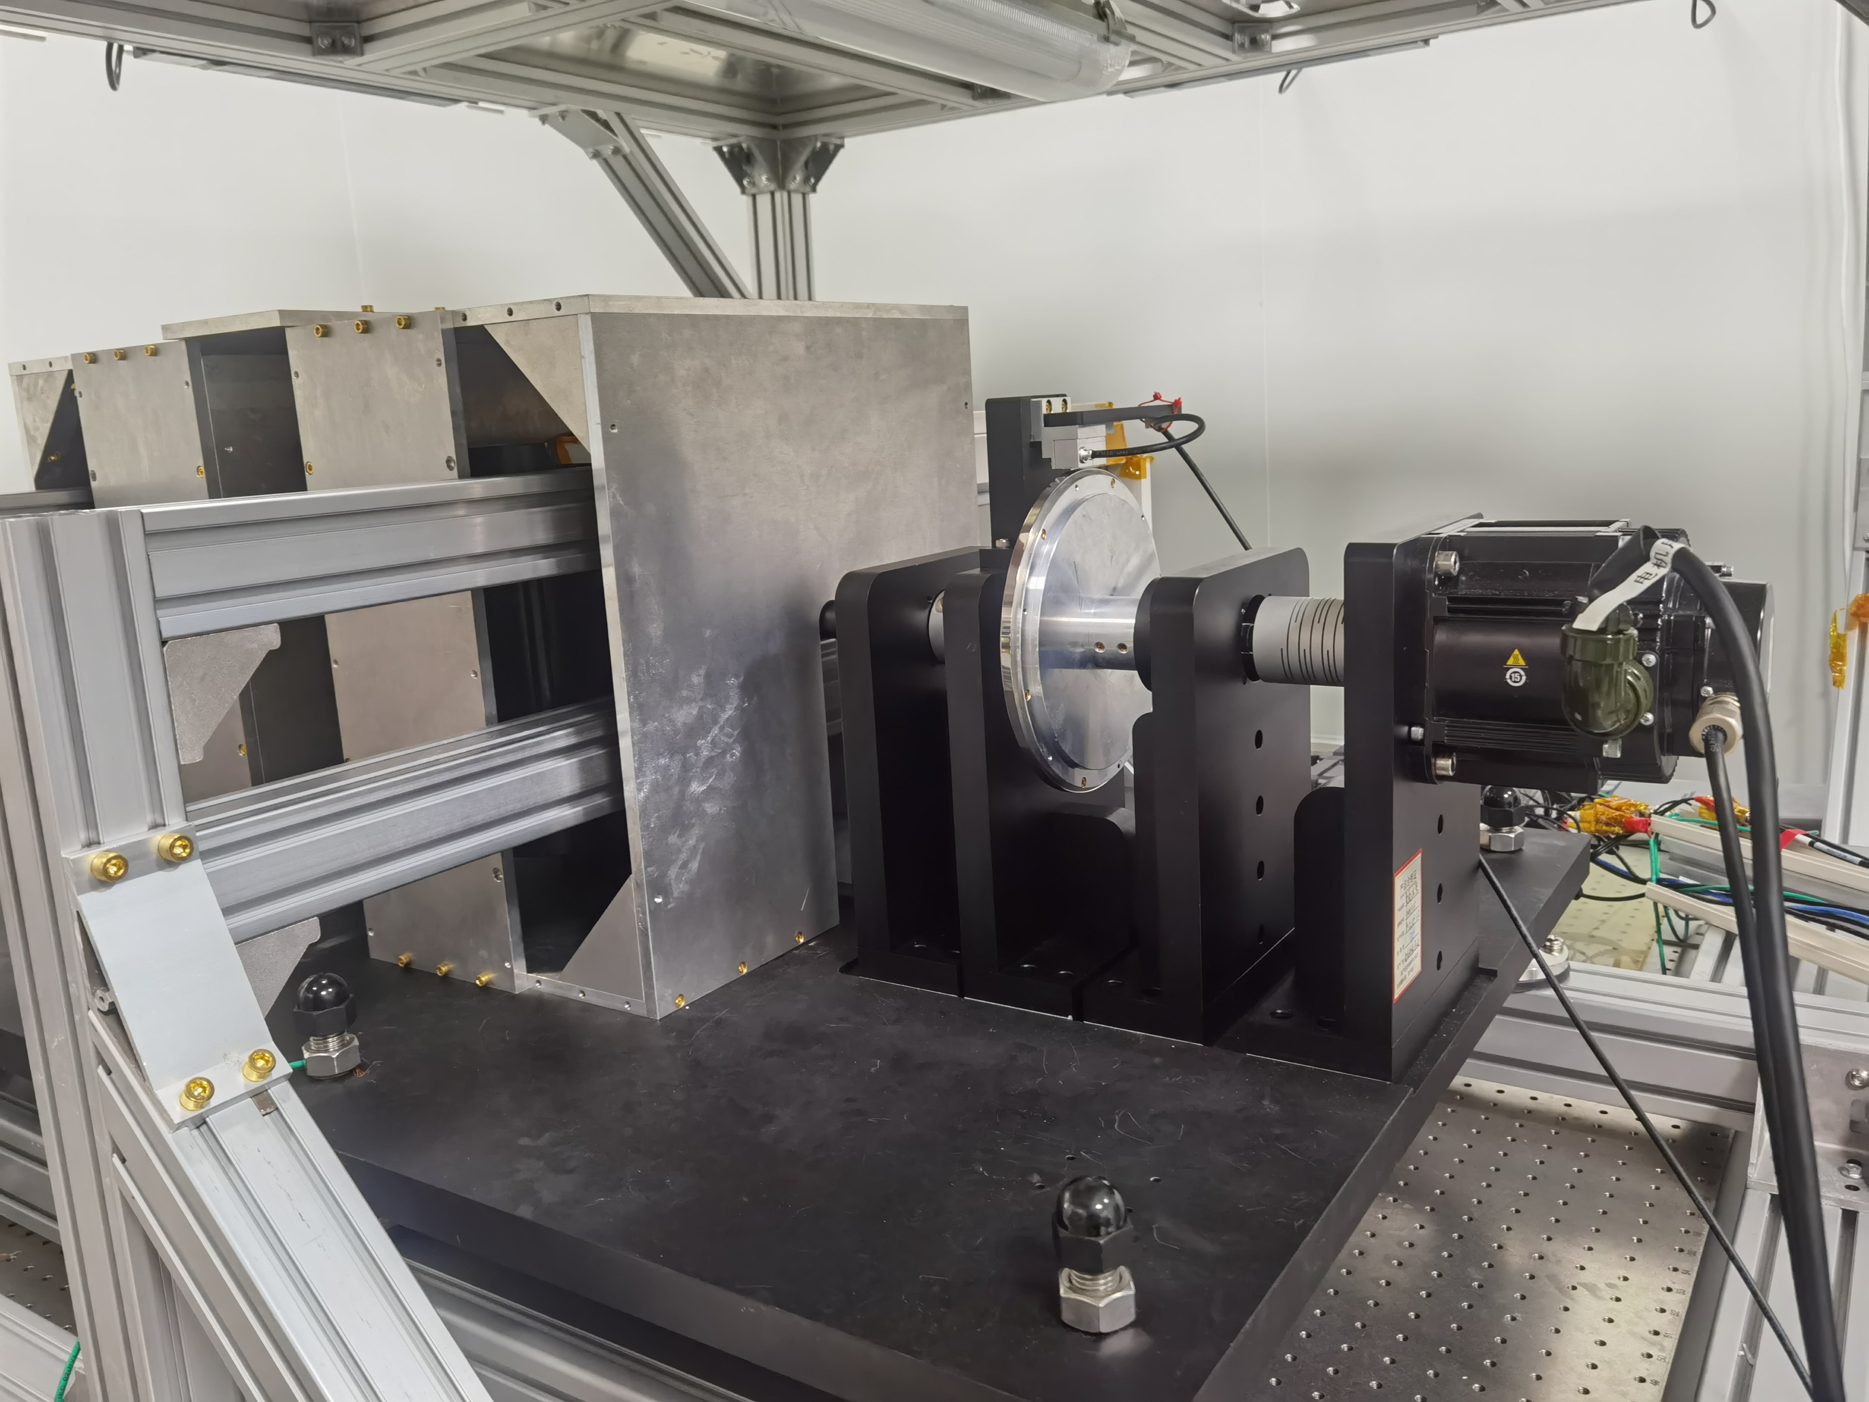
The experiment setup：
encoder
BGO
Servo motor
Pneumatic vibration isolated optical table
K. Y. Wu, S. Y. Chen, G. A. Sun, S. M. Peng, M. Peng, and H. Yan, Phys. Rev. Lett. 129 051802 (2022)

Slide 25
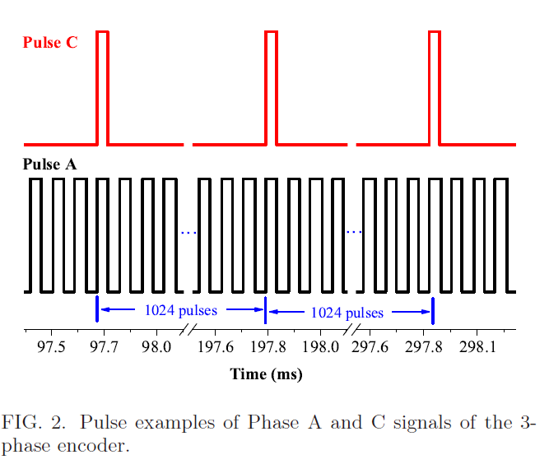
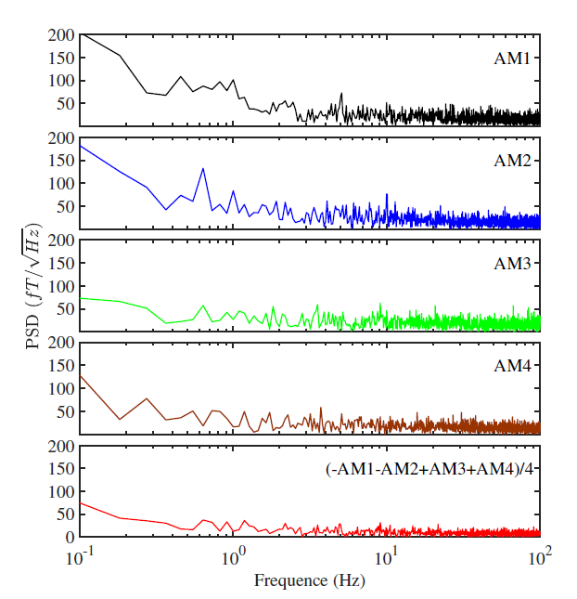
Data taking example:
K. Y. Wu, S. Y. Chen, G. A. Sun, S. M. Peng, M. Peng, and H. Yan, Phys. Rev. Lett. 129 051802 (2022)

Slide 26
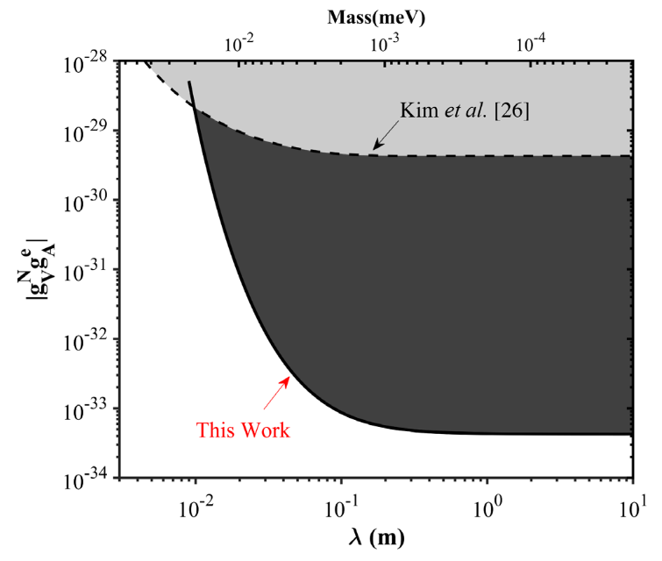
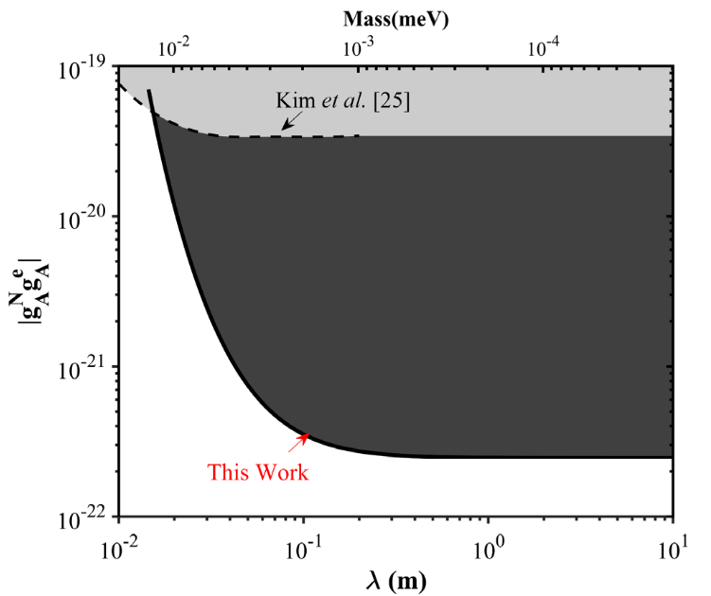
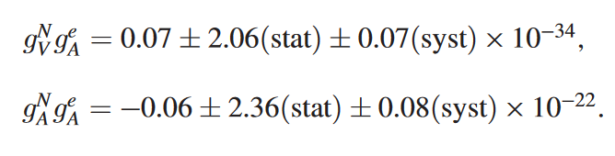
Main results:
K. Y. Wu, S. Y. Chen, G. A. Sun, S. M. Peng, M. Peng, and H. Yan, Phys. Rev. Lett. 129 051802 (2022)

Slide 27
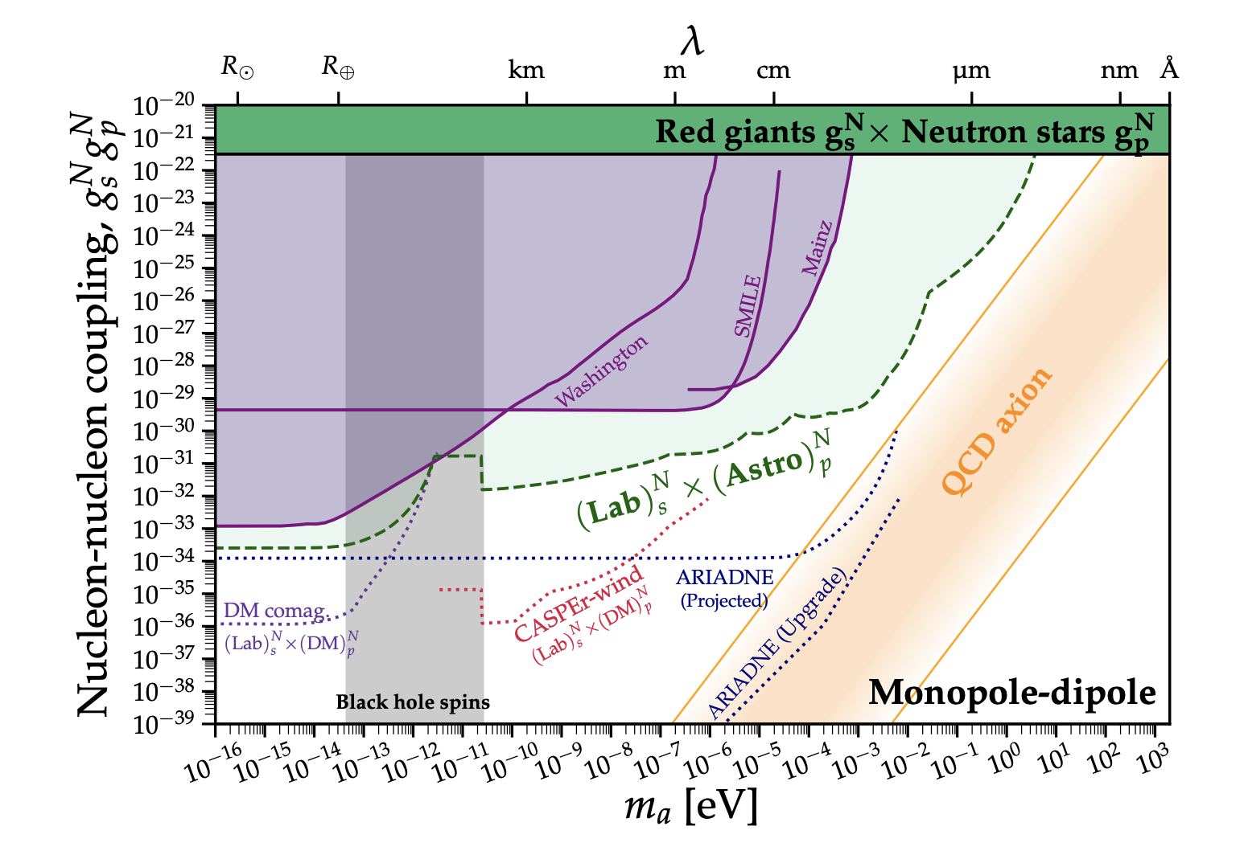
Astrophysical limits：hard to exceed
C. A. J. O’Hare and E. Vitagliano, Phys. Rev. D 102, 115026 (2020).

Slide 28
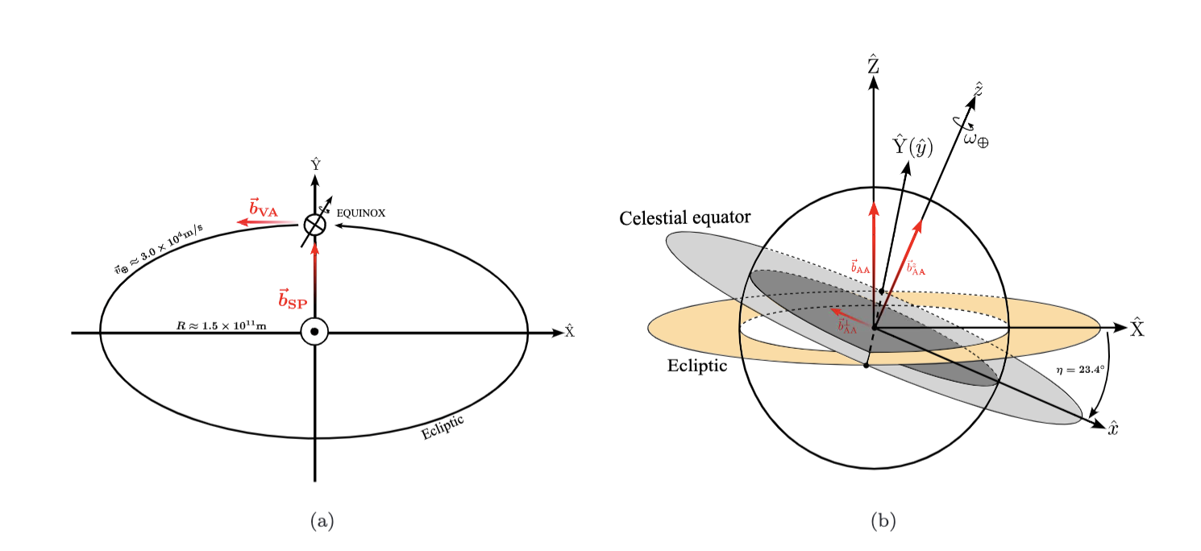
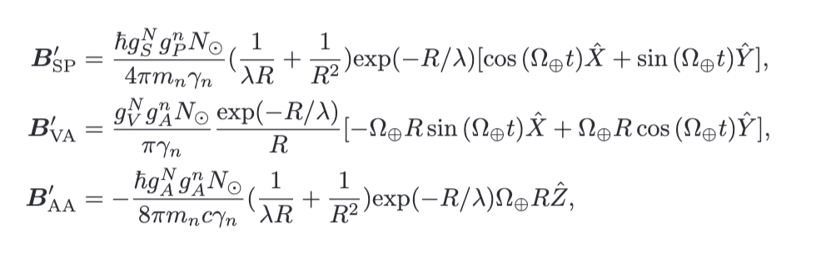
Using the Sun as a source：
L.Y.Wu,K.Y.Zhang, M.Peng, J.Gong H.Yan, Arxiv:2302.09096

Slide 29
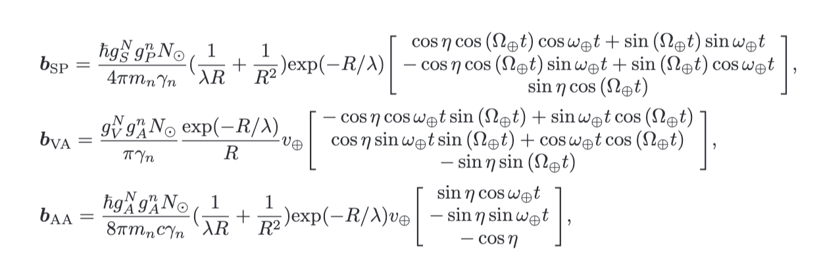
Earth’s rotation as a modulation:
L.Y.Wu,K.Y.Zhang, M.Peng, J.Gong H.Yan, arxiv:2302.09096

Slide 30
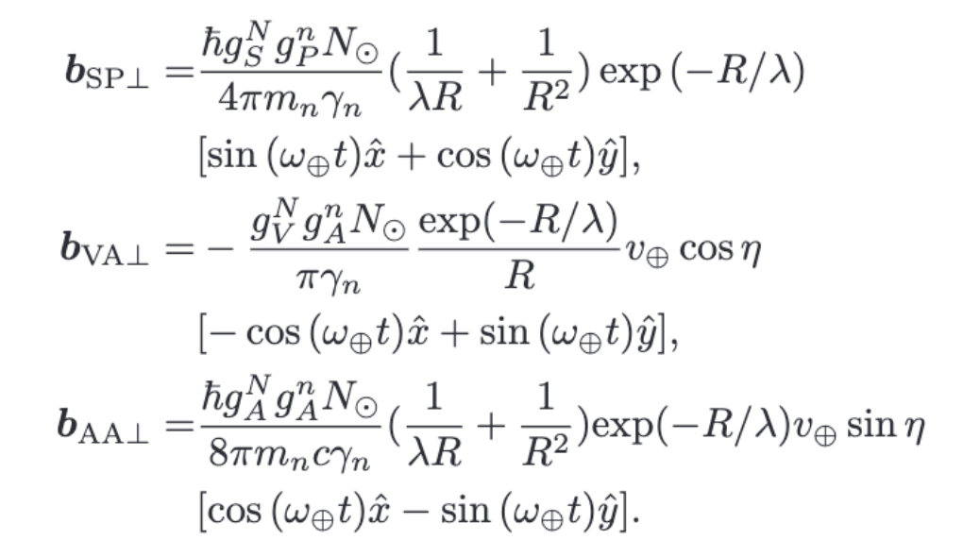

Effective field perpendicular to the Earth’s rotation axis：
Lorentz violation experiment：
F. Allmendinger et al, PRL 112(11),110801, (2014).
L.Y.Wu,K.Y.Zhang, M.Peng, J.Gong H.Yan, arxiv:2302.09096

Slide 31
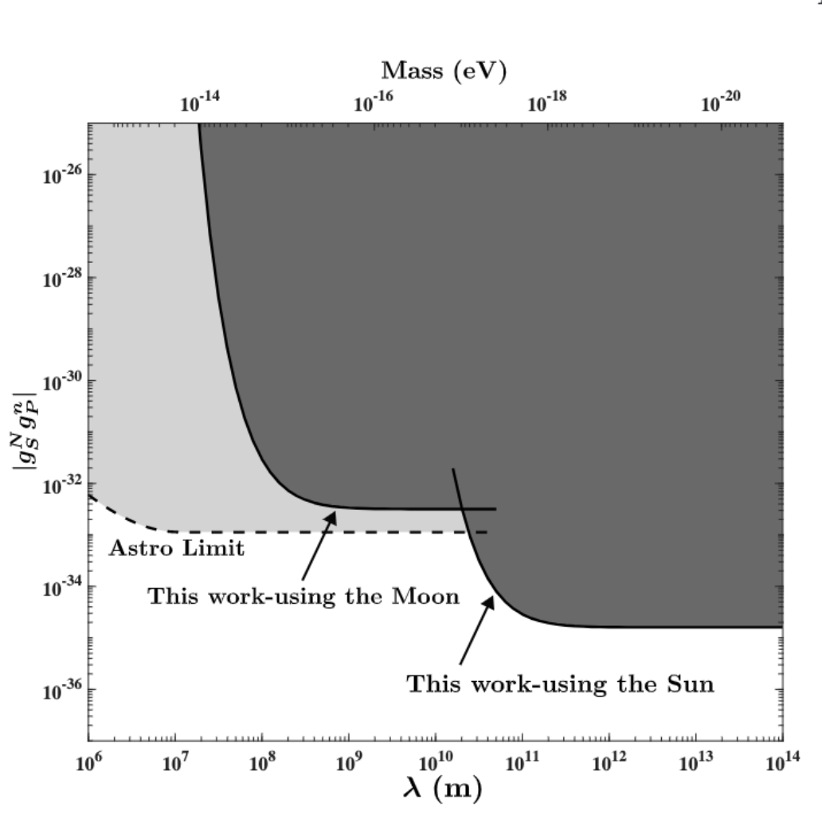
SP type interaction—exceed the astrophysical limit：
σ·r
Exceeds the astrophysical limit by ~70 times
L.Y.Wu,K.Y.Zhang, M.Peng, J.Gong H.Yan, Arxiv:2302.09096

Slide 32
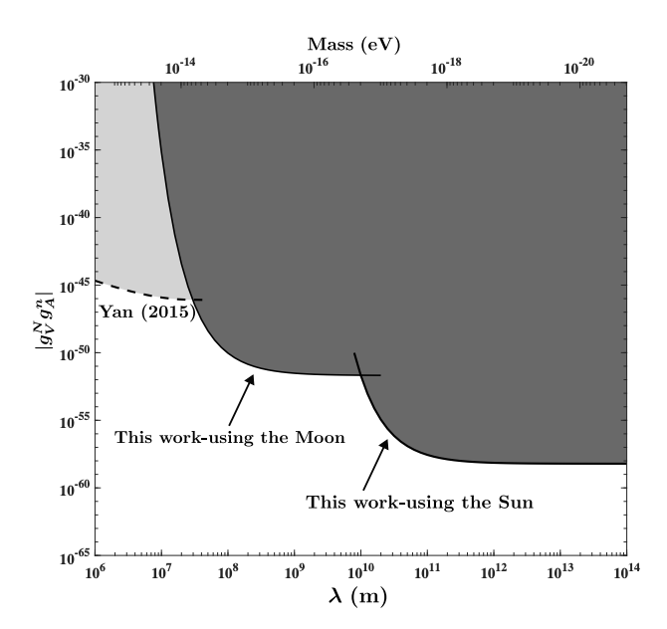
VA type interaction：limits improved by many orders
σ·v
L.Y.Wu,K.Y.Zhang, M.Peng, J.Gong H.Yan, arxiv:2302.09096

Slide 33

AA Type interaction：established constraints at astronomical distances
σ·(v×r)
L.Y.Wu,K.Y.Zhang, M.Peng, J.Gong H.Yan, arxiv:2302.09096

Slide 34

Received Acceptance Just Prior to This Meeting:
L.Y.Wu,K.Y.Zhang, M.Peng, J.Gong H.Yan, arxiv:2302.09096

Slide 35




σ·v
Neutron spin rotation constrains new physics ：
New limits exceed the existing one by more than 7 orders
H.Yan and W.M.Snow, Phys. Rev. Lett.110, 082003(2013).

Slide 36


Spin relaxation time of polarized ³He to constrain the exotic interactions:
<(σ·v)²>
³He
Using the earth as a source；
Using the longest known relaxation times.
H.Yan*,G.A.Sun,S.M.Peng,Y.Zhang,C.Fu,H.Guo and B.Q.Liu, Physical Review Letters, 115, 182001 (2015)

Slide 37

Conclusion & Discussion:
Notes:
Allow me to conclude my presentation with a quote by Richard Feynman: 'All mass is interaction.' It's important to note, and perhaps add, that many of these interactions could, quite likely, be spin-dependent.

Slide 38
Conclusion & Discussion:
Many of these interactions could potentially be spin-dependent.
Notes:
Allow me to conclude my presentation with a quote by Richard Feynman: 'All mass is interaction.' It's important to note, and perhaps add, that many of these interactions could, quite likely, be spin-dependent.

Slide 39
请 批 评 指 正！
谢谢

