Slide 1

Electromagnetic Responses of axions in a high magnetic field with AC modulations
L. F. Wei
email: lfwei@swjtu.edu.cn
Information Quantum information Technology, Southwest Jiaotong University, Chengdu 610031
Collaborators: H. Zheng, Z. J. Zhong, @swjtu；J. Li@cqu; Q. Q. Jiang@cwnu

Slide 2
Outline
I. Backgrounds
II. Proposal and Numerical Results
III. Feasibile Analysis
IV. Discussions

Slide 3
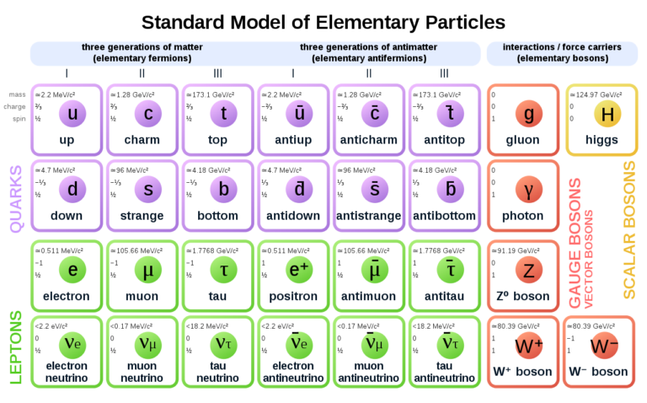
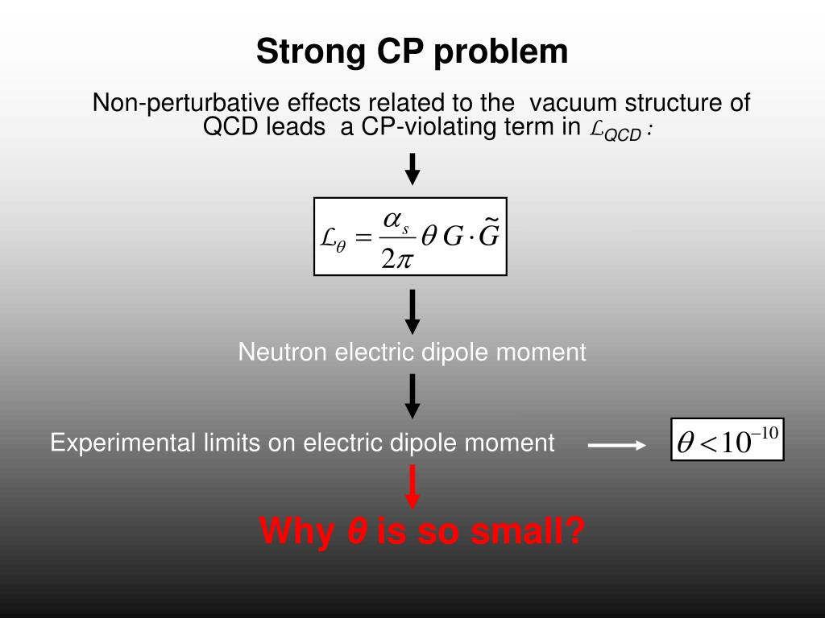
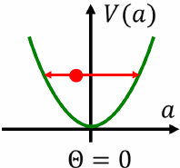
I. Backgrounds-Axion should exist!
1. Standard Model and QCD axions
R. D. Peccei and H. R. Quinn, Phys. Rev. Lett.
38, 1440 (1977),

Slide 4
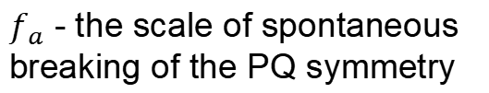
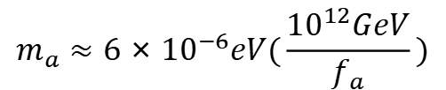
Axion field:
Axion Mass
Axion Density
$$m_{a}≈6×{10}^{−6}eV(\frac{{10}^{12}GeV}{f_{a}})$$
If axion is a dark matter with the constant density, then
$f_{a}$ - the scale of spontaneous breaking of the PQ symmetry
Ref. Weinberg, S., 1978, Phys. Rev. Lett. 40, 223.

Slide 5
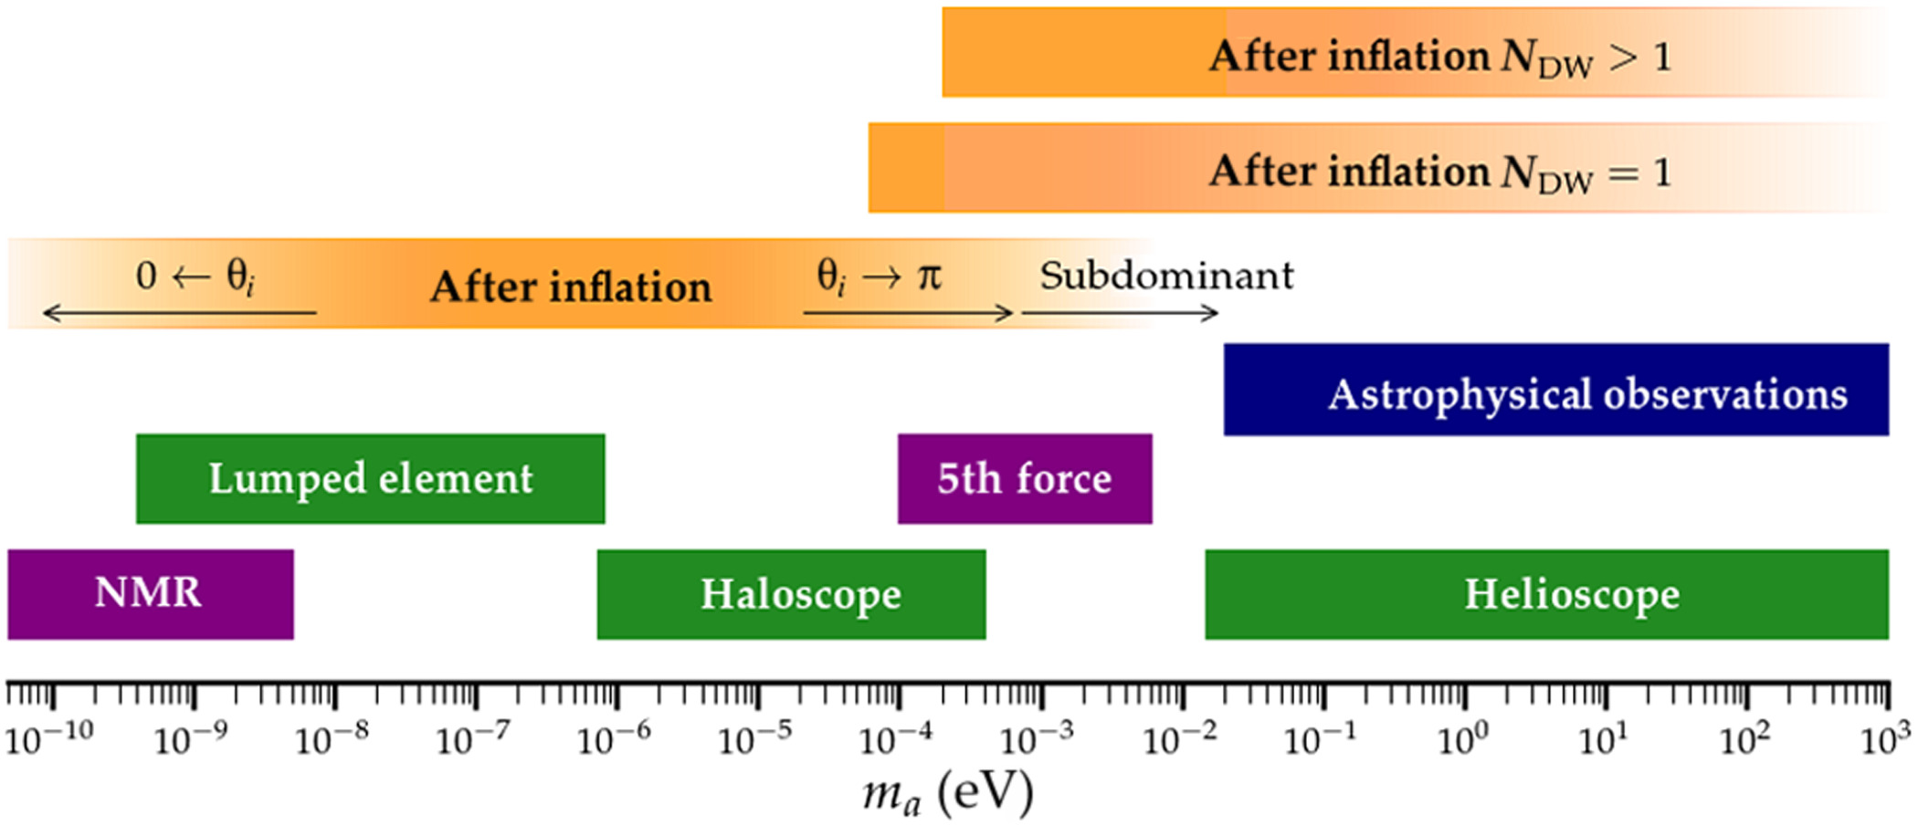
Experimental constraints of the mass range:
Yannis K. Semertzidis, and SungWoo Youn, Axion dark matter: How to see it?, Sci. Adv..8, 9928 (2022).

Slide 6
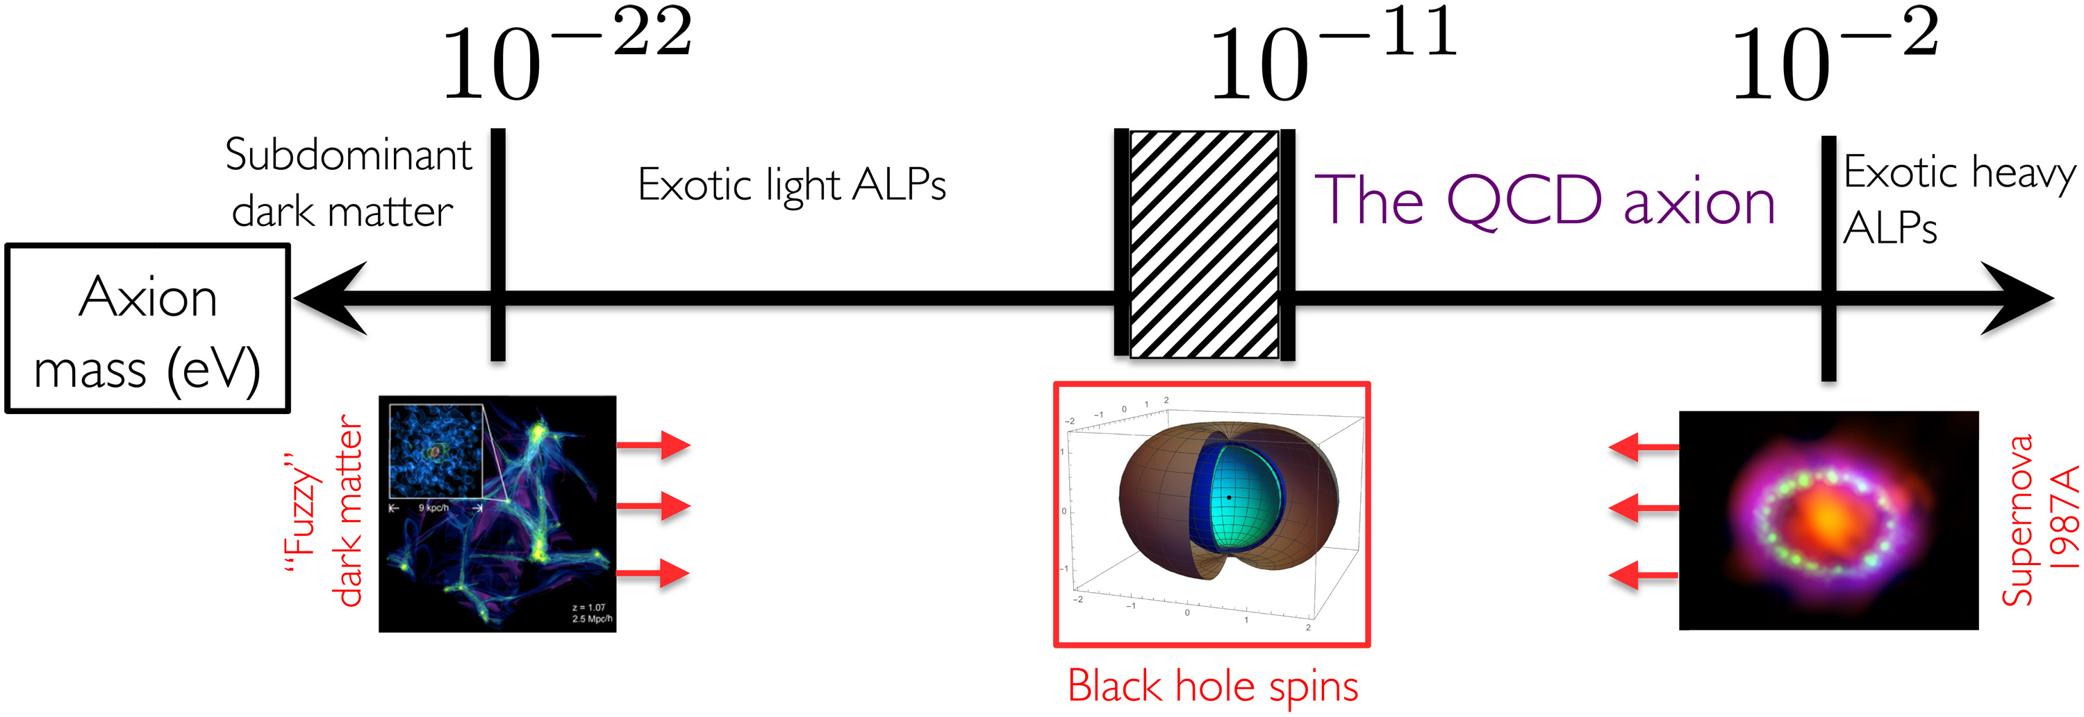
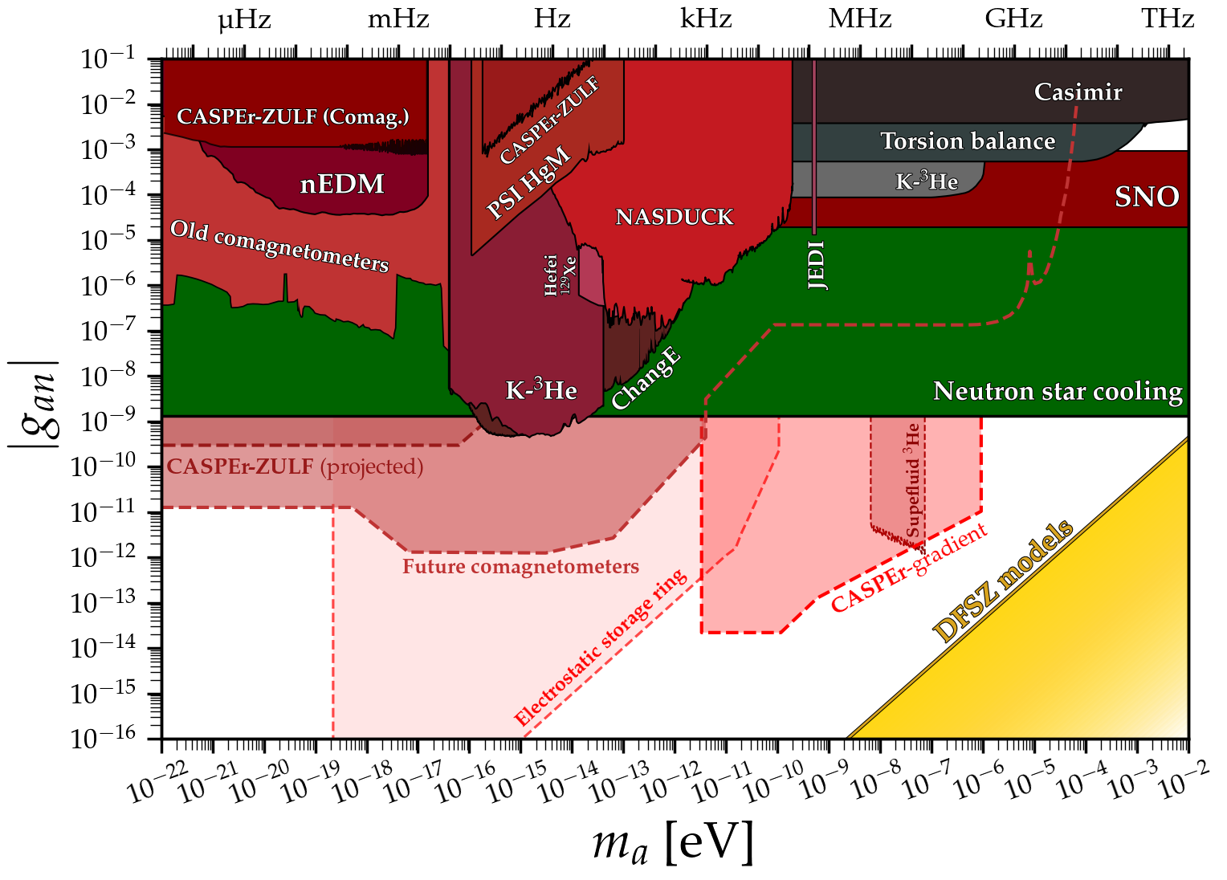
G. G. Raffelt, Astrophysical axion bounds. Lect. Notes Phys. 741, 51–71 (2008)

Slide 7
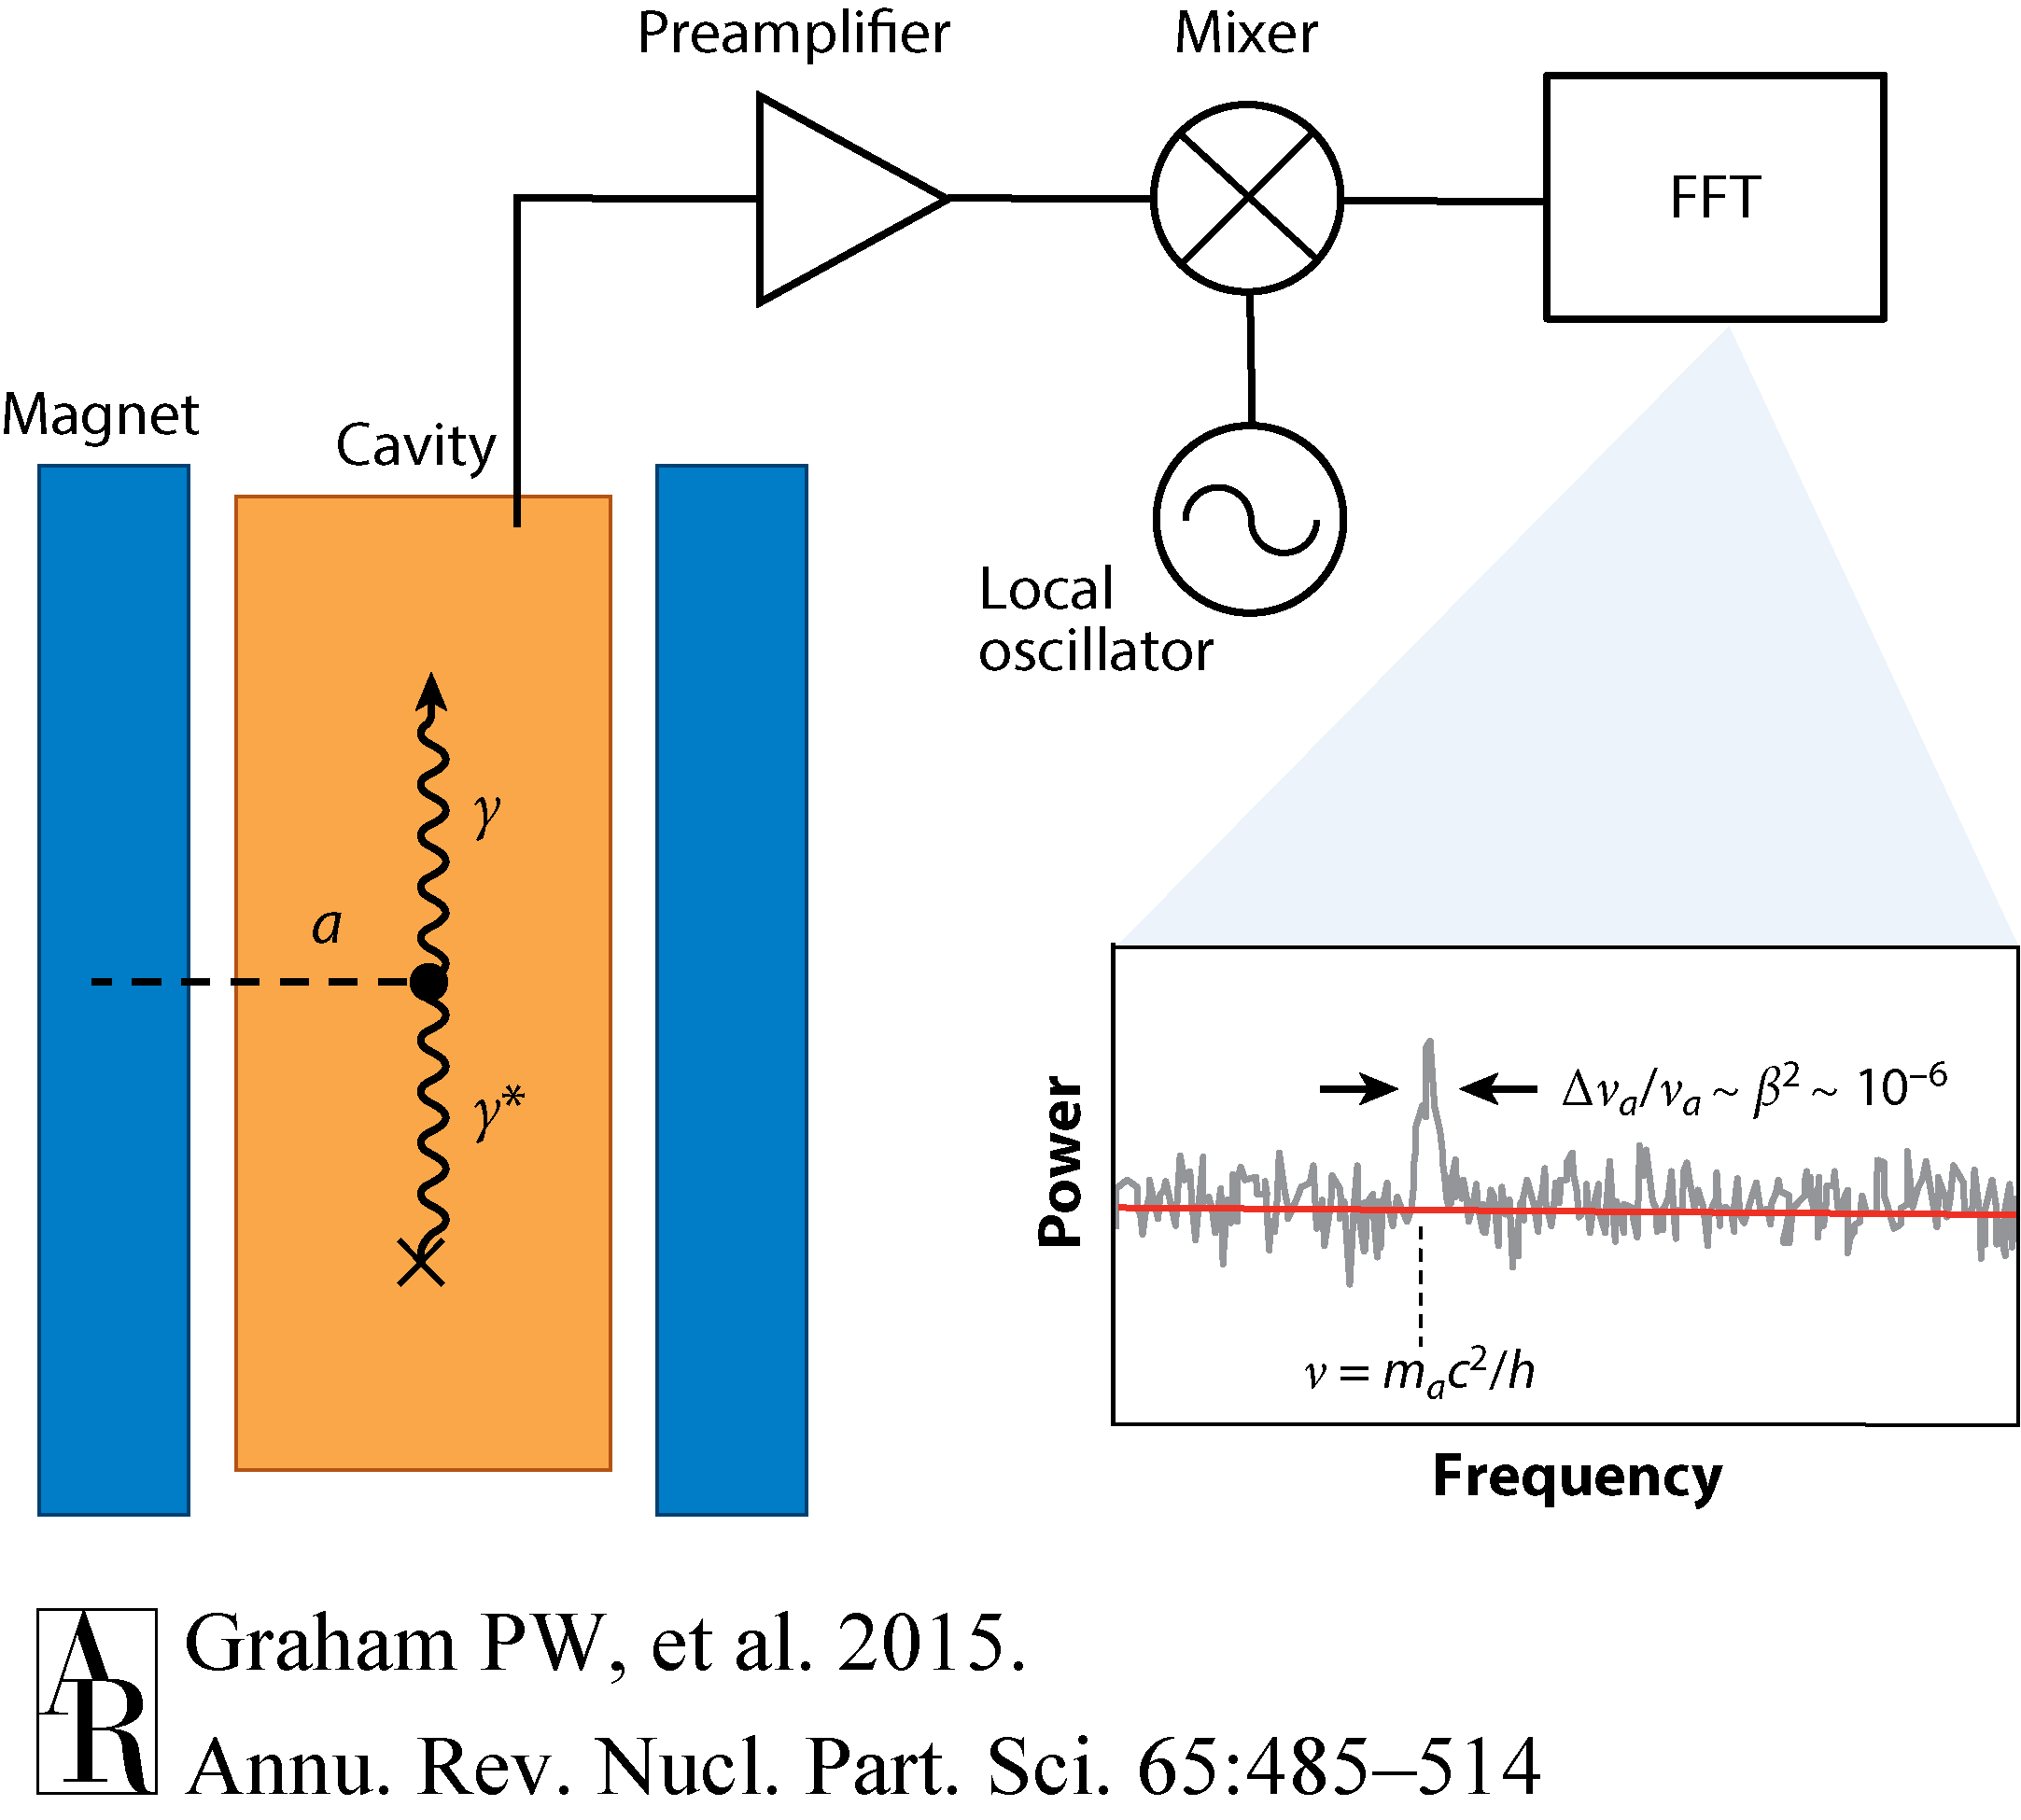

haloscope detected scheme:
$$A=πr^{2}$$
P. Sikivie, Experimental tests of the invisible axions. Rev. Lett. 51, 1415C1417 (1983)
model-dependent coupling strength

Slide 9
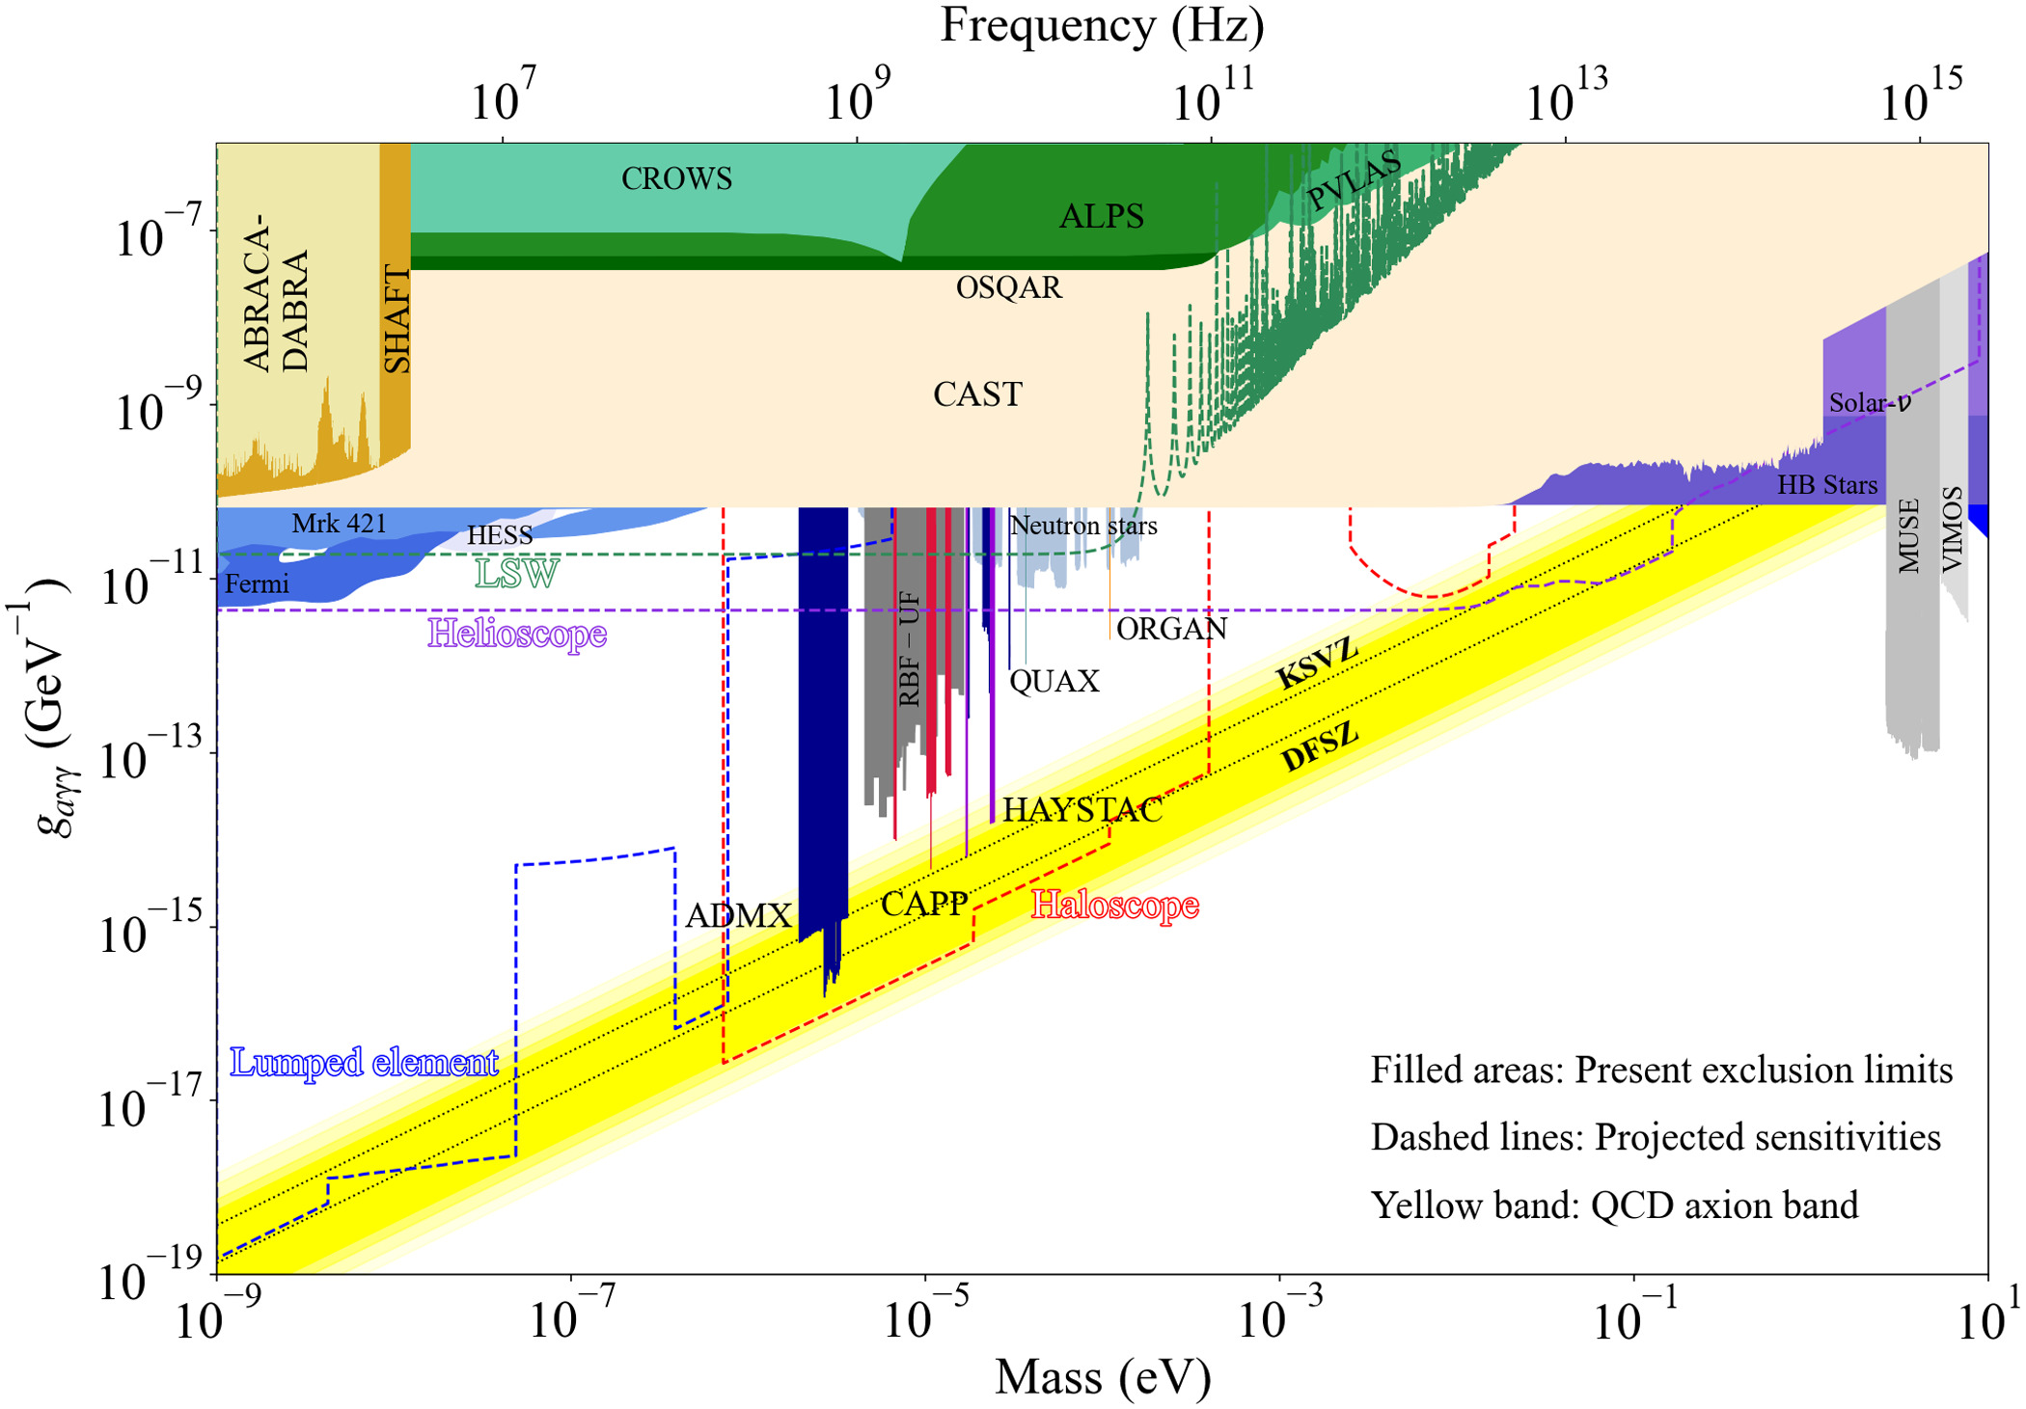

Slide 10
轴子电磁响应探测原理
实际上离单光子水平的灵敏度也还差几个量级。信号需要放大！

Slide 11
II. Proposal and Numerical Results

Slide 12
zero-order effect:
1. Model and Solutions
First-order effect:

Slide 13
1) Only a high stationary magnetic field
we have
the locations of the detectors: Zi

Slide 14
2) A high stationary magnetic field+AC modulations
we have the zero-order effect
The first-order effects
the locations of the detectors: Zi

Slide 15
3) The numerical results and analysis: Electric field signals
Oscillates with the other frequencies=mixing the background + Sum frequency+difference frequency; the amplitudes are related
to the strength of the AC field.
Oscillates with the frequency

Slide 16
4) The numerical results and analysis: Magnetic field signals
Oscillates with the other frequencies=mixing the background + Sum frequency+difference frequency; the amplitudes are related
to the strength of the AC field.
Oscillates with the frequency
\Omega_s=\Omega_a/2

Slide 17
5) Energy flow density:
1) Without the AC field P~10^{-24} W/m^2 @ \omega_a/2, ~10^{-20}W/m^2 @\omega_a/2
2) @ \omega_B=\omega_a, the amplitude can be amplied by 5-6 order

Slide 18
III. Feasibile Analysis:
-------The experimental challenges
1. How to filer out the noise with the same frequency as the background AC field?
2. To get the high magnetic field~10Tesla,
3. Sensitive detection of the first-order response Signals

Slide 19
600cm@6T sperconducting magnet
High-frequency modulations

Slide 20
Single-photon detecting system

Slide 21
Research Platform for Microwave single-photon detector deices

Slide 22
The underway experimental system

Slide 23
IV. Thanks and Discussions

