Slide 1
Identifying axion conversion in compact star magnetospheres with radio-wave polarization signatures
Speaker: Zihan Xue
Advisor: Kejia Lee
2023.7.24

Slide 2
Outline
Introduction
Axion
Pulsar
Method
Theoretical model
Ray tracing method
Result
Discussion and conclusion

Slide 3
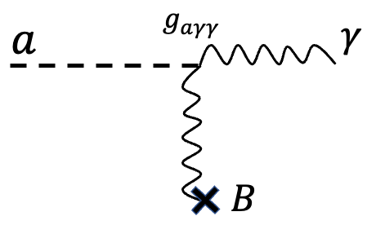
Axion
The ‘Strong CP Problem’ (Peccei & Quinn (1977))
Dark matter (Preskill & Wise (1983), Abbott & Sikivie (1983), Dine & Fischler (1983))
Axion mass:
Axion couplings:
$$m_{a}≈6×{10}^{−6}eV\left(\frac{{10}^{12}GeV}{f_{a}}\right)$$
$$\frac{a}{f_{a}}G_{μν}{\tilde{G}}^{μν}$$
$$\frac{a}{f_{a}}F_{μν}{\tilde{F}}^{μν}$$
$$\frac{1}{f_{a}}∂_{μ}a\overline{ψ}γ^{μ}γ_{5}ψ$$
$$g_{aγγ}aE⋅B$$
(Credit: Sandbox Studio, Chicago, Symmetry Magazine/Fermilab and SLAC)
Notes:
Axion is well-motivated in physics

Slide 4
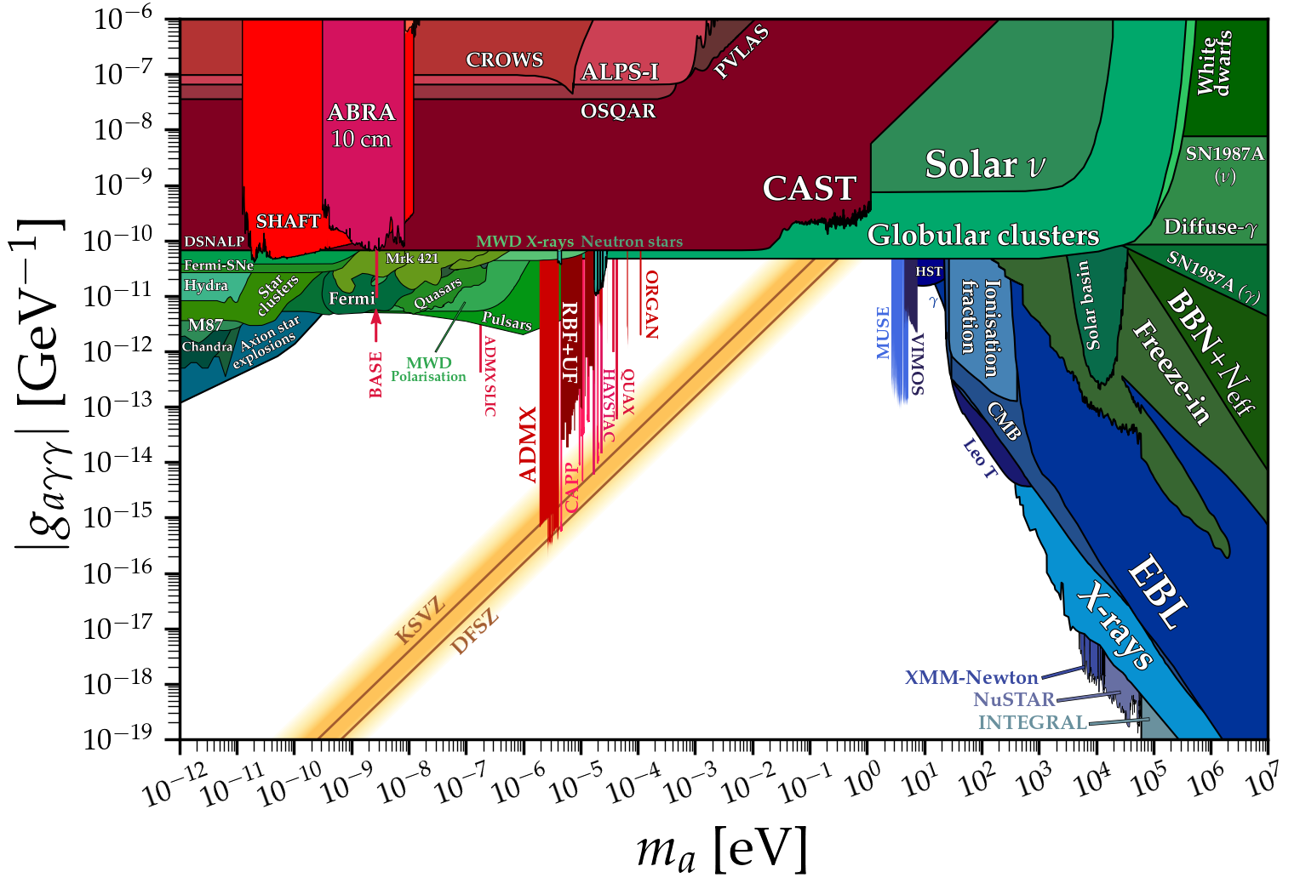
Axion-photon parameter space
https://cajohare.github.io/ AxionLimits/

Slide 5
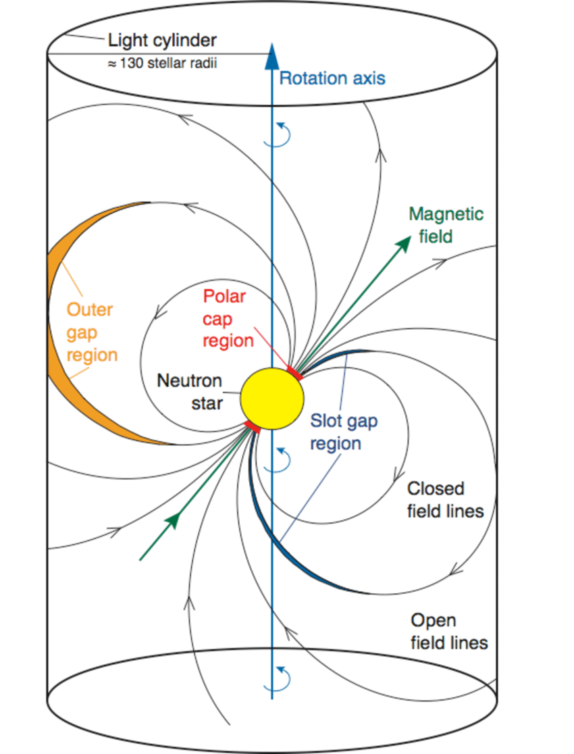
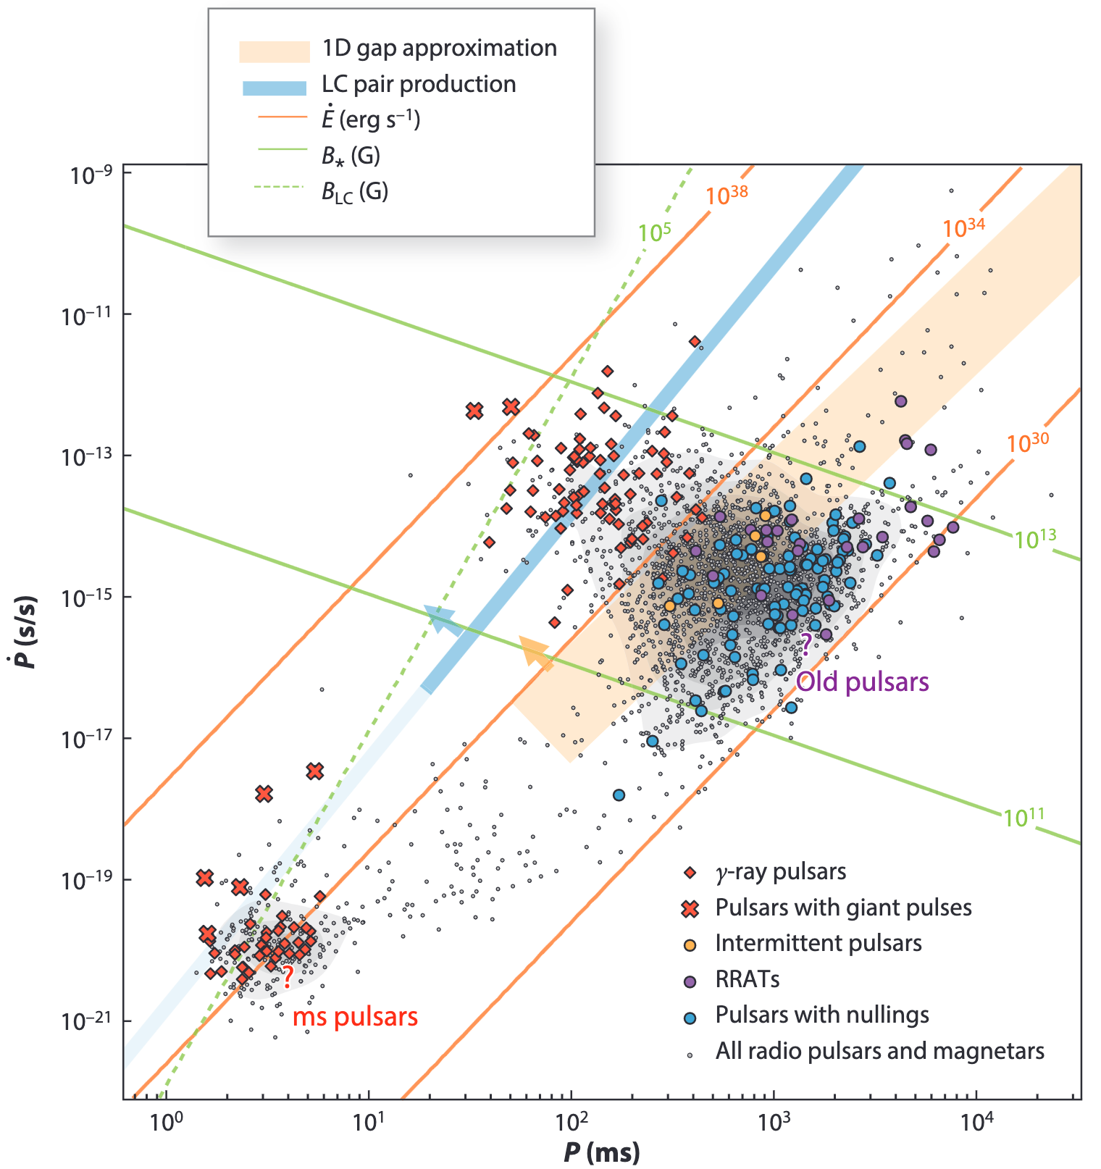
Pulsar
Fast rotating magnetized compact star
$1−2M_{⊙}$ $10km$
Extreme stable rotation
Precision clocks
Extreme laboratories
Dense nuclear matter EoS
Gravity test
Dark matter
…….
Aliu et al. 2008
$$B=3.2×{10}^{19}G \sqrt{P\dot{P}}$$
Philippov & Kramer 2022
Notes:
Show pulsed emission in radio band, some of them are observable in x-ray and gamma-ray
Large moment of inertia and small external torque
All four fundamental forces play a vital role in this system

Slide 6
Why axion + pulsar ?
Make the most of strong astrophysical magnetic field to transfer energy from axion field into photons
Particularly, plasma generates effective mass for photon, allows axion and photon dispersion relations to intersect, thus making the conversion resonant
Strong surface magnetic field (up to ~${10}^{15}G$)
Magnetosphere, plasma frequency $neV−meV$
Narrow spectral line at a frequency determined by axion mass
Ideal environment
Notes:
<5min

Slide 7
Axion electrodynamics
$$−∂_{t}^{2}a+∇^{2}a=m_{a}^{2}a−g_{aγγ}E⋅B$$
$$−∇^{2}E+∇\left(∇⋅E\right)=ω^{2}D+ω^{2}g_{aγγ}aB$$
Magnetoionic
Short planar wave
WKB
Stationary phase approximation
$$−∂_{z}^{2}\left({E_{y} \atop a}\right)= \left(\begin{matrix}\frac{ω^{2}−ω_{p}^{2}}{1−\frac{ω_{p}^{2}}{ω^{2}}\cos^{2}{\tilde{θ}}} & \frac{g_{aγγ}B_{t}ω^{2}}{1−\frac{ω_{p}^{2}}{ω^{2}}\cos^{2}{\tilde{θ}}} \\ \frac{g_{aγγ}B_{t}}{1−\frac{ω_{p}^{2}}{ω^{2}}\cos^{2}{\tilde{θ}}} & ω^{2}−m_{a}^{2}\end{matrix}\right)⋅\left({E_{y} \atop a}\right)$$
$$P_{a→γ}≡\frac{F_{γ}}{F_{a}}≃\frac{1}{ω^{2}}{\left|\frac{E_{y}}{a}\right|}^{2}=\frac{πg_{aγγ}B_{t}^{2}}{2ω_{p}^{′}\left(x_{c}\right)v_{c}}$$
$$ω_{p}=m_{a}$$

Slide 8
Magnetosphere & DM density
Goldreich-Julian (GJ) model (1969)
Static and co-rotating magnetosphere with dipole field
GJ charge number density
Distribution function is conserved along trajectories
Maxwell-Boltzmann distribution
Isotropic
$$n_{GJ}(r)=\frac{2Ω⋅B}{e}\frac{1}{1−Ω^{2}r^{2}\sin^{2}θ}$$
$$F_{obs}=F_{DM}P_{a→γ}$$
$$f(r_{CS},v)=f_{∞}(r_{∞},v_{∞})$$
$$ρ(r)=\frac{2ρ_{∞}^{DM}}{\sqrt{π}}\sqrt{\frac{2GM}{r}}\frac{1}{v_{0}}$$

Slide 9
Polarization
$$I≡⟨E_{1}E_{1}^{∗}⟩+⟨E_{2}E_{2}^{∗}⟩$$
$$Q≡⟨E_{1}E_{1}^{∗}⟩−⟨E_{2}E_{2}^{∗}⟩$$
$$U≡⟨E_{1}E_{2}^{∗}⟩+⟨E_{2}E_{1}^{∗}⟩$$
$$V≡−i(⟨E_{1}E_{2}^{∗}⟩−⟨E_{2}E_{1}^{∗}⟩)$$
Stokes parameters
100% linearly polarized for each photon
Incoherent emission
Degree of linear polarization, position angle
$$I_{i}=ℰ_{1,i}^{2}+ℰ_{2,i}^{2}$$
$$Q_{i}=ℰ_{1,i}^{2}−ℰ_{2,i}^{2}$$
$$U_{i}=2ℰ_{1,i}ℰ_{2,i}$$
$$V_{i}=0$$
$$−∂_{z}^{2}E_{y}=\frac{ω^{2}−ω_{p}^{2}}{1−\frac{ω_{p}^{2}}{ω^{2}}\cos^{2}\tilde{θ}}E_{y}+\frac{g_{aγγ}B_{t}ω^{2}}{1−\frac{ω_{p}^{2}}{ω^{2}}\cos^{2}\tilde{θ}}a$$
Basis
$$y=Ω×k$$
$$x=k×y$$
$$I=Σ_{i}I_{i}$$
$$Q=Σ_{i}Q_{i}$$
$$U=Σ_{i}U_{i}$$
$$V=Σ_{i}V_{i}$$
$$Π=\frac{\sqrt{Q^{2}+U^{2}}}{I}, χ=\frac{1}{2}arctan\frac{U}{Q}$$
Notes:
~8min

Slide 10
Strong directional dependence
$ω_{p}=m_{a}$ + GJ model +DM
$$P_{a→γ}=\frac{πg_{aγγ}^{2}B_{t}^{2}}{2ω_{p}^{′}(x_{c})v_{c}}$$
$$P_{a→γ}=\frac{πg_{aγγ}^{2}B_{t}^{2}}{2ω_{p}^{′}(x_{c})v_{c}}$$
$$ρ_{DM}$$
Notes:
Picture of theoretical model. axion-induced emission can be seen as being generated from a light bulb with a strange shape that resembles a torus in the middle and two spheres on both sides
Surface — where axion conversion take place, color - altitude
Two figure show …

Slide 11
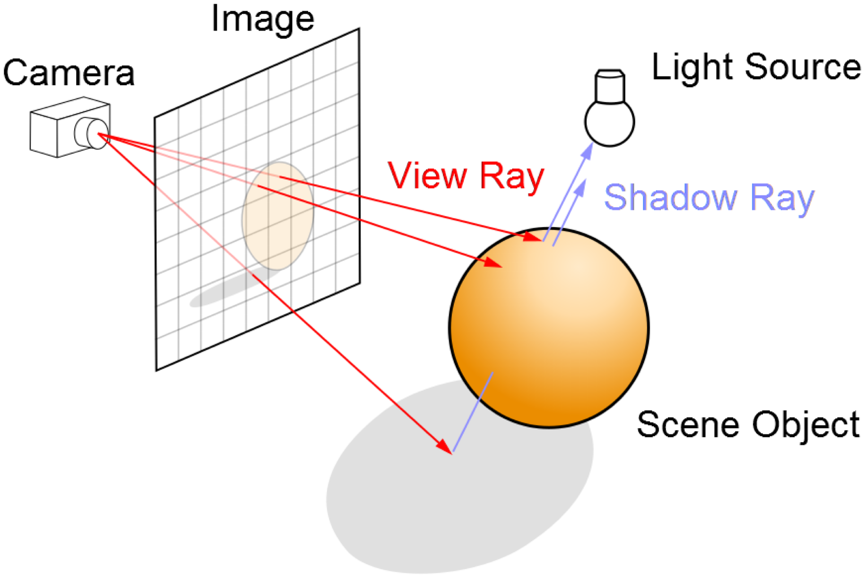
Ray tracing method
Rendering technique to simulate lightning scenes
Tracing the path of light
Procedures:
Grid the image plane
Determine ray path
Trace ray backwards (two models of Geo. Opt.)
Vacuum: straight-line
Plasma: $\frac{d^{2}x^{μ}}{dλ^{2}}+Γ_{νρ}^{μ}\frac{dx^{ν}}{dλ}\frac{dx^{ρ}}{dλ}=−\frac{1}{2}∂^{μ}ω_{p}^{2}$, $\frac{I}{n^{2}ν^{3}}=const$
Sum contributions from all pixels
https://commons.wikimedia.org/wiki/File:Ray_trace_diagram.svg

Slide 12
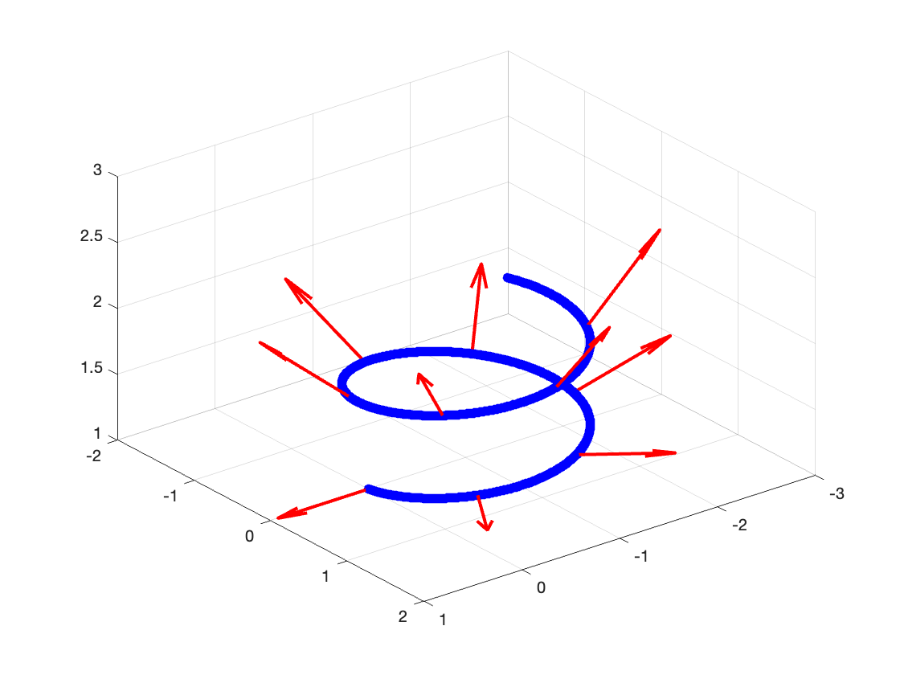
Polarization transport
$\frac{d^{2}x^{μ}}{dλ^{2}}+Γ_{νρ}^{μ}\frac{dx^{ν}}{dλ}\frac{dx^{ρ}}{dλ}=−\frac{1}{2}g^{μν}∂_{ν}ω_{p}^{2}$, $k^{μ}=\frac{dx^{μ}}{dλ}$
$\frac{dk}{dλ}≠0$
Propagation law for unit polarization vector
Derived from Maxwell’s equation
Fermi-Walker transport in three dimension
$\frac{df}{ds}−\left(\frac{dk}{ds}k⋅f−k\frac{dk}{ds}⋅f\right)=0$
Parallel transport with effective line element
$dσ^{2}=n^{2}(dx^{2}+dy^{2}+dz^{2})$
$$y=Ω×k$$
$$x=k×y$$
$$\frac{df}{ds}=−f\left(f⋅\frac{dk}{ds}\right)$$
(Thorne & Blandford (2017)
Notes:
～12min

Slide 13
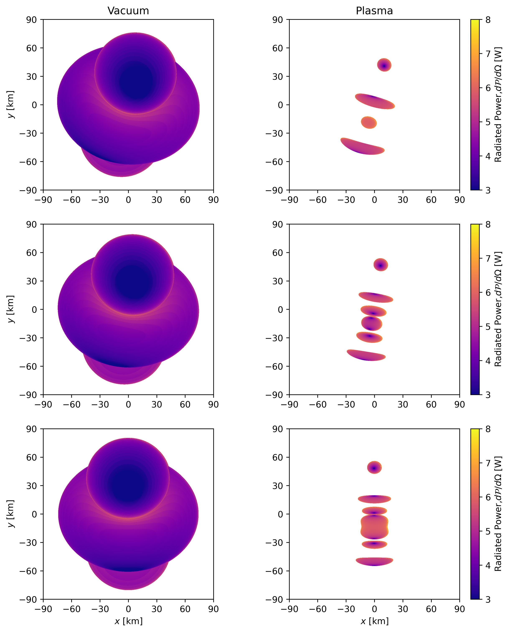
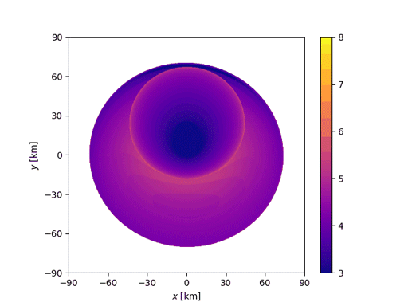
Result - projection image
PSR J0806.4-4123
Higher emission in slit
Split
Brighter
Notes:
This is where plasma lensing comes to work, that more focused light is brighter

Slide 14
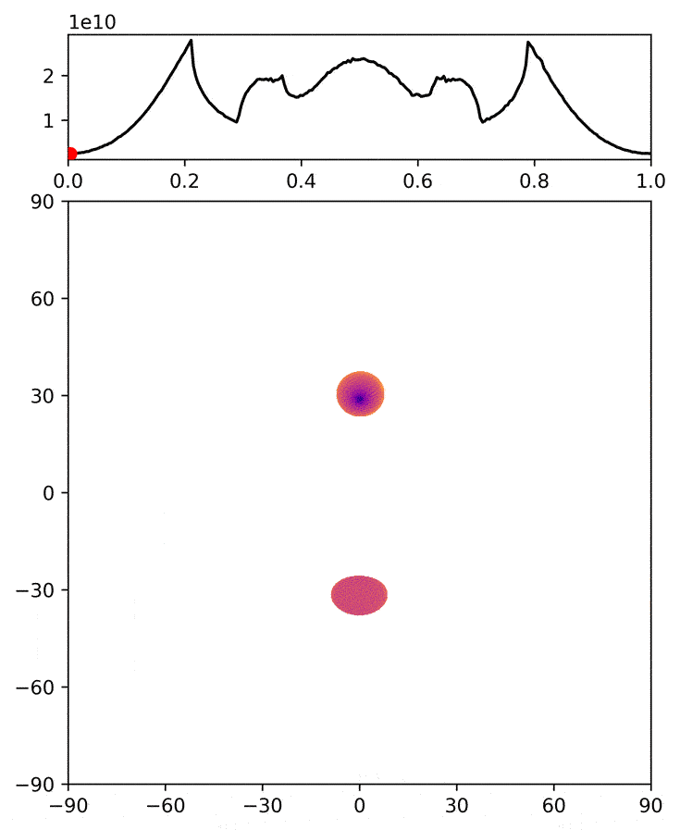
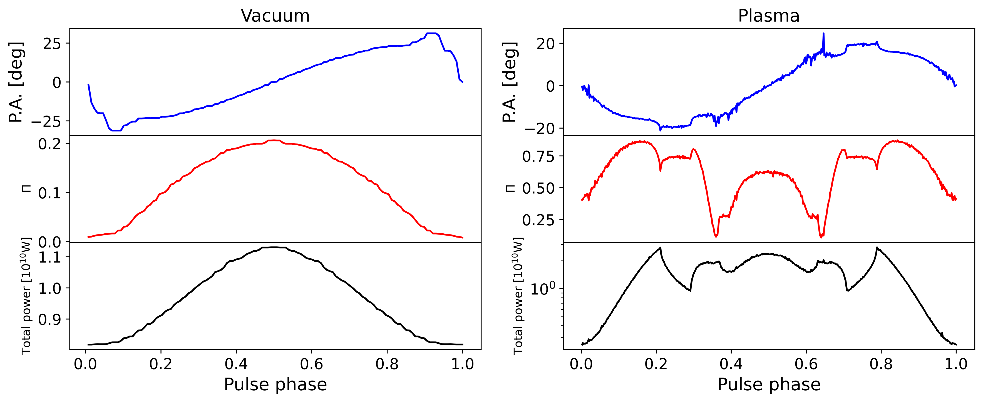
Result - viewing angle 36
Total power ~
Complicated emission pulse profile
Higher degree of polarization
Larger variance

Slide 15
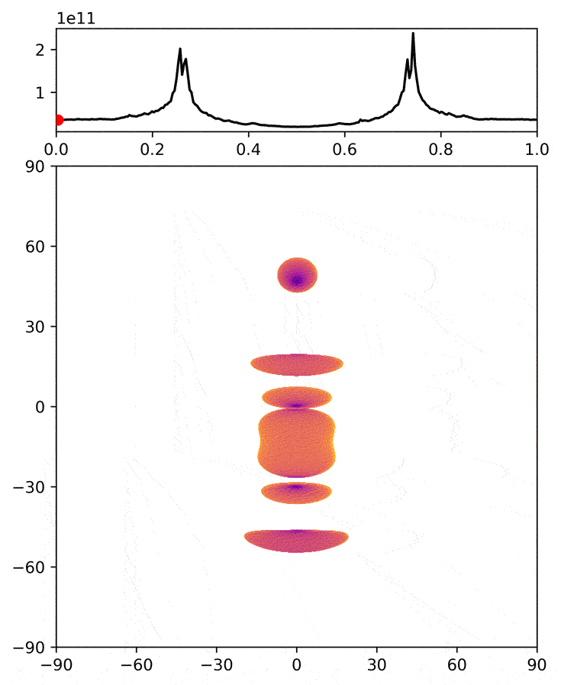
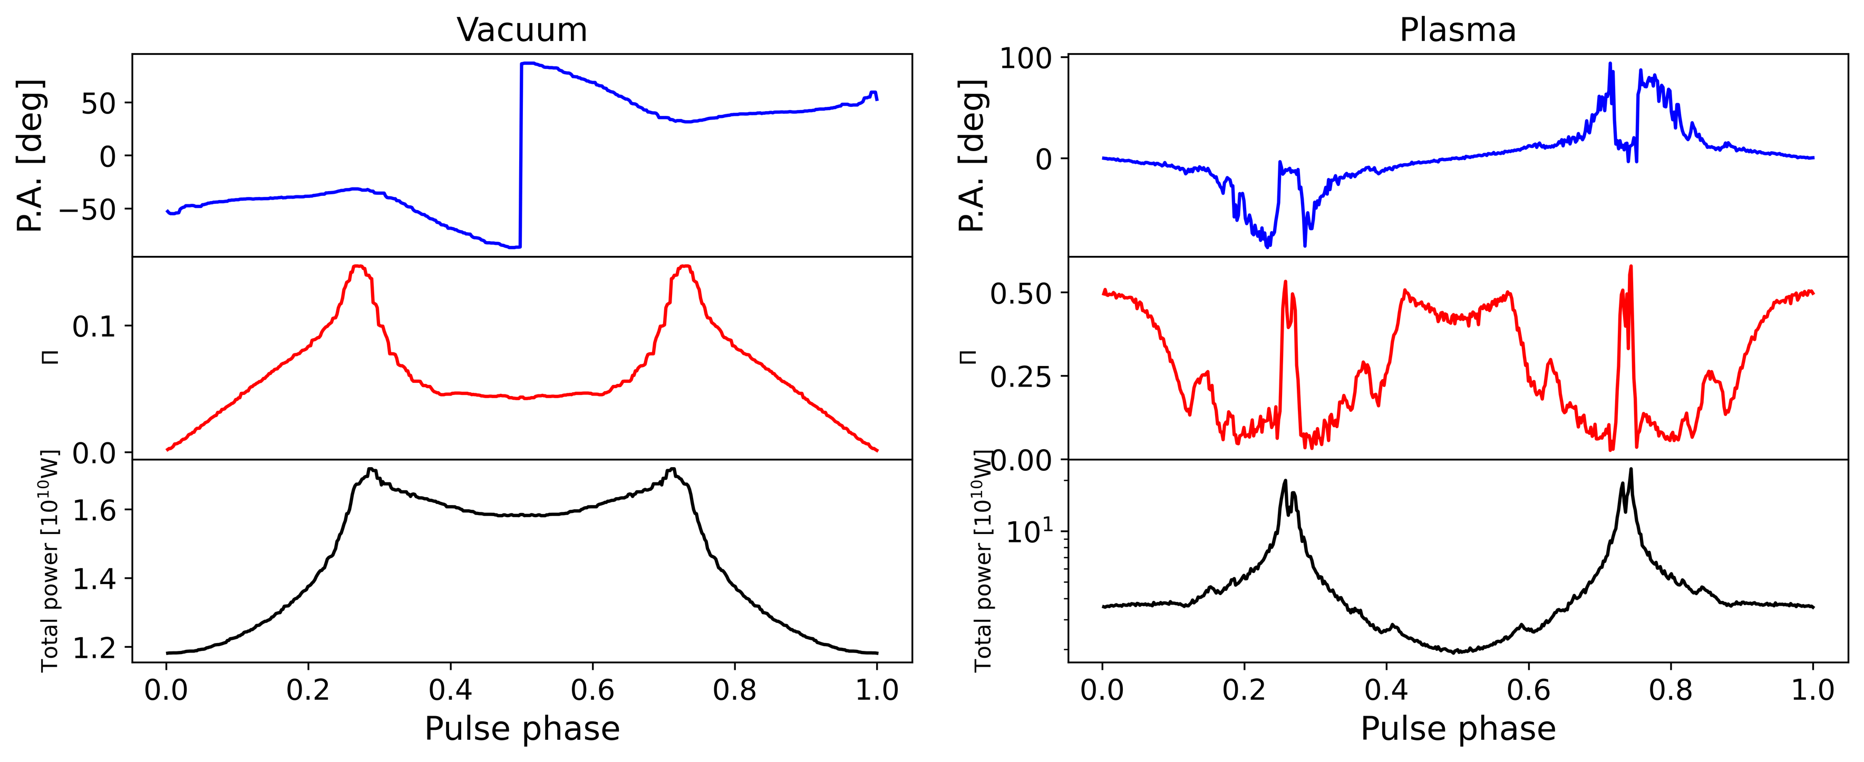
Result - viewing angle 54
Total power increases (lower conversion region(NCS))
Higher degree of polarization
$$0−0.15→0−0.5$$

Slide 16
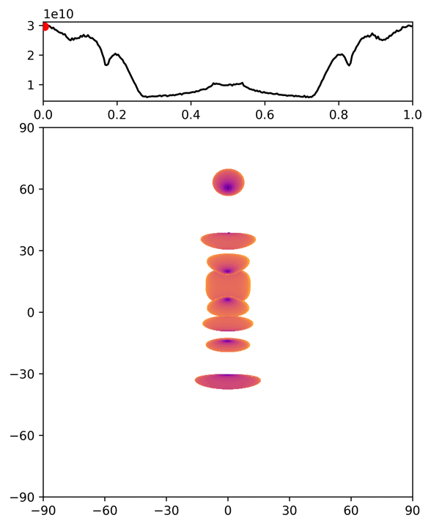
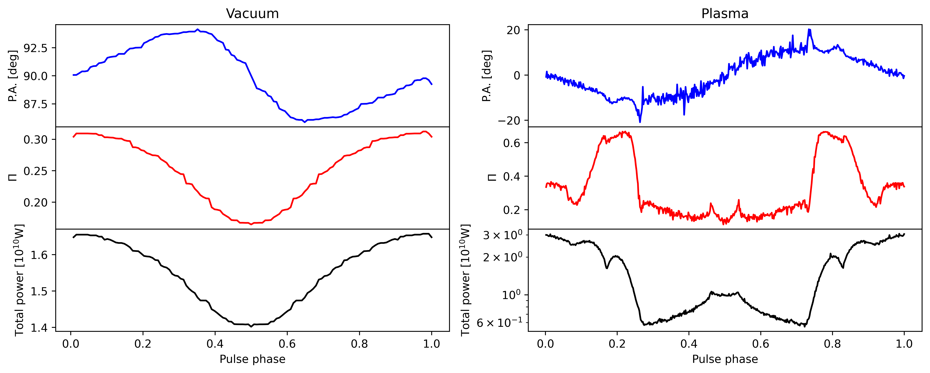
Result - viewing angle 72
Higher degree of polarization
$$0.3→0.7$$

Slide 17
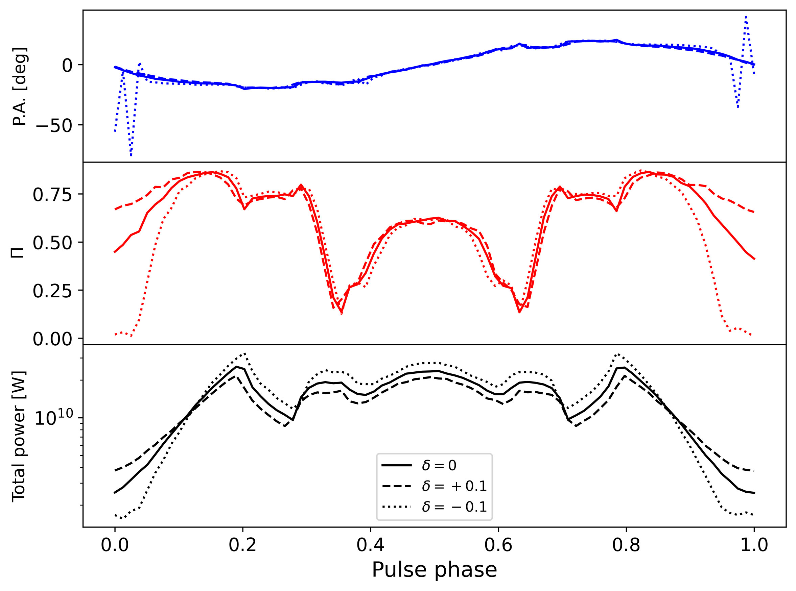
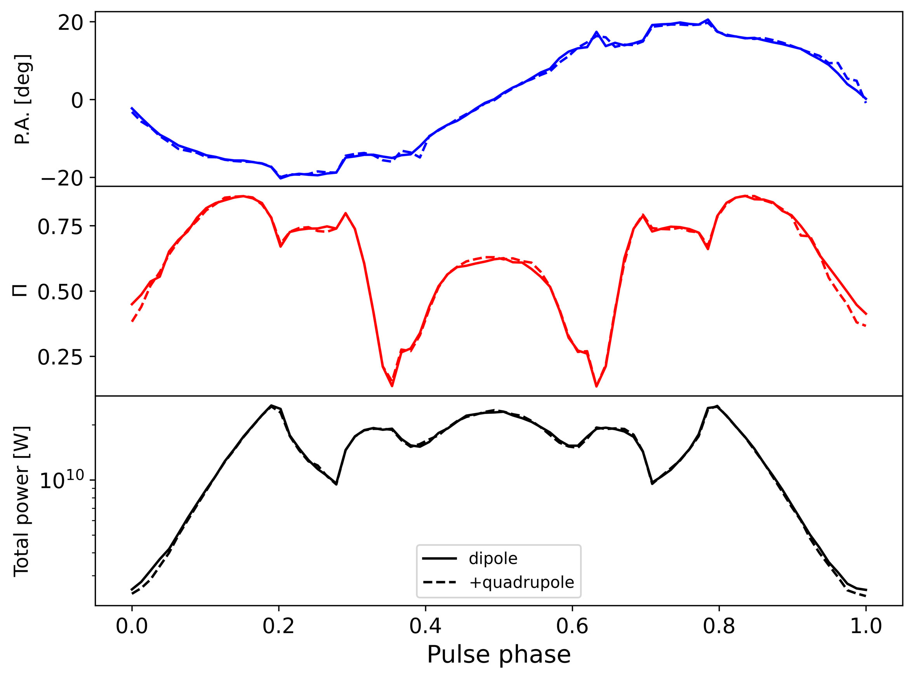
Convergence checks
Integral
Perturbation to magnetic field

Slide 18
Discussion and Conclusion
Calculating axion-induced emission
polarization
propagation effects
Non-trivial polarization structures
help to identify from pulsar emission narrow band signal distinct polarization feature linear polarization dominate
Thanks

