Slide 1
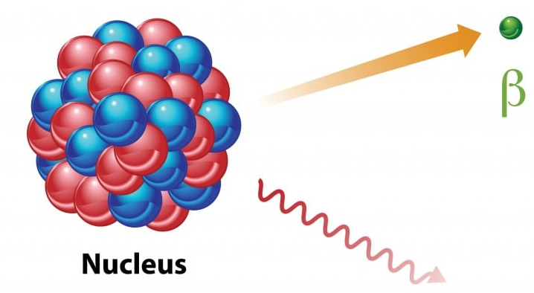

Nuclear decay anomalies as a signature of axion dark matter
$$γ$$
Xin Zhang, National Astronomical Observatories, Chinese Academy of Sciences,
Based on 2303.09865,
In collaboration with Nick Houston (Beijing University of Technology) and Tianjun Li (ITP-CAS)
Axion 2023, July 2023 , zhangxin@nao.cas.cn

Slide 2
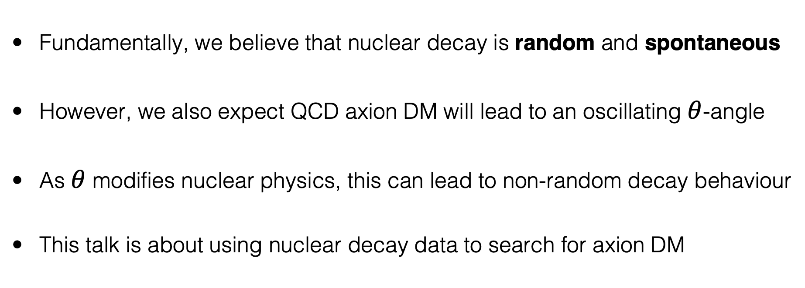
The big picture
Fundamentally, we believe that nuclear decay is random and spontaneous
However, we also expect QCD axion DM will lead to an oscillating $θ$-angle
As $θ$ modifies nuclear physics, this can lead to non-random decay behaviour
This talk is about using nuclear decay data to search for axion DM
Motivation
New experimental strategies for axion DM detection
Explanation of existing nuclear decay anomalies?
Notes:
Spontaneous: independent of external influence
There are certain exceptions (electron capture (e.g. in Be7), quantum (anti)zeno effect, Purcell effect)
Overview: we’re going to introduce 1) the decay formalism, 2) ) a concrete example using 12 years of tritium decay data, and show the

Slide 3
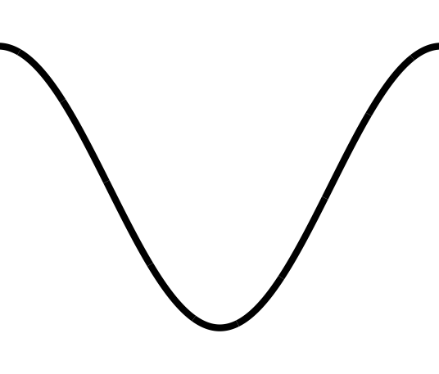
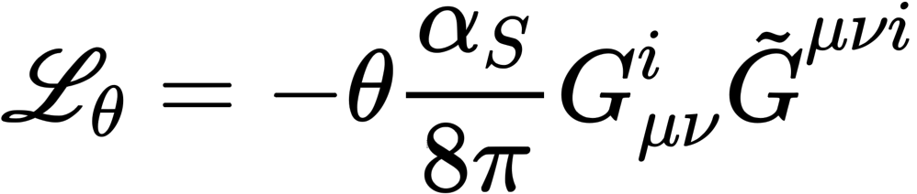
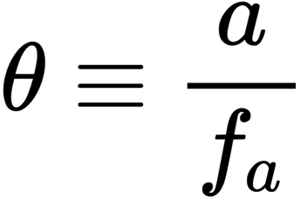
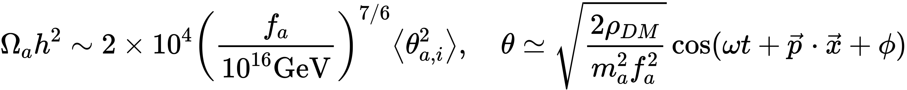
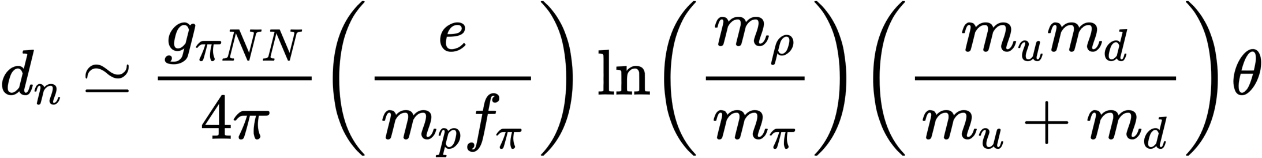



The misalignment mechanism
For QCD axions with initial condition $θ_{a,i}$ we typically have
Many aspects of nuclear physics depend on $θ$, for example:
$$V(θ)$$
$$θ$$
Notes:
This is the theoretical background we required. The misalignment mechanism led to an oscillation theta angel, and we know may aspect
for example, the neutron electric dipole moment or in chir-perturbation theory the neutron proton Mass difference to lowest order in Theta squared looks something like this.

Slide 4
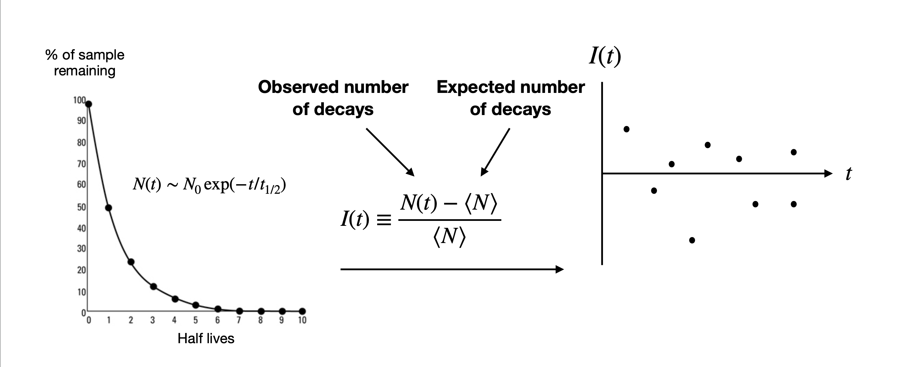

The misalignment mechanism
With $θ∼cos(ωt)$, nuclear decay rates will also oscillate
Notes:
So, this figure on the left here this the standard picture that we expect for exponential decay. It’s a little bit difficult to see from this uh figure if you have evidence of let’s say oscillatory Behavior. So, what one dose is we are our kind of object of interest is the fractional change in the rate right so we have n is the number of decays that you observe in a certain time window and this n is the expected number of the keys that you would have based on the usual exponential decay law.

Slide 5
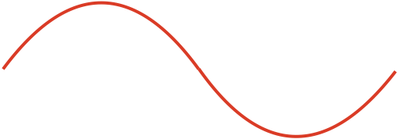

The misalignment mechanism
With $θ∼cos(ωt)$, nuclear decay rates will also oscillate
Is there any evidence for this phenomenon?
A signature we can use
to search for axion DM
Notes:
So, what you then find is that so this quantity I of T you expect that for some you know some the time because nuclear Decay presumably is a random process you have some decays which occur earlier than expected and you’ll some have some decay that occur later than expected (there is no preference either way)so you expect that your data points should be randomly distributed around about zero. This is the standard picture.
But then what we can do is we can look for periodic oscillation in this I(t) because the idea is when let’s say Theta is larger than the binding energy will be uh let me we can go back to here yeah we can see that when Theta is larger there is a you know the lifetime is shorter and when theta is relatively smaller the lifetime is longer.
So that’s the underlying concept that we’re talking about here.

Slide 6
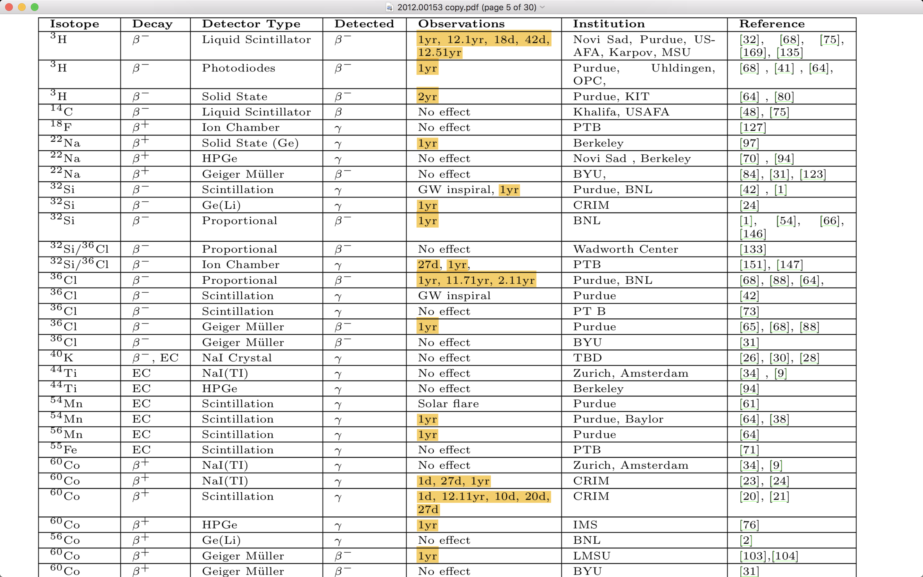
“Anomalies in Radioactive Decay Rates: A Bibliography of Measurements and Theory”, arxiv: 2012.00153
Notes:
Well, it has been claimed in recent years that nuclear decay data has exhibited non-random effects.
this is a bibliography showing a number of nuclear decay anomalies have been reported in the literature. The highlight part is the period of the claimed periodic anomaly effect.

Slide 7
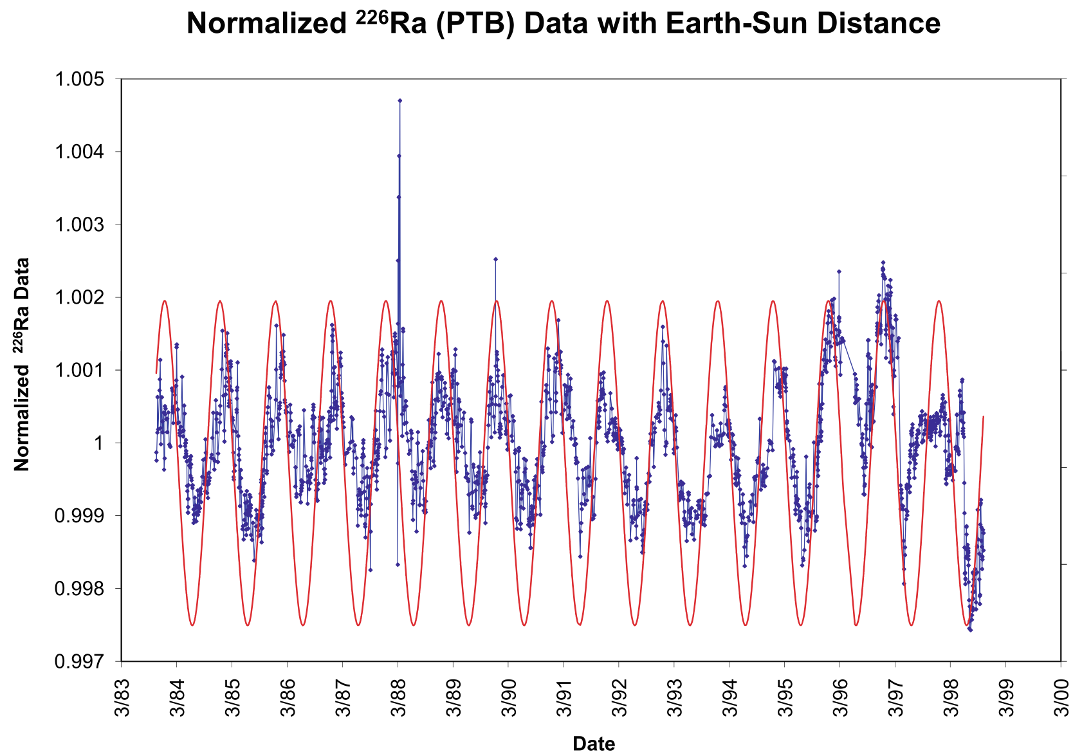
A typical example: Radium-226
“Time-dependent nuclear decay parameters: New evidence for new forces?”, Space Sci.Rev. 145 (2009) 285-335
“Anomalies in Radioactive Decay Rates: A Bibliography of Measurements and Theory”, arxiv: 2012.00153
Notes:
This is a example of radium-226. The period of the claimed periodic effect the claimed anomaly is one year.
Why should we question the randomness of nuclear decay?
Are these nuclear decay anomalies real, or are these statistics lying to us?
For example, it has been claimed that nuclear decay rates vary with distance to the sun, or have some correlation with astrophysical events like solar flares, or gravitational wave events
How seriously should we take these reports?
Radium

Slide 8
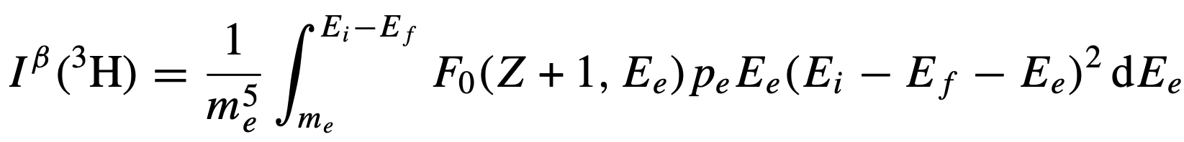
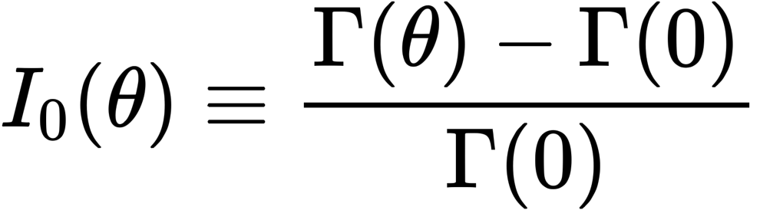

Tritium decay
For simple nuclei, $θ$-dependence is calculable, let’s consider tritium decay:
Where does $θ$-dependence primarily enter?
The underlying quantity of interest is the fractional change in the beta decay rate:
Notes:
Our underlying quantity of interest is the fractional change in the beta decay rate Γ(θ) as a function of θ,
θ-dependence enter the the fractional change by add a small energy shift between initial and final Nuclide state and modifications of the phase space integral.

Slide 9
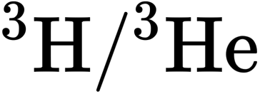
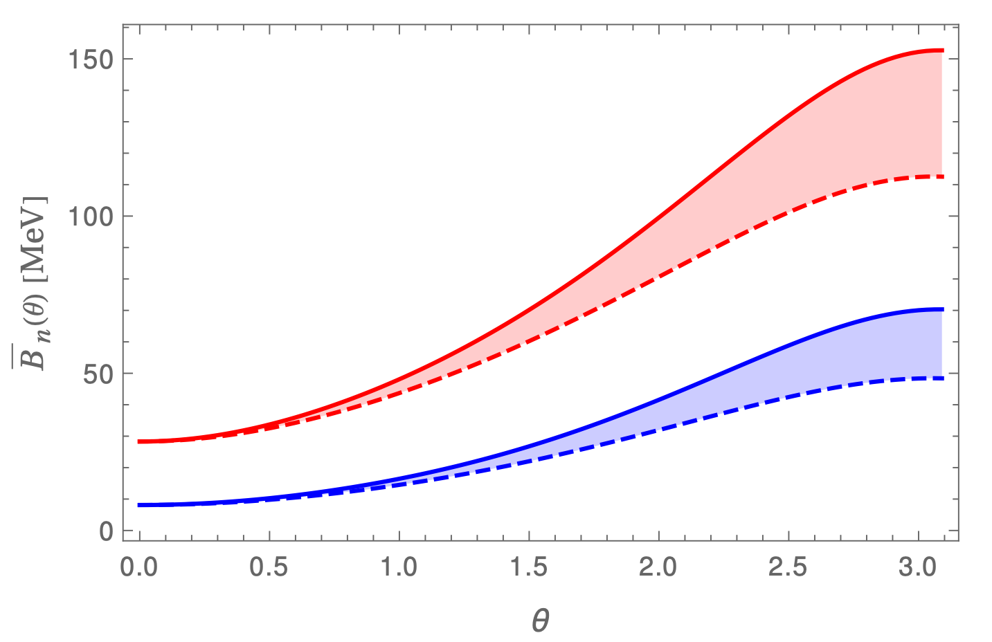
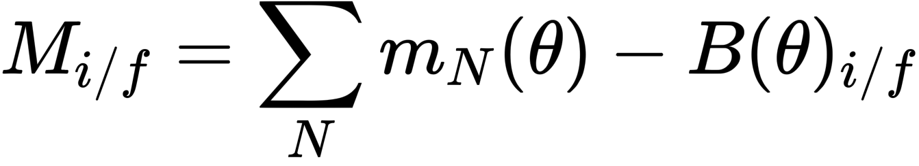
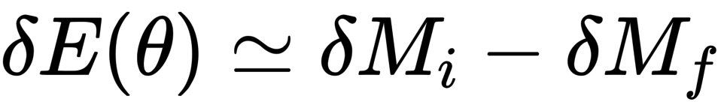
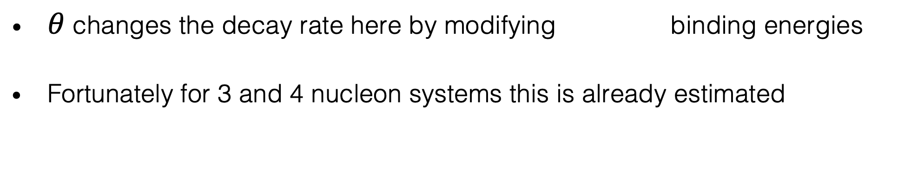
$θ$ changes the decay rate here by modifying binding energies
Fortunately for 3 and 4 nucleon systems this is already estimated
Binding
energy
$θ$-dependence of light nuclei and nucleosynthesis, 2006.12321
Knowing the θ-dependence of the binding energy, we can then calculate the energy shift:
Notes:
This is because the $θ$ angle changes the decay rate by modifying ...

Slide 10
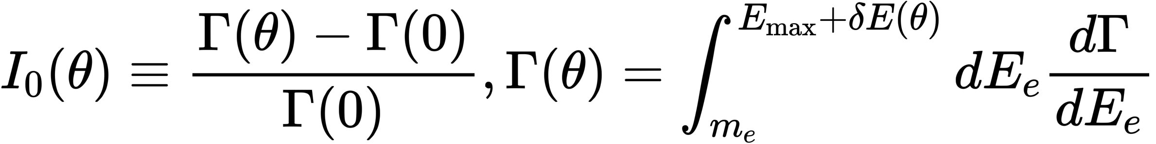
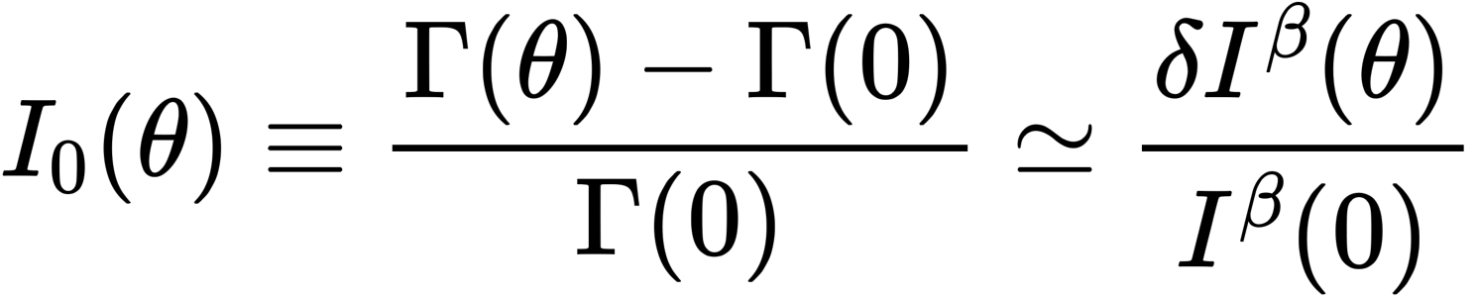
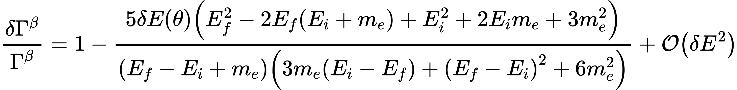
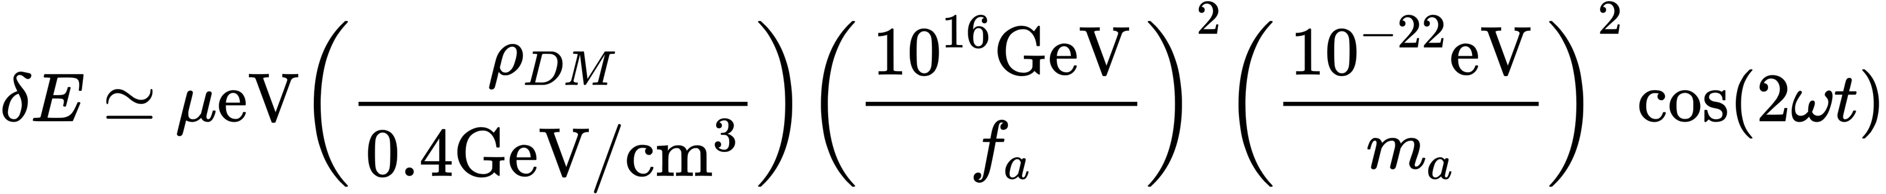
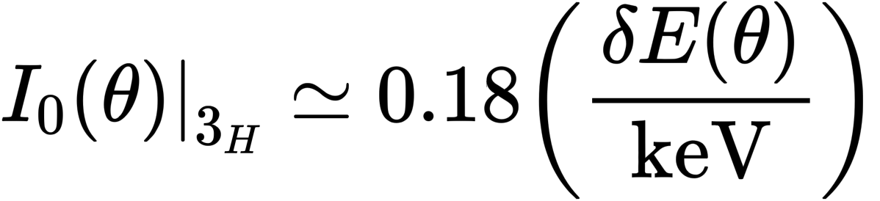

Tritium decay
Add a perturbation $δE(θ)$ to $E_{i}−E_{f}$ :
From the previous slide, we know how $δE$ depends on $θ$, and so
So, now all we need is some tritium data…
(Using Primakoff-Rosen approximation for $F_{0}$ )
Notes:
Next, we add this energy shift as a perturbation to the phase space integral and calculate the fractal change of the decay rate. The final result oscillates about zero, as expected, leading to alternating excesses and deficits in the number of nuclear decays per unit time.

Slide 11
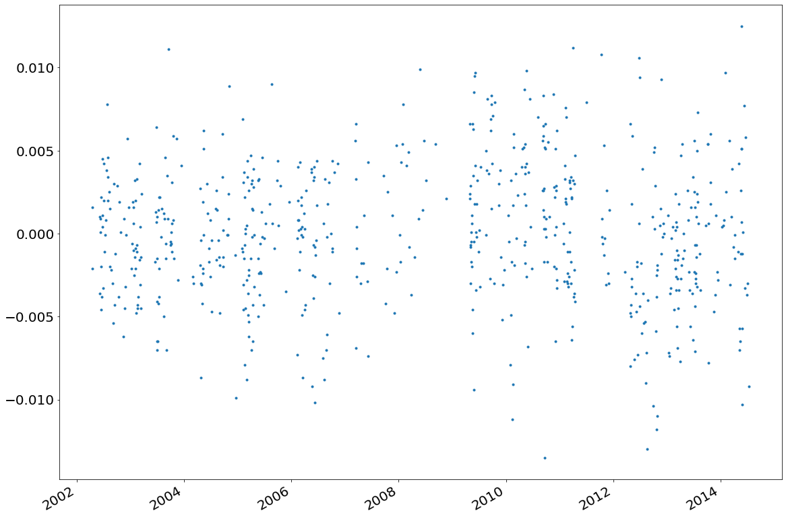
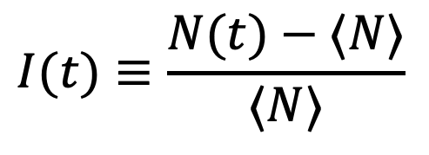
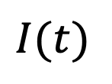
Tritium decay data
$$I(t)$$
Date
$$I(t)≡\frac{N(t)−⟨N⟩}{⟨N⟩}$$
Data is from the European Union’s Joint Research Centre,
at the Directorate for Nuclear Safety and Security in Belgium
Notes:
This is the time-series data from European Commission’s Joint Research Centre(JRC), showing the fractional change in the Tritium beta decay rate
The data arespans approximately 12 years of liquid scintillation counter observations of the decay of an O(microcurie) Tritium source.
It’s difficult to see evidence of any pattern here, so let’s change to Fourier space

Slide 12
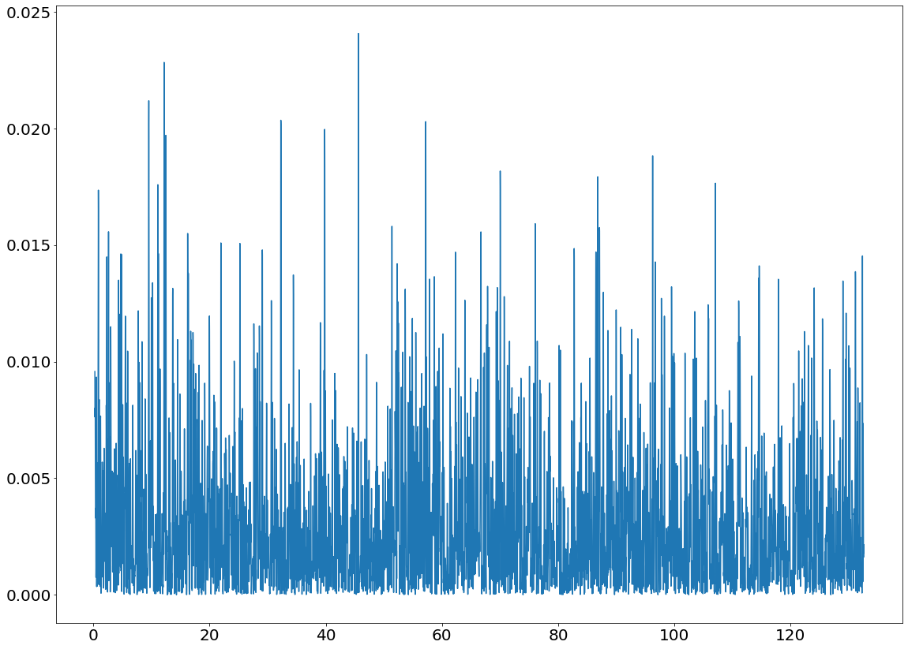
Lomb-Scargle periodogram
Least Squares Spectral Analysis (LSSA) method
Let’s convert the data into frequency space:
Power
Frequency (1/year)
Is there evidence of periodic effects here?
Notes:
Data analysis 1
Because the data are unevenly spaced in time, we need to use a tool called a Lomb-Scargle periodogram to convert the data to frequency space
This is essentially a type of Fourier transform, so it gives us the power at each frequency
With this in hand, we can search for any periodic signals.

Slide 13
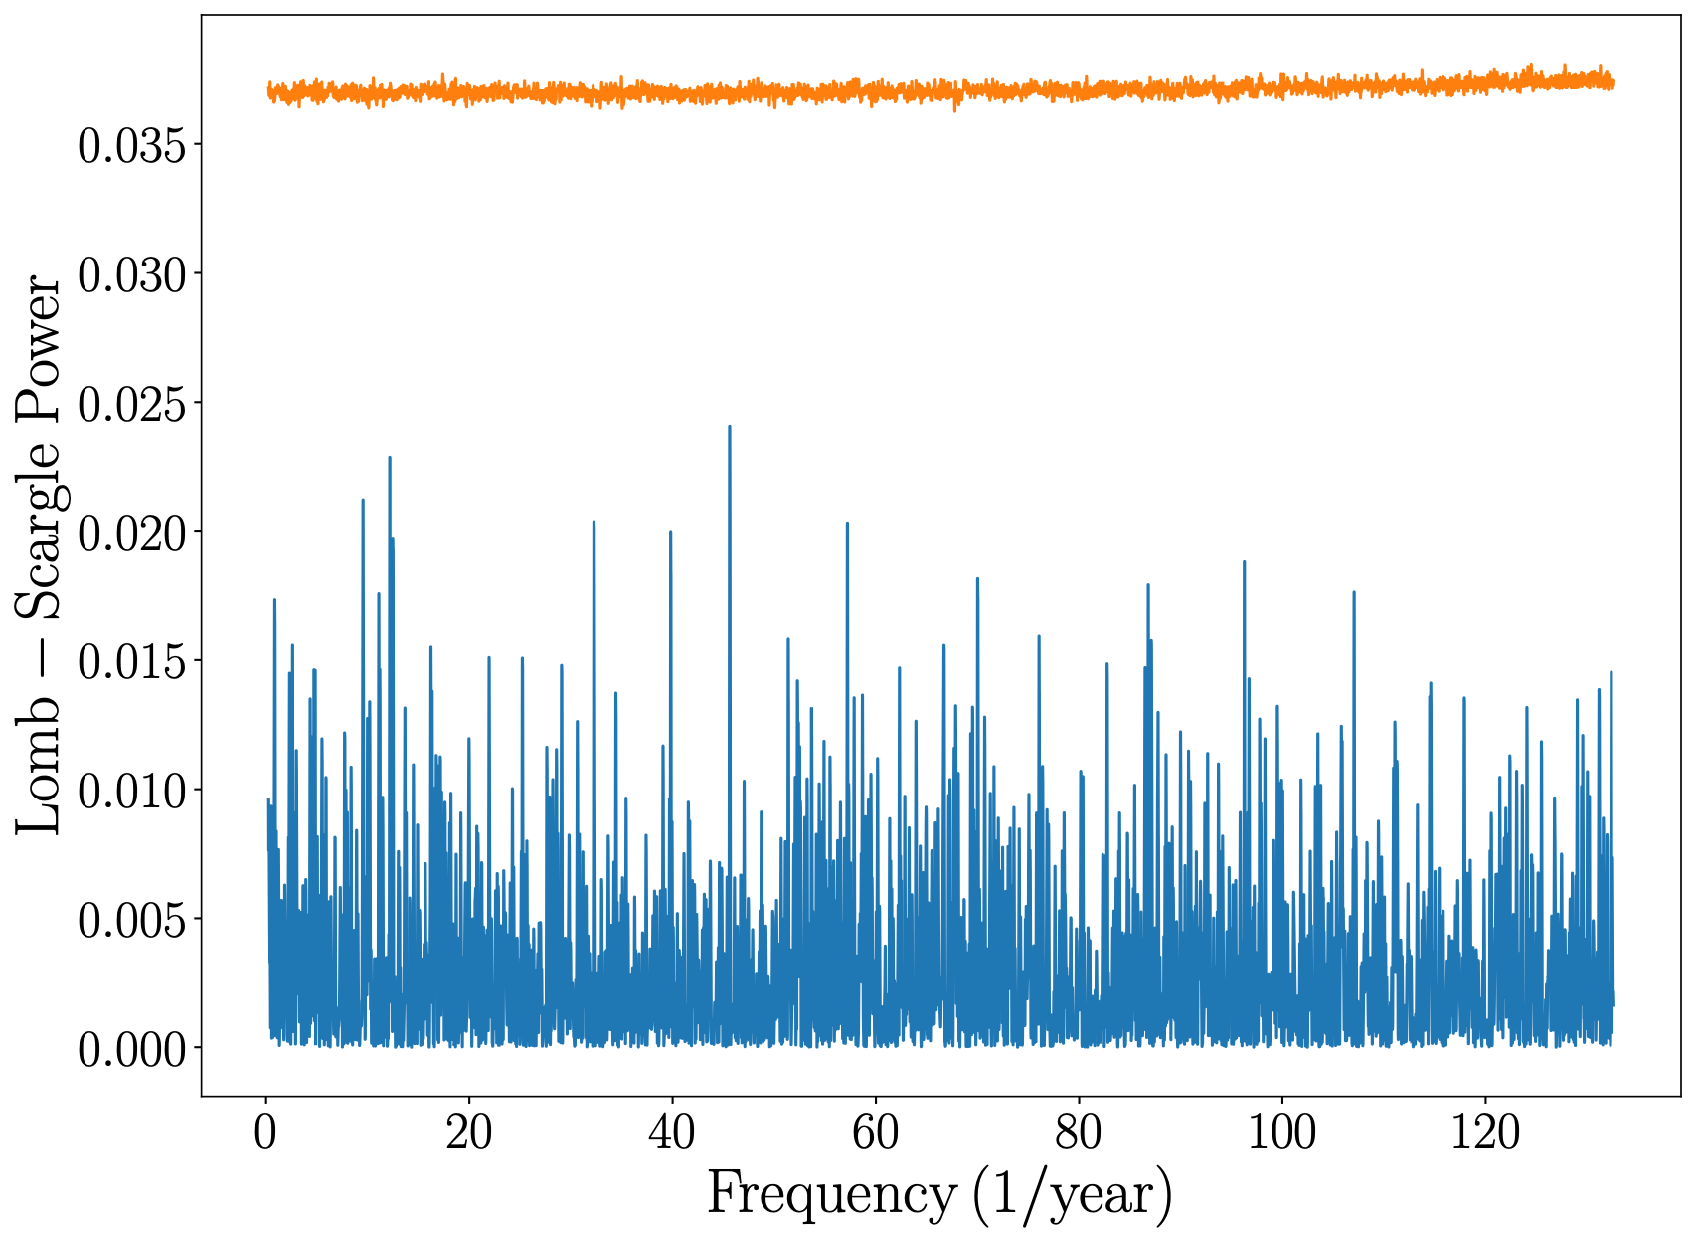

From Monte Carlo simulations:
Original data,
Monte Carlo limit
We can see that the real data points (blue) are all below the 95 % CL limit (orange), and hence well-modelled by random noise
No evidence of non-random behaviour
Notes:
From these CDFs we then determine the false positive (or false alarm) power at 95% confidence level for each frequency, as shown this fig in orange curves.
We can see that nowhere does the original dataset exceed the 95 % confidence level threshold, indicating the data are compatible with the null hypothesis.
Data analysis 4
Repeating this step at each frequency, we derive the orange power limit
We can then see compare the original data (blue) to the (orange)
Therefore they original data are well modelled by the null hypothesis - no evidence of periodic variation!

Slide 14
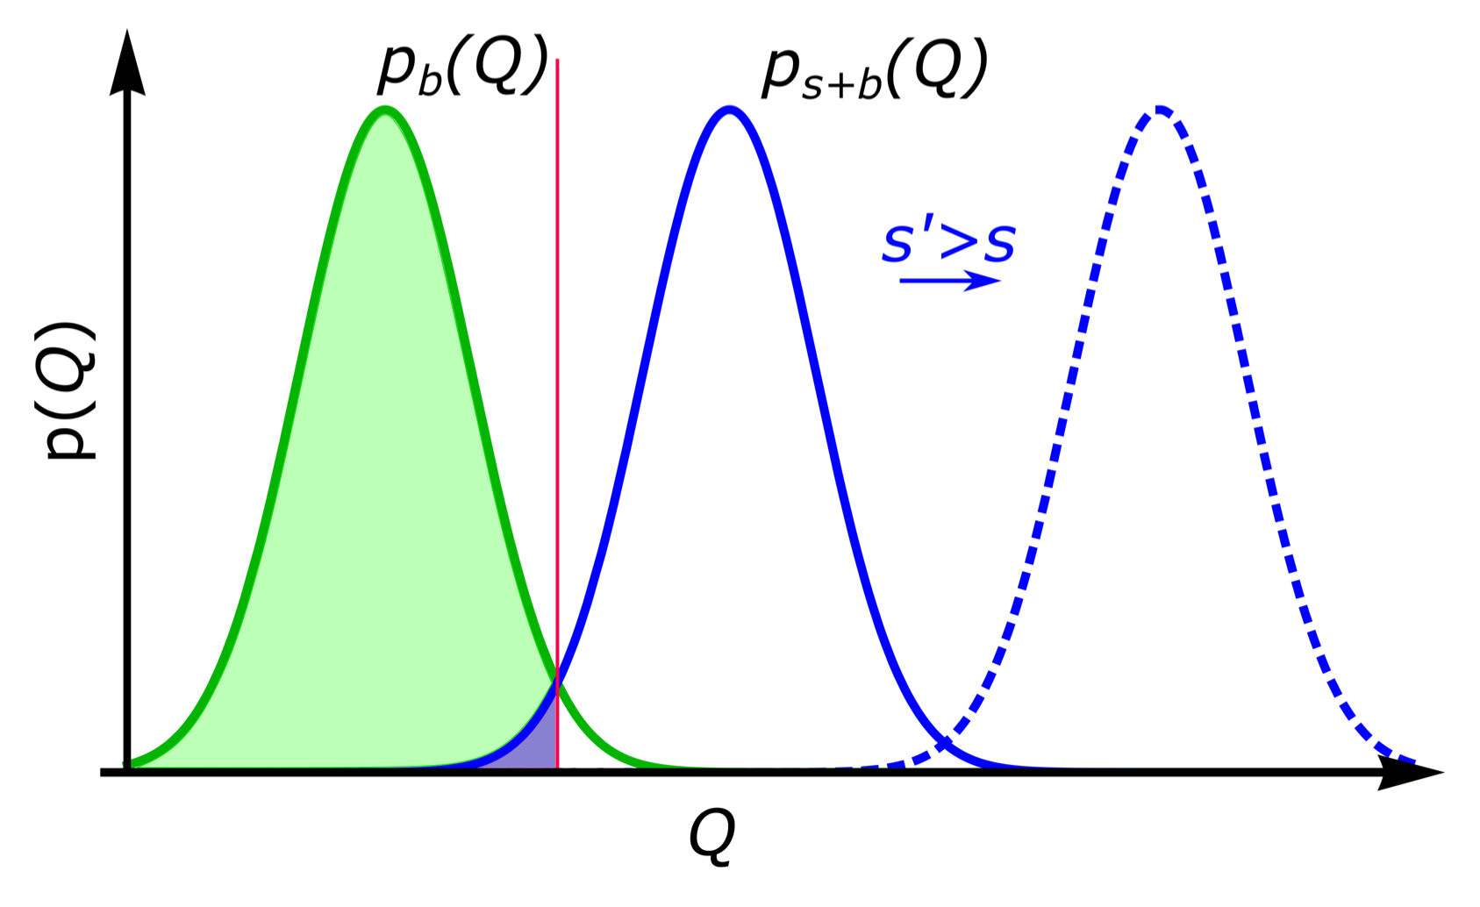
(Figure via 1905.13650)
Repeating this with an injected axion signal:
t
t
t
t
Background only PDF
compatible with data
Background + Signal PDF
excluded by data
Background + Signal PDF
threshold
Varying the axion coupling allows us to find the threshold values
Notes:
To determine the corresponding limit on the axion parameters. We follow a standard frequentist approach.
At each trial frequency we construct another several ten thousands datasets containing Gaussian background and injected axion-derived signals and calculate their periodograms and construst the CDF.
The threshold value of fa is then determined by the condition that the false positive threshold from the background-only CDF coincides with the false negative threshold from the background plus signal CDF, at the desired 95% confidence level.

Slide 15
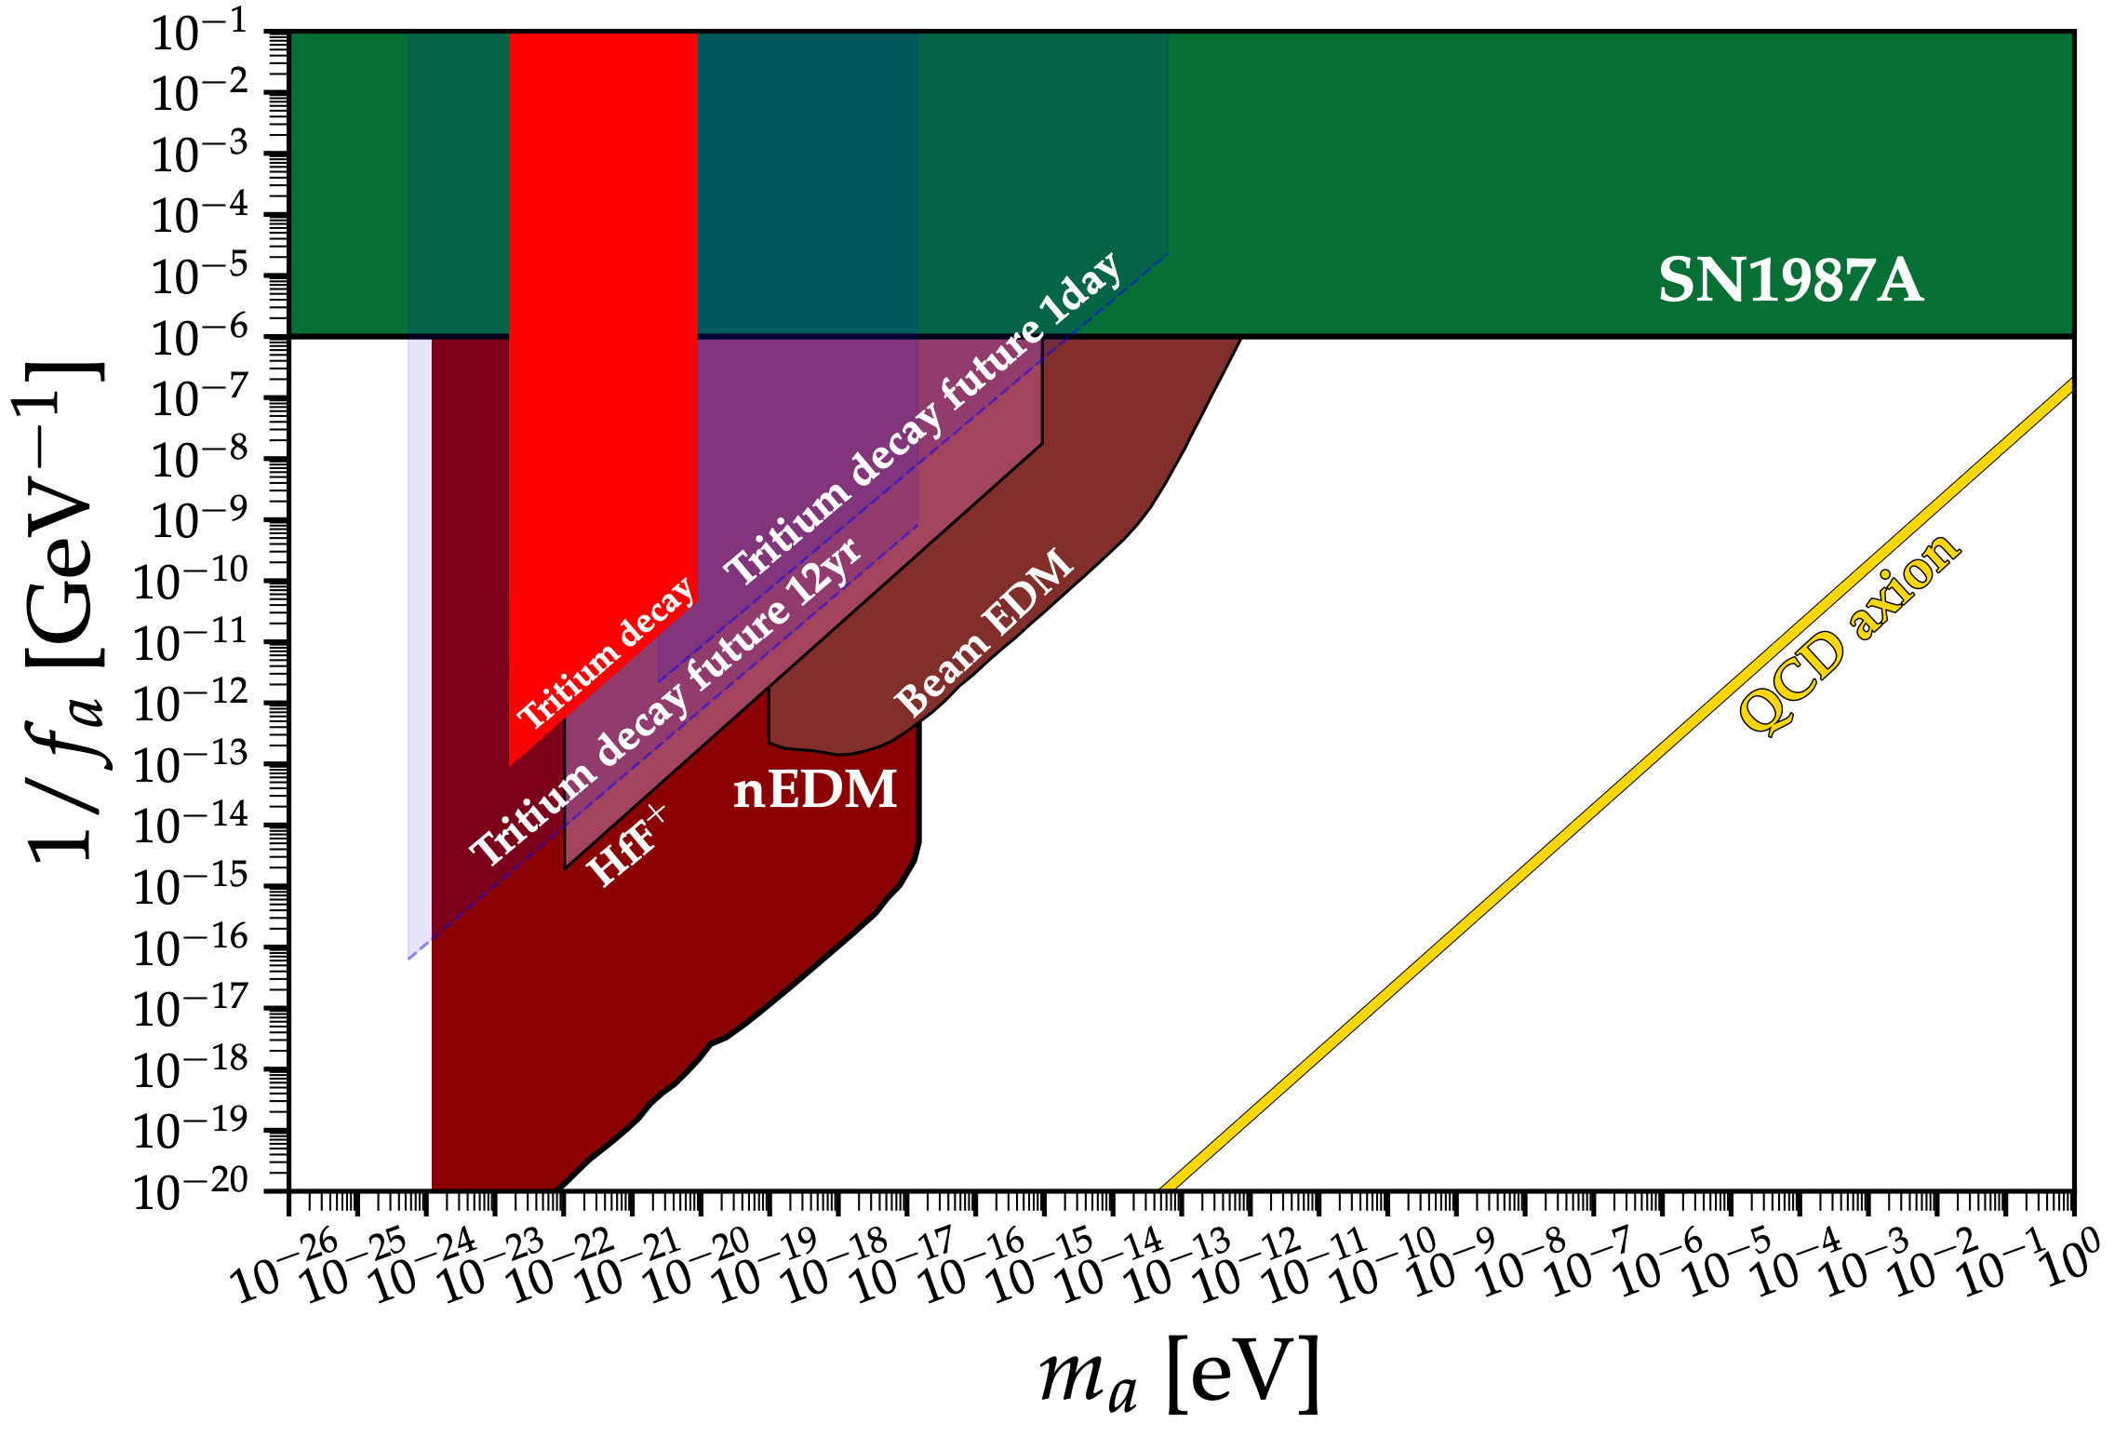
Resulting constraint
(Using the AxionLimits code)
Notes:
We exclude fa below 9.4 × 1012 − 1.8 × 1010 GeV (95 % confidence level) for masses in the 1.7×10−23 −8.7×10−21 eV range.
We also simulate future experimental possibilities, via two fiducial cases.
The first is a longterm experiment designed to search lower frequencies, with 1 measurement per hour over 12 years. The second is a short-term experiment to search higher frequencies, with approximately 1 measurement per second over 1 day. Both schemes increase the initial quantity of tritium by a factor of 100 relative to the JRC dataset, up to a presumed limit imposed by detector pileup.

Slide 16
Resulting constraint
More
observation
time
Shorter time
between observations
More tritium,
more data points,
other radioisotopes,
improved detection setup
(Using the AxionLimits code)

Slide 17
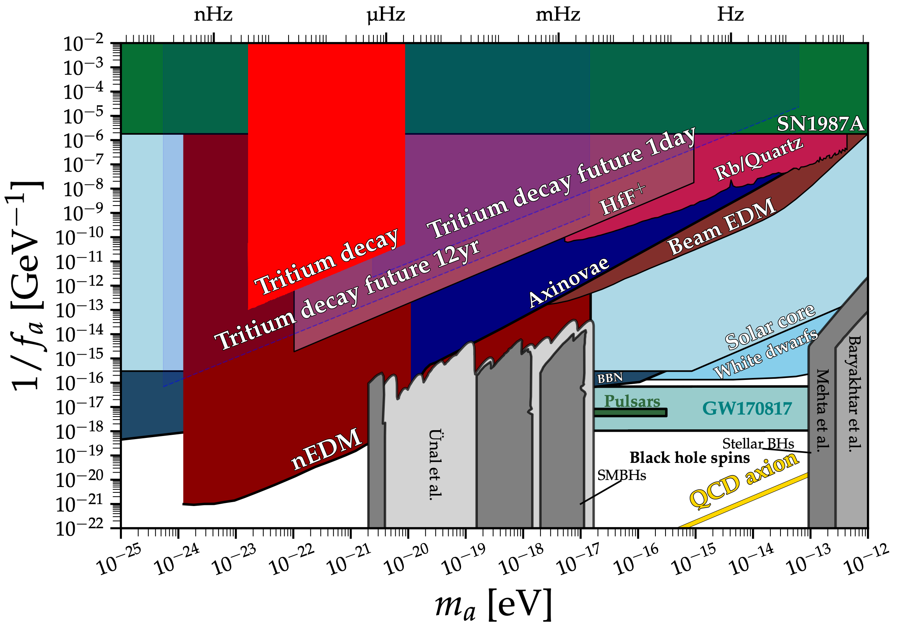
Resulting constraint
More
observation
time
Shorter time
between observations
More tritium,
more data points,
other radioisotopes,
improved detection setup
“An even lighter QCD axion”
1802.10093
2102.00012
(Using the AxionLimits code)
Notes:
The constraints we find at present are not world-leading, we still judge the overall result to be of interest to the community. Our results nonetheless do provide a new laboratory-based independent scheme to searching the QCD axion dark matter, which is complementary to such constraints, doesn't rely on astrophysical and cosmological assumptions and modelling, and doesn’t require the sophisticated experimental methodologies required by other approaches.

Slide 18
Discussion and conclusions
We have explored a new experimental signature for axion DM
In 12 years of tritium decay data we find no evidence of this phenomenon
We used the data to place constraints on axion DM
Is nuclear decay random and spontaneous? Yes, probably…
More details in 2303.09865
Thanks for listening!

Slide 19
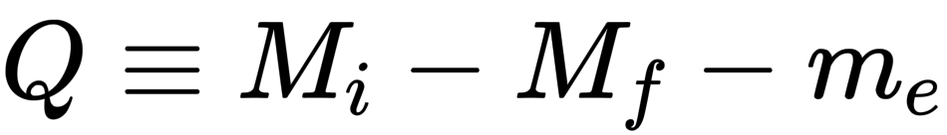
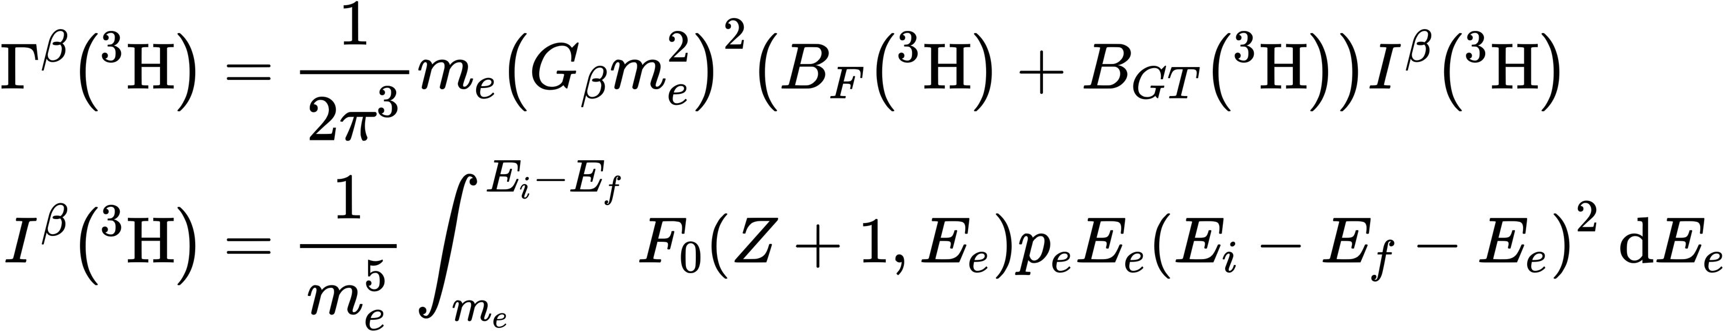
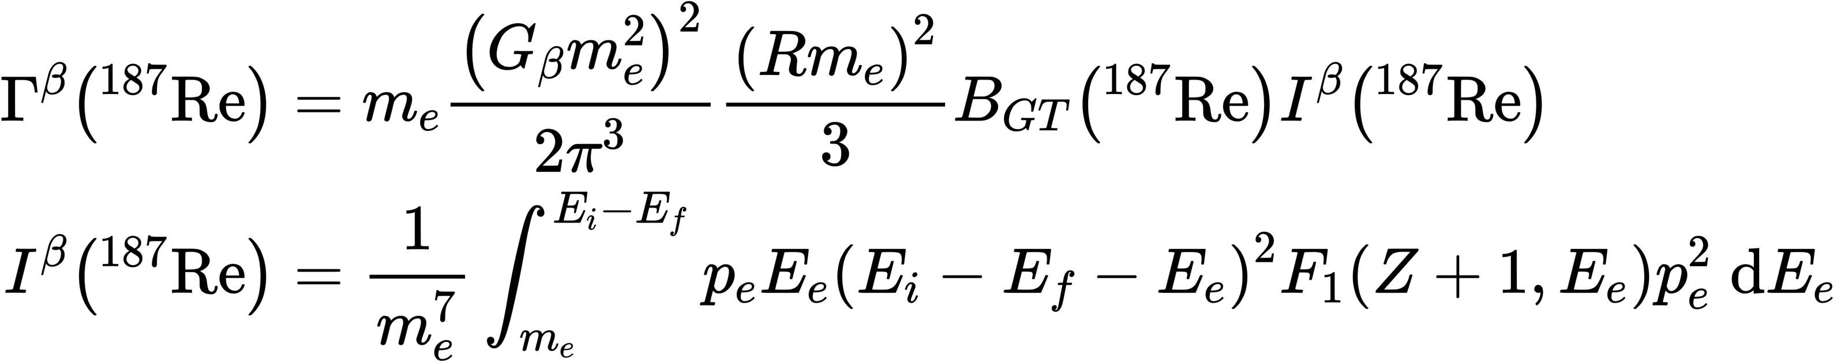
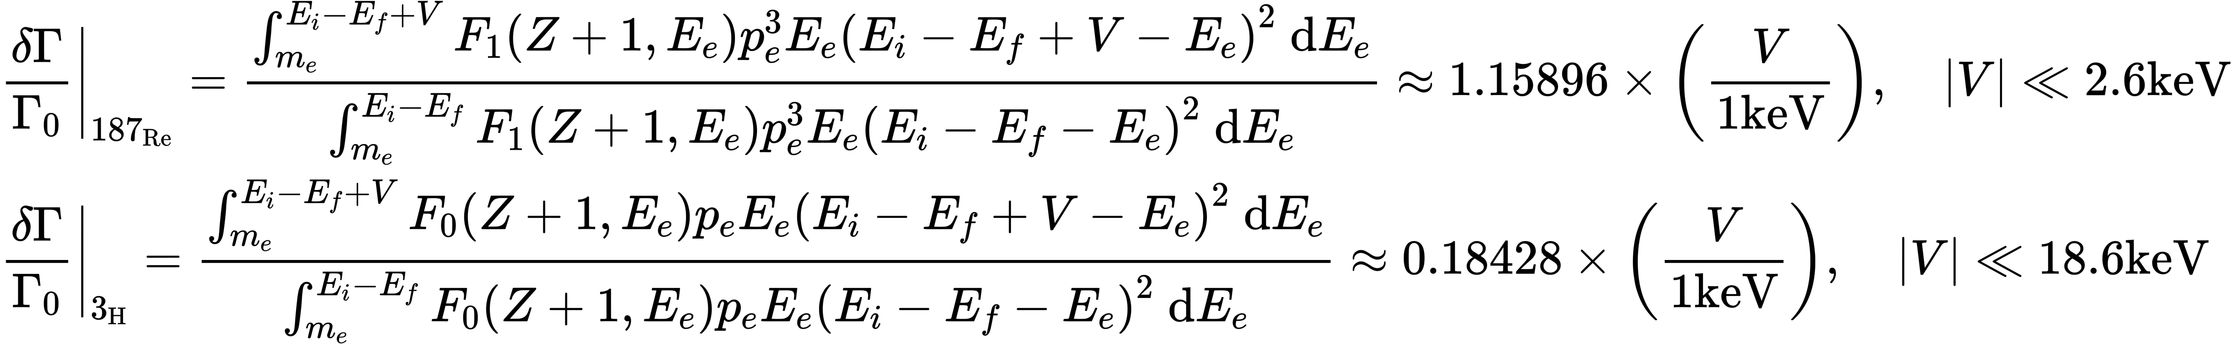
Why Tritium?
Appendix
Decays with smaller resulted in a larger fractional change in the beta decay rate.
Candidates for Low Q nuclides:
H-3, Q=18.6keV；
Re-187, Q=2.6keV；
Pu-241, Q=20.8keV
Notes:
We find that for small perturbations to the decay rate, decays with smaller Q value resulted in a larger fractional change in the beta decay rate.

Slide 20
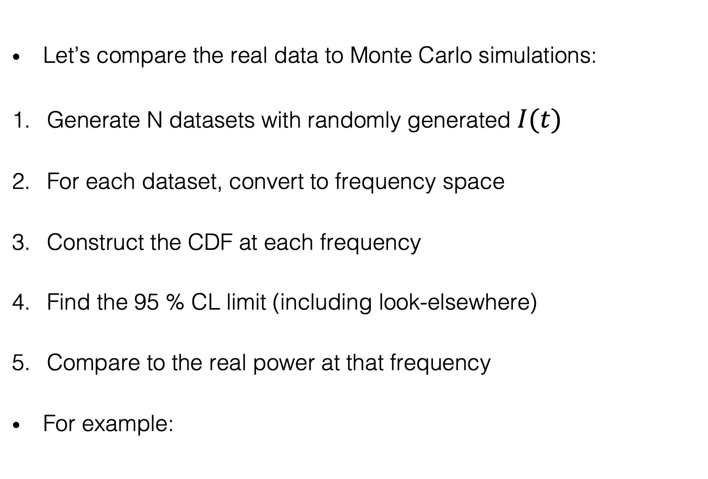
Let’s compare the real data to Monte Carlo simulations:
Generate N datasets with randomly generated $I(t)$
For each dataset, convert to frequency space
Construct the CDF at each frequency
Find the 95 % CL limit (including look-elsewhere)
Compare to the real power at that frequency
For example:
Notes:
This is the data analysis procedure of our work.
Data analysis 2
To do this, we generate fake data using Monte Carlo simulations, with the same time spacing as the original dataset.
For fake dataset we generate a Lomb Scargle periodogram, which allows us to calculate the Cumulative Distribution function at each frequency
We then can find the 95 % CL limit at each frequency (orange).
We can then see that the original data
Therefore they are well modelled by the null hypothesis - no evidence of periodic variation!

Slide 21
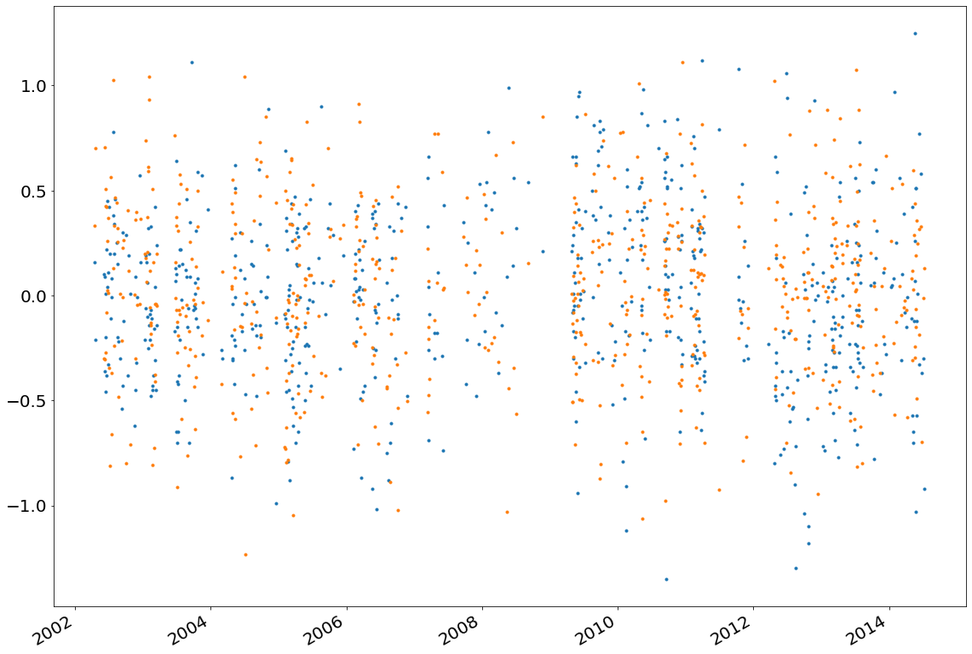
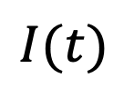
$$I(t)$$
Date
Original data, Monte Carlo data
Notes:
Under the null hypothesis that the dataset contains no axion-induced signal, the time-series datapoints should follow a Gaussian distribution. To place limits on the corresponding power spectrum we then perform Monte Carlo (MC) simulations by generating several ten thousands time-series MC datasets, with the same time spacing as the original data. The MC data points themselves are drawn from a zero-mean Gaussian distribution, with width set by the standard deviation of the original dataset.

Slide 22
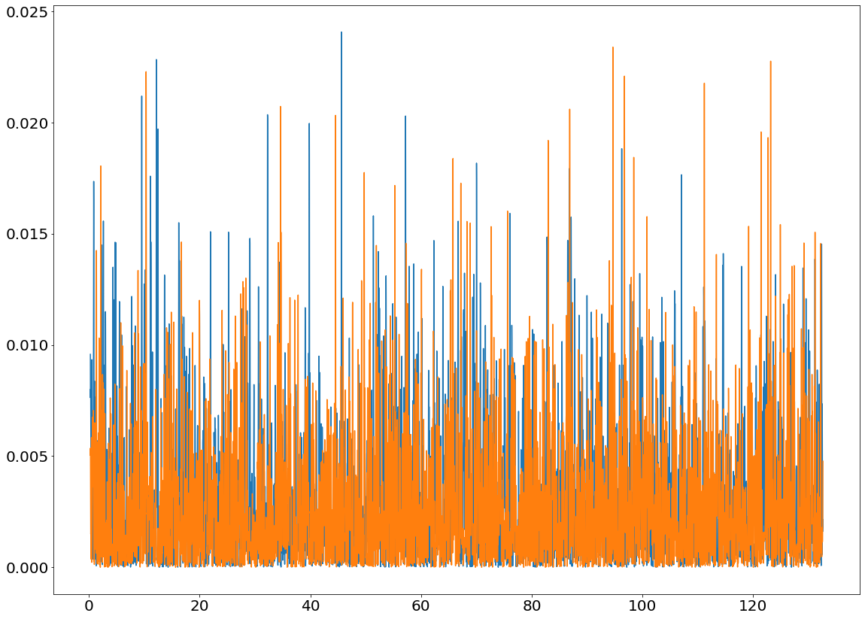
Lomb-Scargle periodogram
Power
Frequency (1/year)
Original data, Monte Carlo data
Notes:
For each MC dataset we can calculate a corresponding periodogram.

Slide 23
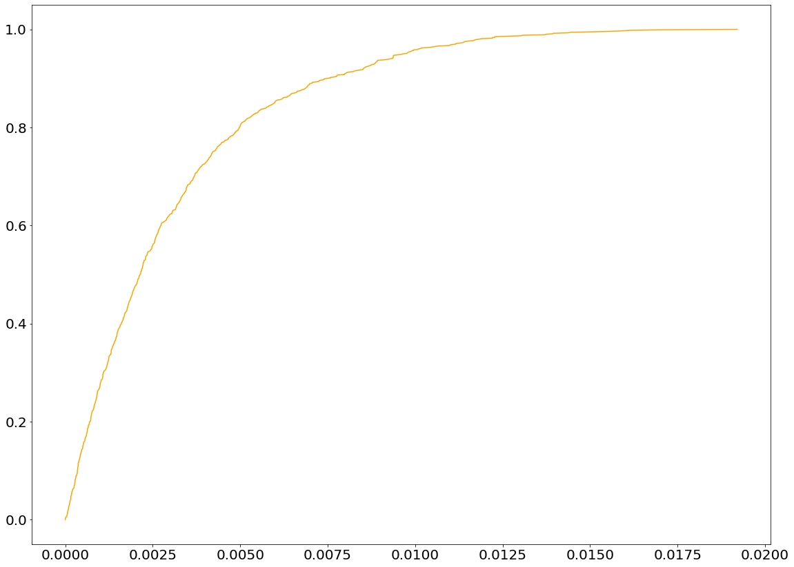
Repeat $N$ times to estimate the power PDF at each frequency
Integrate to get the power CDF:
0.95
Frequency = 0.25/year
Period = 4 years
Cumulative
probability
95 % CL limit
on the power
at this frequency
Power
Notes:
Then use the statistics of these periodograms to construct the Cumulative Distribution Function (CDF) for the power at each frequency.
Data analysis 3
To do this, we generate fake data using Monte Carlo simulations, with the same time spacing as the original dataset.
For fake dataset we generate a Lomb Scargle periodogram, which allows us to calculate the Cumulative Distribution function at each frequency
We then can find the 95 % CL limit at this frequency

