Slide 1
Axion Cavity at Quantum Level
Qiaoli Yang
based on arxiv 2201.08291
with Yu Gao & Zhihui Peng
and Phys.Lett.B 843 (2023) 138004

Slide 2
Assuming QCD axions are one of the major components of DM
Axions produced during the QCD phase transition should be abundant

Slide 3



Axion fluctuations are correlated to the CMB fluctuation.
The observed CMB isocurvature fluctuation is small

Slide 4
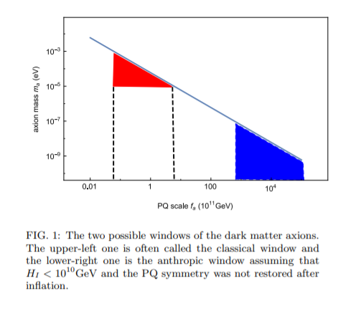


Slide 5
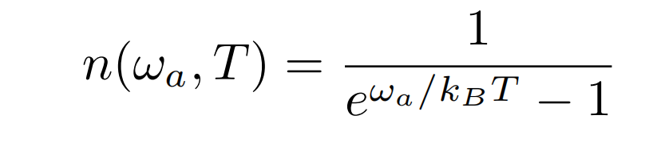
The quantum properties of the Cavity
Modern cryogenic technology can sustain ~20mK or lower temperature
The thermal photons have a very low occupation number n<<1 .
Thus it is useful to consider the quantum picture.

Slide 6
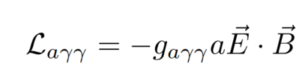
The Quantum picture of the Cavity
(Feynman diagram method could not be used here)
The axion photon coupling is

Slide 7
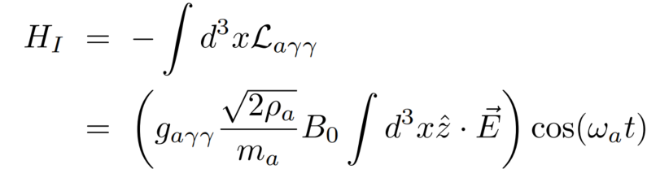
The Quantum picture of the Cavity
The interaction Hamiltonian is

Slide 8
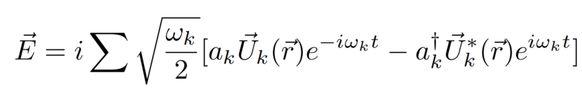

The Quantum picture of the Cavity
The electric field operator in the cavity can be expanded
where is the cavity modes

Slide 9
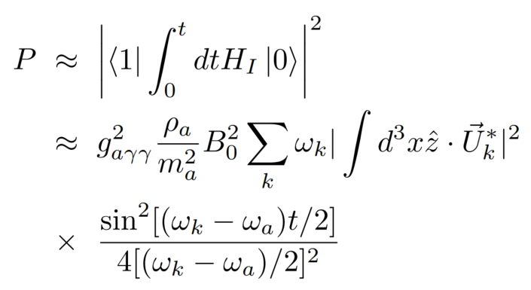
The Quantum picture of the Cavity
The transition probability is

Slide 10
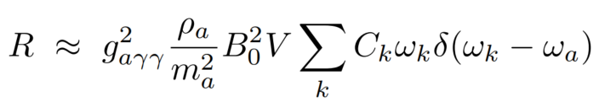
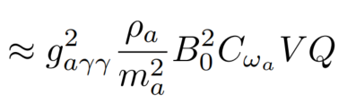
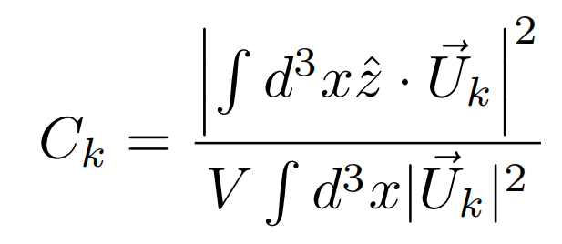
The Quantum picture of the Cavity
The transition rate is
where

Slide 11
The Quantum picture of the Cavity
The transition rate is enhanced by the cavity quality factor Q even for a single transition. Also, it is larger than the classical picture by a factor pi/2
Typical photon emitting rate of the cavity is order of 10Hz.

Slide 12
A cavity at quantum level can be regarded as a single photon emitter with a slow rate~ 10Hz.

Slide 13
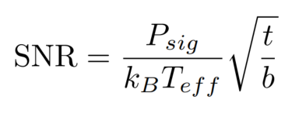
The bottleneck of the haloscope
The linear amplifier with a moderate bandwidth adds noise temperature order of T_eff=10K

Slide 14
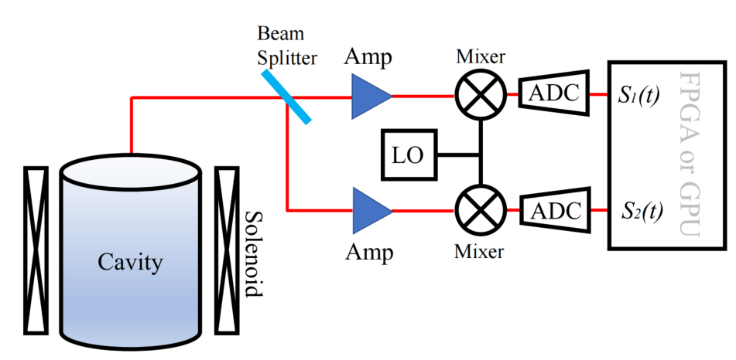
The quantum interferometry

Slide 15


The quantum interferometry
The beam splitter gives two output fields in channel 1 and 2
denotes the signal and denotes the noises.

Slide 16



The quantum interferometry
Then one measures
and
as the real and imaginary part of the field envelopes.

Slide 17

The quantum interferometry
The two path instantaneous power function is
where N₁₂ is the power of correlated noise in channel 1 and 2

Slide 18
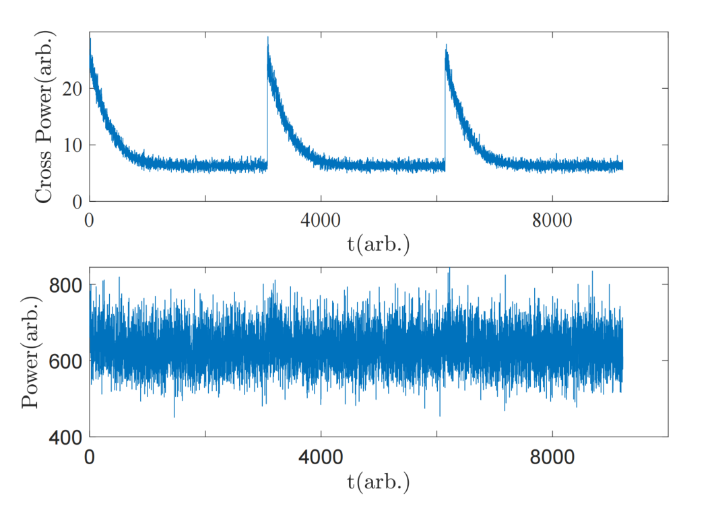
Simulated signal

Slide 19


Dark matter axions induce Quantum transitions

Slide 20



The axion spectrum density I_{a} is high
The interaction term in non-relativistic limit is:
The transition rate is

Slide 21
Hydrogen 1S state transitions
arxiv:1912.11472

Slide 22
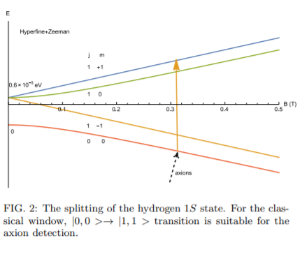
Hydrogen atoms are ideal targets for the classical window

Slide 23
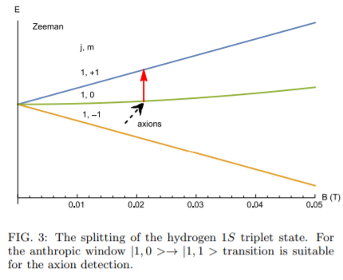
Hydrogen atoms are also ideal targets for the anthropic window

Slide 24
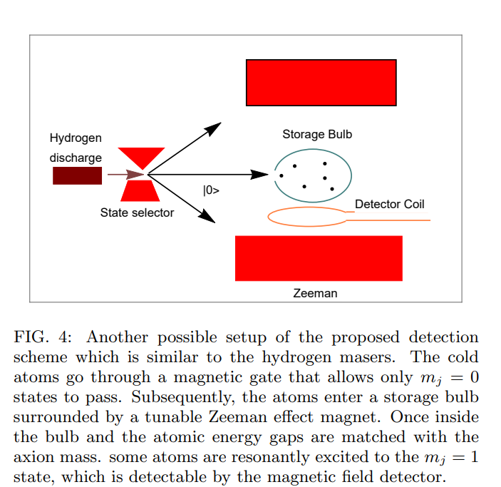

Slide 25
