Slide 1

2023 年度中国科学院理论物理前沿重点实验室年会
Event-Based Monte Carlo Method
for Long-range Interacting Systems
Youjin Deng (邓友金)
中国科大、闽江理论物理协作中心
2023-06-02

Slide 2


Collaborators
Zhijie Fan(范之杰)
USTC
Chao Zhang(张超)
USTC
arXiv:2305. 14082

Slide 3
Outline
Overview
Metropolis filter
Factorized Metropolis filter
Event-based sampling
Event-based Monte Carlo algorithm
arXiv:2305. 14082

Slide 4
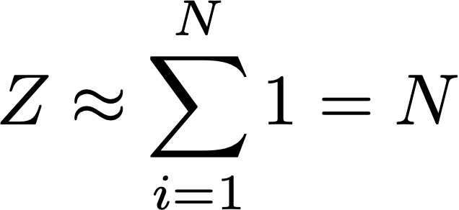
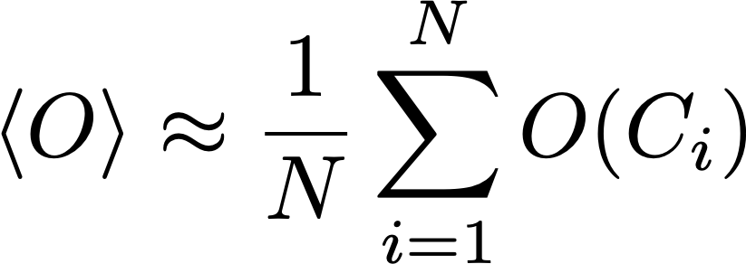
Monte Carlo method
Monte Carlo (MC) method: a statistical-almost experimental-approach to compute integrals using random positions, called samples, whose distribution is carefully chosen
Markov Chain MC (MCMC) method: an importance-sampling approach to sample a given probability distribution W(C) by generating a sequence of random configurations
C_{i} depends only on C_{i-1} and a stochastic transition matrix
Partition sum and Statistical average

Slide 5


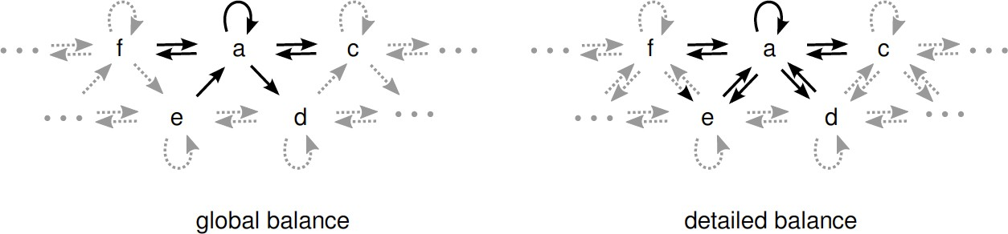
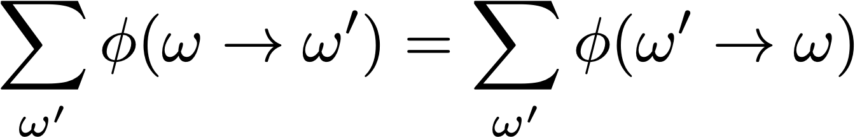
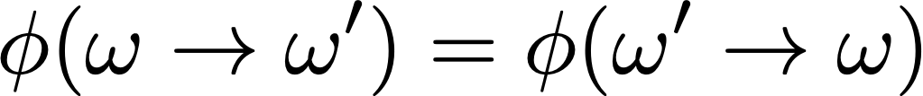
Monte Carlo method
Two ingredients in MCMC
Balance condition of probability flows → static distribution
Ergodicity → converge to static distribution
Probability flow:
: a-priori prob. for proposing the update
: acceptance probability
global balance detailed balance

Slide 6
Quantum Monte Carlo
What is QMC?
QMC = quantum-classical mapping + important sampling
“quantum-classical mapping” “importance sampling”
classical:
quantum:
Q: How to integrate out
without diagonalization?
A: map to (d+1) dim. classical
system
configuration:
general method for
high dimensional integrals

Slide 7
Quantum Monte Carlo
QMC = a large family tree
<<Variational Monte Carlo>> family
<<Diffusion monte Carlo>> family
<<Path integral Monte Carlo>> family
<<Diagrammatic Monte Carlo>> family
Projector Monte Carlo, Green Function Monte Carlo, Diffusion Monte Carlo (+Fix Node, +Stochastic Reconfiguration) …
<<Determinantal Monte Carlo>> family
Auxiliary Field Monte Carlo, Determinantal Monte Carlo, Hirsch-Fye…
Lattice systems (cluster algorithms)
Basic idea: Mapping Quantum system in dimension d to Classical system in dimension d+1
They do classical Monte Carlo on the equivalent problem
World-line QMC (WL): based on Feynman path-integral representation
Stochastic Series Expansion (SSE): based on high-temperature series expansion
Based-on Feynman diagrammatic series expansion

Slide 8
The negative sign problem in QMC
Not as easy as classical Monte Carlo
Calculating the eigenvalues E_{c} is equivalent to solving the problem
Need to find a mapping of the quantum partition function to a classical problem
“Negative sign” problem if some p_{c}<0
Reminiscent of the NP-hard problems
No proof that they are exponentially hard
No polynomial solution either

Slide 9
Working around the sign problem
Simulate “bosonic” systems
Bosonic atoms in optical lattices
Helium-4 supersolids
Nonfrustrated magnets
Simulate sign-problem free fermionic systems
Attractive on-site interactions
Half-filled Mott insulators
Use DMRG and tensor network
Use approximate methods (Dynamical mean field theory, DMFT)
Change basis
employ a Majorana representation of complex fermions
Auxiliary Field Monte Carlo
Diagrammatic Monte Carlo

Slide 10
Other disadvantages for QMC?
Critical slowing down
  Nearby samples in the Markov chain are highly correlated and simulation efficiency drops quickly near phase transitions as system size increases
  Solutions: smart update schemes (algorithms)
    Cluster algorithms (Swendsen-Wang, Wolff, Geometric…)
    Worm algorithm
    Irreversible MC algorithms (event-chain MC method)
    Self-learning MC methods (insight from machine learning)
    ……
  sometimes improve efficiency by a factor of millions!
  system-dependent, and thus not universal

Slide 11
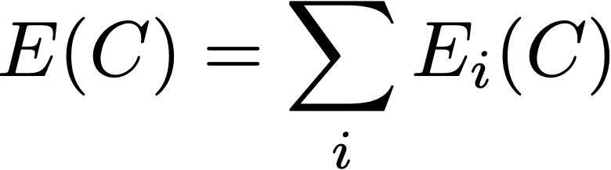
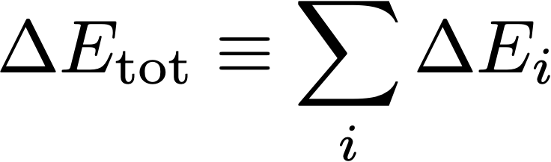
Other disadvantages for QMC?
Computational Complexity
Heavy computational overhead for long-range interacting systems
  Gravitational force
  van der Waals force
  Coulomb force, dipole-dipole interaction
  Neural network, ……
For each single update, one need to calculate:
Sum of all interactions:
Induced total energy change:
O(N) computational complexity per move is proportional to system size N

Slide 12
Outline
Overview
Metropolis filter
Factorized Metropolis filter
Event-based sampling
Event-based Monte Carlo algorithm
arXiv:2305. 14082

Slide 13
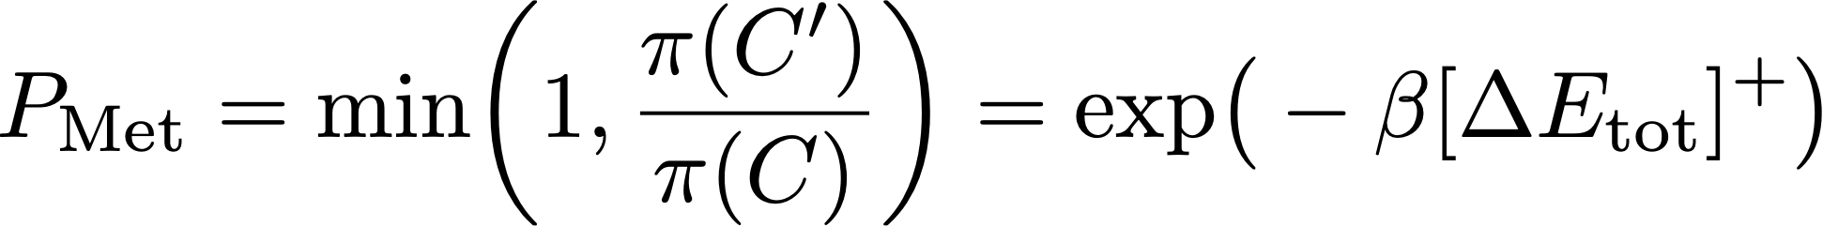
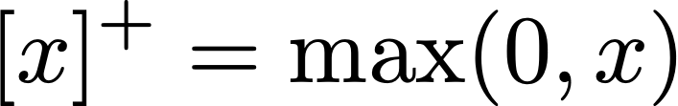
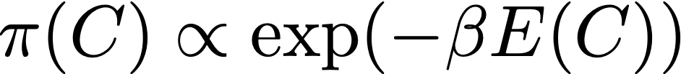

The Metropolis Algorithm (1953)
Metropolis algorithm : a local update MCMC scheme with transition filter
Boltzmann distribution:
Sum of all interactions:
Induced total energy change:
Universal,
Simple Reliable, Effective
Ref: N. Metropolis, A.W. Rusenbluth, M. N. Rusenbluth, A.H. Teller, J. Chem. Phys. 21, 1087 (1953)

Slide 14
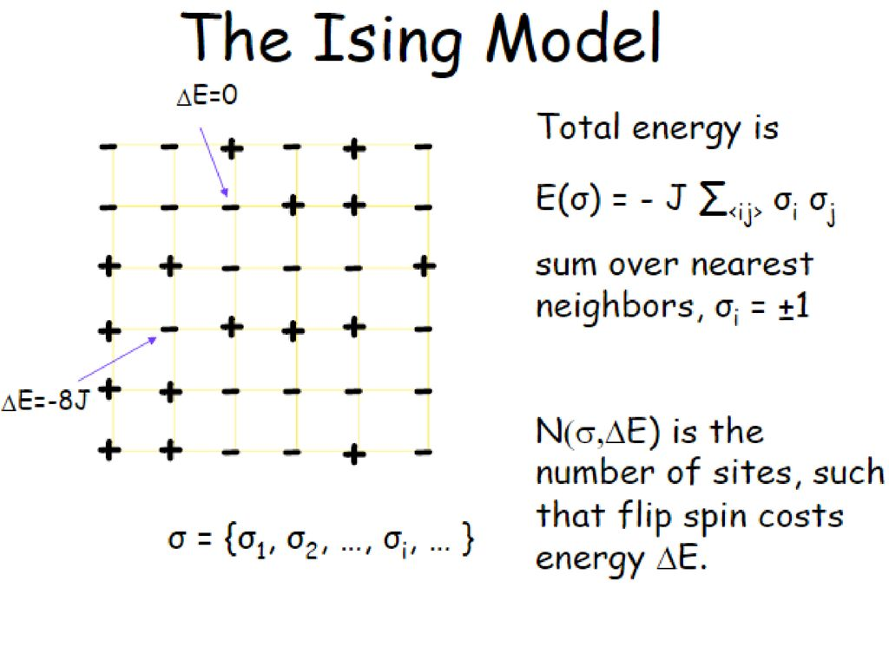

Metropolis algorithm for Classical Spin Model
The Ising model
Total energy is , sum over nearest neighbors,
Metropolis algorithm
Choose a site i
Calculate energy change ΔE if spin at site i is flipped
Generate a random number r such that 0 < r < 1
If r < exp(- ΔE /k_{B}T), flip the spin
Acceptance ratio
P$=e^{−ΔE/κΒΤ}$

Slide 15
Metropolis algorithm for Classical Spin Model
The Ising model: with long-range interaction
Total energy is , sum over ALL neighbors,
Simulating long-range interacting systems is a challenging task due to its computational complexity that the computational effort for each local update is of order O(N), where N is the size of system!
Any good solution?

Slide 16
Outline
Overview
Metropolis filter
Factorized Metropolis filter
Event-based sampling
Event-based Monte Carlo algorithm
arXiv:2305. 14082

Slide 17
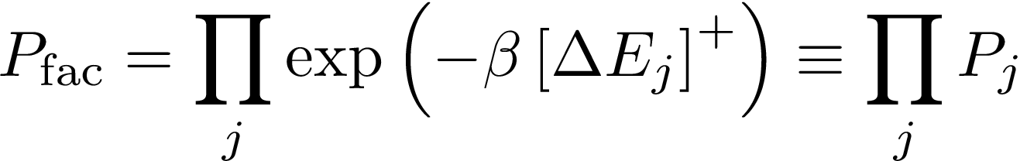







Factorized Metropolis Filter (2014)
$$P_{1}$$
$$P_{2}$$
$$P_{N}$$
$$\sum_{i=1}{ΔE_{i}}$$
$$ΔE_{1}$$
$$ΔE_{2}$$
$$ΔE_{N}$$
Metropolis
Factorized Metropolis Filter
with
Ref: M. Michel, S. C. Kapfer, and W. Krauth, , J. Chem. Phys. 140, 054116 (2014).

Slide 18



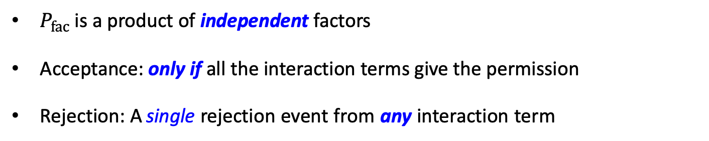
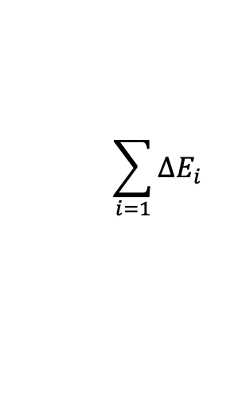
Factorized Metropolis Filter (2014)
$$P_{1}$$
$$P_{2}$$
$$P_{N}$$
$$\sum_{i=1}{ΔE_{i}}$$
$$ΔE_{1}$$
$$ΔE_{2}$$
$$ΔE_{N}$$
$P_{fac}$ is a product of independent factors
Acceptance: only if all the interaction terms give the permission
Rejection: A single rejection event from any interaction term

Slide 19
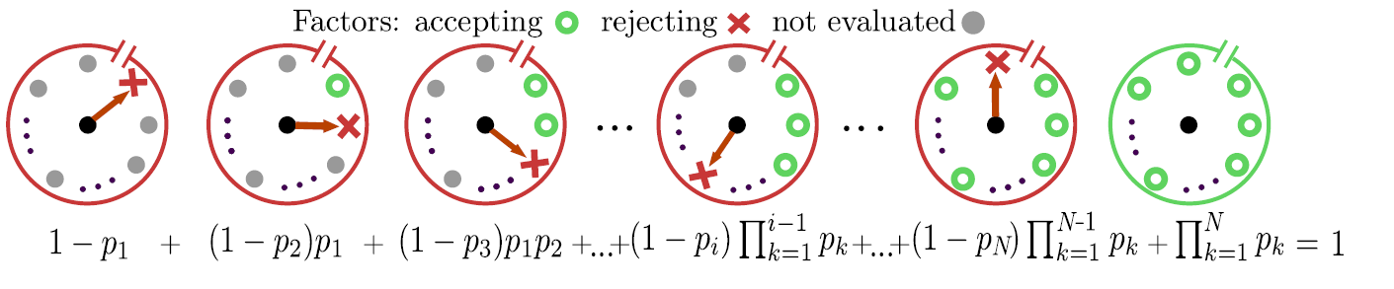
First Rejection Events
Why not sample rejection events instead of visiting all interaction terms?
First-rejection event: the $X$-th factor $P_{j}$ is the first factor to reject the update
Acceptance event: all trials give permission
with

Slide 20

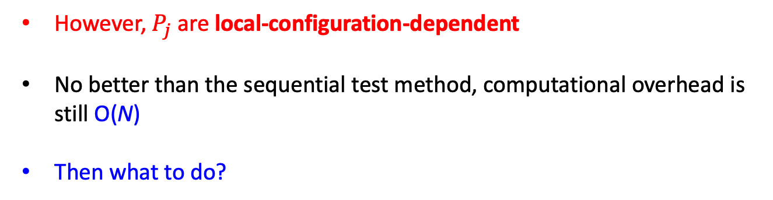







Computational Complexity of Direct Sampling
Direct sampling requires exact knowledge of $P_{j}$s
$$P_{i}$$
$$P_{j}=exp⁡(−β{\left[ΔE_{j}\right]}^{+})$$
$$1$$
$$2$$
$$3$$
$$4$$
$$5$$
$$i$$
However, $P_{j}$ are local-configuration-dependent
No better than the sequential test method, computational overhead is still O(N)
Then what to do?

Slide 21


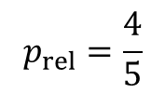
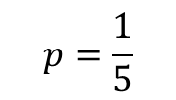
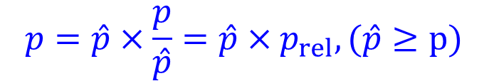
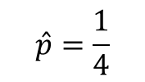
A trivial probability identity
Probability identity:
$$p=\hat{p}×\frac{p}{\hat{p}}=\hat{p}×p_{rel}, (\hat{p}≥p)$$
Example: sampling a random event with prob.1/5 equals to sampling two sequent random events with prob. 1/4 and 4/5
$$p=\frac{1}{5}$$
$$\hat{p}=\frac{1}{4}$$
$$p_{rel}=\frac{4}{5}$$

Slide 22






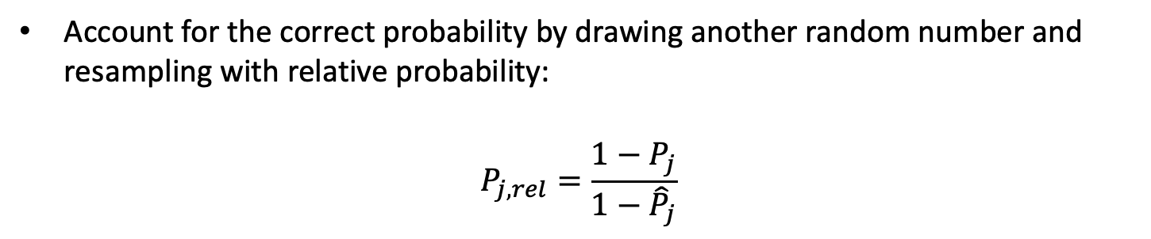


Bound probability for worst case
Introduce a configuration-independent bound probability for each factor:
$${\hat{P}}_{j}≤P_{j}(S→S^{′})$$
Account for the correct probability by drawing another random number and resampling with relative probability:
$$P_{j,rel}=\frac{1−P_{j}}{1−{\hat{P}}_{j}}$$
$${\hat{P}}_{j}$$
$$P_{j,rel}$$
$${\hat{P}}_{j}$$
Bound acceptance
Relative acceptance
True rejection

Slide 23
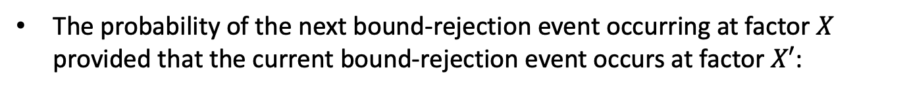
Event-based sampling (2023)
Sample bound-rejection events
The probability of the next bound-rejection event occurring at factor $X$ provided that the current bound-rejection event occurs at factor $X′$:
is the bound hazard rate
Configuration-independent! Can be efficiently generated using various methods: inversion method, Walker’s alias method, thinning method…
Energy evaluation is required only when a bound rejection occurs

Slide 24
Event-based sampling (2023)
The recursive sampling scheme on a tree structure

Slide 25
Box Technique
Factorized Metropolis filter:
The overall acceptance probability may be decreased due to factorization:
Each factor can contain an arbitrary number of interactions!
If a single factor contains all the interaction terms, it reduces to the standard Metropolis filter
The interaction terms can be grouped into boxes of tunable sizes for optimization of efficiency

Slide 26
Event-based sampling (2023)
Benefits for event-based sampling
Reduced computational complexity : from O(N) to O(N^{κ}) (0 ≤ κ ≤ 1). In most cases, O(1) update complexity can be achieved
Flexible update scheme
Box technique: the event-based sampling process can be constructed in various ways enabling further optimization for specific models
These ingredients are very general
model-independent: do not depend on specific configurations
interaction-independent: do not depend on energy functions (attractive/repulsive, two-/many-body, non-frustrated/frustration)
mechanics-independent (class/quantum, physics/non-physics…)
update-scheme-independent

Slide 27
Outline
Overview
Metropolis filter
Factorized Metropolis filter
Event-based sampling
Event-based Monte Carlo algorithm
arXiv:2305. 14082

Slide 28
Event-based Quantum Monte Carlo (EBQMC)
Extended to the long-range quantum system:
d-dimensional quantum model maps onto a (d + 1)-dimensional classical system
Event-based Metropolis Algorithm: the long-range transverse field Ising model
Study magnetic materials, glasses, complex networks, and so on

Slide 29
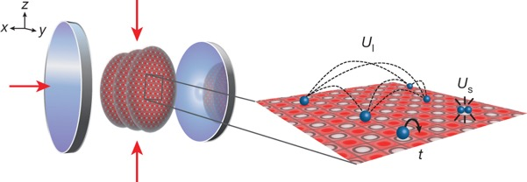
Event-based Quantum Monte Carlo (EBQMC)
Extended to the long-range quantum system:
d-dimensional quantum model maps onto a (d + 1)-dimensional classical system
Event-based worm algorithm: Extended Bose-Hubbard model
Provide valuable insights into quantum phase transitions, quantum magnetism, novel phases, the interplay between disorder and interactions in quantum systems, and so on
Ref: R. Landig et al., Nature 532, 476 (2016)

Slide 30
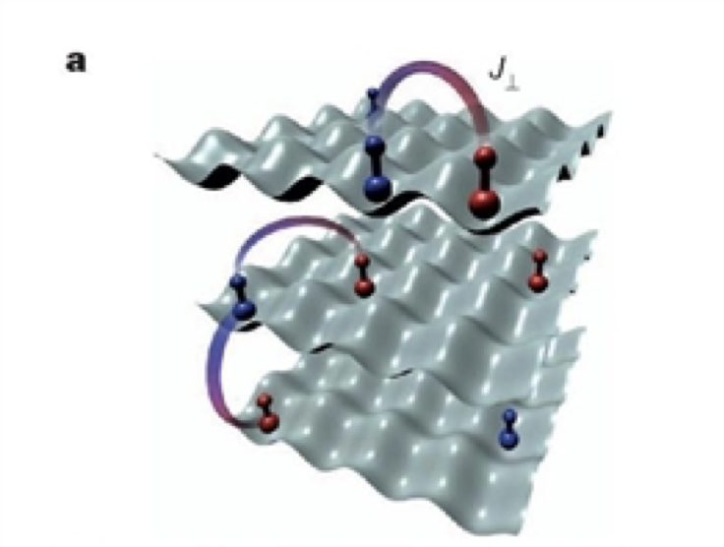
Event-based Quantum Monte Carlo (EBQMC)
Extended to the long-range quantum system:
d-dimensional quantum model maps onto a (d + 1)-dimensional classical system
Event-based worm algorithm with long-range hopping: Long-range XXZ Heisenberg model
Study exotic phases such as long-range magnetic order, spin-glass behavior, or even new types of critical phenomena, and so on
Ref: B. Yan et al., Nature 501, 521 (2013)
K. Hazzard, et al., PRL 113, 195302 (2014)

Slide 31
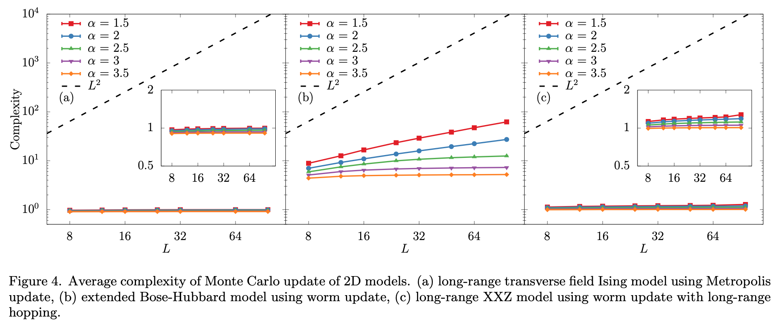
Event-based Monte Carlo algorithm
Simulation

Slide 32
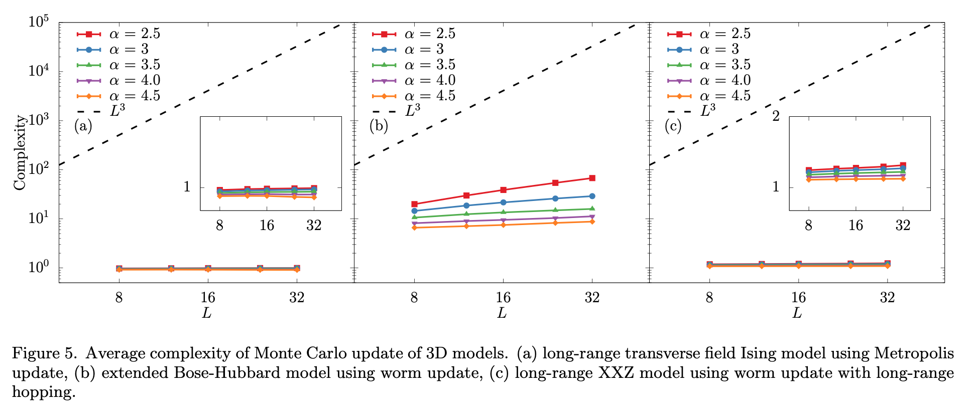
Event-based Monte Carlo algorithm
Simulation

Slide 33
Take-home message
Event-based sampling process can be combined with various update strategies, including the conventional local Metropolis updates, cluster updates, event-chain updates, worm-type updates, etc
Event-based sampling process can be used to deal with long-range interactions (diagonal terms) as well as long-range hopping amplitudes (non-diagonal terms)
Event-based sampling can provide a readily available tool to explore the rich physics of these systems and is a promising candidate for studying long-range interacting systems in various fields of physics

Slide 34
Thank You!

Slide 35
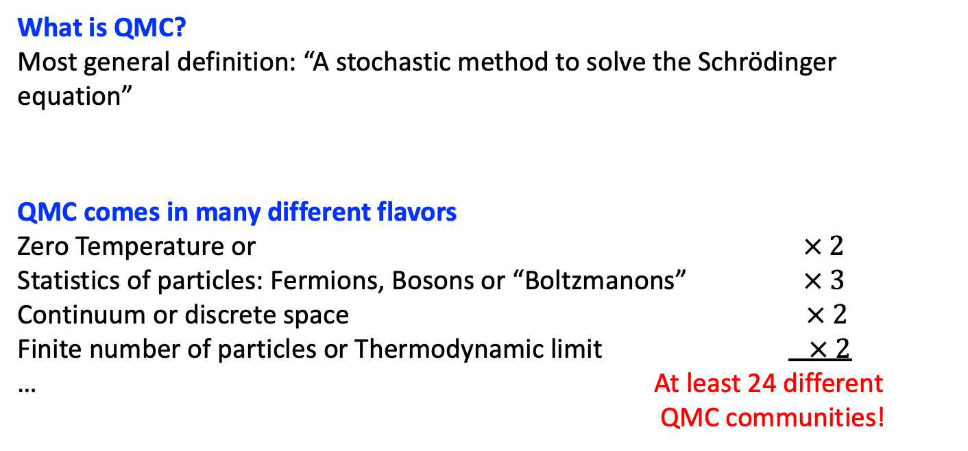
Quantum Monte Carlo
What is QMC?
Most general definition: “A stochastic method to solve the Schrödinger equation”
QMC comes in many different flavors
Zero Temperature or $× 2$
Statistics of particles: Fermions, Bosons or “Boltzmanons” $× 3$
Continuum or discrete space $× 2$
Finite number of particles or Thermodynamic limit $× 2$
… At least 24 different
QMC communities!

