Slide 1




Institute of High Energy Physics, CAS
Some key issues in hadron physics
Qiang Zhao
Division of Theoretical Physics
Institute of High Energy Physics, CAS
zhaoq@ihep.ac.cn
2023年度中国科学院理论物理前沿重点实验室年会，2023.05.31.-06.03.

Slide 2
Outline
1. Hadrons beyond the conventional quark model
2. Open threshold phenomena and near-threshold dynamics
3. Back to the quark model: where are the genuine color-singlet multiquark states?
4. Some crucial issues to be noted

Slide 3
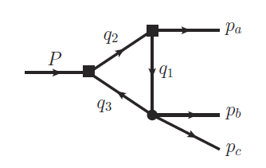
1. Hadrons beyond the conventional quark model
Exotics of Type-I:
J^{PC} are not allowed by Q‾Q configurations, e.g. 0⁻⁻,1⁻⁺ …
Direct observation
Exotics of Type-II:
J^{PC} are the same as Q‾Q configurations
Outnumbering of conventional QM states?
Peculiar properties?
“Exotics” of Type-III:
Leading kinematic singularity can cause measurable effects, e.g. the triangle singularity.
What’s the impact?
How to distinguish a genuine state from kinematic effects?

Slide 4
Additional states beyond the QM flavor symm. pattern imply “exotic” signals!
Light hadrons:‾qq SU(3) flavor nonet: ‾3⊗3 =1⊕8
f₀(1500) ?
a₁(1420)?
η(1405) ?

Slide 5
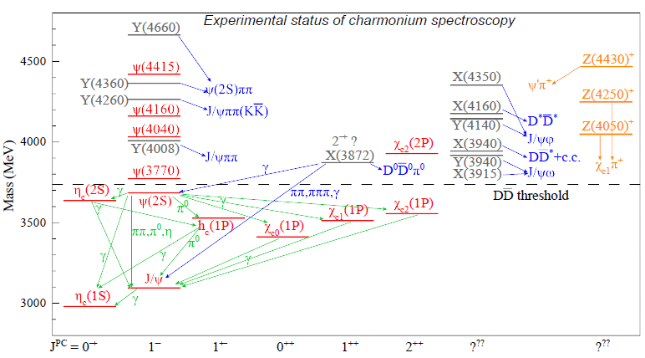
Heavy flavor states: Charmonia and charmonium-like states, i.e. X, Y, Z’s.
Apparent deviations occur above the open charm thresholds.
Charged charmonium states definitely indicate novel phenomena beyond the potential QM.
Zc(4200)
Zc(4020)
Zc(3900)
Most of these new states are close to some S-wave open thresholds.
(I): Zc(3900), Zc(4020), Zc(4430), Zcs(3982) …
(II): Y(4260), Y(4360), X(3872) …
States below the open charm thresholds indicates the success of the potential quark model.

Slide 6
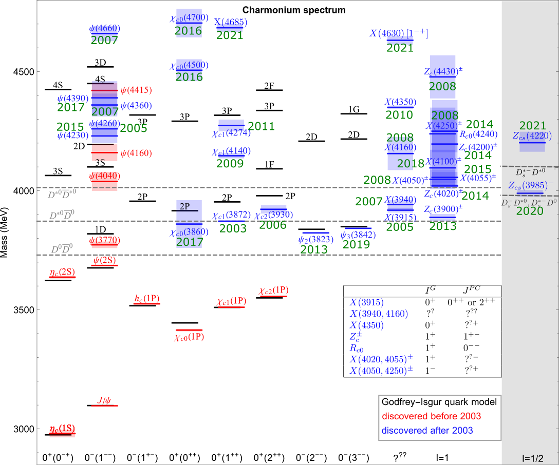
Production processes in experiment
Chart plotted by Fengkun

Slide 8
2. Open threshold phenomena and near-threshold dynamics

Slide 9
Success of potential quark model:
Hadrons are made of quarks (antiquarks) as QCD color singlet
Typical quark model prescription (e.g. Godfrey Isgur model):

Slide 10
The connection between the quark model and QCD ONLY becomes clear in certain circumstances: in the heavy quark limit the soft QCD for quark-antiquark or quark-quark interactions can become much simpler.
However, the effects of the open channels on the soft QCD potential is also evident!
G. S. Bali, et al., Phys. Rev. D62, 054503 (2000)
J. Bulava, et al., Phys. Lett. B793, 493 (2019),
M. Foster and C. Michael (UKQCD), Phys. Rev. D59, 094509 (1999)

Slide 11
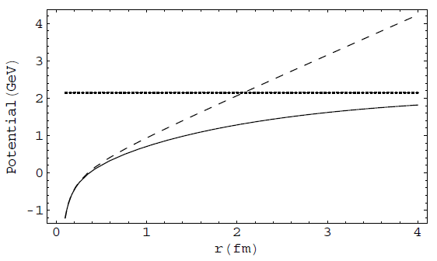
Threshold phenomena and dynamics
Color screening effects? String breaking effects? Unquenched effects? Coupled-channel effects?
V(r) = −κ/r + σ r
LQCD
Linear conf.
‾qq creation
Coulomb
The effect of vacuum polarization due to dynamical quark pair creation may be manifested by the strong coupling to open thresholds and compensated by that of the hadron loops, i.e. coupled-channel effects.
E. Eichten et al., PRD17, 3090 (1987)
E. J. Eichten, K. Lane, and C. Quigg, Phys. Rev. D 69, 094019 (2004)
B.-Q. Li and K.-T. Chao, Phys. Rev. D79, 094004 (2009);
T. Barnes and E. Swanson, Phys.Rev. C77, 055206 (2008)

Slide 12




Typical processes where the open threshold coupled channels can play a role
The open channel couplings introduce NOT ONLY additional dynamics (add. effective DOF) into the hadron structures, BUT ALSO novel kinematic effects, i.e. triangle singularity …
Y.J. Zhang, G. Li, Q. Zhao, PRL(2009);
X. Liu, B. Zhang, X.Q. Li, PLB(2009)
Q. Wang et al. PRD(2012), PLB(2012)
“ρπ puzzle”
X.-H. Liu et al, PRD81, 014017(2010);
X. Liu et al, PRD81, 074006(2010)
Q. Wang et al, PRD2012
G. Li and Q. Zhao, PRD(2011)074005
F.K. Guo, C. Hanhart, G. Li, U.-G. Meiβner and Q. Zhao, PRD82, 034025 (2010); PRD83, 034013 (2011)
F.K. Guo and Ulf-G Meiβner, PRL108(2012)112002
The mass shift in charmonia and charmed mesons, E.Eichten et al., PRD17(1987)3090
X.-G. Wu and Q. Zhao, PRD85, 034040 (2012)

Slide 13
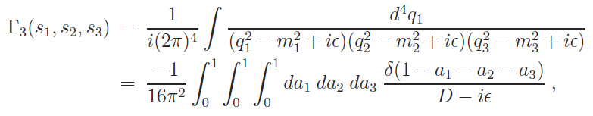



Exotics of Type-III:
Peak structures caused by kinematic effects, in particular, by triangle singularity.
The TS occurs when all the three internal particles can approach their on-shell condition simultaneously:
for all j=1,2,3.
L. D. Landau, Nucl. Phys. 13, 181 (1959);
J.J. Wu, X.-H. Liu, Q. Zhao, B.-S. Zou, Phys. Rev. Lett. 108, 081003 (2012);
Q. Wang, C. Hanhart, Q. Zhao, Phys. Rev. Lett. 111, 132003 (2013); Phys. Lett. B 725, 106 (2013)
X.-H. Liu, M. Oka and Q. Zhao, PLB753, 297(2016);
F.-K. Guo, C. Hanhart, U.-G. Meissner, Q. Wang, Q. Zhao, B.-S. Zou, arXiv:1705.00141[hep-ph], Rev. Mod. Phys. 90, 015004 (2018) ; F.-K. Guo, X.-H. Liu and S. Sakai, Prog. Part. Nucl. Phys. 112, 103757 (2020)

Slide 14
The narrow two-body open thresholds:
Their possible impact on the spectrum should be systematically investigated.
g_{eff}
h₁ (P, V, A, …)
M
h₂ (P, V, A …)

Slide 15
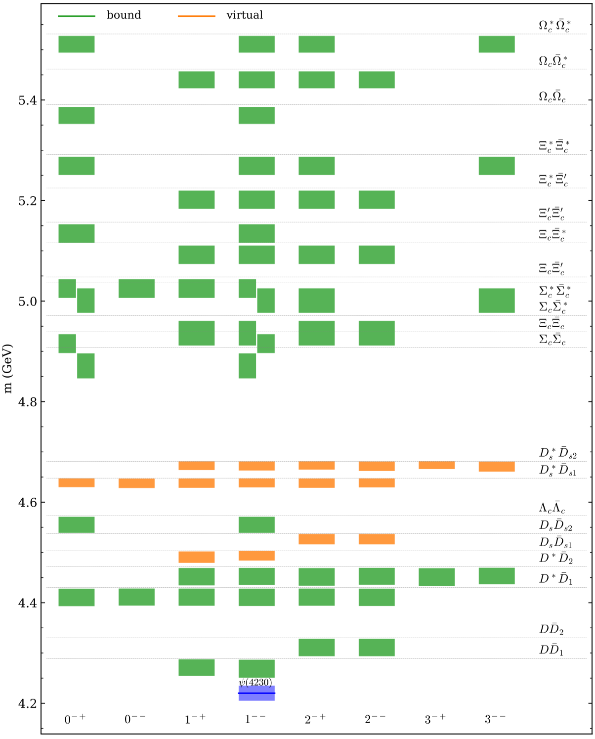
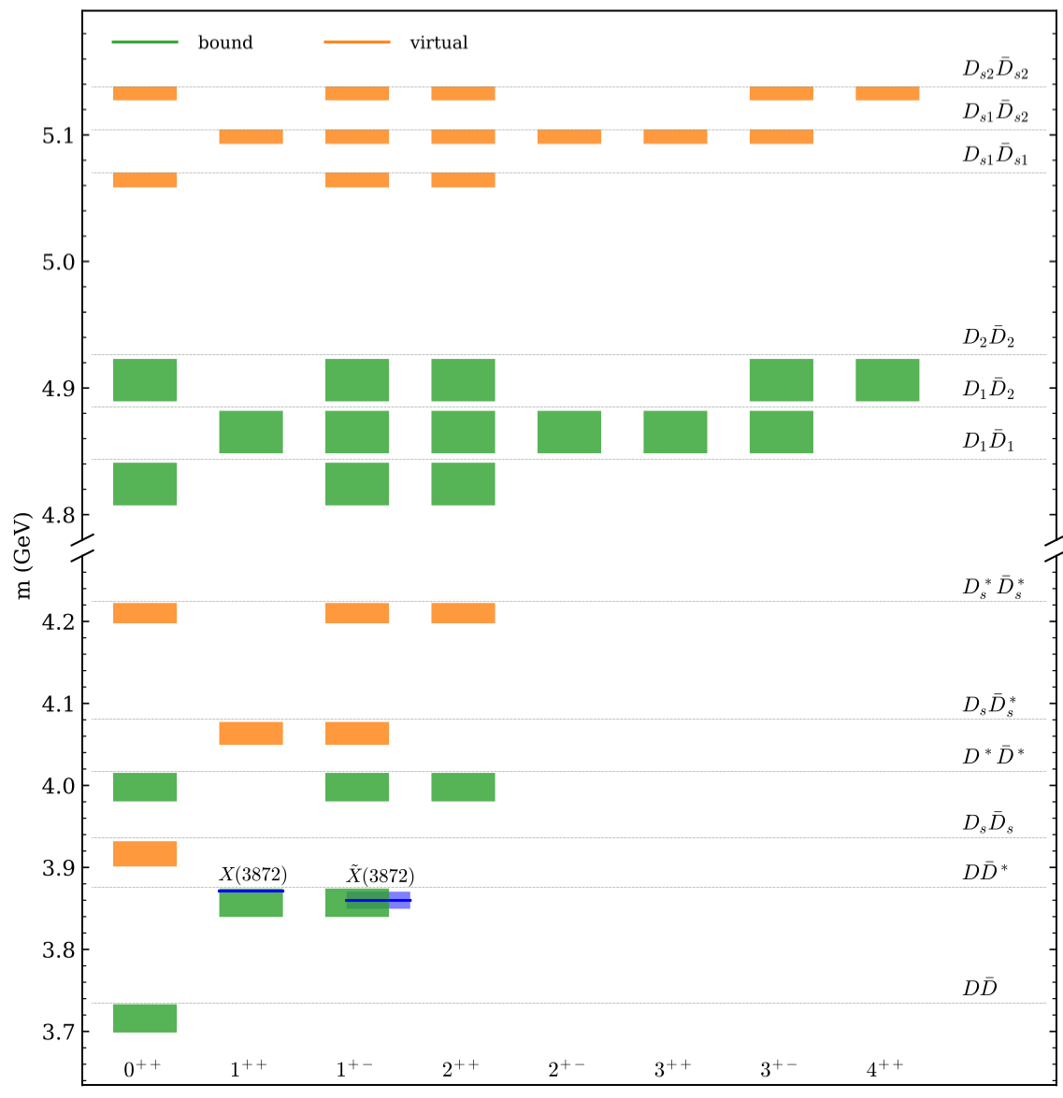
Implementation of EFT with heavy quark symmetry (HQS) and heavy quark spin symmetry (HQSS)
X.-K. Dong, F.-K. Guo, B.-S. Zou, Progr. Phys. 41 (2021) 65 [arXiv:2101.01021]

Slide 16

Dynamics that can contribute in additional to the potential quark model Hamiltonian
$geff$
h₁
Weinberg’s compositeness theorem:
Ψ
h₂
: two-hadron kinetic energy.
: two-hadron reduced mass.
: transition amplitude between the elementary component and two-hadron state.
Wave function in momentum space:
Normalization of the physical wavefunction leads to the interpretation of the states mixings:

Slide 17
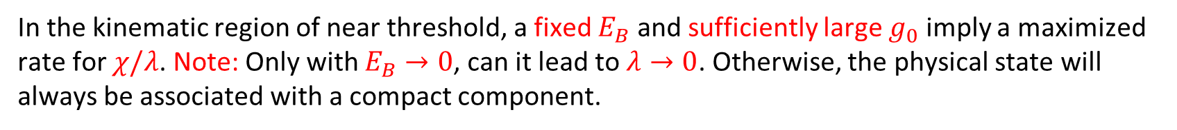

Formation of hadronic molecules
h₁
Ψ
Given that the inverse range of force β >> γ (=(2μE_{B})^{1/2}), the integral can be evaluated model independently for the case of S-wave coupling:
$$geff=g0$$
h₂
In the kinematic region of near threshold, a fixed $E_{B}$ and sufficiently large $g_{0}$ imply a maximized rate for $χ/λ$. Note: Only with $E_{B}→0$, can it lead to $λ→0$. Otherwise, the physical state will always be associated with a compact component.
=
+
+
+ …
The molecular property, to some extent, needs a reasonably good understanding of the short-range component of the physical state.
T matrix for the two continuum hadron scattering:

Slide 18
S wave thresholds and effects on the lineshapes
F.-K. Guo, C. Hanhart, U.-G. Meissner, Q. Wang, Q. Zhao, B.-S. Zou, Rev. Mod. Phys. 90, 015004 (2018)

Slide 19

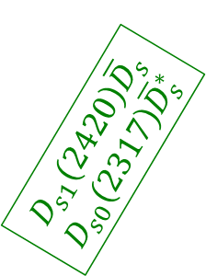
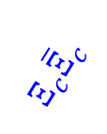


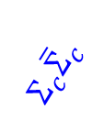
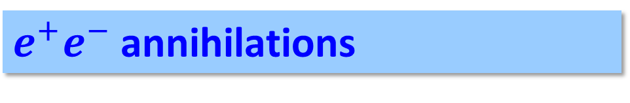
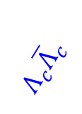



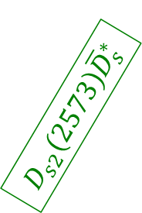
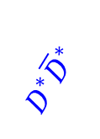
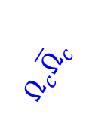

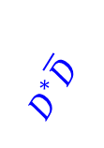

$e^{+}e^{−}$ annihilations
(III) Rich physics, but lack of data
$$D_{s1}\left(2420\right){\overline{D}}_{s}$$
$$D_{s0}\left(2317\right){\overline{D}}_{s}^{∗}$$
(I) Well explored
(II) Recently scanned
$$Σ_{c}{\overline{Σ}}_{c}$$
$$Ω_{c}{\overline{Ω}}_{c}$$
$$Λ_{c}{\overline{Λ}}_{c}$$
$$Ξ_{c}{\overline{Ξ}}_{c}$$
$$D\overline{D}$$
$$D^{∗}\overline{D}$$
$$D_{s}^{}{\overline{D}}_{s}^{}$$
$$D_{s}^{∗}{\overline{D}}_{s}^{}$$
$$D_{s}^{∗}{\overline{D}}_{s}^{∗}$$
$$D^{∗}{\overline{D}}^{∗}$$
$$D_{1}\left(2420\right)\overline{D}$$
$$D_{s2}\left(2573\right){\overline{D}}_{s}^{∗}$$
$$D_{1}\left(2420\right){\overline{D}}^{∗}$$
$$D_{s1}\left(2536\right){\overline{D}}_{s}^{∗}$$
P wave thresholds
$$D_{2}\left(2460\right){\overline{D}}^{∗}$$
S wave thresholds

Slide 20




3. Y(4260) and Zc(3900)/X(3872)
e⁺
π
Y(4260)
π
e⁻
Zc(3900)
J/ψ
ψ(4415)
The first S-wave narrow open charm threshold in vector channel
Y(4360)
D*‾D₁
Charmonium spectrum
Y(4260)
D‾D₁
ψ(4160)
$π$
$γ$
ψ(4040)
X(3872)
D‾D*
ψ(3770)
Zc(3900)
D‾D
ψ′(3686)
$π$
$2π, 3π, γ$
J/ψ
J^{PC} = 1⁻⁻

Slide 21
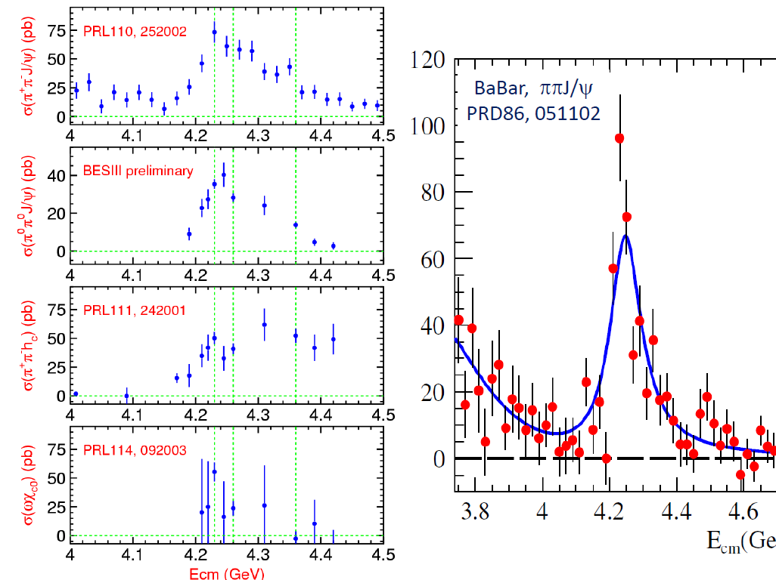
BESIII, arXiv:1611.01317 [hep-ex]
One state or two states?
BESIII, arXiv:1610.07044 [hep-ex]
Gao, et al., 1703.10351[hep-ex]

Slide 22
Resonance parameters extracted around 4.26 GeV in different channels
BESIII

Slide 23
Many papers on the properties of Y(4260), e.g. see recent reviews and reference therein:
H.-X. Chen, W. Chen, X. Liu and S.-L. Zhu, Phys. Rept. 639, 1 (2016)
F.K. Guo, C. Hanhart, U.-G. Meissner, Q. Wang, Q. Zhao, B.-S. Zou, Rev. Mod. Phys. 90, 015004 (2018)
A. Esposito, A. Pilloni and A.D. Polosa, Phys. Rept. 668, 1 (2017)
Why the DD*pi channel has the largest cross sections?
Hadronic molecule picture can explain.
Hybrid picture can possibly explain.
Tetraquark picture seems to be failed.
What are the probes for the internal structures? How to distinguish short-ranged and long-ranged dynamics?
D₁
Ψ
‾D
What is the dynamical connection with the production of Zc(3900) and X(3872)?

Slide 24
Y(4260) could be a hadronic molecule made of DD₁(2420) with coupled channel effects.
Y(4260) may have sizeable couplings to DD₁(2420) if it is a hybrid. Then, how to distinguish them?
D₁
D*
D₁(2420)
Y(4260), 1⁻⁻
Y(4260)
π
D₁
‾D
‾D₀
‾D
‾D(1868)
The production of Zc(3900) is strongly correlated with Y(4260) and enhanced by the triangle singularity kinematics.
D1
π
D*
D
π
J/ψ (hc)
Q. Wang, C. Hanhart, QZ, PRL111, 132003 (2013); PLB(2013)
Q. Wang et al., PRD89, 034001 (2014); M. Cleven et al., PRD90, 074039 (2014);
W. Qin, S.R. Xue, QZ, PRD94, 054035 (2016)

Slide 25

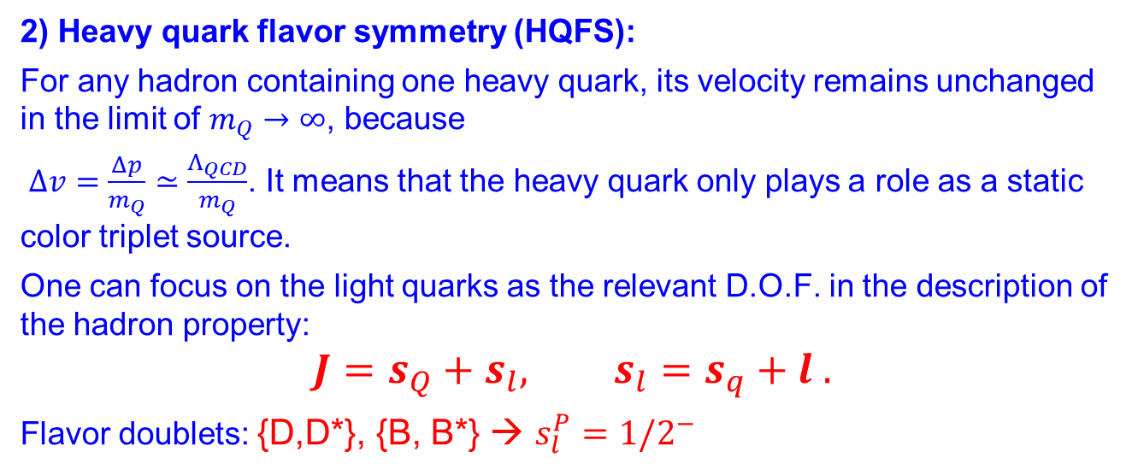

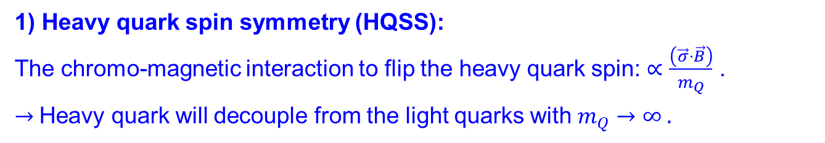




Heavy quark spin symmetry (HQSS) and heavy quark flavor symmetry (HQFS): $SU{\left(2\right)}_{s}⊗SU{\left(2\right)}_{f}$
$$s_{Q}=1/2$$
1) Heavy quark spin symmetry (HQSS):
The chromo-magnetic interaction to flip the heavy quark spin: $∝\frac{\left(\vec{σ}⋅\vec{B}\right)}{m_{Q}}$ .
$→$Heavy quark will decouple from the light quarks with $m_{Q}→∞ .$
+
−
$$s_{l}^{P}=1/2^{−}$$
2) Heavy quark flavor symmetry (HQFS):
For any hadron containing one heavy quark, its velocity remains unchanged in the limit of $m_{Q}→∞$, because
$Δv=\frac{Δp}{m_{Q}}≃\frac{Λ_{QCD}}{m_{Q}}$. It means that the heavy quark only plays a role as a static color triplet source.
One can focus on the light quarks as the relevant D.O.F. in the description of the hadron property:
$$J=s_{Q}+s_{l}, s_{l}=s_{q}+l .$$
Flavor doublets: {D,D*}, {B, B*} → $s_{l}^{P}=1/2^{−}$
$$l$$
$$s_{Q}=1/2$$
+
−
$$s_{l}^{P}=1/2^{−}$$
$$l$$

Slide 26
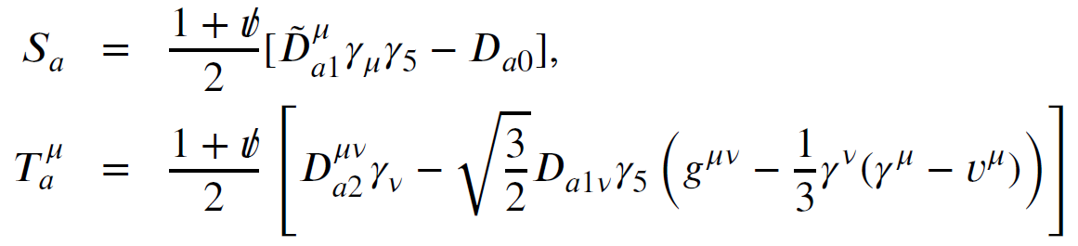
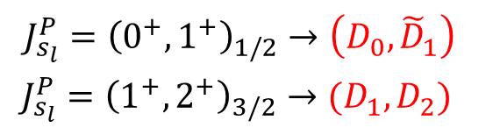
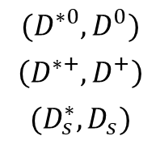
Constructing super fields respecting heavy quark symmetry and chiral symmetry
For instance, the S-wave $\left(D_{a}^{∗}, D_{a}\right), a=u,d,s$, the super field can be written as
Charmed meson of HQSS douplet with $s_{l}^{P}=1/2^{−}$
$$(D^{∗0}, D^{0})$$
$$\left(D^{∗+}, D^{+}\right)$$
$$(D_{s}^{∗}, D_{s})$$
For the P-wave heavy-light mesons, two doublets can be formed, i.e. $J_{s_{l}}^{P}={\left(0^{+},1^{+}\right)}_{1/2}$ and $J_{s_{l}}^{P}={\left(1^{+},2^{+}\right)}_{3/2}$
$$J_{s_{l}}^{P}={\left(0^{+},1^{+}\right)}_{1/2}→\left(D_{0}, {\tilde{D}}_{1}\right)$$
$J_{s_{l}}^{P}={\left(1^{+},2^{+}\right)}_{3/2}→(D_{1},D_{2})$

Slide 27






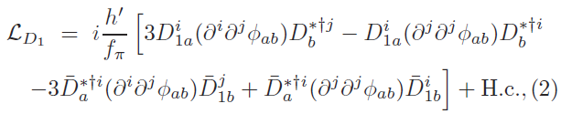
Lagrangians in the NREFT
Y(4260)D₁D coupling:
Zc(3900)DD* coupling:
D₁D*pi coupling:
Q. Wang, C. Hanhart, QZ, PRL111, 132003 (2013); PLB(2013)
Q. Wang et al., PRD89, 034001 (2014); M. Cleven et al., PRD90, 074039 (2014);
W. Qin et al., PRD94, 054035 (2016)

Slide 28

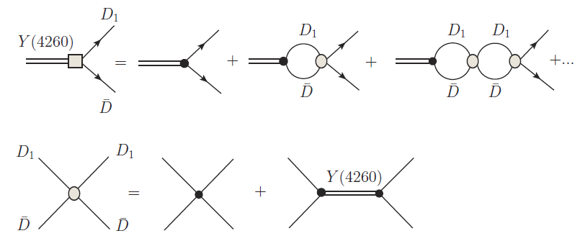
Defining the molecular component of Y(4260)
HQSS breaking is implicated

Slide 29
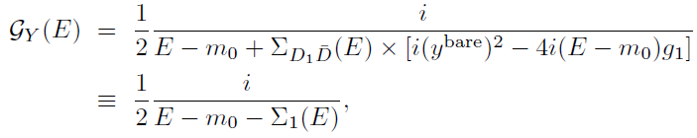







The propagator of Y(4260)
$$e^{+}$$
$$\sqrt{Z}×\sqrt{Z}g_{0}$$
$$e^{−}$$

Slide 30




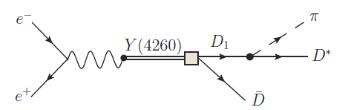

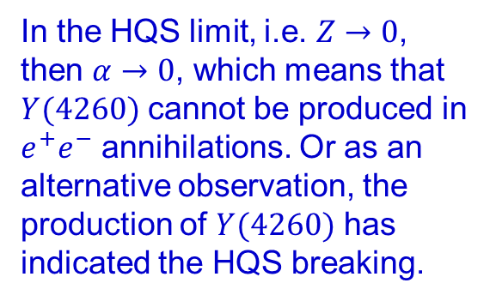
Short-range component
Long-range component
In the HQS limit, i.e. $Z→0$, then $α→0$, which means that $Y(4260)$ cannot be produced in $e^{+}e^{−}$ annihilations. Or as an alternative observation, the production of $Y(4260)$ has indicated the HQS breaking.
Y(4260) is dominated by molecular component but also contains a component (charmonium? Or something else?) as a compact structure.

Slide 31
The general features with the tetraquark or hadronic molecule scenarios:
Very rich spectra are expected.
The form of diquark DoF can lead to very different results for the tetraquark production and decay.
A strong coupling for a tetraquark state into a nearby S-wave threshold may need unitarization which will still introduce a molecular component into the wavefunction.
Limited number of states close to threshold.
Possible mixing with the kinematic singularity, but can be clarified by energy dependence of the lineshape measurement.
Unitarization is crucial and EFT can be implemented. However, whether or not a molecular state can be formed would depend on the detailed dynamics.
h₁
Ψ
h₂

Slide 32
We presumably have understand the main feature of hadronic molecules which are originated from the threshold dynamics. But their relation with the elementary quark model states is still obscure.
Clues for the following issues are also essentially important:
1) What drives higher states to be unstable?
2) To what extent the genuine color-singlet multiquark states are allowed?
3) Do we have a reasonable scheme to combine the genuine color-singlet multiquark states with the long-ranged molecular states arising from the threshold dynamics?

Slide 33
3. Back to the quark model: where are the genuine color-singlet multiquark states?

Slide 34
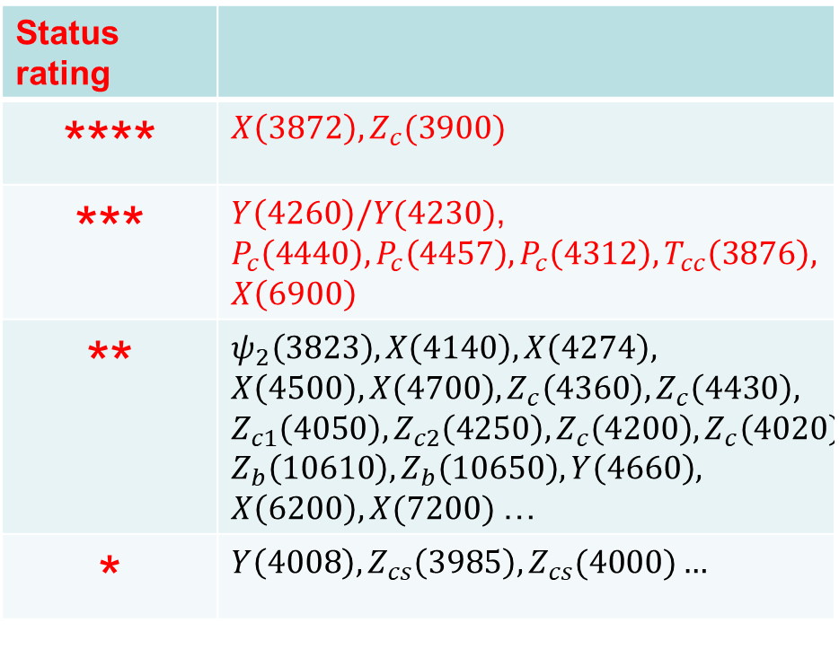
Genuine color-singlet multiquark states vs. hadron molecules
Tetraquark vs. hadronic molecule
Status rating
**** | $X\left(3872\right), Z_{c}(3900)$
*** | $Y\left(4260\right)/Y(4230)$, $P_{c}\left(4440\right), P_{c}\left(4457\right), P_{c}\left(4312\right), T_{cc}\left(3876\right),$ $X\left(6900\right)$
** | $$ψ_{2}\left(3823\right), X\left(4140\right), X\left(4274\right),$$ $$X\left(4500\right), X\left(4700\right), Z_{c}\left(4360\right),Z_{c}\left(4430\right),$$ $$Z_{c1}\left(4050\right), Z_{c2}\left(4250\right), Z_{c}\left(4200\right), Z_{c}\left(4020\right), Z_{b}\left(10610\right), Z_{b}\left(10650\right), Y\left(4660\right),$$ $X\left(6200\right), X(7200)$…
* | $$Y\left(4008\right), Z_{cs}\left(3985\right),Z_{cs}(4000)…$$
Pentaquark vs. hadronic molecule
Why we do not see rich spectra arising from genuine color-singlet multiquark states?

Slide 35

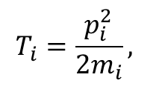
Heavy quarkonium spectrum vs. fully-heavy genuine color-singlet tetraquark states in the quark model
Hamiltonian in a non-relativistic quark model :
$$T_{i}=\frac{p_{i}^{2}}{2m_{i}},$$
Potential smearing factor
Coulomb
Spin-spin correl.

Slide 36

The QM state $χ_{c1}(2P)$ is about 60 MeV higher than the physical state $X(3872)$.
$D{\overline{D}}^{∗}$
W.J. Deng et al., PRD95, 034026 (2017)
[8] T. Barnes, S. Godfrey, and E. S. Swanson, PRD 72, 054026 (2005).
[11] B. Q. Li and K. T. Chao, PRD 79, 094004 (2009).
Godfrey and Isgur, PRD32, 189 (1985)

Slide 37
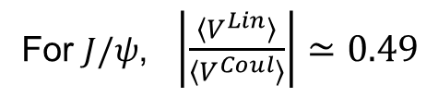


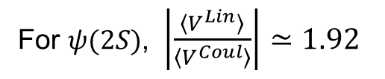
Energy decomposition of the low-lying charmonium states
For $J/ψ$, $\left|\frac{〈V^{Lin}〉}{〈V^{Coul}〉}\right|≃0.49$
$$J/ψ$$
For $ψ(2S)$, $\left|\frac{〈V^{Lin}〉}{〈V^{Coul}〉}\right|≃1.92$
$$ψ(2S)$$
The ratio increases quickly for excited states.
The linear confinement potential increases with the excitation quantum numbers, while the Coulomb potential decreases. Their combined contribution drives the instability of the excited states.
How do these energy terms evolve with the increased constituent degrees of freedom?
W.J. Deng, H. Liu, L.C. Gui, X.H. Zhong, PRD95, 034026 (2017)
M. S. Liu, Q. F. Lu, X. H. Zhong and Q. Zhao, PRD 100, 016006 (2019)

Slide 38
Fully-heavy tetraquarks as ideal exotic candidates
LHCb Collaboration, arXiv:2006.16957v1 [hep-ex]

Slide 39
Unbound fully-heavy tetraquarks:
J.~P.~Ader, J.~M.~Richard and P.~Taxil, Phys.\ Rev.\ D {\bf 25}, 2370 (1982)
J.~M.~Richard, A.~Valcarce and J.~Vijande, Phys.\ Rev.\ D {\bf 95}, 054019 (2017); Phys.\ Rev.\ C {\bf 97}, 035211 (2018)
M.~Karliner, S.~Nussinov and J.~L.~Rosner, Phys.\ Rev.\ D {\bf 95}, 034011 (2017)
J.~Wu, Y.~R.~Liu, K.~Chen, X.~Liu, and S.~L.~Zhu, Phys.\ Rev.\ D {\bf 97}, 094015 (2018)
M. S. Liu, Q. F. Lu, X. H. Zhong and Q. Zhao, Phys. Rev. D 100, 016006 (2019).
M.S. Liu, F.X. Liu, X.H. Zhong and Q. Zhao, 2006.11952 [hep-ph].
X.Z. Weng, X.L. Chen, W.Z. Deng, and S.L. Zhu, arXiv:2010.05163v1 [hep-ph]
Bound fully-heavy tetraquarks:
L.~Heller and J.~A.~Tjon, Phys.\ Rev.\ D {\bf 32}, 755 (1985)
R.~J.~Lloyd and J.~P.~Vary, Phys.\ Rev.\ D {\bf 70}, 014009 (2004)
N.~Barnea, J.~Vijande and A.~Valcarce, Phys.\ Rev.\ D {\bf 73}, 054004 (2006);
M.~N.~Anwar, J.~Ferretti, F.~K.~Guo, E.~Santopinto and B.~S.~Zou, Eur.\ Phys.\ J.\ C {\bf 78}, 647 (2018)
Y.~Bai, S.~Lu and J.~Osborne, Phys.Lett.B 798 (2019) 134930

Slide 41
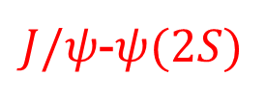
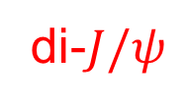
di-$J/ψ$
$J/ψ$-$ψ(2S)$
ATLAS Colla., arXiv:2304.08962v1 [hep-ex]

Slide 42
Constituent quark models:
X. Jin et al., Eur.Phys.J.C 80 (2020) 11, 1083
G. Yang, J.L. Ping, J. Segovia, Symmetry 12 (2020) 11, 1869
X.Z. Wen et al., Phys.Rev.D 103 (2021) 3, 034001 [only the color-magnetic interaction included]
Q.F. Lyu et al., Eur.Phys.J.C 80 (2020) 9, 871 [Extended relativized quark model]
M.C. Gordillo, F. De. Soto, J. Segovia, Phys.Rev.D 102 (2020) 11, 114007 [Difussion Monto Carlo mechod]
M.S. Liu, F.X. Liu, X.H. Zhong, Q. Zhao, 2006.11952 [hep-ph]
G.J. Wang, L. Meng, M. Oka, S.L. Zhu, PRD 104, 036016 (2021)
Coupled-channel approach:
X.K. Dong, V. Baru, C. Hanhart, F.K. Guo, A. Nefediev, Phys.Rev.Lett. 126 (2021) 13, 132001
C. Gong, M.C. Du, Q. Zhao, X.H. Zhong, B. Zhou, Phys.Lett.B 824 (2022) 136794
Z. Zhang et al., Phys.Rev.D 105 (2022) 5, 054026
Z.H. Guo, J.A. Oller, Phys.Rev.D 103 (2021) 3, 034024
C. Gong, M.C. Du, Q. Zhao, Phys.Rev.D 106 (2022), 054011
Diquark model:
M.A. Bedolla et al., Eur.Phys.J.C 80 (2020) 11, 1004
J.F. Giron, R.F. Lebed, Phys.Rev.D 102 (2020) 7, 074003
M. Karliner, J.L. Rosner, Phys.Rev.D 102 (2020) 11, 114039
R.N. Faustov, et al., Universe 7 (2021) 4, 94
H.W. Ke, X.H. Liu, Y.L. Shi, Eur.Phys.J.C 81 (2021) 5, 427
Hybrid tetraquark:
L.B. Wang and C.F. Qiao, Phys.Lett.B 817 (2021) 136339
QCD sum rules:
Z.G. Wang, Int.J.Mod.Phys.A 36 (2021) 02, 2150014
Q.N. Wang, Z.Y. Yang, W. Chen, Phys.Rev.D 104 (2021) 11, 114037
R.H. Wu et al., JHEP 11 (2022) 023
Production and decay mechanisms:
C. Becchi, A. Giachino, L. Maiani, E. Santopinto, Phys.Lett.B 811 (2020) 135952
J.Z. Wang, D.Y. Chen, X. Liu, T. Matsuki, Phys.Rev.D 103 (2021) 7, 071503
R.L. Zhu, Nucl.Phys.B 966 (2021) 115393
Rafał Maciuła et al., Phys.Lett.B 812 (2021) 136010
Y.Q. Ma and H.F. Zhang, 2009.08376 [hep-ph]
F. Feng et al., Phys.Rev.D 106 (2022) 11, 114029
V. P. Gonçalves, Bruno D. Moreira, Phys.Lett.B 816 (2021) 136249
Now, all the calculated masses are above the double charm threshold!

Slide 43
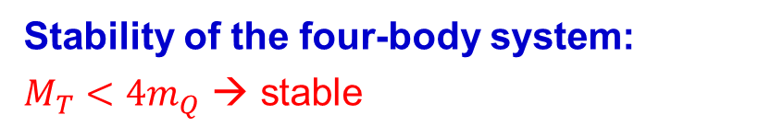
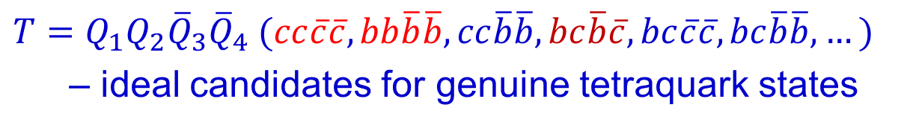
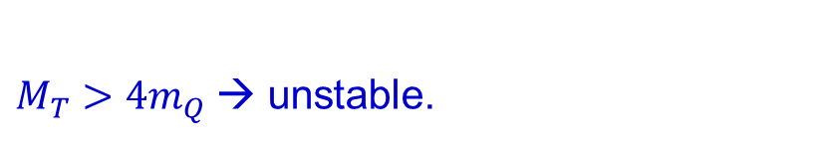
Typical fully-heavy tetraquark system with color-spin-flavor symmetry
$T=Q_{1}Q_{2}{\overline{Q}}_{3}{\overline{Q}}_{4} (cc\overline{c}\overline{c}, bb\overline{b}\overline{b}, cc\overline{b}\overline{b}, bc\overline{b}\overline{c}, bc\overline{c}\overline{c},bc\overline{b}\overline{b}, …)$
– ideal candidates for genuine tetraquark states
Stability of the four-body system:
$M_{T}<4m_{Q}$ → stable
$M_{T}>4m_{Q}$→ unstable.

Slide 44
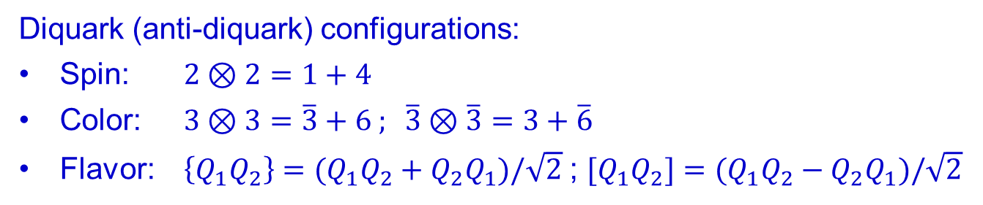
Typical fully-heavy tetraquark system with color-spin-flavor symmetry
$$T=Q_{1}Q_{2}{\overline{Q}}_{3}{\overline{Q}}_{4} (cc\overline{c}\overline{c}, bb\overline{b}\overline{b}, cc\overline{b}\overline{b}, bc\overline{b}\overline{c}, bc\overline{c}\overline{c},bc\overline{b}\overline{b}, …)$$
Diquark (anti-diquark) configurations:
Spin: $2⊗2=1+4$
Color: $3⊗3=\overline{3}+6 ; \overline{3}⊗\overline{3}=3+\overline{6}$
Flavor: $\left\{Q_{1}Q_{2}\right\}=(Q_{1}Q_{2}+Q_{2}Q_{1})/\sqrt{2}$ ; $[Q_{1}Q_{2}]=(Q_{1}Q_{2}−Q_{2}Q_{1})/\sqrt{2}$

Slide 46
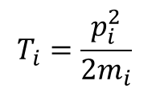
Reminder of the Hamiltonian adopted
Hamiltonian in a non-relativistic quark model:
$$T_{i}=\frac{p_{i}^{2}}{2m_{i}}$$
Color matrix elements:

Slide 47





Dynamic feature for fully-heavy tetraquark system
Jacobi coordinates:
m₁
m₃
$$ξ_{3}$$
$$ξ_{1}$$
$$ξ_{2}$$
$$ξ_{4}$$
m₂
m₄
$$r_{2}$$
Trial wavefunction for the ground states expanded
by a series of Gaussian functions:
Jacobi coordinate
E. Hiyama, Y. Kino, and M. Kamimura, Gaussian expansion method for few-body systems, Prog. Part. Nucl. Phys. 51, 223 (2003).
Liu, Lyu, Zhong, and Zhao, Phys. Rev. D 100, 016006 (2019) ; M. S. Liu, Q. F. Lu, X. H. Zhong and Q. Zhao, Phys. Rev. D 100, 016006 (2019). M.S. Liu, F.X. Liu, X.H. Zhong and Q. Zhao, 2006.11952 [hep-ph].

Slide 48
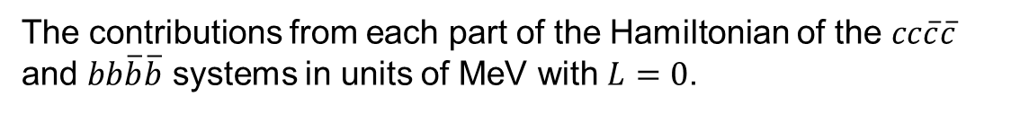
The contributions from each part of the Hamiltonian of the $cc\overline{c}\overline{c}$ and $bb\overline{b}\overline{b}$ systems in units of MeV with $L=0$.
The confining potential contributes a positive energy and cannot be neglected.
This implies that the four-quark systems are located above the two-heavy meson thresholds.
The treatment of the confinement potential seems to distinguish models in the literature.
(See M. S. Liu, Q. F. Lu, X. H. Zhong and Q. Zhao, Phys. Rev. D 100, 016006 (2019), and references therein.)
Predicted masses (MeV) for the $cc\overline{c}\overline{c}$ system compared with other models.

Slide 49
Predicted mass spectra for the$cc\overline{c}\overline{c}$, $bb\overline{b}\overline{b}$ and $bb\overline{c}\overline{c}$ systems.
The transition between color representations $6⊗\overline{6}$ and $3⊗\overline{3}$ seems to be small.
G.J. Wang, L. Meng, M. Oka, S.L. Zhu, PRD 104, 036016 (2021)

Slide 50




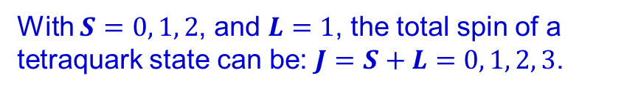
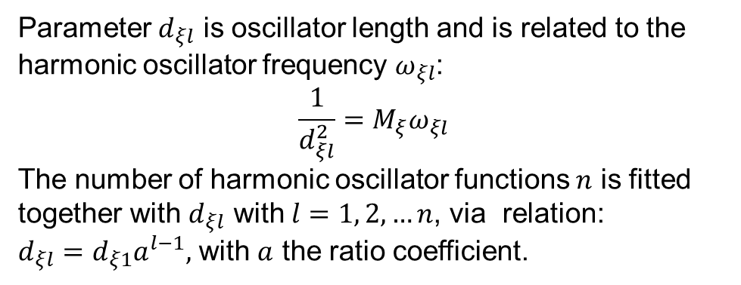

First orbital excitation states
The radial part of the wavefunction is expanded with a series of harmonic oscillator functions:
m₁
m₃
where
$$ξ_{3}$$
$$ξ_{1}$$
$$ξ_{2}$$
$$ξ_{4}$$
m₂
m₄
$$r_{2}$$
Parameter $d_{ξl}$ is oscillator length and is related to the harmonic oscillator frequency $ω_{ξl}$:
$$\frac{1}{d_{ξl}^{2}}=M_{ξ}ω_{ξl}$$
The number of harmonic oscillator functions $n$ is fitted together with $d_{ξl}$ with $l=1, 2, …n$, via relation:
$d_{ξl}=d_{ξ1}a^{l−1},$ with $a$ the ratio coefficient.
Jacobi coordinate
With $S=0, 1, 2$, and $L=1$, the total spin of a tetraquark state can be: $J=S+L=0, 1, 2, 3$.

Slide 51
Predicted masses for the P-wave $cc\overline{c}\overline{c}$ states. ${(ξ}_{1},ξ_{2})$ stands for a configuration containing both $ξ_{1}$ and $ξ_{2}$-mode of orbital excitations, while $(ξ_{3})$ stands for a configuration containing $ξ_{3}$-mode of orbital excitation.

Slide 52
The contributions from each part of the Hamiltonian of the $cc\overline{c}\overline{c}$ systems in units of MeV with $L=1$.
One still sees significant contributions from the confinement potential which push the energy level further beyond the two-heavy meson thresholds.

Slide 54
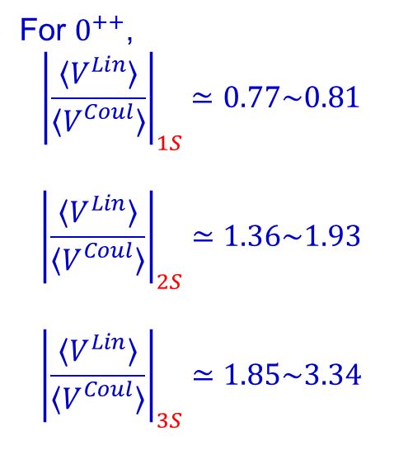
Energy decomposition for the $0^{++}$ states in the ground state, and first and second radial excitations
For $0^{++}$,
$${\left|\frac{〈V^{Lin}〉}{〈V_{}^{Coul}〉}\right|}_{1S}≃0.77\sim 0.81$$
$${\left|\frac{〈V^{Lin}〉}{〈V_{}^{Coul}〉}\right|}_{2S}≃1.36\sim 1.93$$
$${\left|\frac{〈V^{Lin}〉}{〈V_{}^{Coul}〉}\right|}_{3S}≃1.85\sim 3.34$$
Fast growth of the linear confinement potential with the excitation quantum numbers

Slide 55



Sufficient energies for non-annihilation decays:
Rearrangement decays
Two pion production
Open channel decays
$$M_{T}−4m_{Q}>2M_{c\overline{c}}$$
$$M_{T}−4m_{Q}>2M_{c\overline{c}}+2M_{π}$$
$$M_{T}−4m_{Q}>M_{c\overline{c}}+2M_{D}$$
Broad widths for higher excitation multiquark states.

Slide 56





Quark-rearrangement couplings and final-state interactions
$$g0=f(0)$$
h₁ (P, V, A, …)
$ψ_{0}$
Bare couplings from QM
$$g0=f(0)$$
h₂ (P, V, A …)
Physical couplings taking into account the FSIs
h₁
h₁
$ψ_{0}$
Ψ
$$geff=g0$$
h₂
h₂

Slide 57
4. Some crucial issues to be noted
A genuine color-singlet multiquark state may not exist as a stable physical state. However, it should exist as the short-distance component in the physical state.
With the increase of the constituents within the genuine color-singlet multiquark states they will become unstable due to the confinement potential.
The nearby threshold may bring down the energy to stabilize the system which bridges it to the hadronic molecule scenario.
The role played by the triangle singularity mechanism should be included in the analysis.
LQCD can tell more…
… …

Slide 58
Recent reviews on hadron spectroscopy and QCD exotics:
F.K. Guo, C. Hanhart, U. G. Meißner, Q. Wang, Q. Zhao and B.S. Zou, Rev. Mod. Phys. 90, no.1, 015004 (2018);
H.X. Chen, W. Chen, X. Liu and S.L. Zhu, Phys. Rept. 639, 1-121 (2016);
A. Esposito, A. Pilloni and A. D. Polosa, Phys. Rept. 668, 1-97 (2017);
A. Ali, J.S. Lange and S. Stone, Prog. Part. Nucl. Phys. 97, 123-198 (2017);
Y.R. Liu, H. X. Chen, W. Chen, X. Liu and S.L. Zhu, Prog. Part. Nucl. Phys. 107, 237-320 (2019);
N. Brambilla, S. Eidelman, C. Hanhart, A. Nefediev, C.P. Shen, C.E. Thomas, A. Vairo and C.Z. Yuan, Phys. Rept. 873, 1-154 (2020);
R.F. Lebed, R.E. Mitchell and E.S. Swanson, Prog. Part. Nucl. Phys. 93, 143-194 (2017);
Y. Yamaguchi, A. Hosaka, S. Takeuchi and M. Takizawa, J. Phys. G 47, no.5, 053001 (2020).
R.M. Albuquerque, J.M. Dias, K.P. Khemchandani, A. Martinez Torres, F.S. Navarra, M. Nielsen and C. M. Zanetti, J. Phys. G 46, no.9, 093002 (2019)
F.-K. Guo, X.-H. Liu and S. Sakai, Prog. Part. Nucl. Phys. 112, 103757 (2020)
Thanks for your attention!

Slide 59

Coupled-channel explanations
Basic assumption:
Rescatterings of two charmonium states via a short-ranged potential would lead to near-threshold enhancements as either bound states, resonances, or virtual states.
What is the dynamic origin of the short-ranged potential?
$J/ψ$ $J/ψ$, $J/ψ$ $ψ(2S)$, $J/ψ$ $ψ(1D)$
X.K. Dong, V. Baru, F. K. Guo, C. Hanhart and A. Nefediev, arXiv:2009.07795 [hep-ph]

Slide 60
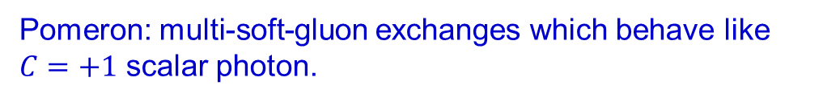
Pomeron exchange for diffractive processes
Diffractive dominance in vector meson photoproduction
dσ/dΩ
t-channel:
Pomeron exchange
s-channel
u-channel
Pomeron: multi-soft-gluon exchanges which behave like $C=+1$ scalar photon.
0
90
180
A. Donnachie and P.V. Landshoff, Nucl. Phys. B 244 (1984) 322; Phys. Lett. B 185 (1987) 403
Scattering angle

Slide 61
Pomeron exchange model for the coupled-channel explanations
The Regge trajectory of the Pomeron exchange
(refecting the feature of color potential?)
Coupling vertex:
Coupling to the charmonium:
C. Gong, M.C. Du, B. Zhou, Q. Zhao, X.H. Zhong, arXiv:2011.11374 [hep-ph]

Slide 62
Transition amplitudes of the tree-level processes:
Project out the partial couplings with the projection operators:

Slide 63

Effective potential without $t$ dependence:
The coupled-channel T –matrix:
L. Roca, E. Oset and J. Singh, Phys. Rev. D 72 (2005), 014002

Slide 64
The coupled-channel potential for $J/ψ$ $J/ψ$, $J/ψ$ $ψ(2S)$, $ψ\left(2S\right)ψ\left(2S\right)$:
Even a good candidate for genuine tetraquark states seems to suffer from threshold dynamics!

Slide 65
K* has been removed from the π K spectrum.
No Zc(3900) signals seem to be present.
Negative results from Belle and LHCb in similar processes.
In contrast, X(3872) can be produced in both B decays and heavy ion collisions.
This, however, may be understandable.
s
‾q
X(3872);
Zc(3900)
X(3872)
q
‾q
‾D (‾D*)
s
‾c
‾q
b
‾c
c
b
‾q
D* (D)
c
‾q
I=0, 1
I=0
Short-distance component is responsible for the large production rate of X(3872) in both B decays and heavy ion collisions [G. Y. Chen, W. S. Huo and Q. Zhao, Chin. Phys. C 39, no. 9, 093101 (2015)].

Slide 66

Experimental evidence for $Z_{cs}(3985)$
BESIII, arXiv:2011.07855v1 [hep-ex]
D_{s1}(2536)
D_{s2}(2573)
M.C. Du, Q. Wang and Q. Zhao, arXiv:2011.09225v1 [hep-ph]

Slide 67
The LHCb di-J/psi events are dominated by double-parton scatterings.
LHCb Collaboration, arXiv:2006.16957v1 [hep-ex]

Slide 68

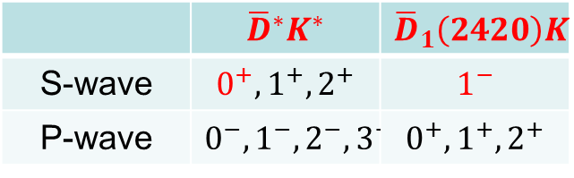
Recent experimental progresses
X(6900)
Zcs(3985)
LHCb Collaboration, arXiv:2006.16957 [hep-ex]
BESIII, arXiv:2011.07855 [hep-ex]
$X_{0}(2900)/X_{1}\left(2900\right)$: $(\overline{c}\overline{s}ud)$
 | $${\overline{D}}^{∗}K^{∗}$$ | $${\overline{D}}_{1}\left(2420\right)K$$
S-wave | $$0^{+}, 1^{+}, 2^{+}$$ | $$1^{−}$$
P-wave | $$0^{−}, 1^{−}, 2^{−}, 3^{−}$$ | $$0^{+}, 1^{+}, 2^{+}$$
LHCb Collaboration, arXiv:2009.00025 [hep-ex]; arXiv:2009.00026 [hep-ex]

Slide 69
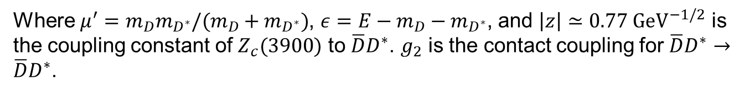
Similar treatment for Zc(3900) as a DD* molecular state
D*
D*
D*
D*
Zc(3900)
Where $μ^{′}=m_{D}m_{D^{∗}}/(m_{D}+m_{D^{∗}})$, $ε=E−m_{D}−m_{D^{∗}}$, and $\left|z\right|≃0.77 {GeV}^{−1/2}$ is the coupling constant of $Z_{c}(3900)$ to $\overline{D}D^{∗}$. $g_{2}$ is the contact coupling for $\overline{D}D^{∗}→\overline{D}D^{∗}$.
Z.H. Guo, J.A. Oller, Phys.Rev.D 103 (2021) 5, 054021
T. Ji et al., Phys.Rev.D 106 (2022) 9, 094002
M.L. Du et al., Phys.Rev.D 105 (2022) 7, 074018

Slide 70
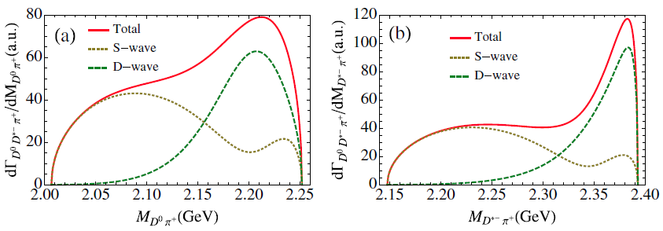
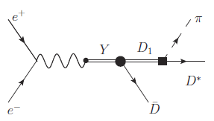
Invariant mass spectra for Dπ, D*π, and ‾DD*
Signature for D₁(2420) via the tree diagram.
The Zc(3900) could have a pole below the DD* threshold.
Dominant S-wave only contributes to different kinematics:

Slide 71
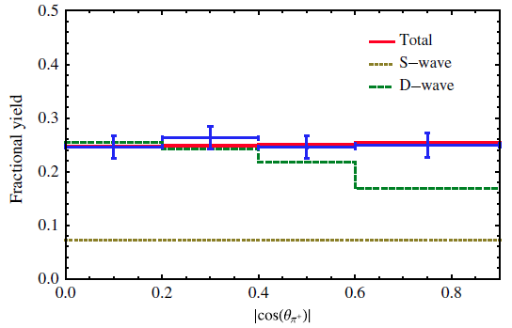
Angular distribution analysis
π⁺
BESIII (2013)
θ_{π}⁺
e⁺
e⁻
D
θ_{πD}
D*
The dominance of D wave at the Zc peak can compromise with the angular distribution.

Slide 72

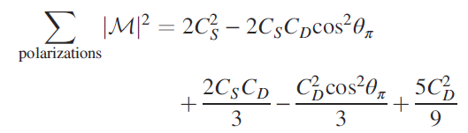



How a D wave can be present?

Slide 73


Y(4260) may have sizeable couplings to DD₁(2420) if it is a hybrid.
Then, how to distinguish them?
$e^{+}e^{−}→K\overline{K} J/$ψ
c
D₁
‾q (‾u,‾d,‾s )
q (u, d, s )
‾c
‾D
A hybrid mode will have access to J/ψ K‾K by quark rearrangement?
Y(4260) as a hybrid:
σ($e^{+}e^{−}→K\overline{K} J/$ψ) ≅ σ($e^{+}e^{−}→ J/$ψ)
BESIII, PRD 97, 071101(R) (2018)

Slide 74


What kind of observables are sensitive to the internal structure of Y(4260)?
D₁D: 2420+1868=4288 MeV
D_{s1}D_{s}: 2460+1968=4428 MeV
2536+1968=4504 MeV
D_{s1}D_{s}*: 2536+2112=4648 MeV
D_{s2}D_{s}*: 2573+2112=4685 MeV
$e^{+}e^{−}→K\overline{K} J/$ψ
Y(4260) as a hadronic molecule:
σ($e^{+}e^{−}→K\overline{K} J/$ψ) << σ($e^{+}e^{−}→ J/$ψ)
Z. Cao and Q.Z., Phys. Rev. D99, 014016 (2019)

Slide 75

Lineshapes of the J/ψK invariant mass spectrum at different energies
-- sensitive to the nearby triangle singularity condition!
BESIII, PRD 97, 071101(R) (2018)
Why Zcs(3985) does not appear in the threshold region?
$\sqrt{S}=4.17$ GeV
T. Xiao et al., Phys.Lett.B 727 (2013) 366-370

Slide 76
BESIII, arXiv:2011.07855v1 [hep-ex]
Experimental evidence for $Z_{cs}(3985)$
D_{s1}(2536)
D_{s2}(2573)
M.C. Du, Q. Wang and Q. Zhao, arXiv:2011.09225v1 [hep-ph]

Slide 77



$$e^{+}e^{−}→ψ\left(3686\right)π^{0}{ π}^{0}$$
BESIII, Phys.Rev. D97 (2018) no.5, 052001
X.-H. Liu, PRD90 (2014) 074004

Slide 78
Production correlation?

Slide 79
K* has been removed from the π K spectrum.
No Zc(3900) signals seem to be present.
Negative results from Belle and LHCb in similar processes.
In contrast, X(3872) can be produced in both B decays and heavy ion collisions.
This, however, may be understandable.
s
‾q
X(3872);
Zc(3900)
X(3872)
q
‾q
‾D (‾D*)
s
‾c
‾q
b
‾c
c
b
‾q
D* (D)
c
‾q
I=0, 1
I=0
Short-distance component is responsible for the large production rate of X(3872) in both B decays and heavy ion collisions [G. Y. Chen, W. S. Huo and Q. Zhao, Chin. Phys. C 39, no. 9, 093101 (2015)].

Slide 80


Implementation of chiral symmetry and heavy quark symmetry
QCD Lagrangian:
Where the Lagrangian is separated by the quark mass scales, i.e. $m_{u,d,s}≪Λ_{QCD}≪m_{c,b,t}$
In the chiral symmetry limit, $m_{u,d,s}→0,$ the left and right quark fields can be separated by the projection operator, $\frac{1±γ_{5}}{2}$ ,

Slide 81


Under the chiral symmetry of $SU{\left(3\right)}_{L}⊗SU{\left(3\right)}_{R}$, the quark fields transform as
The QCD Lagrangian keeps invariant
Chiral symmetry spontaneous breaking: $SU{\left(3\right)}_{L}⊗SU{\left(3\right)}_{R}→SU{\left(3\right)}_{V}$.
Nambu-Goldstone theorem predicts the existence of 8 Goldstone bosons which can be expressed by the $SU(3)$ unitary matrix:
with
The chiral field transforms as
The chiral Lagrangian can be written as

