Slide 1
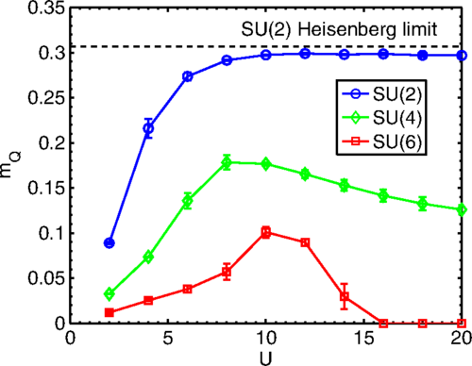
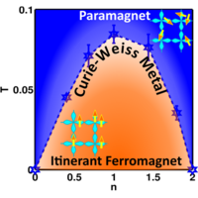
Locality and itineracy from Hubbard models
Congjun Wu
Department of Physics, School of Science, Westlake University
Neel order
ITP Conference, 06/01/2022
Notes:
It is my great pleasure to attend this wonderful workshop. Today I will talk about a hard-core problem of condensed matter physics, locality v.s. itineracy, based on quantum Monte Carlo simulations of different variants of Hubbard models.

Slide 2



Westlake University (西湖大学)
Bird view on the new campus
Institute for theoretical sciences

Slide 3
Collaborators
Da Wang (UCSD→ Nanjing Univ.)
Shenglong Xu (UCSD →UMD → TAMU)
Yi Li (UCSD →Princeton→ Johns Hopkins)
Zi Cai (UCSD→ Innsbruck → Shanghai JT)
Tianxin Ma (Beijing Normal Univ, UCSD)
Lei Wang (IOP)
Yu Wang, Zhi-Chao Zhou, Han Xu (Wuhan Univ.)

Slide 4
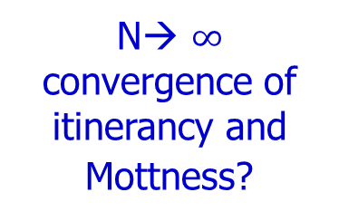
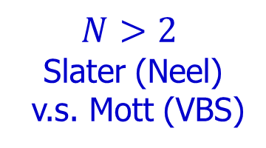
$$N>2$$
Slater (Neel)
v.s. Mott (VBS)
Neel order
Hubbard models
N→ $∞$
convergence of itinerancy and Mottness?
Multi-band
Curie-Weiss Metal
Notes:
I will first talk about the Slater v.s. Mott physics in the interaction driven insulating states. And then I will talk about the Curie-Weiss metal state in the itinerant ferromagnet.

Slide 5
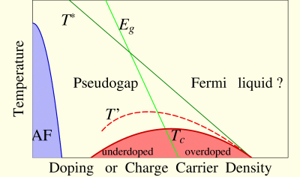
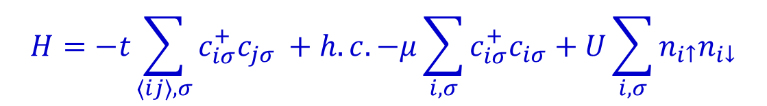
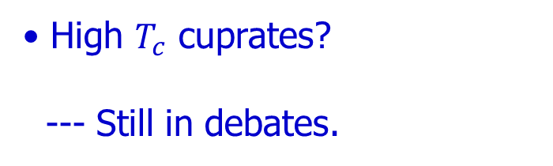
The Hubbard model
$${H=−t\sum_{〈ij〉,σ}^{ }{c_{iσ}^{+}c_{jσ}}}^{ }+h.c.−μ\sum_{i,σ}^{ }{c_{iσ}^{+}c_{iσ}}+U\sum_{i,σ}^{ }{n_{i↑}n_{i↓}}$$
Hubbard 1963: originally for itinerant ferromagnetism (FM) --- unsuccessful.
Successful for metal-Mott insulator transitions.
High $T_{c}$ cuprates?
--- Still in debates.

Slide 6
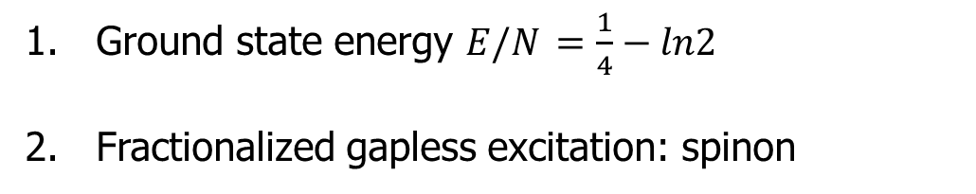
1D Mott state – Absence of long-range order
Half-filled (U>0) – Lieb-Wu solution (Hubbard).
Charge gap opens at U →0: Relevance of the Umklapp term
2. Spin channel is critical → no symmetry breaking
3. Bosonization+Sine-Gordon, DMRG
Bethe ansatz solution for the Heisenberg model.
Ground state energy ${E/N}_{ }={\frac{1}{4}−ln2}^{ }$
Fractionalized gapless excitation: spinon
C. N. Yang, PRL 19, 1312 (1967); Lieb and F. Y. Wu, PRL 20, 1445, (1968).

Slide 7
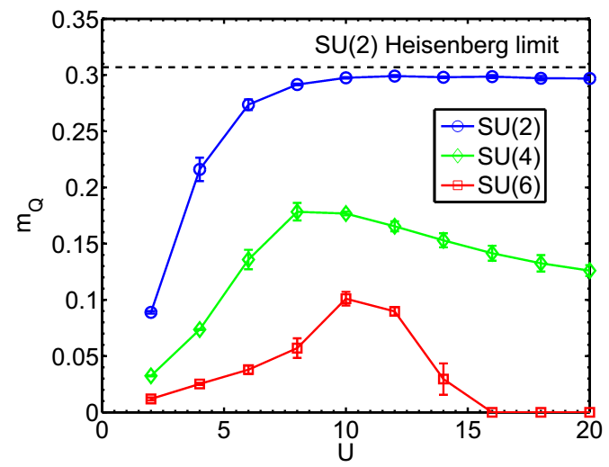
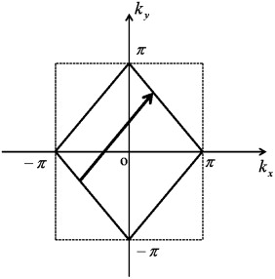

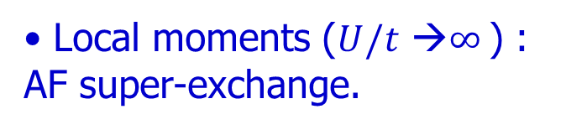
Fermi surface nesting v.s. local moments
Fermi surface nesting ($U/t$ →0 ) : strong charge fluctuations.
Local moments ($U/t$ →$∞^{ }$) : AF super-exchange.
SU(2): Neel order no transition
Determinant QMC.
J. Hirsch, 1985.
$${m∝Δ∝te^{−\sqrt{t/U }}}^{ }$$
Notes:
There are two fundamental viewpoints for interacting insulators. One is based on the Fermi surface nesting in the weak interacting regime. The other is in the strong interaction regime, which is dominated by the Heisenberg superexchange interaction. For the SU(2) case, there exists the afm long range order in both regimes without a phase transition. As confirmed by QMC simulations, the Neel order grows smoothly as increasing the Hubbard repulsion U, and it saturates at large values of U.

Slide 8
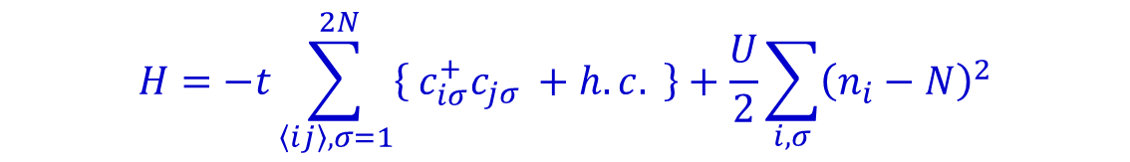
Half-filled SU(2N) Hubbard model
$${H=−t\sum_{〈ij〉,σ=1}^{ 2N}{\left\{ \right.c_{iσ}^{+}c_{jσ}}}^{ }+h.c.\left. \right\}+\frac{U}{2}\sum_{i,σ}^{ }{{\left(n_{i}−N\right)}^{2}}$$
Atomic limit t=0.
# of super-exchange processes scales as $N^{2}$.
SU(4)
one step of exchange
two steps of exchanges

Slide 9
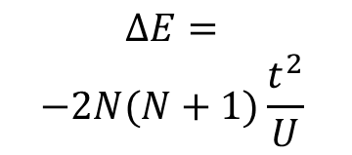
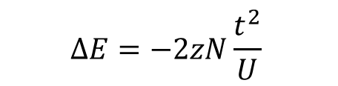
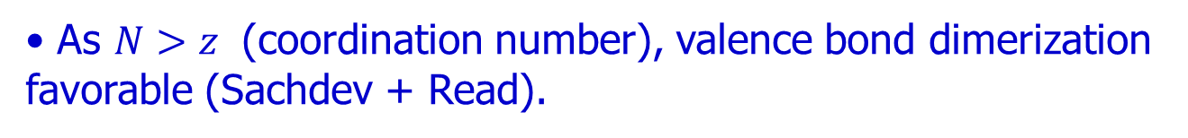
Enhanced spin fluctuations
Neel state unfavorable as N increases.
$${ΔE=−2zN\frac{t^{2}}{U}}^{ }$$
classic-Neel
$${\begin{aligned}ΔE= \\ −2N(N+1)\frac{t^{2}}{U}\end{aligned}}^{ }$$
SU(2N) singlet
Dimer state consists of resonating configurations.
As ${N>z}^{ }$ (coordination number), valence bond dimerization favorable (Sachdev + Read).

Slide 10
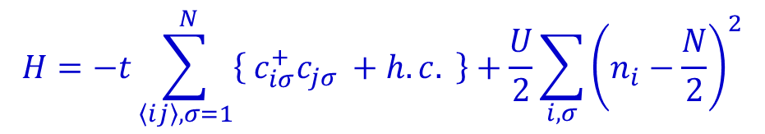
Enhanced spin flucations: SU(4), SU(6)
$${H=−t\sum_{〈ij〉,σ=1}^{ N}{\left\{ \right.c_{iσ}^{+}c_{jσ}}}^{ }+h.c.\left. \right\}+\frac{U}{2}\sum_{i,σ}^{ }{{\left(n_{i}−\frac{N}{2}\right)}^{2}}$$
Neel order
Magnetism suppressed as Mottness grows
D. Wang, Y. Li, Z. Cai, Z. Zhou, Y. Wang, CW, Phys. Rev. Lett. 112, 156403 (2014).
Notes:
We next consider the SU(N) Hubbard model, and study the large N effect to quantum magnetism at the particle-hole symmetric point, i.e. at half-filling. The QMC simulation can be performed in a sign-problem free way. Here are representative results. The blue line is the SU(2) case already explained before for comparison.
Both the SU(4) and SU(6) cases, the Neel orderings are significantly suppressed showing the strong quantum magnetic fluctuations. Furthermore, they are non-monotonic with U. In particular, for the SU(6) case, the AFM is suppressed at around U=14. As for the SU(4) case, it is not clear whether the Neel ordering can survive at U-> infinity or not

Slide 11
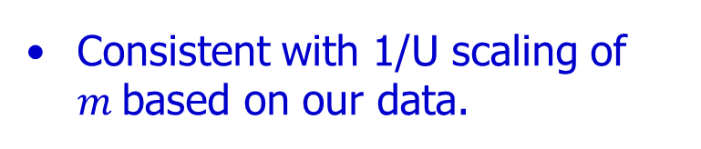
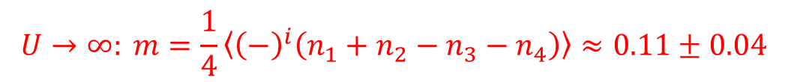
Infinite U limit: SU(4) Heisenberg model
Stronger quantum fluctuations: AF long-range order with a small moment
$${U→∞: m=\frac{1}{4}〈{\left(−\right)}^{i}\left(n_{1}+n_{2}−n_{3}−n_{4}\right)〉≈0.11±0.04}^{ }$$
Assaad et al, arXiv 1906.06938
Consistent with 1/U scaling of $m^{ }$based on our data.
Notes:
A recent work by Assaad directly simulated SU(4) Heisenberg model, which shows that AFM long rang order still exists. Quantum fluctuations are quite strong such that only 20% of the class value still survive. This result actually is consistent with the 1/U extrapolation based on our simulations at finite values of U.

Slide 12
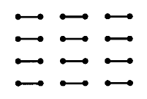
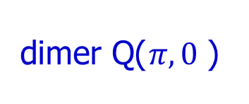

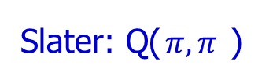

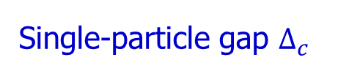
Slater to Mott quantum phase transition: (SU(6))
Mott-Heisenberg
Slater: Q(${π,π}^{ }$)
$U^{∗}$
$U_{c}^{ }$
dimer Q(${π,0}^{ }$)
Single-particle gap $Δ_{c}^{ }$
D. Wang, Lei Wang, CW, Phys. Rev. B 100, 115155 (2019).
Notes:
We look closer to the SU(6) case . We further calculate the single particle gap as plotted by the red line. The gap is tiny at U<10, consistent with Fermi surface nesting and the Neel ordering growing with U. After that the singlet particle gap grows linearly with U, showing the onset of the Mott gap. Then the Neel ordering is suppressed. After a critical value around 14, the Neel ordering is suppressed to zero. After that the system enters to a dimerized VBS phase. The SU(6) case shows a phase transition from the Slater to the Mott region, which is absent in the SU(2) case.

Slide 13
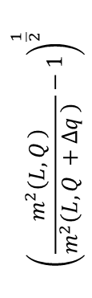

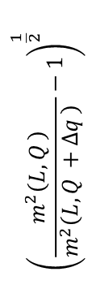
Critical exponents of the AF transition
A continuous transition.
$U_{c}^{ }=13.3±0.05,$
$ν=0.6±0.02$
${η=0.44±0.03 }^{ }$
$${\left(\frac{m^{2}\left(L,Q_{ }\right)}{m^{2}\left(L,Q_{ }+Δq_{ }\right) }−1\right)}^{\frac{1}{2}}$$
$${\left(\frac{m^{2}\left(L,Q_{ }\right)}{m^{2}\left(L,Q_{ }+Δq_{ }\right) }−1\right)}^{\frac{1}{2}}$$
D. Wang, Lei Wang, CW, Phys. Rev. B 100, 115155 (2019)

Slide 14
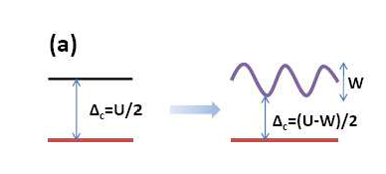
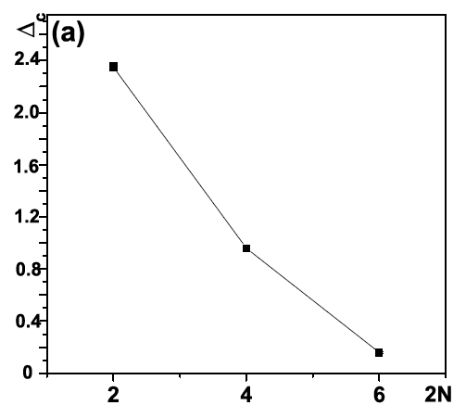
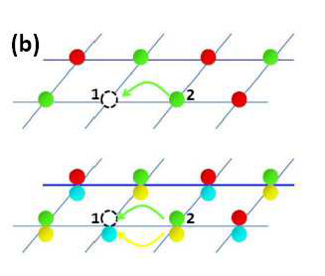
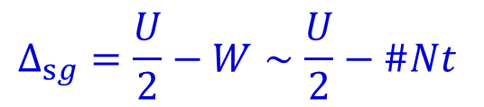
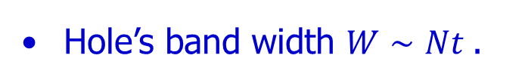
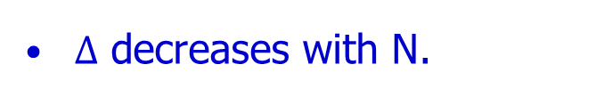
Softened single-particle gap as increasing N
$Δ$ decreases with N.
Hole’s band width ${W∼Nt}^{ }$.
$${Δ_{sg}=\frac{U}{2}−W∼\frac{U}{2}−\#Nt}^{ }$$
Notes:
Now we check the singlet particle scaling as increasing N. This is a simulation at a representative value U=8, the gap roughly decreases linearly as N increases. This could be understood via the following picture: If we add a hole to the half-filling background, which creates an excitation at the gap of U/2. The hopping of the hole generates the band width with reduces the gap. The hopping processes linearly scales with N, hence, the gap drops linearly with N.

Slide 15
Dirac fermion – SU(4) stagger flux Hubbard model
anisotropic Dirac fermion
Plaquette (VBS): absence of singlet-particle gap, but with spin-gap.
H. Xu, Yu Wang, Zhichao Zhou, CW, arxiv1912.11791.

Slide 16

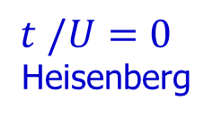
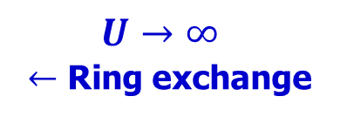
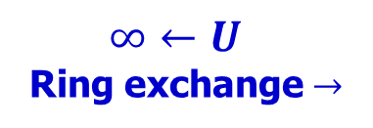

Ring exchange
Ring exchange processes sensitive to $φ_{ }^{ }$: the order of ${t^{4}/U^{3}}^{ }.$
$${U→∞}^{\begin{aligned} \\ \end{aligned}}$$
$←$ Ring exchange
$$t^{ }/{U=0}^{\begin{aligned} \\ \end{aligned}}$$
Heisenberg
$${∞←U}^{\begin{aligned} \\ \end{aligned}}$$
Ring exchange $→$
$0^{ }$- flux
$π^{ }$- flux
AFM
VBS

Slide 17

Digression: doped AFM towards SC (free of the sign prolem)
T. Ma, D. Wang, CW, to appear in PRB, arxiv 1806.03652.
$${V=t}_{⊥}^{ }=0,$$
$U=\frac{5}{2}, J_{⊥}=1, J_{z}=8$
Kramers symm. decomp.
CW, S C. Zhang PRB 71, 155115 (2005).
AFM destabilized and SC developing with doping
Extended s-wave.
single particle gap
Notes:
Now we consider a digression: Doping a Mott insulator towards superconductivity. This work is in collaboration with TX Ma and D Wang. After a long time fight, it was rejected by PRL and will appear
in PRB.
We consider a bilayer Hubbard model with inter-rung Heisenberg interaction, which is equivalent to a variant of the SU(4) Hubbard model. It is a generalization of the Scalapino-Zhang-Hanke model to the 2D plane. In a previous paper with SC, I developed a TR invariant decomposition method, which leads to the sign problem free QMC simulation at certain interaction parameter region.
Recently, we applied this algorithm to simulate this model -- it is a sign-problem free at any doping, which shows the developing of superconductivity upon doing the AFM insulator at half-filling. The single particle gap at half-filling is the Mott gap, which crosses over into the superconducting gap as doping. The pairing symmetry is extended s-wave.

Slide 18
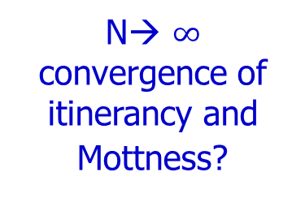
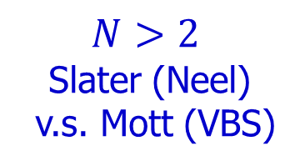
$$N>2$$
Slater (Neel)
v.s. Mott (VBS)
Hubbard models
N→ $∞$
convergence of itinerancy and Mottness?
Multi-band
Curie-Weiss Metal
Notes:
Now let us consider the case of very large values of N, which shows the convergence of itineracy and Mottness.

Slide 19


How do interaction effects scale with N (fixed U, n/N)?
Half-filling (particle density per component)
${\frac{n}{N}=\frac{1}{2}, k}_{f}^{ }=π/2$
Large U limit: Mottness
# of virtual hopping processes scales with ${(\frac{N}{2})}^{2}$
softening of the Mottness → $\frac{{ΔE}_{k}^{ }}{N}≈−Nt^{2}/U$
Small U limit: itinerancy
inter-component collision # scales with $N^{2}$
enhancement of collisions → $\frac{{ΔE}_{U}^{ }}{N}≈\left(N−1\right)U$
Notes:
Now we address an important question: How do interaction effects scale with N with a fixed U? Here we fix at half-filling, and the particle density scales with N. In the large U limit, the system is in the Mott insulating states. The number of virtual hopping processes scales as N^2, hence, the Mottness is softened as enlarging N. If we start with a small U nearly in the itinerant regime. Increasing N enhances inter-particle collisions, which enhances interaction effect.

Slide 20
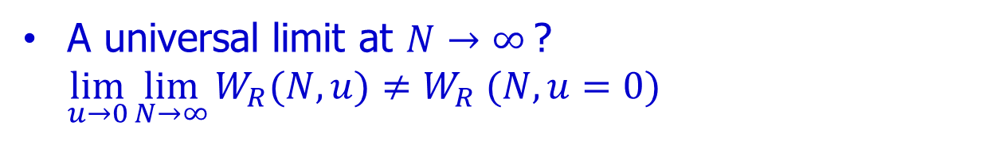

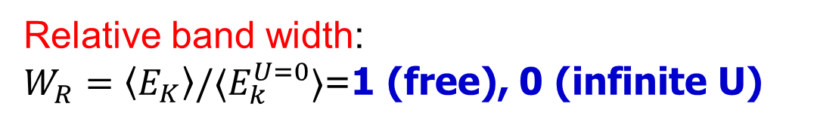
Convergence of itinerancy and locality
Relative band width:
$W_{R}^{ }=〈E_{K}〉/〈E_{k}^{U=0}〉$=1 (free), 0 (infinite U)
U/t=0.5→ 19
weak coupling: enhancement of collision as ${N→∞}^{ }$
1D SU(N)
strong coupling:
softening of Mottness
N=
A universal limit at ${N→∞}^{ }$? $\lim_{u→0}\lim_{N→∞}{W_{R}(N,u)≠W_{R} (N, u=0){ }}⁡$
Notes:
We check the above picture via QMC simulations for the 1D SU(N) Hubbard model, for which N can reach values of 14. It shows a tendency of convergence of itinerancy and locality as N goes large. We define the relative band width, which is the kinetic energy expectation value divided by that of the non-interacting case.
For free system, the relative band width equals 1, and if U is infinity, the relative band width equals 0.
Hence it can reflect the correlation effect. Different lines represent a fixed U as increasing N. U takes values from weak interacting region to strong interacting region.
For the strong interaction case, the relative band width is very small, which is a reflection of Mottness. The band width is due to virtual hopping. The Mottness is softened and band width increases as large N. On the contrary, if we start with a small U at the order of band width, the band width decreases as increasing N in the weak interaction side.
The relative band width seems to approach a limit from opposite directions. A question is that if it means an interacting limit at large N? And we feel that it is a signature of the convergence of itinerancy and locality.

Slide 21
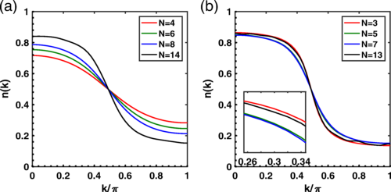

Fermi distribution in the strong coupling regime
Sharpening $n_{f}^{ }(k)$ as N (even) increases
$n_{f}^{ }≠$the ideal Fermi distribution as $N^{ }→∞$
$${U=15, β=30}^{ }$$

Slide 22
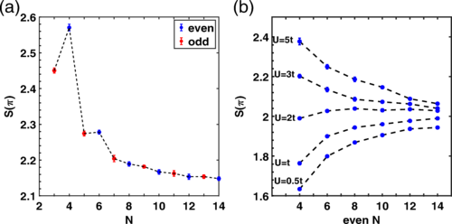
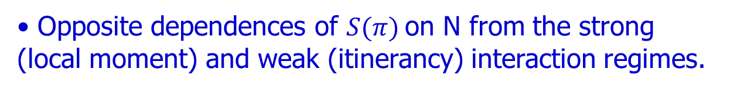

The AF structure factor
Opposite dependences of ${S(π)}^{ }$on N from the strong (local moment) and weak (itinerancy) interaction regimes.
$${\begin{aligned}U=15, \\ β=30\end{aligned}}^{ }$$

Slide 23






$$N>2$$
Slater (Neel)
v.s. Mott (VBS)
$$d_{yz}$$
$$\text{−}t_{∥}$$
$$d_{xz}$$
$${\hat{e}}_{x}$$
$$\text{−}t_{∥}$$
$${\hat{e}}_{y}$$
Hubbard models
N→ $∞$
convergence of itinerancy and Mottness?
Multi-band
Curie-Weiss Metal
Notes:
So far we have talked about insulating states. Next we move to metallic states, actually the Curie-Weiss metal for the itinerant ferromagnetism.

Slide 24
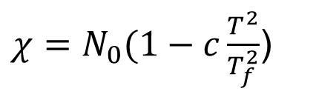
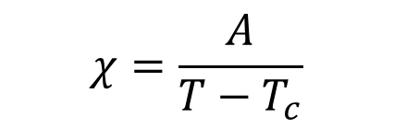
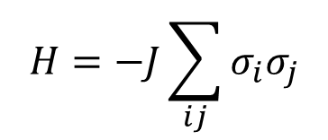
Magnetism: local moments vs. itinerant fermions
Local Moments: non-mobile, no Fermi surfaces.
$$H=−J\sum_{ij}{σ_{i}σ_{j}}$$
$$χ=\frac{A}{T−T_{c}}$$
Curie-Weiss susceptibility
Itinerant fermions: Fermi surfaces – much harder to form FM!
Pauli paramagnetism
FS
$χ=N_{0}(1−c\frac{T^{2}}{T_{f}^{2}}$)
N₀: density of states at the Fermi level
Before moving on , let me clarify what I mean on itinerant electrons.
Notes:
Let me clarify terminology. Most of us first learned the FM through the Ising model, which is a typical model for local moments, there is no FS. For this type mode, we can easily get the spin susceptibility obeying the Curie-Weiss behavior. I am not going to cover this type of magnetism. Instead, I will talk about itinerant metals with mobile fermions, forming Fermi surfaces. In weak coupling regime, the Fermi liquid theory tells us that the magnetic susceptibility has Pauli behavior. It is proportional to the DOS, having very weak dependence on the temperature. It is very hard to develop ferromagnetism based on this mechanism.

Slide 25
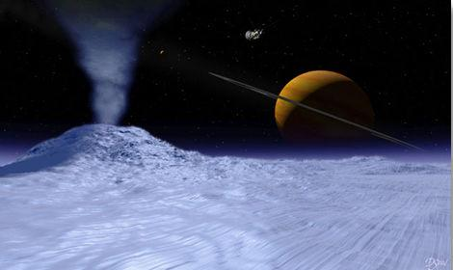
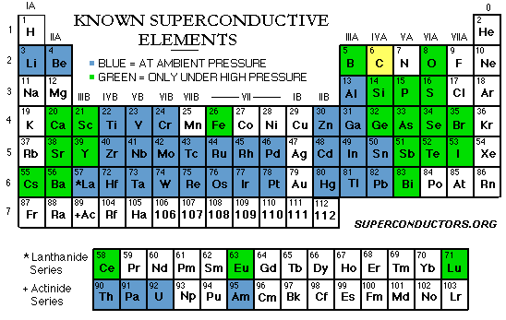
Ferromagnetism (FM) v.s. superconductivity
itinerant FM from Fermi surface instability
FM elements:
Fe Co Ni
Gd
Dy
gadolinium, dysprosium
Notes:
Ferromagnetism seems to be common, which was discovered 2500 years ago. Actually it is not the case. Let us make a comparison with superconductivity. This is the periodic table. The colored elements, that is, the majority of elements are superconducting. Nevertheless, ferromagnetic metals are much rarer, just Fe Co Ni. These rare earth metals are subtle, their ferromagnetism is related to local moments, and we will not talk here. Due to Fermi statistics, electrons do not want to stay in a single component. Naturally it is not easy to have itinerant FM. We feel that FM is common which is kind of an illusion. Iron is a common metal on the earth. Imagine if we were living on a remote satatlite, and there were no irons on it, we would feel that FM is a rare phenomenon.

Slide 26

Exchange v.s. correlation
Wigner: two-electron states are spin singlet.
triplet
$$ψ(r_{1}−r_{2})$$
Correlated nodeless singlet ground state in spite of strong interaction
(uncorrelated ) nodal
Kinetic energy advantage
No ferromagnetism in 1D (Lieb-Mattis) – the ground state requires the minimal number of nodes.
Notes:
The driving force of itinerant FM is the direct Heisenberg exchange interaction. Stoner generalized it to the many-body system and proposed the Stoner criterial. However, Stoner criterial completely neglects the correlation effect. Actually it can be proved that for a two-electron system the ground state is always a correlated singlet state, since it is nodeless. The triplet states have nodes which cost too much kinetic energy. This node argument can also be applied to 1D, such that there is no ferromagnetism in 1D.
FM 的驱动力是Heisenberg最早发现的direct exchange. 对于两个极化电子，它们的反对称空间波函数降低了它们相互接近的可能性，从而减小了相互排斥能。但对于金属的多体问题，存在费米面，电子的自旋极化增加了动能，这是个不利的因素。 Stoner提出了判据，相互作用乘以费米面上的态密度，得到一个无量纲的常数，这个量必须到底order of 1, 才会有铁磁。所以，铁磁不是一个infinitesimal的instability，尤其本质上的强关联特性。
Stoner机制是一个mean-field的机制，有严重的不足。它忽略了correlation, 即电子即使不极化，也可以避免接触，但代价是波函数变得correlated，好处是动能被节省了。实际上，大多数的金属，都是这样，相互作用很强，但不会发生铁磁性。我们来看一个简单的双电子问题，比如氢分子，E. Wigner指出，基态始终是单态。我们学过量子力学，基态波函数是无节点的，而单态是无节点的。 这个结论可以推广到1D多体问题，有Lieb-Mattis定理，即严格1D的系统是没有铁磁的。

Slide 27
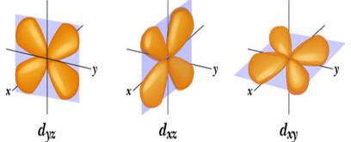


Hund’s coupling $≠$ global FM
Electron/hole spins add up when filling in degenerate orbitals.
Most FM metals have orbital degeneracy and Hund’s coupling.
Fermi surface
Hund’s rule usually cannot polarize the entire lattice!
$$d_{xz}$$
$$d_{yz}$$
Notes:
Most FM metals possess orbital band structure, in which the Hund’s rule plays an important role. The 1st Hund’s rule tells us that electron spins tend to maximize when filling in degenerate orbitals. It is actually a consequence of the direct exchange mechanism we explained before. It has been widely suspected for a long time that the Hund’s rule helps FM but the Hund’s rule alone is not sufficient. Although Hund’s rule is a very general phenomenon, FM is not so common. The reason is that the Hund’s coupling is a local physics. It usually can only polarize electrons on a single site, not is not sufficient to drive the global FM coherence. For example, for an itinerant system, in most situations, different sites polarize the spins in different ways such that the FS remain un-polarized.
(for example, Prof. Kotliar and his collaborators did pioneering work in illustrating the importance of the strong-correlation physics driven by the Hund’s coupling instead of the Hubbard U.)
… are essential, at infinite intra-orbital U, exact phase

Slide 28






The Curie-Weiss Metal
$${χ=\frac{A}{1−T/T_{0}}}^{ }, T_{0}<T≪T_{f}$$
Curie-Weiss susceptibility:
Natural for local moments but not for Fermi surfaces!
Paramagnetic states close to $T_{0}^{ }$: domain fluctuations!
${T>T}_{0}$
FS
$≠^{ }$
cf high $T_{c}$: the normal state, pseudogap.
FM: the CW state is more strongly correlated than the FM.
Notes:
Another well-known difficulty is the paramagnetic state above the Curie temperature – the Curie-Weiss metal. In a wide temperature regime, it exhibits the CW-law. It is natural for the Ising model-like local moment magnetism, but not for metals with Fermi surfaces. The CW metal exhibits dynamic ferromagnetic domain fluctuations in real space. The weak coupling theory often starts with the Fermi liquid theory with unpolarized Fermi surface. Such a momentum space picture cannot capture strong domain fluctuations. This is in analogous to high Tc cuprates. The normal state above Tc, the so-called pseudogap state is more strongly correlated and remains a puzzle. For the FM, the CW state is more strongly correlated. The FM state is already polarized, the exchange physics is more dominated, and the correlation is weakened.

Slide 29
A benchmark via non-perturbative study
An entire phase of the ground state itinerant FM
Y. Li, E. H. Lieb, CW, PRL
112, 217201 (2014).
QMC study to Curie-Weiss metal (sign problem-free)
S. Xu, Y. Li, and CW, PRX 5, 021032, (2015).
The first proof to our knowledge.
A simple and quasi-realistic model
$$d_{yz}$$
$$\text{−}t_{∥}$$
$$d_{xz}$$
$${\hat{e}}_{x}$$
$$\text{−}t_{∥}$$
$${\hat{e}}_{y}$$
Mechanism and
Experiments
Curie-Weiss susceptibility v.s. metallic compressibility
Notes:
在过去的几年中，我们取得了不少进展。建立了一个简单而准现实的模型。事实证明，它的基态表现出整个FM巡回状态，据我们所知，这是第一次。 （著名的长冈FM仅证明了不构成相的单个孔的情况。）我们的以下结果可以用作进一步分析和数值研究的基准。
例如，我们的模型基于dxz和dyz轨道的多轨道。所有电子都是巡游的，没有先验引入局部矩。它捕获了FM金属的两个共同特征：强相互作用和Hund的耦合。然而，为了精确起见，需要一维能带结构：dxz电子沿x方向移动，而dyz电子沿y方向移动。相反，磁性是二维的-当电子在交叉点相遇时，它们按照洪德定律耦合。我们无法感觉到一维频段是必不可少的，尽管我们无法确切证明它。 此外，该模型在任何电子填充时都没有QMC符号问题，因此可以高精度模拟其相图。尤其是，我们对居里-魏斯状态很感兴趣，这表明居里-魏斯自旋磁化率和几乎与温度无关的电荷磁化率。还进行了磁性临界定标。
%%%%%%%%%%%%%%%%%%%%%%%%%%%%%%%%%%%%%%%
In the past a few years, we have made a significant progress. A simple and quasi-realistic model is developed. Its ground states are proved to exhibit an entire phase of itinerant FM, which, to our knowledge, is the first time. (The well-known Nagaoka FM only proved the case of a single hole, which does not constitute a phase. ) Our results below can be used as a benchmark for further analytic and numeric studies.
Our model is based on multi-orbital, say, with dxz and dyz orbitals. All electrons are itinerant without local moments introduced as a priori. It captures two common features of FM metals: strong interaction, and Hund’s coupling. Nevertheless, in order for exactness, 1D band structure is needed: The dxz electrons move along x-direction, and dyz electrons move along the y-direction. In contrast, the magnetism is two-dimensional – when electrons meet at the crossing points, they are coupled by Hund’s rule. The 1D band, we do not feel, is essential although we cannot exact prove it.
Furthermore, this model is free of the QMC sign problem at any electron filling such that its phase diagram can be simulated with high precisions. In particular, we are interested in the Curie-Weiss state – which shows the Curie-Weiss spin susceptibility and nearly temperature independent charge susceptibility. The magnetic critical scaling was also performed.

Slide 30





Strong correlation + Hund’s rule
Intra-orbital repulsion $U→∞$.
Intra-orbital
singlet projected out
Inter-orbital Hund’s coupling J>0, and repulsion V.
Inter-orbital
singlet
$E=J+V$
3-fold triplet
$E=V$
Notes:
For convenience, let me use px,py orbitals to illustrate the interactions. Our modes captures two important features of FM metals: strong interaction, and Hund’s coupling. We consider the strong coupling limit by projecting out the doubly occupied orbitals. Literally this means U at infinity. Physically, it just means that U is sufficiently large such that the probability of doubly occupied orbitals is very small. Nevertheless, two electrons do can sit on the same sites, but in different orbitals. Then they can be classified as spin singlet and triplet. The energy splitting between them is the Hund’s coupling J, whose origin is the exchange interaction explained before.

Slide 31

A rigorous phase of itinerant FM
Theorem: FM ground states at $U→∞$ (fully polarized and unique up to 2Stot+1-fold spin degeneracy).
An entire phase: Valid at any generic fillings, any values for Hund’s coupling J>0, and inter-orbital interaction V.
A reliable reference point for analytic and numeric studies of FM in multi-orbital systems
Yi Li, E. H. Lieb, C. Wu, Phys. Rev. Lett. 112, 217201 (2014)
31
Notes:
We proved that the ground states of the above model are always fully spin-polarized at U→ infty, and they are unique except spin degeneracy. For the first time, we set up an entire phase of FM electrons: It is valid at any generic electron filling, and at any value of Hund’s coupling as long as it is ferromagnetic, and at any value of inter-orbital repulsion V. It establishes a reliable reference point for analytic and numeric studies of iterant FM.

Slide 32






Curie temperatures v.s filling (V=0)
$$T_{0}$$
$${V=0, J=2}^{ }$$
$${\frac{1}{χ}∝1−T/T_{0}}^{ }$$
$$n$$
$T_{0}$→0 at both n→0 (particle vaccum), and
n→ 2 (hole vaccum, spin-1 moments, no FM).
${ T}_{0,max}≈0.08t_{∥}$ at maximal itinerancy (p-h symmetry)
Notes:
Rigorously speaking, there should be no FM long rang order in 2D. Nevertheless, if we extrapolate the linear behavior of the inverse of spin susceptibility, we can obtain the mean-field CW temperature T0. Such a temperature still marks a crossover from the off-critical region to the critical region.
T0 is zero in both at the low filling, which is the electron vacuum, and also when filling → 2, which is the hole vacuum. The maximum of T0 is reached in the presence of an approximate particle-hole symmetry, where the charge carriers are most mobile. It can reach nearly 1/10 of t, if t is 1eV, then T0 can reach the order of 1000K, which is quite significant. Near the hole vacuum, most sites are occupied by two electrons forming spin-1 moments by Hund’s rule. This is an example of Hund’s rule not sufficient to build up FM coherence. We do need mobile electrons or holes to build up FM coherence.
At V = 0,
T0 reaches the maximum approximately 0.08 around
n = 1 at which electrons are most mobile. The curve of
T0 is nearly symmetric with respect to n = 1, i.e., there
is an approximate particle-hole symmetry.
Most sites are occupied by two electrons in
orthogonal orbitals forming a spin-1 moment, while the
mobile holes do not carry spin. Hole’s motion threads
these moments along its trajectory and aligns their di-
rections.

Slide 33


Critical ferromagnetic scaling
SU(2): thermal fluctuations suppress the 2D long-range FM ordering -- Mermin-Wagner theorem.
No long-range order at fintie T (Mermin-Wagner theorem)
If we neglect itineracy and quantum effects:
O(3) NLσ-model: FM directional fluctuations
2D O(3) class
In the critical regime,
As $T<T0$, $χ$ crosses over into an exponential growth.
Itinerant FS
1st or 2nd or phase transition
1D system, landau damping in p-h continuum
Alpha log
Beta
b = 3.1± 0.3
Notes:
Now let us further lower the temperature to enter the critical region. Based on the MW-theorem, there should be no FM long range order at finite temperatures. The critical region should be described the O(3) NL sigma model, demonated by the fluctuations of the orientations of magnetic moments. The susceptibility deviates from the linear behavior but crosses over into an exponential growth as show
Now we move from the off-critical region to the critical region. Based on the MW-theorem, there are no rigorous FM long-range orders in 2D with SU(2) symmetry at any finite temperature in spite of the ground state FM. This is due to strong thermal fluctuations in 2D.
As temperature …
Chi already shows a deviation from the CW-law starting from the CW temperature at the order of 0.1t and it enters the critical region. In this region, the FM order parameter already develops its magnitude, and its directional fluctuations are described by the O(3) non-linear σ-model. The The correlation length grows exponentially
****************************************************************
Next let us consider the critical temperature region. As is well-known, because of the SU(2) symmetry, thermal fluctuations suppress the 2D long-range FM ordering in spite of the ground state FM. we present the crossover of χ−1(T ) from the off-critical
region to the critical region, which exhibits clear deviation away from the CW-law as T ∼ T0 = 0.08tk

Slide 34






Momentum space picture of the CW-metal
2.0
$n_{F}\left(k\right)$=$n_{↑}\left(k\right)$+$n_{↓}\left(k\right)$
Domain flucutations c.f. pseudogap phase of high Tc
$$T_{0}^{ }/t≈0.08$$
At k→0, $n_{↑}\left(k\right)=n_{↓}\left(k\right)≈0.54≪1$
Exclusion in momentum space ${〈n_{k↑}n_{k↓}〉≈0 }^{ }$
large entropy capacity
Notes:
Here is the QMC results of the Fermi occupation at the a temperature slightly higher than Cuire temperature, and is unpolarized. Even at the center of the BZ, the occupation per spin is about 0.54 far from saturation. Rather the distribution is very similar to the polarized system with the same electron filling and temperature. This is consistent with the big domain picture: We estimated that the domain size is about 15 to 20 lattice constants, which means over a few hundred sites, electrons are polarized. The CW phase means an exclusion in momentum space – this kind of disfavoring double occupation typically occurs in real space, but now it is in momentum space. It also shows the CW state has a large entropy capacity, since each state in k space contribute nearly ln2 to entropy if we abuse the entropy formula for non-interacting fermions.

Slide 35



General mechanism – obstacle of kinetic-energy cost
U: brutal but wrong direction
J: driving force, insufficient alone
☺ 大隋江山（Fermi liquid）
程咬金: U(瓦岗寨)
李世民: J 关陇集团
Notes:
Now let me present some general thoughts for itinerant FM. Why FM with itinerant electrons are so difficult is because the kinetic energy cost of polarizing electrons is large. The intra-orbit Hubbard U mostly favors anti-FM, but it can significantly distort the Fermi distribution. The Hund rule J favors FM, but by itself, it’s power is not enough to overcome the high kinentic energy cost. Then based on the distorted Fermi distribution, FM can be achieved with much less kinetic energy cost and could even save kinetic energy.

Slide 36
$$N>2$$
Slater (Neel)
v.s. Mott (VBS)
Neel order
Hubbard models
N→ $∞$
convergence of itinerancy and Mottness?
Multi-band
Curie-Weiss Metal

Slide 37
Back up slides

Slide 38
The AF structure factor
Opposite dependences of ${S(π)}^{ }$on N from the strong (local moment) and weak (itinerancy) interaction regimes.
$${\begin{aligned}U=15, \\ β=30\end{aligned}}^{ }$$

Slide 39


Critical exponents of the AF transition
A continuous transition.
$U_{c}^{ }=13.3±0.05,$
$ν=0.6±0.02$
${η=0.44±0.03 }^{ }$
$${\left(\frac{m^{2}\left(L,Q_{ }\right)}{m^{2}\left(L,Q_{ }+Δq_{ }\right) }−1\right)}^{\frac{1}{2}}$$
$${\left(\frac{m^{2}\left(L,Q_{ }\right)}{m^{2}\left(L,Q_{ }+Δq_{ }\right) }−1\right)}^{\frac{1}{2}}$$
D. Wang, Lei Wang, CW, Phys. Rev. B 100, 115155 (2019).

Slide 40
Fermi distribution in the strong coupling regime
Sharpening $n_{f}^{ }(k)$ as N (even) increases
$n_{f}^{ }≠$the ideal Fermi distribution as $N^{ }→∞$
$${U=15, β=30}^{ }$$

Slide 41







QMC: The Curie-Weiss metal
V=0, J=2
$$κ$$
0.40
0.68
1.00
1.44
1.80
V=0, J=2
$$1/χ_{ }$$
$$T/t$$
$$T/t$$
Spin susceptibility (local-moment like, incoherent):
$${χ=\frac{A}{1−T/T_{0}}}^{ }, T_{0}<T<T_{ch}$$
Compressibility (itineracy): saturation at ${T<T}_{ch}^{ }$, and $T_{ch}^{ }\sim t$
Notes:
Here are the QMC reulsts, showing the clear evidence of the CW metal phase. CW means that the magnetic susceptibility obey the CW law. This is the inverse of spin susceptibility at different electron filling, and the temperature is in the unit of t. The CW law is obvioius from the temperature from the order of t to one order smaller. It means the spin channel is local moment like. On the other hand, within the same range of temperatures, the charge channel susceptiblity, i.e., the compressibility, saturates to be flat. This reflects the Fermi pressure, shows, the metallic feature.

Slide 42


Exchange v.s. correlation
Exchange: Heisenberg → Stoner
triplet
$$UN_{0}>1$$
$$ψ(r_{1}−r_{2})$$
(uncorrelated ) nodal
Correlation: unpolarized electrons still avoid each other.
Kinetic energy advantage
Correlated nodeless singlet ground state in spite of strong interaction (Wigner).
Lieb-Mattis theorem: No ferromagnetism in 1D.
Notes:
FM 的驱动力是Heisenberg最早发现的direct exchange. 对于两个极化电子，它们的反对称空间波函数降低了它们相互接近的可能性，从而减小了相互排斥能。但对于金属的多体问题，存在费米面，电子的自旋极化增加了动能，这是个不利的因素。 Stoner提出了判据，相互作用乘以费米面上的态密度，得到一个无量纲的常数，这个量必须到底order of 1, 才会有铁磁。所以，铁磁不是一个infinitesimal的instability，尤其本质上的强关联特性。
Stoner机制是一个mean-field的机制，有严重的不足。它忽略了correlation, 即电子即使不极化，也可以避免接触，但代价是波函数变得correlated，好处是动能被节省了。实际上，大多数的金属，都是这样，相互作用很强，但不会发生铁磁性。我们来看一个简单的双电子问题，比如氢分子，E. Wigner指出，基态始终是单态。我们学过量子力学，基态波函数是无节点的，而单态是无节点的。 这个结论可以推广到1D多体问题，有Lieb-Mattis定理，即严格1D的系统是没有铁磁的。

Slide 43





Strong correlation + Hund’s rule
Intra-orbital repulsion $U→∞$.
Intra-orbital singlet projected out
Inter-orbital Hund’s coupling J>0, and repulsion V.
$$d_{yz}$$
Inter-orbital
singlet
$$d_{xz}$$
$E=J+V$
3-fold triplet
$+$
$E=V$
Theorem: Fully polarized ground states at arbitrary filling n, arbitrary values of J>0, and V.
Uniqueness except the spin degeneracy.
Notes:
For convenience, let me use px,py orbitals to illustrate the interactions. Our modes captures two important features of FM metals: strong interaction, and Hund’s coupling. We consider the strong coupling limit by projecting out the doubly occupied orbitals. Literally this means U at infinity. Physically U cannot be infinite, it just means that U is sufficiently large such that the probability of doubly occupied orbitals is very small.
Nevertheless, two electrons do can sit on the same sites, but in different orbitals. Then they can be classified as spin singlet and triplet. The energy splitting between them is the Hund’s coupling J, whose origin is the exchange interaction explained before.

Slide 44



SU(N): Enhanced spin and charge fluctuations
Neel state unfavorable as N increases.
${ΔE=−zN\frac{{2t}^{2}}{U}}^{ }$:
z coordination #
classic-Neel
$${\begin{aligned}ΔE= \\ −N(N+1)\frac{2t^{2}}{U}\end{aligned}}^{ }$$
SU(2N) singlet
Enhanced spin fluctuations → New quantum phase transitions
Suppressed charge gap → $N→∞,Δ→0 ,$ another route to non-Fermi liquid?

Slide 45






Ring exchange: 0 and $π^{ }$-flux
Difference from the order of ${t^{4}/U^{3}}^{ }.$
$0^{ }$- flux
$$t^{ }/{U=0}^{\begin{aligned} \\ \end{aligned}}$$
Heisenberg
$π^{ }$- flux
$${U→∞}^{\begin{aligned} \\ \end{aligned}}$$
$${∞←U}^{\begin{aligned} \\ \end{aligned}}$$
AFM
VBS

