Slide 1
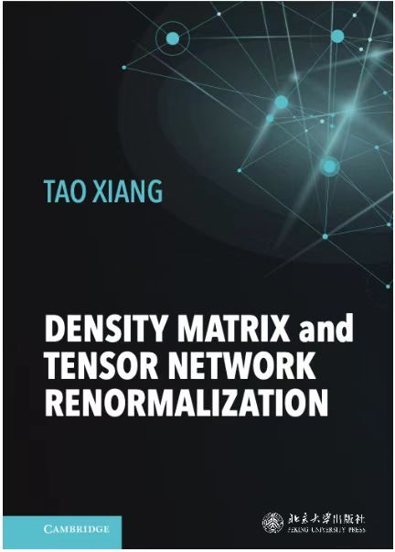
Density matrix and Tensor network
Renormalization
Tao Xiang
Institute of Physics
Chinese Academy of Sciences
txiang@iphy.ac.cn
Cambridge University Press
in press
Notes:
字体大小调大

Slide 2
Basic Idea of Renormalization Group
Outline
General introduction to the theory of tensor network renormalization group
Tensor-network renormalization of low-energy excited states

Slide 3
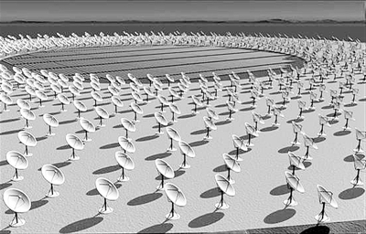
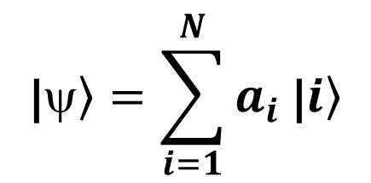
What is density-matrix and tensor-network renormalization for?
Tensor-network
renormalization
Combat the exponential growing problem
In the study of quantum many-body problems in physics, quantum chemistry, quantum information, we often meet the exponential growing problem
Polynomial cost
$$\text{|}\left.ψ\right\rangle =\sum_{i=1}^{N}{a_{i} \text{|}\left.i\right\rangle }$$
Many Body Systems
Exponential Wall
cost grows exponentially with the system size

Slide 4


Brief History of Renormalization Group
Renormalization group (RG) is one of the most important concepts first anticipated by Stueckelberg and Petermann in 1951.
Stueckelberg and Peterman. The normalization group in quantum theory. Helv. Phys. Acta. 24:317, 1951
Stueckelberg
Petermann
According to https://en.Wikipedia.org/wiki/Ernst_Stueckelberg:
“In 1943 he came up with a renormalization program to attack the problems of infinities in quantum electrodynamics (QED), but his paper was rejected by the Physical Review.”

Slide 5
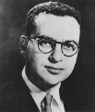

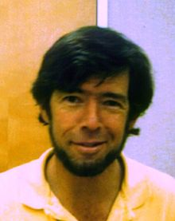
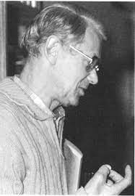
Brief History of Renormalization Group
The modern RG flow equations was introduced by Gell-Mann and Low in 1954 and reformulated by Callan and Symanzik in 1970
Gell-Mann and Low (1954). "Quantum Electrodynamics at Small Distances" Phys. Rev. 95, 1300 (1954)
Gell-Mann
Low
H₀
H₁
H₂
Callan
Symanzik
Energy
••• •••
H_{eff}
RG iteration

Slide 6








RG achieved great success in quantum field theory
Quantum Electrodynamics
They solved the infinite divergence problem in quantum electrodynamics and won the Nobel prize in 1965
Feynman
Schwinger
Tomonaga
Yang-Mills gauge theory
They showed that Yang-Mills gauge theories are renormalizable and shared the 1999 Nobel Prize
’t Hooft
Veltman
Quantum Chromodynamics
They discovered the asymptotic freedom in quantum chromodynamics and won the Nobel Prize in 2004.
Gross
Politzer
Wilczek

Slide 7


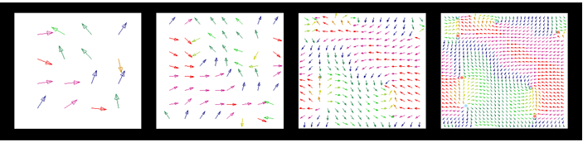
RG application in the field of critical phenomena
In 1966, Kadanoff proposed a block spin scheme to reformulate the scale transformation. His idea, together with the vital contribution of Kenneth Wilson, laid the foundation of the scaling theory of second-order phase transitions and critical phenomena.
Wilson
1982 Nobel prize
Kadanoff
Scale transformation: refine the wavefunction by local RG transformations

Slide 8

The birth of density-matrix and tensor-network renormalization
In 1995, Wilson opened the field of Numerical Renormalization Group by constructing a successive RG solution of the Kondo impurity model
Wilson
1982 Nobel prize
White invented density matrix renormalization group (DMRG) in 1992
Since then, the field of numerical renormalization group has entered the fast-developing track.
White

Slide 9

Basic Idea of Renormalization Group
Basic Idea of Renormalization Group
$$\text{|}\left.ψ\right\rangle =\sum_{k=1}^{N_{total}}{a_{k} \text{|}\left.k\right\rangle ≈}\sum_{k=1}^{N≪N_{total}}{a_{k} \text{|}\left.k\right\rangle }$$
To find a small but optimized basis set to represent accurately a quantum state
Compression of Information
Physics: compression of basis space (truncation of basis states )
Mathematics: low-rank approximation of matrix or tensor

Slide 10
Analytic versus Numerical Renormalization Group
Renormalization Group in Quantum Field Theory
Renormalization of charge, mass, critical exponents, and other physical parameters
Systems must have scaling invariance
Computational Renormalization group
Direct evaluation of quantum wave functions (infinite many parameters)
The systems not necessary to be scaling invariant

Slide 11
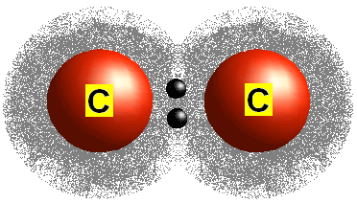
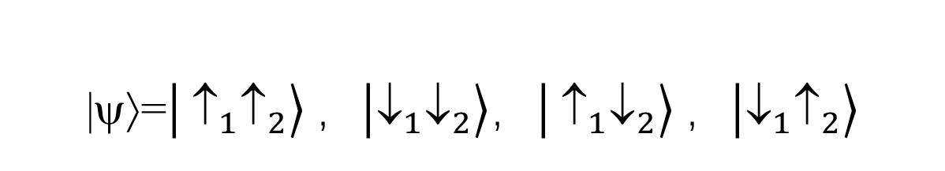
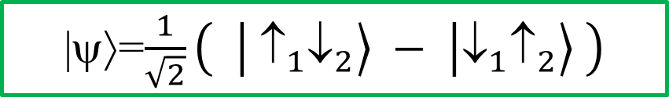
How to Measure Information: Entanglement Entropy
Example: a pair of σ-bonding electrons
|ψ⟩=$\frac{1}{\sqrt{2}}\left( \left|\left.{ ↑}_{1}↓_{2}\right\rangle − \right|\left.{↓_{1}↑}_{2}\right\rangle \right)$
Entangled state: a qubit
|ψ⟩=$\left|\left.{ }_{1}↑_{2}\right\rangle ，\right|\left.{↓_{1}↓}_{2}\right\rangle ，\left|\left.{ ↑}_{1}↓_{2}\right\rangle ，\right|\left.{↓_{1}↑}_{2}\right\rangle$
Disentangled state

Slide 12
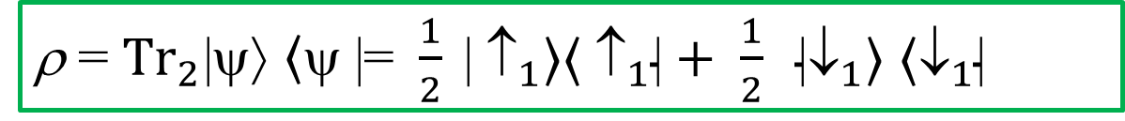

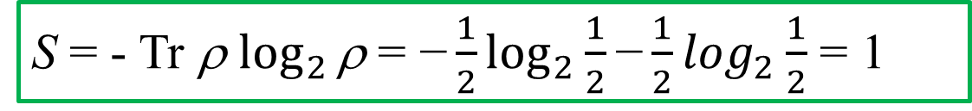
How to Measure Information: Entanglement Entropy
|ψ⟩=$\frac{1}{\sqrt{2}}\left( \left|\left.{ ↑}_{1}↓_{2}\right\rangle − \right|\left.{↓_{1}↑}_{2}\right\rangle \right)$
Entangled state: a qubit
Reduced Density Matrix
ρ = ${Tr}_{2}$|ψ⟩ $\left\langle \text{ψ}\right.$ |=$\frac{1}{2} \text{|}{ ↑}_{1}〉〈{ ↑}_{1}\text{|}+ \frac{1}{2} \text{|}↓_{1}〉 ⟨↓_{1}\text{|}$
Entanglement Entropy
S = - Tr ρ $\log_{2 }\text{ρ}\text{ = −}\frac{1}{2}\log_{2}\frac{1}{2}\text{−}\frac{1}{2}\log_{2}\frac{1}{2}$ = 1

Slide 13
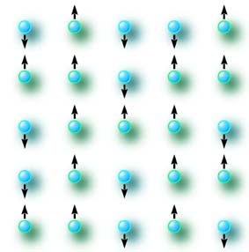

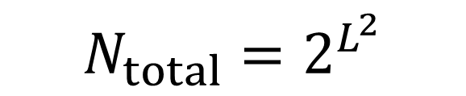

Is Quantum State Renormalizable?
$$\text{|}\left.ψ\right\rangle =\sum_{k=1}^{N_{total}}{a_{k} \text{|}\left.k\right\rangle }$$
L
basis states
L
$$\text{|}\left.ψ\right\rangle ≈\sum_{k=1}^{{N≪N}_{total}}{a_{k} \text{|}\left.k\right\rangle }$$
$${N_{total}=2}^{L^{2}}$$
波函数 基矢
波函数 基矢
basis states

Slide 14
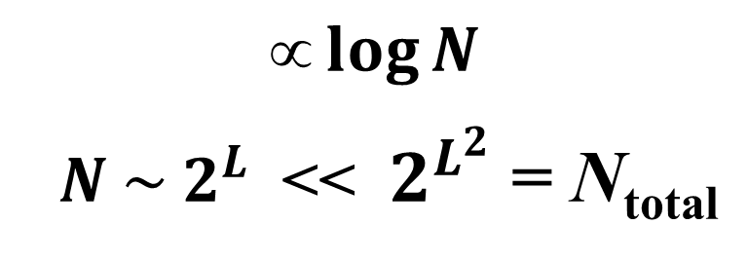
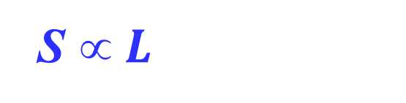
YES! Entanglement Entropy Area Law
B
Entanglement entropy
$$\log{N}$$
$N \sim 2^{L}$ << ${ 2}^{L^{2}}$ = N_{total}
S $ L$
L
A
  Minimum number of basis states needed for accurately representing ground states
L
$$\text{|}\left.ψ\right\rangle ≈\sum_{k=1}^{{N≪N}_{total}}{a_{k} \text{|}\left.k\right\rangle }$$
$${N_{total}=2}^{L^{2}}$$
波函数 基矢
波函数 基矢
basis states

Slide 15


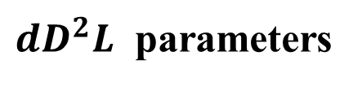
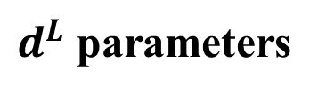

Wave Function that Satisfies the Area Law
1D: Matrix Product States (MPS)
Wave function generated by Density-Matrix Renormalization Group
m₃
m_{L-2}
m₂
…
m₁ m₂ m₃ … … m_{L-1} m_{L}
m_{L-1}
m₁
$$≈$$
d
m_{L}
α β
$$$$
D
Variational parameters
A_{αβ}[m₂ ]
Virtual basis state
$$(m_{1}, …m_{L})$$
$$\left(m_{1}, …m_{L}\right)=TrA\left[m_{1}\right]⋯A\left[m_{L}\right]$$
$d^{L}$ parameters
$dD^{2}L$ parameters

Slide 16
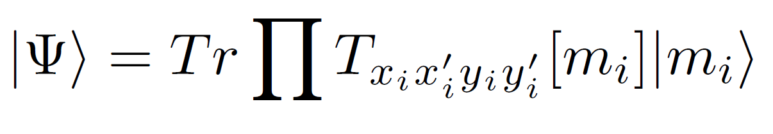
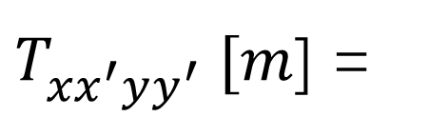



2D: Projected Entangled Pair State
Local tensor
Virtual basis
Physical basis
$y$
$$m$$
$T_{xx^{′}yy^{′}}^{} [m$] =
$$x x′$$
D
y'
Niggemann & Zittarz, Z. Phys. B 101, 289 (1996)
Verstraete & Cirac, cond-mat/0407066

Slide 17
Virtual Bond Dimension D: How Large Needed?
Entanglement entropy area law
S = αL ≈ L ln D D ~ $e^{\text{α}}$
(independent of L)
PEPS is exact ground state wavefunction in the limit D → ∞
D

Slide 18

2D Interacting Fermions: How Large Needed?
Entanglement entropy: with logarithmic correction
S = αL lnL ≈ L ln D D ~ $L^{α}$
D grows in some power law with the system size
D

Slide 19
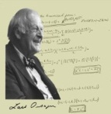
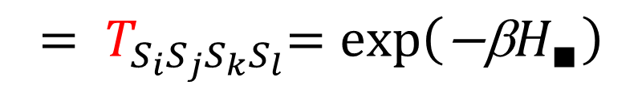





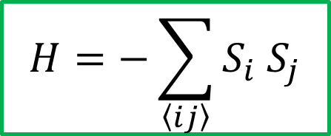
Faithful Representation of Partition Function
Ising model
$$H=−\sum_{\left\langle ij\right\rangle }{S_{i} S_{j}}$$
$$Z=Tr exp\left(−\text{β}H\right)$$
$$=Tr \prod_{∎}{exp\left(−\text{β}H_{∎}\right)}$$
$$=Tr \prod_{\{S\}}{T_{S_{i}S_{j}S_{k}S_{l}}}$$
$$ S_{i}$$
$$ S_{j}$$
$${= T}_{S_{i}S_{j}S_{k}S_{l}}=\text{exp}\left(\text{−}\text{β}H_{∎}\right)$$
$$ S_{l}$$
$$ S_{k}$$
Lars Onsager

Slide 20
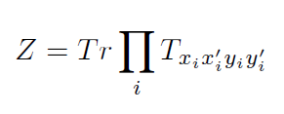
What are tensor network states?
Variational wavefunctions of ground states of quantum lattice models
Faithful representation of partition functions of classical/quantum models

Slide 21
What can tensor-network renormalization do?
Study nearly all physical quantities of quantum many-body
  Ground state, low energy excited states
  Static correlation functions
  Dynamic correlation functions
  Thermodynamic properties
  Non-equilibrium or time-dependent properties

Slide 22
Fields of Applications
Interacting fermions:
  Condensed matter physics, quantum chemistry, nuclear physics
  High-Tc superconductivity: Hubbard, t-J, Kondo lattice models ……
Low-dimensional interacting boson and quantum spin systems:
  Magnetic ordered/spin liquid systems, Heisenberg interactions
  Interacting bosons
Low-dimensional classical statistical models/Machine learning:
  Fundamental models of statistical physics
  Machine learning

Slide 23
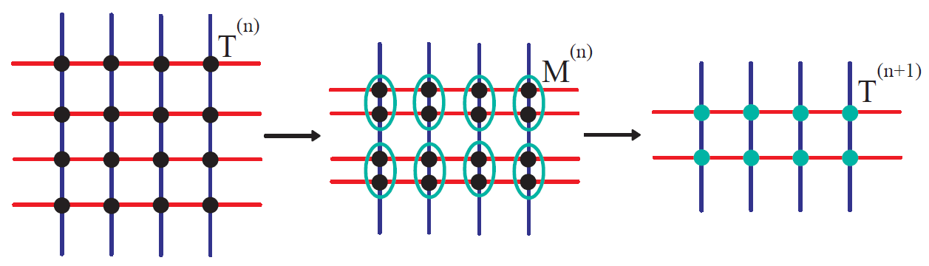
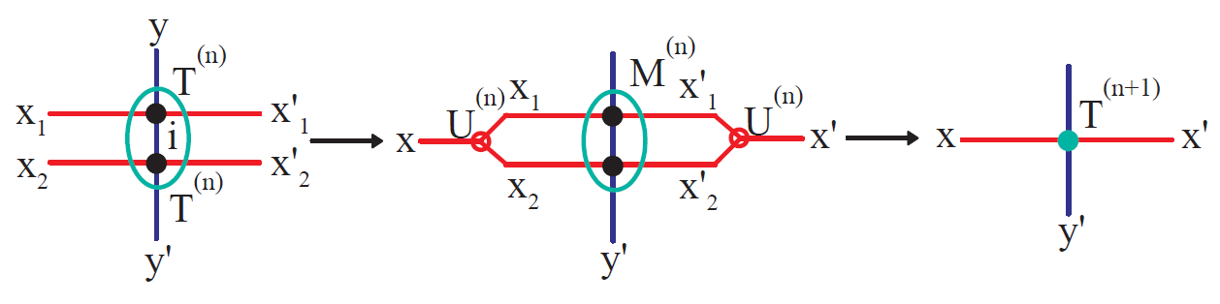
Example: Tensor renormalization through HOSVD
      Z. Y. Xie et al, PRB 86, 045139 (2012)
D
D²
D
Higher-order singular value decomposition (HOSVD)
Truncation:
Lower-rank approximation
y

Slide 24
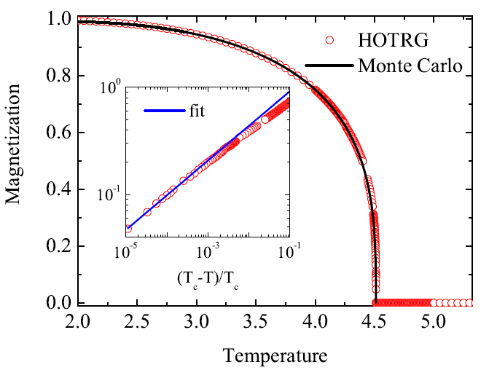
Results for the 3D Ising model
Xie et al, PRB 86,045139 (2012)
D=14
Relative difference is less than 10⁻⁵
MC data:
A. L. Talapov, H. W. J. Blote, J. Phys. A: Math. Gen. 29, 5727 (1996)
X. M. Feng, and H. W. J. Blote, Phys. Rev. E 81, 031103 (2010)

Slide 25
Basic Idea of Renormalization Group
Outline
General introduction to the theory of tensor network renormalization group
Tensor-network renormalization of low-energy excited states

Slide 26
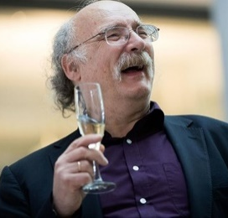
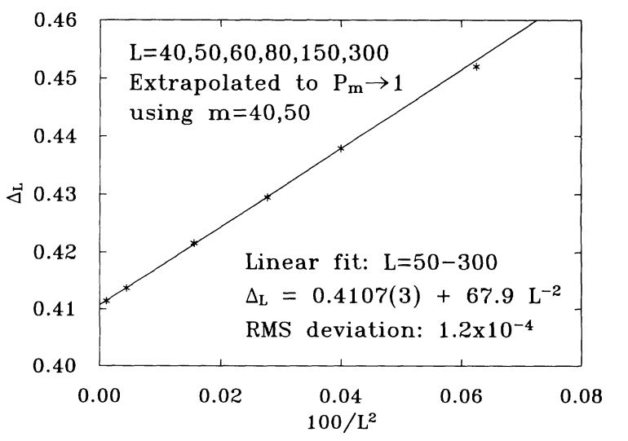

Determination of low-energy eigenstates
Accurate determination of low-energy excited states has long been an important but challenging problem
Haldane conjecture
$$H=\sum_{i}{S_{i}⋅S_{i+1}}$$
The ground state of the antiferromagnetic Heisenberg chain is gapless if S is a half-integer and gapped if S is an integer
F. D. M. Haldane, Phys Lett A 93, 464 (1983)
F. D. M. Haldane, PRL 50, 1153 (1983)
S=1 Haldane gap
S. R. White, PRL 69, 2863 (1992)

Slide 27
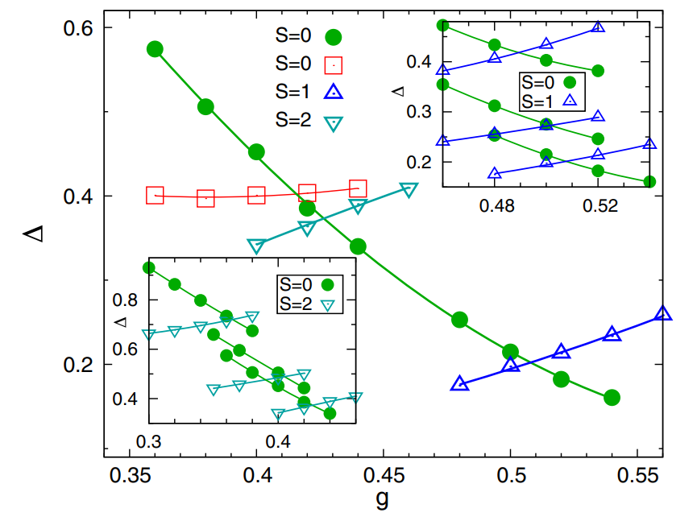
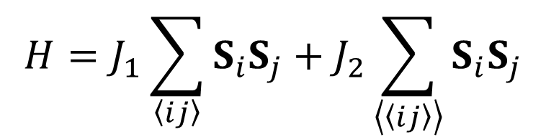
Phase diagram of the J₁-J₂ Heisenberg model
$$H=J_{1}\sum_{\left\langle ij\right\rangle }{S_{i}S_{j}}+J_{2}\sum_{\left\langle \left\langle ij\right\rangle \right\rangle }{S_{i}S_{j}}$$
The phase boundaries are determined by the crossing points in the energies of different spins
L. Wang and A. W. Sandvik, PRL 121, 107202 (2018)

Slide 28
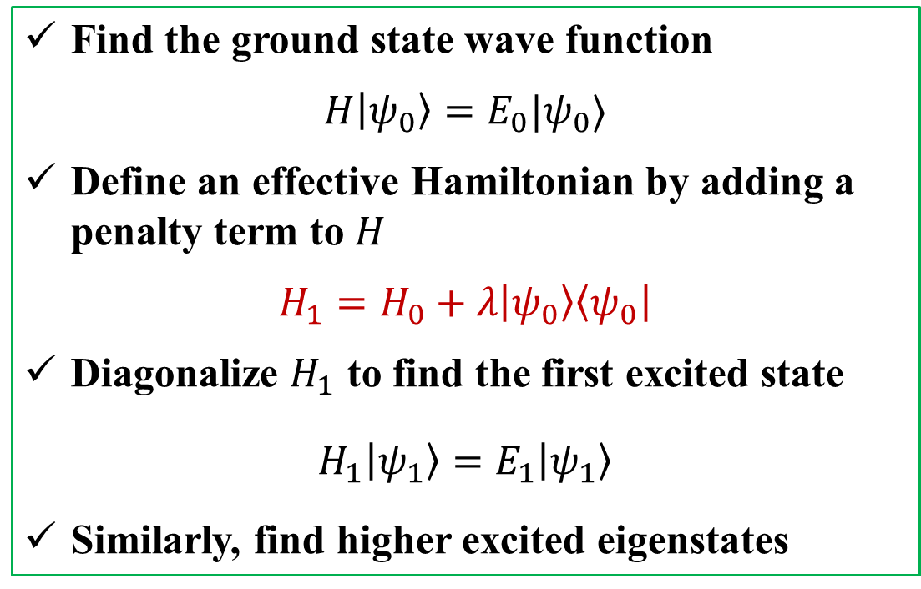
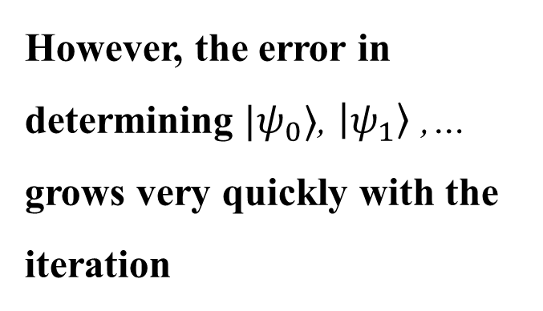
Existing methods for determining low-energy eigenstates
Effective Hamiltonian approach: Add a penalty term
Find the ground state wave function
$$H\left|\left.ψ_{0}\right\rangle \right.=E_{0}|ψ_{0}⟩$$
Define an effective Hamiltonian by adding a penalty term to $H$
$$H_{1}=H_{0}+λ\left|\left.ψ_{0}\right\rangle \right.\left\langle \left.ψ_{0}\right|\right.$$
Diagonalize $H_{1}$ to find the first excited state
$$H_{1}\left|\left.ψ_{1}\right\rangle \right.=E_{1}\left|ψ_{1}\right\rangle$$
Similarly, find higher excited eigenstates
However, the error in determining $|ψ_{0}⟩$, $\left|ψ_{1}\right\rangle$ ,… grows very quickly with the iteration
Notes:
我们都知道最近几年深度学习取得了非常大的成功，DeepMind发展的AlphaGo打败了人类最顶尖的棋手，AlphaFold预测了最准的蛋白质折叠结构。
那么深度学习成功的秘密是什么呢?它们成功最主要的原因之一是使用了自动微分这一技术来优化神经网络。
而张量网络也可以看成一种神经网络，为什么我们不能用自动微分来帮助我们优化张量网络呢？

Slide 29
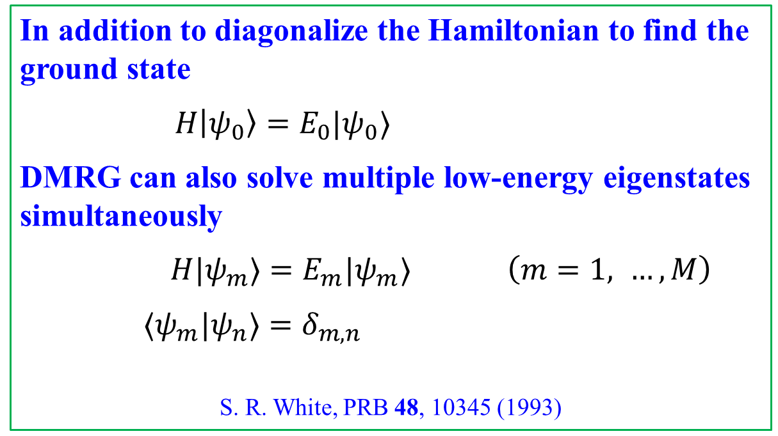
Existing methods for determining low-energy eigenstates
Multi-target DMRG
In addition to diagonalize the Hamiltonian to find the ground state
$$H\left|\left.ψ_{0}\right\rangle \right.=E_{0}|ψ_{0}⟩$$
DMRG can also solve multiple low-energy eigenstates simultaneously
$H|ψ_{m}⟩=E_{m}|ψ_{m}⟩$ $\left(m=1, …, M\right)$
$⟨ψ_{m}|ψ_{n}⟩=δ_{m,n}$
S. R. White, PRB 48, 10345 (1993)
This is a commonly used approach, but the accuracy of the excited eigenstates is still poor in comparison with the ground state
Notes:
我们都知道最近几年深度学习取得了非常大的成功，DeepMind发展的AlphaGo打败了人类最顶尖的棋手，AlphaFold预测了最准的蛋白质折叠结构。
那么深度学习成功的秘密是什么呢?它们成功最主要的原因之一是使用了自动微分这一技术来优化神经网络。
而张量网络也可以看成一种神经网络，为什么我们不能用自动微分来帮助我们优化张量网络呢？

Slide 30
Methods based on the multi-target MPS wave functions
  Multi-target MPS representation of multiple eigenstates
  Multi-target update method (MTU)
  Variational Riemannian optimization method (VRO)
  X. Li, Z. Zhou, G. Xu, R. Chi, Y. Guo, T. Liu, H. Liao, T. Xiang, arXiv:2305.15868

Slide 31
MPS representation of the ground state
Bond matrix entanglement entropy
Left canonical tensor/matrix
Right canonical tensor matrix

Slide 32
Isometric Transformation Matrices
Left isometric
Right isometric
Notes:
我们都知道最近几年深度学习取得了非常大的成功，DeepMind发展的AlphaGo打败了人类最顶尖的棋手，AlphaFold预测了最准的蛋白质折叠结构。
那么深度学习成功的秘密是什么呢?它们成功最主要的原因之一是使用了自动微分这一技术来优化神经网络。
而张量网络也可以看成一种神经网络，为什么我们不能用自动微分来帮助我们优化张量网络呢？

Slide 33
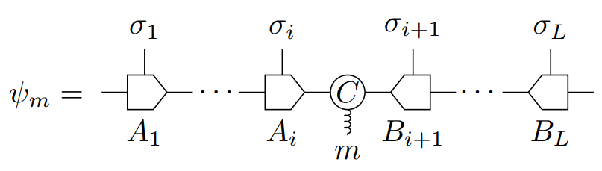
MPS representation of multi-target MPS eigenstates
Multi-target MPS
Bond tensor / multiple bond matrix
Orthonormal condition:

Slide 34
Comparison between MPS and multi-target MPS
Ground state wave function: MPS
Wave functions of multi-target DMRG eigenstates：Multi-target MPS

Slide 35
Methods based on the multi-target MPS wave functions
  Multi-target MPS representation of multiple eigenstates
  Multi-target update method (MTU)
  Variational Riemannian optimization method (VRO)
  X. Li, Z. Zhou, G. Xu, R. Chi, Y. Guo, T. Liu, H. Liao, T. Xiang, arXiv:2305.15868

Slide 36
Update method for evaluating the ground state
Filter out the ground state by cooling the system to zero temperature
Cooling down temperature in small steps
arbitrary initial state
Trotter-Suzuki decomposition

Slide 37
One step of update
SVD
SVD

Slide 38
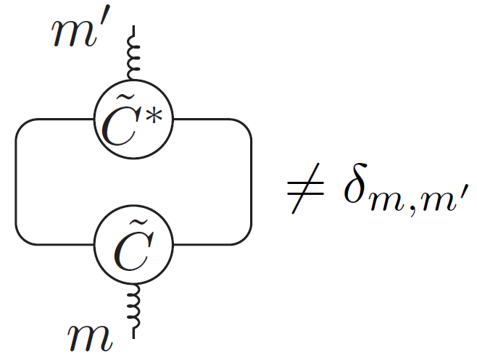
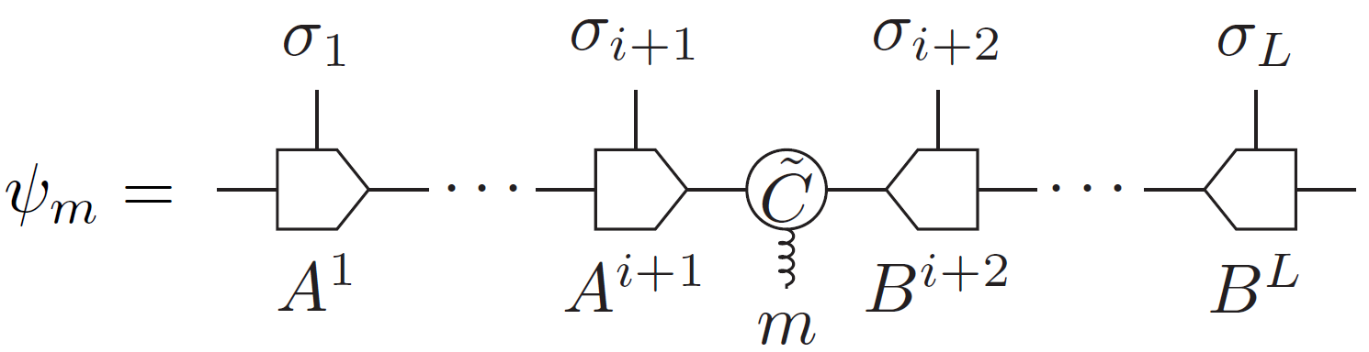
Multi-target update (MTU)
SVD
SVD

Slide 39
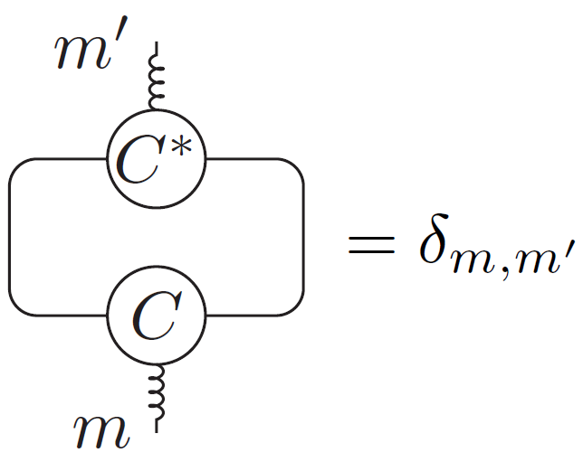
Re-orthonormalizing the canonical center tensor

Slide 40
Methods based on the multi-target MPS wave functions
  Multi-target MPS representation of multiple eigenstates
  Multi-target update method (MTU)
  Variational Riemannian optimization method (VRO)
  X. Li, Z. Zhou, G. Xu, R. Chi, Y. Guo, T. Liu, H. Liao, T. Xiang, arXiv:2305.15868

Slide 41
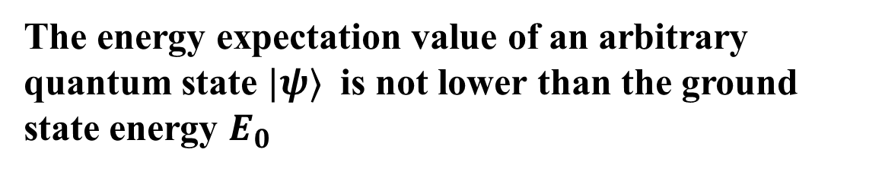
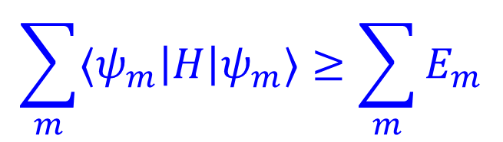


Variational Principle
The energy expectation value of an arbitrary quantum state $|ψ⟩$ is not lower than the ground state energy $E_{0}$
$\frac{⟨ψ|H|ψ⟩}{⟨ψ|ψ⟩}≥E_{0}$
Generalized Variational Principle
For $M$ orthonormal basis states $|ψ_{m}⟩$,
$$\left\langle ψ_{n} | ψ_{m}\right\rangle =δ_{n,m}$$
the sum of their energy expectation values is always high than or equal to the sum of the first $M$ eigenenergies $E_{m}$
$$\sum_{m}{⟨ψ_{m}\left|H\right|ψ_{m}⟩}≥\sum_{m}{E_{m}}$$
E. K. U. Gross, L. N. Oliveira, and W. Kohn, PRA 37, 2805 (1988)
Notes:
我们都知道最近几年深度学习取得了非常大的成功，DeepMind发展的AlphaGo打败了人类最顶尖的棋手，AlphaFold预测了最准的蛋白质折叠结构。
那么深度学习成功的秘密是什么呢?它们成功最主要的原因之一是使用了自动微分这一技术来优化神经网络。
而张量网络也可以看成一种神经网络，为什么我们不能用自动微分来帮助我们优化张量网络呢？

Slide 42
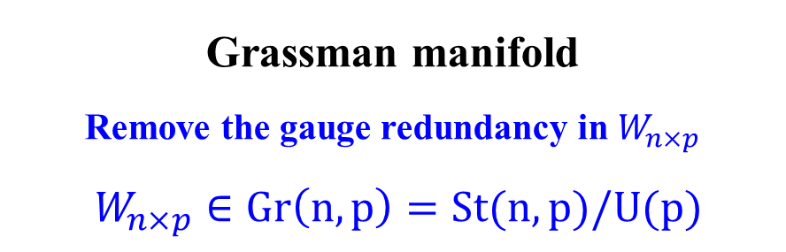

Grassmann manifold
Stiefel manifold
collection of isometric matrices
$W_{n×p}∈St(n,p)$
Grassman manifold
Remove the gauge redundancy in $W_{n×p}$
$W_{n×p}∈Gr\left(n,p\right)=St(n,p)/U(p)$
W = (A, B, C) are isometric matrices

Slide 43
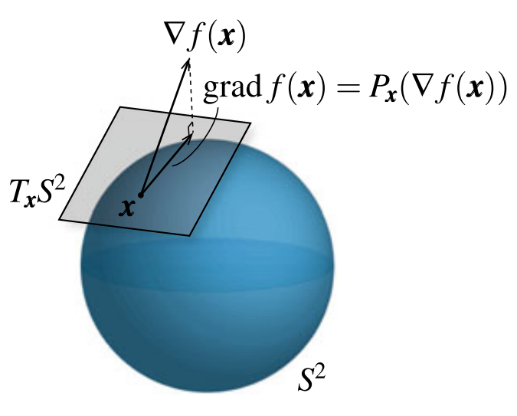
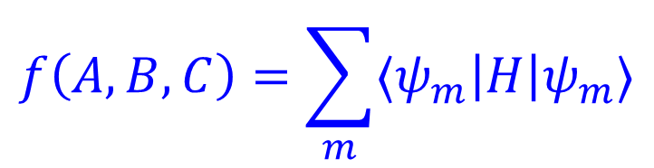
Riemannian Optimization
$$f\left(A,B,C\right)=\sum_{m}{⟨ψ_{m}\left|H\right|ψ_{m}⟩}$$
Cost function:
Optimizing the variational tensors (A, B, C) by minimizing the cost function within the Grassmann manifold
P.-A. Absil, R. Mahony, and R. Sepulchre, Optimization algorithms on matrix manifolds (Princeton University Press, 2008)
H. Sato, Riemannian optimization and its applications (Springer, 2021)

Slide 44



Find the energy eigenstates and eigenvalues
The $M$ basis states, |$ψ_{m}⟩ \left(m=0,…,M−1\right)$, optimized with either MTU or VRO are not the energy eigenstates
$$H_{n,m}=⟨ψ_{n}\left|H\right|ψ_{m}⟩$$
Diagonalize the Hamiltonian matrix, we find the first $M$ eigenenergies and the corresponding eigenstates

Slide 45


Results for the transverse-field Ising chain
Transverse-field Ising model
$$H=\sum_{i}{(−S_{i}^{z}}S_{i+1}^{z}+hS_{i}^{x})$$
$$L=100，D=200，M=30$$

Slide 46

Comparison with the conventional DMRG results
$$L=100，D=200，M=30$$
N. Chepiga, et al. PRB 96, 054425 (2017)

Slide 47


Errors of MTU versus VRO
Energy Levels Errors:
$$δE_{m}=\left|E_{m}^{ex}−E_{m}\right|$$
The errors at the critical point are higher than in the non-critical phases.
VRO has no truncation errors, improving the accuracy by 2 ~ 3 orders of magnitude compared with MTU
$$L=100，D=200，M=30$$

Slide 48





Error in the cost function and variance in energy
$$δf=f−f^{ex}=\sum_{m=0}^{M−1}{\left|E_{m}^{ex}−E_{m}\right|}$$
$$σ=\sqrt{\left\langle H^{2}\right\rangle − {\left\langle H\right\rangle }^{2}}$$
$$L=100，M=30$$
$$L=100，D=200，M=30$$

Slide 49







Basic Idea of Renormalization Group
Summary
Tensor-network renormalization provides a powerful tool for attacking strongly correlated quantum systems
Multi-target MPS presents a natural parametrization of multiple orthonormal basis states
MTU and VRO are two efficient and accurate methods for evaluating low-energy eigenspectra
X. Li Z. Zhou G. Xu R. Chi Y. Guo T. Liu H. Liao

