Slide 1


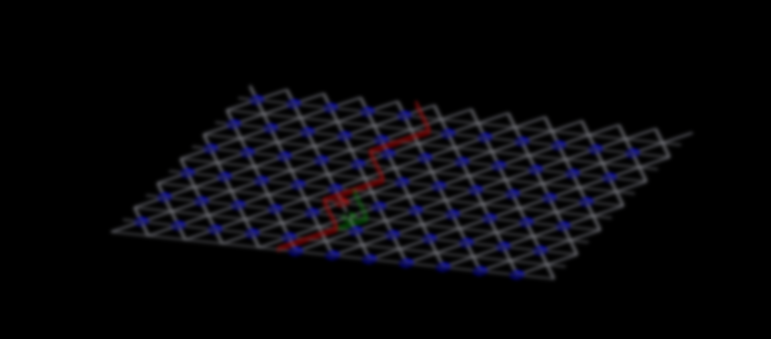
Quantum String in Strongly Correlated System
张学锋 重庆大学
2023年度中国科学院理论物理前沿重点实验室年会

Slide 2
String and Condensed Matter

Slide 3
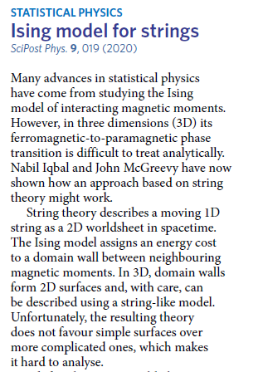
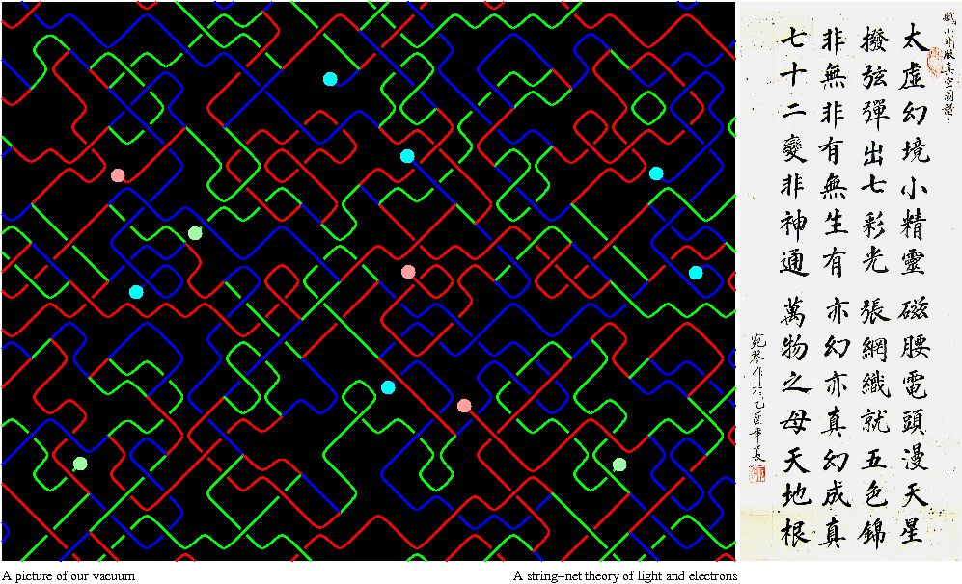
String and Condensed Matter

Slide 4
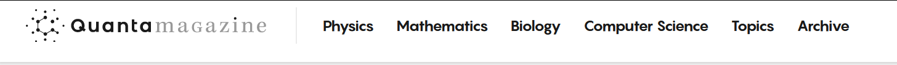

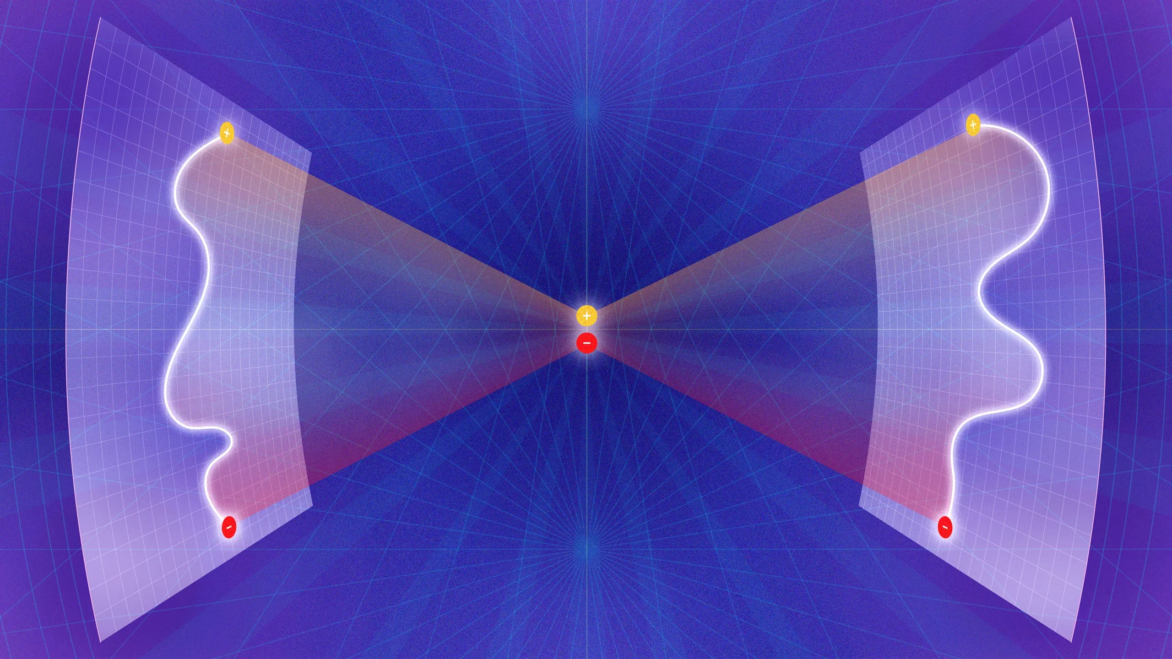
String and Condensed Matter
A New Kind of Symmetry Shakes Up Physics
The symmetries of 20th-century physics were built on points. Higher symmetries are based on one-dimensional lines.
Samuel Velasco/Quanta Magazine

Slide 5
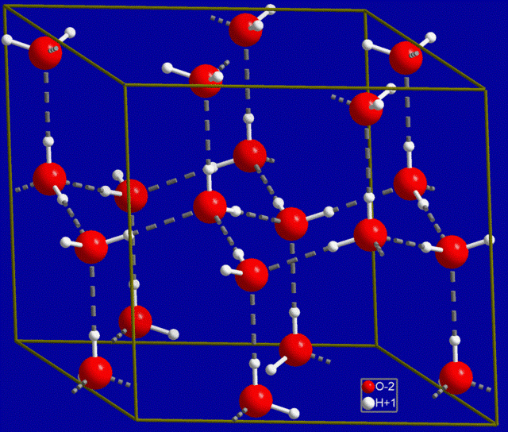
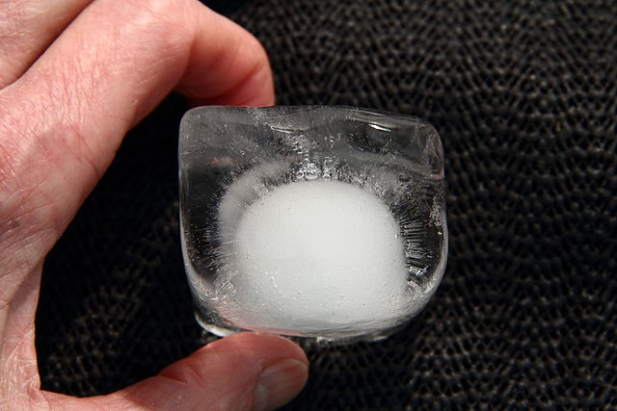
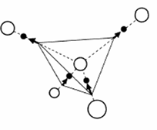
Water ice and Residual entropy
@Wikipedia
2-in 2-out rule
Tetrahedron
Pauling's
Residual entropy
L. Pauling, J. Am. Chem. Soc. 57 (12): 2680–2684 (1935)

Slide 6
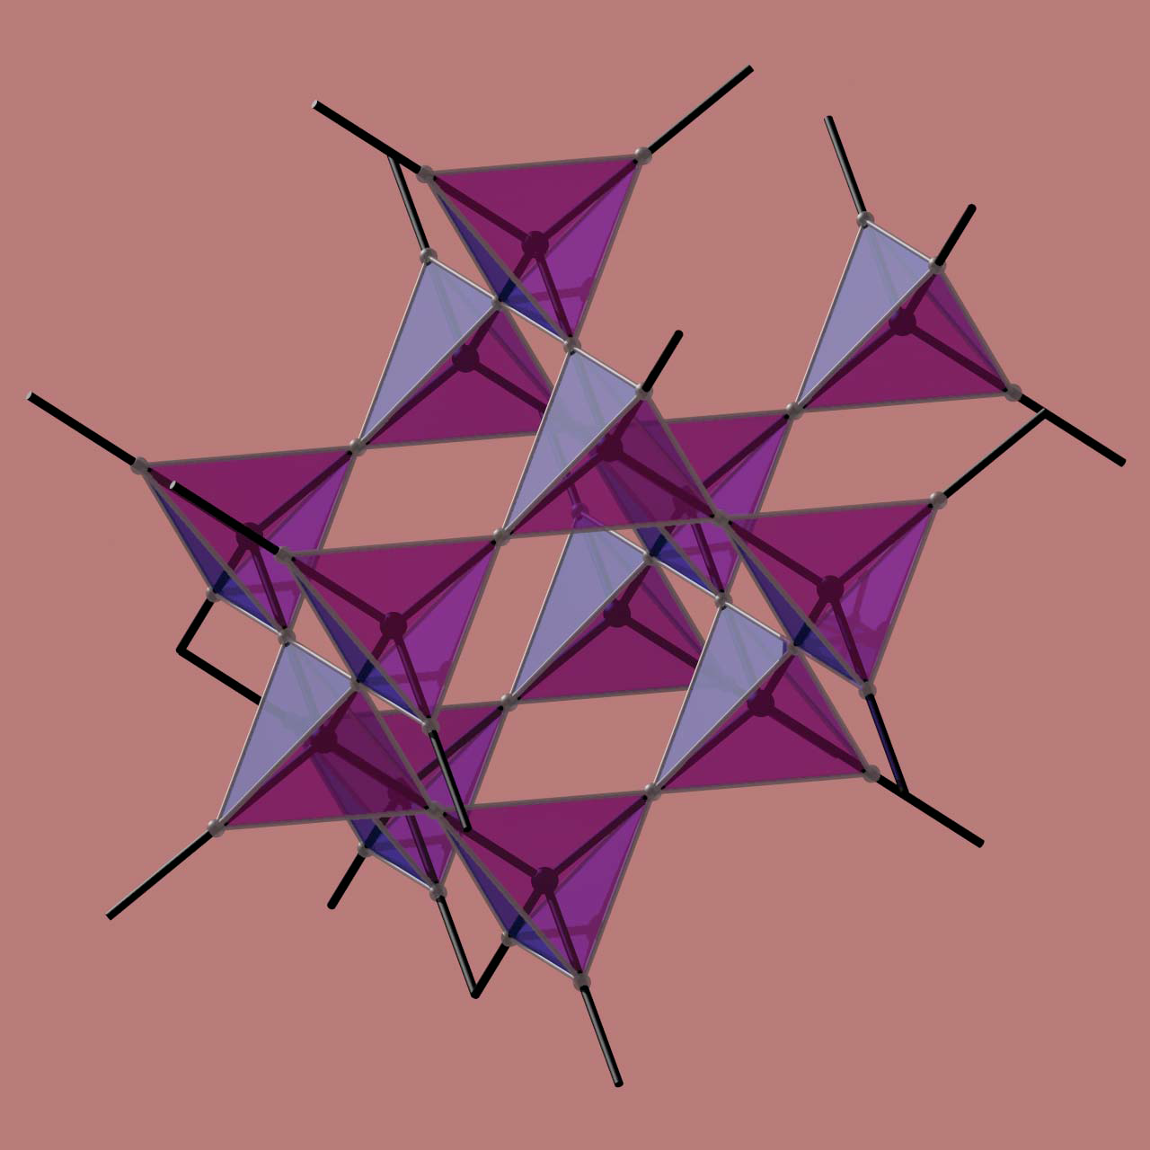
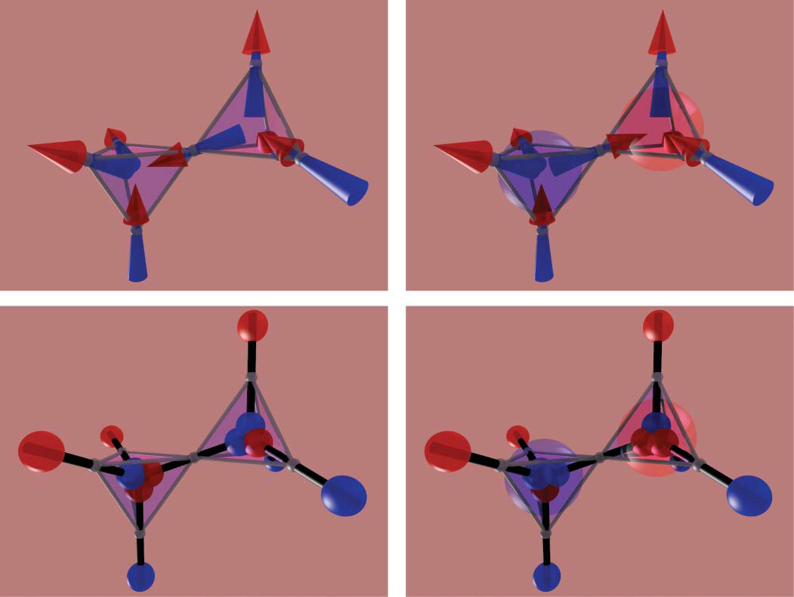
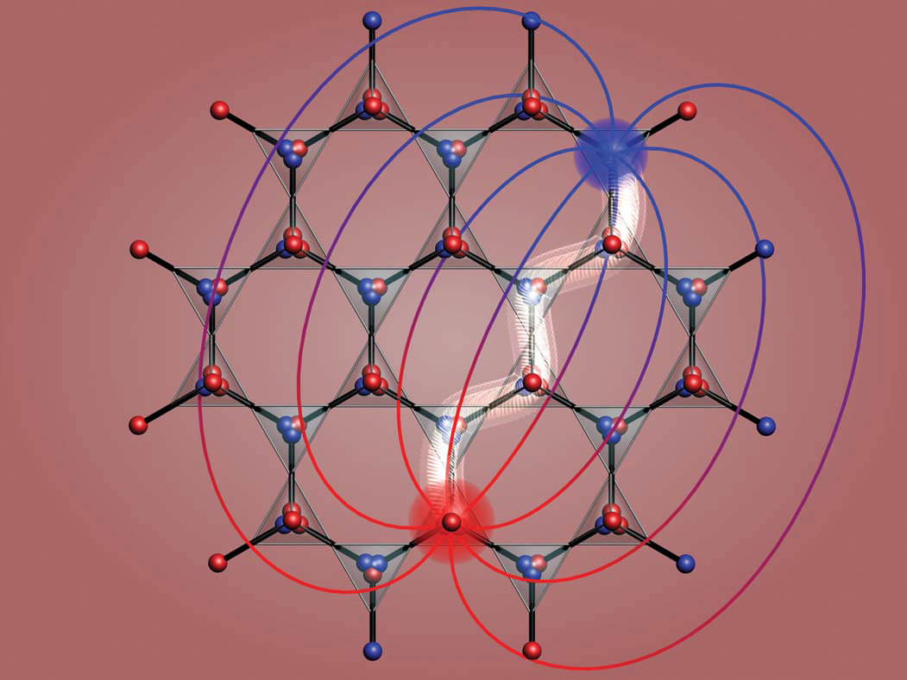
Spin ice ( Dy₂Ti₂O₇ )
2-spin in
2-spin out rule
Pauling’s
Residual entropy
C. Castelnovo, et al.,Nature 451, 42-45 (2008)
D. J. P. Morris, Science 326, 411 (2009)

Slide 7
Effective theory
Classical Electromagnetism:
Positron (N)
Electric line
(Dirac string)
Electron (S)

Slide 8
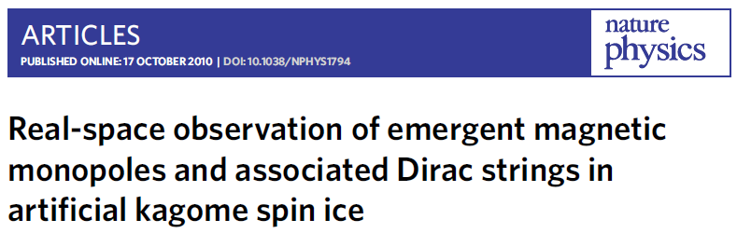
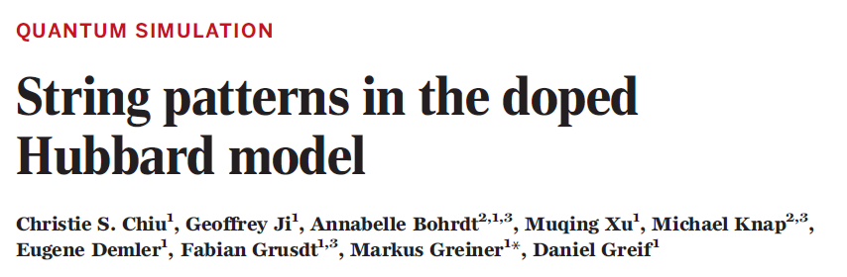
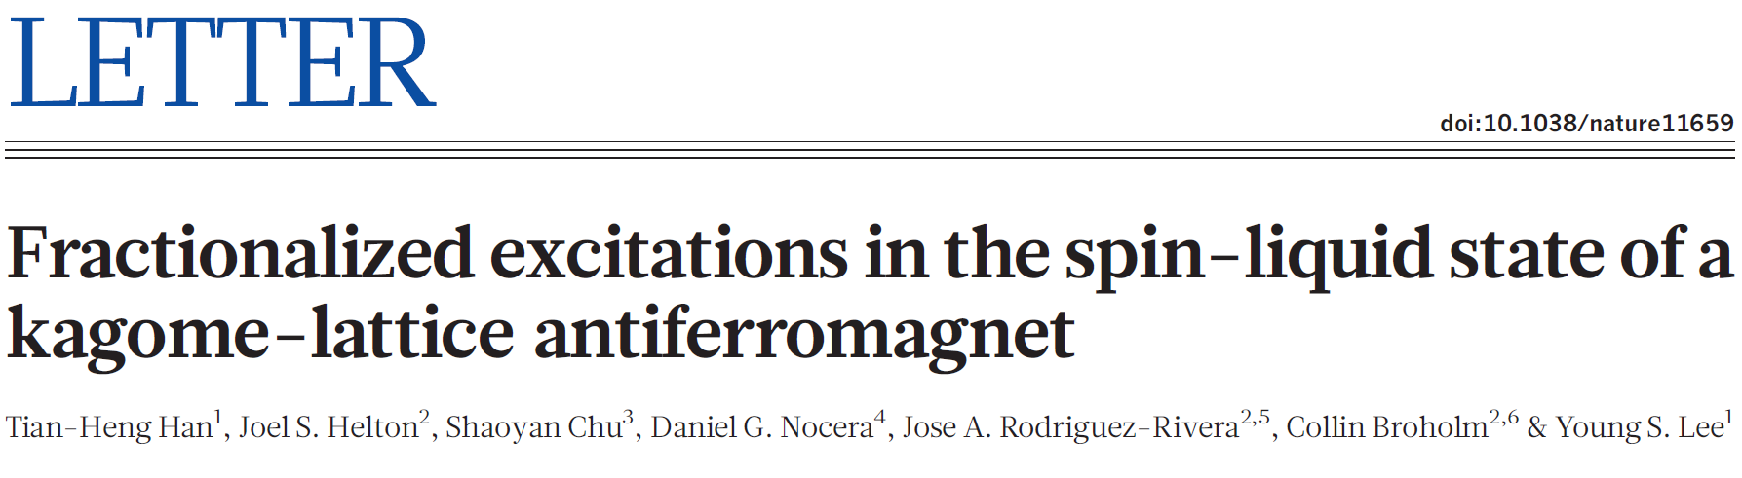
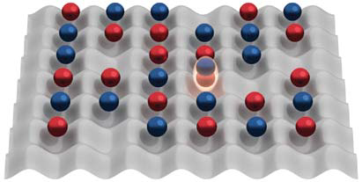
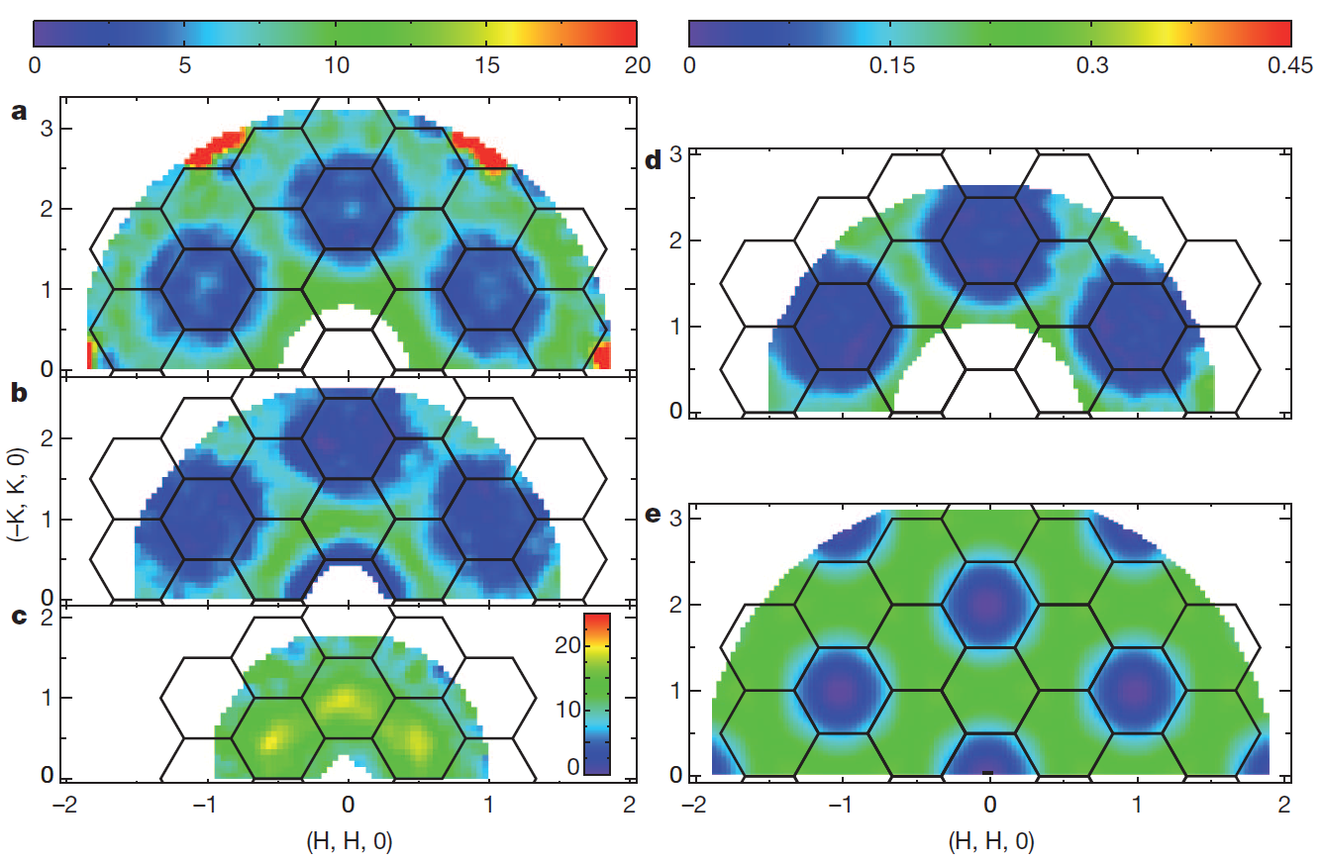
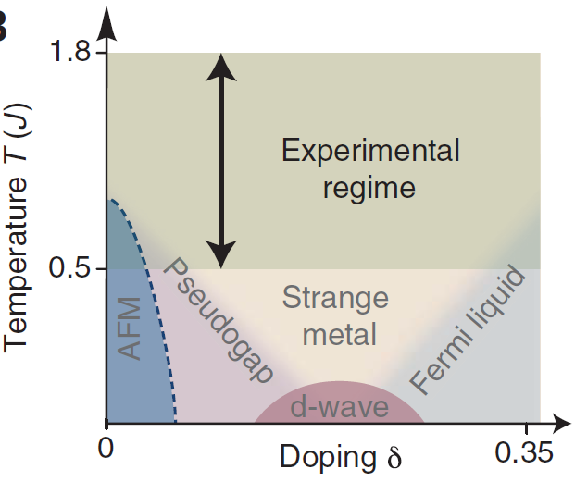
Topological Defect

Slide 9
Frustration and Closed Strings

Slide 10
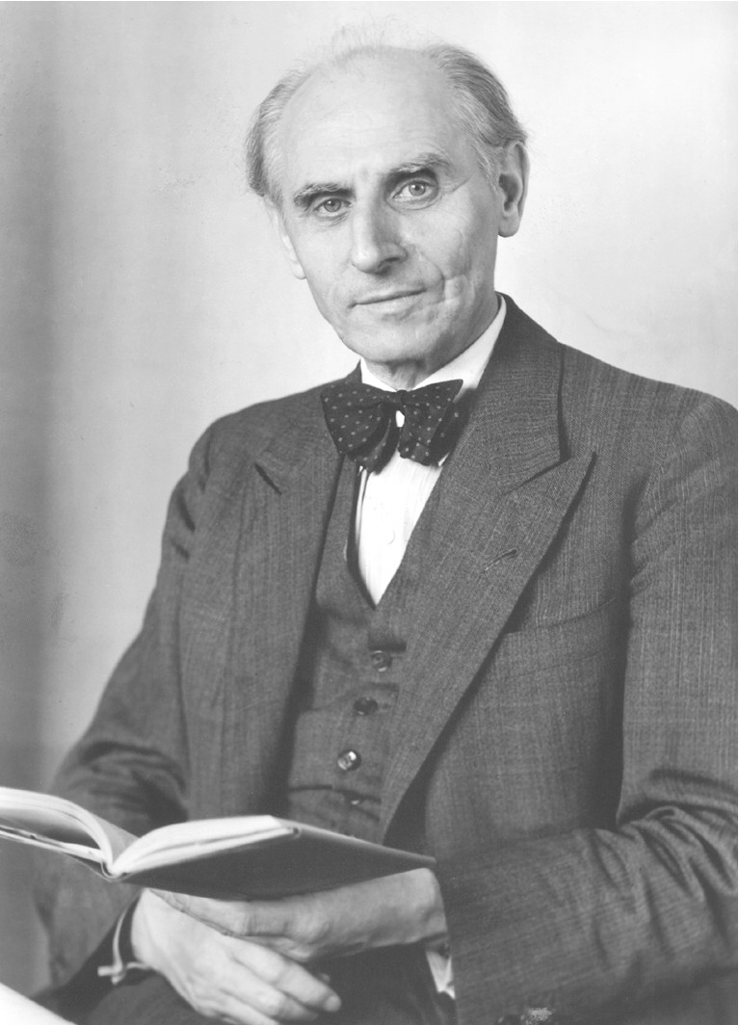

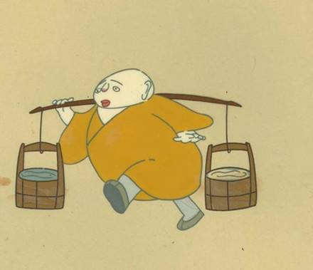
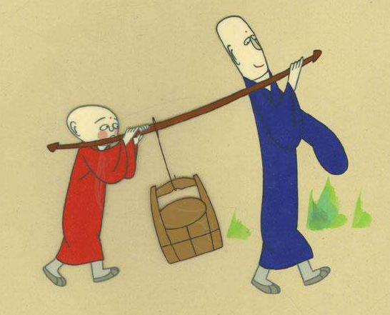




Frustration
$$E=J\sum_{\left\langle i,j\right\rangle }{σ_{i}^{Z}σ_{j}^{Z}}$$
Order
Disorder
Ising Model:
?
$$σ_{i}^{Z}=1$$
$$−1$$
Wilhelm Lenz
(1888-1957)
Ernst Ising （1900-1998）

Slide 11
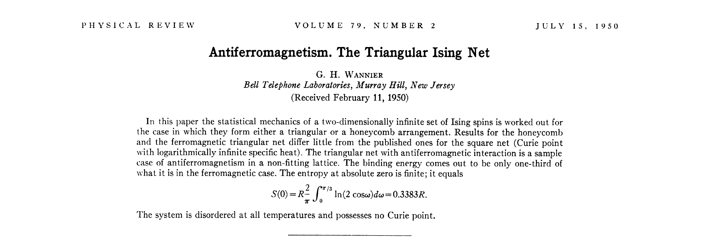
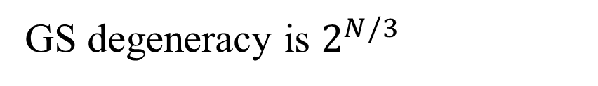
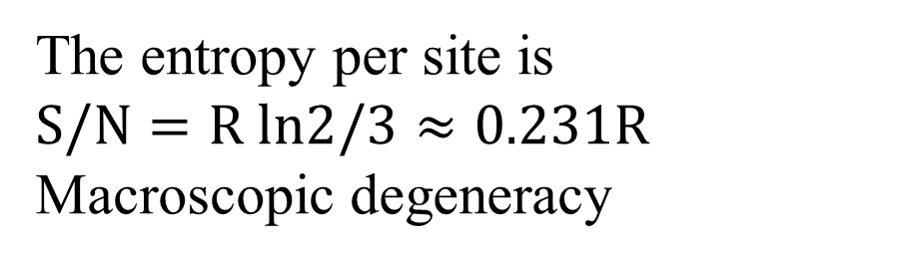
Triangular Lattice
Triangle Constraint:
Triangular Lattice:
Two AF bonds
and
One FM bond
: Both OK
Exact solution:
GS degeneracy is $2^{N/3}$
The entropy per site is
$$S/N=R ln2/3≈0.231R$$
Macroscopic degeneracy

Slide 12
Quantum String
Stripe phase
Perturbation (e.g. Spatial anisotropy)
String excitation
Without breaking the ice rule
ZXF, Phys. Rev. Lett. 117, 193201 (2016)

Slide 13

Dynamics of Quantum String
$$−Ω\sum_{i}{S_{i}^{x}}$$
ZXF, NPJ Quantum Material 7:60 (2022)

Slide 14
Multi-String
ZXF, NPJ Quantum Material 7:60 (2022)

Slide 15
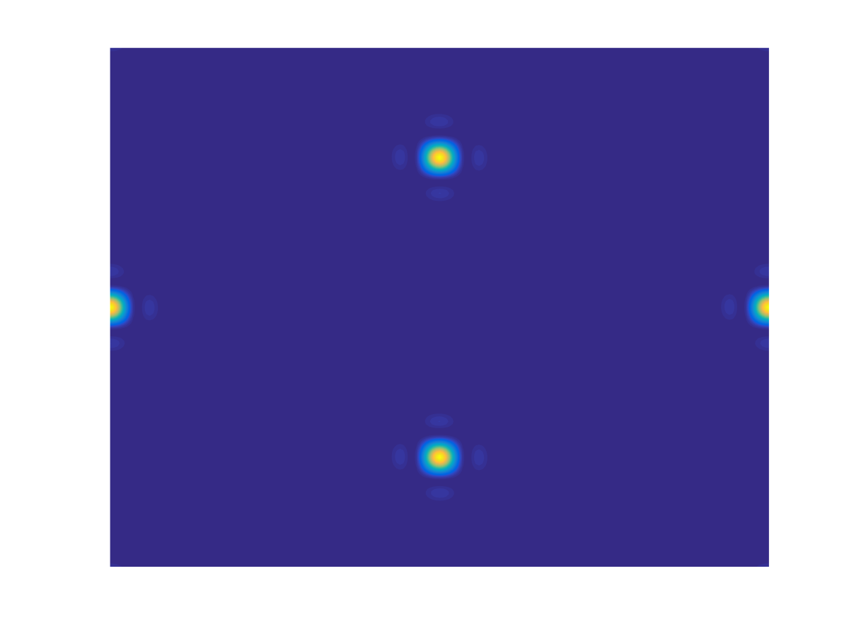
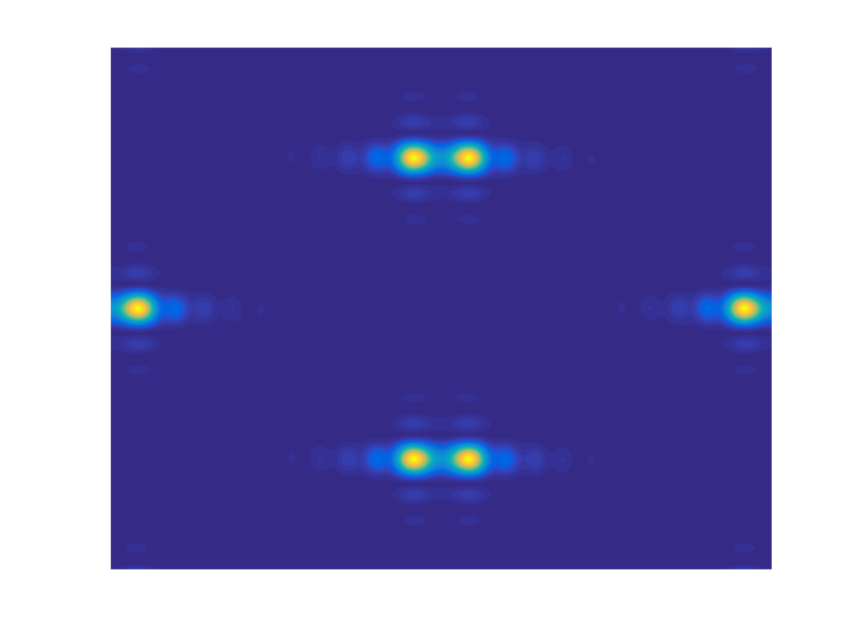
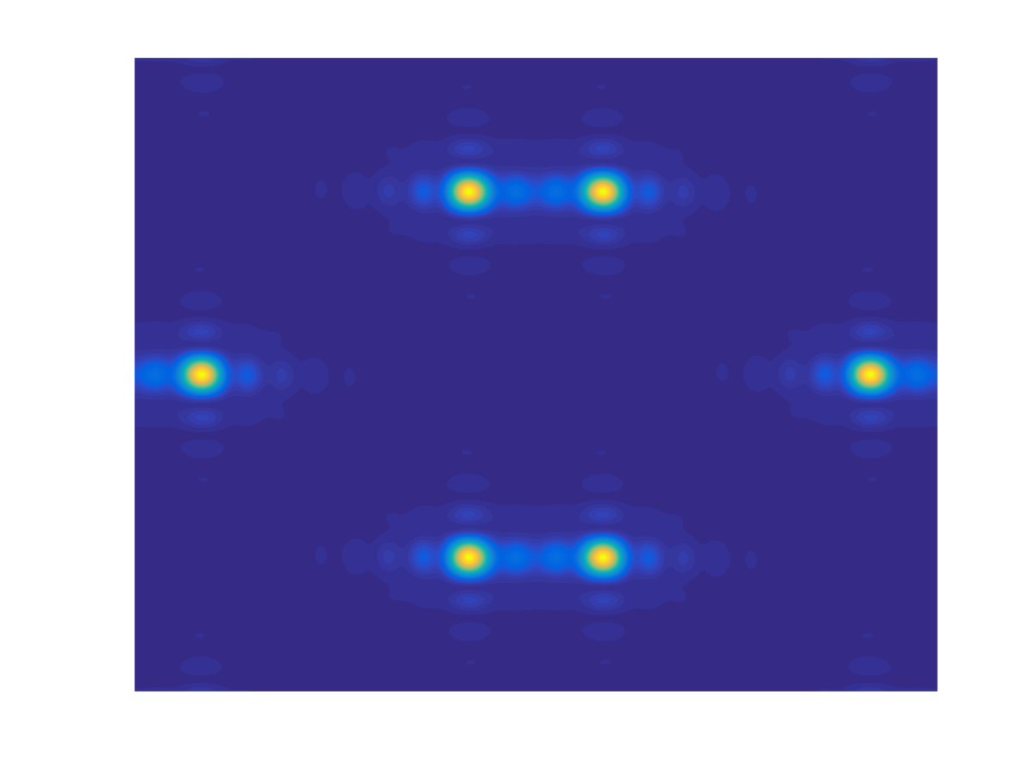
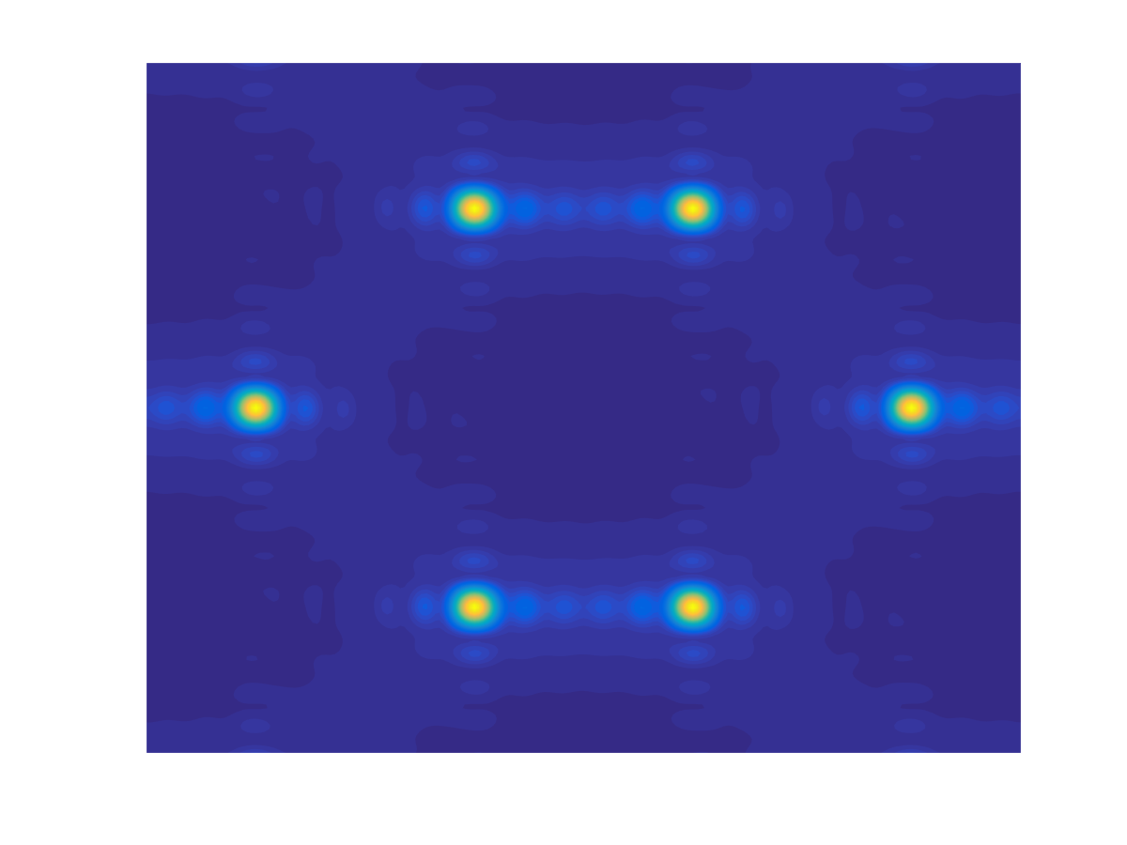
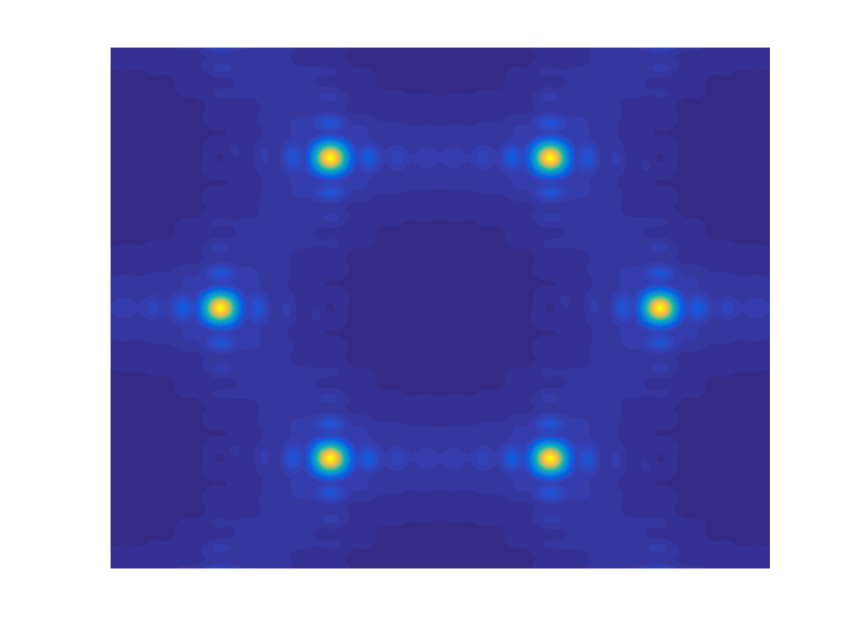
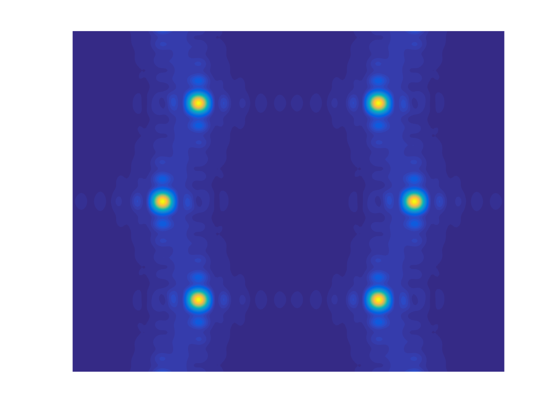
Quantization of String Density
0
2
4
6
8
10
ZXF, Phys. Rev. Lett. 117, 193201 (2016)

Slide 16
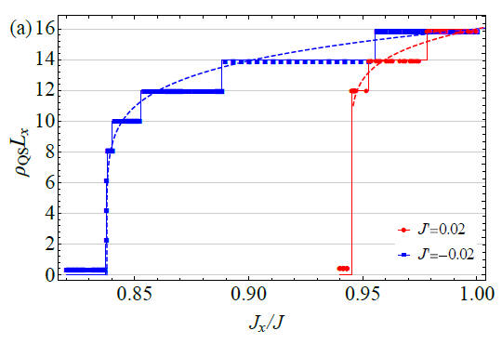




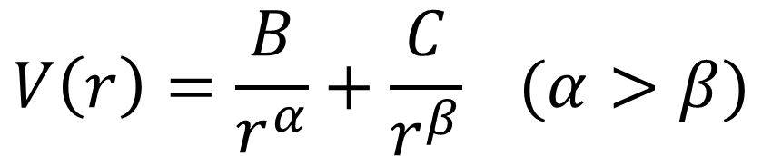

Long range interaction
$$V\left(r\right)=\frac{B}{r^{α}}+\frac{C}{r^{β}} (α>β)$$
$$V\left(r\right)$$
$$C>0$$
$$0$$
$$r$$
$$C<0$$
ZXF SciPost Phys. 14, 037 (2023)

Slide 17
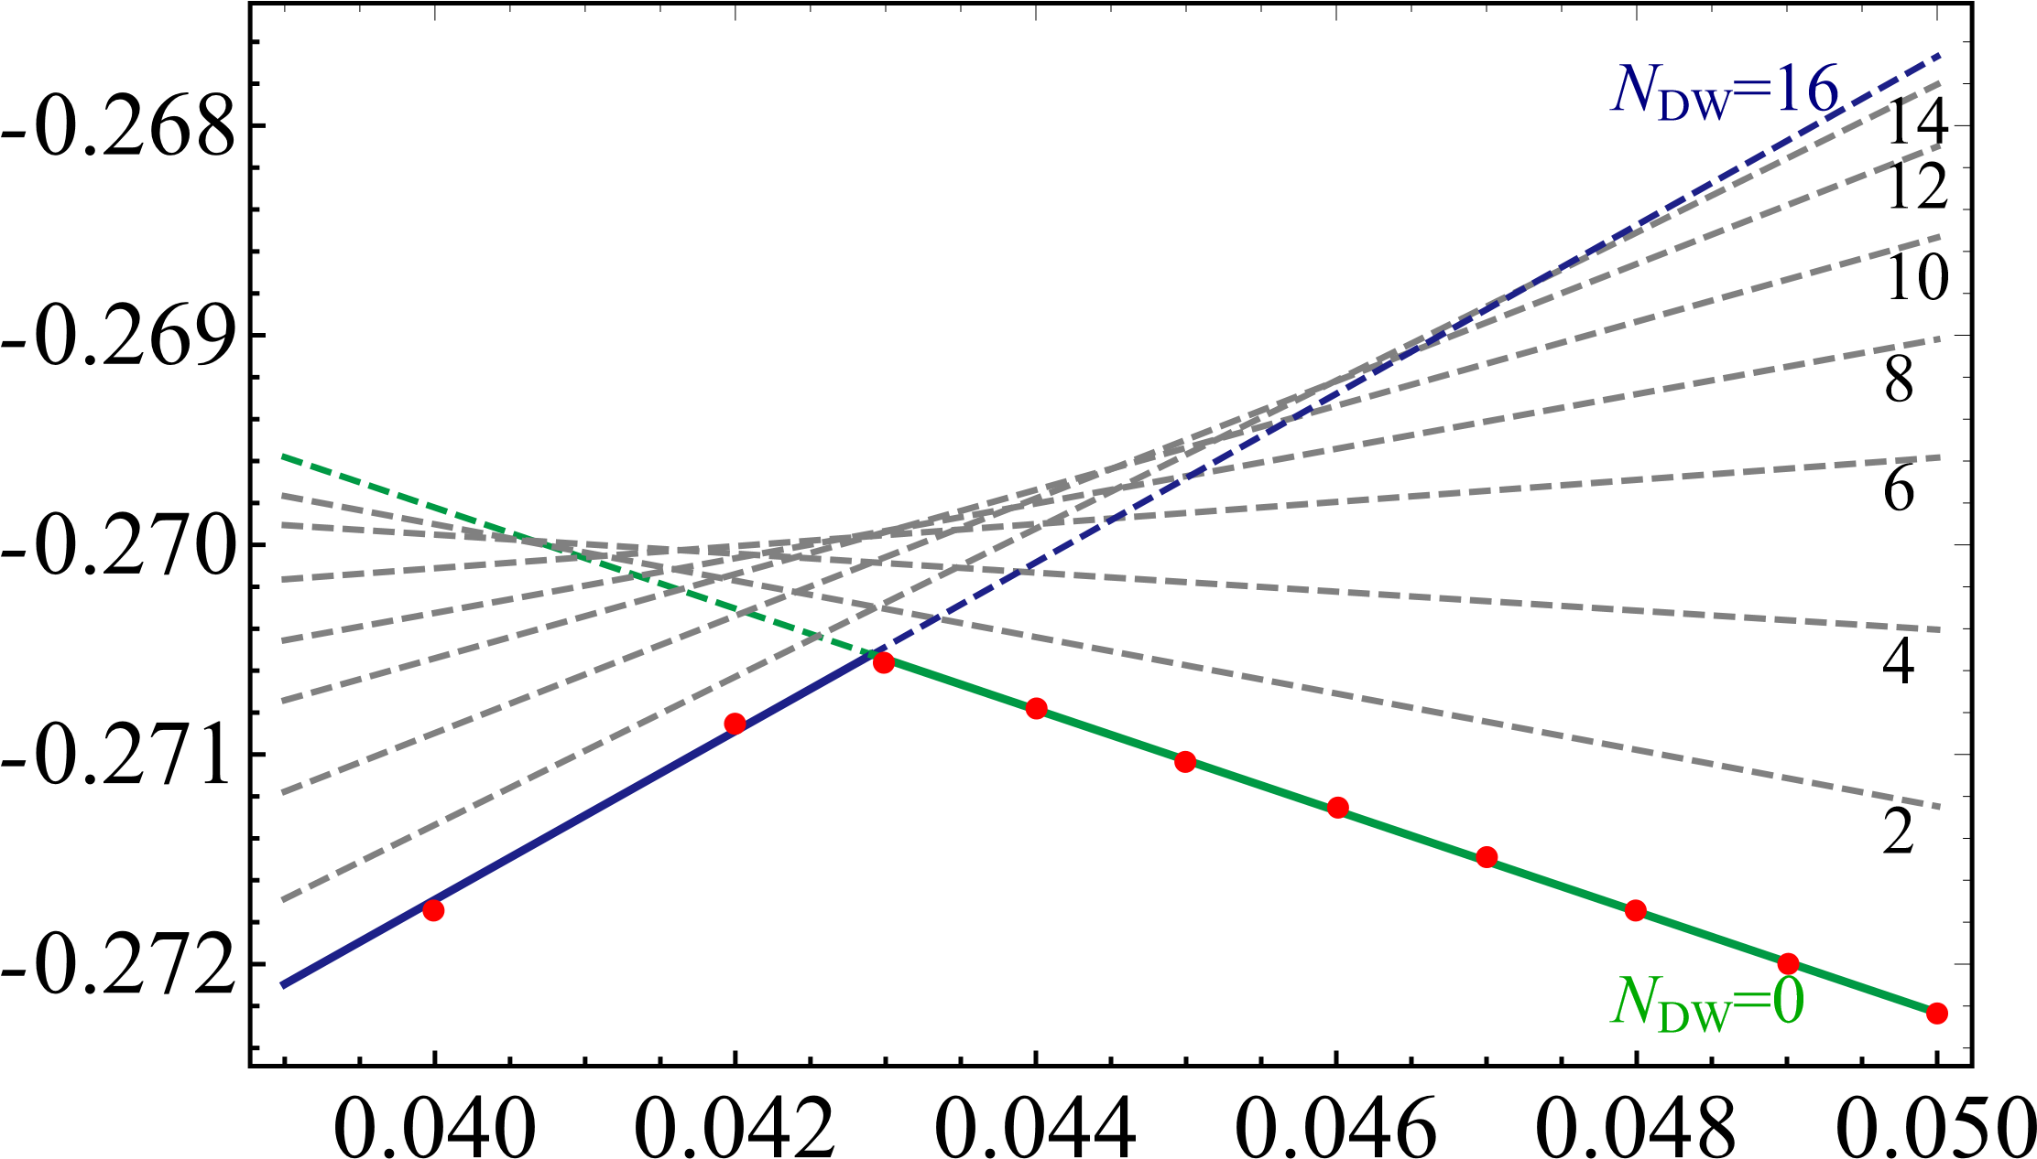

No interaction and RK point
$$E$$
clock
stripe
$$J_{2}$$
ZXF arXiv:2212.10863 (2022)

Slide 18
Mapping to Kagome
1/3 Kagome <-> 1/2 triangular
R. Moessner and S. L. Sondhi
PRB 63, 224401 (2001)

Slide 19
Deconfinement and Open Strings

Slide 20
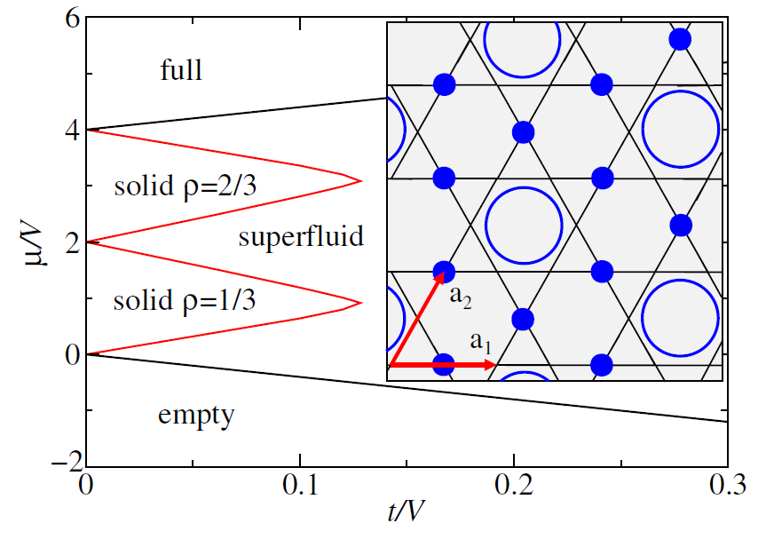
Valence Bond Solid
Extended Bose-Hubbard Model:
$$H=−t\sum_{\left\langle ij\right\rangle }{\left(b_{i}^{†}b_{j}+h.c.\right)}+V\sum_{\left\langle ij\right\rangle }{n_{i}n_{j}}−μ\sum_{i}{n_{i}}$$
$$b_{i}^{†}↔S_{i}^{+}, b_{i}↔S_{i}^{−}, n_{i}↔S_{i}^{z}+1/2$$
Spin ½ XXZ model:
$$H=−t\sum_{\left\langle ij\right\rangle }{\left(S_{i}^{†}S_{j}^{−}+h.c.\right)}+V\sum_{\left\langle ij\right\rangle }{S_{i}^{z}S_{j}^{z}}−(μ−2V)\sum_{i}{S_{i}^{z}}$$
Ice Rule
(Triangle rule) :
Valence bond solid (VBS)
Translational symmetry
Superfluid (SF)
U(1) symmetry
Weakly first order?
S.V. Isakov, et al.
PRL 97, 147202 (2006)
Deconfined phase transition?
K. Damle and T. Senthil
PRL 97, 067202 (2006)

Slide 21
Fractional excitation
Fractional excitation:
Gap Energy
Ground state manifold
(Topological degeneracy):
A. O’Brien, F. Pollmann, and P. Fulde
PRB 81, 235115 (2010)

Slide 22
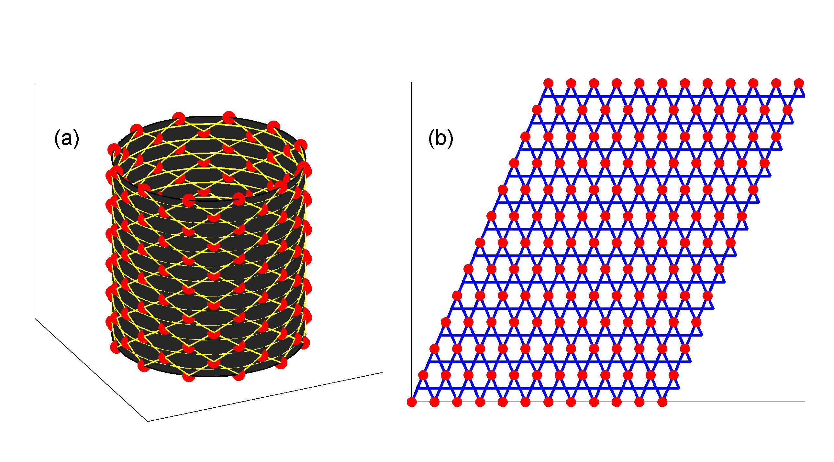
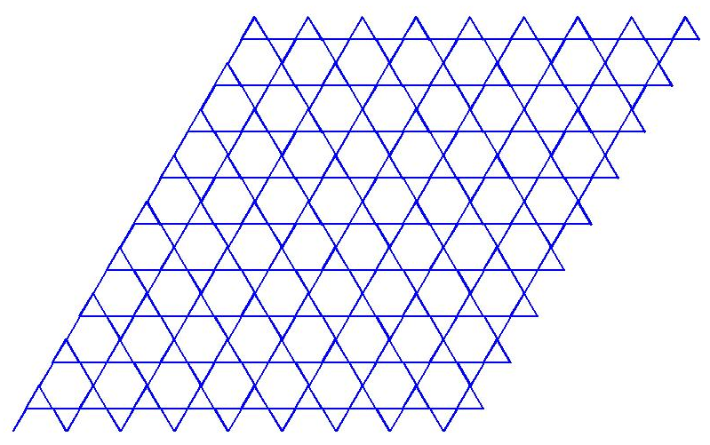
Fractional excitation
ZXF，PRL 111, 147201 (2013)

Slide 23
Fractional excitation
$$−t/V$$
$$−\tilde{t}=−\frac{12t^{3}}{V^{2}}$$
ZXF，PRL 111, 147201 (2013)

Slide 24
Effective model of String
$$−t$$
Spin
Boson
0
$$−\tilde{t}$$
0
0
$$L_{y}$$
1
0
1
0

Slide 25
Quantum Monte Carlo

Slide 26
Lattice Gauge Mapping
Y.-C. He et al.
PRL 112, 137202 (2014)
PRL 114, 037201 (2015)
PRL 115, 267209 (2015)
Gap:
N_{f}=4 spinons
A
Next nearest neighbor hopping of spinons
B

Slide 27
Lattice Gauge Mapping
Resonant
Two spinons couple to U(1) gauge field: easy plane NCCP¹
Effective Euclidean action at 1/3 filling:
Hopping of spinons
Gap
Resonant
VBS
VBS
Deconfined CP?
Superfluid
Neel
U(1) spin liquid
T. Senthil, et al. Science 303, 1490 (2004). PRB 70, 144407 (2004).

Slide 28
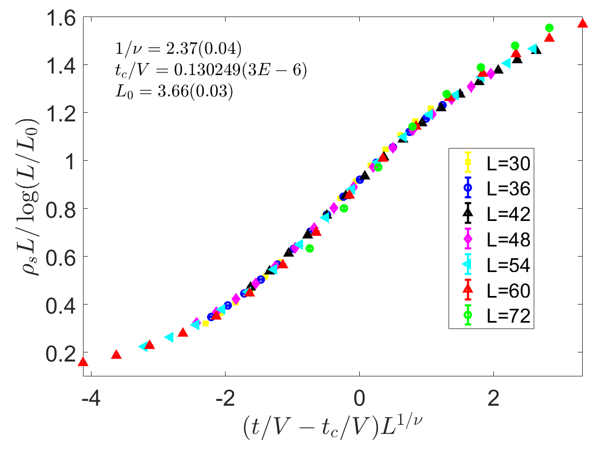
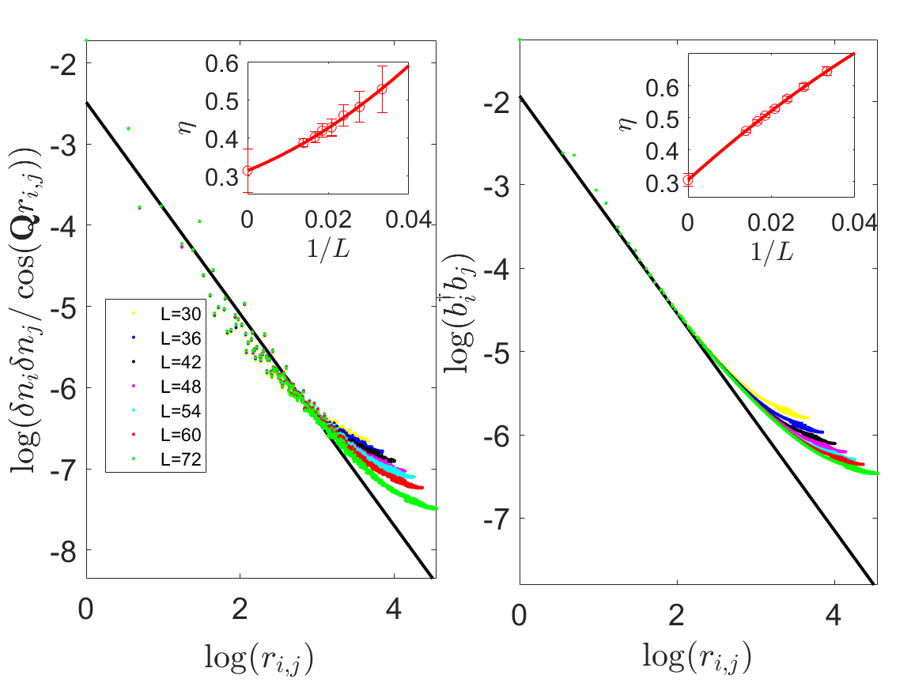
Deconfined Quantum Phase Transition
Drift of superfluid density
Large anomalous critical exponent
$$η_{VBS}=0.313(0.057)$$
$$η_{SF}=0.305(0.020)$$
ZXF， PRL 120, 115702 (2018)

Slide 29
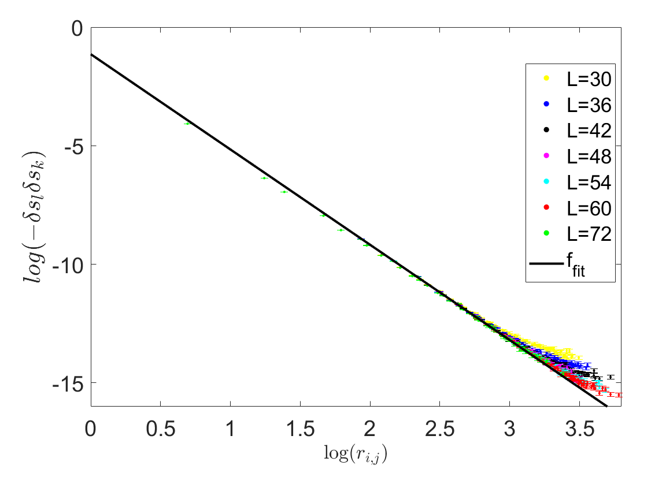
Deconfined Quantum Phase Transition
Scaling dimension of spinon operator is two
Emergent symmetries at the critical point.
Prediction of CFT
Scaling dimension:
$$r^{−2Δ}≈r^{−4.02\left(0.18\right)}$$
ZXF， PRL 120, 115702 (2018)

Slide 30
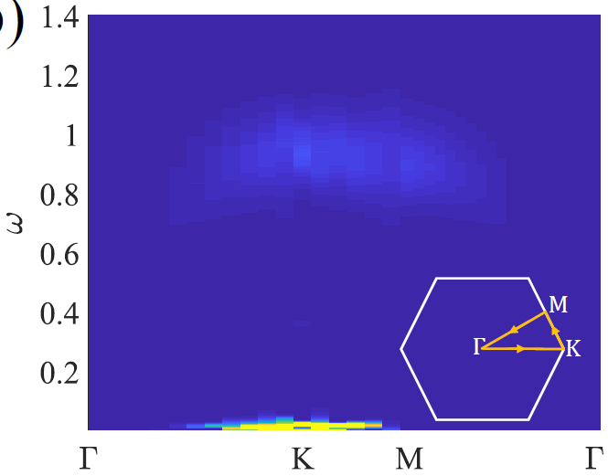
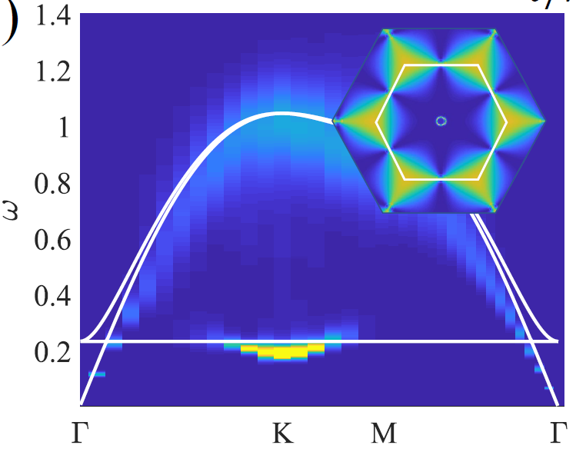
Dynamics of DQCP
VBS
Superfluid Phase
Flat band fragment
Flat band fragment
ZXF， arXiv 2301.12864 (2023)

Slide 31
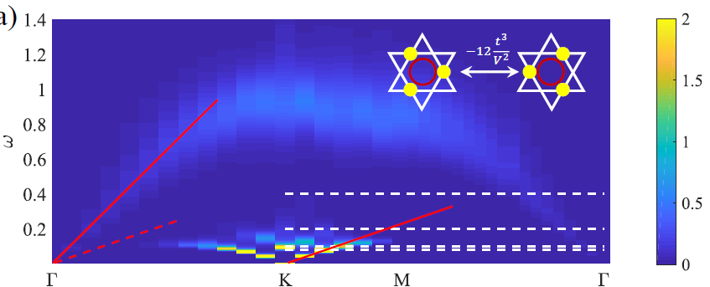
Dynamics of DQCP
Two speeds @DQCP

Slide 32
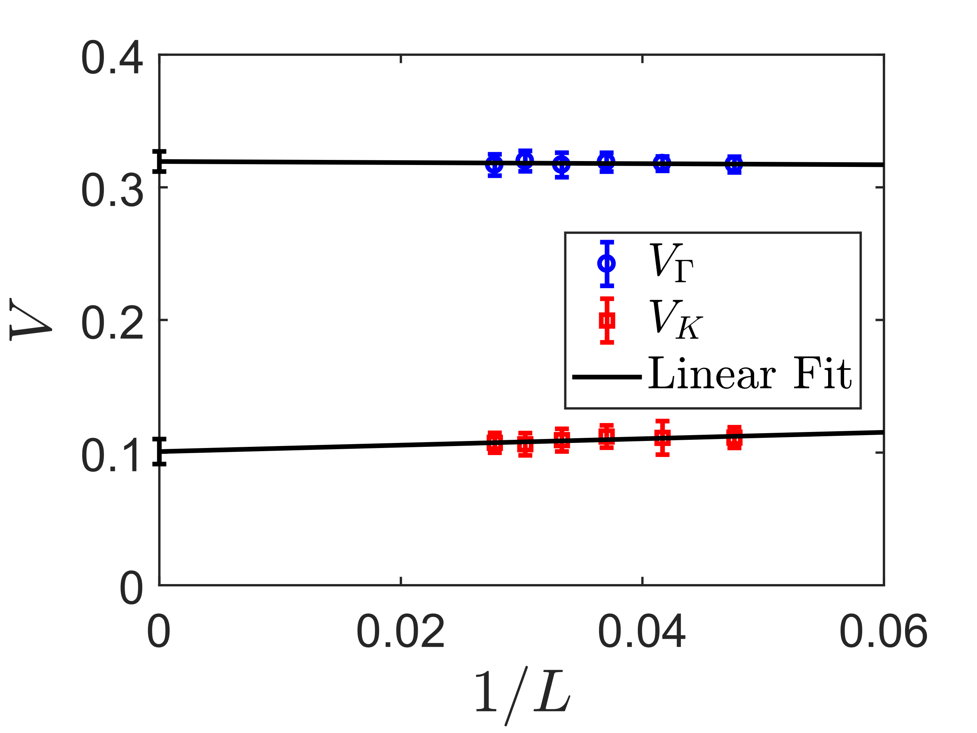
Finite Size Scaling
$Γ−$Branch (Spinon)
$$V_{Γ}^{∞}=0.319(8)$$
$K−$Branch (String)
$$V_{K}^{∞}=0.101(9)$$
ZXF， arXiv 2301.12864 (2023)

Slide 33
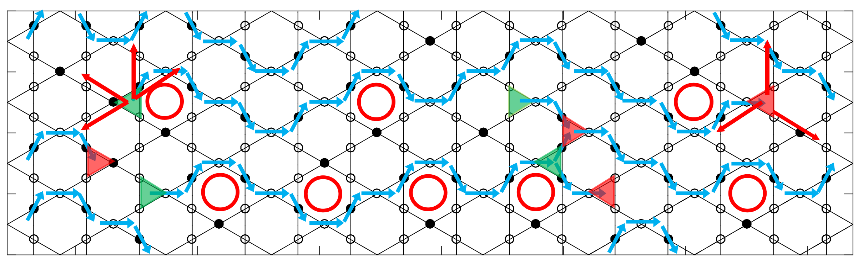
Snapshot @ DQCP
$$Γ−Branch Free Spinon dispersion:$$
$$E\left(k\right)=−\frac{7t}{6}\left(2Cos\left(\frac{\sqrt{3}k_{x}}{2}\right)Cos\left(\frac{k_{y}}{2}\right)+Cos\left(k_{y}\right)\right)≈−t(\frac{7}{2}−\frac{7}{8}k^{2})$$
$$V_{Γ}≈\sqrt{\frac{7}{8}t_{c}}=0.3375$$
$$V_{Γ}^{∞}=0.319(8)$$

Slide 34
Snapshot @ DQCP
$$K−Branch Effective XY model for string$$
JW
$$V_{K}≈\frac{4\tilde{t}}{\sqrt{3}}=0.0612$$
$$H_{string}=\tilde{t}\sum_{i}{S_{i}^{+}S_{i+1}^{−}+h.c.}, \tilde{t}=−\frac{12t^{3}}{V^{2}}$$
$$V_{K}^{∞}=0.101(9)$$

Slide 35
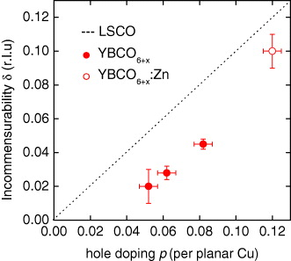
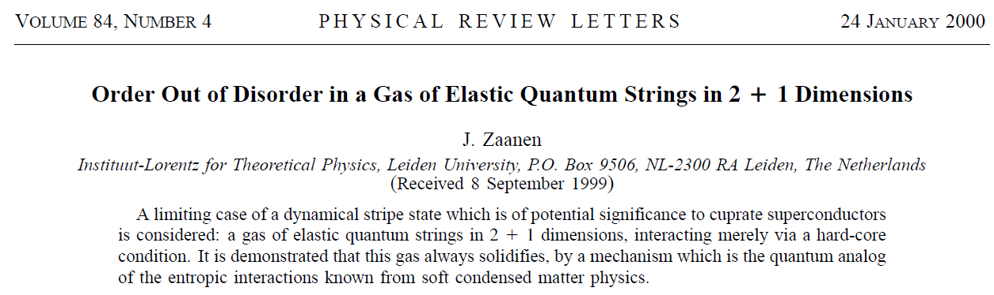
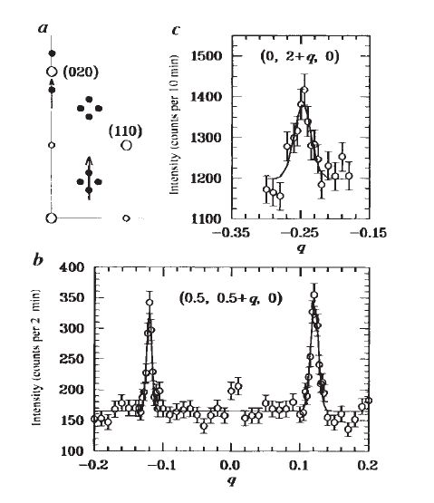
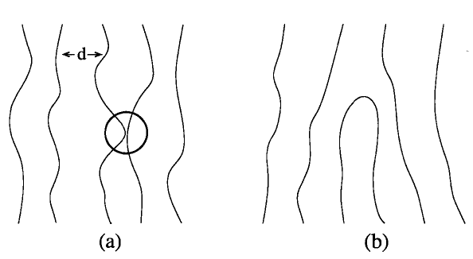
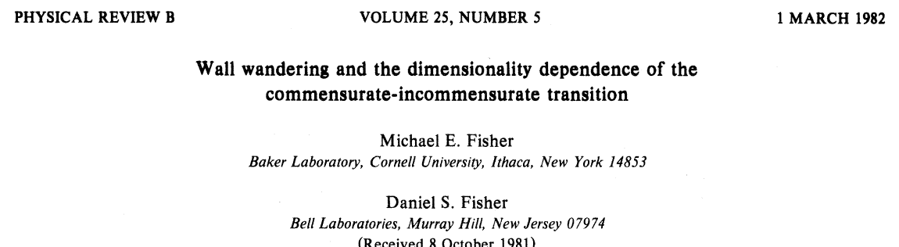
Shade a light on High-Tc
La_{1.48}Nd_{0.4}Sr_{0.12}CuO₄
J.M. Tranquads, et al. Nature, 375, 561 (1995)
D. Haug, et. al, New J. Phys. 12, 105006 (2010).
B-X Zheng, et. al, Science 358, 1155 (2017)

Slide 36

Conclusion

Slide 37



Acknowledgement
Zheng Zhou
@ Perimeter Institute
Prof. Dr. Changle Liu
@ Dali University
Prof. Dr. Zheng Yan
@ Westlake University
Dr. Zi-Jian Xiong
@ Chongqing University
Prof. Dr. Yan Chen
@ Fudan University
Dong-Xu Liu
@ Chongqing University

Slide 38
Dynamics of DQCP
Two speeds @DQCP
$$Γ$$

Slide 39
Dynamics of DQCP
Two speeds @DQCP
$$Γ$$

Slide 40
Dynamics of DQCP
Two speeds @DQCP
$$Γ$$

Slide 41
Dynamics of DQCP
Two speeds @DQCP
$$Γ$$

