Slide 1
致密核物质
与
双中子星并和引力波
Yong-Liang Ma
国科大杭州高等研究院

Slide 2
Y. Fujimoto, K. Fukushima, K. Hotokezaka, K. Kyutoku, e-Print: 2205.03882

Slide 3
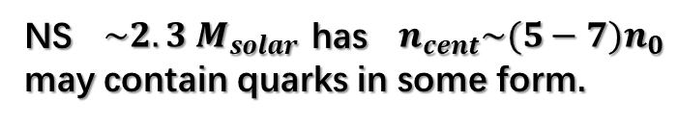
HIAF
NS $\sim 2.3 M_{solar}$has $n_{cent}\sim (5−7)n_{0}$ may contain quarks in some form.
G. Baym, et al., 1707.04966
地面核物理实验
地面实验无法检验、格点QCD无法计算!
依赖于天文学观测的间接信息。
间接限制模型与物态方程

Slide 4
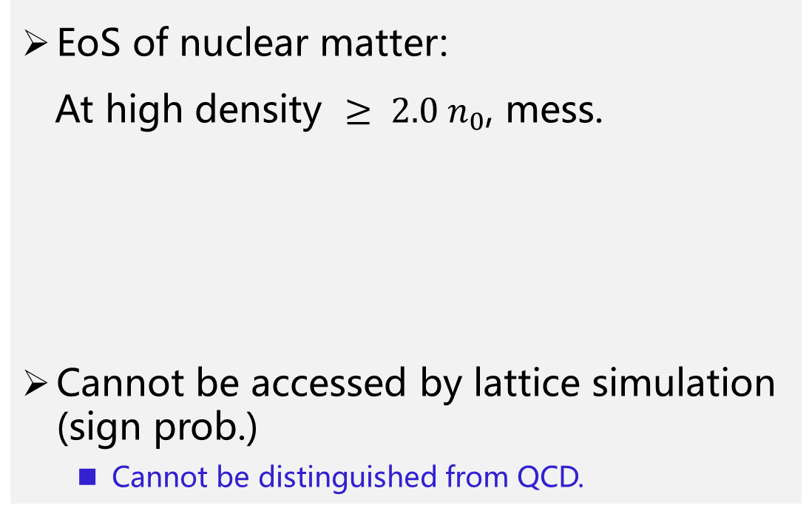
EoS of nuclear matter:
At high density $≥ {2.0 n}_{0}$, mess.
Cannot be accessed by lattice simulation (sign prob.)
  Cannot be distinguished from QCD.
What is the matter made of?
What is the state of compact star matter?
What are the patterns of the symmetries?
……
Hana Gil, et al, 1805.11321
这些问题的解决对粒子物理与核物理中的许多基本问题都有重要意义：手征对称性的破缺机制、核子质量的起源……

Slide 5
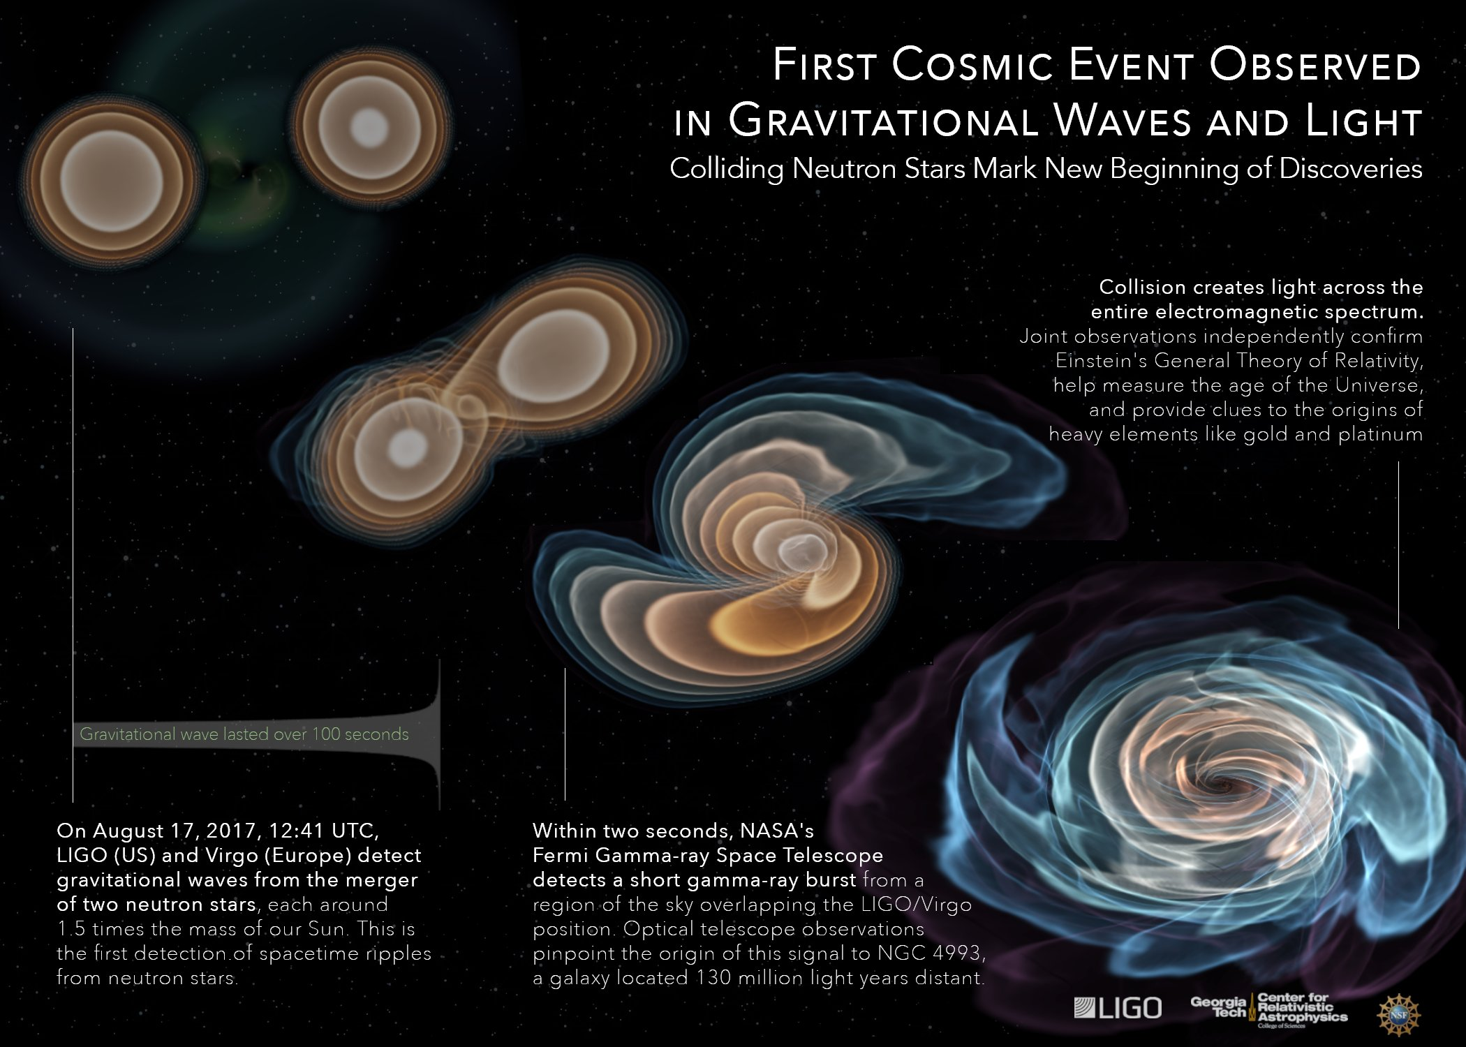
Answers from Astrophysics
INTRO
天文学进入了多信使时代；
为研究高密度区物理提供了新的机遇。
GW170817

Slide 6
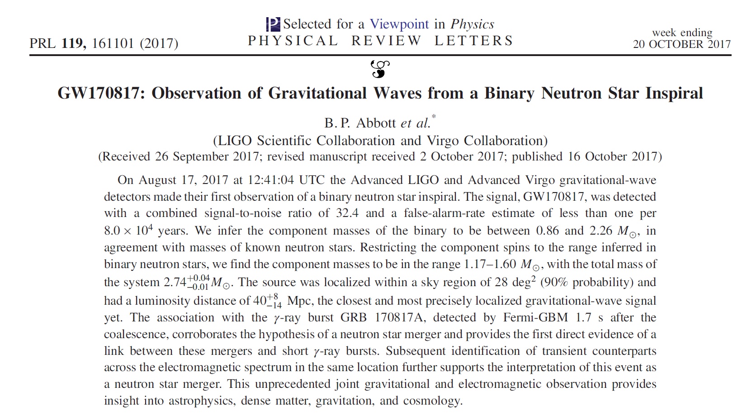
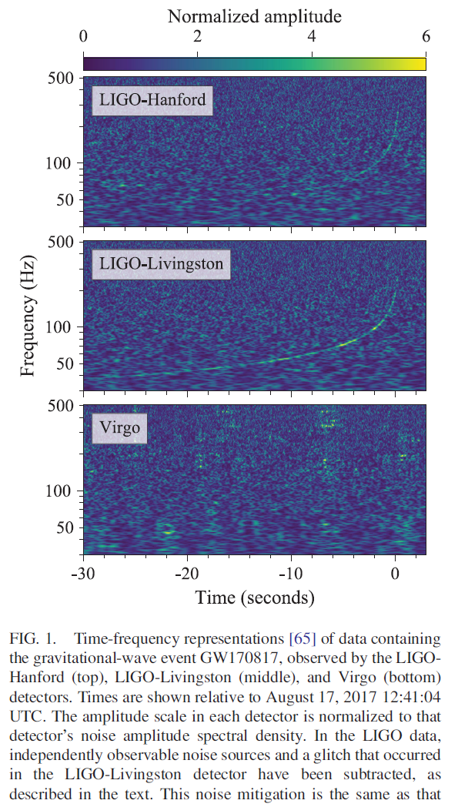
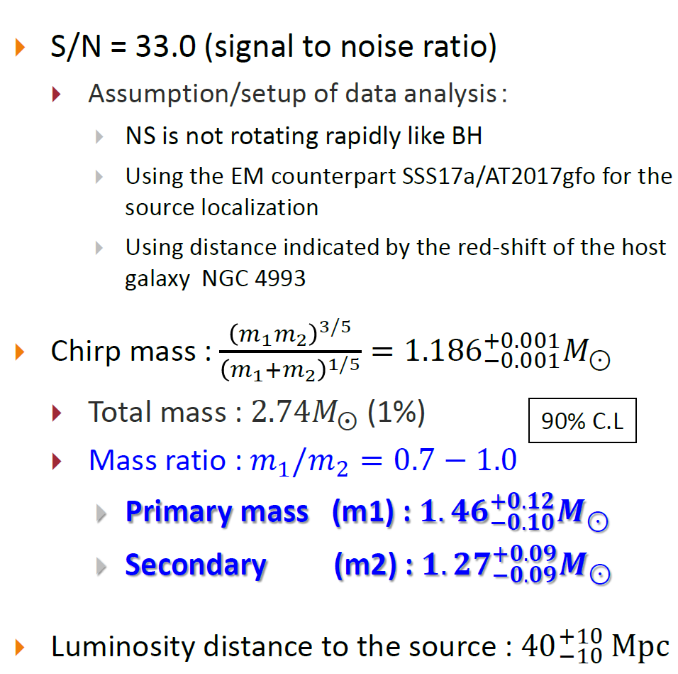
Notes:
潮汐形变的定义，与图形表示

Slide 7
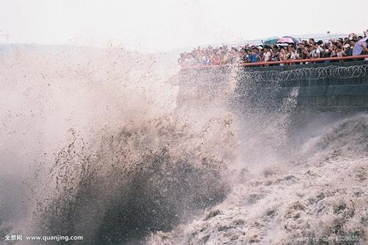
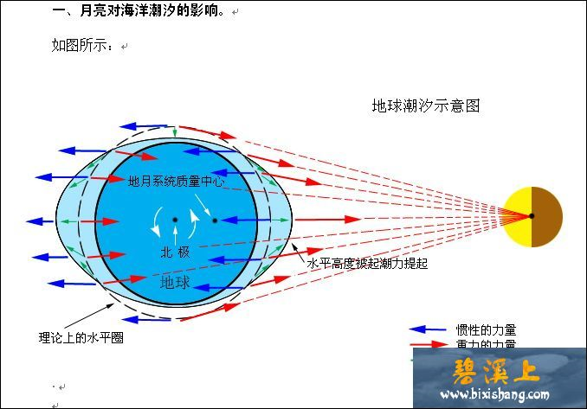
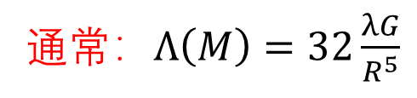

引力波无纵向分量，只有横向剪切分量，拉伸与挤压反复交替、震荡。
潮汐加速度$→潮汐$形变
通常：$Λ\left(M\right)=32\frac{λG}{R^{5}}$

Slide 8
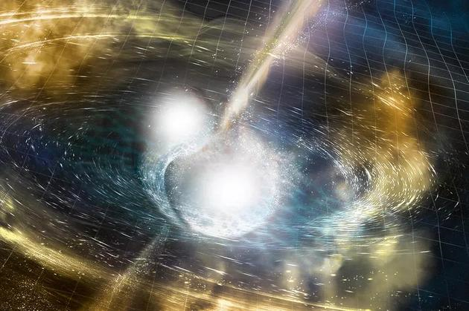
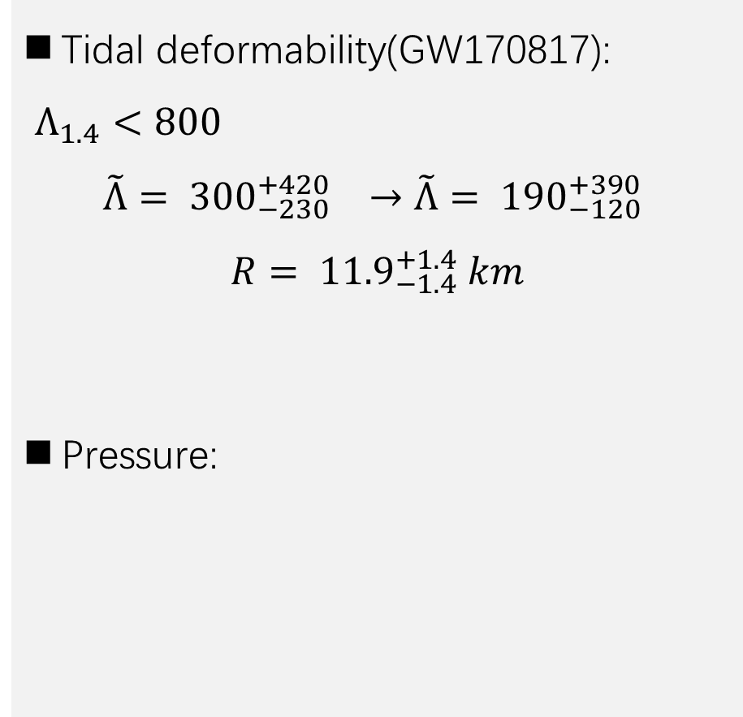

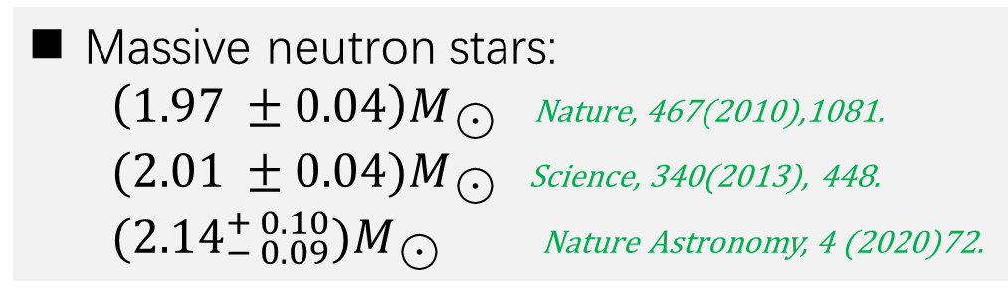
Tidal deformability(GW170817):
$Λ_{1.4}<800$
$$\tilde{Λ}= {300}_{−230}^{+420} →\tilde{Λ}= {190}_{−120}^{+390}$$
$$R= {11.9}_{−1.4}^{+1.4} km$$
Pressure:
C. Y. Tsang, et al., 1807.06571
Massive neutron stars:
$\left(1.97 ±0.04\right)M_{☉}$ Nature, 467(2010),1081.
$(2.01 ±0.04)M_{☉}$ Science, 340(2013), 448.
$({2.14}_{− 0.09}^{+ 0.10})M_{☉}$ Nature Astronomy, 4 (2020)72.
$$≤10n_{0}$$

Slide 9
Notes:
中子星融合的典型波形为千赫兹？为什么？与强相互作用的性质有关？

Slide 10
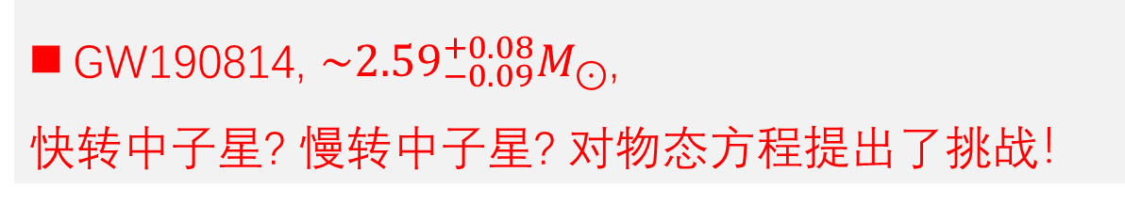
GW190814, $\sim {2.59}_{−0.09}^{+0.08}M_{⊙}$,
快转中子星? 慢转中子星? 对物态方程提出了挑战！
Notes:
中子星融合的典型波形为千赫兹？为什么？与强相互作用的性质有关？

Slide 11
Notes:
中子星融合的典型波形为千赫兹？为什么？与强相互作用的性质有关？

Slide 12
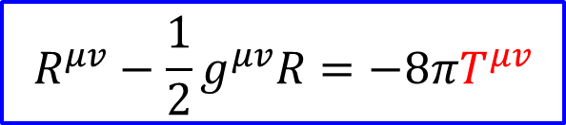
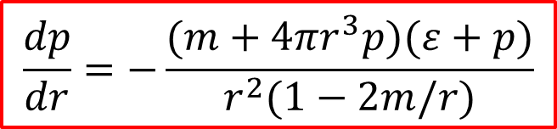


Tolman-Oppenheimer-Volkoff (TOV) 方程
$$R^{μv}−\frac{1}{2}g^{μv}R=−8πT^{μv}$$
物质的性质
对中子星结构的认识主要来自于质量-半径关系的确定
$$ds^{2}=e^{2v}dt^{2}−e^{2λ}dr^{2}−r^{2}(dθ^{2}+\sin^{2}θdφ^{2})$$
$$T^{μv}=u^{μ}u^{v}\left(ε+p\right)−g^{μv}p$$
$$\frac{dm}{dr}=4πr^{2}ε$$
$$\frac{dp}{dr}=−\frac{(m+4πr^{3}p)(ε+p)}{r^{2}(1−2m/r)}$$
Feryal Özel, Paulo Freire, 1603.02698
Notes:
中子星结构图

Slide 13
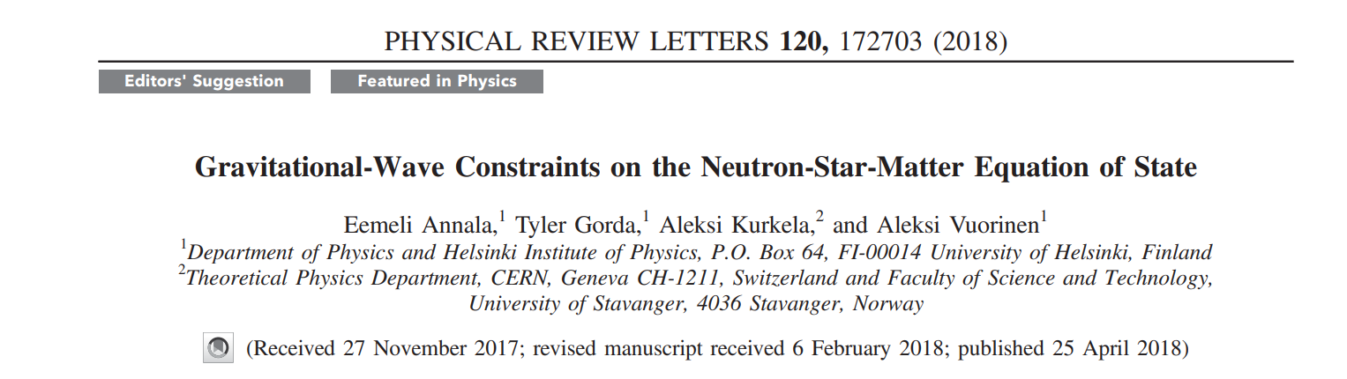
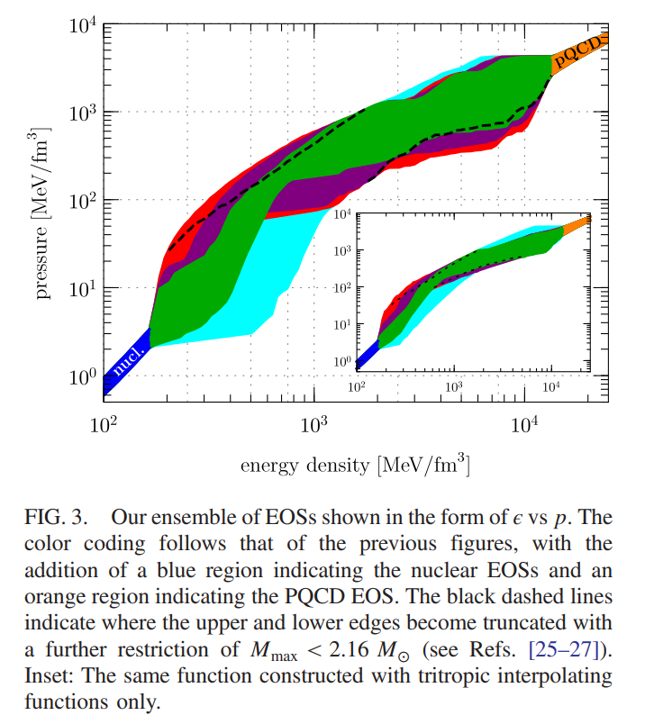
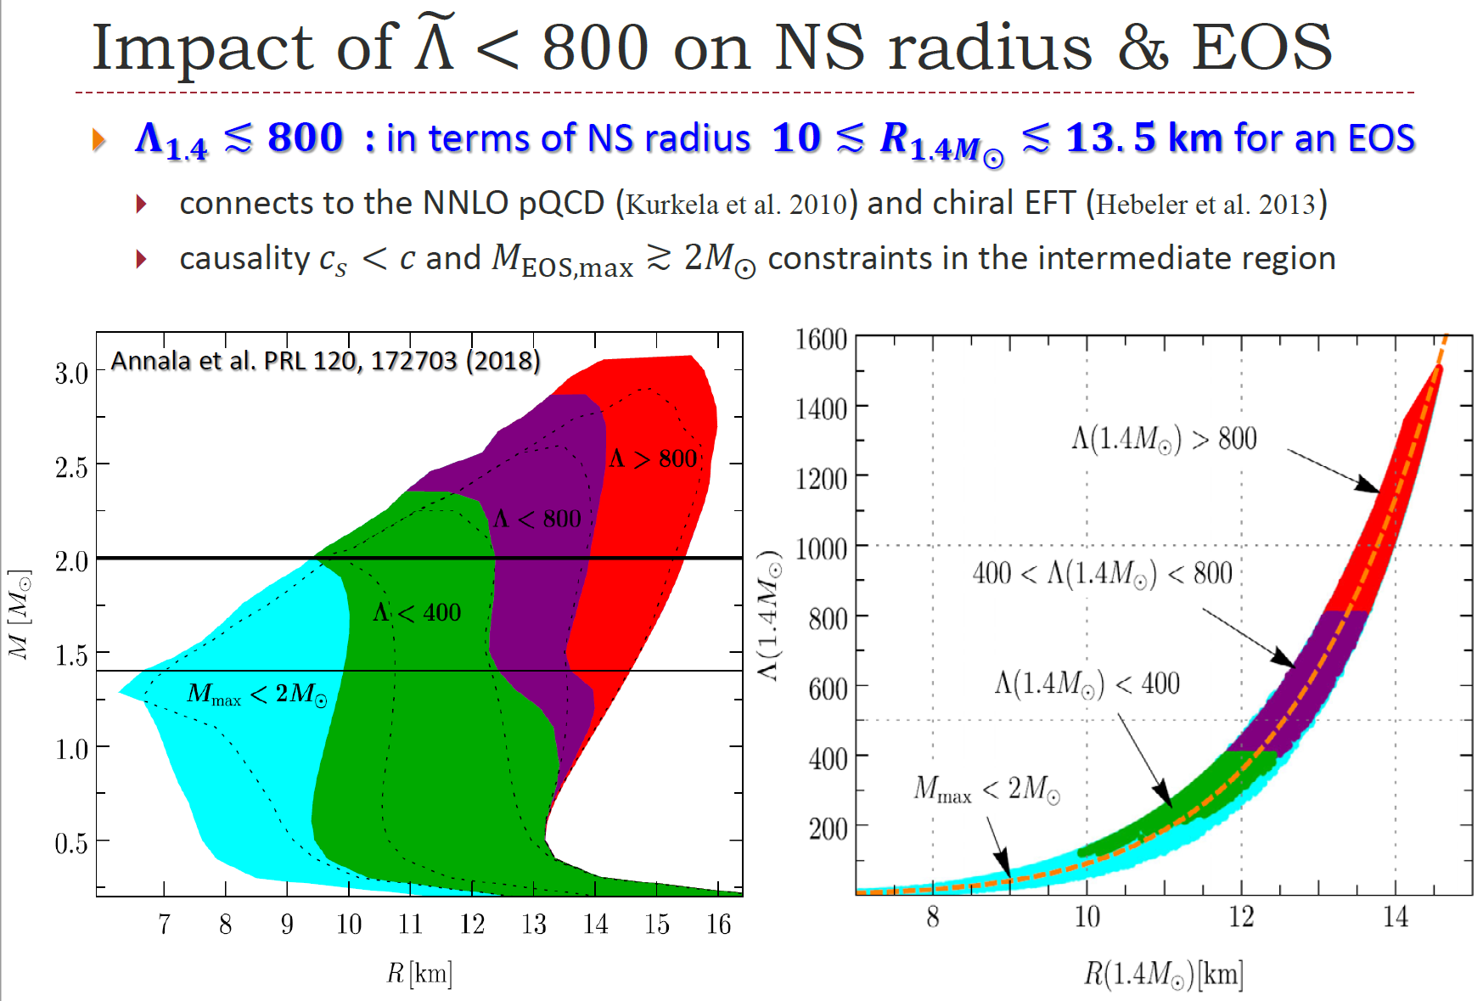
Notes:
查一下电磁信号和引力波信号的优缺点

Slide 14
中子星的内部组成
Pure hadronic matter
Quark matter
Quark-hadron crossover
Topology change
Strange matter
……
Quark-gluon plasma?
Fermi liquid?
Non-Fermi liquid?
(2+1) dimensional sheet?
Popcorn?
……
R. Shankar, Rev. Mod. Phys. 66, 129 (1994).
H. K. Lee and M. Rho, Eur. Phys. J. A 50, 14 (2014)
Y.-L. Ma and M. Rho, Symmetry 13, 1888 (2021).
V. Kaplunovsky, D. Melnikov, and J. Sonnenschein, JHEP 11, 047 (2012).
E. Witten, Phys. Rev. D 30, 272 (1984).
……
电磁波探测？Ⅹ
引力波诊断？√
Notes:
合并前后期电磁辐射对星体结构的依赖？

Slide 15
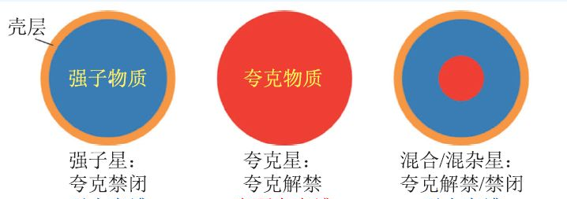
中子星的内部组成
Hadrons and quarks co-exist in the interior of a compact star (hybrid star);
The core of are formed of quarks after a deconfinement phase transition.

Slide 16
Deconfinement Phase Transition
The nature of hadron-quark phase transition at high density (and zero temperature) is still unknown;
Different QCD methods show model-dependent predictions;
We construct both first order phase transition and crossover deconfinement phenomenologically and model-independently;

Slide 17
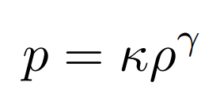

First Order Construction
Assuming a polytropic type mixture-phase:
Maxwell construction which describes a sharp transition
Gibbs construction which describes a soft mixed phase

Slide 18
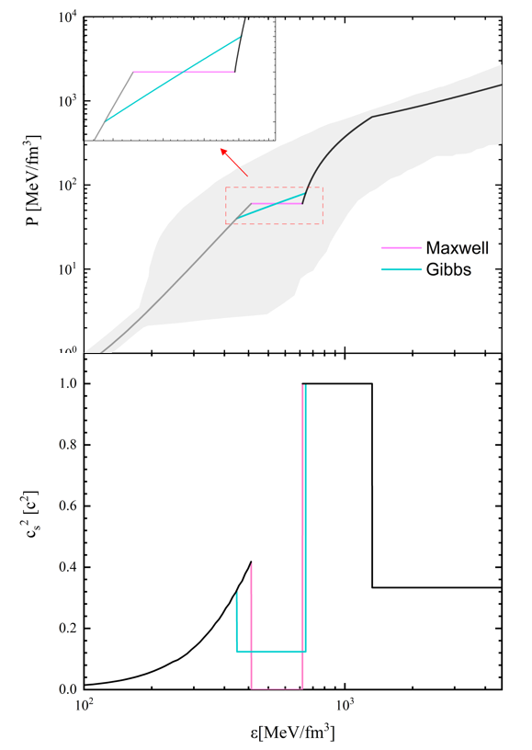
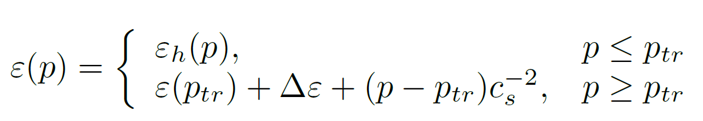
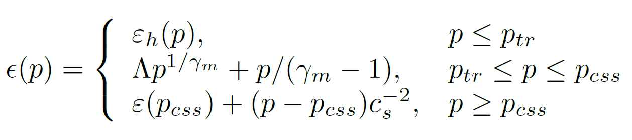
First Order Construction
Maxwell construction:
Gibbs construction
J.E. Christian, et al., EPJA54, 28 (2018);
G. Montana, et al., PRD 99, 103009 (2019)
Bhattacharyya, et al., JPG37, 025201 (2010);
T. Endo, et al., hep-ph/0502216

Slide 19
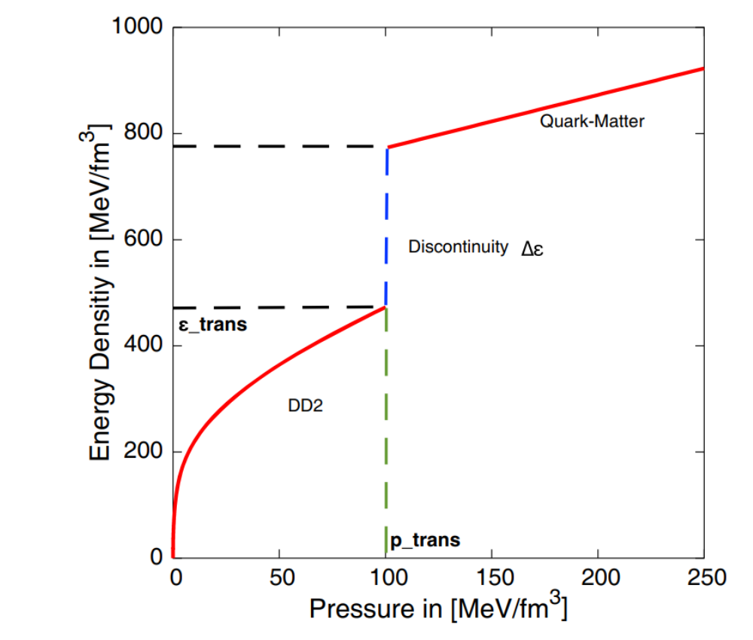



First Order Construction
Maxwell construction:
Parameters describing phase transition:
: where the phase transition takes place
: The energy gap between two phases
Parameters describing quark phase:
: constant sound speed
Notes:
Cs是什么？

Slide 20
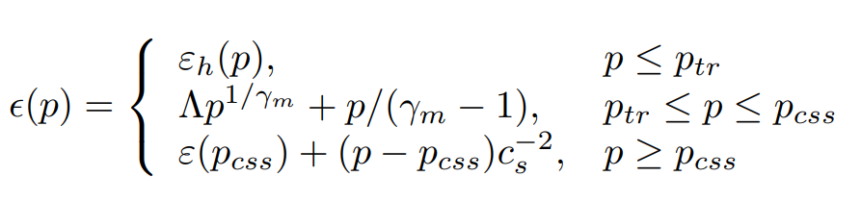


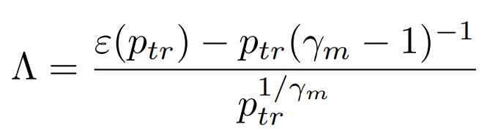
First Order Construction
Gibbs construction:
Parameters describing phase transition:
Parameters describing quark phase:
where the phase transition start and end
the polytropic index
Notes:
Pcss是什么？

Slide 21
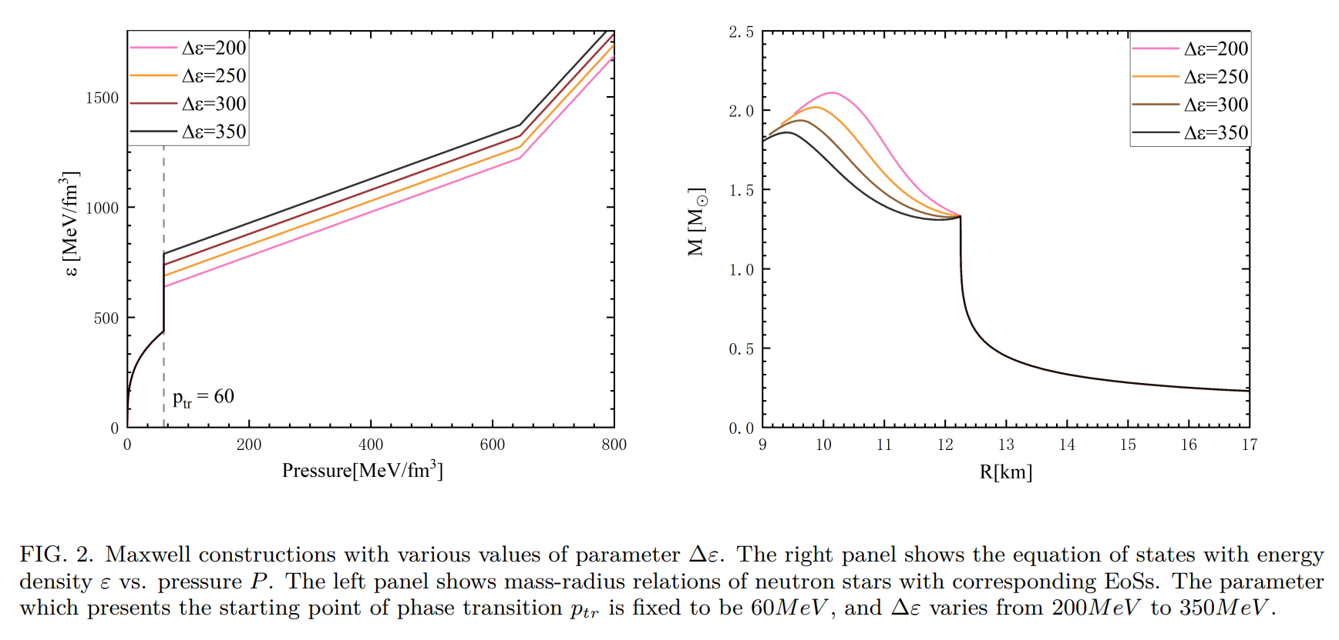
First Order Construction
L. J. Guo, W. C. Yang, YLM & Y. L. Wu, 2306.XXXXX
Stars with Maxwell construction:
Low density, pure APR EoS is used;
A. Akmal, V. R. Pandharipande and D. G. Ravenhall, PRC58, 1804(1998).

Slide 22
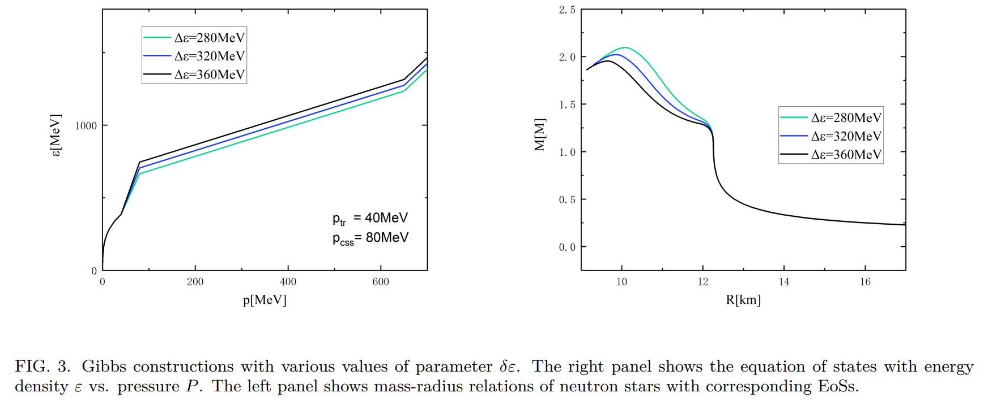
First Order Construction
L. J. Guo, W. C. Yang, YLM & Y. L. Wu, 2306.XXXXX
Stars with Gibbs construction:

Slide 23
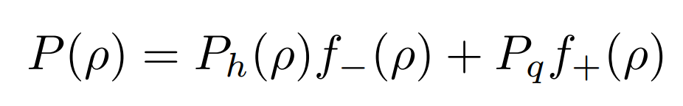
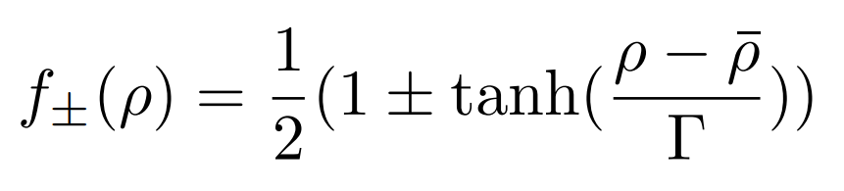
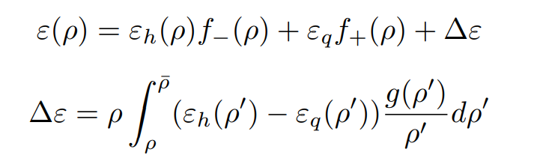

Crossover Construction
Introduce connection function on the pressure:
Energy density therefore can be calculated through thermal dynamical relations:
Notes:
从skyrmion出发计算多重子体系的核物质相关性质，从计算的角度上来讲是很难的，所以我们把他放在手征微扰论下来做，就有了我们的pseudoconformal model也就是PCM模型；这些是pcm模型基于的对称性是这些，而这些是对应的NG粒子

Slide 24
EOS with Crossover
L. J. Guo, W. C. Yang, YLM & Y. L. Wu, 2306.XXXXX

Slide 25
Diagnose EoS using GW waveforms
A typical evolution can be divided in three (or four) phases:
The merger phase:
The two stars come into contact, compressing their matter and giving rise to a complex hydrodynamical phen.
The post-merger phase: The neutron star formed during the merger evolves, with a different phen. depending on its mass, EOS, and angular momentum distribution. The remnant star is bar-deformed, rotates differentially, and emits GWs with high luminosity
The inspiral phase
The collapse phase:
If the merger remnant has a mass greater than the limit for a non-rotating neutron star imposed by its EOS, the neutron star collapses to a black hole, when its rotation has slowed down enough.
Bauswein and Stergioulas 2015 PRD91 124056.

Slide 26
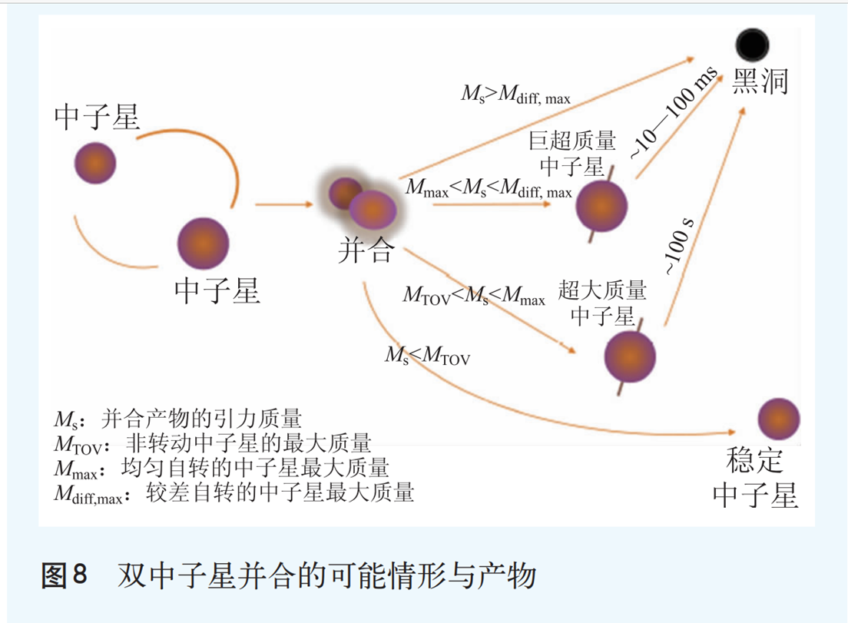
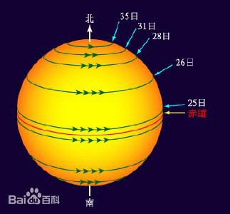
Diagnose EoS at high density
较差自转

Slide 27

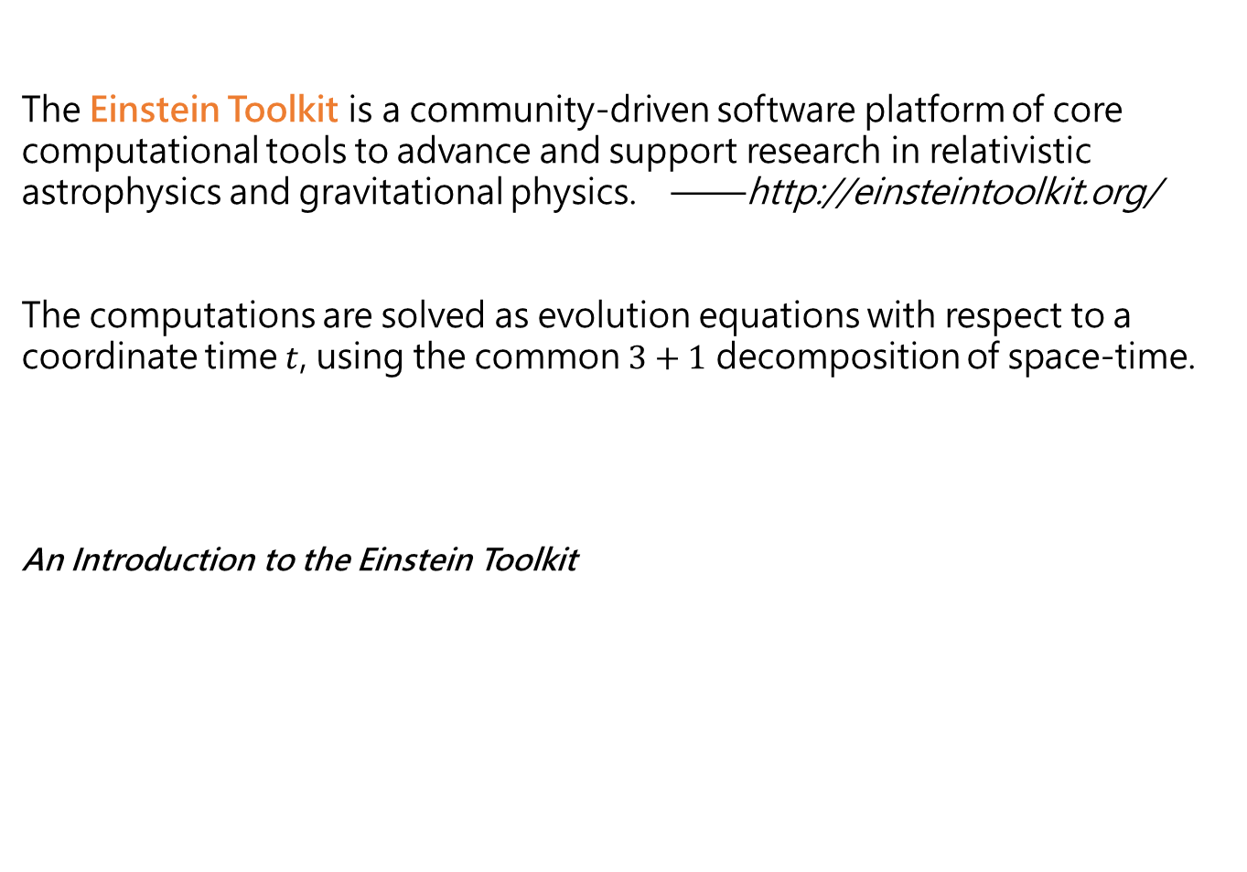
Einstein Toolkit (ETK)
The Einstein Toolkit is a community-driven software platform of core computational tools to advance and support research in relativistic astrophysics and gravitational physics. ——http://einsteintoolkit.org/
The computations are solved as evolution equations with respect to a coordinate time $t$, using the common $3+1$ decomposition of space-time.
An Introduction to the Einstein Toolkit
M. Zilhão and F. Löfﬂer. Int.J.Mod.Phys. A28 (2013) 1340014

Slide 28
GW waveforms from hadron stars
Inspiral phase: The GWs progressively increase both their frequency and amplitude, generating a signal known as “chirp". The point of maximum amplitude is conventionally defined as the merger of the two stars.
After the merger, the signal amplitude drops and then its amplitude raises again, at a higher frequency, which strongly depends on the EOS, for the GW emission due to the rotation of the bar-deformed neutron star remnant.
The post merger GW emission amplitude decreases exponentially, due to the redistribution of angular momentum and the star approaching a more axisymmetric state.
The models collapsing to black hole are clearly recognizable, because after collapse the GW amplitude drops immediately to negligible values.
K. Hotokezaka, et. al., PRD 87 044001

Slide 29
GW from deconfinement phase transition
L. J. Guo, W. C. Yang, YLM & Y. L. Wu, 2306.XXXXX
The differences start to appear only after the merger, which means that the phase transition is merely not covered before merger and is partially covered after merger.
After merger, the remnant of BNS merger is able to form a differential rotating hypermassive neutron star(HMNS) with mass greater than the maximum mass solved from TOV equations.
With the decreasing of differential rotation, the HMNS would collapse to a black hole(BH), which can be identified from zero value GW waveform shown in figure.
The simulations with larger Δε of MC phase transition would experience longer HMNS period before the formation of BH, and this can be explained from the EoS softening caused by the phase transition.
Effect of phase transition parameters/MC
In contrast to previous situation, GW waveform shows tremendous different even in the inspiral phase pf BNS merger process. Simulations with lower ptr value, i.e. larger quark core exists in the interior of NS, would merger quickly than those with higher ptr.

Slide 30
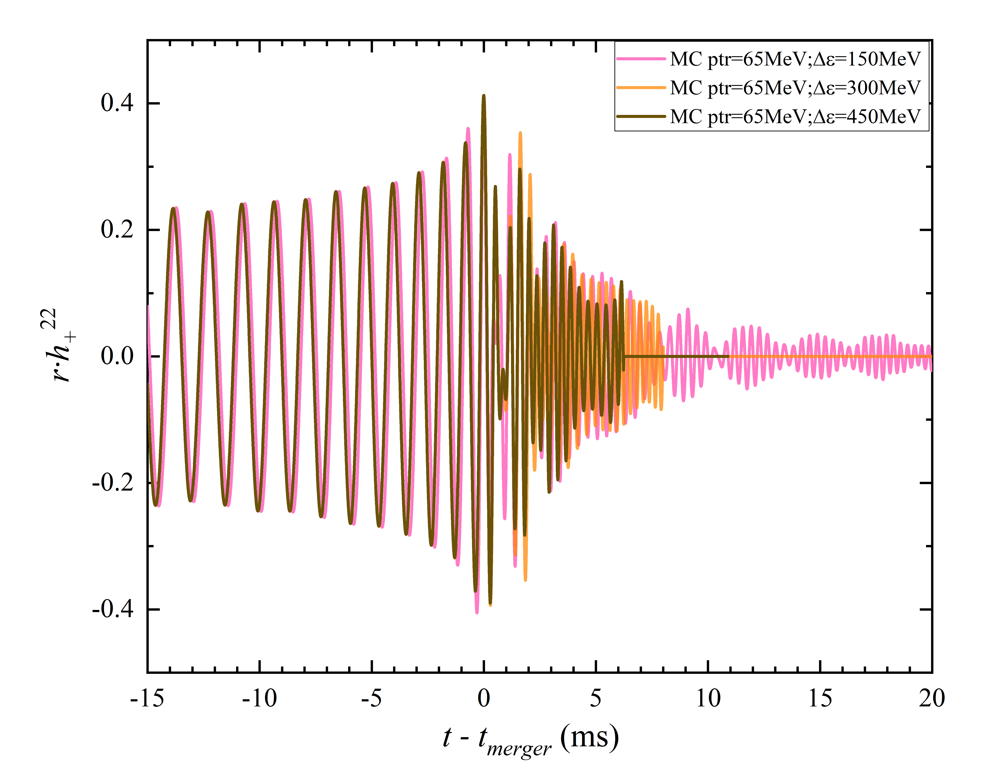
GW from deconfinement phase transition
L. J. Guo, W. C. Yang, YLM & Y. L. Wu, 2306.XXXXX
Notes:
潮汐形变与物态方程的硬度？要说明什么事情？

Slide 31
GW from deconfinement phase transition
Effect of phase transition parameters/GC
L. J. Guo, W. C. Yang, YLM & Y. L. Wu, 2306.XXXXX

Slide 32
GW from deconfinement phase transition
Effect of phase transition parameters/CO
L. J. Guo, W. C. Yang, YLM & Y. L. Wu, 2306.XXXXX

Slide 33
GW from deconfinement phase transition
Effect of NS masses parameters/MC
L. J. Guo, W. C. Yang, YLM & Y. L. Wu, 2306.XXXXX
The component mass makes monstrous difference on the maximum amplitude of GW and mergertime of BNS.
In the left panel, 1.5M⊙ simulations was aborted soon after merger caused by unknown reason, or it collapsed to a BH soon after the merger.

Slide 34
GW from deconfinement phase transition
Effect of NS masses parameters/GC
L. J. Guo, W. C. Yang, YLM & Y. L. Wu, 2306.XXXXX

Slide 35
GW from deconfinement phase transition
Effect of NS masses parameters/CO
L. J. Guo, W. C. Yang, YLM & Y. L. Wu, 2306.XXXXX

Slide 36
GW from deconfinement phase transition
Form of deconfinement phase transition effect on the GW
L. J. Guo, W. C. Yang, YLM & Y. L. Wu, 2306.XXXXX
All simulations have components mass 1.1M⊙ + 1.1M⊙. For MC: ptr = 35MeV and Δε = 100MeV; For GC: ptr = 20MeV, pcss = 50MeV and Δε = 175MeV , with those parameters it could be ensured that EOS of MC and GC can precisely overlap before and after the phase transition as shown in the right panel so that make it possible to control the construction method of phase transition as the only variable between different simulations.

Slide 37
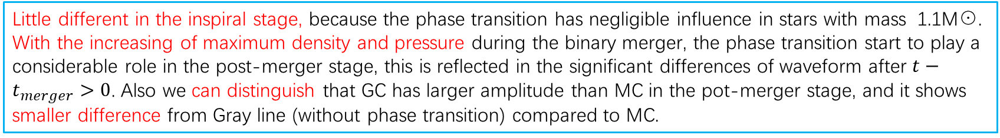
GW from deconfinement phase transition
Form of deconfinement phase transition effect on the GW
L. J. Guo, W. C. Yang, YLM & Y. L. Wu, 2306.XXXXX
Little different in the inspiral stage, because the phase transition has negligible influence in stars with mass 1.1M⊙. With the increasing of maximum density and pressure during the binary merger, the phase transition start to play a considerable role in the post-merger stage, this is reflected in the significant differences of waveform after $t−t_{merger}>0$. Also we can distinguish that GC has larger amplitude than MC in the pot-merger stage, and it shows smaller difference from Gray line (without phase transition) compared to MC.

Slide 38
GW from deconfinement phase transition
Form of deconfinement phase transition effect on the GW
L. J. Guo, W. C. Yang, YLM & Y. L. Wu, 2306.XXXXX
The phase transition parameters of MC: ptr = 35 and Δε = 150MeV , GC and crossover are constructed to ensure the converge of EOS at low and high densities with MC.
We can see that the waveform of MC are most different from other constructions, since it is a very acute first-order phase transition and makes the smallest tidal deformability.

Slide 39
GW from deconfinement phase transition
L. J. Guo, W. C. Yang, YLM & Y. L. Wu, 2306.XXXXX
The rapid increase of the GW frequency happens during merge at $t−t_{merger}=0$, accompanied by a maximum amplitude of the GW as represented by brighter colors in the graphs. the GW frequency of the Maxwell constructed EOS increased even after merge while the Gibbs and crossover constructed EOS decreased.

Slide 40
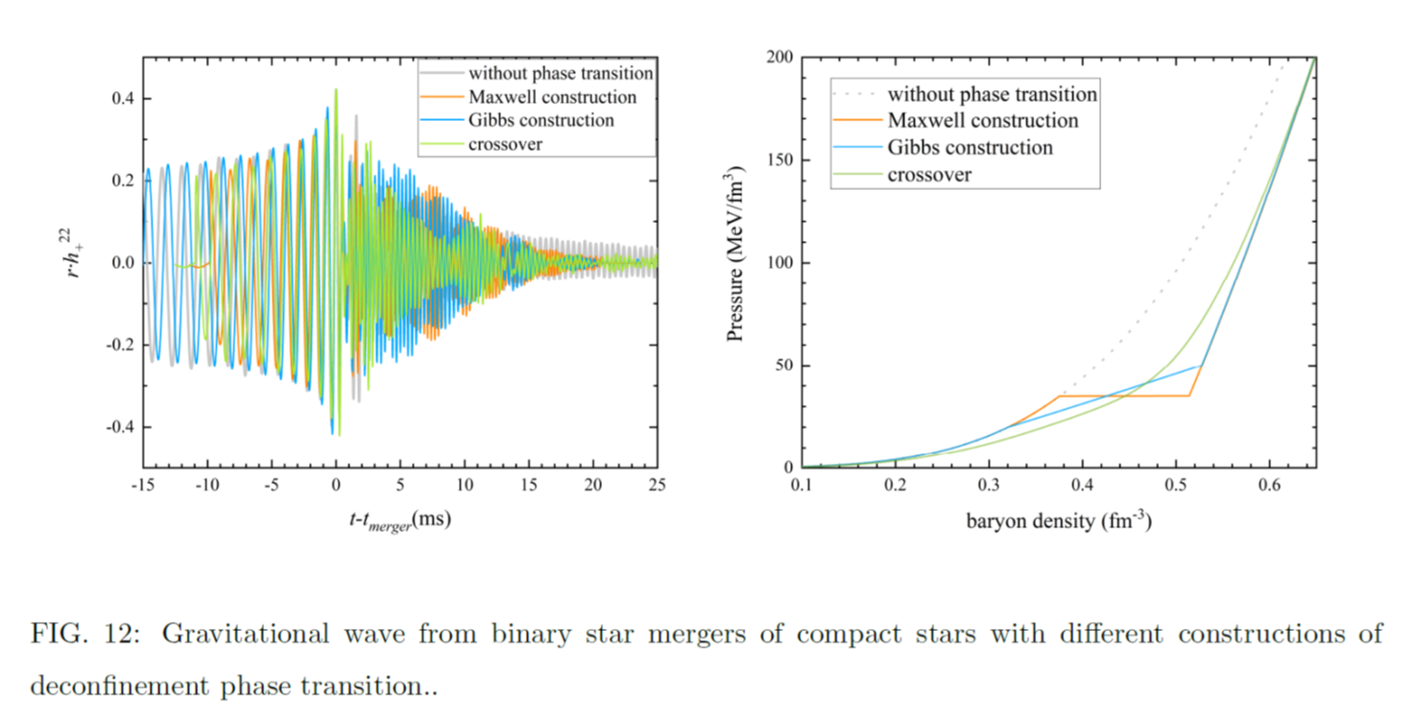
GW from deconfinement phase transition
L. J. Guo, W. C. Yang, YLM & Y. L. Wu, 2306.XXXXX
We can distinguished from density contours in the top panel that CSS phase exits in the cores of compact stars in the whole process of BNS merger even in the inspiral phase,
While in GC scenario the CSS phase only appears after BNS merger when the maximum density is high enough.
In the crossover situation, there is no contours because it is impossible to distinguish the exact density where the transition begins and ends in a crossover phase transition.
Notes:
CSS?

Slide 41
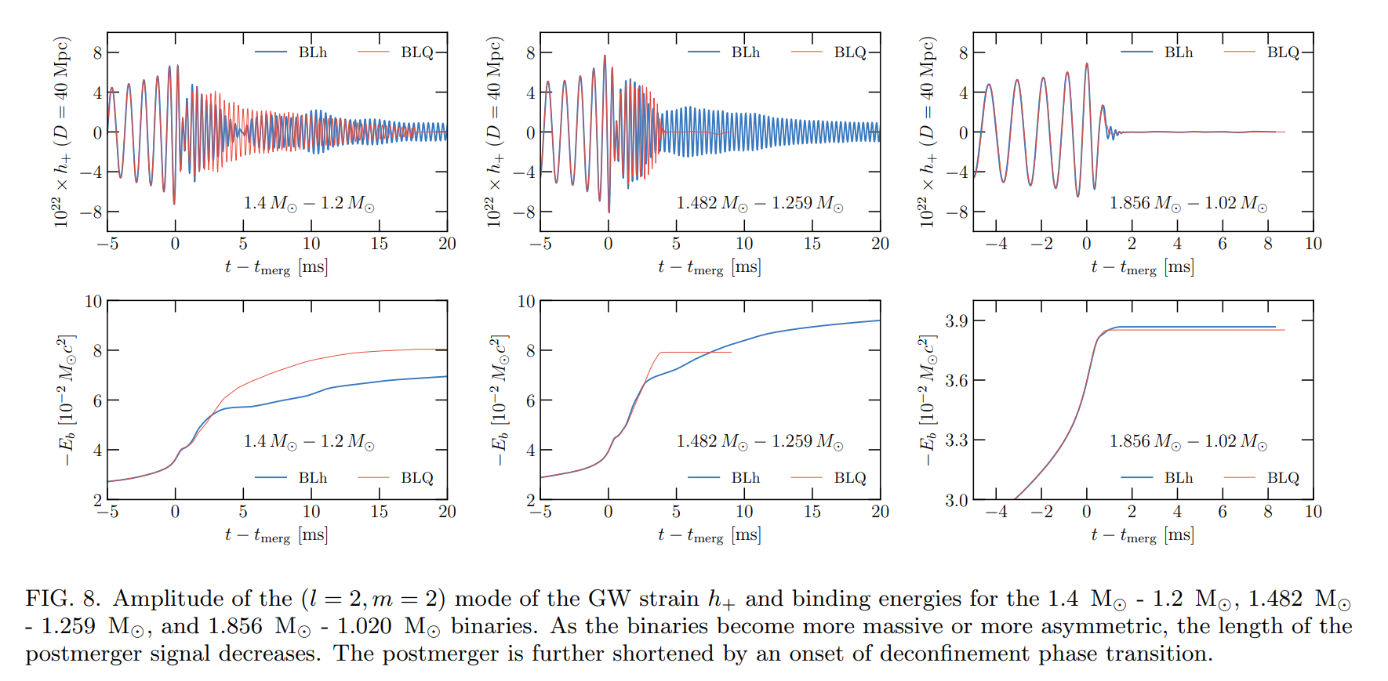
GW from deconfinement phase transition
First order phase transition, asymmetric mass
A. Prakash, et al, 2106.07885

Slide 42
GW from deconfinement phase transition
Y. Fujimoto, et al, 2205.03882

Slide 43
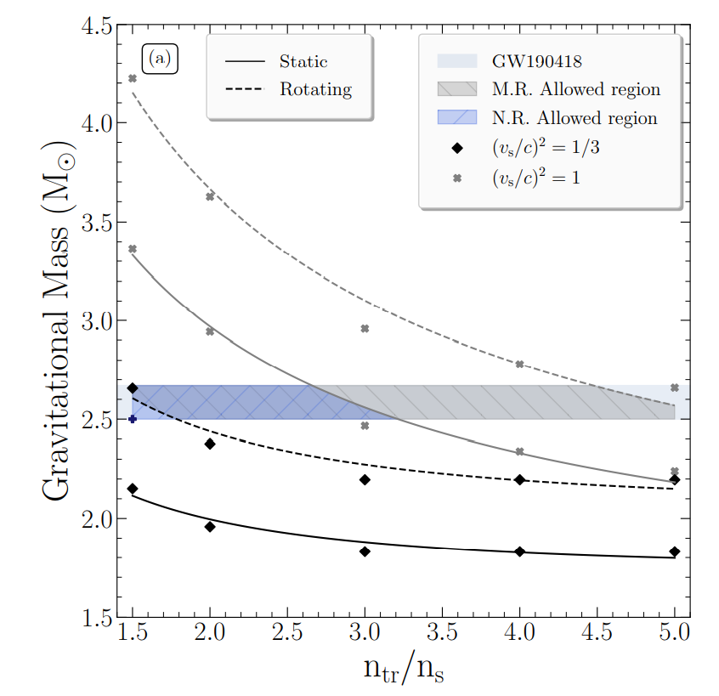
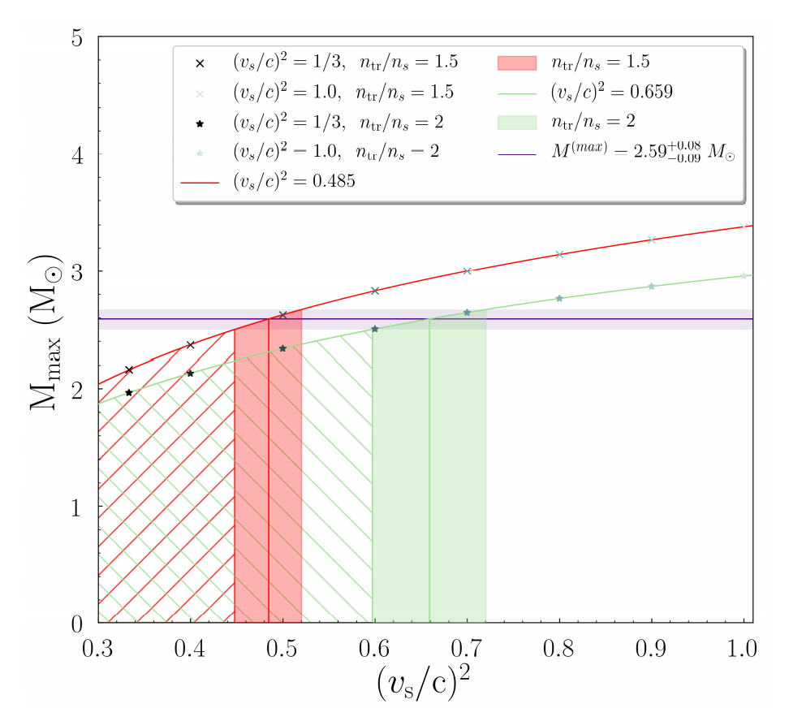
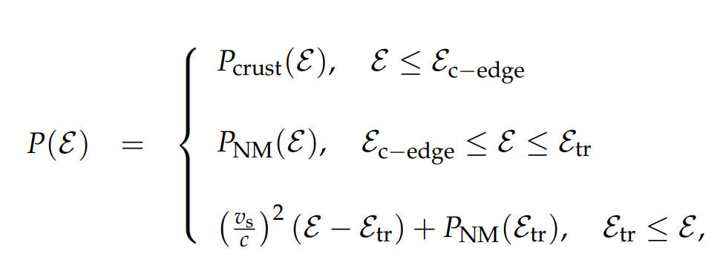
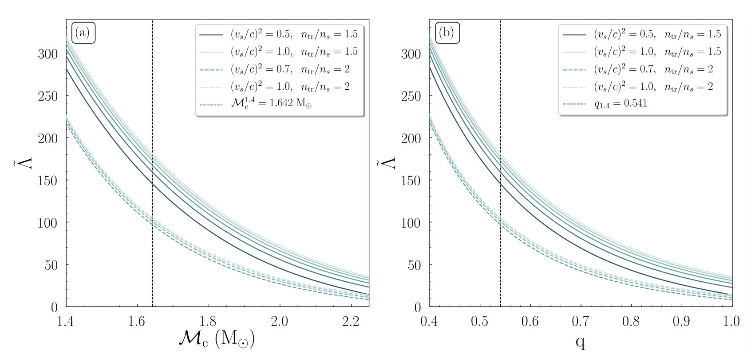
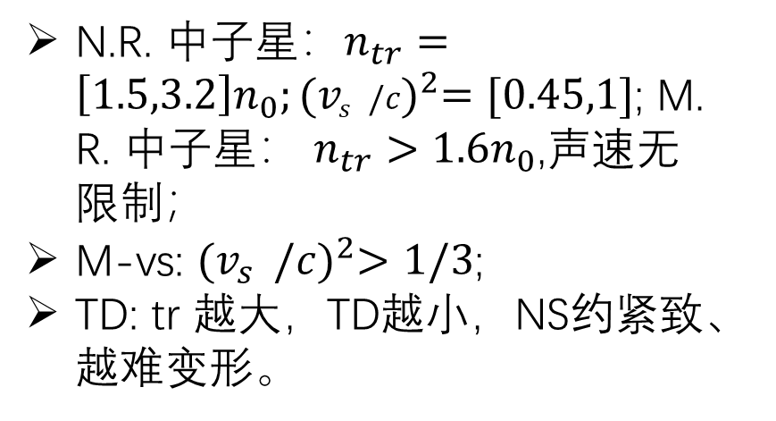
Information from GW190814
Kanakis-Pegios, et al, 2012.09580
N.R. 中子星：$n_{tr}=\left[1.5,3.2\right]n_{0};{(v_{s}^{}/c)}^{2}=[0.45,1]$; M. R. 中子星： $n_{tr}>1.6n_{0}$,声速无限制；
M-vs: ${(v_{s}^{}/c)}^{2}>1/3$;
TD: tr 越大，TD越小，NS约紧致、越难变形。

Slide 44
Pseudoconformal model
Basic new physics considered in our approach
Hidden topology in QCD
  The microscopic degrees of QCD – quark and gluon – enters the system rephrased using Cheshire Cat Principle
Hidden symmetries of QCD
  Hidden scale symmetry
  Hidden local flavor symmetry
  Hidden parity doublet structure of nucleon

Slide 45
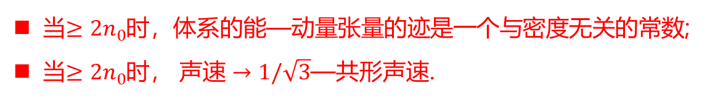
Pseudoconformal model
当$≥2n_{0}$时，体系的能—动量张量的迹是一个与密度无关的常数;
当$≥2n_{0}$时， 声速 $→1/\sqrt{3}$—共形声速.
与中子星内核相关的密度区域
这是一个在之前的模型与理论中从未出现的特征。

Slide 46
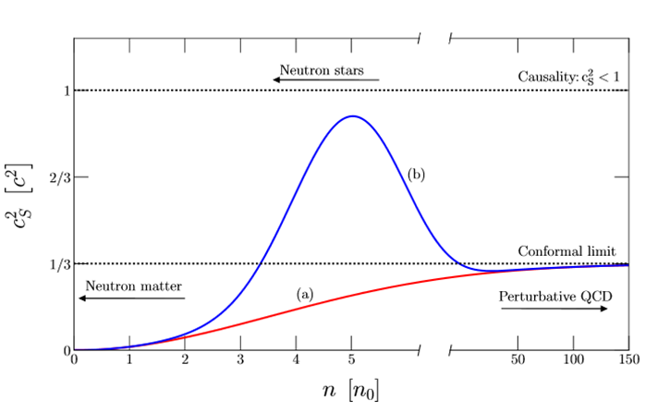


Standard Scenario
$$?$$
Very high density
PQCD applicable
Polytropic index $γ=d(\ln{p})/d(\ln{ε})<2.3→1$
S. Reddy et al, 2018
E. Annala, et al, Nature Physics 2020

Slide 47
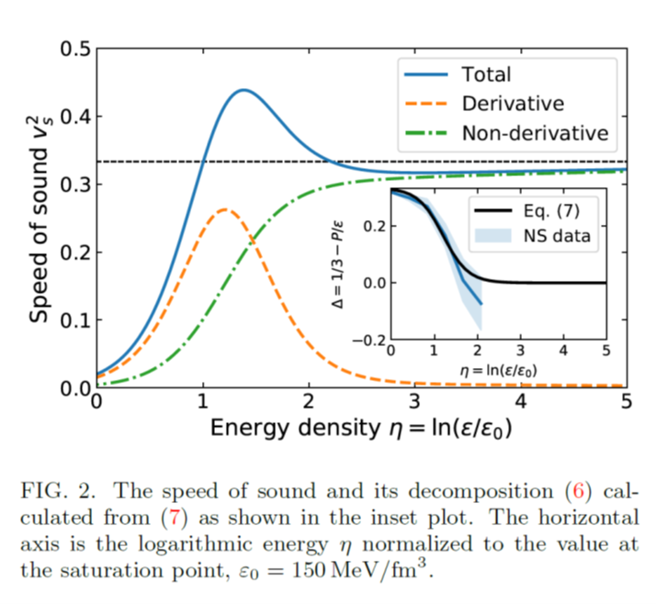
我们的赝共形模型改变了人们以前的认识：
  在渐近密度声速趋近于共形对称性限制的核物质模型，其预言的大质量中子星上限无法给出天文学上观测的大质量中子星 ；
逐渐被承认
Quark-hadron crossover
Quarkyonic matter
Quarkyonic matter
Kapusta & Welle, 2103.16633
Zhao & Lattimer, 2004.08293
Margueron et al, 2103.10209
Fujimoto, et al, 2207.06753

Slide 48
Pseudoconformal model

Slide 49
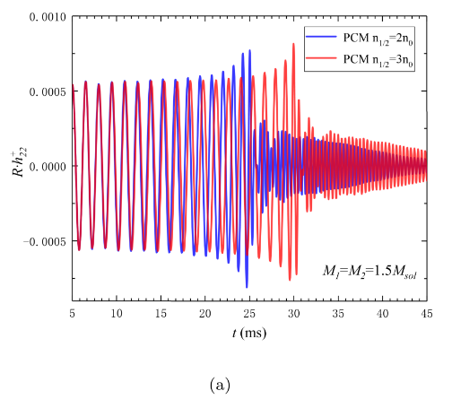
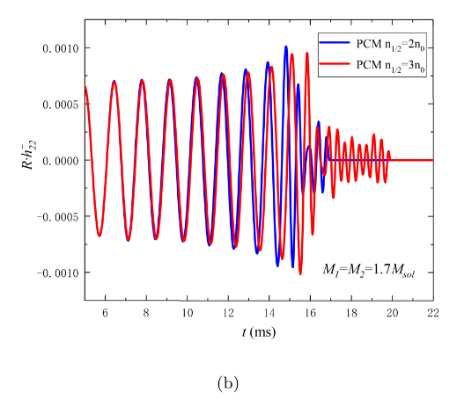
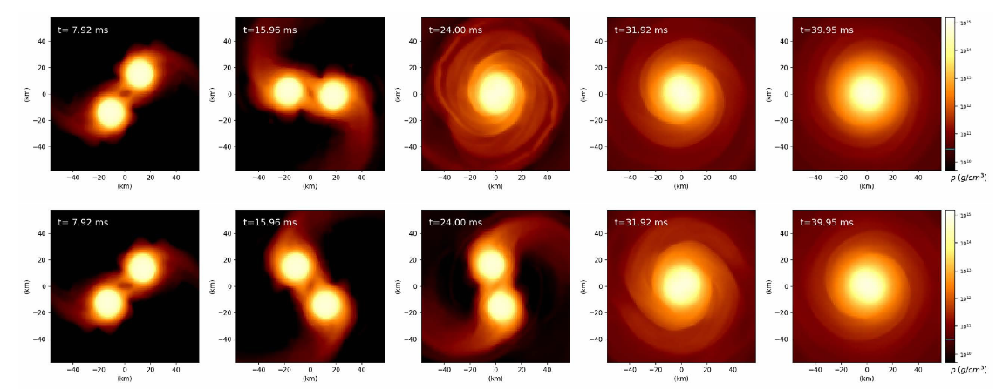
物态方程越硬，物质交换越难；
物态方程越硬，共转次数越多；
最终产物，中子星或黑洞，依赖于物态方程。

Slide 50
Summary and discussions
致密星物质的组成？纯强子？奇异自由度？夸克自由度？新的拓扑结构？
致密星物质的物态？夸克-胶子等离子体？费米流体？非费米流体？晶格结构？
相关组成、物态的检验信号？中子星引力波探测提供了新的实验室。
检验的可能？关键技术指标？技术设计的可行性？

Slide 51

Summary and discussions
应力强度${\sim 10}^{−21}≈h=δL/L$，典型的中子星合并辐射出的引力波的强度；若臂长为1米，需分辨出$δL≤{10}^{−21}$米的变化；
频段范围(1~10)kHz，要达到区分不同的物态方程要求，需要具备 (10~100) kHz的区分度；
信号持续时间(0.01~0.1)s，需要具备(0.01~0.1)ms的区分度;
目前国际上尚缺少探测(10~100)kHz频率引力波的设施。LIGO等观测到的和中子星相关的引力波事件频率<kHz；

Slide 52
Summary and discussions

Slide 53
谢谢！

Slide 55

Quark Degree of Freedom
Strange Quark Star:
“strange matter, which consists of roughly equal numbers of up, down, and strange quarks at high densities, is conjectured to be absolutely stable.”
E. Witten, Phys. Rev. D 30, 272 (1984).
Bodmer-Terazawa-Witten hypothesis

Slide 56


Slide 57
Einstein Toolkit (ETK)
Notes:
国际上有一些科学家针对数值相对论开发一些计算软件，我们选择的是ETK，因为它是开源的。像前面所说的它是对时空进行3+1分解然对方程进行数值求解；这里是两篇对ETK的introduction文章，大家有兴趣的可以了解一下

Slide 58
Einstein Toolkit (ETK)
Notes:
国际上有一些科学家针对数值相对论开发一些计算软件，我们选择的是ETK，因为它是开源的。像前面所说的它是对时空进行3+1分解然对方程进行数值求解；这里是两篇对ETK的introduction文章，大家有兴趣的可以了解一下

Slide 59


Thermal Component
Thermal component of EOS：
Temperature(thermal effect) need to be considered during the NS merging.
Assuming an idealgas-like behavior:
Reasonable range
1.5 ≤ Γ_{th} ≤ 2.0
Suggested value
Γ_{th} = 1.8
A. Bauswein, H.-T. Janka, and R. Oechslin PRD 82,084043(2010)

Slide 60
中子星引力波探测需要的灵敏度；
中子星引力波探测的实验装置；
引力波强度的估计；
潮汐形变量的提取；
中子星-黑洞合并，时间短；
偏振模式；

