Slide 1

Realistic scattering of puffy dark matter
Wenyu Wang
Beijing University of Technology
2023.07 @ TSINGTAO

Slide 2
CONTENT
Introduction to Dark Matter
Small cosmological structure problems, the self-interaction
Realistic Scattering of Puffy dark matter
1. Validity of Born Approximation
2. Self-interaction and Sommerfeld Enhancement
3. The strong interaction to form the puffy dark matter
Conclusion
Based on
WYW, Wu-Long Xu, Bin Zhu, Phys. Rev. D 105 (2022) 7, 075013,
WYW, Wu-Long Xu, Jin Min Yang, Bin Zhu, JHEP06（2023）103

Slide 3
From Camilo A. Garcia Cely

Slide 4
Problems of CDM in small cosmological structure
Though succeeds in the large structure in cosmology, the CDM model still confronts with small structure problems which means that it gives inconsistent predictions in the small cosmological scales such as clusters, galaxies and dwarf galaxies. The problems are so-called
Cusp vs. Core
Missing satellite
Too big to fail
Diversity problem

Slide 5
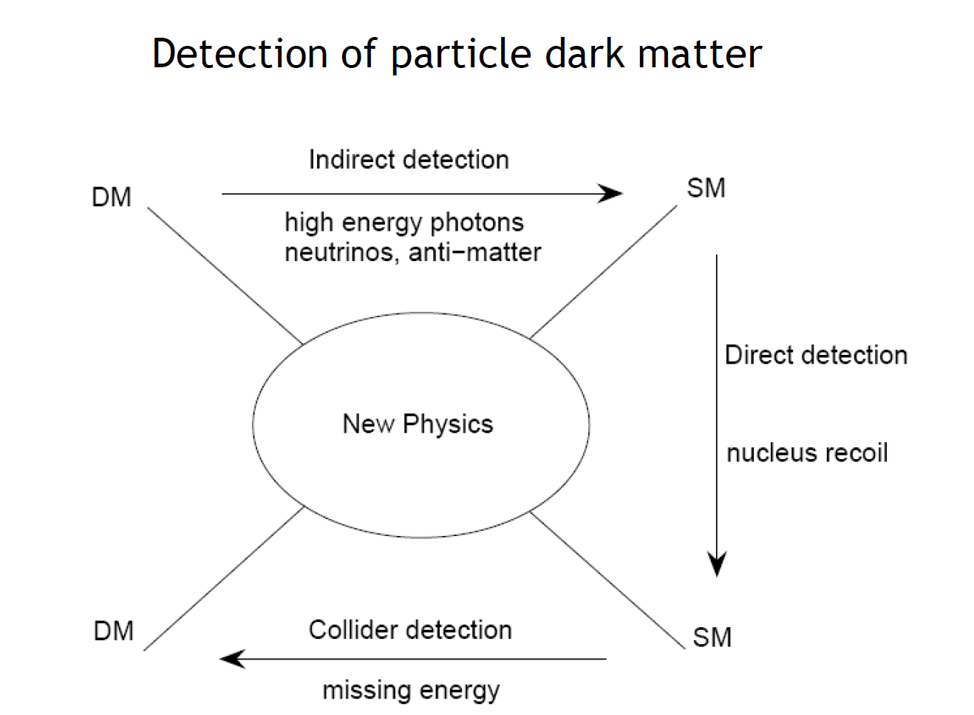
Solutions
Astrophysics
Including baryons in the simulation
Supernova feedback
Tidal effects
Low star-formation rates
Particle physics
Self-interaction between dark matter
Self-interactions

Slide 6
What is self-interactions?
Self-interactions
WIMP, EW?

Slide 7
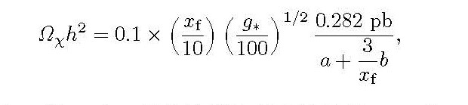
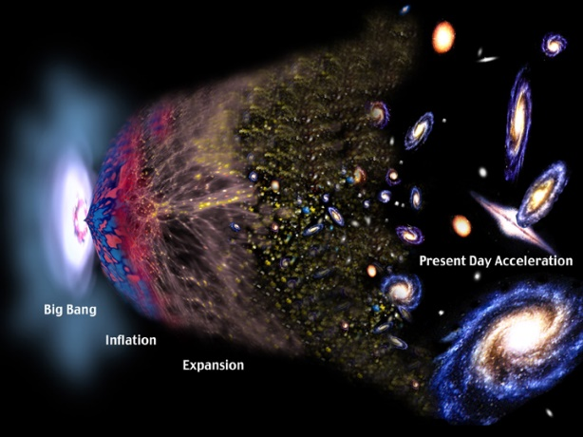
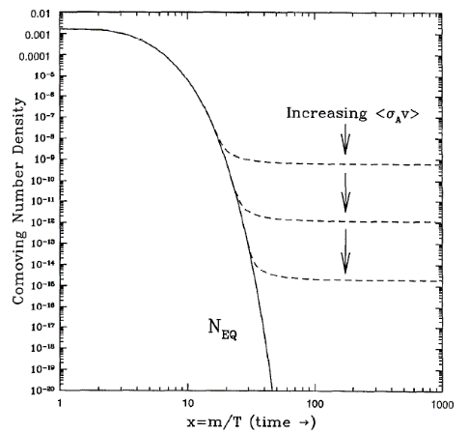
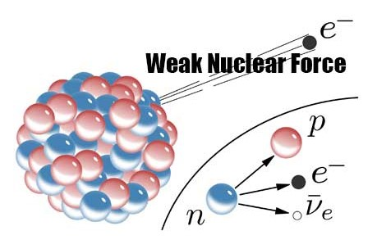
WIMP miracle
The simulation of the small structure needs

Slide 8
Self-interacting DM (SIDM) may provide a consistent solution to the DM deficit problem across all scales, even though individual systems exhibit a wide diversity in halo properties. Since the characteristic velocity of DM particles varies across these systems. Special velocity dependence is needed.

Slide 9
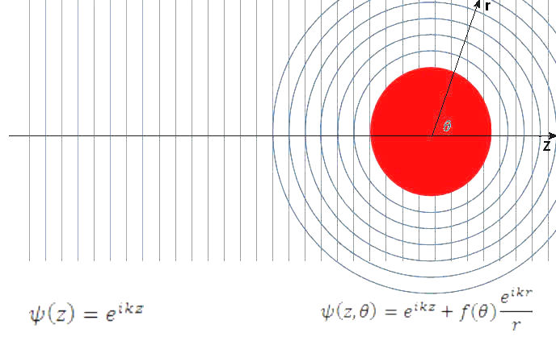





High energy collision and self-interaction?
$$e^{+}$$
$$μ^{+}$$
$$γ$$
$$e^{−}$$
$$μ^{−}$$
Born approximation?

Slide 10
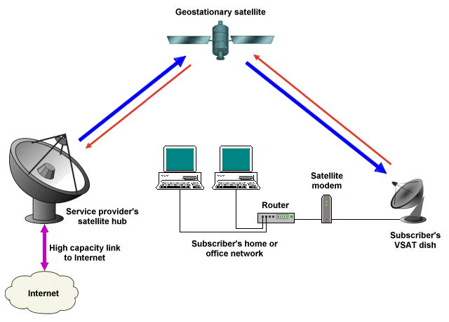

Slide 12
Case of a point dark matter
The classical, Born, and resonant regimes of self-scattering
From S. Tulin et. al. Phys. Rev. D 87, 115007

Slide 13
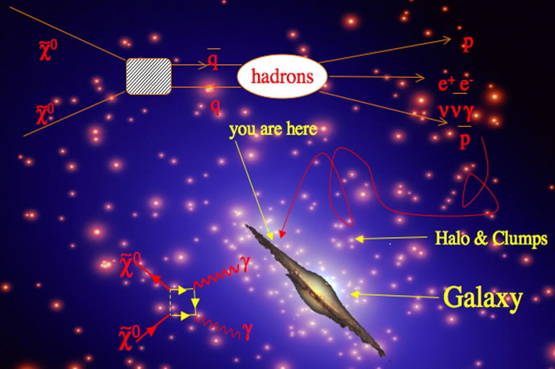

Slide 14
The Sommerfeld Enhancement of the dark annihilation

Slide 15




The Sommerfeld Enhancement is defined as:
Solve the Schrodinger Equation:
With the boundary conditions
Then

Slide 16
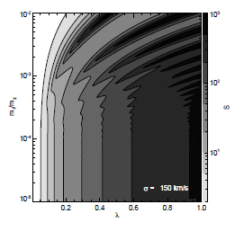
Nima Arkani-Hamed, Douglas P. Finkbeiner, Tracy R. Slatyer, Neal Weiner， Phys. Rev. D79. 015014
In the early universe the Sommerfeld enhancement are much small at the order of 1
In current epoch the Sommerfeld factor become much more significant, and also showing the resonant behavior.

Slide 17
RETURN TO the special velocity dependence requirement!

Slide 18
Solution from puffy dark matter
From Phys. Rev. Lett. 124, 041101 (2020)

Slide 19
In case of Born approximation

Slide 20
From Phys. Rev. Lett. 124, 041101 (2020)
Transfer cross section as a function of the force range and Radius
The reference cross section

Slide 21
Solution for the small scale problems
Velocity dependence of the transfer cross section of puffy dark matter

Slide 22
Three points need to be speculated on
The validity of Born approximation
How about the Sommerfeld Enhancement?
The interaction to confine the matter to form the puffy dark matter

Slide 23
The validity of Born approximation

Slide 24
Case of a point dark matter
Dominant parameter space is resonant, thus the Born approximation are skeptical.

Slide 25
Dominant parameter space is resonant,
From From S. Tulin et. al. Phys. Rev. D 87, 115007

Slide 26


Case of a puffy dark matter
$$R_{χ}$$

Slide 28
The validity of Born approximation
The Yukawa potential are approaching the Coulomb potential in force range with a pole.
The puffy potential removes the pole and the strength decrease along with the increase of the radius.
It seems that the radius effect is not the same as the force range.

Slide 29
The validity of Born approximation

Slide 30
The transfer scattering cross section in puffy dark matter parameter

Slide 31
The resonant cross section may be produced for a small fixed radius-force range ratio.
Additional interacting parameter space are caused by radius effect (tough each other). However, the resonant effect disappears.

Slide 32
The puffy SIDM self-scattering can explain the dwarf galaxies in the Born and resonant regimes, However, the cluster and Milky Way galaxy can only be explained in the non-Born regime. So the cross sections merely in the Born approximation can not solve the small-scale anomalies.

Slide 33
How about the Sommerfeld Enhancement?

Slide 34

New definition of classical limits
>
Point
Puffy

Slide 36
The Sommerfeld Enhancement is reduced in case of puffy dark matter. The wave functions are not changed greatly, because of ‘puffy’ and ‘no pole’. The self-interaction can be enhanced by Radius, This is the key difference between SIDM and SE.
The radius is strongly constrained if a large Sommerfeld factor is required.

Slide 37
Puffy dark matter weakly touch each other!

Slide 38
The interaction to confine the matter to form the puffy dark matter

Slide 39
The interaction to confine the matter to form the puffy dark matter must exists!

Slide 40
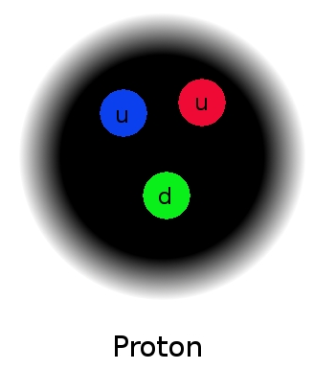
Just like proton and proton collision!

Slide 41
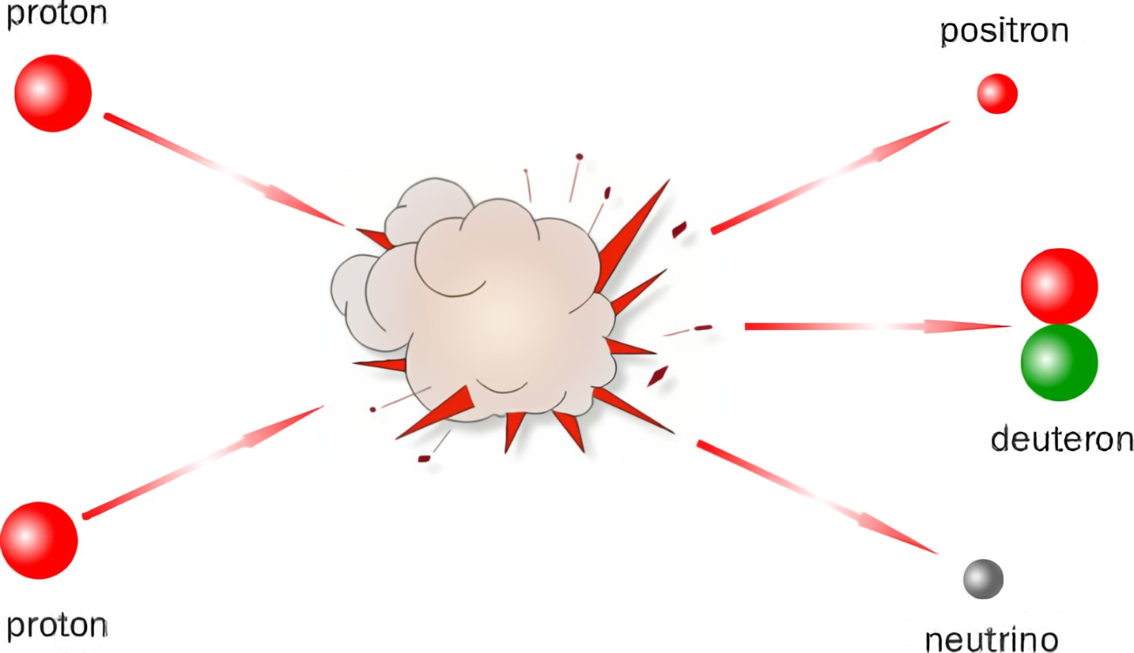

Slide 42
High energy pp elastic scattering

Slide 43
Mass of the mediator
Eikonal approximation

Slide 44
Eikonal approximation

Slide 45
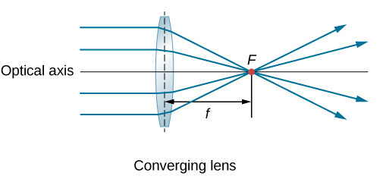
Impact factor
Classical picture of Eikonal approximation

Slide 46
pp elastic scattering

Slide 47
Elastic scattering of self-interacting dark matter
Mass of the mediator
Input parameter

Slide 48
THE KEY POINT IS THE CALCULATION OF THE FORM FACTOR!

Slide 50
A dipole form factor
From Rev. Mod. Phys. 57. 563

Slide 51
Elastic scattering of self-interacting dark matter confronts the small scale problem
Define the reference cross section

Slide 52
Elastic scattering of self-interacting dark matter confronts the small scale problem
Invalid region of Eikonal approximation

Slide 53
CONCLUSION
Self-interaction of dark matter needs deep studies.
The cross sections merely in the Born approximation can not solve the small-scale anomalies.
Though the Self-interaction can be realized, the Sommerfeld Enhancement are reduced in case of puffy dark matter. This is key difference between interacting by a mediator and by radius.
Chou-Yang model are very beautiful and predictive.
Simplicity and analyticity is our struggle!

Slide 54
THANKS！

