Slide 1

中微子有效场论
周顺
中科院高能所
第十二届新物理研讨会，山东大学青岛校区，2023-7-24

Slide 2
A. Evidence for New Physics
The discovery of the Higgs boson @ the LHC: the great success of the SM!
Bass, De Roeck, Kado, Nat. Rev., 21
The last particle predicted by the SM, accounting for all particle masses
The measured couplings to elementary particles vs. the SM predictions

Slide 3
Higgs Potential & Vacuum Stability
The Higgs self-coupling is not yet measured, and the Higgs potential in general not verified
The running couplings in the SM, and given the top-quark & Higgs masses the electroweak vacuum is metastable
Buttazzo et al., JHEP, 13; Bednyakov et al., PRL, 15

Slide 4
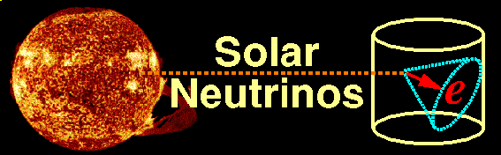
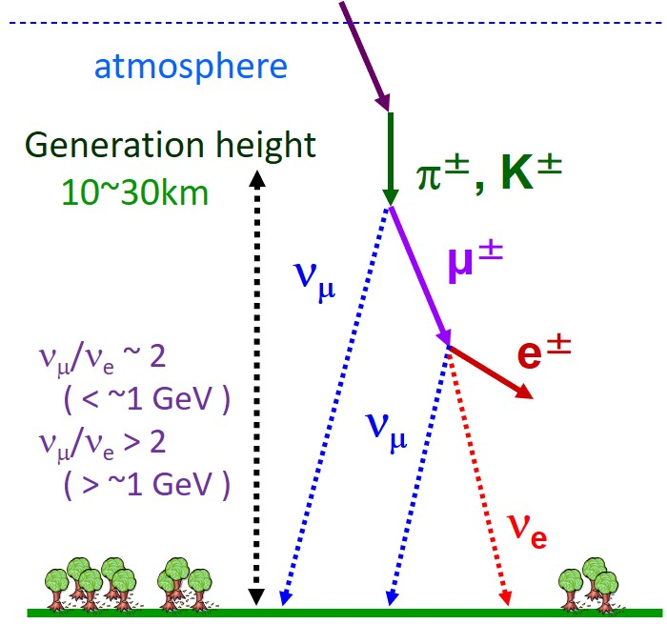
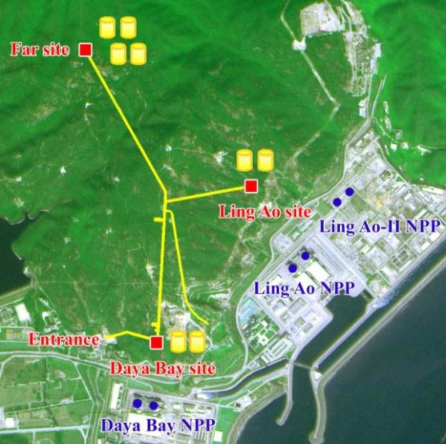
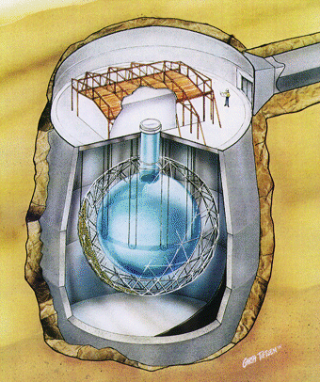
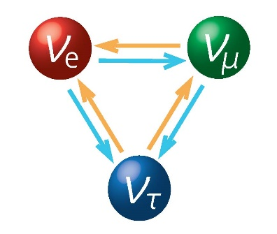
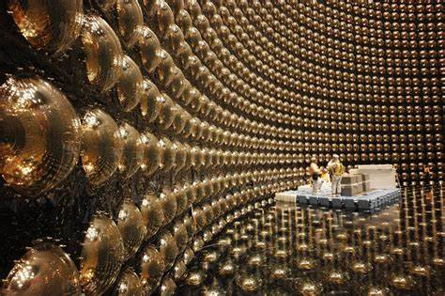

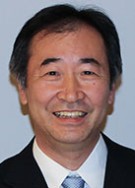
Neutrino Masses
Daya Bay
SNO
Neutrinos are massive !!!
Lepton flavor mixing exists
Super-K
Nobel Prize in 2015

Slide 5
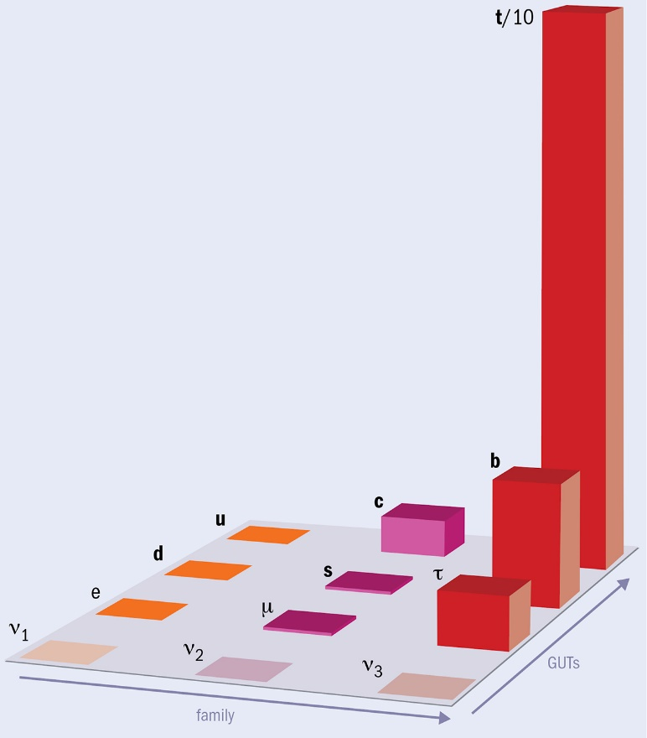
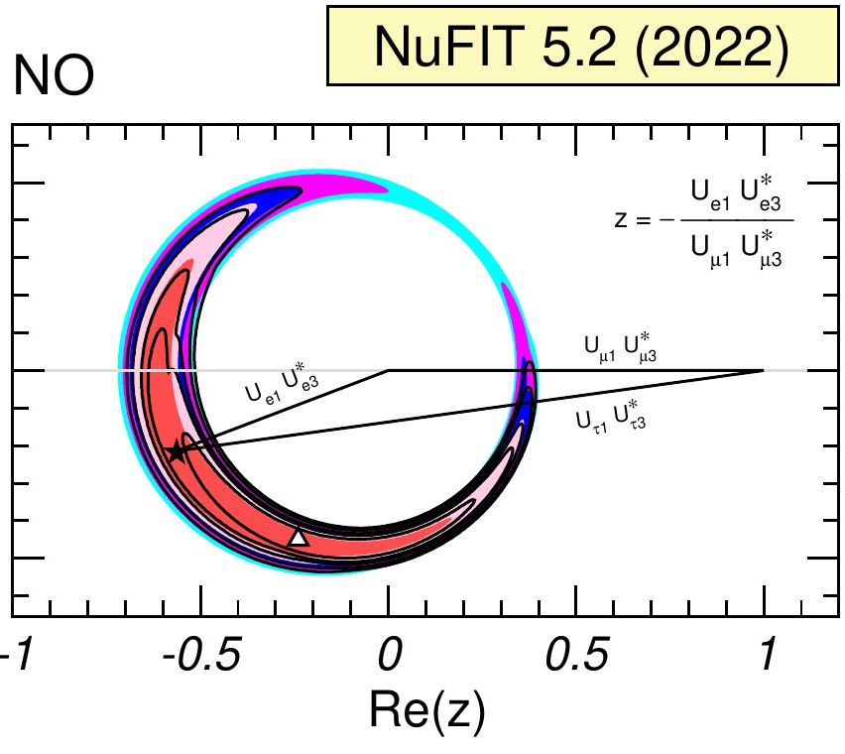




Flavor Puzzles
Strong mass hierarchy
$$m_{t}≫m_{c}≫m_{u}$$
$$m_{b}≫m_{s}≫m_{d}$$
$$m_{τ}≫m_{μ}≫m_{e}$$
Flavor mixing pattern
Xing, Phys. Rept, 20
Credit: A. Tovey
CP violation
$$U=$$

Slide 6
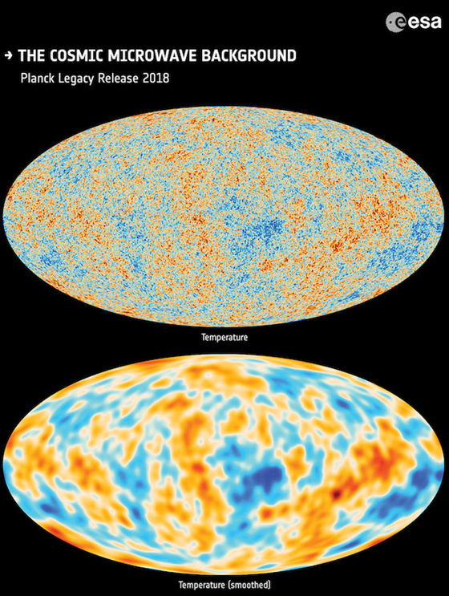
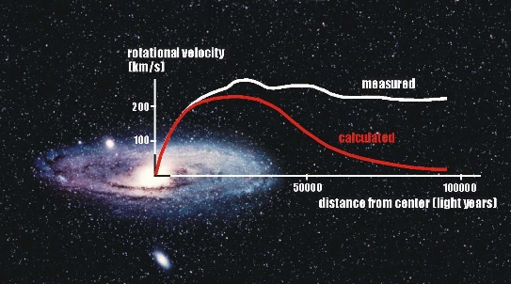
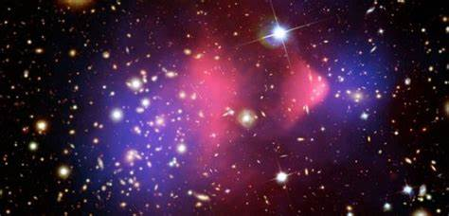
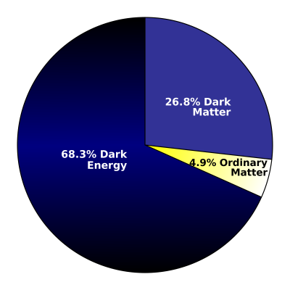

Dark Matter & Baryon Asymmetry
Rotation of galaxies
Bullet clusters
$$η_{\text{B}}≡\frac{n_{\text{b}}−n_{\overline{\text{b}}}}{n_{γ}}=(6.065±0.090)×{10}^{−10}$$
Strong evidence for the existence of dark matter, but no particle candidates in the SM
Dynamical generation of baryon number asymmetry

Slide 7
B. Origin of Neutrino Masses
Basic neutrino parameters
Esteban et al., 2007.14792, NuFIT 5.2 (2022)
Future neutrino oscillation experiments will measure the octant of θ₂₃, the CP-violating phase δ, and the neutrino mass ordering (@JUNO)
The most restrictive bound on absolute neutrino masses is coming from cosmological observations: m₁ + m₂ + m₃ < 0.12 eV (Planck)

Slide 8

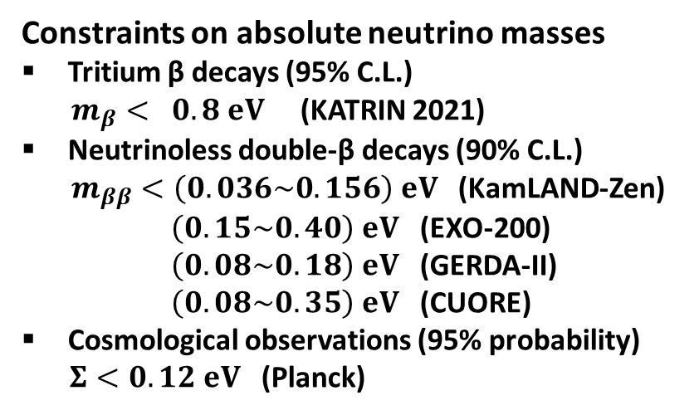


Current Status of Absolute Neutrino Masses
m₁ < m₂ < m₃ (NO) or m₃ < m₁ < m₂ (IO)
$m_{β}={\left(Σ_{i}{\left|U_{ei}\right|}^{2}m_{i}^{2}\right)}^{1/2}$ [eV]
Constraints on absolute neutrino masses
Tritium β decays (95% C.L.)
$m_{β}< 0.8 eV$ (KATRIN 2021)
Neutrinoless double-β decays (90% C.L.)
$m_{ββ}<\left(0.036\sim 0.156\right) eV$ (KamLAND-Zen)
$\left(0.15\sim 0.40\right) eV$ (EXO-200)
$\left(0.08\sim 0.18\right) eV$ (GERDA-II)
$\left(0.08\sim 0.35\right) eV$ (CUORE)
Cosmological observations (95% probability)
$Σ<0.12 eV$ (Planck)
Tritium β decays (KATRIN)
IO
Cosmological Bound
NO
Capozzi et al., 2003.08511
$m_{ββ}=\left|{Σ_{i}U}_{ei}^{2}m_{i}\right|$[eV]
Abazajian et al., 1907.04473
Neutrinoless double-β decays
IO
Cosmological Bound
NO
$Σ=m_{1}+m_{2}+m_{3}$ [eV]

Slide 9
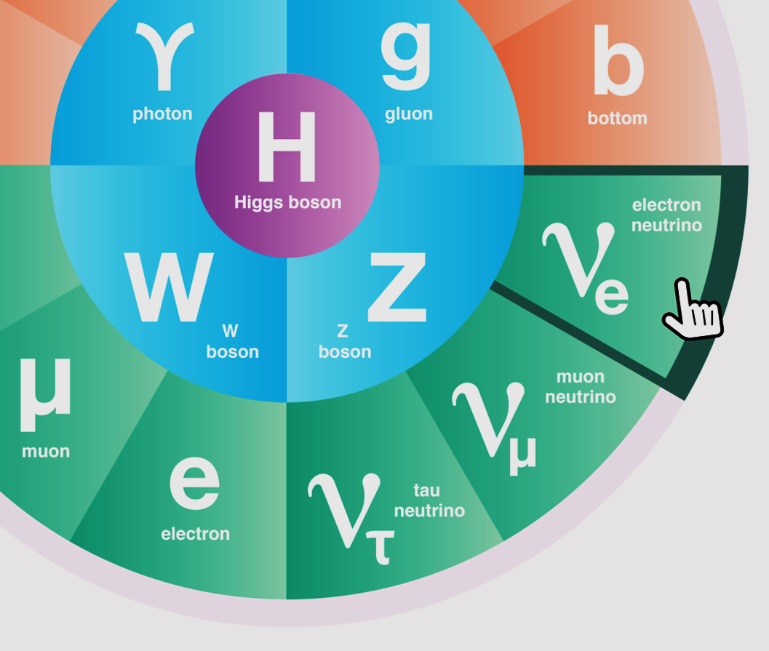
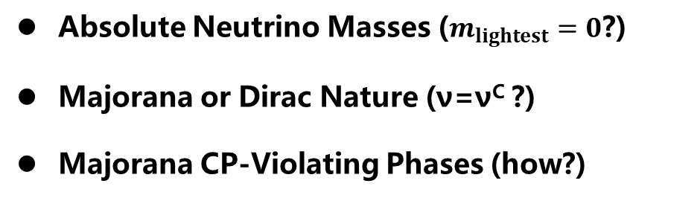
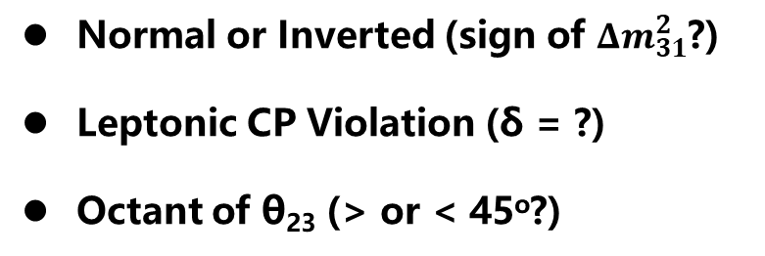
Open Questions in Neutrino Physics
Normal or Inverted (sign of ${Δm}_{31}^{2}$?)
Leptonic CP Violation (δ = ?)
Octant of θ₂₃ (> or < 45º?)
Absolute Neutrino Masses ($m_{lightest}=0$?)
Majorana or Dirac Nature (ν=ν^{C} ?)
Majorana CP-Violating Phases (how?)
ν Roadmap: mass ordering + 0ν2β (Majorana) + LNV/LFV+Colliders+SMPT
Extra Neutrino Species
Exotic Neutrino Interactions
Various LNV & LFV Processes
Leptonic Unitarity Violation
Origin of Neutrino Masses
Flavor Structure (Symmetry?)
Quark-Lepton Connection
Relations to DM and/or BAU

Slide 10
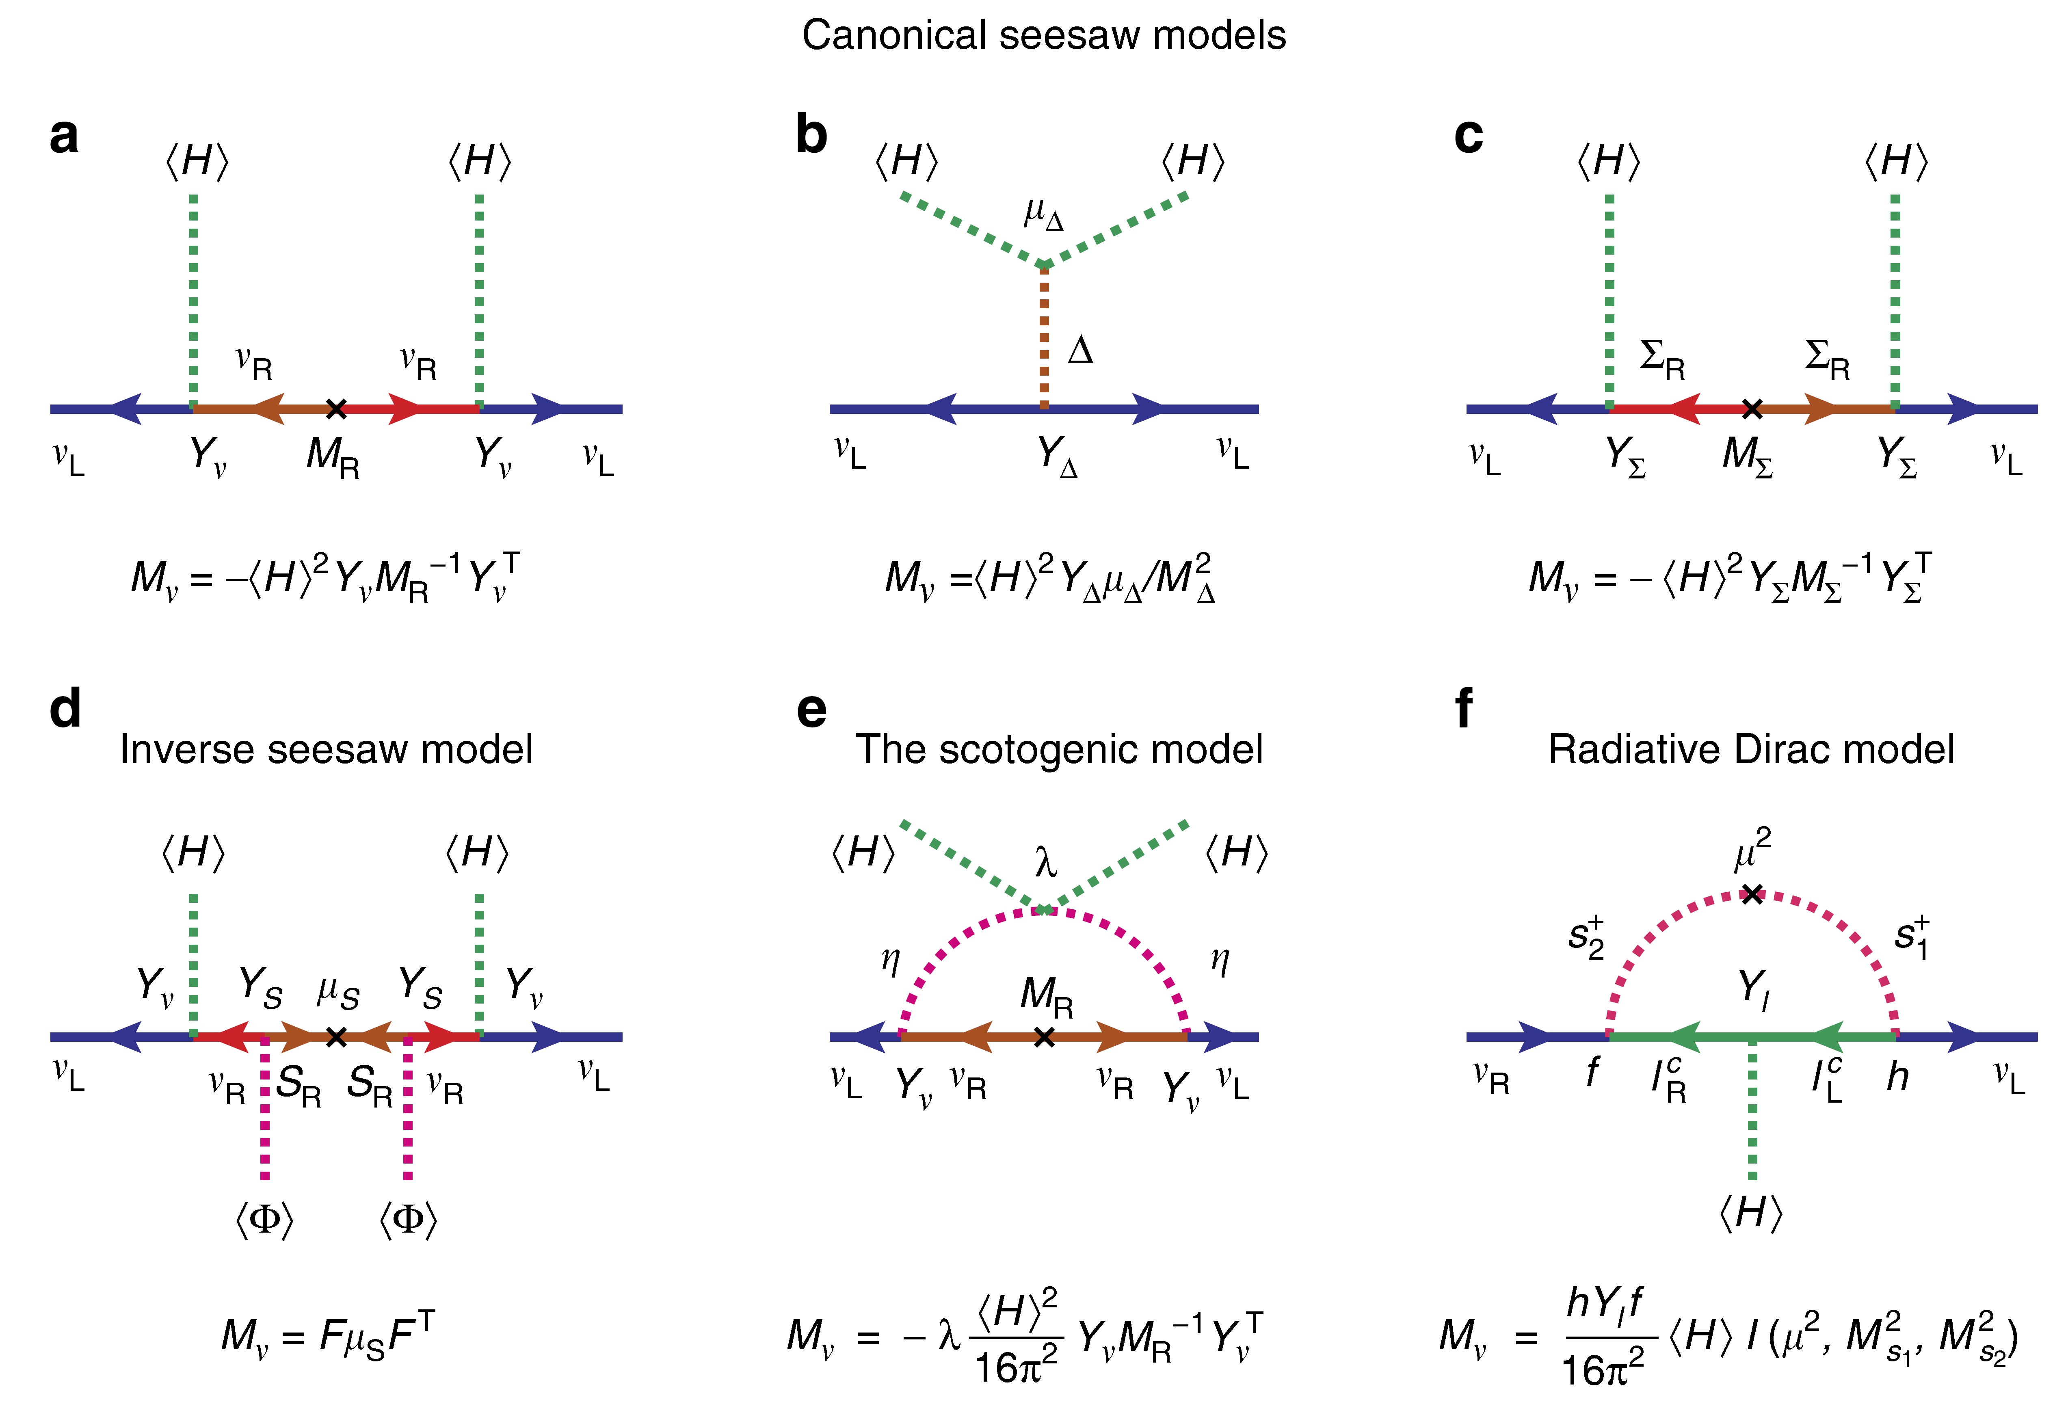
Neutrino Mass Models
Ohlsson, S.Z., 14
Minkowski 77
Magg, Wetterich,…, 80
Foot, Lew, He, Joshi, 89
Mohapatra, Valle, 87
E. Ma, 06
Kanemura et al, 11
Zee, 80, 86; Babu, 88

Slide 11















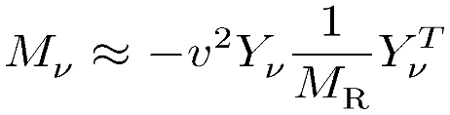
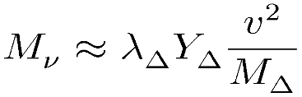

Seesaw Models for Neutrino Masses
Seesaw mechanism: a natural way to understand tiny neutrino masses
Type-I: SM + 3 right-handed Majorana ν’s (Minkowski 77; Yanagida 79; Glashow 79; Gell-Mann, Ramond, Slansky 79; Mohapatra, Senjanovic 79)
Type-II: SM + 1 Higgs triplet (Magg, Wetterich 80; Schechter, Valle 80; Lazarides et al 80; Mohapatra, Senjanovic 80; Gelmini, Roncadelli 80; Cheng, Li, 80)
Type-III: SM + 3 triplet fermions (Foot, Lew, He, Joshi 89)
Can naturally be embedded into the Grand Unified Theories, e.g., SO(10) GUT
Responsible for both tiny neutrino masses and matter-antimatter asymmetry

Slide 12
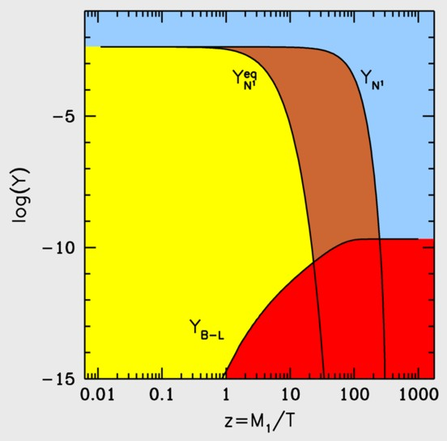
Baryogenesis via Leptogenesis
CP-violating & out-of-equilibrium decays of heavy Majorana neutrinos
CP asymmetries
Fukugita & Yanagida (1986)
Boedeker & Buchmueller, 2021
L number asymmetries
Parameters in the UV model at the high-energy scale
Renormalization
group equations
(RGEs)
Neutrino masses & mixing parameters at low energies
B number asymmetries

Slide 13
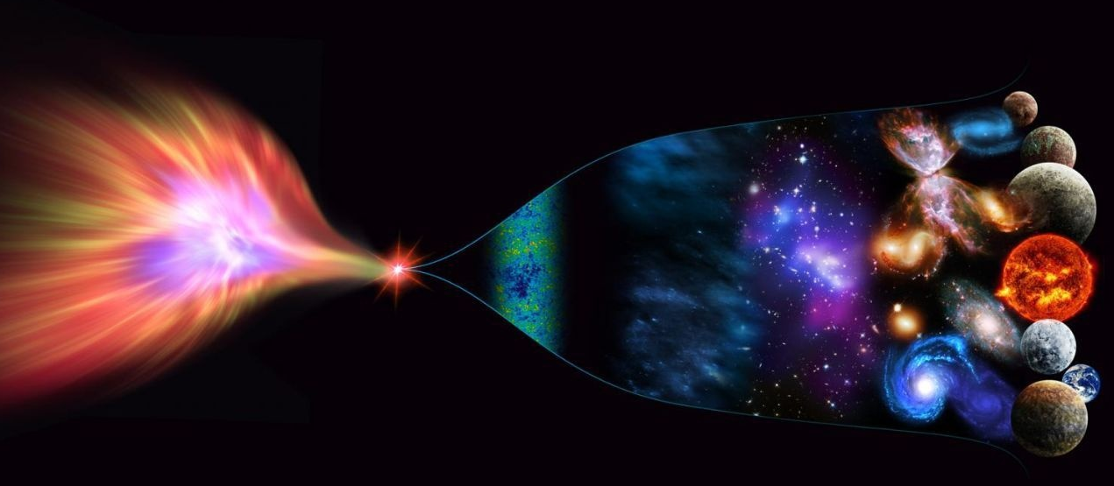
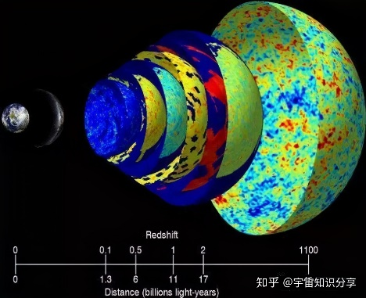

The Energy Scale of New Physics
New Physics
Cosmic Frontier：Matter-antimatter asymmetry/CMB/LSS
10¹⁹ GeV
Planck scale
10¹⁶ GeV
GUT scale
High-intensity Frontier：
Construct low-energy effective field theories (EFTs)，do precision calculations, compare with experimental data
Seesaw scale？
High-energy Frontier: Direct searches at colliders
10³ GeV
TeV
EW
10² GeV
ν oscillations → ν masses → NP
Cai, Han, Li, Ruiz, Front. in Phys. 6 (2018) 40

Slide 14
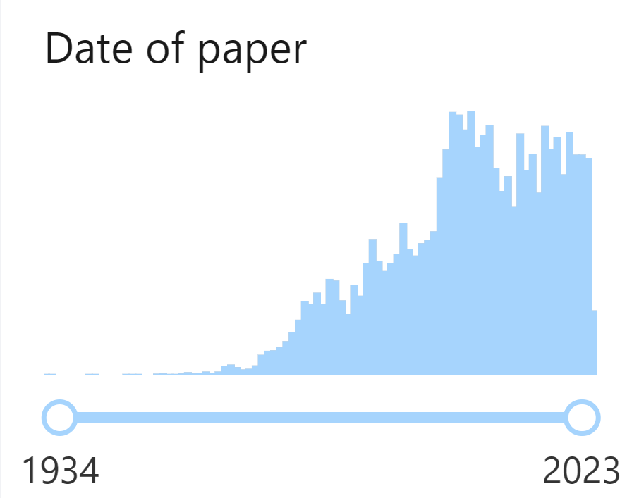

C. Neutrino Effective Field Theories
1243 papers in 2003
1998-2008: discovery of neutrino oscillations
Weinberg, 79
INSPIRE-HEP
find t neutrino
Unique dim-5 Weinberg operator
for Majorana neutrino masses
Integrate out heavy Majorana neutrinos
Derive RGE for the Wilson coefficient of the Weinberg operator
Antusch et al., 2001; Xing, Phys. Rept, 2020

Slide 15
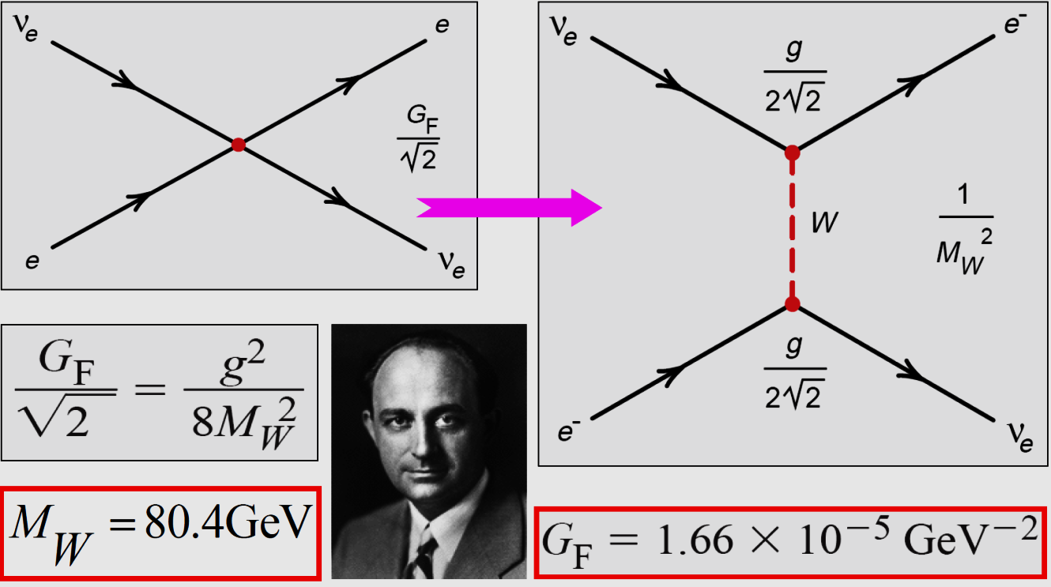

Why EFTs?
Bottom-up approach to new physics
Top-down approach to precision tests of UV-complete models
$$1.166$$

Slide 16
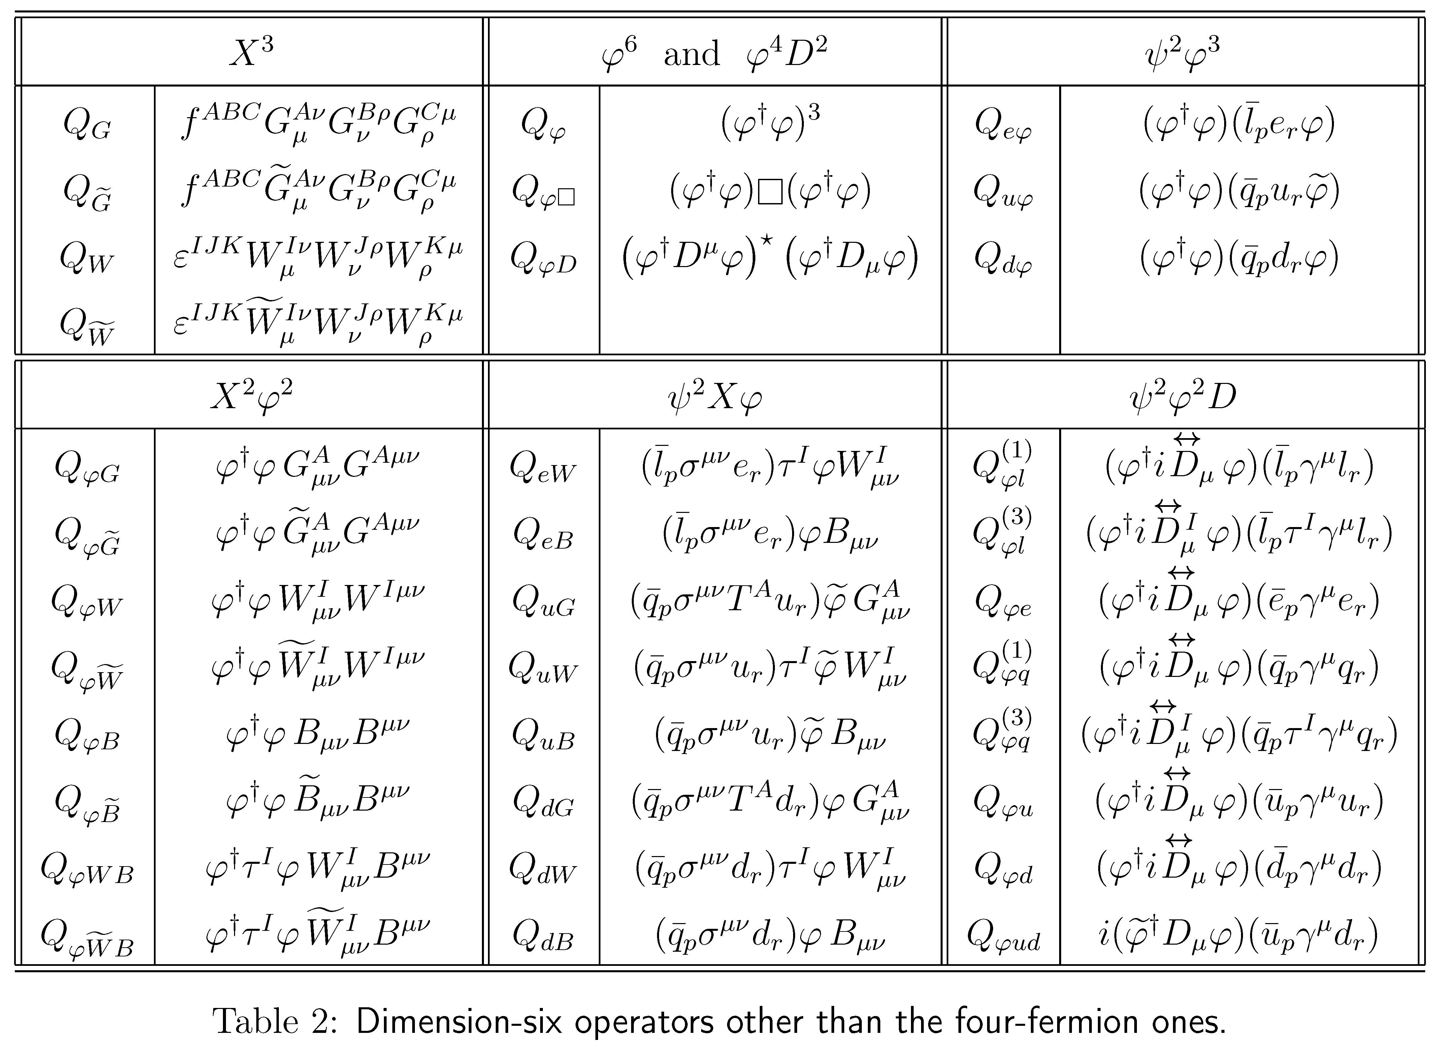
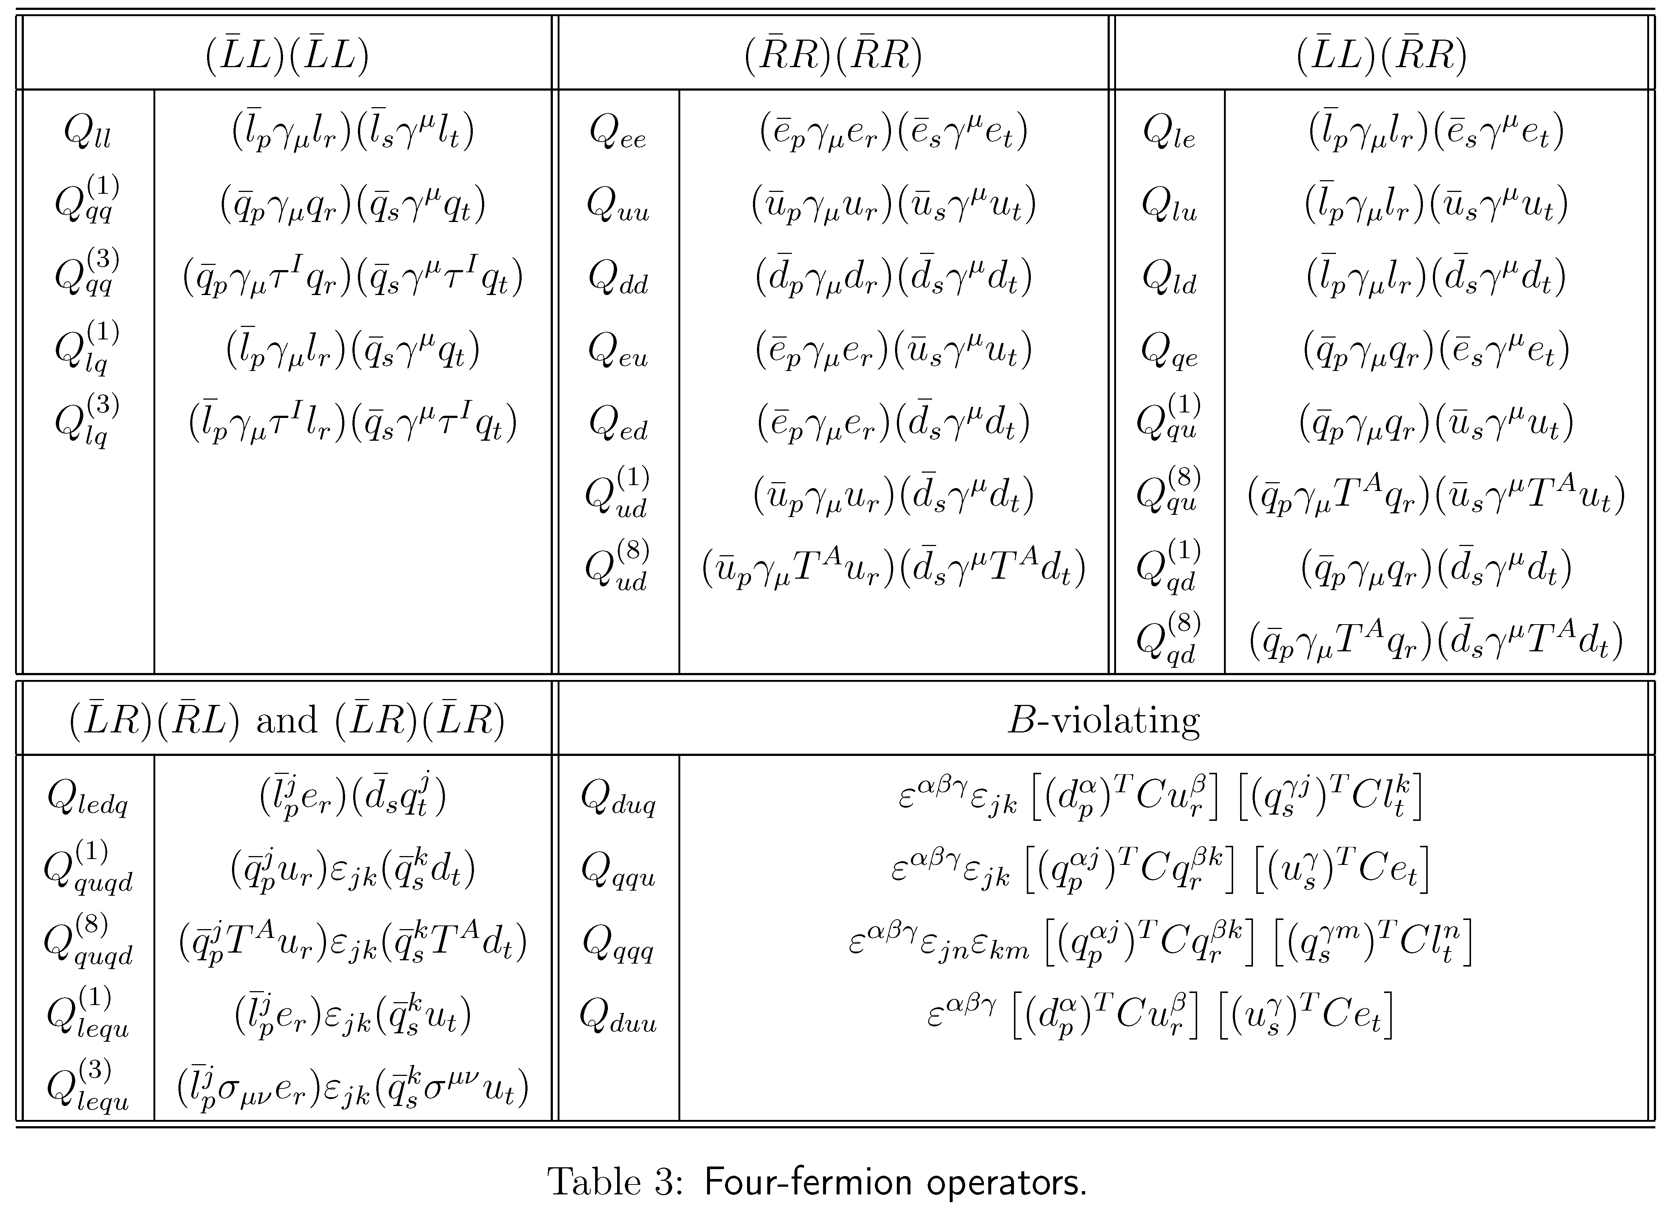
SM Effective Field Theory
Buchmüller & Wyler, 86
Dim-6 operators in the Warsaw basis
Brivio & Trott, Phys. Rept. 793 (2019) 1
Grzadkowski, Iskrzynski, Misiak, Rosiek, 1008.4884
Extended with RH neutrinos?

Slide 17





Which Neutrino Effective Field Theory?
★ A minimal extension of the SM with three right-handed neutrinos
Dirac Neutrinos
Majorana Neutrinos
Generate Dirac ν masses in a similar way to that for quarks and charged leptons, after the spontaneous gauge symmetry breaking
Generate tiny Majorana ν masses via the so-called seesaw mechanism
$$≈174 GeV$$
$$O(0.1 eV)$$
$$O({10}^{−12})$$
$$O(0.1 eV)$$
$$O({10}^{14} GeV)$$
Need to introduce additional symmetries to the SM to forbid a Majorana mass for right-handed neutrino singlets
Need to explain a strong hierarchy for the Yukawa couplings of the SM fermions
Retain the SM symmetries
GUT or TeV energy scale?
The Majorana nature of massive neutrinos

Slide 18
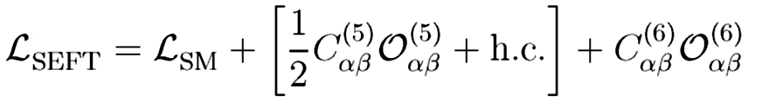
Which Neutrino Effective Field Theory?
★ A minimal extension of the SM with three right-handed neutrinos
The Lagrangian:
νSMEFT: Right-handed neutrinos ν_{R} are around or below the EW scale, then build the EFT with the SM particles + ν_{R} (N）and the SM gauge symmetry
Aparici et al., PRD, 2009; del Aguila et al., PLB, 2009
Bhattacharya & Wudka, PRD, 2016
Liao & Ma, PRD, 2017
SEFT: Right-handed neutrinos ν_{R} in the type-I seesaw model much heavier than the EW scale, then integrate out ν_{R} (N）and construct the Seesaw EFT
Tree & one-loop level matching
Broncano et al., PLB, 2003; NPB, 2003; Elgaard-Clausen & Trott, JHEP, 2017
Coy & Frigerio, PRD, 2019; Zhang & S.Z., JHEP, 2021; Du, Li, Yu, JHEP, 2022

Slide 19
νSMEFT: Operators
Dim-5:
Liao & Ma, PRD, 2017
Li, Ren, Xiao, Yu & Zheng, JHEP, 2021
Dim-6:
There are 19 complete and independent dim-6 operators without counting Hermitian conjugates, and 7 redundant operators are identified
For one or three generations, 29 (1614)/80 (4206) dim-6/dim-7 operators are found with Hermitian conjugates and flavors included

Slide 20
νSMEFT: Phenomenology
Biekötter, Chala, Spanowsky, EPJC, 2021
for
Combination of multiple coefficients
Limits on RRRR and LLRR dim-6 operators, assuming m_{N} = 0.1 GeV

Slide 21
νSMEFT: Phenomenology
Cirigliano et al., JHEP, 2021
Possible contributions to g-2
most contributions are negligible, but

Slide 22
D. Seesaw Effective Field Theory
The type-I seesaw model as a UV-complete theory
Tree-level matching: simply applying the EOM
Expansion up to M⁻² (dim-6 operators)
Seesaw Effective Field Theory (SEFT) @ tree level
Neutrino masses &
flavor mixing
Unitarity violation of
flavor mixing matrix

Slide 23

Low-energy Tests of Type-I Seesaw Model
After the spontaneous gauge symmetry breaking
Normalization:
Diagonalization:
$$U=V^{†}U_{0}$$
The SEFT Lagrangian in the mass basis:
Non-unitary flavor mixing
Minimal unitarity violation (MUV) “equivalent” to SEFT @ tree level
Non-unitarity
Antusch et al., hep-ph/0607020; Antusch & Fischer, 1407.6607

Slide 24
Low-energy Tests of Type-I Seesaw Model
LFV decays of charged leptons in the MUV scheme
The decay width
Xing & Zhang, 2009.09717
However, the calculation in the full theory for M_{i} >> M_{W} gives
Question: What goes wrong with tree-level SEFT? EFT must give the same result as UV theory for low-energy observables

Slide 25
Seesaw Effective Field Theory @ one-loop
Answer: Radiative decays at one-loop require one-loop matching!
Another two relevant dim-6 operators @ one loop
Zhang & S.Z., 2102.04954
leading to the direct EM-dipole vertex
exactly reproducing the result in the full theory (with M_{i} >> M_{W})

Slide 26
Seesaw Effective Field Theory @ one-loop
Choose relevant Feynman diagrams
Zhang & S.Z., 2102.04954
Calculate the amplitudes in the UV theory (hard-momentum)/expansion by regions
Beneke, Smirnov, 98; Smirnov, 02; Jantzen, 11

Slide 27
Seesaw Effective Field Theory @ one-loop
Calculate the amplitudes in the EFT (Green basis)
Matching betwen the amplitudes
Compute more diagrams and match to derive the Wilson coefficients of relevant operators in the Green basis

Slide 28
Seesaw Effective Field Theory @ one-loop
Apply the EoMs to convert into the Warsaw basis
Derive the final WCs for the dipole operators
At one-loop level, two additional operators contribute
One-loop matching necessary for precision tests at the low-energy scale

Slide 29
Seesaw Effective Field Theory @ one-loop
Matching between UV theory and EFT
Cohen, Lu & Zhang, 2011.02484
Functional method for one-loop matching
Covariant Derivative Expansion (CDE)
Expansion by Regions (hard and soft loop momentum)
Gaillard, 86; Chan, 86; Cheyette, 88
Beneke & Smirnov, 98; Smirnov, 02

Slide 30
Seesaw Effective Field Theory @ one-loop
Matching the UV theory with EFT
Zhang & S.Z., 2107.12133
Expansion by Regions
Fuentes-Martin et al., 2212.04510
Fuentes-Martin et al., 2012.08506

Slide 31
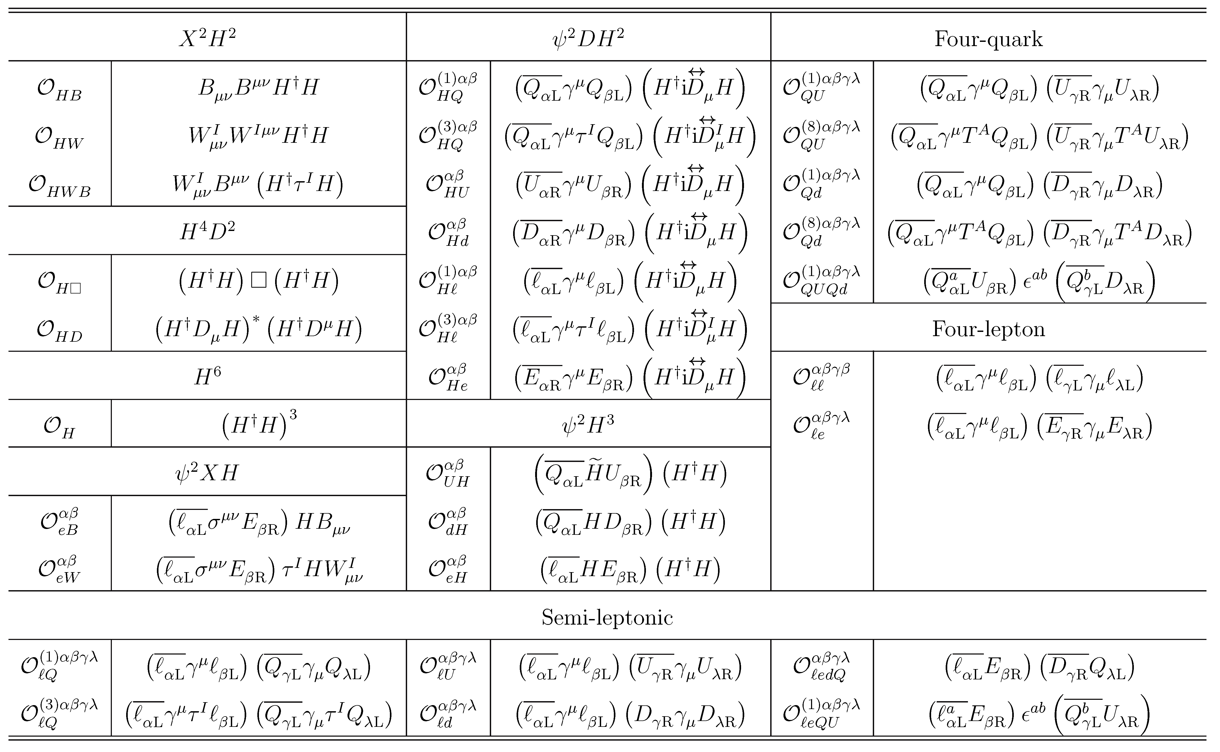
Seesaw Effective Field Theory @ one-loop
Zhang & S.Z., 2107.12133
Out of 59 operators in the Warsaw basis, 31 dim-6 operators in type-I SEFT

Slide 32
RGEs for SEFT
Physical Parameters in SEFT： (12 + 9 from C₆=21)
Yu & S.Z., 2203.10121
3 charged-lepton masses + 3 ν masses+ 15 non-unitary mixing = 21
Physical Parameters in Seesaw:
3 charged-lepton masses + 3 heavy Majorana ν masses + 15 Yukawa Y_{ν} = 21
Though 31 dim-6 operators at 1-loop level, all Wilson coefficients correlated
Strategy for precision tests of seesaw models @ 1-loop
Matching scale
Low-energy scale
Renormalization-group (RG) Running
One-loop
31 dim-6 operators
Wang, Zhang & S.Z., 2302.08140
19 dim-6 operators RGE-induced
A self-consistent framework for precision calculations up to dim-6/at 1-loop
RG Running
Tree-level
operators
+ corrections
12 dim-6 operators

Slide 33
RGEs for SEFT
19 dim-6 operators: double (single) insertion of dim-5(-6) operators
Jenkins, Manohar, Trott, 2016;
Liao, Ma, 2019
9 dim-6 operators as conterterms for double insertions of dim-5 op.
10 dim-6 operators as conterterms for single insertion of dim-6 op.
Dim-5 op. contributions same for three types of SEFTs
Corrections to the RGEs of SM parameters

Slide 34
RGEs for SEFT
Wang, Zhang & S.Z, 2302.08140
Tree-level matching:
Matching conditions:
Mass terms & weak interactions
Vanishing @ matching scale
Different RGEs leading to FCNC terms
LFV Z-decays

Slide 35
Summary & Outlook
EFTs serve as an independent approach to new physics beyond the SM and an efficient tool for low-energy tests of neutrino mass models
# of dim-6 operators
One-loop matching completed with all dim-6 operators & Wilson coefficients for SEFT
Red
Blue
SEFT-I = 31
One-loop RGEs for the Wilson coefficients of operators up to dim-6 derived for SEFT
SEFT-II = 41
SEFT-III = 33
Lepton-flavor-violating processes at the high-intensity frontier/future collider searches
Experimental observations to probe new physics associated with neutrino masses (e.g., νSMEFT)
Experimental observations to distinguish among different neutrino mass models (beyond seesaw, e.g., the scotogenic model also for dark matter)
Liao, Ma, JHEP, 2022; Zhang, JHEP, 2023
Thanks a lot for your attention!

Slide 36
Seesaw Effective Field Theory @ one-loop
Automatic one-loop matching by diagrammatic approach: Matchmakereft
2112.10787
Confirmed by diagrammatic approach: Matchmakereft
Well motivated to complete the one-loop matching of type-II/III seesaw models
Li, Zhang, S.Z., 2201.05082
Du, Li, Yu, 2201.04646
Are our results correct?

Slide 37
A. Field Redefinitions
Criado, Perez-Victoria, 1811.09413
Field redefinitions not equivalent to EOMs
Effective action up to dim-6
One-loop threshold correction
Perform field redefinitions to remove redundant dim-6 operators
Equivalent to EOMs
Extra terms
For type-II seesaw model
Tree-level dim-6 operator in the Green basis
absent in the Warsaw basis
Field redefinitions

Slide 38
A. Field Redefinitions
Extra terms
Contribute to the coefficient of another dim-6 operator in the Warsaw basis
Consistent with Matchmakereft up to this extra term

Slide 39
B. Evanescent Operators
2211.09144
Fierz identity valid at d=4
Evanescent operator
Inserted into a divergent diagram
Scalar-mediated redundant operators at tree level
Triplet scalar in the type-II seesaw

Slide 40
B. Evanescent Operators
Reduction identity
Leading to shifts in the Wilson coefficients of relevant dim-6 operators
Wilson coefficients consistent with both Matchete and Matchmakereft
But Matchmakereft claims the inclusion of evanescent operators, while Matchete not
Careful check or alternative approaches (checked by on-shell amplitudes)

Slide 41
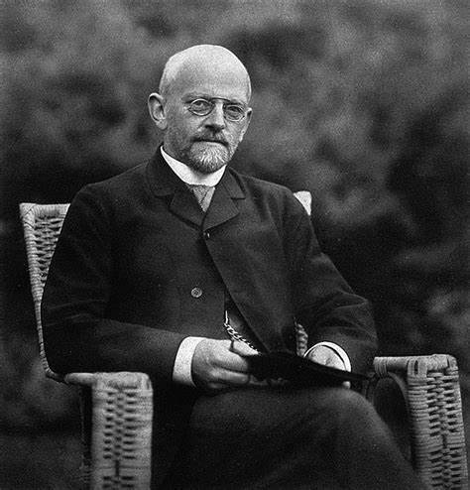
C. Invariant Theory for CP Violation
希尔伯特：23基本数学问题中的第14个
Lectures on the Fourteenth Problem of Hilbert by M. Nagata, 1965
The invariant ring of polynomials C[x₁, x₂, …, x_{n}] in the field C of complex numbers under the symmetric group S_{n} is finitely generated, and the generators are just the elementary symmetric polynomials
David Hilbert
(1862-1943)
Jenkins, Manohar, 2009

Slide 42
味物理中的不变量理论
完整理论：中微子质量的第一类跷跷板模型
Yu, S.Z., PRD/JHEP, 2022
有效理论：树图阶SEFT-I
Wilson系数
无量纲参数：
完整理论：轻子场在味空间的幺正变换
有效理论：Wilson系数味变换

Slide 43
味物理中的不变量理论
构造味不变量的基本单元
Yu, S.Z., PRD/JHEP, 2022
完整理论：
有效理论：
希尔伯特级数（两代轻子的SEFT）
2+4+2+2 = 10 primary invariants
计算Plethystic Logarithm (PL) 函数
2+4+2+5+2+3 = 18 basic invariants
10 primary invariants with (*)
18 基本不变量:
(12 CP-even + 6 CP-odd)
味不变量构造的基本理论

Slide 44
味物理中的不变量理论
不变量构造的具体方案（以两代轻子的SEFT为例）：
对称群 U(2)
基本单元：
表示
特征标函数
参数z₁和z₂为U(2)群maximal torus上的坐标
计算Plethystic Exponential (PE) 函数
通过Molien-Weyl公式计算希尔伯特级数

Slide 45
味物理中的不变量理论
希尔伯特级数（两代轻子的Seesaw）
3+5+1+1 = 10 primary invariants
计算Plethystic Logarithm (PL) 函数
3+5+2+3+3+2 = 18 basic invariants
18 basic invariants:
(12 CP-even + 6 CP-odd)
完整理论与有效理论的比较
具有相同的主不变量，即代数独立的不变量，其数目等于独立物理参数的个数
具有相同的基本不变量，任何味不变量可以表示为基本不变量的多项式函数

Slide 46
味物理中的不变量理论
三代轻子的SEFT中物理参数： (12 + 9 from C₆=21)
Yu, S.Z., PRD/JHEP, 2022
3 带电轻子质量 + 3 中微子质量+ 15 非幺正混合矩阵 = 21
三代轻子的完整Seesaw模型中的物理参数：
3 带电轻子质量 + 3 重马约拉纳中微子质量 + 15 Yukawa系数 Y_{ν} = 21
Broncano, Gavela, Jenkins, NPB/PLB, 2003; Antusch et al., JHEP, 2010
核心结论：树图阶低能有效理论SEFT仅包含1个 dim-5 算符和1个 dim-6 算符，却包含了完整理论中的所有物理参数

Slide 47
味物理中的不变量理论
New sources of CPV for matter-antimatter asymmetry
Flavor symmetries required by fermion flavor mixing
Possible extensions to other EFTs

