Slide 1
Some of recent progress in standard model effective field theory
廖益
华南师大量子物质研究院
2023年7月24日，第十二届新物理研讨会
Disclaimer: quoted refs are not always the first ones.

Slide 2
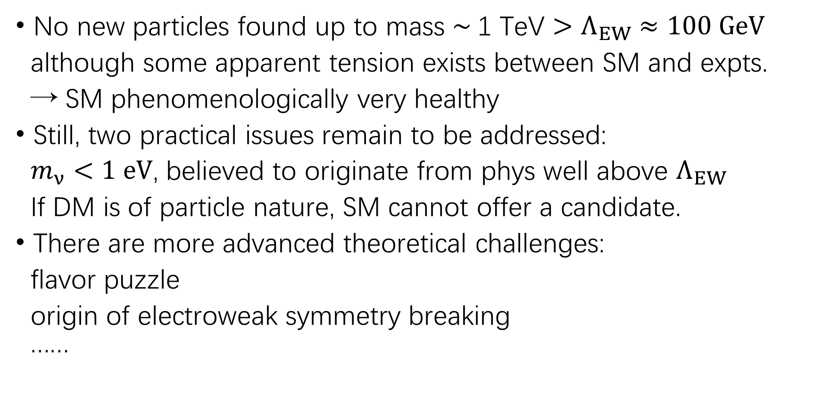
Status of standard model in a few words
No new particles found up to mass $\sim \text{1 }\text{TeV}{>Λ}_{EW} ≈100 GeV$
although some apparent tension exists between SM and expts.
→ SM phenomenologically very healthy
Still, two practical issues remain to be addressed:
$m_{ν}<1 eV$, believed to originate from phys well above $Λ_{EW}$
If DM is of particle nature, SM cannot offer a candidate.
There are more advanced theoretical challenges:
flavor puzzle
origin of electroweak symmetry breaking
……

Slide 3
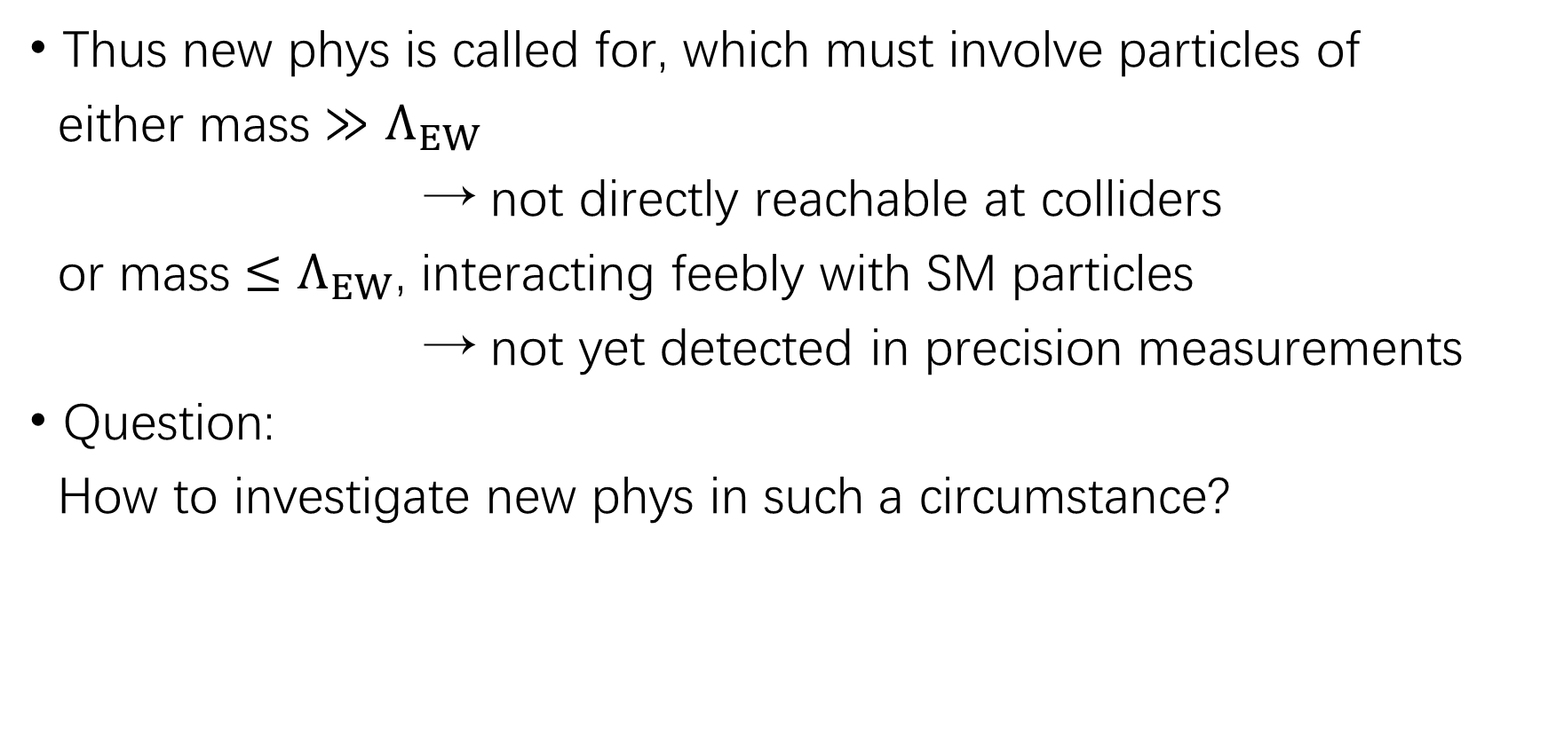
Status of standard model in a few words
Thus new phys is called for, which must involve particles of
either mass $≫Λ_{EW}$
→ not directly reachable at colliders
or mass $≤Λ_{EW}$, interacting feebly with SM particles
→ not yet detected in precision measurements
Question:
How to investigate new phys in such a circumstance?

Slide 4
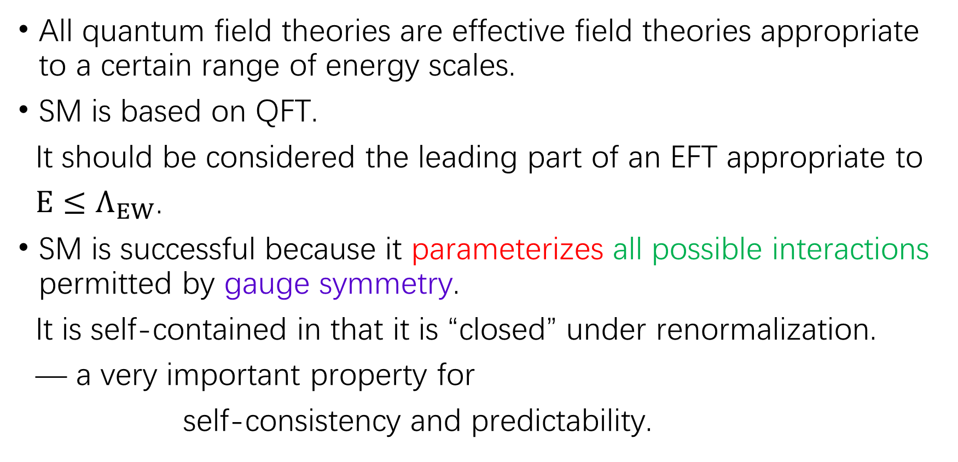
Modern view of standard model
All quantum field theories are effective field theories appropriate to a certain range of energy scales.
SM is based on QFT.
It should be considered the leading part of an EFT appropriate to
$E≤Λ_{EW}$.
SM is successful because it parameterizes all possible interactions permitted by gauge symmetry.
It is self-contained in that it is “closed” under renormalization.
— a very important property for
self-consistency and predictability.

Slide 5


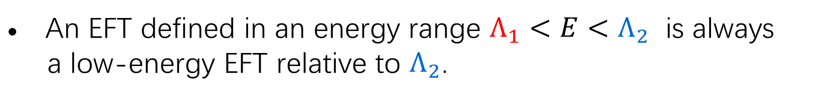
EFT: general discussion
An EFT is an infinite tower of effective interactions organized
by their relative importance.
Given an accuracy expected for a measurement, only a finite
number of effective interactions are important, which are also
self-contained in a similar sense as in a renormalizable theory.
An EFT defined in an energy range $Λ_{1}<E<Λ_{2}$ is always
a low-energy EFT relative to $Λ_{2}$.
$$Λ_{2}$$
“I live here!”
$$Λ_{1}$$

Slide 6
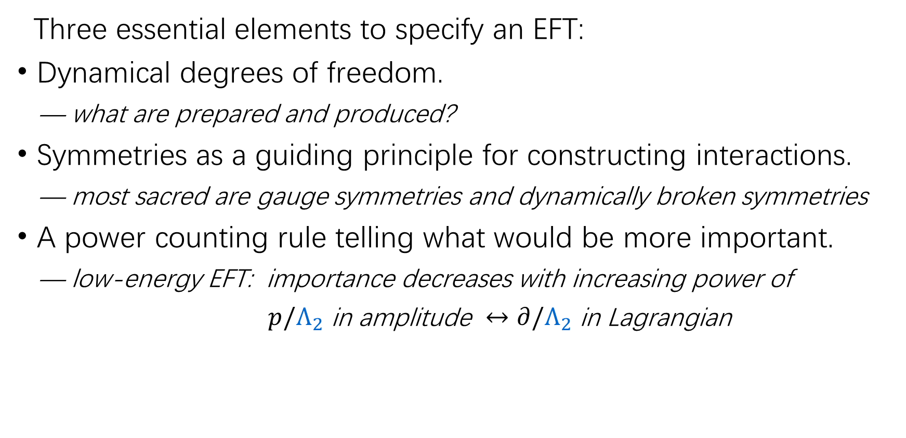
EFT: general discussion
Three essential elements to specify an EFT:
Dynamical degrees of freedom.
— what are prepared and produced?
Symmetries as a guiding principle for constructing interactions.
— most sacred are gauge symmetries and dynamically broken symmetries
A power counting rule telling what would be more important.
— low-energy EFT: importance decreases with increasing power of
$p/Λ_{2}$ in amplitude $↔$ $∂/Λ_{2}$ in Lagrangian
to establish a basis of effective interactions/operators
at each order in low-energy expansion;
to renormalize them to improve perturbation calc, i.e., RGE

Slide 7

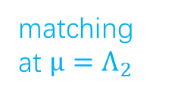

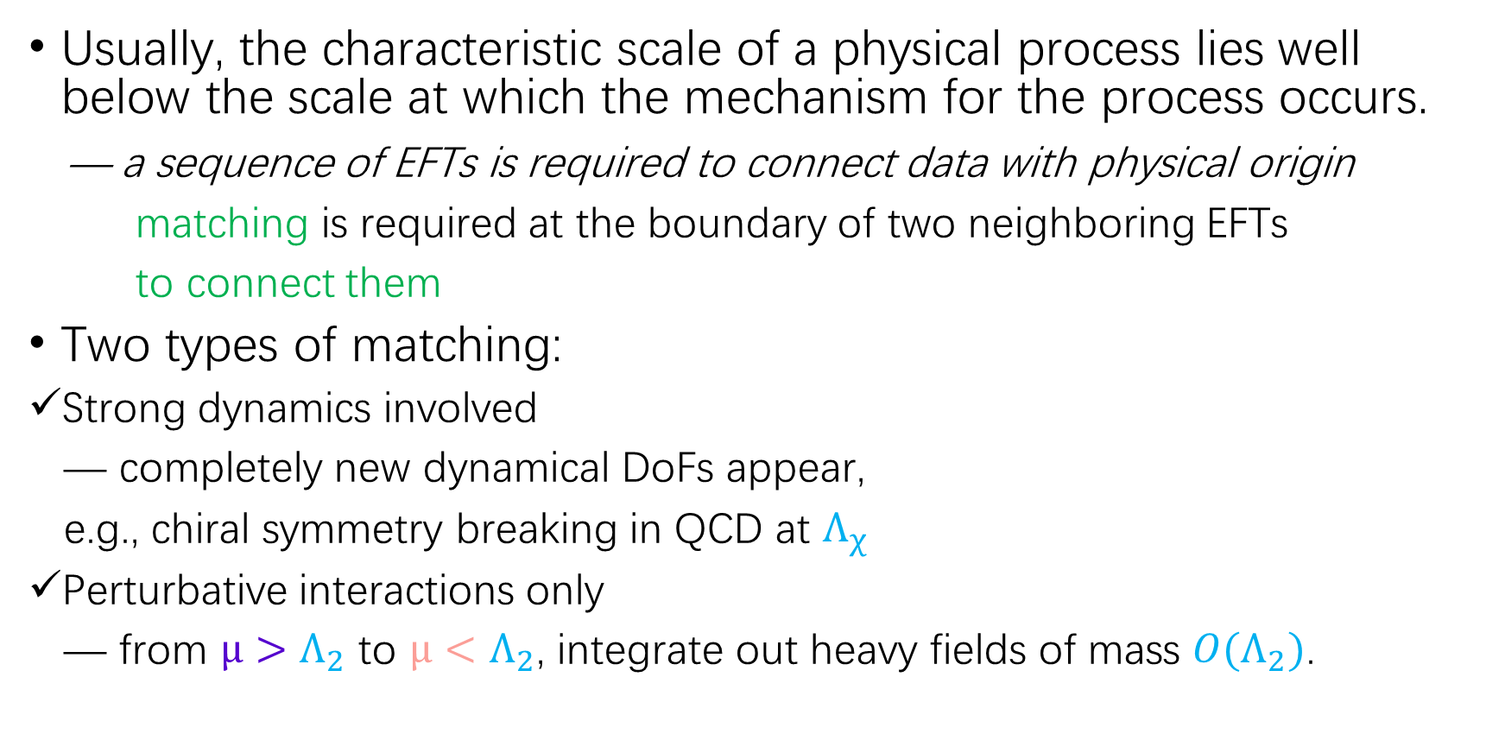



EFT: general discussion
Usually, the characteristic scale of a physical process lies well below the scale at which the mechanism for the process occurs.
— a sequence of EFTs is required to connect data with physical origin
matching is required at the boundary of two neighboring EFTs
to connect them
Two types of matching:
Strong dynamics involved
— completely new dynamical DoFs appear,
e.g., chiral symmetry breaking in QCD at $Λ_{χ}$
Perturbative interactions only
— from $μ>Λ_{2}$ to $μ<Λ_{2}$, integrate out heavy fields of mass ${O(Λ}_{2})$.
$$Λ_{3}$$
$${EFT}_{2}$$
matching at $μ=Λ_{2}$
$$Λ_{2}$$
$${EFT}_{1}$$
$$Λ_{1}$$

Slide 8


How EFT works: $K^{−}→π^{+}l^{−}l^{−}$
The process occurs at $μ\sim {10}^{2} MeV$.
It violates lepton number
— its mechanism is new phys at $μ≫Λ_{EW}$
a sequence of EFTs required
to connect them
A sequence of EFTs:
SMEFT, LEFT, $χ$PT
Bases of operators and RGE in each EFT;
Matching between SMEFT and LEFT,
and between LEFT and $χ$PT.
Matching between SMEFT and
your desired new phys model.

Slide 9
How EFT works: $K^{−}→π^{+}l^{−}l^{−}$

Slide 10
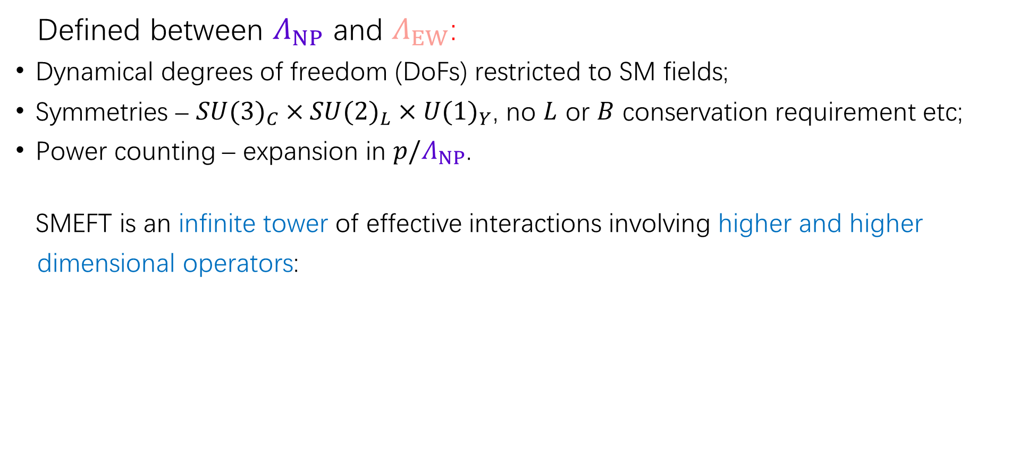
Standard model EFT (SMEFT)
Defined between $Λ_{NP}$ and $Λ_{EW}$:
Dynamical degrees of freedom (DoFs) restricted to SM fields;
Symmetries – ${SU(3)}_{C}×{SU(2)}_{L}×{U(1)}_{Y}$, no $L$ or $B$ conservation requirement etc;
Power counting – expansion in $p/Λ_{NP}$.
SMEFT is an infinite tower of effective interactions involving higher and higher
dimensional operators:
Weinberg 1979
Lehman 2014
Liao-Ma 2016
Li et al, arXiv: 2007.07899
Liao-Ma, arXiv: 2007.08125
GSW 1960s
Buchmuller-Wyler 1986; ……
Grzadkowski et al 2010
– Warsaw basis
Li et al, arXiv: 2005.00008
Murphy, arXiv: 2005.00059
Latest: up to dim-12, Harlander et al, 2305.06832

Slide 11
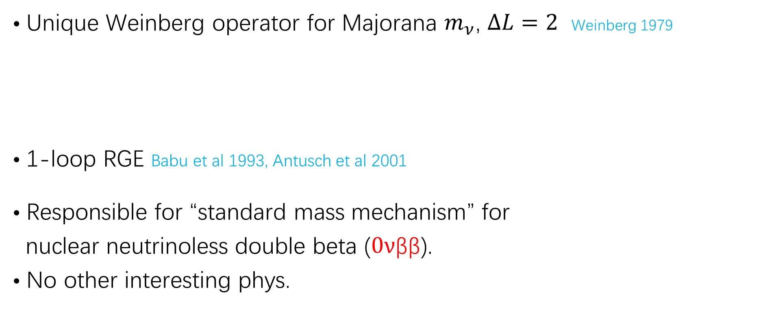
SMEFT: dim-5
• Unique Weinberg operator for Majorana $m_{ν}$, $∆L=2$ Weinberg 1979
• 1-loop RGE Babu et al 1993, Antusch et al 2001
• Responsible for “standard mass mechanism” for
nuclear neutrinoless double beta ($0ν$ββ).
• No other interesting phys.
… Cirigliano et al 2017, 2018

Slide 12
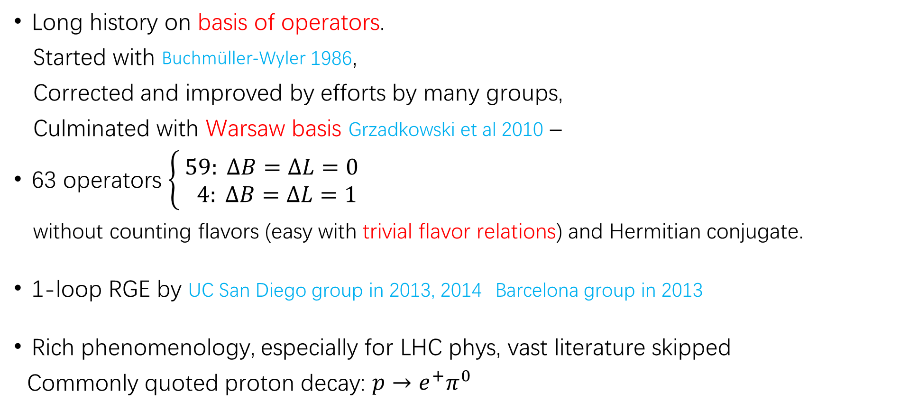
SMEFT: dim-6
Long history on basis of operators.
Started with Buchmüller-Wyler 1986,
Corrected and improved by efforts by many groups,
Culminated with Warsaw basis Grzadkowski et al 2010 –
63 operators $\left\{ \begin{aligned}59: ∆B=∆L=0 \\ 4: ∆B=∆L=1 \end{aligned}\right.$
without counting flavors (easy with trivial flavor relations) and Hermitian conjugate.
1-loop RGE by UC San Diego group in 2013, 2014 Barcelona group in 2013
Rich phenomenology, especially for LHC phys, vast literature skipped
Commonly quoted proton decay: $p→e^{+}π^{0}$

Slide 13
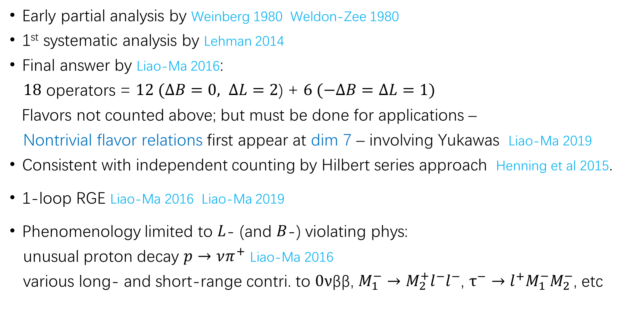
SMEFT: dim-7
Early partial analysis by Weinberg 1980 Weldon-Zee 1980
1st systematic analysis by Lehman 2014
Final answer by Liao-Ma 2016:
$18$ operators = $12 (∆B=0, ∆L=2$) + $6 (−∆B=∆L=1)$
Flavors not counted above; but must be done for applications –
Nontrivial flavor relations first appear at dim 7 – involving Yukawas Liao-Ma 2019
Consistent with independent counting by Hilbert series approach Henning et al 2015.
1-loop RGE Liao-Ma 2016 Liao-Ma 2019
Phenomenology limited to $L$- (and $B$-) violating phys:
unusual proton decay $p→νπ^{+}$ Liao-Ma 2016
various long- and short-range contri. to $0ν$ββ, $M_{1}^{−}→M_{2}^{+}l^{−}l^{−}$, $τ^{−}→l^{+}M_{1}^{−}M_{2}^{−}$, etc
Liao et al, 2019,2020,2021
… Cirigliano et al 2017, 2018, …, Feng et al 2019

Slide 14

SMEFT: dim-8
Many independent operators:
mostly conserve $L$ and $B$, others break $∆B=∆L=1$
RGE done for purely bosonic operators:
Phenomenology partly explored, mainly with bosonic operators:
electroweak precision data, triple gauge couplings, diboson production:
Li et al, 2020; Murphy, 2020
Chala et al, 2021; Bakshi et al, 2022
Degrande and Li, 2023; Corbett et al, 2023

Slide 15

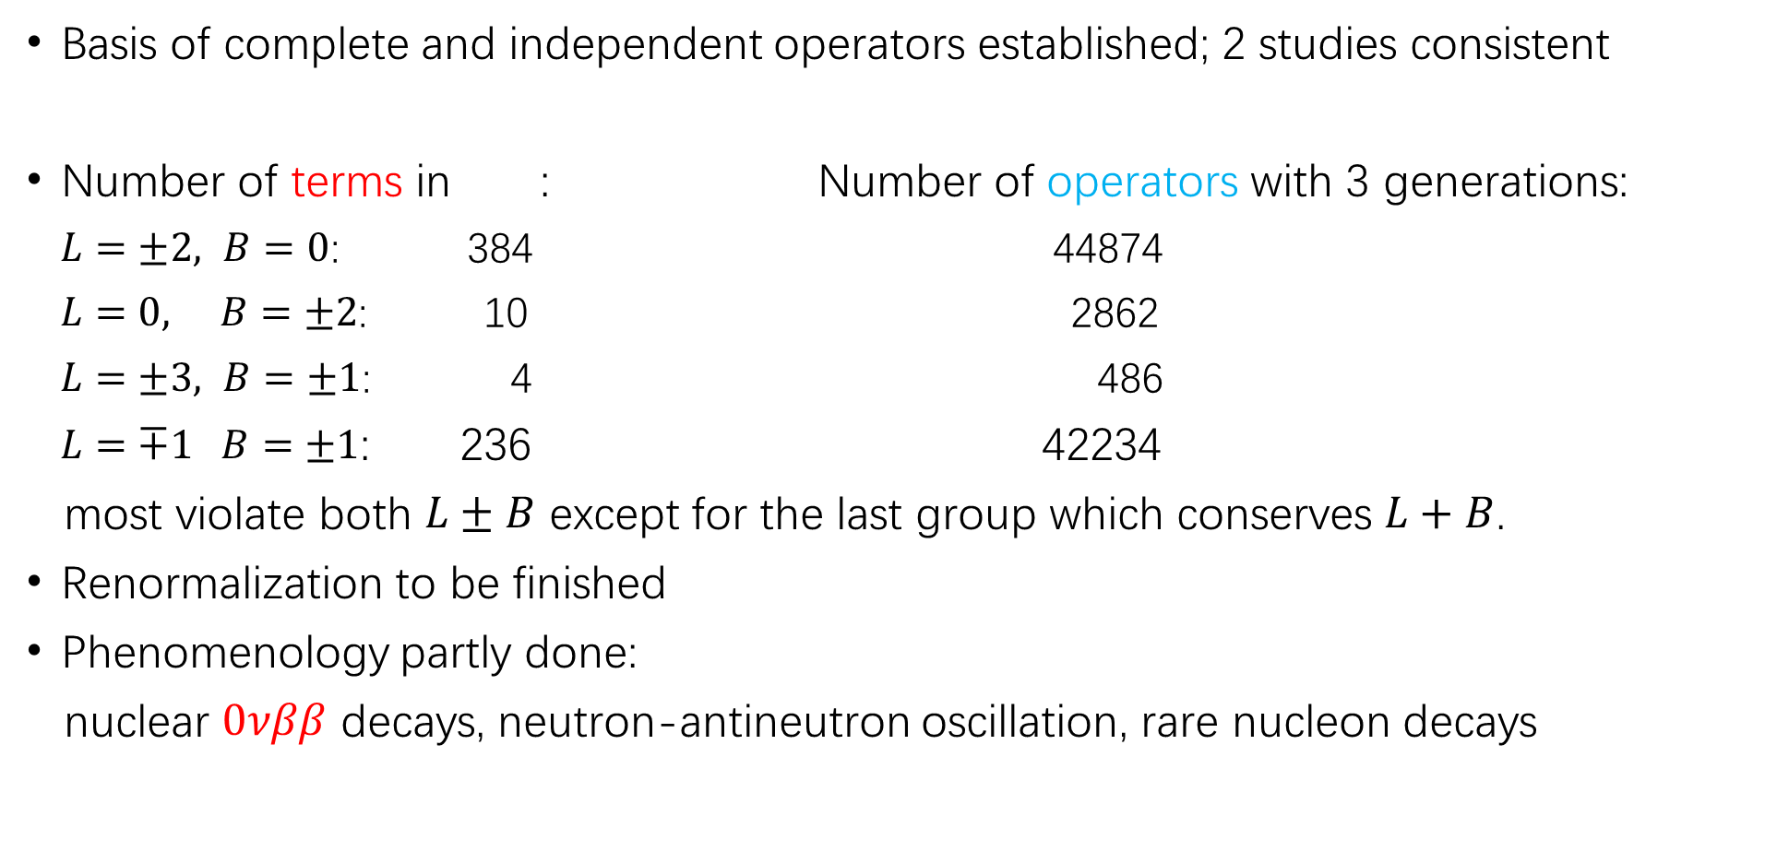
SMEFT: dim-9
Basis of complete and independent operators established; 2 studies consistent
Number of terms in : Number of operators with 3 generations:
$L=±2, B=0$: 384 44874
$L=0, B=±2$: 10 2862
$L=±3, B=±1$: 4 486
$L=∓1 B=±1$: 236 42234
most violate both $L±B$ except for the last group which conserves $L+B$.
Renormalization to be finished
Phenomenology partly done:
nuclear $0νββ$ decays, neutron-antineutron oscillation, rare nucleon decays
Li et al, 2020; Liao-Ma, 2020

Slide 16
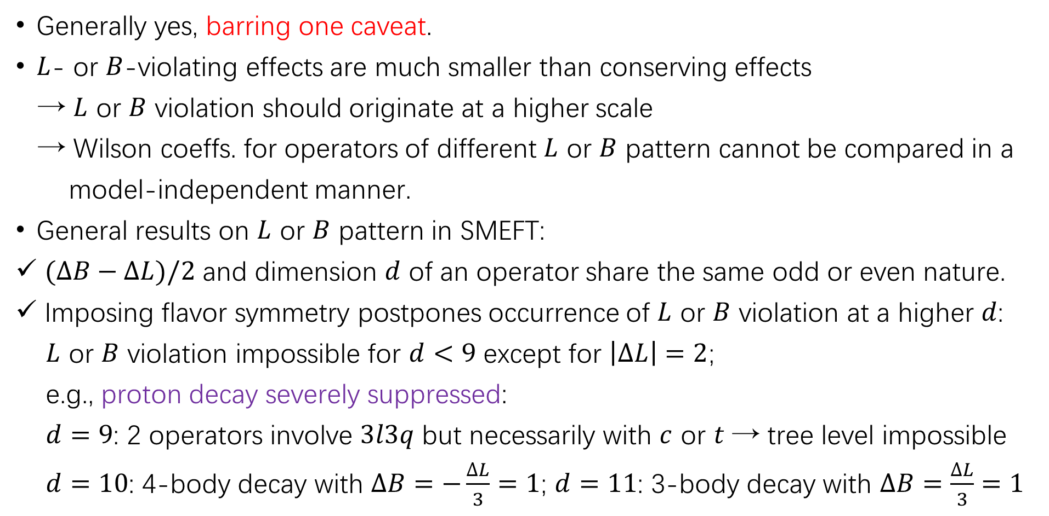
SMEFT: higher-dim operators less important?
Generally yes, barring one caveat.
$L$- or $B$-violating effects are much smaller than conserving effects
→ $L$ or $B$ violation should originate at a higher scale
→ Wilson coeffs. for operators of different $L$ or $B$ pattern cannot be compared in a
model-independent manner.
General results on $L$ or $B$ pattern in SMEFT:
$(∆B−∆L)/2$ and dimension $d$ of an operator share the same odd or even nature.
Imposing flavor symmetry postpones occurrence of $L$ or $B$ violation at a higher $d$:
$L$ or $B$ violation impossible for $d<9$ except for $\left|∆L\right|=2$;
e.g., proton decay severely suppressed:
$d=9$: 2 operators involve $3l3q$ but necessarily with $c$ or $t$ → tree level impossible
$d=10$: 4-body decay with $∆B=−\frac{∆L}{3}=1$; $d=11$: 3-body decay with $∆B=\frac{∆L}{3}=1$
Kobach, 2016
Helset and Kobach, 2019

Slide 17
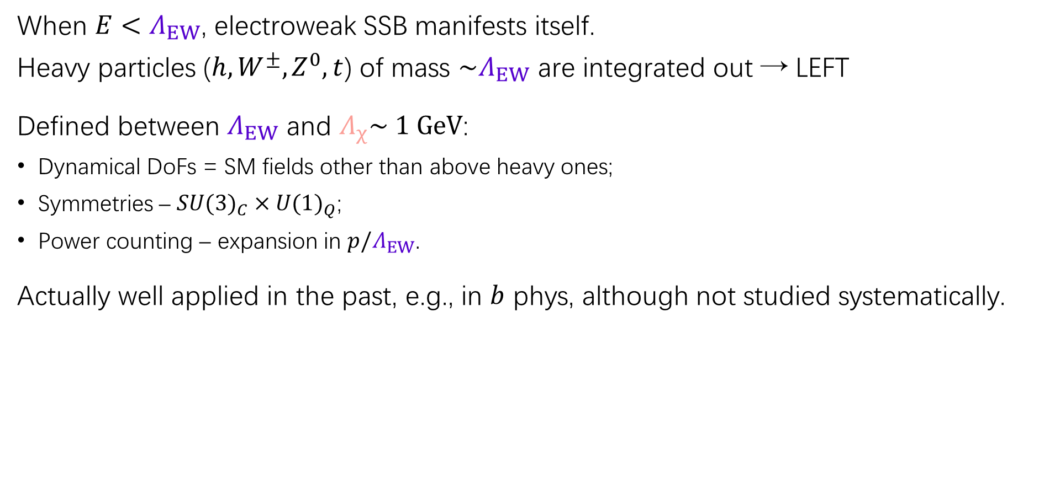

Low-energy EFT
When ${E<Λ}_{EW}$, electroweak SSB manifests itself.
Heavy particles ($h, W^{±}, Z^{0}, t$) of mass $\sim Λ_{EW}$ are integrated out → LEFT
Defined between $Λ_{EW}$ and $Λ_{χ}\sim 1 GeV$:
Dynamical DoFs = SM fields other than above heavy ones;
Symmetries – ${SU(3)}_{C}×{U(1)}_{Q}$;
Power counting – expansion in $p/Λ_{EW}$.
Actually well applied in the past, e.g., in $b$ phys, although not studied systematically.
Jenkins et al, 2017
Murphy, 2020
$\left|∆L\right|=2$ sector:
Liao et al, 2019
Liao et al, 2020
Li et al, 2020
Attention: combined power counting in $1/Λ_{EW}$ and $1/Λ_{NP}$

Slide 18
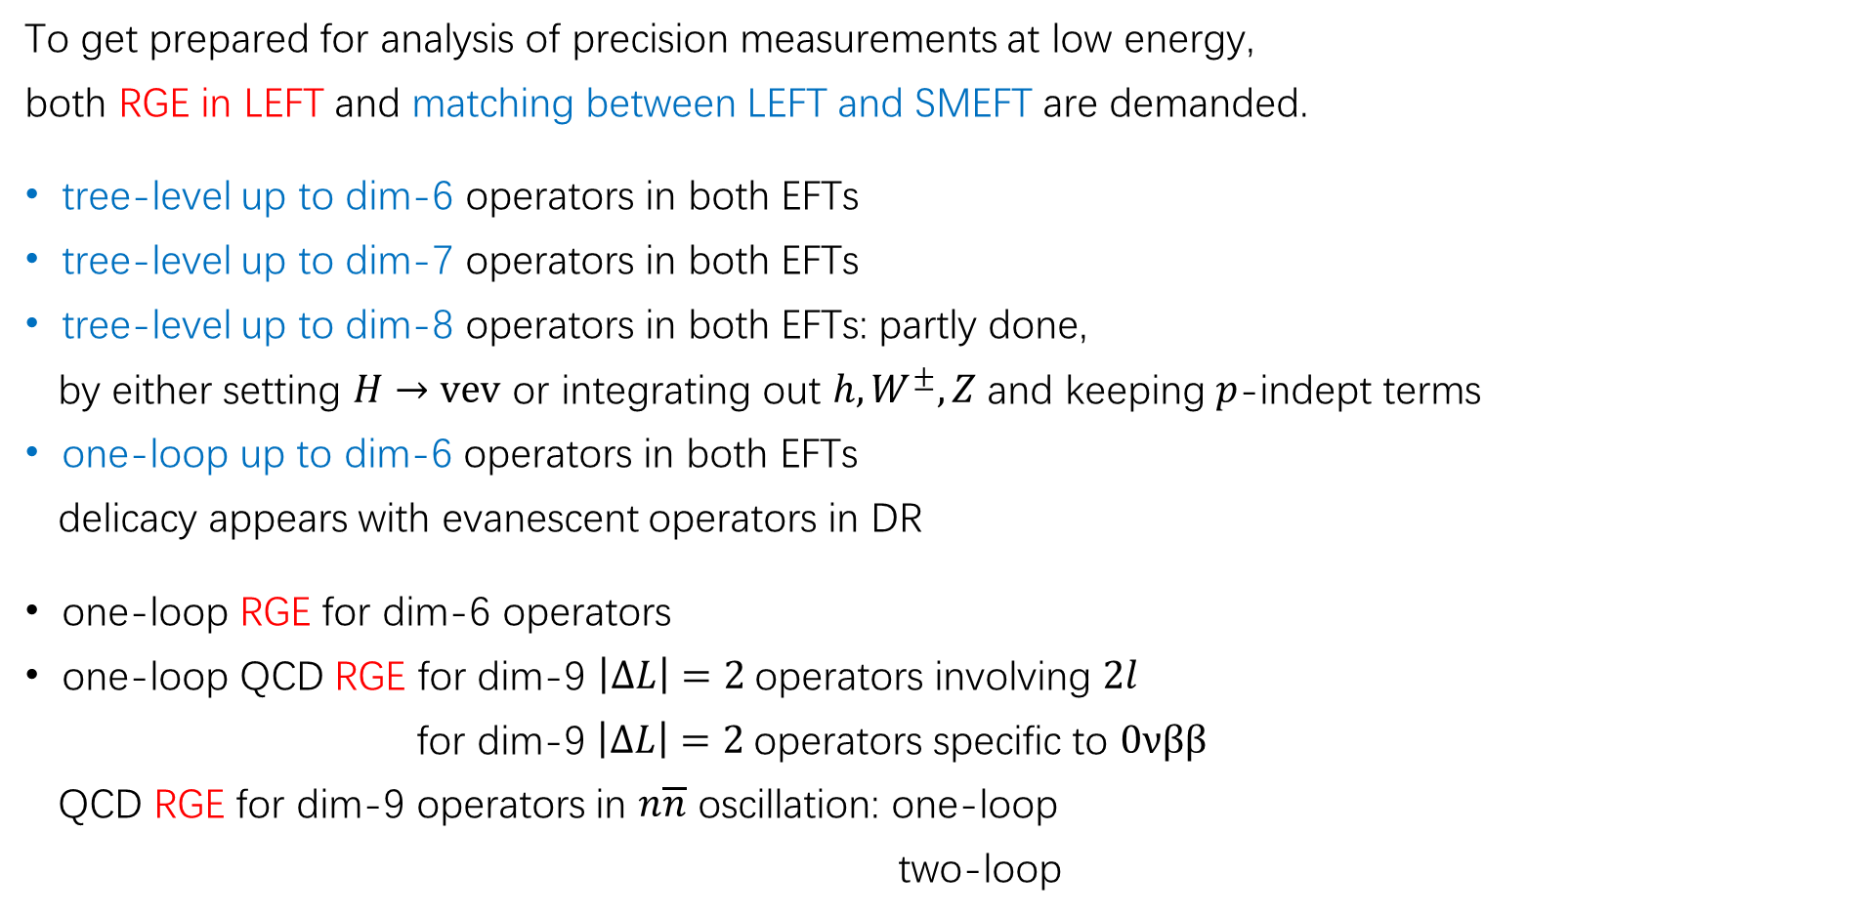
LEFT: RGE and matching to SMEFT
To get prepared for analysis of precision measurements at low energy,
both RGE in LEFT and matching between LEFT and SMEFT are demanded.
tree-level up to dim-6 operators in both EFTs
tree-level up to dim-7 operators in both EFTs
tree-level up to dim-8 operators in both EFTs: partly done,
by either setting $H→vev$ or integrating out $h, W^{±}, Z$ and keeping $p$-indept terms
one-loop up to dim-6 operators in both EFTs
delicacy appears with evanescent operators in DR
one-loop RGE for dim-6 operators
one-loop QCD RGE for dim-9 $\left|∆L\right|=2$operators involving $2l$
for dim-9 $\left|∆L\right|=2$operators specific to $0νββ$
QCD RGE for dim-9 operators in $n\overline{n}$ oscillation: one-loop
two-loop
Jenkins et al, 1709.04486
Liao et al, 2005.08013
Hamoudou et al, 2207.08856
Dekens and Stoffer, 1908.05295
Jenkins et al, 1711.05270
Liao et al, 1909.06272
Cirigliano et al, 1806.02780
Caswell et al, PLB122
Buchoff and Wagman, 1506.00647

Slide 19
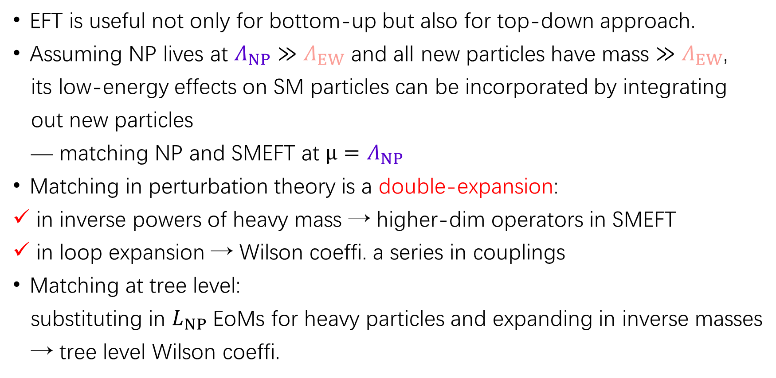
Matching NP to SMEFT
EFT is useful not only for bottom-up but also for top-down approach.
Assuming NP lives at $Λ_{NP}{≫Λ}_{EW}$ and all new particles have mass ${≫Λ}_{EW}$,
its low-energy effects on SM particles can be incorporated by integrating
out new particles
— matching NP and SMEFT at $μ=Λ_{NP}$
Matching in perturbation theory is a double-expansion:
in inverse powers of heavy mass → higher-dim operators in SMEFT
in loop expansion → Wilson coeffi. a series in couplings
Matching at tree level:
substituting in $L_{NP}$ EoMs for heavy particles and expanding in inverse masses
→ tree level Wilson coeffi.

Slide 20

Matching NP to SMEFT at one loop
Past years have witnessed significant progress in 1-loop matching based on:
Functional approach augmented by covariant derivative expansion
Loop integration by method of regions
Features:
The result is directly the 1-loop contribution to whose operators
and Wilson coeffs. are obtained simultaneously.
One only has to work with NP theory without computing in SMEFT!
……; Cohen-Lu-Zhang, 2011.02484

Slide 21
Examples of 1-loop functional matching
Obtain 1-loop contribution to by integrating out heavy
superpartners in MSSM
singlet or triplet scalar
vectorlike fermions
triplet vector boson
fermions or scalars in type-I, -II, and –III neutrino seesaw models
dark-sector particles in scotogenic neutrino mass models
……
Henning et al, 2014; …
…; Jiang et al, 2018; …
…; Zhang, 1610.00710
Huo, 1506.00840
S. Zhou’s talk
Brivio et al, 2108.01094
Zhang-Zhou, 2107.12133
Du et al, 2201.04646
Li et al, 2201.05082
Liao-Ma, 2210.04270

Slide 22
Matching NP to SMEFT?
Issues:
Is the Higgs completely responsible for electroweak SSB?
Do new heavy particles derive all mass from electroweak SSB?
They concern decoupling/nondecoupling of heavy particles and
relation of the Higgs with would-be Nambu-Golstone bosons →
SMEFT or Higgs EFT (HEFT)?
For more discussion on HEFT, see
Here I discuss briefly one recent example:
EFT of 2HDM
on how to integrate out heavy particles to achieve SMEFT with better convergence.
Q. Cao’s talk
Banta et al, 2304.09884

Slide 23
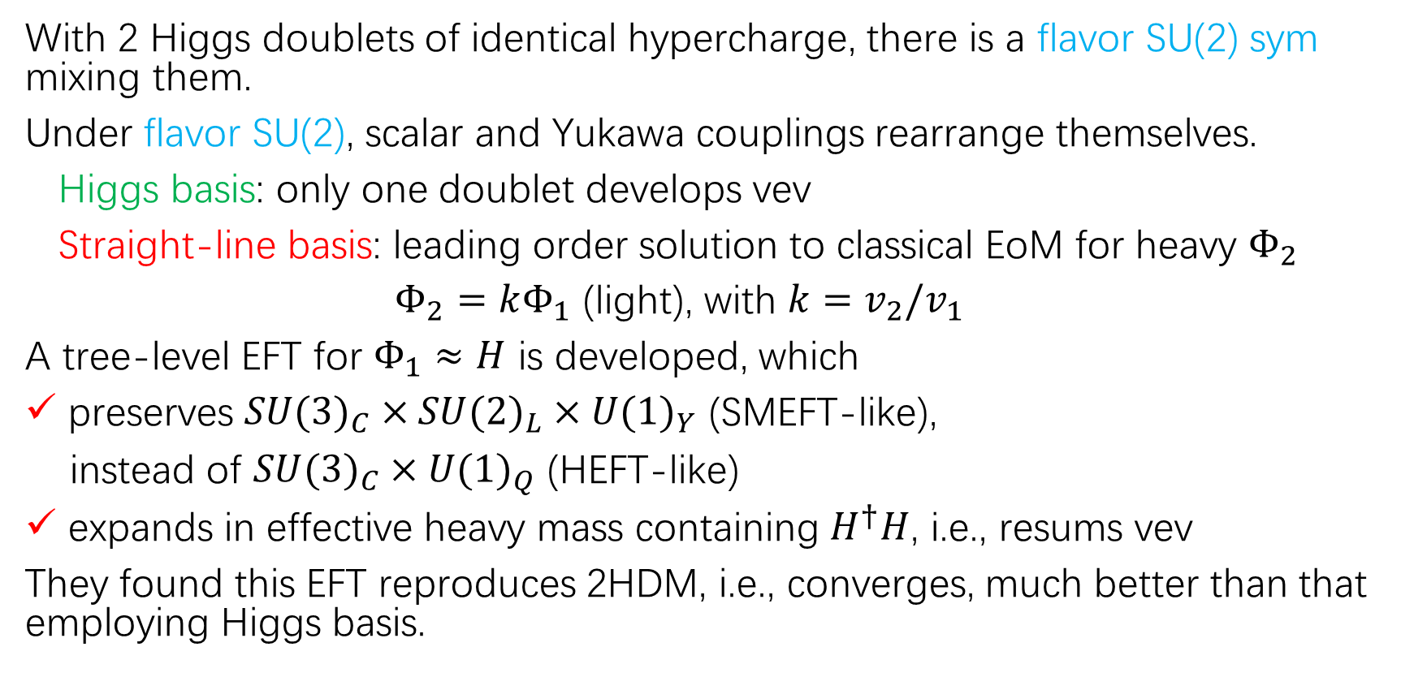
Matching NP to SMEFT?
With 2 Higgs doublets of identical hypercharge, there is a flavor SU(2) sym mixing them.
Under flavor SU(2), scalar and Yukawa couplings rearrange themselves.
Higgs basis: only one doublet develops vev
Straight-line basis: leading order solution to classical EoM for heavy $Φ_{2}$
$Φ_{2}=kΦ_{1}$ (light), with $k=v_{2}/v_{1}$
A tree-level EFT for $Φ_{1}≈H$ is developed, which
preserves ${SU(3)}_{C}×{SU(2)}_{L}×{U(1)}_{Y}$ (SMEFT-like),
instead of ${SU(3)}_{C}×{U(1)}_{Q}$ (HEFT-like)
expands in effective heavy mass containing $H^{†}H$, i.e., resums vev
They found this EFT reproduces 2HDM, i.e., converges, much better than that employing Higgs basis.

Slide 24
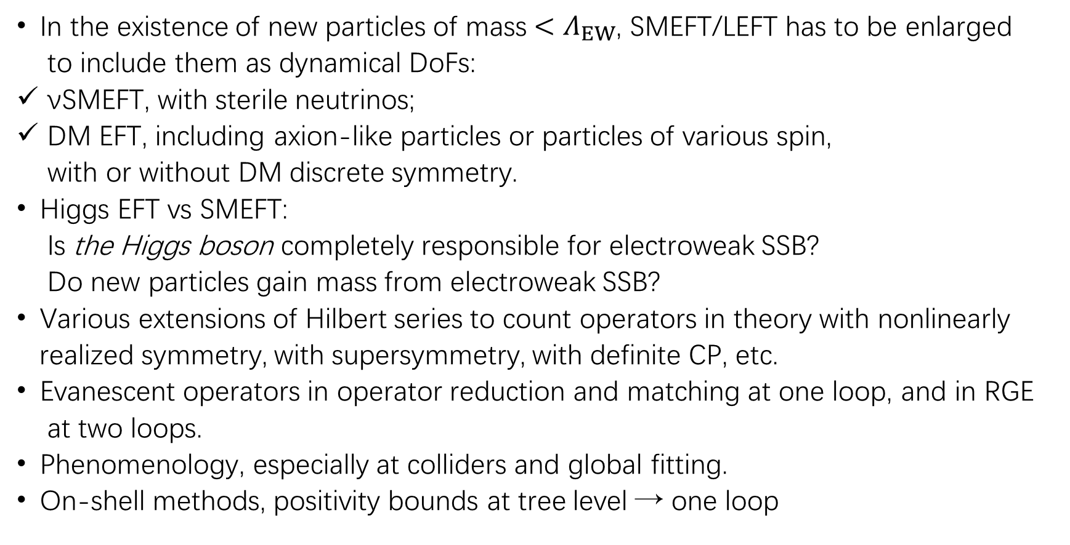
Ongoing activities not covered here
In the existence of new particles of mass ${<Λ}_{EW}$, SMEFT/LEFT has to be enlarged
to include them as dynamical DoFs:
νSMEFT, with sterile neutrinos;
DM EFT, including axion-like particles or particles of various spin,
with or without DM discrete symmetry.
Higgs EFT vs SMEFT:
Is the Higgs boson completely responsible for electroweak SSB?
Do new particles gain mass from electroweak SSB?
Various extensions of Hilbert series to count operators in theory with nonlinearly
realized symmetry, with supersymmetry, with definite CP, etc.
Evanescent operators in operator reduction and matching at one loop, and in RGE
at two loops.
Phenomenology, especially at colliders and global fitting.
On-shell methods, positivity bounds at tree level → one loop
Q. Cao’s talk

