Slide 1
重味强子弱衰变中的味道SU(3)对称性
王 伟
上海交通大学
2023年1月13日
Notes:
1

Slide 2
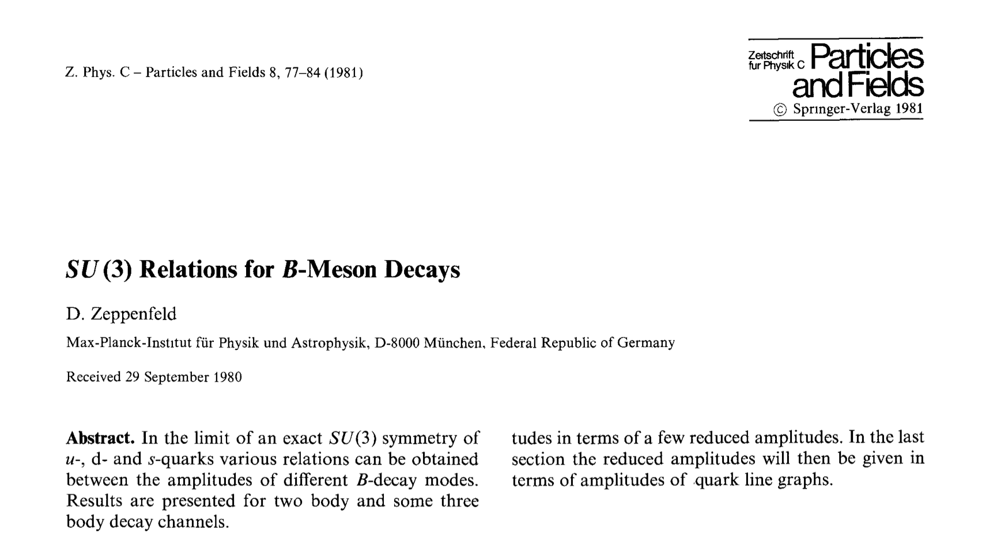
A long history
Zeppendfeld, 1981
Chau,1986
Chau,Cheng,1987, 1989
Savage and Wise, 1989
Deshpande, He, 1995
Chiang, Gronau, Rosner, Suprun 2004
Cheng, Chiang,2010
Li, Lu, Yu, 2012
Geng
Hsiao
Notes:
2

Slide 3
Outline
SU(3) in group theory
Weak Decay Effective Hamiltonian
SU(3) in semileptonic charmed baryon decays
SU(3) in nonleptonic decays:
    IRA vs TDA
Notes:
3

Slide 4
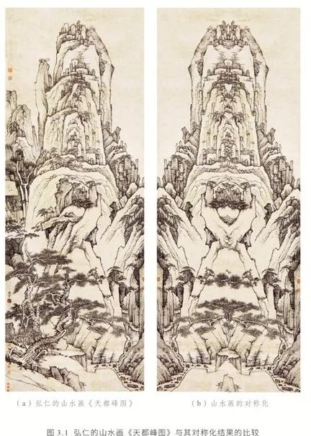
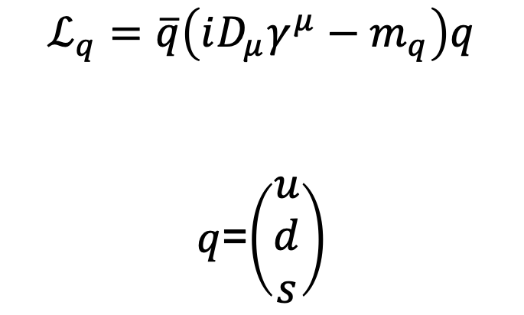
SU(3) in group theory
$$ℒ_{q}=\overline{q}\left(iD_{μ}γ^{μ}−m_{q}\right)q$$
$q$=$\left(\begin{matrix}u \\ d \\ s\end{matrix}\right)$
对称展示宇宙之美，不对称生成宇宙之实
Notes:
4

Slide 5
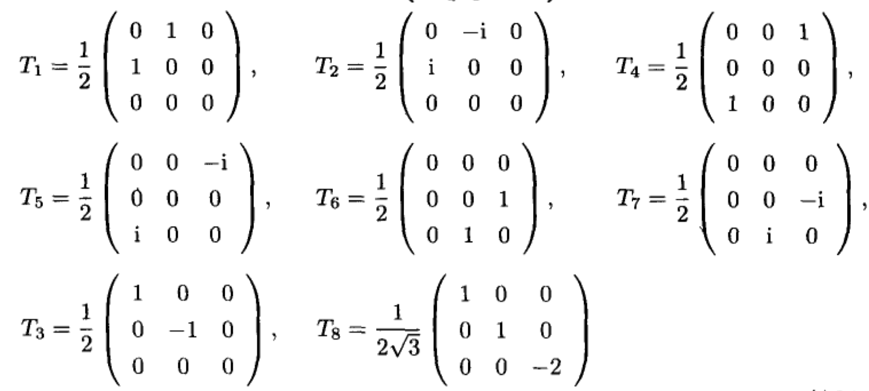
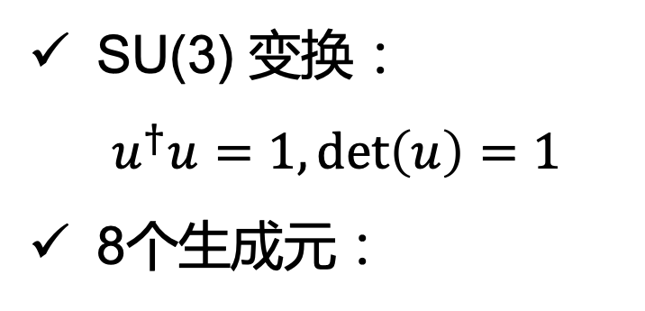
SU(3) in group theory
SU(3) 变换：
$$u^{†}u=1,\det\left(u\right)=1$$
8个生成元：
Notes:
5

Slide 6
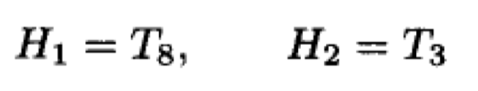
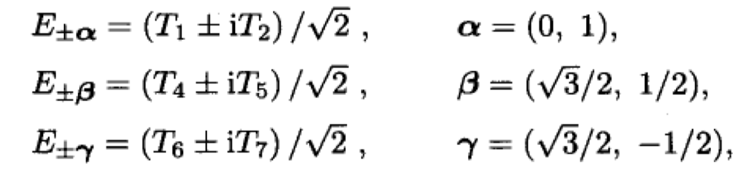
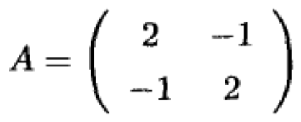


SU(3) in group theory
嘉当-外尔基(Cartan-Weyl basis)：根矢量与素根
$A_{2}$李代数的邓金图与嘉当矩阵
邓金图
嘉当矩阵
Notes:
6

Slide 7

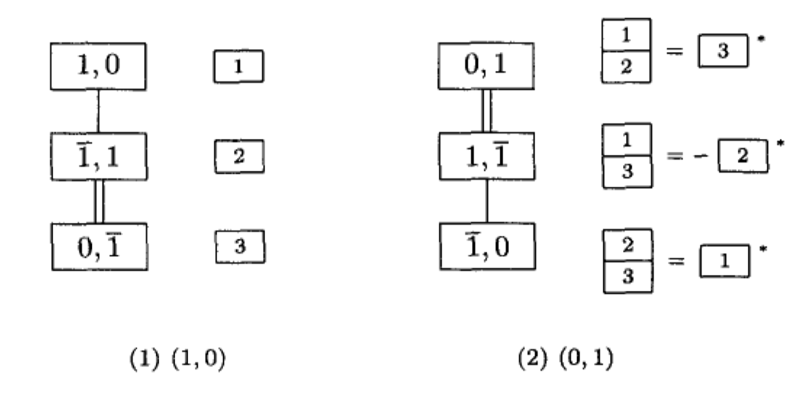
SU(3) in group theory
权矢量与基本主权
方块权图与张量基
Notes:
7

Slide 8
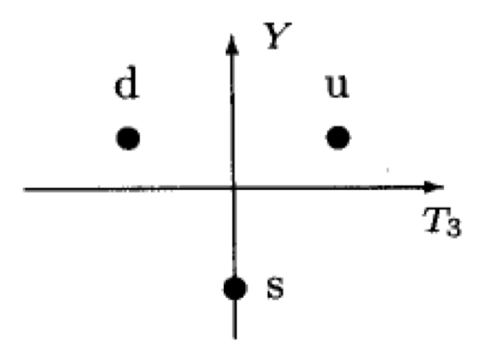
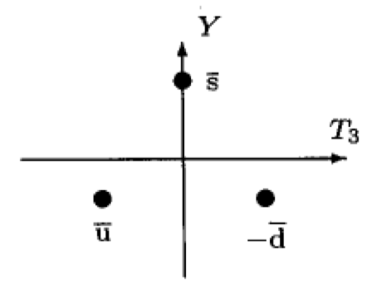
SU(3) in group theory
平面权图
(10)
(01)
Notes:
8

Slide 9
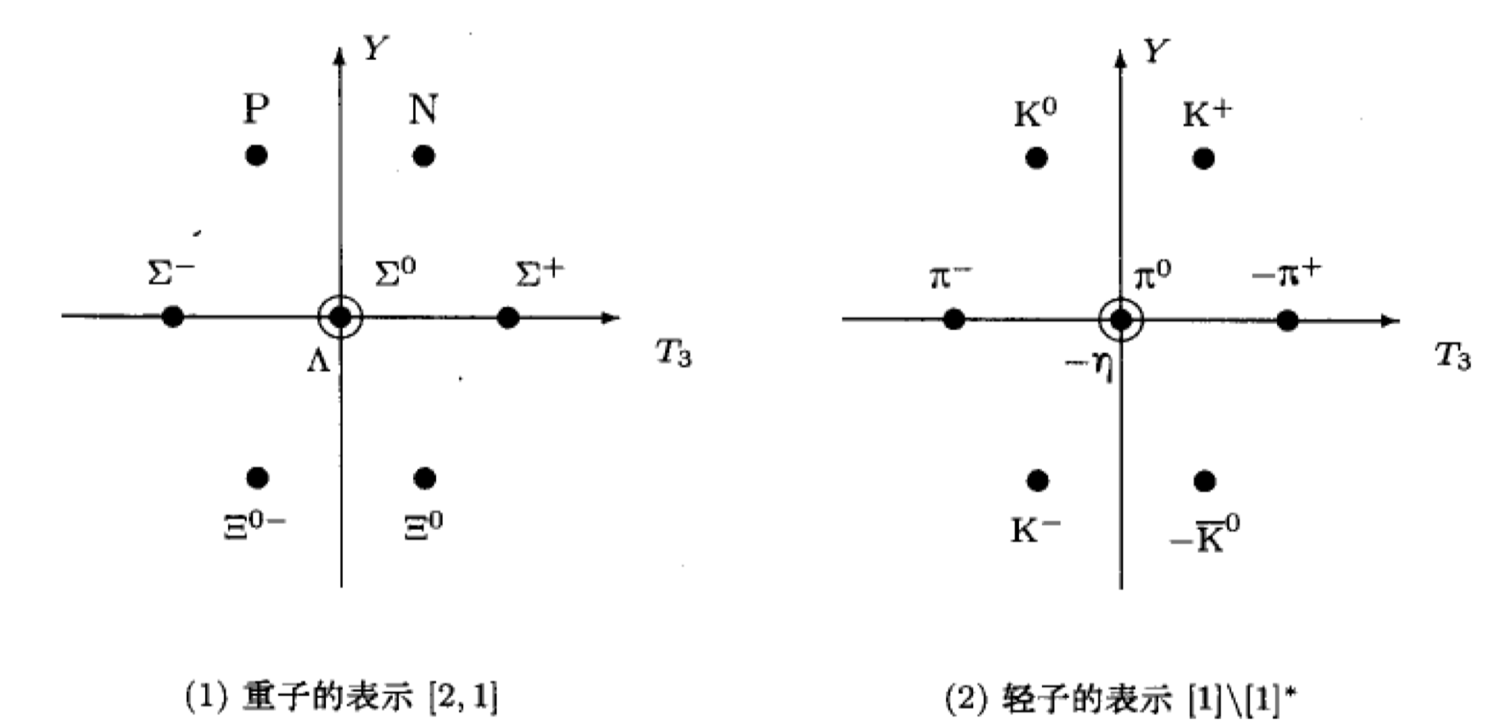
SU(3) in group theory
平面权图
Notes:
9

Slide 10
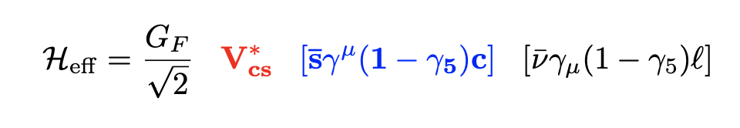
Weak Decay Effective Hamiltonian
SU(3) triplet
Notes:
10

Slide 11
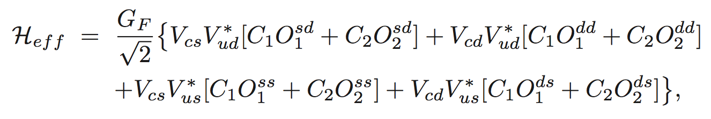
Weak Decay Effective Hamiltonian
Nonleptonic:
Color flow
Different flavors
SU(3) decomposition
Notes:
11

Slide 12
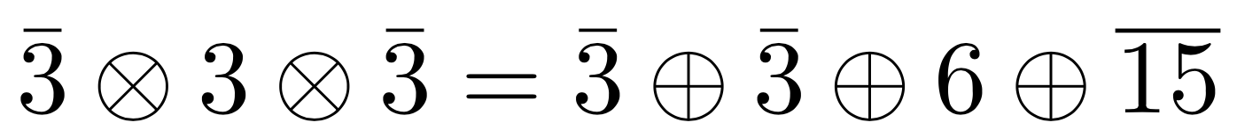
Weak Decay Effective Hamiltonian
Notes:
12

Slide 13
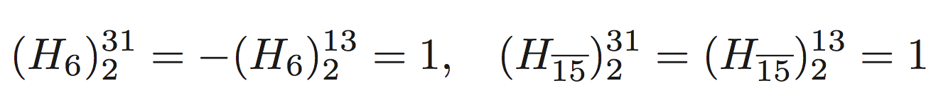
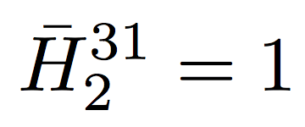
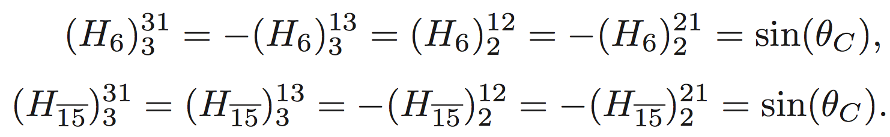
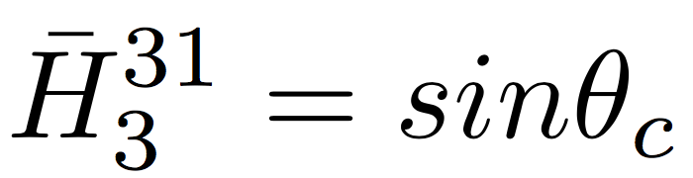
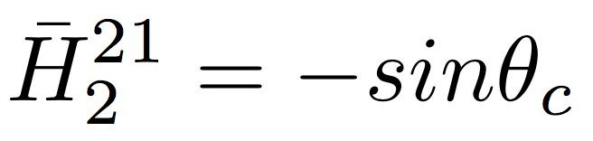
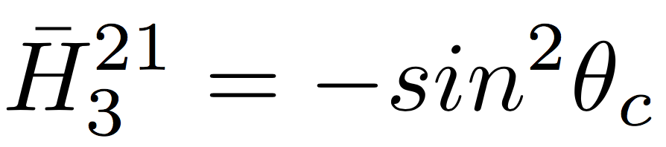
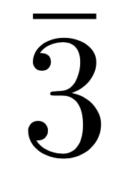
Weak Decay Effective Hamiltonian
Cabibbo-Allowed:
Cabibbo-Suppressed:
Doubly Cabibbo-Suppressed:
In Charm operator vanishes since:
Notes:
13

Slide 14
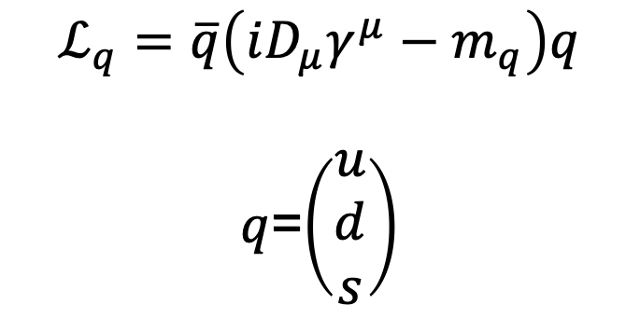
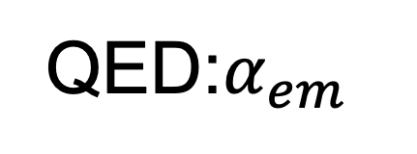


SU(3) symmetry breaking
强子化：$\frac{m_{s}−m_{u}}{Λ_{QCD}}$
$$ℒ_{q}=\overline{q}\left(iD_{μ}γ^{μ}−m_{q}\right)q$$
$q$=$\left(\begin{matrix}u \\ d \\ s\end{matrix}\right)$
硬散射：$\frac{m_{s}−m_{u}}{Q}$
QED:$α_{em}$
Notes:
14

Slide 15
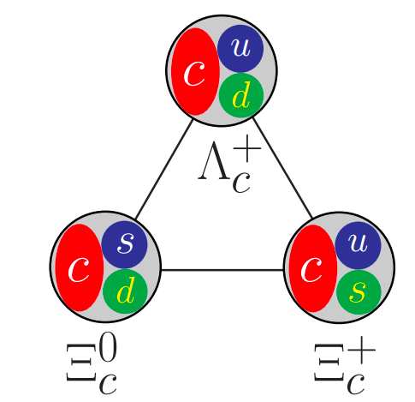
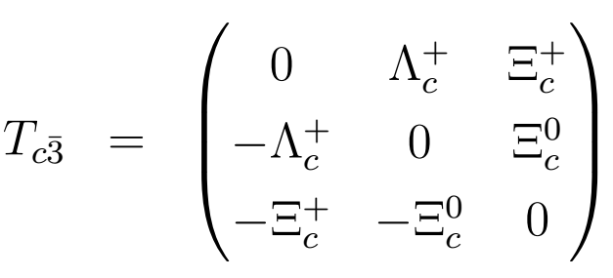
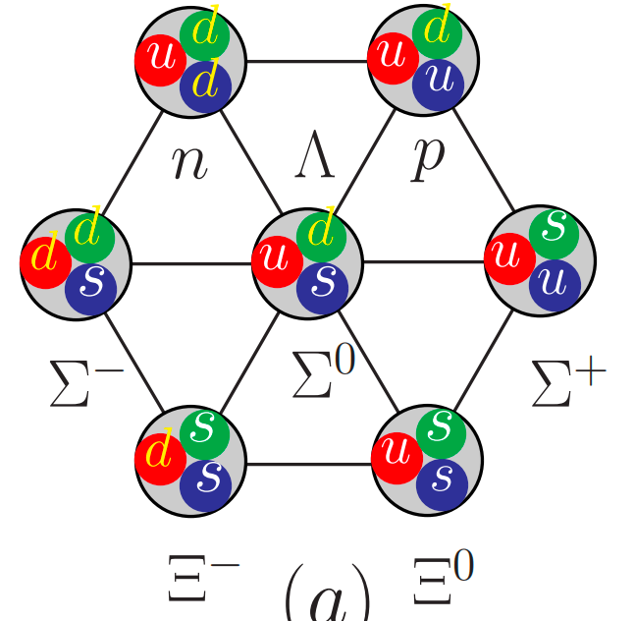
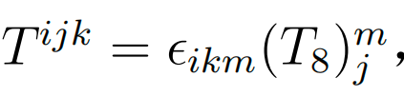
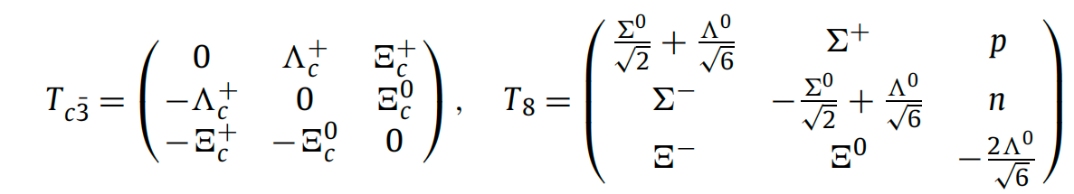



SU(3) in semileptonic charmed baryon decays
SU(3) symmetry analysis
u d s
u
d
s
Anti-triplet:
Octet:
Hamiltonian:
Notes:
15

Slide 16

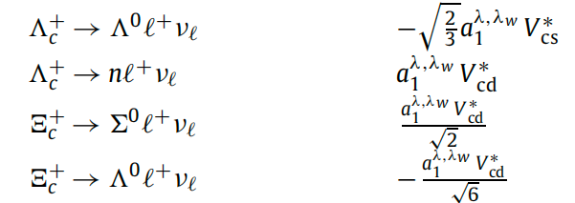
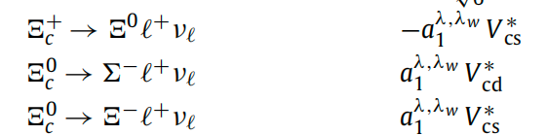
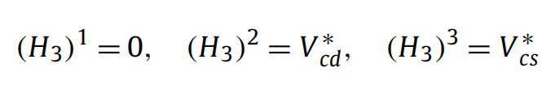
SU(3) in semileptonic charmed baryon decays
SU(3) relations
Hamiltonian, initial state and final state in SU(3) matrix
Amplitude:
expand
Notes:
16

Slide 17
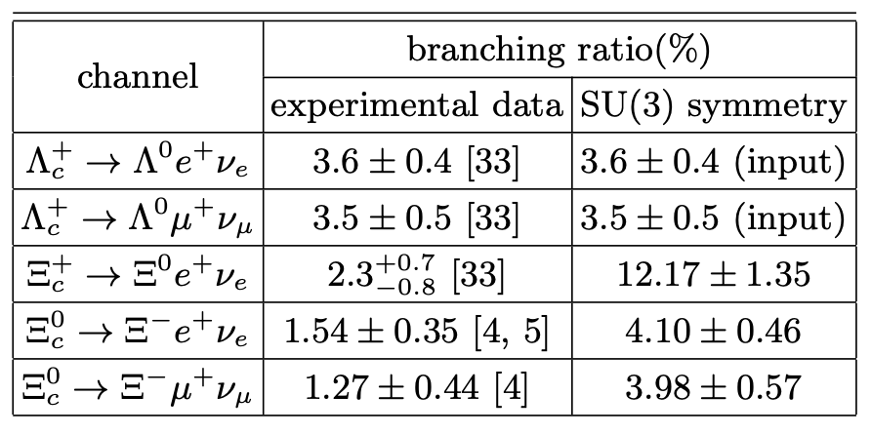
SU(3) in semileptonic charmed baryon decays
SU(3) relations
input data
6σ standard deviation
6σ standard deviation
5σ standard deviation
1. PDG/PTEP 083C01 2020
2. Belle, 2103.06496/PRL 2021
3. ALICE, 2105.05187/PRL 2021
Very large SU(3) symmetry breaking effect
Notes:
17

Slide 18
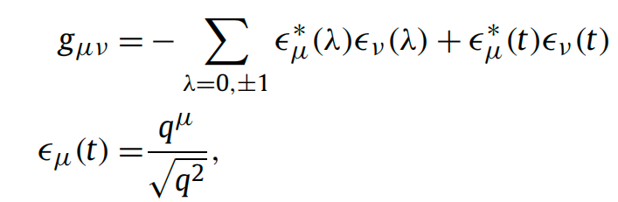
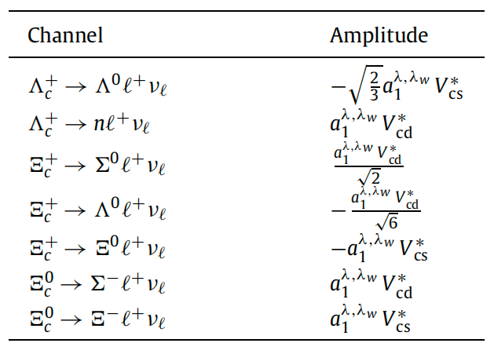
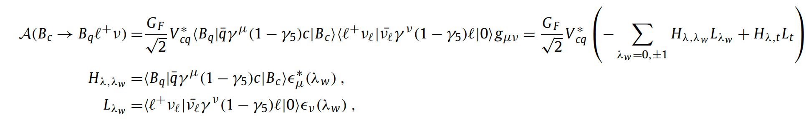

SU(3) in semileptonic charmed baryon decays
SU(3) symmetry in semi-leptonic decays
The SU(3) amplitude in semi-leptonic decays
SU(3) matrix
Notes:
18

Slide 19
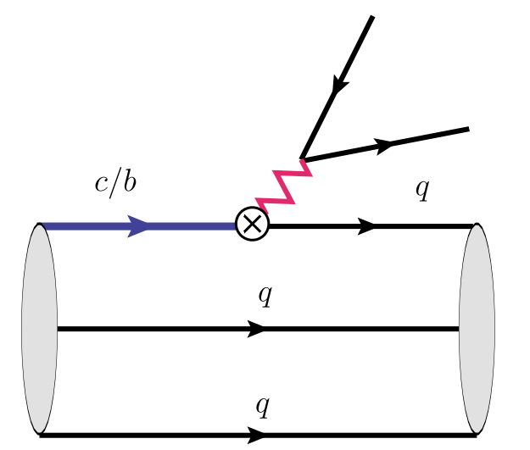
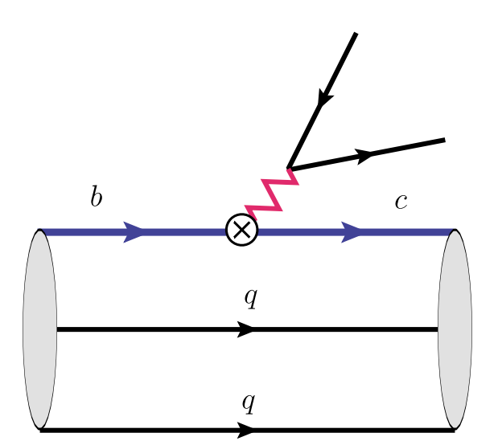
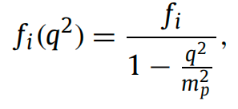
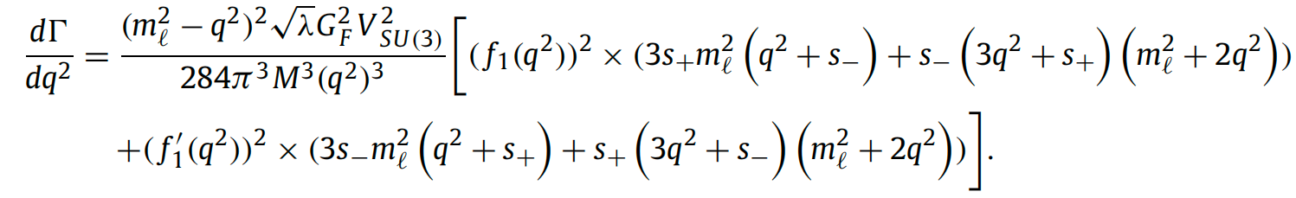

SU(3) in semileptonic charmed baryon decays
SU(3) symmetry in semi-leptonic decays
dominant
suppressed by 1/mb
Notes:
19

Slide 20
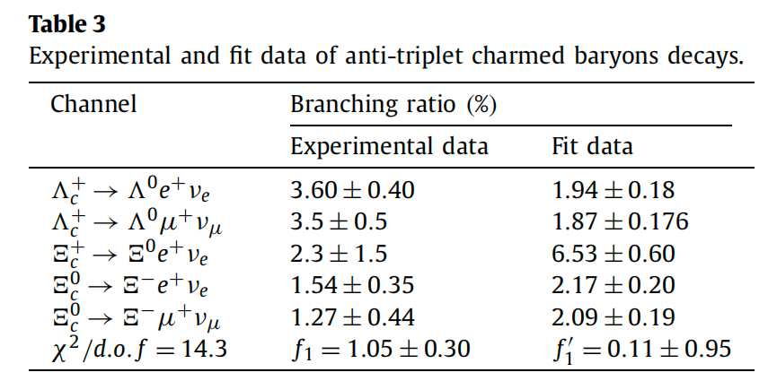
SU(3) in semileptonic charmed baryon decays
SU(3) symmetry in semi-leptonic decays
incompatible with SU(3) symmetry
Notes:
20

Slide 21
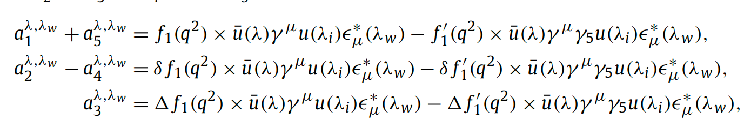
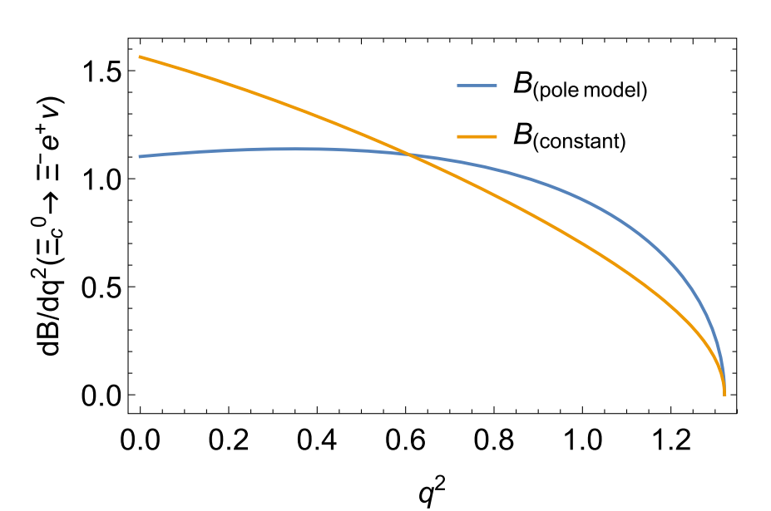
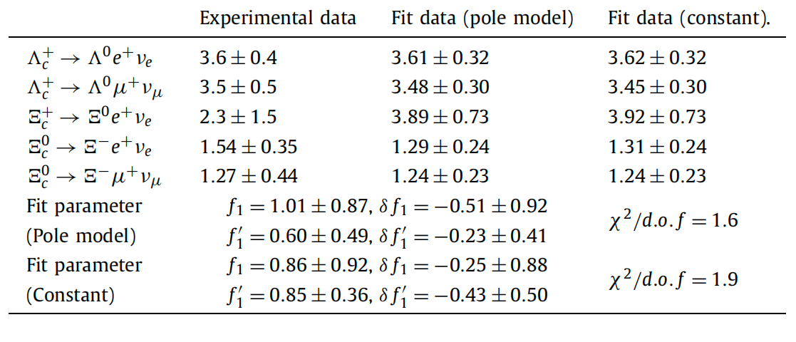
SU(3) in semileptonic charmed baryon decays
global fit
Helicity amplitude:
The differential branching ratio with two different treatments of form factors
Pole model
Constant
Notes:
21

Slide 22
SU(3) in semileptonic charmed baryon decays
global fit
Helicity amplitude:
The differential branching ratio with two different treatments of form factors
Pole model
Constant
Notes:
22

Slide 23

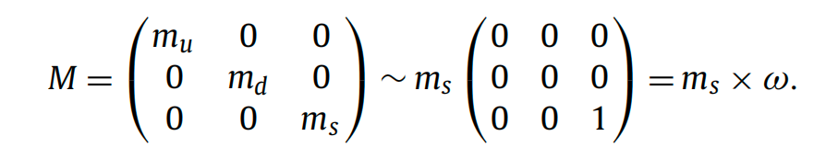
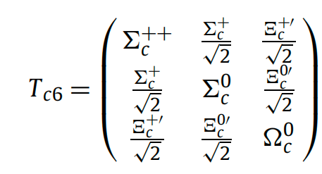

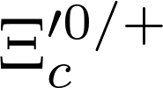
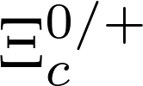


SU(3) in semileptonic charmed baryon decays
mixing effect
Symmetry breaking matrix:
Amplitude:
The anti-triplet and sextet mixing: the SU(3) symmetry breaking effect ω.
ω
Notes:
23

Slide 24
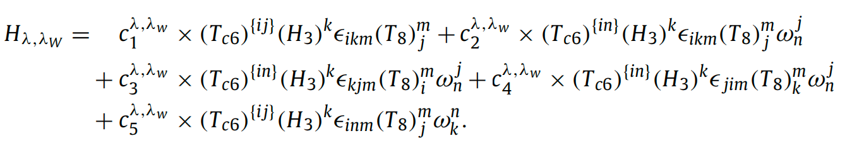



SU(3) in semileptonic charmed baryon decays
mixing effect
SU(3) amplitude
Amplitude of sextet semi-leptonic decays:
Amplitude after sextex and anti-triplet mixing:
Notes:
24

Slide 25



SU(3) in semileptonic charmed baryon decays
mixing effect
SU(3) amplitude
Redefine the helicity amplitude:
Absorb the θ and $c_{1}$ into $a_{2}$ and $a_{4}$
Notes:
25

Slide 26






SU(3) in semileptonic charmed baryon decays
Prodiction
Scenarios
Assuming $a_{5}$ has no contributions
Assuming $a_{2}$
$a_{3}$ and $a_{5}$ has no contributions
Notes:
26

Slide 27





$Ξ_{c}−Ξ_{c}^{′}$ mixing
27
$Ξ_{c}$ and SU(3) breaking
Triplet
Sextet
2203.10352, Ke, Li
2210.07211, Geng, Jin , Liu
θ = 16.27◦ ± 2.30◦ or 85.54◦ ± 2.30◦
|θ| = 0.137(5)π

Slide 28



$Ξ_{c}−Ξ_{c}^{′}$ mixing
28
$Ξ_{c}$ and SU(3) breaking
Preliminary
Preliminary
Hang Liu, Qi-An Zhang, in preparation

Slide 29

$Ξ_{c}−Ξ_{c}^{′}$ mixing
29
$Ξ_{c}$ and SU(3) breaking
Preliminary
Preliminary
Hang Liu, Qi-An Zhang, in preparation

Slide 30


$Ξ_{c}−Ξ_{c}^{′}$ mixing
30
Mixing angle
直接拟合
求解本征
Hang Liu, Qi-An Zhang, in preparation

Slide 31

$Ξ_{c}−Ξ_{c}^{′}$ mixing
31
Small mixing angle:
SU(3) breaking
Heavy quark symmetry breaking
Charm quark mass dependence

Slide 32
SU(3) in nonleptonic decays
• with reduced amplitudes
Notes:
32

Slide 33
SU(3) in nonleptonic decays
Topological Diagram Amplitude
1) T: color-allowed tree amplitude
2) C: color-suppressed tree diagram
3) E: W-exchange diagram
4) P: QCD penguin contributions
5) S: ﬂavor singlet QCD penguin
6) P_{EW}: electroweak penguin
…
Notes:
33

Slide 34

SU(3) in nonleptonic decays
Irreducible Representation Amplitude
Notes:
34

Slide 35


SU(3) in nonleptonic decays
TDA:
Very intuitive
Easy to estimate
$×$diagram by diagram
$×$C-G coefficient
IRA
Tensor formalism
$×$ not intuitive
$×$ unknown
Notes:
35

Slide 36

SU(3) in nonleptonic decays
Tensor formalism for TDA：
He, Wang,CPC42,103108(2018)
Notes:
36

Slide 37



SU(3) in nonleptonic decays
Substituting the above decompsition expression into the TDA:
He, Wang,CPC42,103108(2018)
The two realizations are equivalent
Notes:
37

Slide 38
SU(3) in nonleptonic decays
T+E
C-E
A+E
One amplitude is not independent
Notes:
38

Slide 39

SU(3) in nonleptonic decays
From F.S.Yu
Notes:
39

Slide 40

SU(3) in nonleptonic decays
From F.S.Yu
Notes:
40

Slide 41

SU(3) in nonleptonic decays
From F.S.Yu
Notes:
41

Slide 42

New Developments
D.Wang, C.P.Jia, F.S.Yu, 2021
14 topological diagrams with tree operators
Notes:
42

Slide 43

New Developments
43
From F.S.Yu

Slide 44
Summary
44
Flavor SU(3) is a useful tools to analyze heavy quark weak decays
Large SU(3) symmetry breaking effects are found in semileptonic charmed baryon decays
Nonleptonic decays: two realizations of SU(3) are equivalent, and both are useful.
SU(3) analysis with dynamics (Factorization Assisted Topological Approach)
  Thank you very much!

