Slide 1
Probe Fundamental Physics via the η and ηꞌ Decays
Liping Gan
University of North Carolina Wilmington
Outline
Overview of η and ηꞌ Physics
Standard Model Tests
  JLab Primakoff experimental program
BSM Physics Search: Symmetry and Dark Sector
  JLab Eta Factory (JEF) experiment
  A new proposal: REDTOP
Summary

Slide 2
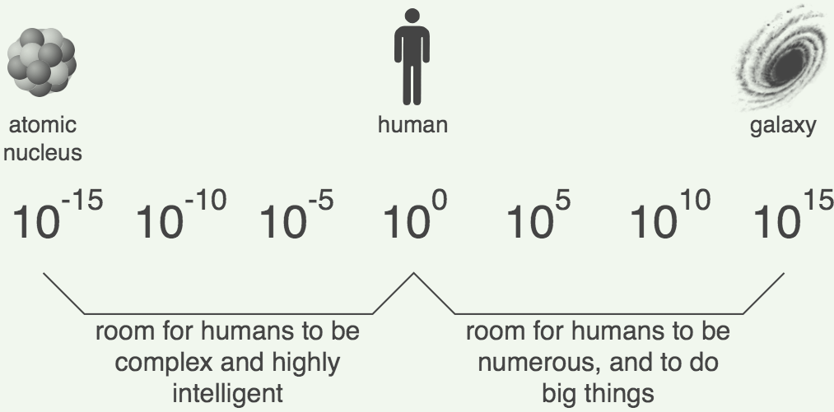
Challenges in Physics
Confinement QCD
Nature of QCD confinement
Its relationship to the dynamical chiral symmetry breaking
New physics beyond the Standard Model (SM)
New sources of CP violation
Dark matter
Dark energy
η and ηꞌ decays provide sensitive probes to explore both fundamental issues

Slide 3
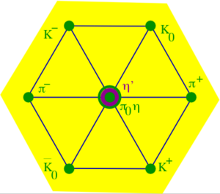

Why η is a unique probe for QCD and BSM physics?
A Goldstone boson due to spontaneous breaking of
QCD chiral symmetry
η is one of key mesons bridging our
understanding of low-energy hadron dynamics
and underlying QCD
All its possible strong and EM decays are forbidden in the lowest order so that η has narrow decay width (Γ_{η} =1.3KeV compared to Γ_{ω}=8.5 MeV)
    Enhance the higher order contributions (by a factor of ~7000
    compared to ω decays). Sensitive to weakly interacting forces.
Eigenstate of P, C, CP, and G:
tests for C, CP
Its quantum numbers are the same as Higgs or vacuum (except parity) and its decays are flavor-conserving
effectively free of SM backgrounds for new physics search.

Slide 4
Rich η (and ηꞌ) Physics
Standard Model Tests:
Chiral symmetry and anomalies
Extract η-ηꞌ mixing angle and quark mass ratio
Theory inputs to HLbL for (g-2)_{μ}
QCD scalar dynamics
Fundamental Symmetry Tests:
C, CP violations
P, CP violations
Lepton flavor violations
BSM Physics in Dark Sector:
Vector bosons (B boson, dark photon and X boson)
Dark scalars
Pseudoscalars (ALPs)
BSM weak decays
Phys. Rept. 945 (2022) 1-105

Slide 5
Low-Energy QCD Symmetries and Light Mesons
QCD Lagrangian in Chiral limit (m_{q}→0) is invariant under:
Chiral symmetry SU_{L}(3)xSU_{R}(3) spontaneously breaks to SU(3)
  8 Goldstone Bosons (GB)
U_{A}(1) is explicitly broken:
(Chiral anomalies)
  Γ(π⁰→γγ), Γ(η→γγ), Γ(η′→γγ)
  Non-zero mass of η₀
SU_{L}(3)xSU_{R}(3) and SU(3) are explicitly broken:
  GB are massive
  Mixing of π⁰, η, η′
  The π⁰, η, η′ system provides a rich laboratory to study the symmetry structure of QCD at low energies.

Slide 6




Axial Anomaly and $Γ(P→γγ)$
P→γγ decay proceeds primarily via the chiral anomaly in QCD.
The chiral anomaly prediction is exact for massless quarks:
k₁
^{P}
k₂
For $π^{0}$:
Γ(π⁰→γγ) is one of the few quantities in confinement region that QCD can calculate precisely at ~1% level to higher orders! It offers the most sensitive test to chiral anomaly
Γ($η^{(′)}$→γγ) is sensitive to the mixing angle due to SU(3) breaking

Slide 7
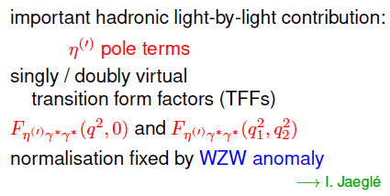
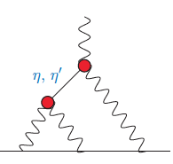

Transition Form Factor and ${(g−2)}_{μ}$
HLbL

Slide 8
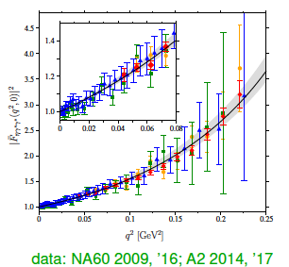
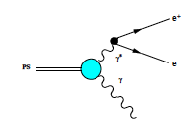
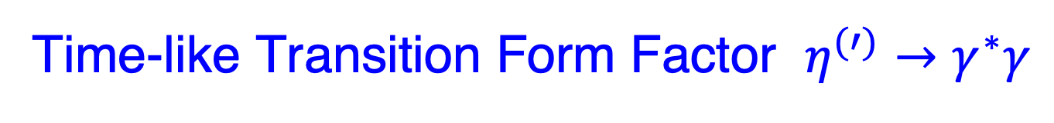
Time-like Transition Form Factor $η^{(′)}→γ^{∗}γ$
P

Slide 9
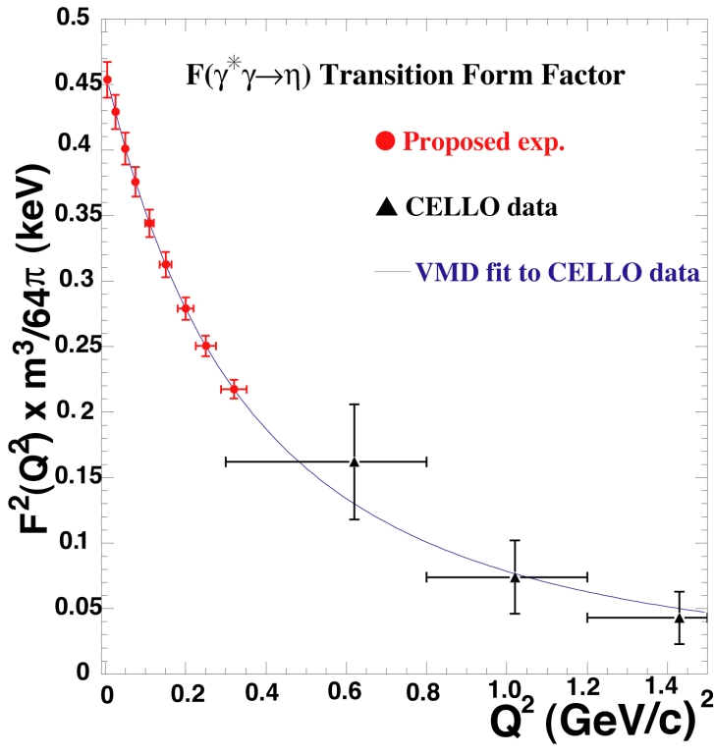
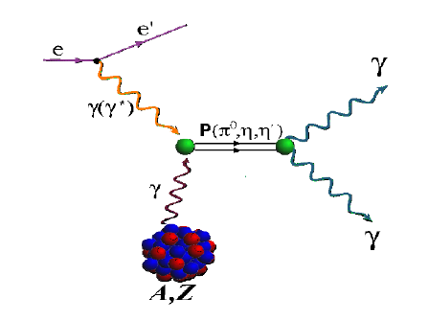



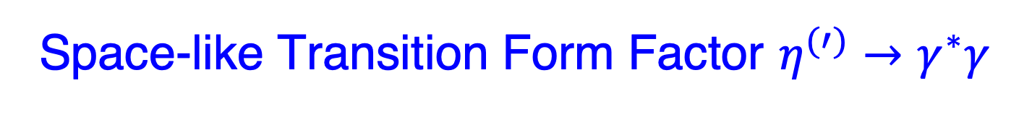


Space-like Transition Form Factor $η^{(′)}→γ^{∗}γ$
Experimental approaches:
Collider: $e^{−}e^{+}→η^{(′)}$ $e^{−}e^{+}$
Virtual Primakoff: $e^{−}A→η^{(′)}$ $e^{−}A$
Slope:
$Q^{2}$=$−q^{2}$

Slide 10
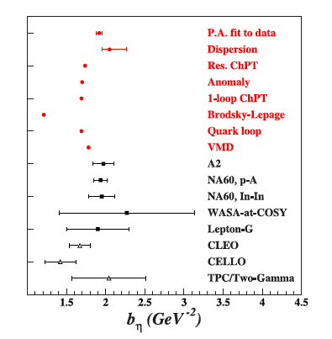
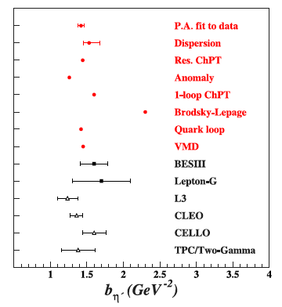
Status of TFF Slope Parameters

Slide 11
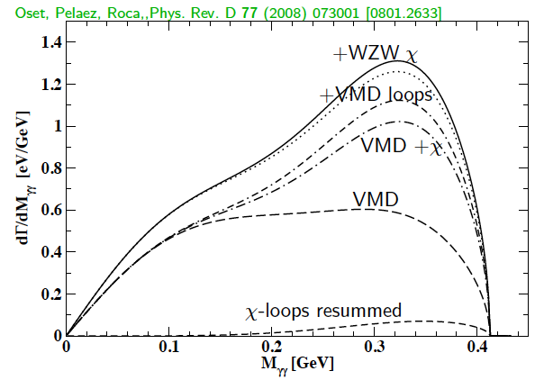
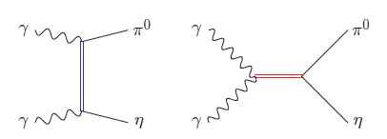
SM allowed η→π⁰γγ
A rare window to probe interplay of VMD & scalar resonances in ChPT to calculate O(p⁶) LEC’s in the chiral Lagrangian
The major contributions to η →π⁰γγ are two O(p⁶) counter-terms in the
chiral Lagrangian an unique probe for the high order ChPT.
L. Ametller, J, Bijnens, and F. Cornet, Phys. Lett., B276, 185 (1992)
Shape of Dalitz distribution is sensitive to the role of scalar resonances.
LEC’s are dominated by resonances
Gasser, Leutwyler 84; Ecler, Gasser, Pich, de Rafael1989; Donoghue, Ramirez, Valencia 1989
a₀, a₂
ρ, ω

Slide 12
Primakoff Program at JLab 6 & 12 GeV
Precision measurements of electromagnetic properties of π⁰, η, η′ via Primakoff effect
Two-Photon Decay Widths:
    Γ(π⁰→γγ) @ 6 GeV
    Γ(η→γγ)
    Γ(η′→γγ)
Transition Form Factors
at Q² of 0.001-0.3 GeV²/c²:
F(γγ*→ π⁰), F(γγ* →η), F(γγ* →η′)
Input to Physics:
precision tests of chiral
symmetry and anomalies
determination of light quark
mass ratio
η-η′ mixing angle
input to calculate HLbL in (g-2)_{μ}
Input to Physics:
π⁰,η and η′ electromagnetic
interaction radii
is the η′ an approximate
Goldstone boson?
input to calculate HLbL in (g-2)_{μ}

Slide 13
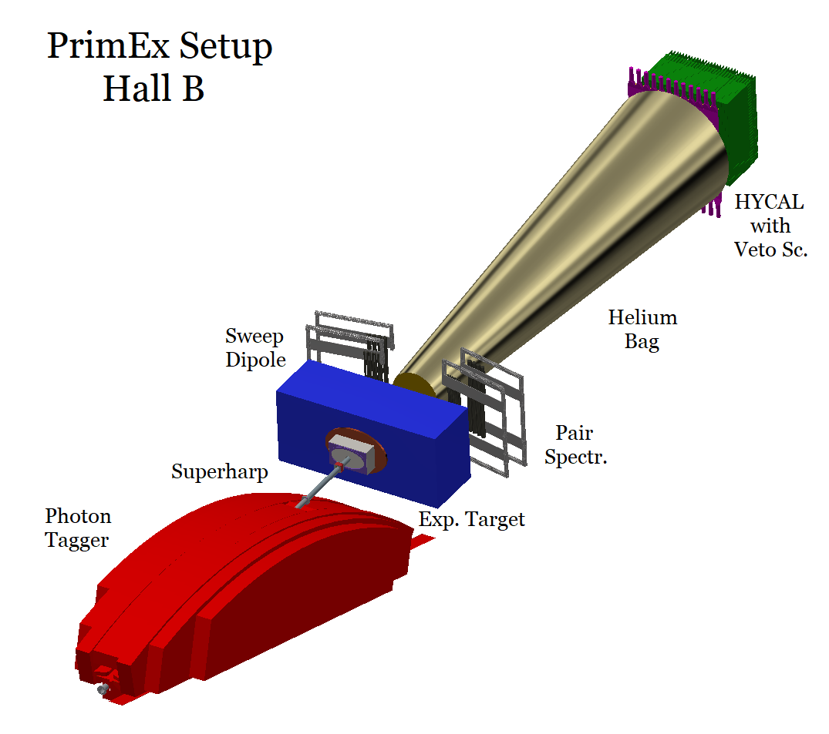
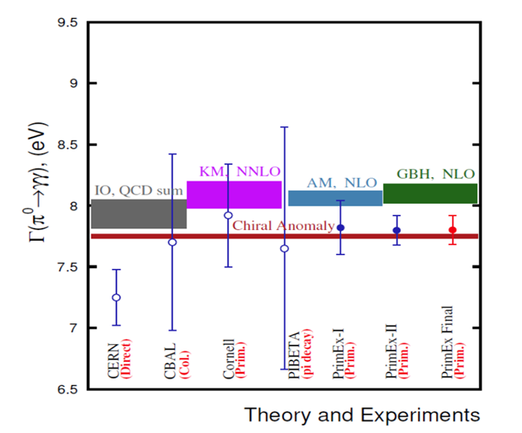
Primakoff Program at JLab 6 & 12 GeV
Precision measurements of electromagnetic properties of π⁰, η, η′ via Primakoff effect
Two-Photon Decay Widths:
    Γ(π⁰→γγ) @ 6 GeV
    Γ(η→γγ)
    Γ(η′→γγ)
Transition Form Factors
at Q² of 0.001-0.5 GeV²/c²:
F(γγ*→ π⁰), F(γγ* →η), F(γγ* →η′)
Science 368, 506-509 (2020)
Input to Physics:
precision tests of chiral
symmetry and anomalies
determination of light quark
mass ratio
η-η′ mixing angle
input to calculate HLbL in (g-2)_{μ}
Input to Physics:
π⁰,η and η′ electromagnetic
interaction radii
is the η′ an approximate
Goldstone boson?
input to calculate HLbL in (g-2)_{μ}
1.50% accuracy

Slide 14
Primakoff Program at JLab 6 & 12 GeV
Precision measurements of electromagnetic properties of π⁰, η, η′ via Primakoff effect
Two-Photon Decay Widths:
    Γ(π⁰→γγ) @ 6 GeV
    Γ(η→γγ)
    Γ(η′→γγ)
Transition Form Factors
at Q² of 0.001-0.5 GeV²/c²:
F(γγ*→ π⁰), F(γγ* →η), F(γγ* →η′)
On-Going PrimEx-eta experiment
Two data sets were collected in 2019 and in 2021.
The third run is scheduled for 2022
Input to Physics:
precision tests of chiral
symmetry and anomalies
determination of light quark
mass ratio
η-η′ mixing angle
input to calculate HLbL in (g-2)_{μ}
Input to Physics:
π⁰,η and η′ electromagnetic
interaction radii
is the η′ an approximate
Goldstone boson?
input to calculate HLbL in (g-2)_{μ}

Slide 15
Physics for Γ(η→γγ) Measurement
Resolve long standing discrepancy between previous collider and Primakoff measurements:
2. Extract η-η′mixing angle:
PDG
3. Improve calculation of the η-pole
contribution to Hadronic
Light-by-Light (HLbL) scattering
in (g-2)_{μ}
4. Improve all partial decay widths
in the η-sector

Slide 16
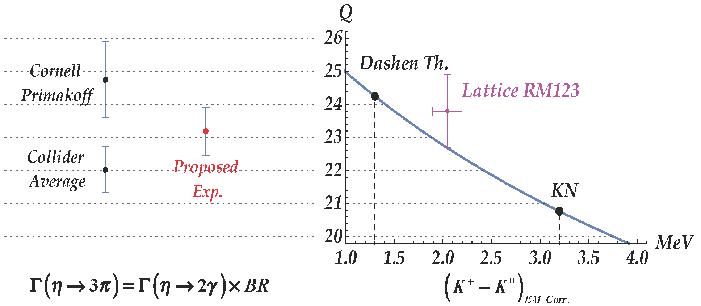
Precision Determination Light Quark Mass Ratio
  A clean probe for quark mass ratio:
    𝜂→3π decays through isospin violation:
    is small
    Amplitude:
Phys. Rept. 945 (2022) 1-105

Slide 17
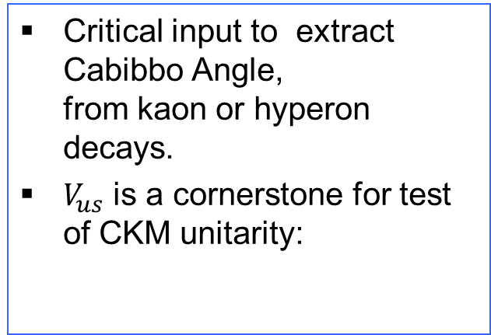
Precision Determination Light Quark Mass Ratio
  A clean probe for quark mass ratio:
    𝜂→3π decays through isospin violation:
    is small
    Amplitude:
Phys. Rept. 945 (2022) 1-105

Slide 18
PrimEx-eta Experiment on Γ(η→γγ) in Hall D
Tagged photon beam (~8.0-11.7 GeV).
Pair spectrometer and a TAC detector for the photon flux control.
Liquid Hydrogen (3.5% R.L.) and ⁴He targets (~4% R.L.)
The η decay photons are detected by Forward Calorimeter (FCAL); the charged decay
particles of η are detected by the GlueX spectrometer.
CompCal and FCAL to measure electron Compton scattering for control of overall
systematics.
18

Slide 19




Preliminary Results on the η Yield
η Yield from phase I data:
Simulations:
$$η→γγ$$
preliminary
$$η→π^{0}π^{0}π^{0}$$
$$γ+{}_{}^{4}{He}→η+{{}_{}^{4}{He}r}^{2}$$
$$E_{γ}: 8−11 GeV πr^{2}$$
More details presented by Igal Jaegle, Y07.00003

Slide 20
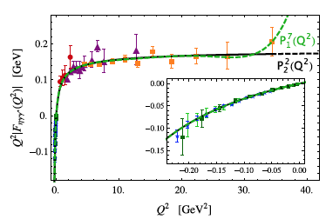
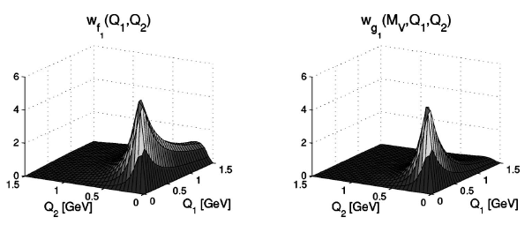
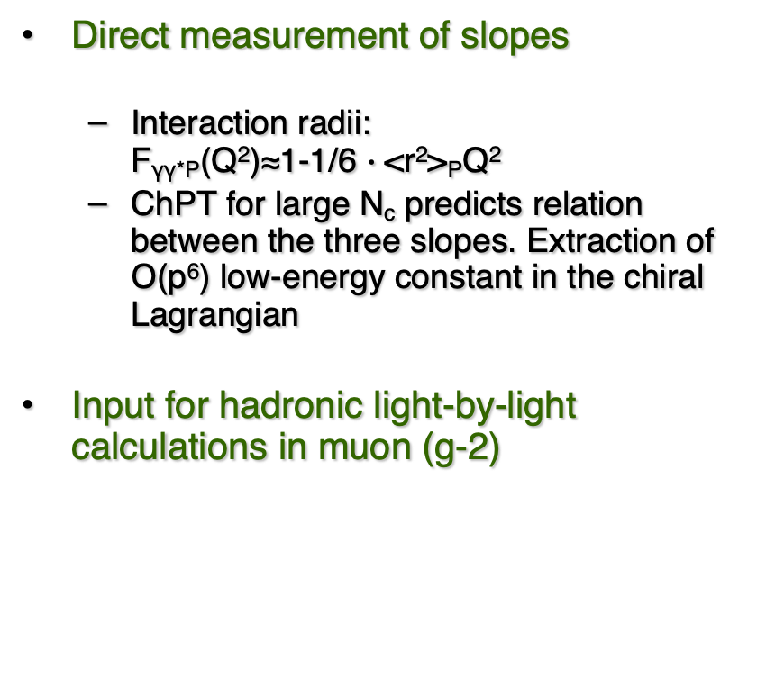
Space-Like Transition Form Factors
(Q² : 0.001-0.3 GeV²/c²)
Direct measurement of slopes
  Interaction radii:
  F_{γγ*P}(Q²)≈1-1/6 $∙$<r²>_{P}Q²
  ChPT for large N_{c} predicts relation between the three slopes. Extraction of Ο(p⁶) low-energy constant in the chiral Lagrangian
Input for hadronic light-by-light calculations in muon (g-2)
F(γγ*→ η)
No data
Phys.Rev.D65,073034
Eur.Phys.J. C75, 414 (2015)

Slide 21
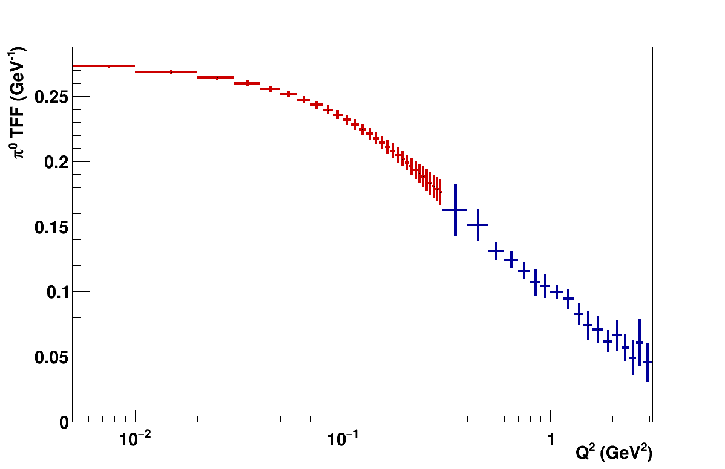

Space-Like Transition Form Factors
(Q² : 0.001-0.3 GeV²/c²)
Direct measurement of slopes
  Interaction radii:
  F_{γγ*P}(Q²)≈1-1/6 $∙$<r²>_{P}Q²
  ChPT for large N_{c} predicts relation between the three slopes. Extraction of Ο(p⁶) low-energy constant in the chiral Lagrangian
Input for hadronic light-by-light calculations in muon (g-2)
F(γγ*→ η)
Projected E12-22-003
on F(γγ*→ π⁰)
Phys.Rev.D65,073034

Slide 22
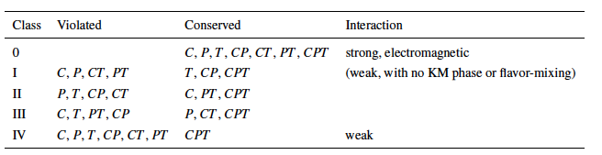
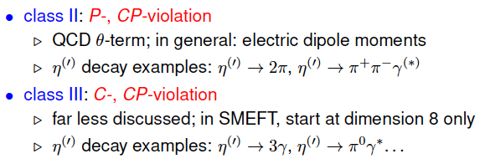
Discrete Symmetries
A new C- and T-violating, and P-conserving interaction was proposed by Bernstein, Feinberg and Lee Phys. Rev.,139, B1650 (1965) and Lee
Class III has much weaker experimental constraint, offer a opportunity for new physics search.

Slide 23
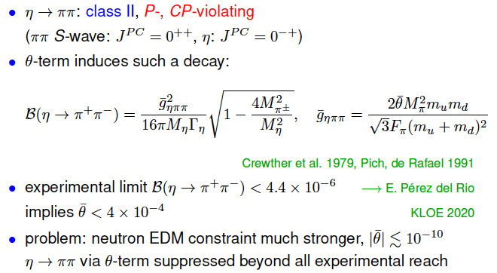
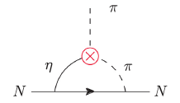

Class II: P-, CP-Violation in $η^{(′)}→ππ$

Slide 24


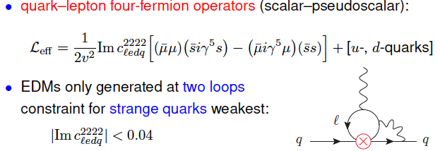
Class II: P-, CP-Violation via Strange-Quark-Muon Operators
Offer good opportunities for P-, CP-violation tests

Slide 25
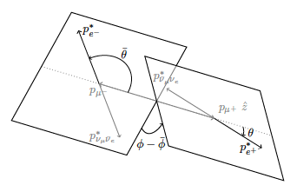

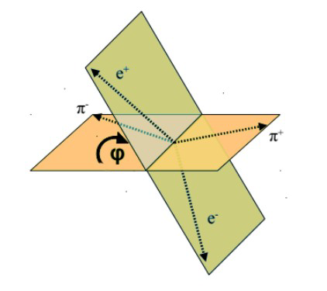
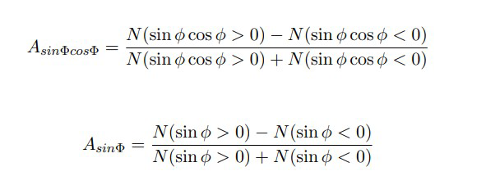



Class II: P-, CP-Violation via Scalar Operators (cont.)
$μ$-polarization asymmetry in $η^{(′)}→μ^{+}u^{−}$, $η^{(′)}→γμ^{+}u^{−}$, $η^{(′)}→π^{0}μ^{+}u^{−}$
JHEP 01, 031 (2019)
hep-ph/0202002
Angular asymmetry in decay planes:
$η^{(′)}→μ^{+}u^{−}e^{+}e^{−}$
$$η^{(′)}→π^{+}π^{−}e^{+}e^{−}$$

Slide 26
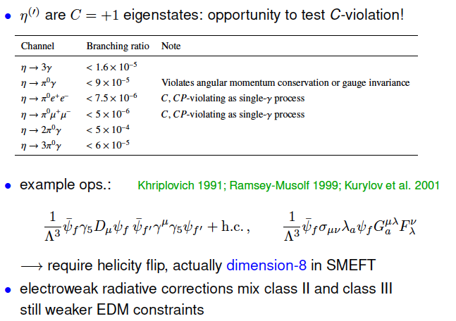
Class III: C- and CP-Violation

Slide 27

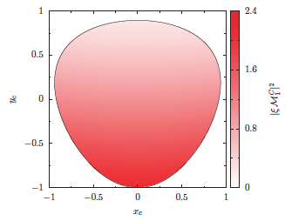
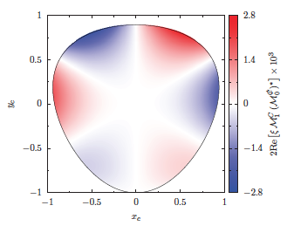
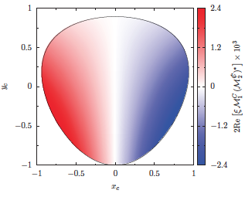
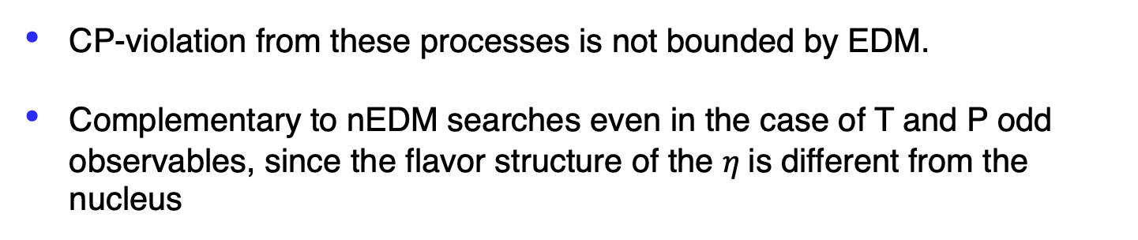
Class III: C- and CP-Violation in $η^{(′)}→π^{+}π^{−}π^{0}$, $η^{′}→π^{+}π^{−}η$
CP-violation from these processes is not bounded by EDM.
Complementary to nEDM searches even in the case of T and P odd observables, since the flavor structure of the $η$is different from the nucleus

Slide 28

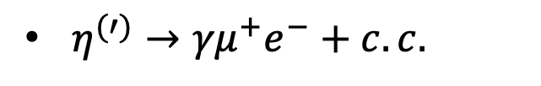
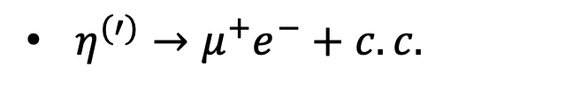
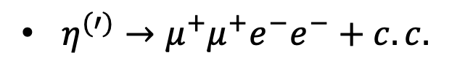
Lepton Flavor violations
$η^{(′)}→μ^{+}e^{−}+c.c.$
$η^{(′)}→{γμ}^{+}e^{−}+c.c.$
$η^{(′)}→{μ^{+}μ}^{+}e^{−}e^{−}+c.c.$
PDG limit:

Slide 29
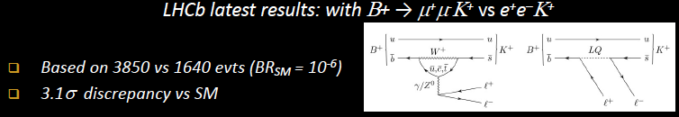
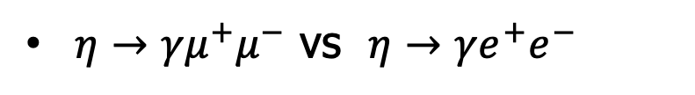
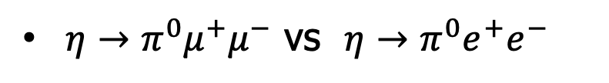
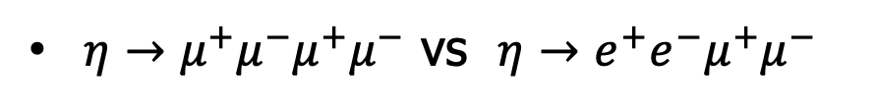
Lepton Universality Tests
$η→γ{μ^{+}μ}^{−}$ vs $η→γ{e^{+}e}^{−}$
$η→{{μ^{+}μ}^{−}μ^{+}μ}^{−}$ vs $η→{e^{+}e}^{−}{μ^{+}μ}^{−}$
$η→π^{0}{μ^{+}μ}^{−}$ vs $η→π^{0}{e^{+}e}^{−}$

Slide 30
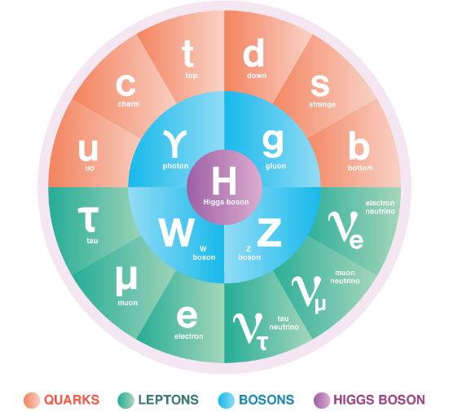
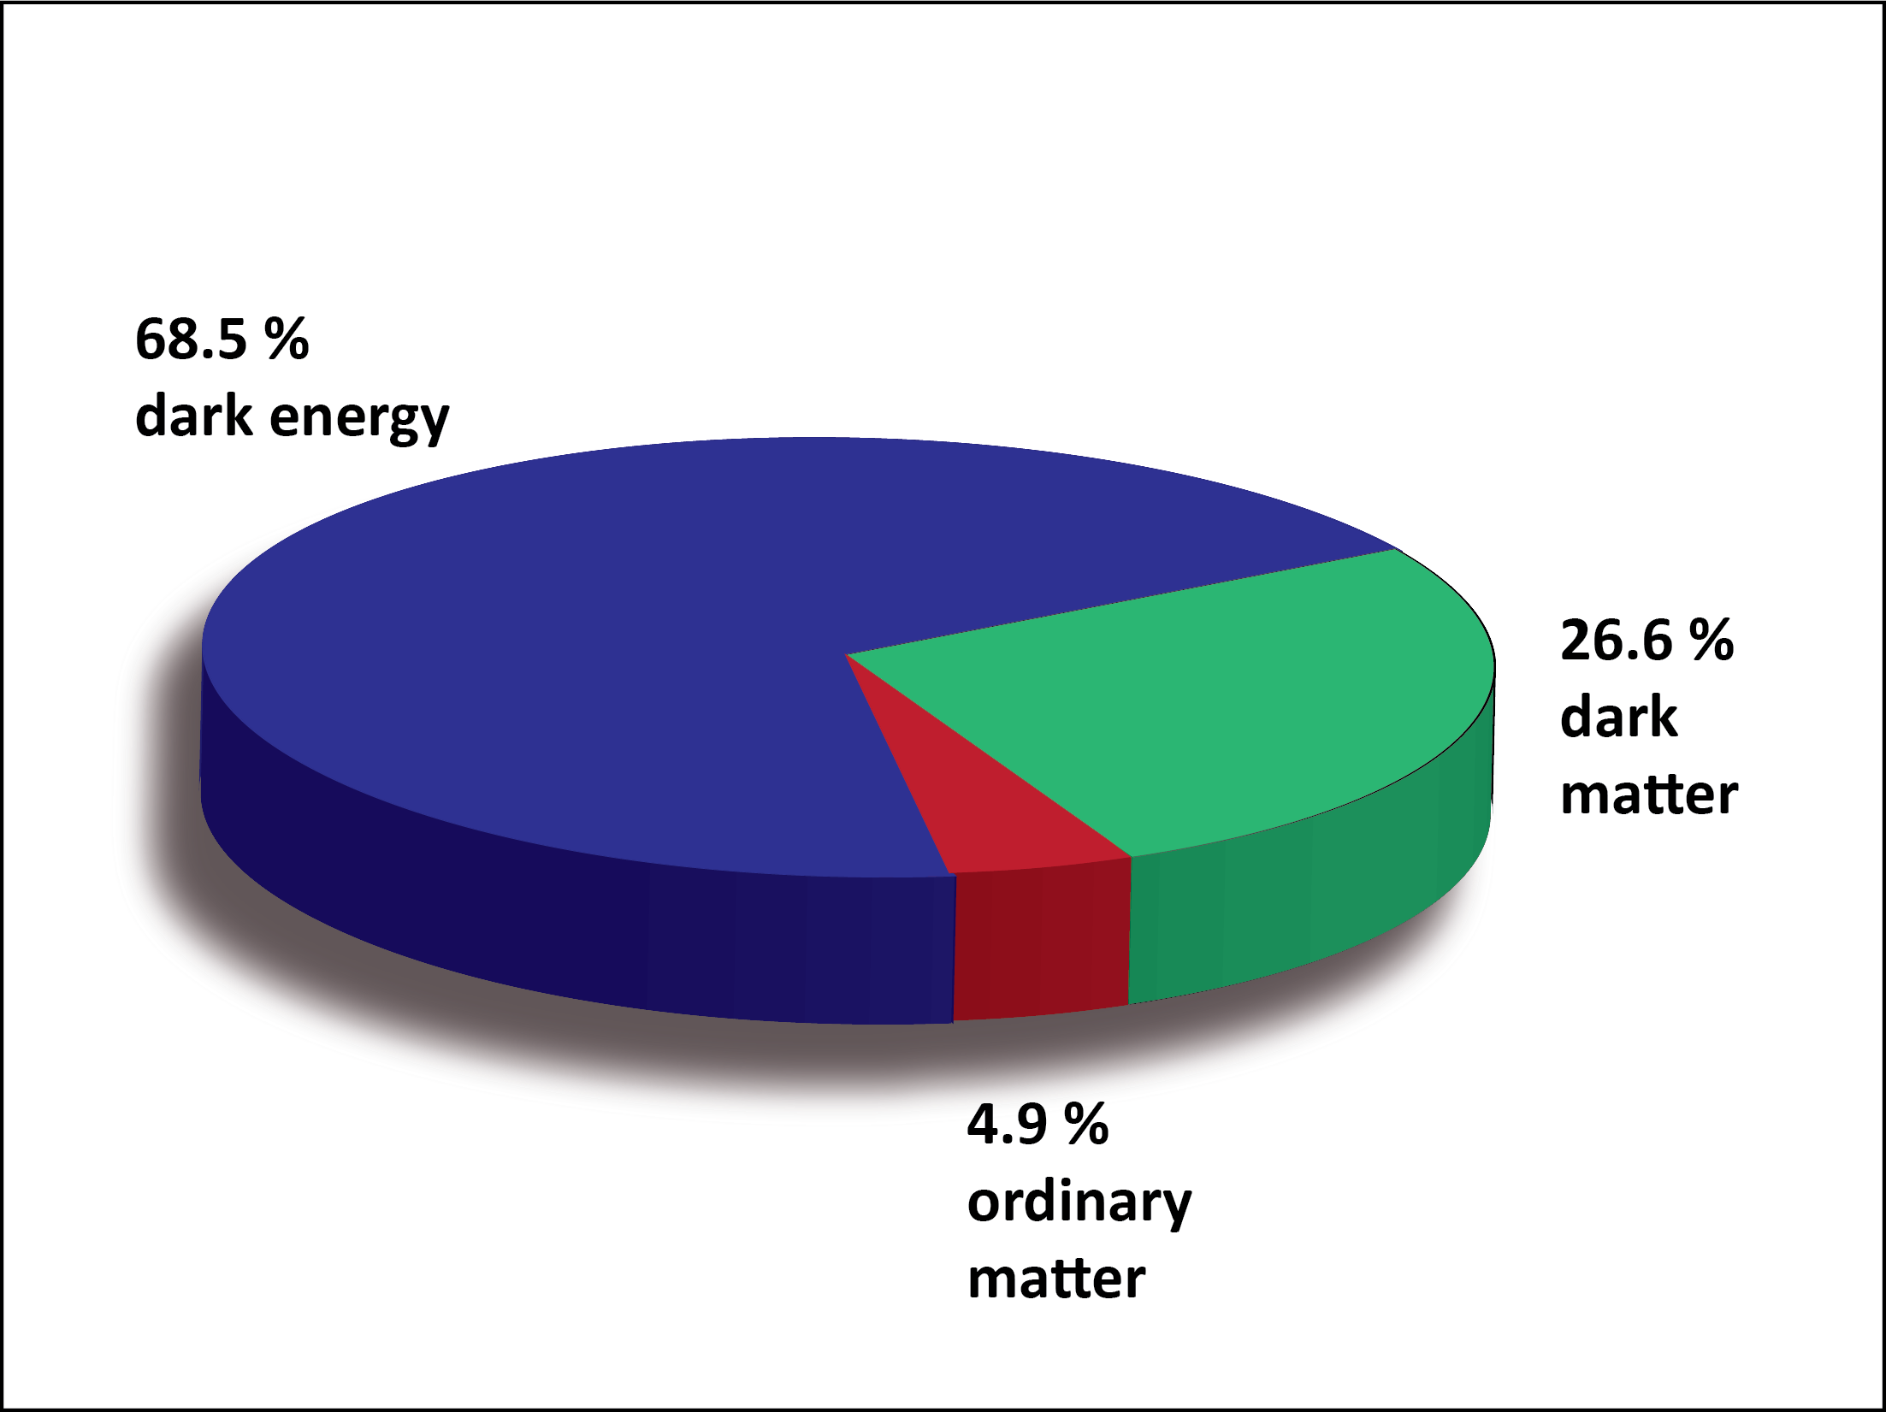
BSM Physics in Dark Sector
Open questions:
What is dark matter?
How is the matter-antimatter asymmetry generated?
What dynamics is responsible for neutrino masses?
What physics underlies the Higgs sector and sets the weak scale?
Why is CP conserved by the strong interactions?

Slide 31
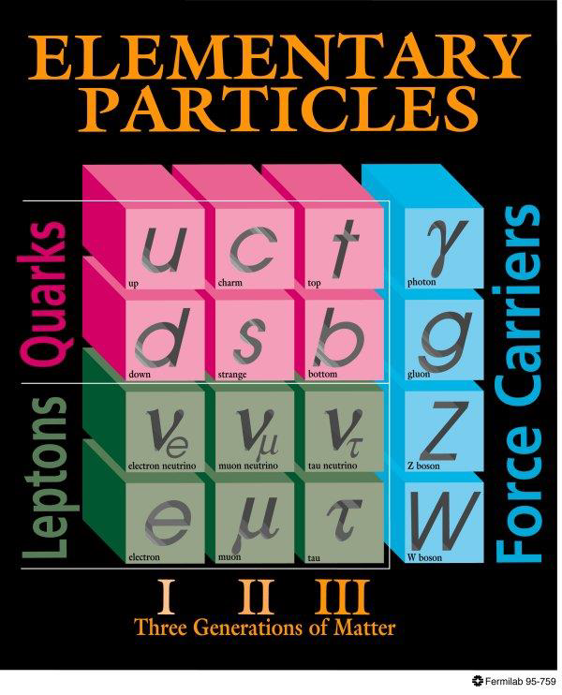
Motivation for New Physics
Dark Sector
New gauge forces, bosons and fermions beyond SM.
The stability of dark matter can be explained by the dark charge conservation.

Slide 32
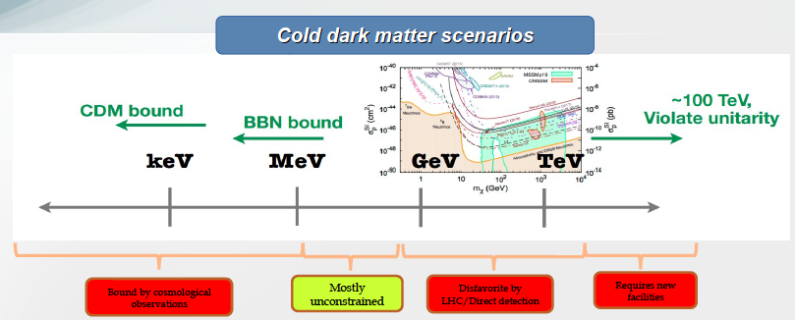
Where to Search for Dark Matter?
Sub-GeV region represents a good discovery opportunity

Slide 33
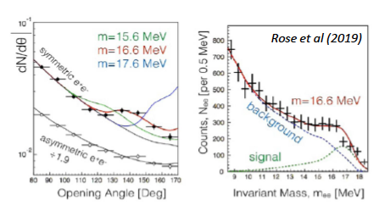
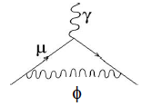

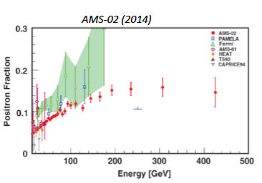
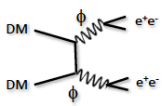




Motivation for sub-GeV New Physics
If these anomalies are interpreted in terms of new physics, all point to new forces with mediator particles in the MeV–GeV mass range!

Slide 34
Landscape of BSM Physics Search
arXiv:1504.04855
η/ηꞌ decays
Complementary to other types of experiments, η/ηꞌ decays offer unique sensitivity for sub-GeV new physics that are flavor-conserving, light quark-coupling, PC-conserving.

Slide 35




Portals Coupling SM and Dark Sector
Standard Model:
Dark Sector:
Gauge Interactions?
Dark matter?
Portals:
vector
Scalar
Fermion
ALP
Fermion: $η→π^{0}H,$
$with H→νN_{2}$, $N_{2}→h^{′}N_{1}$, $h^{′}→e^{+}e^{−}$
Phys. Rept. 945 (2022) 1-105, arXiv:2207.06905, arXiv:2203.07651

Slide 36





World Competition in η Decays
e⁺e⁻ Collider
New Experiments:
Proposed REDTOP
Fixed-target
hadroproduction
CBELSA/TAPS at ELSA
JEF at JLab
Photoproduction

Slide 37
JLab Eta Factory (JEF) Experiment
FCAL-II
Simultaneously produce η/ηꞌ on LH₂ target with 8.4-11.7 GeV tagged photon beam via γ+p → η/ηꞌ+p
Reduce non-coplanar backgrounds by detecting recoil protons with GlueX detector
Upgraded Forward Calorimeter with High resolution, high granularity
PWO insertion (FCAL-II) to detect multi-photons from the η/ηꞌ decays
The GlueX detector will detect the charged products from the η/ηꞌ decays
37

Slide 38

Uniqueness of JEF Experiment
Two-orders of magnitude background suppression comparing to all other experiments:
a) η/η’ energy boost; b) FCAL-II; c) exclusive detections
A2 at MAMI: γp→ηp (E_{γ}=1.5 GeV)
(P.R. C90, 025206)
JEF: γp→ηp (E_{γ}=8.4-11.7 GeV)
Signal+backgrounds
η→π⁰γγ signal
η →π⁰π⁰π⁰ background
other backgrounds
η →π⁰π⁰π⁰
other backgrounds
1 day’s running
2. Capability of running in parallel with GlueX and other experiments in Hall D
high-statistics data set
3. The only facility can simultaneously produce tagged η and ηꞌ with similar
rates (~5x10⁷ per 100 days)

Slide 39
Production Rate
JEF for 100 days of beam:
 | η | η’
Tagged mesons | 6.5x10⁷ | 4.9x10⁷
Previous Experiments:
Experiment | Total η | Total η’
CB at AGS | 10⁷ | -
CB MAMI-B | 2x10⁷ | -
CB MAMI-C | 6x10⁷ | 10⁶
WASA-COSY | ~3x10⁷ (p+d), ~5x10⁸ (p+p) | -
KLOE-II | 3x10⁸ | 5x10⁵
BESIII | ~10⁷ | ~5x10⁷
JEF offers a competitive η/η’ production rate with much cleaner backgrounds

Slide 40








Main JEF Physics Objectives
1. Search for sub-GeV hidden bosons
vector:
    Leptophobic vector B ꞌ
    Hidden or dark photon:
scalar S:
Axion-Like Particles (ALP):
2. Directly constrain CVPC new physics:
3. Precision tests of low-energy QCD:
  Interplay of VMD & scalar dynamics in ChPT:
  Transition Form Factors of η⁽ꞌ⁾ :
4. Improve the quark mass ratio via Dalitz distributions of η→3π
$$η^{(′)}→3γ,{ η}^{(′)}→2π^{0}γ,{ η}^{(′)}→π^{+}π^{−}π^{0}$$

Slide 41


A Key Channel: η→π⁰γγ
Phys. Rept. 945 (2022) 1-105
Search for sub-GeV gauge bosons
  A leptophobic vector B^{ꞌ}:
  η→γ B^{ꞌ}, B^{ꞌ} →π⁰γ
  An scalar S:
  η→π⁰S, S→γγ
A 100 keV-100 MeV
electrophobic scalar can
solve proton radius and
(g-2)_{μ} puzzles.
PR,D100,095020; Nucl.Phy.B,114638.
PL, B221, 80
PR,D89,114008
100 days’ beam
100 days’ beam
A rare window to probe interplay of VMD & scalar resonance in ChPT
PR,C78,015206

Slide 42

Test Charge Conjugation Invariance
C Violating η neutral decays
Mode | Branching Ratio (upper limit) | No. γ’s
3γ | < 1.6•10⁻⁵ | 3
π⁰γ | < 9•10⁻⁵
2π⁰γ | < 5•10⁻⁴ | 5
3γπ⁰ | Nothing published
3π⁰γ | < 6•10⁻⁵ | 7
3γ2π⁰ | Nothing published
C is maximally violated in the weak force and is well tested.
Assumed in SM for electromagnetic and strong forces, but it is not experimentally well tested
(current direct constraint: $Λ≥1$ GeV)

Slide 43

Experimental Improvement on C-violating η→3γ
SM contribution:
BR(η→3γ) <10⁻¹⁹ via P-violating
weak interaction.
A calculation due to new
physics by Tarasov suggests:
BR(η→3γ)< 10⁻²
Sov.J.Nucl.Phys.,5,445 (1967)
Proj. JEF
(100 days’ beam)
Improve BR upper limit by one order of magnitude to directly tighten the constraint on CVPC new physics

Slide 44

Improve Quark-Mass Ratio via 𝜂→3π Dalitz Distributions
  A clean probe for quark mass ratio:
    decays through isospin violation:
    is small
    Amplitude:
  Uncertainties in quark mass ratio
$$A(s,t,u)=\frac{1}{Q^{2}}\frac{m_{K}^{2}}{m_{π}^{2}}(m_{π}^{2}−m_{K}^{2})\frac{M(s,t,u)}{3\sqrt{3}F_{π}^{2}}$$
Phys. Rept. 945 (2022) 1-105

Slide 45



Current Status of the JEF Experiment
Non-rare decay data has been collecting with the GlueX spectroscope experiment since 2016.
A PWO insert to upgrade FCAL is under construction.:
  Mass production of 1600 PWO modules is on-going.
  Engineering design for calorimeter frame is finalized.
  Installation of the PWO insert is scheduled for 2023.
PWO module
Undergraduate workforce
(2x2x20 cm³)
  Rare decay data with FCAL-II is expected in 2024.

Slide 46

A New Proposal: REDTOP
up to ~5x0¹³ η per year!
arXiv:2203.07651

Slide 47

REDTOP Detector
JEF may still lead in rare neutral decays
REDTOP will have the best sensitivity for rare charged modes.

Slide 48

arXiv:2203.07651

Slide 49


Slide 50


Slide 51


Slide 52


Slide 53
Summary
The η/η’ decays offer sensitive probes for SM tests and BSM physics searches.
  Precision tests of SM: chiral anomaly test, the role of scalar dynamics in ChPT; transition form factors of η/η’ to calculate HLbL contributions in (g-2)_{μ} ; improve the light quark mass ratio and the η-η’ mixing angle
  Test fundamental symmetries: search for new sources of CP violations
  Search for sub-GeV hidden forces and hidden particles: vector, scalar, fermion and ALP portals.
Experimental perspectives:
  Precision frontier (highly suppressed backgrounds): the JLab Primakoff experimental program and the JEF experiment.
  High intensity frontier (up to ~5x10¹³ η per year): REDTOP
A global experimental efforts at different facilities will offer opportunities for discoveries in the η sector.
Thanks for support by NSF PHY-1812396 and PHY-2111181

