Slide 1
Generating Configurations: A brief introduction
王伟
上海交通大学

Slide 2
Outline
Path Integral
“Correct” configurations
Metropolis and HMC
Implementation of HMC in chroma
Hands-on
Reference: 1.格点量子色动力学导论
2. Wei Sun,“Introduction to HMC with Chroma”

Slide 3
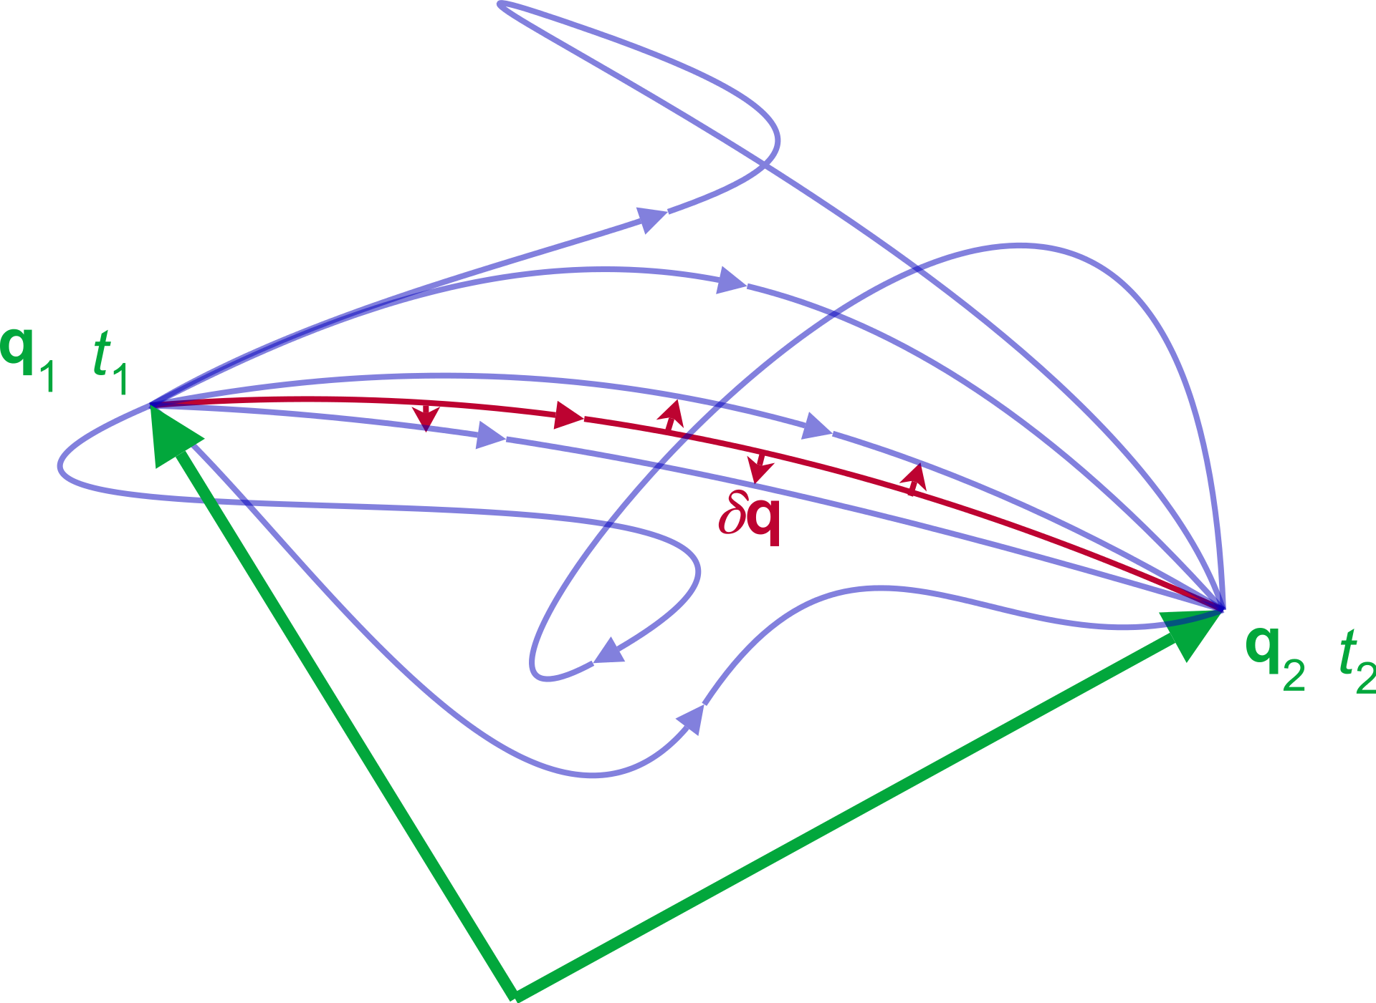
Path Integral Again
S
Classical mechanics

Slide 4
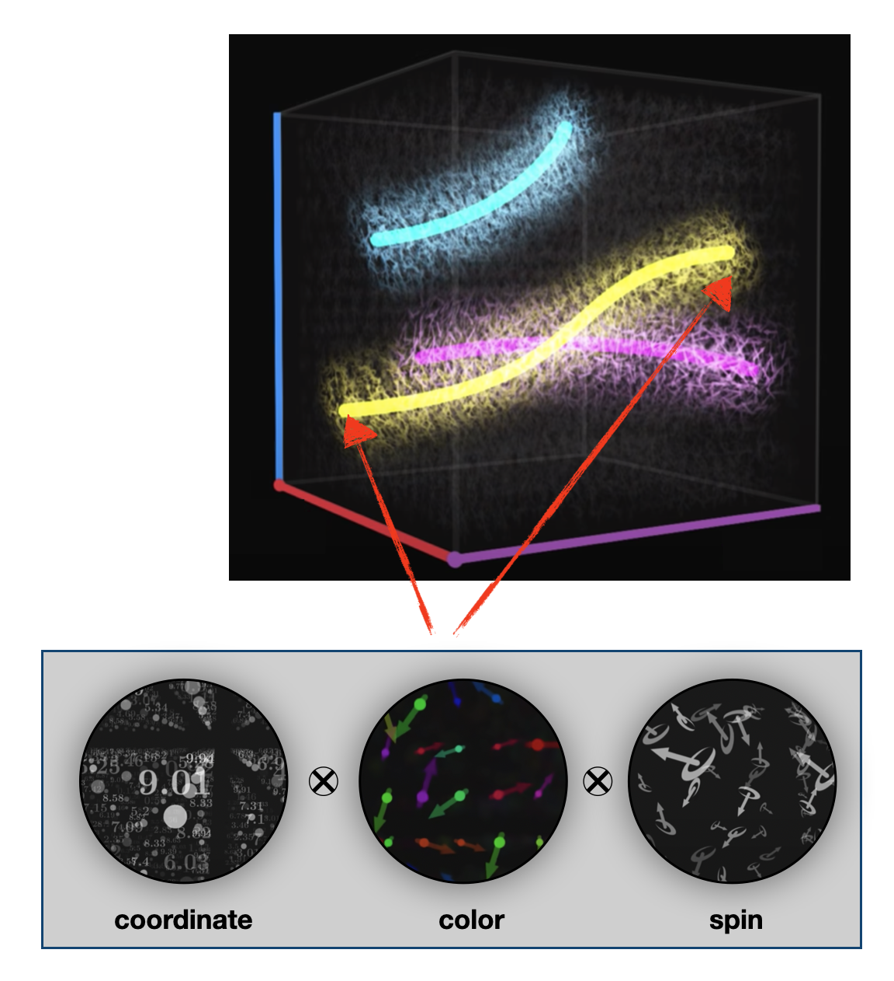
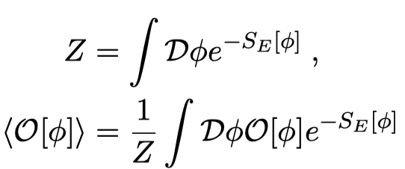
Path and Configuration
Configuration: {ϕ_{x} , x ∈ Λ}

Slide 5
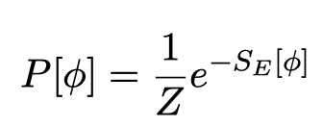
“Correct” Configurations
Brutal force Discretization: 10⁴格点，加法: 2^(10⁴)~ 10^(3×10³)
Monte Carlo: importance Sampling
玻尔兹曼分布:

Slide 6
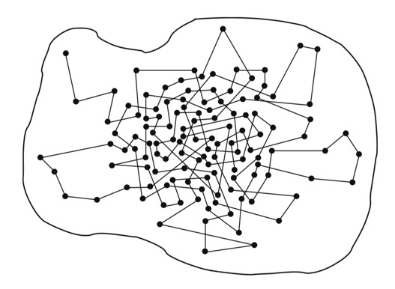
Generate the Configurations
How do we find the configurations following the desired distribution $P\left(x\right)$ ?
Markov chains
$$φ^{(0)}⟶φ^{(1)}⟶φ^{(2)}⟶⋯⋯$$

Slide 7
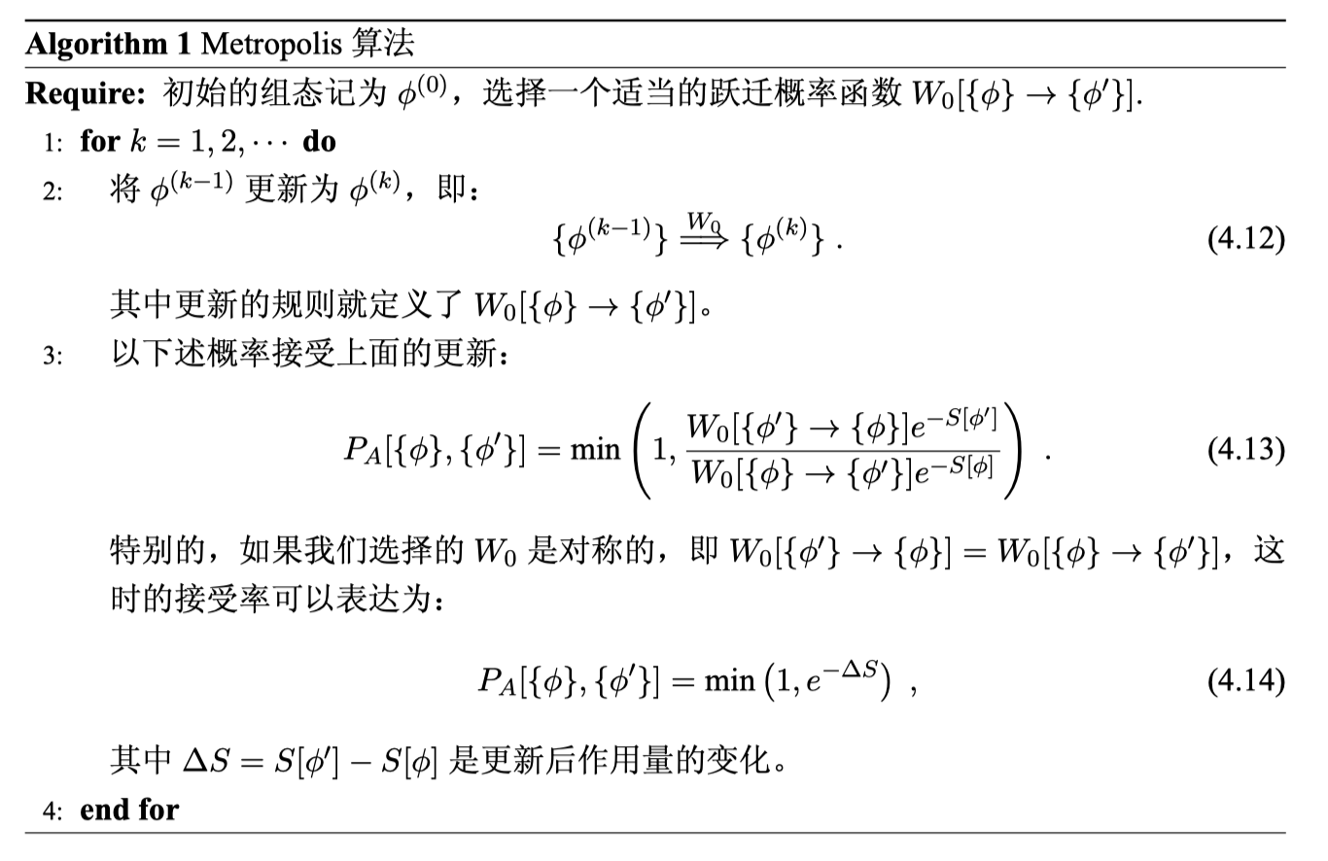
Generate the Configurations: Metropolis

Slide 8
Generate the Configurations: HMC
分子动力学(Molecular dynamics Algorithm) /杂化算法(Hybrid Algorithm)

Slide 9
Generate the Configurations: HMC
蛙跳积分法(leapfrog integration)

Slide 10
Generate the Configurations: HMC
Hybrid Monte Carlo

Slide 11
Implementation of HMC in Chroma

Slide 12
Implementation of HMC in Chroma

Slide 13
Implementation of HMC in Chroma

Slide 14
Hands-on of HMC
install chroma (GPU), skip
Make your source code, skip
cp –r /dssg/home/acct-phyhfei/phyhfei-user3/work/two_flavor .
ls
bash clear.sh

Slide 15
Hands-on of HMC
sbatch hmc.sh and wait for sometime (check the status with squeue) until it shows:
Configurations: dummy_run_cfg_xxx.lime
How and Why?

Slide 16
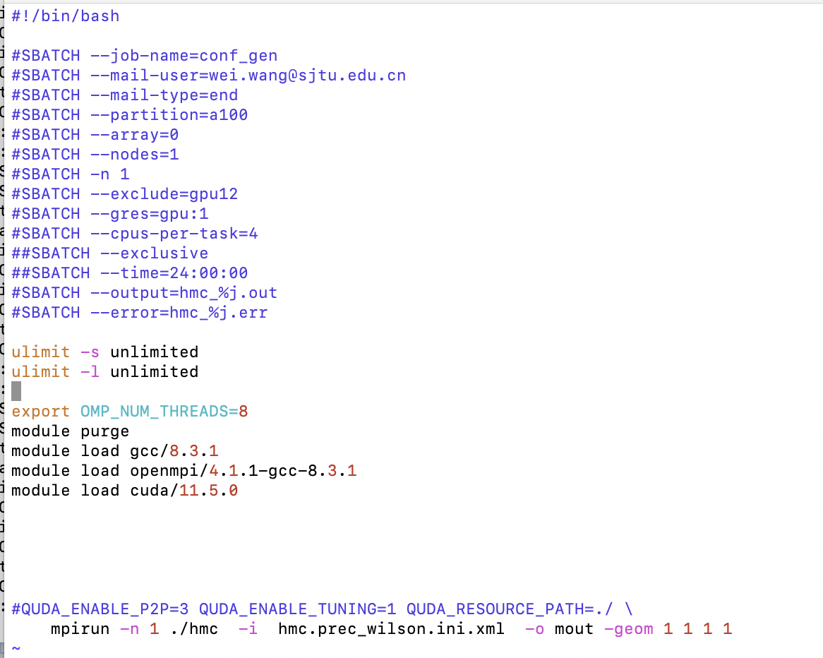
Hands-on of HMC
Hmc.sh
常规操作
hmc读入产生

Slide 17
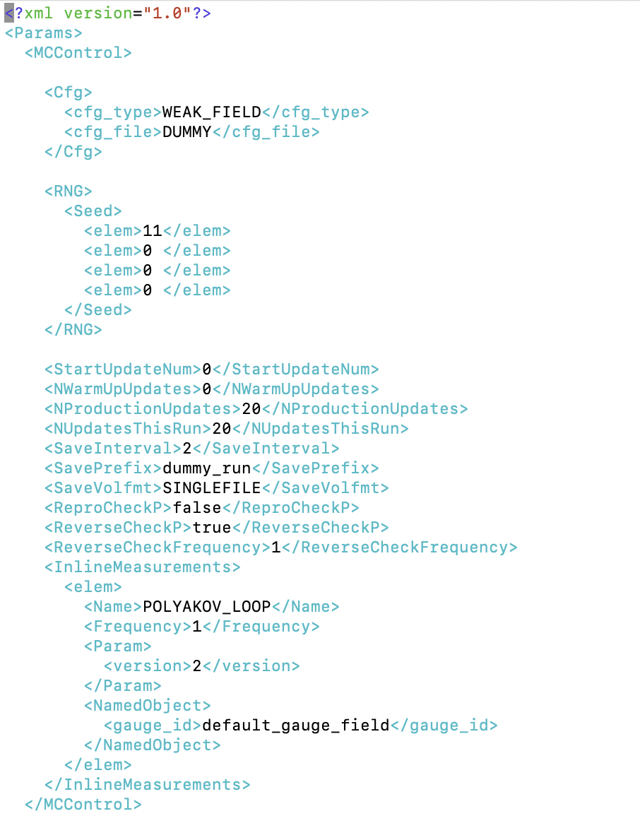
Hands-on of HMC
hmc.prec_wilson.ini.xml

Slide 18
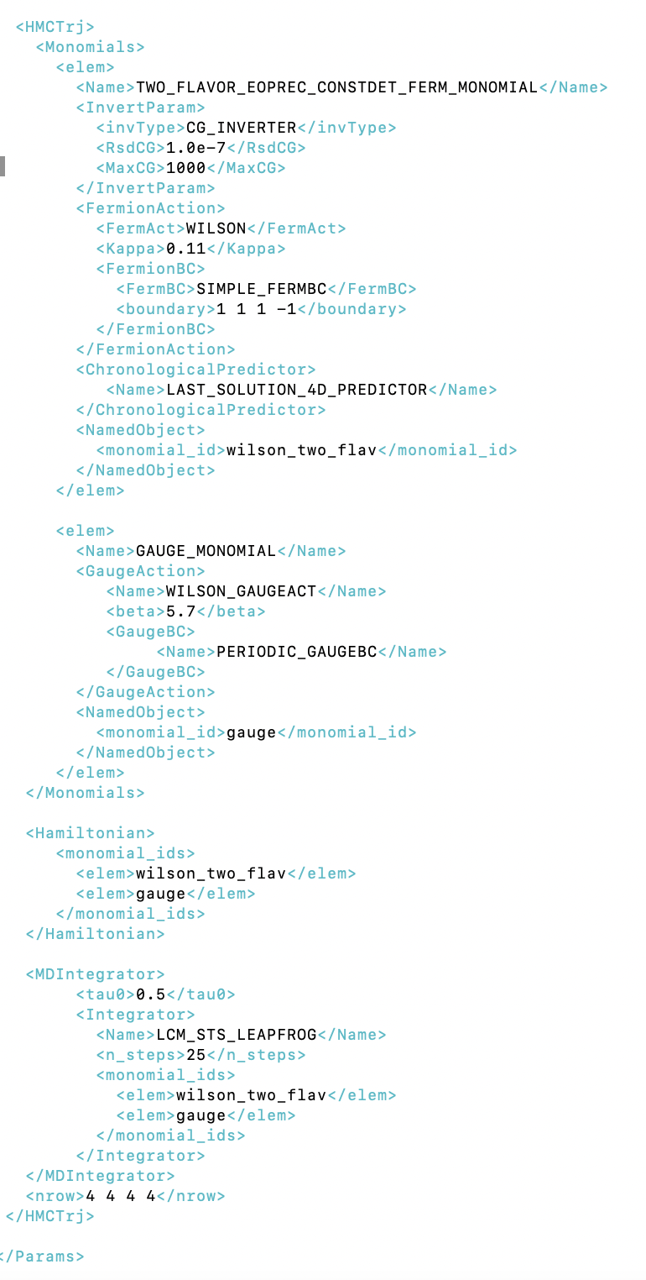
Hands-on of HMC
hmc.prec_wilson.ini.xml

Slide 19
Hands-on of HMC
Homework
Generate a few (10) configurations by your own
What is the type, size of this configuration?
What other information can you find, and what is the meaning?
How to continuously generate the confs?（Hint: dummy_run_restart_2.xml)
How to use this configuration to calculate the physical quantities, e.g. hadron mass? ***
Modify the parameters and see what you can find.
Your accounts at Siyuan will be cleared by 24:00 28th August, please:
back up all your belongings.
in case you still want to use it for some time, please contact me in private.

Slide 20
See you in future!

Slide 21
Backup

Slide 22
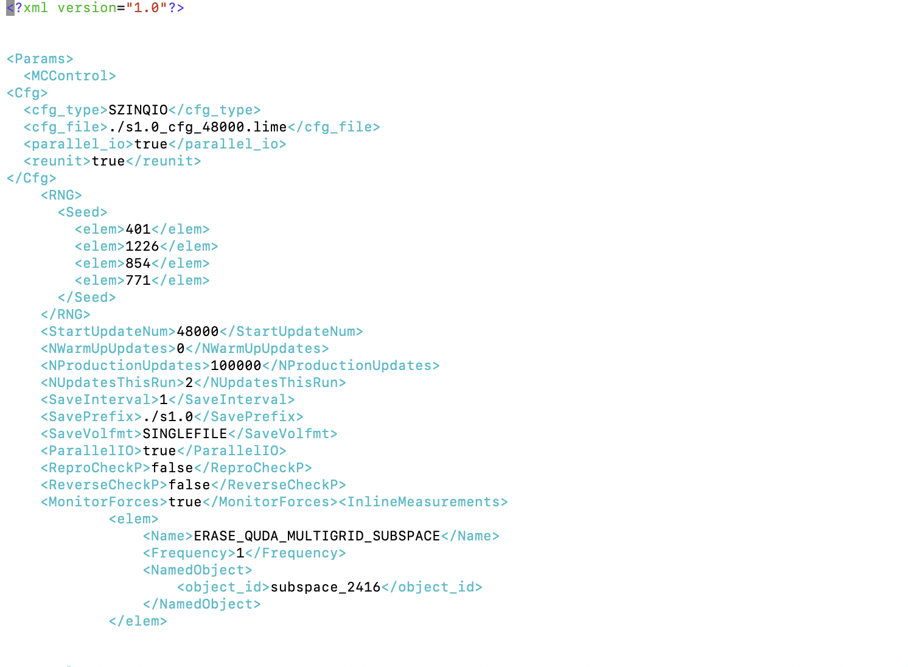
Hands on examples of HMC
Code path: /dssg/home/acct-phyhfei/phyhfei-user3/work/mass_2770_2400_u0_24_72_5nd3
XML

