Slide 1
质子和Pion介子分布函数的对立统一
Lei Chang(常雷)
leichang@nankai.edu.cn
Nankai University
Proton and pion distribution functions in counterpoint, arXiv: 2203.00753(PLB)
Parton distributions of light quarks and antiquarks in the proton, arXiv:2201.07870(PLB)
Emergence of pion parton distribution, arXiv:2201.00884(PRD/Letter)
强子物理在线论坛（第48届）
2022/05/13，线上

Slide 2
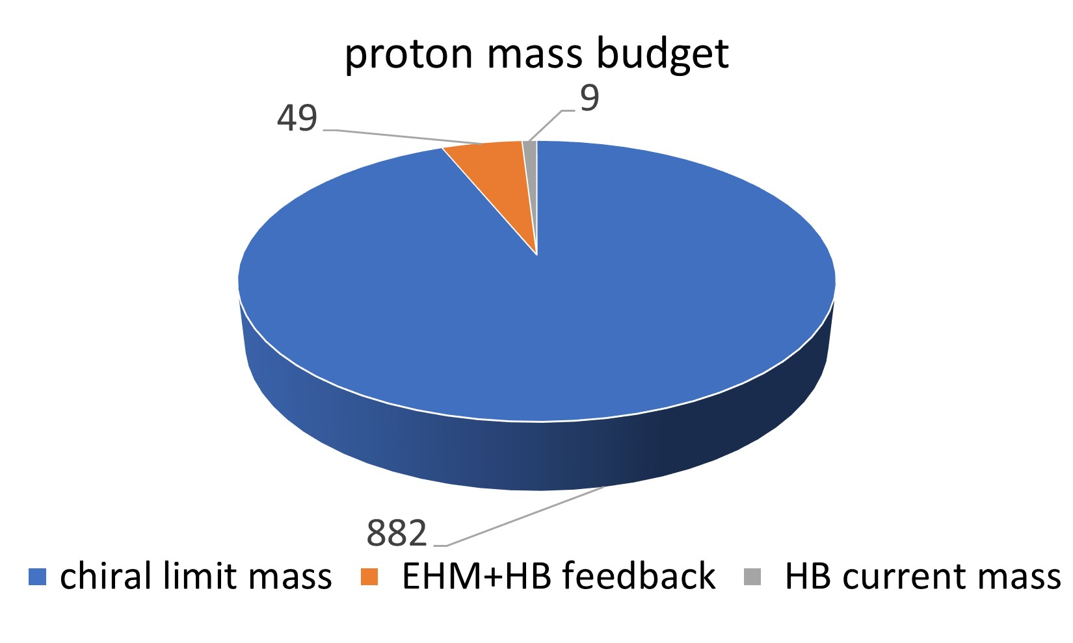
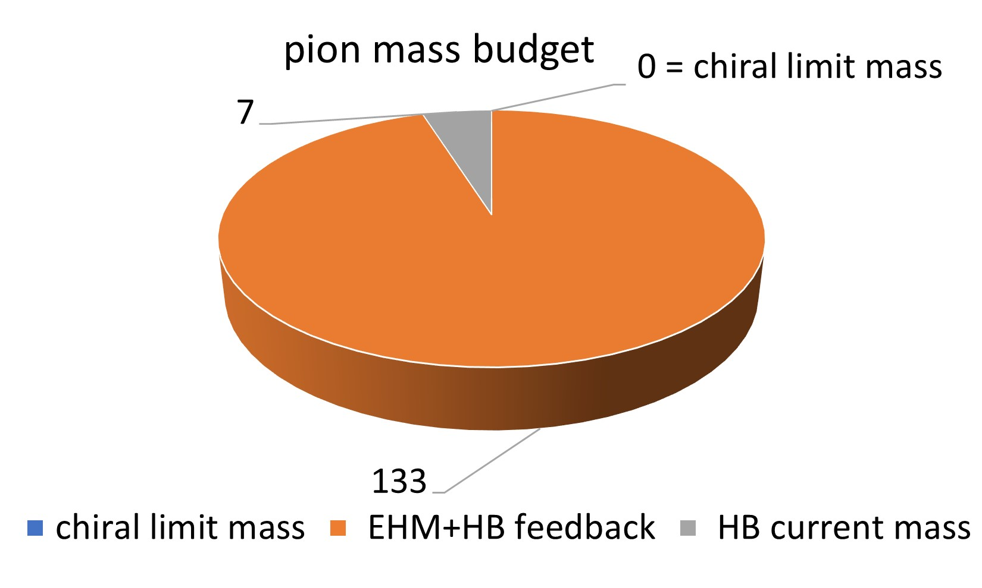
Mass budget
Insights into the emergence of mass from studies of pion and kaon structure, PPNP 120 (2021) 103883
chiral limit mass: absence of Higgs coupling
HB current mass: Higgs-boson effects
EHM+HB feed back: interference between emergent hadronic mass and HB current mass
Absence of Higgs(in the chiral limit)
A very large fraction of the measured proton mass emerges as a consequence of the trace anomaly…by glue and the interactions between them;
Pion mass is ZERO(NG mode associated with DCSB)
Restoring Higgs boson couplings
Sum of hadron’s valence-quark current masses……..0.01 m_{p}
Interference………………quark condensates☺
5% for proton 95% for pion
1

Slide 3
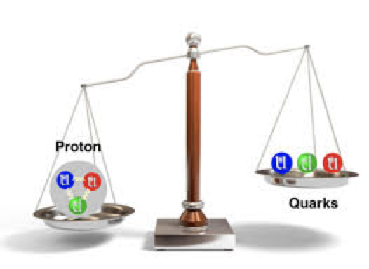
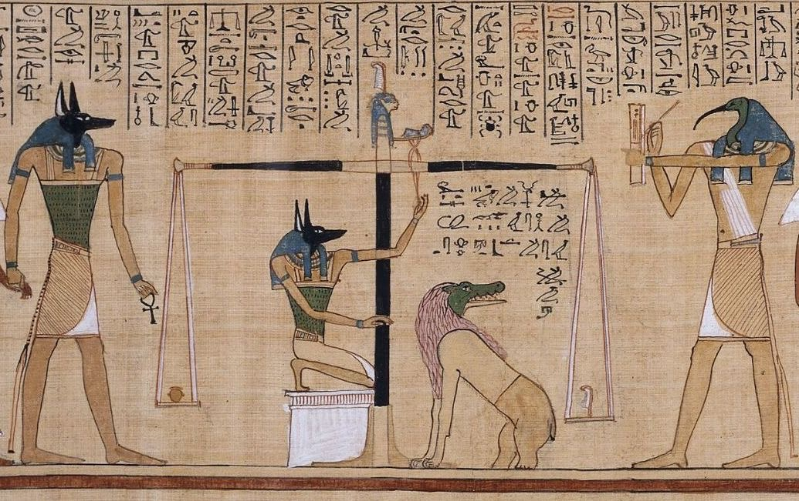
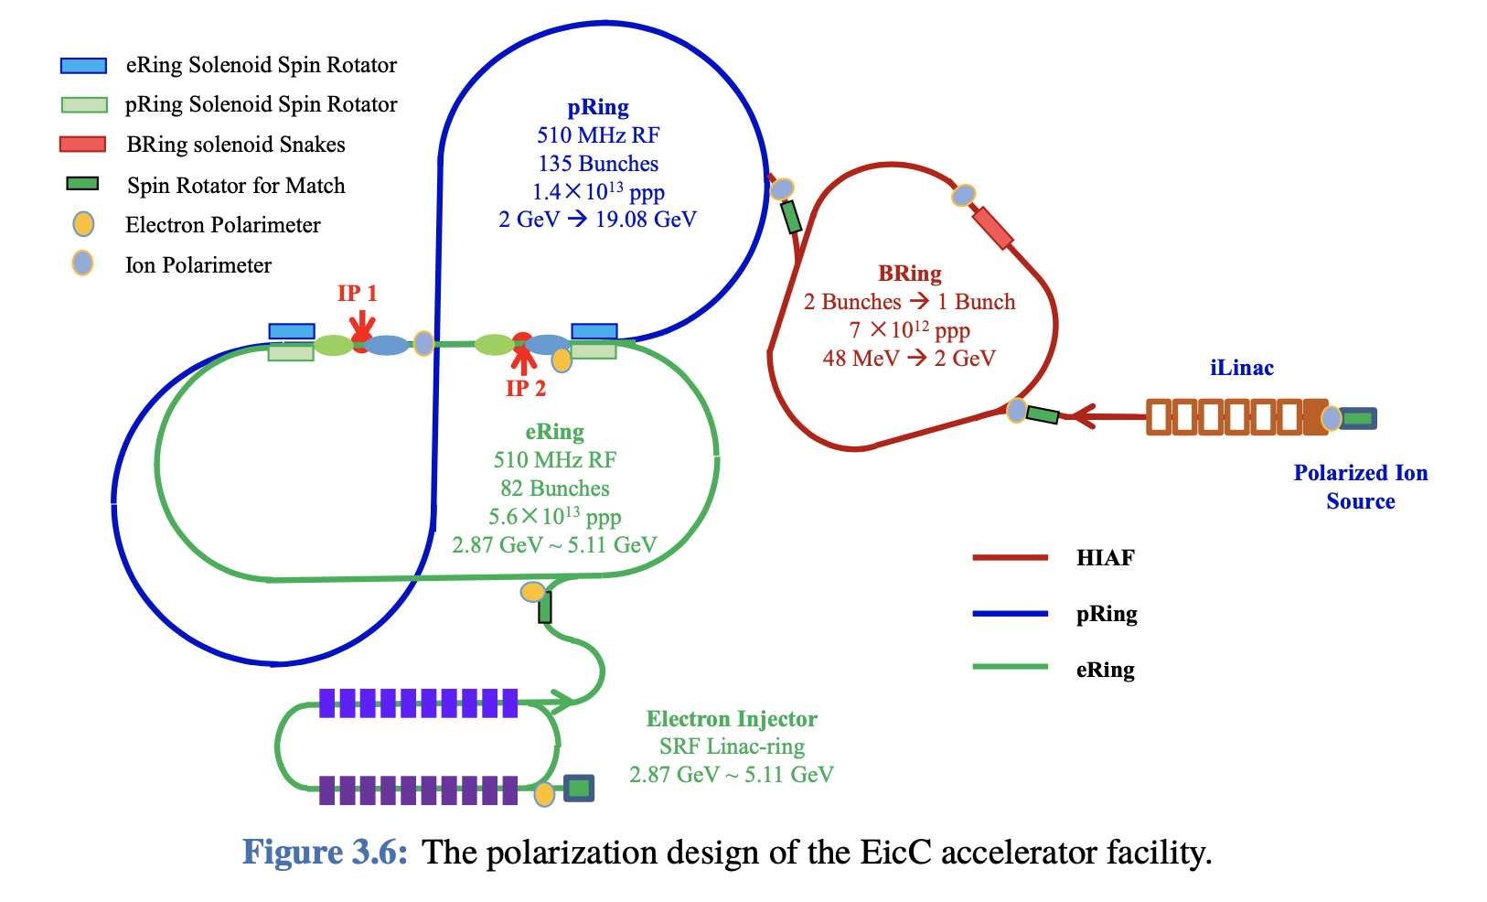
Mass puzzle
“How does the mass of the proton arise?”
Confinement: no gluon or quark has been seen to propagate over a length scale which exceeds the proton radius…influence of emergent mass
Pion/Kaon Proton distribution amplitudes
electromagentic form factors
structure functions
On the same footing
2

Slide 4

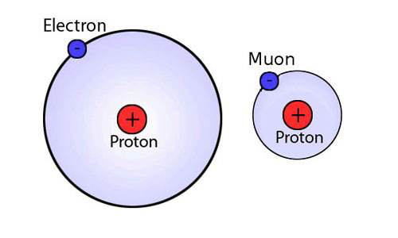
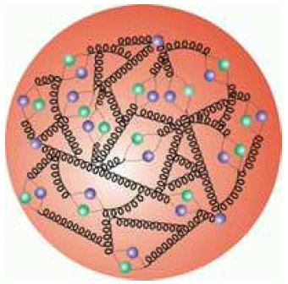
Describe quark-antiquark bound-state
Trace anomaly
All renormalisable four-dimensional theories possess a trace anomaly;
The size of the trace anomaly in QED must be great deal smaller than that in QCD.
QED
QCD
Field theory Successful:
Nonrelativistic quantum mechanics to handle bound state;
Perturbation theory to handle relativistic effects
Field theory not Successful yet:
Growth of the running coupling constant in the infrared region;
Confinement;
Dynamical Chiral Symmetry Breaking;
Possible nontrivial vacuum structure in hadron
3

Slide 5
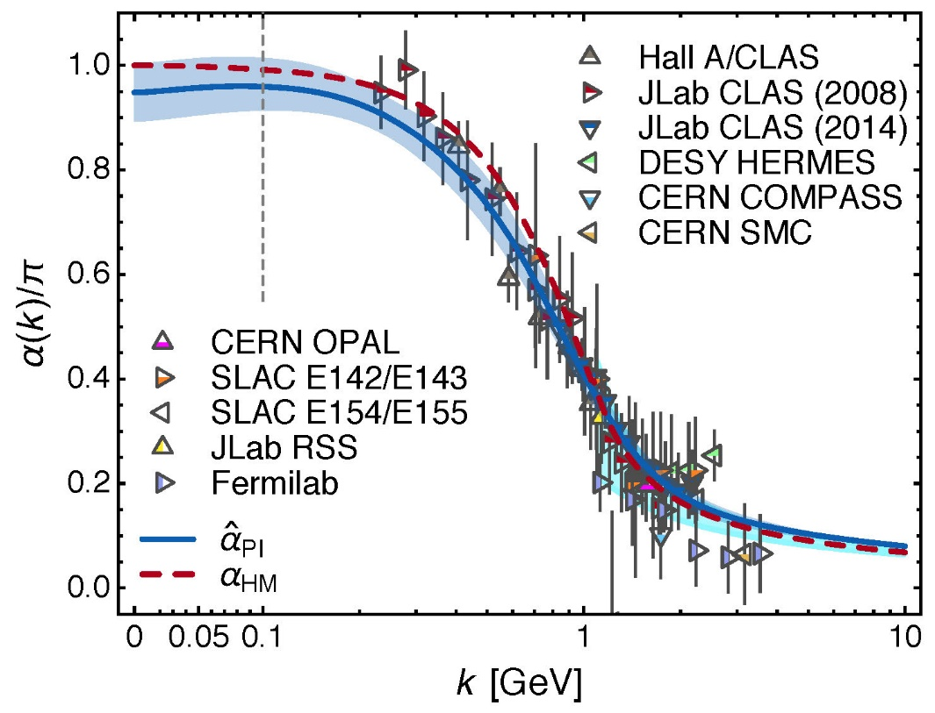
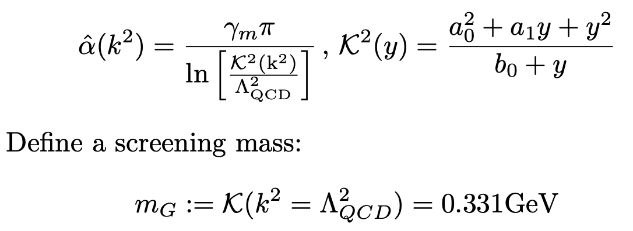
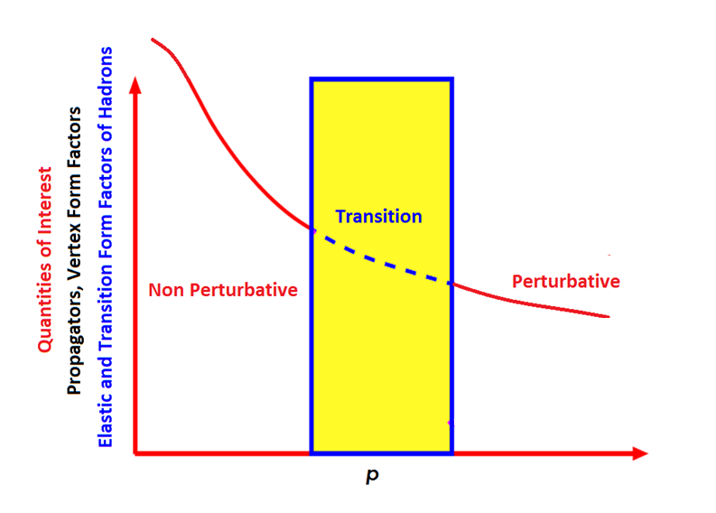
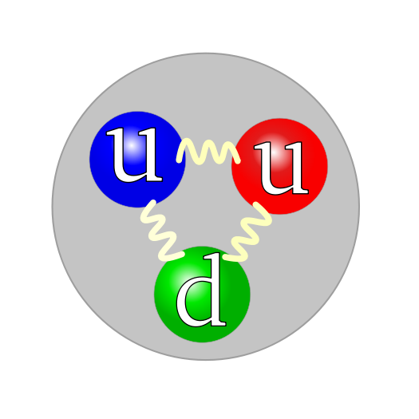
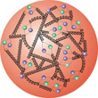
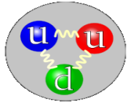
PI running coupling of QCD
The running coupling alters at m_{G} so that modes with k²<m² are screened from interactions and theory enters a practically conformal domain.
Gluon/Quarks progressivley become more sorphisticated as experience grew with formulating and solving the quark gap equation and as computational methods and power improved for lattcie-regularised QCD.
4

Slide 6

Imagine the Hadron at the Hadronic Scale
Evolution
$$m_{G}=0.331GeV‼!$$
5

Slide 7

Imagine the Hadron at the Hadronic Scale
Evolution
$$m_{G}=0.331GeV‼!$$
6

Slide 8
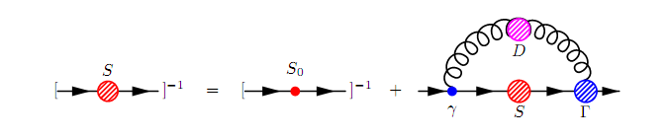
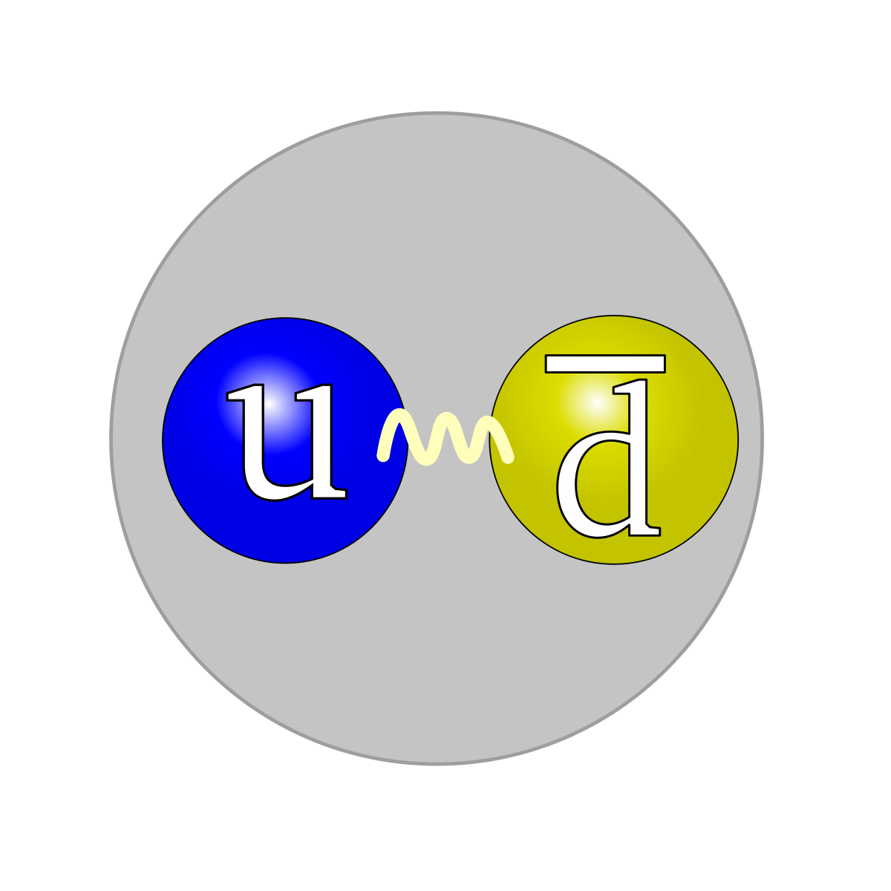
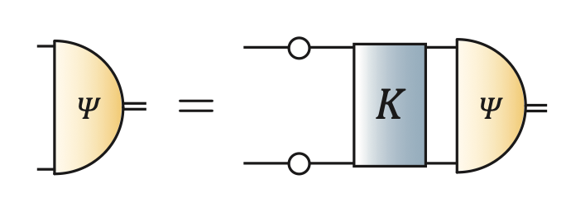
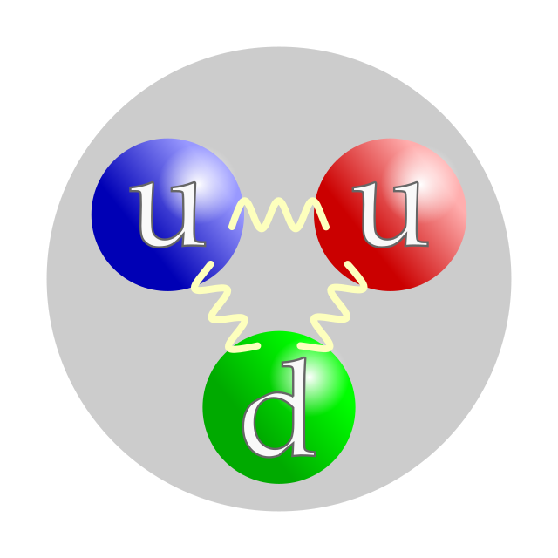
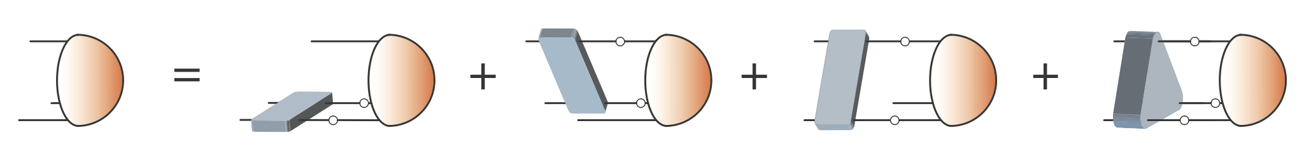
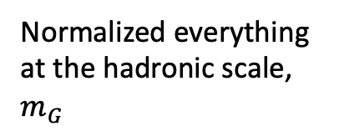
Imagine the Hadron at the Hadronic Scale
Normalized everything at the hadronic scale, $m_{G}$
Continuum Schwinger function Method
7

Slide 9
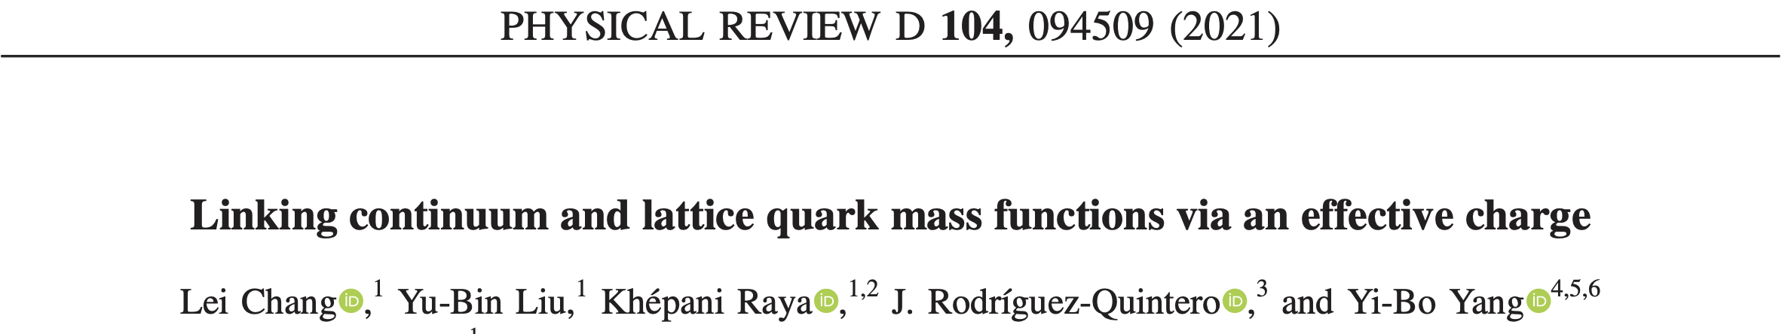
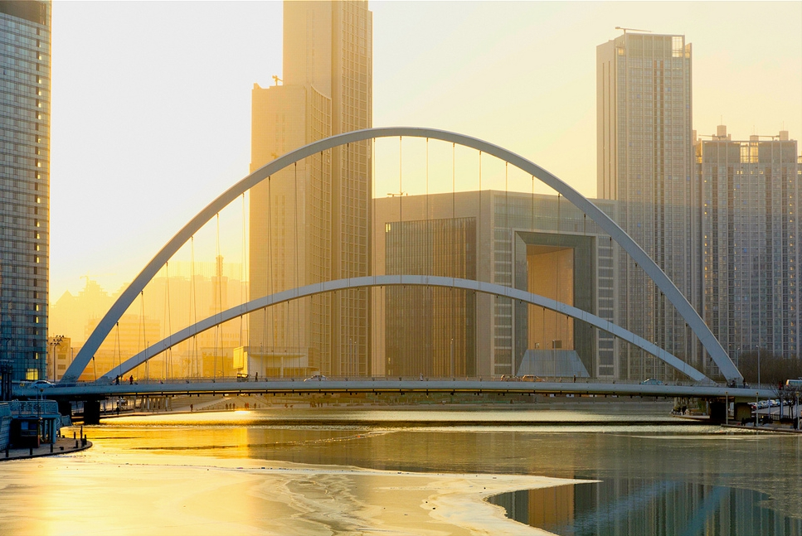
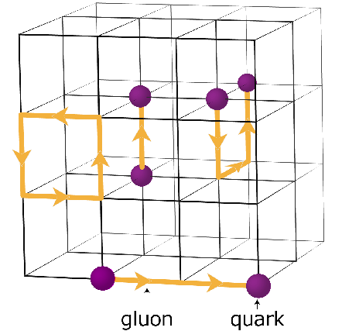
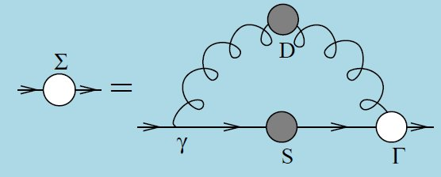
Quark Mass ___ Dynamical Chiral Symmetry Breaking
8

Slide 10
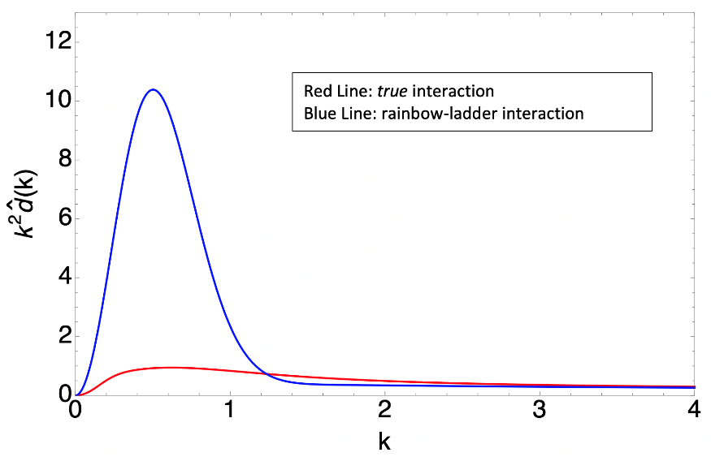
Quark Mass ___ Dynamical Chiral Symmetry Breaking
Linking continuum and lattice quark mass functions via an effective charge, LC, et al., PRD104(2021)094509
Rainbow-Ladder: input strong interaction by hand
vs
DSEs meeting lQCD!
Current quark mass evolution of MASS
One parameter!
Mass scale introduced by PI coupling
Trigger quark mass
DCSB enhance quark-gluon coupling
9

Slide 11


“Constituent” quarks
$${M_{0}≈m}_{G}$$
In the chiral limit, the perturbative massless quark obtain a large infrared mass through the interactions of gluon;
M₀ is about m_{p}/3 and runs as a logarithm-corrected 1/k² power-law in the ultraviolet region;
The strong interaction of a quark with its (gluon) surrounding gives rise to a “constituent” quark with effective mass M₀;
This consistuent quark has the finite size(B. Povh and J. Hufner, PLB245(1990)653) and finite magnetic moment;
10

Slide 12
Describe bound-state(incomplete. example)
A relativistic equation for Bound-State problem
Salpeter and Bethe, PR84(1951)1232
Sketching the Bethe-Salpeter kernel
Chang and Roberts, PRL103(2009)081601
Munczek, PRD52(1995)4736
Yuan-Ben Dai, et al, PRD43(1991)1717
1951
1974/1976
1991
1995
1998
2009
……
Lane, PRD10(1974)2605
Politzer, NPB117(1976)397; Pagels…
Pion mass and decay constant
Maris, Roberts and Tandy, PLB420(1998)267
L.D.Faddeev, Sov. Phys. JETP12, 1014(1961)
G. Eichmann
Si-xue Qin
1961
2009
2018
......Quark-Diquark Model of the Nucleon(many many papers)……
11

Slide 13

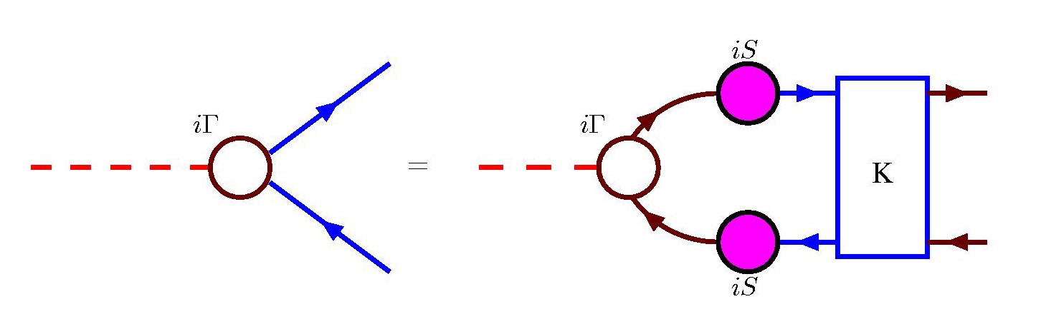

Describe bound-state(incomplete. example)
A relativistic equation for Bound-State problem
Salpeter and Bethe, PR84(1951)1232
Sketching the Bethe-Salpeter kernel
Chang and Roberts, PRL103(2009)081601
Munczek, PRD52(1995)4736
Yuan-Ben Dai, et al, PRD43(1991)1717
1951
1974/1976
1991
1995
1998
2009
……
Lane, PRD10(1974)2605
Politzer, NPB117(1976)397; Pagels…
Pion mass and decay constant
Maris, Roberts and Tandy, PLB420(1998)267
from QCD
$$𝒦=\frac{δΣ}{δS}$$
12

Slide 14
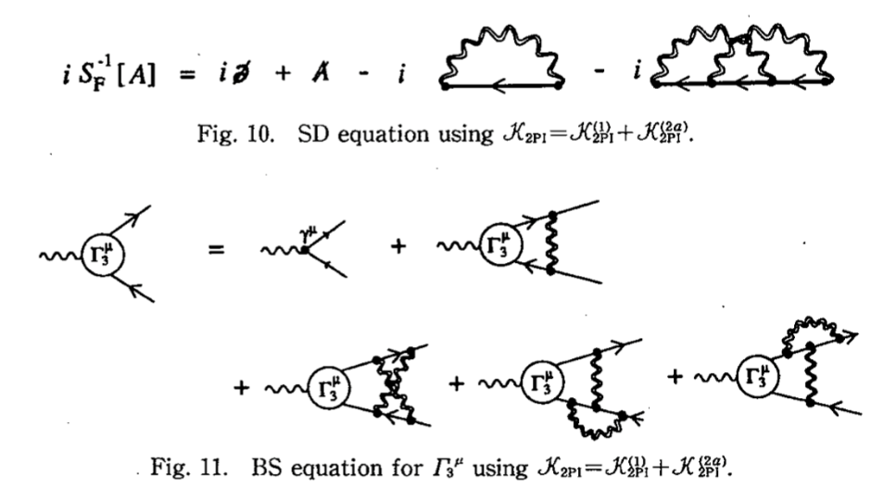
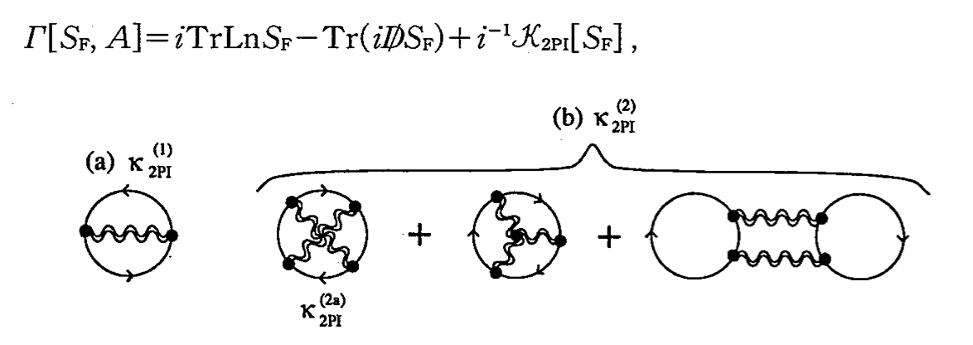

Truncation(Put Physics at Right Place)
One Way: CJT approach->2PI, 3PI,…
QCD
Exact representation
lQCD
DSEs
Modeling…HadronPhysics
Our Way: Minding the quark-gluon vertex
SCL
Truncation
How to construct quark-gluon vertex nonperturbatively?
Symmetry!
MC
??
QCD
13

Slide 15
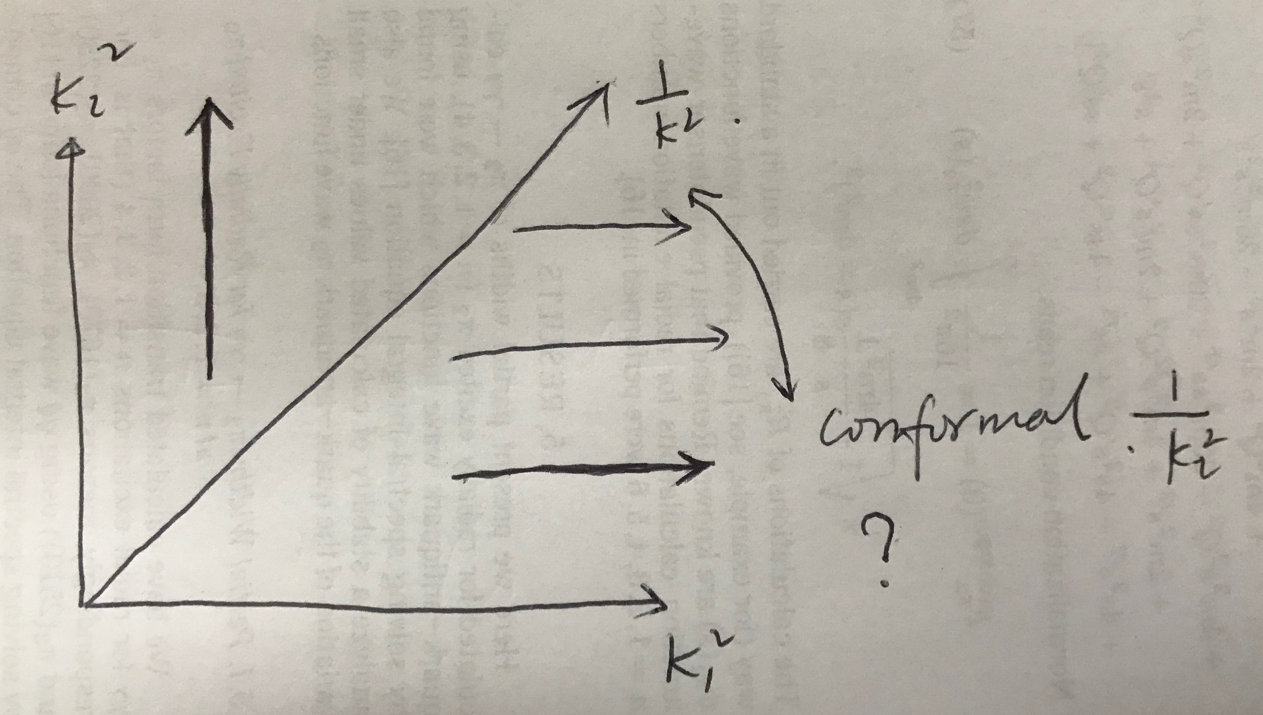
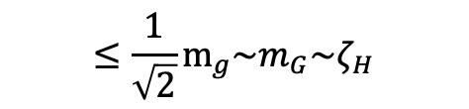
Calculate the Hadron at the Hadronic Scale
Inflection points
Red line: running gluon propagagor
Blue line: vector part of propagator
Black line: BSW function
$$≤\frac{1}{\sqrt{2}}m_{g}\sim m_{G}\sim ζ_{H}$$
14

Slide 16

Calculate the Hadron at the Hadronic Scale
pion
Symmetry(2013)
PLB737(2014)23
CPC(2020)031002
Toy model
Rainbow-Ladder truncation
Systematic
PLB829(2022)137078
2022-2023
proton
CSM developments
15

Slide 17
Calculate the Hadron at the Hadronic Scale
pion
Symmetry(2013)
PLB737(2014)23
CPC(2020)031002
Toy model
Rainbow-Ladder truncation
Systematic
Story of pion
16

Slide 18
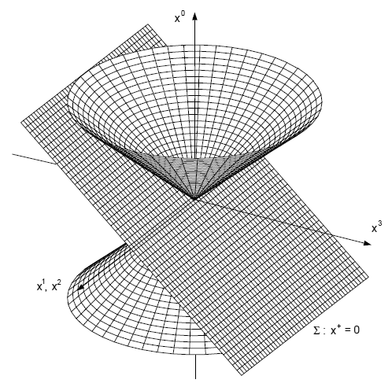
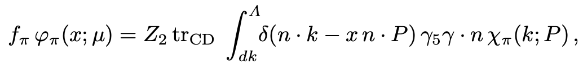

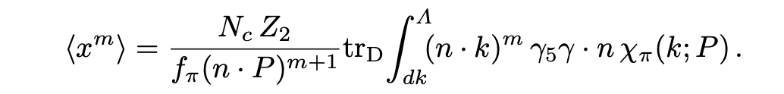
Distribution Amplitude(truncation independent)
Calculate moments;
Restruct DA from moments!
Arbitrary many moments is necessary!
17

Slide 19
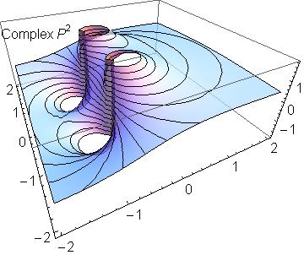
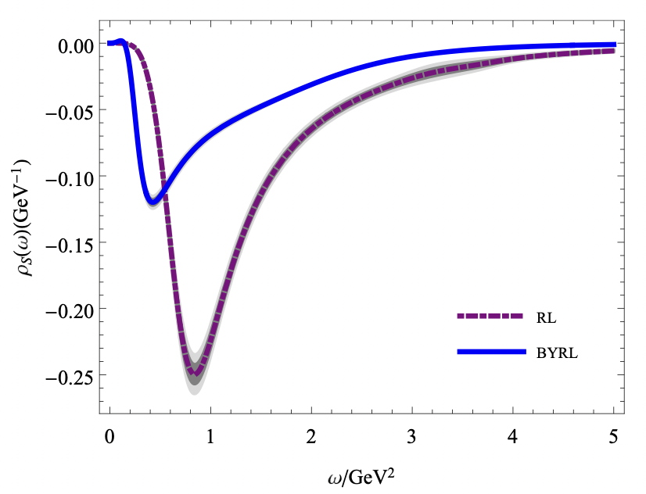
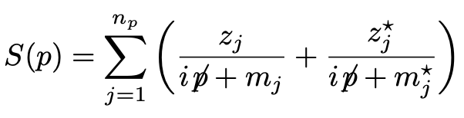
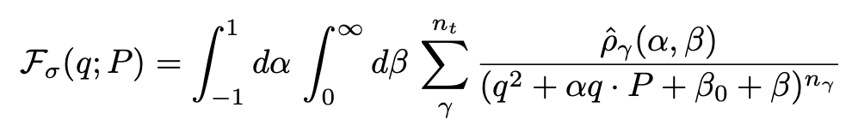

DA moments-----Method-1: Nakanishi-type representation
Imaging dynamical chiral symmetry breaking: pion wave function on the light front. LC, et al., PRL110(2013)132001
Quark propagator
Bethe-Salpeter amplitude
Zehao Zhu, et al., PRD103(2021)034005（new representation）
Standard Feynman integrals familiar from perturbation theory
18

Slide 20

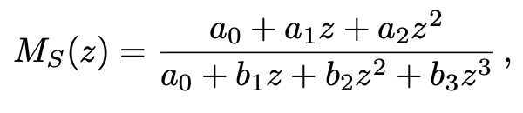
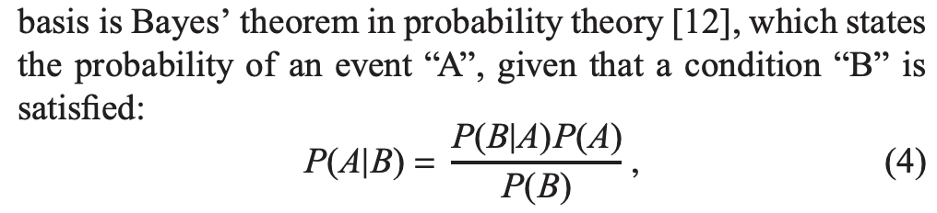
DA moments-----Methods: complementary
Brute force + Schlessinger Point Method extrapolation
Leading-twist parton distribution amplitudes of S-wave heavy-qukaonia. Minghui Ding, et al., PLB753(2016)330;
Symmetry, symmetry breaking, and pion parton distributions. Minghui Ding, , et al., PRD101(2020)054014.
Maximum Entropy Method
Bayesian extraction of PDA from BS wave function. Fei Gao, et al., PLB770(2016)551.
19

Slide 21
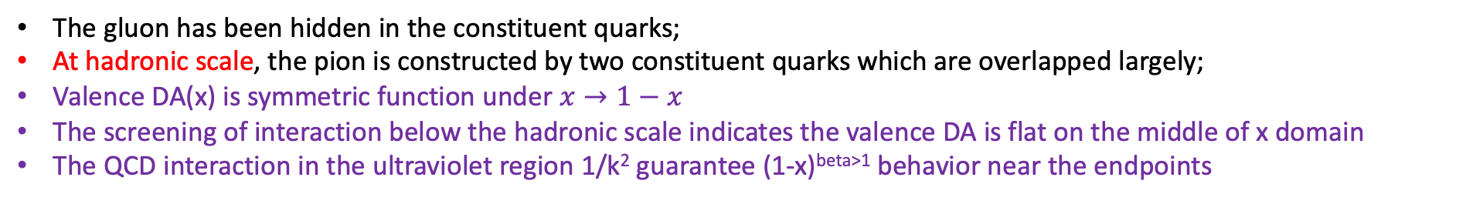
Imagine Pion global picture
The gluon has been hidden in the constituent quarks;
At hadronic scale, the pion is constructed by two constituent quarks which are overlapped largely;
Valence DA(x) is symmetric function under $x→1−x$
The screening of interaction below the hadronic scale indicates the valence DA is flat on the middle of x domain
The QCD interaction in the ultraviolet region 1/k² guarantee (1-x)^{beta>1} behavior near the endpoints
20

Slide 22
Imagine Pion global picture
The gluon has been hidden in the constituent quarks;
At hadronic scale, the pion is constructed by two constituent quarks which are overlapped largely;
Valence DA(x) is symmetric function under $x→1−x$
The screening of interaction below the hadronic scale indicates the valence DA is flat on the middle of x domain
The QCD interaction in the ultraviolet region 1/k² guarantee (1-x)^{beta>1} behavior near the endpoints
1. Imaging dynamical chiral symmetry breaking: pion wave function on the light front.
LC, et al., PRL110(2013)132001;
21

Slide 23
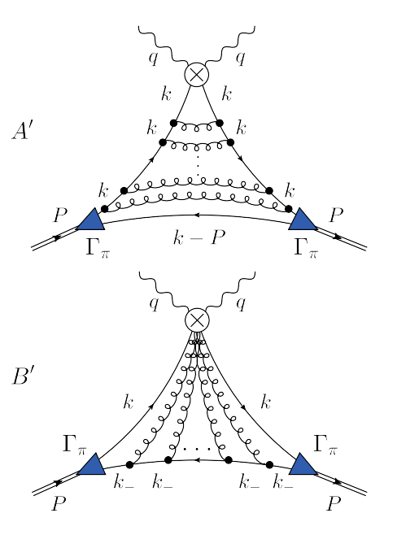
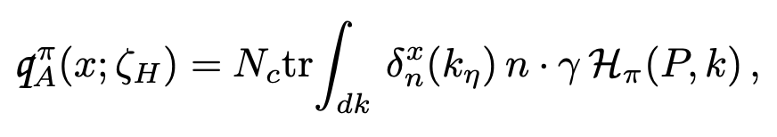
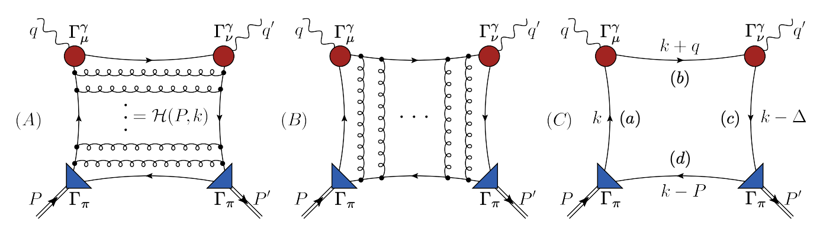
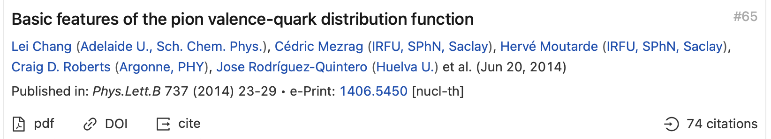
A practical way to calculate DF
Consider pion Compton scattering Amplitude $ℋ$
RL truncation
Sum rules!!!
20

Slide 24
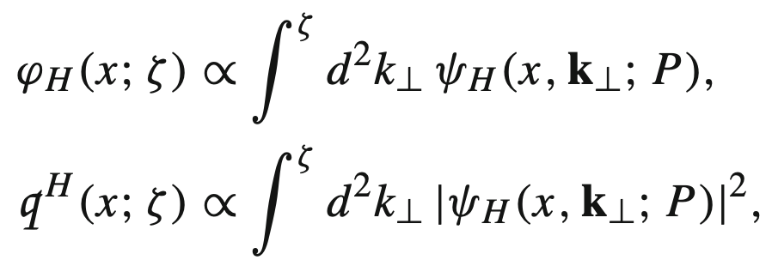

A practical way to calculate DF
LC, et al., PLB737(2014)23, arXiv: 1406.5450
Consider pion Compton scattering Amplitude $ℋ$
RL truncation
Beyond Rainbow-Ladder truncation
at Hadronic Scale
DF(x) = DA(x)² !
Factorization
$$ζ→ζ_{H}$$
21

Slide 25
Calculate the Hadron at the Hadronic Scale
Story of proton
Toy model
Rainbow-Ladder truncation
Systematic
PLB829(2022)137078
2022-2023
proton
CSM developments
22

Slide 26
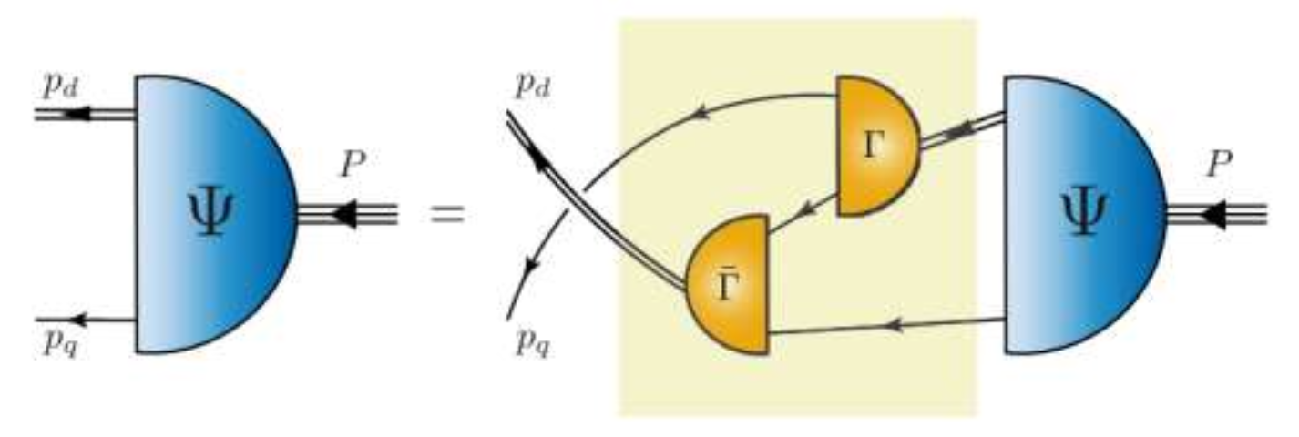
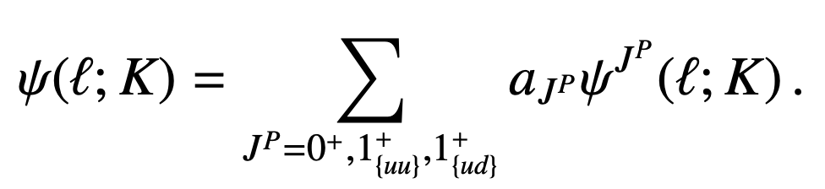
Stage-I: algebraic model
Quark+diquark Faddeev equation
Proton’s wave function: [ud](isoscalar-scalar_0⁺) and {uu},{ud}(isovector-pseudovector_1⁺) correlations
23

Slide 27
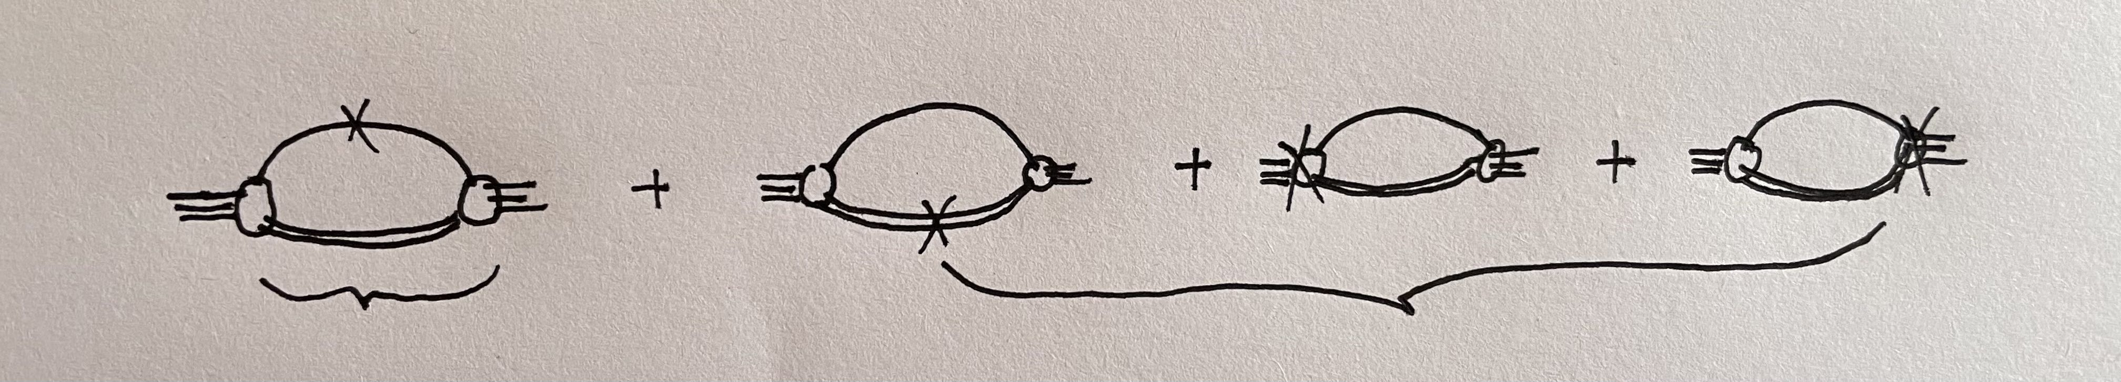
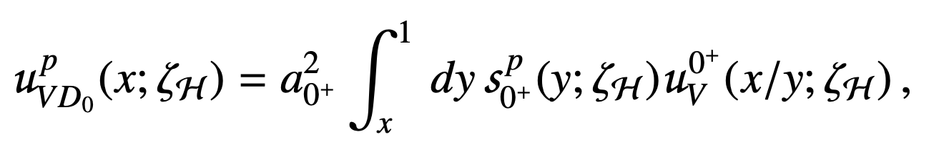
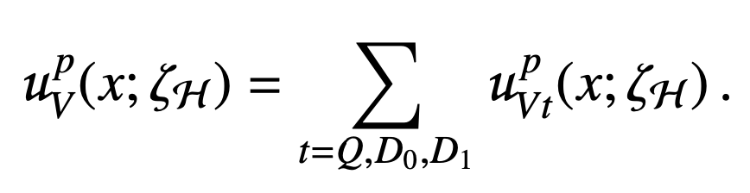
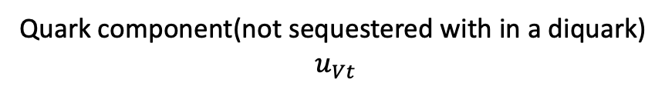


Find quarks in the proton
Quark-diquark picture
Quark component(not sequestered with in a diquark)
$$u_{Vt}$$
diquark component(scalar+pseudovector)
$$s_{0^{+}},s_{1^{+}}$$
Counting quarks in the diquark component(convolution)
Quarks in proton=
$$quarks in diquark$$
$$⨂$$
Diquark in proton
Similar expression for scalar and pseudovector diquarks
24

Slide 28






Models
Propagators for quark and diquarks
Faddeev amplitudes
Quark distribution in the diquarks
Four parameters: M=0.4GeV, M₀=0.78GeV, M₁=0.92
$r_{10}=a_{1^{+}}/a_{0^{+}}$
$ω\left(z\right)=\frac{1−2z}{2}$
$1/k^{4}$ behaviors
$My choice$
25

Slide 29


Large-x behavior

Slide 30



Large-x behavior
Guy F. de Teramond, et al, LFHQCD
Jiangshan Lan, et al, Light front Hamitonian
Kyle D. Bendner, et al, DSEs
27

Slide 31

Large-x behavior
Guy F. de Teramond, et al, LFHQCD
NJL-like!
Jiangshan Lan, et al, Light front Hamitonian
Kyle D. Bendner, et al, DSEs
Limited moments!
28

Slide 32

Large-x behavior
Guy F. de Teramond, et al, LFHQCD
Jiangshan Lan, et al, Light front Hamitonian
Global fit
with Threshold resummation
Kyle D. Bendner, et al, DSEs
29

Slide 33

Large-x behavior
Guy F. de Teramond, et al, LFHQCD
Jiangshan Lan, et al, Light front Hamitonian
Kyle D. Bendner, et al, DSEs
29

Slide 34
Large-x behavior
Guy F. de Teramond, et al, LFHQCD
We are preparing a paper to answer WHY based on the ultraviolet analysis of BS amplitude of massless pion.
Jiangshan Lan, et al, Light front Hamitonian
Kyle D. Bendner, et al, DSEs
30

Slide 35



Large-x behavior
Cui, et al., CPL39(2022)041401(Schlessinger Point Method extroplating MARATHON experiment data)
Our model
$r_{10}=0, 0.47(6)$
$\frac{1}{k^{4}}$asymptotic behavior of Faddeev amplitudes guarantee
31

Slide 36


Distributions at the hadronic scale
Valence quarks carry all the momentum of hadron at the hadroni scale
Diquark correlations $u_{V}(x)≠d_{V}(x)$ in the proton
Pion is the Nature’s most dilated PDF
26

Slide 37

Imagine the Hadron at the Hadronic Scale
Evolution
$$From the hadronic scale$$
$$m_{G}=0.331GeV$$
$$to any scale$$

Slide 38




Evolution
The gluon has been hidden in the constituent quarks;
At hadronic scale, the pion/proton is constructed by two quarks which are overlapped largely;
Let gluon/sea show up!
DGLAP with the effective charge
Mass correction
Threshold function $𝒫_{qg}^{ζ}\sim θ(ζ−δ_{q})$
Pauli blocking factor
32

Slide 39

Evolution
Notably, so long as the hadronic scale and the evolution equations are the same for a given family of hadrons, then the light-front momentum fractions stored in each parton class are also the same for these kindred hadrons at any scale.
pointwise behavior???
33

Slide 40
Breaking News!
Val[Lat] Sufian et al., arXiv: 1901.03921
(valence DF: using lattice-calculated matrix element obtained through spatially separated current-current correlations in coordinate space)
Glue/5[Lat] Fan et al., arXiv: 2104.06372
(Glue DF: using pseudo-PDF approach(Balitsky, Morris and Radyushkin,arXiv:1910.13963))
CSM see short review: LC and C.D.Roberts,
Chin.Phys.Lett.38(2021)081101.
Lattice methods: moments(…)
LaMET(Ji)
good lattice cross section(Qiu…)
pseudo-PDF(Radyushkin…)
Continuum QCD approach
A long story from 2013
Within uncertainties, there is pointwise agreement between the two results on the entire depicted domains
34

Slide 41

Evolution ($ζ_{3}=m_{J/ψ}=3.097GeV$)
Pion possess significantly more support on the valence domain than those in the proton!
35

Slide 42

Ending debate on the large-x behavior of pion and wait for the experiments
Develop RL truncation of proton techniques and calculate the proton structure function directly
Systematic error controls
pion
PLB737(2014)23
CPC(2020)031002
Toy model
Rainbow-Ladder truncation
Systematic
PLB829(2022)137078
2022-2023
proton

Slide 43

Ending debate on the large-x behavior of pion and wait for the experiments
Develop RL truncation of proton techniques and calculate the proton structure function directly
Systematic error controls
pion
PLB737(2014)23
CPC(2020)031002
Toy model
Rainbow-Ladder truncation
Systematic
PLB829(2022)137078
2022-2023
proton

Slide 44





Slide 45

Describe quark-antiquark bound-state
Cornwall, 1985
4

Slide 46
Continuum Schwinger function Method
Dyson, F. J. (1949), “The S Matrix In Quantum Electrodynamics,” Phys. Rev. 75, 1736.
Schwinger, J. S. (1951), “On The Green’s Functions Of Quantized Fields: 1 and 2,” Proc. Nat. Acad. Sci. 37 (1951) 452; ibid 455.
Dyson-Schwinger Equations
Bethe-Salpeter Equations(Nambu)
Faddeev Equation
Ward-Takahashi identity
Scattering Problem
……
They provide a systematic, symmetry-preserving approach to solving the bound-state problem in QCD;
Predictions from CSM analyses are practically identical to those obtained via the lattice-regularized theory.
DSEs group
Chang，et al, PLB829(2022)137078
Cui, et al, EPJA 57 (2021) 5, EPJC80 (2020) 1064
Ding, et al, CPC44 (2020) 031002, PRD101(2020)054014
Binosi, et al, PLB790(2019)257
Chen, et al, PRD98(2018) 091505
Gao, et al, PRD96 (2017) 034024
Chang, et al, PLB737(2014), PRL110(2013)132001,PRL111(2013)1418002
8

