Slide 1
Oscillating Features in the Neutron Electromagnetic Structure
报告人：胡继峰 (代表BESIII国际合作组)
单位：华南师范大学量子物质研究院

Slide 2
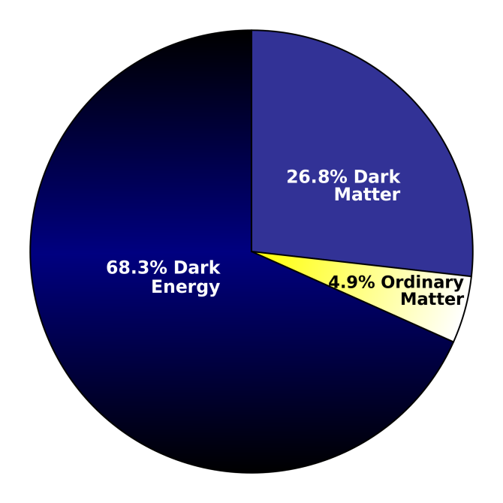
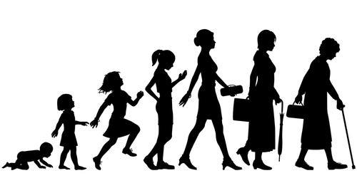
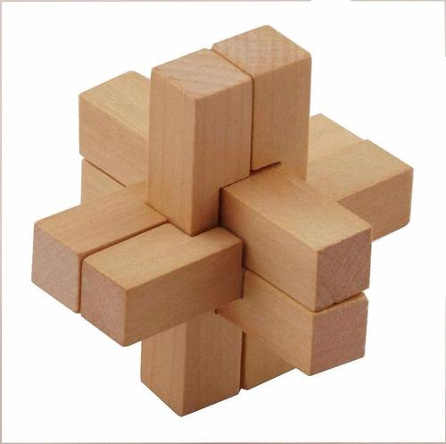
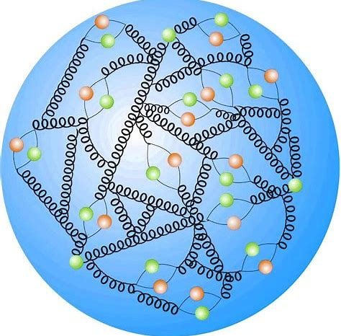
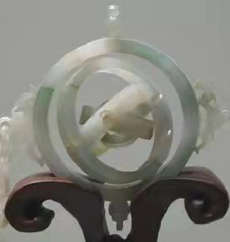
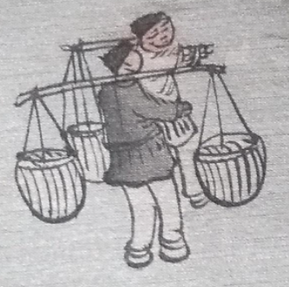
Motivation
  Major components of visible matter
  Key of understanding the strong interaction

Slide 3
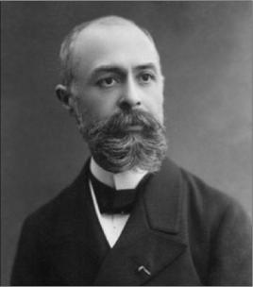
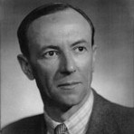
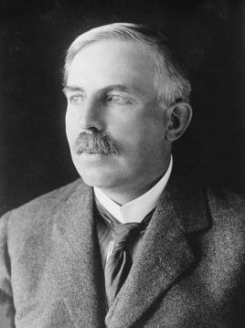
Before Discovery of the Neutron
1896 发现β-衰变， Henri Becquerel, Marie/Pierre Curie， 1903 诺贝尔奖
1919 发现质子，Ernest Rutherford, 1908诺贝尔
1932 发现中子，James Chadwick，1935 诺贝尔奖

Slide 4
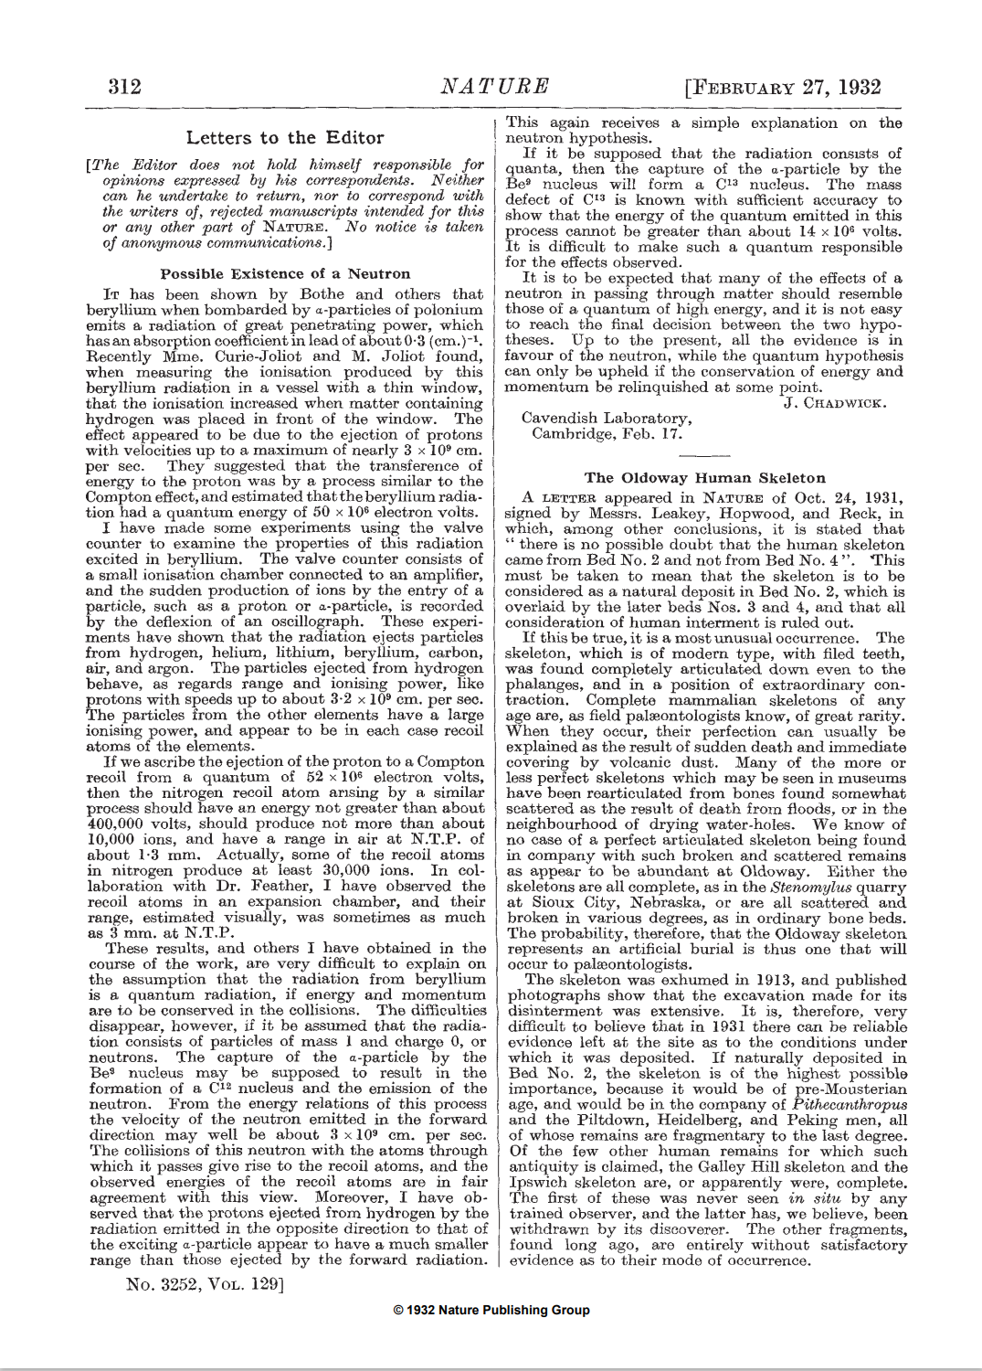
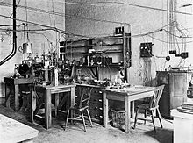
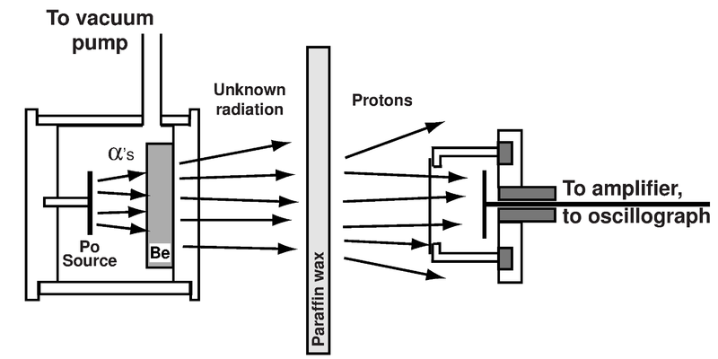
Discovery of the Neutron (1932)
James Chadwick - Wikipedia
https://www.nature.com/articles/129312a0.pdf
Sir Ernest Rutherford's laboratory
early technique
《Possible existence of a Neutron》

Slide 5
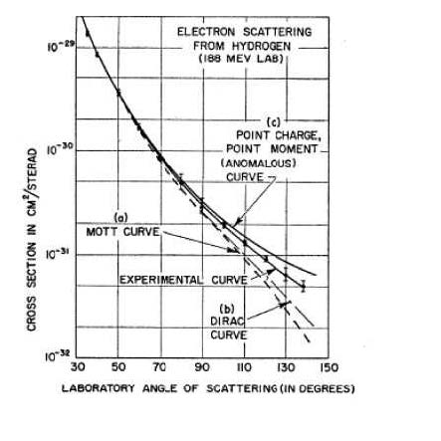
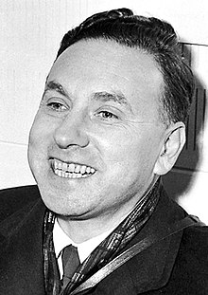
Electron Scattering (1950s)
Hofstadter R. etc., “electron scattering and nuclear structure” Rev. Mod. Phys. 28, 214–254 (1956)
Robert Hofstadter - Biographical (nobelprize.org)
Over a period of time lasting at least two thousand years, Man has puzzled over and sought an understanding of the composition of matter. … Indeed this structure may be quite complex, so that the elegant idea of elementarity must be abandoned.

Slide 6


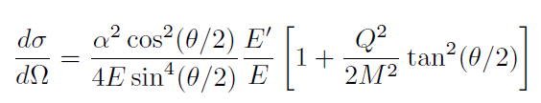



Electromagnetic Form Factor
Point-like scattered by point-like
The structured scattered by Point-like
Spin=0
Spin=½
|F(q)|²
^{dσ/dΩ}_{Mott}
|F(q)|²≡1
Hofstadter R. etc., Rev. Mod. Phys. 28, 214–254 (1956)
Prog.Part.Nucl.Phys.59:694-764,2007
A parameterized function depending on the momentum transfer q².
Imaging the nucleon structure using the electromagnetic probe q².
Simplest observable
$$G_{E}=F_{1}+{τF}_{2}$$
$$G_{M}=F_{1}+F_{2}$$

Slide 7
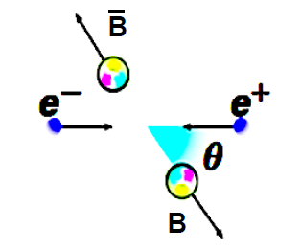
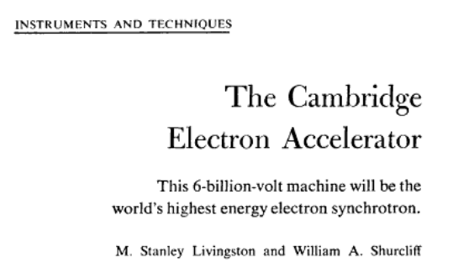
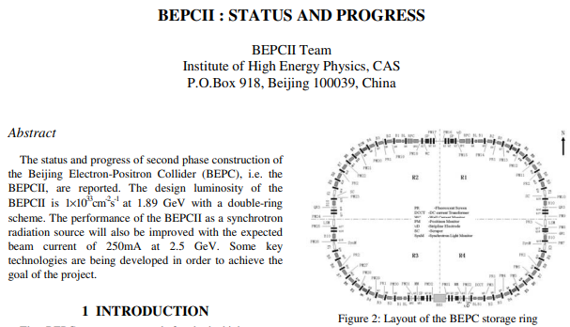
Experiments
Scattering experiment
Annihilation experiment
q²<0
q²>0
Livingston, M. S., & Shurcliff, W. A. (1961). The Cambridge Electron Accelerator. Science, 134(3486), 1186–1193. http://www.jstor.org/stable/1707819
Notes:
Scattering:
Laboratoire de l’Acc´elerateur Lin´eaire in Orsay, (1956)
Cambridge Electron Accelerator (1962)
Electron-Synchrotron at Bonn,
Stanford Linear Accelerator Center (SLAC),
Deutsches Elektronen-Synchrotron (DESY, MAINZ)
the electron accelerators at CEA-Saclay
Nationaal Instituut voor Kernfysica en Hoge Energie Fysica (NIKHEF)
MIT-Bates, the Mainz Microtron (MAMI)
21century: Continuous Electron Beam Accelerator Facility (CEBAF) of the Jefferson Lab (Jlab)
JPAC
annihillation: FINUDA, DA_PHI_NE, KLOE, FENICE, BESI,BESII, CLEO
21 century: BESIII, BABAR,
但是，中子相关测量始终没有进展

Slide 8
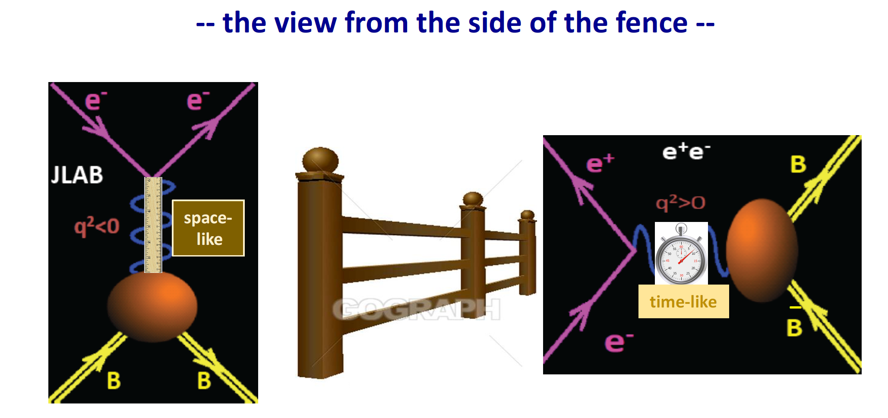
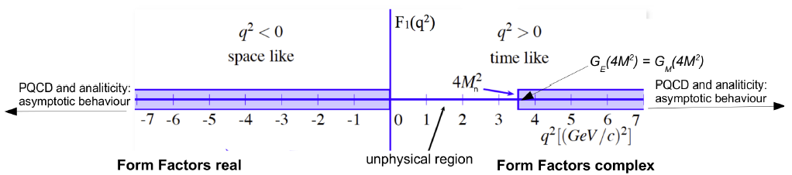


Space-like versus Time-like
Borrowed from Prof. Olsen’s talk.
Dispersion relation
$$\left|G_{M,E}(−∞)\right|=\left|G_{M,E}\left(∞\right)\right|$$
Notes:
FINUDA, DA_PHI_NE, KLOE, FENICE, BESI,BESII

Slide 9
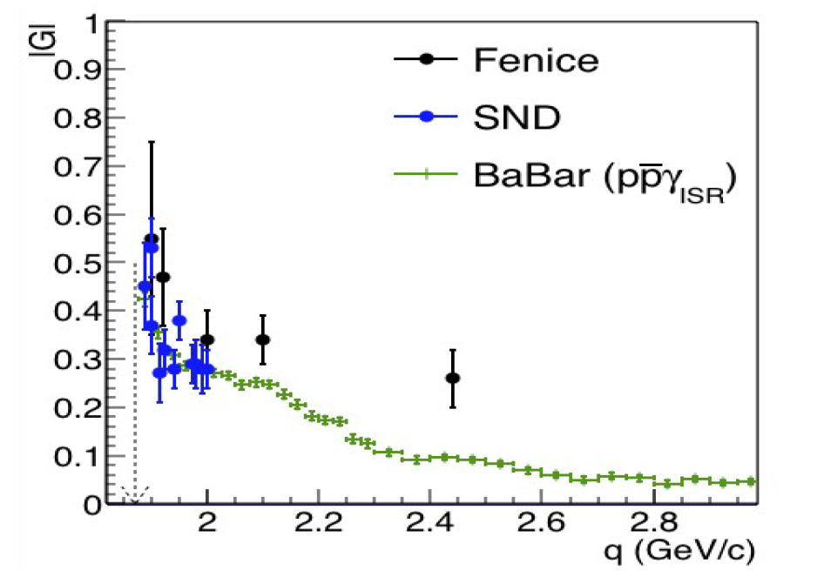

The γ*-Nucleon Coupling Puzzle (1998)
A puzzle for over 20 years
Prof. Rinaldo BALDINI FERROLI
Nucl. Phys. B 517, 3 (1998).
Phys. Rev. D 90, 112007 (2014).
EPJ Web Conf. 212, 07007 (2019).

Slide 10
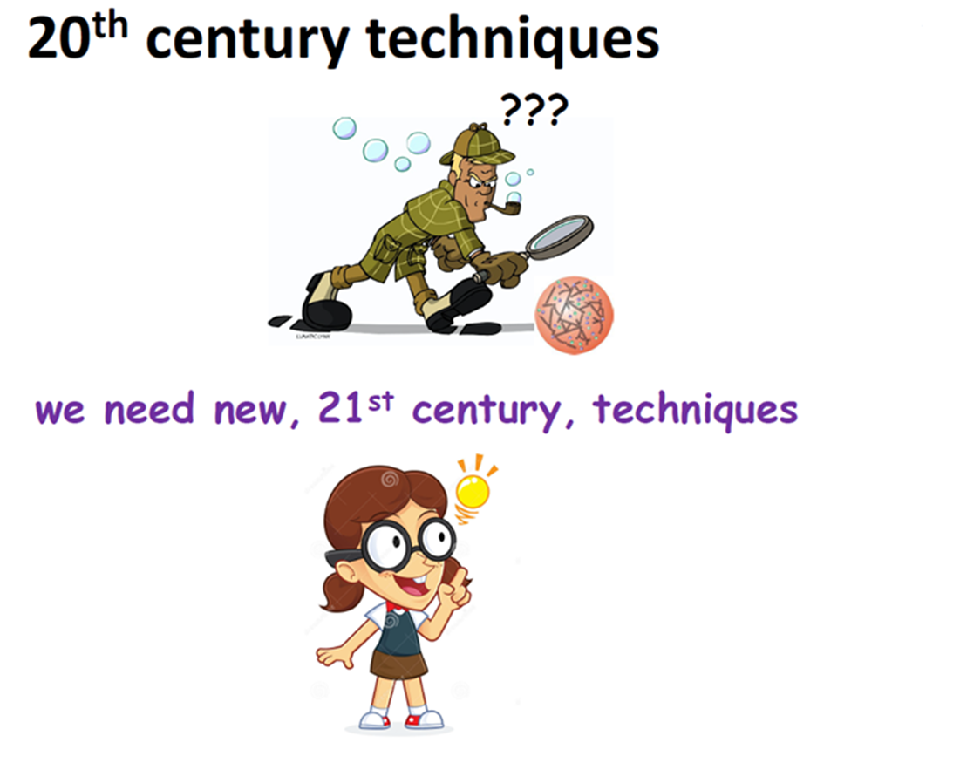
Precision Era
was out
Borrowed from Prof. Olsen’s talk.
does BESIII address something new ?

Slide 11
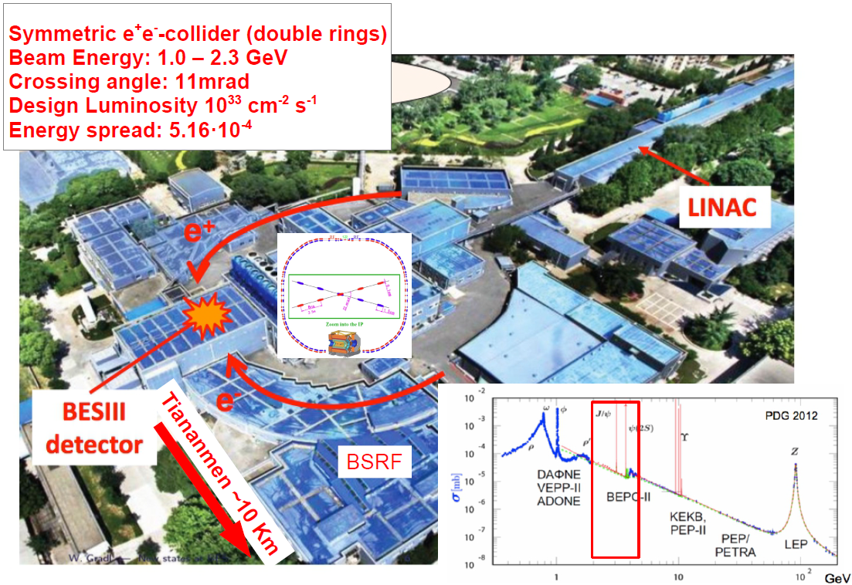
The BEPCII Collider
  BEPCII is a high luminosity collider.

Slide 12

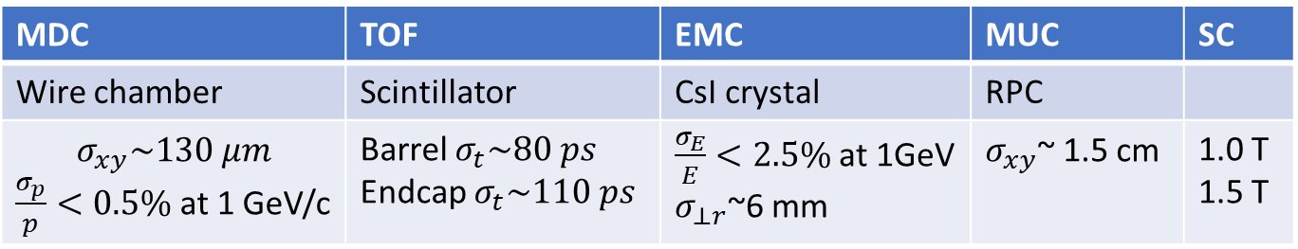
The BESIII Experiment
Nucl. Instrum. Meth. A 614, 345 (2010)
A precision frontier experiment under running in tau-charm energy region.
Babar
MDC | TOF | EMC | MUC | SC
Wire chamber | Scintillator | CsI crystal | RPC
$$σ_{xy}\sim 130 μm$$ $\frac{σ_{p}}{p}<0.5\%$at 1 GeV/c | Barrel $σ_{t}\sim 80 ps$ Endcap $σ_{t}\sim 110 ps$ | $\frac{σ_{E}}{E}<2.5\%$at 1GeV $σ_{⊥r}$~6 mm | $σ_{xy}$~ 1.5 cm | 1.0 T 1.5 T

Slide 13

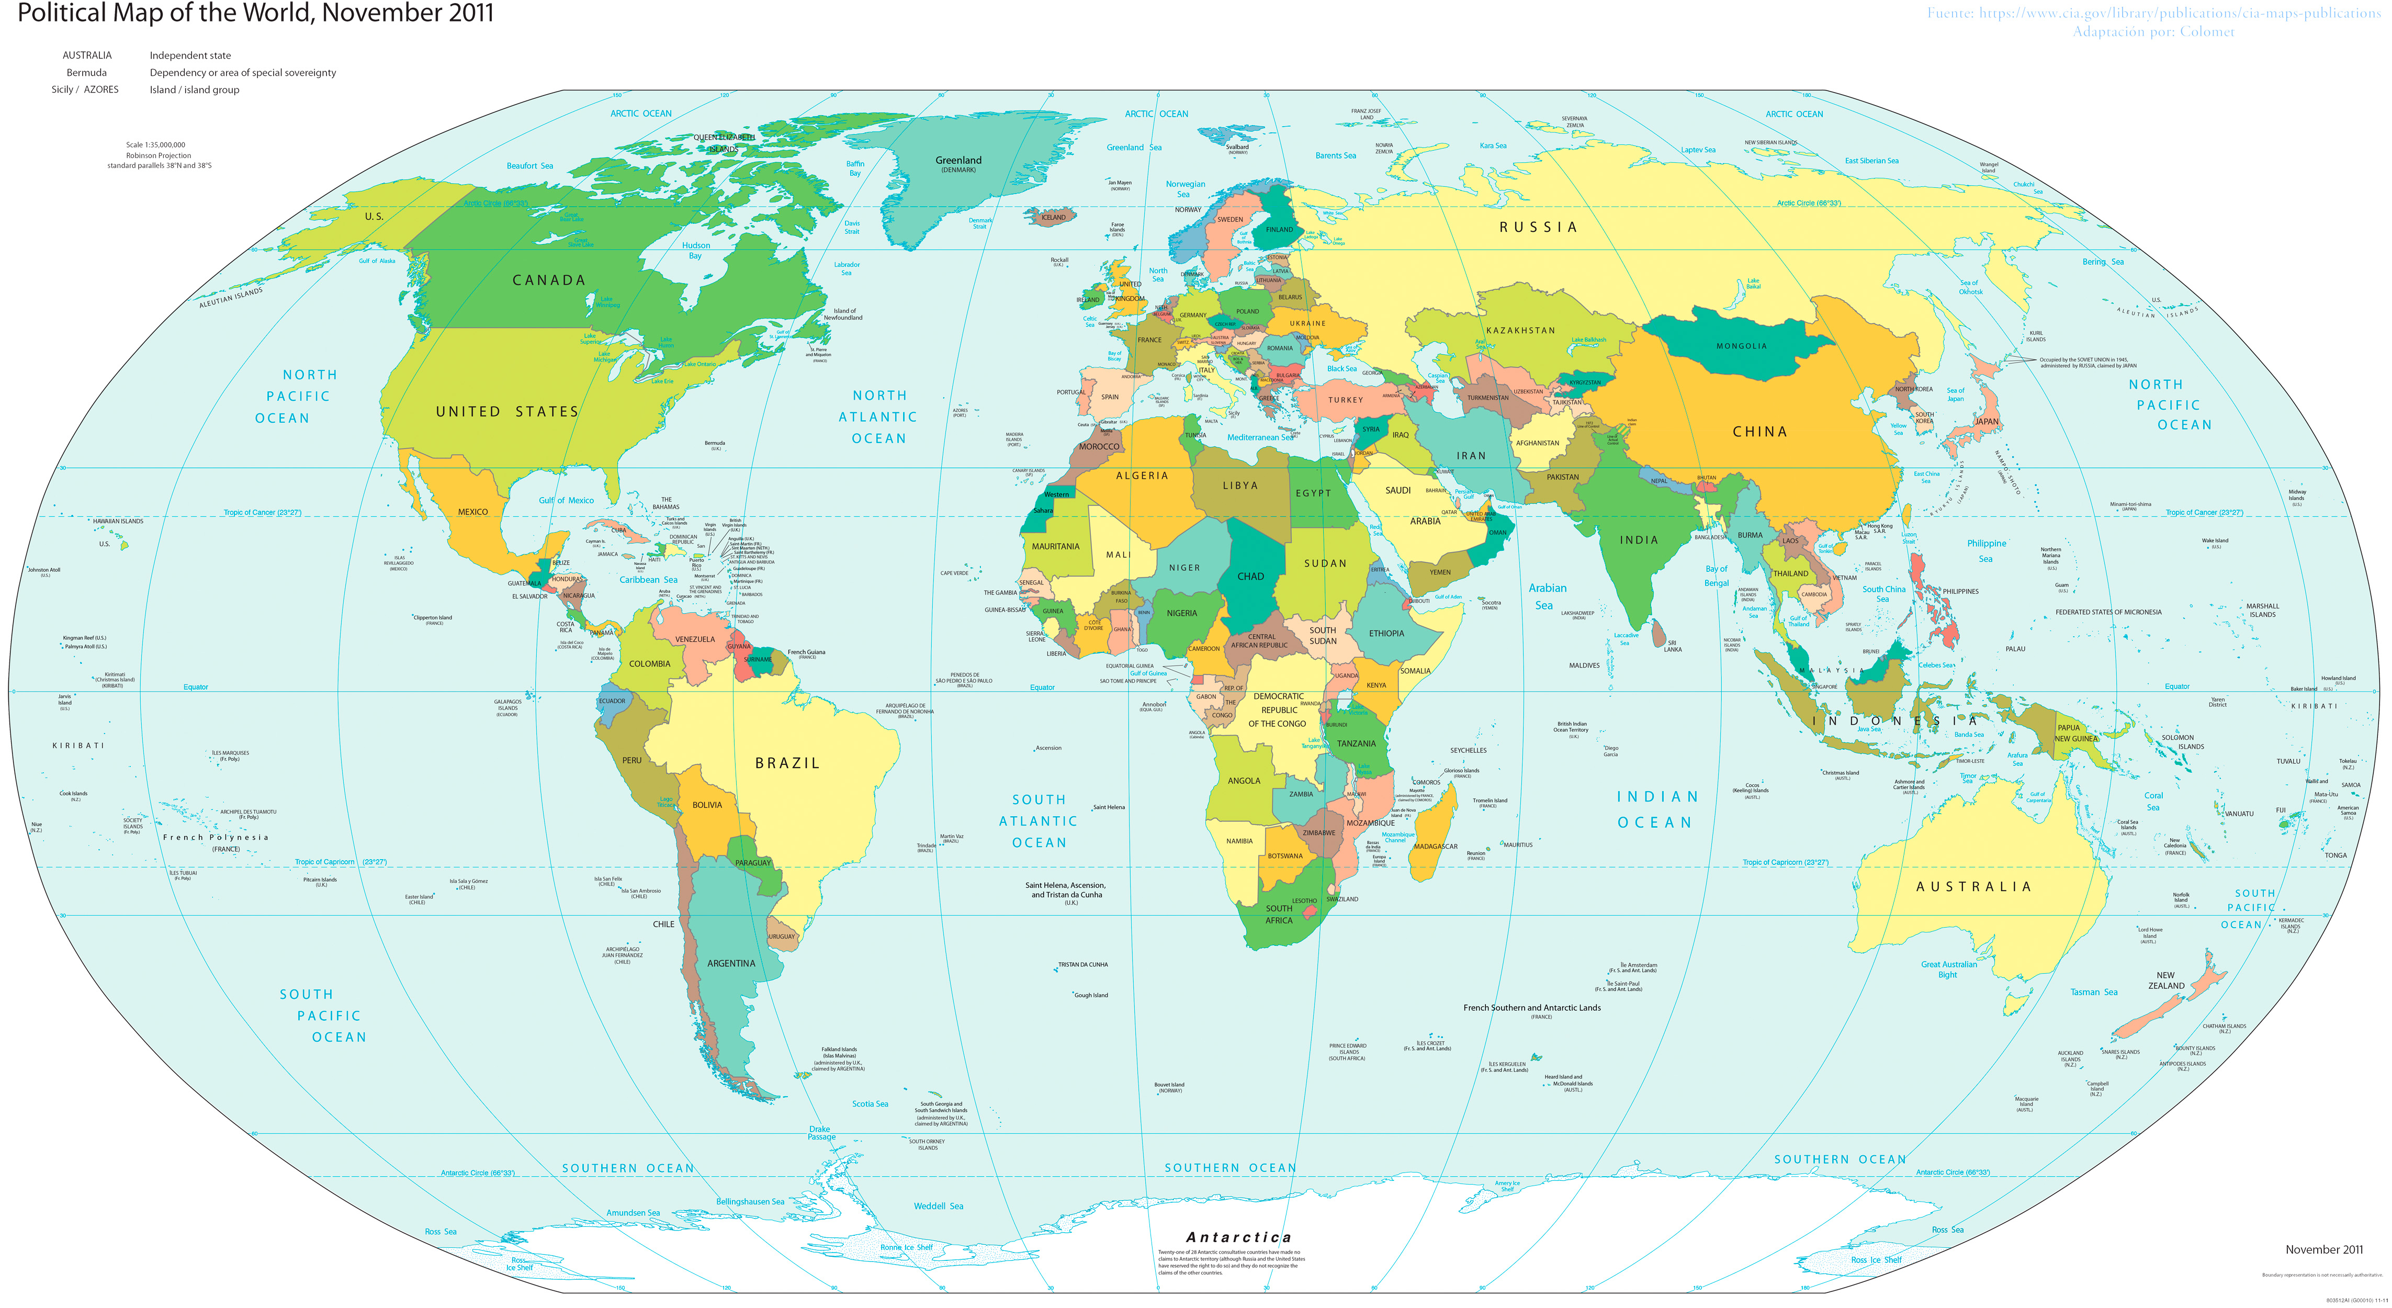

BESIII Collaboration
Europe (17/115)
Germany (6): Bochum University,
GSI Darmstadt, Helmholtz Institute Mainz, Johannes Gutenberg University of Mainz, Universitaet Giessen,University of Münster
Italy (3): Ferrara University, INFN, University of Torino
Netherlands (1):KVI/University of Groningen
Russia (2): Budker Institute of Nuclear Physics, Dubna JINR
Sweden (1):Uppsala University
Turkey (1):Turkish Accelerator Center Particle Factory Group
UK (2): University of Manchester, University of Oxford
Poland (1)National Centre for Nuclear Research
Asia (6/10)
Pakistan (2): COMSATS Institute of Information Technology
University of the Punjab, University of Lahore
Mongolia (1): Institute of Physics and Technology
Korea (1): Chung-Ang University
India (1): Indian Institute of Technology madras
Thailand (1): Suranaree University of Technology
USA(4/8)
Carnegie Mellon University
Indiana University
University of Hawaii
University of Minnesota
China (48/367)
Institute of High Energy Physics (146), other units(221): Beijing Institute of Petro-chemical Technology, Beihang University,
China Center of Advanced Science and Technology, Fudan University,
Guangxi Normal University, Guangxi University,
Hangzhou Normal University, Henan Normal University,
Henan University of Science and Technology,
Huazhong Normal University, Huangshan College, Hunan University,
Hunan Normal University, Henan University of Technology
Institute of modern physics, Jilin University, Lanzhou University, Liaoning Normal University, Liaoning University, Nanjing Normal University, Nanjing University, Nankai University, North China Electric Power University,
Peking University, Qufu normal university, Shanxi University,
Shanxi Normal University, Sichuan University, Shandong Normal University,
Shandong University, Shanghai Jiaotong Univeristy, Soochow University,
South China Normal University, Southeast University, Sun Yat-sen University,
Tsinghua University, University of Chinese Academy of Sciences, University of Jinan, University of Science and Technology of China,
University of Science and Technology Liaoning,
University of South China, Wuhan University, Xinyang Normal University,
Zhejiang University, Zhengzhou University,YunNan University , China University of Geosciences
South America (1/1)
Chile: University of Tarapaca
~500 members
From 76 institutions in 16 countries
Borrowed from Prof. Li Hai-bo’s talk.
Notes:
运行实验离不开人，简要介绍合作组

Slide 14
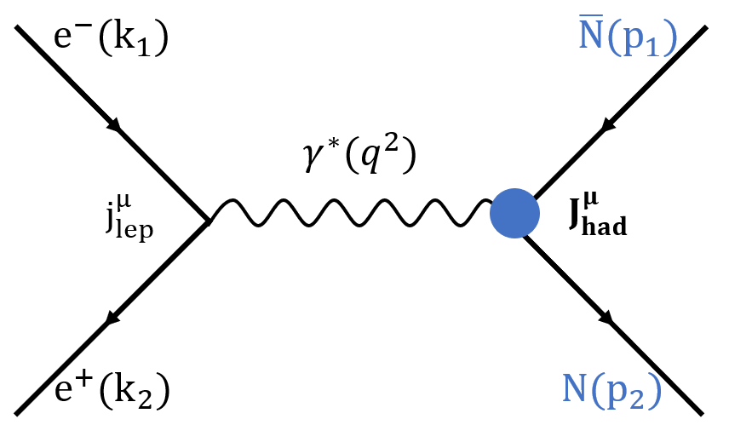
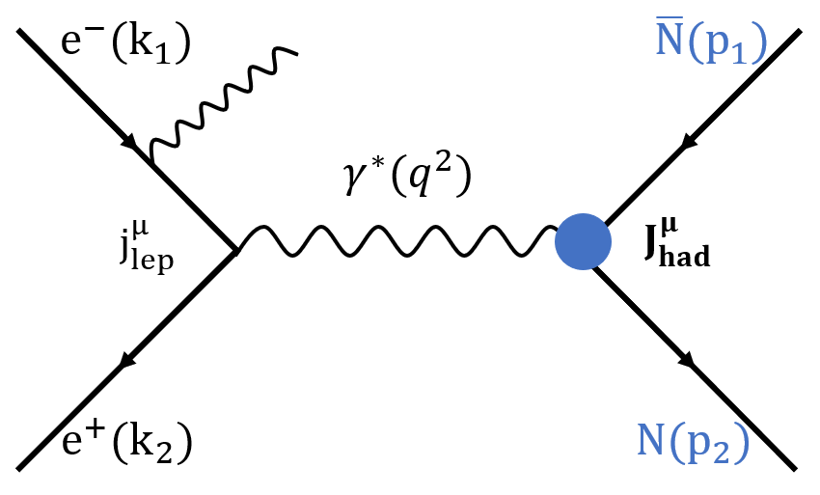
Access to Time-like Form Factor
Energy scan
Initial-state-radiation
Energy Scan | Initial-state-radiation
逐能量点采集数据 | 高能量点采集数据
Q^{2 ~} 误差< 1 MeV | Q²~ 误差 several to tens of MeV
Fixed s | From threshold to s
 | suppression by the ISR photon

Slide 15
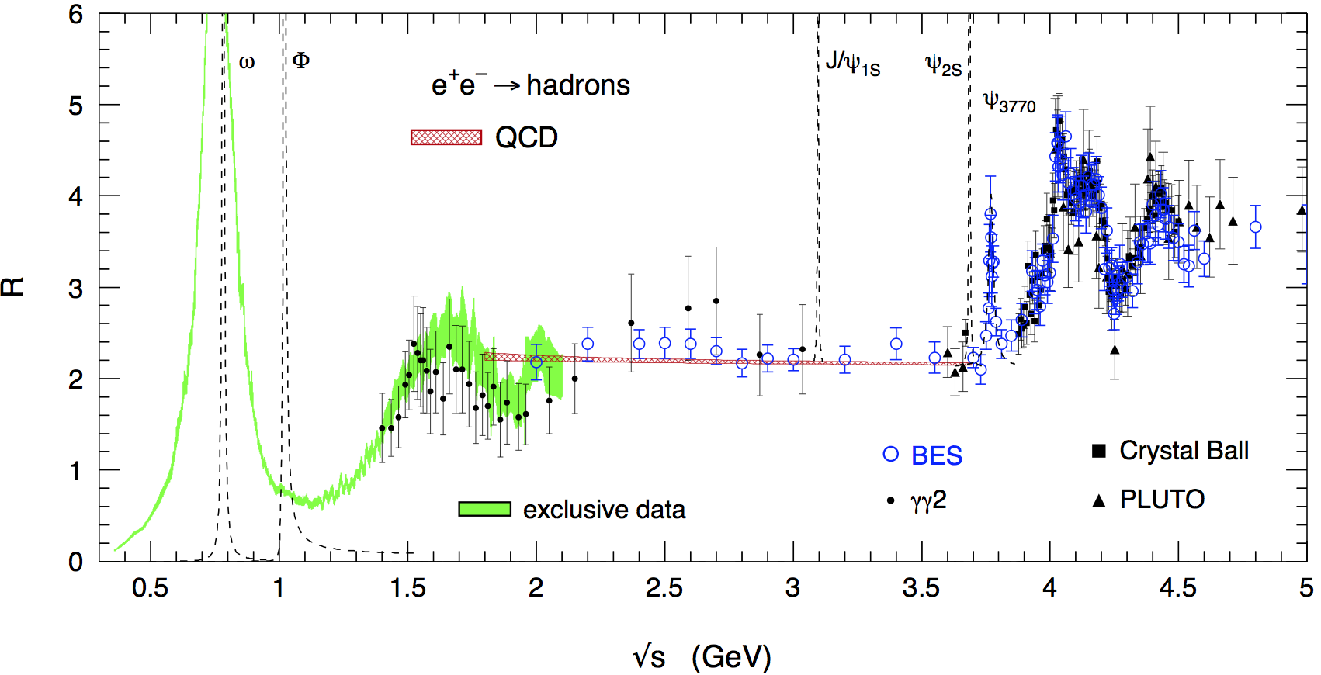
Taking Data
Borrowed from Prof. Li Hai-bo’s talk.
688 pb⁻¹ R-scan data and 10 billion J/Ψ data.
Sampling 22 energies, 688 pb⁻¹ 7 energies 7460 pb⁻¹
2.0 GeV | 2.05 | … | 3.02 | 3.08 |  | 3.773 | … | ... | … | 4.60

Slide 16

Taking Data
[GeV]
[亿]
2011 tau mass scan, 2012 R scan, 2013-2014 R scan phase 2, 2014-2015 R scan phase 1.
Notes:
BESIII合作组制定了周密的数据采集方案，并开展了数据采集。

Slide 17


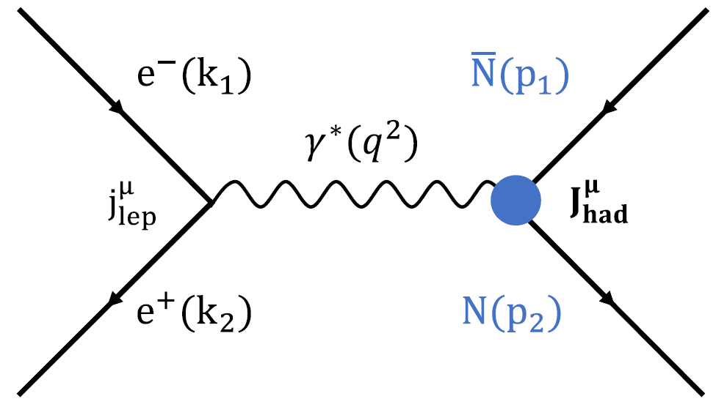
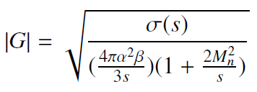
How to Measure ?
Counting …
Assuming
3. Translationσ to |G|
1. Experimental Cross-section
2. Theoretical Cross-section
该报告只涉及有效形状因子|G|

Slide 18




Challenges
5. 优化效率
4. 校准
2. 鉴别
3. 分离
1. 重建
$$N^{obs}$$
$$N^{obs}$$
We develop a package for the neutral reconstruction, and verify it using $e^{+}e^{−}→γγ$.
We develop a package for the neutral reconstruction, and verify it using 𝑒^+ 𝑒^−→𝛾𝛾.
We use time-of-flight to identify photon/neutron with $e^{+}e^{−}→γγ$ and $J/Ψ→π^{+}π^{−}π^{0}→π^{+}π^{−}γγ$.
We use time-of-flight to identify photon/neutron with 𝑒^+ 𝑒^−→𝛾𝛾 and J/Ψ→𝜋^+ 𝜋^− 𝜋^0→𝜋^+ 𝜋^− 𝛾𝛾.
We try three solutions to minimize the statistical errors and verify each solution using $J/Ψ→n\overline{n}$.
We try three solutions to minimize the statistical errors and verify each solution using J/Ψ→𝑛𝑛 ̅.
We calibrate detection efficiency using $J/Ψ→pπn/\overline{n}$ taking advantage of 10 billion J/Ψ.
We calibrate detection efficiency using J/Ψ→pπ𝑛/𝑛 ̅ taking advantage of 10 billion J/Ψ.
We calibrate trigger efficiency using $e^{+}e^{−}→p\overline{p}$.
We calibrate trigger efficiency using 𝑒^+ 𝑒^−→𝑝𝑝 ̅.
$$N^{obs}$$
$$ε_{cor} ε_{trg}(1+δ)$$
$$ε_{MC}$$

Slide 19

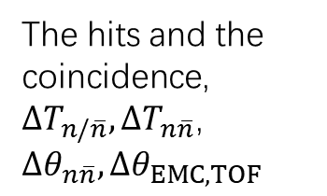
Categories for maximizing efficiency
EMC Crystals
TOF Scintillators
The coincidence
~9 packages, new + revised;
3 months development;
debug event by event, number by number;
5 months verification;
7 round checks.
The hits and the coincidence,
${∆T}_{n/\overline{n}},{∆T}_{n\overline{n}}\text{,}$ ${∆θ}_{n\overline{n}},{∆θ}_{EMC,TOF}$
Time of flight,
Path of flight
TOF Scintillators
Category A
$${(EMC+TOF)}^{\overline{n}}+{TOF}^{n}$$
〖(EMC+TOF)〗^n ̅ +TOF^n
Category B
$${(EMC+TOF)}^{\overline{n}}+{EMC}^{n}+MUC$$
〖(EMC+TOF)〗^n ̅ +EMC^n+MUC
Category C
$${EMC}^{\overline{n}}+{EMC}^{n}+MUC$$
EMC^n ̅ +EMC^n+MUC
Notes:
由此，实验组制定了3个不同的分析方案

Slide 20
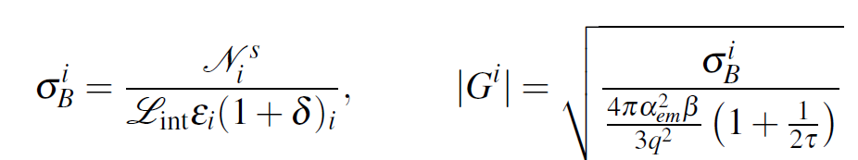
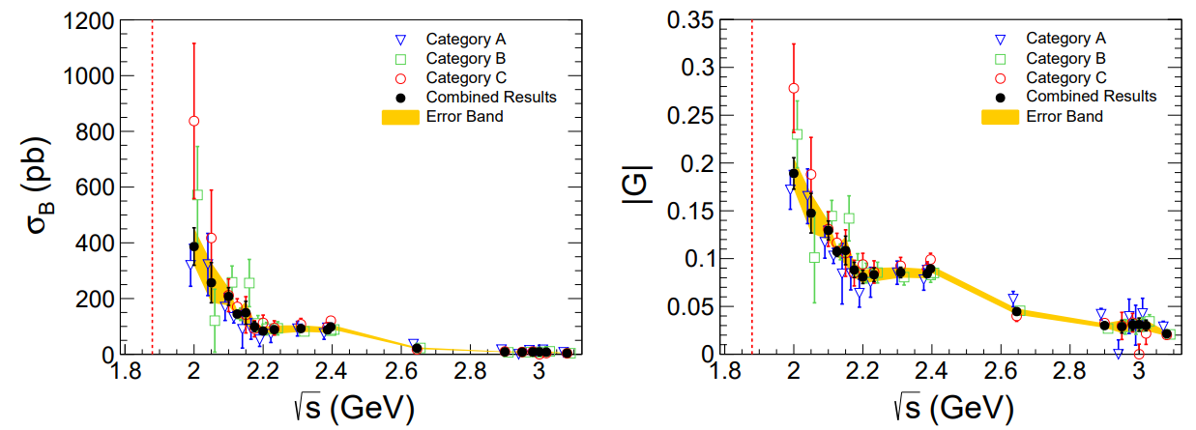
Results of Three Categories
i = A, B, C
We combine 3 categories to get the best measurement.

Slide 21
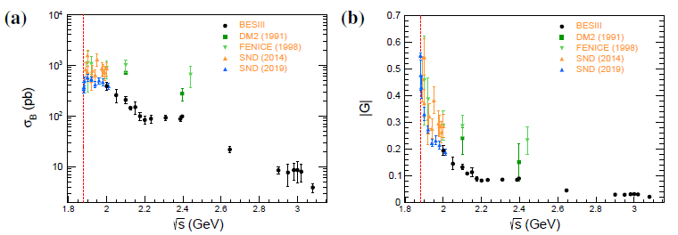
Cross-sections and Form Factors
  1st highlight of the results: most precise in the time-like region.
  The precision improved > a factor of ~30 over previous results.
(a) Cross-section (b) Effective Form Factor
Nature Physics volume 17, p1200–1204 (2021)

Slide 22
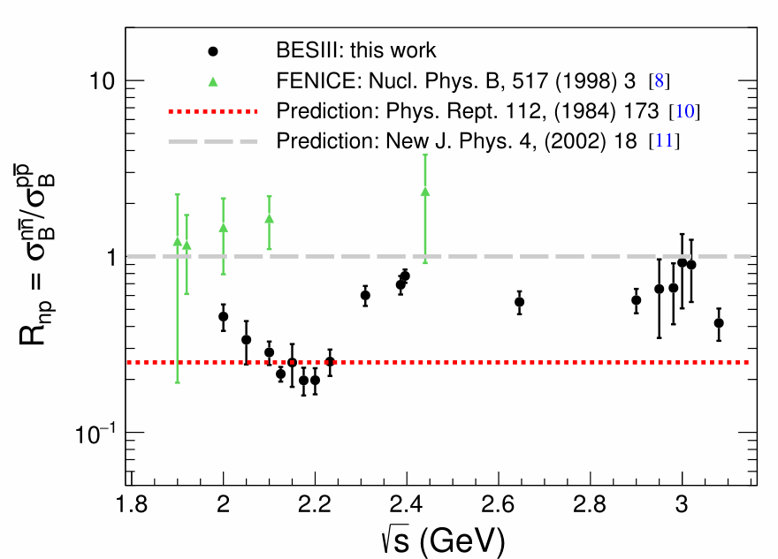
Cross-section Ratios
  2nd highlight of the results: precise ratios in 2.0~3.08 GeV.
  Clearly clarifying the photo-nucleon interaction puzzle.
PRL. 124 (2020) no.4, 042001
[8]: Phys. Rev. D 99, no. 1, 014510 (2019); [10]: Z. Phys. C 52, 631 (1991).; [11]: Phys. Rept. 112, 173420 (1984)

Slide 23
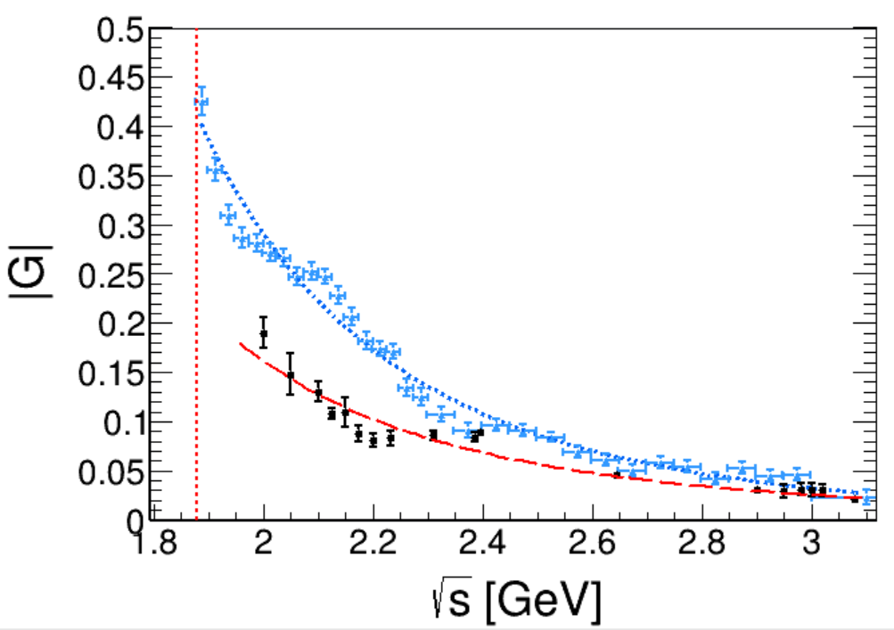
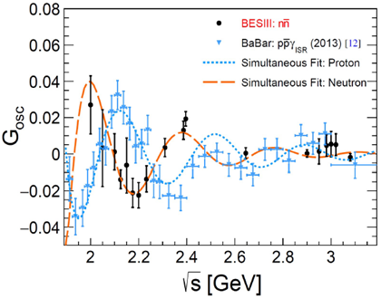


Oscillation in the Form Factors
  3rd highlight of the results: oscillation around the dipole law.
  A phase shift around (125±12)° is observed.
$$G_{D}^{p}=\frac{1}{1+\frac{q^{2}}{m_{a}^{2}}}\frac{F^{p}}{{(1−\frac{q^{2}}{0.71})}^{2}}$$
$$G_{D}^{n}=\frac{F^{n}}{{(1−\frac{q^{2}}{0.71})}^{2}}$$
PRC 93, 035201 (2016).
PRL 114, 232301 (2015).
PRD 92, 198 034018 (2015).
Nobody predicted this

Slide 24
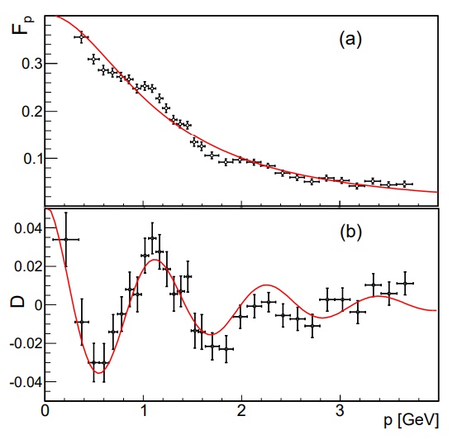


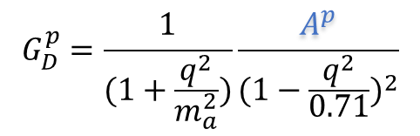
Periodic Interference Structures
The Proton
PRL 114 (2015) no.23, 232301
$$G_{D}^{p}=\frac{1}{(1+\frac{q^{2}}{m_{a}^{2}})}\frac{A^{p}}{{(1−\frac{q^{2}}{0.71})}^{2}}$$
BaBar Data
$$F_{osc}=Ae^{−Bp}\cos{(Cp+D)}$$
$$p≡\sqrt{E^{2}−M^{2}}, E≡\frac{q^{2}}{2M}−M$$
Nobody predicted this

Slide 25
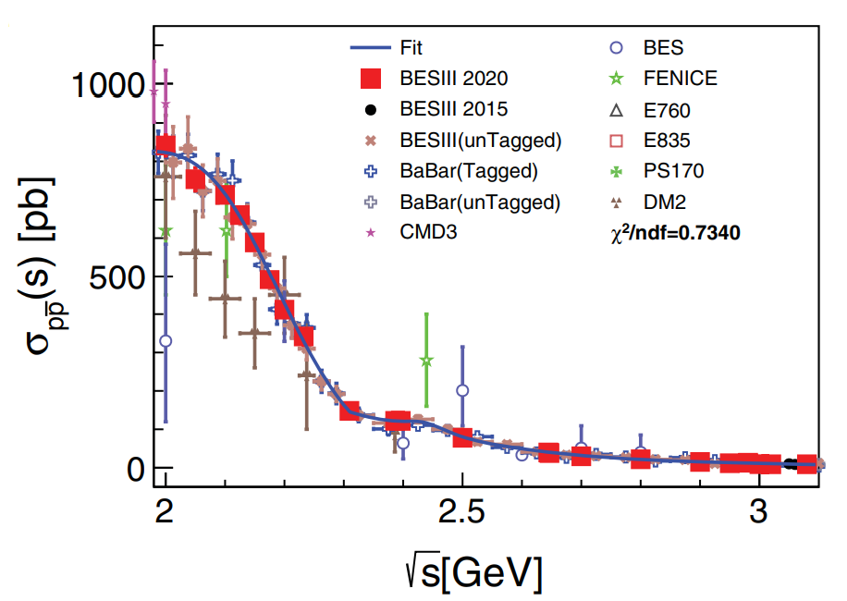
The Proton Time-like Form Factor
The Proton
PRL 124, 042001 (2020)
PRD 99, 092002 (2019)
PRD 91, 112004 (2015)
Most precise measurements in the time-like region

Slide 26
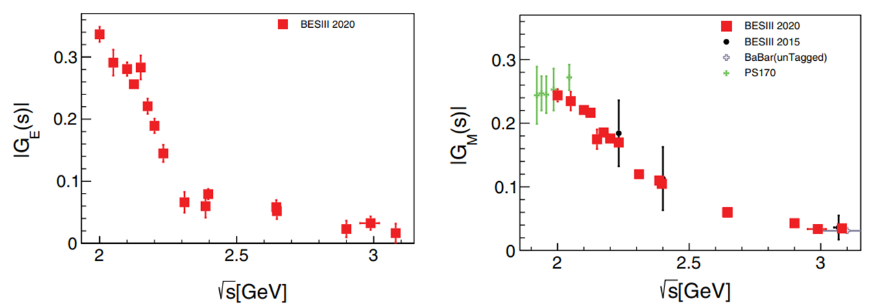

1st Precise Separation G_{E} from G_{M}
The Proton
$$\frac{dσ_{p\overline{p}}}{dΩ}=\frac{4πα_{em}^{2}βC}{3q^{2}}[{\left|G_{M}\right|}^{2}\left(1+\cos^{2}{θ}\right)+\frac{4M_{n}^{2}}{q^{2}}{\left|G_{E}\right|}^{2}\sin^{2}{θ}]$$
PRL 124, 042001 (2020)
Precision: |G_{E}| 2-94%, |G_{M}| 1.5-9%
the precision comparable to the one in spacelike region
Notes:
添加引用

Slide 27
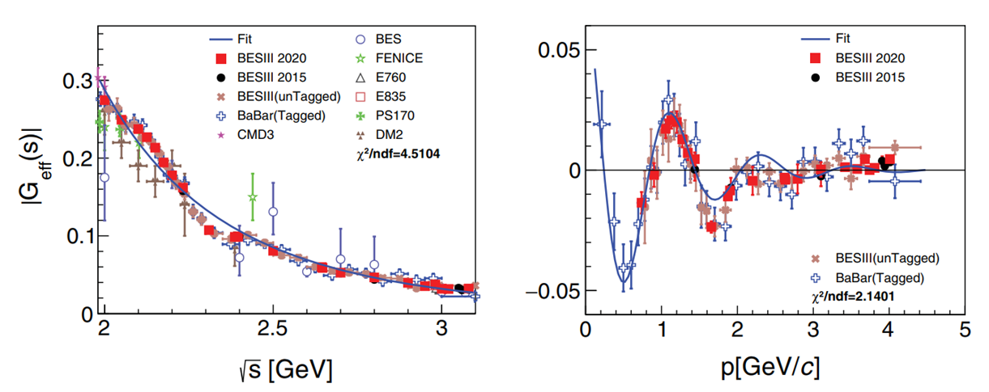
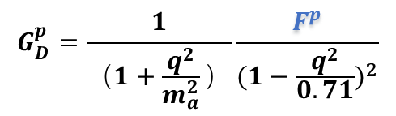
Confirmation
The Proton
G_{osc}
$$G_{D}^{p}=\frac{1}{（1+\frac{q^{2}}{m_{a}^{2}}）}\frac{F^{p}}{{(1−\frac{q^{2}}{0.71})}^{2}}$$
Oscillation exists and needs more understanding.

Slide 28



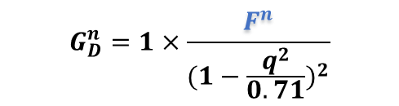

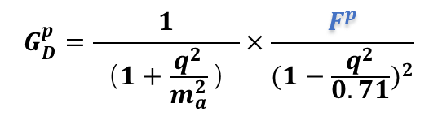
Understanding the Form Factor
Physics Reports 550–551 (2015) 1–103
Charge density distribution (Fourier transformation), or time-space revolution (generalized Fourier transformation).
Semi-classical:
质子
Generalized:
$$G_{D}^{p}=\frac{1}{（1+\frac{q^{2}}{m_{a}^{2}}）}×\frac{F^{p}}{{(1−\frac{q^{2}}{0.71})}^{2}}$$
$$F\left[f(x)⊗g(x)\right]=F\left[f\left(x\right)\right]∗F[g(x)]$$
$$G_{D}^{n}=1×\frac{F^{n}}{{(1−\frac{q^{2}}{0.71})}^{2}}$$
Notes:
添加引用

Slide 29




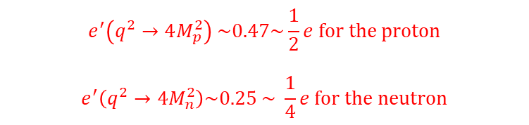




Understanding the Form Factor
Quark-antiquark creation and transition to nucleon, and effective coupling
$$σ_{e^{+}e^{−}→μ^{+}μ^{−}}∝α^{2}$$
$$σ_{e^{+}e^{−}→n\overline{n}}∝{α^{2}\left|G\right|}^{2}$$
$$\sqrt{α}$$
$$\sqrt{α}$$
$$\sqrt{α}$$
$$\sqrt{α^{’}}$$
$$e^{′}=\sqrt{{\left|G\right|}^{2}}e$$
$$e^{′}\left(q^{2}→4M_{p}^{2}\right) \sim 0.47\sim \frac{1}{2}e for the proton$$
$$e^{′}\left(q^{2}→4M_{n}^{2}\right)\sim 0.25 \sim \frac{1}{4}e for the neutron$$
Notes:
添加引用

Slide 30
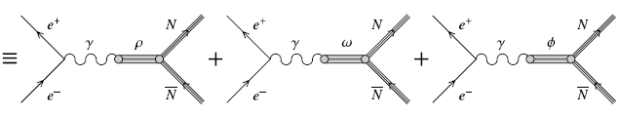

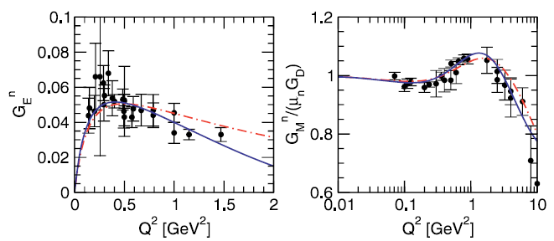
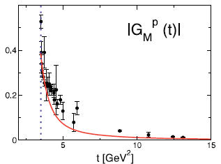

Understanding the Form Factor
EPJA 28, s01, 49 57 (2006)
doi:10.1140/epja/i2006-09-006-5
Notes:
添加引用

Slide 31



Understanding the Form Factor
$$Γ^{μ}{=γ}^{μ}F_{1}\left(q^{2}\right)+\frac{iκσ^{μν}q_{ν}}{2M_{B}}F_{2}(q^{2})$$
Leading order
N = p, n, Λ, Σ ...
Unique access to non-stable baryons in the TL region at BESIII.
Notes:
添加引用Rinaldo

Slide 32
A Story of the Nucleon Picture
A point particle
Before 1936
A structured particle
1950s
3 valence quark model
1964
Spin crisis
1988
valence quark + sea quark + gluon revolution
recent
Charge radius puzzle
2020
But the story has no ending
The interaction puzzle
2021
在深入理解中子图像的过程中，BESIII合作组做出了里程碑的工作。

Slide 33



Today
Science vol.358, p79-85 (2017/10/6)
Nature vol.575 p 61 (2019 /11/7)
PRL 120, 183001 (2018)
RRL 118, 102001 (2017)
Still many questions
Physics: Highlights from 2017 (aps.org)
2010
2013
Nucleon Spin
Nucleon radius
Nucleon mass, spin, lifetime, interaction

Slide 34




Outlook at Super Tau-Charm Factory
1. $\frac{dσ}{dΩ}=\frac{α^{2}βC}{4q^{2}}\left[\left(1+\cos^{2}{θ}\right){\left|G_{M}\right|}^{2}+\frac{1}{τ}\sin^{2}{θ}{\left|G_{M}\right|}^{2}\right],C=\frac{\frac{πα}{β}}{1−exp⁡(−\frac{πα}{β})}\underset{→}{β→0}\frac{πα}{β}$
2. Two-photon exchange
3. precise disentanglement G_{E} from G_{M}
1. 𝑑𝜎/𝑑Ω=(𝛼^2 𝛽𝐶)/(4𝑞^2 ) [(1+cos^2⁡𝜃 ) |𝐺_𝑀 |^2+1/𝜏 〖𝑠𝑖𝑛〗^2⁡𝜃 |𝐺_𝑀 |^2 ],𝐶=(𝜋𝛼/𝛽)/(1−exp⁡(−𝜋𝛼/𝛽)) →┴(𝛽→0) 𝜋𝛼/𝛽
2. Two-photon exchange
3. precise disentanglement G_{E} from G_{M}
Fine structure in oscillation, in particular near the production threshold.
$$F_{osc}=A \frac{sin⁡(Bp+C)}{Bp}$$
Notes:
末态散射

Slide 35

From Idea to Fruit
1. 提出想法、制定数据采集方案
Before 2012年
2. 申请机器时间，采集数据
2012-2015年
3. 分析数据，发表结果
2016-2021年
BESIII实验开展一项工作的典型流程
$${\left\langle i | H | f\right\rangle }^{2}→M_{easurment}$$

Slide 36
Summary
For the neutron time-like form factor, BESIII collaboration
released novel results with the best precision so far.
clarified the interaction puzzle persistent for over 20 years.
observed an oscillating behavior similar to the one in the proton.
More work needed to dig out the implication from our data
Thanks for your attention
Acknowledgement to the owners because some pictures are borrowed from the internet without any contact.

Slide 37


Appendix

Slide 38

FENICE实验结果之前的理论预测
Model | $$R≡\frac{σ(e^{+}e^{−}→n\overline{n})}{e^{+}e^{−}→p\overline{p}}$$ | Year
QCD sum rules | $\frac{e_{d}^{2}}{e_{u}^{2}}\sim$0.25 | Brodsky, 1972
Baryon leading quark+diquark | 0.06 @ q^2 = 25 GeV^2 | Chernjak 1983 Hyer 1992
EVDM ρ + ω | ~14 | Cabibbo, 1961
Veneziano Rec | ~2 | Koerner
PDG Rec. | ~100 | Voci ,1982
Unitary Amplitude | ~25 | Dubnicka, 1988
Unitary Amplitude | <1 | Dubnicka, 1992
NN strong FSI | <=1 @threshold | Dalkarov, 1992 Meshcheryakov 1993
U Spin invariance | >1 @ q^2~4-5 GeV^2 | Biagini, 1991
Notes:
一切皆有可能

Slide 39
About the Challenge
百万里挑一
Notes:
替换

