Slide 1
Review on exotic hadrons in the complex-scaling range of a quark model
Gang Yang
Zhejiang Normal University
yanggang@zjnu.edu.cn
2021.11.12

Slide 2
Outline
Introduction
Glimpses of recently experimental data on exotic hadrons.
Theoretical framework of our investigation.
Discussion
Tetraquark states in doubly and fully heavy, strange hidden-charm sectors.
Studies on hidden-charm pentaquarks are necessarily referred.
Summary

Slide 3
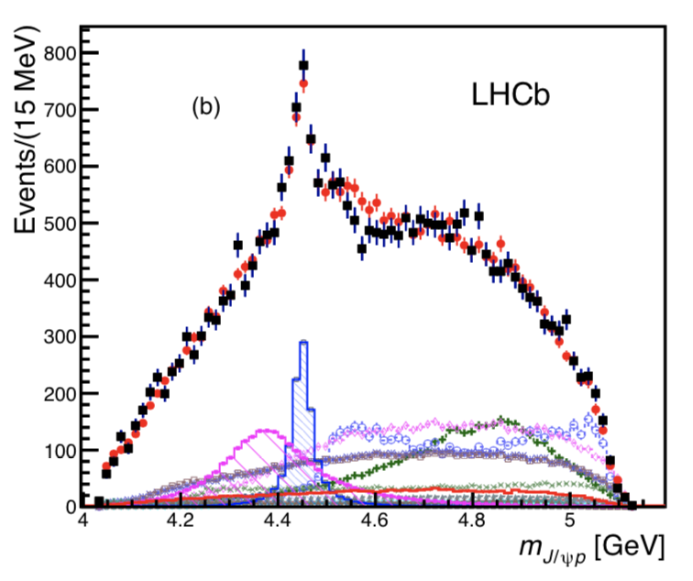
The firstly announced $P_{c}$ states
Two exotic structures, which were referred to as pentaquark-charmonium states ${P_{c}(4380)}^{+}$ and ${P_{c}(4450)}^{+}$, were observed in the $Λ_{b}^{0}→J/ψpK^{−}$ decays in 2015.
Their experimental masses and widths are
$$M=4380±8±29MeV, Γ=205±18±86MeV;$$
$$M=4449.8±1.7±2.5MeV, Γ=39±5±19MeV.$$
R. Aaij et al. (LHCb), Phys. Rev. Lett. 115, 072001 (2015).

Slide 4
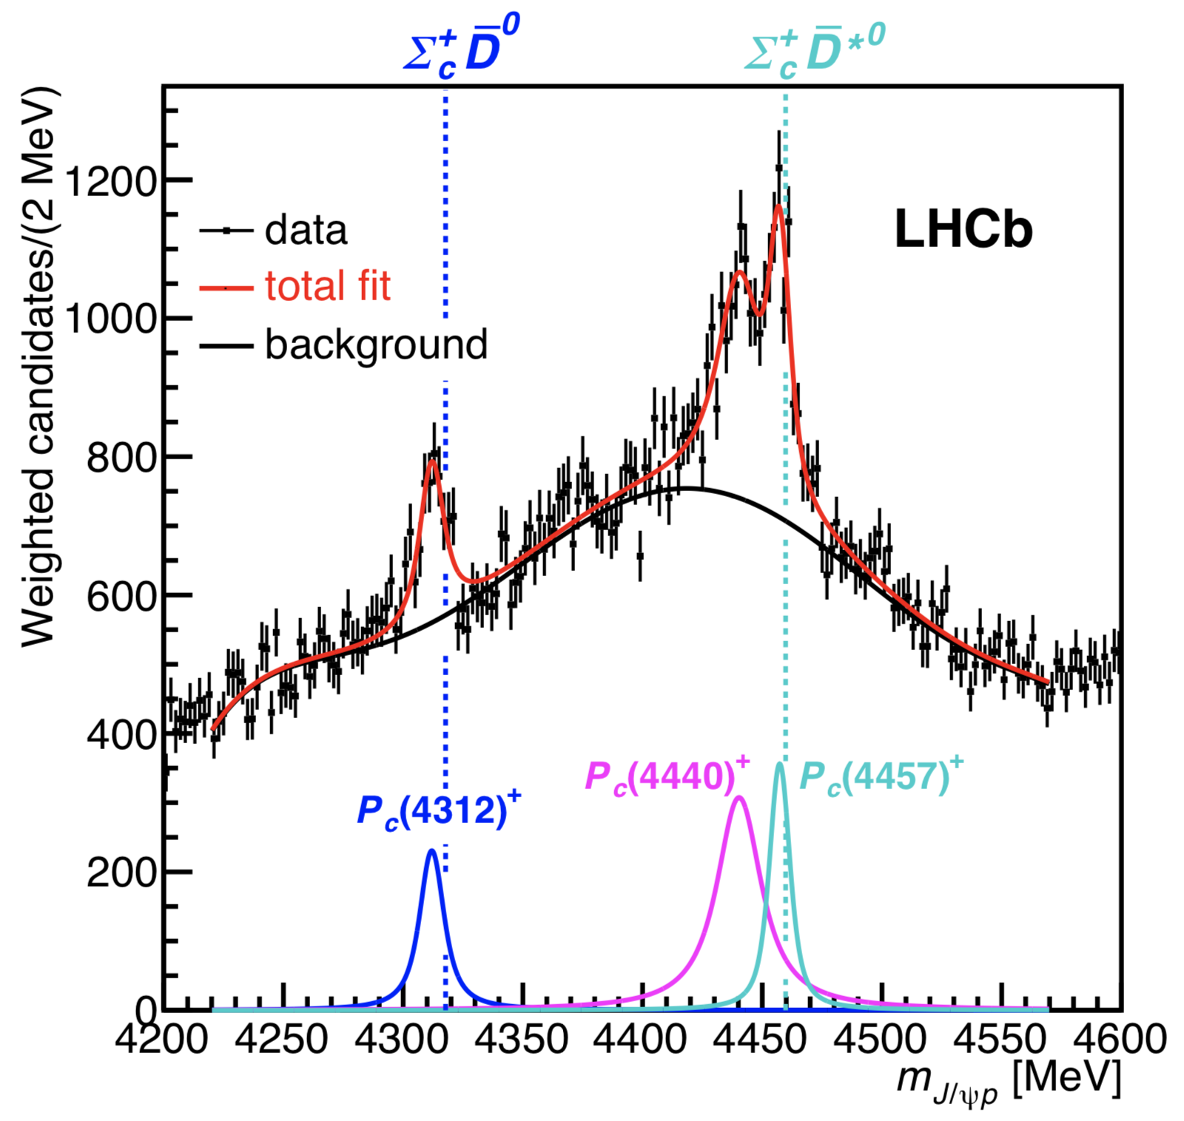
The subsequently reported $P_{c}$ states
Three narrow pentaquark states, ${P_{c}(4312)}^{+}$, ${P_{c}(4440)}^{+}$ and ${P_{c}(4457)}^{+}$, were observed in the $Λ_{b}^{0}→J/ψpK^{−}$ decays with higher statistical significances in 2019. Particularly, all of them are more than 5.0 $σ$.
Their experimental masses and widths are
$M={4311.9±0.7}_{−0.6}^{+6.8} MeV, Γ={9.8±2.7}_{−4.5}^{+3.7} MeV;$
$M={4440.3±1.3}_{−4.7}^{+4.1} MeV, Γ={20.6±4.9}_{−10.1}^{+8.7} MeV;$
$M={4457.3±0.6}_{−1.7}^{+4.1} MeV, Γ={6.4±2.0}_{−1.9}^{+5.7} MeV.$
R. Aaij et al. (LHCb), Phys. Rev. Lett. 122, 222001 (2019).

Slide 5
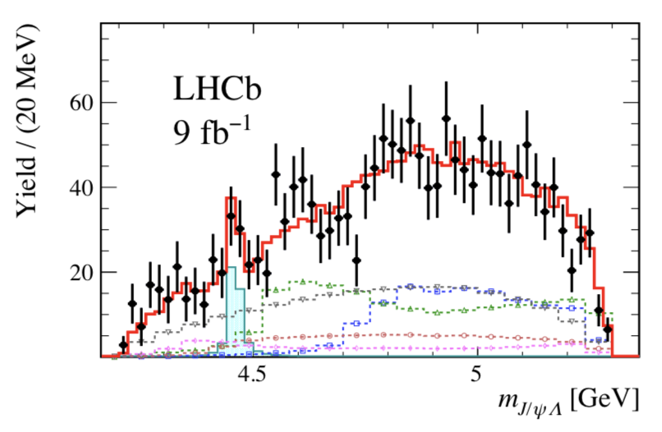
Hidden-charm pentaquark with strangeness ${P_{cs}(4459)}^{0}$
A new structure, which is consistent with being due to a $P_{cs}^{0}$ state, is found in the $Ξ_{b}^{−}→J/ψΛK^{−}$ decays in 2020. The experimental mass and width is
$$M={4458.8±2.9}_{−1.1}^{+4.7} MeV, Γ={17.3±6.5}_{−5.7}^{+8.0} MeV.$$
Additionally, several $Ξ^{−}$ excited states, ${Ξ(1690)}^{−}$, ${Ξ(1820)}^{−}$ and ${Ξ(1950)}^{−}$ etc., are also reported. [R. Aaij et al. (LHCb), Sci. Bull. 66 (2021) 1278-1287.]

Slide 6
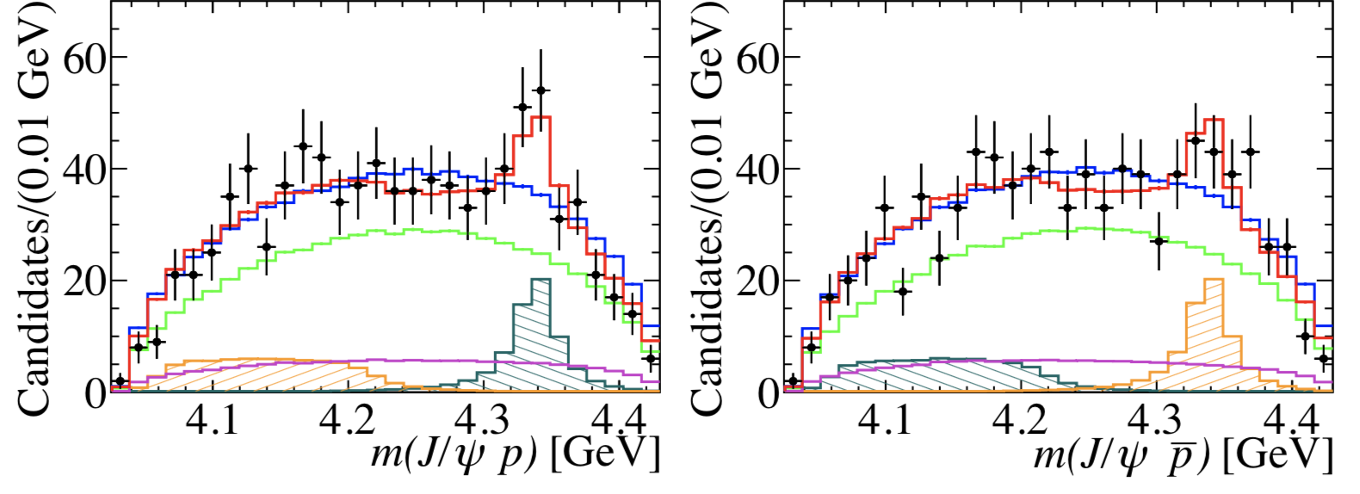
Resonance is also found in the $J/ψp(\overline{p})$ mass spectrum
A new structure with a significance in the range of 3.1 to 3.7 $σ$ is found in the $B_{s}^{0}→J/ψp\overline{p}$ decays in 2021. The experimental mass and width is
$$M={4337}_{−4−2}^{+7+2} MeV, Γ={29}_{−12−14}^{+26+14} MeV.$$
R. Aaij et al. (LHCb), arXiv:2108.04720 [hep-ex].

Slide 7
A large amount of excited baryons
${Ω_{c}(3000)}^{0}$, ${Ω_{c}(3050)}^{0}$, ${Ω_{c}(3065)}^{0}$ and ${Ω_{c}(3090)}^{0}$.
R. Aaij et al. (LHCb), arXiv:2107.03419 [hep-ex]. R. Aaij et al. (LHCb), Phys. Rev. Lett. 118, 182001 (2017).
J. Yelton et al. (Belle), Phys. Rev. D 97, 051102 (2018).
${Ω_{b}(6316)}^{−}$, ${Ω_{b}(6330)}^{−}$, ${Ω_{b}(6340)}^{−}$ and ${Ω_{b}(6350)}^{−}$.
R. Aaij et al. (LHCb), Phys. Rev. Lett. 124, 082002 (2020).
${Ξ_{c}(2923)}^{0}$, ${Ξ_{c}(2939)}^{0}$ and ${Ξ_{c}(2965)}^{0}$.
R. Aaij et al. (LHCb), Phys. Rev. Lett. 124, 222001 (2020).
${Ξ_{b}(6327)}^{0}$, ${Ξ_{b}(6333)}^{0}$, ${Ξ_{b}(6100)}^{−}$, ${Ξ_{b}(6227)}^{0}$ and ${Ξ_{b}(6227)}^{−}$.
R. Aaij et al. (LHCb), arXiv:2110.04497 [hep-ex]. R. Aaij et al. (LHCb), Phys. Rev. D 103, 012004 (2021).
R. Aaij et al. (LHCb), Phys. Rev. Lett. 121, 072002 (2018).
A. M. Sirunyan et al. (CMS), Phys. Rev. Lett. 126, 252003 (2021).
${Λ_{b}(6146)}^{0}$ and ${Λ_{b}(6152)}^{0}$.
R. Aaij et al. (LHCb), Phys. Rev. Lett. 123, 152001 (2019).
${Σ_{b}(6097)}^{±}$ and $Σ_{b}^{∗±}$.
R. Aaij et al. (LHCb), Phys. Rev. Lett. 122, 012001 (2019).

Slide 8
Unidentified baryons
In the $Λ_{b}^{0}→Λ_{c}^{+}K^{+}K^{−}π^{−}$ decay process, no open-charm pentaquark signature is found. [R. Aaij et al. (LHCb), Phys. Lett. B 815, 136172 (2021).]
No significant signal for the doubly heavy $Ξ_{bc}^{0}$ baryon is observed within a mass interval 6.7-7.2 GeV of the $Ξ_{bc}^{0}→D^{0}pK^{−}$ channel. [R. Aaij et al. (LHCb), JHEP 11(2020) 095.]
No significant signal for the doubly charmed $Ω_{cc}^{+}$ baryon is observed within a mass interval 3.6-4.0 GeV of the $Ω_{cc}^{+}→Ξ_{c}^{+}K^{−}π^{+}$channel. [R. Aaij et al. (LHCb), Sci. China-Phys. Mech. Astron. 64, 101062 (2021).]

Slide 9
Charm-strange resonances
New charm-strange resonances necessarily contribute to the $D^{−}K^{+}$ mass spectrum in studyinng the $B^{+}→D^{+}D^{−}K^{+}$ decays by the LHCb collaboration. They are signed as $X_{0,1}(2900)$ and the corresponding parameters are
$$M_{0}=2866±7MeV, Γ_{0}=57±13MeV;$$
$$M_{1}=2904±5MeV, Γ_{1}=110±12MeV.$$
R. Aaij et al. (LHCb), Phys. Rev. Lett. 125, 242001 (2020).
R. Aaij et al. (LHCb), Phys. Rev. D 102, 112003 (2020).

Slide 10
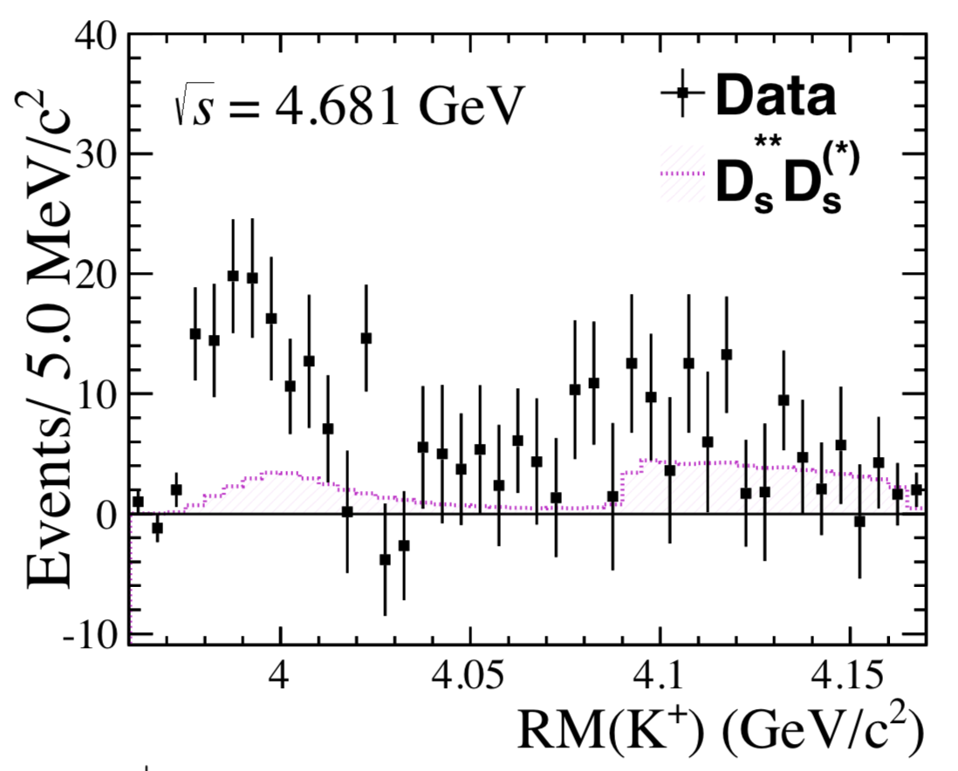
Hidden charm tetraquark with strangeness
A near-threshold structure, $Z_{cs}(3985)$, is reported in the $e^{+}e^{−}→K^{+}(D_{s}^{−}D^{∗0}+D_{s}^{∗−}D^{0})$ process by the BESIII collaboration.
$$M={3982.5}_{−2.6}^{+1.8}±2.1MeV, Γ={12.8}_{−4.4}^{+5.3}±3.0MeV.$$
M. Ablikim et al. (BESIII), arXiv:2011.07855 [hep-ex].

Slide 11
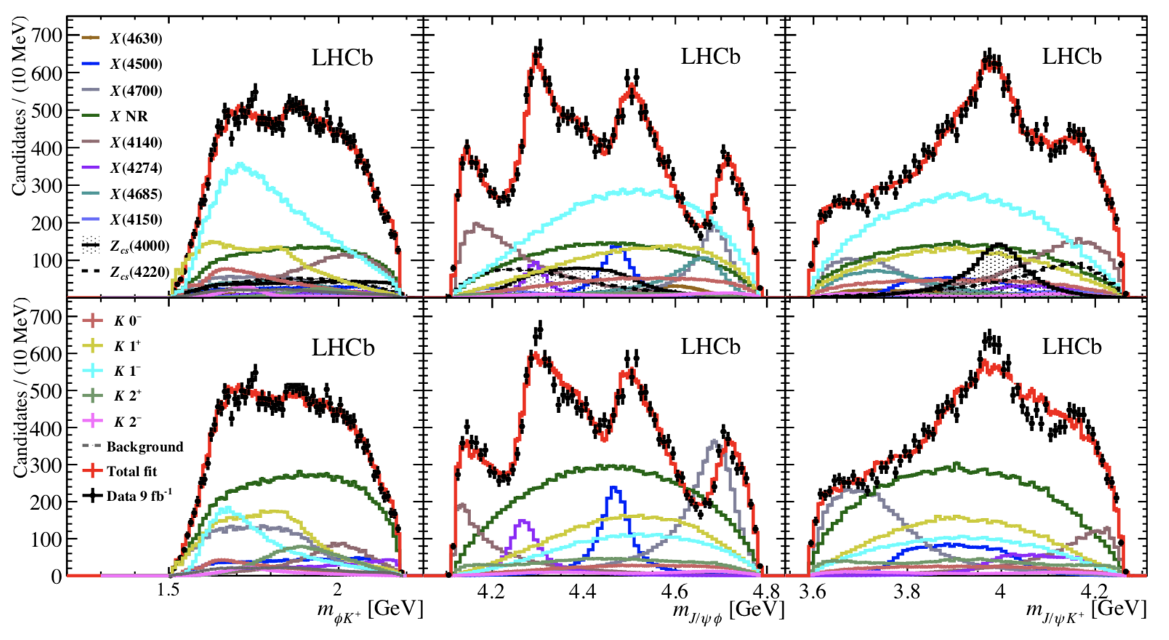
More charmonium-like resonances with strangeness are reported in the $B^{+}→J/ψφK^{+}$ decay by the LHCb collaboration. Particularly, $Z_{cs}(4000)$ and X(4685) are observed with high significance in $1^{+}$ state. Meanwhile, $Z_{cs}(4220)$ and X(4630) are also reported with significance exceeding 5$σ$.
$$M={4003±6}_{−14}^{+4}MeV, Γ=131±15±26MeV;$$
$$M={4216±24}_{−30}^{+43}MeV, Γ={233±52}_{−73}^{+97}MeV;$$
$$M={4626±10}_{−110}^{+18}MeV, Γ={174±27}_{−73}^{+134}MeV;$$
$$M={4684±7}_{−16}^{+13}MeV, Γ={126±15}_{−41}^{+37}MeV.$$
R. Aaij et al. (LHCb), Phys. Rev. Lett. 127, 082001 (2021).
Default model
Run 1 model

Slide 12
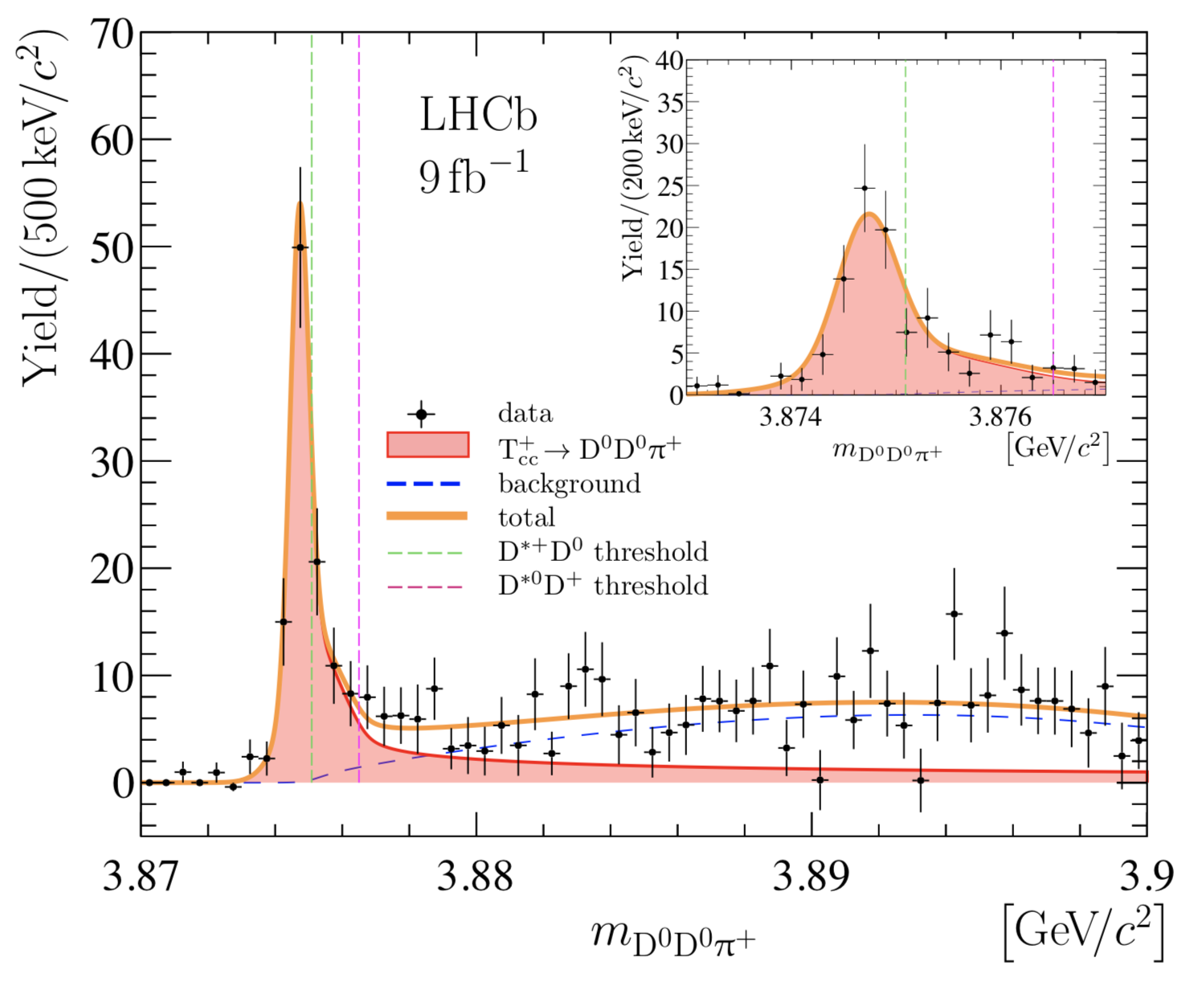
Doubly charmed tetraquark
An exotic narrow resonance in the $D^{0}D^{0}π^{+}$ mass spectrum just below the $D^{∗+}D^{0}$ threshold is studied by the LHCb. The state with mass $\sim 3875$ MeV is compatible with isoscalar $T_{cc}^{+}$ tetraquark which spin-parity is $1^{+}.$
$E_{B}=−{360±40}_{−0}^{+4}keV, Γ={48±2}_{−14}^{+0}keV;$
R. Aaij et al. (LHCb), arXiv:2109.01056 [hep-ex].
$E_{B}={−273±61±5}_{−14}^{+11}keV, Γ={410±165±43}_{−38}^{+18}keV;$
R. Aaij et al. (LHCb), arXiv:2109.01038 [hep-ex].

Slide 13
Structures in the di-$J/ψ$ mass spectrum
In the di-$J/ψ$ invariant mass spectrum, a narrow peak X(6900), a broad one within a mass region 6.2-6.8 GeV, and a hint for a possible structure around 7.2 GeV are reported by the LHCb collaboration. These could indicate the existence of fully-charm tetraquarks.
R. Aaij et al. (LHCb), Sci. Bull. 65 (2020) 1983.

Slide 14
Previously announced exotic states
X(3872)
S. K. Choi et al. (Belle), Phys. Rev. Lett. 91, 262001 (2003).
X(4100)
R. Aaij et al. (LHCb), Eur. Phys. J. C78, 1019 (2018).
$Z_{c}(3900)$
M. Ablikim et al. (BESIII), Phys. Rev. Lett. 110, 252001 (2013).
$Z_{c}(4020)$
M. Ablikim et al. (BESIII), Phys. Rev. Lett. 111, 242001 (2013).
M. Ablikim et al. (BESIII), Phys. Rev. Lett. 112, 132001 (2014).
$Z_{c}(4050)$
R. Mizuk et al. (Belle), Phys. Rev. D 78, 072004 (2008).
$Z_{b}(10610)$, $Z_{b}(10650)$
A. Bondar et al. (Belle), Phys. Rev. Lett. 108, 122001 (2012).

Slide 15
Recently announced exotic states which are categorized in multiquark contents.
Tetraquarks
Charm-strange: $X_{0,1}(2900)$.
Strange hidden-charm: $Z_{cs}(3985)$, $Z_{cs}(4000)$, $Z_{cs}(4220)$; X(4630), X(4685).
Doubly charmed: $T_{cc}(3875)$.
Fully charmed: X(6900).
Pentaquarks
Hidden-charm: $P_{c}(4312)$, $P_{c}(4337)$, $P_{c}(4380)$, $P_{c}(4440)$, $P_{c}(4457)$.
Strange hidden-charm: $P_{cs}(4459)$.

Slide 16
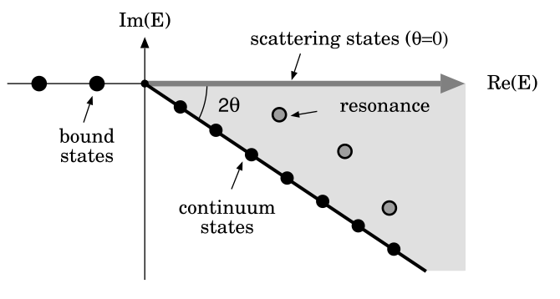
Theoretical framework
Complex scaling method
In the complex-scaling range of investigation, it is necessary to transform the coordinates of relative motions between quarks with a complex rotation, $\overset{⃑}{r}→\overset{⃑}{r}e^{iθ}$, and solving the complex scaled Schr$\ddot{o}$dinger equation
$$\left[H\left(θ\right)−E\left(θ\right)\right]Ψ(θ)=0.$$
Particularly, the bound, resonance and scattering states can be classified simultaneously in this framework according to the so-called ABC theorem.
J. Aguilar et al, Commun. Math. Phys. 22, 269 (1971).

Slide 17
Chiral quark model
Generally, a N-body Hamiltonian can be written as
$$H=\sum_{i=1}^{N}{\left(m_{i}+\frac{{\overset{⃑}{p}}_{i}^{2}}{2m_{i}}\right)}−T_{CM}+\sum_{j>i=1}^{N}{V\left({\overset{⃑}{r}}_{ij}\right)}.$$
The two-body interplay contains the color confinement, one-gluon exchange and Goldstone-Boson exchange terms,
$$V\left({\overset{⃑}{r}}_{ij}\right)=V_{CON}\left({\overset{⃑}{r}}_{ij}\right)+V_{OGE}\left({\overset{⃑}{r}}_{ij}\right)+V_{χ}\left({\overset{⃑}{r}}_{ij}\right).$$
Within only the central parts of potential are considered, each terms are read as the following parts.

Slide 18
Color confinement potential
$$V_{CON}\left({\overset{⃑}{r}}_{ij}\right)=\left[−a_{c}\left(1−e^{−μ_{c}r_{ij}}\right)+∆\right]\left({\overset{⃑}{λ}}_{i}^{c}∙{\overset{⃑}{λ}}_{j}^{c}\right),$$
where $a_{c}$, $μ_{c}$ and $∆$ are parameters, ${\overset{⃑}{λ}}^{c}$ is the Gell-Mann matrices in SU(3) color.
One-gluon exchange potential
$$V_{OGE}\left({\overset{⃑}{r}}_{ij}\right)=\frac{1}{4}α_{s}\left({\overset{⃑}{λ}}_{i}^{c}∙{\overset{⃑}{λ}}_{j}^{c}\right)\left[\frac{1}{r_{ij}}−\frac{1}{6m_{i}m_{j}}\left({\overset{⃑}{σ}}_{i}∙{\overset{⃑}{σ}}_{j}\right)\frac{e^{−r_{ij}/r_{0}(μ)}}{r_{ij}r_{0}^{2}(μ)}\right],$$
where $α_{s}$ is the QCD strong coupling constant, $m_{i}$ is the constituent quark mass and $\overset{⃑}{σ}$ is the Pauli matrices in spin degree of freedom.
The contact potential in color-magnetism term has been regularized as
$$δ\left({\overset{⃑}{r}}_{ij}\right)\sim \frac{1}{4πr_{0}^{2}}\frac{e^{−r_{ij}/r_{0}(μ)}}{r_{ij}},$$
with $r_{0}\left(μ\right)=r_{0}/μ$.

Slide 19
Chiral potentials
The pion, kaon, $η$ and $σ$ exchange interactions can be expressed as below
$$V_{π}\left({\overset{⃑}{r}}_{ij}\right)=\frac{g_{ch}^{2}}{4π}\frac{m_{π}^{3}}{12m_{i}m_{j}}\frac{Λ_{π}^{2}}{Λ_{π}^{2}−m_{π}^{2}}\left[Y(m_{π}r_{ij})−\frac{Λ_{π}^{3}}{m_{π}^{3}}Y(Λ_{π}r_{ij})\right]\left({\overset{⃑}{σ}}_{i}∙{\overset{⃑}{σ}}_{j}\right)\sum_{a=1}^{3}{\left({\overset{⃑}{λ}}_{i}^{a}∙{\overset{⃑}{λ}}_{j}^{a}\right)},$$
$$V_{σ}\left({\overset{⃑}{r}}_{ij}\right)=−\frac{g_{ch}^{2}}{4π}\frac{Λ_{σ}^{2}}{Λ_{σ}^{2}−m_{σ}^{2}}m_{σ}\left[Y\left(m_{σ}r_{ij}\right)−\frac{Λ_{σ}}{m_{σ}}Y\left(Λ_{σ}r_{ij}\right)\right],$$
$$V_{K}\left({\overset{⃑}{r}}_{ij}\right)=\frac{g_{ch}^{2}}{4π}\frac{m_{K}^{3}}{12m_{i}m_{j}}\frac{Λ_{K}^{2}}{Λ_{K}^{2}−m_{K}^{2}}\left[Y(m_{K}r_{ij})−\frac{Λ_{K}^{3}}{m_{K}^{3}}Y(Λ_{K}r_{ij})\right]\left({\overset{⃑}{σ}}_{i}∙{\overset{⃑}{σ}}_{j}\right)\sum_{a=4}^{7}{\left({\overset{⃑}{λ}}_{i}^{a}∙{\overset{⃑}{λ}}_{j}^{a}\right)},$$
$$V_{η}\left({\overset{⃑}{r}}_{ij}\right)=\frac{g_{ch}^{2}}{4π}\frac{m_{η}^{3}}{12m_{i}m_{j}}\frac{Λ_{η}^{2}}{Λ_{η}^{2}−m_{η}^{2}}\left[Y(m_{η}r_{ij})−\frac{Λ_{η}^{3}}{m_{η}^{3}}Y(Λ_{η}r_{ij})\right]\left({\overset{⃑}{σ}}_{i}∙{\overset{⃑}{σ}}_{j}\right)\left[cosθ_{p}\left({\overset{⃑}{λ}}_{i}^{8}∙{\overset{⃑}{λ}}_{j}^{8}\right)−sinθ_{p}\right],$$
where $Y\left(x\right)=e^{−x}/x$ is the Yukawa function and ${\overset{⃑}{λ}}^{a}$ is the Gell-Mann matrices in SU(3) flavor.
Meanwhile $m_{π}$, $m_{K}$ and $m_{η}$ are the experimental masses of the SU(3) Goldstone-Bosons, $m_{σ}$ is given by the PCAC relation $m_{σ}^{2}≃m_{π}^{2}+4m_{u, d}^{2}$.
The chiral coupling constant, $g_{ch}$ is determined from the $πNN$ coupling constant as
$\frac{g_{ch}^{2}}{4π}=\frac{9}{25}\frac{g_{πNN}^{2}}{4π}$ $\frac{m_{u, d}^{2}}{m_{N}^{2}}$.

Slide 20
Model parameters and application in conventional hadrons
The chiral quark model parameters, which have been fixed in advance reproducing hadron, hadron-hadron and multiquark phenomenology, are listed below.
 | $m_{u}=m_{d}$ (MeV) | 313
Quark Mass | $m_{s}$ (MeV) | 555
 | $m_{c}$ (MeV) | 1752
 | $m_{b}$ (MeV) | 5100
 | $Λ_{π}=Λ_{σ}$ (${fm}^{−1}$) | 4.20
Goldstone-Bosons | $Λ_{η}=Λ_{K}$ (${fm}^{−1}$) | 5.20
 | $$g_{ch}^{2}/4π$$ | 0.54
 | $θ_{p}$ ($°$) | -15
 | $a_{c}$ (MeV) | 430
Confinement | $μ_{c}$ (${fm}^{−1}$) | 0.70
 | $∆$ (MeV) | 181.1
 | $$α_{0}$$ | 2.118
OGE | $Λ_{0}$ (${fm}^{−1}$) | 0.113
 | $μ_{0}$ (MeV) | 36.976
 | $r_{0}$ (MeV fm) | 28.17

Slide 21
Theoretical and experimental (in parentheses) masses of the ground states of selected hadrons, unit in MeV. Model parameters are referenced as before.
J. Vijande et al., J. Phys. G: Nucl. Part. Phys. 31 (2005) 481-506.
Symmetry 12, 1869 (2020).
$$π$$ | $$η$$ | $$ρ$$ | $$ω$$ | D | $$D^{∗}$$ | $$D_{s}$$ | $$D_{s}^{∗}$$
149(135) | 689(548) | 772(770) | 696(783) | 1897(1870) | 2017(2007) | 1989(1968) | 2115(2112)
B | $$B^{∗}$$ | $$B_{s}$$ | $$B_{s}^{∗}$$ | $$B_{c}$$ | $$B_{c}^{∗}$$ | $$η_{c}$$ | $$η_{b}$$
5278(5280) | 5319(5325) | 5355(5366) | 5400(5415) | 6276(6276) | 6331(-) | 2989(2984) | 9454(9398)
$$J/ψ$$ | $$Υ$$
3097(3097) | 9505(9460)
N | $$Λ_{c}$$ | $$Σ_{c}$$ | $$Σ_{c}^{∗}$$ | $$Ξ_{cc}$$ | $$Ξ_{cc}^{∗}$$ | $$Λ_{b}$$ | $$Σ_{b}$$
744(939) | 2099(2286) | 2505(2454) | 2549(2518) | 3663(3519) | 3717(-) | 5626(5619) | 5817(5811)
$$Σ_{b}^{∗}$$
5834(5832)

Slide 22
A lattice QCD inspired quark model
According to lattice QCD investigations, the interplay between a pair of heavy quarkonium can be well approximated by the Cornell potential, viz., a linear confinement plus a Coulomb interaction along with a spin-spin dependent term. Therefore the two-body interactions read as
$$V_{Q\overline{Q}}\left({\overset{⃑}{r}}_{ij}\right)=−\frac{α}{r_{ij}}+σr_{ij}+βe^{−γr_{ij}}\left({\overset{⃑}{s}}_{i}∙{\overset{⃑}{s}}_{j}\right).$$
The parameters $α$, $σ$, $β$ and $γ$ are chosen as below, besides, the quark-quark interaction $V_{QQ}$ is half of $V_{Q\overline{Q}}$.
Quark Mass | $m_{c}$ (MeV) | 1290
 | $m_{b}$ (MeV) | 4700
Coulomb | $$α$$ | 0.4105
Confinement | $σ$ (${GeV}^{2}$) | 0.2
 | $γ$ (GeV) | 1.982
Spin-Spin | $β_{c}$ (GeV) | 2.06
 | $β_{b}$ (GeV) | 0.318

Slide 23
Within this model, the theoretical and experimental masses of the S-wave heavy quarkonium are listed below (unit in MeV).
J. Zhao et al., Prog. Part. Nucl. Phys. 114, 103801 (2020).
Symmetry 12, 1869 (2020).
Phys. Rev. D 104, 014006 (2021).
State | $$M_{th}$$ | $$M_{exp}$$
$$η_{c}(1S)$$ | 2968 | 2981
$$η_{c}(2S)$$ | 3655 | 3639
$$J/ψ(1S)$$ | 3102 | 3097
$$ψ(2S)$$ | 3720 | 3686
$$η_{b}(1S)$$ | 9401 | 9398
$$η_{b}(2S)$$ | 9961 | 9999
$$Υ(1S)$$ | 9463 | 9460
$$Υ(2S)$$ | 9981 | 10023

Slide 24
Wavefunction of multiquark system
A complete antisymmetry wavefunction, which includes color, spin, flavor and spatial degrees of freedoms, is written as
$$Ψ_{JM_{J}, I, i, j, k}=𝒜\left[{\left[ψ_{L}χ_{S}^{σ_{i}}\right]}_{JM_{J}}χ_{I}^{f_{j}}χ_{k}^{c}\right].$$
Particularly, $ψ_{L}$, $χ_{S}^{σ_{i}}$, $χ_{I}^{f_{j}}$ and $χ_{k}^{c}$ stand for the spatial, spin, flavor and color wavefunctions, respectively. $𝒜$ is the antisymmetry operator of system.

Slide 25
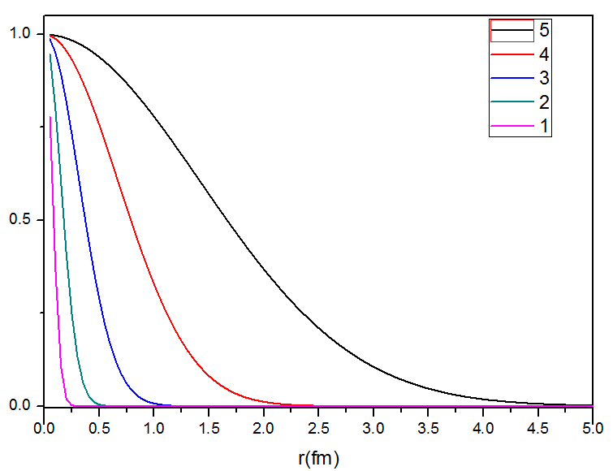
Gaussian expansion method
E. Hiyama et al., Prog. Part. Nucl. Phys. 51(2003) 223-307.
The intrinsic spatial wavefunction is expanded in Gaussian bases which are taken in geometric progression form. Generally it read as
$$φ_{nlm}\left(\overset{⃑}{r}\right)={\left[\frac{2^{l+2}{\left(2v_{n}\right)}^{l+\frac{3}{2}}}{\sqrt{π}\left(2l+1\right)}\right]}^{\frac{1}{2}}e^{−v_{n}r^{2}}Y_{lm}\left(\hat{r}\right).$$
The infinitesimally shifted Gaussian basis is also employed in studying angular excitation state, in which no laborious Racah algebra is required.
$$φ_{nlm}\left(\overset{⃑}{r}\right)=N_{nl}\lim_{ε→0}{\frac{1}{{(v_{n}ε)}^{l}}}\sum_{k}^{k_{max}}{C_{lm,k}}e^{−v_{n}{(\overset{⃑}{r}−ε{\overset{⃑}{D}}_{lm,k})}^{2}}.$$
Particularly, the Gaussian parameter $v_{n}$ reads
$$v_{n}={\left[r_{max}^{\frac{n−1}{N−1}}∙r_{min}^{\frac{(n−1)(N−2)}{N−1}}\right]}^{−2}.$$

Slide 26
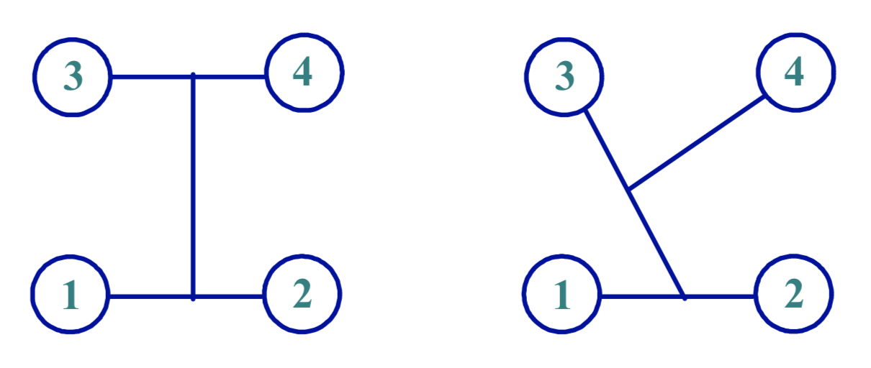
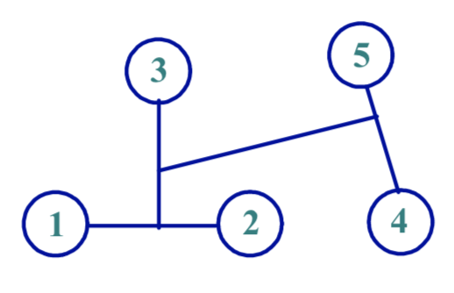
In the relative motion coordinates, the spatial wavefunction of 4- and 5-body system can be generally written as
Tetraquark: $ψ_{LM_{L}}={\left[{\left[φ_{n_{1}l_{1}}\left(\overset{⃑}{ρ}\right)φ_{n_{2}l_{2}}\left(\overset{⃑}{λ}\right)\right]}_{l}φ_{n_{3}l_{3}}\left(\overset{⃑}{R}\right)\right]}_{LM_{L}}.$
Pentaquark: $ψ_{LM_{L}}={\left[{\left[{\left[φ_{n_{1}l_{1}}\left(\overset{⃑}{ρ}\right)φ_{n_{2}l_{2}}\left(\overset{⃑}{λ}\right)\right]}_{l}φ_{n_{3}l_{3}}\left(\overset{⃑}{r}\right)\right]}_{l^{′}}φ_{n_{4}l_{4}}\left(\overset{⃑}{R}\right)\right]}_{LM_{L}}.$
The internal Jacobi coordinates of tetra- and penta-quark read as
$\left\{\begin{aligned}\overset{⃑}{ρ}={\overset{⃑}{x}}_{1}−{\overset{⃑}{x}}_{2} \\ \overset{⃑}{λ}={\overset{⃑}{x}}_{3}−{\overset{⃑}{x}}_{4} \\ \overset{⃑}{R}=\frac{m_{1}{\overset{⃑}{x}}_{1}+m_{2}{\overset{⃑}{x}}_{2}}{m_{1}+m_{2}}−\frac{m_{3}{\overset{⃑}{x}}_{3}+m_{4}{\overset{⃑}{x}}_{4}}{m_{3}+m_{4}} \end{aligned}\right.,$ $\left\{\begin{aligned}\overset{⃑}{ρ}={\overset{⃑}{x}}_{1}−{\overset{⃑}{x}}_{2} \\ \overset{⃑}{λ}={\overset{⃑}{x}}_{3}−\frac{m_{1}{\overset{⃑}{x}}_{1}+m_{2}{\overset{⃑}{x}}_{2}}{m_{1}+m_{2}} \\ \overset{⃑}{R}={\overset{⃑}{x}}_{4}−\frac{m_{1}{\overset{⃑}{x}}_{1}+m_{2}{\overset{⃑}{x}}_{2}+m_{3}{\overset{⃑}{x}}_{3}}{m_{1}+m_{2}+m_{3}} \end{aligned}\right.. \left\{\begin{aligned}\begin{aligned}\overset{⃑}{ρ}={\overset{⃑}{x}}_{1}−{\overset{⃑}{x}}_{2} \\ \overset{⃑}{λ}={\overset{⃑}{x}}_{3}−\frac{m_{1}{\overset{⃑}{x}}_{1}+m_{2}{\overset{⃑}{x}}_{2}}{m_{1}+m_{2}} \\ \overset{⃑}{r}={\overset{⃑}{x}}_{4}−{\overset{⃑}{x}}_{5}\end{aligned} \\ \overset{⃑}{R}=\frac{m_{1}{\overset{⃑}{x}}_{1}+m_{2}{\overset{⃑}{x}}_{2}+m_{3}{\overset{⃑}{x}}_{3}}{m_{1}+m_{2}+m_{3}}−\frac{m_{4}{\overset{⃑}{x}}_{4}+m_{5}{\overset{⃑}{x}}_{5}}{m_{4}+m_{5}}\end{aligned}\right..$

Slide 27
Results and Discussions
Since our theoretical investigation on $P_{c}$ states which were experimentally reported in 2015, a dozen of exotic resonances listed below are systematically studied within the similar frameworks. Plausible predictions and interpretations for them may indicate an effectiveness of the application of GEM and CSM in CQM.
 |  | Tetraquarks
Charm-strange | $$X_{0,1}(2900)$$
Strange hidden-charm | $$Z_{cs}(3985)$$ | $$Z_{cs}(4000)$$ | $$Z_{cs}(4220)$$ | X(4630) | X(4685)
Doubly charmed | $$T_{cc}(3875)$$
Fully charmed | X(6900)
 |  | Pentaquarks
Hidden-charm | $$P_{c}(4312)$$ | $$P_{c}(4337)$$ | $$P_{c}(4380)$$ | $$P_{c}(4440)$$ | $$P_{c}(4457)$$

Slide 28
Hidden-charm pentaquarks
Two baryon-meson configurations are considered in constructing the wave function of system. However, the inner quarks are not confined in a particular sub-cluster, and the spatial part is expanded in Gaussian bases $φ_{nlm}\left(\overset{⃑}{r}\right)$ introduced before.
In the color degree of freedom, both singlet and octet bases are employed. They are generally read as
$$χ_{1}^{c}=\frac{1}{\sqrt{18}}\left(rgb−rbg+gbr−grb+brg−bgr\right)\left(\overline{r}r+\overline{g}g+\overline{b}b\right),$$
$$χ_{k}^{c}=\frac{1}{\sqrt{8}}\left(χ_{3,1}^{k}χ_{2,8}−χ_{3,2}^{k}χ_{2,7}−χ_{3,3}^{k}χ_{2,6}+χ_{3,4}^{k}χ_{2,5}+χ_{3,5}^{k}χ_{2,4}−χ_{3,6}^{k}χ_{2,3}−χ_{3,7}^{k}χ_{2,2}+χ_{3,8}^{k}χ_{2,1}\right),$$
where the baryon and meson sub-clusters bases can be referenced in the paper.
Phys. Rev. D 95, 014010 (2017).

Slide 29
The spin and flavor wave functions are also obtained by two clusters couplings formalism. In particular, for a S-wave system, the spin-parity from ${1/2}^{−}$ to ${5/2}^{−}$ is considered, and isospin is settled to be $1/2$.
$$χ_{S, M_{S}}^{σ}(5)=\sum{C_{S_{3}, M_{S3}, S_{2}, M_{S2}}^{S, M_{S}}χ_{S_{3}, M_{S3}}^{σ}(3)χ_{S_{2}, M_{S2}}^{σ}(2)}.$$
$$χ_{\frac{1}{2}, \frac{1}{2}}^{f}(5)=\sum{C_{I_{3}, { M}_{I3}, I_{2}, M_{I2}}^{\frac{1}{2}, \frac{1}{2}}χ_{I_{3}, { M}_{I3}}^{f}(3)χ_{I_{2}, M_{I2}}^{f}(2)}.$$

Slide 30
According to the experimental announcements of the ${P_{c}(4380)}^{+}$ and ${P_{c}(4450)}^{+}$ states in 2015, a systematical study on pentaquark-charmonium states was performed in a chiral quark model.
Therein, apart from a $Σ_{c}^{∗}\overline{D}$ molecular interpretation for the ${P_{c}(4380)}^{+}$, which quantum number is predicted to be $\frac{1}{2}{\frac{3}{2}}^{−}$, all of the later reported three resonances in 2019 can be well compatible with our investigation.
Particularly, the ${P_{c}(4312)}^{+}$ and ${P_{c}(4440)}^{+}$ are identified as $Σ_{c}\overline{D}$ and $Σ_{c}{\overline{D}}^{∗}$ molecules, respectively. Both of them are predicted within $\frac{1}{2}{\frac{1}{2}}^{−}$ state. An $Σ_{c}{\overline{D}}^{∗}$ molecular resonance in $\frac{1}{2}{\frac{3}{2}}^{−}$ state is consistent with the ${P_{c}(4457)}^{+}$. These results are also in line with many theoretical investigations.
(They can be referenced in Table III and IV of the paper.)

Slide 31
Summarized theoretical masses on the hidden-charm pentaquarks by different investigations.
 | $$\frac{1}{2}{\frac{1}{2}}^{−}$$ | $$\frac{1}{2}{\frac{3}{2}}^{−}$$ | $$\frac{1}{2}{\frac{5}{2}}^{−}$$ |  | $$\frac{1}{2}{\frac{1}{2}}^{−}$$ | $$\frac{1}{2}{\frac{3}{2}}^{−}$$ | $$\frac{1}{2}{\frac{5}{2}}^{−}$$
This work | $$Λ_{c}{\overline{D}}^{∗}(4291)$$ | $$Σ_{c}^{∗}\overline{D}(4370)$$ | $$Σ_{c}^{∗}{\overline{D}}^{∗}(4438)$$ | Ref. 4 | $$Σ_{c}\overline{D}(4311)$$ | $$Σ_{c}^{∗}\overline{D}(4376)$$ | $$Σ_{c}^{∗}{\overline{D}}^{∗}(4523)$$
G. Yang et al, PRD 95, 014010 (2017). | $$Σ_{c}\overline{D}(4312)$$ | $$Σ_{c}{\overline{D}}^{∗}(4459)$$ |  | M. Liu et al, PRL 122, 242001 (2019). | $$Σ_{c}{\overline{D}}^{∗}(4440)$$ | $$Σ_{c}{\overline{D}}^{∗}(4457)$$
 | $$Σ_{c}{\overline{D}}^{∗}(4421)$$ | $$Σ_{c}^{∗}{\overline{D}}^{∗}(4510)$$ |  |  | $$Σ_{c}^{∗}{\overline{D}}^{∗}(4500)$$ | $$Σ_{c}^{∗}{\overline{D}}^{∗}(4510)$$
 | $$Σ_{c}^{∗}{\overline{D}}^{∗}(4422)$$ |  |  | Ref. 5 | $$Σ_{c}\overline{D}(4317)$$ | $$Σ_{c}{\overline{D}}^{∗}(4461)$$
Ref. 1 | $$Σ_{c}\overline{D}(4306)$$ | $$Σ_{c}{\overline{D}}^{∗}(4309)$$ | $$Σ_{c}^{∗}{\overline{D}}^{∗}(4517)$$ | J. He, EPJC 79, 393 (2019). | $$Σ_{c}{\overline{D}}^{∗}(4427)$$
H. Huang et al, EPJC 76, 624 (2016). | $$Σ_{c}{\overline{D}}^{∗}(4444)$$ | $$Σ_{c}^{∗}\overline{D}(4450)$$ |  | Ref. 6 | $$Σ_{c}\overline{D}(4306)$$ | $$Σ_{c}{\overline{D}}^{∗}(4452)$$
 | $$Σ_{c}^{∗}{\overline{D}}^{∗}(4503)$$ | $$Σ_{c}^{∗}{\overline{D}}^{∗}(4514)$$ |  | C. Xiao et al, PRD 100, 014021 (2019). | $$Σ_{c}{\overline{D}}^{∗}(4453)$$
Ref. 2 | $$Σ_{c}\overline{D}(4307)$$ | $$Σ_{c}{\overline{D}}^{∗}(4445)$$ |  | Ref. 7 | $$Λ_{c}{\overline{D}}^{∗}(4327)$$ | $$Λ_{c}{\overline{D}}^{∗}(4367)$$ | $$Σ_{c}^{∗}{\overline{D}}^{∗}(4546)$$
H. Huang et al, PRD 99, 014010 (2019). | $$Σ_{c}{\overline{D}}^{∗}(4450)$$ | $$Σ_{c}^{∗}\overline{D}(4376)$$ |  | X. Weng et al, PRD 100, 016014 (2019). | $$Λ_{c}\overline{D}(4372)$$ | $$NJ/ψ(4367)$$
 | $$Σ_{c}^{∗}{\overline{D}}^{∗}(4525)$$ | $$Σ_{c}^{∗}{\overline{D}}^{∗}(4523)$$ |  |  | $$Λ_{c}{\overline{D}}^{∗}(4480)$$ | $$Λ_{c}{\overline{D}}^{∗}(4476)$$
Ref. 3 |  | $$Σ_{c}{\overline{D}}^{∗}(4370)$$
H. Chen et al, PRL 115, 172001 (2015). |  | $$Σ_{c}^{∗}\overline{D}(4450)$$

Slide 32
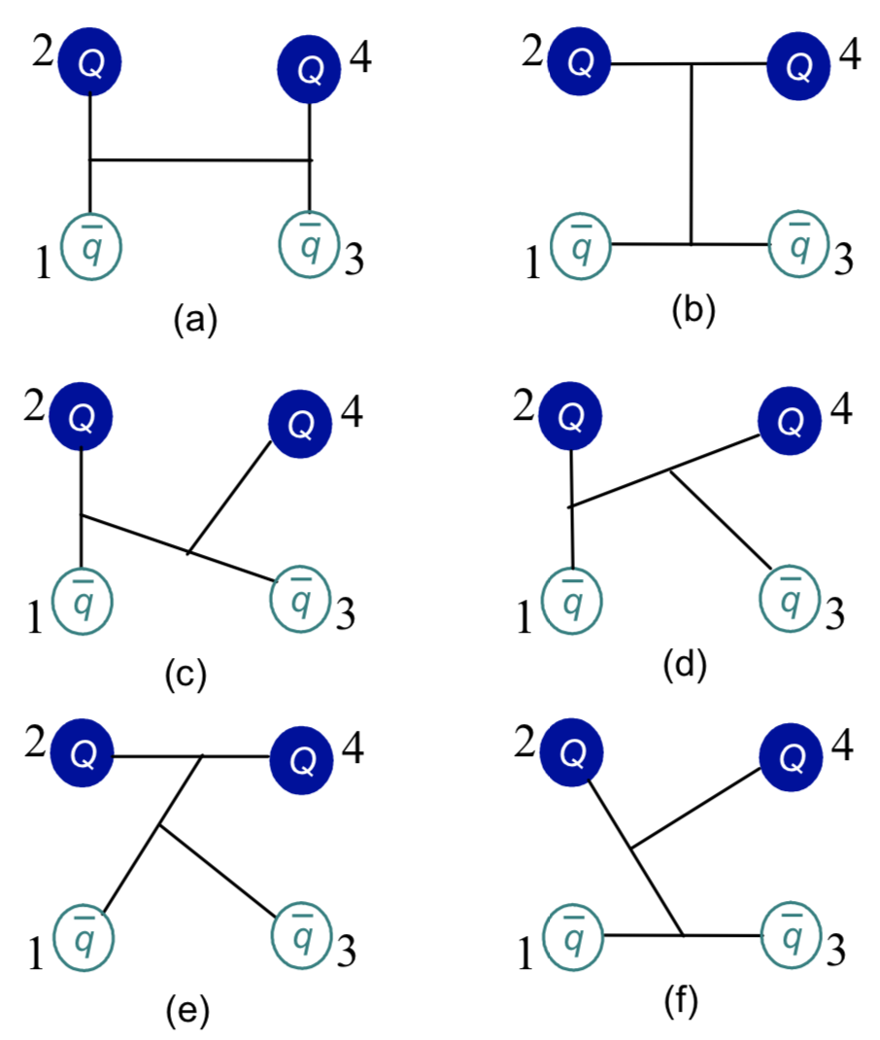
Doubly heavy tetraquark
According to the successful application of ChQM and GEM in pentaquarks, this formalism along with CSM is then further employed in studying on doubly heavy tetraquarks.
In a $QQ\overline{q}\overline{q}$ $\left(Q=c, b;q=u,d, s\right)$ system, three kinds of structures, viz., dimeson, diquark-antidiquark and K-type configurations are generally considered.
Apart from commonly accessible bases in spin, flavor and spatial degrees of freedoms, the color channels are considered completely, and they are read as the following 12 cases.
Symmetry 12, 1869 (2020).
Phys. Rev. D 101, 014001 (2020).
Phys. Rev. D 102, 054023 (2020).

Slide 33
$1×1$: $χ_{1}^{c}=\frac{1}{3}\left(\overline{r}r+\overline{g}g+\overline{b}b\right)\left(\overline{r}r+\overline{g}g+\overline{b}b\right);$
$8×8$: $χ_{2}^{c}=\frac{\sqrt{2}}{12}(3\overline{b}r\overline{r}b+3\overline{g}r\overline{r}g+3\overline{b}g\overline{g}b+3\overline{g}b\overline{b}g+3\overline{r}g\overline{g}r+3\overline{r}b\overline{b}r+$
$2\overline{r}r\overline{r}r+2\overline{g}g\overline{g}g+2\overline{b}b\overline{b}b−\overline{r}r\overline{g}g−\overline{g}g\overline{r}r−\overline{b}b\overline{g}g−\overline{b}b\overline{r}r−\overline{g}g\overline{b}b−\overline{r}r\overline{b}b);$
3$×\overline{3}$: $χ_{3}^{c}=\frac{\sqrt{3}}{6}(\overline{r}r\overline{g}g−\overline{g}r\overline{r}g+\overline{g}g\overline{r}r−\overline{r}g\overline{g}r+\overline{r}r\overline{b}b−\overline{b}r\overline{r}b+\overline{b}b\overline{r}r−$
$\overline{r}b\overline{b}r+\overline{g}g\overline{b}b−\overline{b}g\overline{g}b+\overline{b}b\overline{g}g−\overline{g}b\overline{b}g);$
6$×\overline{6}$: $χ_{4}^{c}=\frac{\sqrt{6}}{12}(2\overline{r}r\overline{r}r+2\overline{g}g\overline{g}g+2\overline{b}b\overline{b}b+\overline{r}r\overline{g}g+\overline{g}r\overline{r}g+\overline{g}g\overline{r}r+$
$\overline{r}g\overline{g}r+\overline{r}r\overline{b}b+\overline{b}r\overline{r}b+\overline{b}b\overline{r}r+\overline{r}b\overline{b}r+\overline{g}g\overline{b}b+\overline{b}g\overline{g}b+\overline{b}b\overline{g}g+\overline{g}b\overline{b}g);$
$K_{1}−type:$ ${\left[C_{\left[11\right],[1]}^{[21]}C_{\left[21\right],[11]}^{[221]}C_{\left[221\right],[1]}^{[222]}\right]}_{5},$ ${\left[C_{\left[11\right],[1]}^{[111]}C_{\left[111\right],[11]}^{[221]}C_{\left[221\right],[1]}^{[222]}\right]}_{6};$
$K_{2}−type:{\left[C_{\left[11\right],[1]}^{[111]}C_{\left[111\right],[1]}^{[211]}C_{\left[211\right],[11]}^{[222]}\right]}_{7},$ ${\left[C_{\left[11\right],[1]}^{[21]}C_{\left[21\right],[1]}^{[211]}C_{\left[211\right],[11]}^{[222]}\right]}_{8};$
$K_{3}−type:$ ${\left[C_{\left[1\right],[1]}^{[2]}C_{\left[2\right],[11]}^{[211]}C_{\left[211\right],[11]}^{[222]}\right]}_{9},$ ${\left[C_{\left[1\right],[1]}^{[11]}C_{\left[11\right],[11]}^{[211]}C_{\left[211\right],[11]}^{[222]}\right]}_{10};$
$K_{4}−type:$ ${\left[C_{\left[11\right],[11]}^{[22]}C_{\left[22\right],[1]}^{[221]}C_{\left[221\right],[1]}^{[222]}\right]}_{11},$ ${\left[C_{\left[11\right],[11]}^{[211]}C_{\left[211\right],[1]}^{[221]}C_{\left[221\right],[1]}^{[222]}\right]}_{12}.$
The necessary bases can be found in the paper too.

Slide 34
Lowest-lying states of doubly charm tetraquarks with $IJ^{P}={01}^{+}$, unit in MeV.
$T_{cc}^{+}$ reported by the LHCb.
N. Li et al., PRD 88, 114008 (2013).
N. Li et al., CPL 38, 092001 (2021).
L. Meng et al., PRD 104, 051502 (2021).
X. Dong et al., Commun. Theor. Phys. 73 (2021) 125201.
X. Ling et al., arXiv:2108.00947.
R. Chen et al., arXiv:2108.01911.
X. Weng et al., arXiv:2108.07242.
Y. Huang et al., arXiv:2108.13028.
X. Chen, arXiv:2109.02828.
M. Du et al., arXiv:2110.13765.
Channel | Color | M | $$E_{B}$$ | $$M^{′}$$
$D^{+}D^{∗0}$(3877) | S | 3915 | 0 | 3877
 | H | 4421 | +506 | 4383
 | S+H | 3914 | -1 | 3876
 | Percentage (S, H): 97.3%, 2.7%
$D^{∗+}D^{∗0}$(4018) | S | 4034 | 0 | 4018
 | H | 4390 | +356 | 4374
 | S+H | 4033 | -1 | 4017
 | Percentage (S, H): 95.5%, 4.5%
$${\left(cc\right)}^{∗}(\overline{u}\overline{d})$$ |  | 3778
$$(cc){\left(\overline{u}\overline{d}\right)}^{∗}$$ |  | 4220
Mixed |  | 3726
Since there are strong couplings among these channels, a deeply bound state is obtained at 3726 MeV and a compact tetraquark structure is also concluded with $r_{\overline{u}\overline{d}}=0.658$ fm, $r_{\overline{q}c}=0.666$ fm and $r_{cc}=0.522$ fm.
$${(D^{+}D^{∗0})}^{1}$$ | $${(D^{∗+}D^{∗0})}^{1}$$ | $${(D^{+}D^{∗0})}^{8}$$ | $${(D^{∗+}D^{∗0})}^{8}$$ | $${\left(cc\right)}^{∗}(\overline{u}\overline{d})$$ | $$(cc){\left(\overline{u}\overline{d}\right)}^{∗}$$
25.8% | 15.4% | 10.7% | 11.2% | 36.7% | 0.2%

Slide 35
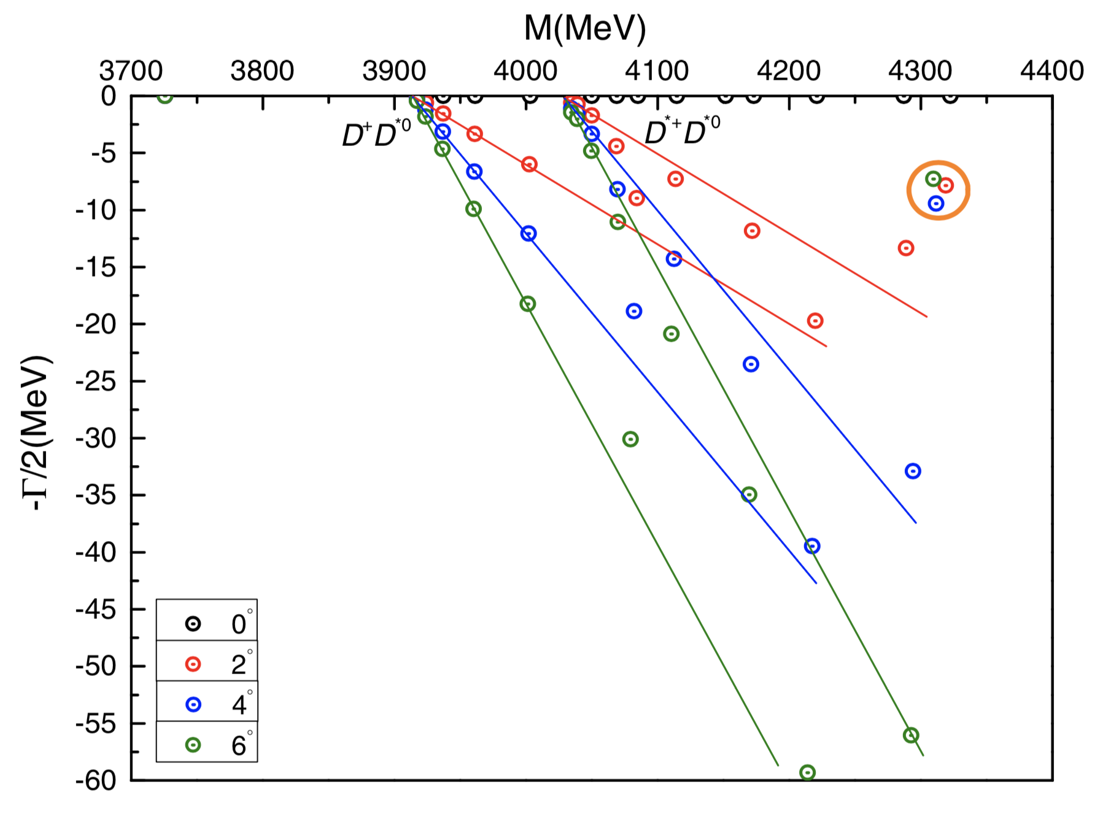
In a complete coupled-channel calculation by CSM and the rotated angle $θ$ varies from $0^{°}$ to $6^{°}$, the bound state remains at 3726 MeV of real-axis. Moreover, a narrow resonance which mass and width is 4312 MeV and 16.0 MeV is clearly shown below.

Slide 36
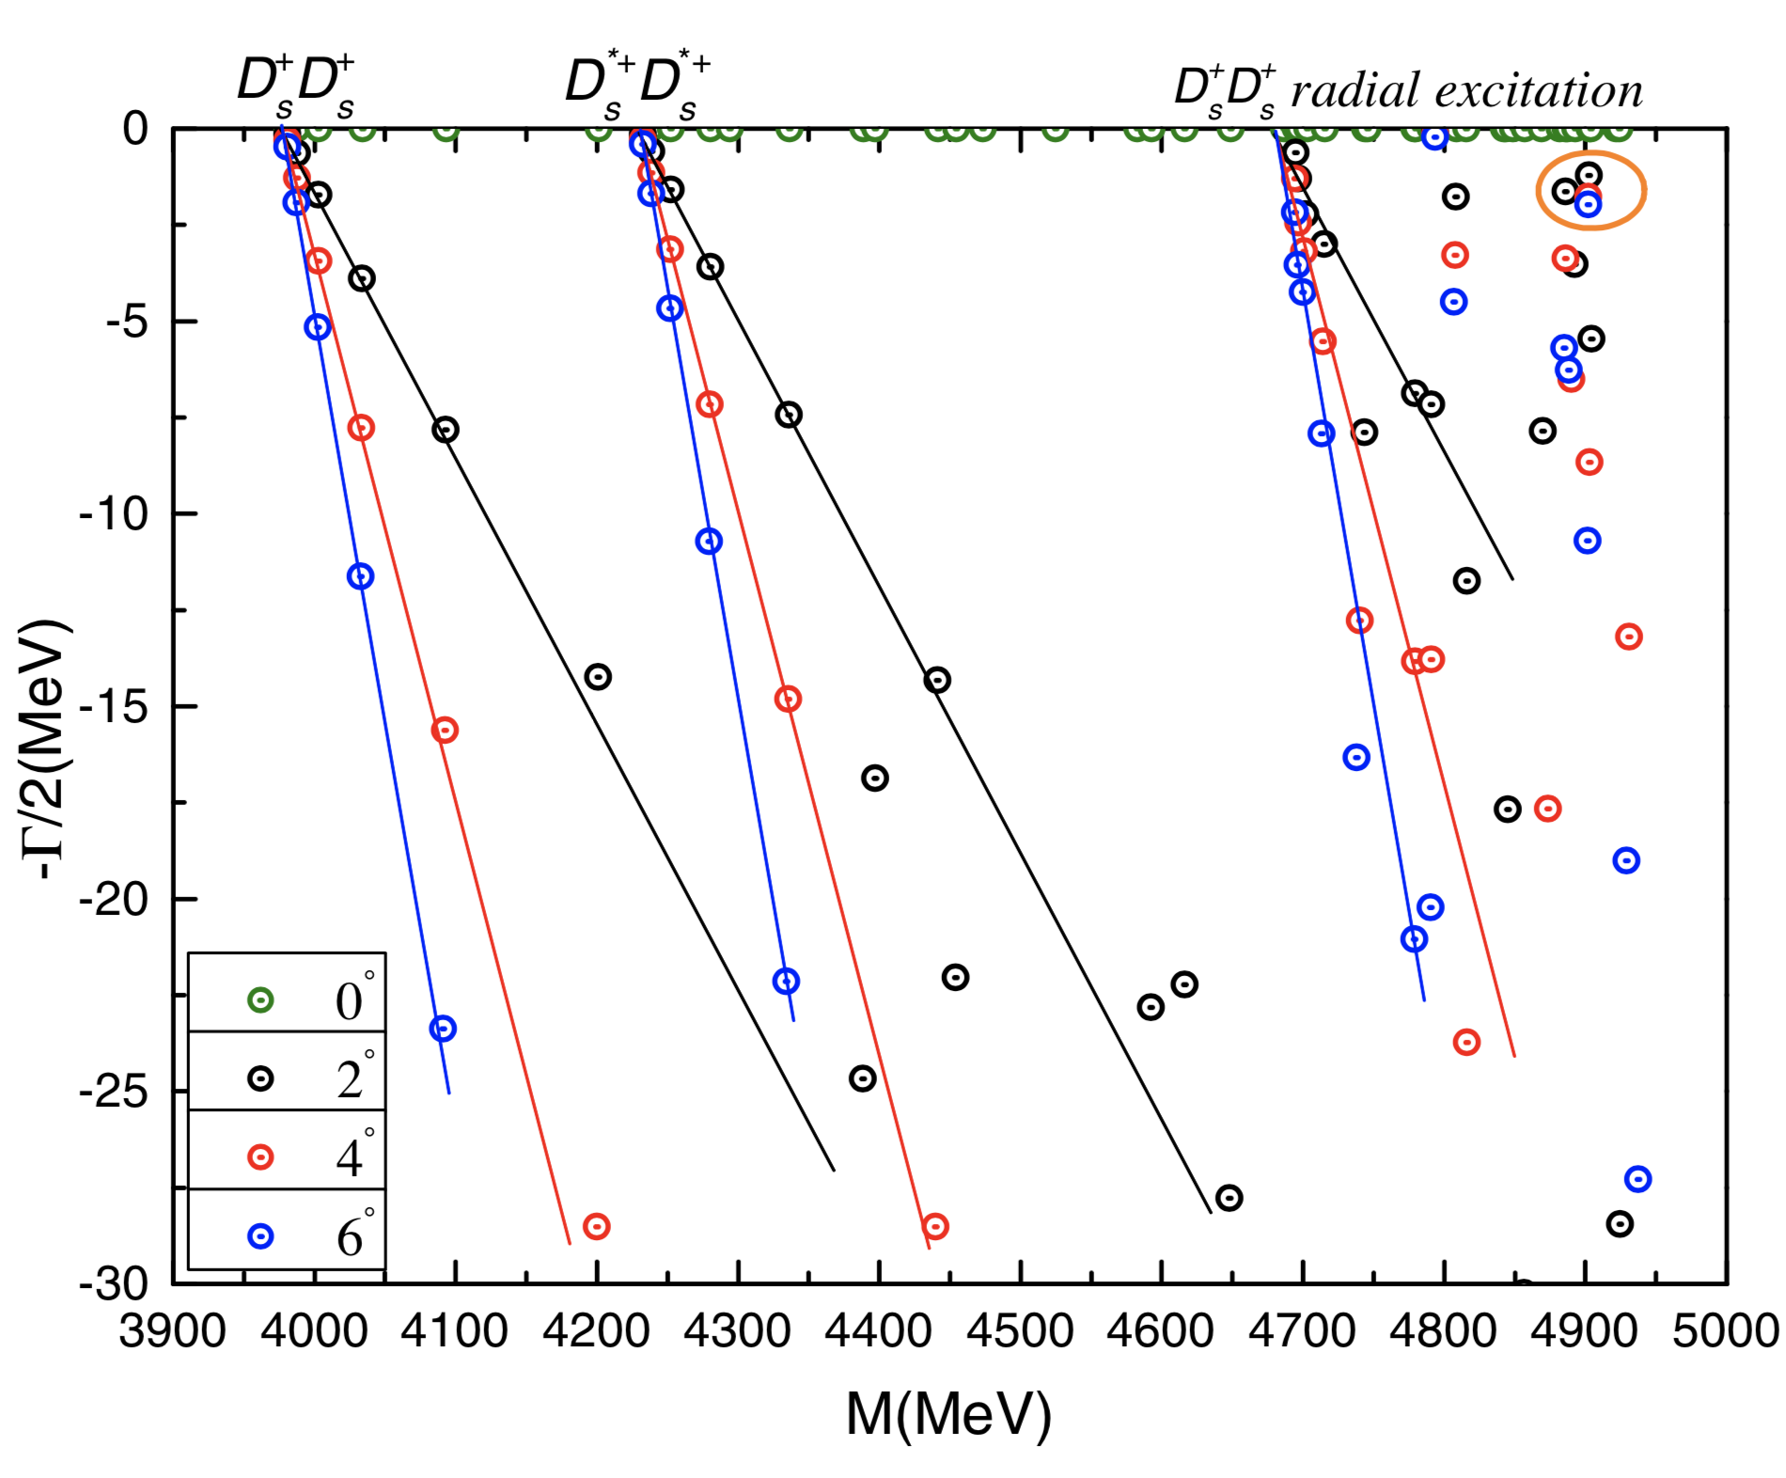
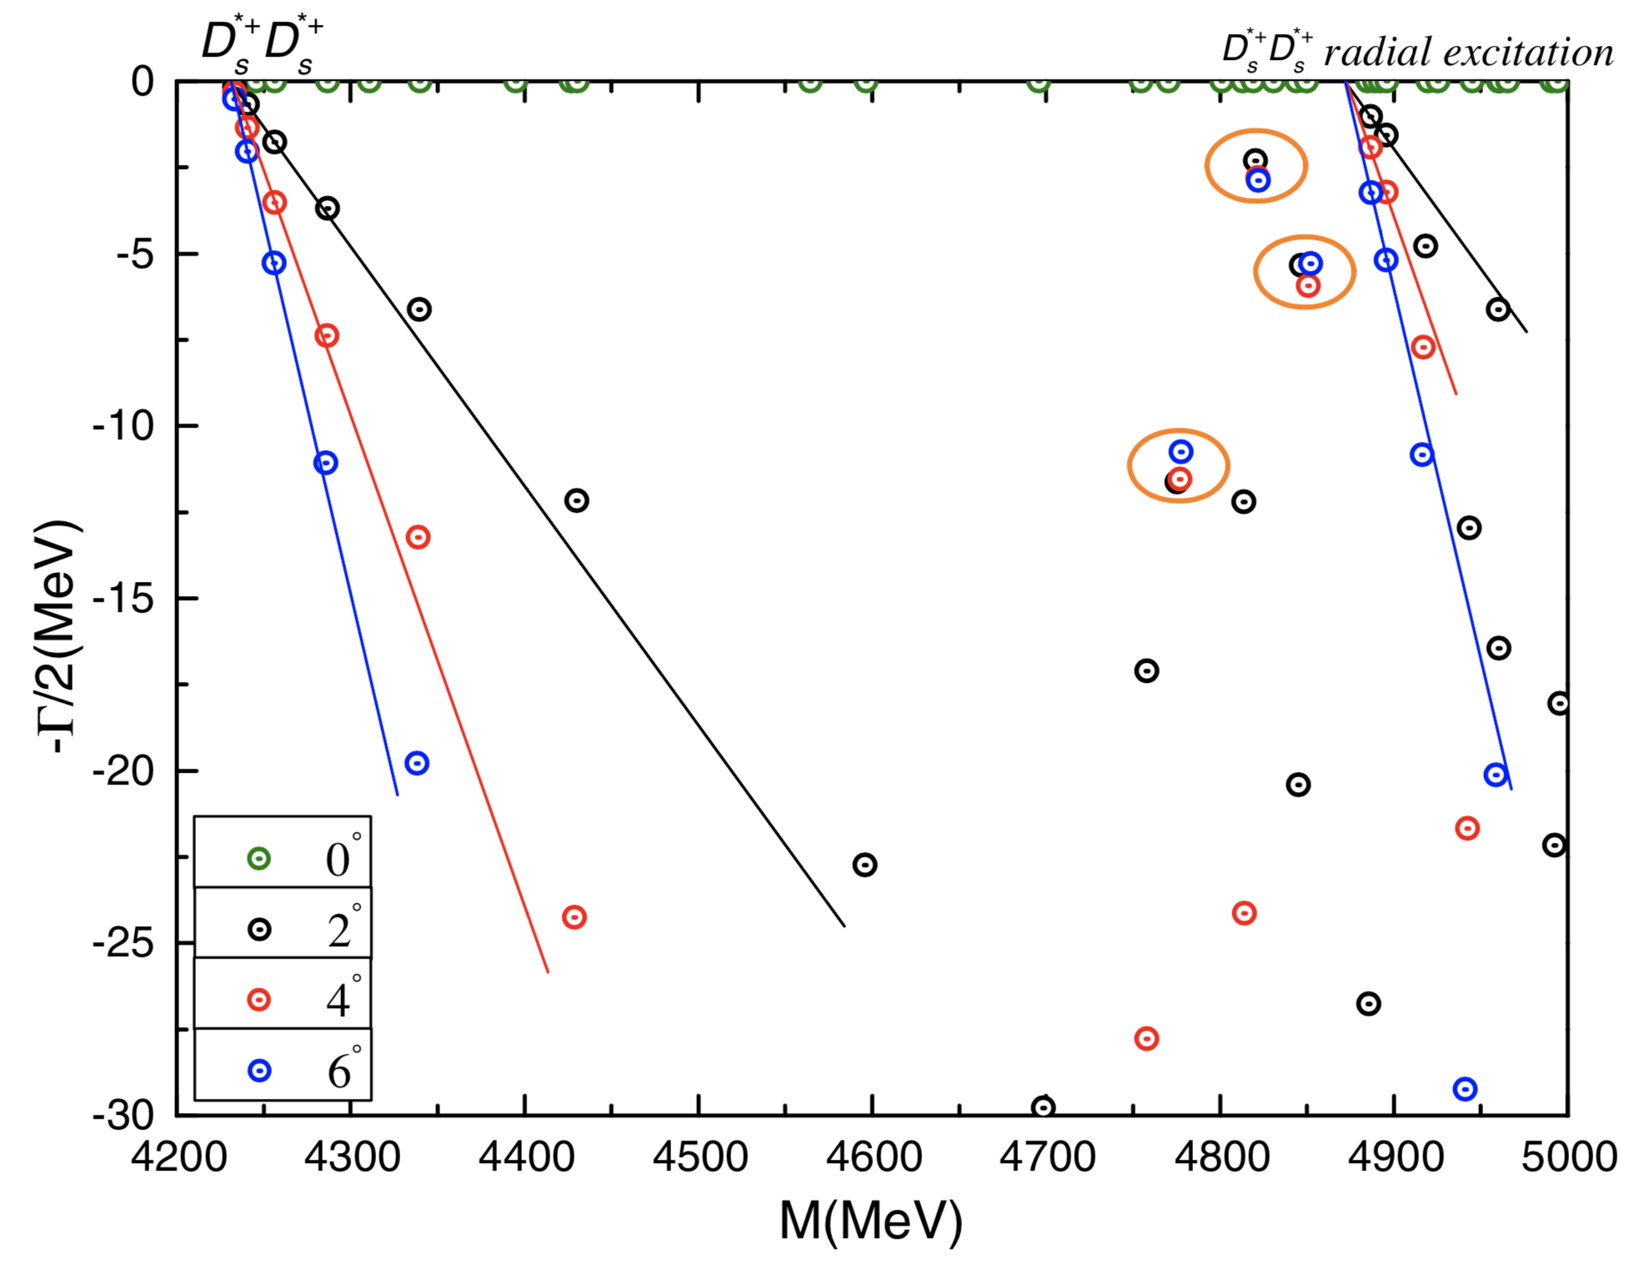
Resonances are obtained in ${00}^{+}$(left) and ${02}^{+}$(right) states of $cc\overline{s}\overline{s}$ system with CSM study on a fully coupled-channel case. The resonance poles read (in MeV)
${00}^{+}$: 4902-3.54i;
${02}^{+}$: 4821-5.58i, 4846-10.68i, 4775-23.26i.

Slide 37
Lowest-lying states of doubly bottom tetraquarks with $IJ^{P}={01}^{+}$, unit in MeV.
Channel | Color | M | $$E_{B}$$ | $$M^{′}$$
$B^{−}{\overline{B}}^{∗0}$(10604) | S | 10585 | -12 | 10592
 | H | 10987 | +390 | 10994
 | S+H | 10562 | -35 | 10569
 | Percentage (S, H): 83.0%, 17.0%
$B^{∗−}{\overline{B}}^{∗0}$(10650) | S | 10672 | -11 | 10639
 | H | 10974 | +336 | 10986
 | S+H | 10601 | -37 | 10613
 | Percentage (S, H): 79.6%, 20.4%
$${\left(bb\right)}^{∗}(\overline{u}\overline{d})$$ |  | 10261
$$(bb){\left(\overline{u}\overline{d}\right)}^{∗}$$ |  | 10787
Mixed |  | $${10238}^{1st}$$ $${10524}^{2nd}$$
Since a strong coupling effect, two bound states are obtained in a fully coupled-channel case, their sizes are ~0.6 fm.
 | $${(B^{−}{\overline{B}}^{∗0})}^{1}$$ | $${(B^{∗−}{\overline{B}}^{∗0})}^{1}$$ | $${(B^{−}{\overline{B}}^{∗0})}^{8}$$ | $${(B^{∗−}{\overline{B}}^{∗0})}^{8}$$ | $${\left(bb\right)}^{∗}(\overline{u}\overline{d})$$ | $$(bb){\left(\overline{u}\overline{d}\right)}^{∗}$$
1st | 20.7% | 17.9% | 9.3% | 9.4% | 42.6% | 0.1%
2nd | 25.6% | 14.8% | 9.5% | 9.1% | 40.2% | 0.8%

Slide 38
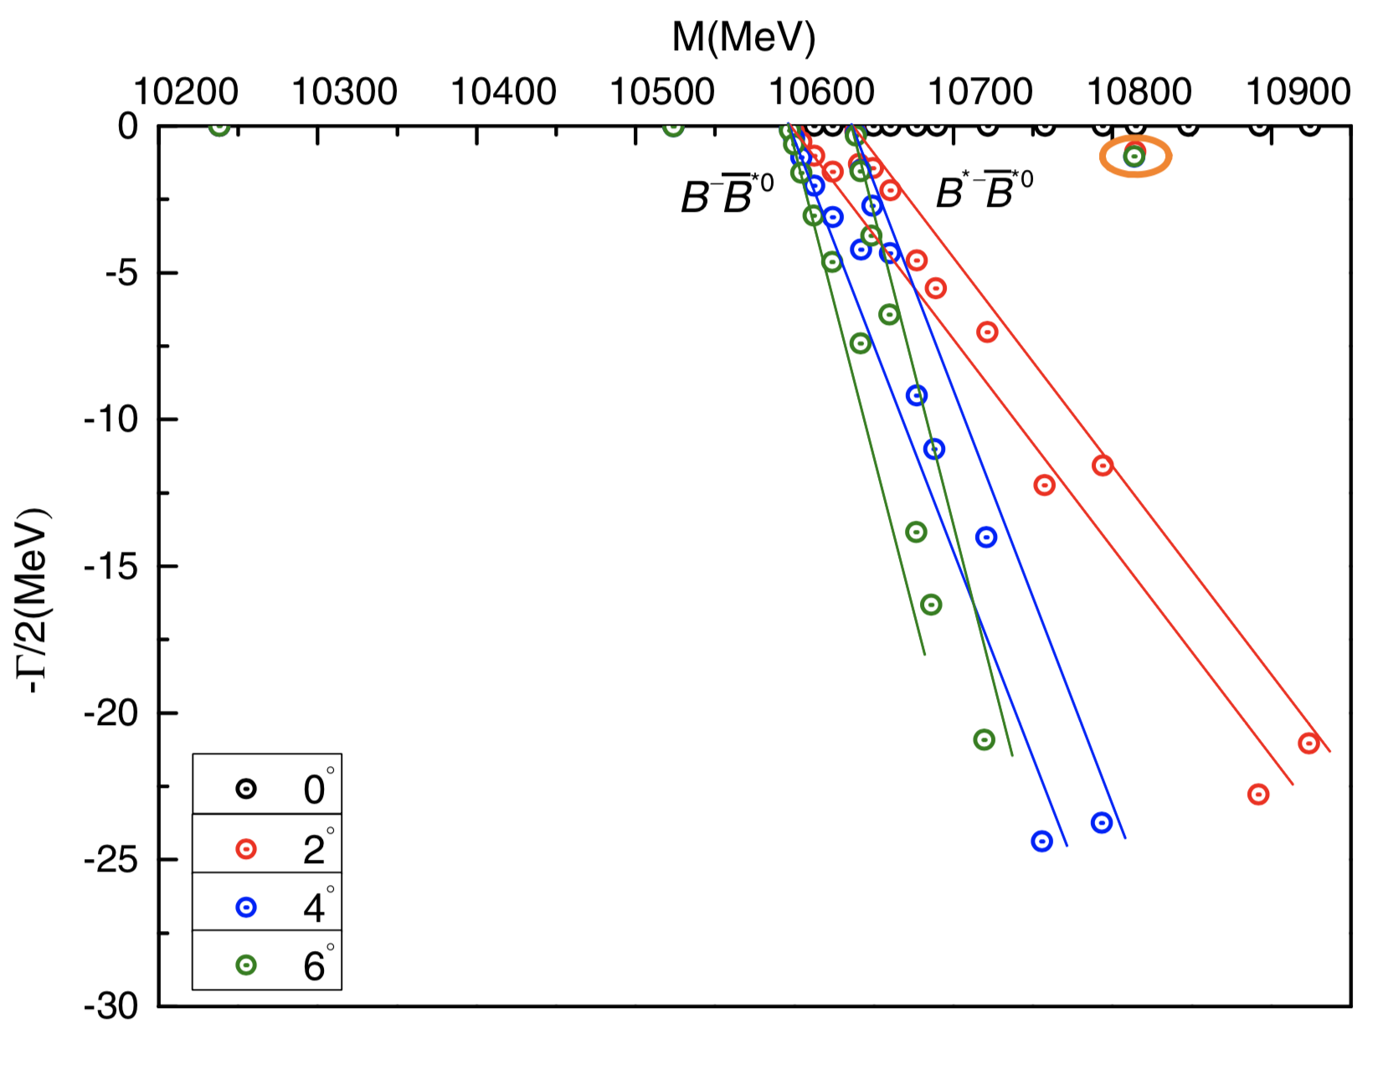
In a complete coupled-channel calculation by CSM and the rotated angle $θ$ varies from $0^{°}$ to $6^{°}$, the two bound states remain at 10238 MeV and 10524 MeV of real-axis. Moreover, a quite narrow resonance which mass and width is 10814 MeV and 2.0 MeV is clearly shown below.

Slide 39
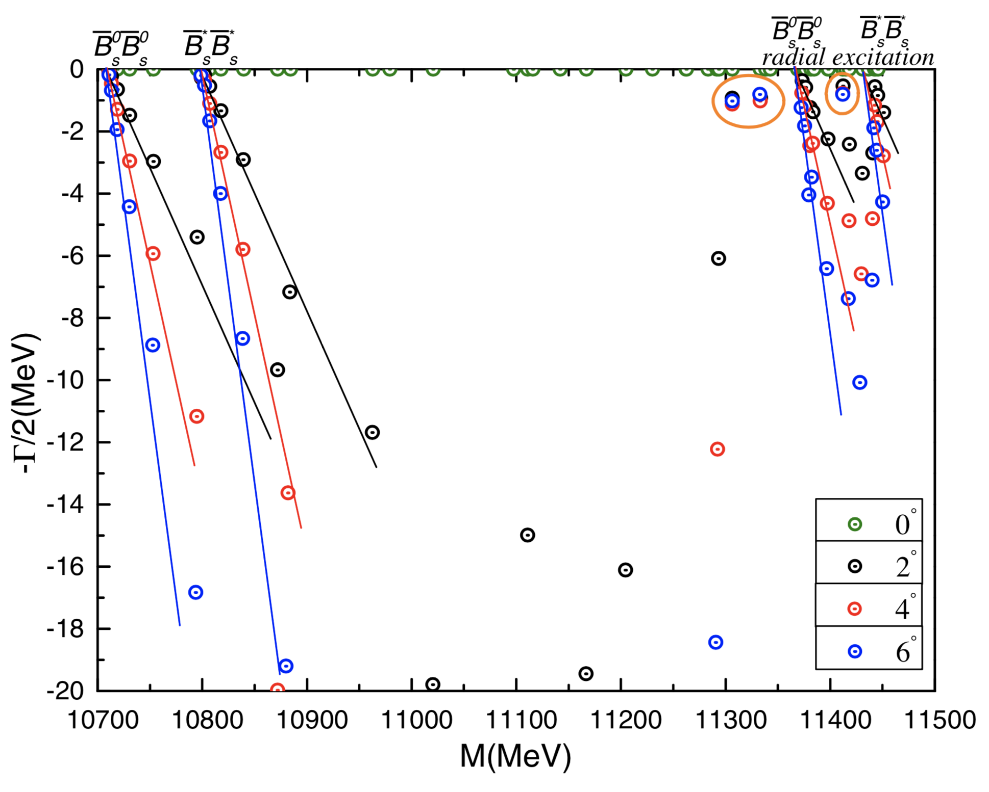
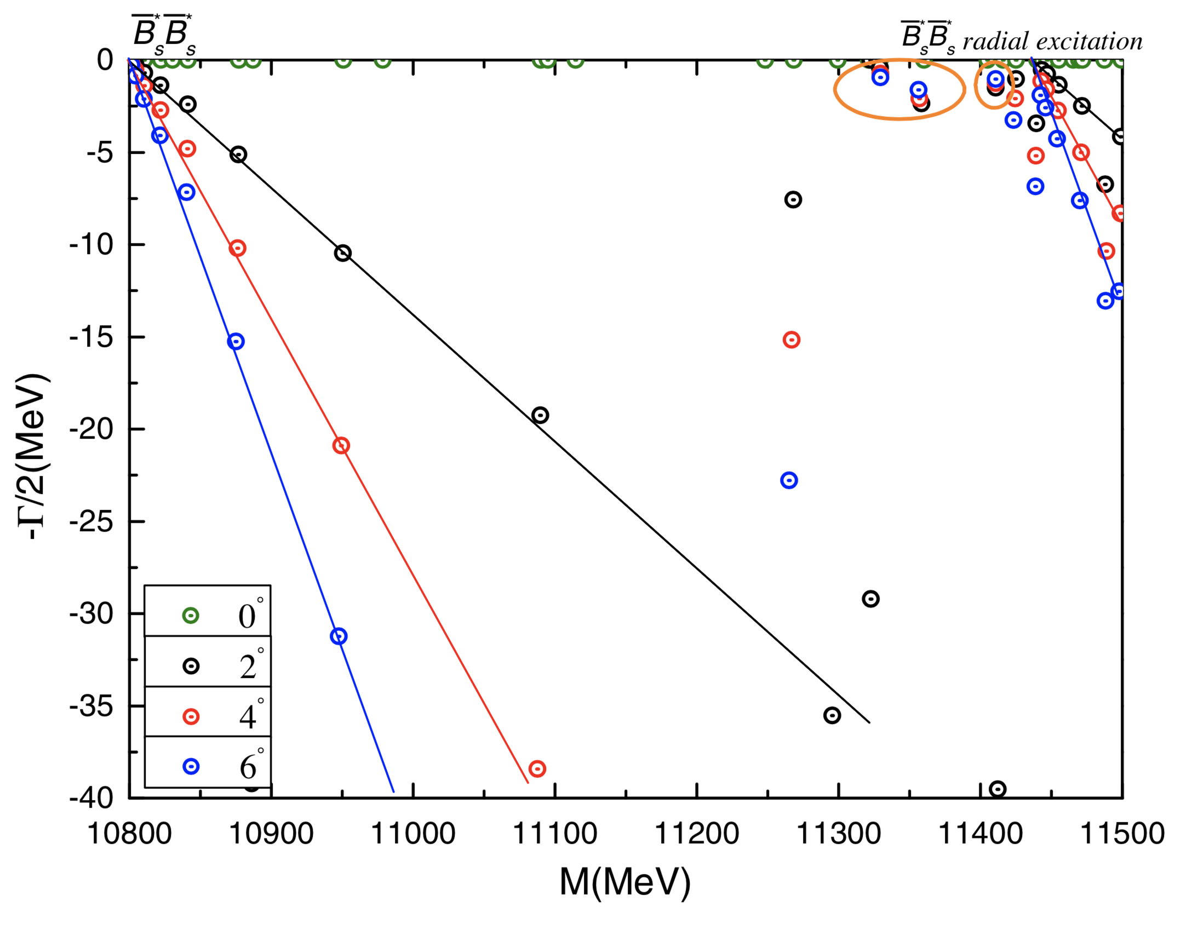
Resonances are obtained in ${00}^{+}$(left) and ${02}^{+}$(right) states of $bb\overline{s}\overline{s}$ system with CSM study on a fully coupled-channel case. The resonance poles read (in MeV)
${00}^{+}$: 11306-1.86i, 11333-1.84i, 11412-1.54i;
${02}^{+}$: 11329-1.48i, 11356-4.18i, 11410-2.52i.

Slide 40
Lowest-lying states of charm-bottom tetraquarks with $IJ^{P}={00}^{+}$, unit in MeV.
Channel | Color | M | $$E_{B}$$ | $$M^{′}$$
$D^{0}{\overline{B}}^{0}$(7147) | S | 7172 | -4 | 7143
 | H | 7685 | +509 | 7656
 | S+H | 7171 | -5 | 7142
 | Percentage (S, H): 96.4%, 3.6%
$D^{∗0}{\overline{B}}^{∗0}$(7334) | S | 7327 | -9 | 7325
 | H | 7586 | +250 | 7584
 | S+H | 7297 | -39 | 7295
 | Percentage (S, H): 87.8%, 12.2%
$$(cb)(\overline{u}\overline{d})$$ |  | 7028
$${\left(cb\right)}^{∗}{\left(\overline{u}\overline{d}\right)}^{∗}$$ |  | 7482
Mixed |  | 6980
In a complete coupled-channel study, a bound state is obtained at 6980 MeV and a compact tetraquark structure is also concluded with $r_{\overline{u}\overline{d}}=0.635$ fm, $r_{\overline{q}c}=0.653$ fm, $r_{\overline{q}b}=0.610$ fm and $r_{cb}=0.428$ fm.
$${(D^{0}{\overline{B}}^{0})}^{1}$$ | $${(D^{∗0}{\overline{B}}^{∗0})}^{1}$$ | $${(D^{0}{\overline{B}}^{0})}^{8}$$ | $${(D^{∗0}{\overline{B}}^{∗0})}^{8}$$ | $$(cb)(\overline{u}\overline{d})$$ | $${\left(cb\right)}^{∗}{\left(\overline{u}\overline{d}\right)}^{∗}$$
26.4% | 21.5% | 1.6% | 1.9% | 48.5% | 0.1%

Slide 41
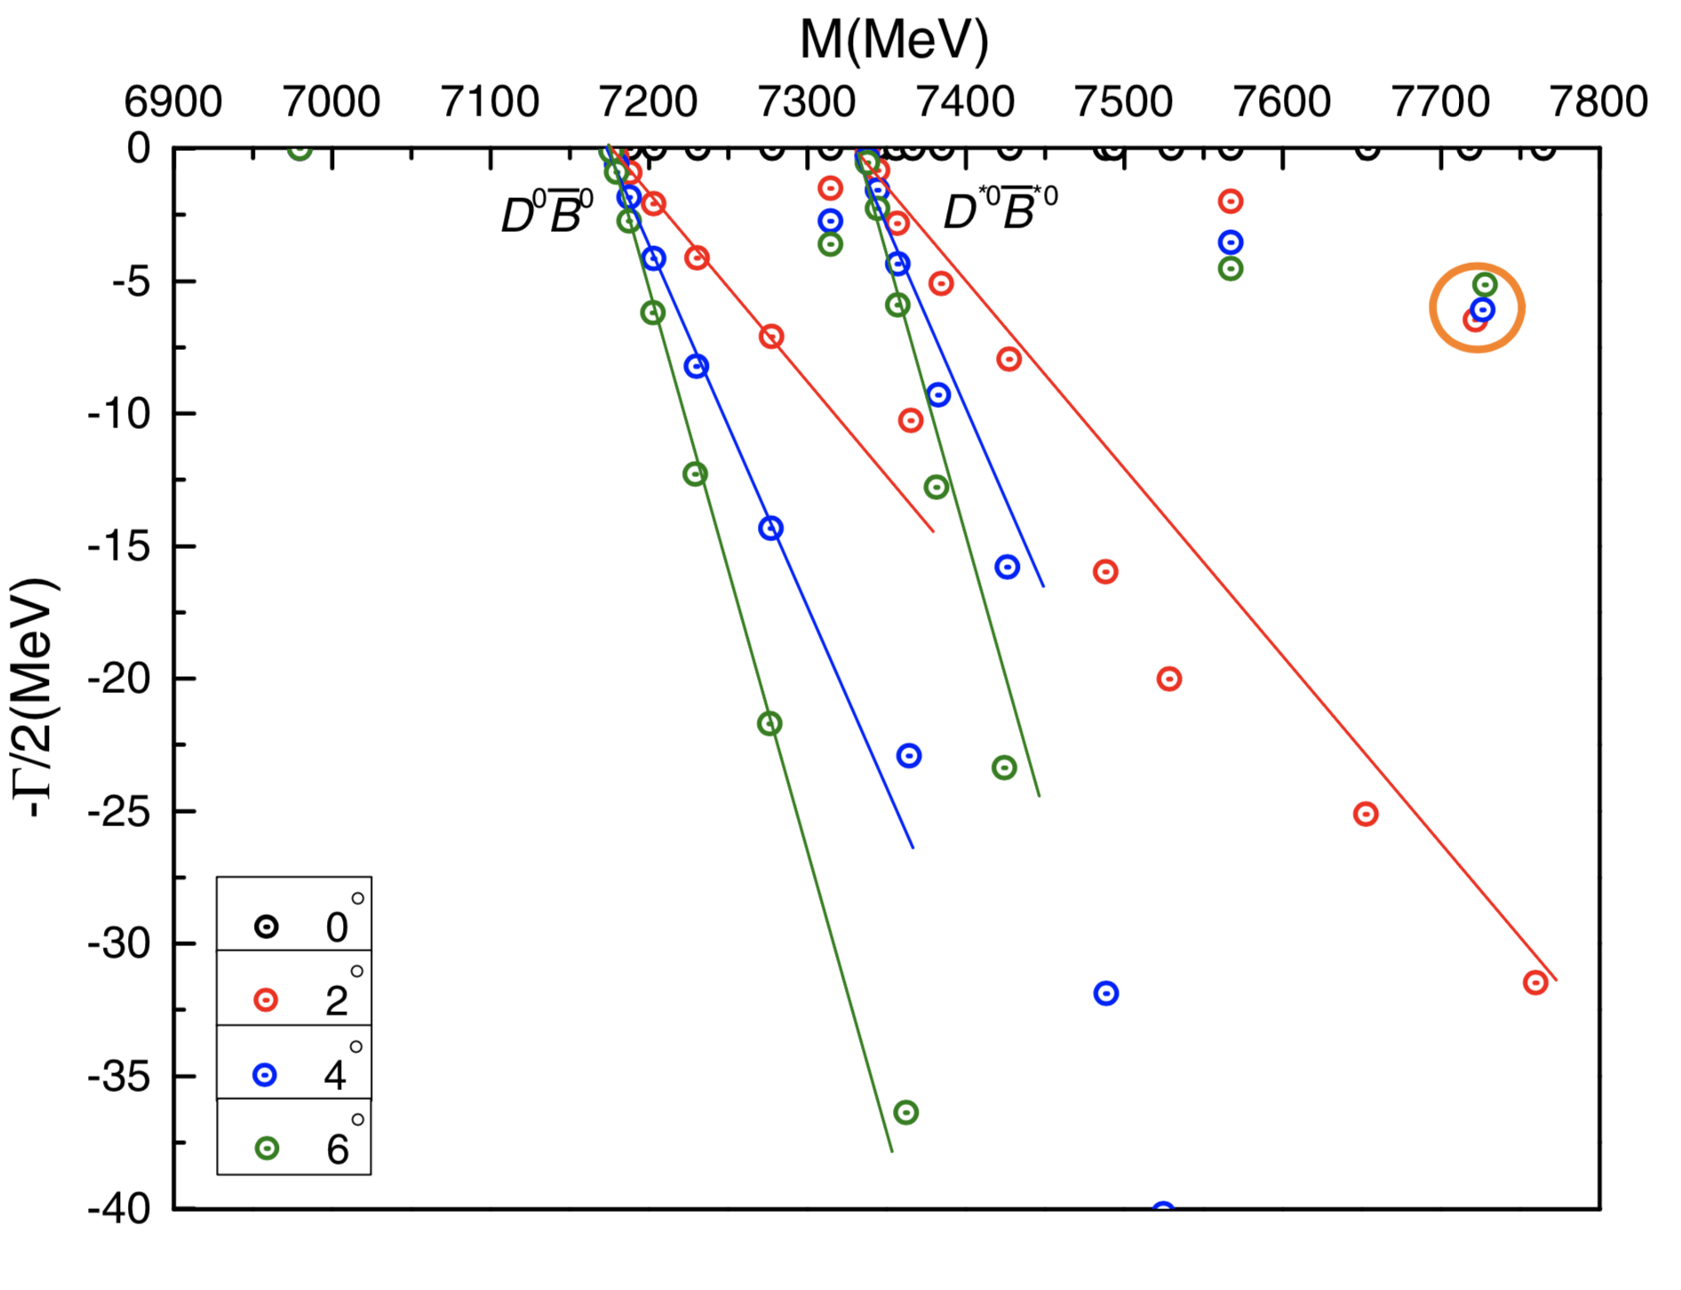
In a complete coupled-channel calculation by CSM and the rotated angle $θ$ varies from $0^{°}$ to $6^{°}$, the bound state remains at 6980 MeV of real-axis. Moreover, a narrow resonance which mass and width is 7726 MeV and 12.2 MeV is clearly shown below.

Slide 42
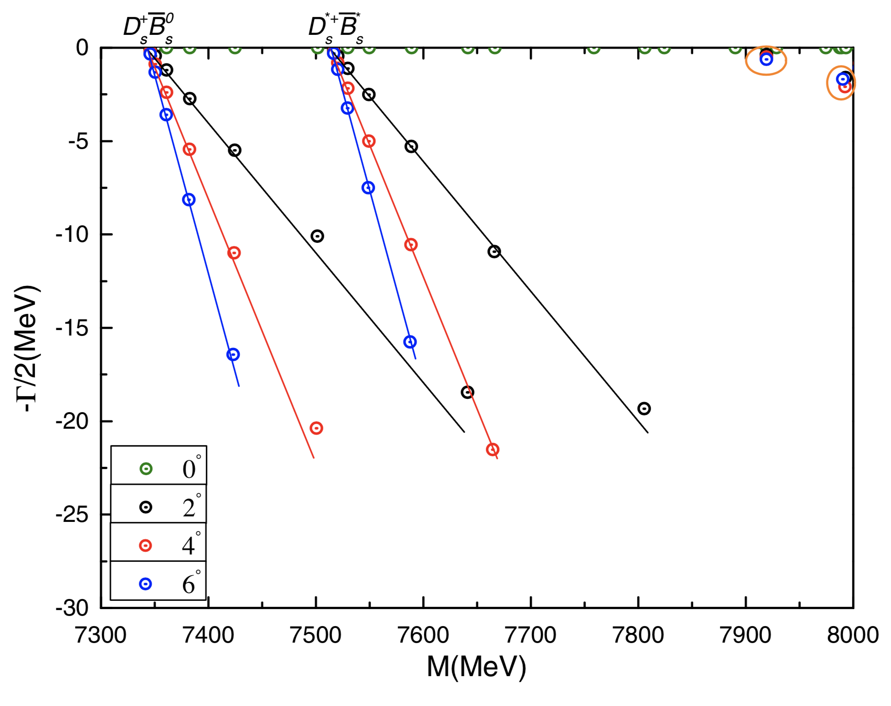
Resonances are obtained in ${00}^{+}$ state of $cb\overline{s}\overline{s}$ system with CSM study on a fully coupled-channel case. The resonance poles read (in MeV)
7919-1.02i, 7993-3.22i.

Slide 43
Lowest-lying states of charm-bottom tetraquarks with $IJ^{P}={01}^{+}$, unit in MeV.
Channel | Color | M | $$E_{B}$$ | $$M^{′}$$
$D^{0}{\overline{B}}^{∗0}$(7193) | S | 7214 | -3 | 7190
 | H | 7694 | +477 | 7670
 | S+H | 7213 | -4 | 7189
 | Percentage (S, H): 96.8%, 3.2%
$D^{∗0}{\overline{B}}^{0}$(7288) | S | 7293 | -2 | 7286
 | H | 7707 | +412 | 7700
 | S+H | 7292 | -3 | 7285
 | Percentage (S, H): 96.8%, 3.2%
$D^{∗0}{\overline{B}}^{∗0}$(7334) | S | 7334 | -2 | 7332
 | H | 7691 | +354 | 7688
 | S+H | 7326 | -10 | 7324
 | Percentage (S, H): 89.3%, 10.7%
$${\left(cb\right)}^{∗}(\overline{u}\overline{d})$$ |  | 7039
$$(cb){\left(\overline{u}\overline{d}\right)}^{∗}$$ |  | 7531
$${\left(cb\right)}^{∗}{\left(\overline{u}\overline{d}\right)}^{∗}$$ |  | 7507
Mixed |  | 6997

Slide 44
In a complete coupled-channel study, a bound state is obtained at 6997 MeV and a compact tetraquark structure is also concluded with $r_{\overline{u}\overline{d}}=0.632$ fm, $r_{\overline{q}c}=0.661$ fm, $r_{\overline{q}b}=0.616$ fm and $r_{cb}=0.434$ fm. The distances are quite comparable with those in ${00}^{+}$ state of $cb\overline{u}\overline{d}$ tetraquark.
$${(D^{0}{\overline{B}}^{∗0})}^{1}$$ | $${(D^{∗0}{\overline{B}}^{0})}^{1}$$ | $${(D^{∗0}{\overline{B}}^{∗0})}^{8}$$ | $${(D^{0}{\overline{B}}^{∗0})}^{8}$$ | $${(D^{∗0}{\overline{B}}^{0})}^{8}$$ | $${(D^{∗0}{\overline{B}}^{∗0})}^{8}$$ | $${\left(cb\right)}^{∗}(\overline{u}\overline{d})$$ | $$(cb){\left(\overline{u}\overline{d}\right)}^{∗}$$ | $${\left(cb\right)}^{∗}{\left(\overline{u}\overline{d}\right)}^{∗}$$
20.2% | 11.6% | 16.8% | 1.4% | 1.3% | 1.8% | 46.4% | 0.1% | 0.4%

Slide 45
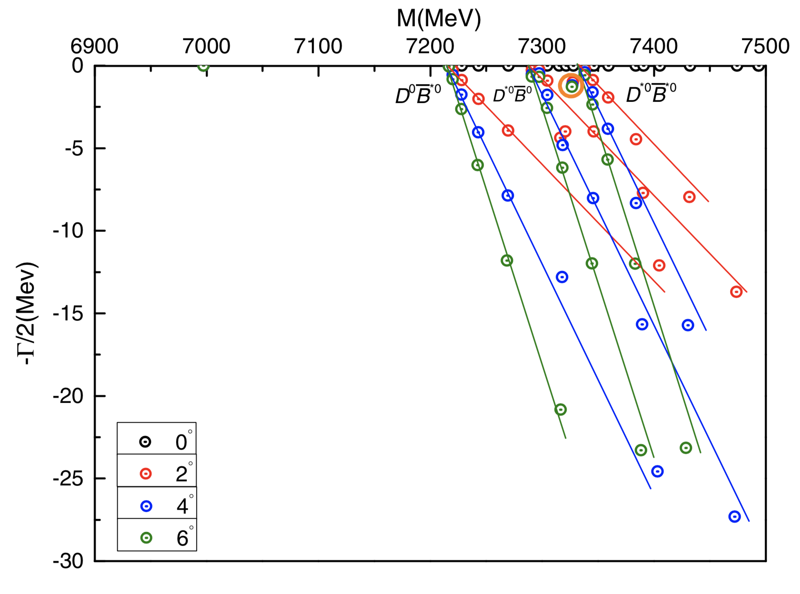
In a complete coupled-channel calculation by CSM and the rotated angle $θ$ varies from $0^{°}$ to $6^{°}$, the bound state remains at 6997 MeV of real-axis. Moreover, a narrow resonance which mass and width is 7327 MeV and 2.4 MeV is clearly shown below.

Slide 46
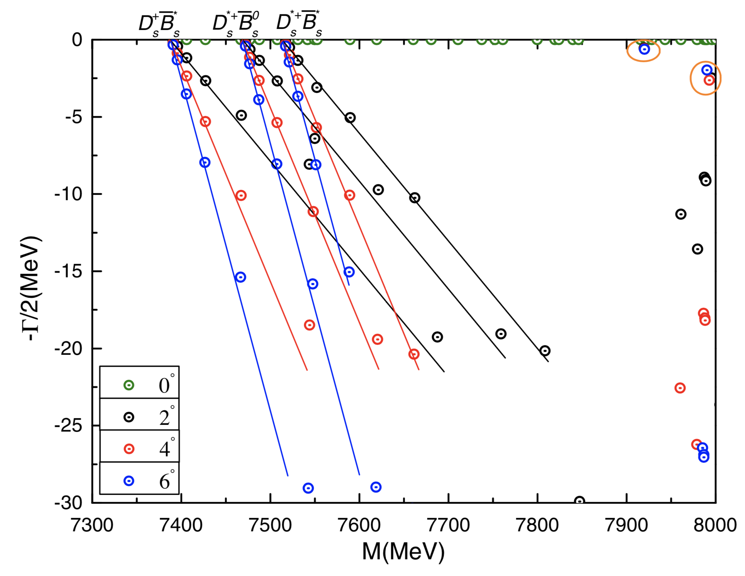
Resonances are obtained in ${01}^{+}$ state of $cb\overline{s}\overline{s}$ system with CSM study on a fully coupled-channel case. The resonance poles read (in MeV)
7920-1.02i, 7995-4.96i.

Slide 47
Lowest-lying states of charm-bottom tetraquarks with $IJ^{P}={02}^{+}$, unit in MeV.
Channel | Color | M | $$E_{B}$$ | $$M^{′}$$
$D^{∗0}{\overline{B}}^{∗0}$(7334) | S | 7334 | -2 | 7332
 | H | 7720 | +384 | 7718
 | S+H | 7334 | -2 | 7332
 | Percentage (S, H): 99.8%, 0.2%
$${\left(cb\right)}^{∗}{\left(\overline{u}\overline{d}\right)}^{∗}$$ |  | 7552
Mixed |  | 7333
In a complete coupled-channel study, a bound state is obtained at 7333 MeV and a loosely molecular structure is concluded with $r_{\overline{u}\overline{d}}=2.248$ fm, $r_{\overline{q}c}=1.612$ fm, $r_{\overline{q}b}=1.597$ fm and $r_{cb}=2.102$ fm.
$${(D^{∗0}{\overline{B}}^{∗0})}^{1}$$ | $${(D^{∗0}{\overline{B}}^{∗0})}^{8}$$ | $${\left(cb\right)}^{∗}{\left(\overline{u}\overline{d}\right)}^{∗}$$
98.6% | 0.3% | 1.1%

Slide 48
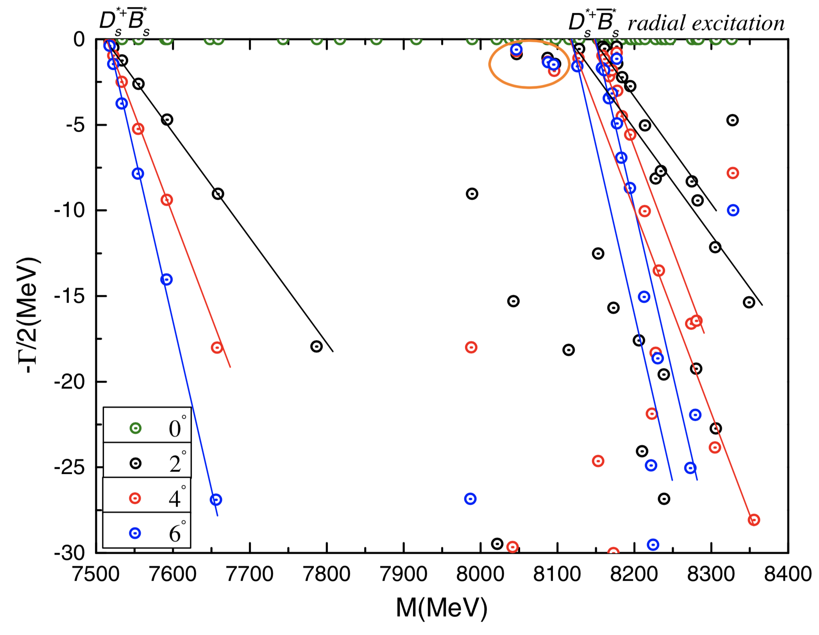
Resonances are obtained in ${02}^{+}$ state of $cb\overline{s}\overline{s}$ system with CSM study on a fully coupled-channel case. The resonance poles read (in MeV)
8046-1.42i, 8096-2.90i.

Slide 49
Comparison of theoretical masses on the iso-scalar doubly heavy tetraquark in bound states by different predicctions (unit in MeV).
 | $$0^{+}$$ | $$1^{+}$$ | $$2^{+}$$ | $$0^{+}$$ | $$1^{+}$$ | $$2^{+}$$ | $$0^{+}$$ | $$1^{+}$$ | $$2^{+}$$
 | $$cc\overline{q}\overline{q}$$ |  |  | $$cb\overline{q}\overline{q}$$ |  |  | $$bb\overline{q}\overline{q}$$
This work |  | 3726 |  | 6980 | 6997 | 7333 |  | 10238, 10524
D. Ebert et al., PRD 76, 114015 (2007). |  | 3935 |  | 7239 | 7246 |  |  | 10502
B. S. Brac et al., Z. Phys. C 57, 273 (1993). |  | 3931 |  | 7206 | 7244 |  |  | 10525
D. Janc et al., Few-Body Syst. 35, 175 (2004). |  | 3876 |  |  |  |  |  | 10504
D. M. Brink et al., PRD 57, 6778 (1998). |  |  |  |  |  |  |  | 10558
J. Vijande et al., EPJA 19, 383 (2004). |  | 3764 |  |  |  |  |  | 10261
J. Vijande et al., PRD 74, 054018 (2006). |  | 3927 |  |  |  |  |  | 10426
B. A. Gelman et al., PLB 551, 296 (2003). |  | 3905

Slide 50
Conclusions
The reported $T_{cc}^{+}(3875)$ state is well obtained in $D^{+}D^{∗0}$ channel of ${01}^{+}$ state by ChQM investigation, besides this formalism is also successfully described the $P_{c}^{+}$ states.
For the doubly heavy tetraquarks within $0^{+}$, $1^{+}$ and $2^{+}$ isoscalar or isovector states, bound states are only obtained in ${01}^{+}$ states of $cc\overline{u}\overline{d}$, $cb\overline{u}\overline{d}$ and $bb\overline{u}\overline{d}$ systems. Besides, bound states of $cb\overline{u}\overline{d}$ tetraquark are also found in ${00}^{+}$ and ${02}^{+}$ states.
No bound state is available in all quantum states of $QQ\overline{s}\overline{s}$ $\left(Q=c, b\right)$ system.
Narrow resonances are obtained in these doubly heavy tetraquark systems.

Slide 51
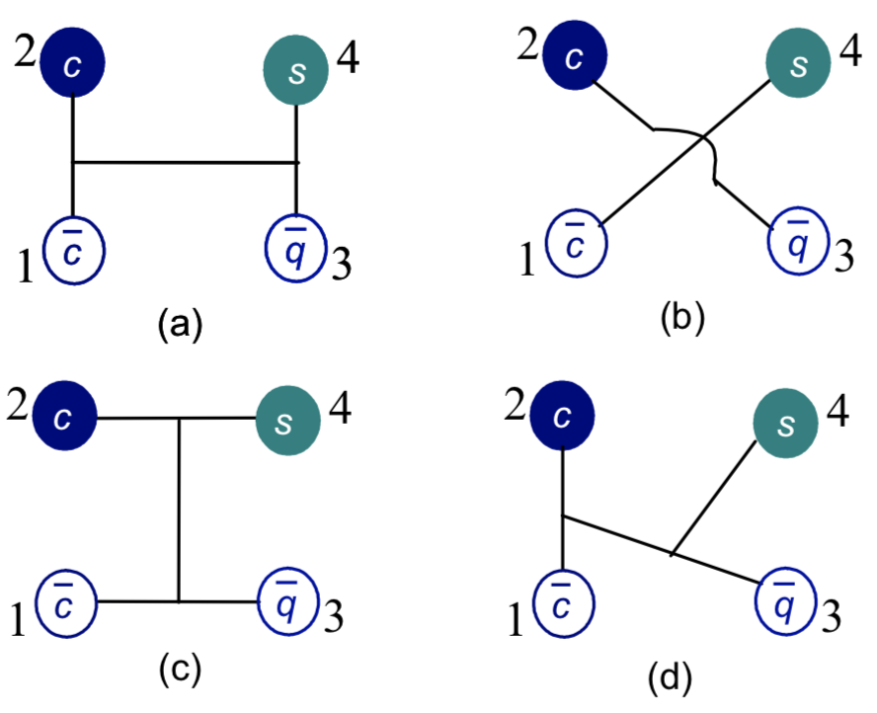
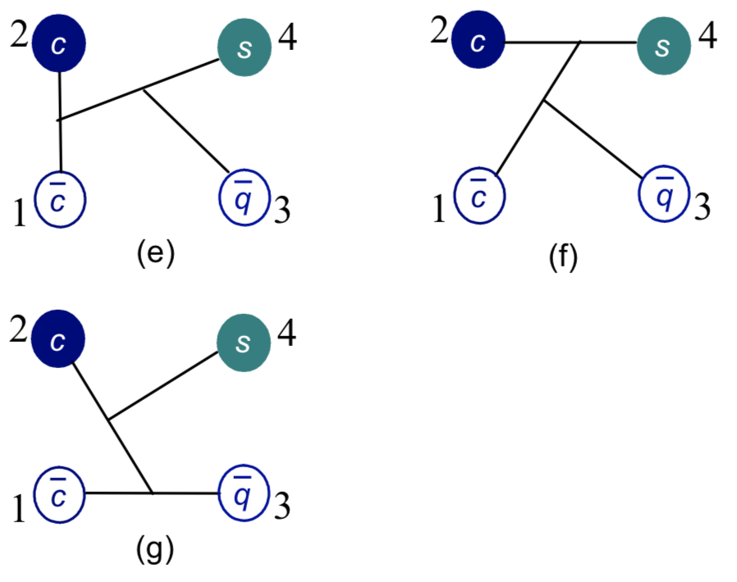
Strange hidden-charm tetraquark
Four charmonium-like resonances with strangeness, $Z_{cs}(4000)$, $Z_{cs}(4220)$, X(4630) and X(4685) are reported in the $B^{+}→J/ψφK^{+}$ decay by the LHCb collaboration.
The same theoretical framework is employed in investigating on a c$\overline{c}s\overline{q}$ tetraquark system. Generally, 7 configurations below are considered.
arXiv:2109.04311.

Slide 52
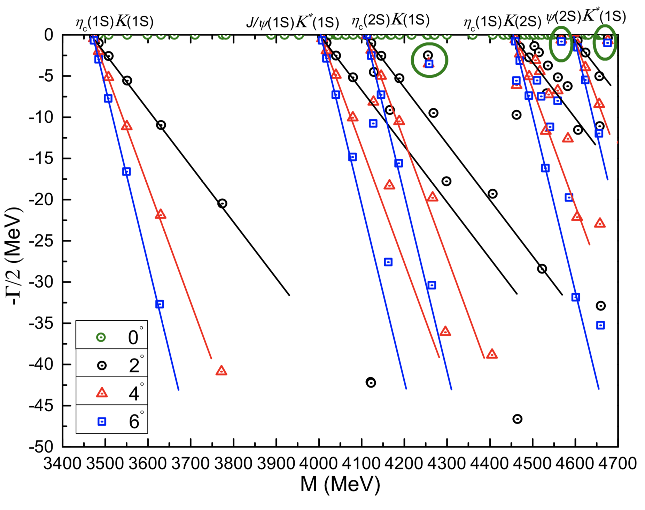
$0^{+}$ state
In a partial coupled-channel CSM study, which the dimeson structures are divided into $(c\overline{q})(s\overline{c})$ and $(c\overline{c})(s\overline{q})$ two cases, hidden-color of meson-meson, diquark-antidiquark and K-type channels are all included.
The distributions of complex energies are shown below, particularly only $(c\overline{c})(s\overline{q})$ is considered in the dimeson channel.
Three narrow resonance poles are obtained and their complex energies are (in MeV)
4255-5.0i (candidate of $Z_{cs}(4220)$);
4567-1.6i;
4675-1.9i
(candidate of X(4685), but with
different spin assignment).

Slide 53
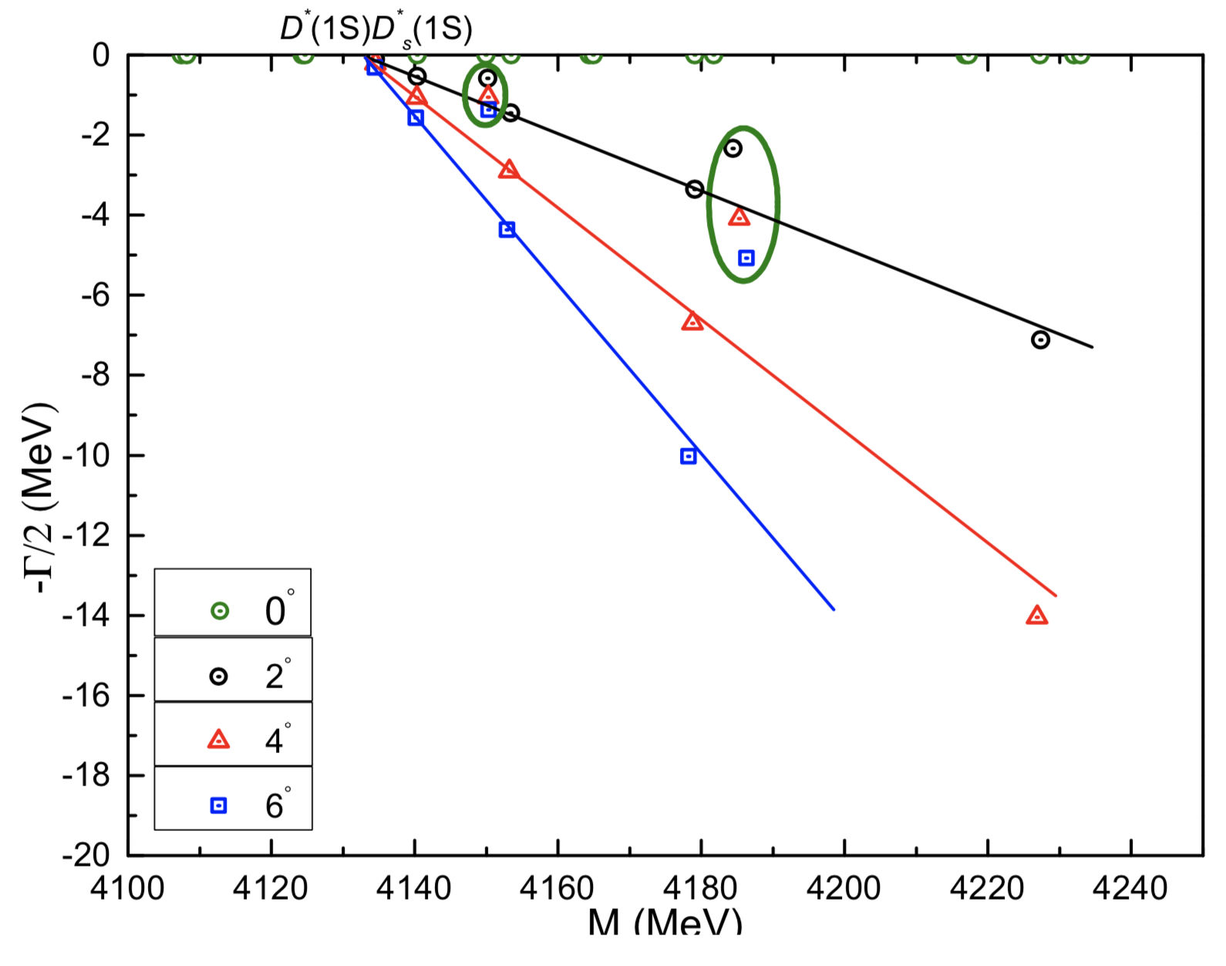
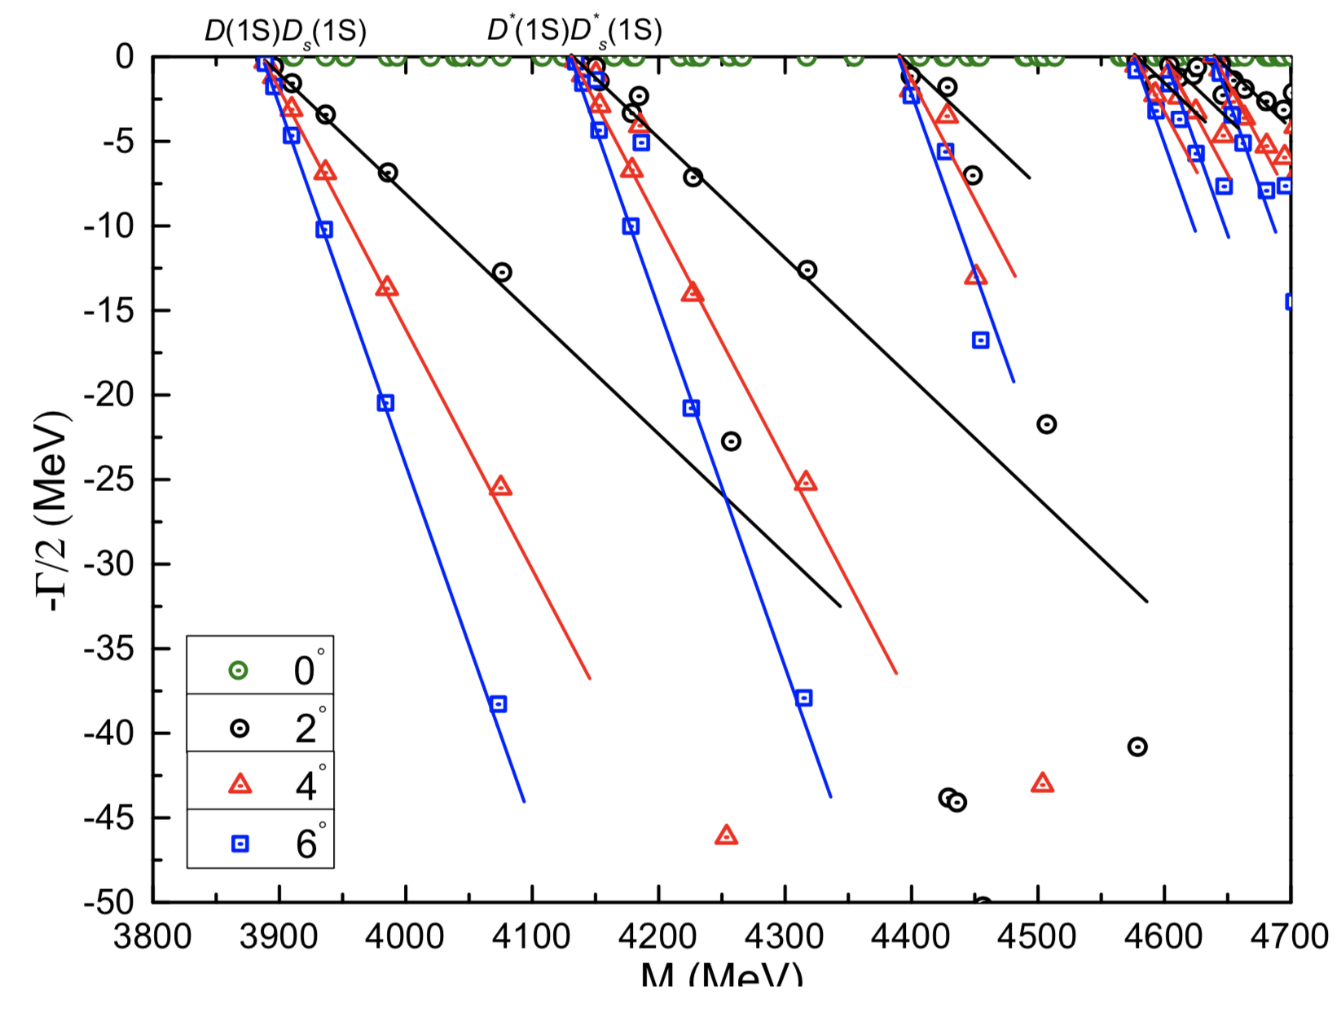
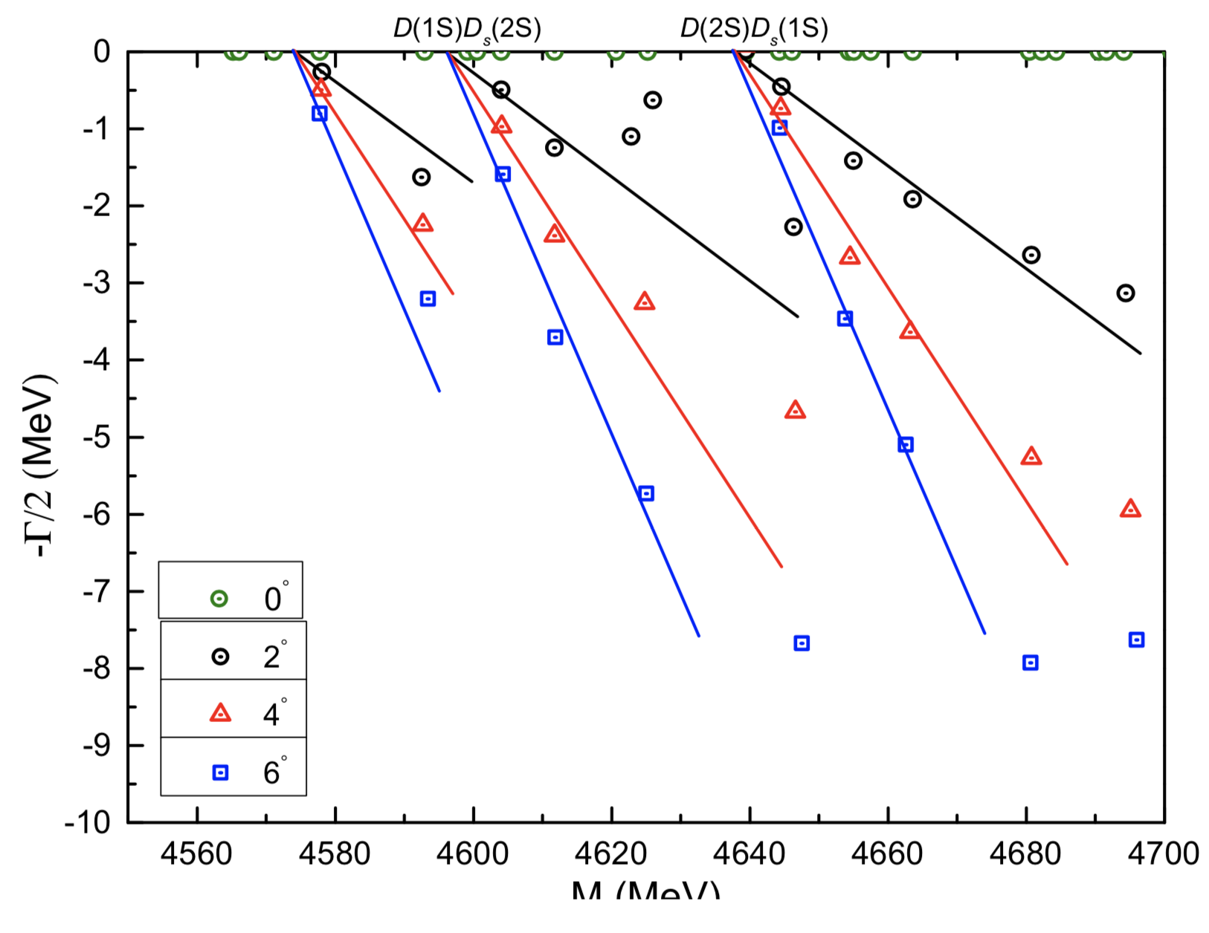
The distributions of complex energies of $0^{+}$ state, particularly only $(c\overline{q})(s\overline{c})$ is considered in the dimeson channel.
Enlarged parts of dense energy regions are on the right.
Particularly, two resonances, (4150, 2.2) MeV and
(4185, 8.2) MeV are obtained.

Slide 54
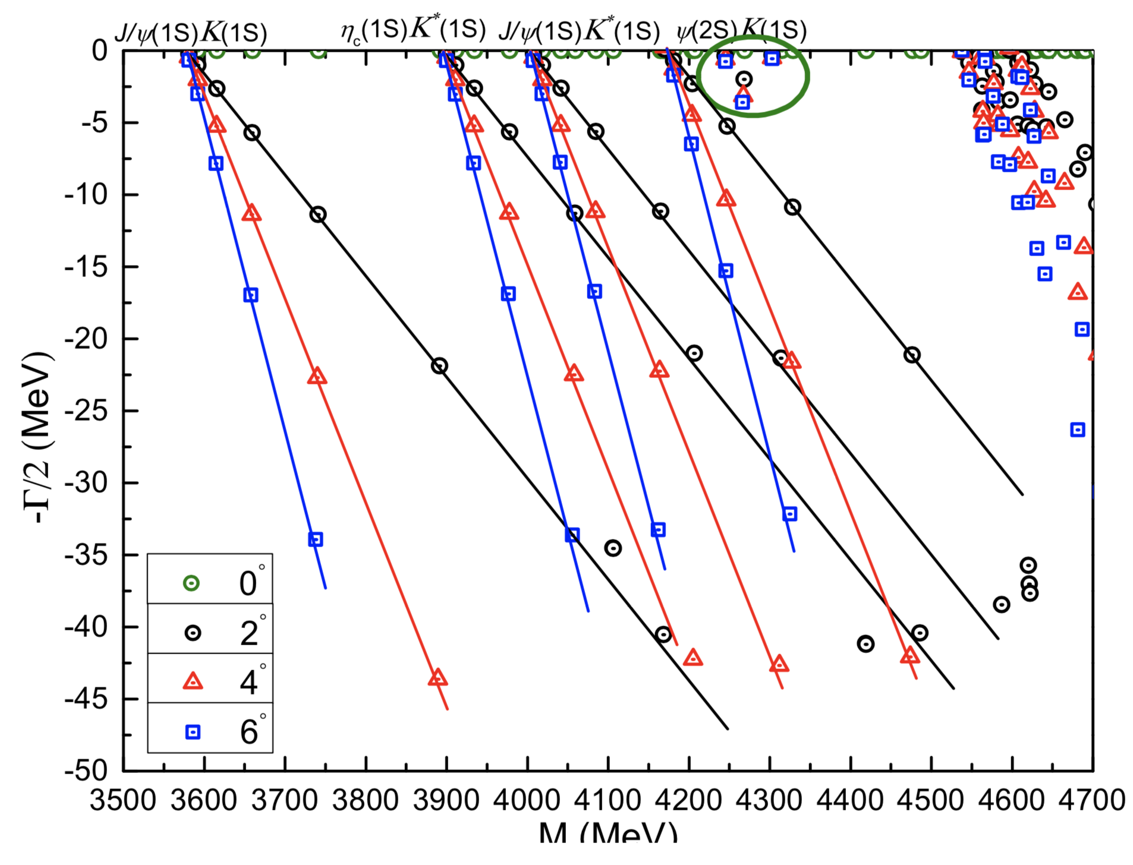
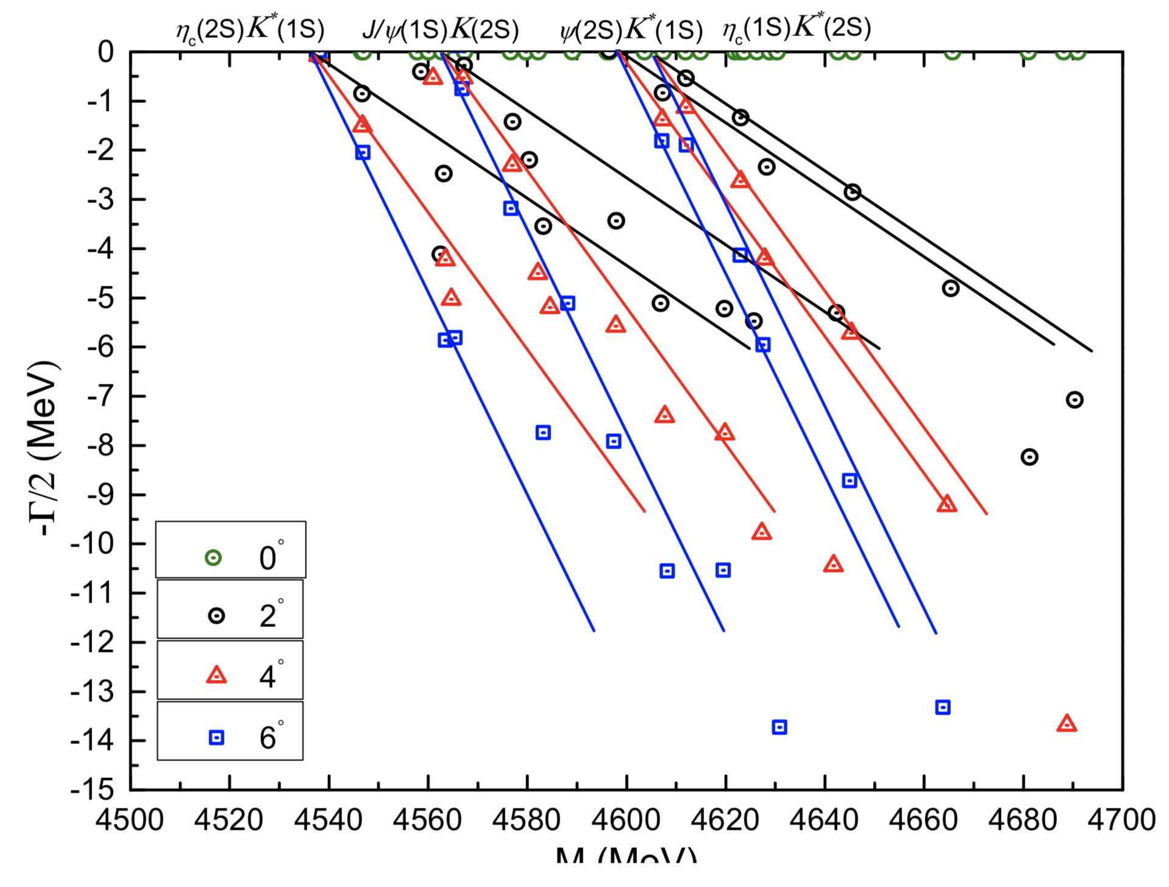
$1^{+}$ state
Similar procedures, which only $(c\overline{q})(s\overline{c})$ dimeson channels are excluded, are performed in a coupled-channel investigation. Three stable resonances are obtained, masses and widths (in MeV) are
4254-0.8i (also candidate of $Z_{cs}(4220)$),
4267-6.2i and 4303-1.0i.

Slide 55
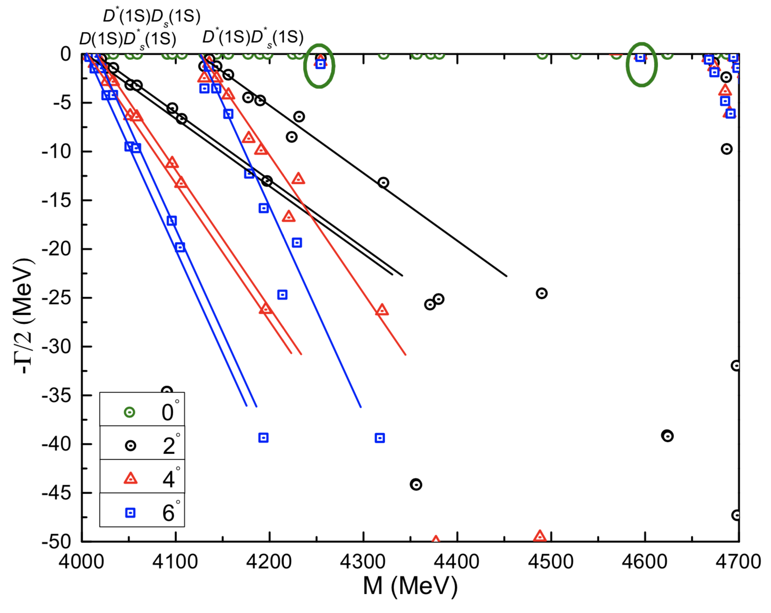
The distributions of complex energies of $1^{+}$ state, particularly only $(c\overline{q})(s\overline{c})$ is considered in the dimeson channel.
Two narrow resonance poles are obtained and their complex energies are (in MeV)
4254-1.6i
(almost degenerate state);
4594-0.6i.

Slide 56
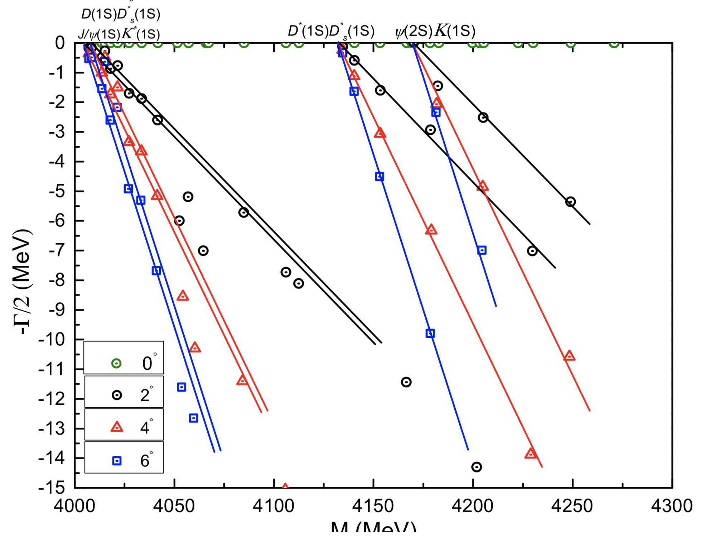
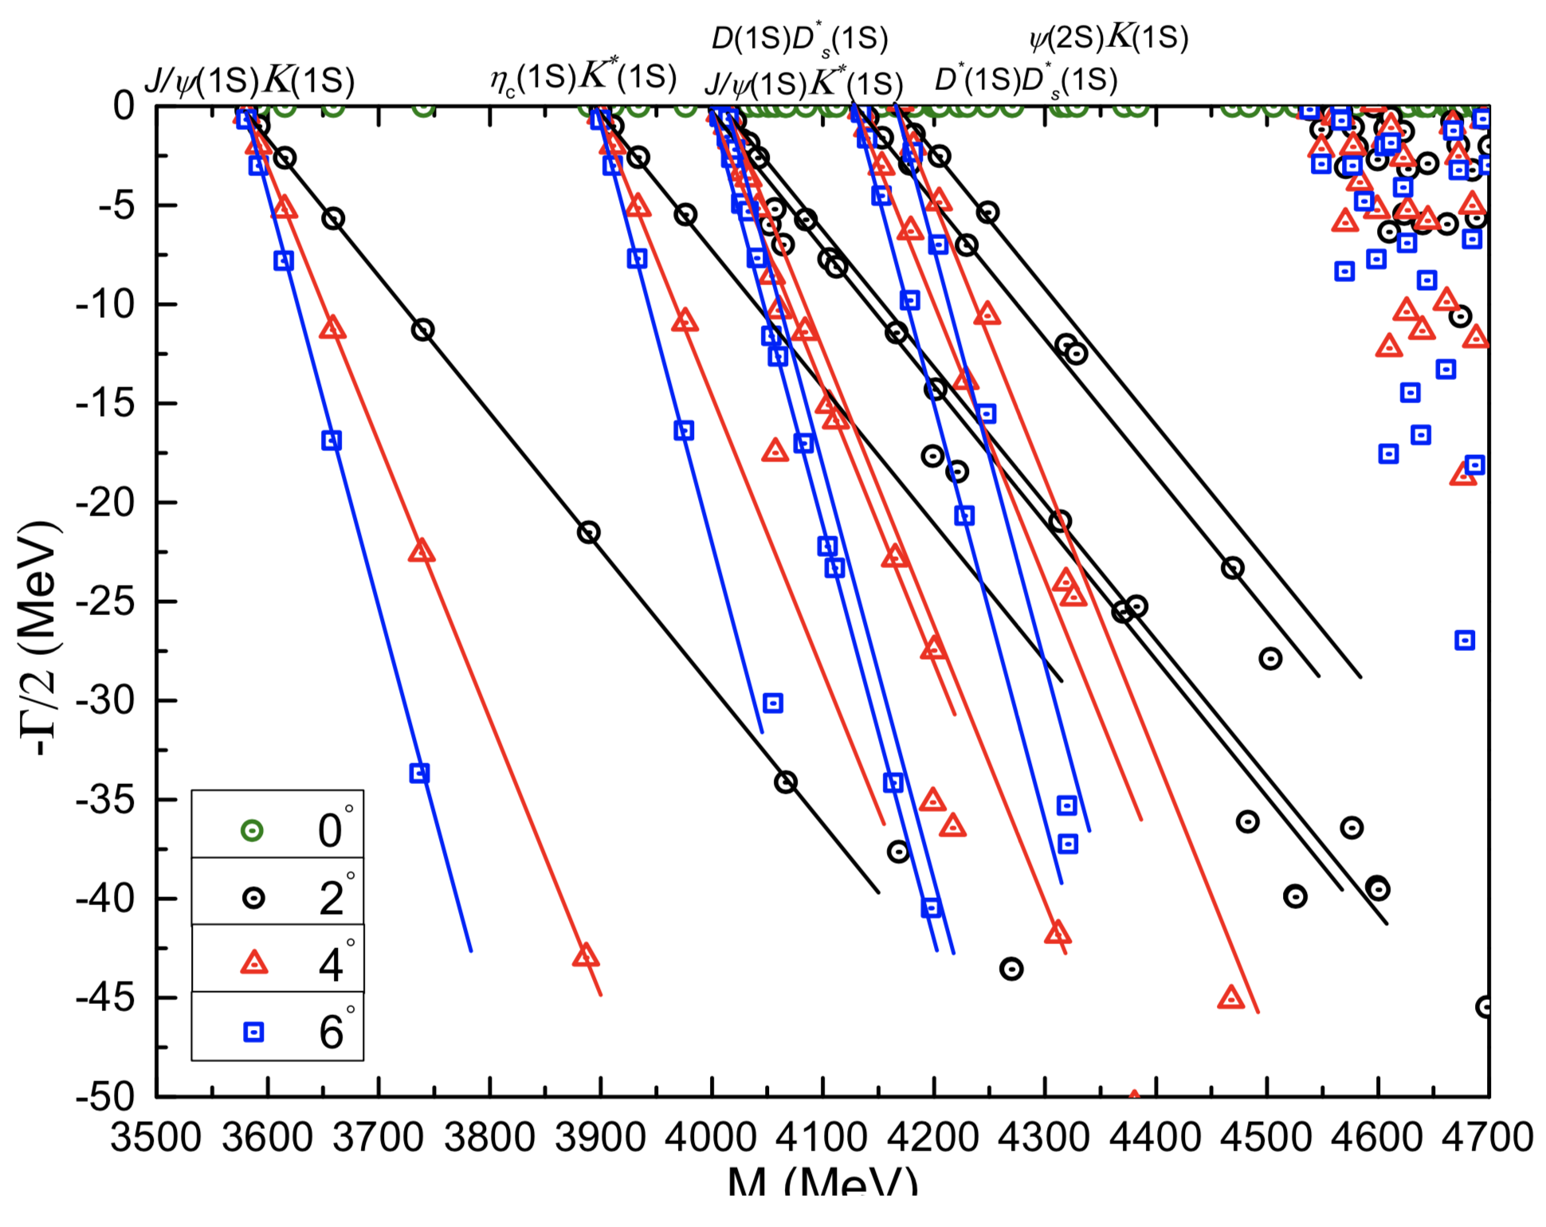
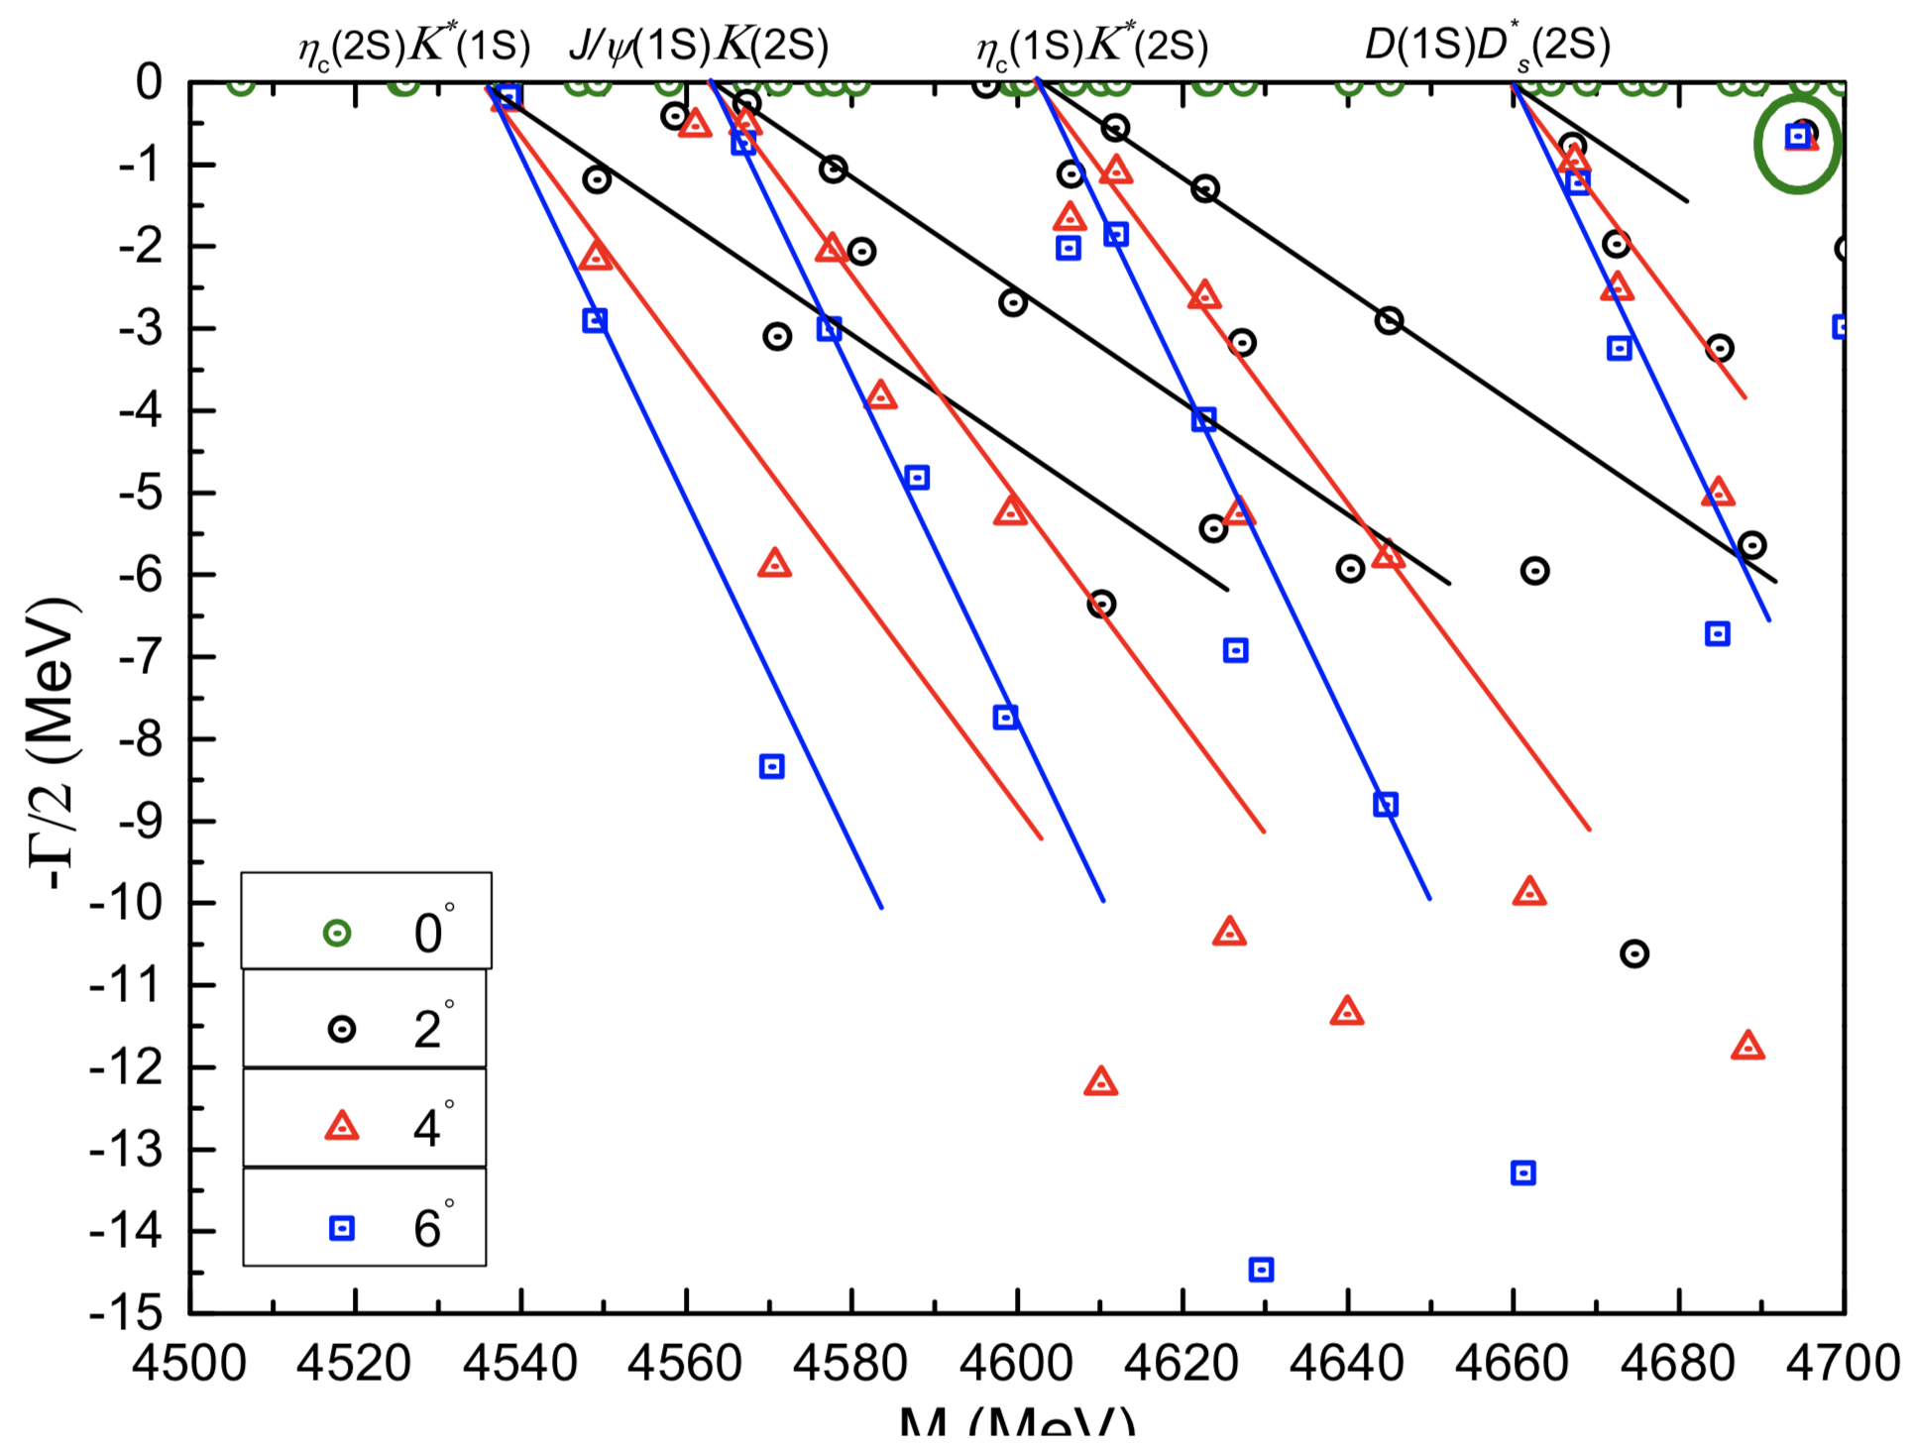
One narrow resonance pole is found in the complete coupled-channel calculation of c$\overline{c}s\overline{q}$ tetraquark in $1^{+}$ state. The calculated energy is 4695-1.3i MeV and can be a good candidate of the X(4685).

Slide 57
When all exotic configurations, which include hidden-color of dimeson, diquark-antidiquark and K-type channels, are considered in a coupled-channel calculation for $1^{+}$ state, four resonances below 4.2 GeV are found.
Particularly, the following table lists the inner structures of these exotic resonancces, and their theoretical masses are in the parentheses.
Therein, the $Z_{cs}(3985)$ and $Z_{cs}(4000)$ can both be identified as compact c$\overline{c}s\overline{q}$ tetraquark state and their sizes are less than 1 fm.
State | $$r_{\overline{c}c}$$ | $$r_{\overline{c}\overline{q}}$$ | $$r_{\overline{c}s}$$ | $$r_{c\overline{q}}$$ | $$r_{cs}$$ | $$r_{s\overline{q}}$$
$Z_{cs}(3947)$ | 0.41 | 0.78 | 0.71 | 0.77 | 0.71 | 0.70
$Z_{cs}(4038)$ | 0.35 | 0.95 | 0.87 | 0.95 | 0.87 | 0.87
$Z_{cs}(4137)$ | 0.44 | 0.94 | 0.83 | 0.92 | 0.86 | 0.88
$Z_{cs}(4199)$ | 0.58 | 0.80 | 0.67 | 0.74 | 0.73 | 0.87

Slide 58
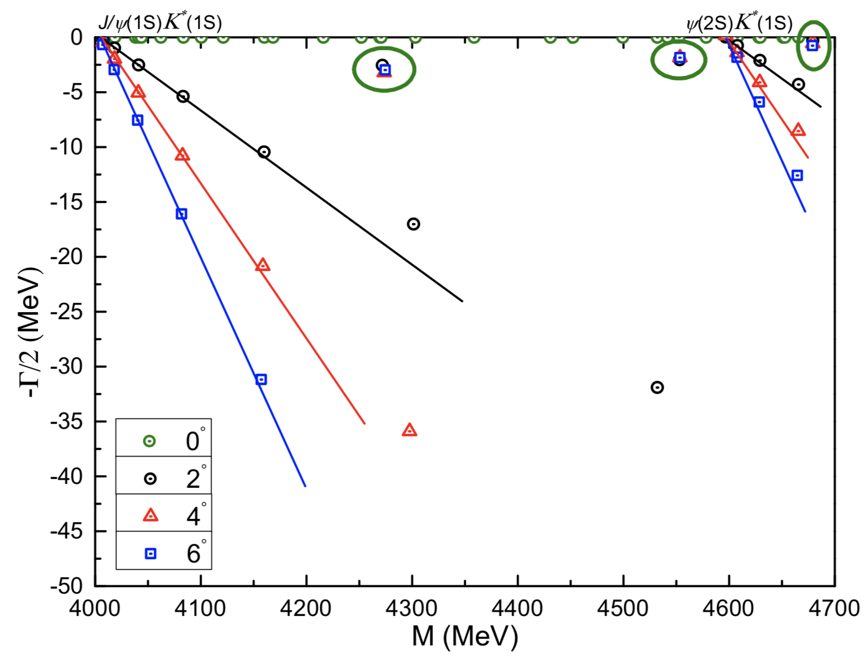
$2^{+}$ state
When only $(c\overline{q})(s\overline{c})$ dimeson channels are excluded in a coupled-channel investigation. Three resonances are obtained, masses and widths (in MeV) are
4271-5.2i,
4553-4.0i,
4678-1.6i
(candidate of X(4685), but with
different spin assignment).

Slide 59
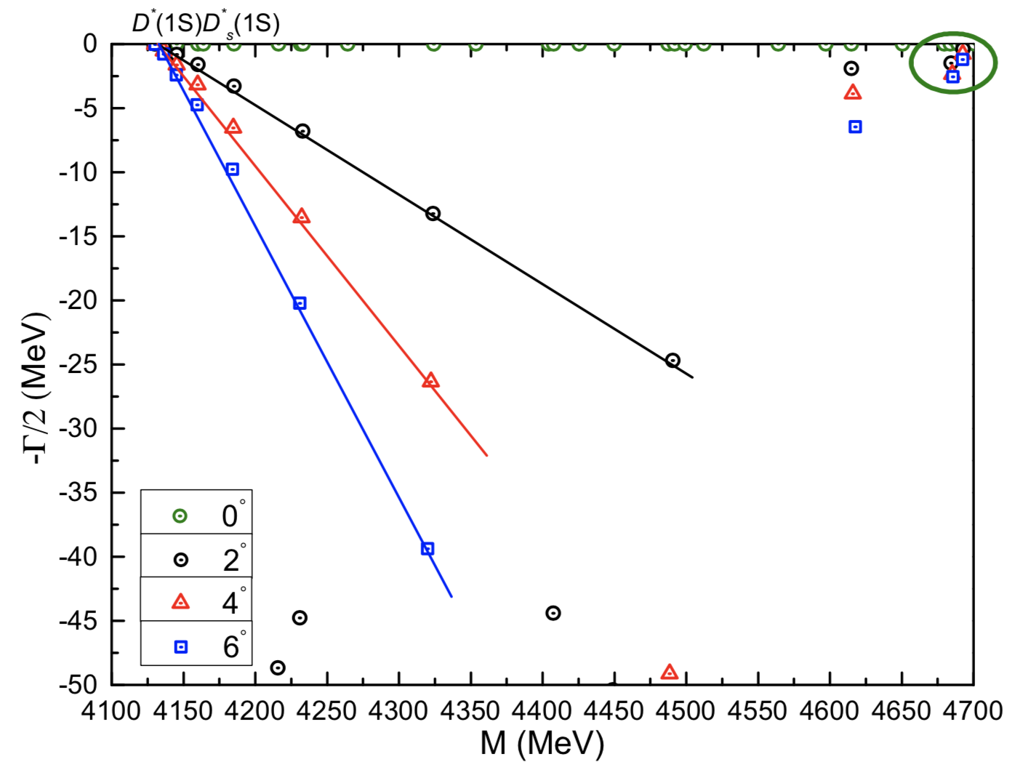
The distributions of complex energies of $2^{+}$ state, particularly only $(c\overline{q})(s\overline{c})$ is considered in the dimeson channel.
Two quite close resonance poles are obtained and their complex energies are (in MeV)
4685-4.8i;
4692-1.6i.
Although their masses coincide with the X(4685), the spin-parity is different from its experimental assignment.

Slide 60
Conclusions
The $Z_{cs}(3985)$ and $Z_{cs}(4000)$ can both be identified as compact c$\overline{c}s\overline{q}$ tetraquark in $1^{+}$state.
The X(4685) can be well identified as a hadronic molecular resonancce with ${J^{P}=1}^{+}.$
The $Z_{cs}(4220)$ could be compatible with a hadronic molecular resonance of either $η_{c}K$ with $0^{+}$ or $ψK$ and $D^{∗}D_{s}^{∗}$ with $1^{+}$.
Structures are also found in a mass range between 3.8 GeV and 4.6 GeV.

Slide 61
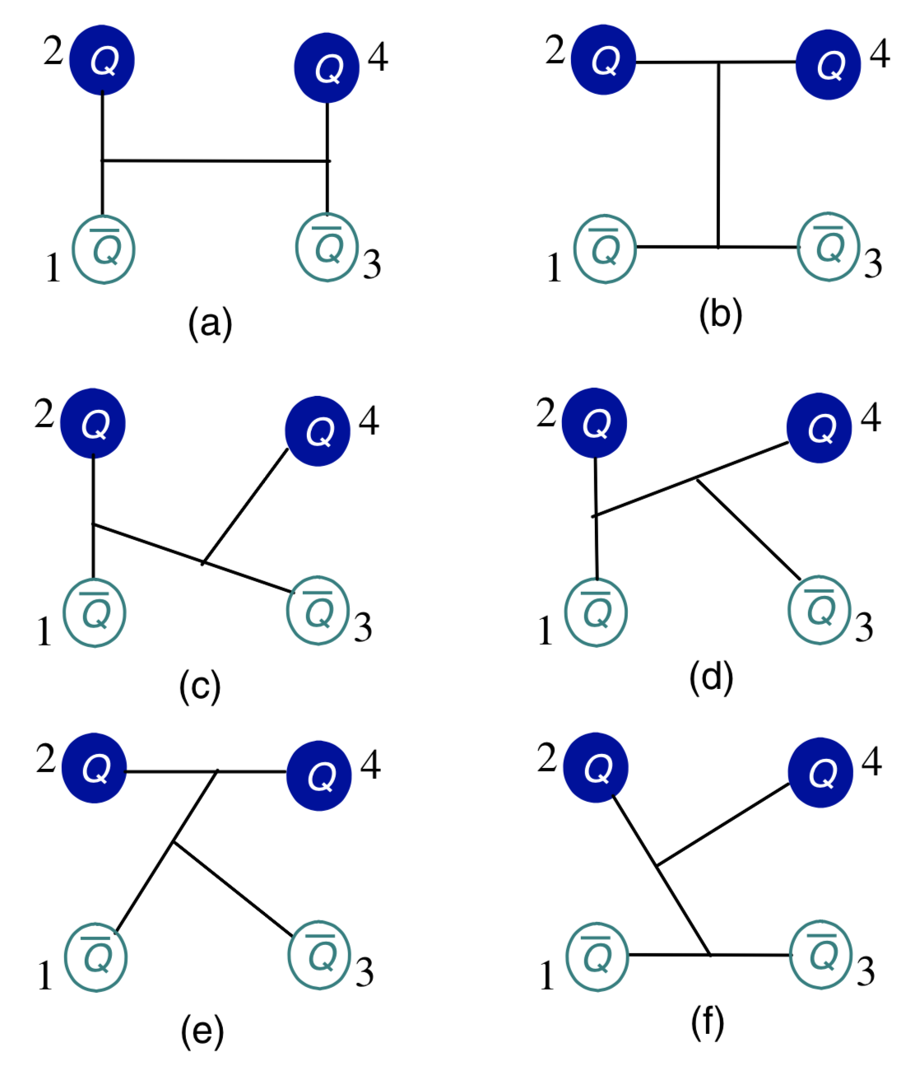
Fully heavy tetraquarks
Fully heavy tetraquarks, $QQ\overline{Q}\overline{Q} (Q=c, b)$, are systematically investigated by a lattice-QCD inspired quark model, which interaction reads
$$V_{Q\overline{Q}}\left({\overset{⃑}{r}}_{ij}\right)=−\frac{α}{r_{ij}}+σr_{ij}+βe^{−γr_{ij}}\left({\overset{⃑}{s}}_{i}∙{\overset{⃑}{s}}_{j}\right).$$
Six configurations, including meson-meson, diquark-antidiquark and K-type structures, are considered for $0^{+}$, $1^{+}$ and $2^{+}$ state.
No bound state is found, however, several narrow resonances are available.
Particularly, the $cc\overline{c}\overline{c}$ resonances reported experimentally can be well identified. Resonances with masses between 18.9 and 19.6 GeV are found in $bb\overline{b}\overline{b}$ system. Charm-bottom resonances are obtained within 9.8-16.4 GeV.
Phys. Rev. D 104, 014006 (2021).

Slide 62
Predicted fully charm and bottom tetraquark resonances are summarized below, unit in MeV.
$$J^{P}$$ | Resonance | Mass | Width | Resonance | Mass | Width
 | $$cc\overline{c}\overline{c}$$ |  |  | $$bb\overline{b}\overline{b}$$
$$0^{+}$$ | $$η_{c}(1S)η_{c}(2S)$$ | 6640 | 0.66 | $$η_{b}(1S)η_{b}(1S)$$ | 18882 | 1.42
 | $$η_{c}(1S)η_{c}(2S)$$ | 6762 | 1.14 | $$Υ(1S)Υ(1S)$$ | 19019 | 1.28
 | $$J/ψ(1S)ψ(2S)$$ | 6875 | 3.74 | $$η_{b}(1S)η_{b}(2S)$$ | 19394 | 0.16
 | $$J/ψ(1S)ψ(2S)$$ | 6987 | 4.00 | $$Υ(1S)Υ(2S)$$ | 19454 | 0.46
 | $$J/ψ(1S)ψ(2S)$$ | 7195 | 8.00
$$1^{+}$$ | $$J/ψ(1S)J/ψ(1S)$$ | 6274 | 0.06 | $$Υ(1S)Υ(1S)$$ | 19198 | 0.22
 | $$J/ψ(1S)J/ψ(1S)$$ | 6653 | 1.20 | $$η_{b}(1S)Υ(2S)$$ | 19402 | 0.22
 | $$η_{c}(2S)J/ψ(1S)$$ | 6885 | 4.10
$$2^{+}$$ | $$J/ψ(1S)ψ(2S)$$ | 7007 | 1.02 | $$Υ(1S)Υ(2S)$$ | 19473 | 0.42
 |  |  |  | $$Υ(1S)Υ(2S)$$ | 19633 | 0.40

Slide 63
Predicted $cb\overline{c}\overline{c}$ and $cb\overline{b}\overline{b}$ tetraquark resonances are summarized below, unit in MeV.
$$J^{P}$$ | Resonance | Mass | Width |  | Resonance | Mass | Width
 | $$cb\overline{c}\overline{c}$$ |  |  |  | $$cb\overline{b}\overline{b}$$
$$0^{+}$$ | $$J/ψ(1S)B_{c}^{∗}(1S)$$ | 9813 |  | 4.02
$$1^{+}$$ | $$J/ψ(1S)B_{c}^{∗}(1S)$$ | 9823 |  | 2.41 | $$Υ(1S){\overline{B}}_{c}^{∗}(1S)$$ | 16031 | 24.61
 | $$η_{c}(1S)B_{c}^{∗}(2S)$$ | 9898 |  | 1.33 | $$Υ(2S){\overline{B}}_{c}^{∗}(1S)$$ | 16303 | 1.80
 | $$η_{c}(1S)B_{c}^{∗}(2S)$$ | 9928 |  | 3.80
 | $$η_{c}(1S)B_{c}^{∗}(2S)$$ | 9974 |  | 8.21
 | $$η_{c}(2S)B_{c}^{∗}(1S)$$ | 10284 |  | 3.00
$$2^{+}$$ | $$ψ(2S)B_{c}^{∗}(1S)$$ | 10563 |  | 6.61 | $$Υ(1S){\overline{B}}_{c}^{∗}(1S)$$ | 16312 | 1.12

Slide 64
Predicted $bb\overline{c}\overline{c}$ and $cb\overline{c}\overline{b}$ tetraquark resonances are summarized below, unit in MeV.
$$J^{P}$$ | Resonance | Mass | Width |  | Resonance | Mass | Width
 | $$bb\overline{c}\overline{c}$$ |  |  |  | $$cb\overline{c}\overline{b}$$
$$0^{+}$$ | $$B_{c}^{∗}(1S)B_{c}^{∗}(1S)$$ | 12768 | 1.73 |  | $$J/ψ(1S)Υ(1S)$$ | 12820 | 0.62
 |  |  |  |  | $$ψ(2S)Υ(1S)$$ | 13449 | 2.81
$$1^{+}$$ | $$B_{c}(1S)B_{c}^{∗}(2S)$$ | 13214 | 0.66 |  | $$J/ψ(1S)Υ(1S)$$ | 12858 | 0.60
 |  |  |  |  | $$η_{c}(1S)Υ(2S)$$ | 13002 | 0.94
 |  |  |  |  | $$ψ(2S)Υ(1S)$$ | 13290 | 1.81
$$2^{+}$$ | $$B_{c}^{∗}(1S)B_{c}^{∗}(1S)$$ | 12965 | 17.42 |  | $$J/ψ(1S)Υ(1S)$$ | 12826 | 1.25
 | $$B_{c}^{∗}(1S)B_{c}^{∗}(1S)$$ | 13236 | 4.40 |  | $$ψ(2S)Υ(1S)$$ | 13321 | 3.40
 | $$B_{c}^{∗}(1S)B_{c}^{∗}(1S)$$ | 13248 | 3.41

Slide 65
Summary
Recently announced exotic states which are categorized in multiquark contents.
Tetraquarks
Charm-strange: $X_{0,1}(2900)$ [Phys. Rev. D 103, 074011 (2021)].
Strange hidden-charm: $Z_{cs}(3985)$, $Z_{cs}(4000)$, $Z_{cs}(4220)$; X(4630), X(4685).
Doubly charmed: $T_{cc}(3875)$.
Fully charmed: X(6900).
Pentaquarks
Hidden-charm: $P_{c}(4312)$, $P_{c}(4337)$, $P_{c}(4380)$, $P_{c}(4440)$, $P_{c}(4457)$.
Strange hidden-charm: $P_{cs}(4459)$.
Theoretically, the CQM along with GEM and CSM are successfully employed in investigating hidden-charm pentaquark systems, doubly and fully heavy, strange hidden-charm and charm-strange tetraquark systems etc.
The experimentally reported $P_{c}$, $T_{cc}$, $Z_{cs}$ and X states can be well identified or even well predicted in advance.
Several extra exotic resonances, which are theoretically obtained in these multiquark sectors, still need to be confirmed in future experiments.

Slide 66
Thank you so much!

