Slide 1
Study of $m_{π}$-dependence of $ρ$ on the lattice
Kang Yu (UCAS) ,
Collaborator : J.J. Wu, Y. Li, D.B. Leinweber, A.W. Thomas
第六届强子谱和强子结构会议 2023.8 北京

Slide 2
Outline
Motivation : Why $m_{π}$-dependence ?
Introduction of the formalism : HEFT
The analysis of $ρ$ meson lattice spectrum
Summary and Outlook

Slide 3
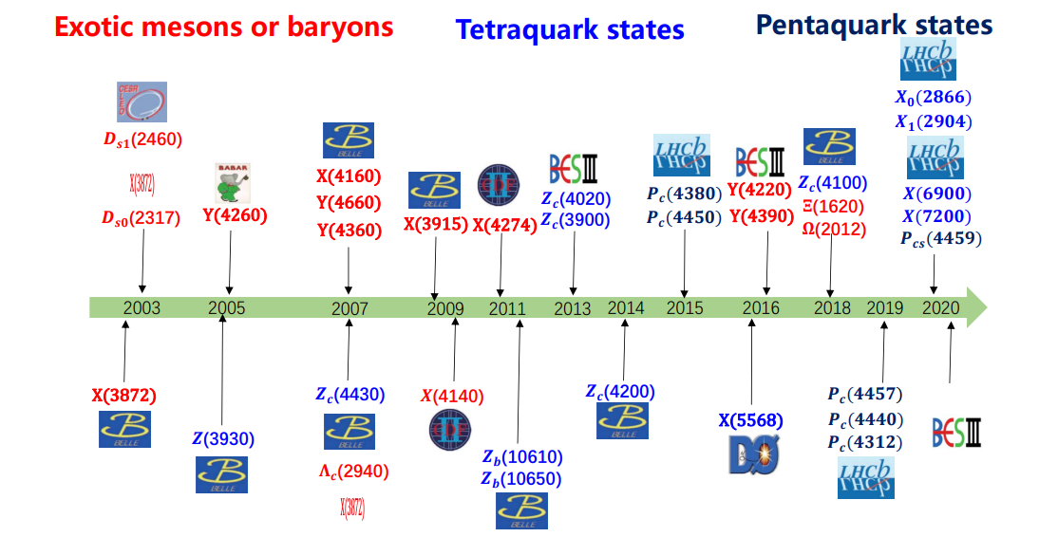
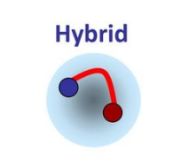
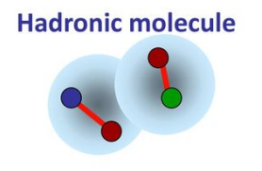
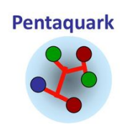
Motivation : Why $m_{π}$-dependence ?
From slides of
耿立升，王恩老师

Slide 4
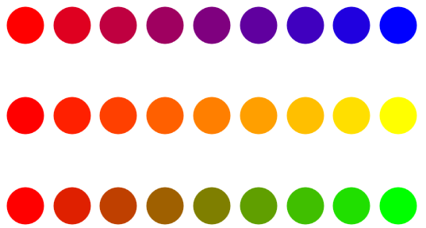
Motivation : Why $m_{π}$-dependence ?
physical $m_{π}$
$$m_{π} (m_{u,d})$$
model A
model B
model C

Slide 5
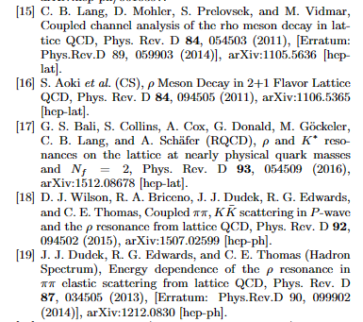
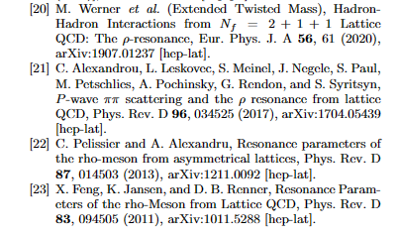
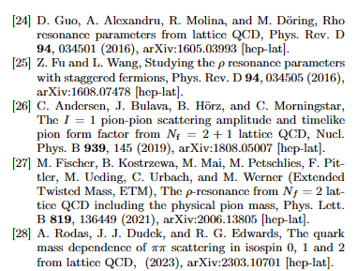
Motivation : Why $m_{π}$-dependence ?
many lattice data for I=L=1 $ππ$ sector

Slide 6
Introduction of the formalism — HEFT
Lattice QCD
1. QCD theory: on a box in the Euclidean 4-d space
2. a → UV cutoff, L=N_{s}a → Infrared truncation
3. Lattice QCD → a model of statistical physics.
Φ: field quantity, S[ϕ]: Action, O[ϕ]:physical quantity
4. Monte Carlo method
5. Three steps for Lattice QCD to real world
a，Configuration
b，Measurement
c，Transformation
QCD theory
(N_{s}a)³ x (N_{T}a)
N_{s}a
a
T matrix & Resonance
(Phase Shifts, inelasticity , ……)
Lattice Spectrum
Lüscher’s Method
M. Luscher, NPB 354, 531 (1991).
Partial Wave Analysis
Lattice QCD
Non-perturbative
Observable
(Differential Cross Sections)
QCD theory

Slide 7
Introduction of the formalism — HEFT
Lattice QCD
1. QCD theory: on a box in the Euclidean 4-d space
2. a → UV cutoff, L=N_{s}a → Infrared truncation
3. Lattice QCD → a model of statistical physics.
Φ: field quantity, S[ϕ]: Action, O[ϕ]:physical quantity
4. Monte Carlo method
5. Three steps for Lattice QCD to real world
a，Configuration
b，Measurement
c，Transformation
J. M. M. Hall etc. PRD 87(2013), 094510
J.-j. Wu etc. PRC90 (2014), 055206
Y. Li etc. PRD 101(2020), 114501
PRD 103(2021), 094518
QCD theory
(N_{s}a)³ x (N_{T}a)
Hamiltonian
N_{s}a
infinite vol
finite vol
a
Equivalent
T matrix & Resonance
(Phase Shifts, inelasticity , ……)
Lattice Spectrum
Lüscher’s Method
M. Luscher, NPB 354, 531 (1991).
Partial Wave Analysis
Lattice QCD
Non-perturbative
Observable
(Differential Cross Sections)
QCD theory

Slide 8
Introduction of the formalism — HEFT
1. Finite-volume matrix Hamiltonian model for a Δ→Nπ system
J.M.M. Hall, A.C.-P. Hsu, D.B. Leinweber, A.W.Thomas, R.D. Young Phys.Rev. D87 (2013) no.9, 094510
2. Finite-volume Hamiltonian method for coupled-channels interactions in lattice QCD
Jia-Jun Wu, T.-S.H.Lee, A.W.Thomas, R.D. Young Phys.Rev. C90 (2014) no.5, 055206
3. Hamiltonian effective field theory study of the N∗(1535) resonance in lattice QCD
Zhan-Wei Liu, Waseem Kamleh, Derek B. Leinweber, Finn M. Stokes, Anthony W. Thomas, Jia-Jun Wu Phys.Rev.Lett. 116 (2016) no.8, 082004
4. Lattice QCD Evidence that the Λ(1405) Resonance is an Antikaon-Nucleon Molecule
J.M.M. Hall, W. Kamleh, D. B. Leinweber, Benjamin J. Menadue, Benjamin J. Owen, A.W.Thomas, R.D. Young Phys.Rev.Lett. 114 (2015) no.13, 132002
5. Hamiltonian effective field theory study of the N∗(1440) resonance in lattice QCD
Zhan-Wei Liu, Waseem Kamleh, Derek B. Leinweber, Finn M. Stokes, Anthony W. Thomas, Jia-Jun Wu Phys.Rev. D95 (2017) no.3, 034034
6. Structure of the Λ(1405) from Hamiltonian effective field theory
Zhan-Wei Liu, Jonathan M.M. Hall, Derek B. Leinweber, Anthony W. Thomas, Jia-Jun Wu Phys.Rev. D95 (2017) no.1, 014506
7. Nucleon resonance structure in the finite volume of lattice QCD
Jia-jun Wu, H. Kamano, T.-S.H.Lee , Derek B. Leinweber, Anthony W. Thomas Phys.Rev. D95 (2017) no.11, 114507
8. Structure of the Roper Resonance from Lattice QCD Constraints
Jia-jun Wu, Derek B. Leinweber, Zhan-wei Liu, Anthony W.Thomas Phys.Rev. D97(2018) no.9, 094509
9. Kaonic Hydrogen and Deuterium in Hamiltonian Effective Field Theory
Zhan-wei Liu, Jia-jun Wu, Derek B. Leinweber, Anthony W. Thomas Phys.Lett.B 808(2020),135652
10. Partial Wave Mixing in Hamiltonian Effective Field Theory
Yan Li, Jia-jun Wu, Curtis D. Abell, Derek B. Leinweber, Anthony W. Thomas Phys.Rev. D101(2020) no.11,114501
11. Hamiltonian effective field theory in elongated or moving finite volume
Yan Li, Jia-jun Wu, Derek B. Leinweber, Anthony W. Thomas Phys.Rev. D103(2021) no.9, 094518
12. Regularisation in Nonperturbative Extensions of Effective Field Theory
Curtis D. Abell, Derek B. Leinweber, Anthony W. Thomas, Jia-jun Wu Phys.Rev. D103(2021) no.9, 094518
13. Novel Coupled Channel Framework Connecting the Quark Model and Lattice QCD for the Near-threshold Ds States
Zhi Yang, Guang-Juan Wang, Jia-jun Wu, Shi-lin Zhu, Makoto Oka Phys.Rev.Lett.128(2022),112001
14. The investigations of the P-wave Bs​ states combining quark model and lattice QCD in the coupled channel framework
Zhi Yang, Guang-Juan Wang, Jia-jun Wu, Shi-lin Zhu, Makoto Oka JHEP01 (2023) 058
15. Effects of multiple single-particle basis states in scattering systems
Curtis D. Abell, Derek B. Leinweber, Anthony W. Thomas, Jia-jun Wu arXiv: 2305.18790
……

Slide 9
Introduction of the formalism — HEFT
T matrix & Resonance
(Phase Shifts,
inelasticity , ……)
infinite vol
finite vol
Hamiltonian
Lattice Spectrum
a genuine $q\overline{q}$ confined state at quark level
but a Fock state at hadronic level
Fock Space
span{ $\left|ρ_{B}\right\rangle , \left|ππ(k)\right\rangle , (|ωπ(k)⟩)$ }
$E_{thr}\left(ωπ\right)∼920$ MeV
$E_{thr}\left(K\overline{K}\right)∼1000$ MeV
Interaction
$V_{ππ} ≔ \left\langle ρ_{B}\left|V^{I=L=1}\right|ππ\right\rangle =\frac{g_{ρππ}}{2π\sqrt{3}}\frac{k}{\sqrt{m_{ρ}^{B} }E_{π}\left(k\right)}\frac{1}{{\left(1+k^{2}/Λ_{ρππ}^{2}\right)}^{2}}$ , from$L= g_{ρππ} {\vec{ρ}}^{μ} ⋅(\vec{π}×∂_{μ}\vec{π})$
$V_{ωπ} ≔ \left\langle ρ_{B}\left|V^{I=L=1}\right|ωπ\right\rangle =\frac{g_{ωρπ}}{2π\sqrt{6}}\frac{k\sqrt{m_{ρ}^{B}}}{\sqrt{E_{π}\left(k\right)E_{ω}\left(k\right)}}{\left(\frac{Λ_{ωρπ}^{2}−μ_{π}^{2}}{k^{2}+Λ_{ωρπ}^{2}}\right)}^{2}$ , from $L= g_{ωρπ} ε_{μναβ}{ ∂}^{μ}ω^{ν}∂^{α} {\vec{ρ}}^{β}⋅\vec{π}$
$H=H_{0}+H_{I}$
$H_{0}=\sum_{M}{m_{ρ}^{B}\left|ρ_{B},M\right\rangle \left\langle ρ_{B},M\right|+\sum_{α}{∫d^{3}k (\sqrt{k^{2}+m_{α_{1}}^{2}}+\sqrt{k^{2}+m_{α_{2}}^{2}})}|α,k⟩⟨α,k| }$
$H_{I}=∫d^{3}k V_{α}(k)|α,k⟩⟨ρ_{B},M|+h.c.$
Friedrich-Lee Model
also see slide from 周智勇老师

Slide 10
Introduction of the formalism — HEFT
T matrix & Resonance
(Phase Shifts,
inelasticity , ……)
infinite vol
finite vol
Hamiltonian
Lattice Spectrum
$O\left(3\right)→O_{h}/C_{4/3/2v}$ $\left|ρ_{B}\right\rangle →{\left|ρ_{B}\right\rangle }_{L}$ $\left|α,k\right\rangle →\sqrt{\frac{V}{{\left(2π\right)}^{3}}}|α,k\left(n\right)⟩$ $∫d^{3}k→\sum_{n∈Z^{3}}{ }$
$H=\sum_{Γ}{H_{Γ}}=\sum_{Γ}{H_{0,Γ }+H_{I,Γ }}$ $H_{Γ}=\left(\begin{matrix}m_{ρ}^{B} & v \\ v^{T} & h\end{matrix}\right)$
$\det\left(H−EI\right)=0$
$E(m_{ρ}^{B},g_{ρππ},Λ_{ρππ},g_{ωρπ},Λ_{ωρπ})$
$$h=diag(2E_{π}\left(k_{1}\right),2E_{π}\left(k_{2}\right), ⋯,E_{π}\left(k_{1}^{′}\right)+E_{ω}(k_{1}^{′}),E_{π}\left(k_{2}^{′}\right)+E_{ω}(k_{2}^{′}),⋯)$$
$$v= \left(V_{ππ}^{fin}\left(k_{1}\right),V_{ππ}^{fin}\left(k_{2}\right),⋯,V_{ωπ}^{fin}\left(k_{1}^{′}\right),V_{ωπ}^{fin}\left(k_{2}^{′}\right),⋯\right)$$
$V_{α}^{fin}\left(k(n)\right)=\sqrt{\frac{{\left(2π\right)}^{3}}{V}} J_{α}(k(n)) \sqrt{Z_{Γ}\left(k\left(n\right)\right)} V_{α}(k(n))$
Jacobian of the boost
due to O(3) symmetry breaking

Slide 11
Introduction of the formalism — HEFT
T matrix & Resonance
(Phase Shifts,
inelasticity , ……)
infinite vol
finite vol
Hamiltonian
Lattice Spectrum
$$t_{αβ}\left(k_{α},k_{β},E\right)=V_{αβ}\left(k_{α},k_{β},E\right)+\sum_{γ}{∫k_{γ}^{2}}dk_{γ}\frac{V_{αγ}\left(k_{α},k_{γ},E\right)t_{γβ}\left(k_{γ},k_{β},E\right)}{E−\sqrt{k_{γ1}^{2}+m_{γ_{1}}^{2}}−\sqrt{k_{γ2}^{2}+m_{γ_{2}}^{2}}+i0^{+}}$$
$t_{ππ,ππ}\left(E\right)=\frac{{|V}_{ππ}{\left.​\right|}^{2}}{E−m_{ρ}^{B}−Σ(E)}$ , Self Energy $Σ\left(E\right)=Σ_{ππ}\left(E\right)+Σ_{ωπ}(E)$
$$Σ_{α}\left(E\right)=\int{\frac{d^{3}q}{{\left(2π\right)}^{3}}\frac{{|V}_{α}{\left.​\right|}^{2}}{E−\sqrt{k_{α1}^{2}+m_{α_{1}}^{2}}−\sqrt{k_{α2}^{2}+m_{α_{2}}^{2}}+i0^{+}}}$$

Slide 12
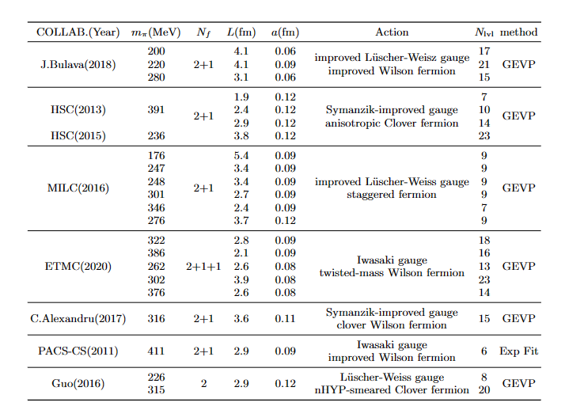
analysis of lattice spectrum
strategy A : $g_{ωρπ}=0, m_{ρ}^{B} , g_{ρππ}, Λ_{ρππ}$ free
20 $m_{π}$ in total

Slide 13
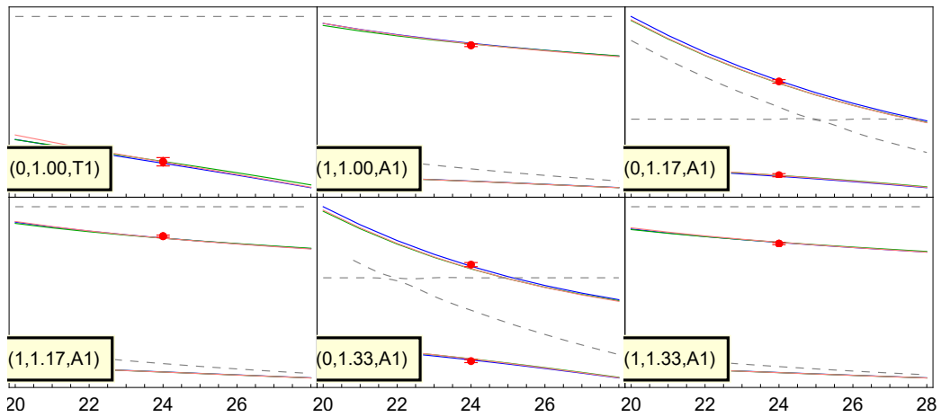
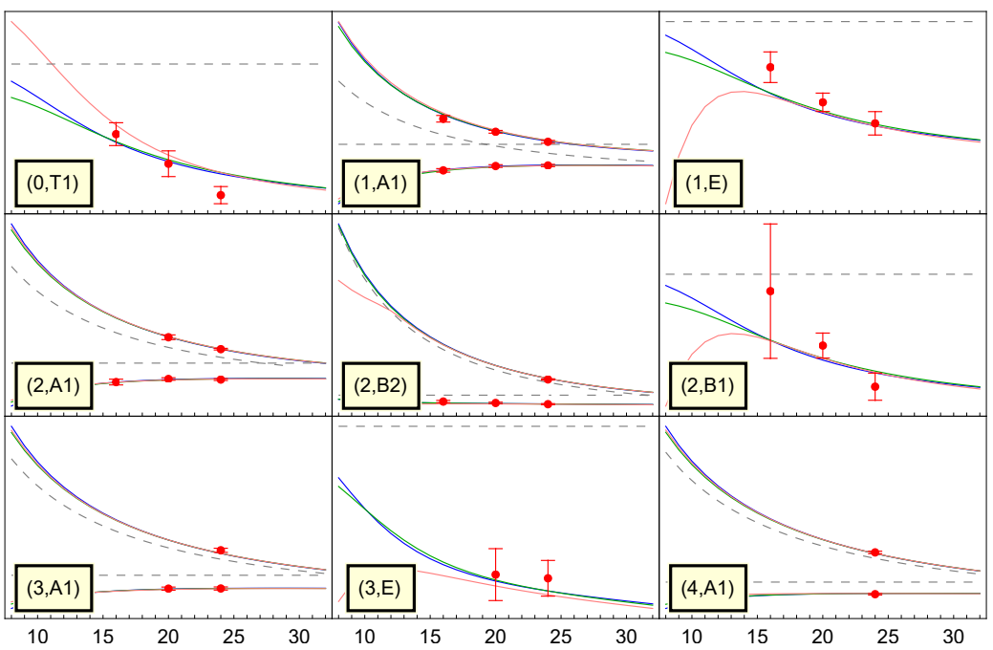
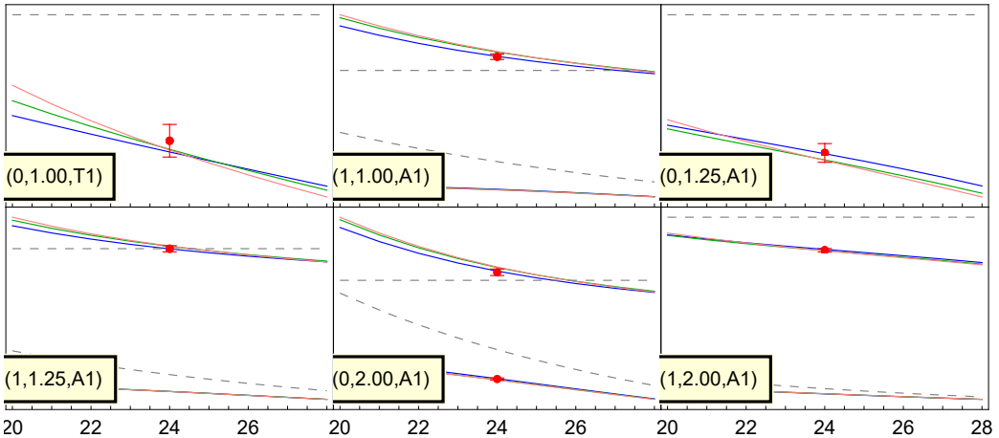
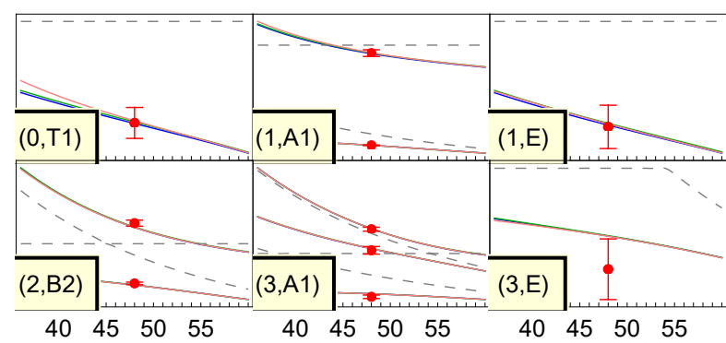
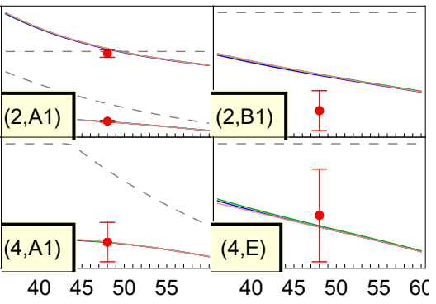
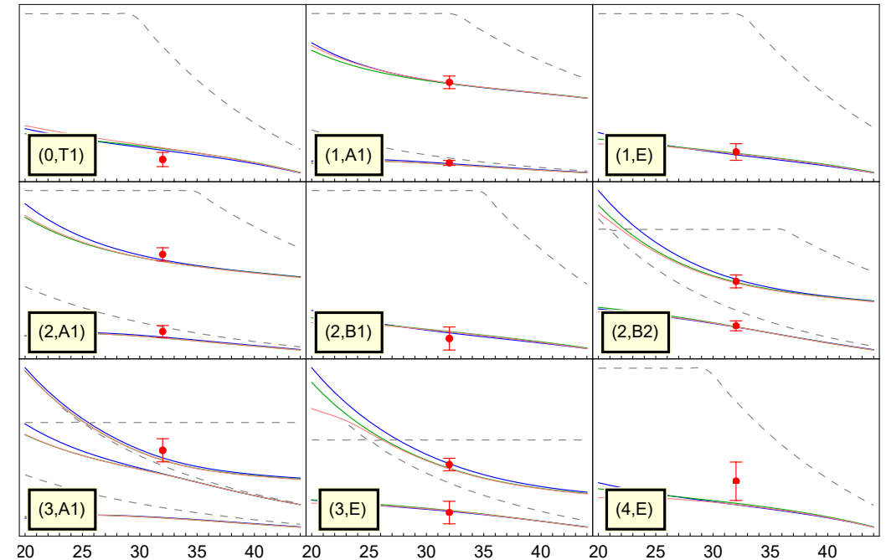
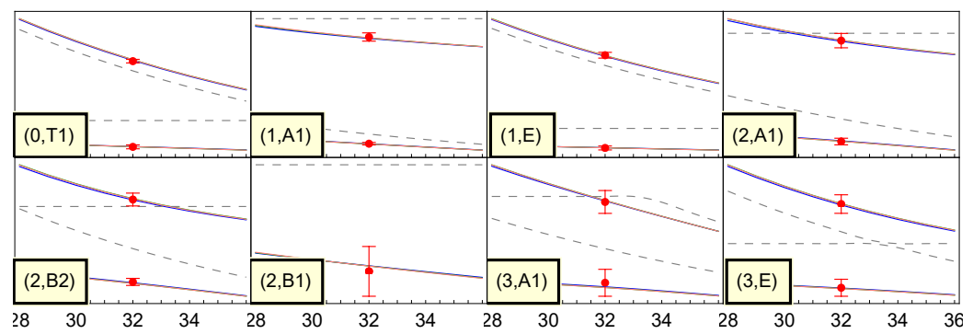
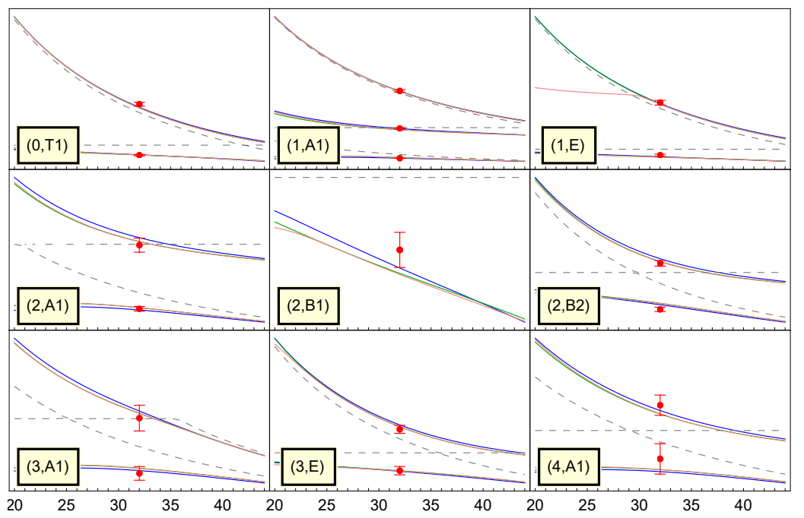
MILC
Guo et al.
HSC
176
226
236
391
247
248
330
315
275
301
Bulava et al.
280
200
346
220
ETMC
376
262
C.Alexrandru et al.
302
316
322
386
PACS-CS
411

Slide 14
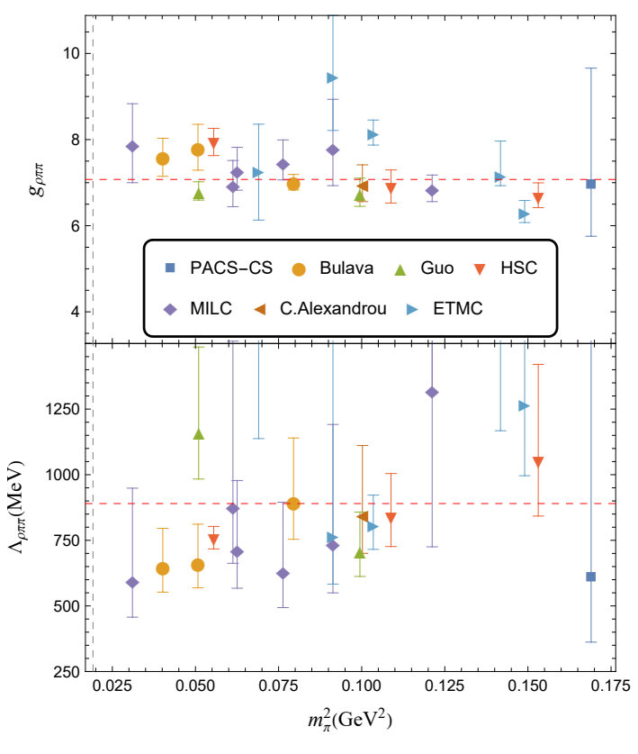
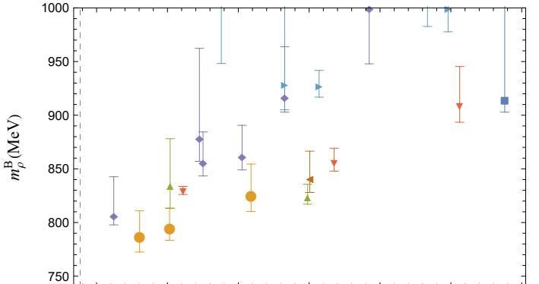
analysis of lattice spectrum
strategy A : $g_{ωρπ}=0, m_{ρ}^{B} , g_{ρππ}, Λ_{ρππ}$ free
Messy!🤔

Slide 15
analysis of lattice spectrum
strategy A : $g_{ωρπ}=0, m_{ρ}^{B} , g_{ρππ}, Λ_{ρππ}$ free
Messy!🤔

Slide 16
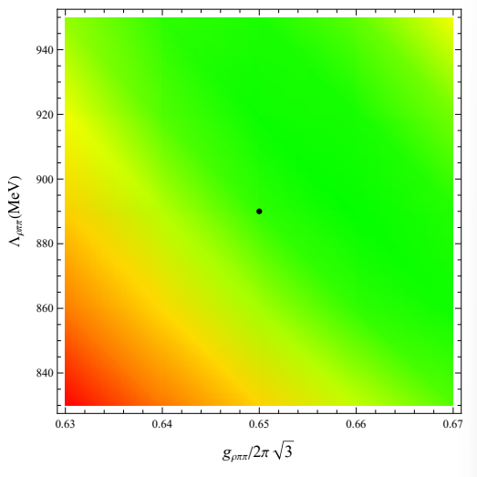
analysis of lattice spectrum
strategy B : $g_{ωρπ}=0, m_{ρ}^{B}$free, $g_{ρππ}, Λ_{ρππ}$ fixed
$$g_{ρππ}=7.07 , Λ_{ρππ}=890 MeV$$
$$N_{f}=2$$
$$g_{ρππ}=6.75 , Λ_{ρππ}=950 MeV$$

Slide 17
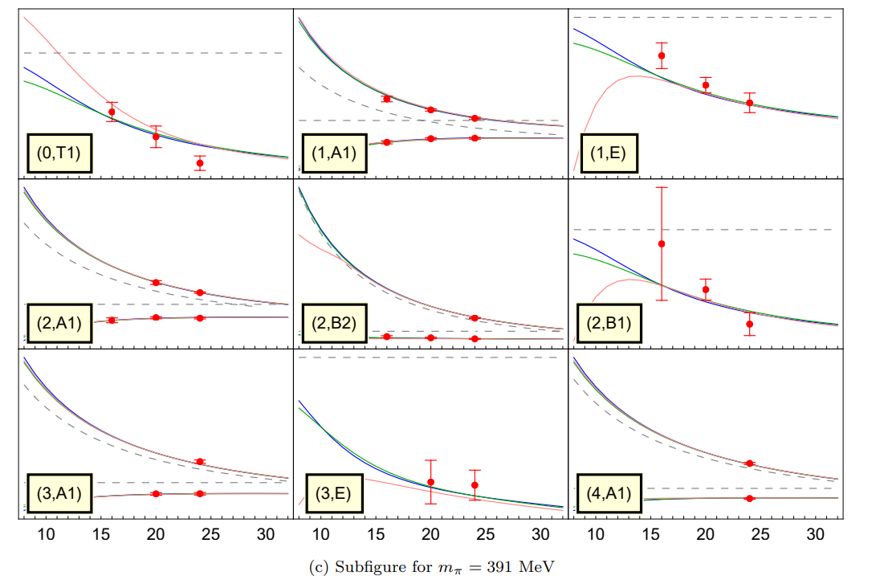
analysis of lattice spectrum
strategy B : $g_{ωρπ}=0, m_{ρ}^{B}$free, $g_{ρππ}, Λ_{ρππ}$ fixed
Green Lines

Slide 18
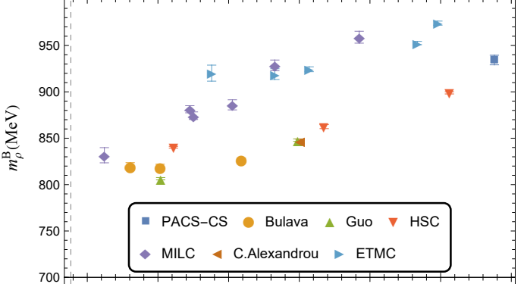
analysis of lattice spectrum
strategy B : $g_{ωρπ}=0, m_{ρ}^{B}$free, $g_{ρππ}, Λ_{ρππ}$ fixed
Error reduces,
But Still Messy!😐

Slide 19
analysis of lattice spectrum
strategy C : $m_{ρ}^{B}$free, $g_{ρππ}, Λ_{ρππ} , g_{ωρπ},Λ_{ωρπ}$ fixed
$g_{ρππ} :7.07→7.40$ $Λ_{ρππ} :890→900$MeV
($N_{f}=2$
$g_{ρππ} :6.75→7.07$ $Λ_{ρππ} :950→980$MeV )
To determine $g_{ωρπ},Λ_{ωρπ}$ , look at the experimental result : $Γ_{ω→ρπ→3π}≈Γ_{ω→3π}$and $δ_{ππ}^{l=1}(E)$
$g_{ωρπ}=18/GeV$
$Λ_{ωρπ}=Λ_{ρππ}=900$MeV

Slide 20
analysis of lattice spectrum
strategy C : $m_{ρ}^{B}$free, $g_{ρππ}, Λ_{ρππ} , g_{ωρπ},Λ_{ωρπ}$ fixed
Pink Lines

Slide 21
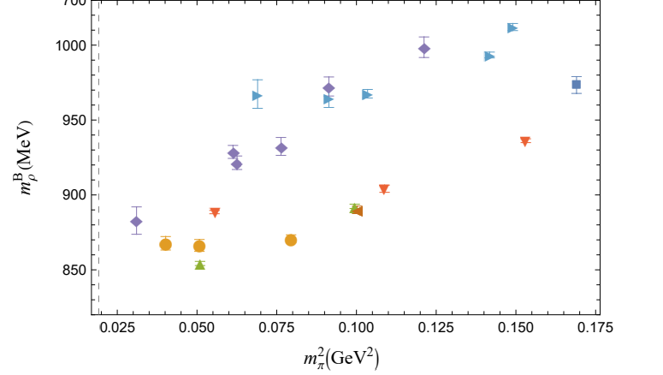
analysis of lattice spectrum
strategy C : $m_{ρ}^{B}$free, $g_{ρππ}, Λ_{ρππ} , g_{ωρπ},Λ_{ωρπ}$ fixed
Gap is not filled 😕
keep this issue in mind,
go on for extrapolation ...

Slide 22
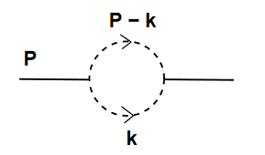
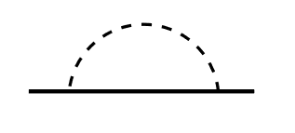
Extrapolation
from $ππ,ωπ$ loop
$$m_{ρ}^{P}=c_{0}^{′}+c_{1}^{′}m_{π}^{2}+c_{2}^{′}m_{π}^{3}+c_{3}^{′}m_{π}^{4}\log\left(\frac{m_{π}^{2}}{m_{ρ}^{2}}\right)+O(m_{π}^{4})$$
ChEFT:
Ulf-G. Meißner
Eur.Phys.J.C 40 (2005) 97-119
our model:
$$m_{ρ}^{P}≈m_{ρ}^{B}+Re(Σ(m_{P}))$$
$$m_{ρ}^{B}=c_{0}+c_{1} m_{π}^{2}$$
😟
unexpected difference between LQCD Collaboration
$$m_{ρ}^{B}=c_{0}+c_{1} m_{π}^{2}+ξa^{2}$$
$$m_{ρ}^{B}=(c_{0}+ξ_{0}a^{2})+(c_{1}+ξ_{1}a^{2})m_{π}^{2}$$

Slide 23
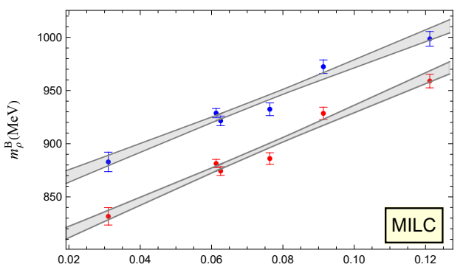
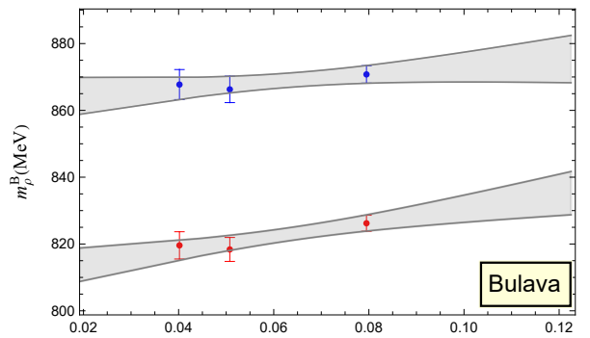
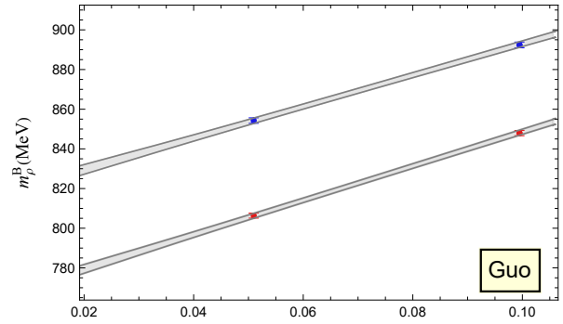
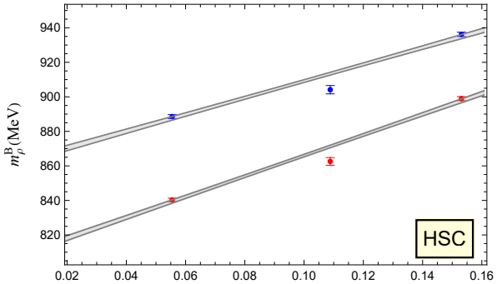
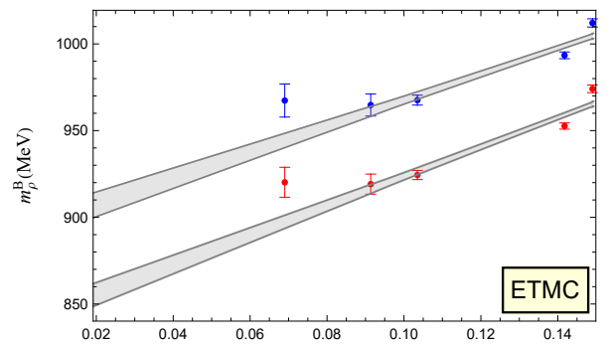
Extrapolation
$$g_{ωρπ}≠0$$
$$g_{ωρπ}=0$$

Slide 24
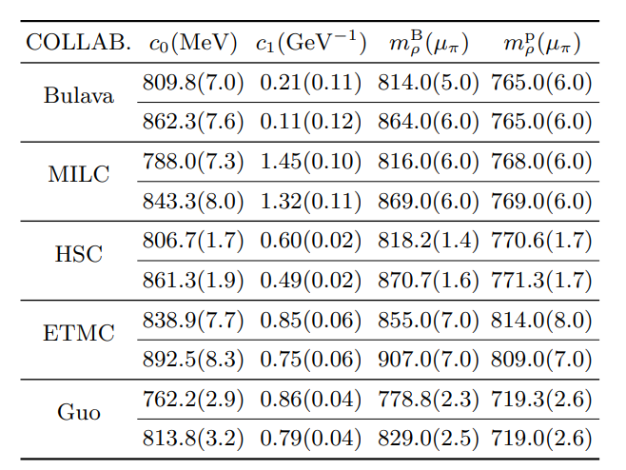
Extrapolation
bare / pole mass of $ρ$ at $μ_{π}=138.5MeV$
$$g_{ωρπ}=0$$
$$m_{ρ}^{B}=c_{0}+c_{1} m_{π}^{2}$$
$$g_{ωρπ}≠0$$

Slide 25
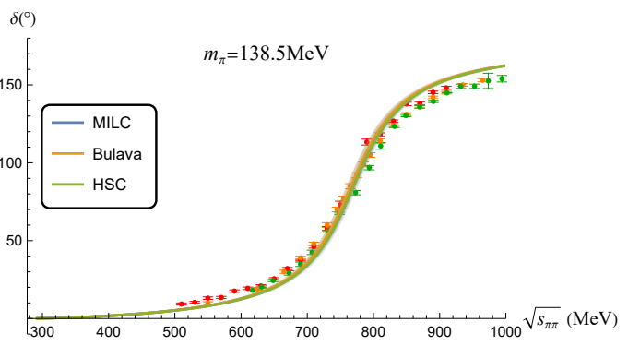
Extrapolation
bare / pole mass of $ρ$ at $μ_{π}=138.5MeV$
😀
$$g_{ωρπ}=0$$
$$g_{ωρπ}≠0$$

Slide 26
Extrapolation
bare / pole mass of $ρ$ at $μ_{π}=138.5MeV$
😕
$$g_{ωρπ}=0$$
$$g_{ωρπ}≠0$$

Slide 27
Extrapolation
$$g_{ωρπ}=0$$
$$g_{ωρπ}≠0$$
$$m_{ρ}^{B}=c_{0}+c_{1} m_{π}^{2}$$

Slide 28
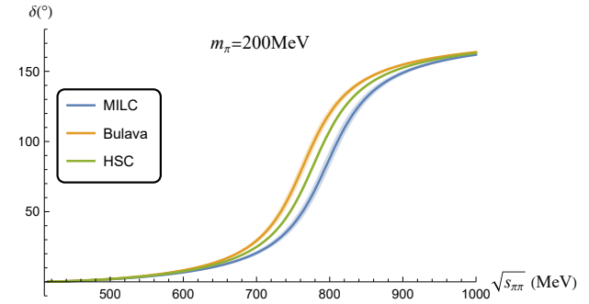
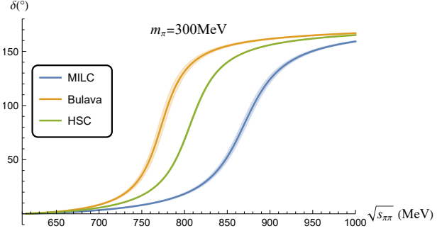
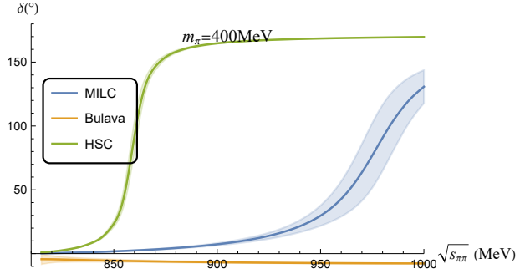
Extrapolation

Slide 29
Summary
$g_{ρππ}$ and $Λ_{ρππ}$ is weakly dependent on $m_{π}$ (at least for the range from 140 to 400 MeV)
$m_{ρ}^{B}$ has a linear relation to $m_{π}^{2}$ : $m_{ρ}^{B}=c_{0}+c_{1}m_{π}^{2} {,c}_{1}$ is more robust and hence may contain more physical information of the structure of $ρ$
In our model, data from HSC, MILC and Bulava et al. are all in agreement with experimental result while that from ETMC and Guo et al deviates.
There are unexpected intrinsic differences between each LQCD Collaboration.

Slide 30
Outlook
$ρ$ from the CLQCD configuration
$f_{0}\left(500\right), f_{0}\left(980\right),a_{0}(980)$ (have NO $q\overline{q}$ core), at unphysical $m_{π}$
Possible methods to reconcile the possible difference between LQCD collaboration
...

Slide 31
Thanks!

Slide 35
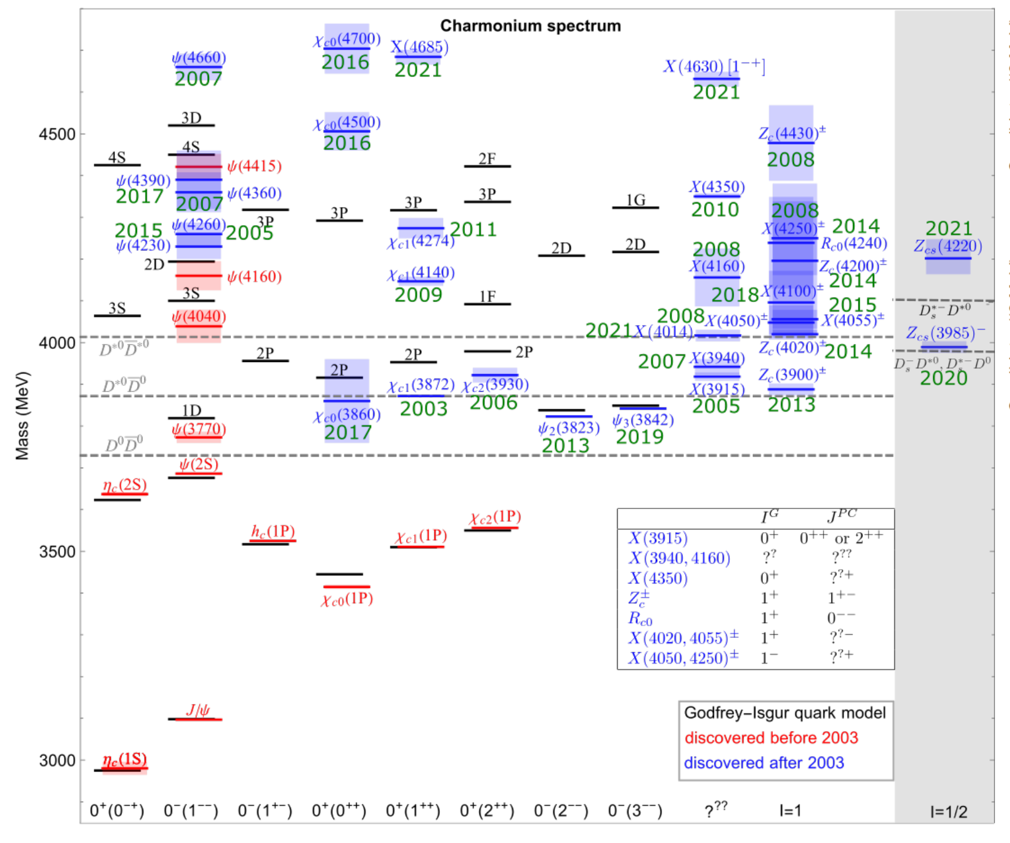
Motivation : Why $m_{π}$-dependence ?

