Slide 1
Strong decays of $T_{c\overline{s}0 }^{a}{\left(2900\right)}^{++/0}$ as a fully open-flavor tetraquark state
连丁坤
中山大学
arXiv:2302.01167
Collaborators: W.Chen, H.X.Chen, L.Y.Dai, T.G.Steele
第六届强子谱和强子结构研讨会
国科大雁栖湖 2023.8.29

Slide 2
Content
Quark model and exotic hadron
Experiment and theory on $T_{c\overline{s}0}^{a}{\left(2900\right)}^{++/0}$
Strong decays of $T_{c\overline{s}0}^{a}{\left(2900\right)}^{++/0}$
Conclusion

Slide 3
Quark model and exotic hadron
Conventional hadrons: meson , baryon
$$q$$
$$q$$
$$q$$
$$\overline{q}$$
$$q$$
Exotic hadrons: more configurations
$$q$$
$$q$$
$$q$$
$$q$$
$$q$$
$$q$$
$$\overline{q}$$
$$q$$
$$\overline{q}$$
$$\overline{q}$$
$$\overline{q}$$
$$\overline{q}$$
$$q$$
Tetraquark
Hadronic molecule
Pentaquark
$$\overline{q}$$
$$q$$
Hybrid meson
Glueball

Slide 4
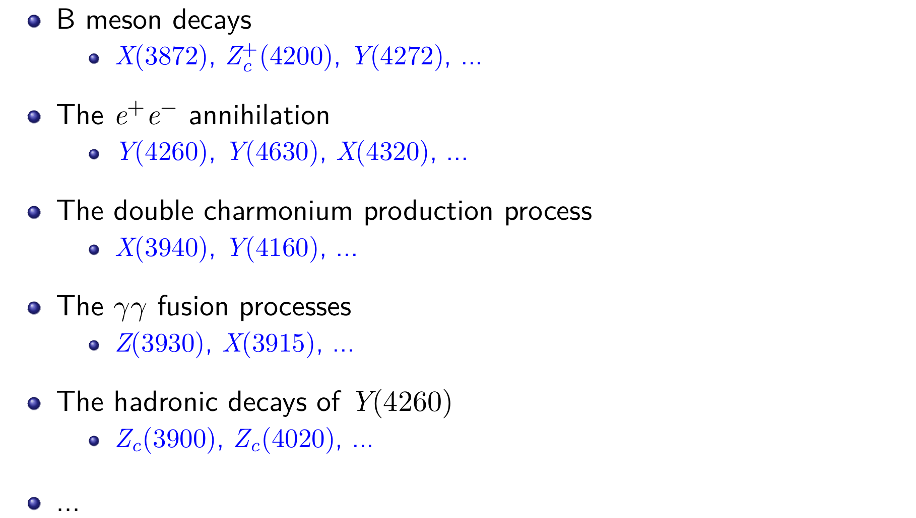
Since 2003, numerous XYZ states that can be interpreted as tetraquarks
have been found in experiments.

Slide 5
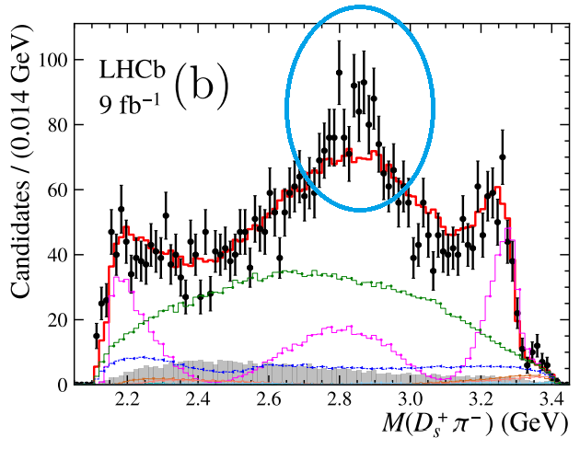
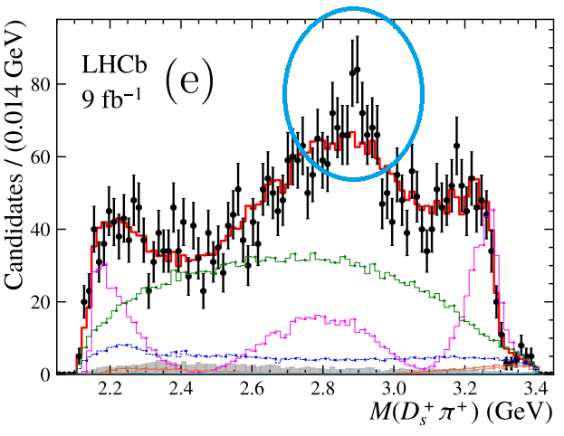
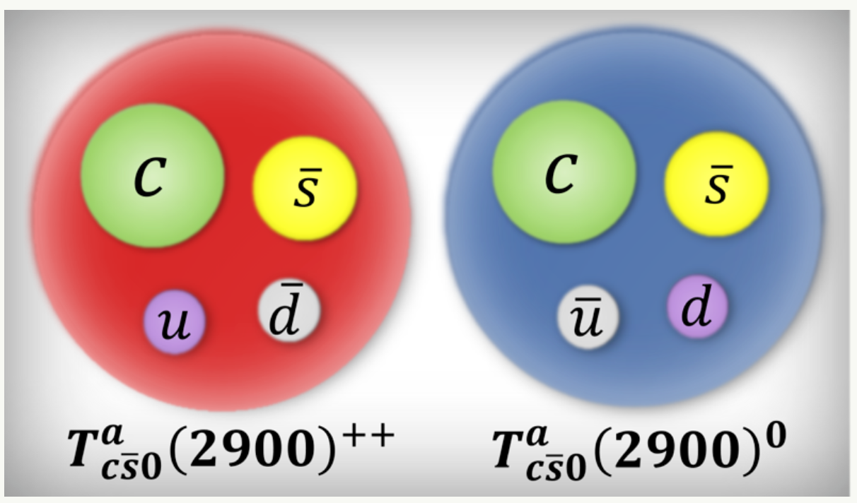
$T_{c\overline{s}0 }^{a}{\left(2900\right)}^{++/0}$ : experiment of LHCb
Two new resonant states are observed in $B$ meson decays: $B^{0}→{\overline{D}}^{0}D_{s}^{+}π^{−}$ and $B^{+}→D^{−}D_{s}^{+}π^{+}$. PRL131 (2023) 4, 041902
Mass: $M=2.908±0.011±0.020 GeV$
Width: $Γ=0.136±0.023±0.013 GeV$
Spin-parity: $J^{P}=0^{+}$
https://news.sciencenet.cn/htmlnews/2023/8/506164.shtm

Slide 6
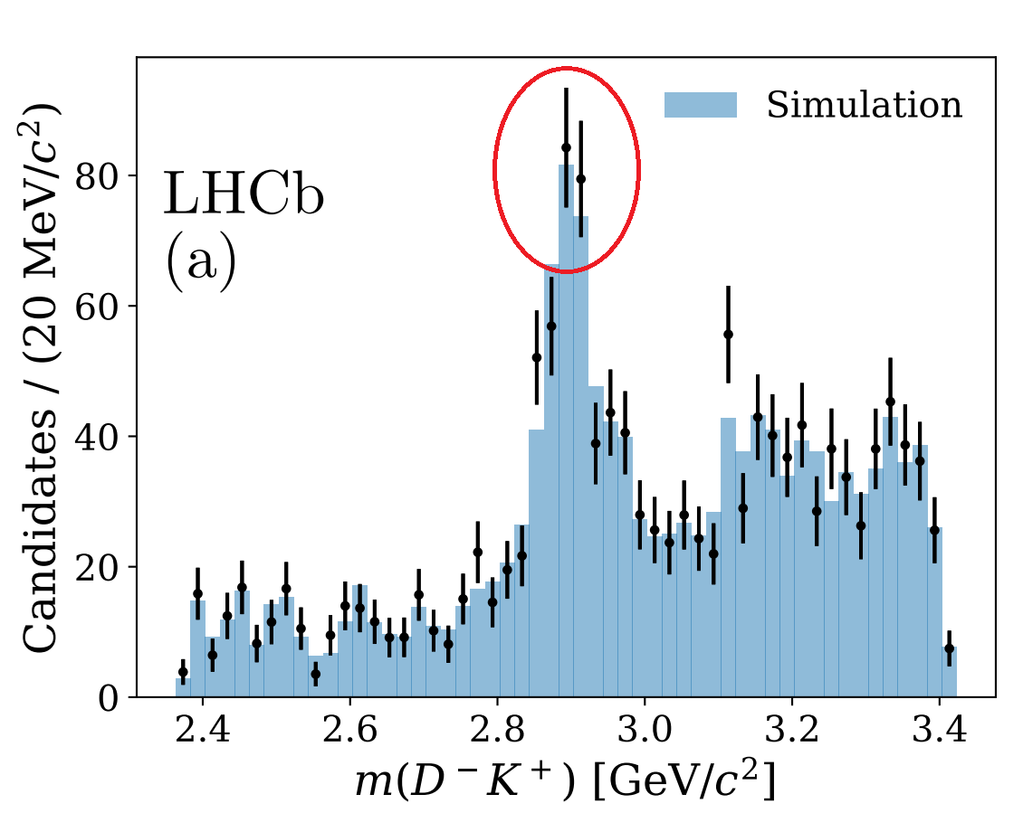
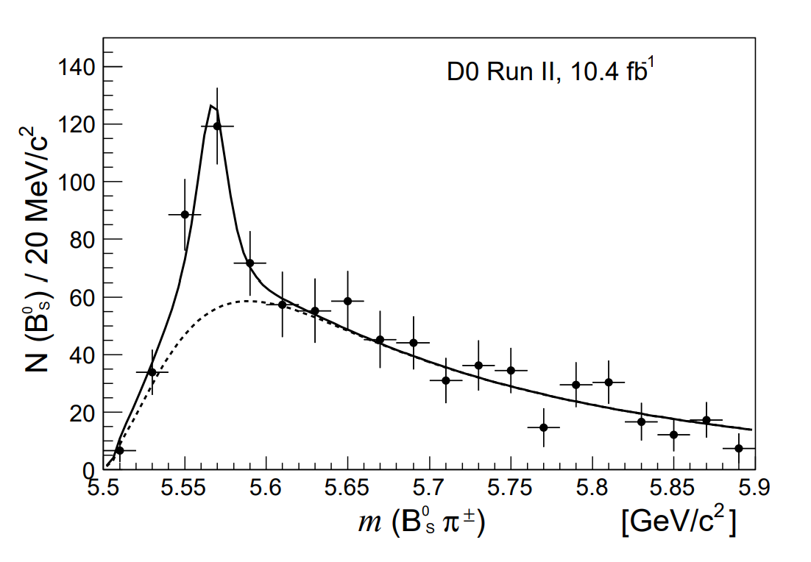
Other fully open-flavor tetraquark states
$X_{0}(2900)$ and $X_{1}(2900)$ $[ud\overline{s}\overline{c}]$ (PRL 125, 242001, PRD 102, 112003)
$X\left(5568\right)$ $[su\overline{d}\overline{b}]$ (not confirmed by later experiments) (PRL 117, 022003,PRD 97, 092004)

Slide 7
$T_{c\overline{s}0 }^{a}{\left(2900\right)}^{++/0}$ : theoretical studies
Compact state: $\left[cu\right][\overline{s}\overline{d}]$
Chen et al predicted the existence of $T_{c\overline{s}0 }^{a}{\left(2900\right)}^{++/0}$ and possible decay channels. PRD95, 114005 (2017)
Molecular state: meson-meson
$D^{∗}−K^{∗}$ ($\left[c\overline{d}\right]−[u\overline{s}]$) , (2208.10196, 2212.03018, 2212.12001)
$D_{s}^{∗}−ρ$ ($\left[u\overline{d}\right]−[c\overline{s}]$), (2207.02648)
There could exist many sates around 2.9GeV!
Resonance-like structure:
The decay width is important!
the $D^{∗}K^{∗}$ threshold effect (EPJC 82, 955)
threshold effect from the $D^{∗}K^{∗}$ and $D_{s}^{∗}ρ$ channels (2211.01302)

Slide 8
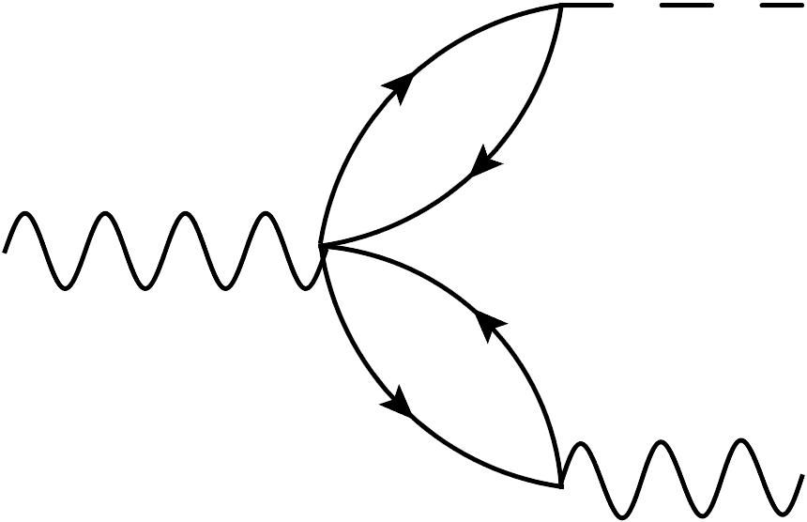
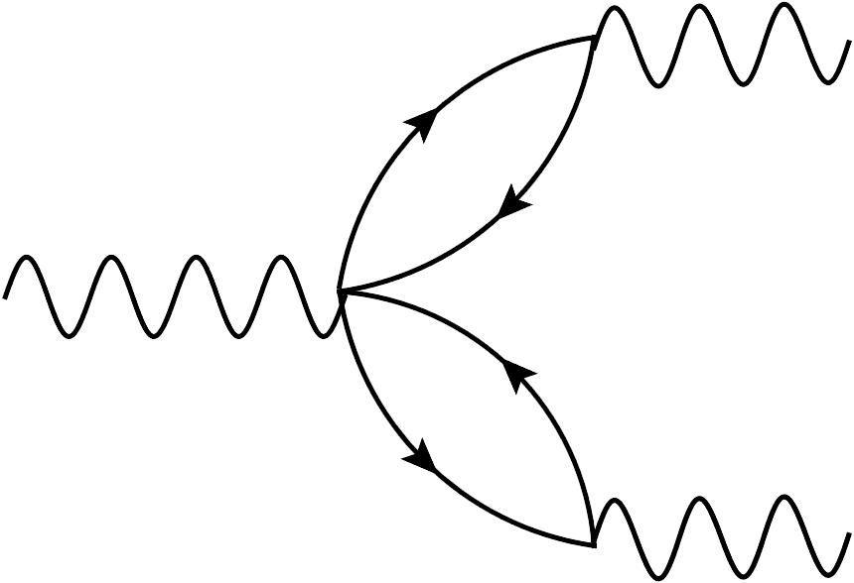
Strong decays of $T_{c\overline{s}0 }^{a}{\left(2900\right)}^{++/0}$
Four channels are considered: $T_{c\overline{s}0}^{a}→D_{s}π, DK, D_{s}^{∗}ρ, D_{s1}π$
S-wave
S-wave
$$T_{c\overline{s}0}^{a}$$
$$π$$
$$T_{c\overline{s}0}^{a}$$
$$K$$
$$D_{s}$$
$$D$$
$$S→PP$$
$$S→PP$$
S-wave
P-wave
$$T_{c\overline{s}0}^{a}$$
$$ρ$$
$$T_{c\overline{s}0}^{a}$$
$$π$$
$$D_{s}^{∗}$$
$$D_{s1}$$
$$S→VV$$
$$S→AP$$
quark-content rearrangement

Slide 9
Three-point correlation function in the framework of QCD sum rule
Insert the complete set to obtain the above equation.
LSZ reduction formula:
Define the effective Lagrangian to extract the coupling constant $g_{ABC}$
Width formula:

Slide 10
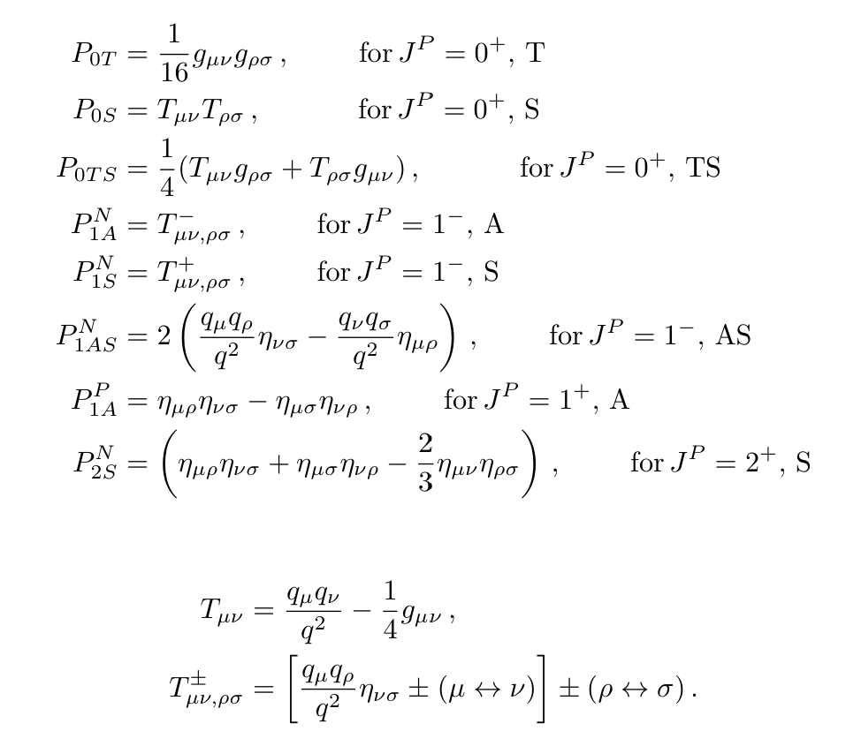
Current operator: $J_{T_{c\overline{s}0}^{a}}^{μν}=c_{a}^{T}Cγ^{μ}u_{b}({\overline{d}}_{a}γ^{ν}C{\overline{s}}_{b}^{T}−{\overline{d}}_{b}γ^{ν}C{\overline{s}}_{a}^{T})$
PRD95, 114005 (2017)

Slide 11
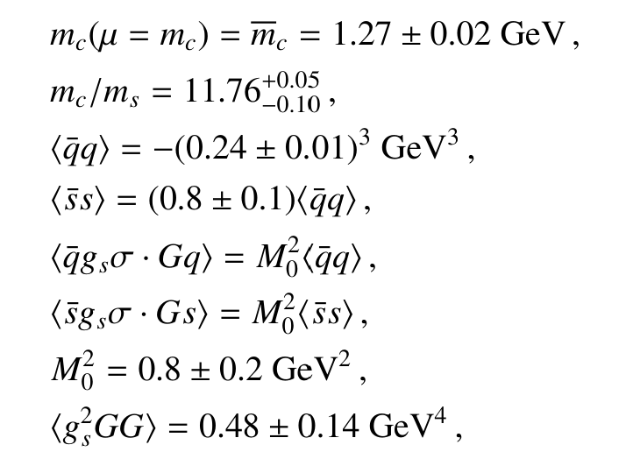
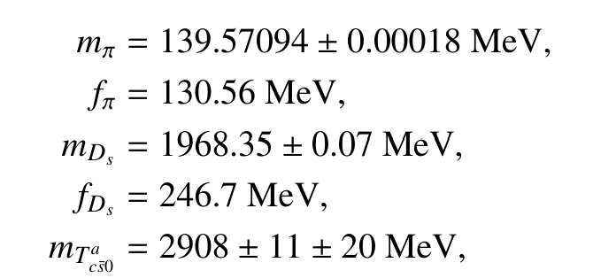
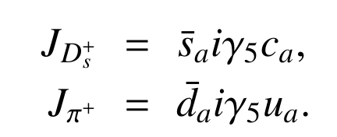
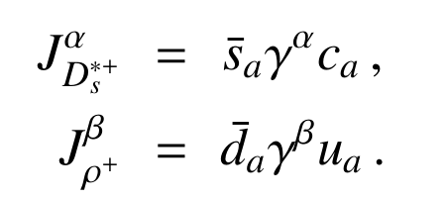
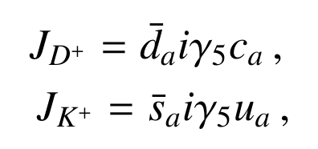
Parameters
Non-perturbative effects are considered
Hadronic parameters(PDG2022)
Current operators coupling to the hadrons

Slide 12
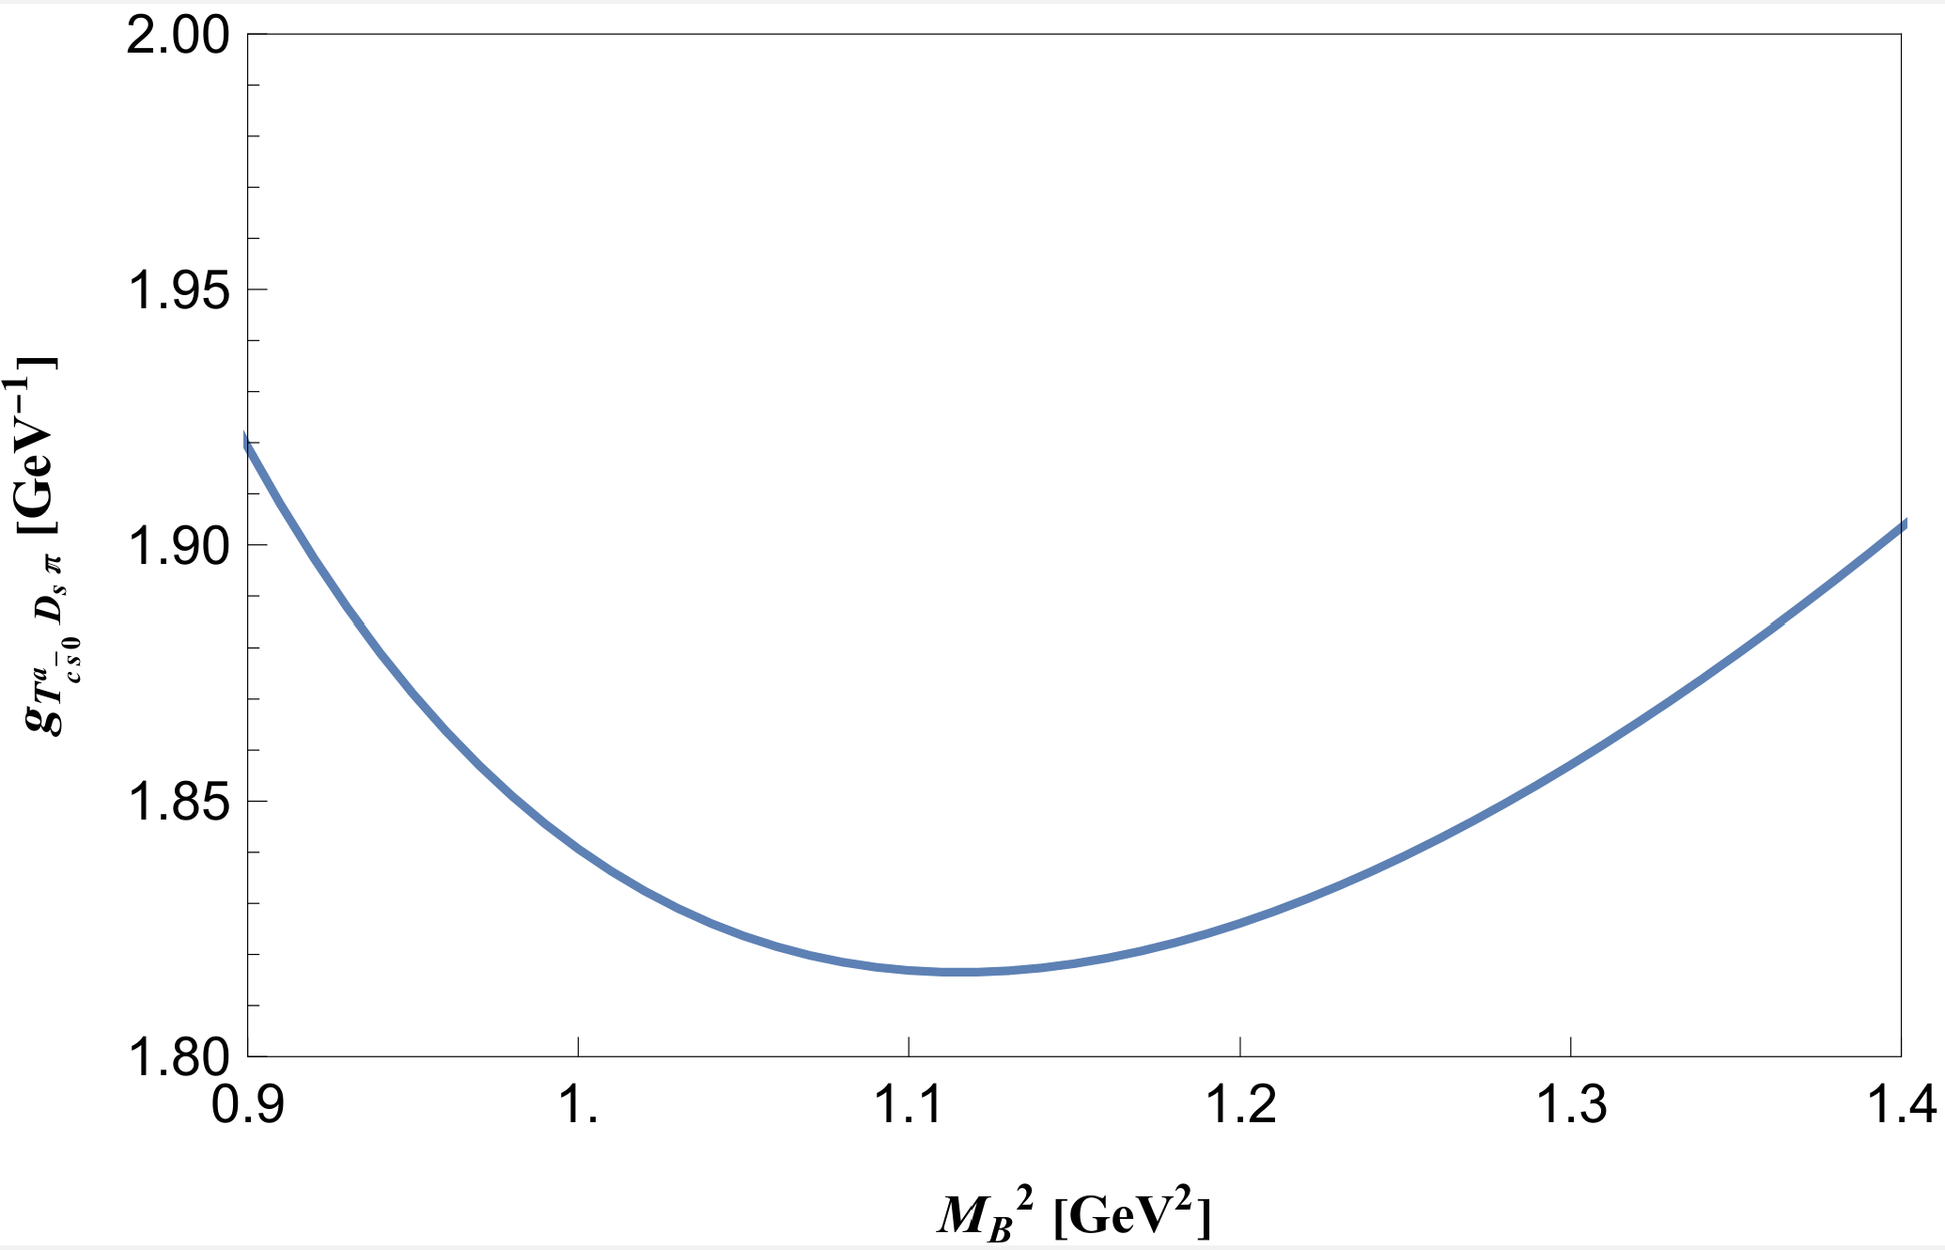
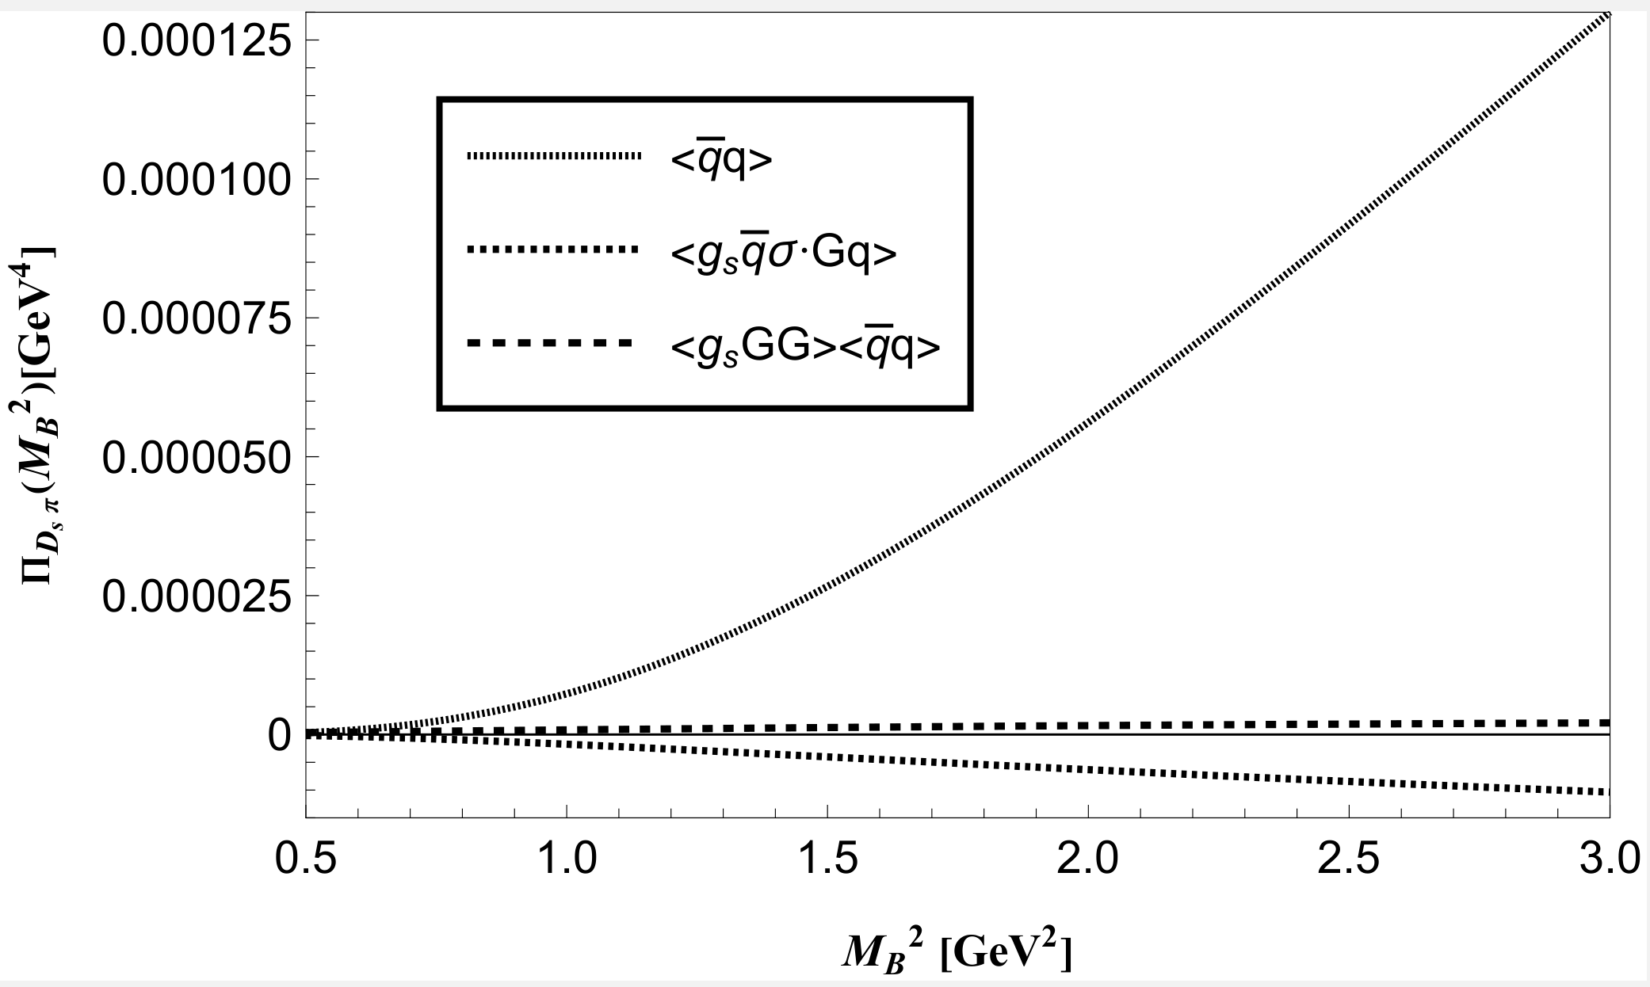
Numerical result
$D_{s}π$ channel: $S→PP$
$$ℒ_{T_{c\overline{s}0}^{a}D_{s}π}=−g_{T_{c\overline{s}0}^{a}D_{s}π}T_{c\overline{s}0}^{a}∂^{μ}π∂_{μ}D_{s}+h.c.$$
$$<D_{s}(p′)π(q)|T_{c\overline{s}0}^{a}\left(p\right)> =ig_{T_{c\overline{s}0}^{a}D_{s}π}p^{′}⋅q$$
Coupling constant and decay width:
the mass of pion is ignored!
$$g_{T_{c\overline{s}0}^{a}D_{s}π}=1.82±0.52 {GeV}^{−1}$$
$$Γ\left(T_{c\overline{s}0}^{a}→D_{s}π\right)=\frac{g_{T_{c\overline{s}0}^{a}D_{s}π}^{2}p^{∗}\left(m_{T_{c\overline{s}0}^{a}},m_{D_{s}},m_{π}\right)}{32πm_{T_{c\overline{s}0}^{a}}^{2}}\left(m_{T_{c\overline{s}0}^{a}}^{2}−m_{D_{s}}^{2}−m_{π}^{2}\right)=48.5±30.0 MeV$$

Slide 13
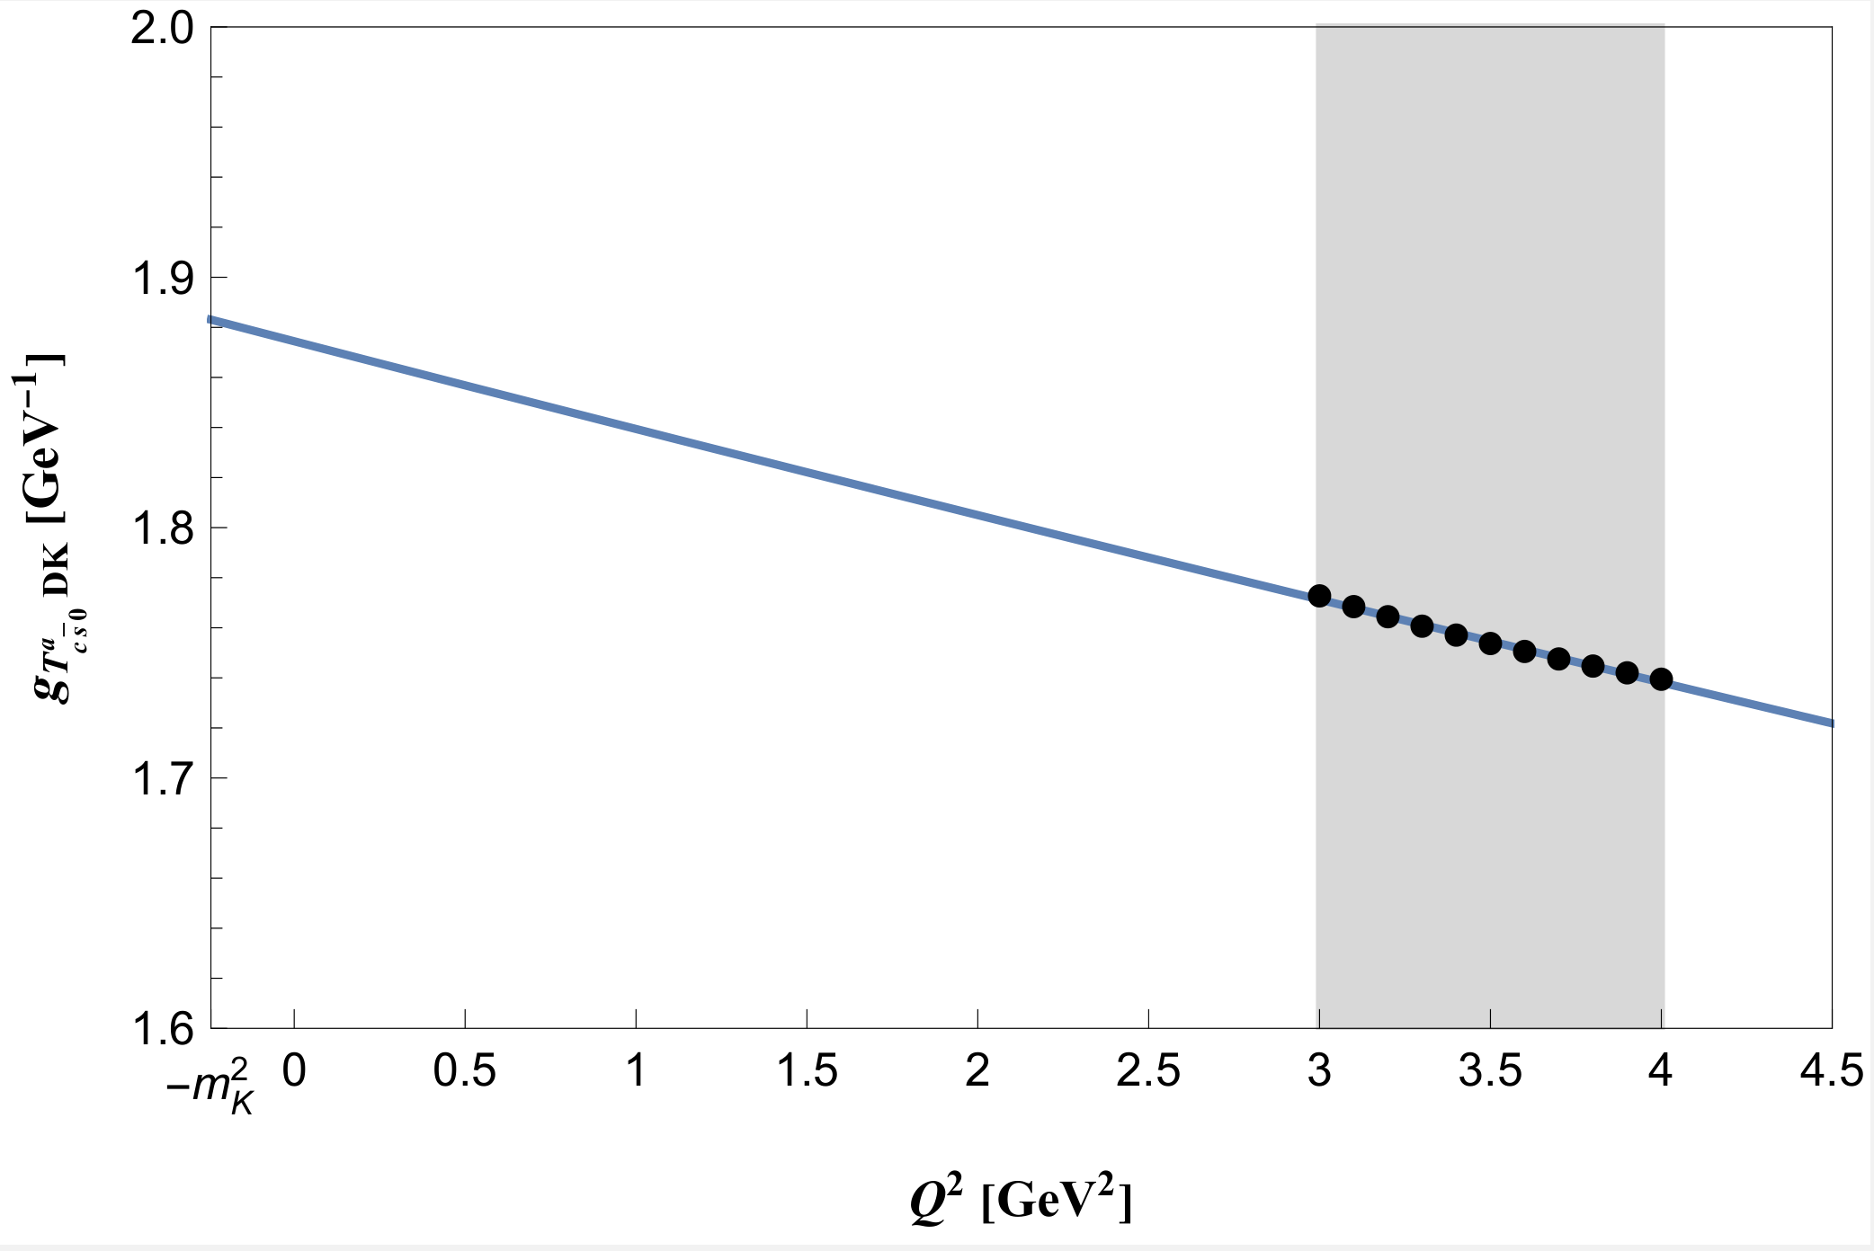
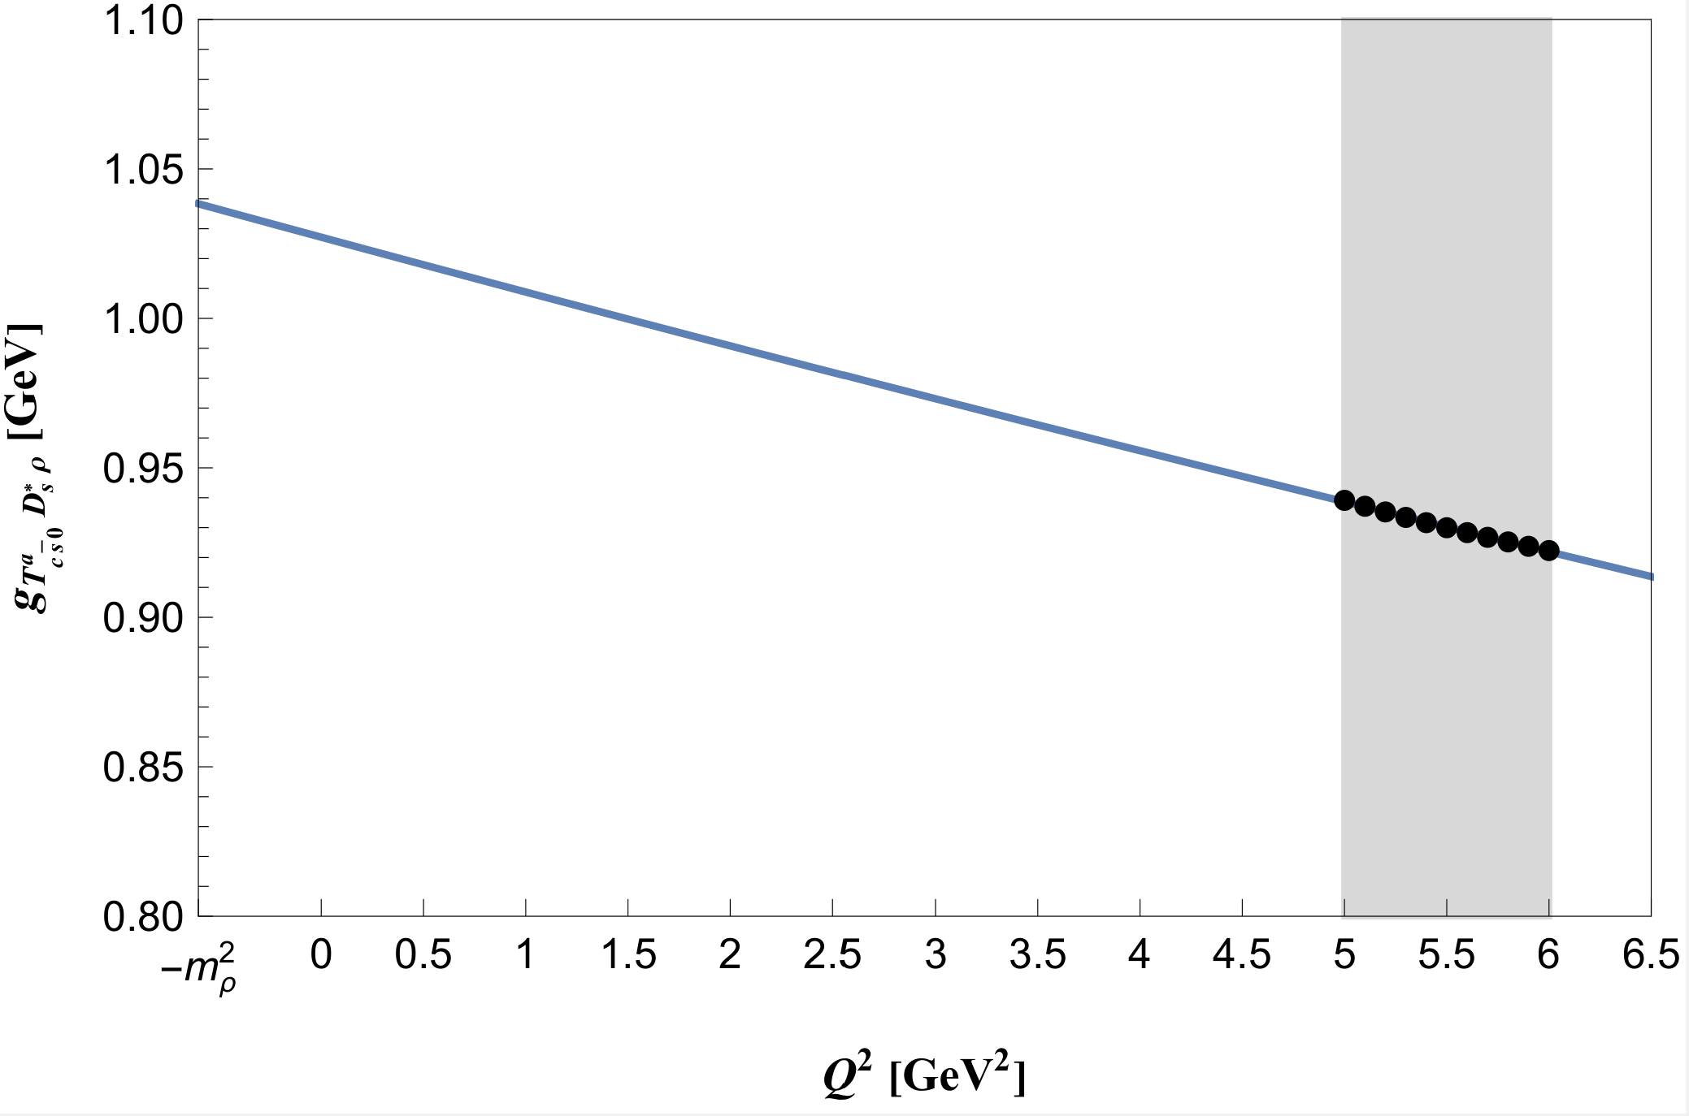
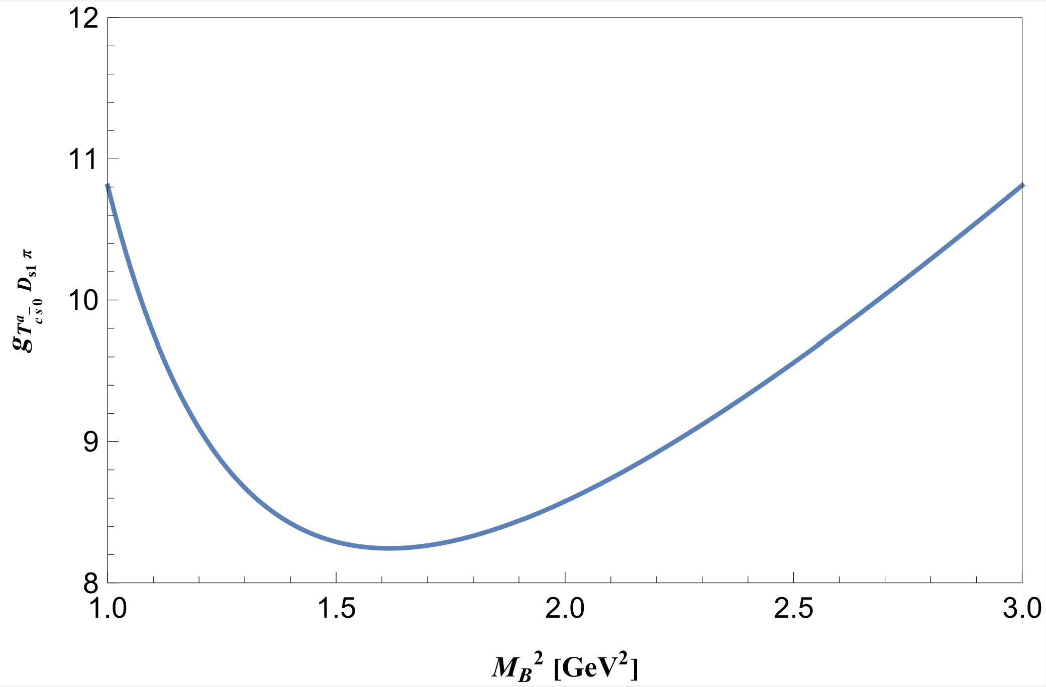
$DK$ channel: $S→PP$
the mass of $K$ cannot be ignored!
$$g_{T_{c\overline{s}0}^{a}DK}=g_{1}e^{{−g}_{2}Q^{2}}$$
$$g_{T_{c\overline{s}0}^{a}DK}\left(Q^{2}=−m_{K}^{2}\right)=1.88±0.55 GeV^{−1}$$
$$Γ\left(T_{c\overline{s}0}^{a}→DK\right)=69.2 ± 40.8 MeV$$
$D_{s}^{∗}ρ$ channel: $S→VV$
the mass of $ρ$ cannot be ignored!
$$g_{T_{c\overline{s}0}^{a}D_{s}^{∗}ρ}\left(Q^{2}=−m_{ρ}^{2}\right)=1.04±0.48 GeV$$
$$g_{T_{c\overline{s}0}^{a}D_{s}^{∗}ρ}=g_{1}e^{{−g}_{2}Q^{2}}$$
$$Γ\left(T_{c\overline{s}0}^{a}→D_{s}^{∗}ρ\right)=2.4 ±2.3 MeV$$
$D_{s1}π$ channel: $S→AP$
the mass of pion is ignored!
$$g_{T_{c\overline{s}0}^{a}D_{s1}π}=8.24 ± 2.23$$
$$Γ\left(T_{c\overline{s}0}^{a}→D_{s1}π\right)=27.2 ±15.0 MeV$$

Slide 14
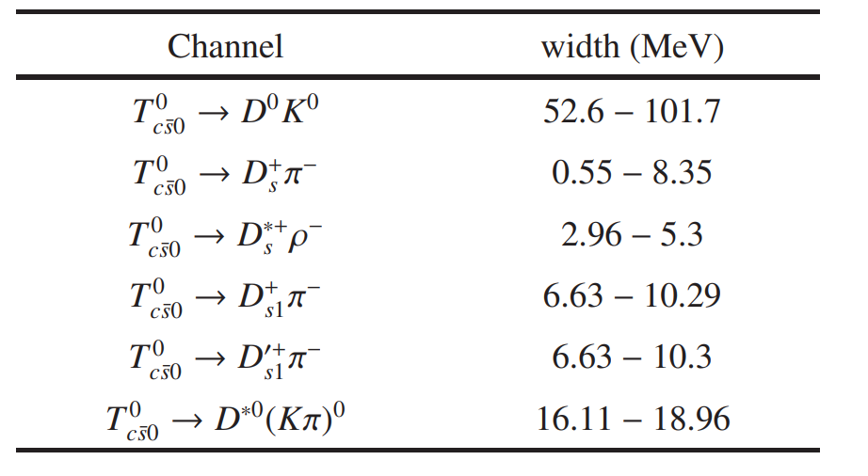
Comparison
Our result:
$$Γ\left(T_{c\overline{s}0}^{a}→D_{s}π\right)=48.5±30.0 MeV$$
$$Γ\left(T_{c\overline{s}0}^{a}→DK\right)=69.2 ± 40.8 MeV$$
$$Γ\left(T_{c\overline{s}0}^{a}→D_{s}^{∗}ρ\right)=2.4 ±2.3 MeV$$
$$Γ\left(T_{c\overline{s}0}^{a}→D_{s1}π\right)=27.2 ±15.0 MeV$$
the relative branch ratios:
total width: $Γ_{T_{c\overline{s}0}^{a}}=161.7±94.8 MeV$
$$Γ\left(T_{c\overline{s}0}^{a}→D_{s}π\right):Γ\left(T_{c\overline{s}0}^{a}→DK\right):Γ\left(T_{c\overline{s}0}^{a}→D_{s}^{∗}ρ\right):Γ\left(T_{c\overline{s}0}^{a}→D_{s1}π\right)≈1.00:1.10:0.04:0.43$$
Nonrelativistic potential quark model: (PRD 107 (2023) 9, 096020)
the relative branch ratios:
$$Γ\left(T_{c\overline{s}0}^{a}→D_{s}π\right):Γ\left(T_{c\overline{s}0}^{a}→DK\right):Γ\left(T_{c\overline{s}0}^{a}→D_{s}^{∗}ρ\right)=1.00:1.41:0.01$$
$D^{∗}K^{∗}$ molecule with effect Lagrangian approach: (PRD 107 (2023) 3, 034018)
$DK$ channel is dominant!
$D_{s}π$ channel is much smaller!

Slide 15
Conclusion
The first doubly charged hadron$T_{c\overline{s}0}^{a}{\left(2900\right)}^{++}$ was observed in the $B$ meson decay process by LHCb in 2022. It has at least four different quarks $c\overline{s}u\overline{d}$;
The existence of the doubly-charged $c\overline{s}u\overline{d}$ was firstly predicted in 2017, after the observation, many theoretical studies show states around 2.9GeV;
In the compact tetraquark picture, we calculated four strong decay channels of $T_{c\overline{s}0}^{a}(2900)$: $D_{s}π$, $DK$, $D_{s}^{∗}ρ$, $D_{s1}π$. The total width is in agreement with LHCb’s result;
To confirm the structure of $T_{c\overline{s}0}^{a}{\left(2900\right)}^{++}$, it is necessary to measure the partial decay widths in future experiments, especially the $D_{s}π$ and $DK$ channels. The relative branching ratios are also important.

Slide 16
Thank you!

