Slide 1
New Look at $ψ\left(4160\right)$ and $ψ(4230)$
----Could they be the same state?
周智勇
东南大学
Arxiv: 2304.07052,
in collaboration with Chun-Yong Li and Zhiguang Xiao
2023年8月28日，中国科学院大学，雁栖湖

Slide 2
01
01
Motivation
02
02
Simplest Friedrichs model
03
03
General Friedrichs-Lee-QPC scheme
04
04
Numerical studies of $e^{+}e^{−}→\overline{D}D,\overline{D}D^{∗},{\overline{D}}^{∗}D^{∗},D\overline{D}π$ cross section data
05
05
Conjectures about 𝝍(𝟒𝟏𝟔𝟎) and 𝝍(𝟒𝟐𝟑𝟎)

Slide 3
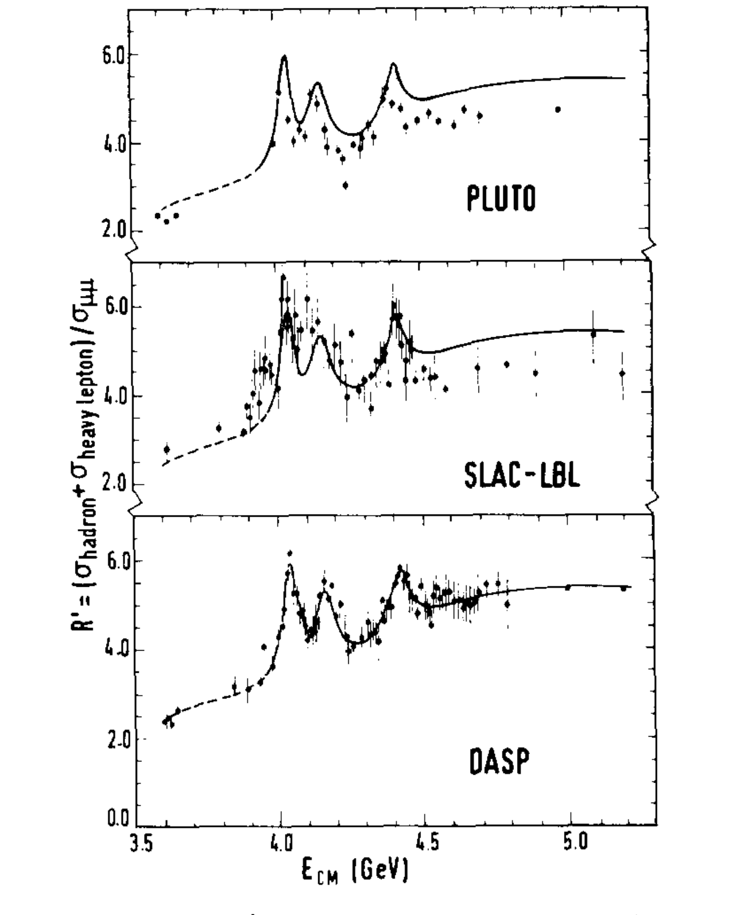
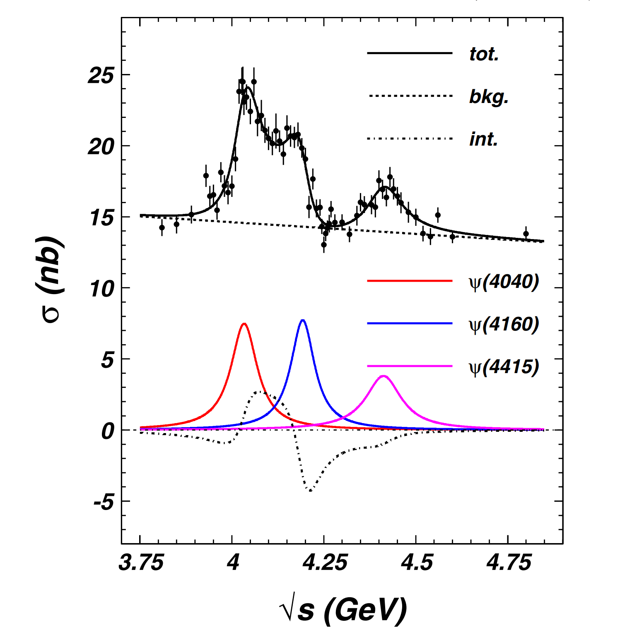
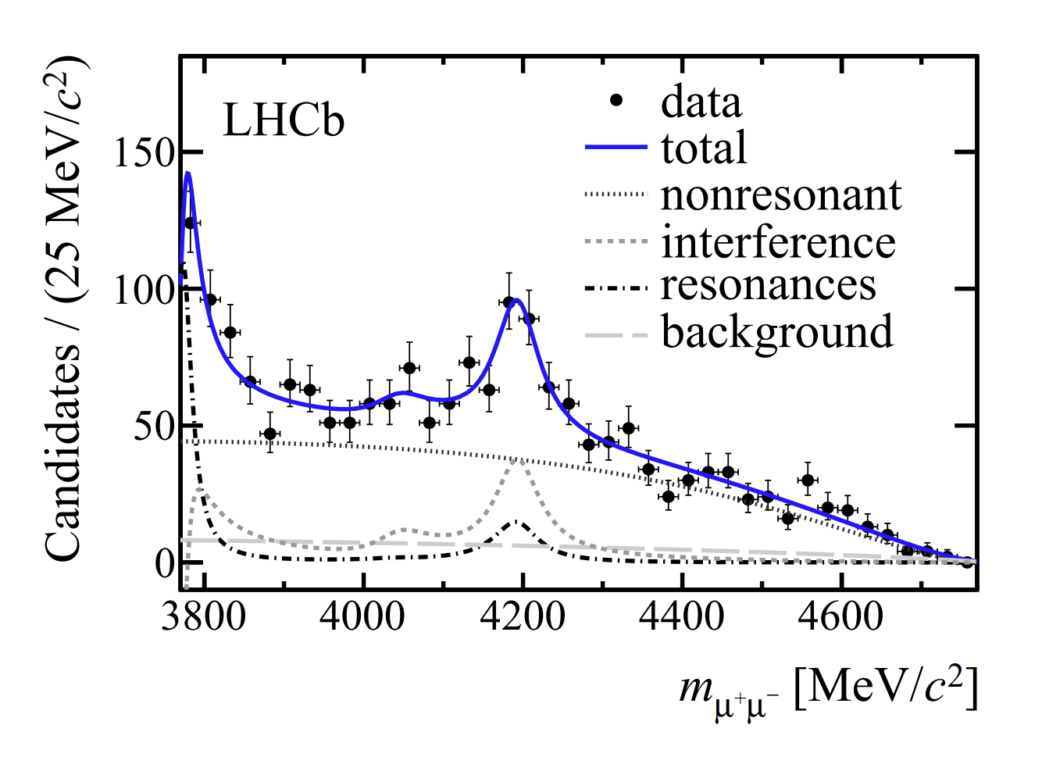
Motivation
Experiment status of $ψ\left(4160\right)$
BES
PRD. 82 (2010) 077501
PRL 111 (2013) 11, 112003
PLB. 76 (1978) 361

Slide 4
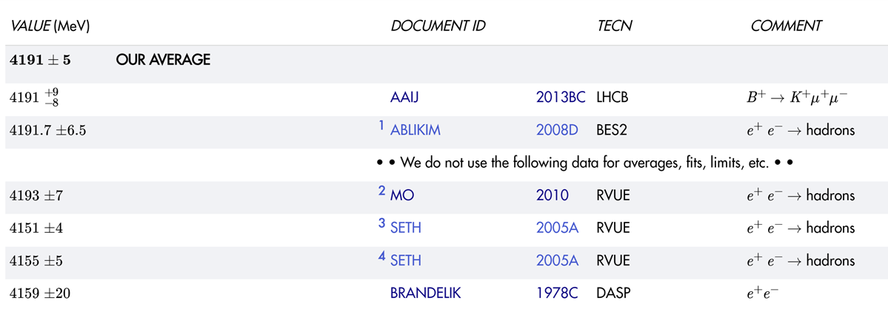
Motivation
Experiment status of $ψ\left(4160\right)$

Slide 5
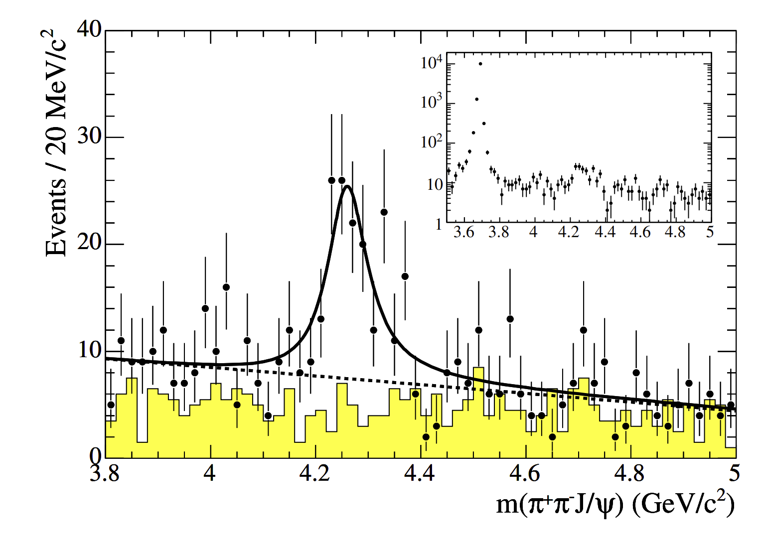
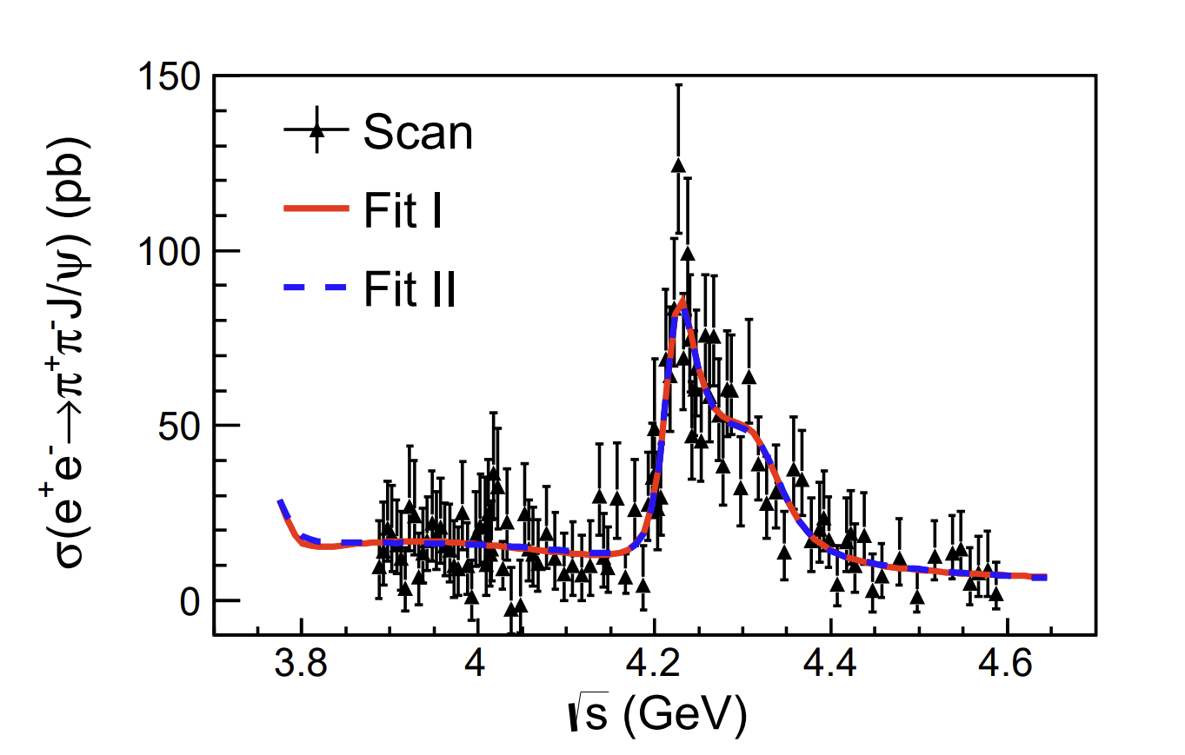
Motivation
Experiment status of $ψ\left(4230\right)$
BABAR
BES
PRL. 95 (2005) 142001
PRL. 118 (2017) 9, 092001

Slide 6
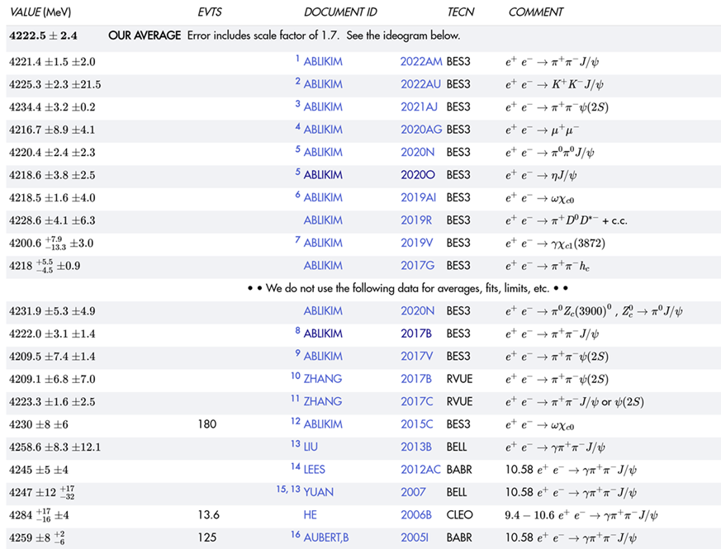
Motivation
Experiment status of $ψ\left(4230\right)$

Slide 7
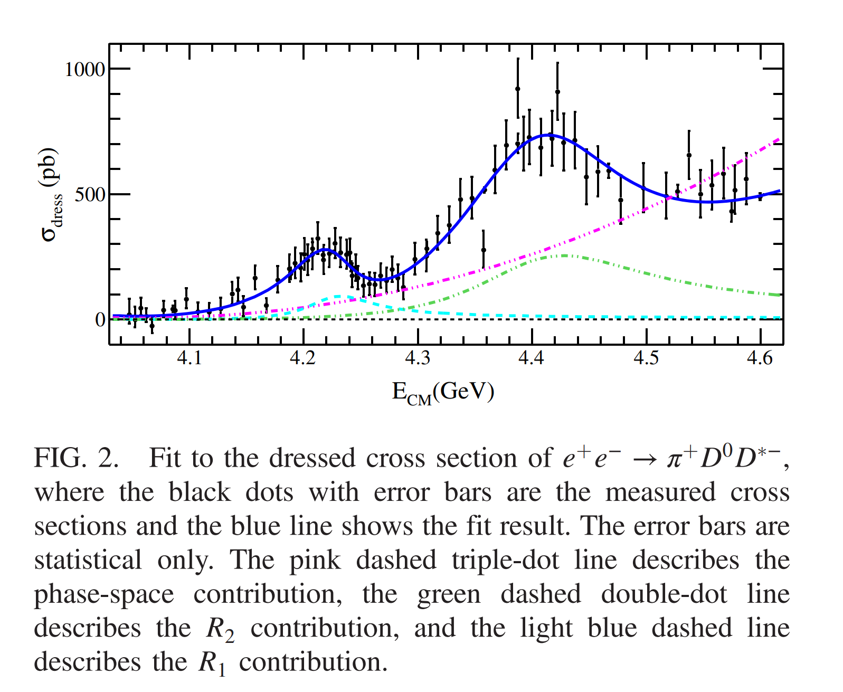
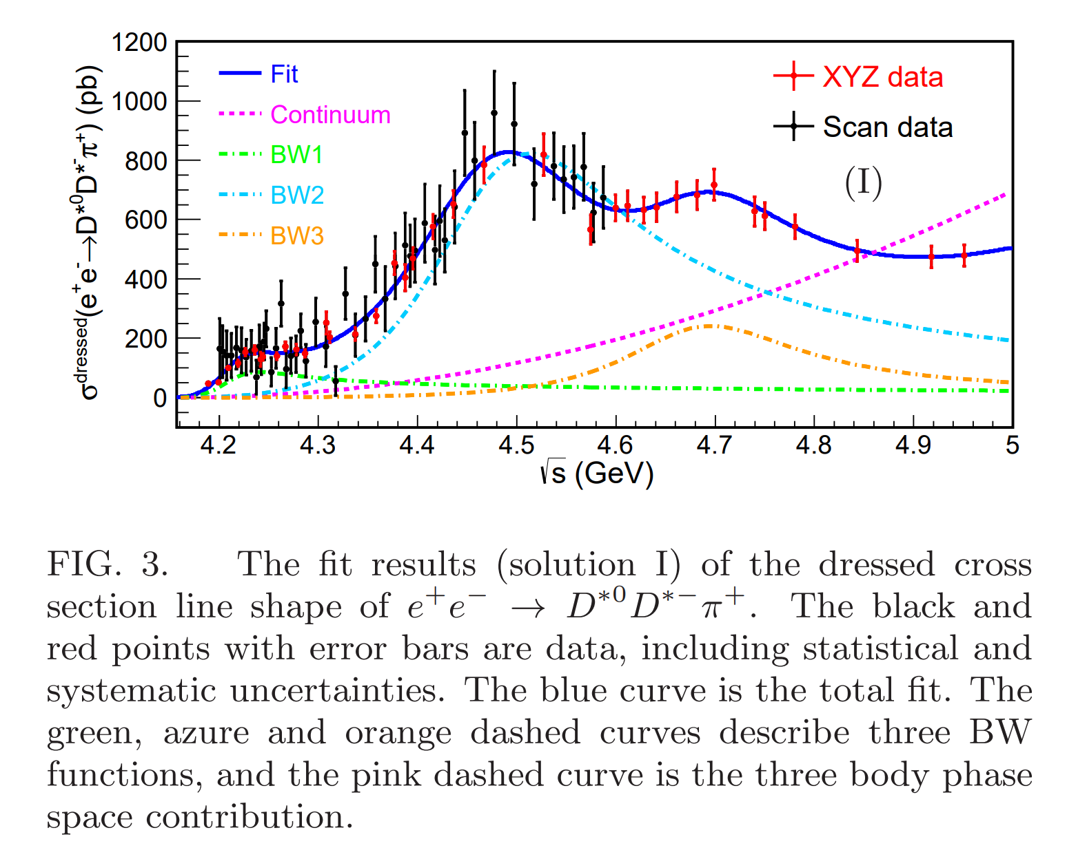
Motivation
Experiment status of $ψ\left(4230\right)$
BES
BES
PRL. 122 (2019) 102002
PRL. 130 (2023) 121901

Slide 8
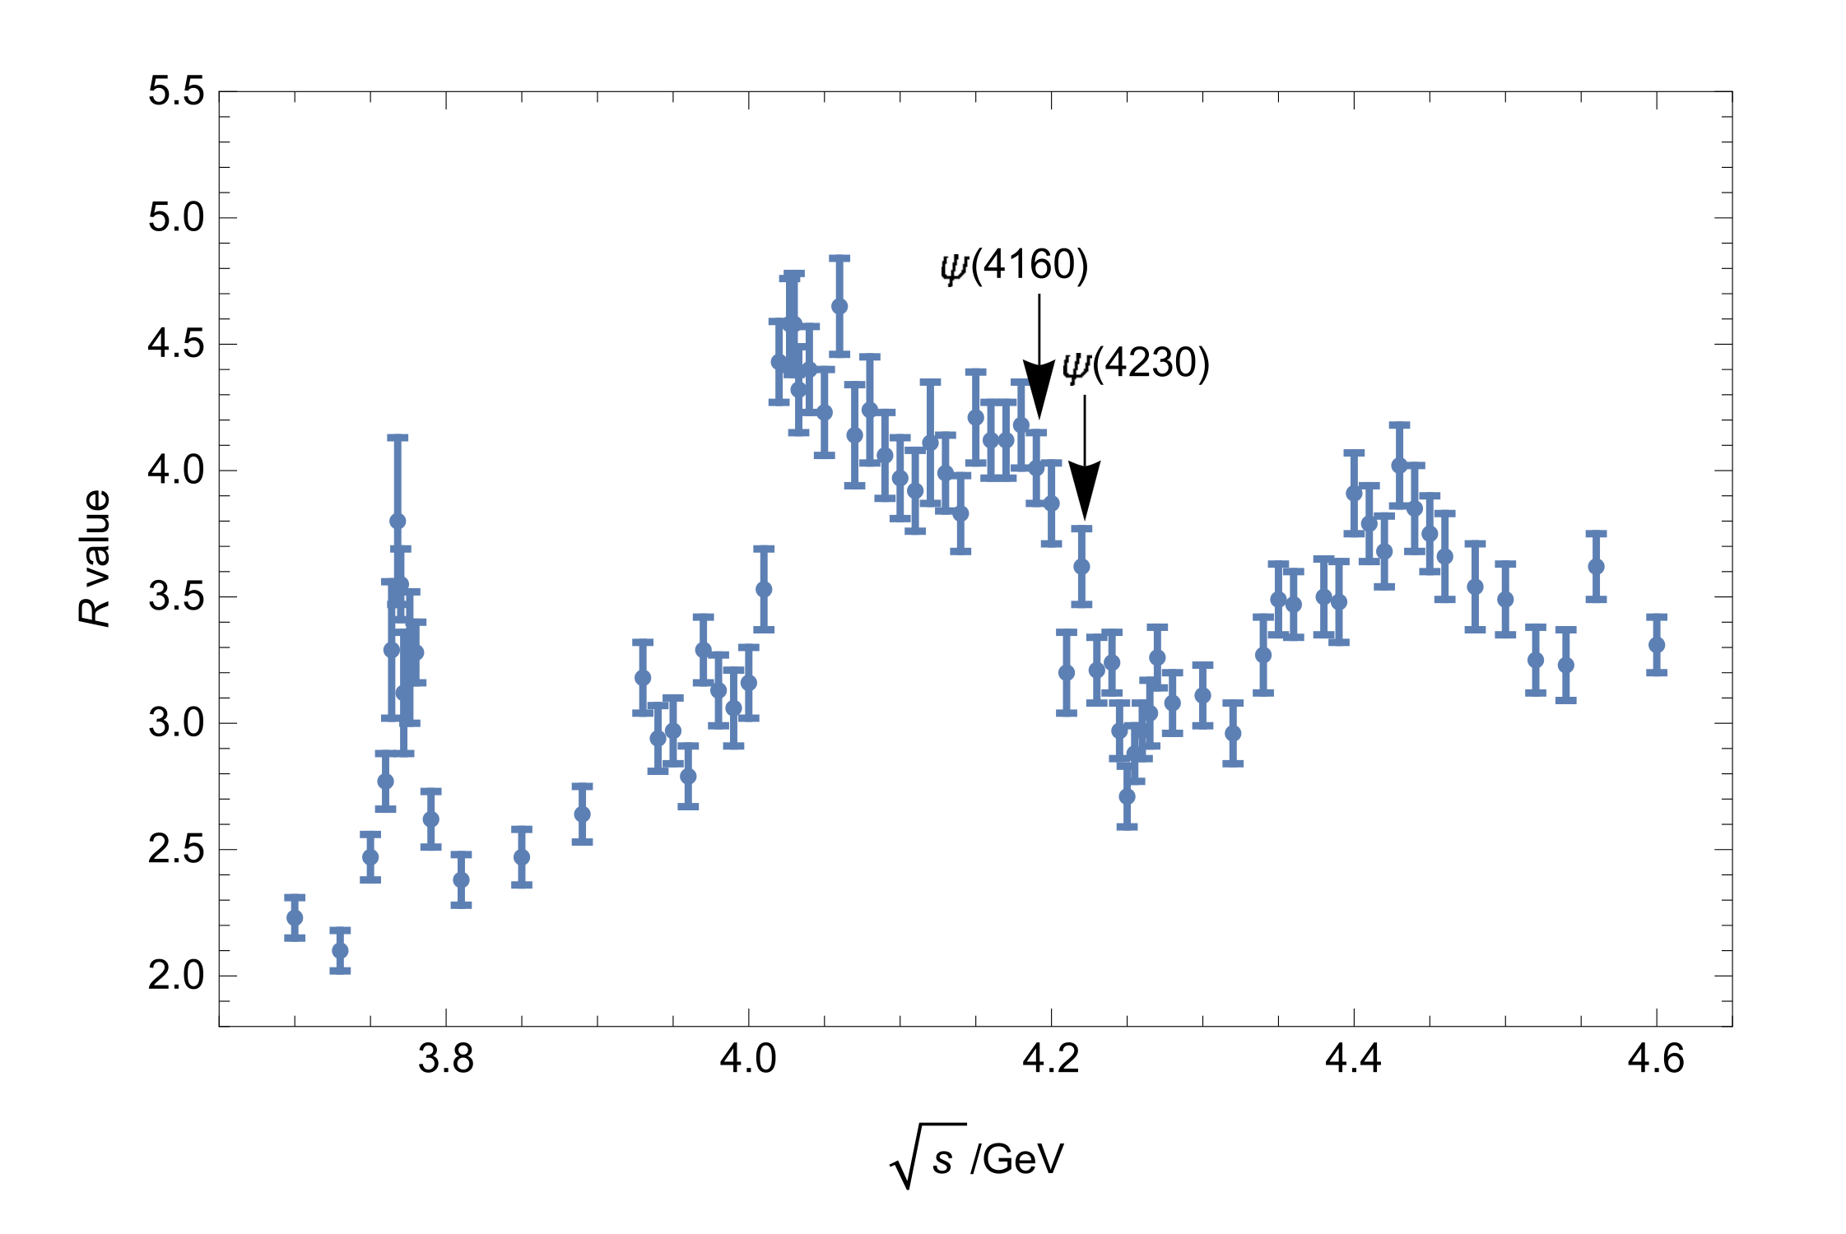
Motivation
$ψ\left(4160\right)$ and $ψ\left(4230\right)$
$ψ\left(4160\right)$
$ψ\left(4230\right)$
Mass Width
$4191±5$ MeV $70±10$ MeV
Both of them are $1^{−−}$states, small mass splitting, similar widths
Hardly accommodated in the quark models simultaneously
Mutually exclusive decay modes
𝝍(𝟒𝟏𝟔𝟎) mainly open-charm modes
𝝍(𝟒23𝟎) mainly hidden-charm modes, except $π^{+}D^{0}D^{∗−}$ and $D^{∗0}D^{∗−}π^{+}$
No same decay mode has been reported.
Mass Width
$4222.5±2.4$ MeV $48±8$ MeV
BES

Slide 9
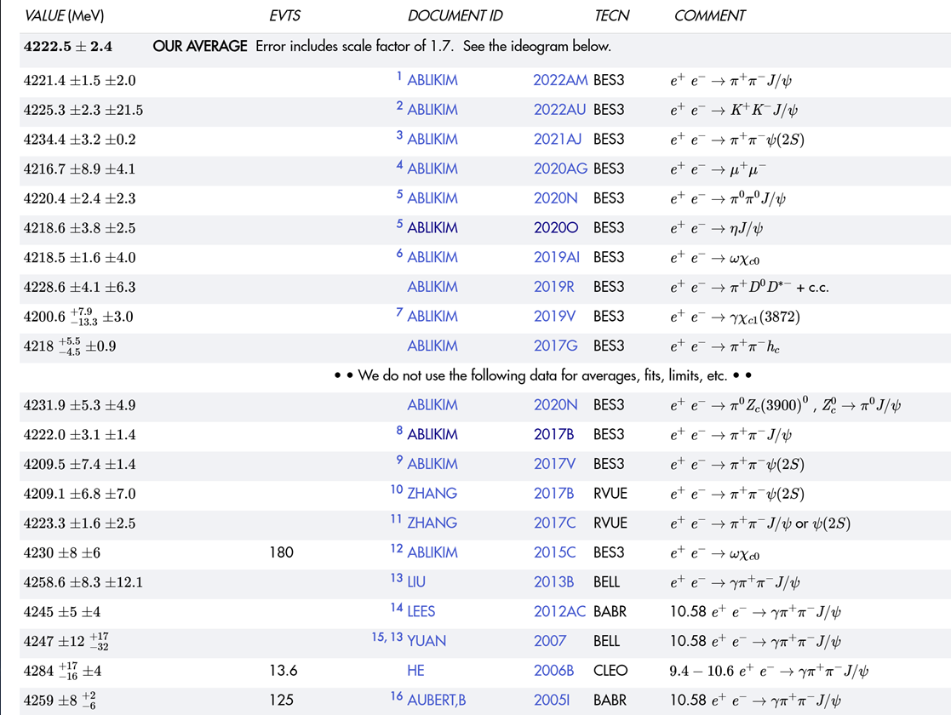
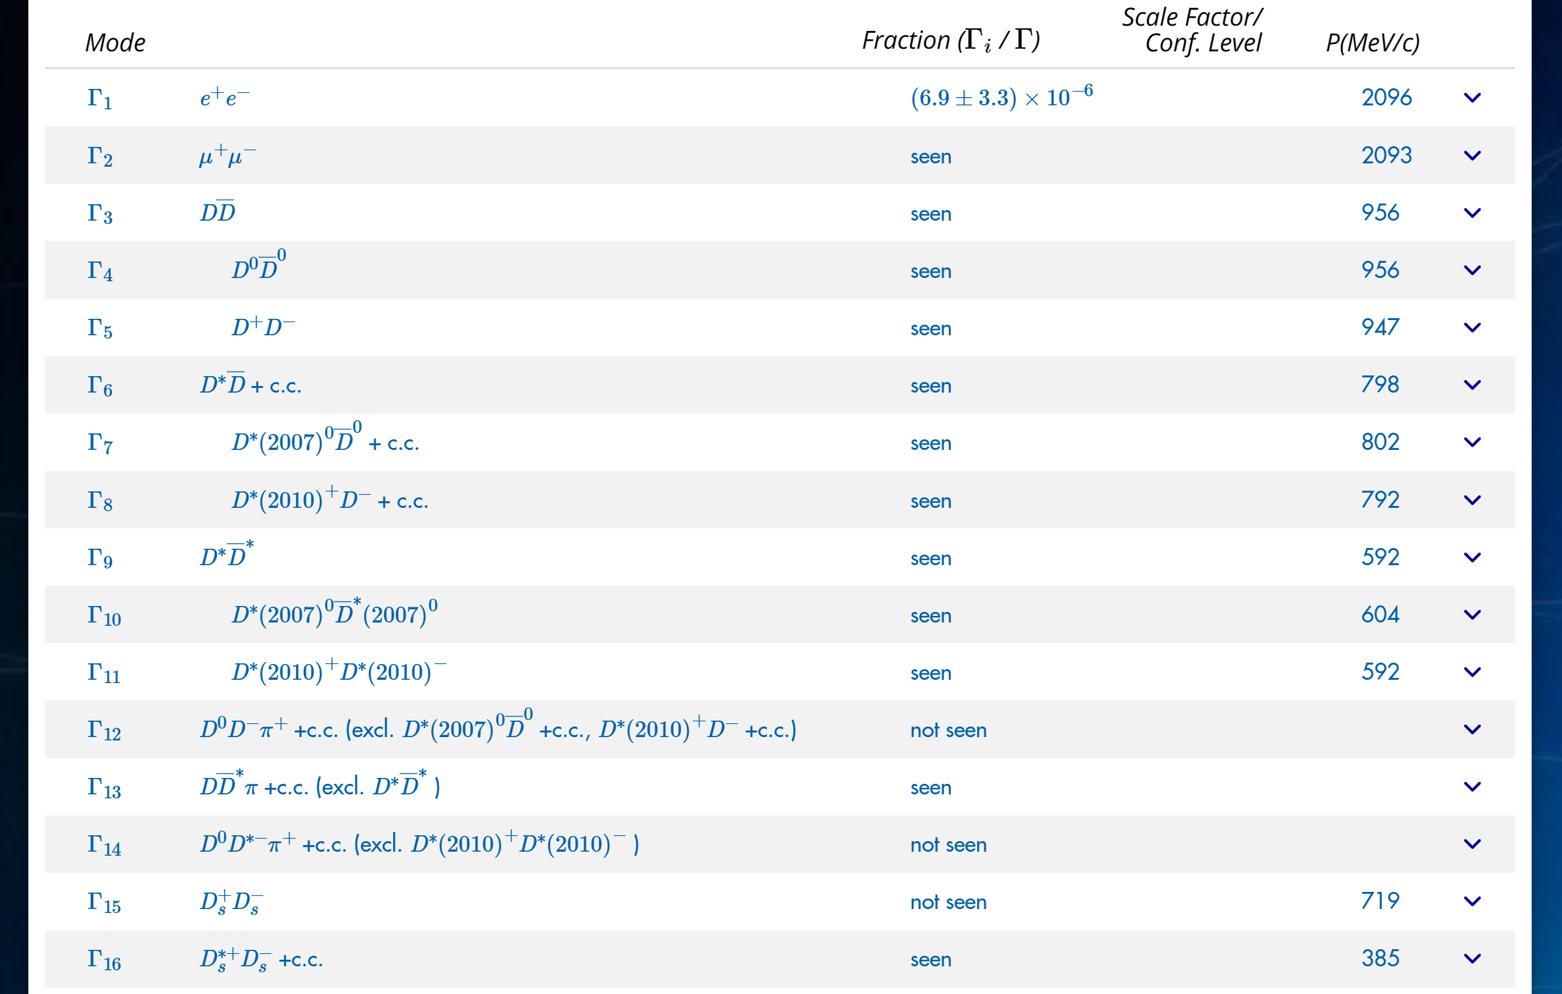
Motivation
$ψ\left(4160\right)$ $ψ\left(4230\right)$

Slide 10
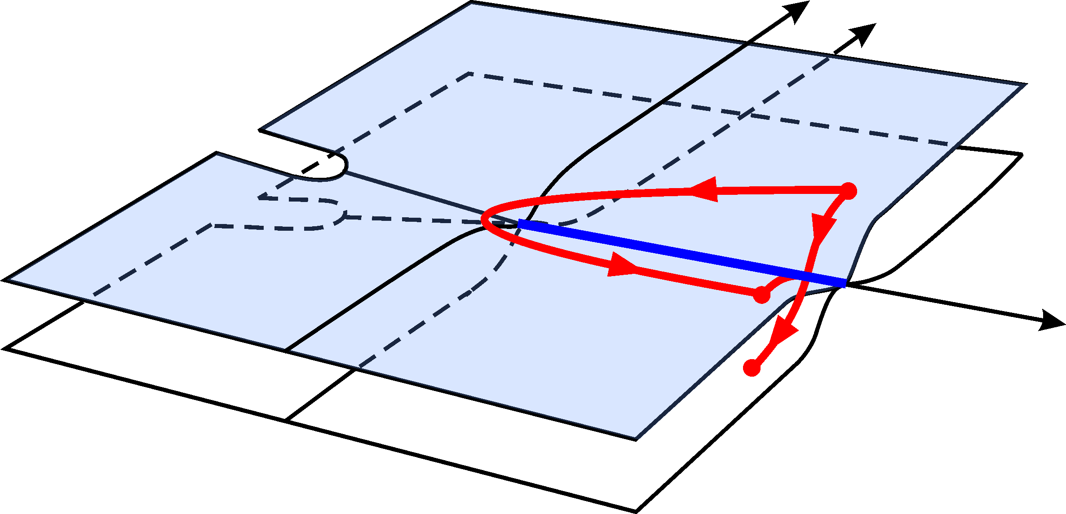
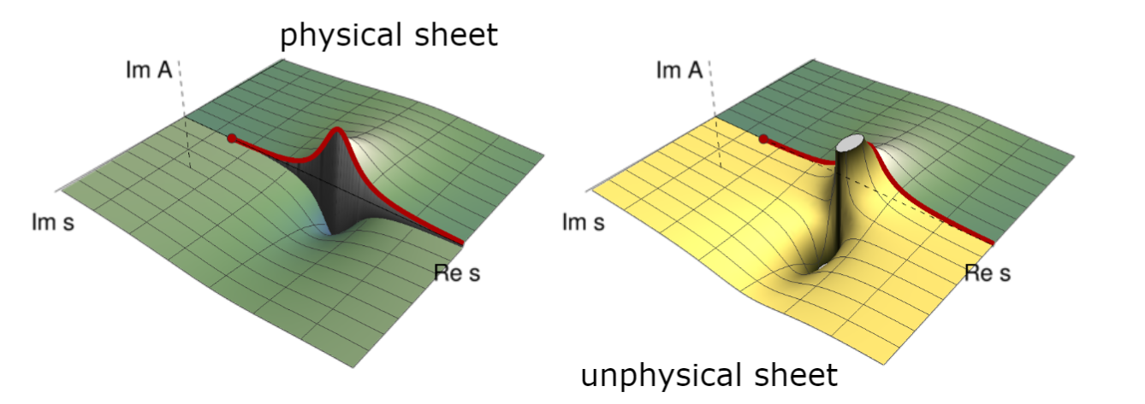
Background
How to describe a resonance
黎曼面结构
$${\left\langle p_{1}^{′}p_{2}^{′},b | iT|p_{1}p_{2},a\right\rangle }_{}=i{\left(2π\right)}^{4}δ^{4}\left(p_{1}+p_{2}−p_{1}^{′}−p_{2}^{′}\right)ℳ{\left(p_{1},p_{2};p_{1}^{′},p_{2}^{′}\right)}_{ba}$$
Disc $ℳ_{ba}=ℳ_{ba}−ℳ_{ab}^{∗}=i{\left(2π\right)}^{4}\sum_{c}{∫dΦ_{c}ℳ_{cb}^{∗}ℳ_{ca}}$
$$Imℳ_{ba}=\sum_{c}{ℳ_{cb}^{∗}ρ_{c}ℳ_{ca}}$$
Unitarity and analyticity
PDG review

Slide 11
Background
How to describe a resonance
The simplest Breit-Wigner
$$T=\frac{1}{M^{2}−s−i M Γ}$$
Or Breit-Wigner distribution with energy-dependent width
Blatt-Weisskopf Barrier Factors
$$T_{l}\left(s\right)=\frac{B_{l}^{2}\left(q\right)Γ}{M^{2}−m^{2}−i ρB_{l}^{2}\left(q\right)m_{0}Γ}$$
$$F_{0}\left(x\right)=1$$
$$F_{1}\left(x\right)=\sqrt{\frac{x}{x+1}}$$
$$F_{2}\left(x\right)=\sqrt{\frac{13x^{2}}{{\left(x−3\right)}^{2}+9x}}$$
$$⋯⋯$$
$B_{l}\left(q,q_{R}\right)=\frac{F_{l}(q)}{F_{l}(q_{R}) }$, $ρ_{i}=\frac{2q_{i}}{m}$
by Hippel and Quigg (1972)

Slide 12
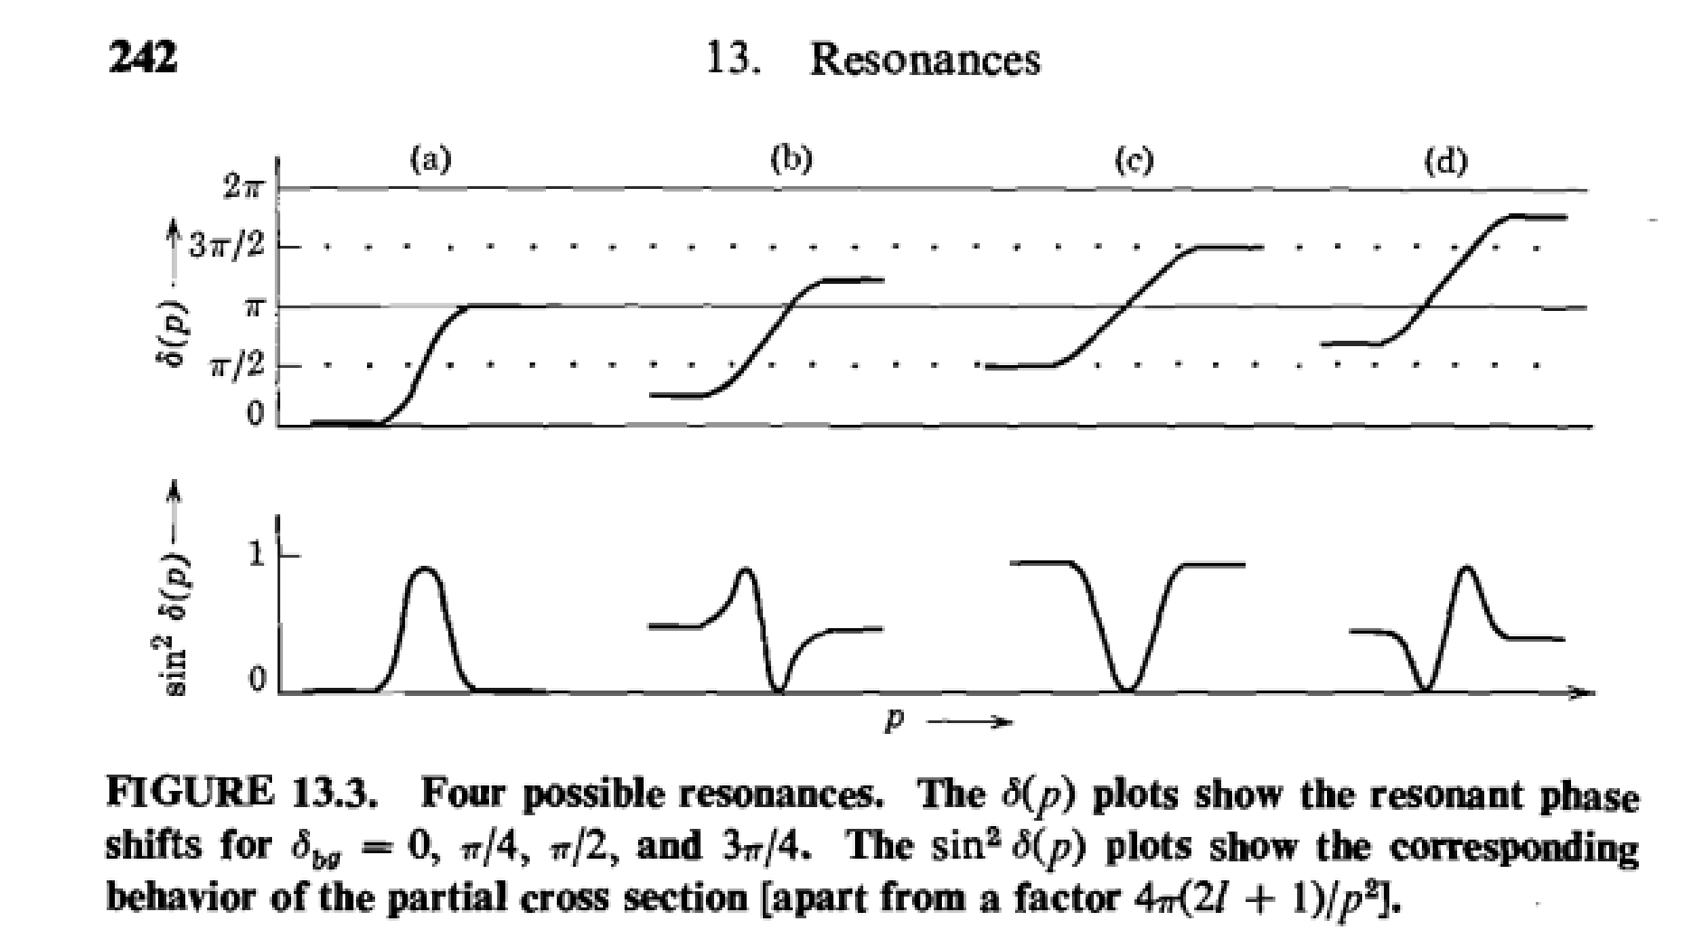
Background
A lesson from Taylor’s book
J.R.Taylor,
Scattering theory,
P241-242

Slide 13
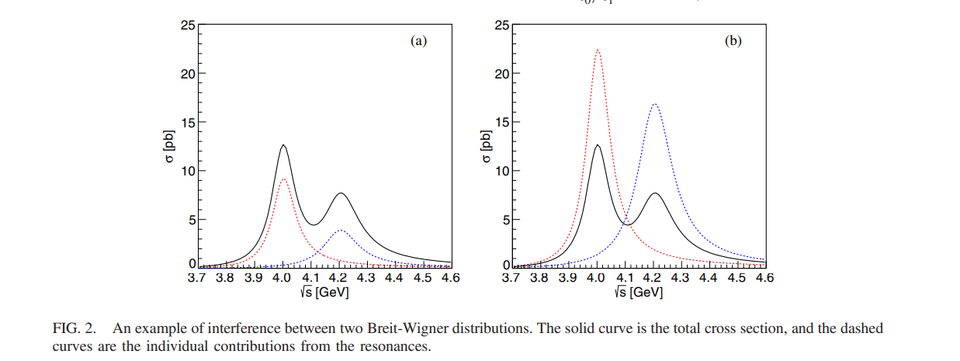
Motivation
What we should know about Breit-Wigner distribution in the experimental analysis
Only distribution, no analyticity
Multi-solution ambiguity
$n+1$ Breit-Wigner with $2^{n}$ solutions
of similar fit quality
K. Zhu et. al., IJMPA 26, 4511 (2011)
A. D. Bukin, arXiv:0710.5627
X. Han and C. P. Shen, CPC 42, 043001 (2018)
Y. Bai and D.Chen, PRD 99, 072007
PRD 99, 072007

Slide 14
Motivation
What we should know about Breit-Wigner distribution in the experimental analysis
Only distribution, no analyticity
Multi-solution ambiguity
Non-unitrarity

Slide 15
Motivation
Coupled-channel models with unitarity
E. Eichten, K. Gottfried, T. Kinoshita, K. Lane, and T.-M. Yan, Phys.Rev. D 21, 203 (1980)
N. A. Tornqvist, Z. Phys. C 68, 647 (1995)
H.-B. Li, X.-S. Qin, and M.-Z. Yang, Phys. Rev. D 81, 011501 (2010)
X. Cao and H. Lenske, Hadron 2019, pp. 433–437, arX-iv:1408.5600
A. Limphirat, W. Sreethawong, K. Khosonthongkee, and Y. Yan, Phys. Rev. D 89, 054030 (2014)
N. N. Achasov and G. N. Shestakov, Phys. Rev. D 86, 114013 (2012)
Y.-J. Zhang and Q. Zhao, Phys. Rev. D 81, 034011 (2010)
J. Segovia, D. R. Entem, and F. Fernandez, Phys. Rev. D 83, 114018 (2011)
T. V. Uglov, Y. S. Kalashnikova, A. V. Nefediev, G. V. Pakhlova, and P. N. Pakhlov, JETP Lett. 105, 1 (2017)
T. Wolkanowski, F. Giacosa, and D. H. Rischke, Phys. Rev. D 93, 014002 (2016), arXiv:1508.00372
Z. Yang, G.-J. Wang, J.-J. Wu, M. Oka, and S.-L. Zhu, Phys. Rev. Lett. 128, 112001 (2022)
S. X. Nakamura, Q. Huang, J. J. Wu, H. P. Peng, Y. Zhang, and Y. C. Zhu, Phys.Rev.D 107 (2023) 9, L091505
Z.-L. Zhang, Z.-W. Liu, S.-Q. Luo, F.-L. Wang, B. Wang, and H. Xu, Phys. Rev. D 107, 034036 (2023)
……

Slide 16
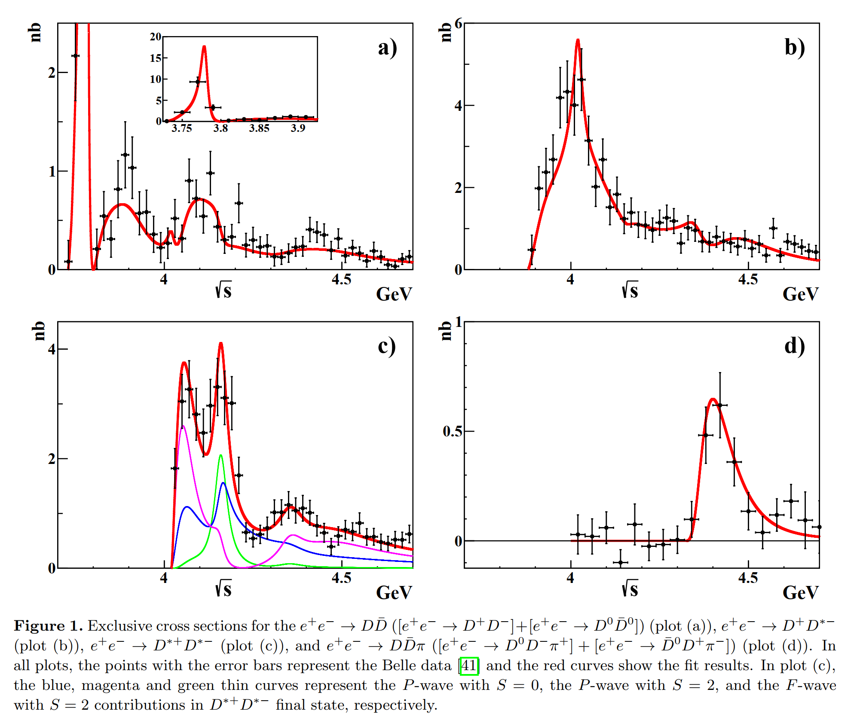
Motivation
A method to restore the unitarity----K matrix
$$S=1+2i A$$
$$A=K{\left(1−iK\right)}^{−1}$$
$$K_{ij}=\sum_{α}{G_{iα}\left(s\right)}\frac{1}{M_{α}^{2}−s}G_{jα}(s)$$
$$G_{iα}^{2}\left(s\right)=g_{iα}^{2}\frac{k_{i}^{2l_{i}+1} }{\sqrt{s}}θ(s−s_{i})$$
$$A_{ij}=\sum_{αβ}{G_{iα}\left(s\right)P_{αβ}\left(s\right)G_{jβ}(s)}$$
$${\left(P^{−1}\left(s\right)\right)}_{αβ}=\left(M_{α}^{2}−s\right)δ_{αβ}−i\sum_{m}{G_{mα}G_{mβ}}$$
Uglov et al., JETP Lett. 105, 1 (2017), arXiv:1611.07582
Belle data
33 free parameters to fit well $e^{+}e^{−}→D\overline{D},D\overline{D^{∗}},D^{∗}\overline{D^{∗}},D\overline{D}π$, but no poles’ informations could be extracted.

Slide 17
Friedrichs-Lee model
Background
Gamow态的数学基础
Energy eigenfunction with a complex eigenvalue, proposed by G.Gamow to understand alpha decay.
However, in Hilbert space, a self-adjoint operator can only admit real eigenvalues. A rigorous treatment to Gamow state require an extension of Hilbert space to Rigged Hilbert space(RHS).
Friedrichs-Lee 模型
A solvable model to demonstrate the properties of Gamow state.
Several variants:
Lee model
Fano model
Anderson model
G.Gamow , Z.Phys. 51 (1928) 204-212
A.Bohm, M.Gadella, Dirac kets, Gamow vectors, and Gelfund Triplets, Springer Lectures Notes in Physics Vol.348, Springer, Berlin
K. O. Friedrichs, Communications on Pure and Applied Mathematics 1, 361 (1948).
T. D. Lee, Phys. Rev. 95, 1329 (1954),
U. Fano, Phys. Rev. 124, 1866 (1961).
P. W. Anderson, Phys. Rev. 124, 41 (1961).

Slide 18
Simplest Friedrichs model
Background
Free Hamiltonian $H_{0}$ with a simple continuous spectrum $R^{+}≡[0,∞)$, and a discrete eigenstate $|1⟩$with the eigenvalue $ω_{0}>0$.
Then the free Hamiltonian is
Normalization :
Suppose there is an interaction between the continuous and discrete parts

Slide 19
Simplest Friedrichs model
Background
We can solve the eigenstate $|Ψ(x)⟩$ of the full Hamiltonian $H=H_{0}+V$, with eigenvalue $x$.
Since the $\left|1\right\rangle$ and $|ω⟩$ form a complete set, $|Ψ(x)⟩$ could be expressed as
Using
We have

Slide 20
Simplest Friedrichs model
Background
For Eigenvalue
Define resolvent function
Solution:

Slide 21
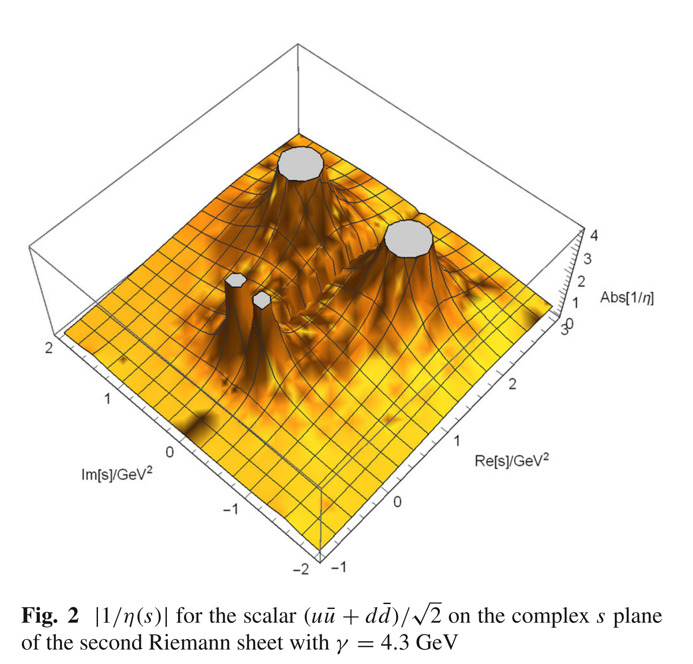
Relativistic Friedrichs-Lee-QPC scheme
Two-pole structure(双极点结构)
resolvent function
$$η\left(s\right)=s−ω_{0}^{2}−\int_{sth}{ds′\frac{ρ(s′)}{s−s^{′}+iε}}$$
$$ρ\left(s\right)≡2ω_{0}\frac{kE_{1}E_{2}}{\sqrt{s}}α{\left(k\right)}^{2}$$
双极点结构：一个裸态产生两个共振极点.
Phys.Rev.D 83 (2011) 014010
Eur.Phys.J.C 80 (2020) 12, 1191
Eur.Phys.J.C 81 (2021) 6, 551

Slide 22
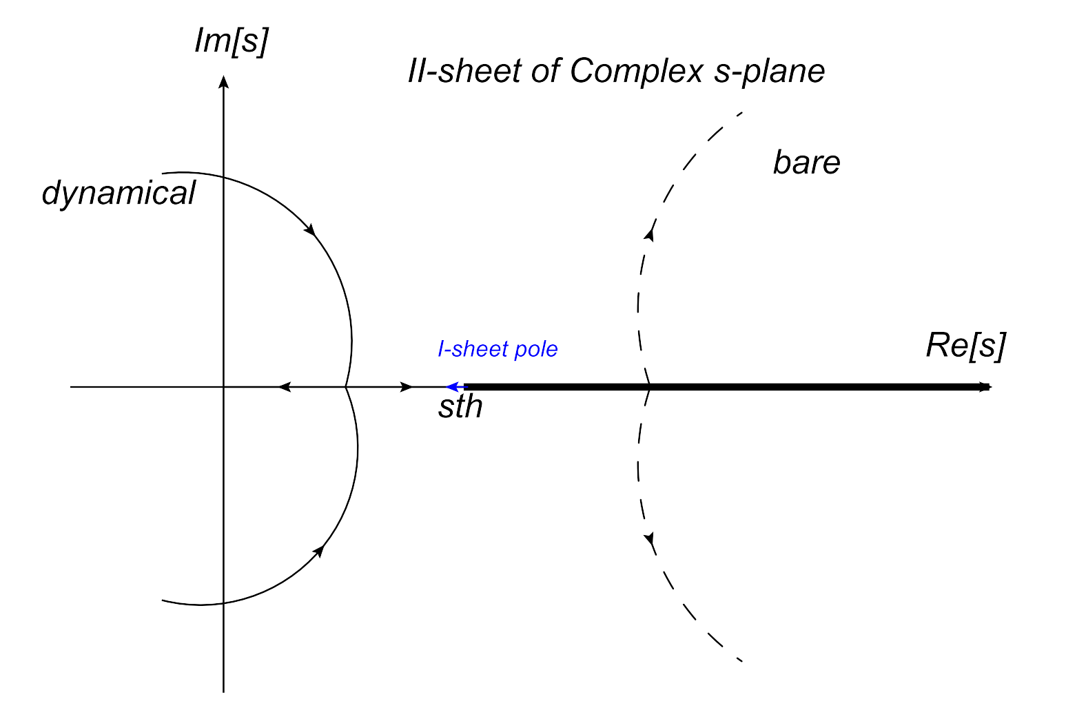
Relativistic Friedrichs-Lee-QPC scheme
Two-pole structure(双极点结构)
The general trajectories of two pairs of poles for the two-pole
structures on the second Riemann sheet of the s-plane as γ increases.
Eur.Phys.J.C 80 (2020) 12, 1191
Eur.Phys.J.C 81 (2021) 6, 551

Slide 23
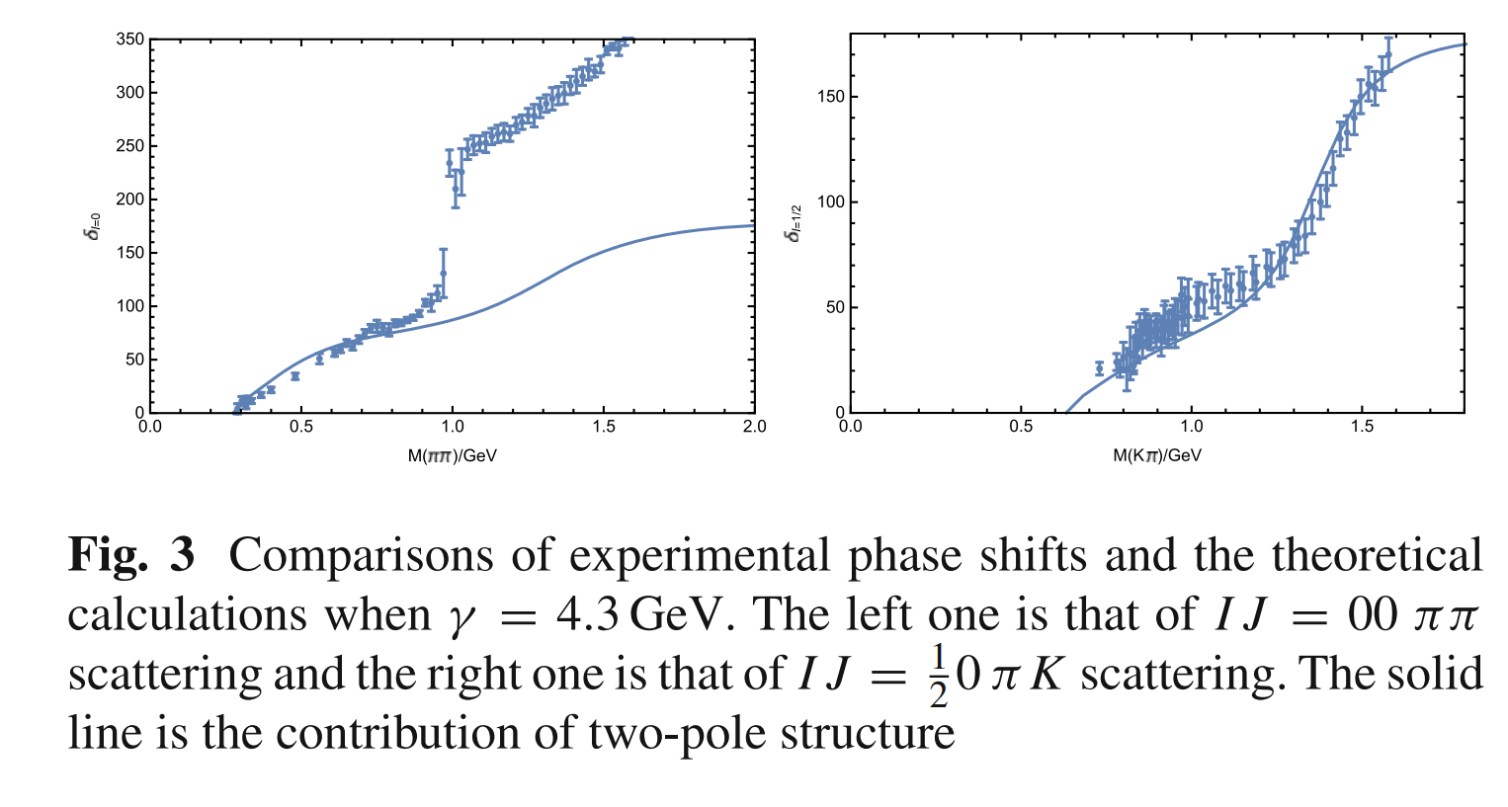
Two pole structure
Sum rule:
This kind of two-pole structure contribute a total phase shift of ${180}^{∘}$ in the single channel approximation
Eur.Phys.J.C 80 (2020) 12, 1191
Eur.Phys.J.C 81 (2021) 6, 551

Slide 24
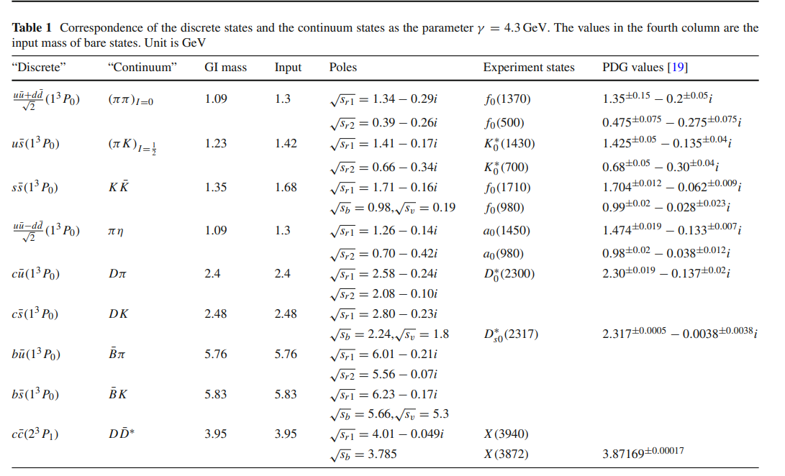
Two pole structure
猜测：双极点结构的普遍性
An ambitious prediciton with only a few parameters in this scheme
(1) Some Bare Masses (2) a global coupling $γ$
Eur.Phys.J.C 80 (2020) 12, 1191
Eur.Phys.J.C 81 (2021) 6, 551

Slide 25
Two pole structure
猜测：双极点结构的普遍性
An ambitious prediciton with only a few parameters in this scheme
(1) Some Bare Masses (2) a global coupling $γ$
$results of γ=3.0$GeV
$$D_{0}^{∗}(2300)$$
$$D_{s0}^{∗}(2317)$$
$$X(3872)$$
Notice that it is a prediction with only one parameter $γ$.
Eur.Phys.J.C 80 (2020) 12, 1191
Eur.Phys.J.C 81 (2021) 6, 551

Slide 26
Extended Friedrichs-Lee-QPC scheme with multi discrete and continuous states
多粒子多道的Friedrichs-Lee-QPC框架
Hamiltonian
Scattering matrix
$ψ$coupling to hadron pairs QPC model
$ψ$coupling to $e^{+}e^{−}$
Cross section of $e^{+}e^{−}→hadron pairs$

Slide 27
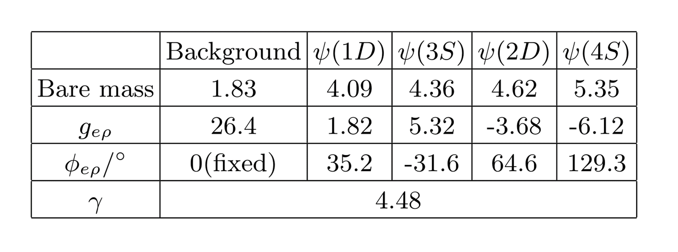
Analysis of $e^{+}e^{−}→D\overline{D},D\overline{D^{∗}},D^{∗}\overline{D^{∗}},D\overline{D}π$
多粒子多道的Friedrichs-Lee-QPC框架拟合
4 channels
$$e^{+}e^{−}→D\overline{D},D\overline{D^{∗}},D^{∗}\overline{D^{∗}},D\overline{D}π$$
4 bare discrete states are supposed
$$ψ\left(1D\right),ψ\left(3S\right),ψ\left(2D\right),ψ(4S)$$
15 parameters

Slide 28
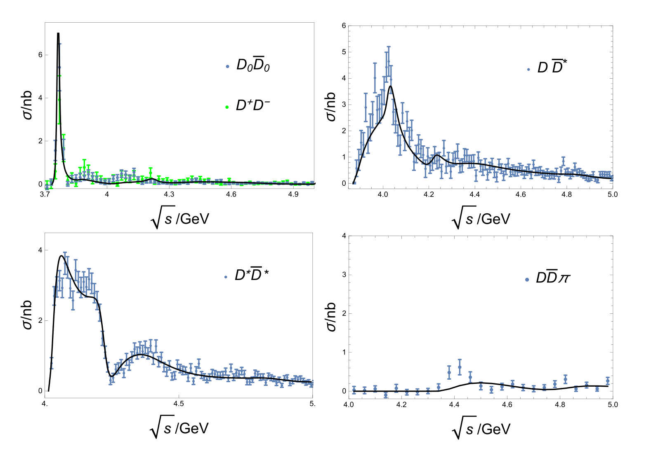
Analysis of $e^{+}e^{−}→D\overline{D},D\overline{D^{∗}},D^{∗}\overline{D^{∗}},D\overline{D}π$
Combined fit of $e^{+}e^{−}→D\overline{D},D\overline{D^{∗}},D^{∗}\overline{D^{∗}},D\overline{D}π$
Belle 2008
Belle 2018
Belle 2018
Belle 2008
$\frac{χ^{2}}{d.o.f}=\frac{379}{293−15}\sim 1.36$

Slide 29
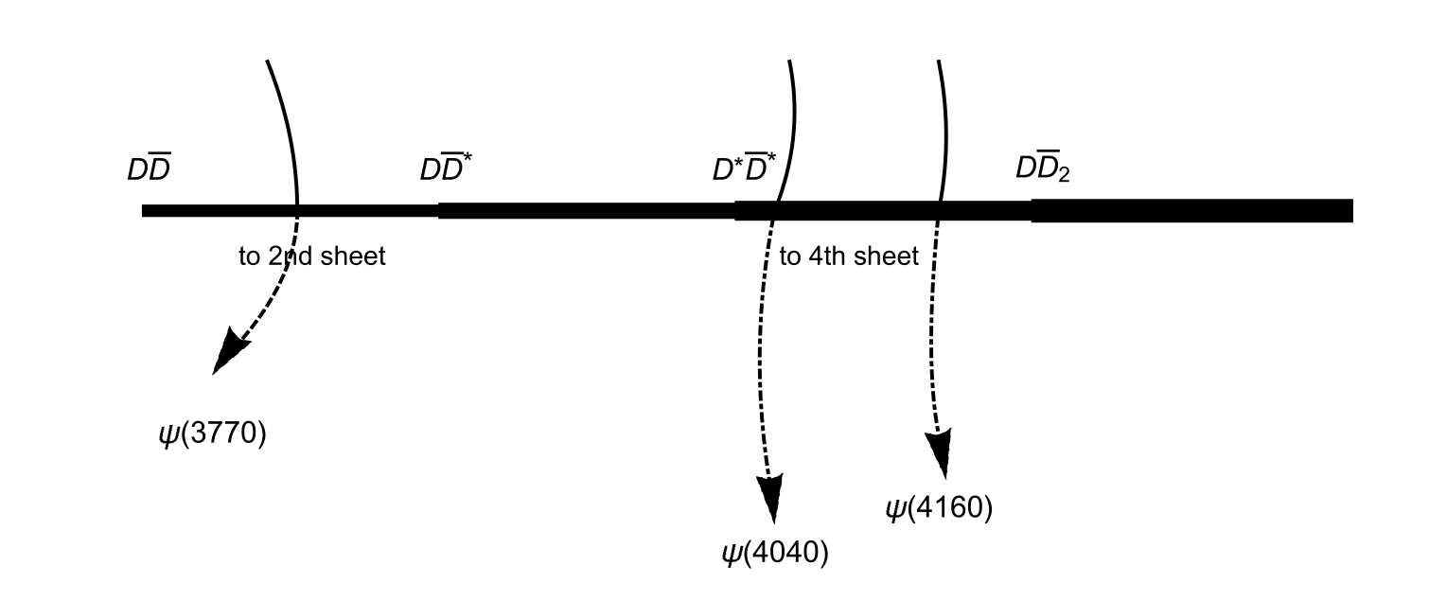
Analysis of $e^{+}e^{−}→D\overline{D},D\overline{D^{∗}},D^{∗}\overline{D^{∗}},D\overline{D}π$
Extract the nearby poles
4 channels
16 Riemann sheets
Extract the nearby poles by find the solution of $det\left[η^{(N−sheet)}\right]=0$

Slide 30
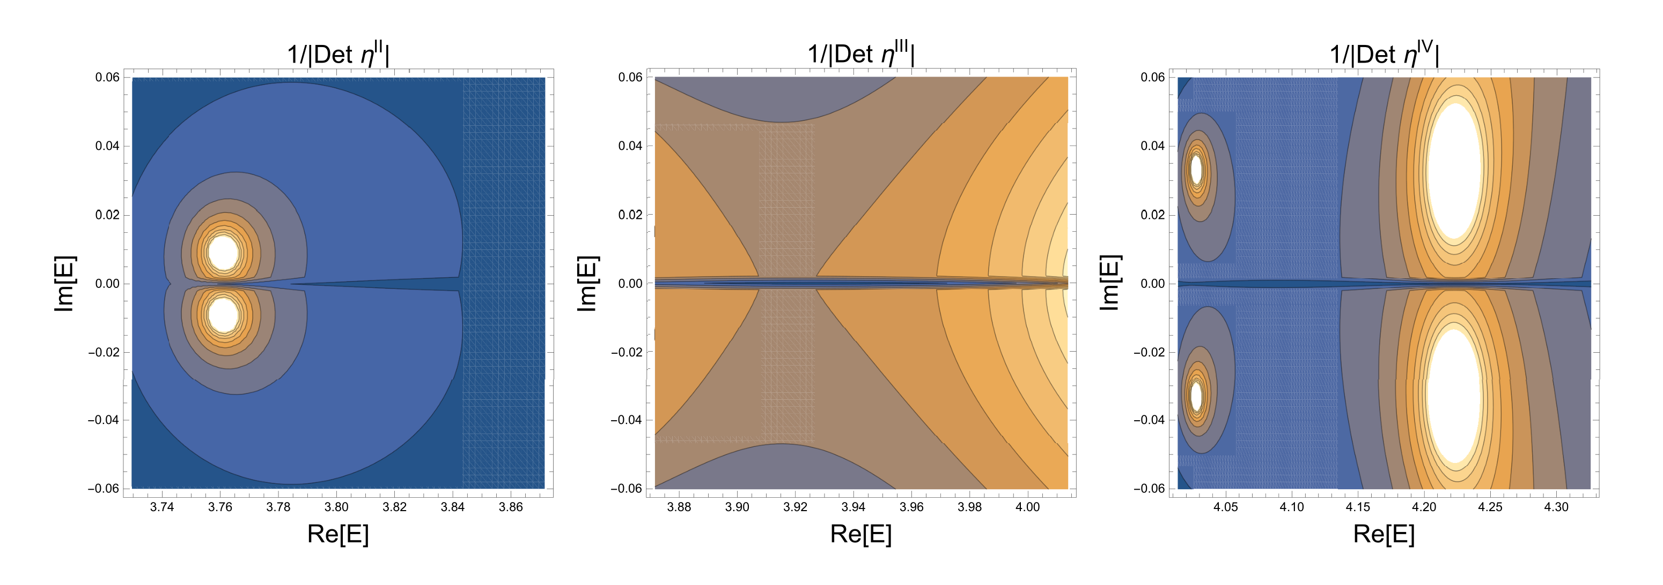
Analysis of $e^{+}e^{−}→D\overline{D},D\overline{D^{∗}},D^{∗}\overline{D^{∗}},D\overline{D}π$
Contour plots of $1/det[η]$ on unphysical Riemann sheets
$z_{0,1}^{IV}=4.028−\frac{0.068}{2}i$ GeV
$$ψ(4040)$$
$z_{0}^{II}=3.762−\frac{0.020}{2}i$ GeV
A shadow pole above $D^{∗}{\overline{D}}^{∗}$, $ψ\left(4008\right)???$
$z_{0,2}^{IV}=4.222−\frac{0.064}{2}i$ GeV
$$ψ(3770)$$
$$ψ(4160)/ψ(4230)$$

Slide 31
Analysis of $e^{+}e^{−}→D\overline{D},D\overline{D^{∗}},D^{∗}\overline{D^{∗}},D\overline{D}π$
Contour plots of $1/det[η]$ on 4-th sheet
$z_{0,2}^{IV}=4.222−\frac{0.064}{2}i$ GeV
$$ψ(4160)/ψ(4230)$$
at the half hillside of sharp declined cross section, neither at the shoulder nor at the dip

Slide 32
Analysis of $e^{+}e^{−}→D\overline{D},D\overline{D^{∗}},D^{∗}\overline{D^{∗}},D\overline{D}π$
Contour plots of $1/det[η]$ on 4-th sheet
$z_{0,2}^{IV}=4.222−\frac{0.064}{2}i$ GeV
$$ψ(4160)/ψ(4230)$$
at the half hillside of sharp declined cross section, neither at the shoulder nor at the dip

Slide 33
$ψ(4160)$ and $ψ(4230)$
If 𝝍(𝟒𝟏𝟔𝟎) and 𝝍(𝟒𝟐𝟑𝟎) are the same $ψ(2^{3}D_{1})$ state
benefits
Quark model expectation
Explanation of the mutually exclusive decay modes of 𝝍(𝟒𝟏𝟔𝟎) and 𝝍(𝟒𝟐𝟑𝟎)
Reliability of coupled channel method analysis
Challenges faced in verifying this conjecture
A fit with more bare discrete states and more decay model
$D\overline{D},D\overline{D^{∗}},D^{∗}\overline{D^{∗}},D{\overline{D}}_{1},D{\overline{D}}_{2}^{∗},D_{s}^{+}D_{s}^{−},$ $D_{s}^{+}D_{s}^{∗−},$ $D_{s}^{∗+}D_{s}^{∗−},⋯⋯$
More accurate experiment data

Slide 34
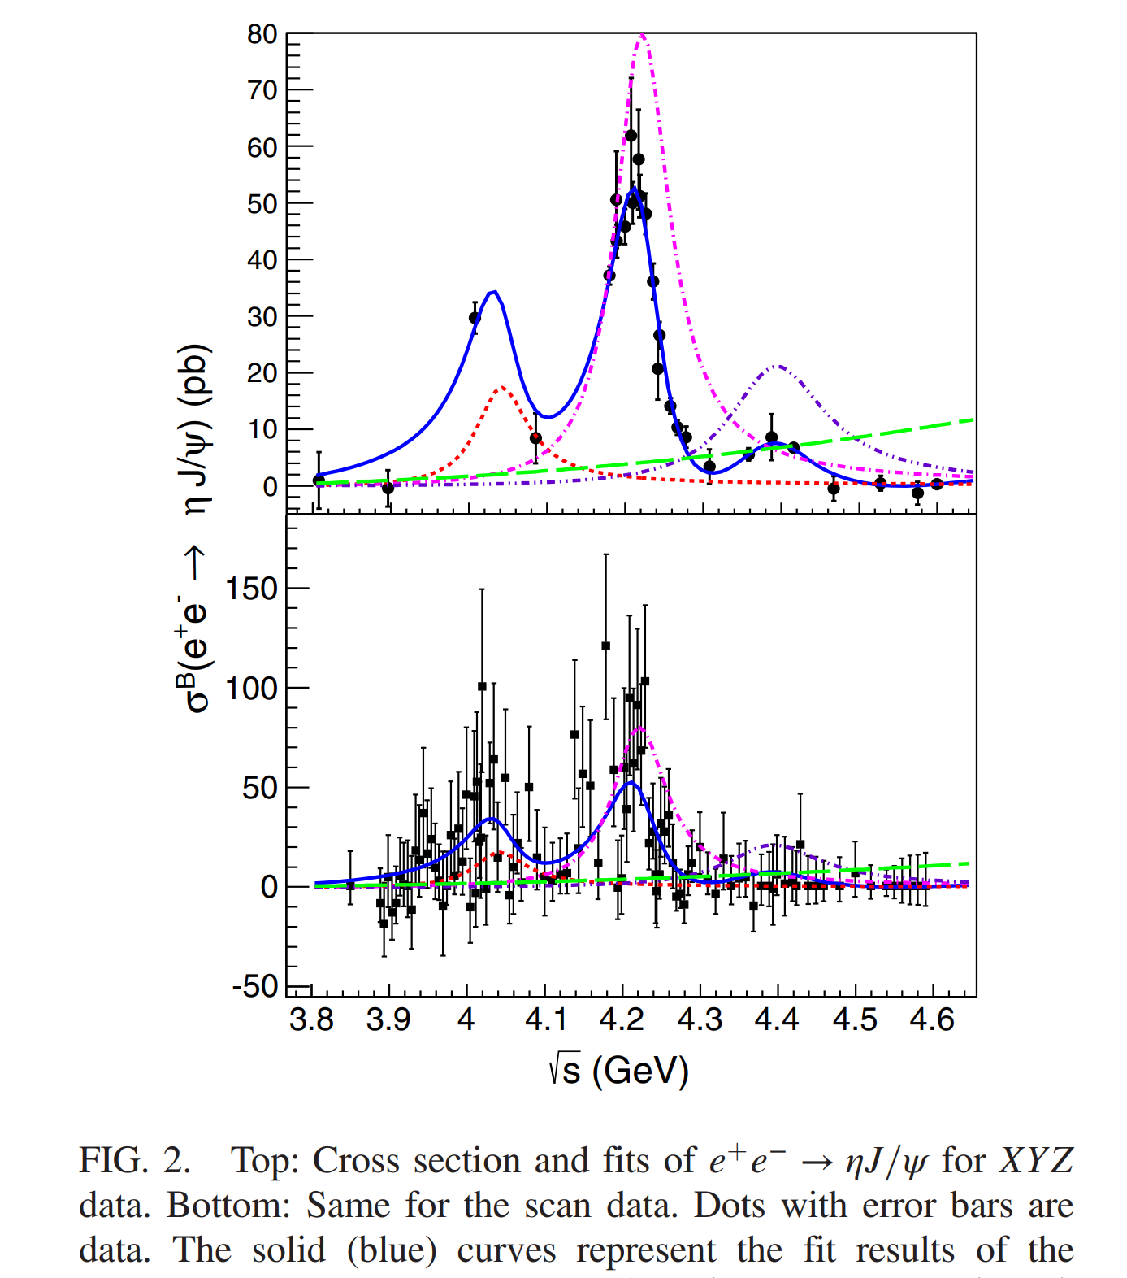
Analysis of $e^{+}e^{−}→D\overline{D},D\overline{D^{∗}},D^{∗}\overline{D^{∗}},D\overline{D}π$
Expected experiment explorations
More precise $J/ψη$ data
BES,
PRD 102, 031101

Slide 35
Analysis of $e^{+}e^{−}→D\overline{D},D\overline{D^{∗}},D^{∗}\overline{D^{∗}},D\overline{D}π$
Expected experiment explorations
More precise $D_{s}^{(∗)+}D_{s}^{(∗)−}$ data
Belle, PRD 83, 011101(R) (2011)

Slide 36
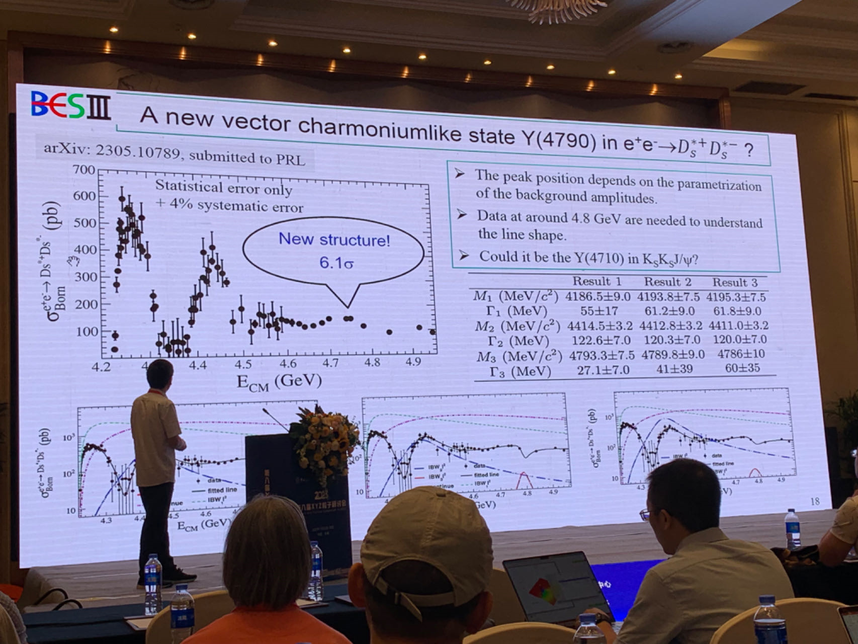
Analysis of $e^{+}e^{−}→D\overline{D},D\overline{D^{∗}},D^{∗}\overline{D^{∗}},D\overline{D}π$
Expected experiment explorations
More precise $D_{s}^{(∗)+}D_{s}^{(∗)−}$ data
Prof. Yuan’s talk
2023.7.26
BES, arxiv: 2305.10789

Slide 37
Summary
$ψ(4160)$ and $ψ(4230)$ might be the same $ψ(c\overline{c} 2^{3}D_{1})$ state.
More experiments such as $J/ψη$ and $D_{s}^{(∗)}{\overline{D}}_{s}^{(∗)}$are required to verify or falsify the conjecture.
We present a coupled-channel scheme with unitarity and analyticity, which could be used to study several resonances and several decay modes simultaneously.
This scheme could be rewritten into the form used in the experimental analysis.

Slide 38
Thanks for your patience！

